Slide 1
Introduction to 3D Design using Fusion 360
Melissa A. Hines

Slide 2
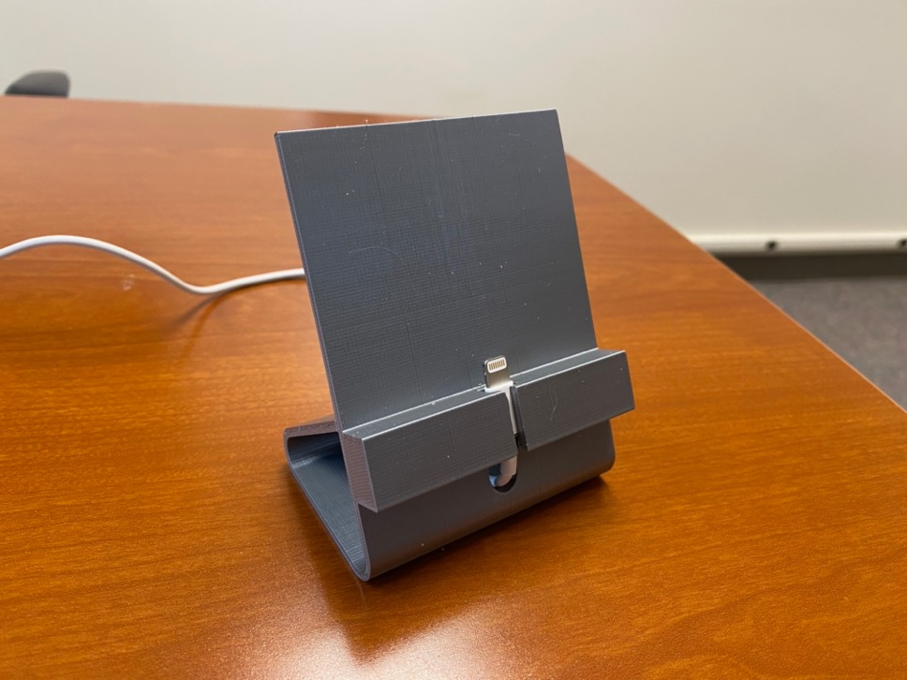
Goal: Mobile Phone Charging Stand
Use parametrized design principles to create modifiable stand for any phone
Suitable for 3D printing

Slide 3
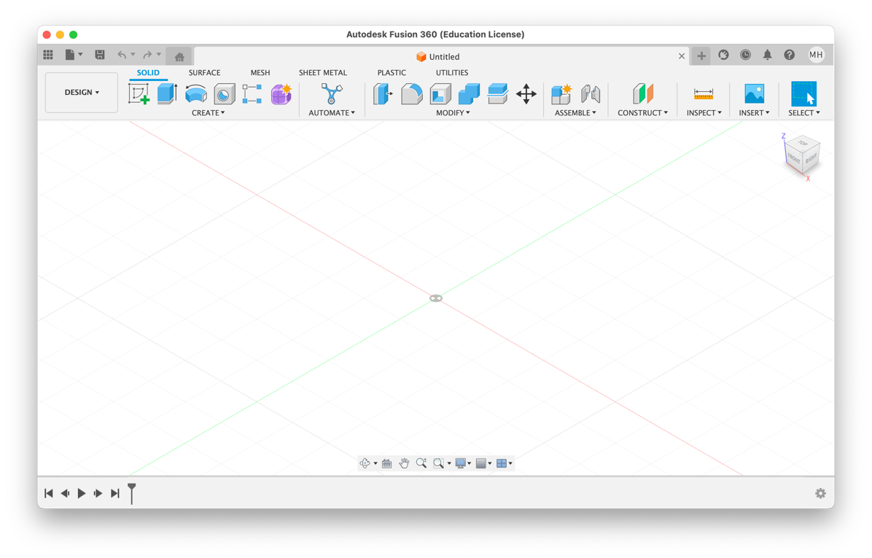
Setting Preferences in Fusion 360
Preferences
Default Units/Design Panel
Set Units = inches
(Trackpad Mac) General panel: Select “Use Gesture-Based View Navigation.” Preview Features Panel: Set “Native Trackpad” under General
(Optional) General Panel
Set favorite 3D interface choices
I use:
Z up
“Fusion 360” shortcuts
“Free Orbit” = Default Orbit type

Slide 4

Parametrizing the Design for Specific Phone/Cable
Initial design with my parameters, then change to match your phone/cable

Slide 5
Parametrizing the Design for Specific Phone/Cable
Initial design with my parameters, then change to match your phone/cable

Slide 6
Entering the Design Parameters
Accuracy of 3D Printer
z 0.004"
x, y 0.010"
In the Modify menu of the toolbar, select “Change Parameters.” Click “+ User Parameter,” then define each of the 9 parameters in the table above. When you are finished, close the window using the “OK” button at the lower right.

Slide 7

Making the Stand Body
Component: 3D part capable of motion with its own unique origin
We will have 2 components: Stand body and phone support
Body: Any continuous 3D shape
A component may have as many bodies as needed
Sketch: Geometric profile (2D) that defines 3D design
A body is typically defined by a sketch
Stand body (component)
Phone support (component)

Slide 8
Creating Stand Body
Create new component (named standBody)
Create new sketch in component

Slide 9
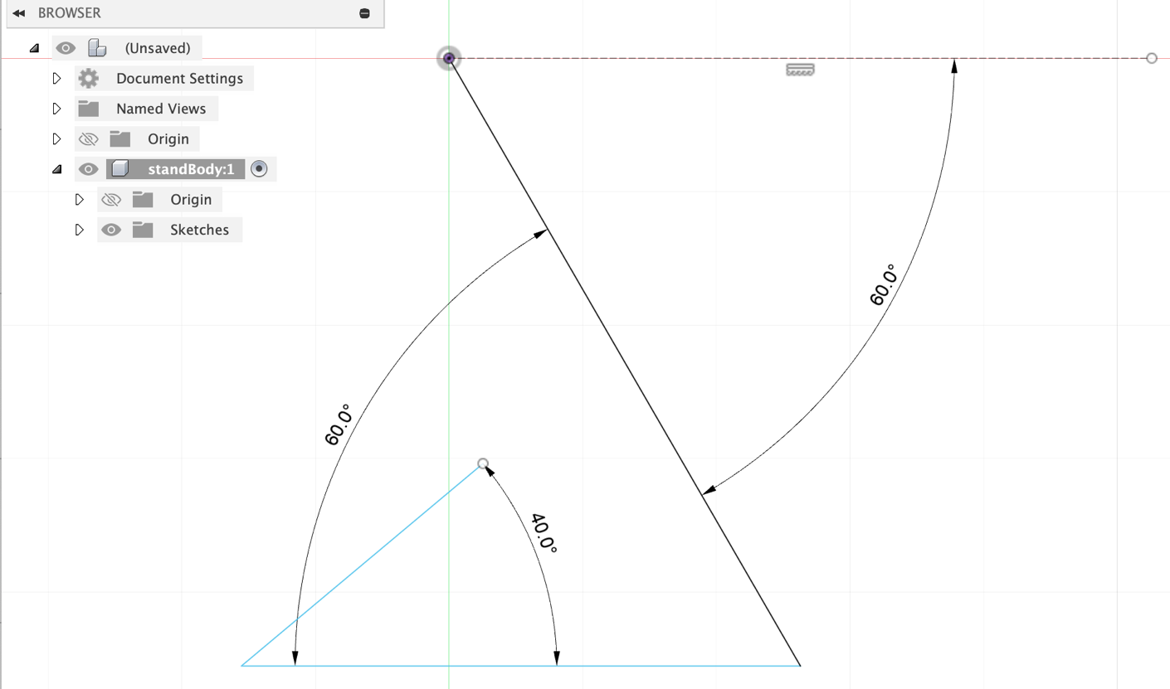
Sketch the Stand Body and Fillet Corners
This does not define the final shape, just its starting point.

Slide 10
Dimension the Face of the Stand

Slide 11
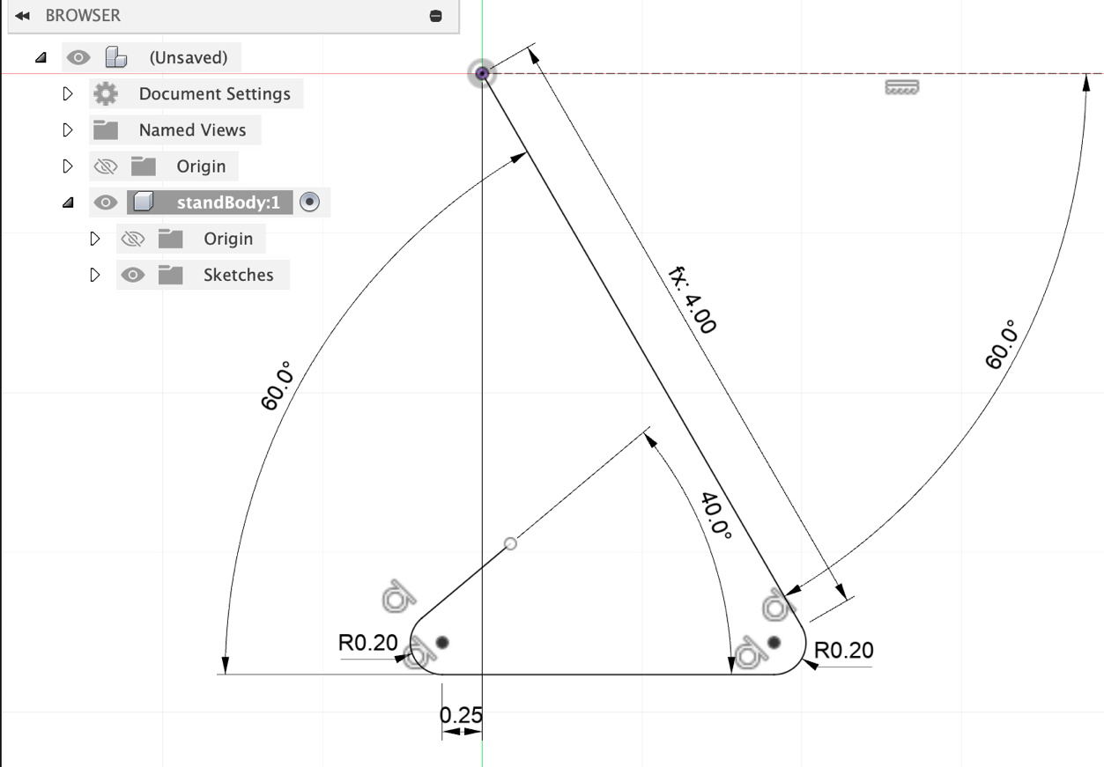
Dimension the Base of the Stand
The LHS of the base must be to the left of the phone’s center of mass

Slide 12
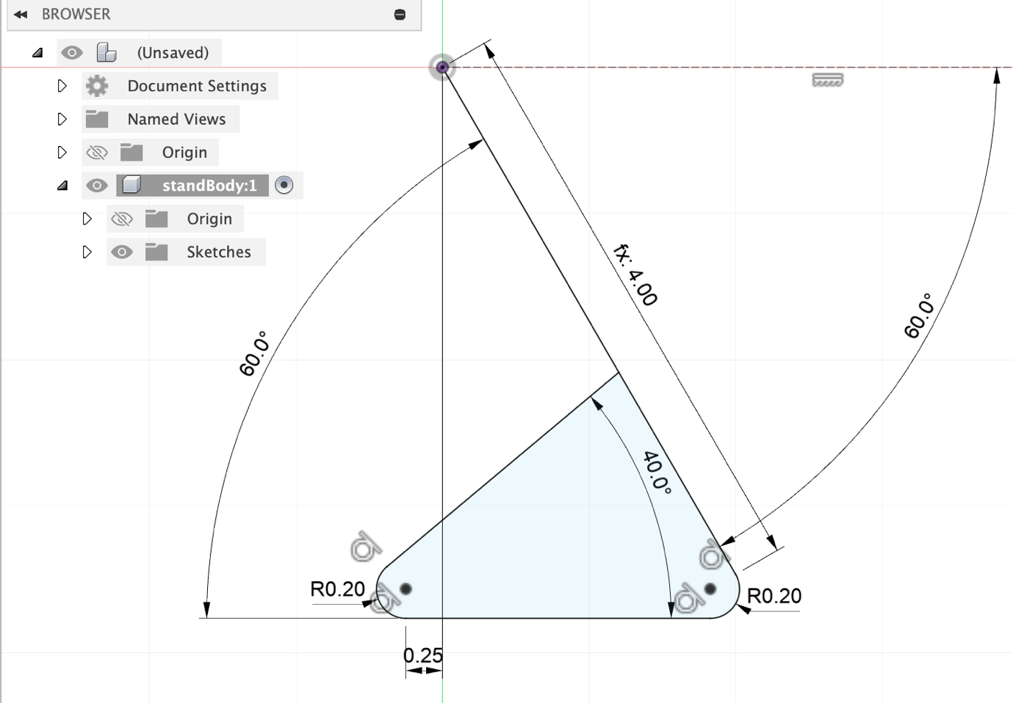
Constrain the Stand End to be Coincident with Back

Slide 13

Extruding the Sketch to Make a Body using Thin Extrude
Extrude sketch in perpendicular direction while giving sketch thickness

Slide 14
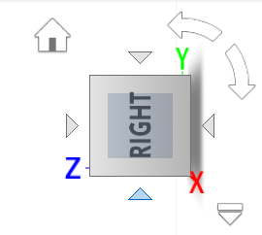

Navigating in 3D
Use trackpad + modifier keys
Use navigation icon on RHS of screen
Use buttons at bottom of screen (esc to exit)
Look at
Zoom
Orbit
Pan

Slide 15
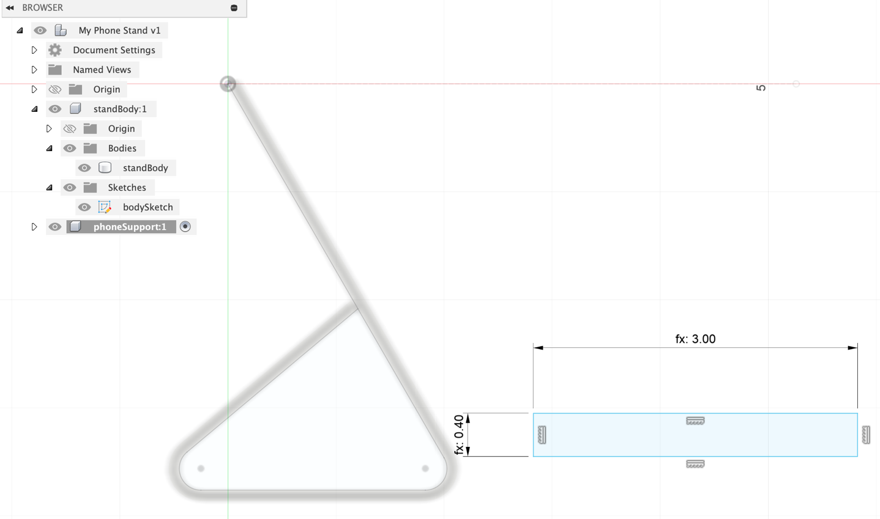
Creating Phone Ledge
Create new component
Create new sketch
ledgeWidth
standWidth

Slide 16
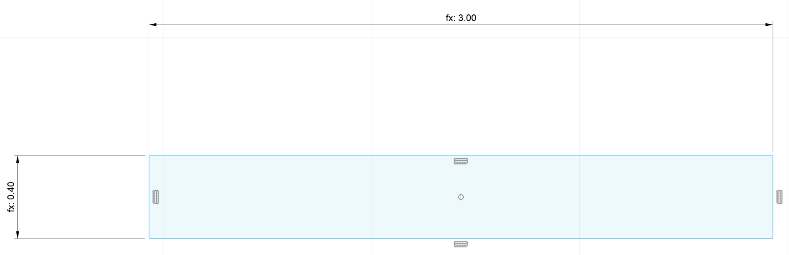
Define Point at Center of Phone Ledge

Slide 17
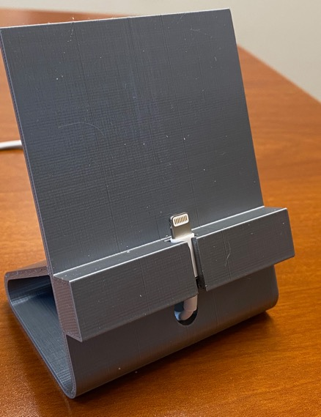
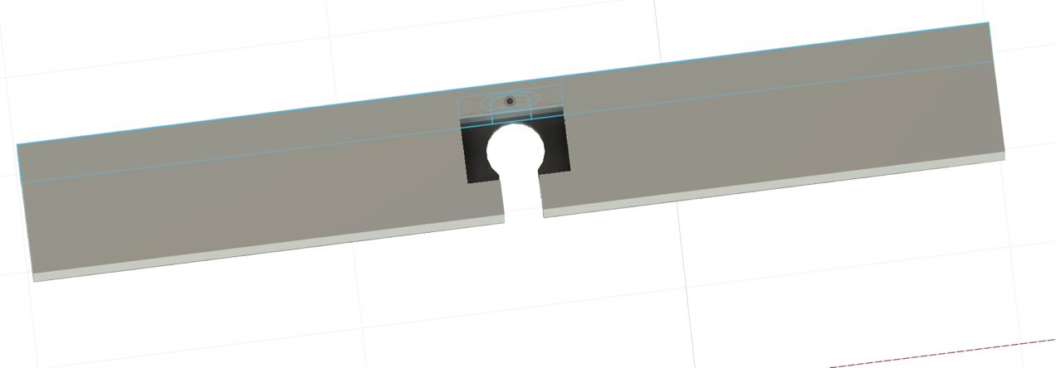
Define Top View of Phone Ledge
Circle with diameter = cableGrommet
Circle with Diameter = cableDiameter
Center Rectangle = plugWidth × plugDepth
Lines from cableDiameter to front

Slide 18
Extrude Entire Phone Ledge
Height = plugHeight + 0.15

Slide 19
Use Extrude to Cut Features in Phone Ledge
Circle with diameter = cableGrommet (Thru)
Circle with Diameter = cableDiameter (Thru)
Lines from cableDiameter
Center Rectangle (Depth = plugHeight)

Slide 20
Use a Fixed Joint to Assemble Stand
Pinned @
origin
First step:
Define stand face
First selection
(flyer)
Second selection
(flyee)

Slide 21
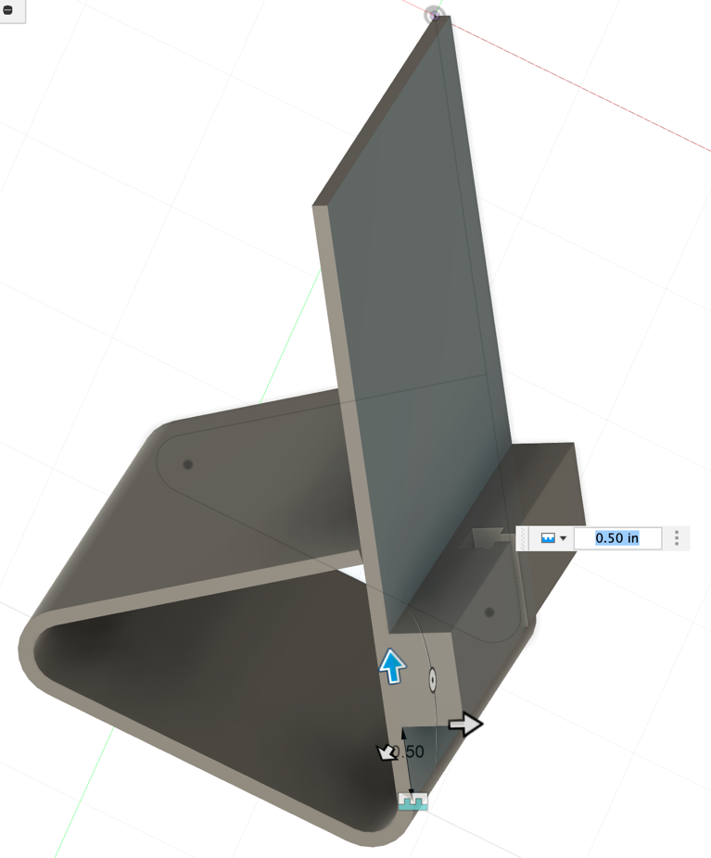
Drag Ledge into Place
Joint should be 0.5" above
bottom of stand face

Slide 22

Possible Modifications
Create a thru hole below ledge for cable
Fillet plug recess to match your cable plug
Fillet front of ledge for aesthetics
Modify stand height, making sure c-of-m remains supported
Engrave CBB logo / your name into face,…

Slide 23
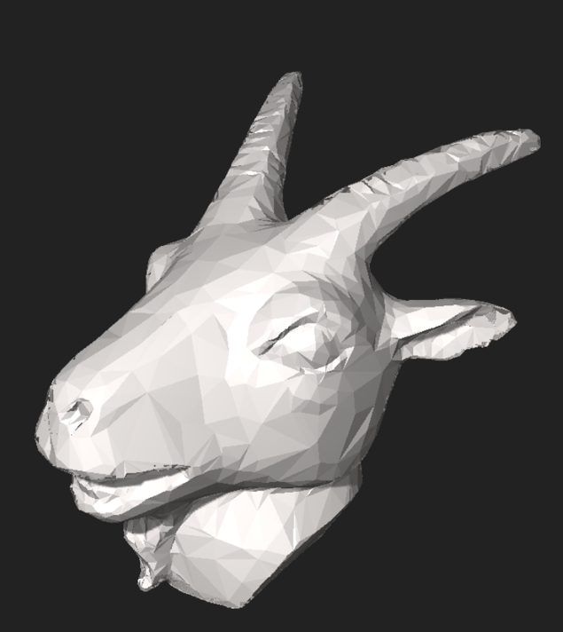
3D Printing a Design
Export .stl from Fusion 360 (STL = stereolithograph)
Creates a triangulated surface
Triangulated Goat’s Head

Slide 24
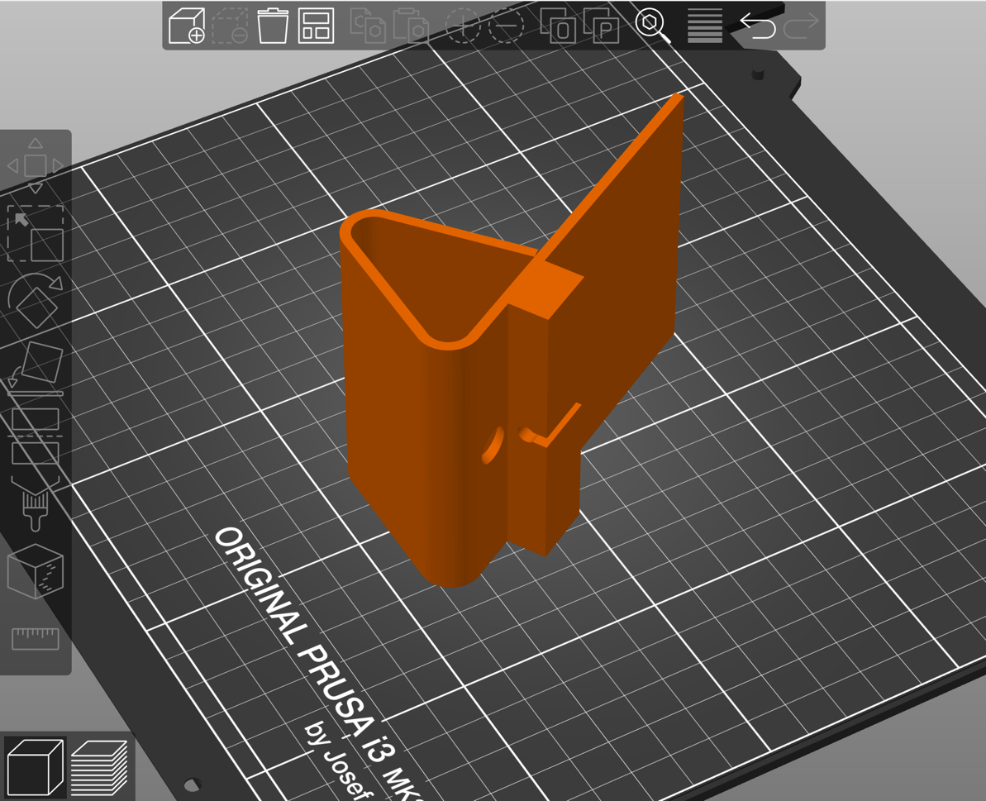
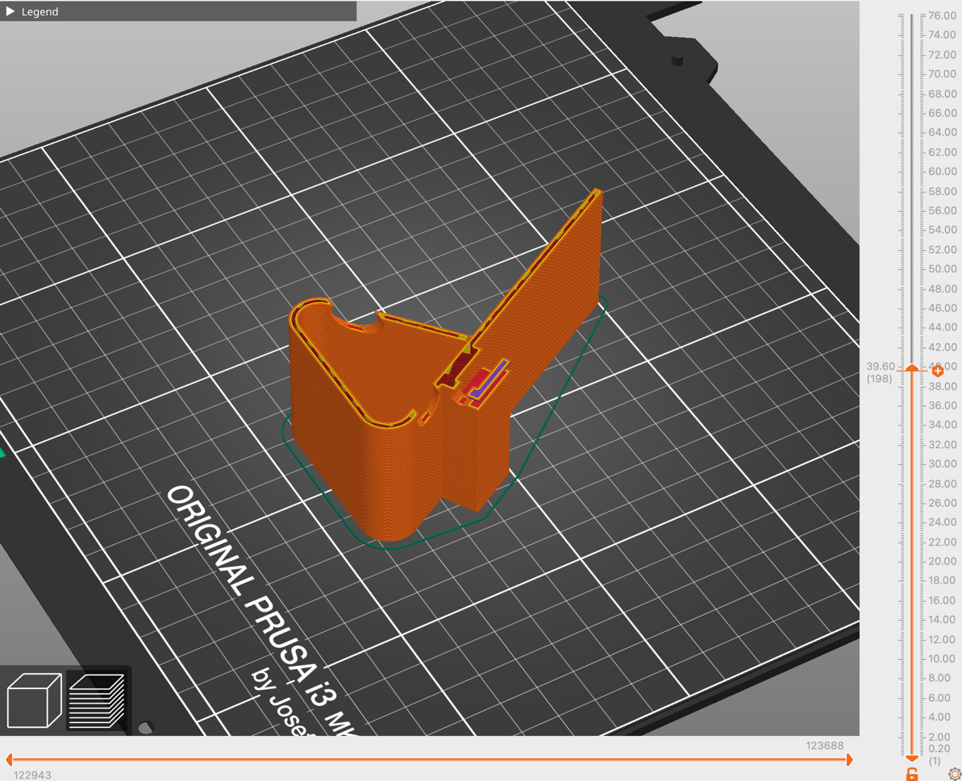
Use a Slicer to Create 3D Print Instructions from .stl
Problem
Printing unsupported regions

Slide 25
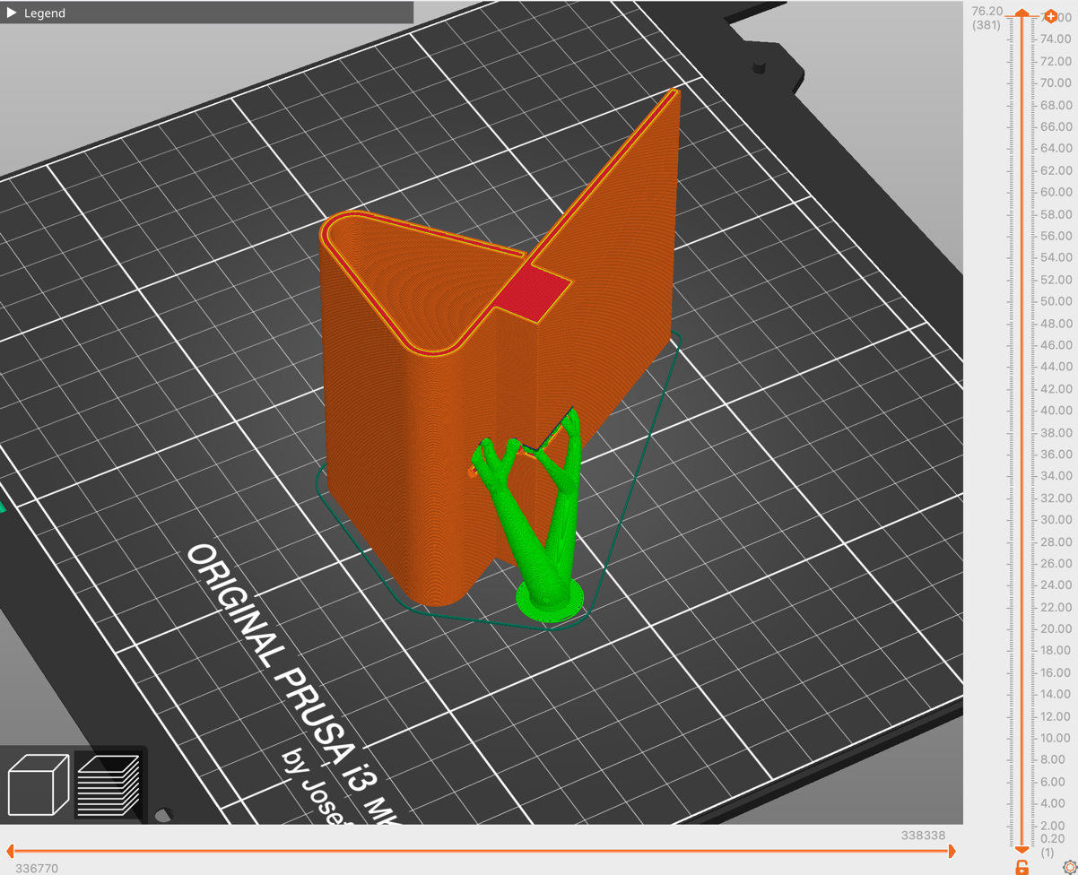
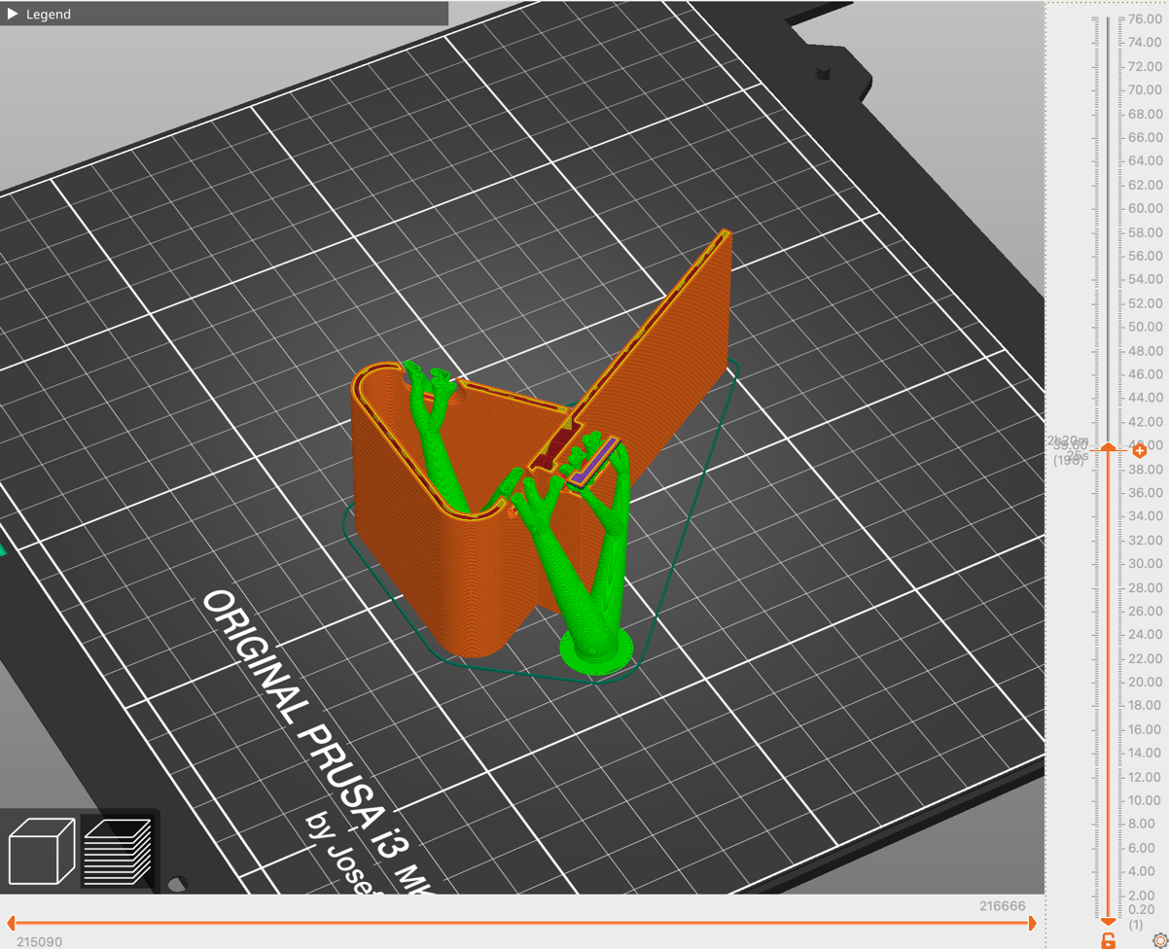
Use a Slicer to Create 3D Print Instructions
Solution
Add supports!

Slide 26
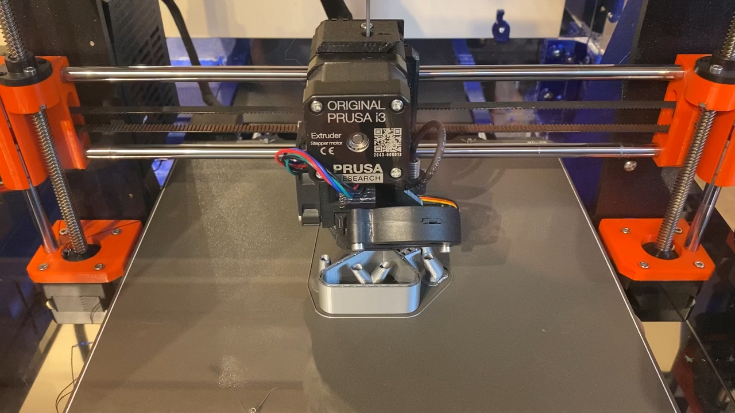
Printing the Phone Stand

