Slide 1
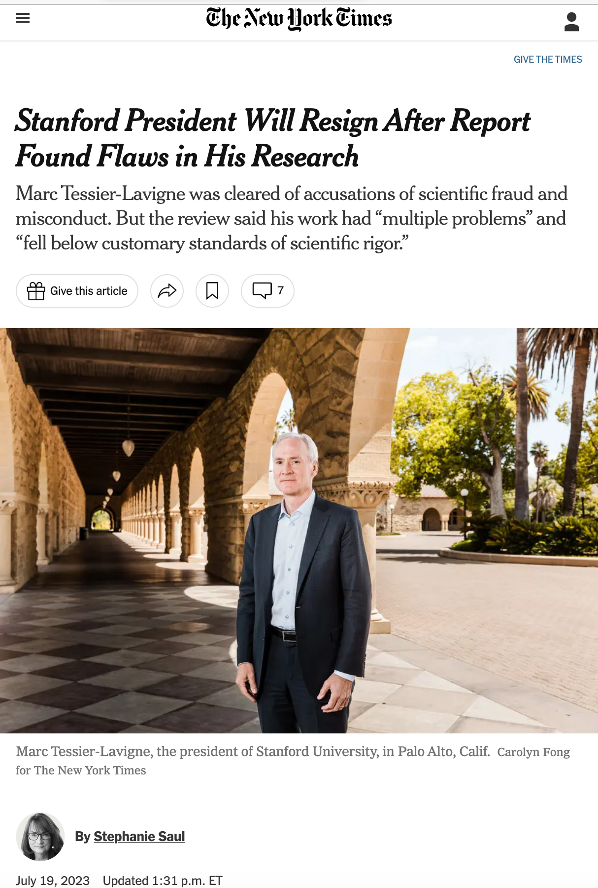
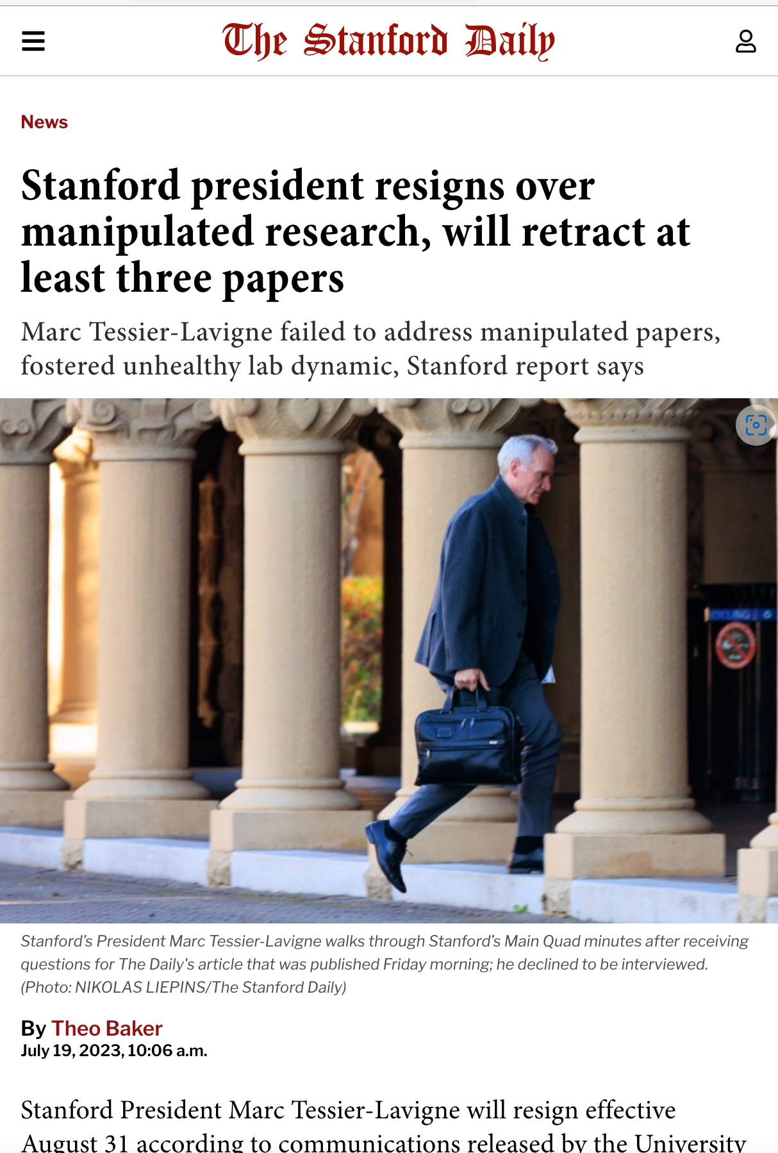

Slide 2
What is “ethics”?
“Ethics is doing the right thing, even when no one is watching.”
-- unknown

Slide 3
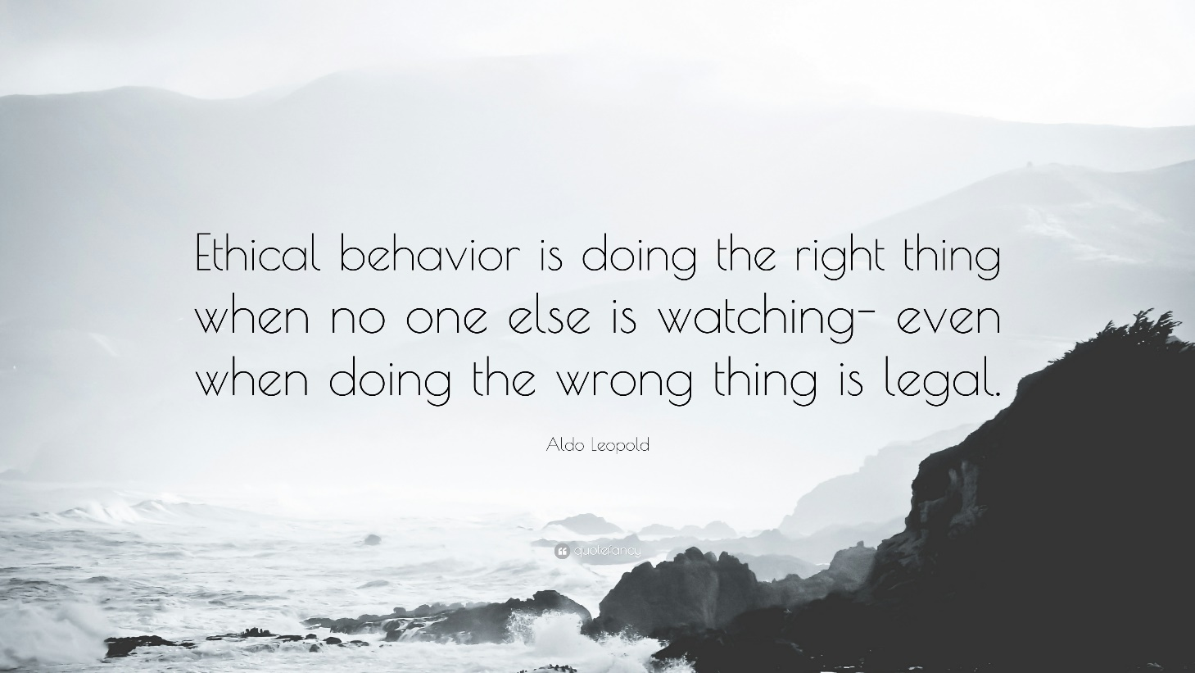
Good morning, Paul:
I did some digging around about our favorite ethics quote and discovered....
[1]
﻿The American author and philosopher Aldo Leopold once said “Ethical
behaviour is doing the right thing when no one else is watching—even
when doing the wrong thing is legal.”
Aldo Leopold was an American author, philosopher, naturalist, scientist,
ecologist, forester, conservationist, and environmentalist. He was a
professor at the University of Wisconsin and is best known for his book
A Sand County Almanac, which has sold more than two million copies.
https://en.m.wikipedia.org/wiki/Aldo_Leopold
[2]
Ethics Education 13 Jun 2018
How to Do the Right Thing Even if No One Is Watching
Michael G. McMillan CFA
https://www.cfainstitute.org/en/ethics-standards/education/how-to-do-right-thing-even-if-no-one-is-watching
Overview
Michael McMillan, Director of Ethics Education, looks at how CPAs can be
prepared when facing ethical dilemmas in the profession. Article
originally published in A Plus, the magazine of the Hong Kong Institute
of CPAs.
Introduction
The American author and philosopher Aldo Leopold once said “Ethical
behaviour is doing the right thing when no one else is watching—even
when doing the wrong thing is legal.”
This quote raises an important question: why should we do anything, let
alone the right thing, if what we are being asked to do (or what we are
observing others doing) is legal and unobservable? The simple answer to
this question is: values. An ethical dilemma occurs when we find
ourselves in a situation or circumstance that conflicts with our
personal values. These values, which are cross-cultural and universal
include: honesty, respect, responsibility, fairness, and compassion.
[3]
Ruidoso News
Chamber News: Ethics are about doing the right thing
Becky Brooks, Guest Columnist
Published 3:40 p.m. MT June 21, 2018
https://www.ruidosonews.com/story/money/business/2018/06/21/ethics-doing-right-thing-even-when-no-none-looking/723355002/
Aldo Leopold coined the phrase, “ethical behavior is about doing the
right thing even when no one is watching – even when doing the wrong
thing is legal.”
I love that saying. It reminds me to be ever mindful of my own behavior
and remember that my decisions can and will impact not only my own life,
but also the lives of those around me.
Melanie-Claire Mallison (CNF) pointed me to the origin of this quote….

Slide 4
FUNDAMENTAL PRINCIPLES OF SCIENTIFIC RESEARCH
1. Scientific Honesty: Do not commit scientific fraud, i.e. do not fabricate, fudge, trim, cook, destroy, or misrepresent data.
2. Carefulness: Strive to avoid careless errors or sloppiness in all aspects of scientific work.
3. Intellectual Freedom: Scientists should be allowed to pursue new ideas and criticize old ones. They should be free to conduct research they find interesting.
4. Openness: i.e. share data, results, methods, theories, equipment, and so on. Allow people to see your work, be open to criticism.
5. The principle of credit: Do not plagiarize the work of other scientists, give credit where credit is due (but not where it is not due).
6. The principle of public responsibility: Report research in the public media when a) the research has an important and direct bearing on human happiness and b) the research has been sufficiently validated by scientific peers.
David Resnik
Department of Philosophy
University of Wyoming

Slide 5
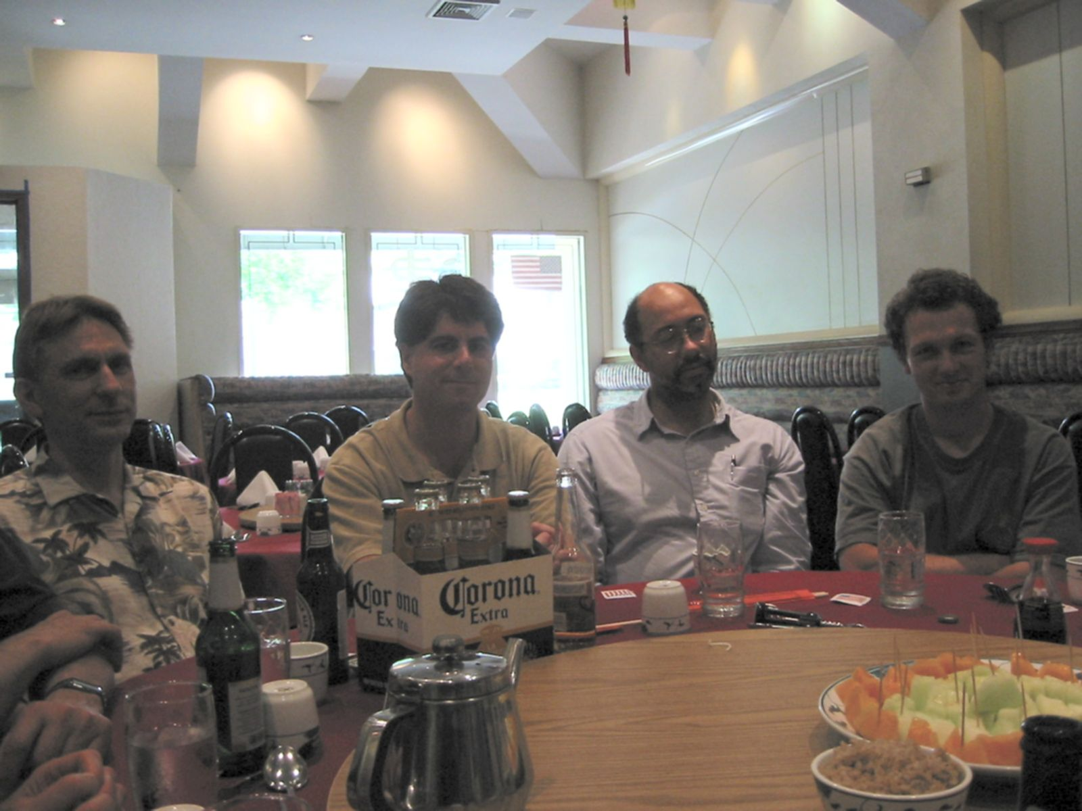
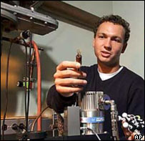
The Short Career of Jan Hendrik Schön
David Muller
Paul McEuen
Personal observations on:
What happened
What went wrong
What we can do about it

Slide 6
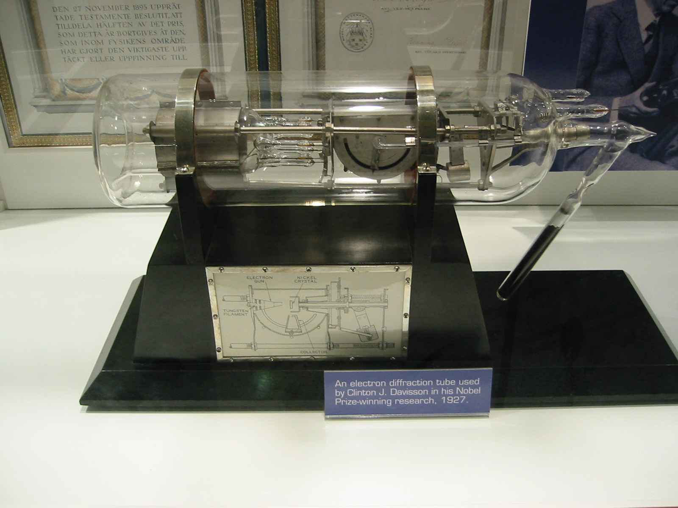
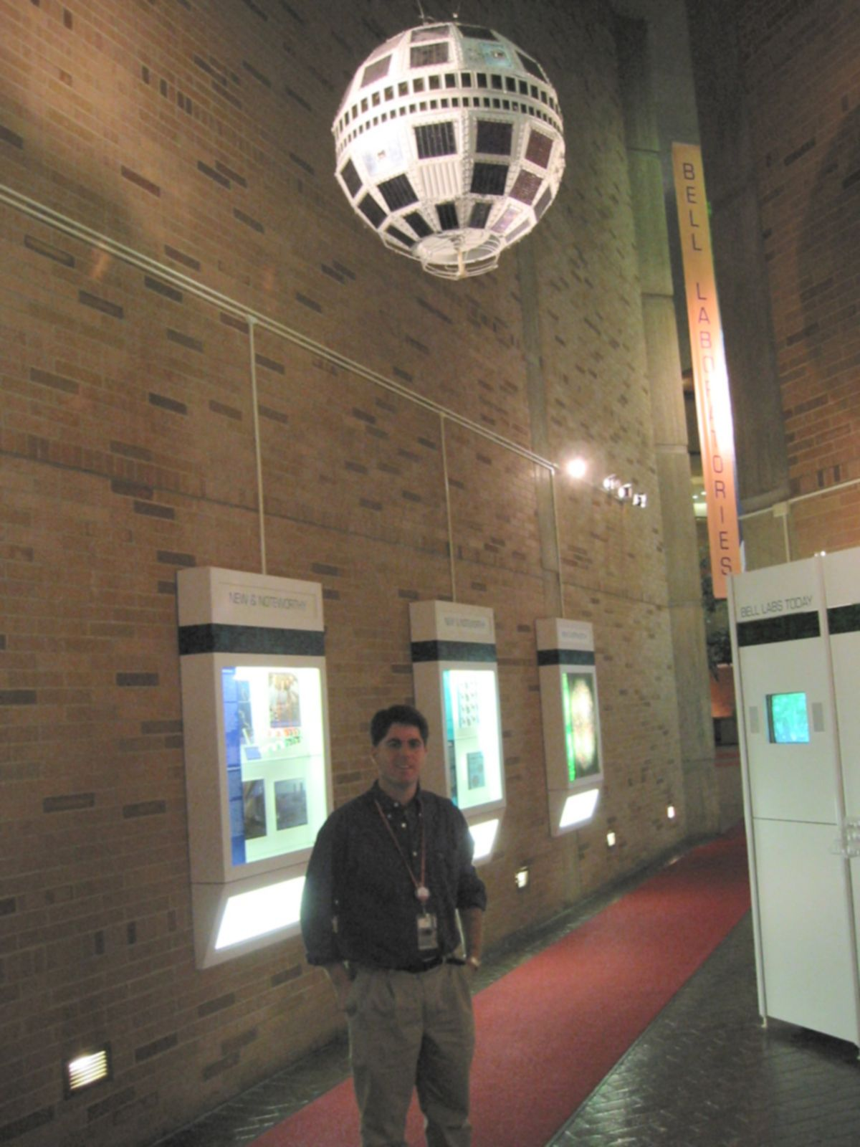
The History of Bell Labs
Founded by Alexander Graham Bell
Research Arm of AT&T, then Lucent, Alcatel
7 Nobel Prizes, 13 Nobel Laureates
Some Inventions:
The Transistor,
1st Communications Satellite
The Laser, CCD, Solar Cell,
Unix, C
Information Theory: Shannon, Nyquist

Slide 7

The Perfect Storm
The Rise and Fall
of
Hendrik Schon
Personal observations on:
What happened
What went wrong
What we can do about it
Paul McEuen
David Muller

Slide 8
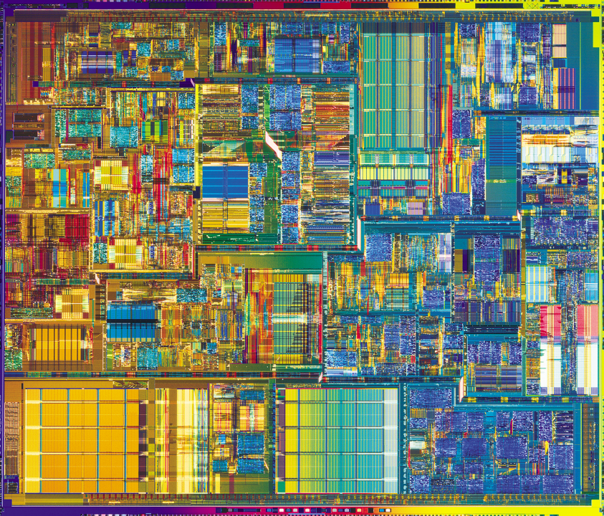
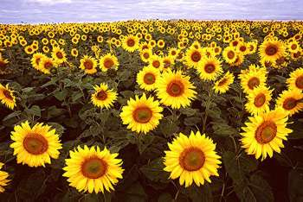
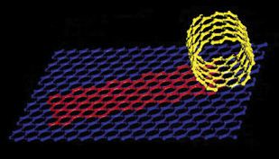
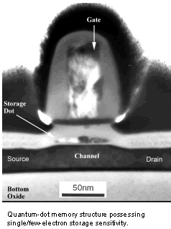
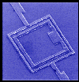
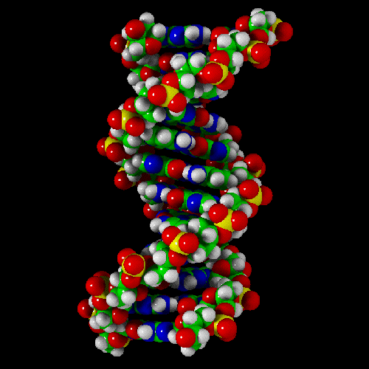
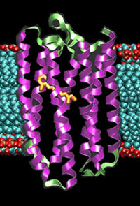
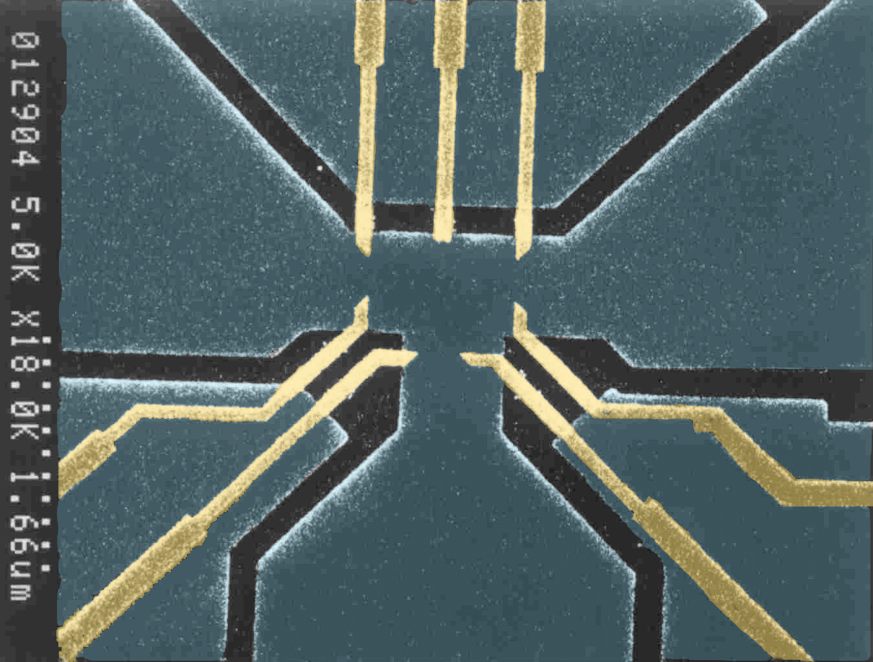
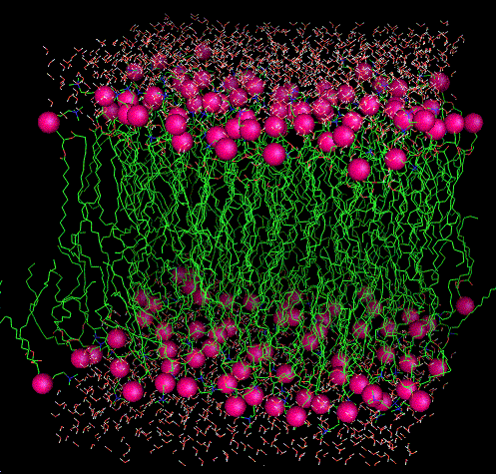
Two Nanotechnologies

Slide 9
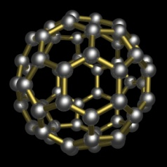
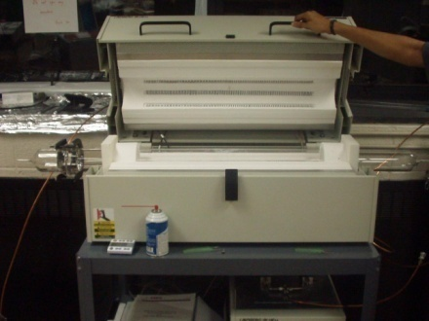
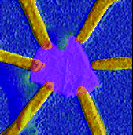
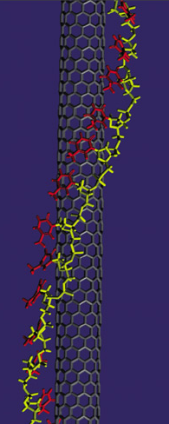
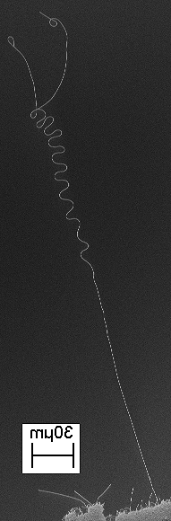
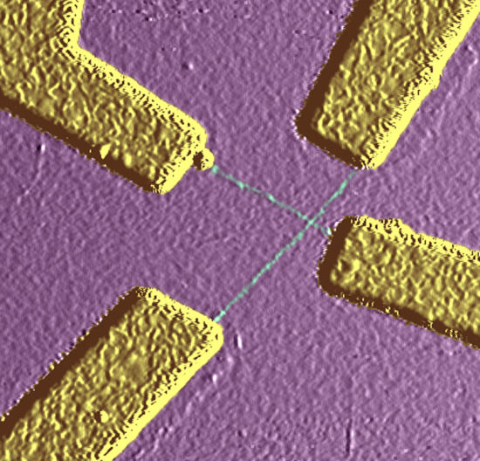
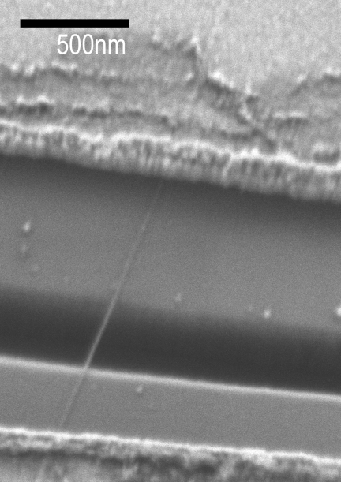
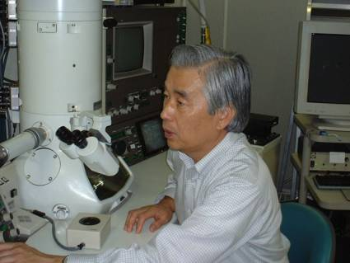
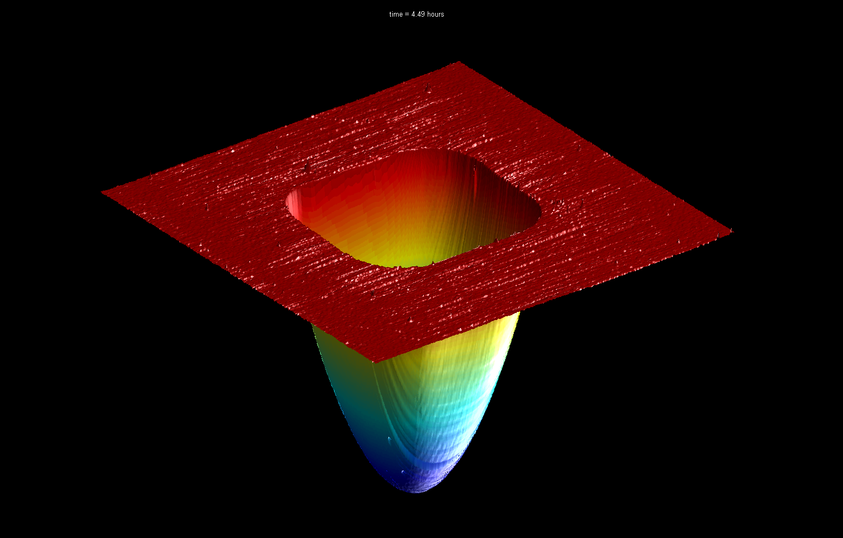
Nano Carbon
catalyst
Strongest mat’l in world
Higher mobility than Si
Truly molecular scale

Slide 10
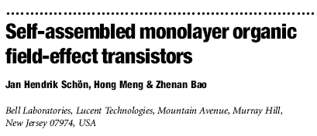
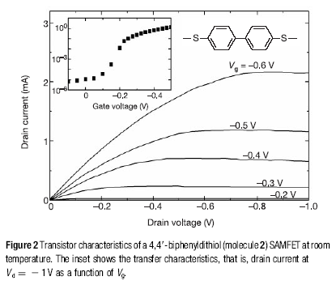
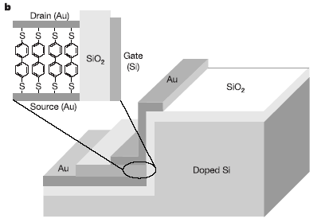
Following
VGs courtesy of
David Muller
Nature 413, 713 (2001).
Gate Modulation ~ 10⁵
P-Channel g ~ 10 mA/V

Slide 11
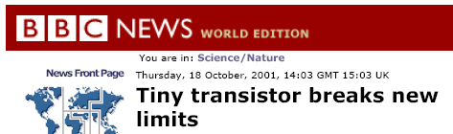
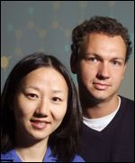
A Single-Molecule Transistor
Bell Labs scientists usher in new era of molecular-scale electronics
FOR RELEASE WEDNESDAY OCTOBER 17, 2001 Tiny organic transistors may lead to less expensive and more powerful chips
"The molecular-scale transistors that we have developed may very well serve as the historical 'bookend' to the transistor legacy started by Bell Labs in 1947,“ Federico Capasso, physical research vice president at Bell Labs.

Slide 12
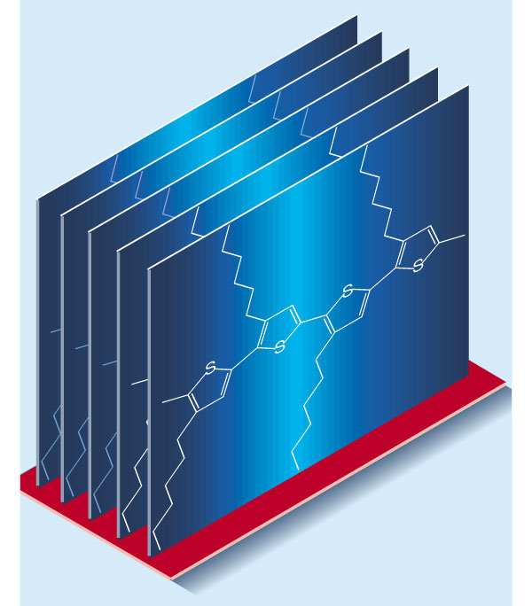
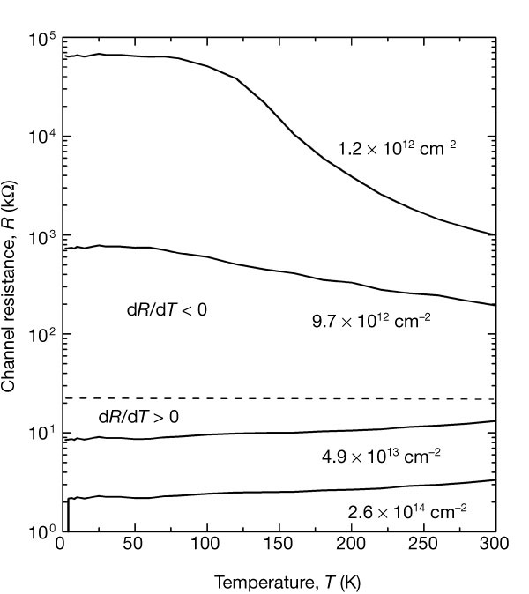
Superconducting Plastic
Gate-induced superconductivity in a solution-processed organic polymer film
J. H. Schön¹, A. Dodabalapur¹, Z. Bao¹, Ch. Kloc¹, O. Schenker² & B. Batlogg^{1,3}
Nature 410, 189-192 (8 March 2001)

Slide 13
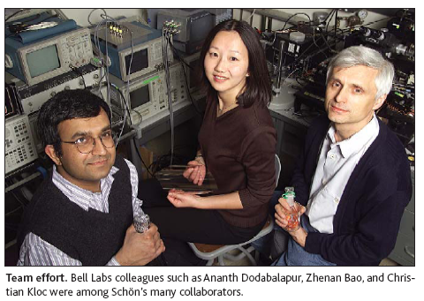
First Electrically-Pumped Organic Laser
First electrically powered organic laser may lead to more widespread use of lasers for various applications FOR RELEASE FRIDAY JULY 28, 2000

Slide 14
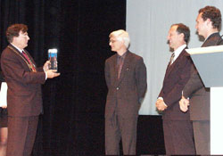
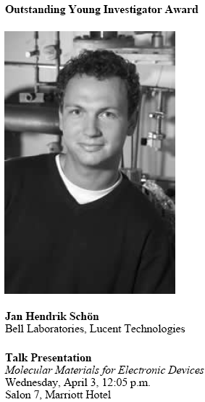
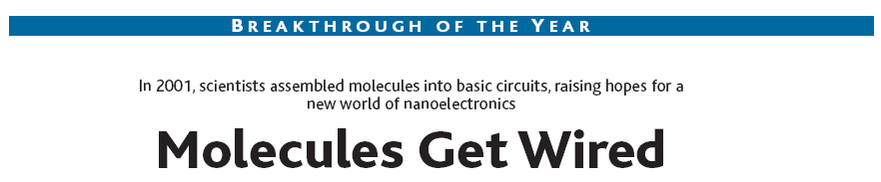
“Magic Hands”
1 Paper every 8 days in 2001!
With 25 coauthors
6 patent filings
numerous international awards
Braunschweig Prize
Science Magazine:

Slide 15
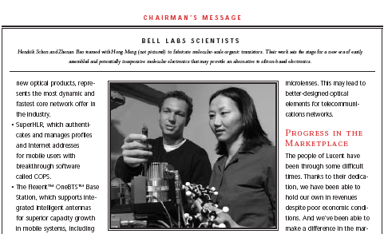
Lucent’s 2001 Annual Report to Shareholders, pg 3.

Slide 16
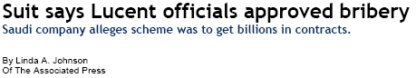
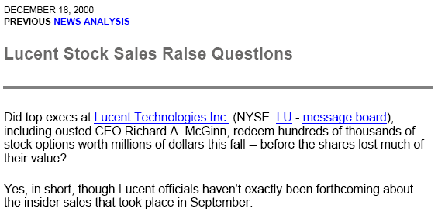
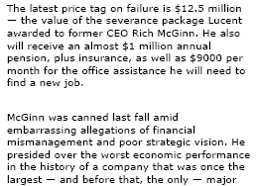
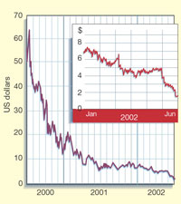
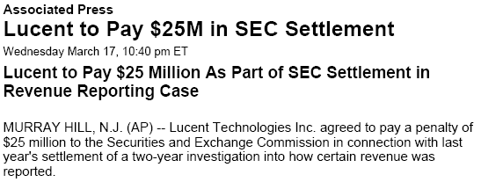
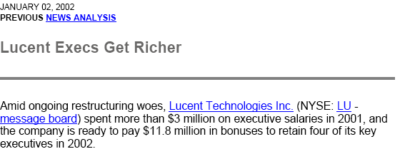
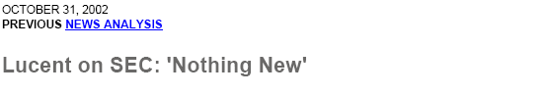
A Company in Trouble

Slide 17
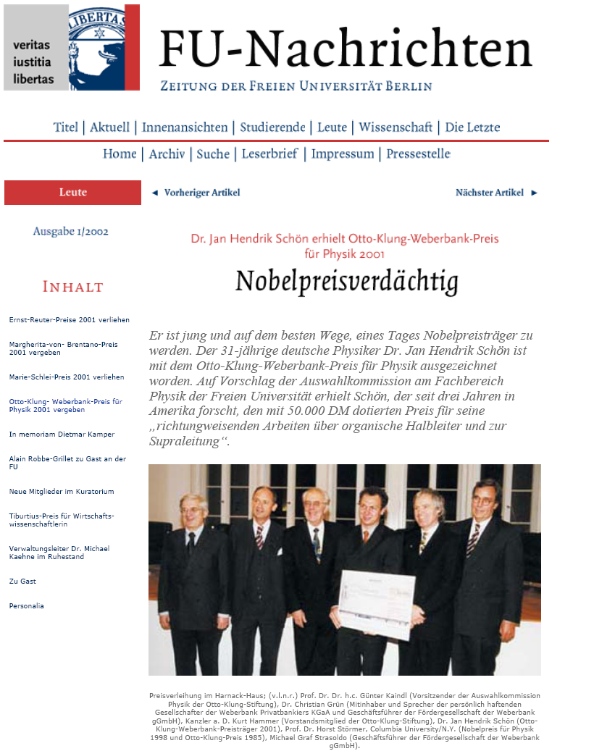

Slide 18
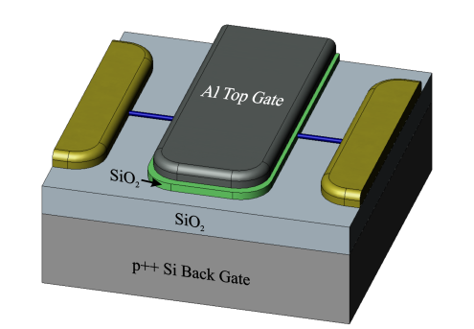
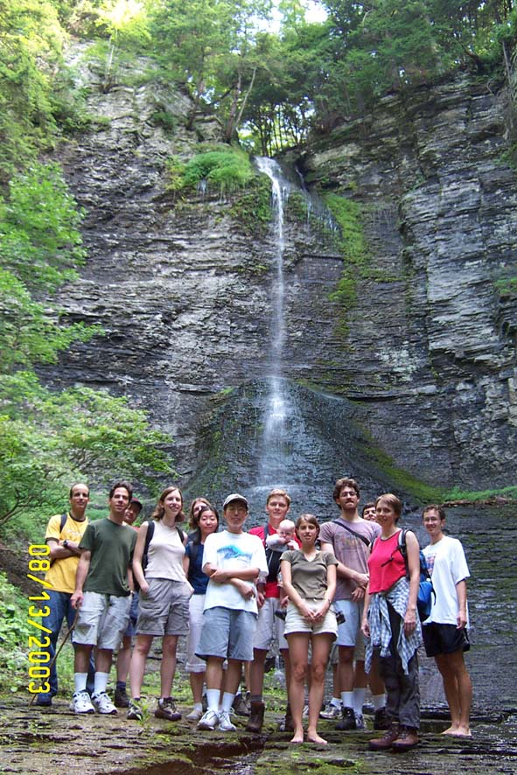
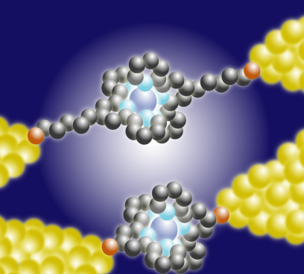
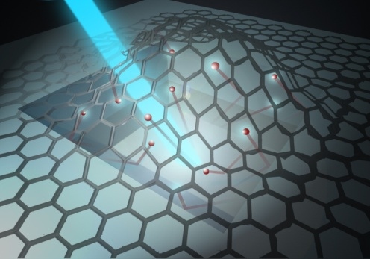
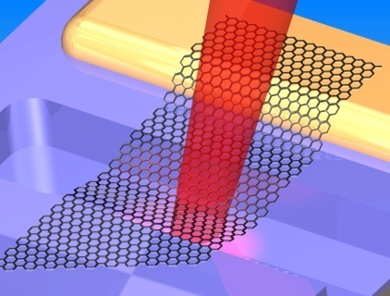




McEuen Group
= Nanocarbon
Electronics
Zhaohui Zhong
Nathan Gabor
Jay Sharping
(w/ Gaeta)
PDMS Channel
Fluid
Al₂O₃
Glass

Slide 19




New carbon nanoelectronic materials
From Cornell 2001
NSF NSEC proposal
C
60
Nanotubes
Ultrasmall quantum dot
Supercondunct. transistor
Narrowest transistors
Longest room temp.
mean free path of any material
Pentacene
Polythiophene
Very high mobilities
Lasing, supercond.
Flexible, Solution
processed, supercond.

Slide 20

Duplicate Noise in Different Papers

Slide 21



Duplicate Curves

Slide 22

Duplicate Curves

Slide 23
Superconducting Plastic
Nature 410, 189-192 (8 March 2001)

Slide 24


Thousands upon thousands….

Slide 25



Independent Commission: May 2002
Physics Today:
Bell Labs Convenes Committee to Investigate Questions of Scientific Misconduct
Is there an innocent explanation for the appearance of similar figures in different publications?
External Panel of scientists examine all papers
Interviews all coauthors
Off limits: Patents, Management responsibility
Science:

Slide 26



“Superconducting” Polythiophene
May 2002
Bare Pad from Hendrik 5/14/02
Al₂O₃ 30 nm nominal
1 μm Mo
Optical scope at 100 x
Glass slide
(note interference fringes)
Optical scope at 10 x
Mo
Alumina gate oxide
Polycrystalline Mo
Al₂O₃
Glass slide

Slide 27
What is Misconduct?
“Research misconduct is being defined as including fabrication, falsification, or plagiarism in proposing, performing, or reviewing research, or in reporting research results, but not as including honest error or differences of opinion”
“A finding of misconduct requires a determination, based on a preponderance of the evidence, that research misconduct has occurred, including a conclusion that there has been a significant departure from accepted practices of the relevant research community and that it be knowingly, intentionally, or recklessly committed.
(Fed. Regist. 70, section 42 CFR Part 93.103; 2005).

Slide 28

Sep 2002
http://publish.aps.org/reports/
Only Schön made devices
No coauthors ever witnessed an experiment
No laboratory records were kept
Original data (if it existed)
was deleted from the computers
Nearly every rule of scientific documentation violated.

Slide 29


All Papers retracted
All coauthors agreed
(except by Hendrik Schon)

Slide 30


Slide 31





Schon/Bell labs Case: Who is at fault?
Co-workers?
Journals?
Managers?
Community?

Slide 32

Fallout?
Millions of dollars spent by other groups trying to duplicate results
>40 PhD students, postdocs spent 2-3 years of their life trying (&failing) to get similar results
We still don’t know how well organic semiconductors can perform
Scientific process as self-correcting: none of the work could be reproduced, all papers retracted

Slide 33


When did it Start?
Publication in
Sol. Eng. Mater and Sol. Cells 1998
PhD Thesis, 1997

Slide 34


The Dark Secret of
Hendrik Schon
BBC Documentary
The Science Channel

Slide 35

Ethics & Values
02.2 APS GUIDELINES FOR PROFESSIONAL CONDUCT
(Adopted by Council on November 10, 2002)
Ethics Case Studies
Topics
Conflict of Interest
Data Acquisition
Educational Concerns
Health and Safety
Human Subjects Research
Issues of Bias
Mentoring
Publication Practices
Responsible Conduct of Research and Participation
Other Ethics Education Resources
http://www.aps.org/policy/statements/02_2.cfm
REPORT OF THE INVESTIGATION COMMITTEE
ON THE POSSIBILITY OF SCIENTIFIC
MISCONDUCT IN THE WORK OF HENDRIK
SCHÖN AND COAUTHORS
September 2002
http://publish.aps.org/reports/
http://www.aps.org/programs/education/ethics/index.cfm

Slide 36

ON BEING A SCIENTIST
A GUIDE TO RESPONSIBLE CONDUCT IN RESEARCH
THIRD EDITION (2009)
Committee on Science, Engineering, and Public Policy
NATIONAL ACADEMY OF SCIENCES,
NATIONAL ACADEMY OF ENGINEERING,
AND INSTITUTE OF MEDICINE OF THE NATIONAL ACADEMIES
THE NATIONAL ACADEMIES PRESS
Washington, D.C.
Free download on NAS site
http://www.nap.edu/catalog.php?record_id=12192
First, researchers have an obligation to
honor the trust that their colleagues place in them.
Second, researchers have an obligation to themselves.
Third, researchers have an obligation to act in ways that serve the public.

Slide 37


Slide 38
Hippocratic Oath – Classical
I swear by Apollo Physician and Asclepius and Hygeia and Panaceia and all the gods and goddesses, making them my witnesses, that I will fulfill according to my ability and judgment this oath and this covenant:
To hold him who has taught me this art as equal to my parents and to live my life in partnership with him, and if he is in need of money to give him a share of mine, and to regard his offspring as equal to my brothers in male lineage and to teach them this art - if they desire to learn it - without fee and covenant; to give a share of precepts and oral instruction and all the other learning to my sons and to the sons of him who has instructed me and to pupils who have signed the covenant and have taken an oath according to the medical law, but no one else.
etc. etc.

Slide 39
Pathological Science
Irving Langmuir (1881-1957) ,
Colloquium at The Knolls Research Laboratory, GE, December 18, 1953
Entitled “the science of things that aren't so,"
“These are cases where there is no dishonesty involved but where people are tricked into false results by a lack of understanding about what human beings can do to themselves in the way of being led astray by subjective effects, wishful thinking or threshold interactions.”
Examples: “N-rays”, - debunked: R. W. Wood, Nature, 70 (1904)
“Mitogenic Rays”
“Polywater”, debunked: Franks, F., Polywater. 1981, MIT Press
“cold fusion”
Google “Langmuir, Pathological Science”

Slide 40
Symptoms of Pathological Science
(from Irving Langmuir’s lecture)
The maximum effect that is observed is produced by a causative agent of barely detectable intensity, and the magnitude of the effect is substantially independent of the intensity of the cause.
The effect is of a magnitude that remains close to the limit of detectability; or, many measurements are necessary because of the very low statistical significance of the results.
Claims of great accuracy.
Fantastic theories contrary to experience.
Criticisms are met by ad hoc excuses thought up on the spur of the moment.
Ratio of supporters to critics rises up to somewhere near 50% and then falls gradually to oblivion.

Slide 41


Cold Fusion (1989)
Stanley Pons and Martin Fleischman
Tiny amount of excess heat produced
By electrolysis. Attributed to
“D+D-> He⁴+γ in Pd
(but no He⁴ detected, or He³+n)

Slide 42

What Causes People to Cheat?
Effect of Workplace Climate
Nature 520, 713 (30 April 2015)
Correlation is not causation, but…
B. C. Martinson et al.
Sci. Eng. Ethics 19, 813–834 (2013)

Slide 44

September 22, 2016, 2:51 PM
Cuomo backers Alain Kaloyeros, Joseph Nicolla face corruption charges
“State Attorney General Eric Schneiderman separately announced corruption charges Thursday afternoon against Alain Kaloyeros, the politically-connected president of SUNY Polytechnic Institute, over alleged bid-rigging schemes.”
“The charges came the same day [US attorney] Bharara announced unrelated charges against Kaloyeros — one of the state's highest paid employees”
“Physicist in Albany Corruption Case Was a Geek With Big Goals”
He consistently ranked among the state’s highest paid employees, earning a total of $1.17 million in salary and other performance-based payments last year

Slide 46



Identifying, Tracking and Correcting Errors
Retraction Watch – Tracking retractions as a window into the scientific process
https://retractionwatch.com/
Database of retractions, and investigations beyond “unhelpful retraction notices”
https://pubpeer.com

