Slide 1
Characterizing Ordered Alkali Antimonides for High Brightness Electron Guns
Chad Pennington
Cornell University , Department of Physics + CLASSE
CBB Annual Meeting, July 20, 2023

Slide 2
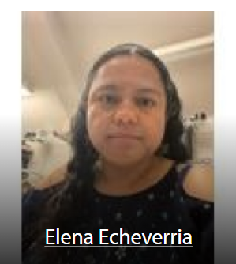
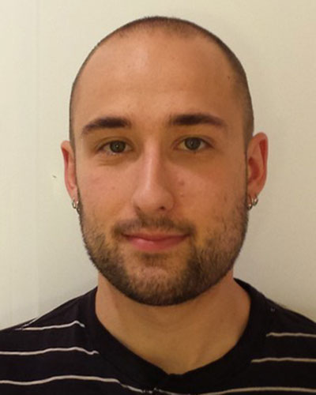
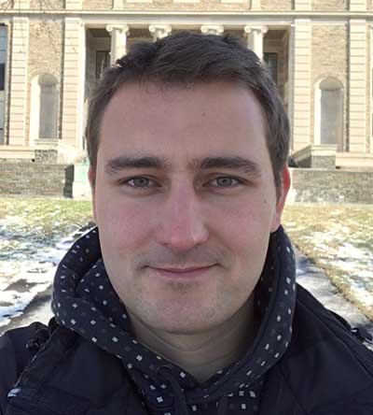
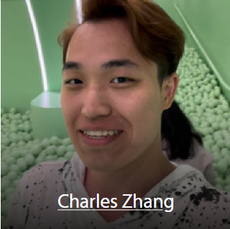
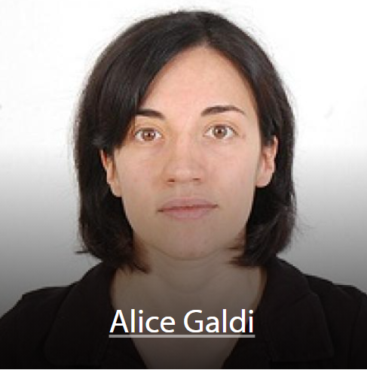
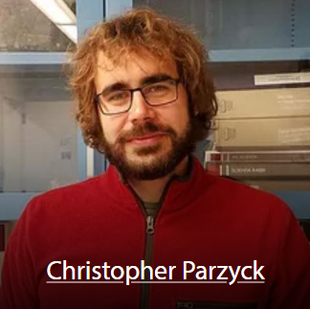
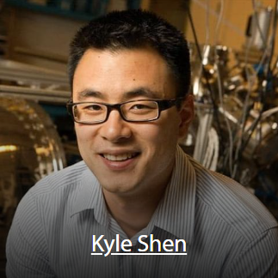
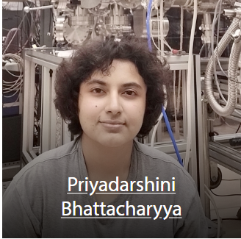
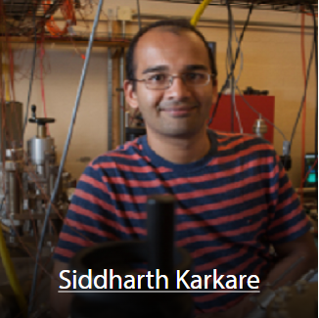
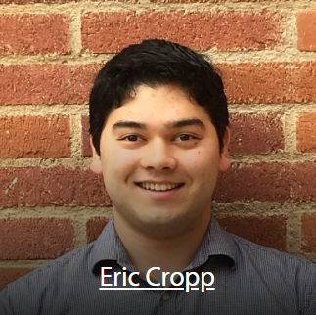
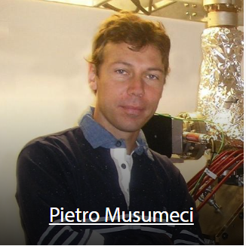
Acknowledgements
Maxson Group
Hines Group
Will DeBenedetti, Postdoc, LANL
Jan Balajka, Postdoc, TU Wien
Shen Group
Karkare Group
Now at U. Salerno
Musumeci Group
Brookhaven National Lab: Mengjia Gaowei, Kenneth Evans-Lutterodt
SLAC: John Smedley

Slide 3
What makes a great photocathode?
1.) Brightness: a figure for the quality of the electron beam.
2.) Lifetime: how long the photocathode maintains efficiency during operation.
In modern accelerators, beam brightness is limited at the photocathode.
Alkali Antimonides (Cs₃Sb, K₂CsSb, Na₂KSb etc.) are excellent photocathode materials. Question: can we improve them?

Slide 4
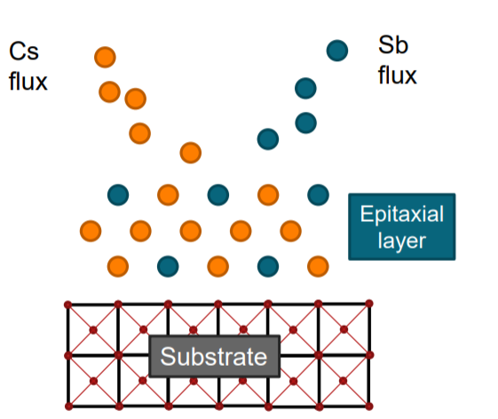
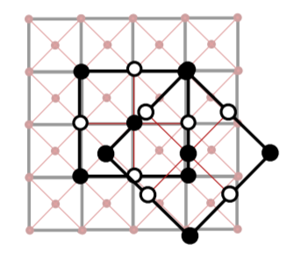
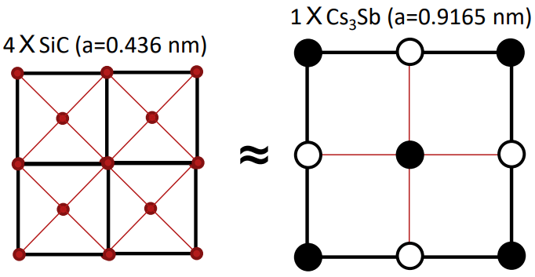
Epitaxy and why it matters
Answer: We can.
Cs₃Sb is conventionally grown polycrystalline with random long-range order.
Material ordering eliminates defects that contribute to electron momentum spread (roughness, grain boundaries)
We lattice-match Cs₃Sb films with the crystal substrate (e.g. 3C-SiC(100)) via Molecular Beam Epitaxy (MBE)
Epitaxy is the alignment of crystal layers with respect to an underlying crystal seed layer.
Figure courtesy of Alice Galdi

Slide 5
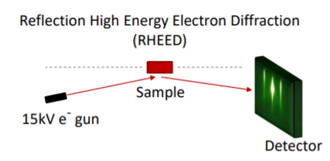
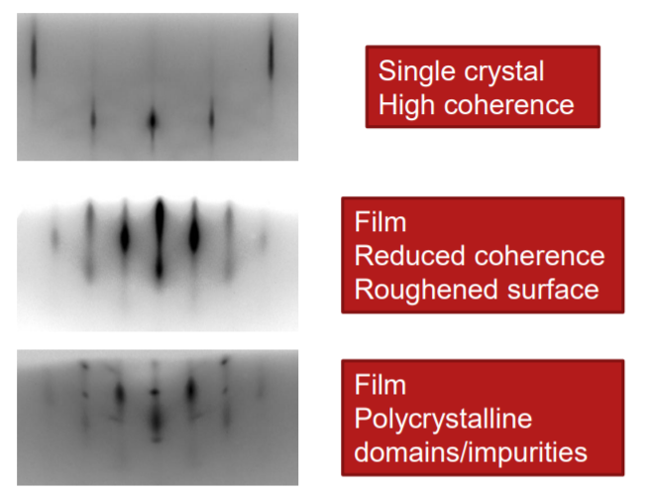
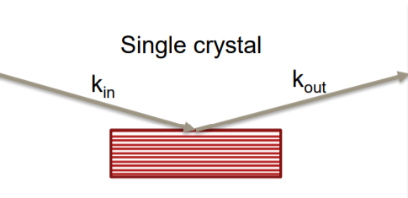
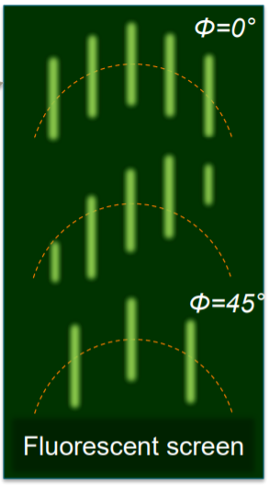
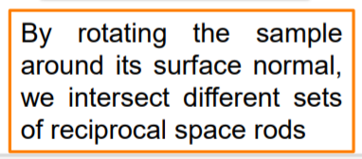
RHEED: a tool for determining epitaxy
RHEED identifies the surface structure through grazing incidence over the first few atomic layers of the sample.

Slide 6
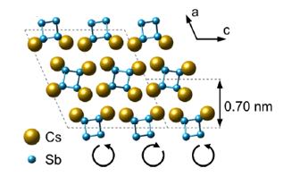
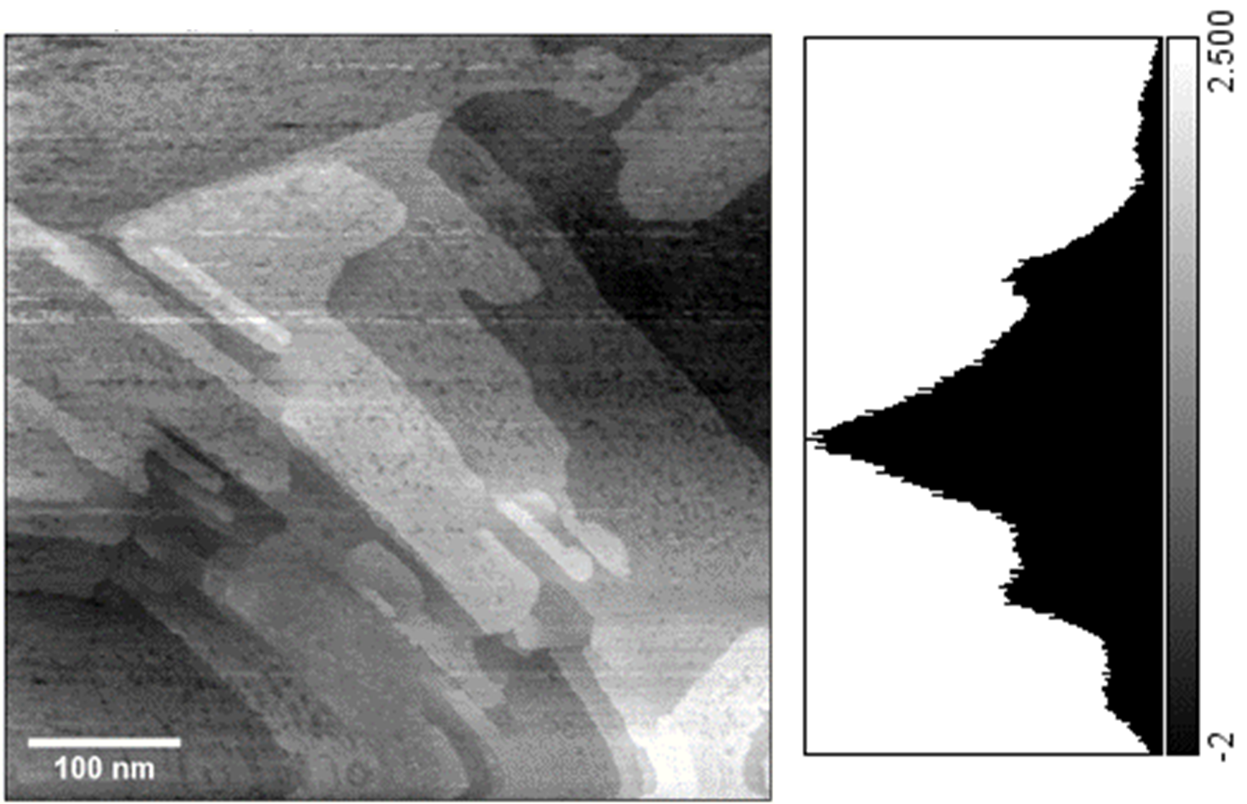
A new stoichiometric phase: Cs₁Sb₁
Azimuthally independent streaks in RHEED
fiber-textured surface
Image band pass filtered for contrast
Scanning Tunneling Microscopy (STM)
- Surface roughness ~0.6 nm.
-Multimodal histogram indicates flat steps along surface.
STM results courtesy of Hines Lab
[2] C.T. Parzyck, C.A. Pennington et al, “Atomically smooth films of CsSb: a chemically robust visible light
photocathode” arXiv:2305.19553

Slide 7
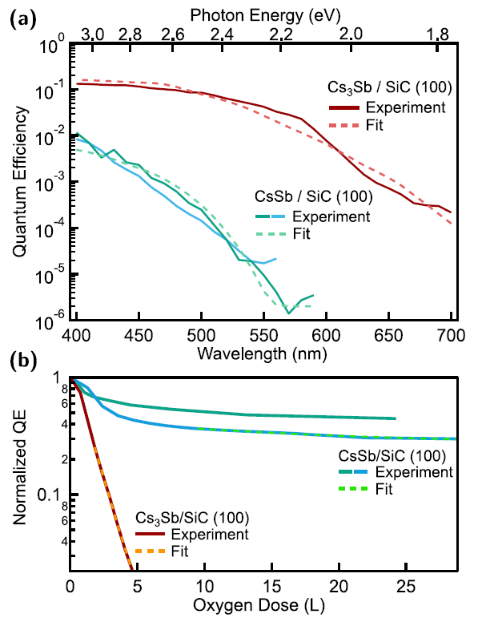
CsSb compared to Cs₃Sb
Estimated work functions of CsSb and Cs₃Sb to be 2.18 eV and 1.63 eV respectively using a modified Dowell-Schmerge model for semiconductors. [2]
CsSb has a photoemission threshold near 570 nm (green-ish light).
Cs₃Sb has the higher quantum efficiency in the visible range. CsSb is exceptionally more robust to oxidation, with the ratio of the decay constants being over an order of magnitude.
Comparable roughness depending on growth technique.

Slide 8
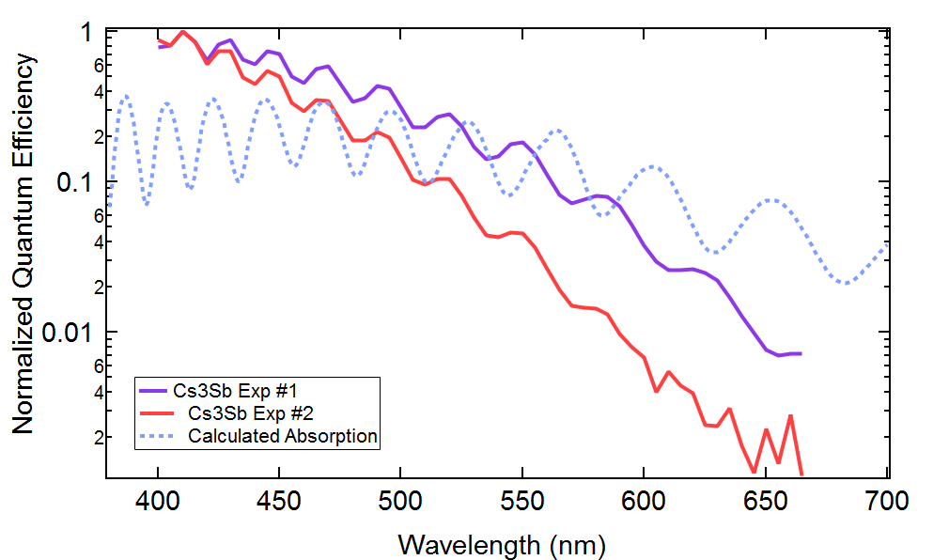
Optical interference in the cathode substrate
Cs₃Sb < 10 nm thick
3C-SiC(100)
1.3 um
Si(100)
~0.5 mm
Optical interference modulates the QE by a factor of two with ~20 nm period.
Film thickness can be chosen to maximize QE at desired laser wavelength.
Further engineering potential – distributed Bragg reflectors (DBRs).
Enhanced photocathode performance through optimization of film thickness and substrate
Journal of Vacuum Science & Technology B 35, 022202 (2017); https://doi.org/10.1116/1.4976527

Slide 9
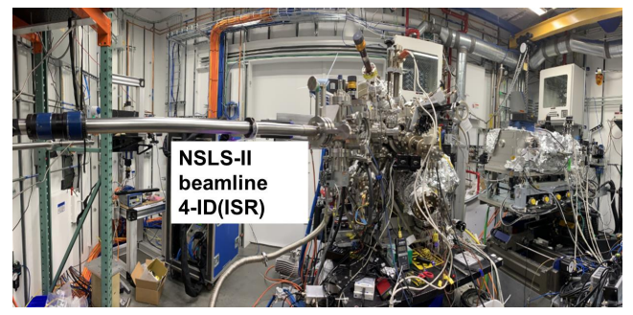
Growing Cathodes: Digitally.
Pulsed Laser Deposition(PLD)
266 nm pulsed excimer laser vaporizes Sb target, condensing on substrate.
Consistent rep rate and laser fluence leads to extremely stable and controlled deposition rates.
Does PLD vaporize atomic Sb or molecular Sb₄?
Growth Controls:
T_{substrate}
Flux rate
Characterization:
RHEED – surface structure
XRD – bulk structure
XRR – thickness and roughness (rms)
XRF - stoichiometry
QE

Slide 10
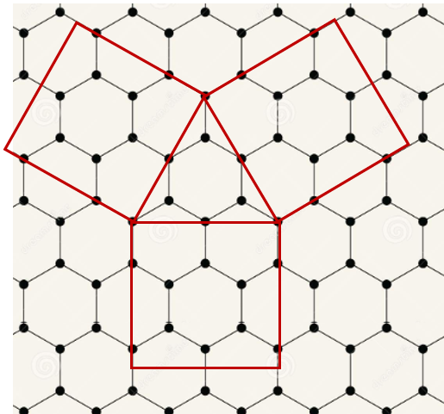
CsK₂Sb with epitaxial domains
Preliminary Data
RHEED e-beam
K₂CsSb lattice constant: ~8.61 Angs
Graphene lattice constant: ~2.46 Angs
The first epitaxial, bi-alkali antimonide photocathode confirmed with RHEED.

Slide 11
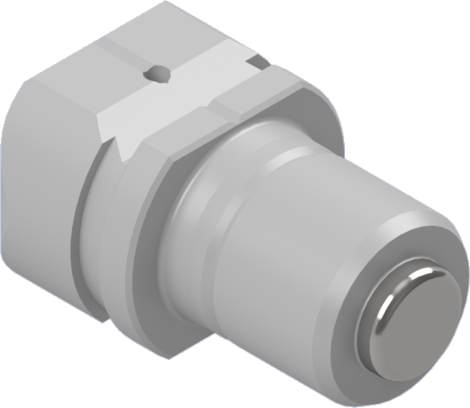
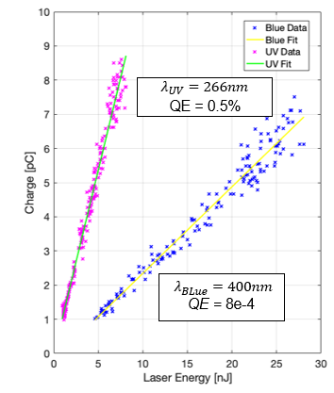
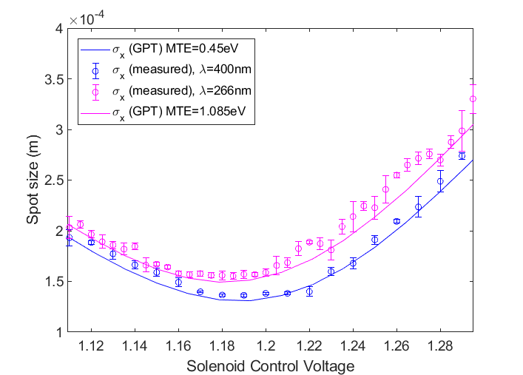
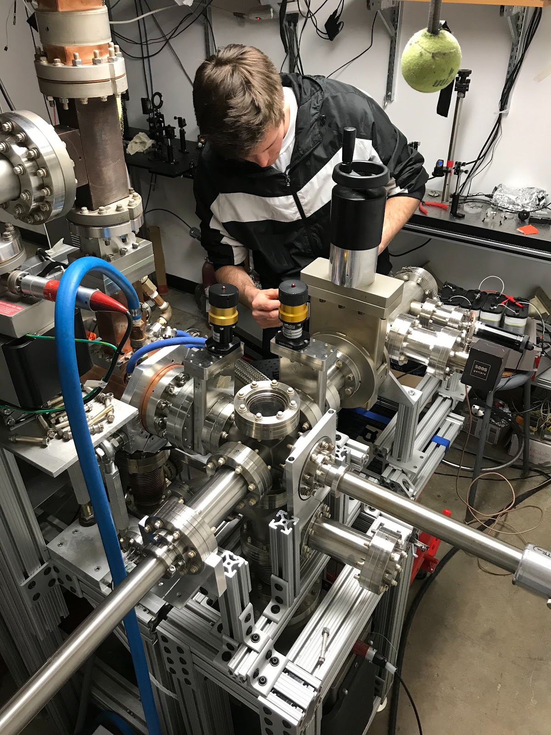
Alkali antimonides at high gradients
Na-K-Sb grown on molybdenum plug surface
INFN/DESY/LBNL cathode plug
Sol current (a.u.)
Next steps and future directions:
- Test percent-level QE cathodes at high gradients (planned for summer 2023).
- Put a semiconductor substrate (e.g. SiC) on the INFN plug to test ordered AA cathodes at high gradients.
UCLA Pegasus loadlock

Slide 12
Conclusions and Future Directions
Improved crystalline order of alkali antimonides is a promising path to higher brightness photocathodes.
The Cs₁Sb₁ photocathode has superb resistance to oxidation, low roughness, and a photoemission threshold in the visible range.
MTE measurements of novel cathodes are underway at Cornell (See Charles Zhang’s poster tomorrow!).
Implement semiconductor substrates (e.g. SiC) on the INFN plug.

Slide 13
Thank you for your attention.
Any questions?
Image courtesy of Samuel J. Levenson

Slide 14
Backup Slides

Slide 15
Exploiting optical interference effects via distributed Bragg reflectors (DBRs) could be an exciting way to enhance QE.

