Slide 1
Simulation of the Field Enhancement Effect and Surface Roughness in Nb₃Sn
Aiden Harbick, Mark Transtrum
March 7, 2023

Slide 2
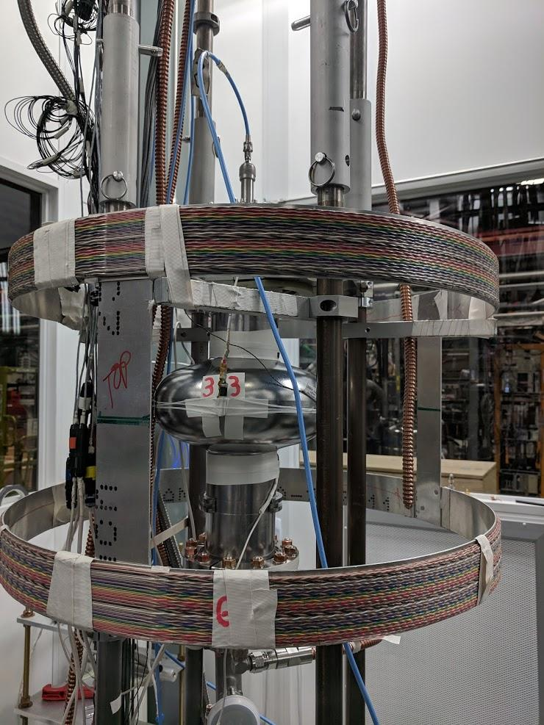
SRF Cavities
SRF Cavities are and important component of modern particle accelerators
Nb primary workhorse of cavities up to this point
Optimized through decades of research
Exploring cutting edge materials to build the next generation of accelerators
Nb₃Sn is a promising SRF candidate
Tc ~2x higher than Nb (operates at higher temp)
Theoretically larger accelerating fields
Nb₃Sn cavity construction is currently much less optimized than Nb cavities
Image Provided Courtesy of Sam Posen

Slide 3
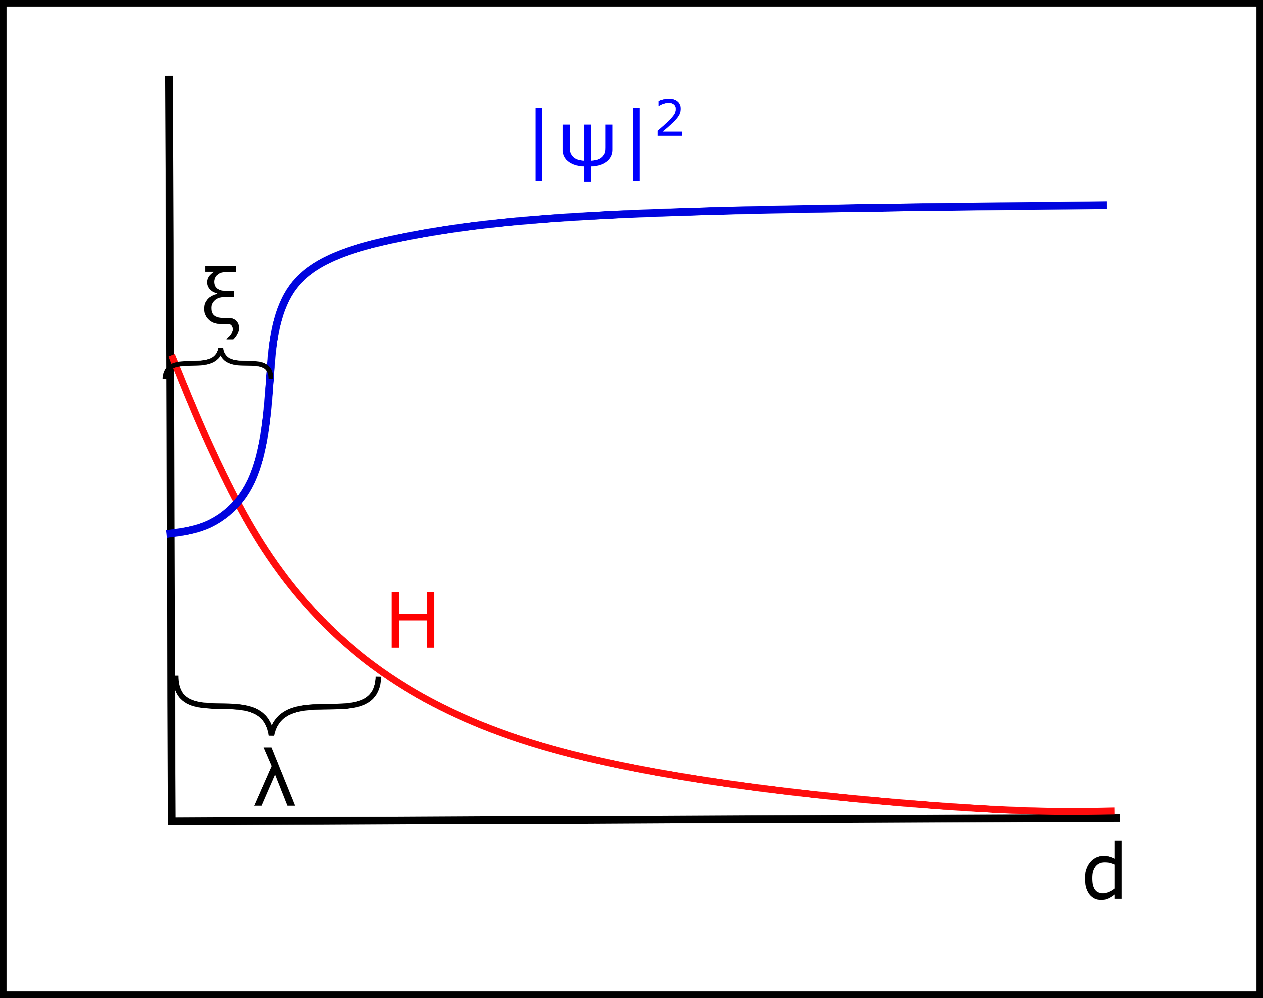
Superconducting Length Scales
There are two main length scales which govern the properties of superconductors
The penetration depth describes how far field can ‘penetrate’ into the superconductor
The coherence length gives a characteristic length for variations in the superconducting order parameter
The order parameter squared can be thought of as giving the density of superconducting electrons
The ratio of these two length scales is called the Ginzburg-Landau parameter, $κ=\frac{λ}{ξ}$
Notes:
Mention we mostly think about the high-level abstractions, but there is microscopic interpretations

Slide 4
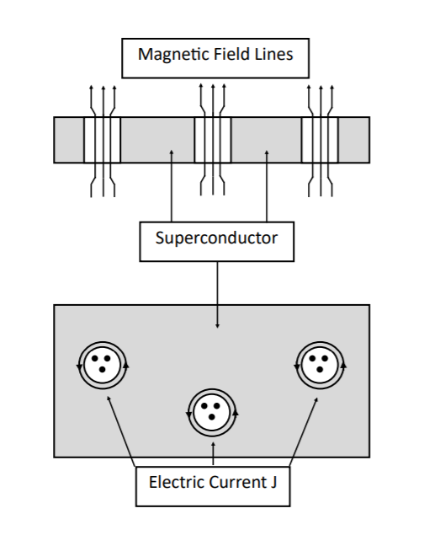
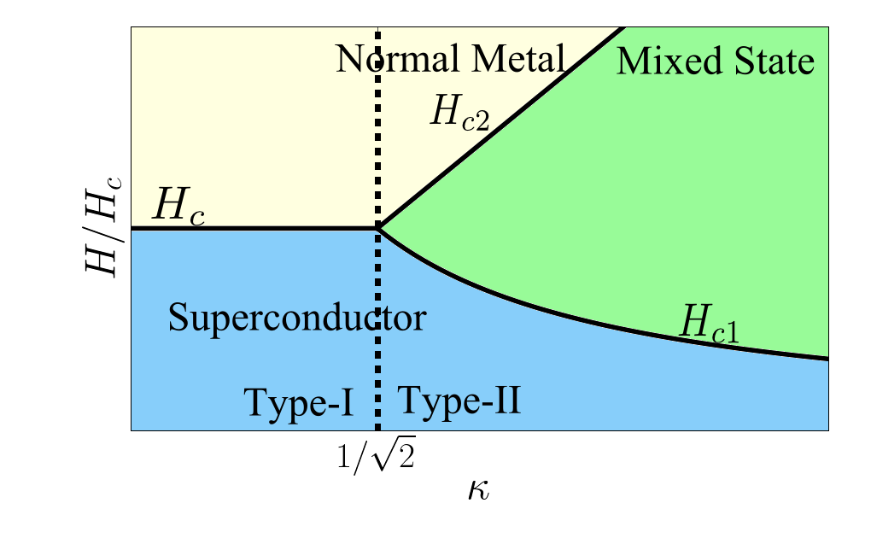
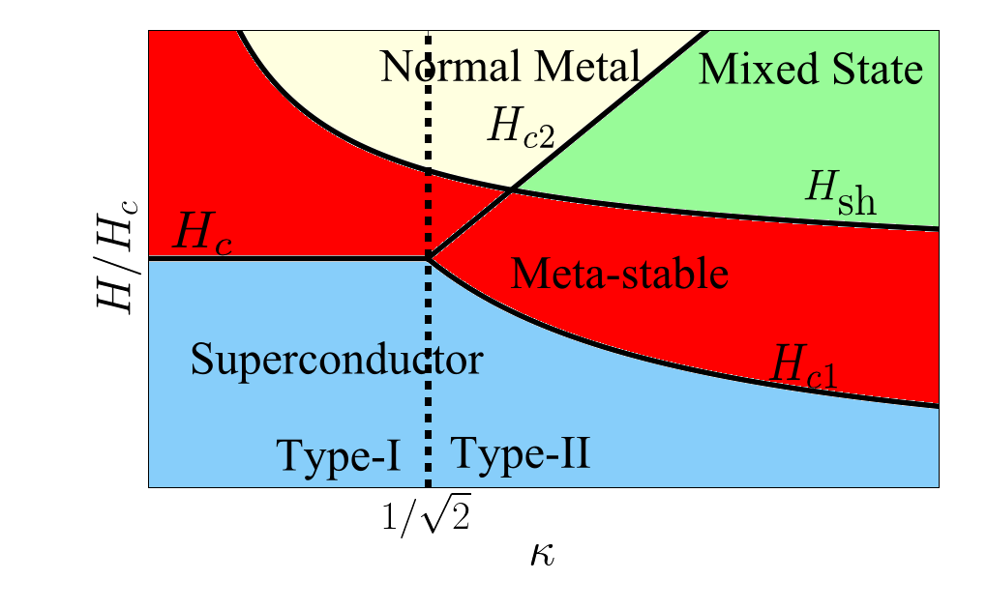
Critical Fields
At temperatures below Tc, the state of the superconductor is determined by the externally applied field
Critical fields separate different superconducting states:
For SRF cavities, the superheating field is the main limiting factor when it comes to performance

Slide 5
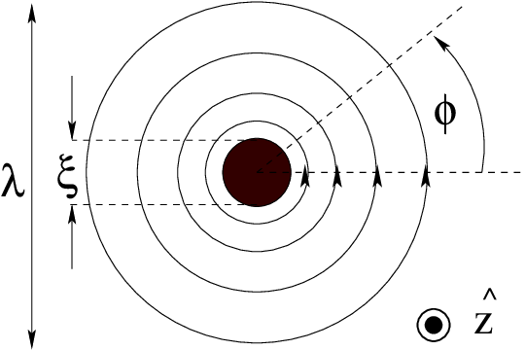
Length Scales in the Vortex State
These lengths also determine the size of vortices (for type II superconductors)
Coherence length gives size of the normal core
Penetration depth gives the size of the region where screening current flows around the vortex
This means that materials with different values of $κ$ will have different sized vortices
Phys. Rev. B 73, 134511

Slide 6
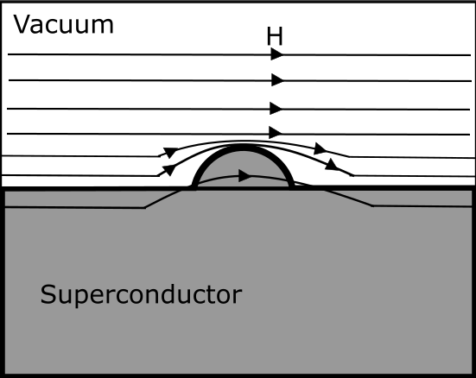
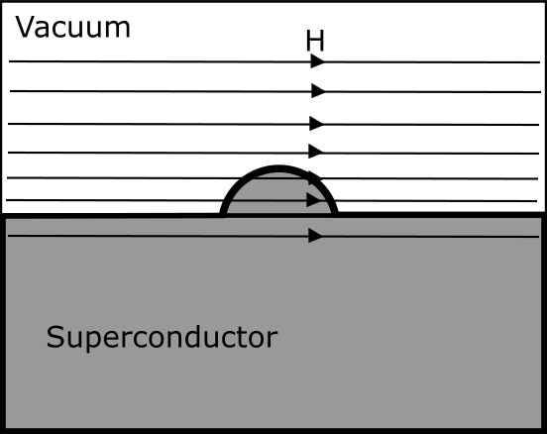
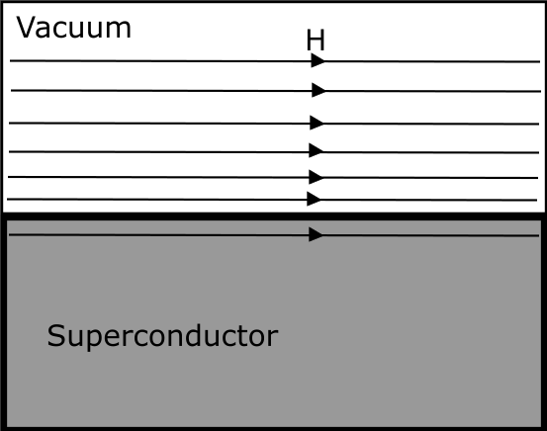
Field Enhancement and Surface Roughness
Field enhancement is a superconducting phenomenon in which rough surface structures lead to larger (enhanced) magnetic field magnitude near the surface.
When near $H_{sh}$, this enhanced field could lead to vortex nucleation
The size and shape of these surface defects determines their impact
Our goal is to perform simulations capable of producing field enhancement and make predictions for how different surface defects impact SRF performance
 | Nb | Nb₃Sn
Penetration Depth (nm) | ~40 | ~100
Coherence Length (nm) | ~40 | ~4
Field Enhancement!
Notes:
Make clear slide 5 is basic theory, surface roughness introduces new non-trivial length scales to the problem, this leads us to our research questions

Slide 7
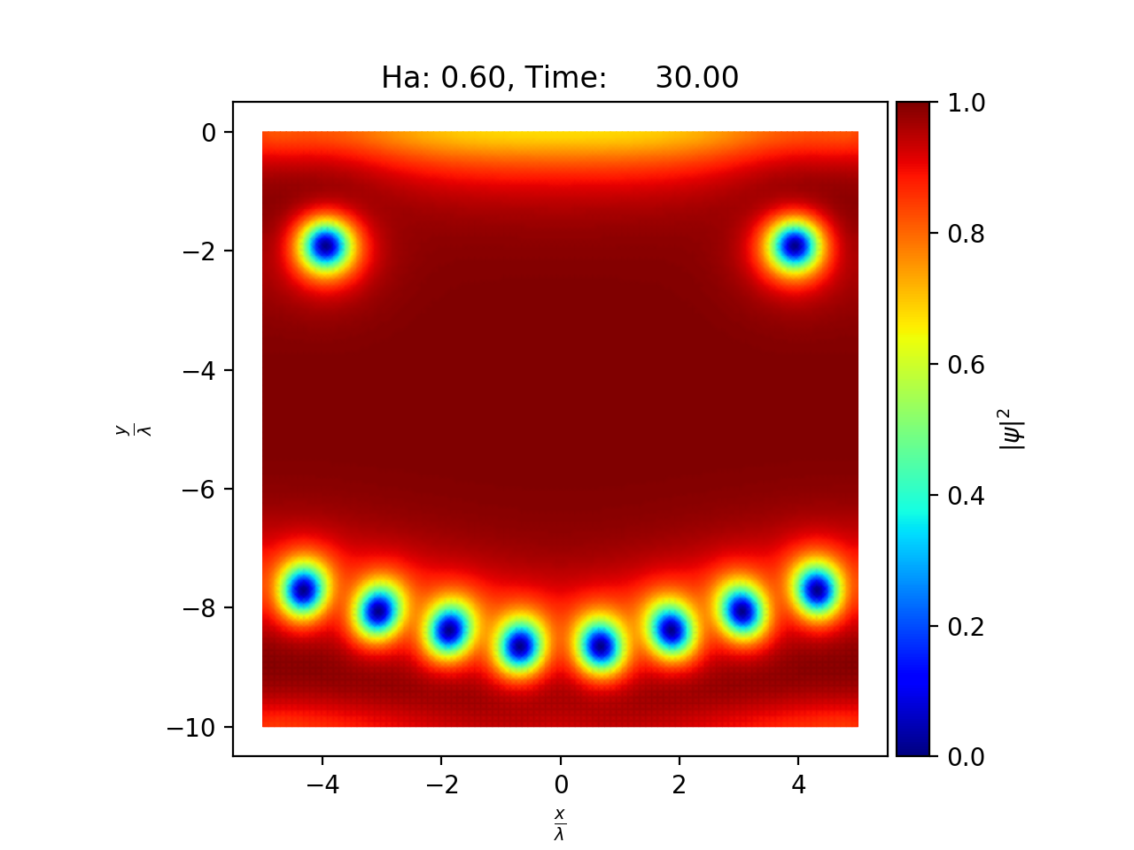
Time-Dependent Ginzburg-Landau Theory
Phenomenological model, valid near Tc
TDGL is a reasonable mesoscopic model
Captures relevant SRF phenomena such as vortex dynamics
Reasonable computational cost
Solving the below equations for ψ and A give important mesoscopic features
We use a finite element method to get solutions
Notes:
Give people and idea of the scale of simulation, typical simulation has x mesh points, runs for y long, etc.

Slide 8
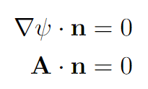
Boundary Conditions
The boundary conditions for TDGL are:
These equations ensure no current can flow out of the superconductor
To apply external magnetic field on the boundary we additionally impose:
This prevents field enhancement!
Schematic:

Slide 9
Incorporating Field Enhancement
Schematic for Field Enhancement Simulations
Note: A is continuous across the internal boundary, but this is automatically enforced by finite element
This formulation follows that of Oripov and Anlage (Physical Review E 101, 033306)

Slide 10
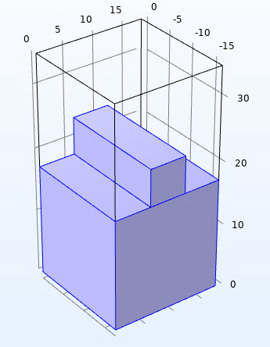
“Step Function” Bump Geometry
The main geometry I have been focusing on first is what I have been calling a step function bump
TDGL is best at making qualitative predictions so using an idealized geometry like this is a natural choice
We want to get a sense of the various tradeoffs associated with general surface features of different sizes
This geometry allows us to unambiguously define surface features of specific widths/heights
Height
Width
Notes:
Basic superconductors have just 2 length scales, when looking at surface roughness theres height/width/curvature length scales; very high dimensional parameter space; want to isolate what we think will be the most relevant/highest order effects

Slide 11
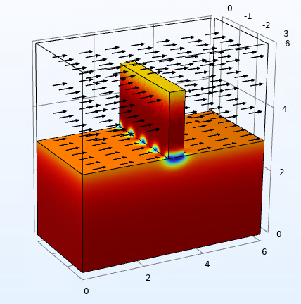
The Tall Bump Limit
The primary focus of my results in this presentation will be on the tall bump limit
In this limit, vortices enter the bump very easily, but will not be able to penetrate the bulk
These vortices will reduce the cavity’s efficiency, but will not prevent operation
Vortices being able to enter the bulk leads to large amounts of dissipation and represents a cavity-quenching phenomenon
Question to answer: If we have a surface defect that can nucleate vortices, at what characteristic width can those vortices easily enter the bulk?
Notes:
Note cavities in the bump can reduce efficiency but don’t prevent operation (modify text) Add eq. H>>lambda>>xi

Slide 12
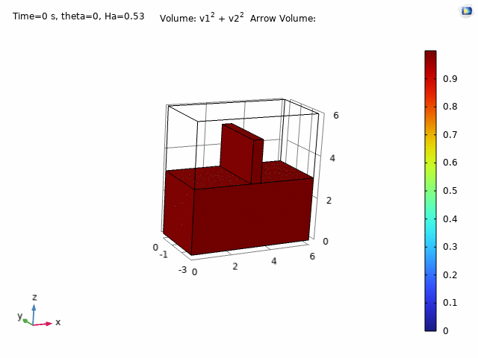
Vortex Bulk Entry
No Bulk Entry:
Bulk Entry:

Slide 13
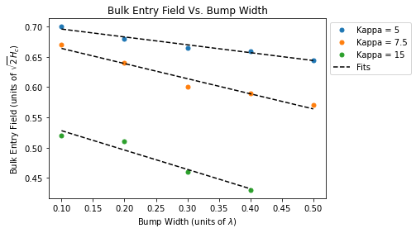
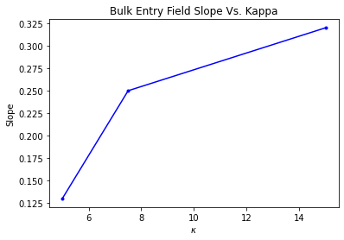
Preliminary Results
We calculated the field at which vortices first are able to enter the bulk varying width as well as $κ$
Idea: Calculate the slope of the small width trend for different $κ$ values, and use this to extract the relevant length scale
A should be close to the bulk Hsh value, C is a (currently unknown) function of $κ$
The increasing slope with $κ$ is consistent with idea that small $ξ$ = more sensitive to surface defects
Notes:
Remove kappa = 10, we have a sanity check, small bumps matter more for larger kappa. But now we have a path to quantify this, though we still need more time to get more datapoints and work out the details

Slide 14
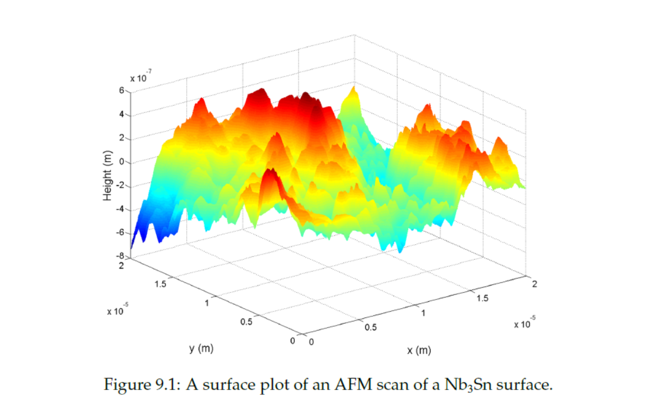
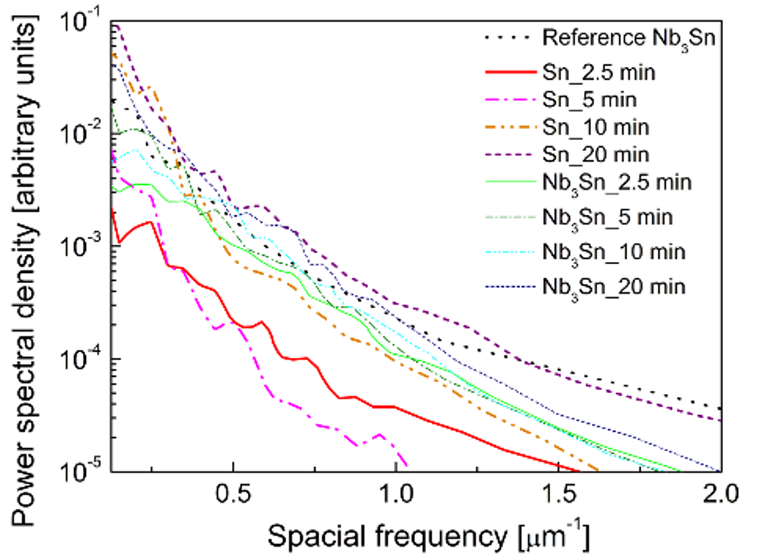
Future Plans
We still have more work to do to explore different specific length scales
We plan to also look at ‘wide bump limit’ and length scales associated with curvature
There is a lot of room for future collaboration, in particular:
Directly simulate some part of the RF surface based on AFM scan
Create random surface roughness profiles based on power spectral density characterizations of surface roughness
Porter, R. D. (2021) Ph.D. Dissertation
Figure provided courtesy of Zeming Sun
(I am unsure of original source)

Slide 15
Summary
Primary Takeaways:
Length scales play an important role in determining the properties of a superconductor
Surface roughness introduces more length scales to the interactions of magnetic fields with the superconducting state
We simulate rough vacuum-superconductor interfaces via finite element simulations
In the ‘tall bump limit,’ the width dependence of bulk entry appears roughly linear
The slope change for different $κ$ aligns with our expectations (though more data is needed)
This work was supported by the US National Science Foundation under Award OIA-1549132, the Center for Bright Beams
Notes:
Remind takeaways of superconductivity (length scales), remind surface roughness introduces more length scales, finite element methods allow us to do this, basically summarize talk more, research conclusions more sparse

