Slide 1
Mechanistic Investigations of the Substrate-Mediated Factors Influencing Nb₃Sn Film Growth
Sarah Willson, Rachael Farber, Ajinkya Hire, Van Do, Richard Hennig, Steven Sibener
CBB Annual Meeting 2023

Slide 2
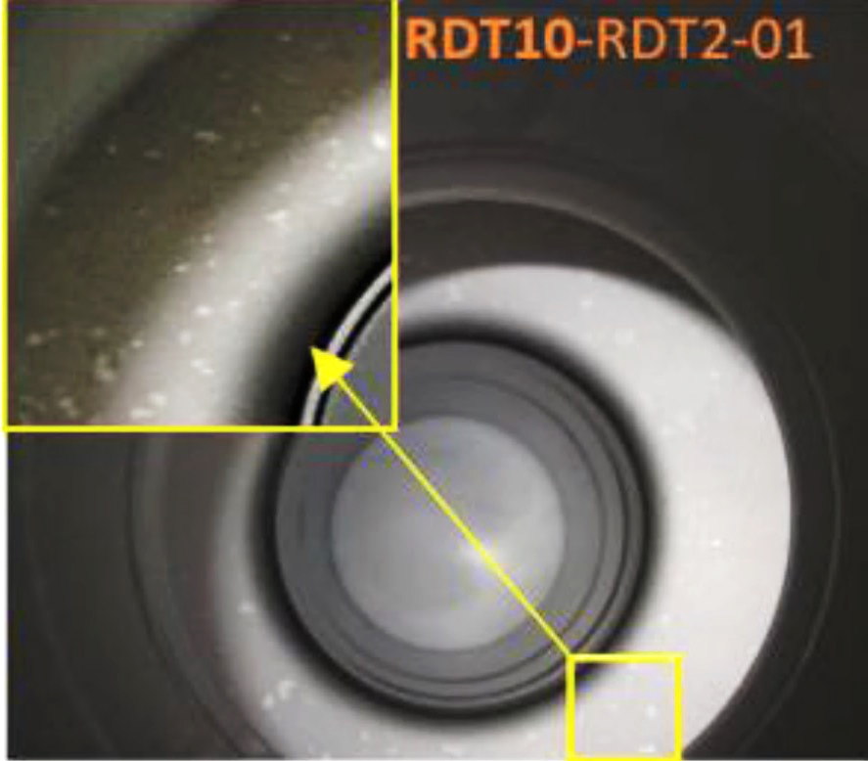
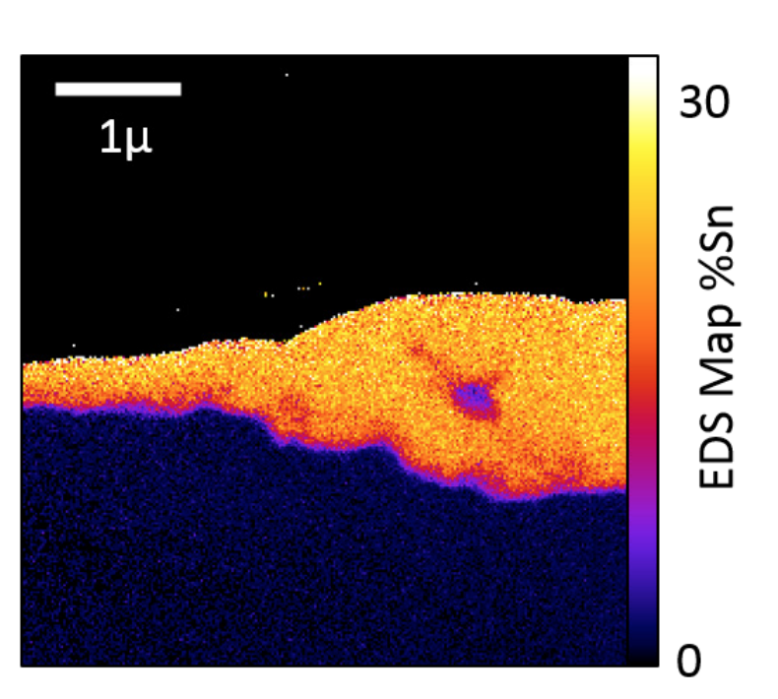
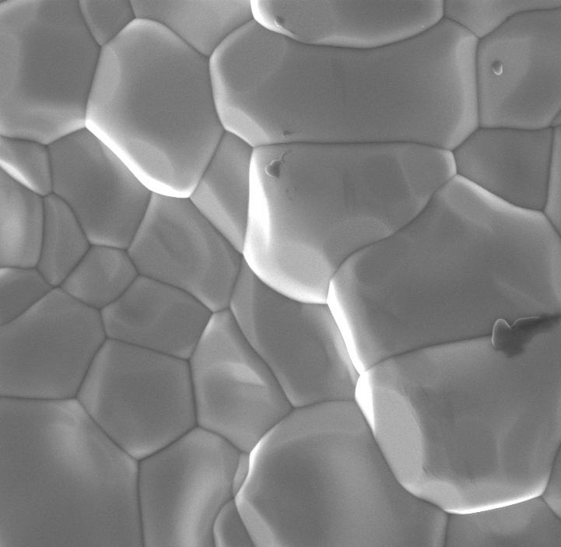
Nb₃Sn Cavity SRF Performance is Limited By Near-Surface Defects that Quench Superconductivity
Sn segregation on SRF cavity surface
Sn-depleted
interface
region
400 nm
Stoichiometric and structural inhomogeneities, surface roughness, grain size, etc.
Impacts
Superconducting critical temperature, accelerating gradients, quality factor, etc.
U. Pudasaini, et al. Supercond. Sci. Technol. 32, 045008 (2019).
Nb₃Sn Sample Supplied by R. Porter (Cornell Univ., SLAC)

Slide 3
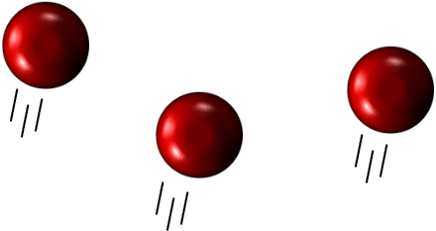
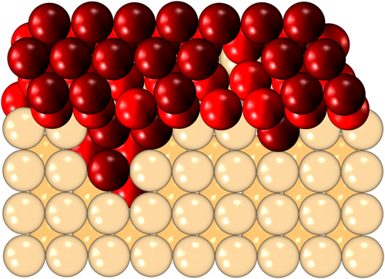
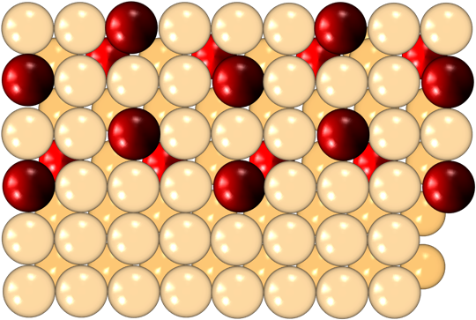
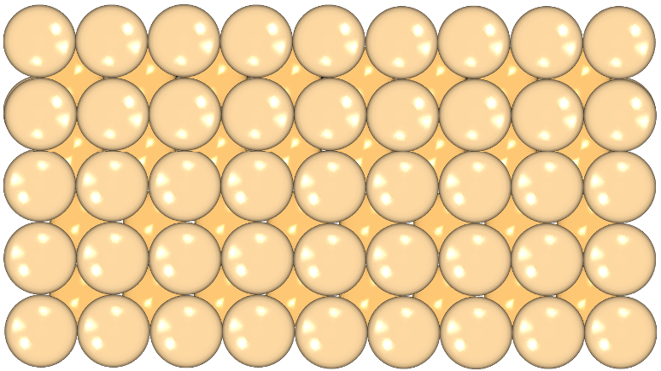
Conducting Growth Studies for Optimal Nb₃Sn Films
Nb₃Sn growth and quality dependent on:
1. Deposition conditions
Relationship between Sn vapor flux and Nb substrate deposition temperature
  Insufficient Sn flux → Sn-deficient regions
  Excess Sn flux → persistence of Sn hot spots
2. Nb substrate morphology
Nb surface sites determine initial Nb-Sn interfacial interactions
  Nucleating agent typically used to stabilize adlayers
Many Nb oxidation states and structures with unique energetics
Nb₃Sn Growth – Vapor Deposition
Sn atoms
Coating
Incorporation
Nb₃Sn film
Nb substrate
T: 500 -1000 ºC
T: 950 -1200 ºC
It is not well understood which specific Nb features influence Sn nucleation and alloy growth

Slide 4
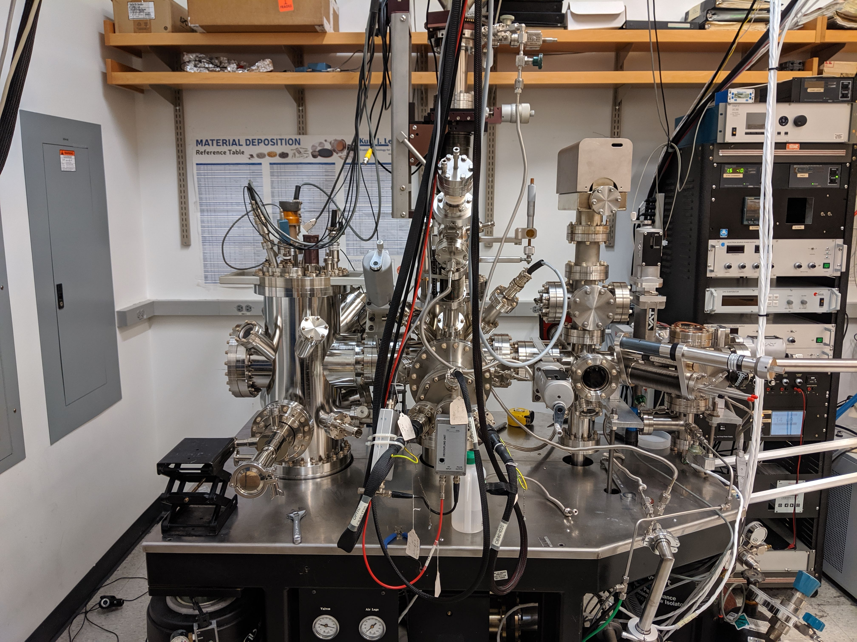
Experimental Techniques
Ultra-high vacuum chamber with in situ:
Nb substrate modification
  Annealing ( < 1700 °C), Ar⁺ sputtering, gas dosing
    Control over oxidation, roughness, contaminants, etc.
Nb₃Sn growth
  3 independent electron beam evaporation cells
  Vapor flux calibrated with quartz crystal microbalance (QCM) to sub-monolayer (ML) precision
  Variable substrate deposition temperature
Surface characterization
  Auger electron spectroscopy (AES)
  X-ray photoelectron spectroscopy (XPS)
  Scanning tunneling microscopy/spectroscopy (STM/STS)
Ex situ analysis
Scanning electron microscopy (SEM)
Energy dispersive spectroscopy (EDX)
Grazing incidence X-ray diffraction (GIXRD)
Atomic force microscopy (AFM)
STM Chamber
Cleaning & Analysis Chamber
Growth Chamber

Slide 5
Outline
Thickness
Examining Nb₃Sn film growth across coverage regimes
How can we leverage surface chemistry techniques to better understand reactivity of these SRF interfaces?
Can studying Nb and Nb₃Sn surface behavior inform optimal film growth efforts?
Comparing morphology and oxidation pathways for:
  Nb substrate
  Nb₃Sn film
1 μm
Full Nb₃Sn film
30 nm
Initial film growth
5 nm
Sn wetting & nucleation
Sub-monolayer
Atomic interactions

Slide 6
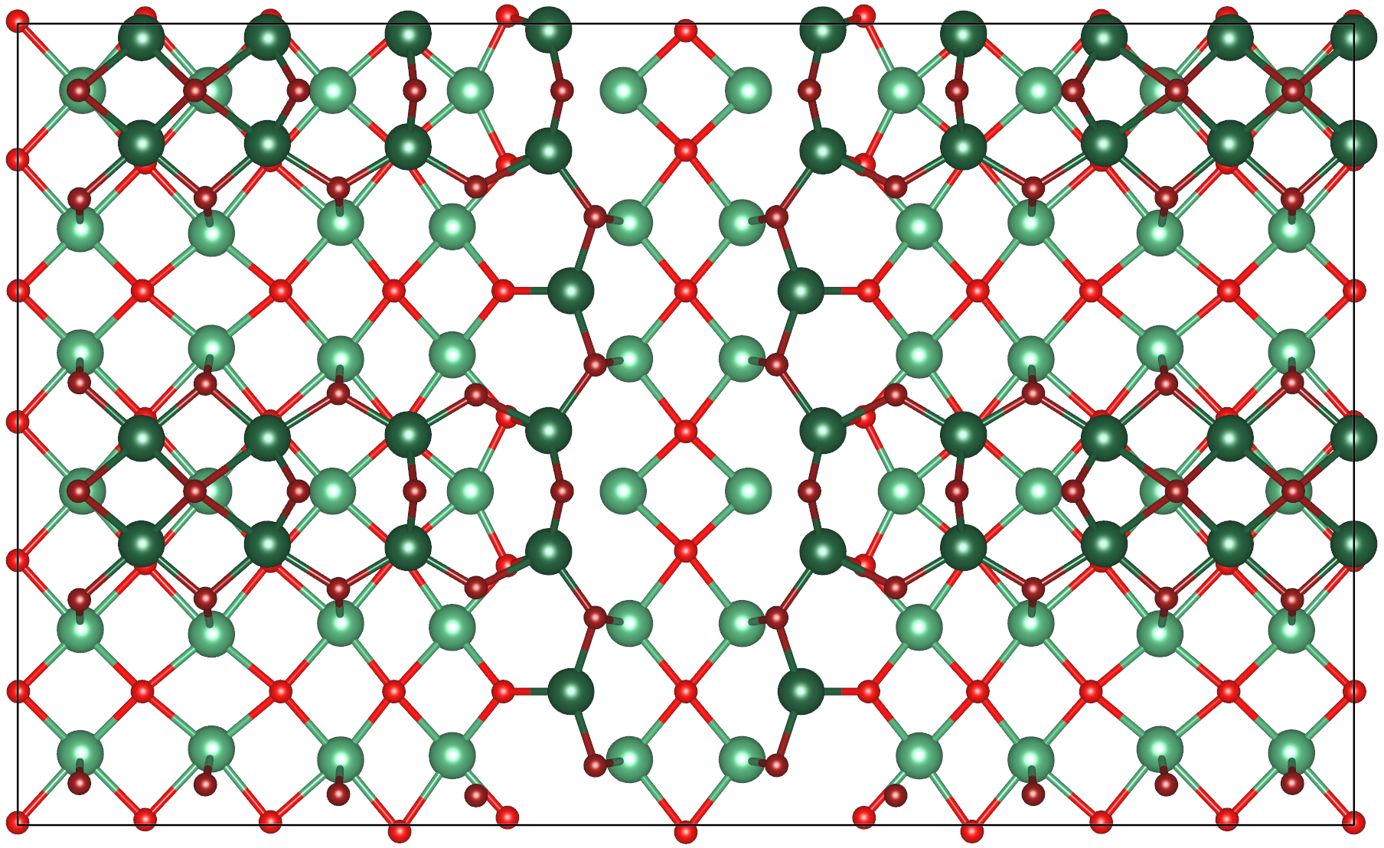
Niobium Oxidation at Sn Deposition Temperatures
Nb₂O₅
  Near-amorphous structure with many possible crystalline phases
  Rapid reformation from either from either bulk precipitation or dissociative chemisorption of environmental H₂O/O₂
NbO
  High temperature annealing ( >1530 ºC) forms various reconstructions
  (3×1)-O/Nb(100) forms a highly ordered “ladder” structure
STM of (3×1)-O Nb(100)
ladder edge
(3×1)-O/Nb(100) unit cell
ladder rung
ladder rows
S.A. Willson, R.G. Farber, A.C. Hire, R.G. Hennig, S.J. Sibener, J. Phys. Chem. C 2023, 127, 6, 3339–3348

Slide 7
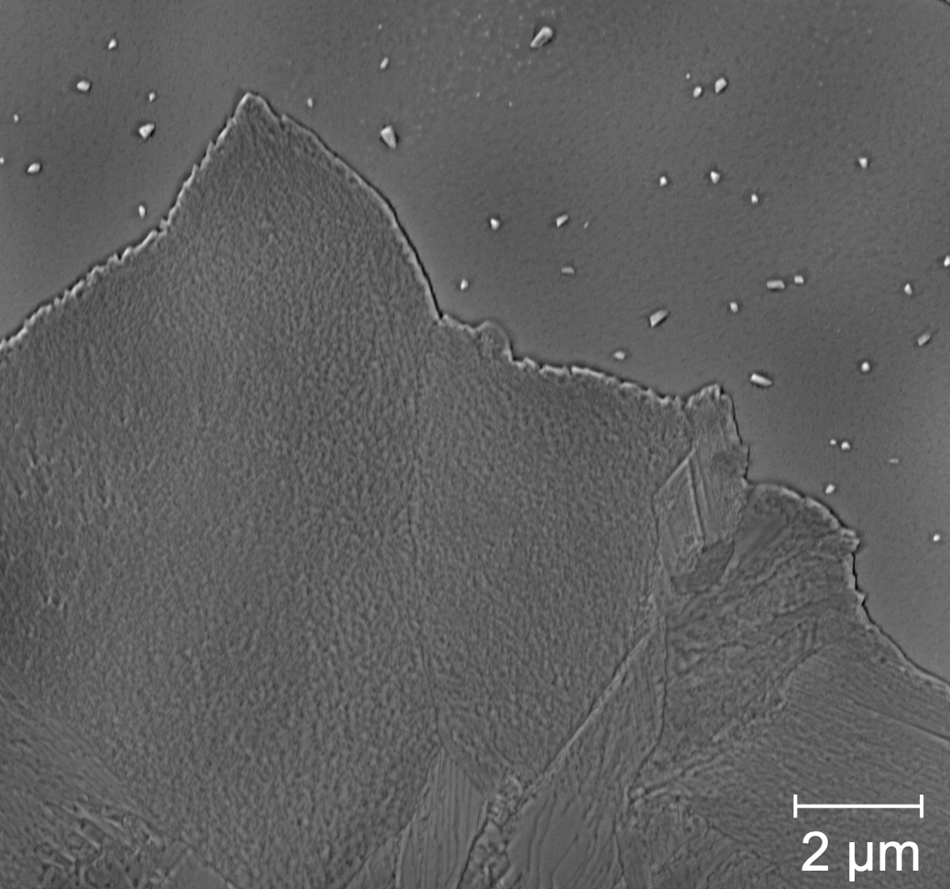
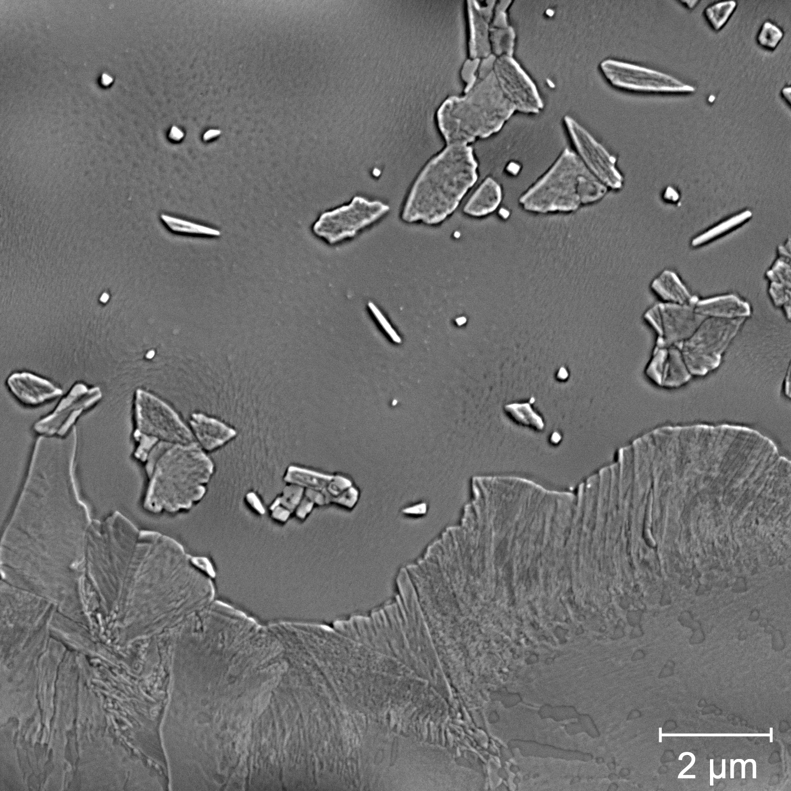
Nb Oxidation Impact on Sn Nucleation and Nb₃Sn Growth
Compared Sn nucleation and initial Nb₃Sn film growth for Sn deposited on polycrystalline Nb in either a NbO or Nb₂O₅ state
  Films grown under same coating conditions (T_{dep}: 850 - 900ºC)
  Similar Nb₃Sn film morphologies
  More Sn nucleation sites on Nb₂O₅
    Growth of new intermetallic domains
30 nm Nb₃Sn films
Sn islands on Nb
NbO
Nb₂O₅
New intermetallic domains & more Sn islands
vs.
Nb₃Sn film
More oxidized Nb surface enhances Sn nucleation and aids in the formation of new intermetallic domains

Slide 8
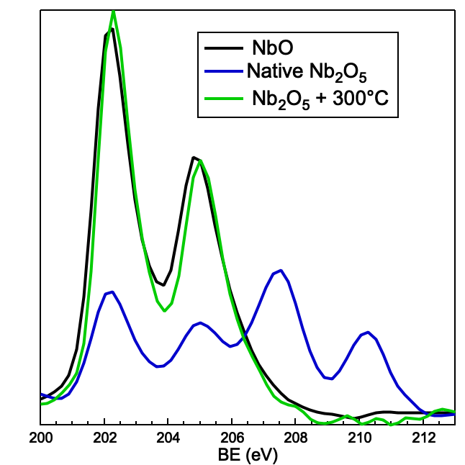
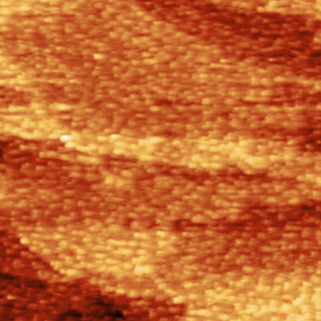
Niobium Oxidation at Sn Deposition Temperatures
Is oxygen playing a role in Nb₃Sn coordination?
Low temperature annealing reduces Nb₂O₅ → NbO
  Same BE and O at. % as NbO with disordered structure
During heated deposition on Nb₂O₅, Sn is interfacing with a NbO with different available binding sites
Nb₂O₅+ 300 ºC → NbO
Nb⁺⁵
15 nm
Is Sn adsorption unfavorable at specific (3×1)-O/Nb(100) surface sites?

Slide 9
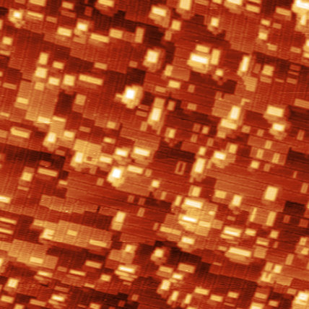
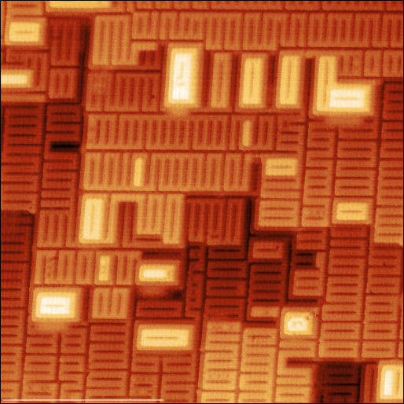
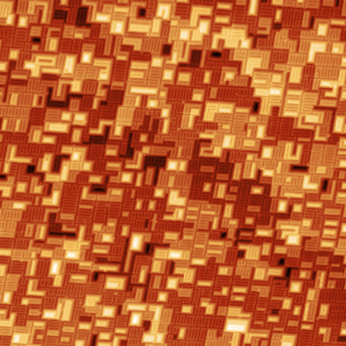
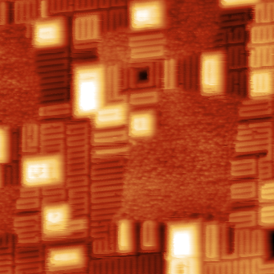
Sn Nucleation on (3×1)-O/Nb(100)
Sn unable to form uniform layer on (3×1)-O/Nb(100) surface
Increased (3×1)-O/Nb(100) defect density
  Higher proportion of edge sites not containing the characteristic (3×1) coordination
  Sn persists at higher temperatures due to favorable defects on Nb surface
Medium defect density (17.8 %)
Sn + 850 ºC anneal
Sn fully desorbed
High defect density (31.3 %)
Sn remaining on surface
Sn + 850 ºC anneal
Surface defects do impact Sn desorption rates and improve nucleation
Farber, R.G., Willson, S.A., Sibener, S.J. JVST A 39, 063212 (2021)

Slide 10
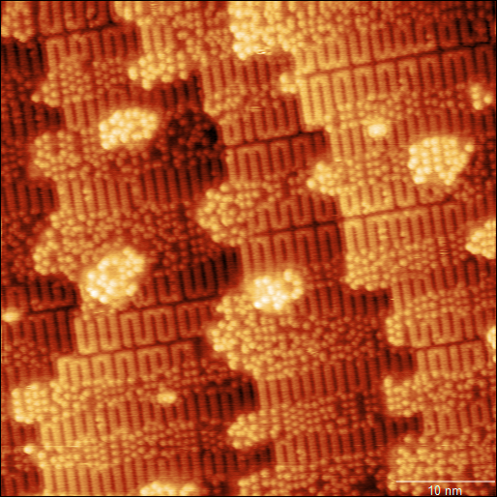
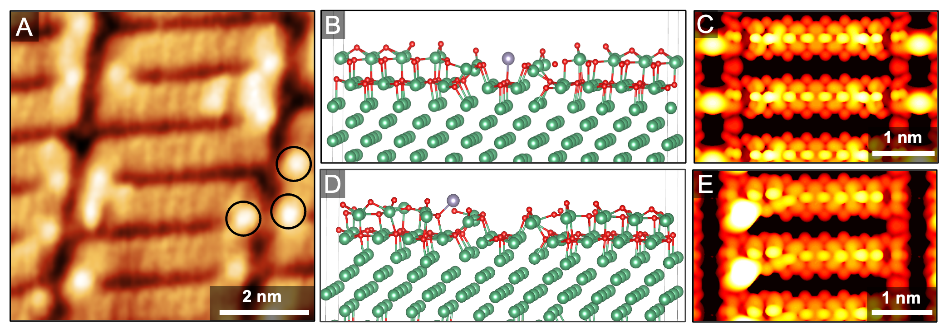
(3×1)-O/Nb(100) Binding Energies
Both experimental and theoretical results suggest instability of Sn adlayers and atoms along the on (3×1)-O rung sites
DFT calculations done by Ajinkya Hire (Hennig Group)
  Identified only 2 favorite Sn adsorption sites
  No converged Sn overlayer on (3×1)-O/Nb(100) with experimental atomic spacing
Sn diffusing to ladder edge sites
adsorbed Sn atoms
Evidence for specific
(3×1)-O/Nb(100) surface sites inhibiting Sn nucleation
Nanoscale structure drives Sn stability on the surface
S.A. Willson, R.G. Farber, A.C. Hire, R.G. Hennig, S.J. Sibener, J. Phys. Chem. C 2023, 127, 6, 3339–3348

Slide 11
Outline
Comparing morphology and oxidation pathways for:
  Nb substrate
  Nb₃Sn film
    CBB collaborators demonstrated
      Persistence of Nb₃Sn oxides
      Impact of oxides on field dependence & SRF performance
Z. Sun et al., arXiv:2305.02467 [cond-mat.mtrl-sci]

Slide 12
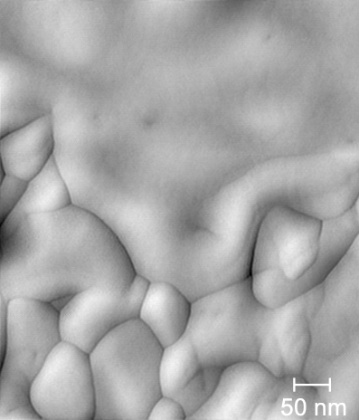
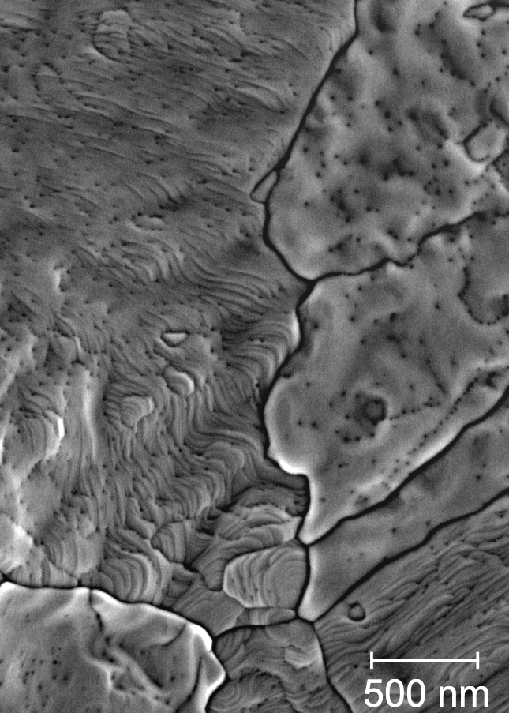
Varying Surface Morphology of Nb₃Sn Grains
3 Distinct Nb₃Sn Grains
Type 1 Smooth, stoichiometric Nb₃Sn
  Only found in films > 275 nm thick
  Evidence of coalescing
  Higher thermal stability, resistance to degradation
Type 2 Corrugated, Sn-deficient
  30 – 50 nm surface buckling
  Largest surface area
  Sn deficiency throughout film, not segregated to the surface region
  Observed for all film growth conditions and thicknesses, preferentially found at surface
Type 3: Rough, Sn-rich
  ~ 50 – 100 nm spherical grains
  Higher roughness determined by grain size
  Observed across all films
AFM
SEM
Different stoichiometry, roughness, and thermal stability of Nb₃Sn indicate varying SRF performance

Slide 13
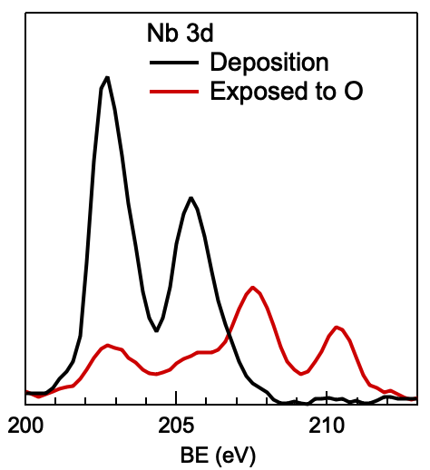
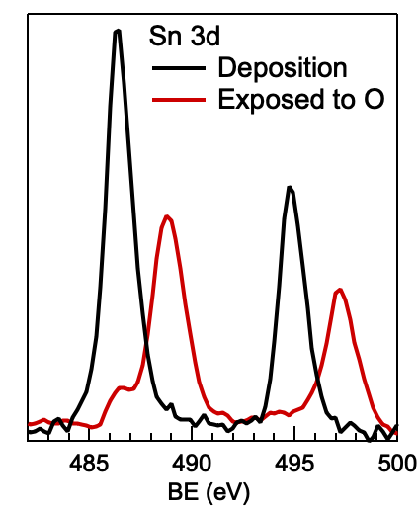
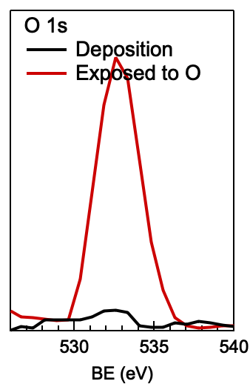
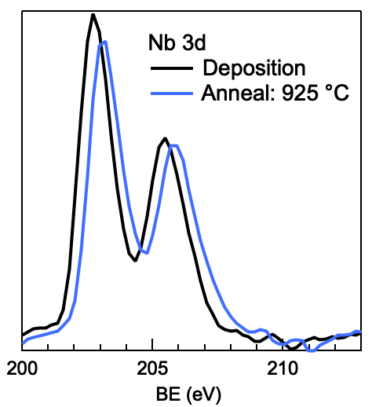
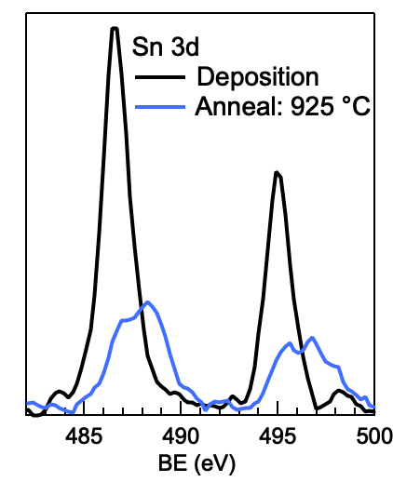
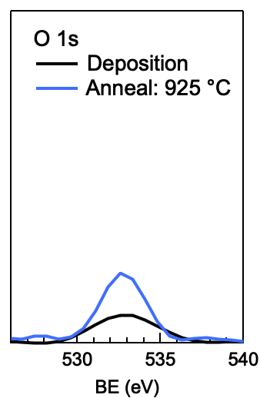
Nb₃Sn Surface Stability and Oxidation Pathways
Energetically unfavorable terminations prone to:
  Reconstructions (i.e. NbO/Nb(100) → (3×1)-O/Nb(100))
  Reactivity (oxidation, contamination, etc.)
Observed 2 Distinct Oxidation Pathways
Atmosphere Exposure
  Nb₃Sn does not form an oxide post-deposition (UHV, in situ)
  Post-oxygen exposure: formation of Nb(V)–Sn(IV)–O complex
    Oxide shift in both Nb, Sn XPS doublets
    Fully reducible – gentle annealing fully removes oxygen
Annealing Sn-deficient Nb₃Sn
  Post-deposition annealing drives Sn segregation via precipitation & desorption
  Film deterioration: in situ formation of Nb(II)-Sn(II/IV)-O complex
    Oxide distinct from atmospheric-driven complex
    Sn oxide resistant to annealing under UHV
XPS: Nb₃Sn Exposed to Atmosphere
Sn⁺⁴
Nb⁺⁵
XPS: Thermal Degradation of Deteriorating Nb₃Sn
Nb⁺²
Sn^{+2,4}

Slide 14
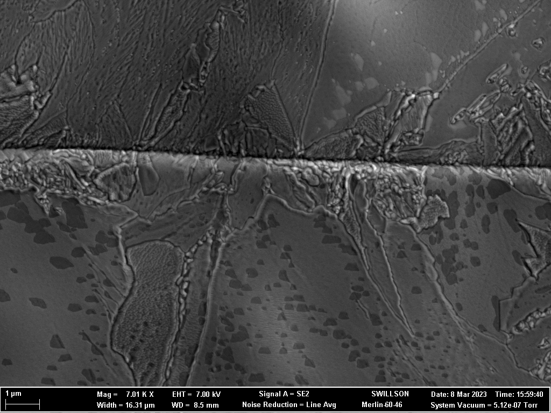
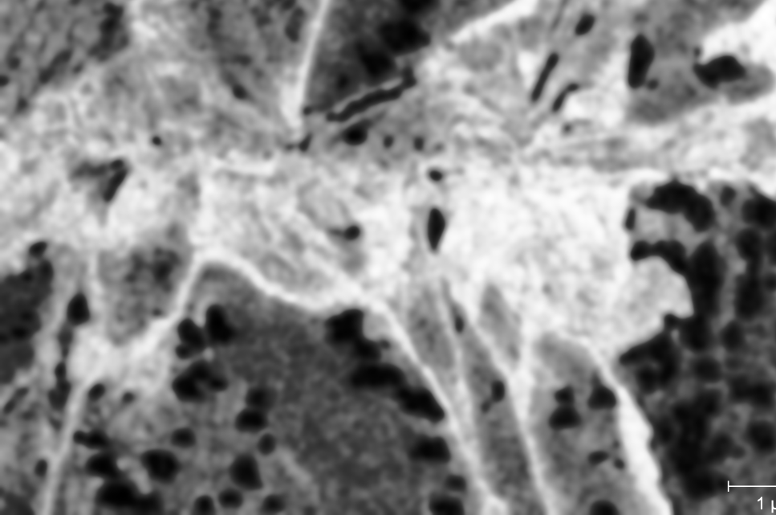
Nb₃Sn Surface Stability and Oxidation Pathways
Energetically unfavorable terminations prone to:
  Reconstructions (i.e. NbO/Nb(100) → (3×1)-O/Nb(100))
  Reactivity (oxidation, contamination, etc.)
Observed 2 Distinct Oxidation Pathways
Atmosphere Exposure
  Nb₃Sn does not form an oxide post-deposition (UHV, in situ)
  Post-oxygen exposure: formation of Nb(V)–Sn(IV)–O complex
    Oxide shift in both Nb, Sn XPS doublets
    Fully reducible – gentle annealing fully removes oxygen
Annealing Sn-deficient Nb₃Sn
  Post-deposition annealing drives Sn segregation via precipitation & desorption
  Film deterioration: in situ formation of Nb(II)-Sn(II/IV)-O complex
    Oxide distinct from atmospheric-driven complex
    Sn oxide resistant to annealing under UHV
  Insulating Sn oxide regions identified with BSE mapping
    Morphologic & chemical marker to Nb₃Sn decomposition
Secondary e⁻
Backscattered e⁻

Slide 15
Summary
Compared morphology and oxidation pathways for:
  Nb substrate
    Demonstrated structural factors that limit alloy growth on a less oxidized Nb surface
  Nb₃Sn film
    Identified Nb₃Sn grain morphologies, stabilities, and oxidation processes
Studies have provided a broad overview of Nb₃Sn growth and optimization ranging from:
Contributes to the overall SRF/CBB mission to understand complex reactive interfaces for industrial implementation
Sn adsorption and incorporation
10 nm
Nb₃Sn Morphologies
Atomic-surface dynamics
Mesoscale materials growth
Nb₃Sn reactivity & stability

Slide 16







Thank you for listening!
Special thanks to
Sibener Group
  Prof. Steve Sibener
  Prof. Rachael Farber
  Grad student Van Do
  Undergrad student Helena Lew-Kiedrowska
CBB
  SRF Theme
This work was supported by the U.S. National Science Foundation under Award PHY-1549132, the Center for Bright Beams.

Slide 17
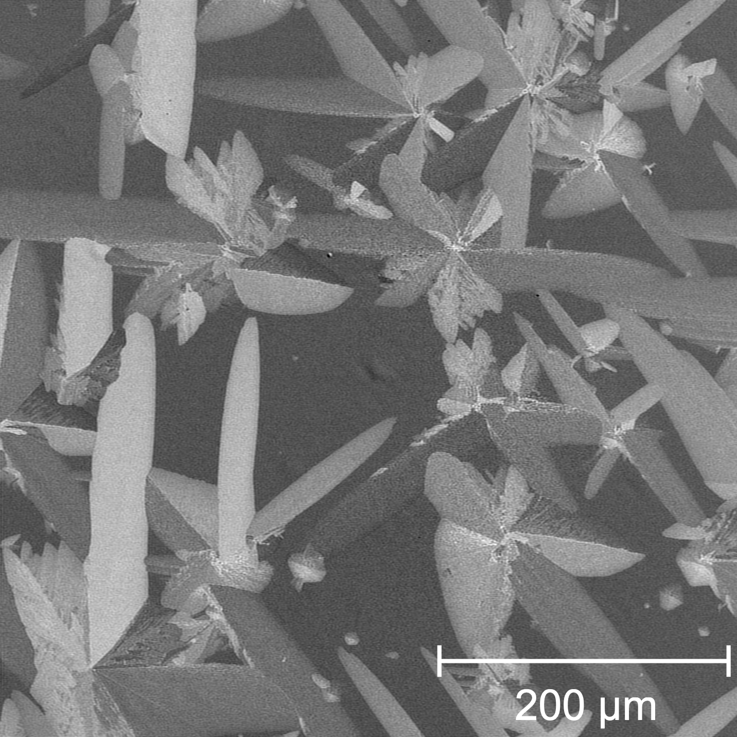
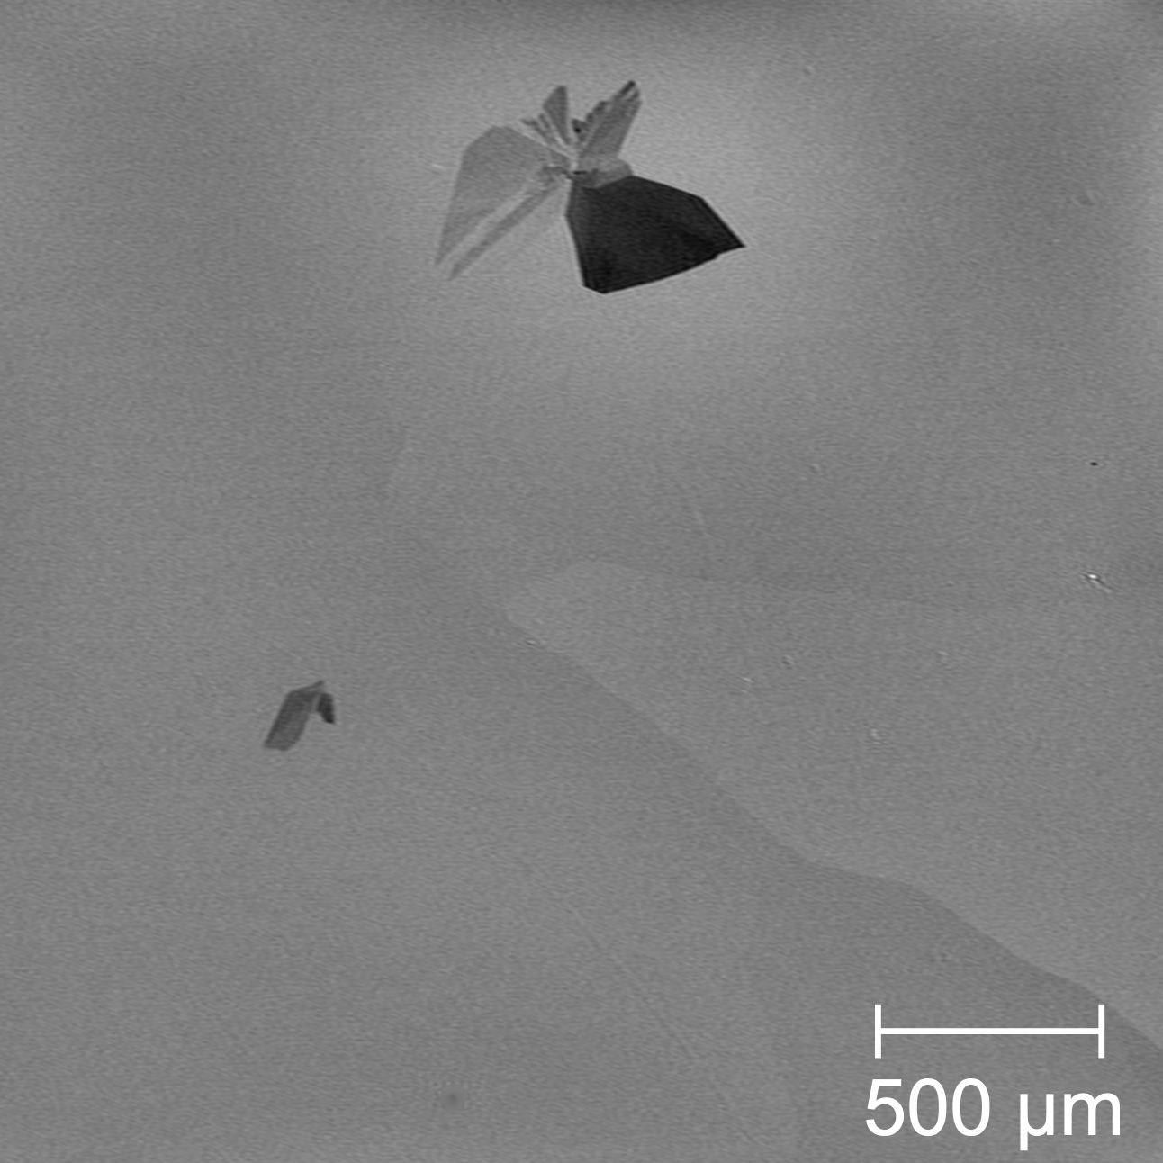
Nb Oxidation Impact on Sn Nucleation and Nb₃Sn Growth
Compared Sn nucleation and initial Nb₃Sn film growth for NbO or Nb₂O₅ polycrystalline Nb
  Films grown under same coating conditions
  Similar Nb₃Sn film coverage and morphology
  More Sn nucleation on Nb₂O₅
    Growth of new intermetallic domains
Impact of varying Nb oxidation/structure is much less significant than the crystallographic orientation
NbO
Nb₂O₅
Sn islands on Nb
New intermetallic domains
vs.
Nb₃Sn film
Nb(100)
Nb(111)
vs.
Crystallographic orientation is the dominating factor in early stages of Nb₃Sn film growth
High domain coverage
Poor nucleation

Slide 18
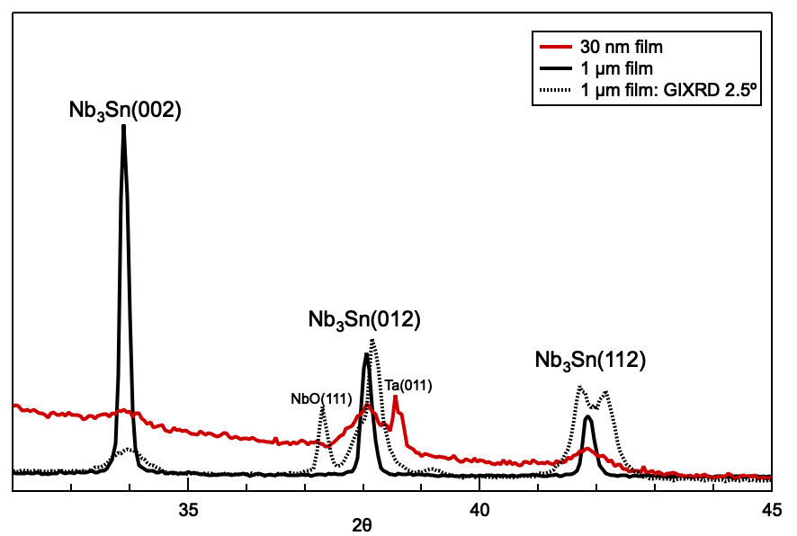
Varying Surface Morphology of Nb₃Sn Grains
3 Distinct Nb₃Sn Grains
Type 1 Smooth, stoichiometric Nb₃Sn
  Only found in films > 275 nm thick
  Evidence of coalescing
  Higher thermal stability, resistance to degradation
Type 2 Corrugated, Sn-deficient
  30 – 50 nm buckling at surface
  Largest surface area
  Sn deficiency throughout film, not segregated to the surface region
  Observed for all film growth conditions and thicknesses
Type 3: Rough, Sn-rich
  ~ 50 – 100 nm spherical grains
  Higher roughness determined by grain size
  Observed across all films
Diffraction of Nb₃Sn Films
Preference for thicker films
Dominating at surface & in thin films
Small domain, always present
Associating surface morphology with grain orientation

