Slide 1
Machine Learning Applications for Improving Accelerator Operations at Brookhaven National Laboratory
Lucy Lin
Advisor: Georg Hoffstaetter de Torquat
CBB Annual Meeting
July 20, 2023

Slide 2
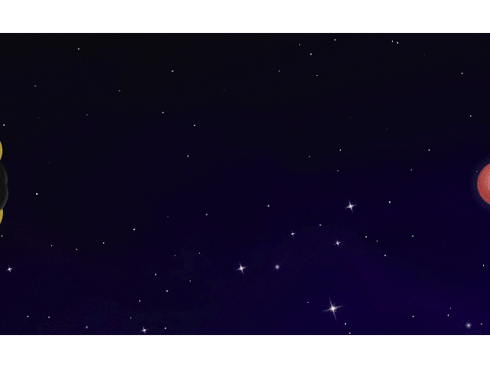
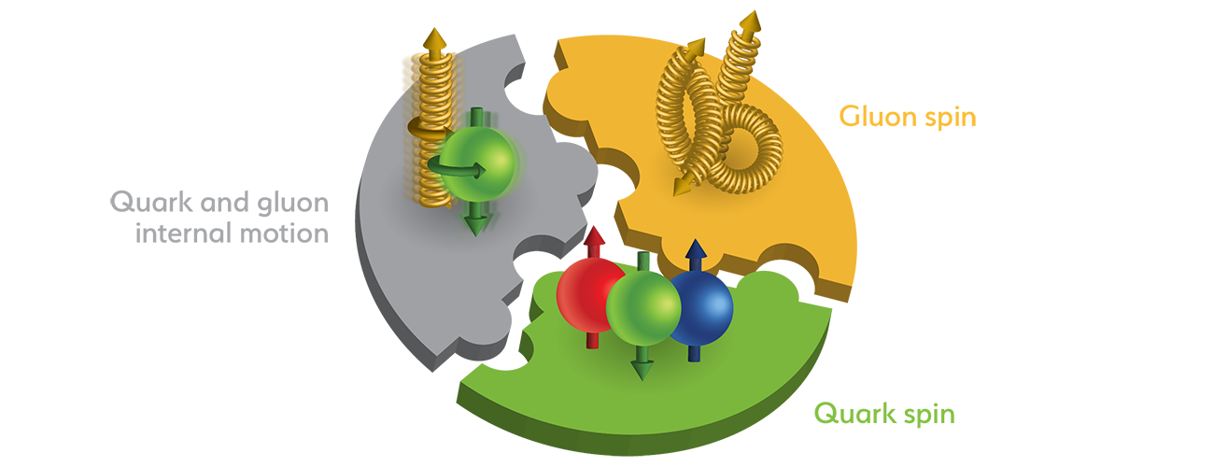
The Electron Ion Collider (EIC)
Collisions between fundamental particles produce a 3-D snapshot of their internal arrangement of quarks and gluons
Understand strong nuclear force: how are quarks and gluons held together within ordinary matter?
Solve spin crisis: The three main constituent quarks cannot account for a proton’s total spin. How exactly do quarks and gluons contribute to a proton’s spin?
We improve EIC luminosity, polarization, and operation with machine learning (ML) techniques

Slide 3
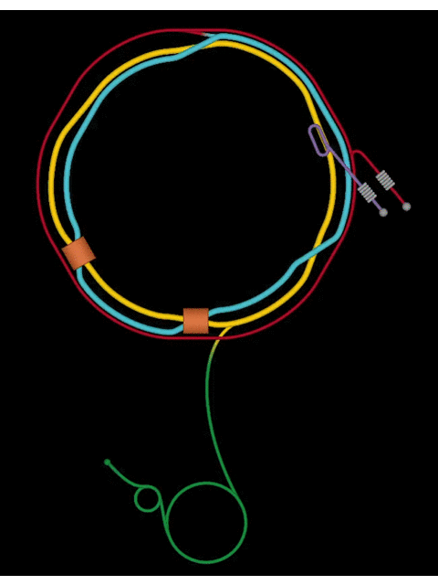
Injector compound for RHIC and EIC
Relativistic Heavy Ion Collider (RHIC): largest operating accelerator in the US.
Electron Ion Collider (EIC): the nation’s largest particle accelerator project.
Alternating Gradient Synchrotron (AGS) and its Booster serve as part of the injector compound for RHIC and future EIC.
Bright ion beams in the AGS and Booster are required for optimal luminosity and highest polarization in RHIC and EIC.
Obtaining bright beam requires more accurate beam control in the injector compound, which is currently mostly hand tuned by operators.
Injector Compound

Slide 4
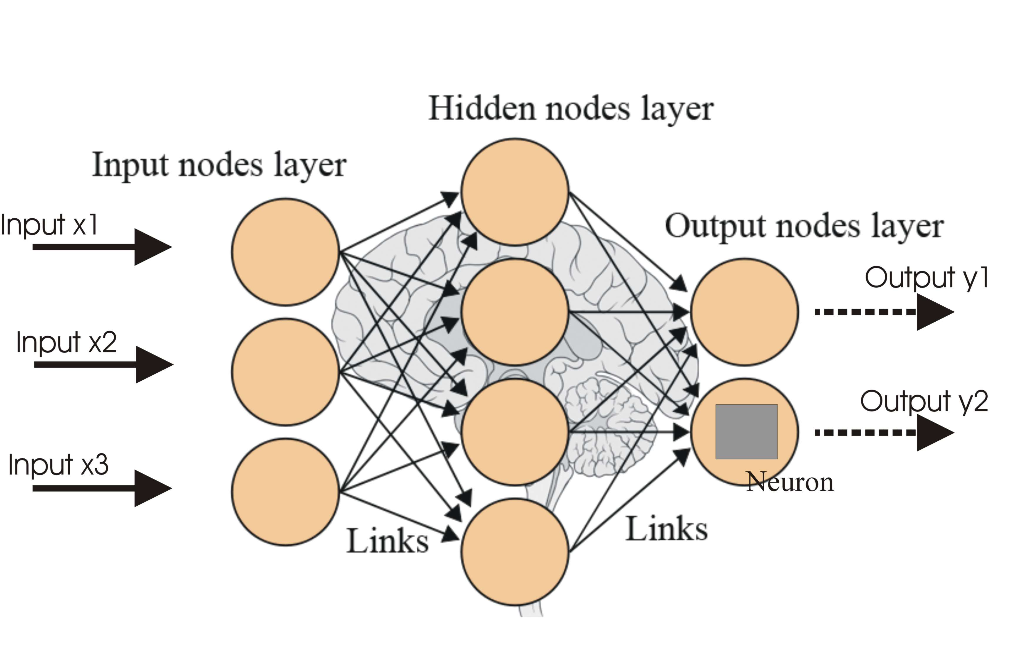
ML Method 101: Neural Network (NN)
Establish mapping between a given set of inputs $\vec{X}$ and corresponding outputs $\vec{Y}$
No prior knowledge about the mapping is needed for training
Trained NN model is faster and cheaper to evaluate than the real system

Slide 5
Machine Learning for Better Orbit Correction

Slide 6
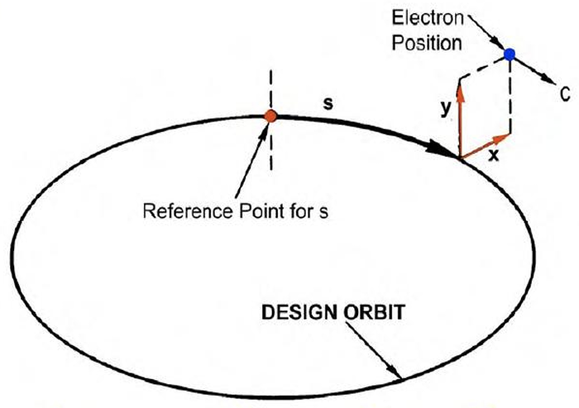
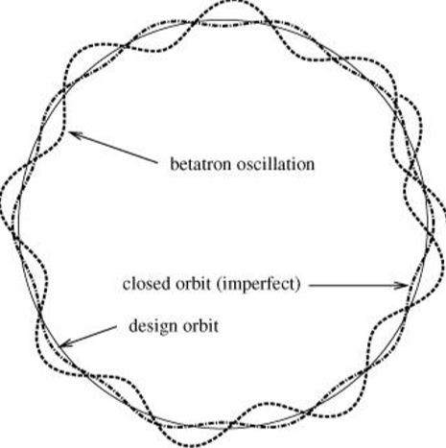
Orbit in an Accelerator
Design orbit: ideal orbit the particles should move on, defined as $(x=0,y=0)$
Particles need to be bent (by dipoles) and focused (by quadrupoles)
Closed orbit: equilibrium orbit actually moved on, with harmonic oscillations around the design orbit caused by magnet focusing force

Slide 7
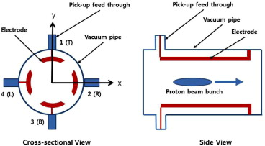
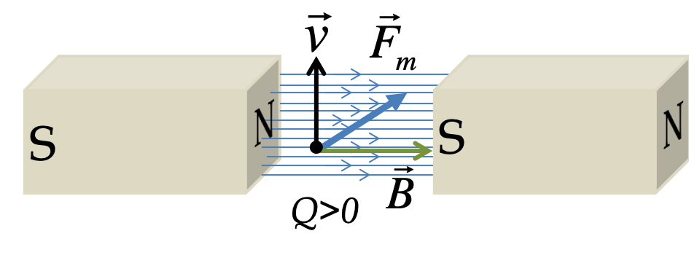
Orbit Measurement and Correction
Beam Position Monitor (BPM): pick up electrodes (PUE) measure charges induced by electric field of the beam
Corrector magnet: dipole magnets for closed orbit correction, give horizontal / vertical kicks to charged particles

Slide 8
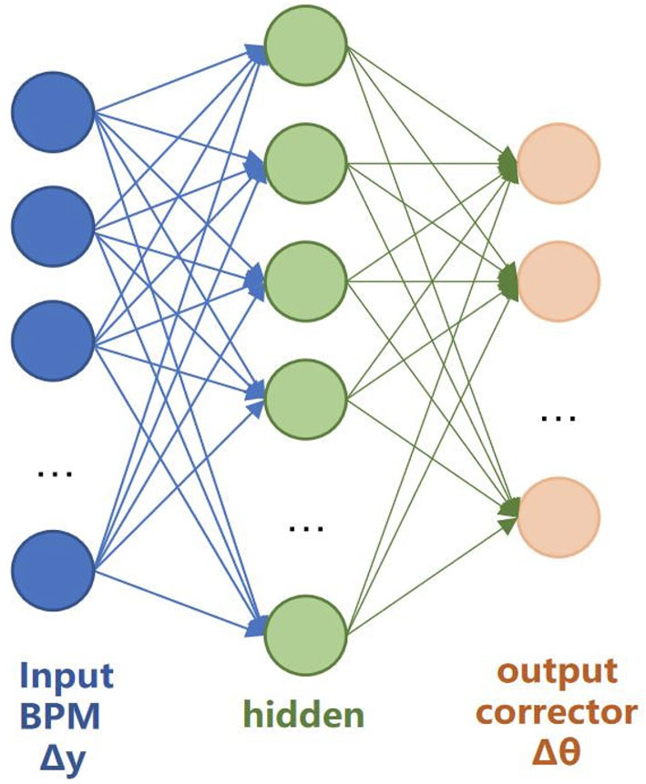
Orbit Correction with Neural Network
Traditional orbit correction
obtain mapping from corrector settings $\vec{θ}$ to orbit measurements $\vec{y}$
inverse mapping to get corrector settings $∆\vec{θ}$ needed to cancel orbit deviations $∆\vec{y}$
Orbit correction with NN
train directly to get inverse mapping, no need for extra calculation
easily update with new data and stay accurate

Slide 9
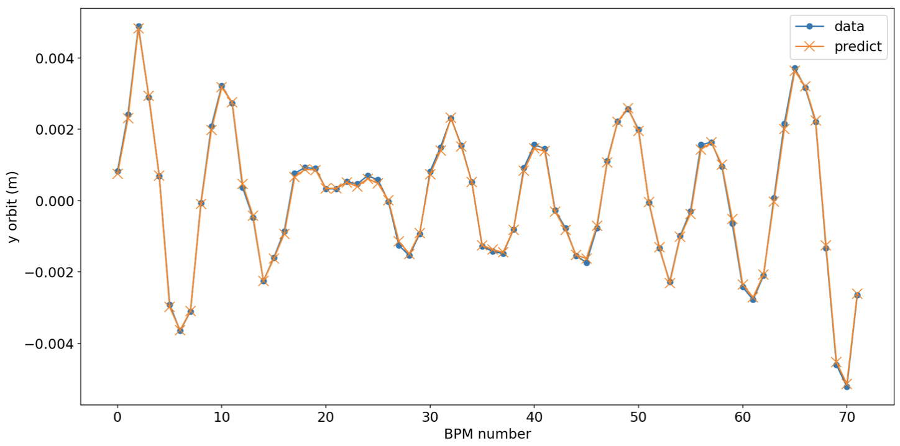
NN model: corrector $→$ orbit
Input vertical corrector kick $→$ Output y orbit measured at BPM
Trained on 800 data pairs, tested on 200 data pairs: accuracy = 99.8%

Slide 10
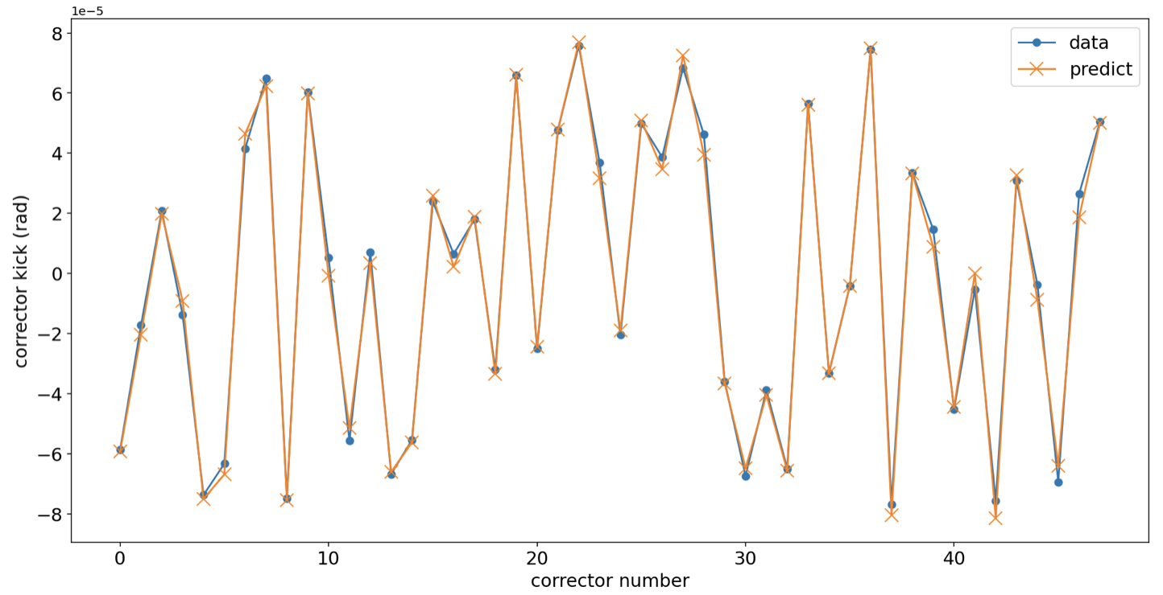
Inverse NN model: orbit $→$ corrector
Input y orbit measured at BPM $→$ Output vertical corrector kick
Trained on 800 data pairs, tested on 200 data pairs: accuracy = 99.3%

Slide 11
Future work: error identification
Neural network can establish mapping between any inputs and outputs with sufficient data
Machine error sources (e.g., misalignment, gradient / calibration errors, etc.) can be included as outputs of an inverse NN model for beam-based error diagnostic algorithm
Neural Network
$$\left[\begin{matrix}I_{magnet} \\ ε_{machine} \\ ⋮\end{matrix}\right]$$
$$\left[\begin{matrix}\vec{x} \\ \vec{y} \\ ⋮\end{matrix}\right]$$
Magnet settings + Machine errors
Beam properties (e.g. orbit)

Slide 12
Current to Magnet Strength Calibration with Neural Network

Slide 13
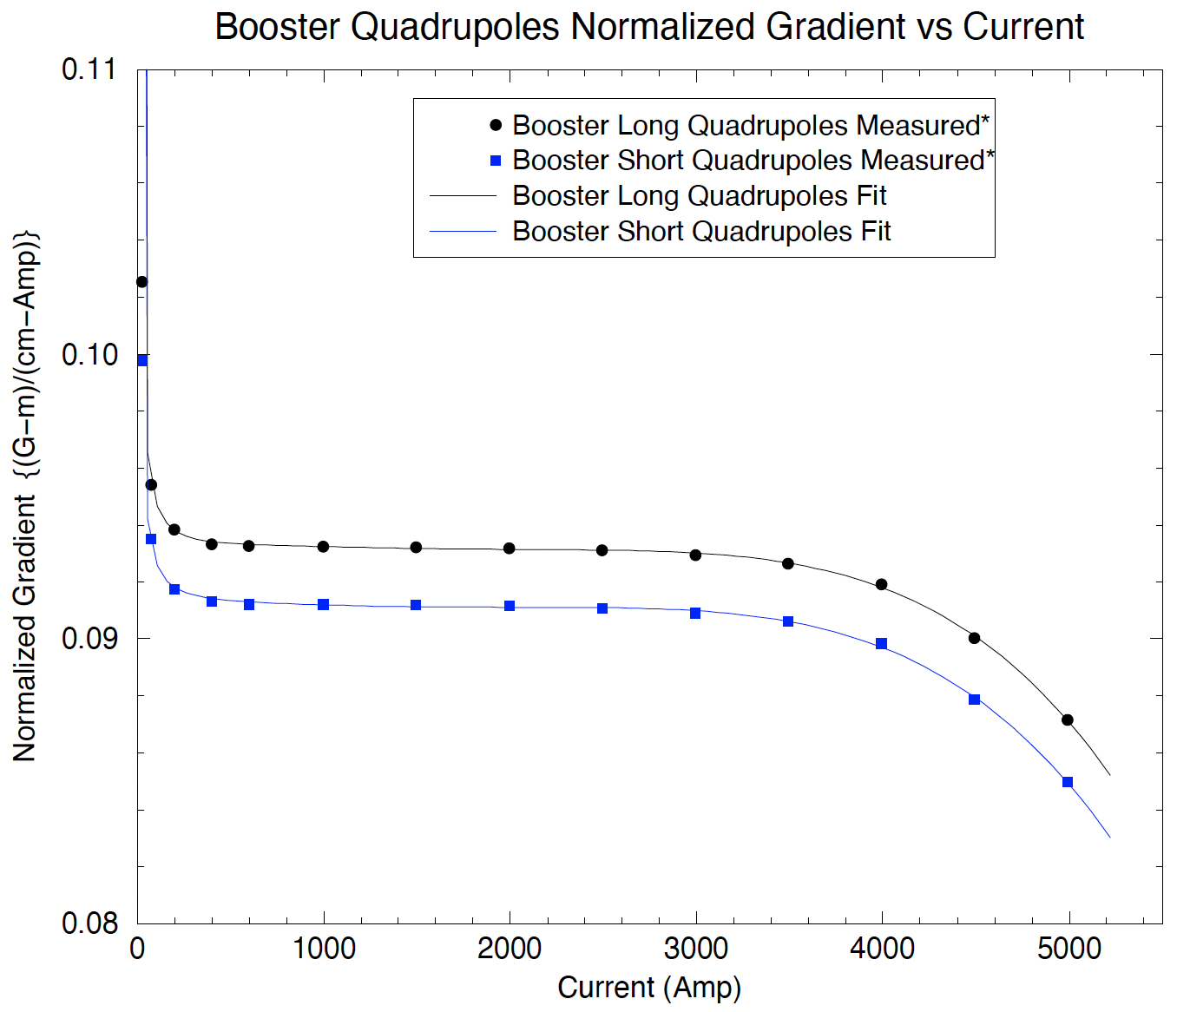
Magnet current to strength mapping
Magnet transfer function: mapping between the power supply (PS) current and the resulting strength of a magnet
Example: 5th order polynomial for Booster quadrupoles
Transfer functions are measured before the magnets were installed in the ring, and there is no existing way to verify them after installation.

Slide 14
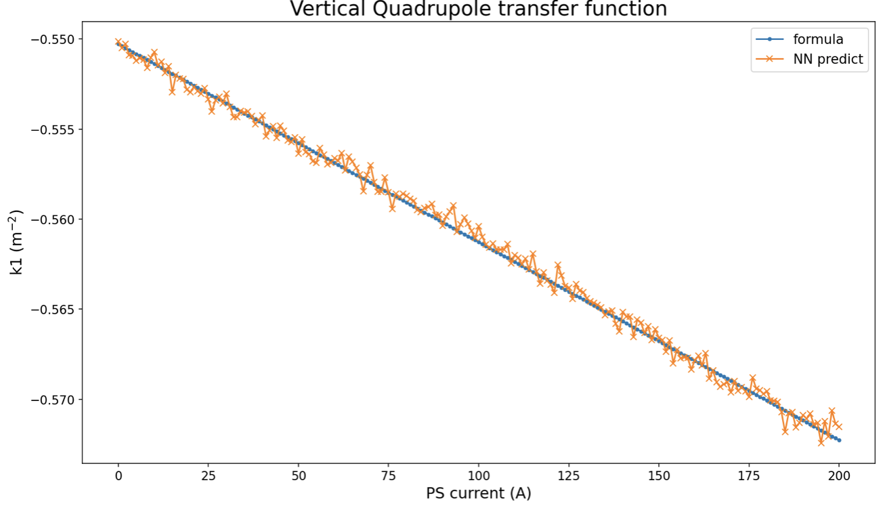
Preliminary NN model training results
Input y orbit under different quadrupole PS currents $→$ Output corresponding vertical quadrupole strength
Initial data was collected with magnet settings within the linear range of the transfer function, working on collecting more data
Trained on 800 data pairs, tested on 200 data pairs: accuracy = 99.5%

Slide 15
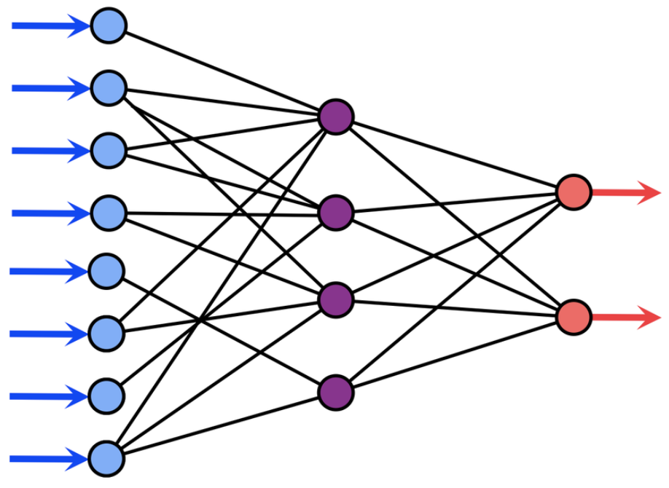
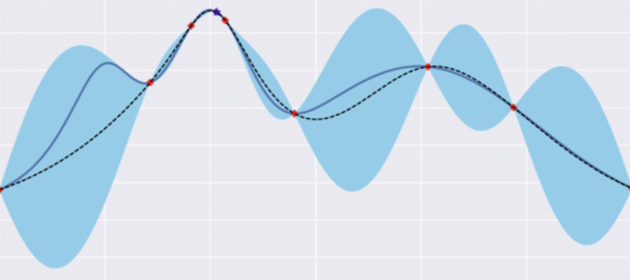
Future work: Optimization with ML
Neural Network
Control parameters + Environmental factors
Evaluation Metric (e.g., agreement with real measurements)
Bayesian Optimization
Find best settings for desired machine state

Slide 16
References
[1] W. Lin, et al., “Machine Learning Applications for Orbit and Optics Correction at the Alternating Gradient Synchrotron”, in Proc. IPAC’23, Venice, Italy, May 2023.
[2] W. Lin, et al., “AGS Booster Beam-based Main Quadrupole Transfer Function Measurements”, in Proc. IPAC’23, Venice, Italy, May 2023.
[3] N. Ketkar, “Feed forward neural networks,” in Deep Learning with Python: A Hands-on Introduction. 2017, pp. 17–33.
[4] K. Brown, et al., “A high precision model of AGS Booster Tune Control,” in Proc. EPAC’02, Paris, France, June 2002, pp. 548–550.

Slide 17
Thanks
Petra Adams, Kevin Brown, Bhawin Dhital, Yuan Gao, Levente Hajdu, Kiel Hock, Vincent Schoefer
Georg Hoffstaetter de Torquat, David Sagan
Weining Dai, Bohong Huang, Thomas Robertazzi

Slide 18
Thank you! Questions?

