Slide 1
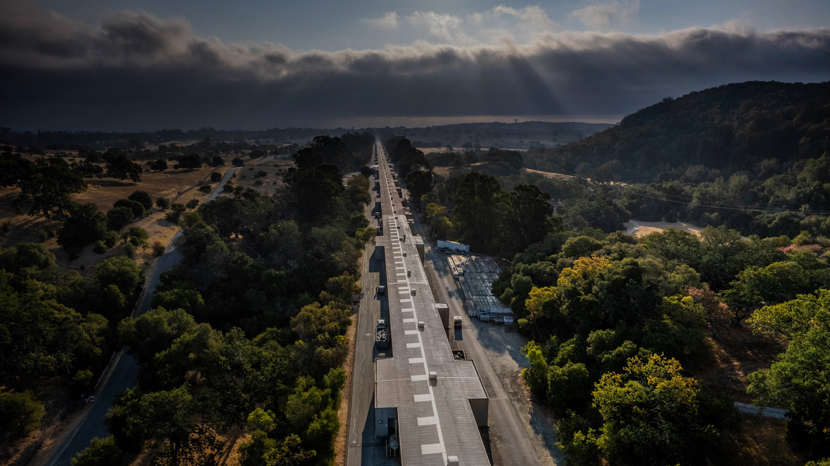
PWFA staging at the C3 Demonstrator
A. Knetsch, E. Nanni, J. Wu
SLAC National Accelerator Laboratory
21. July 2023

Slide 2
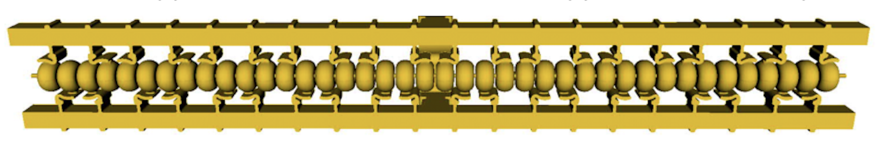
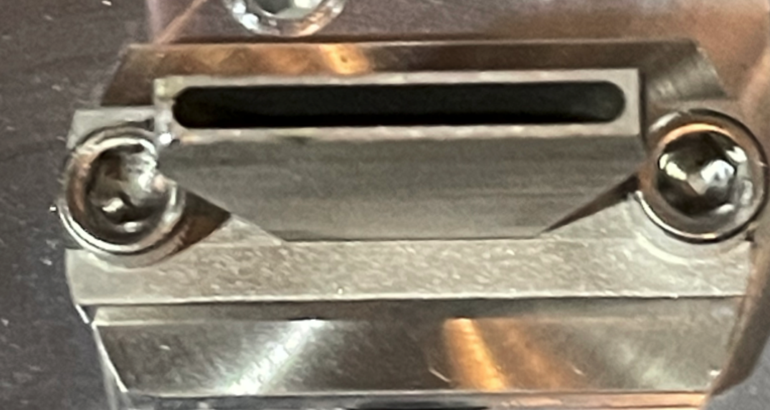
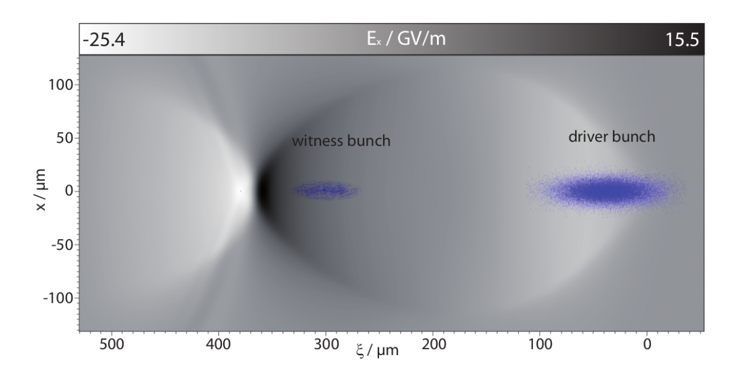
Why include plasma wakefield accelerators ?
RF module
Plasma module
meter-scale
Efficient energy transfer from one beam to another
Very high accelerating gradients O(1-10 GV/m)
Plasma wake structure at sub-mm
Require source of high-current beams (~kA)
cm scale
Plasma wake
~ 100 um

Slide 3
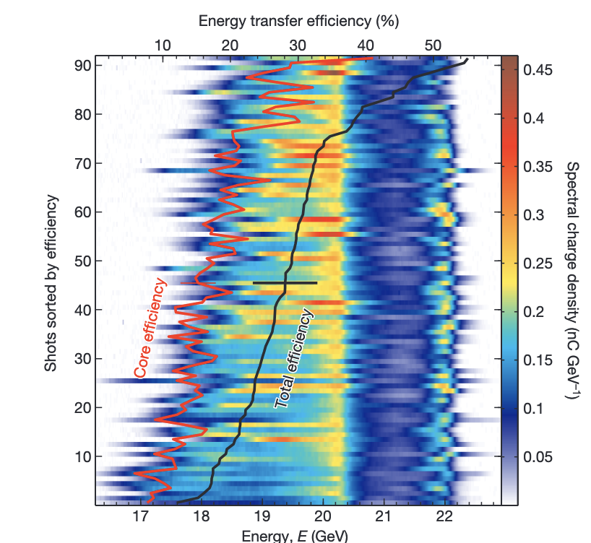
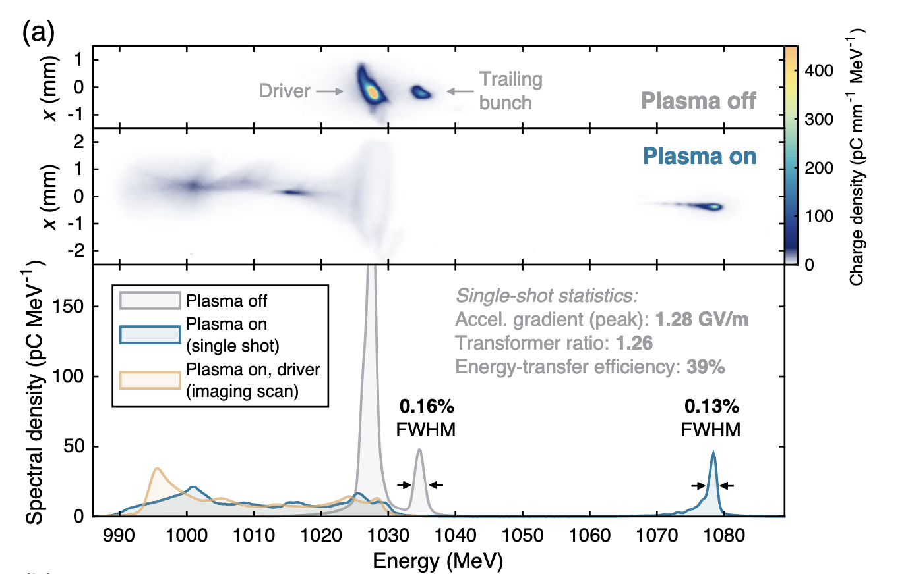
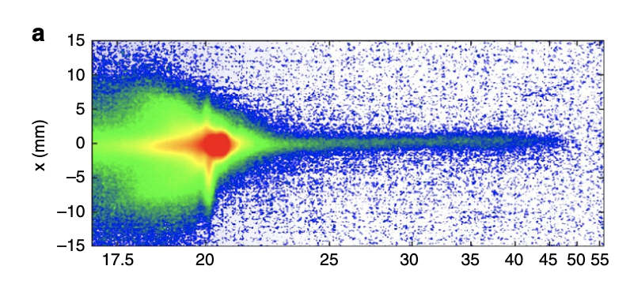
Single-stage PWFAs improve continuously
SLAC FACET I
DESY FLASHForward
M. Litos, et al. Nature (2014)
S. Corde, et al. Nature Comm. (2015)
CA Lindstrøm, et al. Phys. Rev. Lett. (2021)
40 % Energy-transfer efficiencies
GV/m accelerating gradient
Emittance preservation

Slide 4
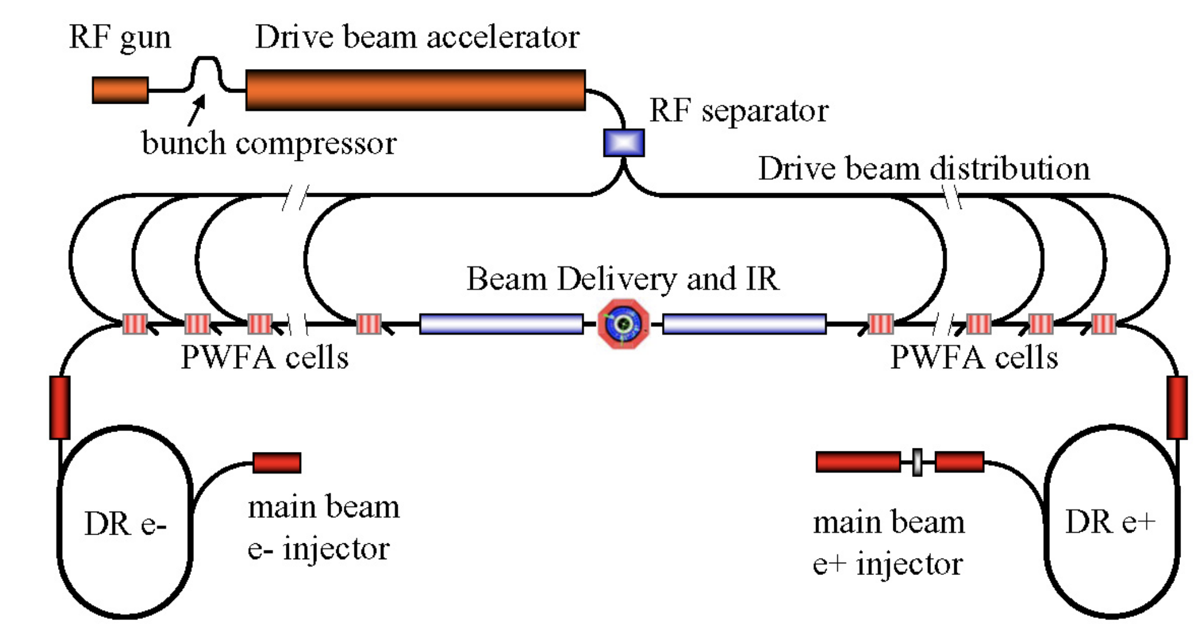
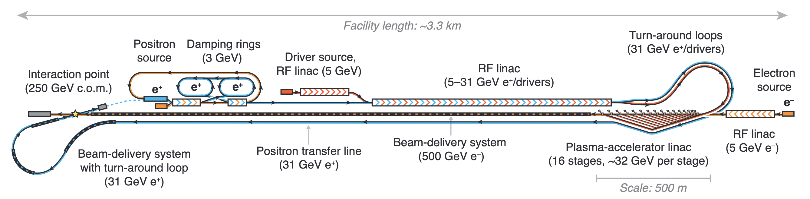
Multi-stage PWFAs as path to e⁺ e⁻ collider
B. Foster, R. D'Arcy, and C. A. Lindstrom. arXiv preprint arXiv:2303.10150 (2023), accepted for NJOP
Source: A. Seryi et al. PAC09, Vancouver, BC (2009).
Series of several subsequent PWFA stages as a path forward to reach TeV energies
Defining parameter: Average accelerating gradient
Plasma accelerators are inherently small
Scalable to > TeV ?

Slide 5

Core components (strongly simplified)
Pre-accelerator
Witness-beam transport
Final focusing
IP
Plasma stage
In-coupling
Out-coupling
dump
Total LINAC length
Short intra-plasma distances
Least-intrusive driver coupling
High average gradient pre-accelerator

Slide 6
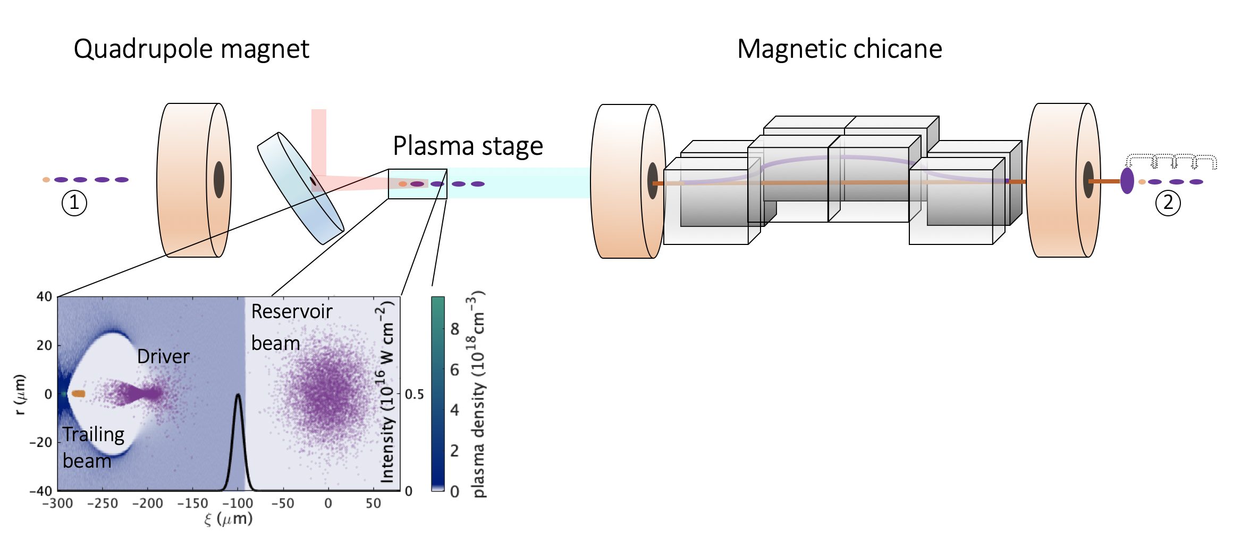
Laser-gated staging
Trailing beam
Laser
Drive beam
O(100um) spacing
Depleted Drive beam
Ultrashort ionization front separates plasma-dominated and magnet-dominated lattice
In and outcoupling of driver-beams in temporal domain
Small spacing between driver beams minimizes intra-stage path length
A. Knetsch, et al. arXiv preprint arXiv:2210.02263 (2022), accepted for PRL

Slide 7
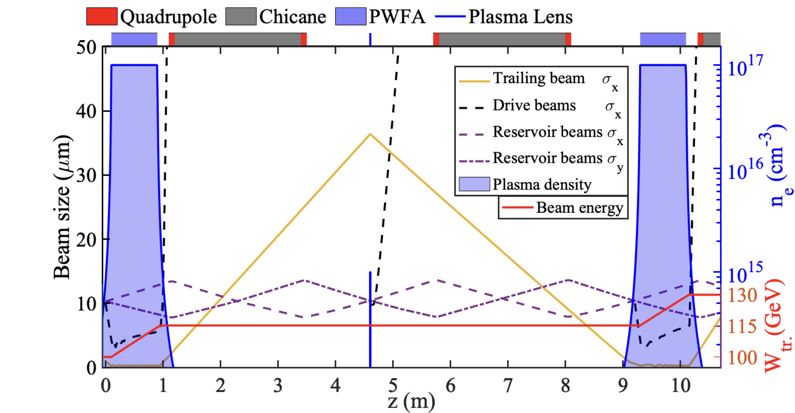
3 Lattices on one axis
2.5 GeV Driver
10 GeV Driver
10 GeV beams superior choice to reach 1 TeV for being more rigid agains coherent synchrotron radiation
Average gradient > 1 GV/m up to 1 TeV (assuming 30 MV/m pre-accelerator)

Slide 8
3 Lattices on one axis
Longitudinal phase space
10 GeV Driver
Few kA drive-beam currents
Low energy spread in drive beams
Drive-beam energy may vary

Slide 9
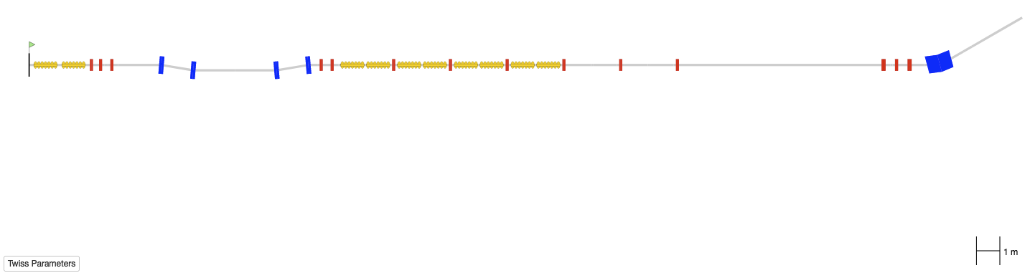

How could PWFAs be implemented in C3 stage2 ?
Current model of C3 Stage2
~ 45 m

Slide 10
How could PWFAs be implemented in C3 stage2 ?
Current model of C3 Stage2
Shorten chicane
Plasma section
~ 45 m

Slide 11
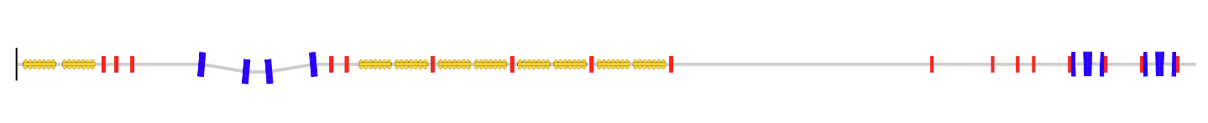
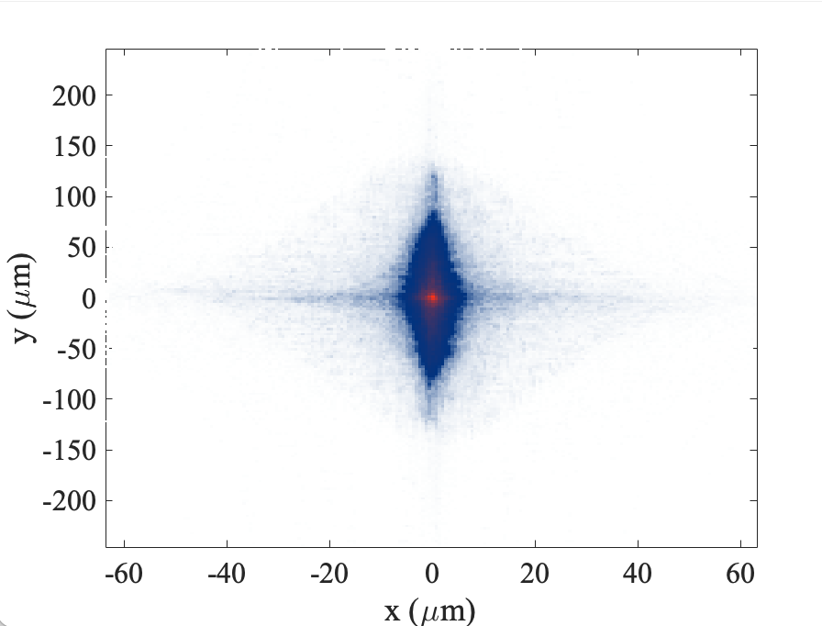
How could PWFAs be implemented in C3 stage2 ?
Plasma lens
Collimator / mask
matching
PWFA
PWFA
36.5 m
1 ps
1 ps
Matching section needs to match into FODO and plasma lattice
Quadrupoles >100 T/m necessary (PMQs)
Chicane dipoles: B= 1 T, L=0.125 m for 1 ps spacing

Slide 12
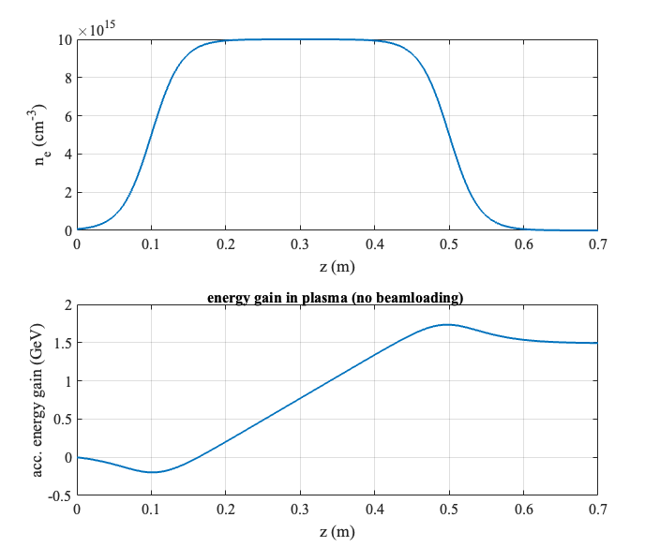
Plasma ramps
Ramps
Increase acceptable incoming beta
Increase beta out of plasma
Reduce divergence out of plasma
But also:
On ramps, trailing beams slip into decelerating phase and fields are not optimally loaded
Ramps can cost a significant part of efficiency
→ Ramps become costly/useless for high-energy trailing beams

Slide 13
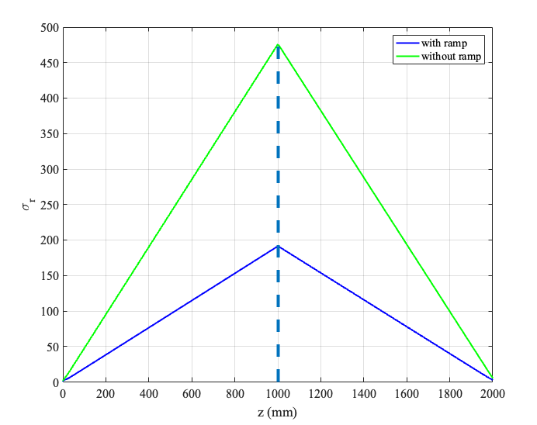
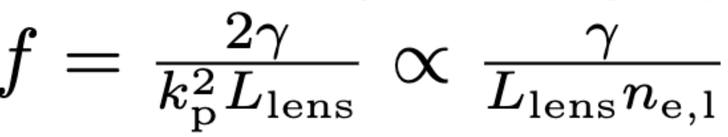
Refocusing with plasma lens ( 2f-2f imaging ) f=0.5 m
(um)
Plasma Plateau density n_{e} = 1x10¹⁶ cm⁻³
Ideal Matched β_{m} = 3.6 mm
‘With ramps’ case : 6 β_{m} = 21.5 mm
Lens plasma density n_{L}= 1x10¹⁴ cm⁻³
f= 0.5 m
Plasma exit
Plasma entrance
CE Doss, et al. "Laser-ionized, beam-driven, underdense, passive thin plasma lens." Physical Review Accelerators and Beams 22.11 (2019): 111001.

Slide 14
To conclude
Plasma lens
matching
PWFA
PWFA
36.5 m
Cold copper technology interesting in combination with plasma accelerators
Compact demonstrator for staged PWFAs
Ideally expected energy final energy: 3.6 GeV (two times energy doubled)
Average gradient of machine ~ 100 MV/m

