Slide 1
Probe Needle Setup

Slide 2
RH0004 on standard module holder and needle card
Viewed from top
Imux_A Imux_B VDDD_A VDDA_B GND B
GNDA VMUX_A VMUX_B VDDA_A VDDD_B
Example:
Probing VDDD_A

Slide 3
Probing »by hand»

Slide 4
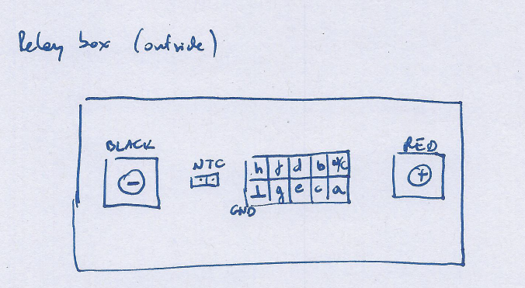
Relay Box
The Relay Card allows to connect the 10 pins a … h to red and GND to black.
Those connect to the digital volt meter. It contains an arduino that takes
a letter corresponding to the pin below (9600 baud).
The software takes care that there will be no two pins connected or shorted
to GND. Care must be taken on connecting the ribbon cable to the box though. GND should connect to GND_A (pin 1 on probe card is GND_B)
Relay box inside
(CROC modification needed
for 2x2 modules shown in lower pic)

Slide 5
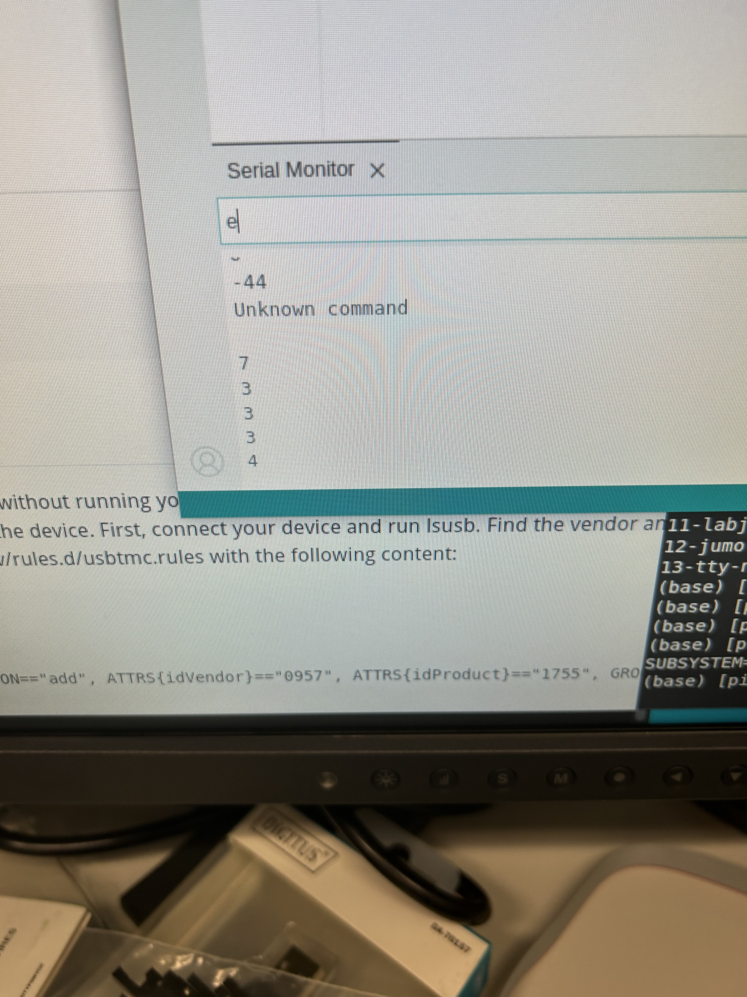
Probing with box:

Slide 6
Still missing:
Software to tell the relay box to connect VDDD, VDDDA of chip X via suitable serial input
Scan the input current via the Keysight or other LV PS
Read out Digital Voltmeter input from the probe needle card
Several solutions already exist:
dirigent, just needs to adjust the pin matrix
Standalone python code from Vasilije Perovic
C code by the Purdue group

