Slide 1
Production, Acceleration and Stability of High Brightness Electron Beams in Cryogenic RF Structures
Beam Dynamics and Control CBB Meeting – 2023/09/28
Speaker: F. Bosco*
PI: Prof. J. Rosenzweig
* fbosco@physics.ucla.edu
This work was supported by the U.S. National Science Foundation under Award PHY-1549132, the Center for Bright Beams
Notes:
My PI and I, postdoc at ucla and cbb member since April
the project I am working on is

Slide 2
About Me
Education
Jan 2023 – PhD in Accelerator Physics at the University of Rome “La Sapienza”
May 2019 – Master degree in Electronics Engineering at the University of Rome “La Sapienza”
October 2016 – Bachelor degree in Electronics Engineering at the University of Rome “La Sapienza”
Research experience
2019 – 2023: PhD Researcher at La Sapienza’s Department for Basic and Applied Engineering
2022: Visiting graduate researcher at UCLA in the Particle Beam Physics Laboratory (PBPL)
2018: Internship at Fermi National Accelerator Lab
Main research interests
Accelerator physics, beam dynamics, collective effects, tracking codes, high brightness electron
linacs, RF photo-injectors, electrodynamics and RF-systems, particle driven radiation sources
Notes:
My background is in EE, I majored art URLS where I also got my PhD in acc physics. Collab with ucla and

Slide 3
Outiline
Cryogenic RF Initiatives
High field C-band RF structures
State of the art facilities: UC-XFEL, C3
Investigating solutions to enhance the brightness
CYBORG Beamline at MOTHRA
Present status
Next steps towards commissioning
MILES – Beam Dynamics
Simplified modeling for self-induced fields
Example of applications: e.g. stability and mitigation of BBU effects
Notes:
What’s next? Research goals for my postdoc

Slide 4
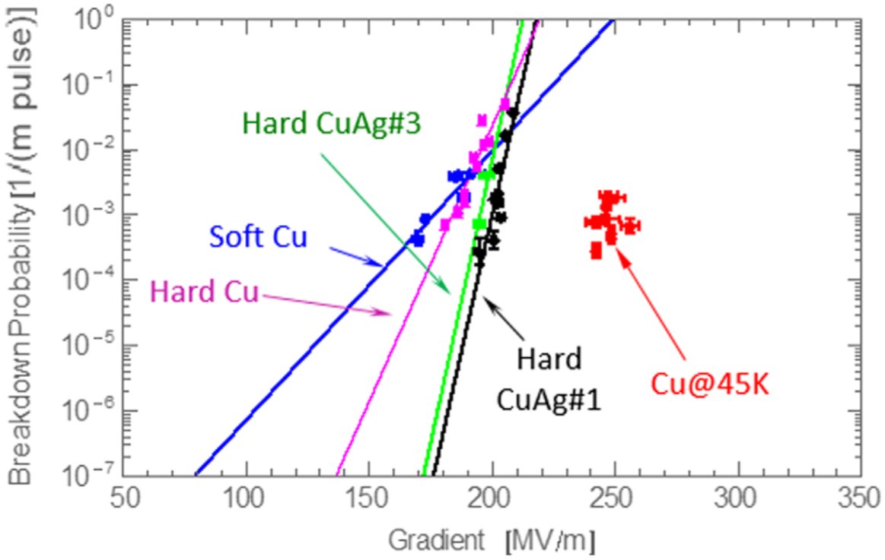
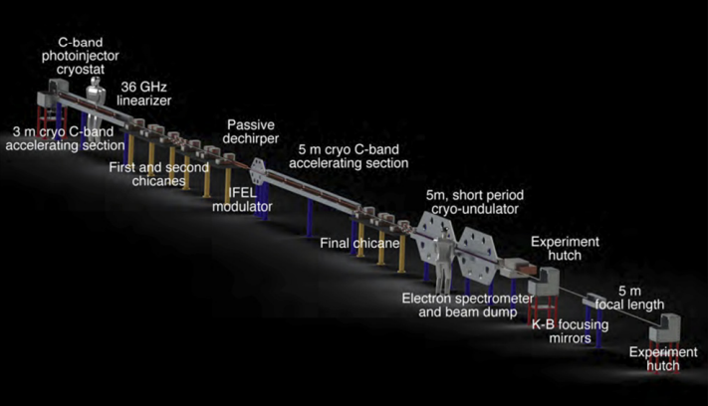
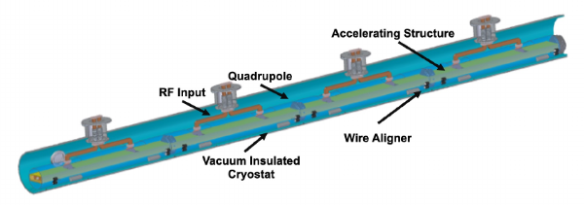
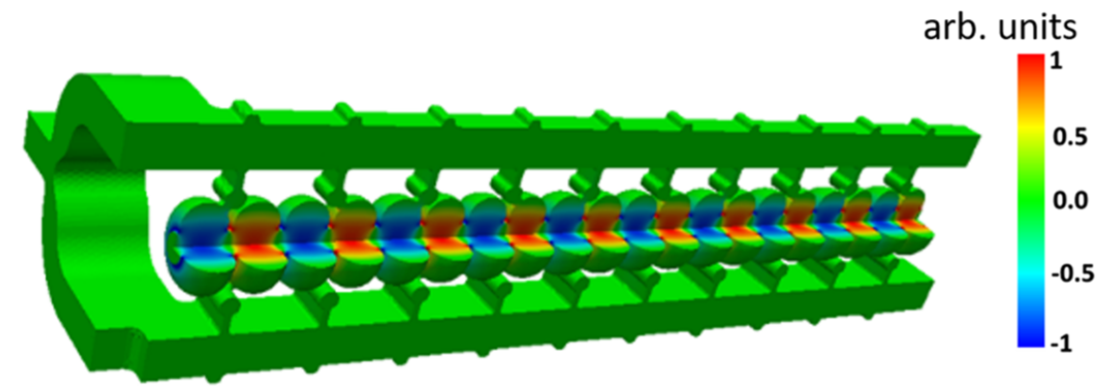
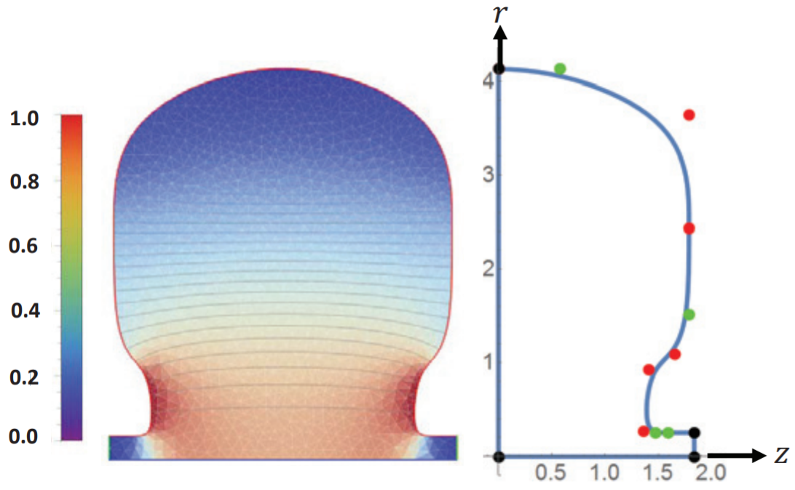
Cryogenic RF Initiatives
Scientific collaboration of research institutes in the fields of accelerators and beam physics
Interest in high brightness electron linac-based facilities exploiting advanced accelerator concepts
Compact, high brilliance radiation sources (FEL, ICS)
High luminosity $e^{+}e^{−}$ linear colliders for HEP
High gradient acceleration in RF Structures
Distributed coupling linacs: use of guiding manifolds
Optimized cavity topology to enhance the efficiency of acceleration
Cryogenic operation ($∼$77K) to reduce the breakdown probability rates
Initiatives
Ultra-Compact X-rays Free Electron Laser (UC-XFEL): new paradigm for university-scale facilities
Cool Copper Collider ($C^{3}$): based on C-band ($∼$6 GHz) cryo-cooled, distributed coupling linacs ($∼125 MV/m$)
Notes:
Larger picture
This work takes place in the framework of an international collaboration
The partners involved share the interest in exploiting advanced accelerator and beam physics concepts in order to realize state-of-the-art facilities based on high brightness electron linear accelerators
The main initiatives of the collaboration are addressed to compact, particle-driven radiation sources such as FEL and ICS machines but there is, in addition, a strong interest for high luminosity lepton colliders
In this context, our research group contributes to the beam dynamics studies with a special dedication for the collective effects attributed to space charge forces and wakefileds. The former describe the field produced and experienced by the charged beam itself whereas the latter is responsible for the interaction of the beam with the surrounding environment

Slide 5
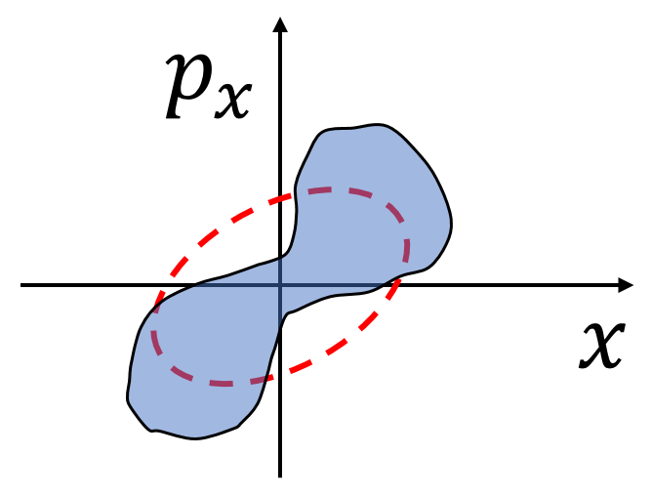
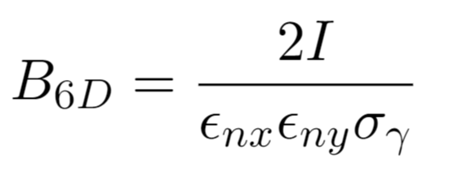
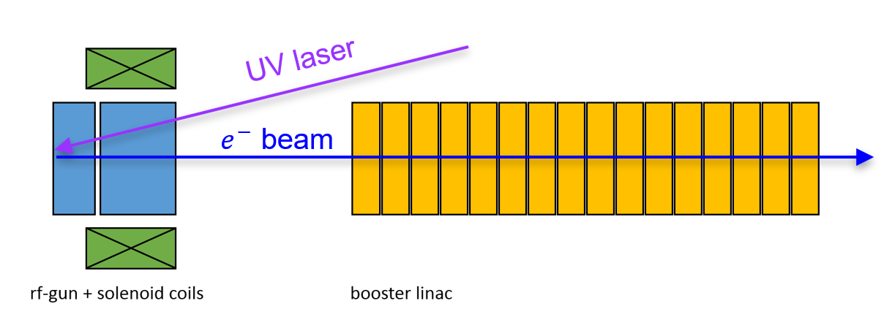
Beam Brightness
The performance of advanced linac-based application relies on the high beam brightness: high current, low transverse emittances and narrow energy spectrum
A demanding example: efficient FEL radiation: $σ_{γ}/\left\langle γ\right\rangle <ρ$ and $ε_{nx}/\left\langle γ\right\rangle <λ_{r}/4π$ where $ρ∝B_{6D}$ is the Pierce parameter
Brightness is hard to preserve: must be high at source and not diluted by the linac
M. Reiser, Theory and Design of Charged Particle Beams,
John Wiley & Sons, New York, 1994
RF photoinjectors: a “recipe” for high brightness $e^{−}$ beams
Photo-emission: UV, sub-ps laser pulse illuminating a metallic photo-cathode
Acceleration: high field multi-cell standing wave RF cavity
Focusing: a solenoid magnets controls emittance and spotsize
Energy-boost: matching to a linac where the beam experiences gentle focusing and emittance compensation
Notes:
The 6D brightness is a quantity that provides information on the beam intensity, spectrum and solid angle as it depends on the peak current, the energy spread and the rms emittances.
The brightness is thus a measure of the 6D phase space density and crucially impacts the quality of the radiation in electron-driven light sources
In addition, the rms emittances account for the transverse phase space area as well as its distortion which allows to describe the confinement of the beam nearby the reference trajectory
High brightness electron beams are typically produced by rf photoinjectors where the photo-emission occurs inside a SW multi-cell cavity which rapidly accelerates the particles acting against the intense repulsive intra-beam forces
Photoinjectors also exist in the hybrid configuration which combines a SW and a TW section through a coupling cell
The SW section still provides for the energy gain, a solenoid magnet introduces transverse focusing and emittance control as in the case of conventional rf guns whereas the TW can provide longitudinal focusing
In fact, the peculiarity of this device is that the field in the two sections is 90 degrees out of phase which introduces an energy-time correlation so that, as the beam propagates in a drift space, it experiences a ballistic compresses which enhances the peak current with a positive impact on the brightness

Slide 6
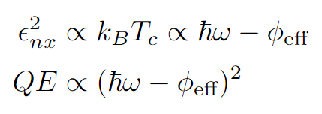
How to Improve the Brightness at Source?
Effective temperature (MTE) and QE trade-off: for $ℏω≫φ_{eff}$
Additional knobs
Maximum achievable current density: high launch field at cathode
Laser wavelength tuning: for $ℏω→φ_{eff}⇒T_{c}→T_{m}$ (physical material temperature)
Materials: novel photo-cathodes with enhanced performance
$${∝J}_{max}$$

Slide 7
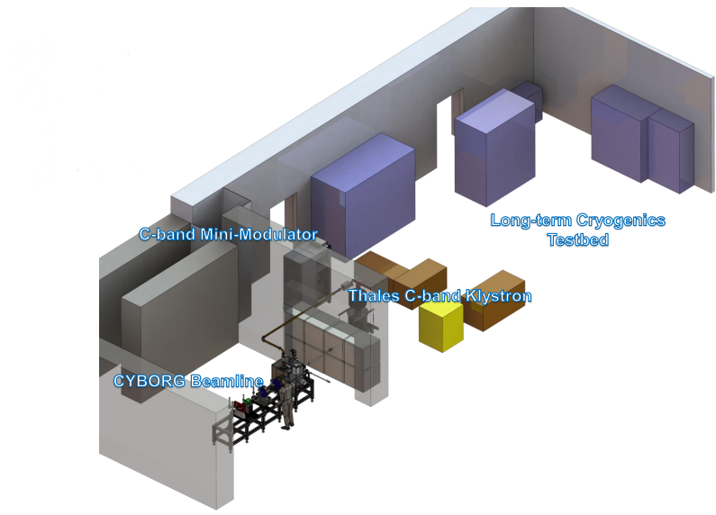
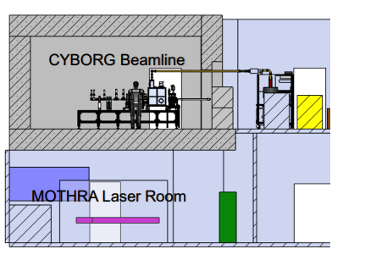
CYBORG Beamline
CYBORG (CrYogenic Brightness Optimized RF Gun)
Investigate the attainable brightness at the source in high field (>120 MV/m) cryogenic (<90 K) RF guns at the emission threshold ($ℏω∼φ_{eff}$)
Stepping stone for the UC-XFEL cryogenic 1.6 cell RF gun
The beamline is situated in MOTHRA Lab (Multi-Objective Testing for High field RF Accelerators), on-campus lab at UCLA
Courtesy of G. Lawler
Notes:
MOTHRA is an on-campus lab at UCLA that performs studies for the development of high gradient rf accelerators. In particular the beamline sketched here is under development and it aims to investigate the attainable beam brightness of cryogenic photocathodes by use of a half cell gun
The latter will establish a proof-of-principle for the operation of cryogenic rf guns and a stepping stone for the actual 1.6 cell photoinjector foreseen by the UCXFEL

Slide 8
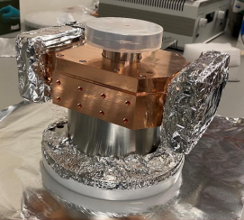
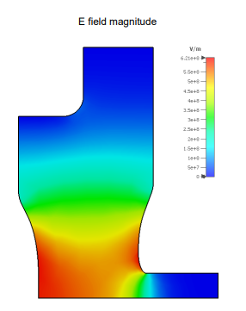
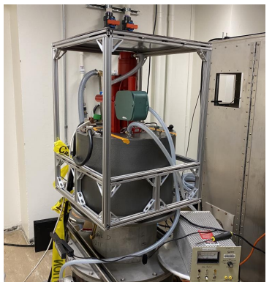
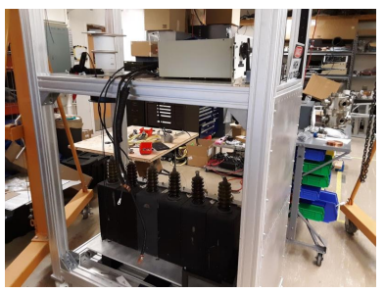
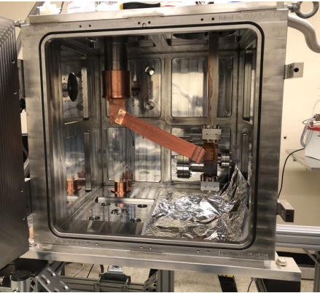
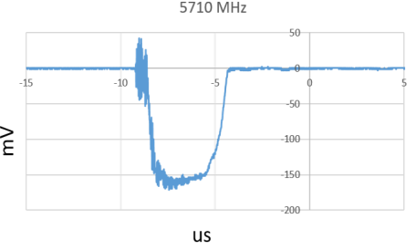
CYBORG Beamline (2)
Half-cell C-band (5.712 GHz) RF gun in thermal contact with a cryostat cold-head
Phase 1: Copper photo-cathode
Phase 2: Design of a load-lock system to test alternative photo-cathodes
Optics (solenoid and quadrupole magnets)
Diagnostics (screens, spectrometer, FC/ICT, emittance-meter)
0.5 gun + cryostat
Klystron+modulator
Courtesy of G. Lawler

Slide 9
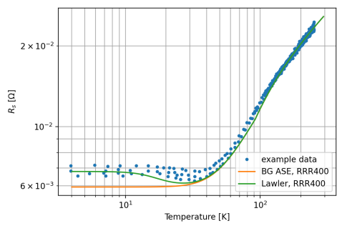
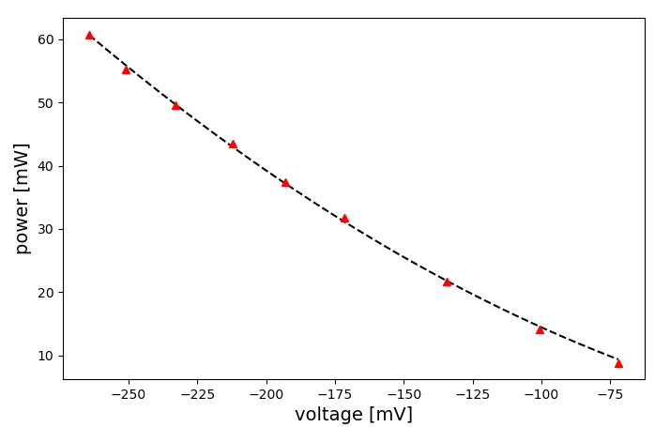
Current Status
Characterization of the cryo-RF infrastructure
Cooling capabilities
Temperature dependent surface resistivity
Frequency detuning
Vacuum tests
Klystron to gun connection (waveguide, circulator, probes): ready for high field tests (e.g. dark current)
Surface resistance vs temperature
Crystal detector probe calibration

Slide 10
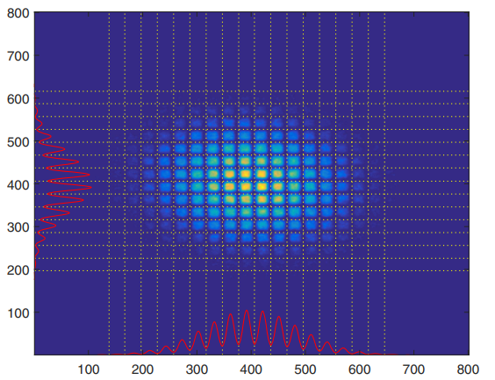
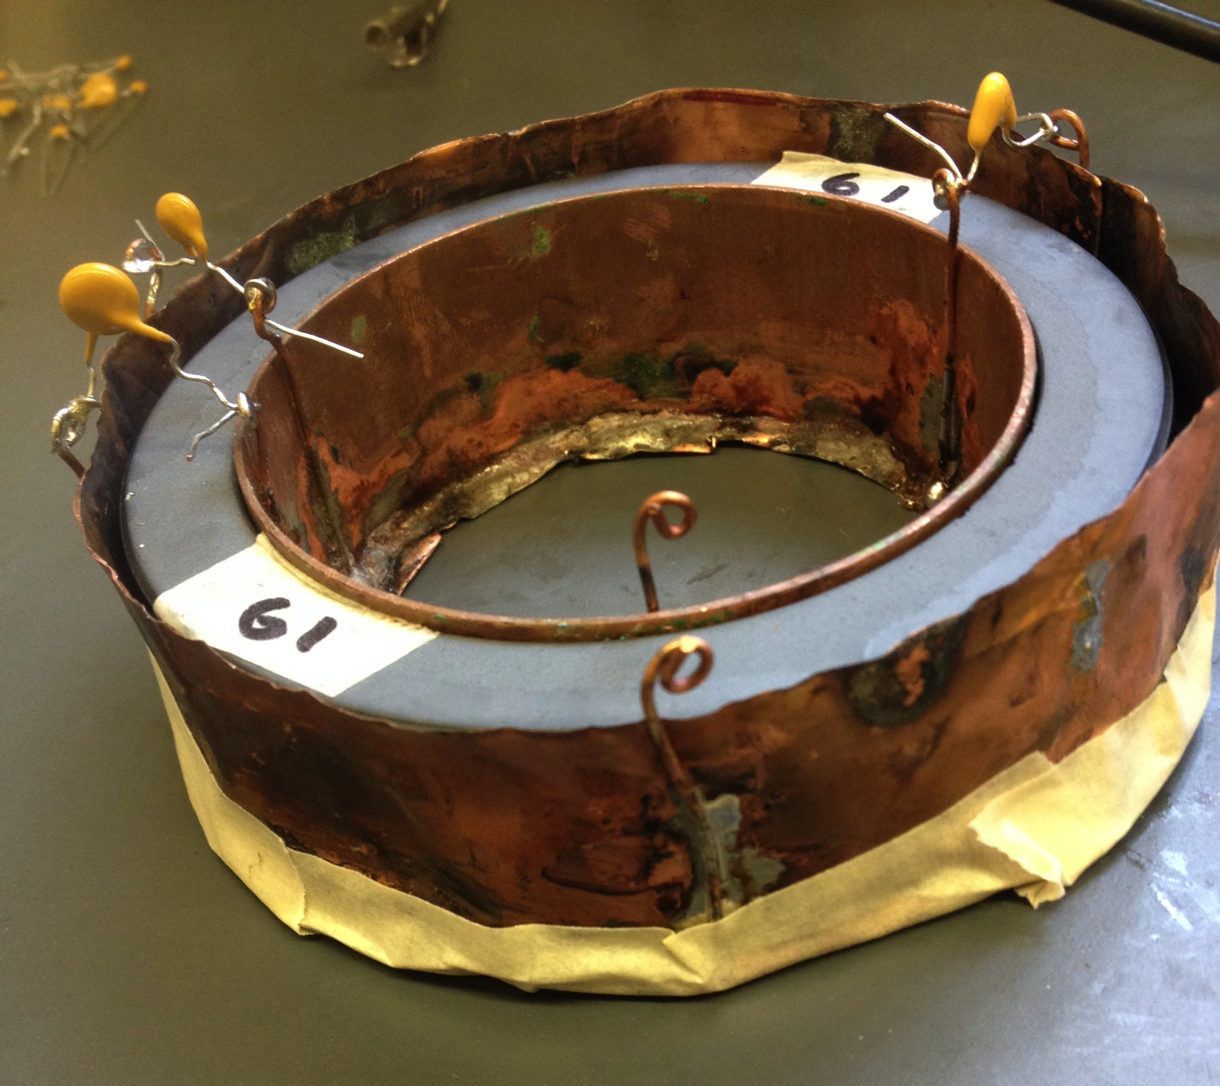
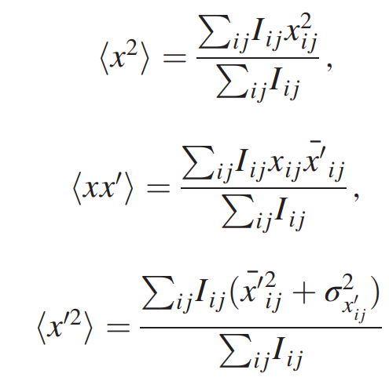
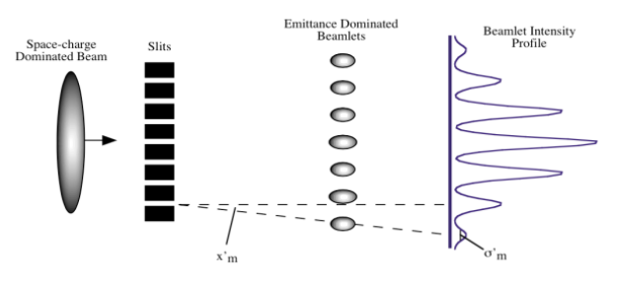
What’s Next?
Steps towards the commissioning of the beamline
Installing the optics/diagnostics: alignment with HeNe laser
Transport of the UV Laser to the cathode
UV Laser & RF Gun field synchronization: design of a MW circuit that controls the phase delay
Design of a TEM grid system for the emittance measurement of low charge beams
Design of an ICT system for non-destructive charge measurement
(*tasks I have started to work on recently/will start soon)

Slide 11
Beam Dynamics Studies with the code MILES
Notes:
Imagine we produce a decent emittance at the source: we don’t want

Slide 12
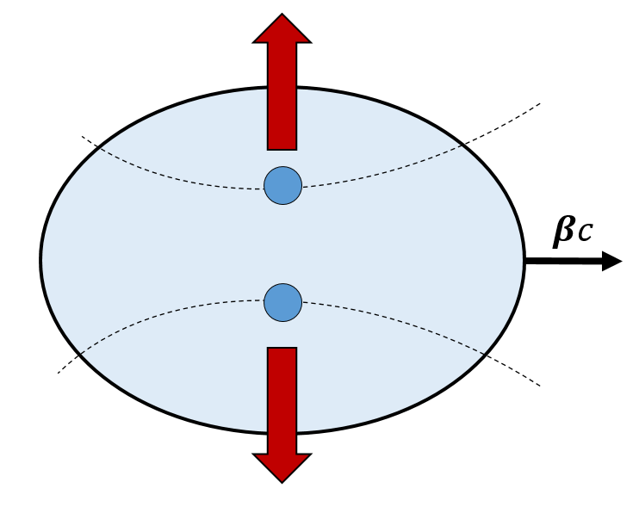
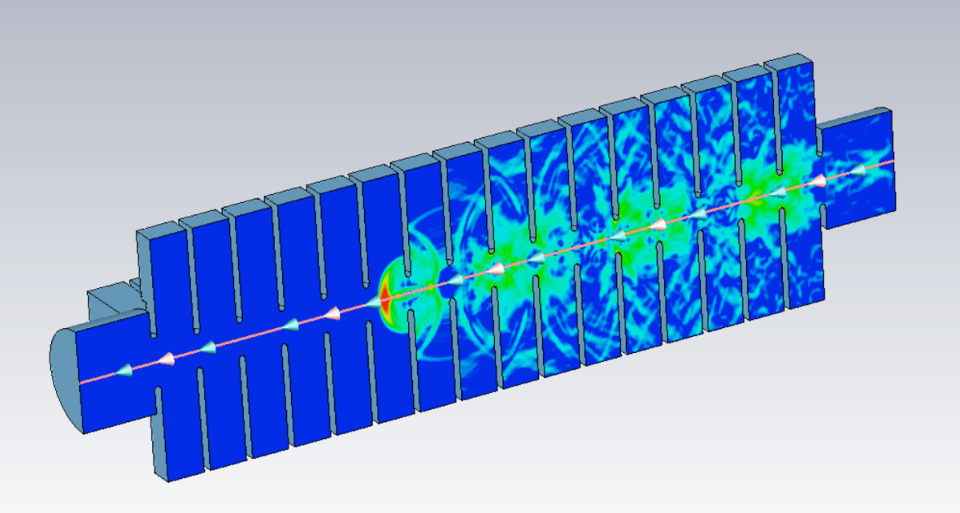
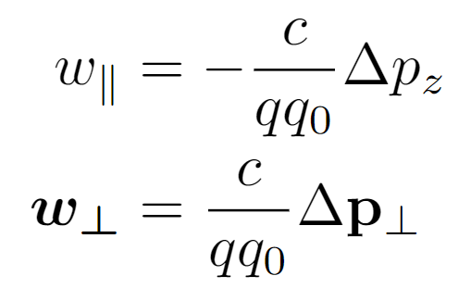
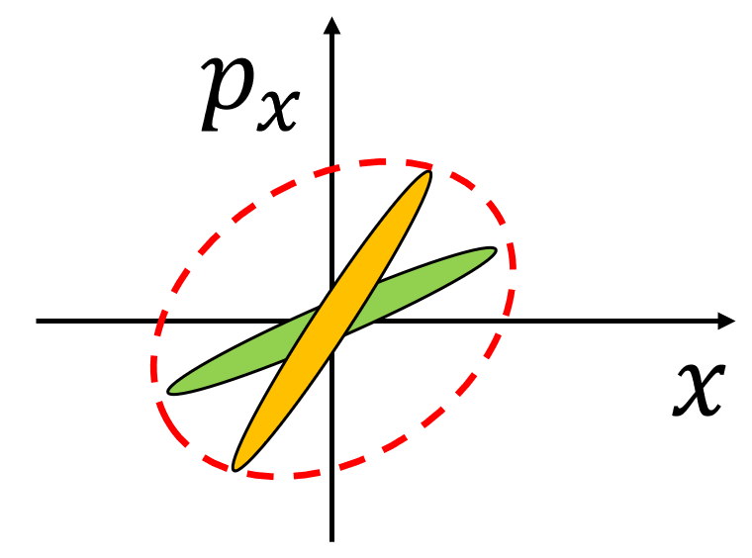
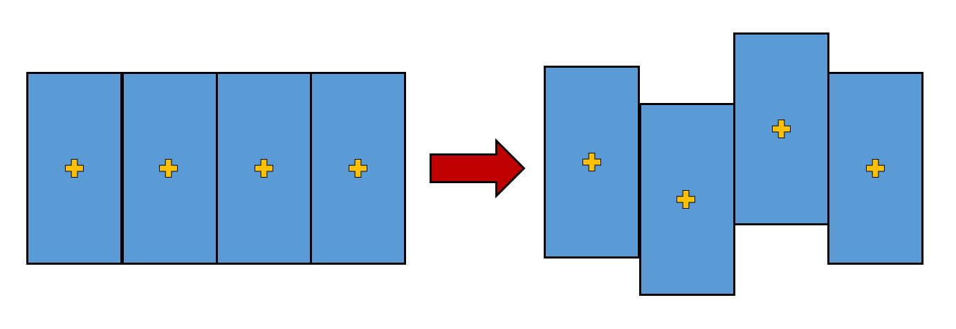
Collective Effects in Linacs
Space Charge Forces
Wakefield Interaction
Charged particles exert mutual repulsive forces
For two particles at distance $r$ traveling with velocity $βc$ one has radial force ($γ=1/\sqrt{1−β^{2}}$)
Field generated by the beam, diffracted by the discontinuities and acting back on the beam itself
Responsible for energy spread and transverse deflection
Slice-dependent deflection dilutes the projected rms emittance: BBU effects
For an arbitrary distribution, the strength of the force depends on both its shape and size
Generally slice-dependent
Courtesy of M. Migliorati
Space charge forces – PIC Methods
Solve Poisson equation in the beam frame
Lorentz field transformation in the lab frame
Integration of the equations of motion
Wakefield interaction – Convolution integral
Knowledge of the wake-function
Calculate the wake-potential (convolution integral with the current)
Notes:
To be clear, when we talk about fast algorithms we should mention the conventional approaches utilized to describe the two types of collective effects we are interested in
The strength of the space charge forces arising from the local field produced by the charge distribution itself, generally depends on both the shape and the size of the beam and therefore common models utilize PIC methods
On the other hand the wakefields arising from the interaction of the charges with surrounding environment and responsible for energy spread as well as transverse deflections are commonly described by the convolution between the charge density and the so-called wakefunctions accounting for the interaction between two charges

Slide 13
The Code MILES
Dedicated tracking code
Motivation to investigate wakefields effects in linacs in presence of non-negligible space charge endangering the nominal beam quality
Use of simple semi-analytical models: flexible and time-efficient tool (factors $∼$1/40-1/10) with acceptable reduction of the accuracy
Main applications: investigation of misalignment effects and design of possible correction schemes
Miles Davis (May 26, 1926 – September 28, 1991)
MILES = Multi-bunch and Intra-beam effects in Linacs Evaluating Stability
F. Bosco et al., “Fast models for the evaluation of self-induced field effects in linear accelerators,” NIM-A vol. 1056, p. 168642, 2023 https://doi.org/10.1016/j.nima.2023.168642
Modeling overview and comparison with other codes
 | MILES approach | Commonly utilized approaches
Space Charge | Equivalelent ellipsoid or Multi-slice superposition | Particle in cell (PIC)
Wakefields | Algebraic formalism | Convolution integral or FFT equivalent
Notes:
The necessity to perform customized studies on wakefield effects has motivated us to develop MILES: a dedicated tracking code investigating wakefield effects in linacs while also including simple models for space charge forces
The code uses semi-analytical approaches that yield a flexible and time-efficient tool at the expenses of an acceptable reduction of the accuracy
For the sake of time today I will not focus on the models adopted by this code however if anyone is curious to know more you can find the details on this paper that was accepted in NIM las week

Slide 14
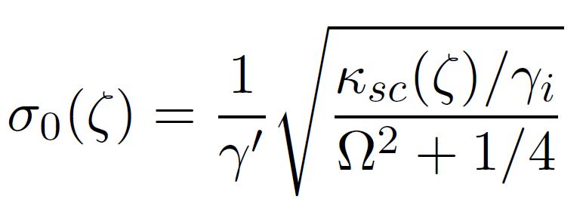
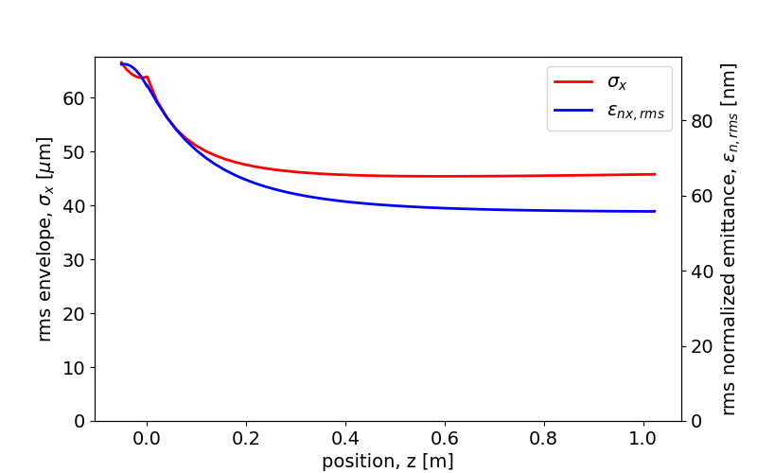
Injection in a Linac Booster - WP
Emittance compensation in a split RF photo-injector: RF gun + linac booster
Beam-linac matching: proper combination of acc. gradient, transverse focusing, current, energy and spotsize
Shift the injection position and adjust the avg accelerating field to minimize the final emittance
(total drift = 112 cm + d)

Slide 15
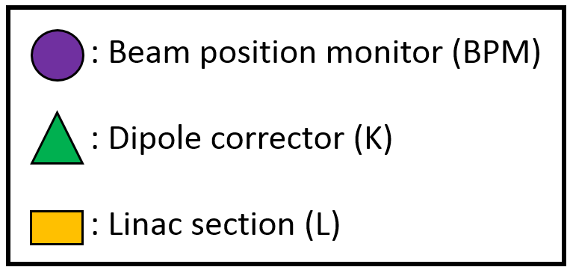
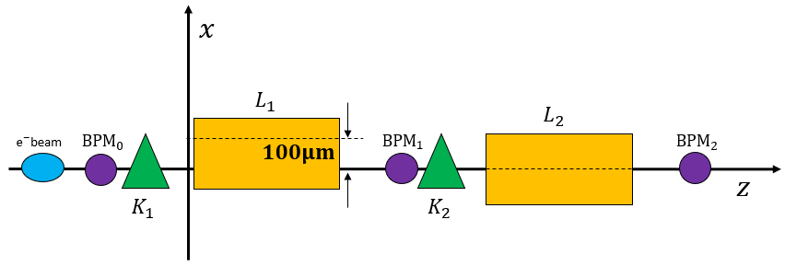
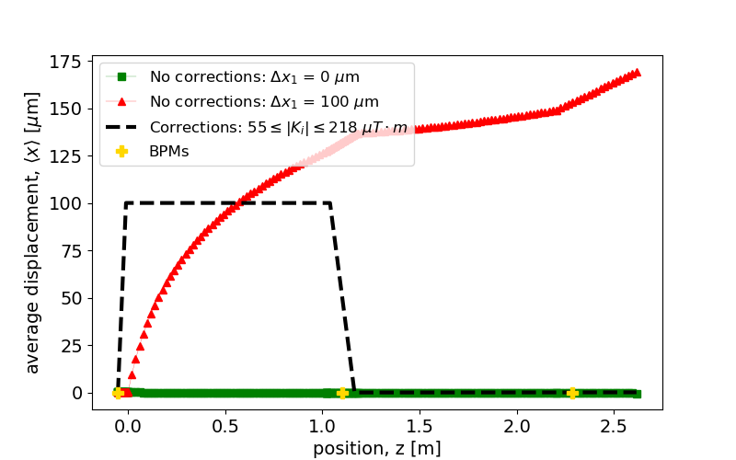
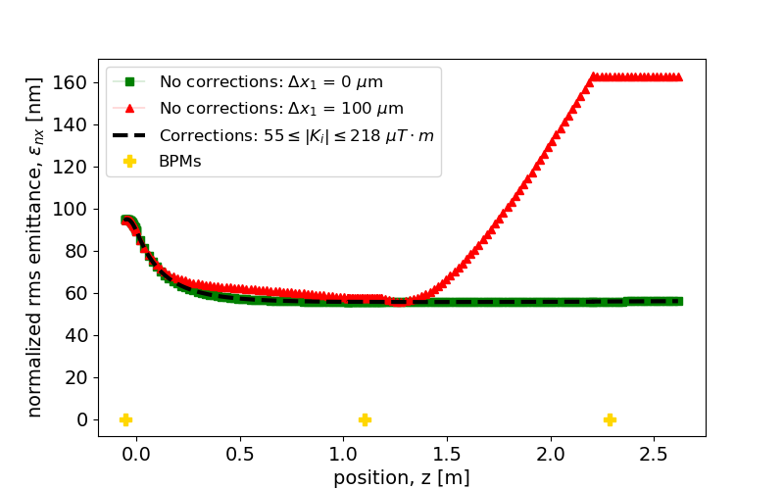
Beam Based Alignment (BBA)
Alignment errors cause off-axis motion: excitation of dipole wakes leads to emittance growth
Design of correction schemes: BPM readings are used to adjust the strength in the steering dipole correctors
Reference case from the UC-XFEL
Two section linac ($∼2 m$)
Section 1 is 100 $μm$ off-axis
$〈x〉$ vs $z$
$ε_{nx,rms}$ vs $z$
Moderate corrector strength (order of $∼50÷220 μT⋅m$)
Notes:
An alternative approach I have recently investigated is to find a trajectory for which the excitation of dipole wakefield is minimized so that we can expect minimum emittance growth
If two dipole correctors per linac module are employed instead of a single one, we have two degrees of freedom which allow to adjust the offset and the angle independently at each section’s input
This procedure forces the beam to travel always on the axis of a given linac section so that dipole wakes are not excited and the emittance growth is limited
The solution is very simple and it works with moderate strength of the dipole correctors

Slide 16
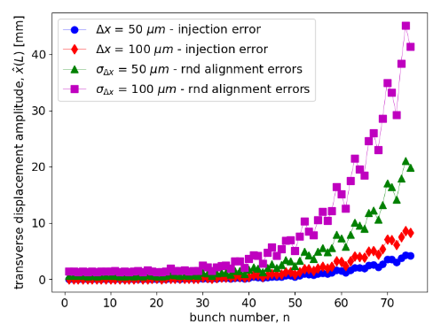
What’s Next?
Long range BBU effetcs: mutual interaction among different bunches in multi-pulse operation
High luminosity linear colliders -> C3 and its intermediate stages (250 GeV, 550 GeV, TeV-scale)
Hard X-rays FELs for chip metrology (2.44 GeV)
Identify potential new problems that can be described by and benefit from the fast simulation framework
E.g. Dielectric wakefield accelerators (DWA) rectangular slabs with alternating gradient for BNS damping

Slide 17
Conclusions
Beam Dynamics and Control CBB Meeting – 2023/09/28
Advanced accelerator applications rely on high brightness electron beams: motivation to increase the beam brightness
Near threshold emission at cryogenic temperatures with high launch fields has notable advantages
CYBORG beamline: a demonstrator for this emission scheme
Progress in the development of the cryo-RF infrastructure
Excitement for the next steps leading to the machine commissioning
Potential quality dilution due to strong self-induced EM fields: modeling and mitigation with dedicated codes
Acknowledgements
G. Lawler, A. Fukasawa, Y. Sakai, O. Williams, J. Rosenzweig, G. Andonian,
P. Manwani, M. Yadav, W. Lynn, J. Mann, S. O’Tool, J. Pan, J. Phillips, G. Anand
Thank you for your attention
(Questions are welcome)
* fbosco@physics.ucla.edu
This work was supported by the U.S. National Science Foundation under Award PHY-1549132, the Center for Bright Beams

Slide 18
Acknowledgements
Acknowledgements
G. Lawler, A. Fukasawa, Y. Sakai, O. Williams, J. Rosenzweig, G. Andonian, P. Manwani, M. Yadav, W. Lynn, J. Mann, S. O’Tool, J. Pan, J. Phillips, G. Anand

Slide 19
Spare slides

Slide 20
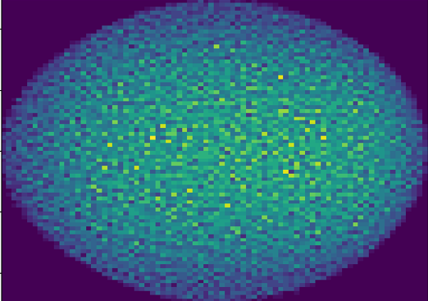
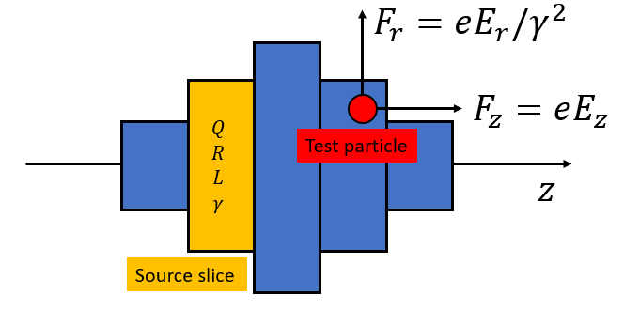
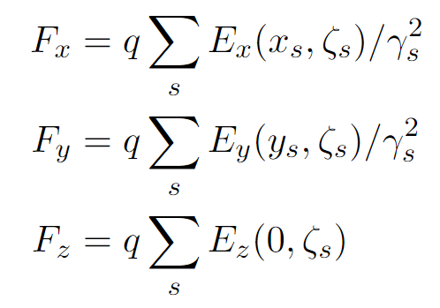
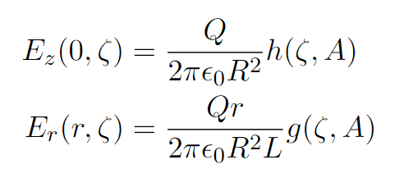
Modeling Space Charge Forces
Beams consist of large ensembles of charged particles exerting mutual repulsive forces
For arbitrary distributions, the strength of the force depends on both its shape and size
Exact solution typically utilizes particle in cell (PIC) approaches
Equivalent ellipsoid method
Multi-slice superposition method
An equivalent uniform ellipsoid is associated to the actual beam distribution
Self-induced forces are known analytically
Forces are linear: self consistent model
Divide the beam in cylindrical slices with individual size, energy and aspect ratio
Field produced by each (uniform) slice is known analytically ($∂/∂θ=0$, $∂E_{z}/∂r=0$)
Superposition of the fields produced by all the slices
Advantages
Very fast ($∼30$ times of 3D PIC )
Successfully reproduces rms size ($σ_{x},σ_{y},σ_{z}$) and energy spread ($σ_{E}$)
Limitations
Absence of correlation prevents the observation of emittance dynamics
Loss of axial symmetry in presence of strong transverse wakefield
Advantages/Limitations
Correlation between the planes describes the emittance dynamics
Allows description of more arbitrary geometries
More time-consuming but still faster than PIC
Notes:
For what concerns SC forces, the strength of such effects depends on the shape and the size of the distribution, and therefore their description utilizes PIC methods
Here I am showing two alternative semi-analytical methods:
The first one associates the actual beam to an equivalent uniform ellipsoid which produces well-known self induced forces
whereas the second one divides the beam in cylindrical slices with individual size and energy and producing a field in this form in the surrounding space
The force acting on each particle is then given by the superposition of the EM field produced by all the slices
The ellipsoid method is very fast and in many practical cases reproduces the rms beam dimension and energy spread correctly
However, since the forces are not slice-dependent, the model forbids to observe well-known emittance dynamics that are induced by the independent evolution of the beam slices
In addition, in presence of wakefields, the deflection introduced by the transverse wake will displace the centroid of each slice breaking the symmetry that is implied in the ellipsoidal model meaning that the model is not valid in strong-BBU regime unless correction schemes for the trajectories are introduced
The multi-slice approach overcomes both this limitations: it exhibits correlation between the planes and allows description of more arbitrary shapes. The drawback is that this method become more time consuming but remains faster than a PIC

Slide 21
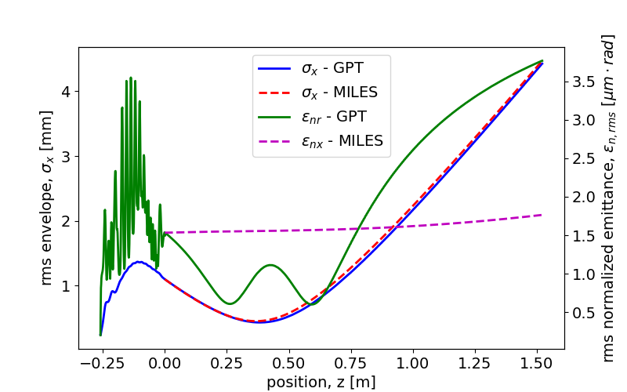
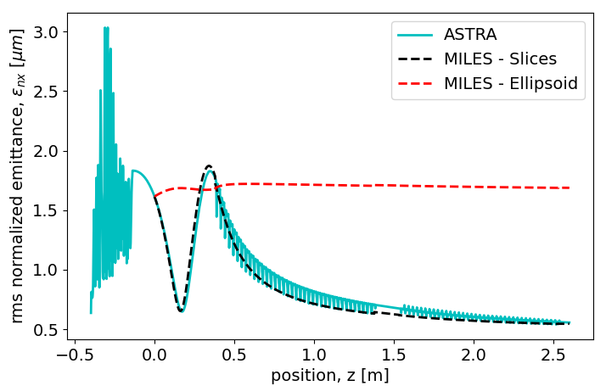
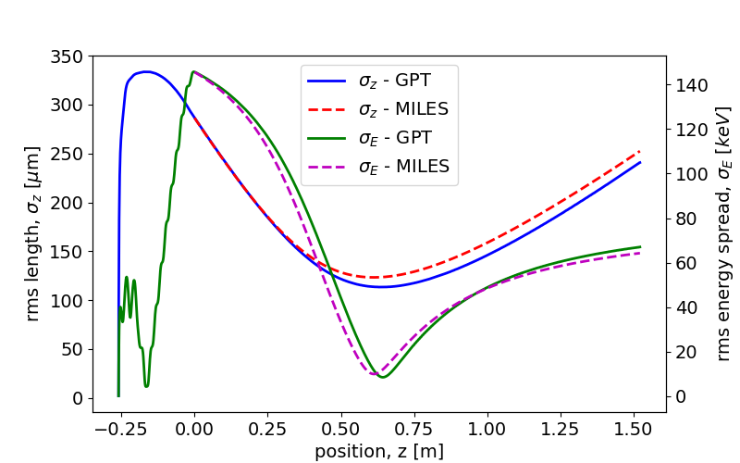
Modeling Space Charge Forces (2)
Equivalent ellipsoid method
Multi-slice superposition method
$250 pC$ $e^{−}$ beam from the C-band hybrid photoinjector
Evolution in a field-free (drift) region with GPT (solid lines) and with the ellipsoidal model in MILES (dashed lines)
$250 pC$ $e^{−}$ beam produced by the hybrid gun and matched to its invariant envelope in a booster linac
Emittance dynamics: oscillations in the drift and compensation in the linac
Transverse plane: $σ_{x}$, $ε_{nx }$
Injection in the booster
Longitudinal plane: $σ_{z}$, $σ_{E}$
M. Ferrario et al., Direct measurement of the double emittance minimum in the beam dynamics of the Sparc high-brightness photoinjector, Phys. Rev. Lett. 99, 234801 (2007).
Notes:
Here we can see some examples where our approach is compared to codes like GPT and ASTRA, both using PIC
In both cases we consider the beam produced by the hybrid photoinjector that, on the left, propagates in a long drift space and on the right is injected in a booster linac receiving emittance compensation
On the LHS MILES is using the Ellipsoidal model which, as anticipated, describes the transverse and the longitudinal dimensions as well as the energy spread correctly but it fails to reproduce the emittance oscillation
On the RHS the ellipsoidal model still fails in describing the evolution of the rms emittance however the multi-slice approach reproduces successfully both the oscillation in the drift and the compensation process

Slide 22
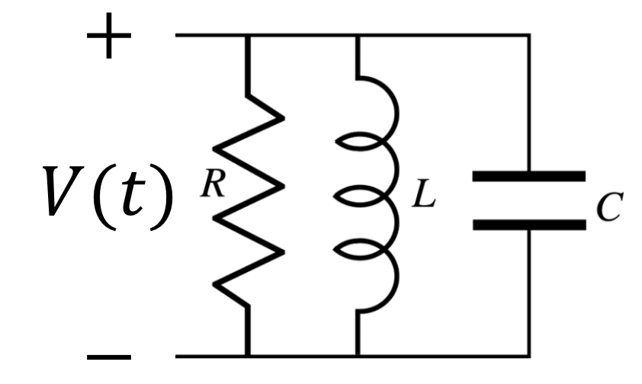
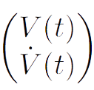
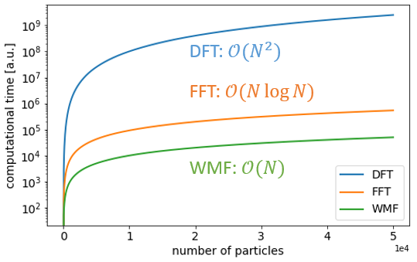
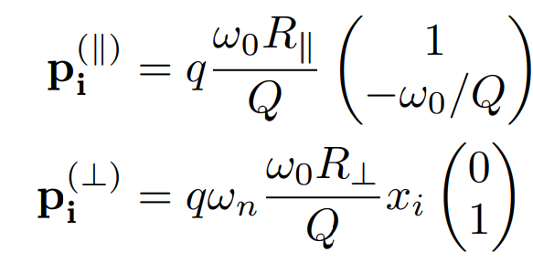
Modeling Wakefield Effects
Interaction of a particle with a cavity resonant mode
The change in momentum (energy/deflection) is described by the equivalent shunt circuit voltage
Evolution of the voltage state
Recursive formula
State after the $n$ charges have passed
$N$ particles $⇒$ $N−1$ operations
Perturbation:
Kick induced by the passing charges
Free-evolution:
Homogenous 2nd order differential equation
Notes:
Here I want to introduce the algebraic formalism that I developed in order to describe the effects of both longitudinal and transverse wakefields
The fundamental idea upon which the formalism relies is the interaction of a charged particle with a resonant cavity mode
Such modes can wither be the actual higher order modes excited in the accelerating structures or can be used to represent arbitrary wakefunctions
It can be shown that the energy variation as well as the deflection of a particle interacting with a resonant mode can be described in terms of the voltage across the equivalent RLC circuit representing the mode. Therefore, all is needed is to keep track of the evolution of the voltage continuously excited by the passing charges
The evolution of the voltage state, consisting of the voltage and its derivative, is described by this operator where the matrix M accounts for the free-evolution according to the usual homogeneous differential equation whereas the perturbation vector p modifies the state after the passage of a new charge
The voltage state after the transit of n charges is obtained by the composition of operators of such kind and provides a recursive formula which significantly reduces the number of operations with respect to the convolution integral approach

Slide 23
Collective Effects in Linacs
Space Charge Forces
Wakefield Interaction
Beams consist of large ensembles of charged particles exerting mutual repulsive forces
For two particles at distance $r$ traveling with velocity $βc$ one has the radial force ($γ=1/\sqrt{1−β^{2}}$)
Field generated by the beam, diffracted by the surrounding environment and acting back on the beam itself
Causality: for $β→1$ the self-field acts behind the source
Responsible for energy spread and transverse deflection
For an arbitrary distribution, the strength of the force depends on both its shape and size
Courtesy of M. Migliorati
Space charge forces – PIC Methods
Solve Poisson equation in the beam frame
Lorentz field transformation in the lab frame
Integration of the equations of motion
Wakefield interaction – Convolution integral
Knowledge of the wake-function
Calculate the wake-potential (convolution integral with the current)
Notes:
To be clear, when we talk about fast algorithms we should mention the conventional approaches utilized to describe the two types of collective effects we are interested in
The strength of the space charge forces arising from the local field produced by the charge distribution itself, generally depends on both the shape and the size of the beam and therefore common models utilize PIC methods
On the other hand the wakefields arising from the interaction of the charges with surrounding environment and responsible for energy spread as well as transverse deflections are commonly described by the convolution between the charge density and the so-called wakefunctions accounting for the interaction between two charges

Slide 24
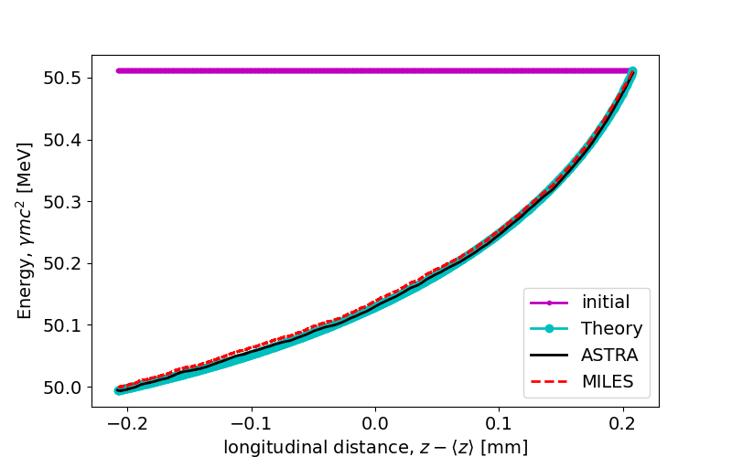
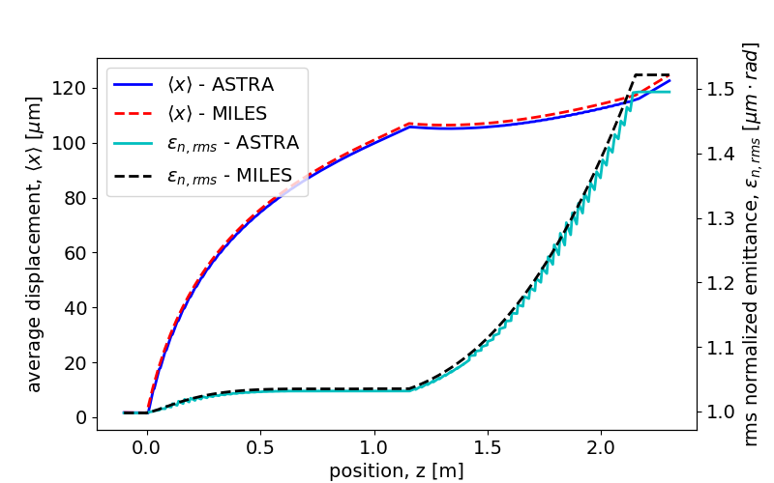
Modeling Wakefield Effects (2)
Short-range wakefield (SRWF) effects in a distributed coupling linac
Longitudinal monopole and transverse dipole wake-functions from diffraction theory
Longitudinal interaction
Transverse interaction
$50 MeV$ rectangular beam propagating on-axis in a $∼1 m$ long linac section: long. phase-space
$5 MeV$ rectangular beam propagating in two linac sections with transverse offset $Δx_{1}=100 μm$ and $Δx_{2}=0$
Head
Injection
Extraction
Tail
Energy spread induced by the longitudinal SRWF in a linac section (longitudinal phase space)
Misaligned linac section: the beam propagates off axis exciting dipole wakes which cause emittance growth
Notes:
Here we consider an example where the SRWF excited in a distributed coupling linac cause mutual interaction among particles in the same bunch
The longitudinal and transverse binary interaction in a periodic accelerating structure is described by use of diffraction theory by means of well known wake-functions
In the first example the longitudinal wakefield excited in the linac affects the energy spread of an originally monochromatic beam modifying its projection on the LPS
In the second example a misaligned linac section causes the beam centroid to travel off-axis where dipole wakefields are excited causing a growth of the rms emittance
In both cases our model reproduces the expected behavior

Slide 25
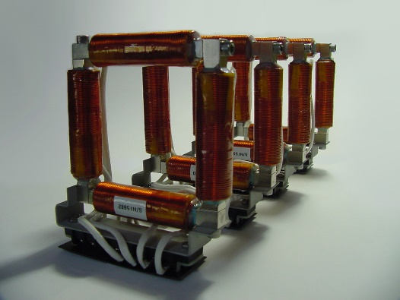
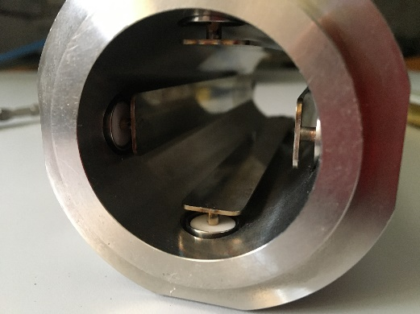
Trajectory Steering
Steering magnets: dipole fields of moderate strength providing correction of the trajectories
Transverse kick from a corrector of integrated field $K$
Beam position monitors (BPMs) measure the transverse position of the beam
Beam based alignment (BBA): adjust the strength of the kickers as a function of the BPM readings
Courtesy of A. Mostacci
Notes:
As shown by the previous example, dipole wakes excited in misaligned linacs are a cause of emittance dilution
Therefore it is useful to exploit our code to design correction schemes for the beam trajectories based on the combination of BPMs steering dipole magnets
BPMs measure the transverse displacement of the beam at various locations and such information can be exploited to adjust accordingly the strength of the dipole kickers upstream modifying the center-of-mass trajectory
This correction technique is known as beam based alignment

Slide 26
Beam Based Alignment (BBA)
Alignment errors cause off-axis motion: excitation of dipole wakes leads to emittance growth
Design of correction schemes: BPM readings are used to adjust the strength in the steering dipole correctors
Reference case from the UC-XFEL
Two section linac ($∼2 m$)
Section 1 is 100 $μm$ off-axis
One-to-one steering: one corrector upstream each linac section
“Wake-free” steering: two correctors upstream each linac section
$〈x〉$ vs $z$
$ε_{nx,rms}$ vs $z$
$〈x〉$ vs $z$
$ε_{nx,rms}$ vs $z$
Moderate corrector strength ($∼10÷100 μT⋅m$)
Notes:
Here we show two possible correction schemes applied to a common reference case where the first section of the UCXFEL linac is 100 um off-axis
On the LHS we use one steering magnet per linac section forcing the trajectory to intersect the linac axis at the BPM locations which reduces but does not prevent the emittance growth since the algorithm aims for a local control of the trajectory instead of a global optimization
On the RHS instead, we use two steering magnets per linac section so that we can force the beam to propagate always on the axis of each section regardless of the misalignments. In this case the excitation of dipole wakes is minimized and the emittance is preserved
----
As shown by the previous example, dipole wakes excited in misaligned linacs are a cause of emittance dilution
Therefore it is useful to exploit our code to design correction schemes for the beam trajectories where measurements of the transverse offset are used to adjust the strength of the steering dipoles deflecting the beam

Slide 27
Sources of Wakefields in Linacs
Field generated by the beam, diffracted by the surrounding environment and acting back on the beam
Responsible for energy spread and transverse deflection
Modes in resonant cavities
Periodic accelerating structures
Longitudinal monopole and transverse dipole higher order modes (HOMs) in the accelerating cavities
Responsible for the long-range wakefield (LRWF) interaction ($ω_{n}=ω_{0}\sqrt{1−{\left(2Q\right)}^{−2}}$ and $α=ω_{0}/2Q$)
Longitudinal monopole and transverse dipole impedance from diffraction theory
Responsible for the short-range wakefield (SRWF) interaction in periodic accelerating structures
$ω_{0}$, $Q$, $R$
Notes:
So far we have only focused on the benefits associated with this type of structures but we should also say that high shunt impedance structures are accompanied by stronger wakefields
Wakefields are self-induced EM fields produced by the beam and diffracted by the discontinuity of in the surrounding geometry
Such parasitic fields introduce energy spread and transverse deflection that are described by a dedicated formalism that makes use of the wake-functions
In rf linacs the main contribution of wakefields is introduced by the interaction with the accelerating structures themselves
Depending on the time scale of the separation among the particles, two types of effects are observed: a long range interaction due to the excitation of HOMs introduces coupling among different bunches whereas a short range interaction due to the cell irises introduces intra-beam coupling described by diffraction theory

Slide 28
Beam Breakup Effects
Long-range transverse interaction
Short-range transverse interaction
Off-axis bunches
Excitation of dipole HOMs
Transverse deflection
!
Instability: the amplitude of the center of mass oscillation grows
!
Phase space dilution: the correlation between the planes is a cause of emittance growth
Notes:
These two types of interaction in the transverse plane are responsible for BBU effects
In particular, in the LR time-scale bunches traveling off-axis will excite dipole HOMs which causes deflection of the trailing bunches. Eventually, this process repeats itself in a cycle leading to an instability: the amplitude of the transverse oscillation grows without control
In the short-range time-scale the slice-dependent deflection induced by the SRWF introduces a correlation between the longitudinal and transverse planes leading to a growth of the projected emittance

Slide 29
Beam Loading Effects
Long-range longitudinal interaction
Short-range longitudinal interaction
Before
After
Bunch to bunch final energy variation due to the longitudinal LRWF
Energy spread induced by the longitudinal SRWF in a linac section (LPS)
!
Energy exchange with self-EM fields:
bunch-to-bunch and intra-beam energy spread
Notes:
Similarly, on the longitudinal plane particle exchange energy with the longitudinal wakefields which leads to bunch to bunch energy spread in the long-range time scale and intra-beam energy spread in the short range time scale

Slide 30
Wakefields in the $3π/4$ Structures
SRWF
LRWF
Monopole HOMs
Dipole HOMs
Dipole
Monopole
Solid - $3π/4$-mode
Dashed -- $π$-mode
= $3π/4$-mode
Notes:
We should start by a quantitative description of our wakefields
In the SR case the wakefunctions can be calculated by the geometric parameters of the cell and we can notice that such fields are sligthly stronger for the 3pi/4 mode (in solid lines)
And the same is true for the R/Q of the higher order modes so me must be prepared more serious problems

Slide 31
Long-range BBU in the $C^{3}$ Linac
BBU studies for the 250 GeV CM working point of the $C^{3}$ linear collider
Center of mass oscillations and beam loading effects in multi-bunch operation: sequence of point-like, structureless macro-particles carrying the whole bunch charge
Notes:
The following example takes into account the 250 GeV CM working point of the C3 linear collider
The relevant parameters for our purposes can be read from this column

Slide 32
Long-range BBU in the $C^{3}$ Linac (2)
Mitigation: detuning of the HOMs
Unstable motion if the ratio $f_{HOM}/f_{b}$ is close to an integer (see Mosnier)
Small variations of the original geometry: HOMs exhibit different frequencies in subsequent linac sections
$700 ns$ RF-pulse (flat-top) filled with 133 bunches, $1 nC$ each, and $5.26 ns$ separation (30 RF-periods)
Acceleration at an avg loaded gradient of $70 MeV/m$
Injection $100 μm$ off axis causes excitation of dipole HOMs
Amplitude of the transverse oscillation for each bunch in the rf-pulse at the interaction point normalized to the first bunch’s amplitude
Notes:
Here we investigate an injection error of 100 um in absence of mitigation techniques and
The plot shows the amplitude of the transverse oscillation and the energy for each one of the 133 bunches in the rf-macro pulse at the end of the linac.
Allow me a quick comment on the beam loading: I shouldn’t have included this effect as the loaded gradient already accounts for it. The reason why I did is to show that this effect is indeed strong and this energy droop is consistent with the beam power to rf power ratio
For the transverse oscillations, amplitudes are normalized to the value of the first bunch (which by causality doesn’t experience dipole wakes) showing grow factors ranging from 20k to 140k that require clearly require mitigation

Slide 33
Long-range BBU in the $C^{3}$ Linac (3)
Detuning of the HOMs
Unstable motion if the ratio $f_{HOM}/f_{b}$ is close to an integer (see Mosnier)
Mitigation through frequency spread (or detuning)
Small variations of the original cavity geometry: HOMs exhibit different random frequencies in subsequent linac sections
Amplitude of the transverse oscillation for each bunch in the rf-pulse at the interaction point normalized to the first bunch’s amplitude
Notes:
It is possible to demonstrate that the motion becomes highly unstable when the ratio of the HOM frequency and the bunch repetition rate is close to an integer as the mode and the pulsed beam fulfill a resonant condition
A possible mitigation scheme, known as frequency spread, consists in applying small changes to the nominal geometry of the cavity so that the mode will appear with different frequencies in subsequent linac sections
Such fluctuations break the coherent interplay of the pulsed beam with the mode
Repeating the previous simulation with frequency spread. We can observe that, since all the normalized amplitudes are close to 1, breaking the interaction pattern cancels the BBU-effects completely

Slide 34
SRWF and LRWF Simultaneously
Reference case
UC-XFEL scenario (100 bunches, 6 RF-bucket ($∼1 ns$) separation: 100 pC, 0.5 mm rms long beam, ~100 nm emittance at injection)
2 linac sections: $6.9 MeV<γmc^{2}<150 MeV$ with the 1st section is 100 um off-axis
Notes:
The last bit that I want to show is an extension of the capabilities of our simulations in order to include simultaneously space charge, sr and long range wakefields in the same simulations and observe some of their subtle interplays
Here we are considering again the same scenario from the previous slide ust without correction magnets but we accelerate a train of 100 bunches to observe, ina ddition their mutual coupling.
A subtle effect that we notice is that the bunch to bunch energy variations due to the beam loading affect the beam trajectories so that one observes slightly different emittances between the first and the last bunch of the RF pulse

Slide 35
Acknowledgements
INFN-LNF
D. Alesini
M. Behtouei
A. Cianchi
L. Faillace
M. Ferrario
A. Gallo
A. Giribono
B. Spataro
C. Vaccarezza
UCLA
G. Andonian
O. Camacho
S. Crisp
A. Fisher
A. Fukasawa
G. Lawler
M. Lenz
W. Lynn
J. Mann
P. Manwani
P. Musumeci
J. B. Rosenzweig
Y. Sakai
O. Williams
M. Yadav
SLAC
C. Emma
Z. Li
N. Majernik
E. Nanni
R. Robles
S. Tantawi
Radiabeam
P. Carriere
M. Kravchenko
A. Murokh
M. Ruleas
La Sapienza
M. Carillo
E. Chiadroni
L. Ficcadenti
D. Francescone
G. Franciosini
L. Giuliano
M. Migliorati
A. Mostacci
L. Palumbo
G. J. Silvi
LANL
P. Anisimov
D. Kim
E. Symakov
Notes:
I want to thank my supervisors prof. MM and LP but also I want to acknowledge all the people with whom I had positive scientific discussions during daily work, meetings and workshops

