Slide 1
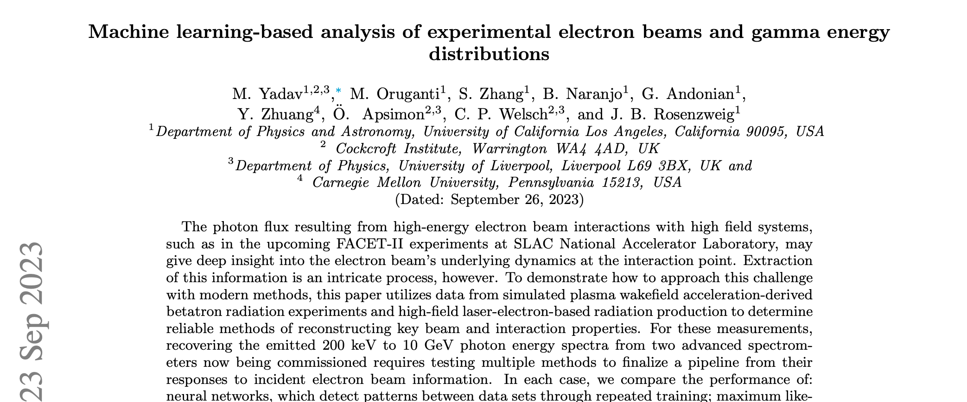
Machine learning-based analysis of high-intensity electron beams and gamma energy distributions
Monika Yadav
PI: Prof James Rosenzweig
yadavmonika@g.ucla.edu
28 Sep 2023

Slide 2
Outlines
Identifying beam parameters from different types of betatron radiation data. Compton spectrometer (few keV to few MeV)
Maximum Likelihood Estimation (MLE)
Machine Learning (ML)
Methods specific to the pair spectrometer (100s of MeV to few GeV) analysis
ML
MLE
QR decomposition methods.
Notes:
MLE: This statistical technique determines unknown parameters from a given distribution of observed data.
Various beam diagnostic devices and techniques already exist, such as the beam current transformer used to measure beam intensity or charge and laser-Compton scattering used to measure transverse beam spot size and emittance
main concepts behind MLE and lay out a method for using an MLE algorithm to identify beam parameters from different types of betatron radiation data.
Because information about the properties of the beam (e.g., emittance, energy) is encoded in the betatron radiation spectrum, measurements of this radiation can be used in principle to reconstruct beam parameters, mainly through the changing characteristics of the radiation with strength parameter $K$

Slide 3
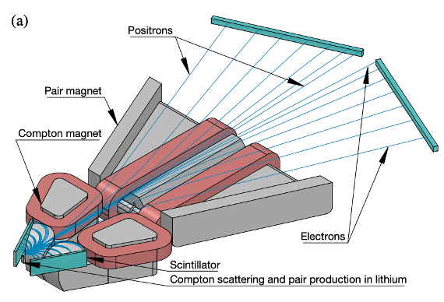
Background
Diagram of UCLA Spectrometer
Betatron radiation is produced by the transverse oscillation of particles within beams in PWFA.
This radiation can be used as a beam diagnostic. This has several advantages including being single-shot, and non-destructive.
Notes:
For FACET-II, at photon energies ranging from 200 keV through 30 MeV, a dedicated Compton spectrometer, termed CPT.
Its magnetic field geometry is sextupole-like, permitting a sizeable single-shot energy range.
Positron-Electron Detector for Radiative Observations
channels the photons through a beryllium converter target.
energies between 10 MeV and 10 GeV
produce electron-positron pairs through the nuclear field interaction

Slide 4
Part-1
Given the radiation spectrum, how can we interpret it to reconstruct the initial beam parameters?

Slide 5
Reconstruction of beam parameters using MLE
The goal of the analysis is to determine the value for an initially unknown parameter $σ$which allows the probability distribution function f(x|$σ$) to best model a set of observed x vectors.
Previously generated training sets of spectra were converted into probability distributions as a function of photon energy.
Probability distributions and the test spectra as inputs into the likelihood function, the likelihood can be plotted for spot size.

Slide 6
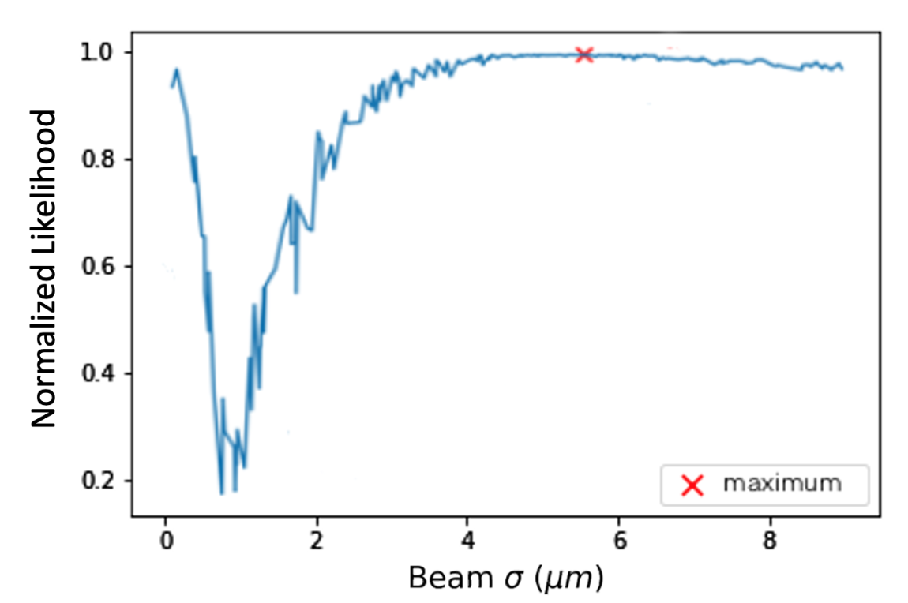
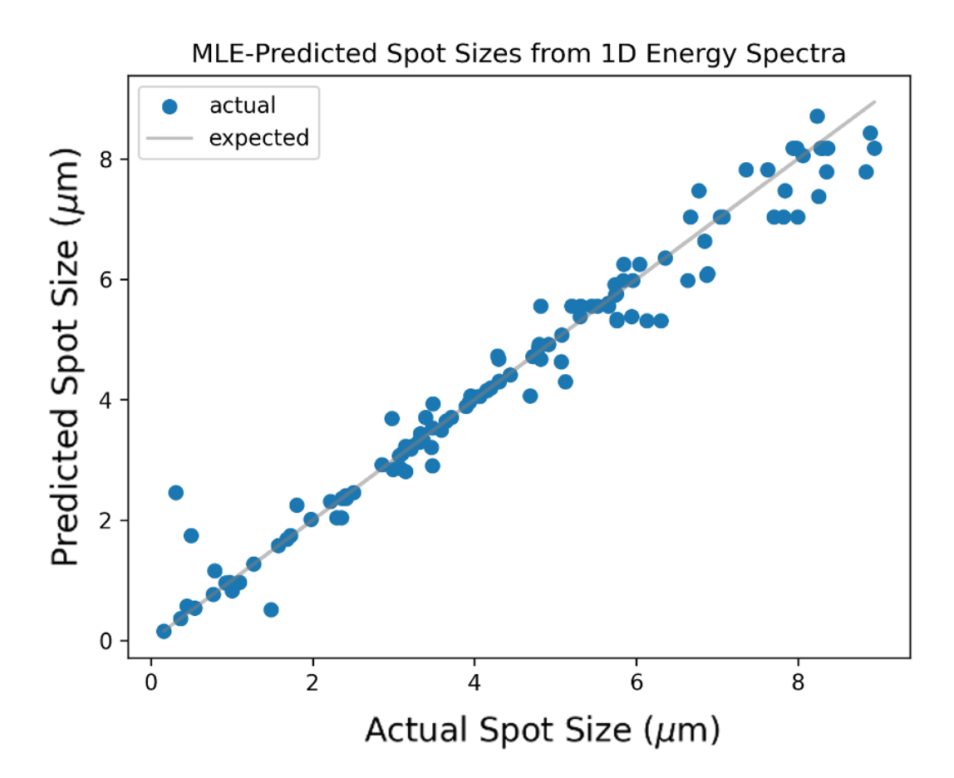
Maximum likelihood estimation results
This statistical technique determines unknown parameters from a given distribution of observed data.
120 different test simulations were run. 310 simulations were run with only spot size varied between them.
Notes:
120 different ``test'' simulations were run, with spot sizes chosen similarly.
310 simulations were run with only spot size varied between them.

Slide 7
Reconstruction of beam parameters using ML
The machine learning tasks use densely connected neural networks, which are comprised of several layers containing any number of nodes.
The free parameters of the models are the number of layers, the size of each layer, and the activation function of each layer.
The direct 1D model had three hidden layers of 460, 246, and 128 nodes, while the double differential case model had two hidden layers of 800 and 100 nodes.

Slide 8
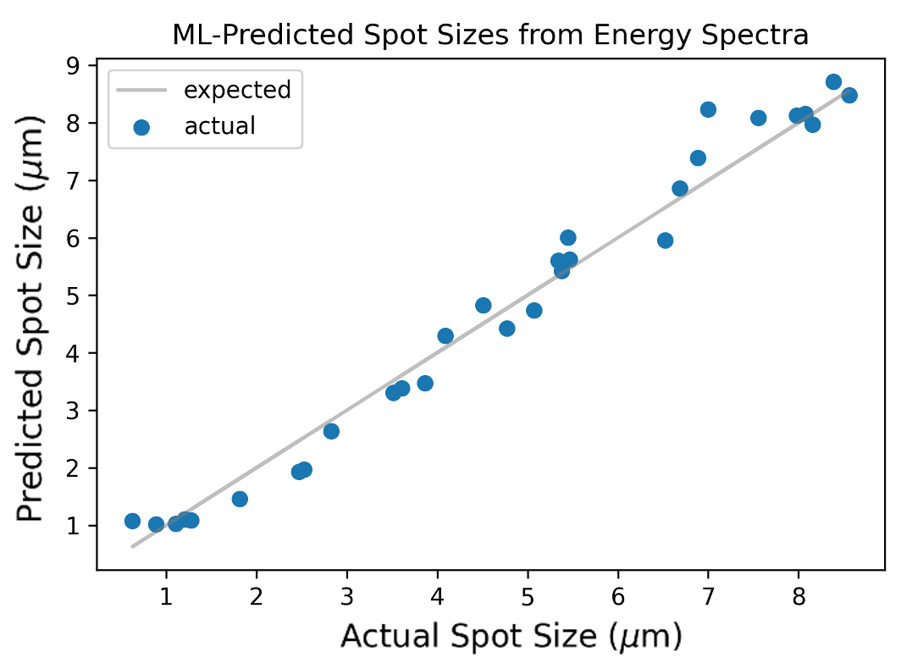
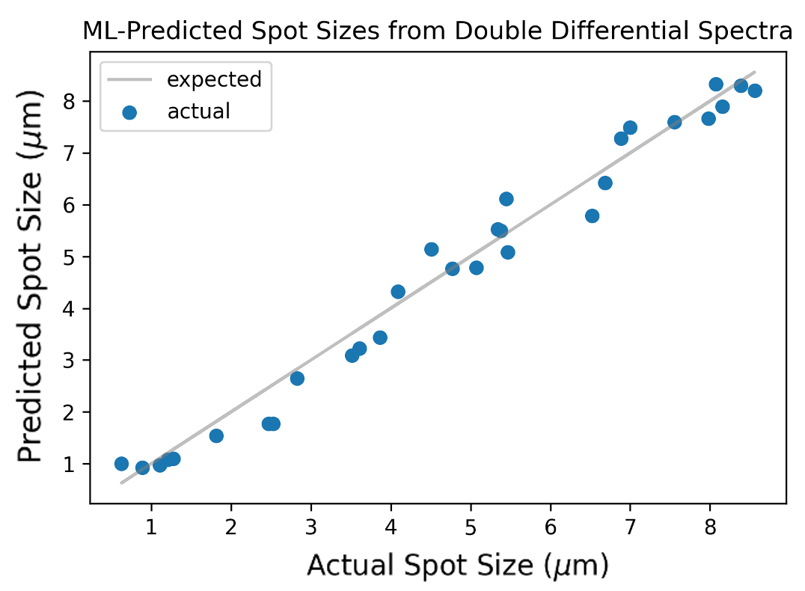
Reconstruction of beam parameters using ML
ML model prediction spot size using 90 training cases and 30 test cases.
Simulation data was used to train a fully connected neural network. Then, the model was used to identify parameter values for test data.
Their radiation spectra were compared to an experimental spectrum produced by a beam of unknown spot size.

Slide 9
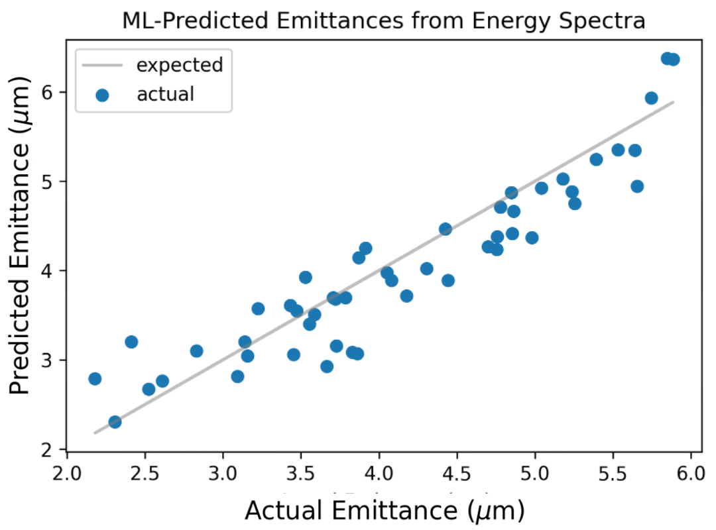
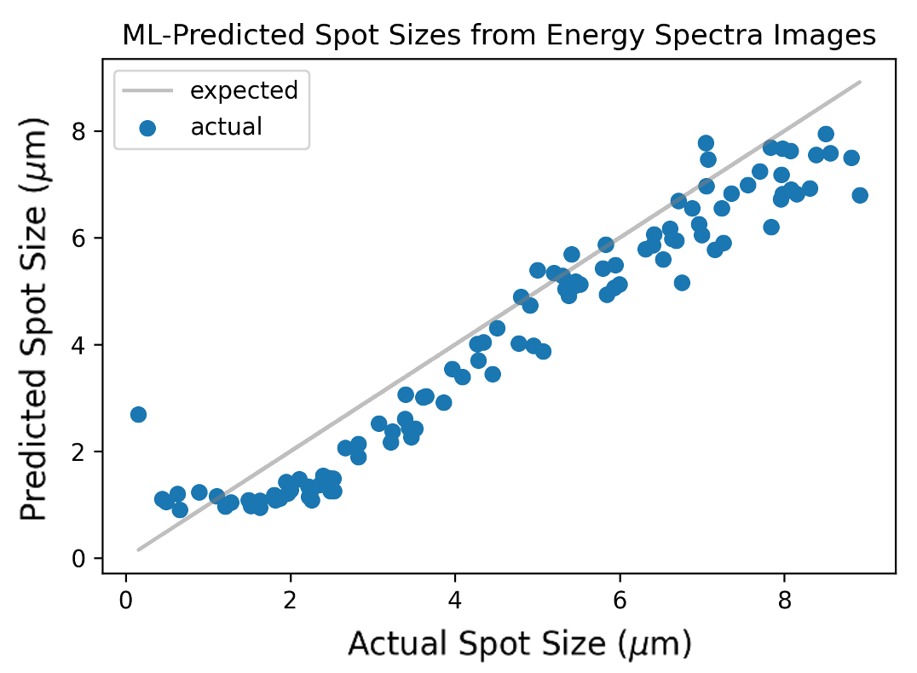
Reconstructing beam parameters using ML
ML model prediction results for emittance using 1D radiation spectrum with 130 sets of training data and 50 test cases.
150 x150 image input ML model prediction results for spot size. The results are like predictions from raw spectrum data.
Notes:
In addition to the direct ML models, another model was trained to predict spot sizes from 150 $\times$ 150-pixel images of the radiation spectra rather than from the spectrum data itself, which allows for broader application of these ML beam diagnostics. For this 150 $\times$ 150 image input model, the neural network contains six hidden layers with 200, 100, 100, 20, 20, and 10 nodes, and the model was trained over 100 epochs using the loss function
Overfitting occurs when the model fits too exactly against the training data and generalizes poorly to the test data
the persisting inaccuracy at low spot sizes is likely related to the equivalent \textit{K} parameter values for the simulated small spot size beams. For a single particle, \textit{K} is given by

Slide 10
Part-2
Given the spectrometer data, how can we interpret it to reconstruct the energy distribution of the incoming gamma rays?

Slide 11
Predict incident gamma spectra based on spectrometer data
ML
Requires synthesized training data
Makes no assumptions about gamma energy distributions
ML-EM
Requires accurate guess of gamma energy distribution
Has no reliance on training data
QR
Matrix decomposition
x represents the gamma energy distribution
y represent the spectrometer's responses
Notes:
The three methods included: developing a machine-learning model, combining the model with the MLE algorithm, and applying QR decomposition to the R matrix.
The linear relationship between the energy distribution of photons and the spectrometer’s response.
Gamma energy distribution, coefficients, and the spectrometer’s responses.
Linear relation permits building a matrix that can be used to generate any number of training and test cases for training and assessing the accuracy of different models when recovering the photon energy distributions from spectral responses.

Slide 12
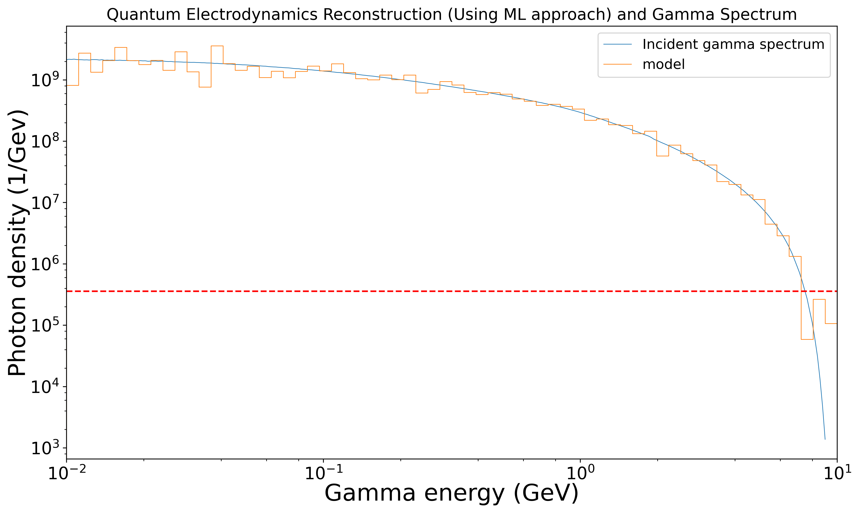
QED case using ML
The model predicts the correct distribution pattern between bins 1 and 30 (approximately corresponding to a range of 10-250 MeV).
In the higher energy bins, the model's predicted photons fall within the spectrometer's dynamic range in the nonlinear Compton scattering.
Training data was synthesized by creating an arbitrary energy distribution and multiplying each x -x-vector by the matrix to generate the corresponding spectrum (or y-vector) that PEDRO would measure

Slide 13
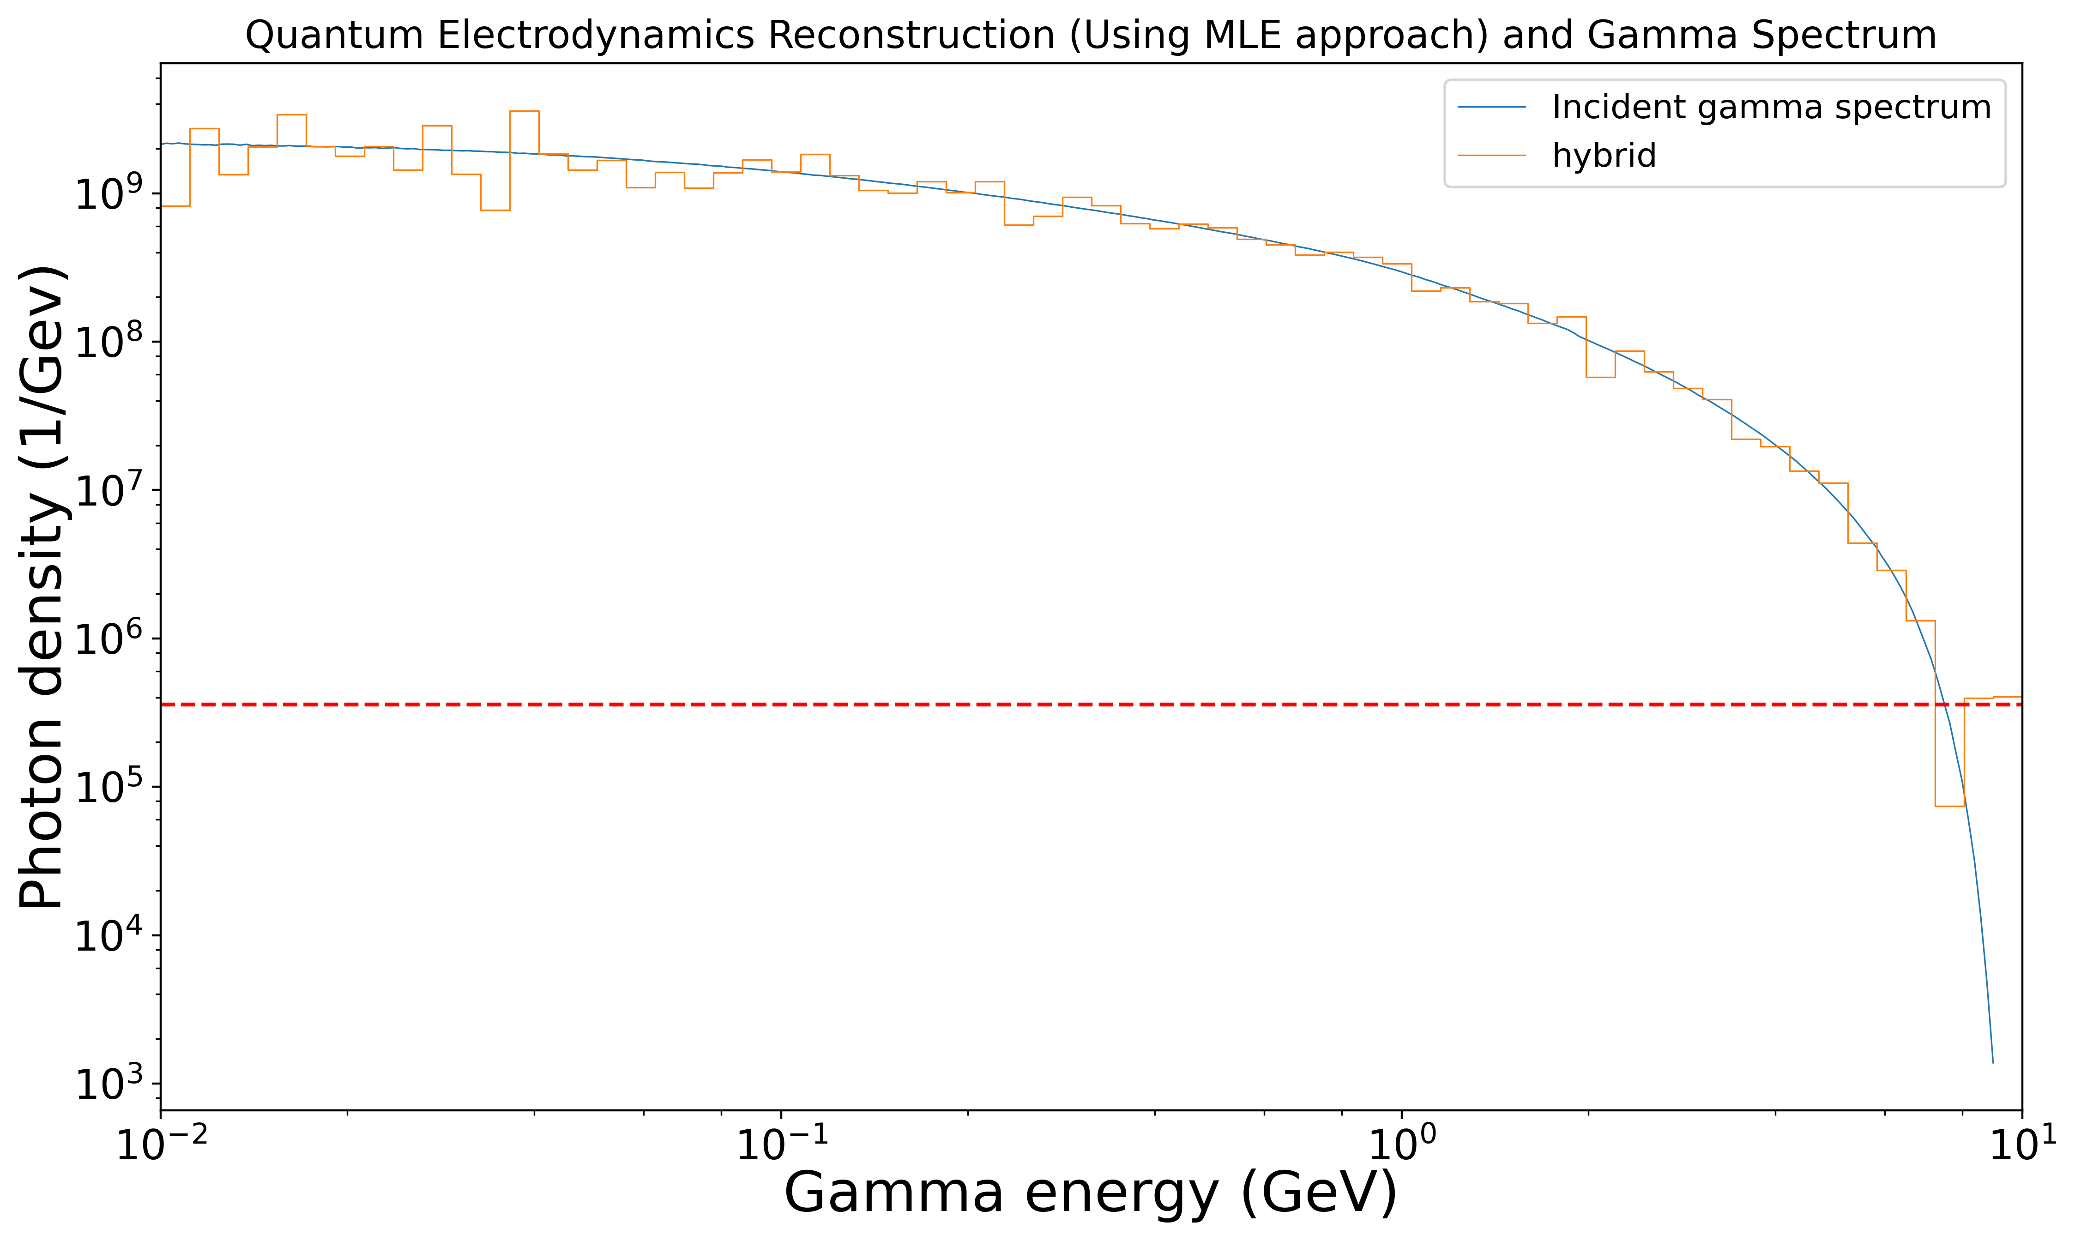
QED case using MLE
In the smooth cases from the hybrid approach closely follow the pattern of the gamma distribution across all the energy ranges (with a deviation from the filamentation case above 250 MeV).
Notes:
Using the ML model's guess, which may be close to the true distribution, the MLE algorithm may also reliably converge to the true distribution, as the issue of incorrectly identified convergent points is suppressed.

Slide 14
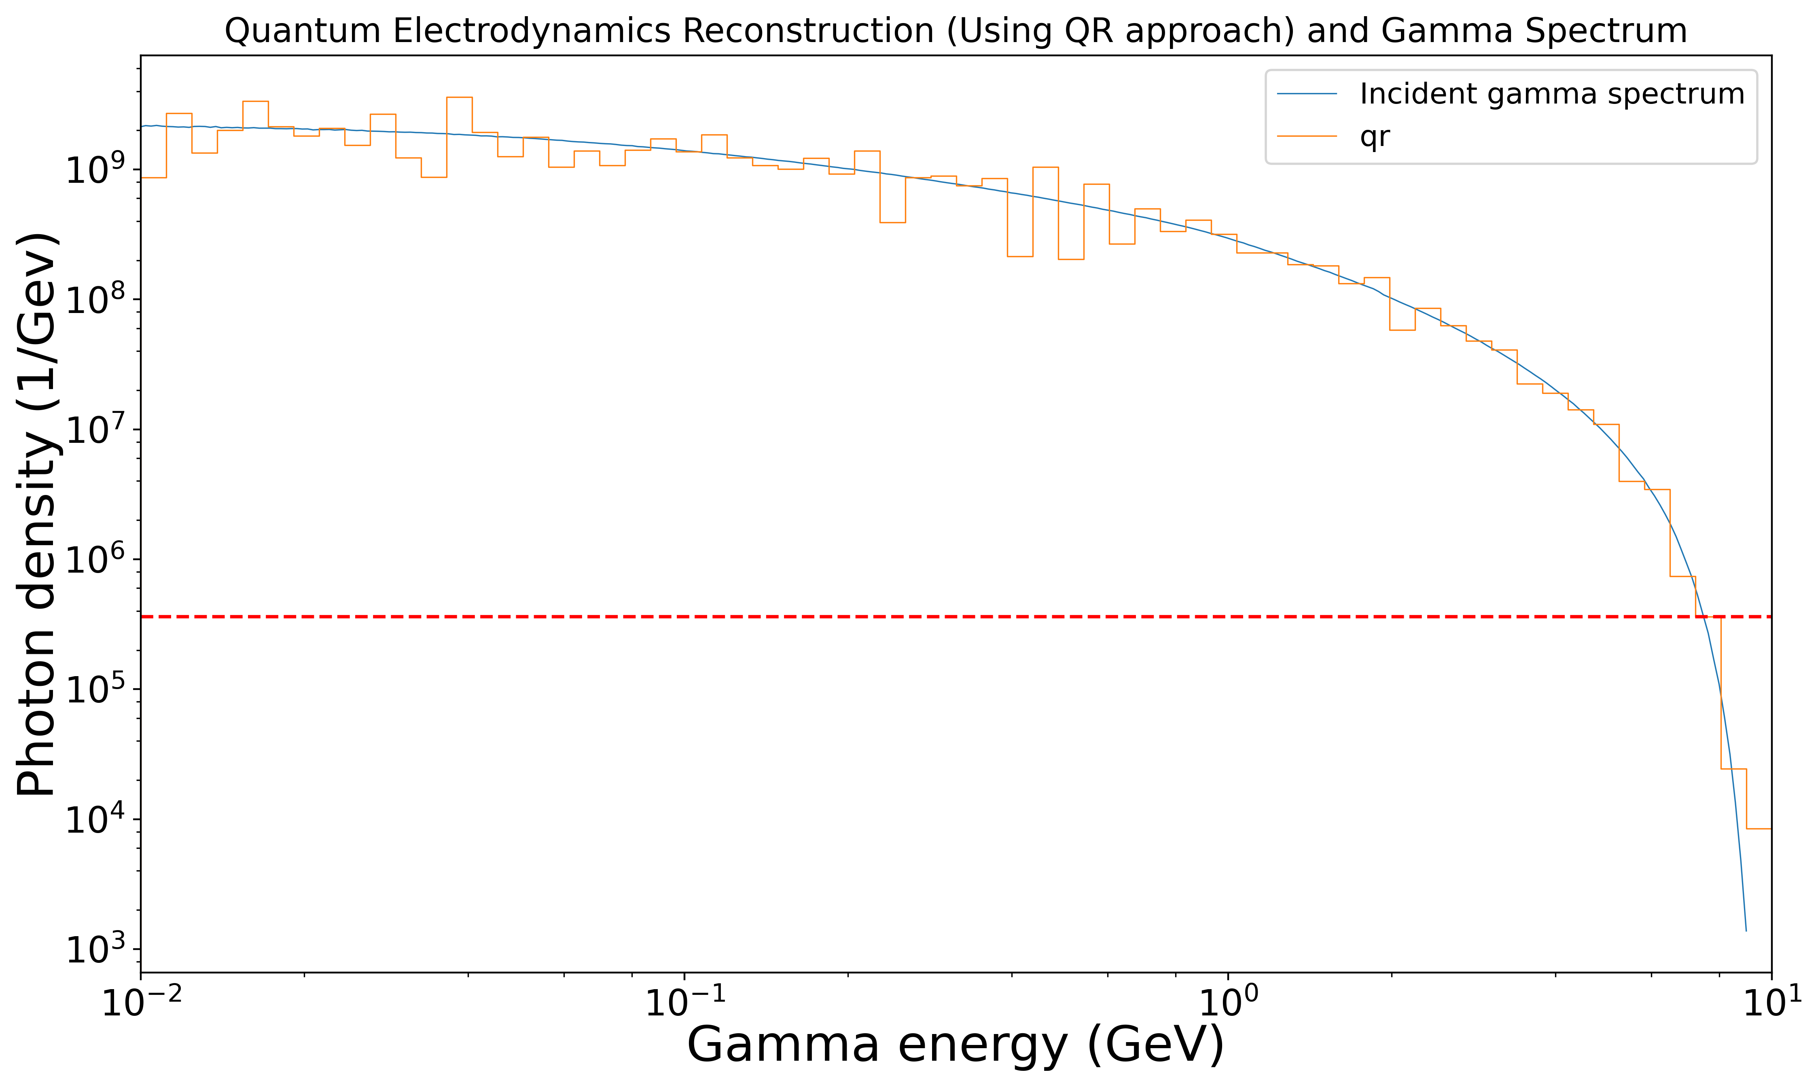
QED case using QR
Within a single iteration, QR decomposition generates distributions with an accuracy like that of the other two approaches.
Across all energy bins, the QR decomposition method predicts the correct pattern and frequencies of photons, with the standard exception of the range above roughly 250 MeV in the filamentation case.
The computational analysis goal is to invert the response matrix R effectively so, given a PEDRO spectrum, the originating x-vector may be recovered.

Slide 15
Conclusion
We have developed an accurate betatron radiation model for PWFA experiments.
Studied beam and spectrum reconstruction using MLE, QR and ML.
QR decomposition method requires the least amount of calculational time.
Non-destructive virtual diagnostics
Ongoing work on the multishot case.

Slide 16
Future goals
Optimizing the precision phase space control of particle accelerator systems is crucial for improving their performance and efficiency.
ML techniques can significantly enhance the tuning and control processes.
Utilizing ML algorithms such as neural networks or reinforcement learning, to create data-driven models that can predict and optimize accelerator parameters.
Developing real-time control systems that use ML algorithms to continuously adjust accelerator parameters based on beam diagnostics data.

Slide 17
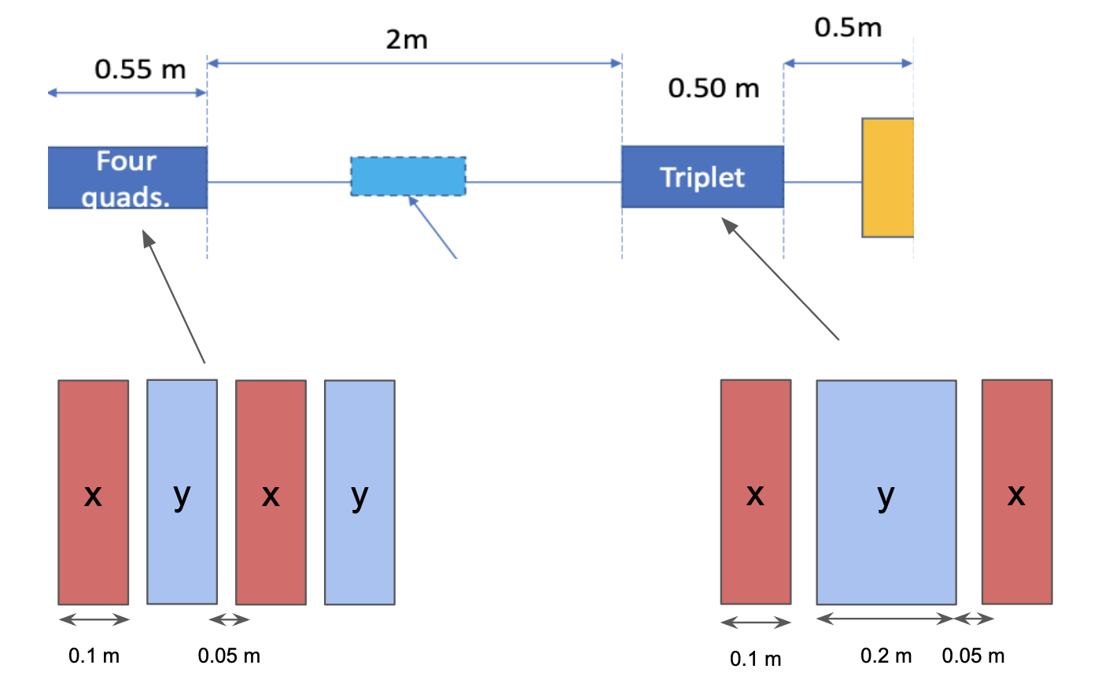
MITHRA Beam Transport
Megavolt InTense High-gradient
Research Accelerator (MITHRA)
After linac:
avgG: 6.255e+01
$σ_{x}$: 7.818e-05 m
$σ_{z}$: 1.924e-05 m
Emit_x_rms : 1.651e-06 rad
Beginning of plasma:
33 MeV
$σ_{x}$: 6e-05 m
$σ_{y}$: 3.2e-05 m
$σ_{z}$: 1.6e-04 m
Emit_x_rms: 1.4855e-06 rad
Emit_y_rms: 4.4512e-06 rad

Slide 18
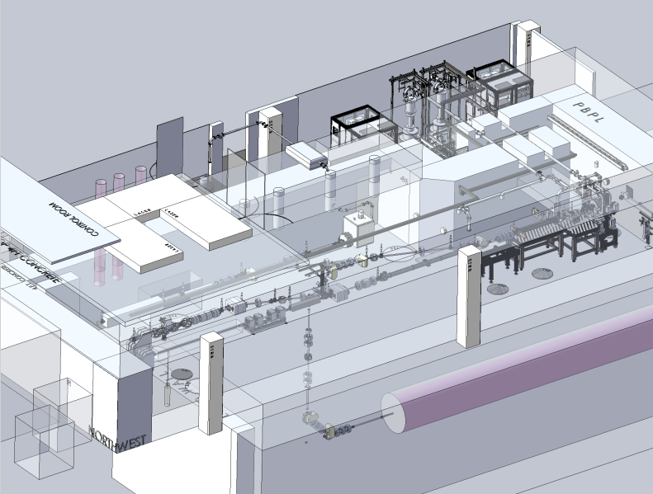
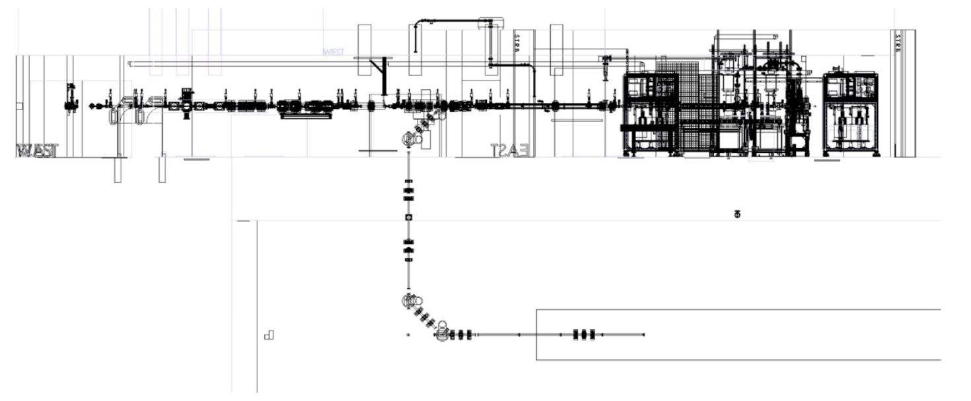
MITHRA Beam Transport
Transport line from MITHRA 20-30 MeV output the
LAPD for magnetized PWFA experiments.
Schematic of U-bend connecting the MITHRA beamline to the LAPD plasma column in the basement of UCLA's STRB.

Slide 19
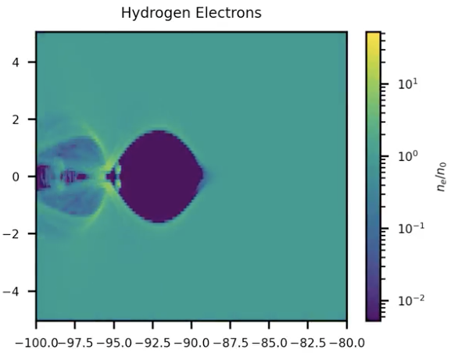
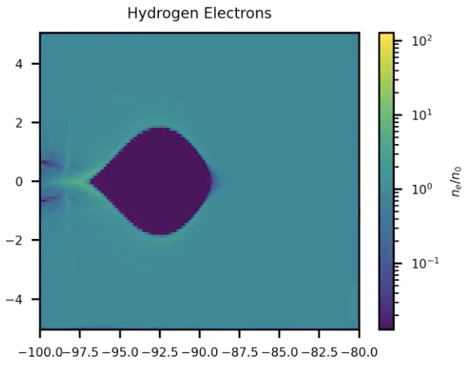
Large Plasma Device
Beam 1 (3m, no external magnetic field)
Beam 1 (3m, 2.026 T external magnetic field)

Slide 20
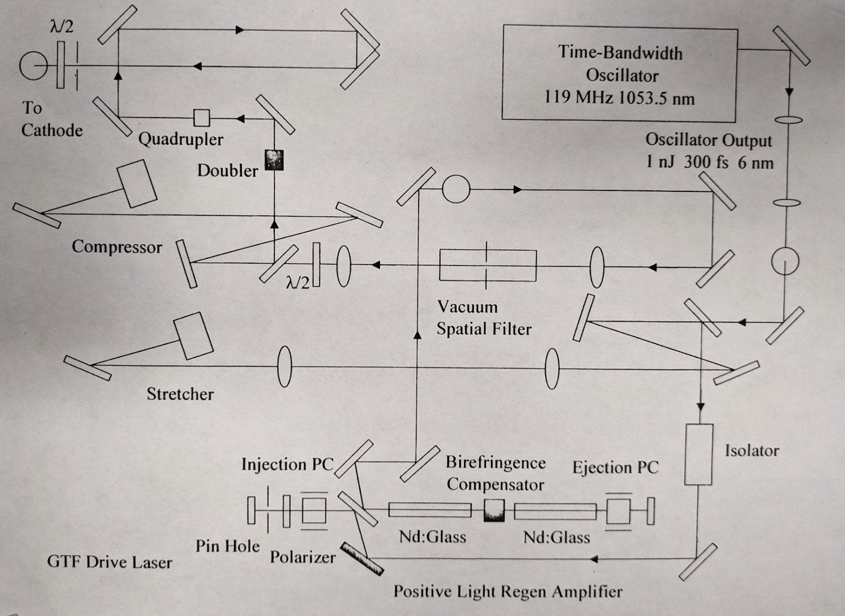
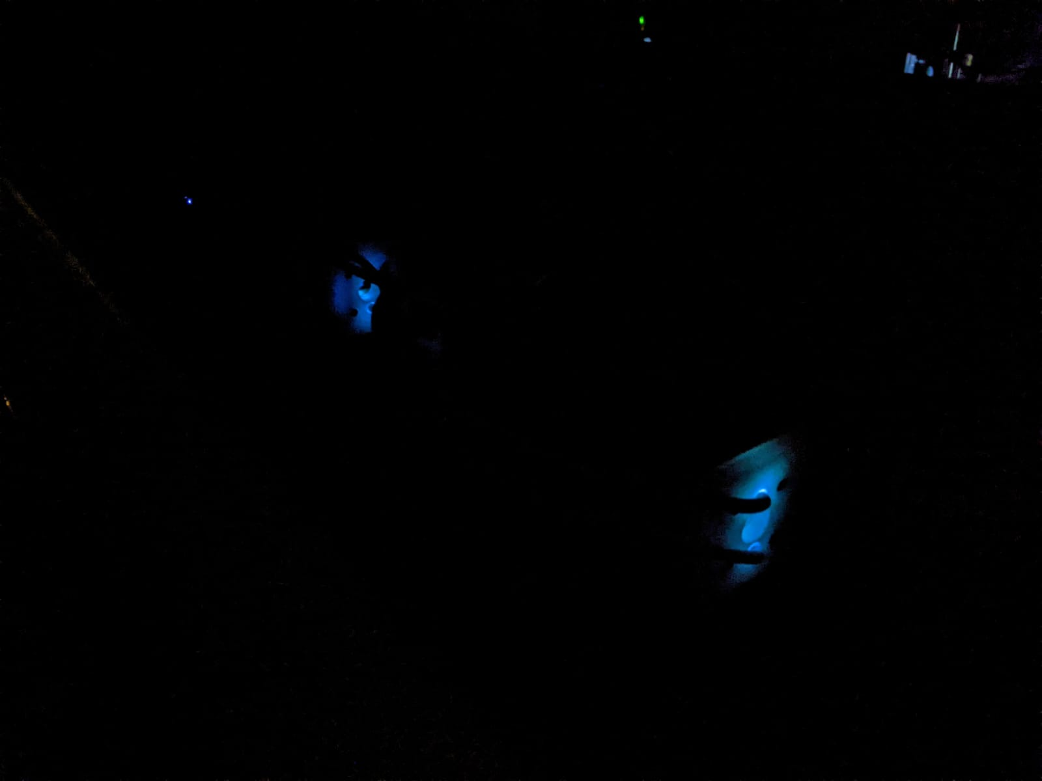
LASER
Laser alignment
Cooling water system
Check the flash lamps
Nd: glass
Understand the system before seeding
Amplification of laser

Slide 21
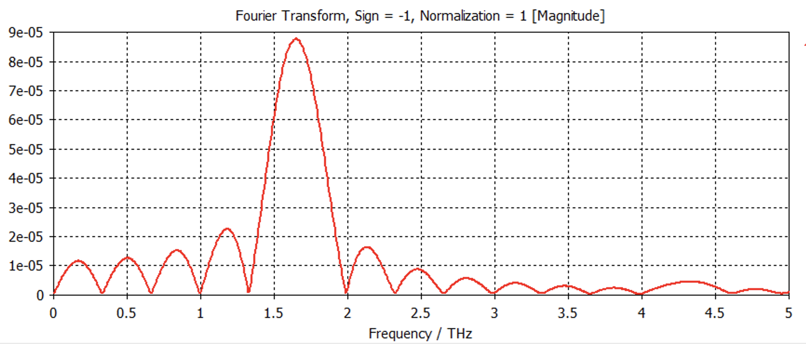
1.65 THz frequency
Energy: 33 MeV
$σ_{x}$: 6e-05 m
$σ_{y}$: 3.2e-05 m
$σ_{z}$: 1.6e-04 m
Charge 100 pC
Emit_x_rms: 1.4855e-06 rad
Emit_y_rms: 4.4512e-06 rad

Slide 22
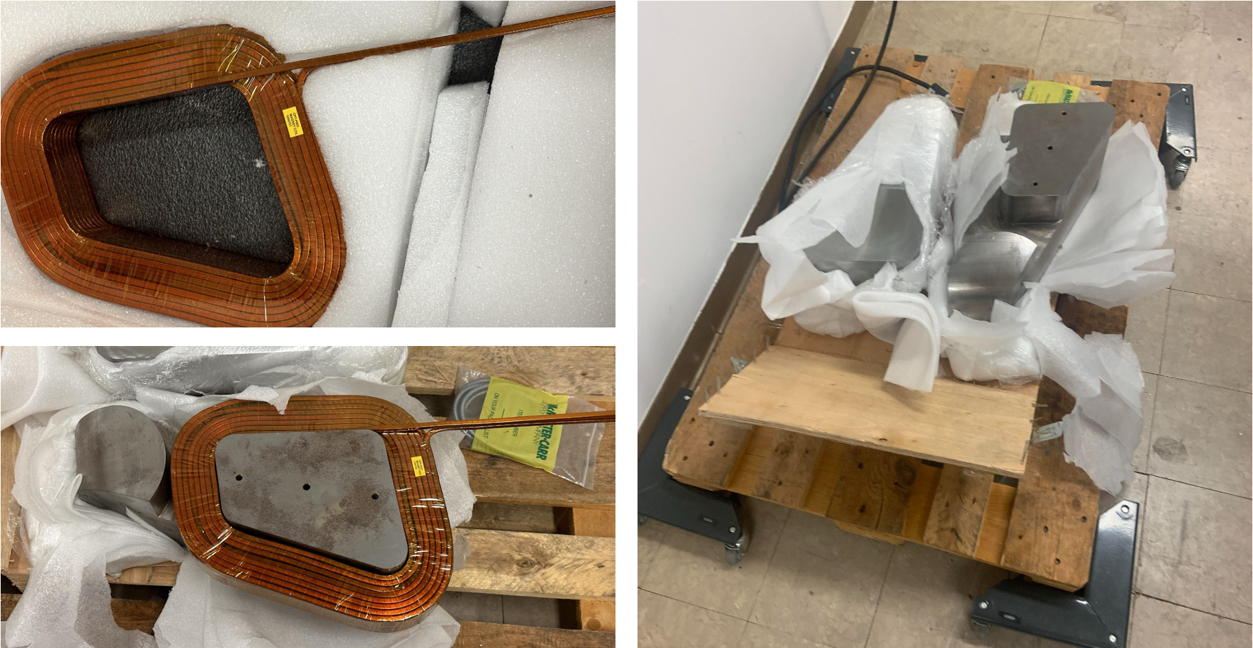
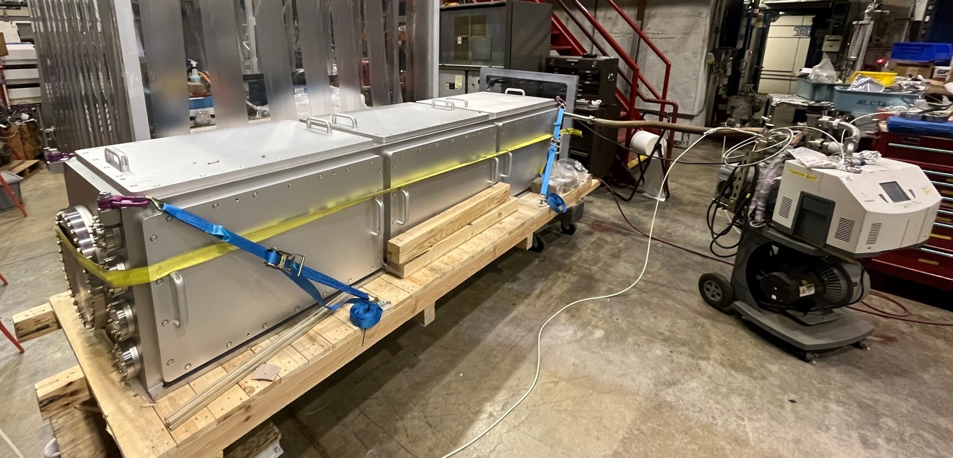
Spectrometer Installation at SLAC

