Slide 1
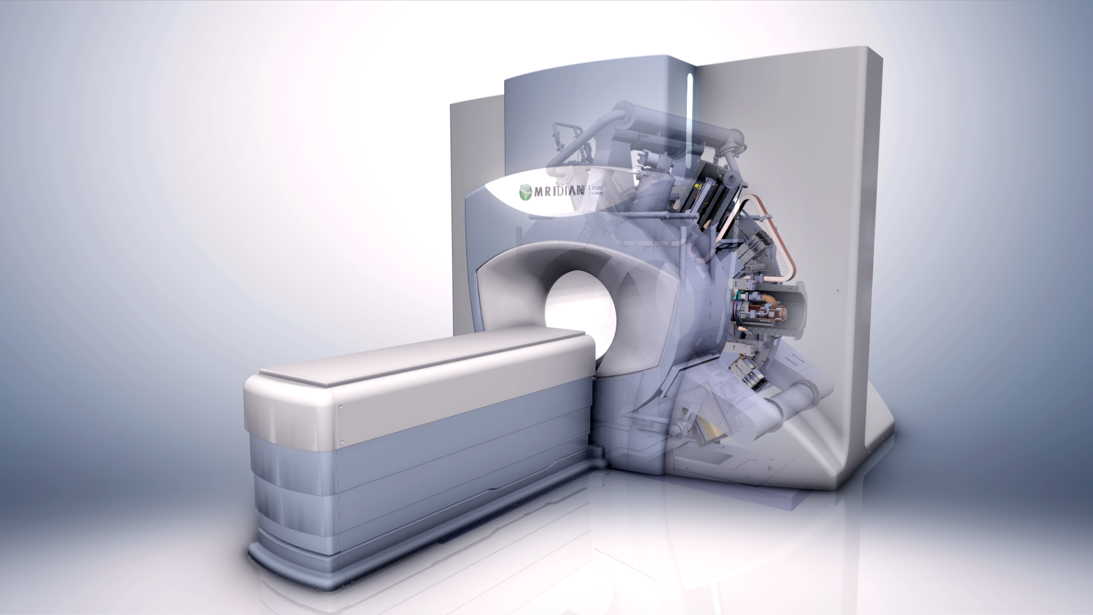
Beams for medical treatment
Massimo Dal Forno
July 21, 2023
2023 CBB Annual Symposium: Accelerators and Society

Slide 2
Outline
Introduction
Radiation therapy
Imaging techniques
ViewRay MRIdian Linac
                Magnet, rf system, MLC
Clinical applications

Slide 3
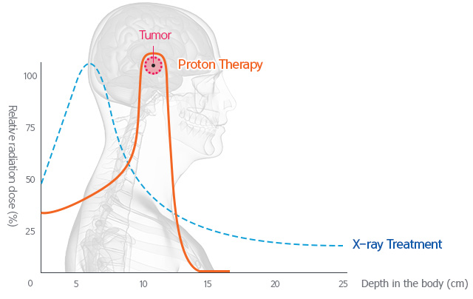

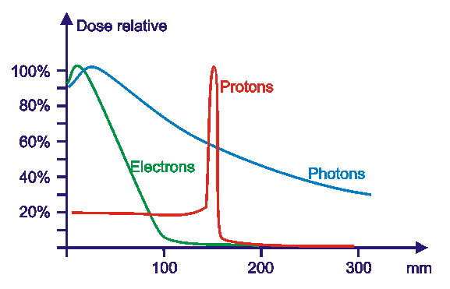
Radiation therapy, Bragg peak
Beam
entrance
Types
Electrons
Photons
Protons
Carbon Ions
Beam
entrance

Slide 4
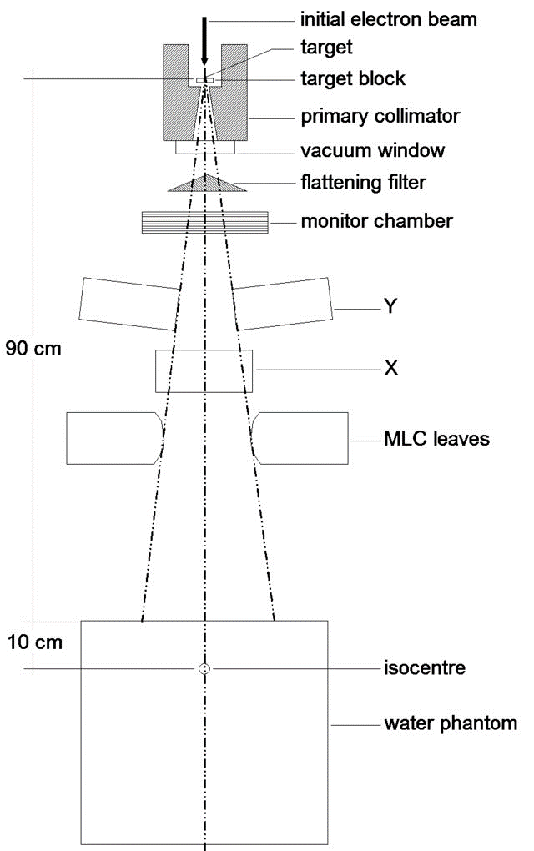
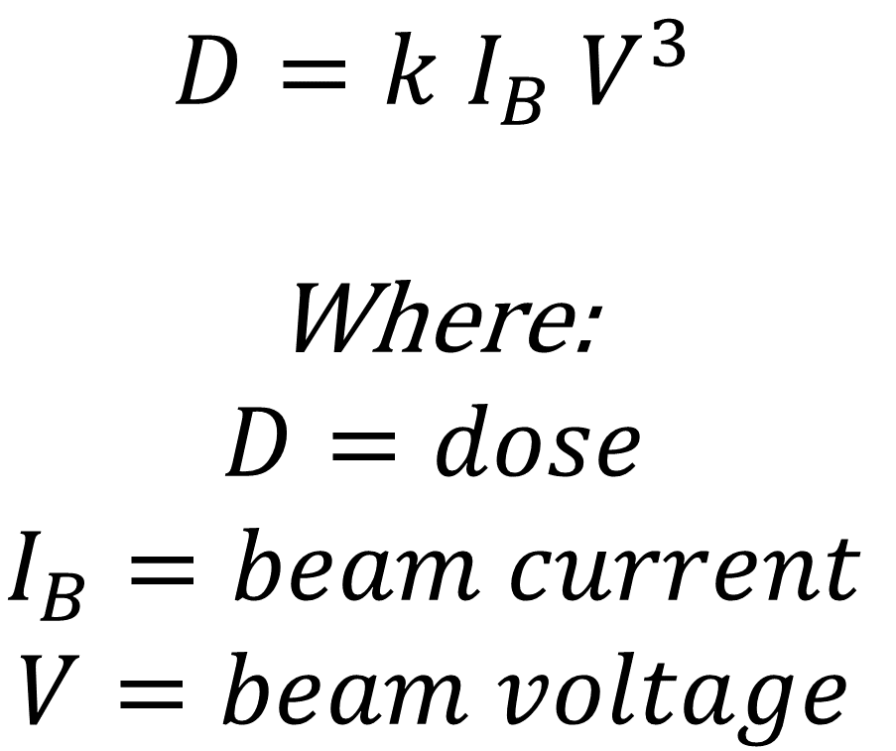
Treatment with photons (X-rays, γ-rays)
$$D=k I_{B} V^{3}$$
Where:
$$D=dose$$
$$I_{B}=beam current$$
$$V=beam voltage$$

Slide 5
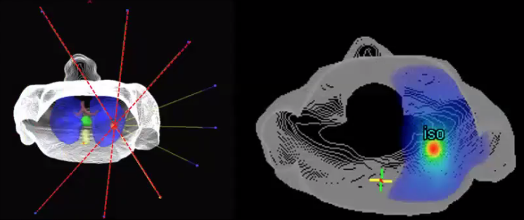
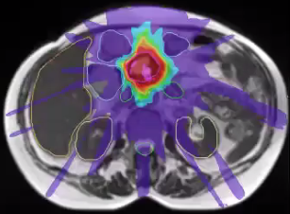
Radiation therapy
Deliver radiation to the tumor, sparing surrounding organs
“Shoot” from several angles (machine has a gantry that rotates around the patient)
Radiation sums up at isocenter
Isodose contours
Courtesy U Wisconsin

Slide 6
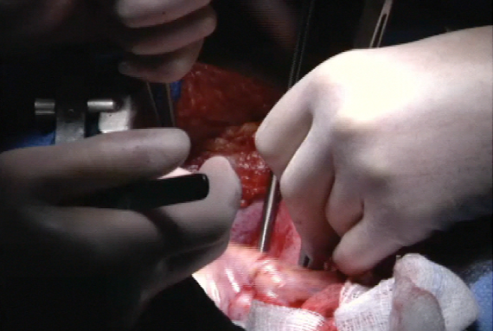
Seeing, It’s the unfair advantage
Surgeons cut open patients and see all of the motion and treat around it
Radiation oncologist need to see the motion in real time

Slide 7
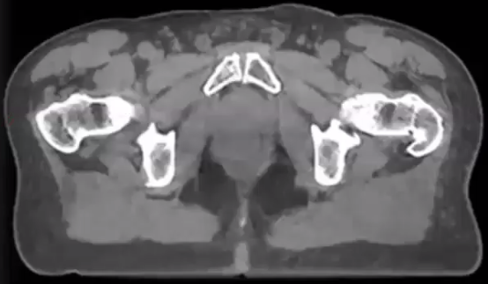
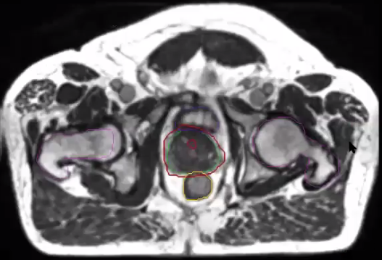
Imaging techniques
CT (Computerized Tomography)
MRI (Magnetic Resonance Imaging)
Bladder
Prostate
Rectum
Courtesy Wash U
No radiation delivered when imaging!
ViewRay integrates Linac with MRI

Slide 8
ViewRay Inc. established in 2004
FDA Cobalt 60 - May 2012, first treatment January 2014
FDA Linac - February 2017, first treatment July 2017

Slide 9
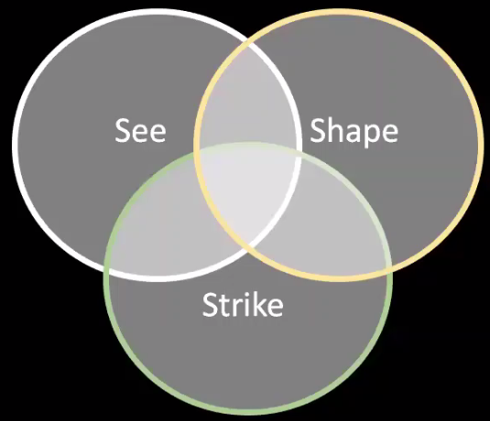
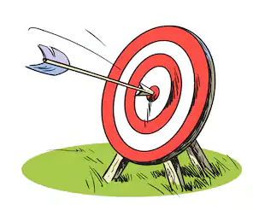
The ViewRay paradigm
* We can only win at the intersection
*
don’t miss the target

Slide 10
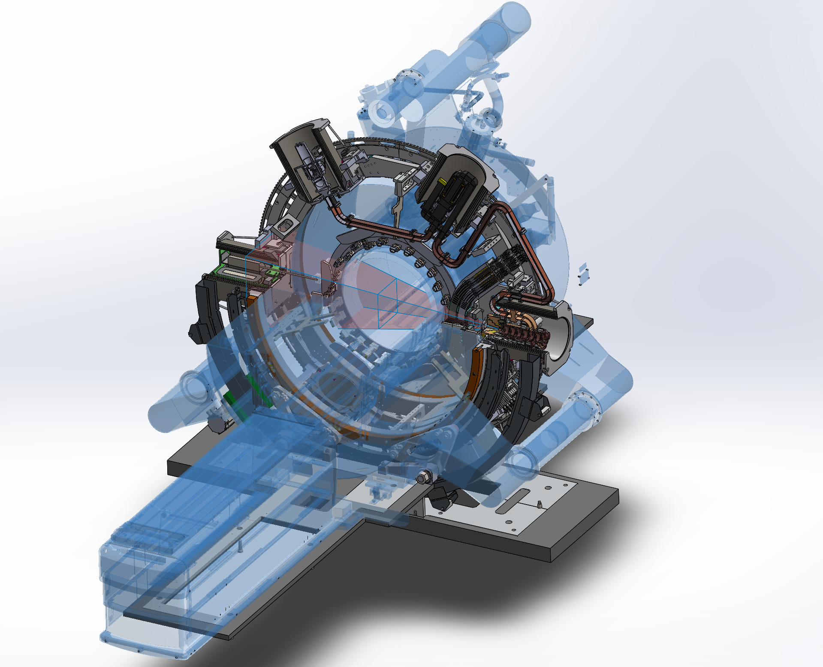
ViewRay MRIdian Linac
Two unique technologies
  A 0.35T MRI magnet for imaging the patient
  A linac for Radiation Therapy
Optimized Magnet
  Clear, high SNR images
  Continuous fast imaging without overheating patient
  Geometric precision with high spatial integrity
Radiation source silent to the MRI
  Accurate dose delivered as planned
  No image interference, no image artifacts
Compact system fits in existing rooms
Protected by US and international patents
Diagnostic magnets are optimized for diagnosing patients
ViewRay’s magnet is optimized for treating patients
Magnetic & RF
shielding technology*
Split MRI magnet
Double-focused
MLC*
Linear
Accelerator*
Patient table

Slide 11
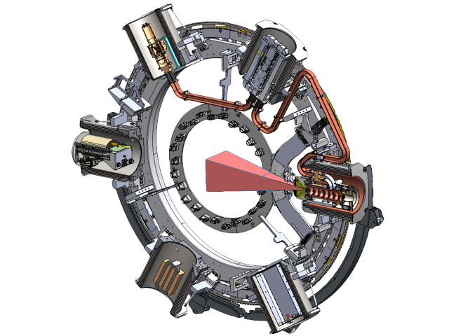
LINAC Based Radiation System
Magnetron
Circulator
Compact inline S-Band 6 MV standing wave linac with side coupled cavities;
Designed for >6 Gy/min
±180º gantry rotation
  360º treatment around patient;
Source-Axis distance = 90 cm (vs 143.5 cm of competitive systems);
Triode e-gun, designed for beam gating (competitive systems don’t have this).
S-Band
Linac
Pulse
Transformer
Gun
Driver

Slide 12
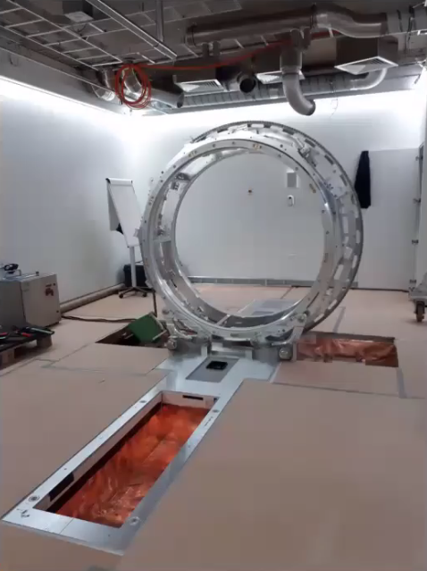
Gantry

Slide 13
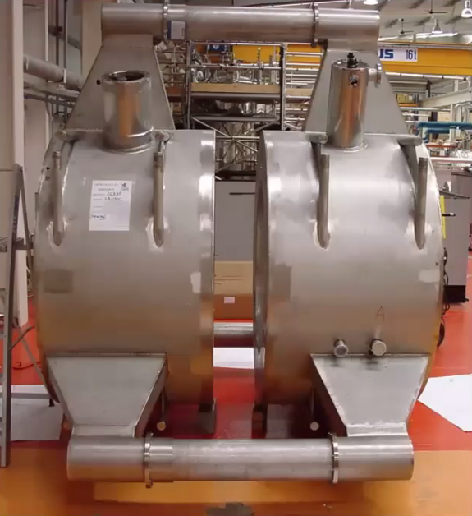
Split magnet

Slide 14
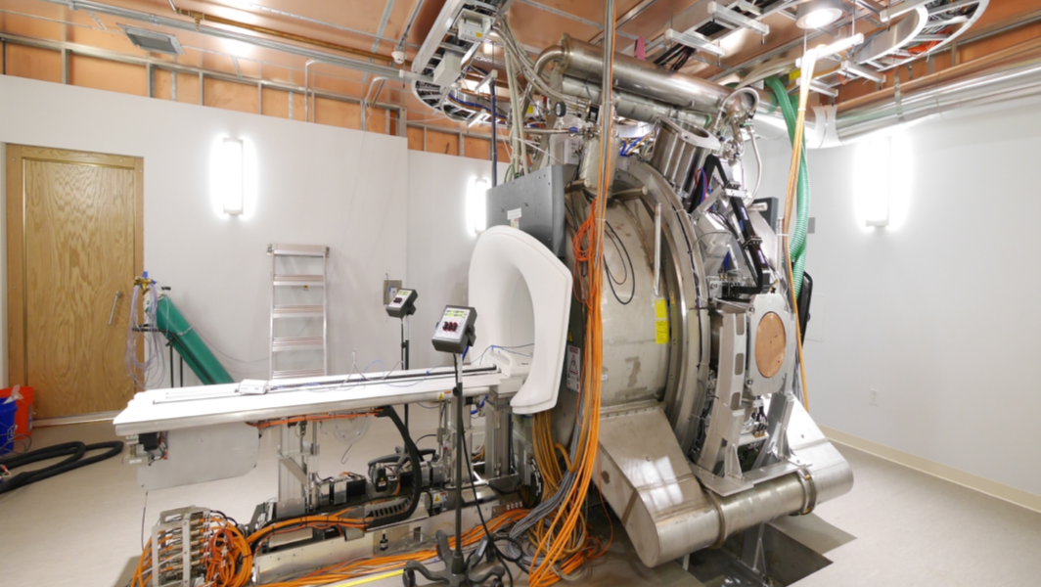
ViewRay Linac installed in the vault

Slide 15
Shielding the magnetic field
Concentric
layers of steel

Slide 16

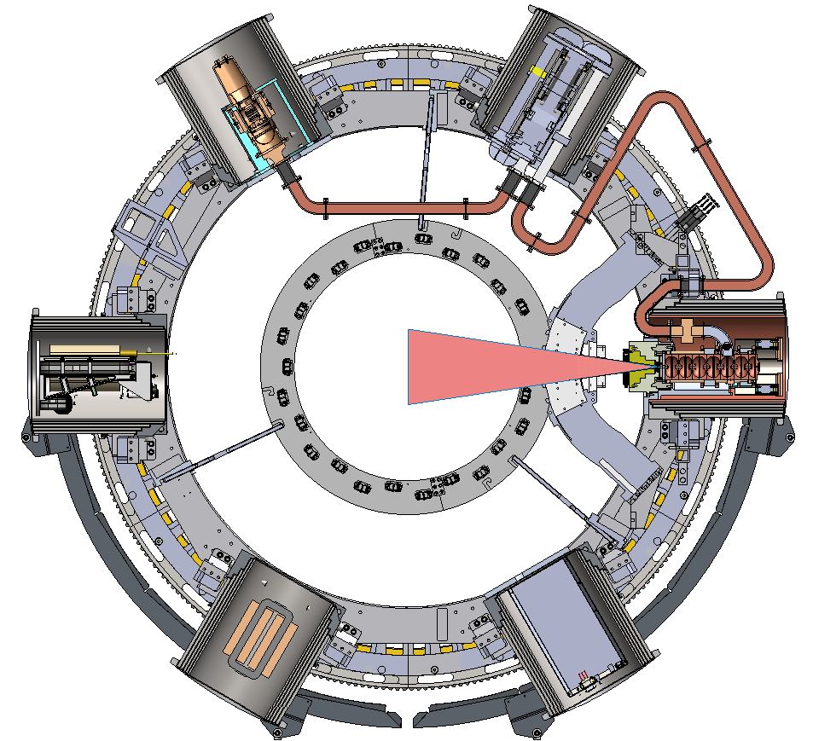
Building concentric ferromagnetic rings we create voids in the magnetic field to shield the Linac components
Similar to Russian nesting dolls
Magnetic
free zone
Magnetic field lines
All linac compact on gantry & shielded

Slide 17
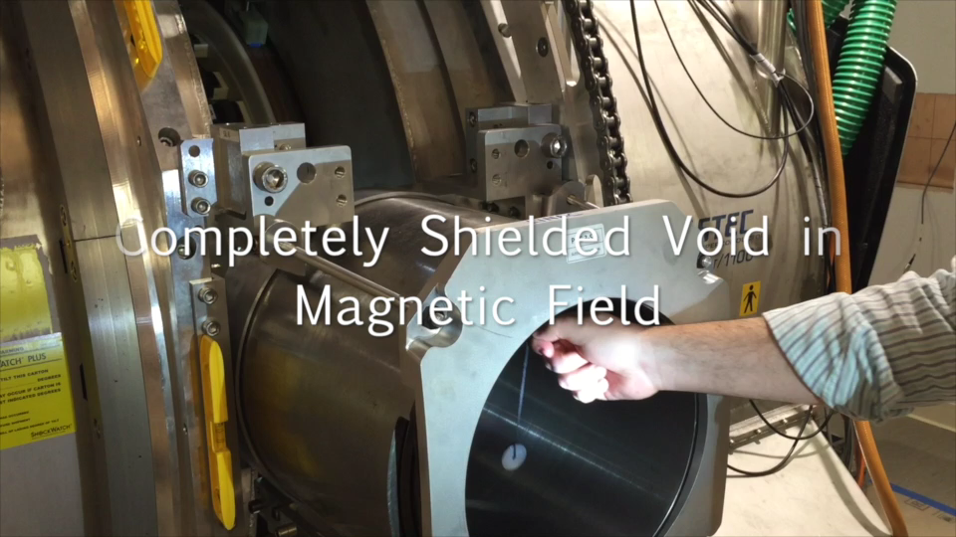
Magnetic Shield Technology

Slide 18
B Field Plots in the Bucket
Magnetic field is reduced at Gauss level

Slide 19
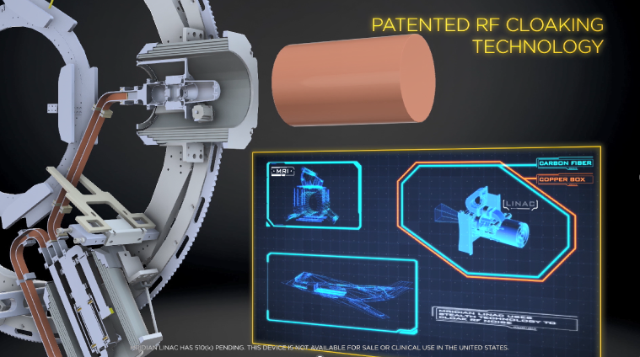
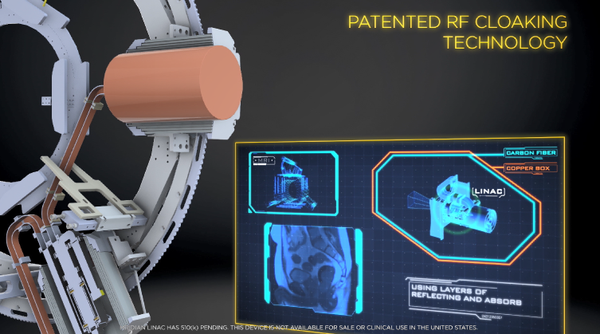
RF Cloaking Technology

Slide 21
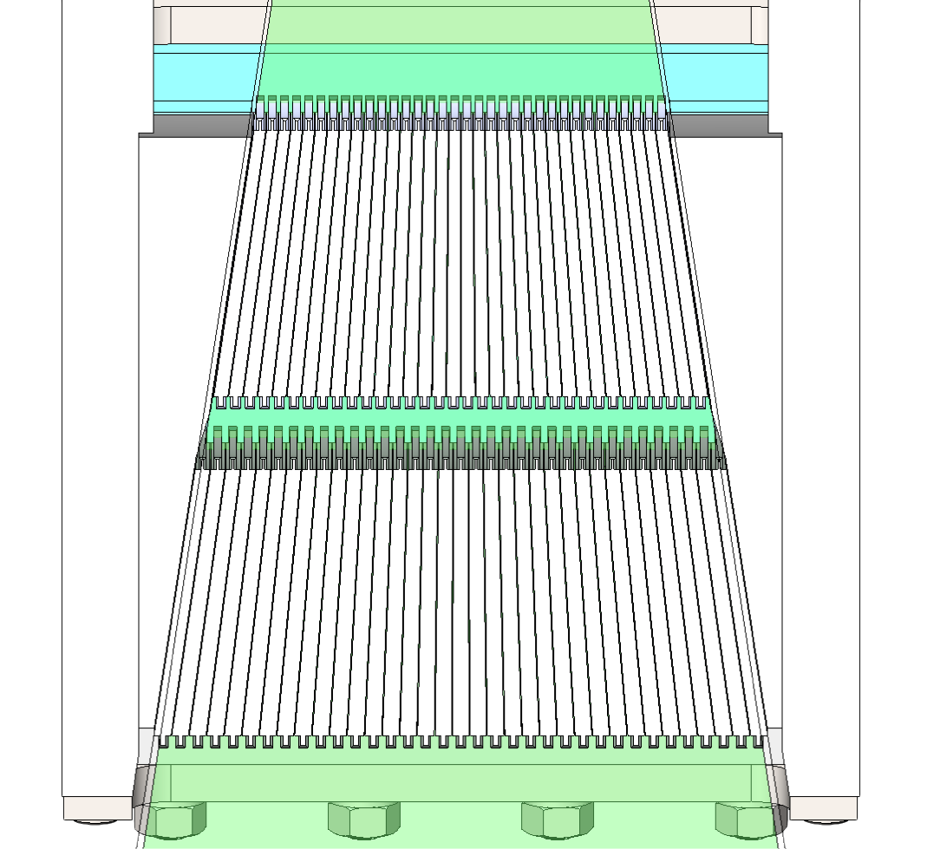
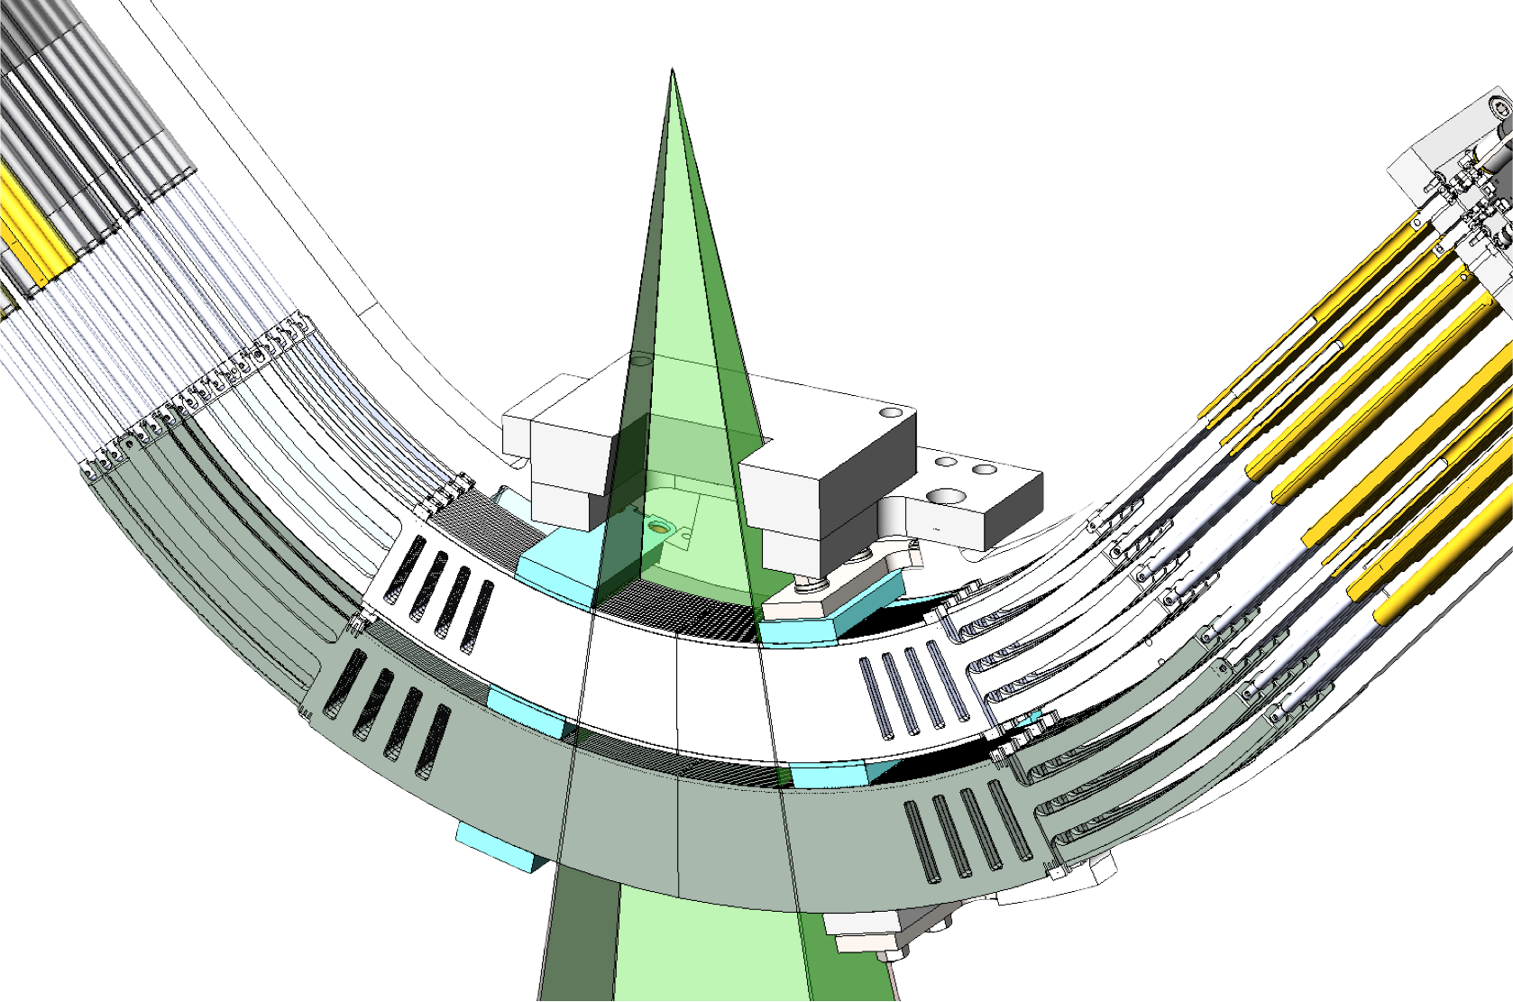
Double Stacked Double Focused
Multi Leaves Collimators (MLC)
138 leaf Double-focus, Double-stack MLC
  68 leaf upper stack; 70 leaf lower stack
  Upper stack offset by ½ leaf width
  MLC faces stays parallel
  Minimum penumbra
Sharpest radiosurgery beam!
Notes:
• Rotating Gantry Assembly
• 3 Independent Co60 Headed Design
• Enabling Fast IMRT, SBRT or Conformal External Beam Radiation with Asynchronous Delivery
• Mounted with 120 degree separation
• 15,000 Ci per source
• ±240 degree Rotation for 2 or 3 Head Operation for Maximum Reliability.
• 3 Doubly Focused MLC Systems
• 180 MLC Leaves. 60 per Head
• Best-in-class MLC for Reduced Penumbra & Interleaf Leakage

Slide 22
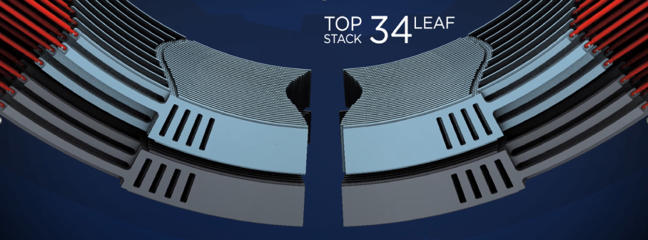
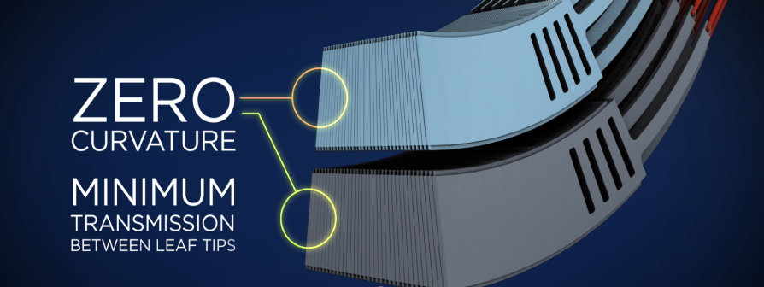
Double Stacked Double Focused MLC

Slide 23
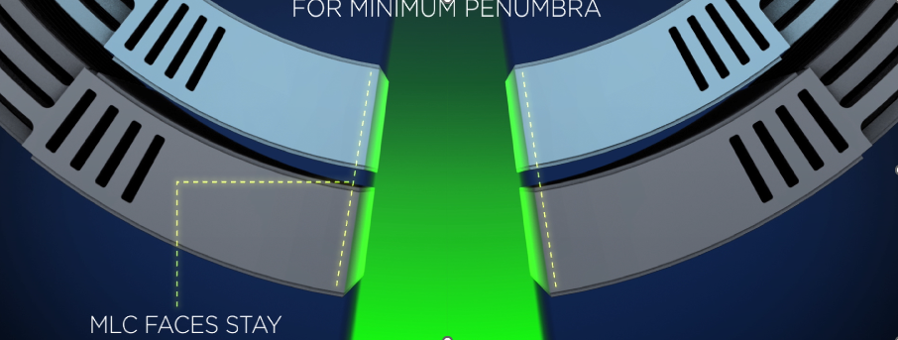
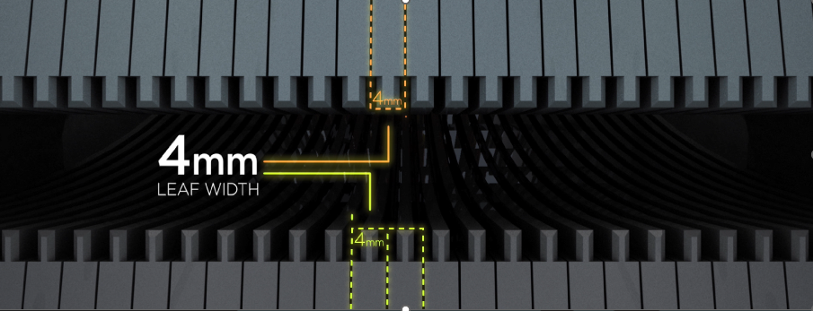
Double Stacked Double Focused MLC

Slide 24
Clinical Applications

Slide 25
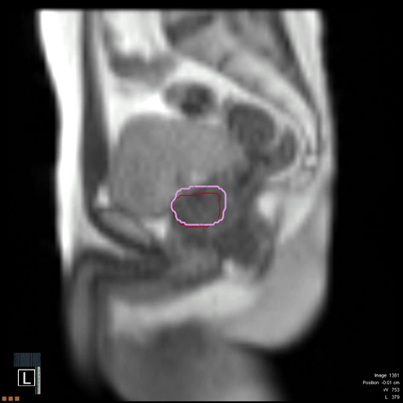
Gating with Organ Motion
Pink: User define contour: The Radiation beam is shot inside this contour
Red: Contour of the organ to treat (obtained with organ MRI-imaging and auto-contouring)
  Gating mode:
  when the organ moves out of the contour:
    The MRI computer vision sees that the organ is moving out of the contour;
  The machine turns off the radiation beam
Notes:
From Left to right
Box 1 – Pancreas
Box 2 – Lung
Box 3 – Prostate
Box4 – Breast

Slide 26
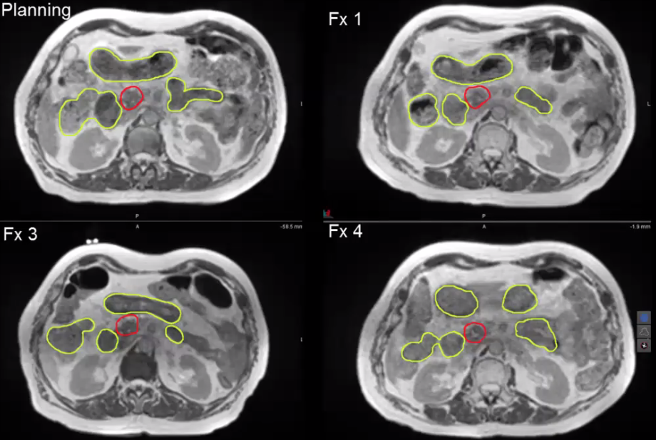
Day by day variations of organ distances
mm are miles!
ViewRay can see these changes and on-table adapt
Notes:
From Left to right
Box 1 – Pancreas
Box 2 – Lung
Box 3 – Prostate
Box4 – Breast

Slide 27
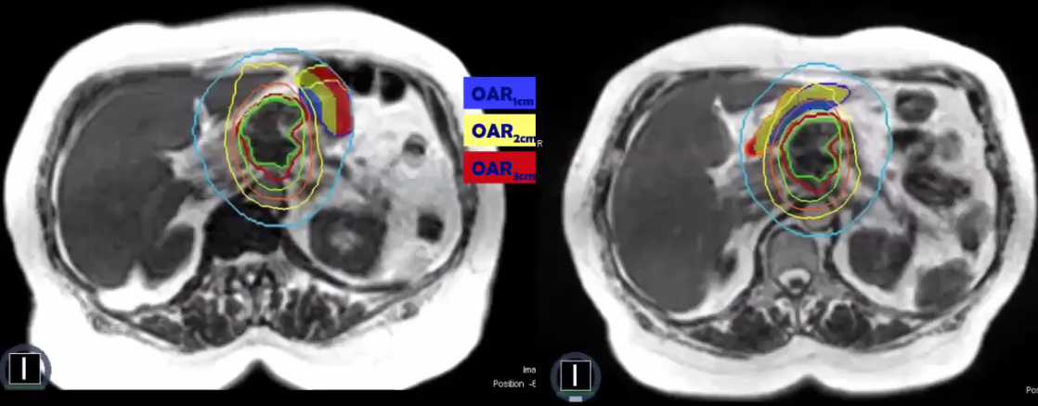
Day by day variations of organ position
Organ to be treated
Day 1
Sensible organ
Day 2
Courtesy VUmc
Notes:
From Left to right
Box 1 – Pancreas
Box 2 – Lung
Box 3 – Prostate
Box4 – Breast

Slide 28
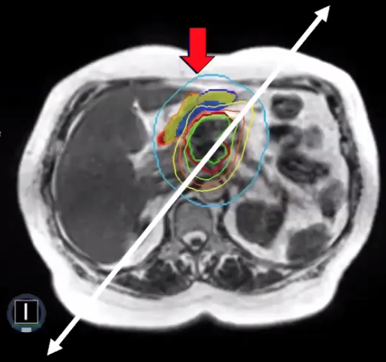
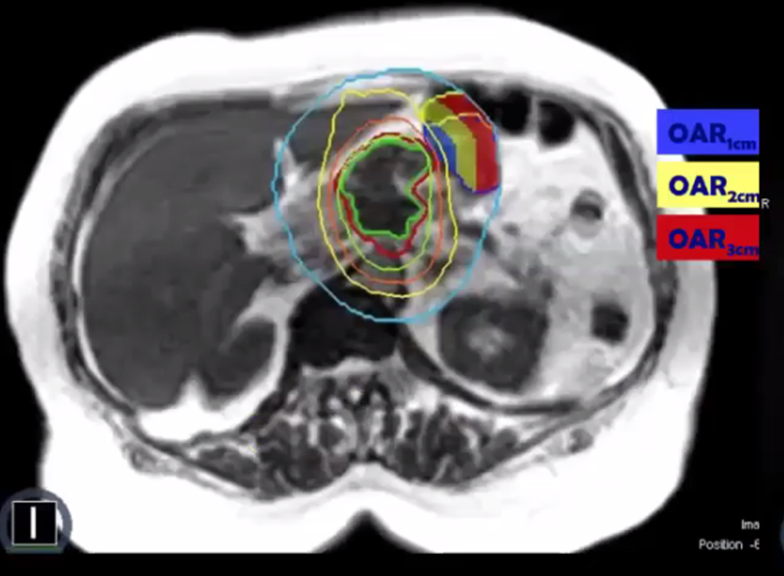
Day by day variations of organ position
Allows accounting for day to day changes
On-table adaptive radiation therapy (oART)
Notes:
From Left to right
Box 1 – Pancreas
Box 2 – Lung
Box 3 – Prostate
Box4 – Breast

Slide 29
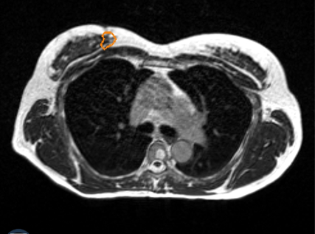
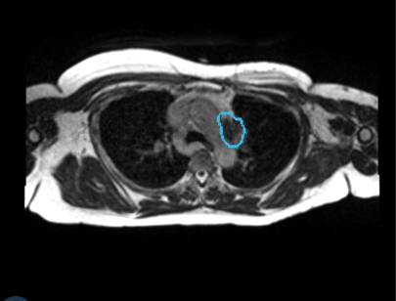
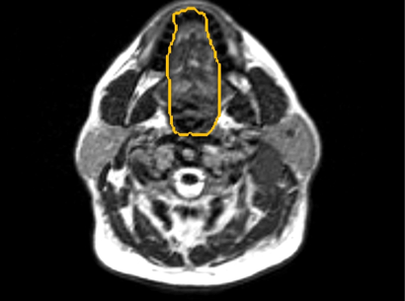
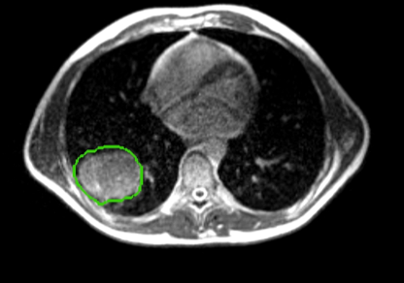
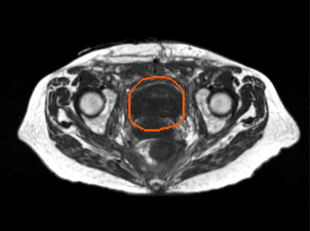
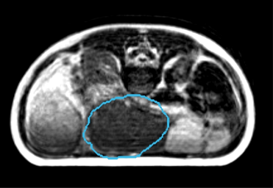
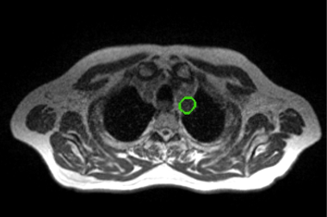
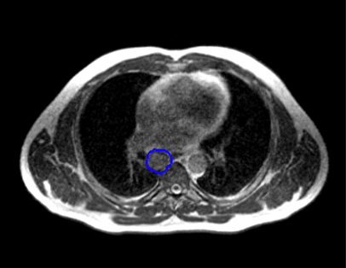
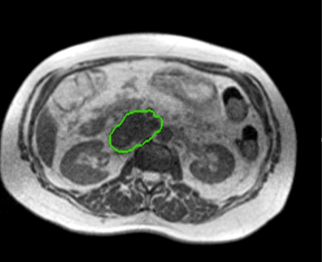
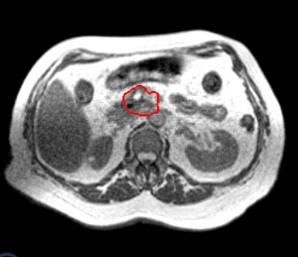
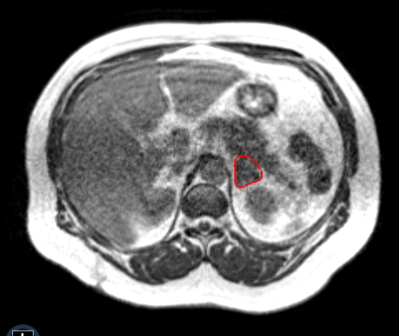
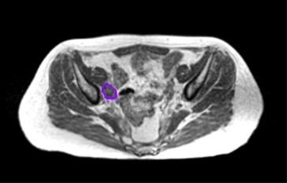
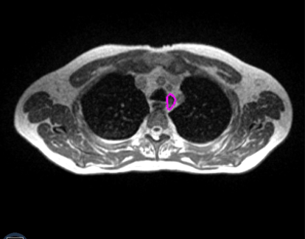
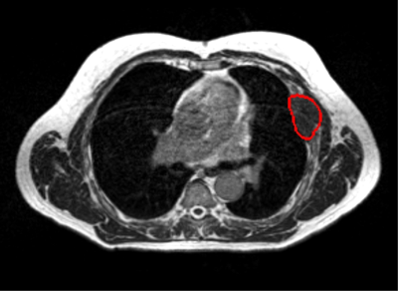
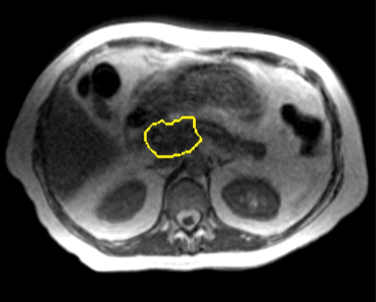
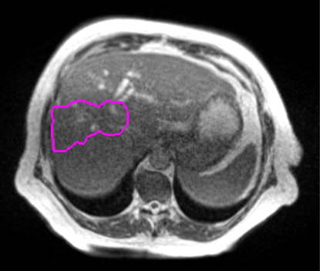
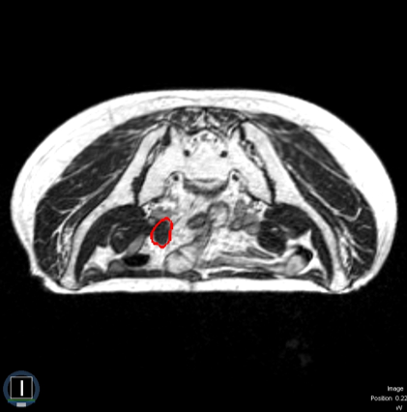
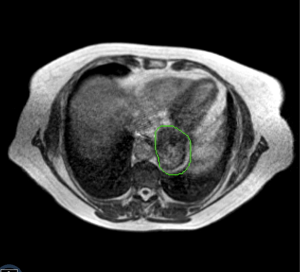










Right Breast
Mediastinum
Head/Neck
Right Lung
Bladder
Mesenteric
Aortic Arch
Hilum
Soft Tissue ABD
Pancreas
Mediastinal LN
Adrenal
Rib
Pelvic LN
Paraaortic
Liver
Iliac
Stomach
Spine
Soft Tissue Neck
Left Lung
Spleen
Colon
Periaortic
Left Breast
Prostate
Soft Tissue Pelvis
Rectum

