Slide 1
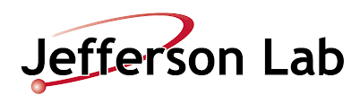
From the Lab to your Sewage Plant
Treating Wastewater with Electron Beam
  “[…] the laboratory’s mission is to:
  - deliver discovery-caliber research by exploring the atomic nucleus and its fundamental constituents, including precise tests of their interactions;
  - apply advanced particle accelerator, detector and other technologies to develop new basic research capabilities and to address the challenges of modern society;
  - advance knowledge of science and technology through education and public outreach, and;
  - provide responsible and effective stewardship of resources.”
John Vennekate
Center for Bright Beams – Annual Symposium
Accelerators and Society

Slide 2
Outline
Environmental Applications of Accelerators
  history & today
Accelerators in Science
Compact Accelerators based on Superconductivity
Technology Development at JLab and beyond
Water Irradiation Studies
Summary

Slide 3
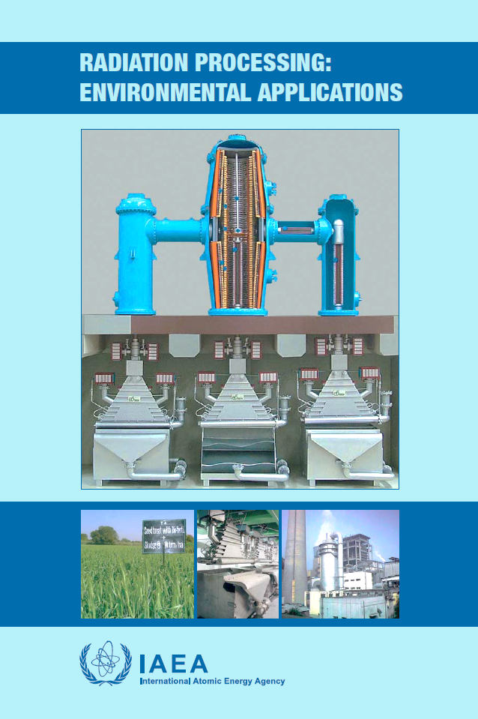
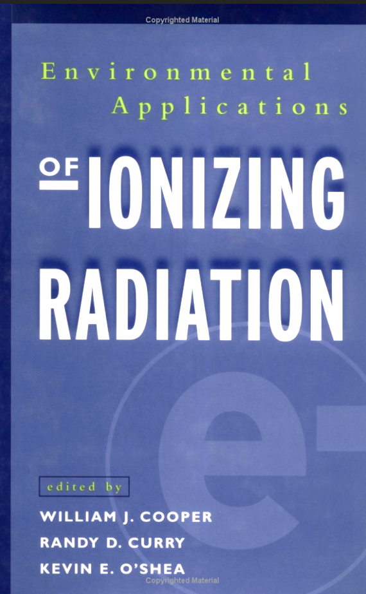

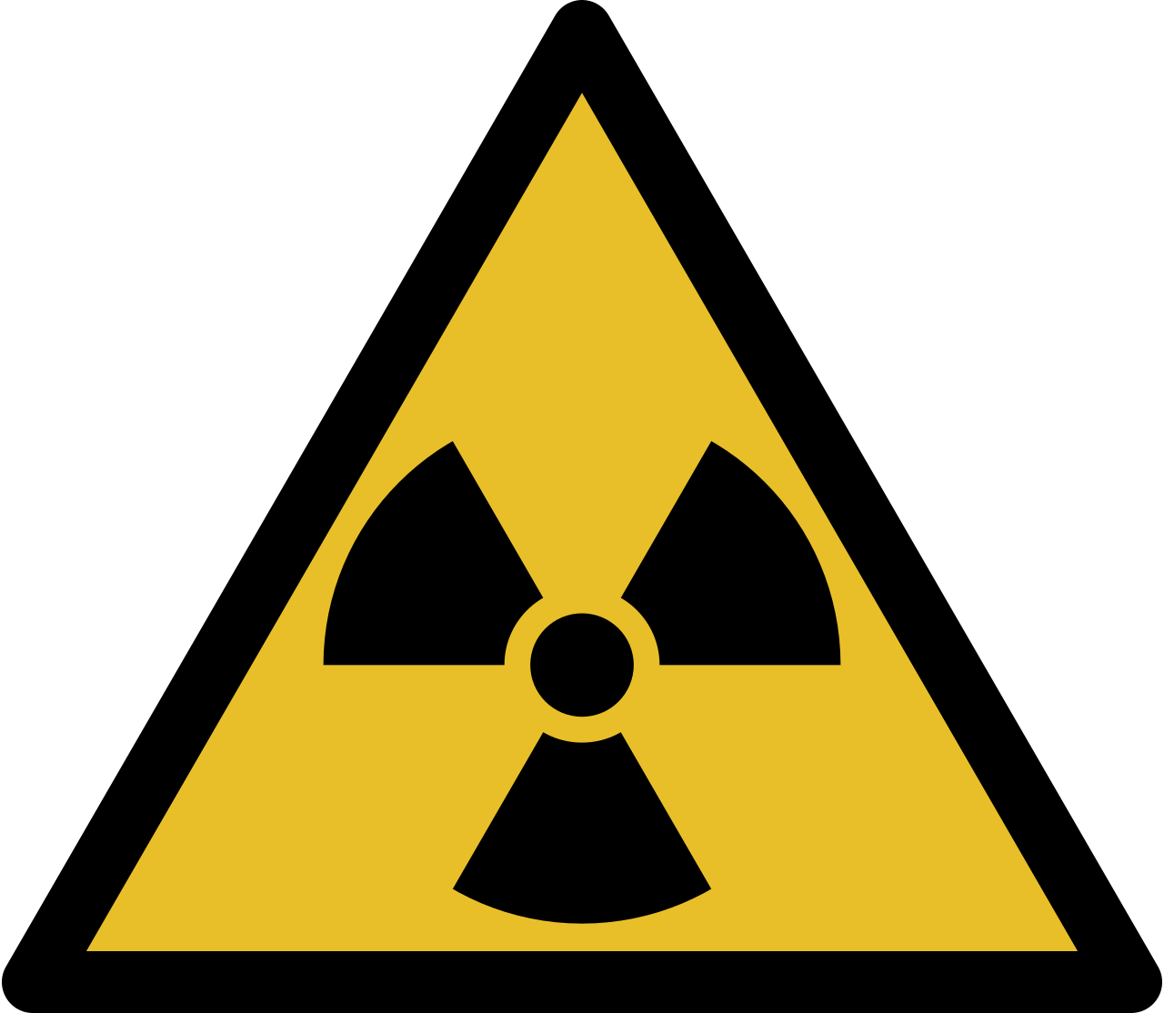
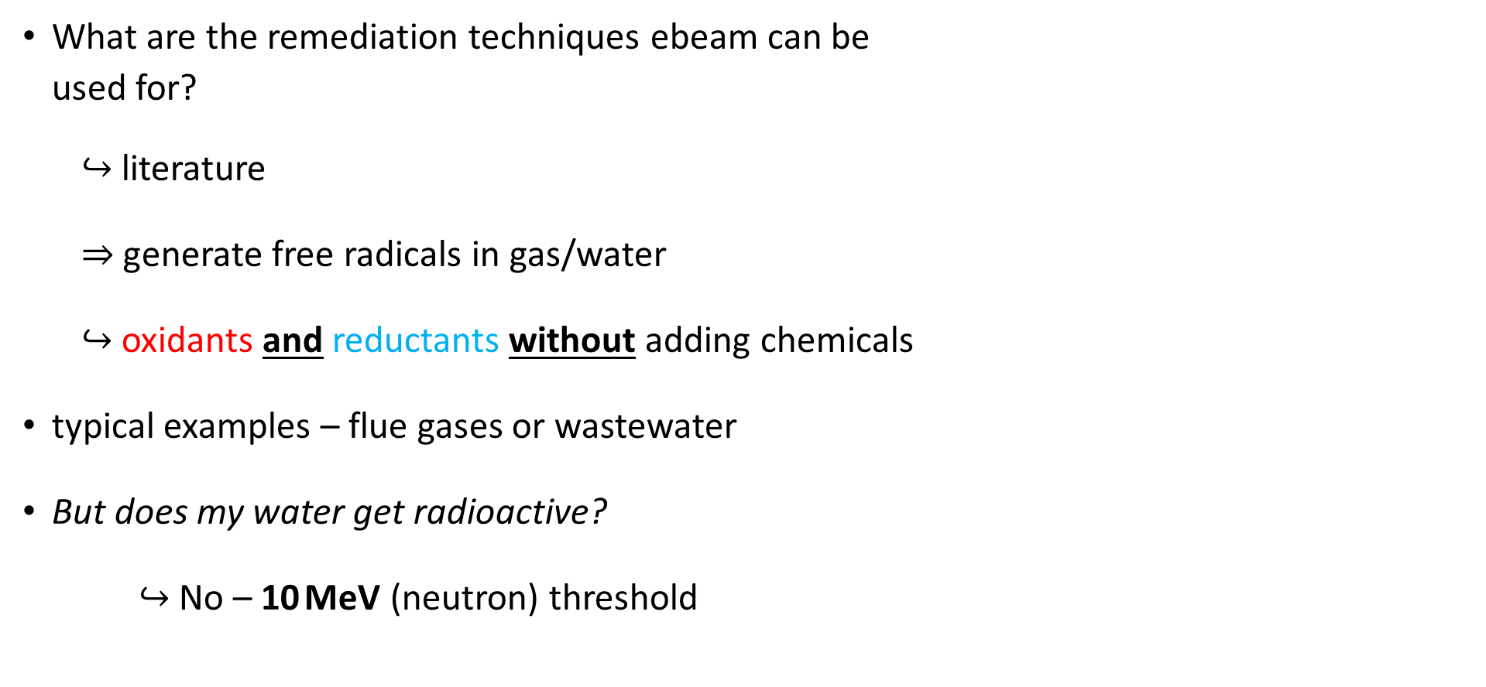
Environmental Applications of Accelerators?
What are the remediation techniques ebeam can be
used for?
$↪$ literature
$⇒$ generate free radicals in gas/water
$↪$ oxidants and reductants without adding chemicals
typical examples – flue gases or wastewater
But does my water get radioactive?
$↪$ No – 10 MeV (neutron) threshold
©Fox Broadcasting Company

Slide 4
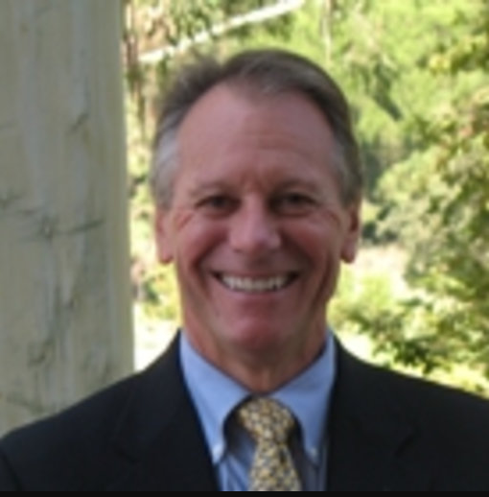
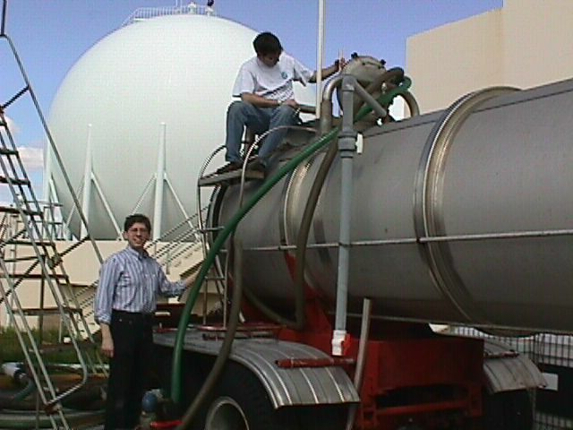
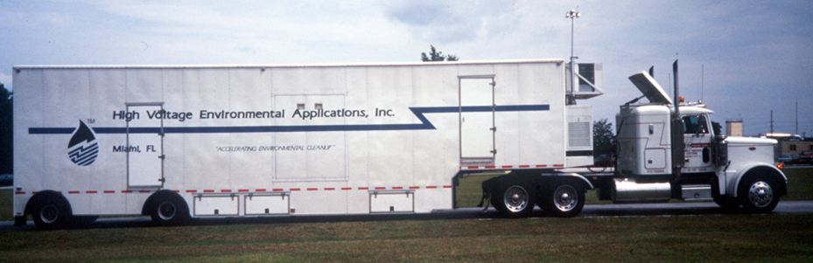
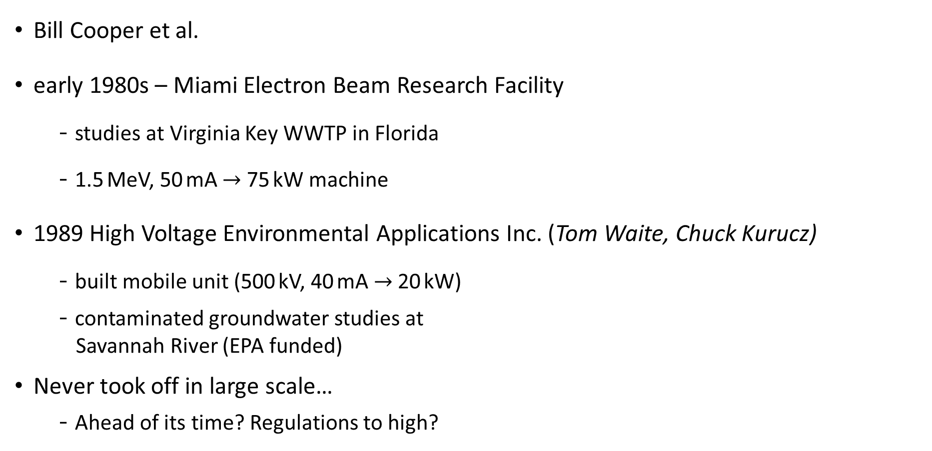
First Steps in the US
Bill Cooper et al.
early 1980s – Miami Electron Beam Research Facility
  studies at Virginia Key WWTP in Florida
  1.5 MeV, 50 mA $→$ 75 kW machine
1989 High Voltage Environmental Applications Inc. (Tom Waite, Chuck Kurucz)
  built mobile unit (500 kV, 40 mA $→$ 20 kW)
  contaminated groundwater studies at
  Savannah River (EPA funded)
Never took off in large scale…
  Ahead of its time? Regulations to high?
pictures courtesy W. Cooper

Slide 5
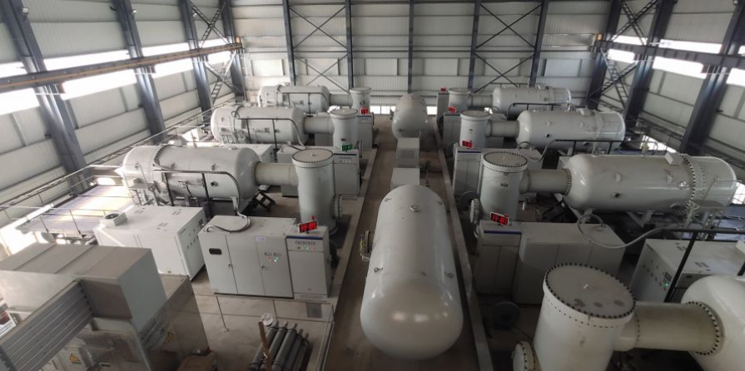
Fast Forward $→$ Ebeam Treatment Today
2006 – Deagu dyeing treatment plant in South Korea
  10,000 m³/h
  1 MeV, 400 kW accelerator
2020 – Guanhua Knitting Factory wastewater in China
  30,000 m³/h
  7 accelerators in total
…
(1990s flue gas treatment in coal power plants in Poland, China, …)

Slide 6
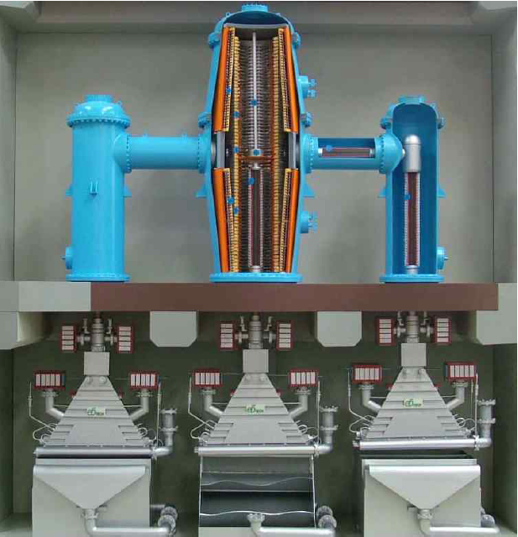
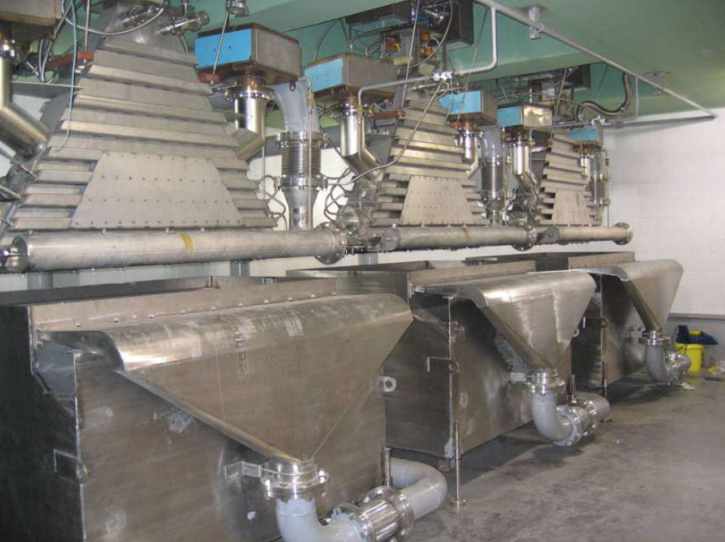
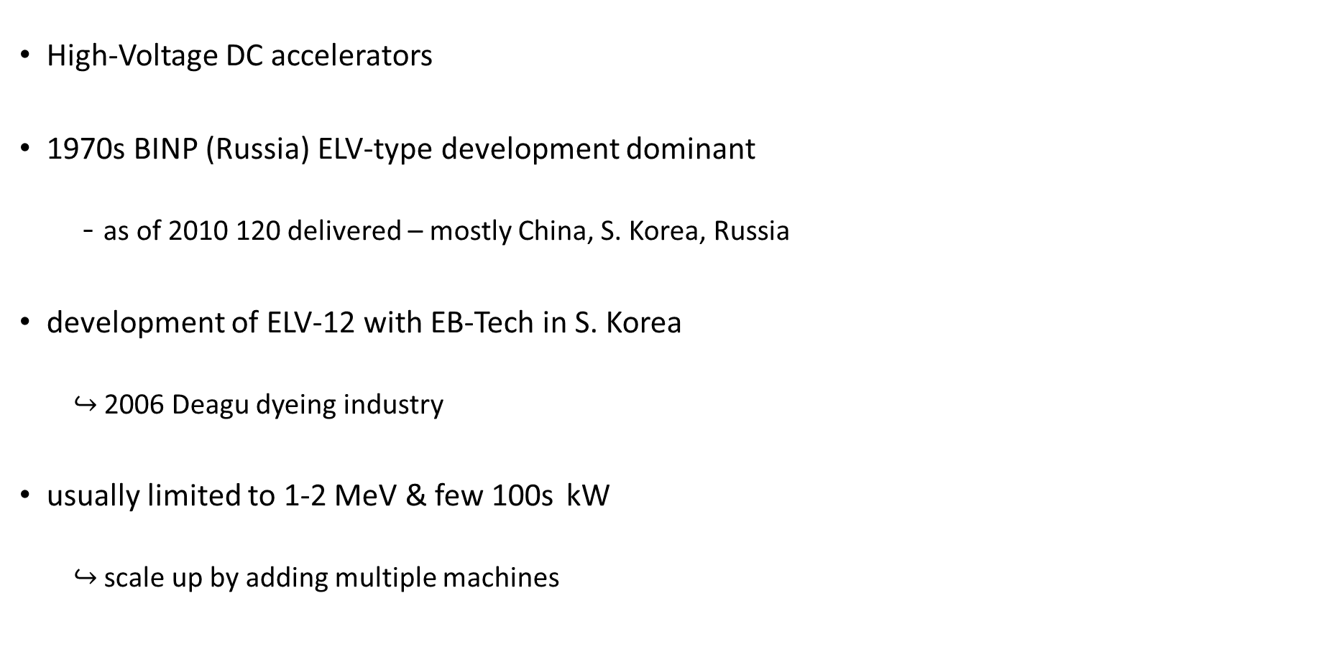
Technology in Use
High-Voltage DC accelerators
1970s BINP (Russia) ELV-type development dominant
  as of 2010 120 delivered – mostly China, S. Korea, Russia
development of ELV-12 with EB-Tech in S. Korea
  $↪$ 2006 Deagu dyeing industry
usually limited to 1-2 MeV & few 100s kW
  $↪$ scale up by adding multiple machines

Slide 7
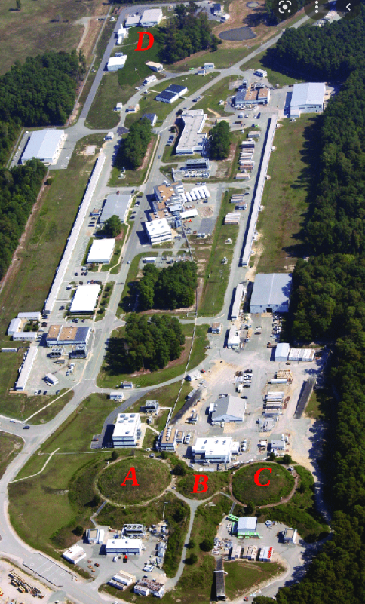
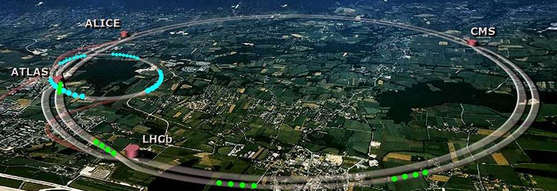
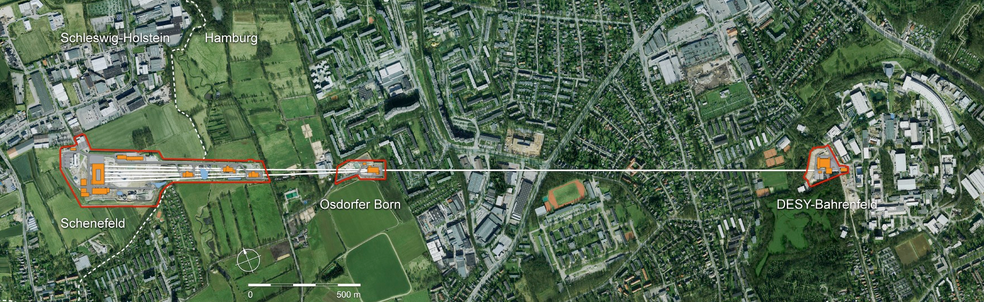
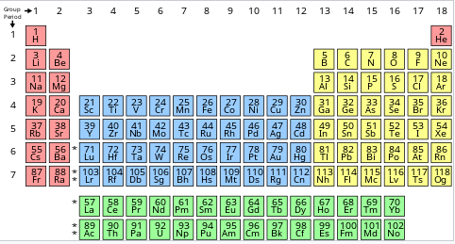
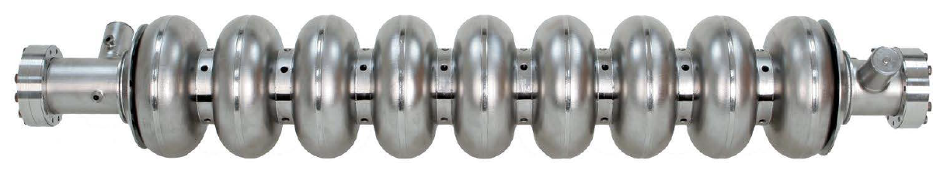

Accelerators in Science
CEBAF @ JLab
(first large SRF CW accelerator)
LHC @ CERN, Switzerland
XFEL @ DESY, Germany
LCLS II, SHINE, PAL-XFEL,
EIC, ILC(?), FCC(?),…
  $↪$ SRF – Superconducting Radio Frequency
  Element of choice: Nb
  operation temp $\sim$2 K

Slide 8
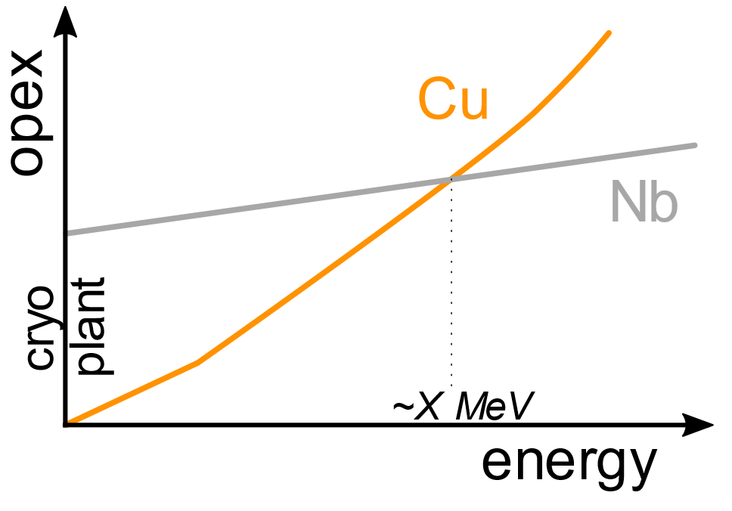
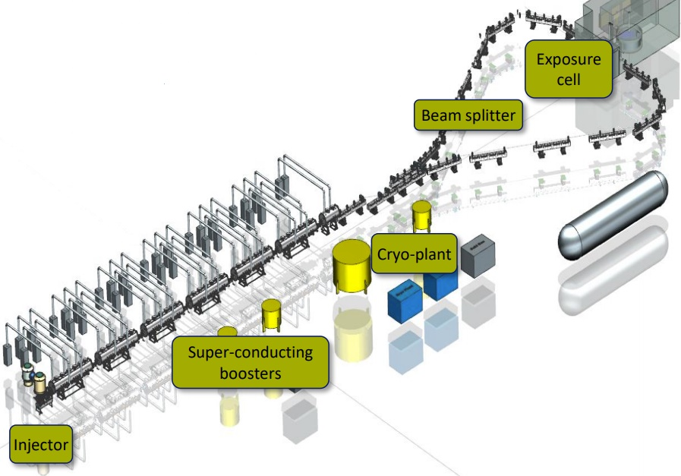

SRF for Industry?
Why SRF (Nb) over NC RF (Cu)?
  $↪$ power conversion $→$ amplifier/RF power to beam power
  $↪$ higher energy/beam power $→$ go SC $↔$ BUT cryoplant!
  DISCLAIMER
  NOT to scale!!!
  Don’t quote me
  on this one!
But does this make sense for industry?
  The “SMART accelerator” – radioisotopes $≥$300 M€, XX MeV
©IRE – The SMART Accelerator

Slide 9
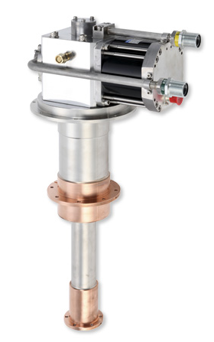
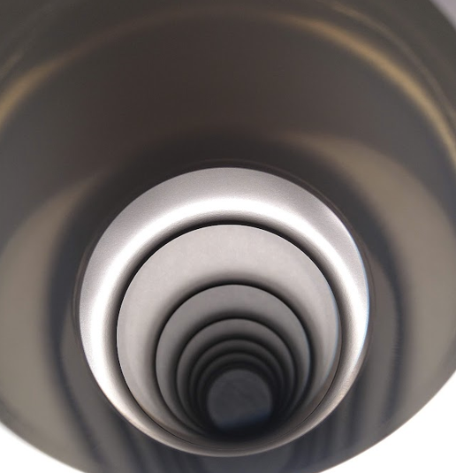
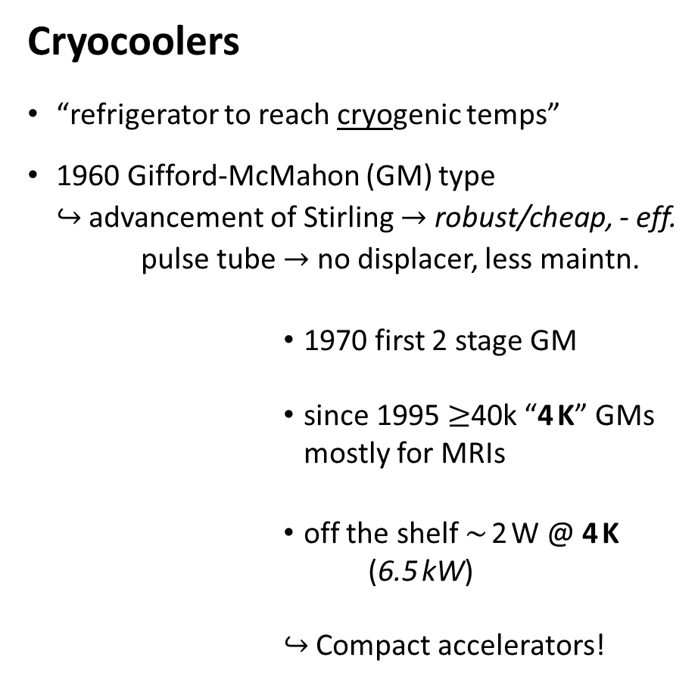
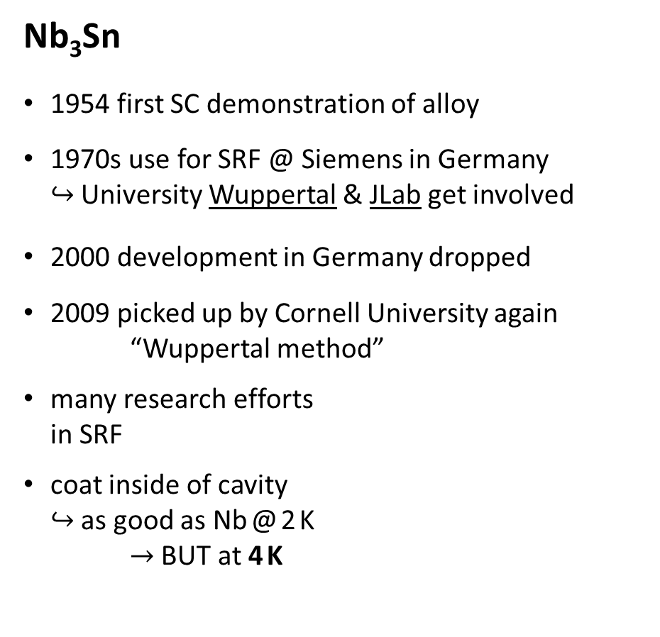

Technology Leap – Nb₃Sn and Cryocoolers
Nb₃Sn
1954 first SC demonstration of alloy
1970s use for SRF @ Siemens in Germany
$↪$ University Wuppertal & JLab get involved
2000 development in Germany dropped
2009 picked up by Cornell University again
“Wuppertal method”
many research efforts
in SRF
coat inside of cavity
$↪$ as good as Nb @ 2 K
$→$ BUT at 4 K
Cryocoolers
“refrigerator to reach cryogenic temps”
1960 Gifford-McMahon (GM) type
$↪$ advancement of Stirling $→$ robust/cheap, - eff.
pulse tube $→$ no displacer, less maintn.
          1970 first 2 stage GM
          since 1995 $≥$40k “4 K” GMs
          mostly for MRIs
          off the shelf $\sim$ 2 W @ 4 K (6.5 kW)
          $↪$ Compact accelerators!
$$∞$$
©Sumitomo Heavy Industries

Slide 10
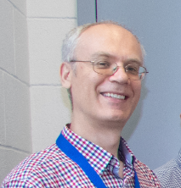
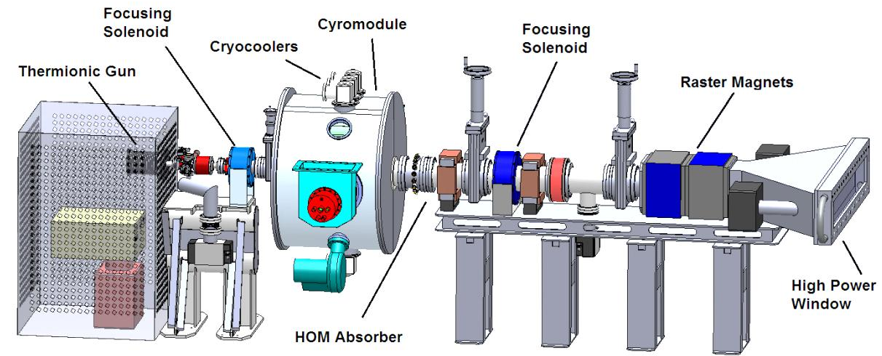
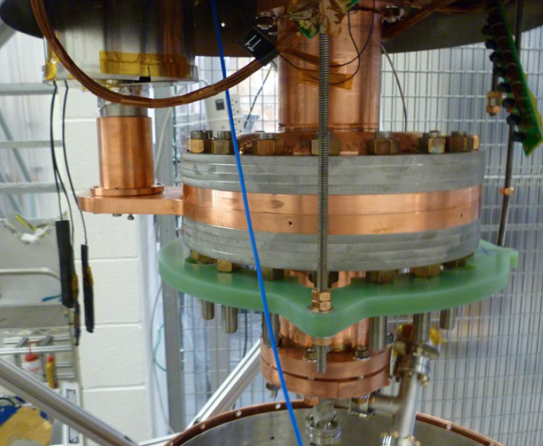
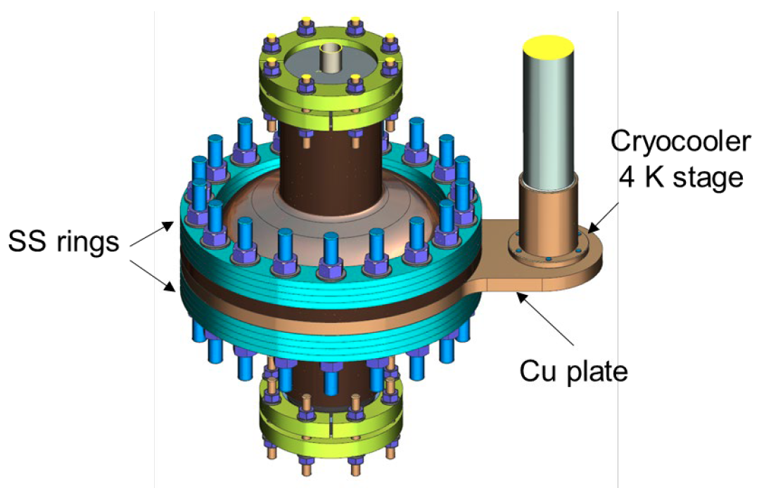
What does such a compact machine look like?
2018 G. Ciovati et al. – design for 1 MeV & 1 MW
prototype cavity
1495 MHz single-cell
cost analysis
invest | [M$]
RF source | 3.2
SRF module | 0.92
injector & beamline | 0.32
installation | 2.75
total | 7.25
operation
req. power | 2.75 MW
Maintenance | 145 k$/a
opex (incl. 32 % amort) | 262 $/h
cost per irradiation | 12.75 ¢/t/kGy
@ 4 kGy & 3 Mgal/d | 1930 $/Mgal
51 ¢/m³

Slide 11
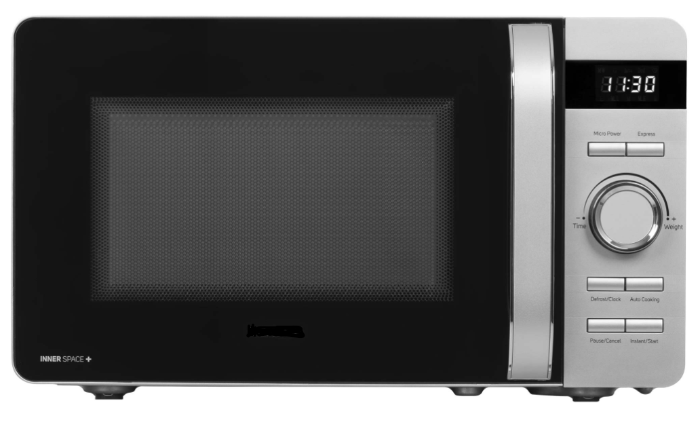
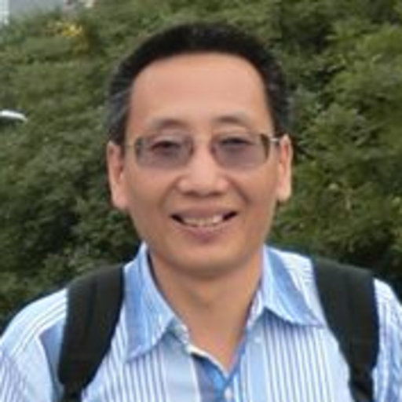

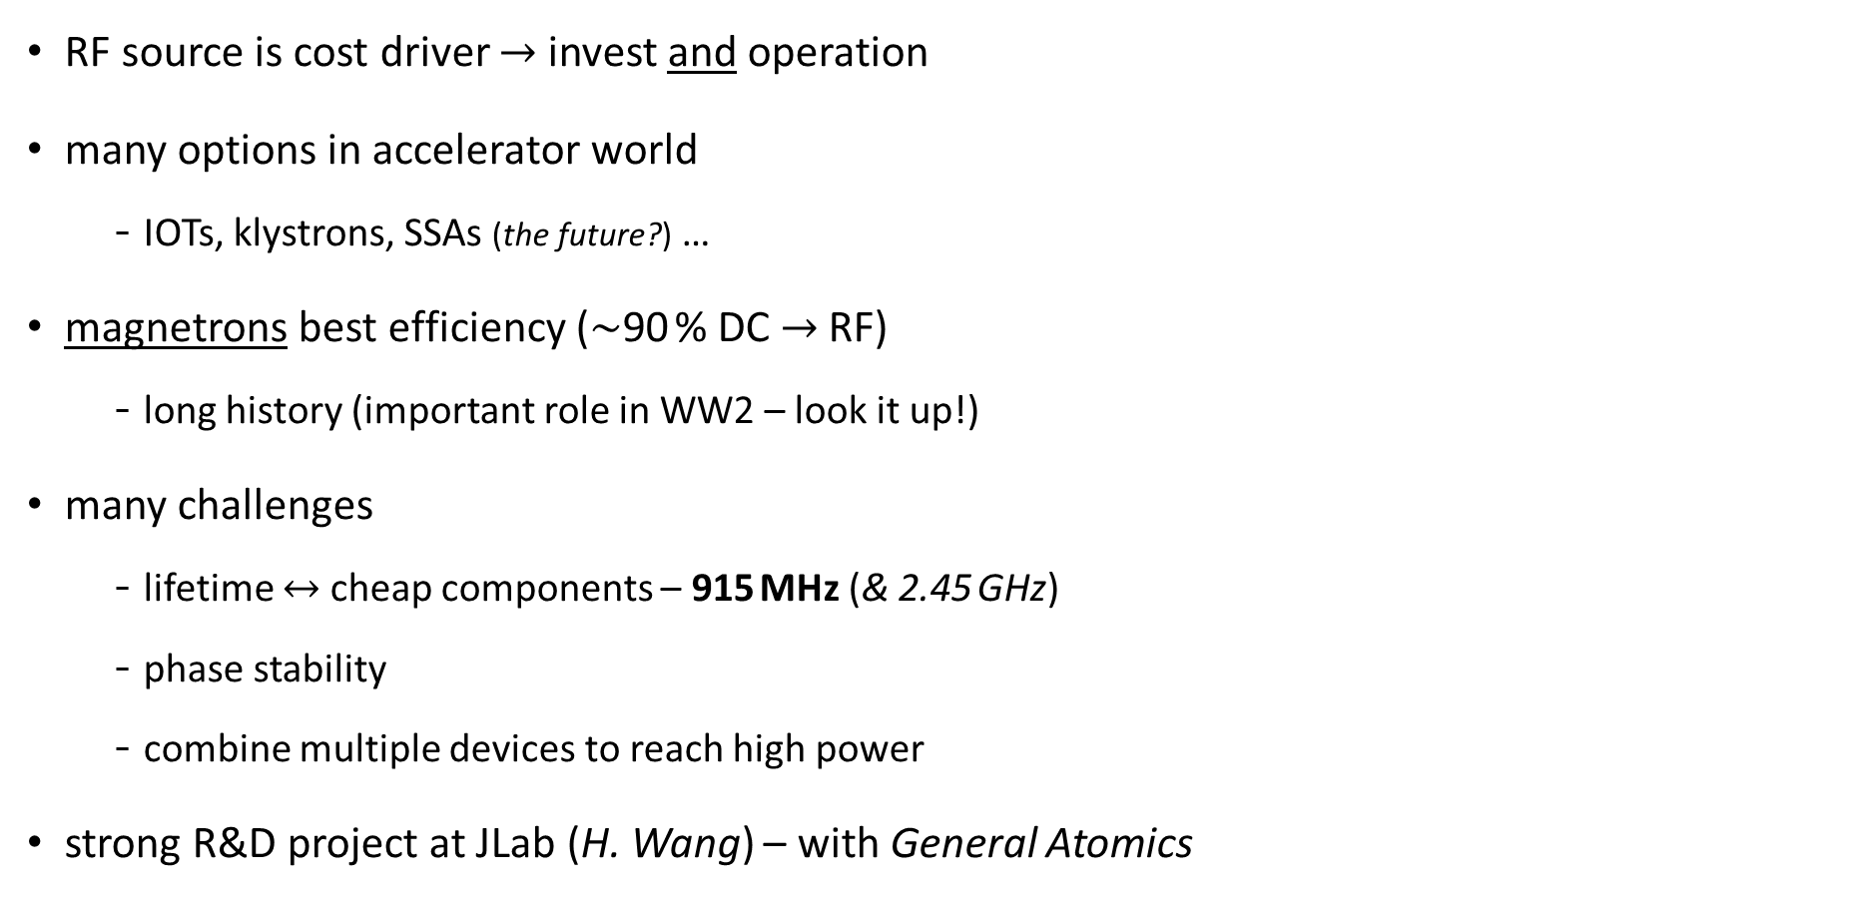
RF Source Development – Magnetrons
RF source is cost driver $→$ invest and operation
many options in accelerator world
  IOTs, klystrons, SSAs (the future?) …
magnetrons best efficiency ($\sim$90 % DC $→$ RF)
  long history (important role in WW2 – look it up!)
many challenges
  lifetime $↔$ cheap components – 915 MHz (& 2.45 GHz)
  phase stability
  combine multiple devices to reach high power
strong R&D project at JLab (H. Wang) – with General Atomics

Slide 12
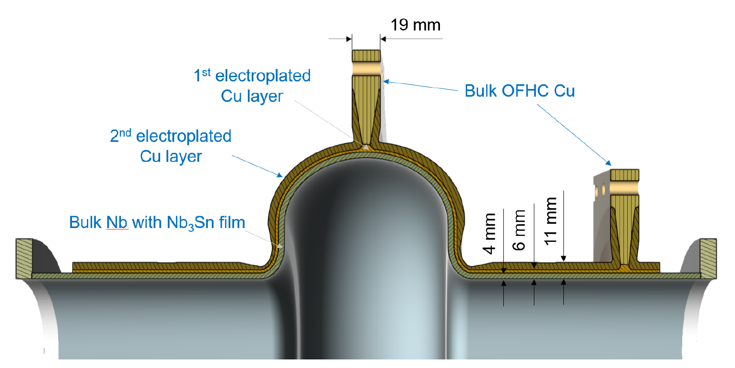

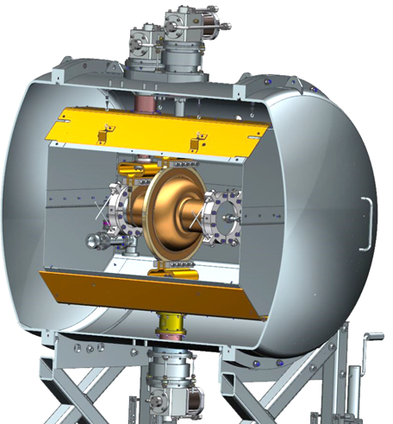
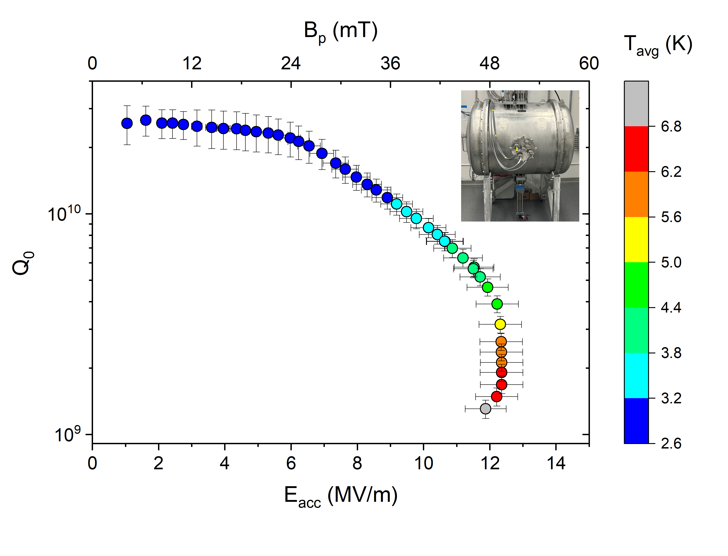
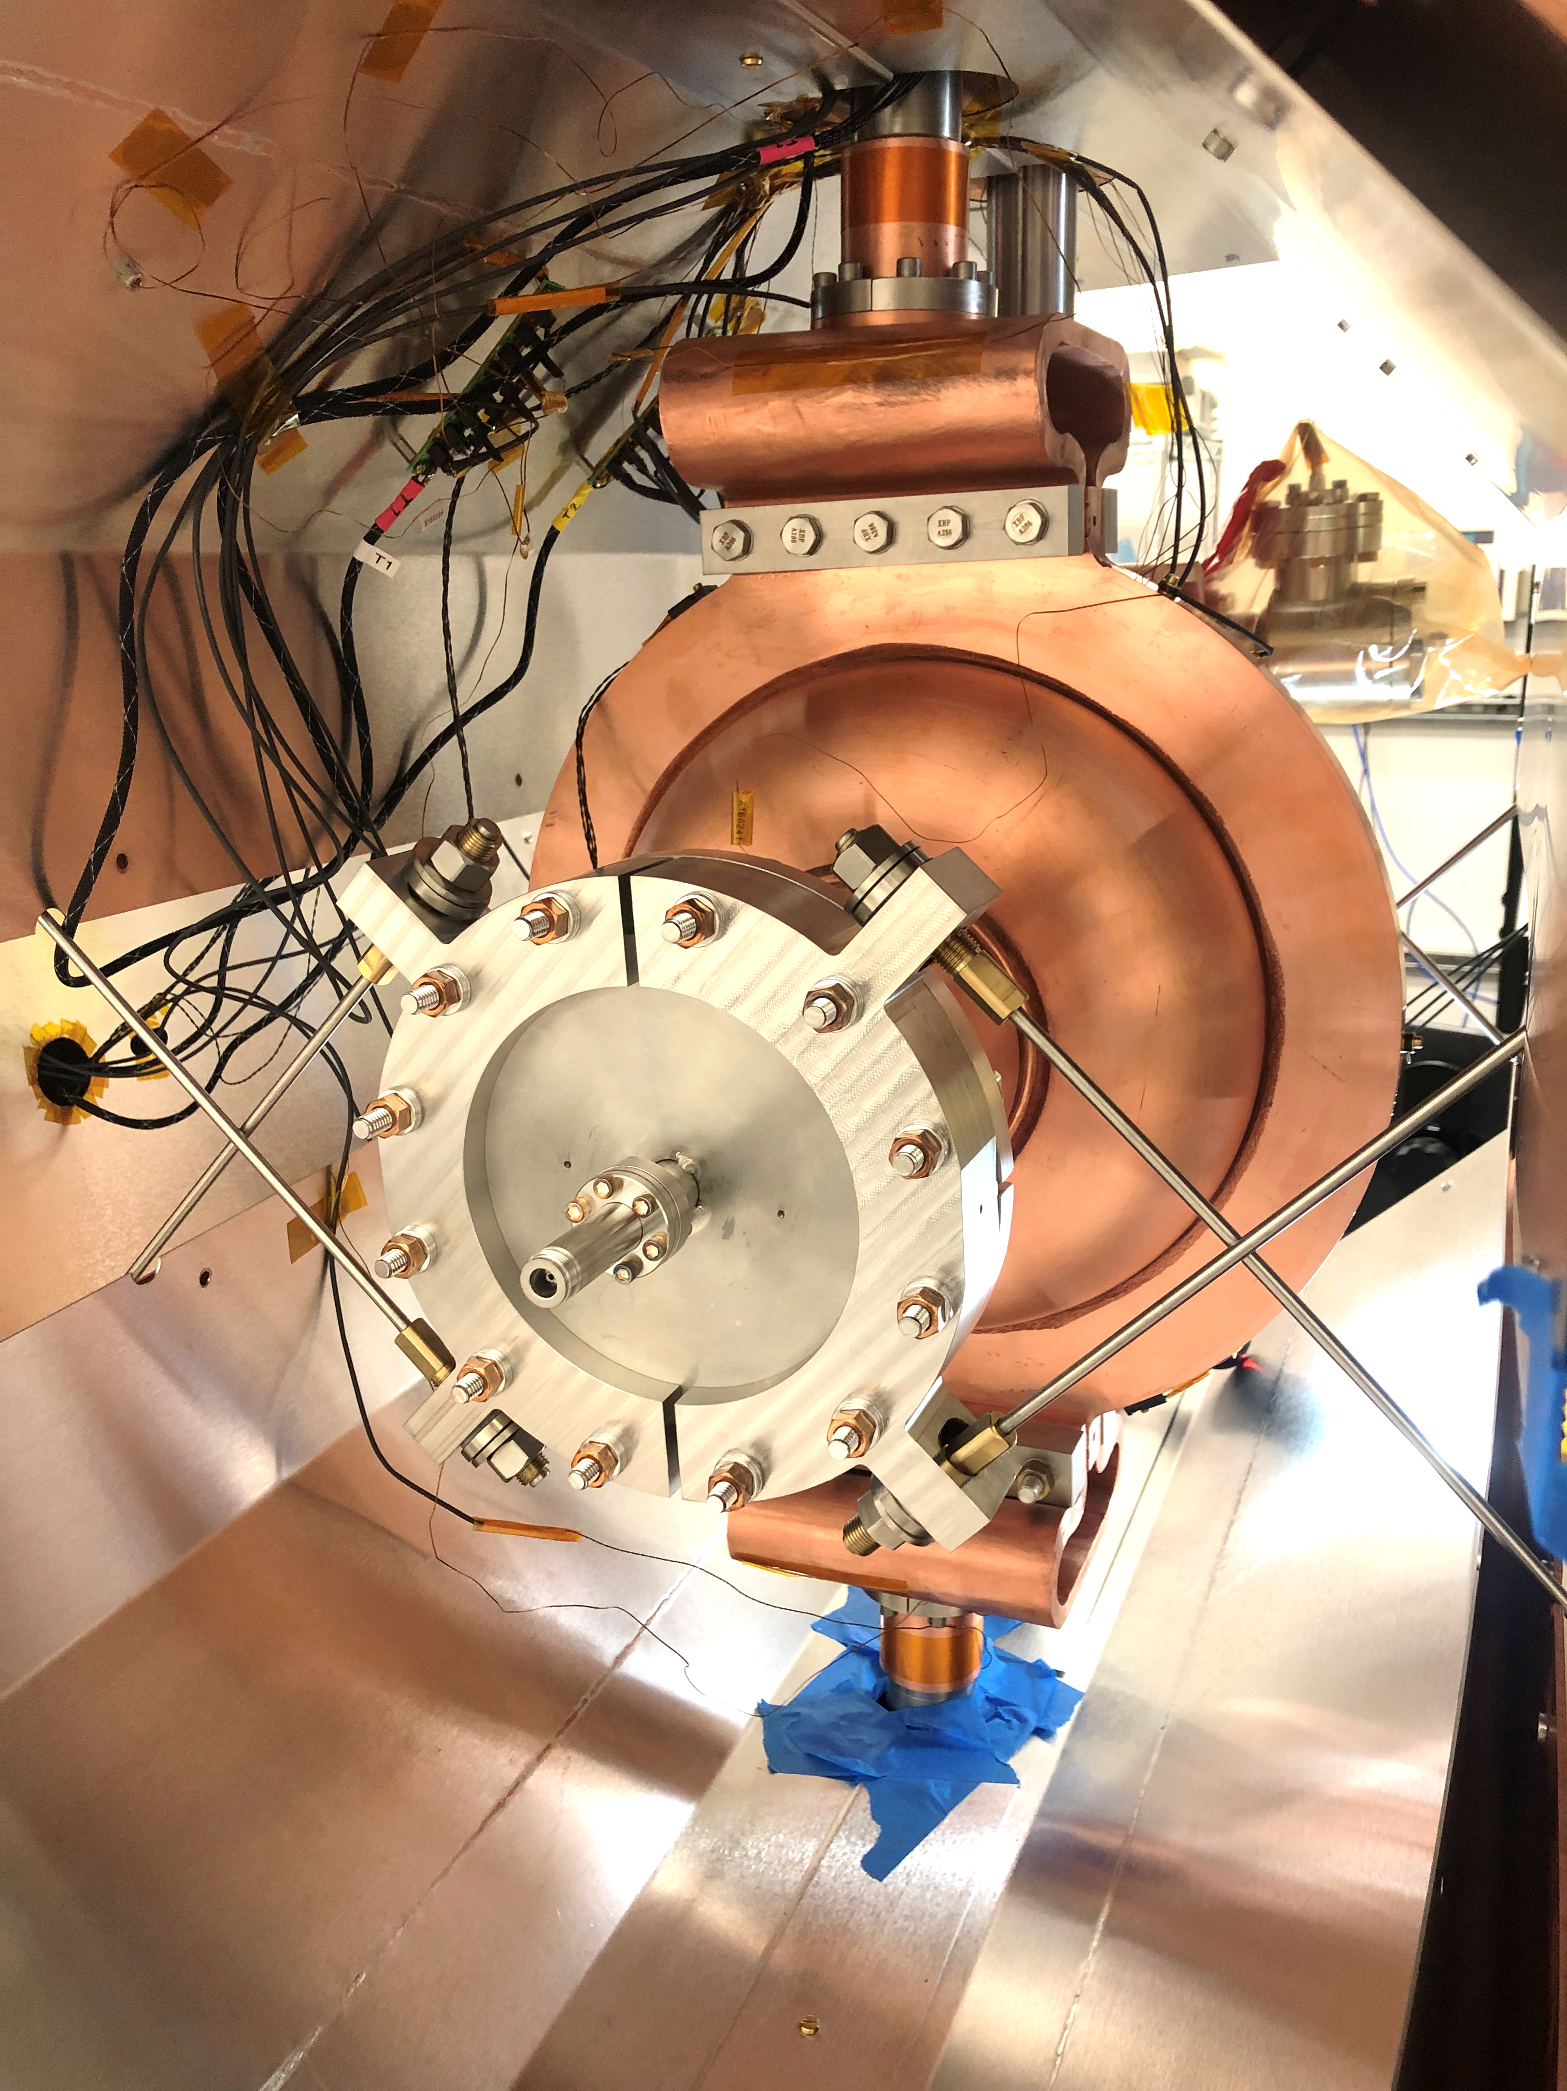

New Single Cell Prototype
915 MHz magnetron $→$ adapted frequency to benefit of magnetron technology
re-evaluated 1 MeV linac design at 915 MHz
new proof-of-concept cavity (952 MHz) in horizontal test cryostat
performed horizontal test at
$↪$ record performance

Slide 13
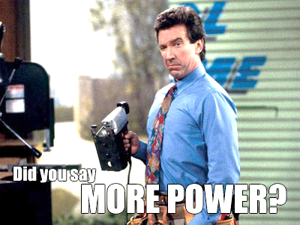
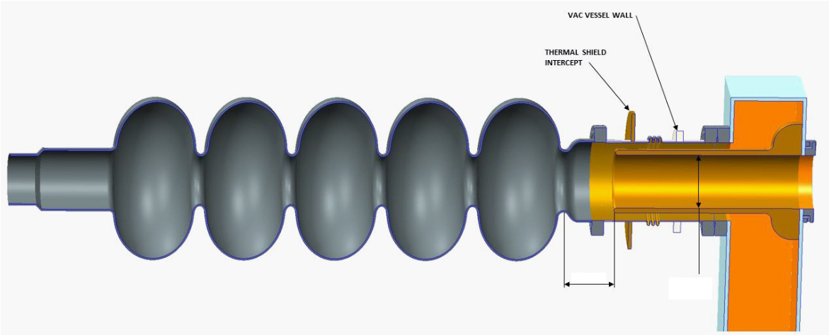
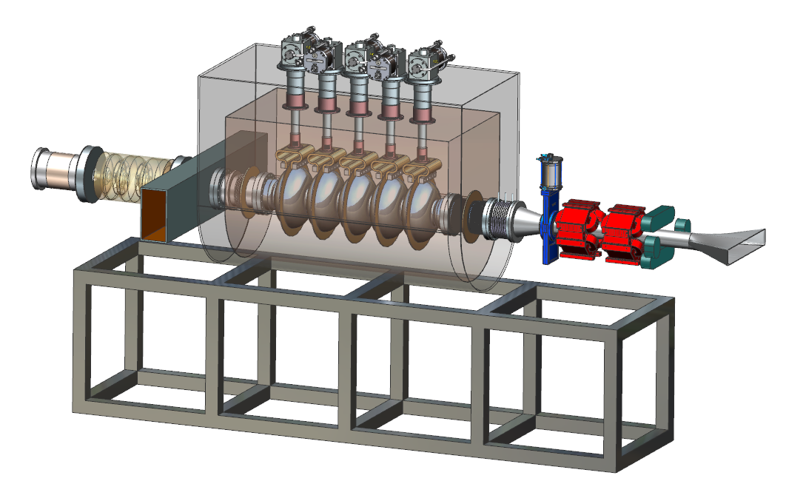
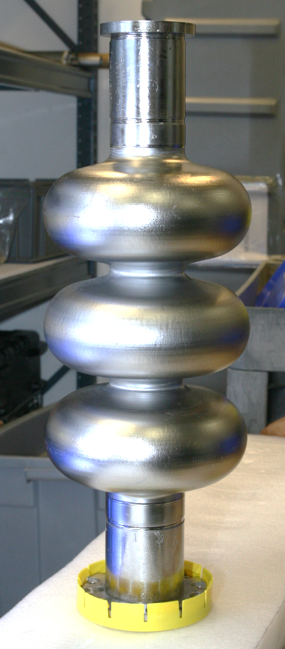
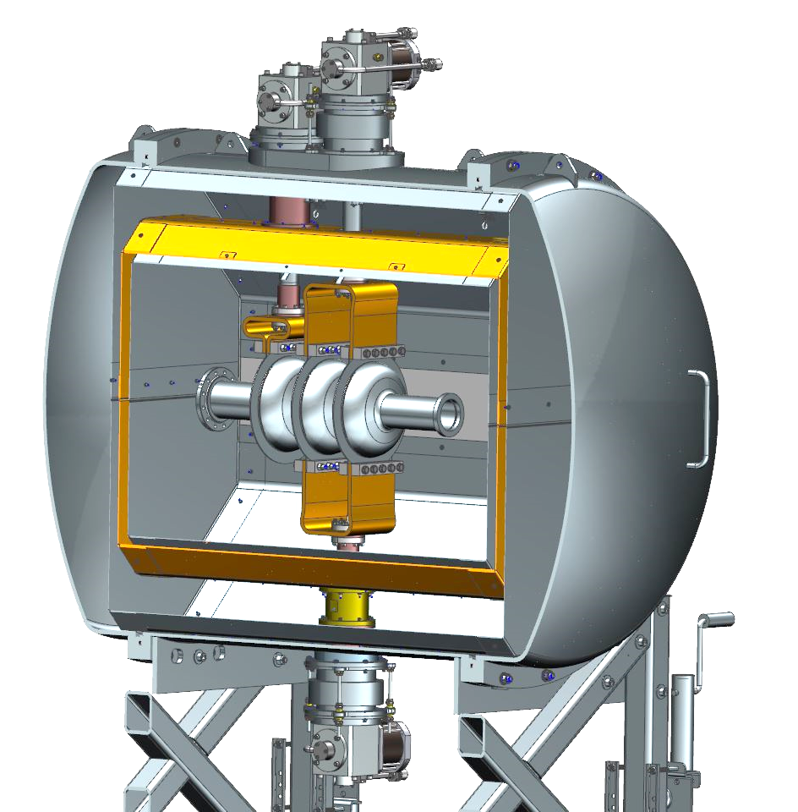

Go for 10 MeV – Multicell Development
            1 MeV penetration depth e⁻ in water $\sim$ 3 - 4 mm
            $↪$ not very practical
            move to 10 MeV (remember threshold) $→$ 3 - 4 cm
            single cell $→$ multi-cell cavity
            $↪$ not new for SRF but for CC
develop multi-cell cavity (RF parameters, FPC etc.)
& update design of compact accelerator
915 MHz (magnetron)
5-cell $↔$ known performance
test CC concept with 3-cell
in horizontal cryostat
ENERGY
––––––
©Buena Vista Television

Slide 14
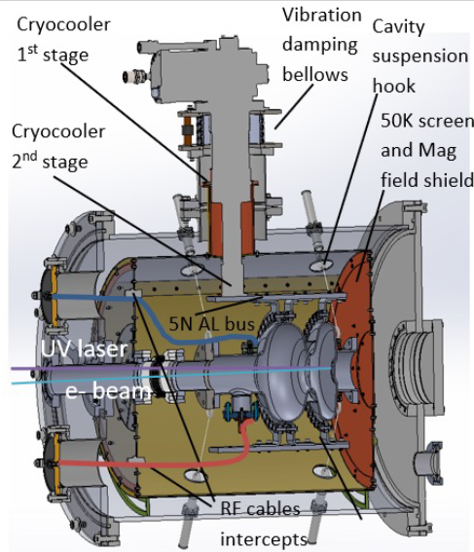
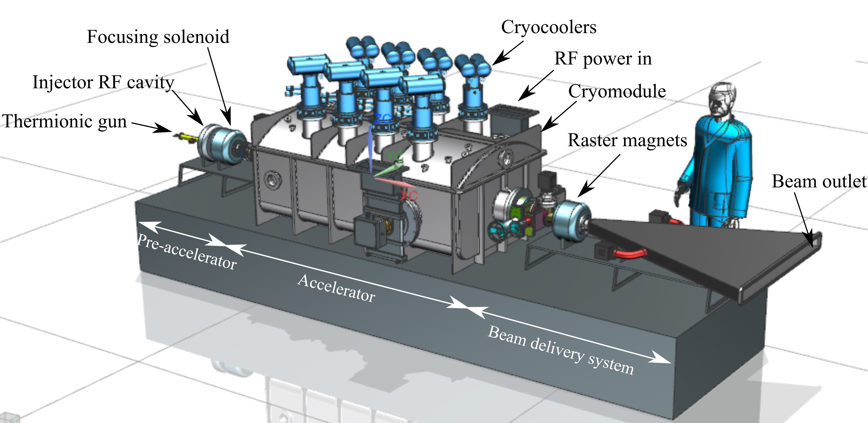

Other Approaches – We’re not the only ones!
many other developments (US & beyond)
  $↪$ G. Eremeev ICHEP’22
FNAL
  650 MHz (motivated by PIP II)
Euclid Beamlabs
  UED/UEM, 2W SRF gun
RadiaBeam
  small, mobile CM, 650 MHz $↔$ collab. FNAL
Cornell, IMP (China), KEK (Japan), …

Slide 15
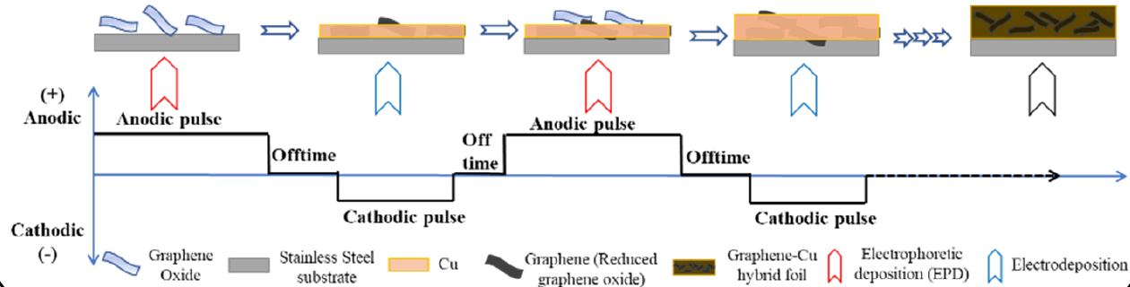
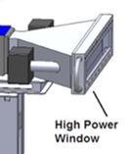
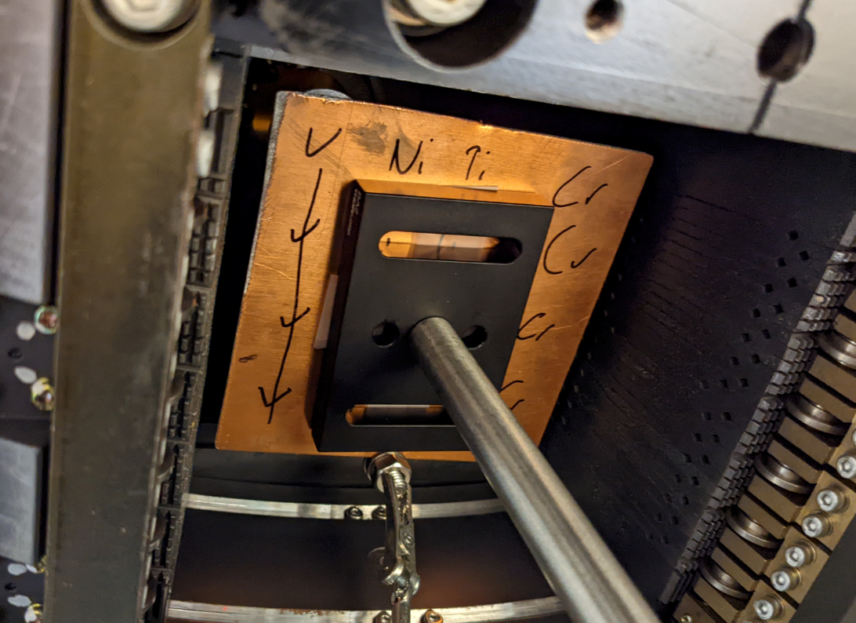


Beyond SRF @ JLab
RF source $→$ magnetron see above (DOE Accelerator Stewardship)
injector studies (VA state funding)
thermal connections CCR $↔$ cavity
  “Graphene-Cu Hybrid Foil Thermal Straps for Conduction Cooling of SRF systems”
  SBIR Phase II with Faraday Technology Inc. (pending)
beam exit window (DOE Accelerator Stewardship)
  Old Dominion U (H. Baumgart, A. Elmustafa) & James Madison U (S. Pendleton, L. A. Banu)
  interface beamline $↔$ target
Courtesy JMU

Slide 16






New threats to our water? – “Forever Chemicals”
Can ebeam help?
©HBO

Slide 17





Ebeam Studies @ JLab
collaboration with HRSD (High R&D reputation nationwide – we got lucky!)
existing 10 MeV machine @ JLab $→$ UITF
1,4-dioxane (forever chemical) & PFAS
X. Li & R. Pearce – NIM A & Water Science & Technology
lower hanging fruit
need more power/dose …

Slide 18




Summary
When is it going to happen?
  $↪$ We’ll get there!
Self-reflection: Ebeam irradiation will only be one tool in the toolbox!
$↪$ Collaboration with water treatment community important!
Why are you telling me this?
  $↪$ JLab mission!
  & You’re the taxpayer $→$ We’re doing this for you!
  $++$ We need you/young talent to help us push this!
SRF accelerator in WWTP

Slide 19








Recruitment Pitch – Come to JLab!
Great times to be in SRF! $↔$ Everybody is hiring! $→$ many interesting projects & positions
Why JLab/VA?
  JLab i.e. CEBAF basically spinoff of Cornell
    $↪$ formed SRF institute “2nd to none”
  We got mountains!
  We got beaches!
  We got Wegmans!
  Did I mention Costco? (Just across the street!!)
EIC $↔$ “next, big thing” – all SRF @ JLab
$↪$ jlab.org/recruiting $↔$ recruiting@jlab.org (Vennekate@jlab.org)

Slide 20

Acknowledgements & References
Many thanks to all our partners
  General Atomics, HRSD, ODU, JMU, Faraday Tech, SHI, NCSU, FNAL, …
individuals
  Bill Cooper, John Rathke, Tom Schultheiss, F. Hannon …
the JLab staff
DOE trust & funding $↔$ the taxpayer!
I apologize for all ©’s and “Courtesy of […]” I missed!
References (not complete at all)
W. Cooper et al. “Treatment of Wastewater with High Energy Electron Beam Irradiation”, 1992 Wat. Sci. Tech. and many, many more
G. Ciovati et al. “Design of a cw, low-energy, high-power superconducting linac for environmental applications”, Phys. Rev. A & B, 2018
G. Eremeev “Worldwide industrial developments for compact accelerators based on the Nb3Sn superconducting radiofrequency (SRF) technology”, ICHEP’22
R.C. Dhuley et al. “Design of a 10 MeV, 1000 kW average power electron-beam accelerator for wastewater treatment applications”, Phys. Rev. A & B, 2022
X. Li et al. “Design and commissioning of an e-beam irradiation beamline at the Upgraded Injector Test Facility at Jefferson Lab”, NIM A, 2022
R. Pearce et al. “Electron beam treatment for the removal of 1,4-dioxane in water and wastewater”, Water Science & Technology, 2023
H. Wang “Magnetron R&D Progress for High Efficiency CW RF Sources of Industrial Accelerators”, NAPAC‘22

Slide 21
Questions anyone?
From the Lab to your Sewage Plant – J. Vennekate

