Slide 1
An accelerated approach to chip fabrication
Bruce Dunham
VP of Engineering
xLight, Inc.
July 21, 2023

Slide 2
Outline
Accelerator-based sources for Lithography
Electron Beam Inspection and Lithography
Ion Implantation
Careers in Accelerator Physics

Slide 3
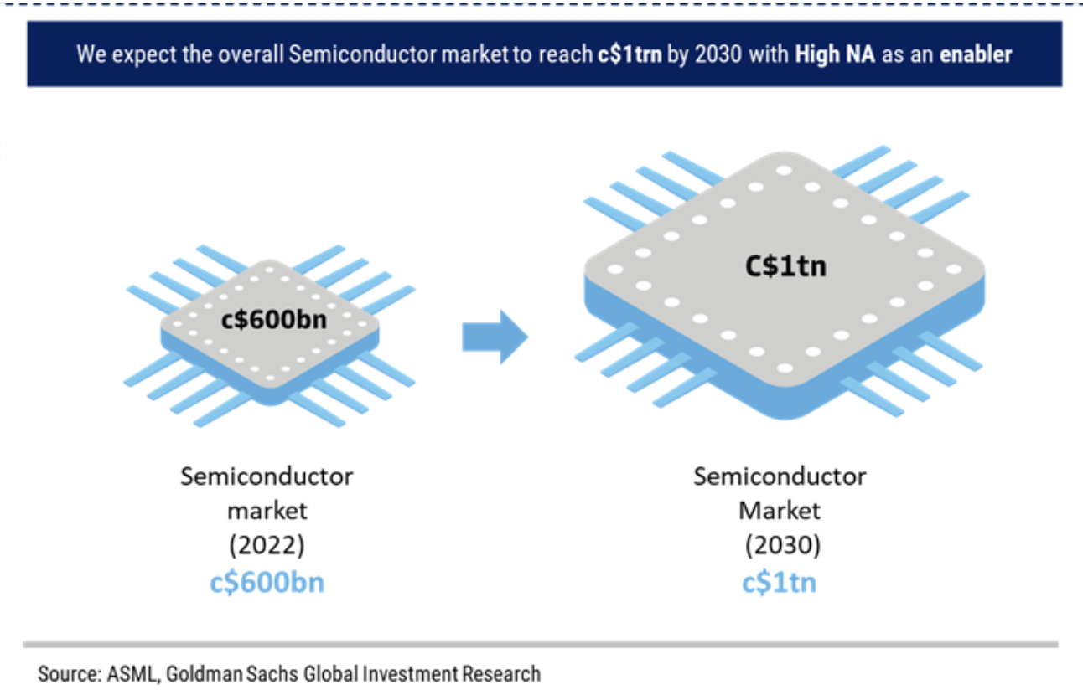

Market Size

Slide 4
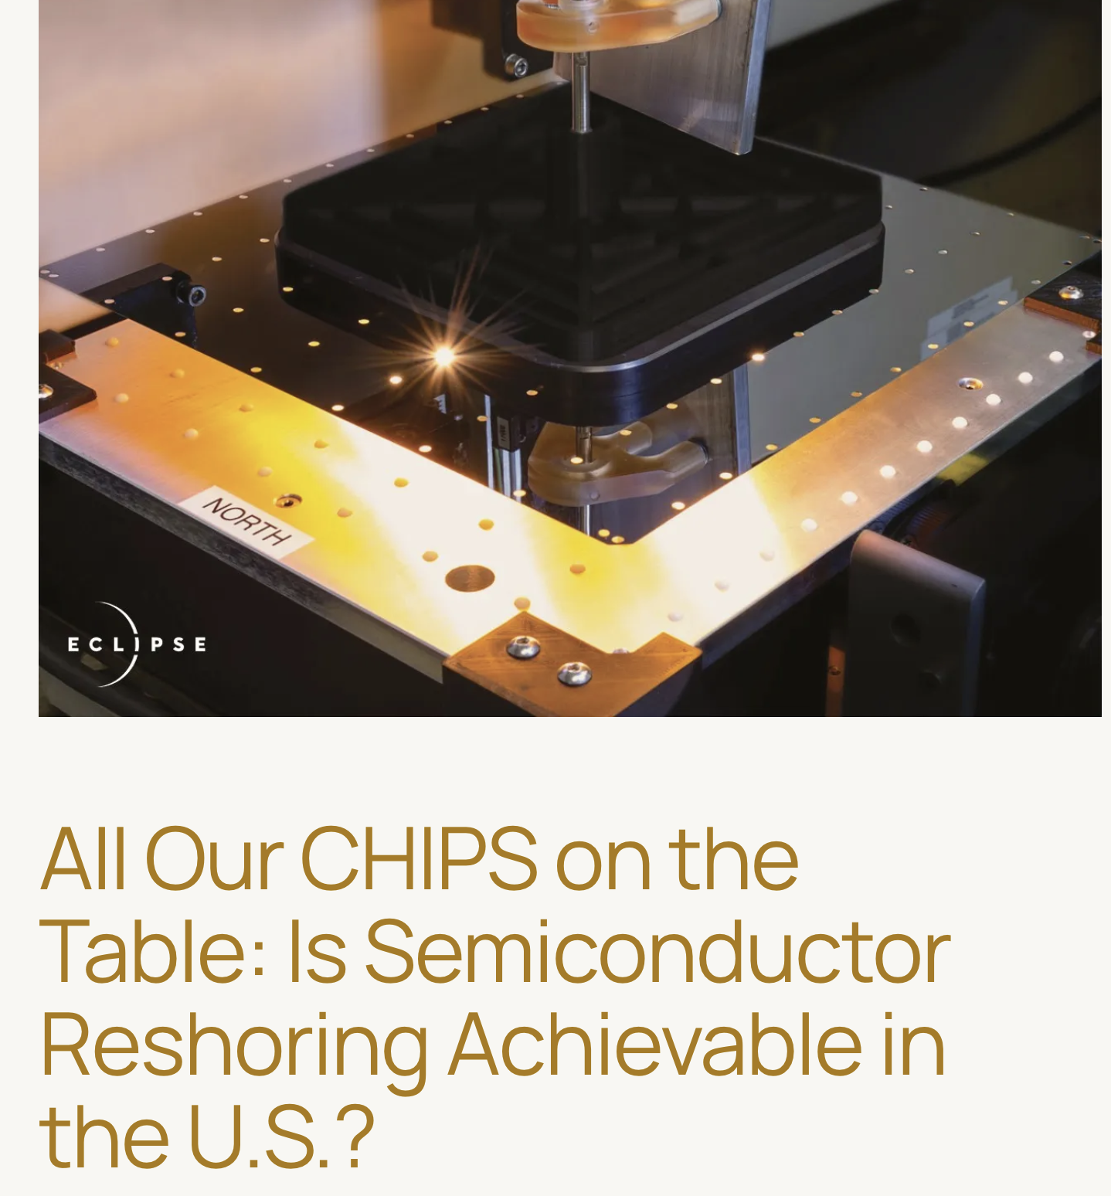

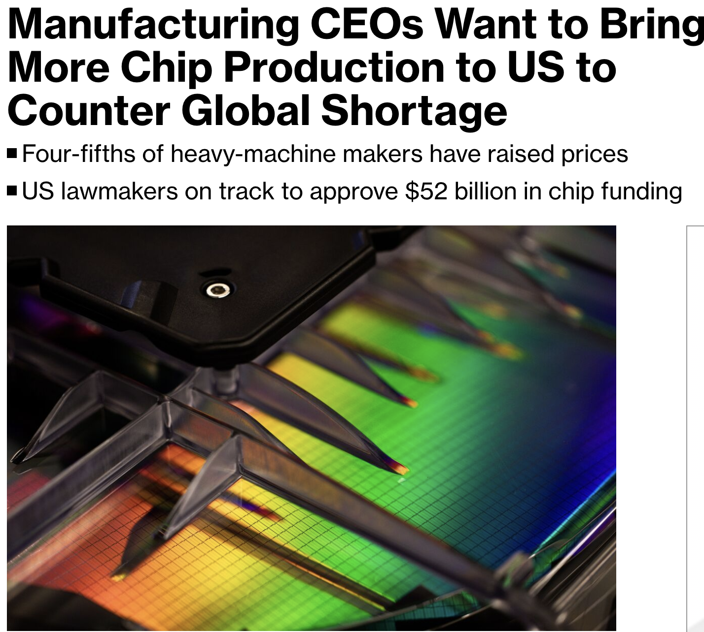
On-Shoring of Chip Production

Slide 5
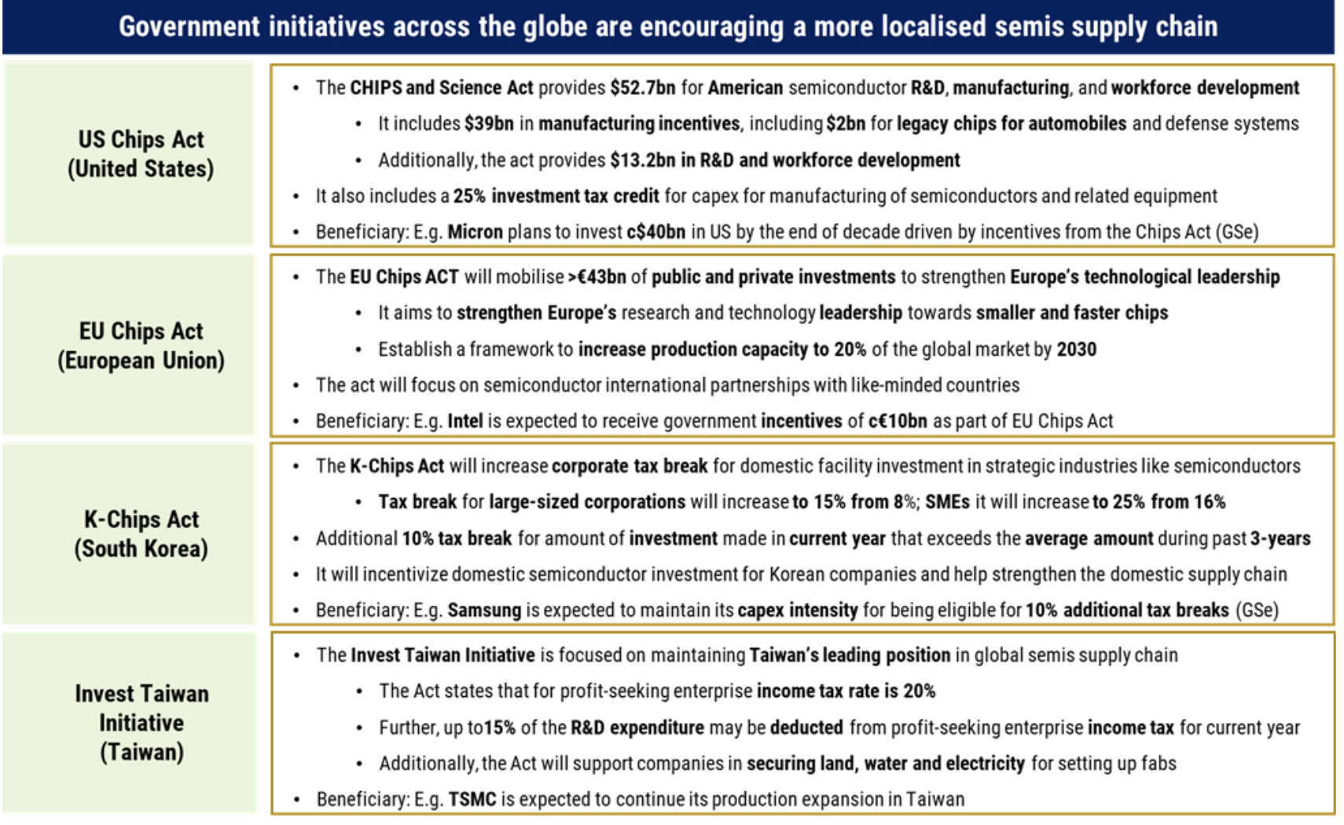
International Funding for Chips

Slide 6
Modern Lithography for Chip Production

Slide 7
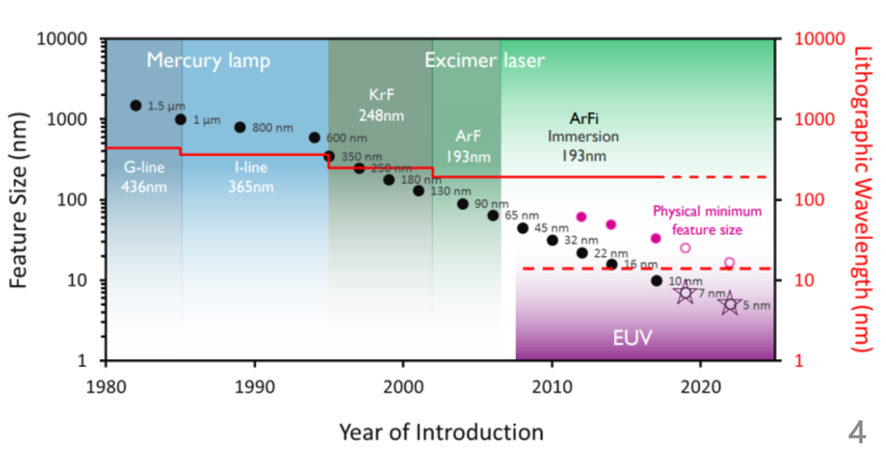
Light Drives Innovation

Slide 8
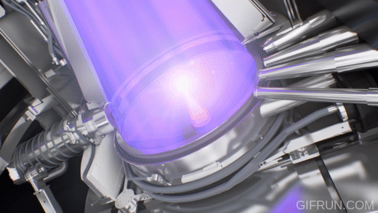
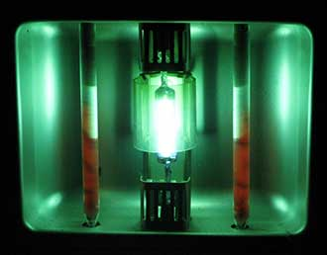
Light Drives Innovation

Slide 9
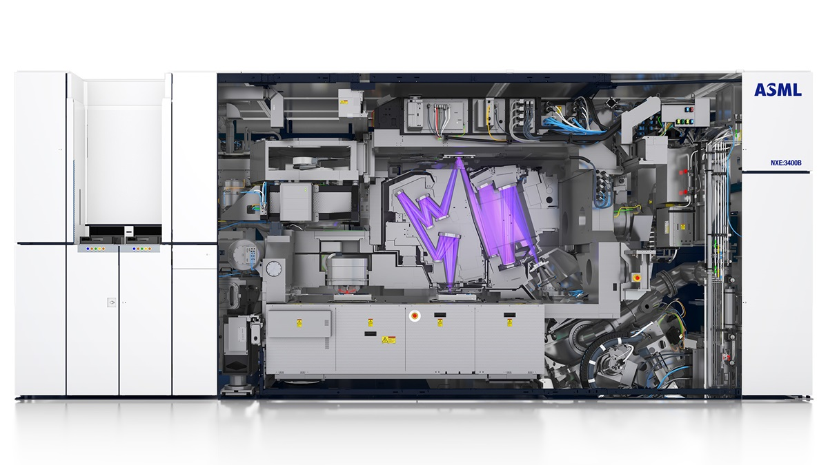
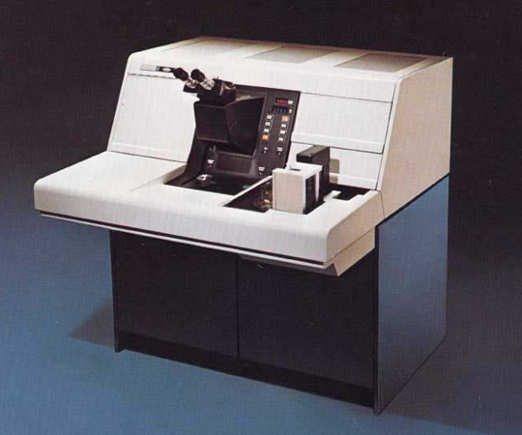
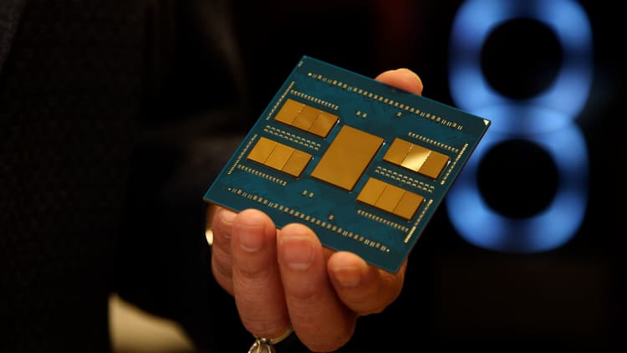
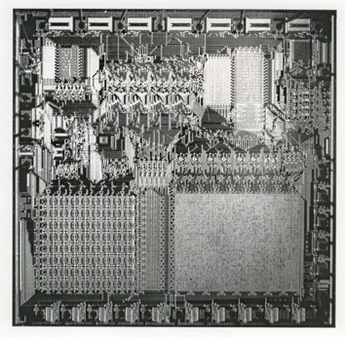
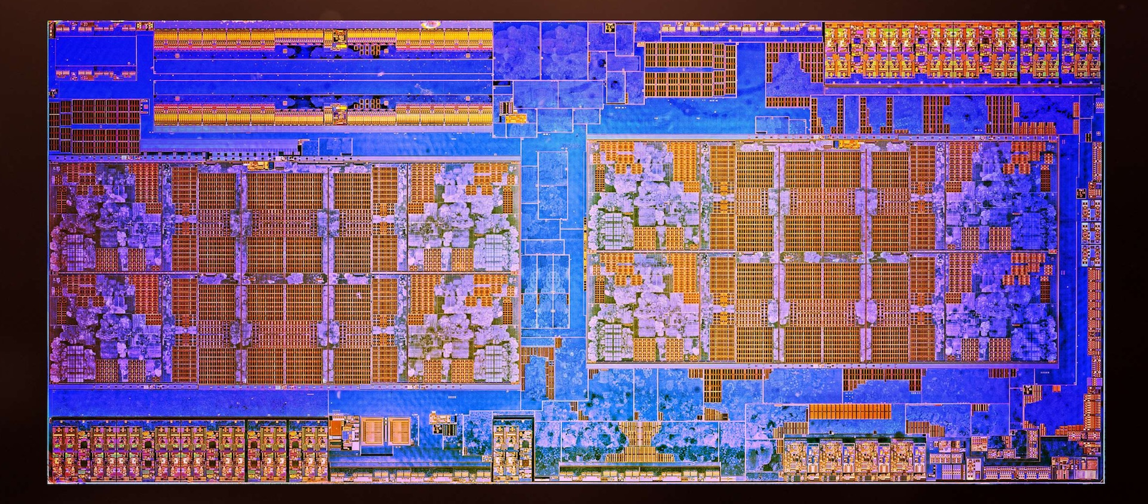
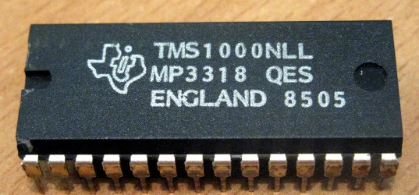
Lithography Powers Moore’s Law

Slide 10
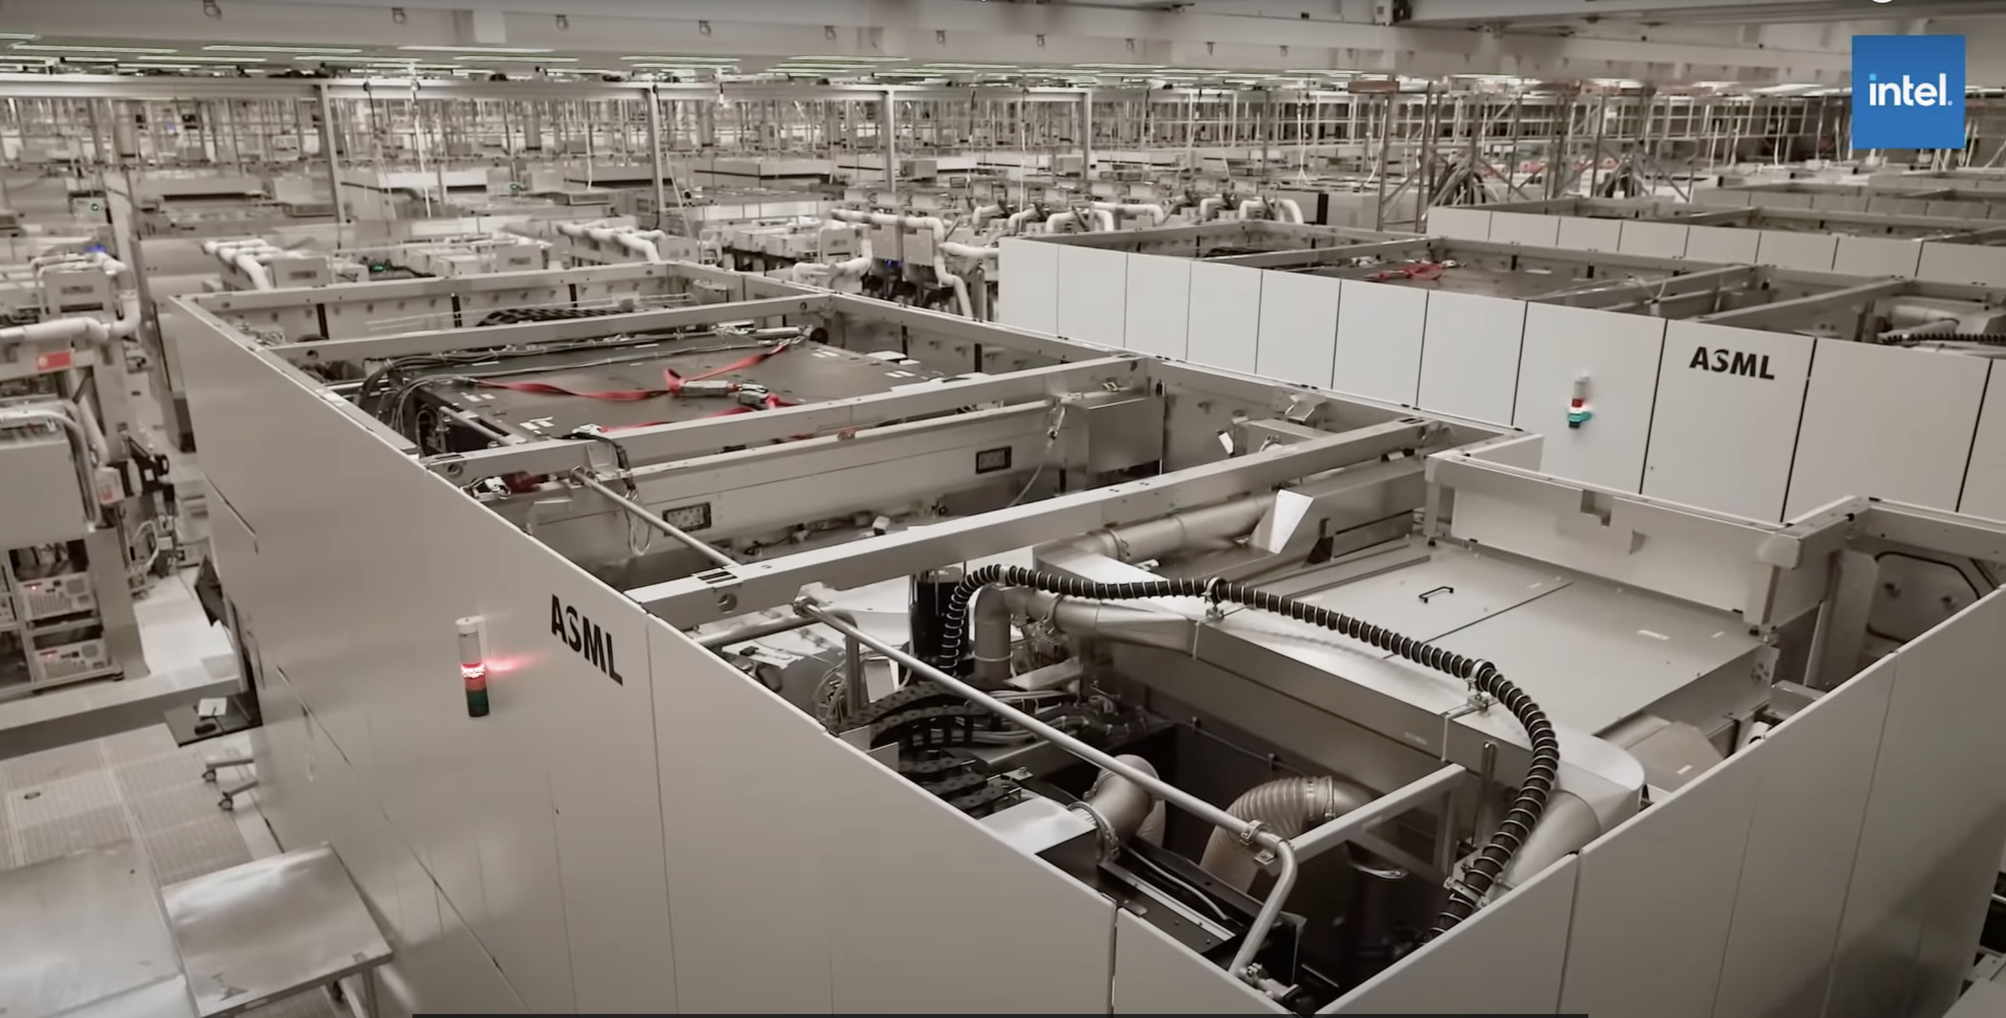
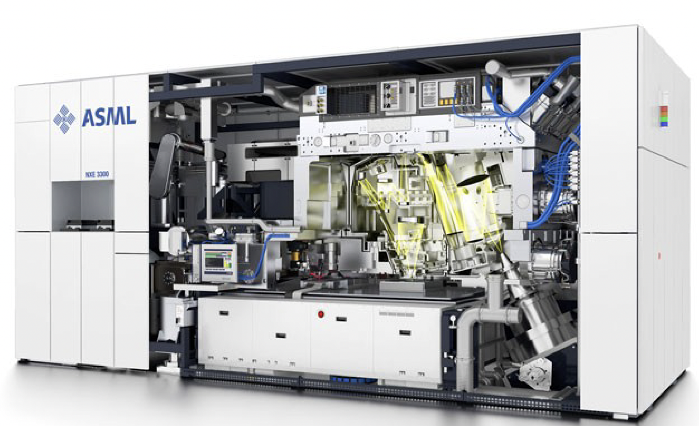
Lithography Powers Moore’s Law

Slide 11
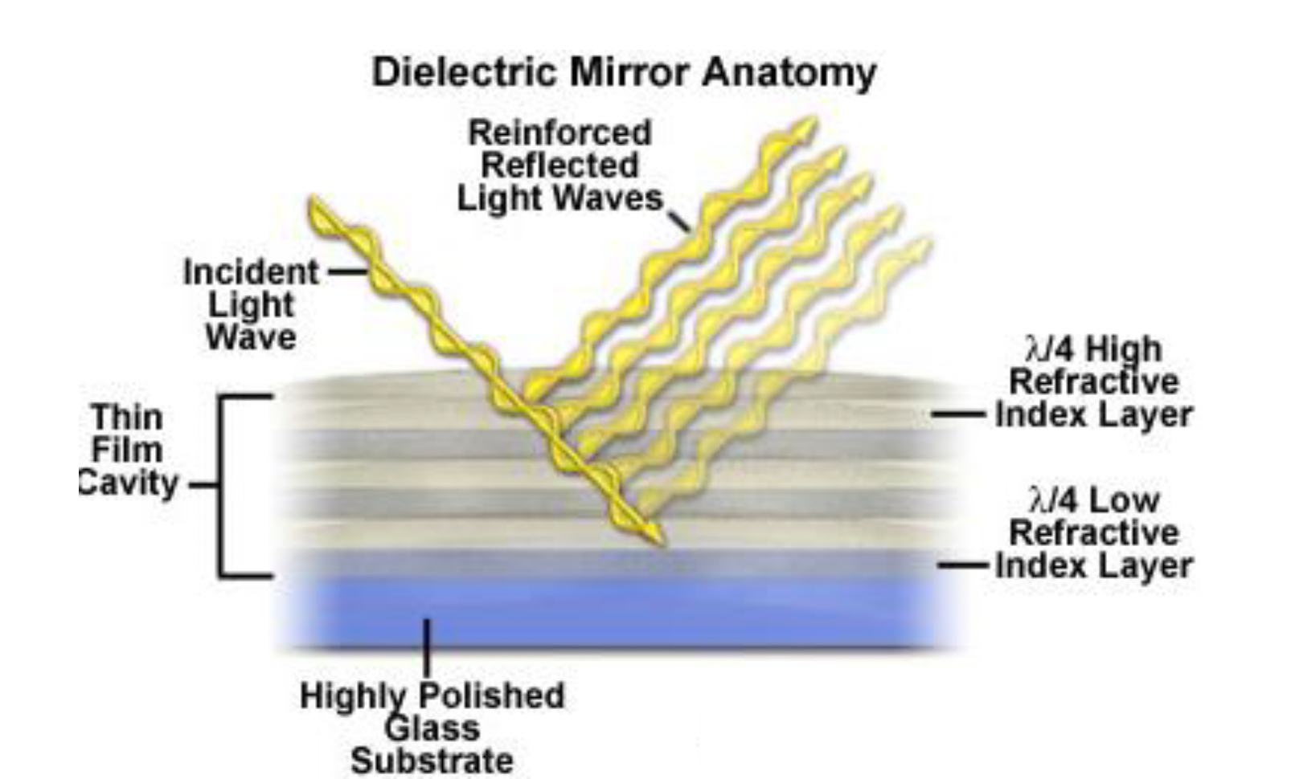
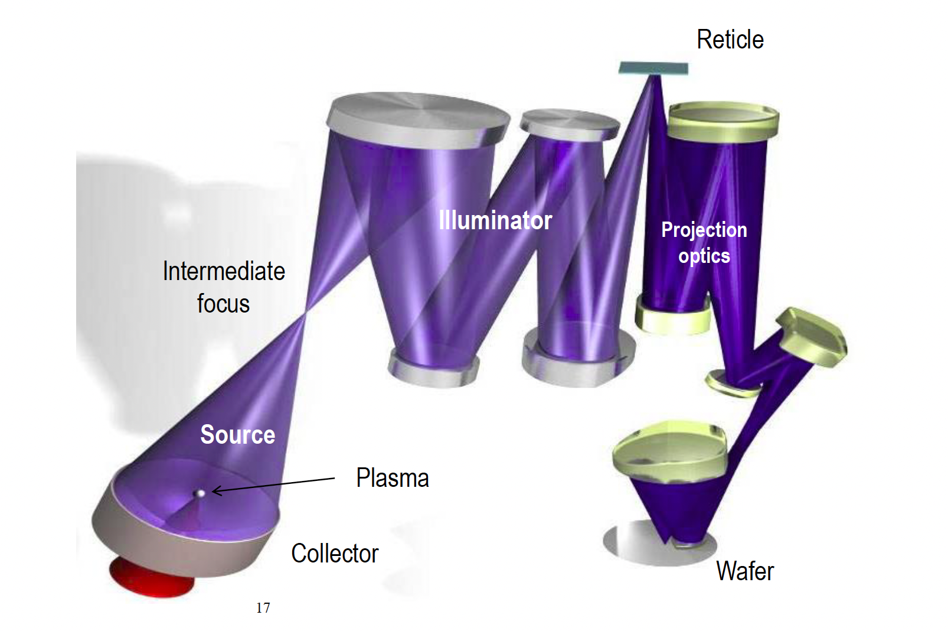
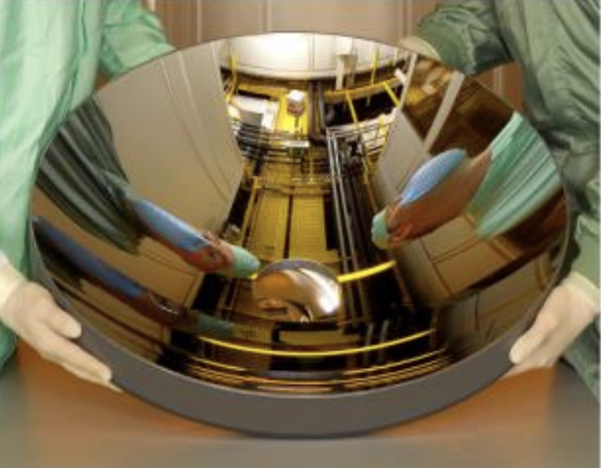
EUV Lithography uses a 13.5 nm LPP Source

Slide 12
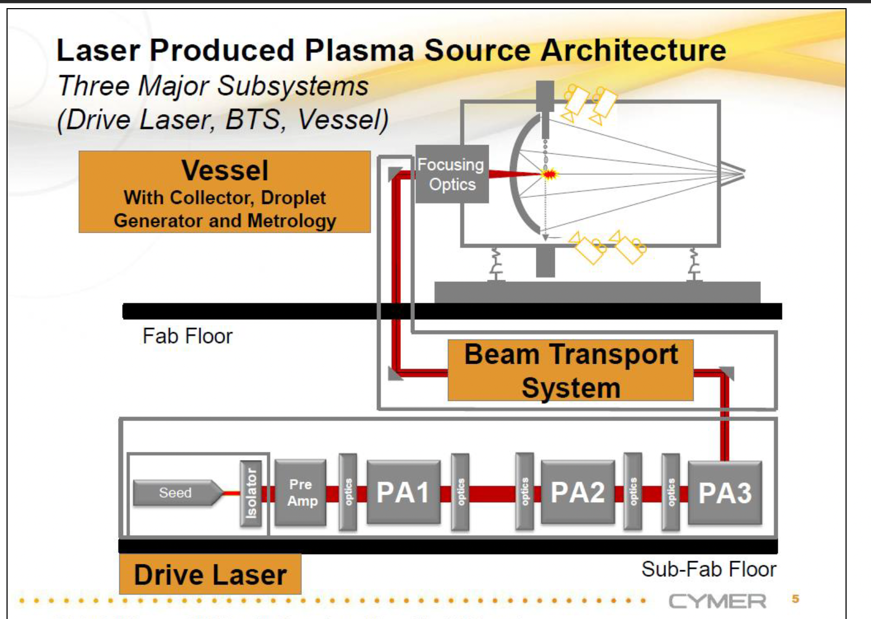
EUV Lithography uses a 13.5 nm LPP Source
200 Watts needed from the source to meet minimum requirements
10 years ago, reaching 200W was a problem, so we worked on an accelerator-based solution
ASML finally got >200W, and dropped the accelerator solutions

Slide 13
EUV LPP is Not Scalable

Slide 14
Accelerator Based Options for EUV

Slide 15
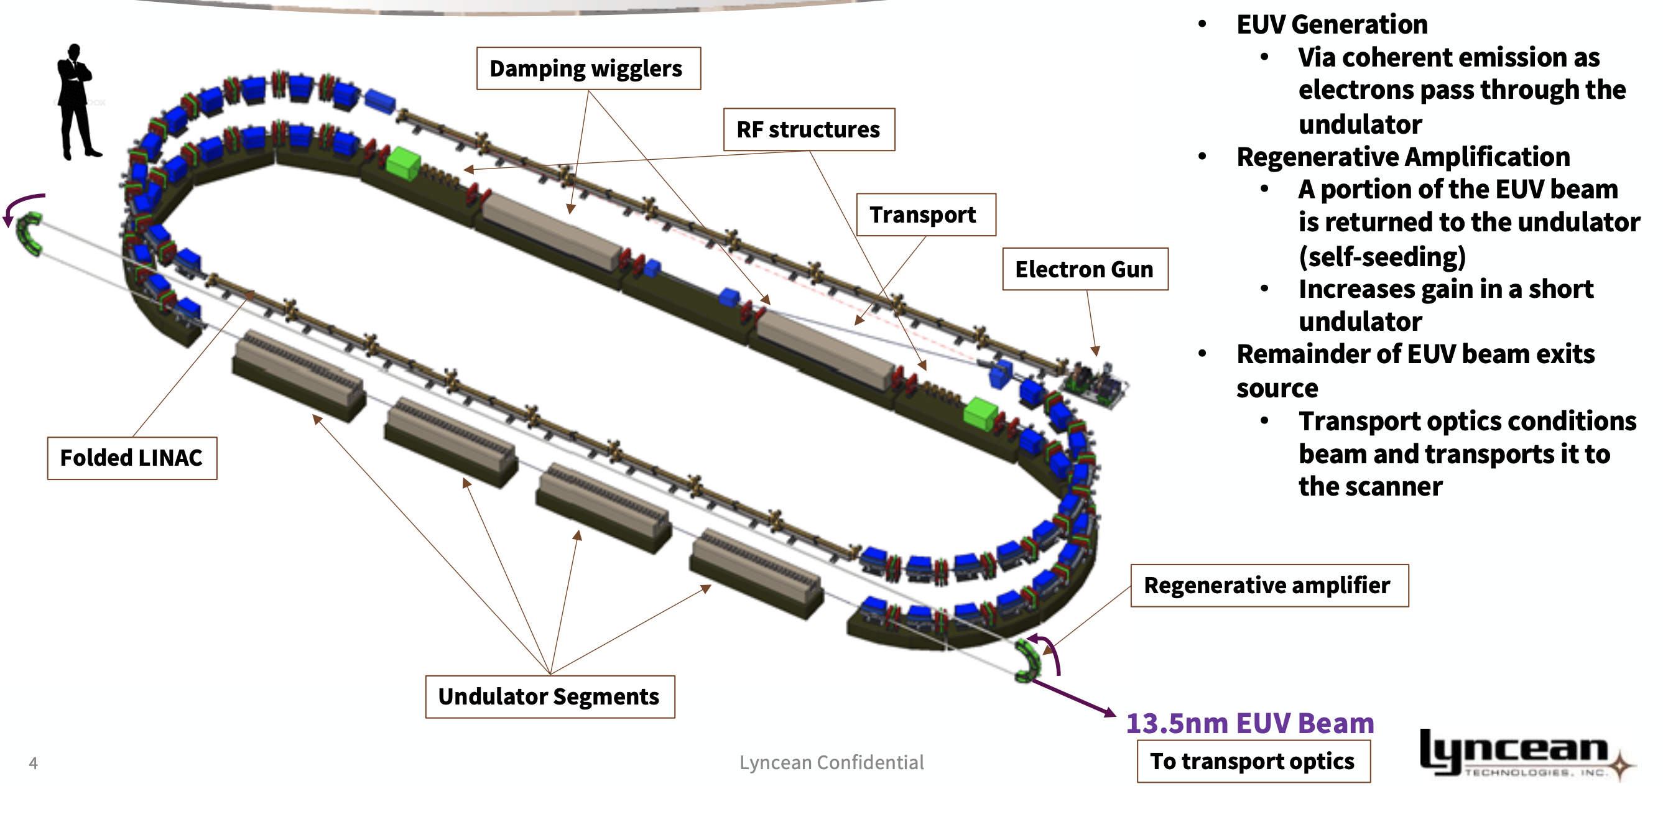
Accelerator EUV Source – Lyncean
From: 5th EUV-FEL Workshop 2021

Slide 16
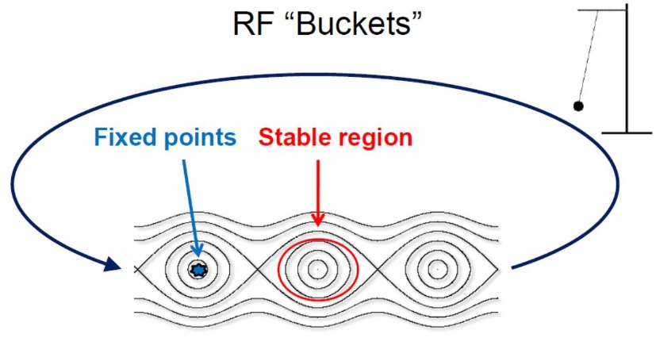
EUV Lithography – SSMB
A new idea to create coherent radiation from steady-state microbunching (SSMB) of the electron beam in a storage ring has been under development for the past few years.
The natural idea of SSMB is a scaling from microwave to optical, i.e. using laser modulator to replace RF to microbunch the beam and let it stay in a steady state.
Ratner, Chao: PRL 105.15 (2010): 154801

Slide 17
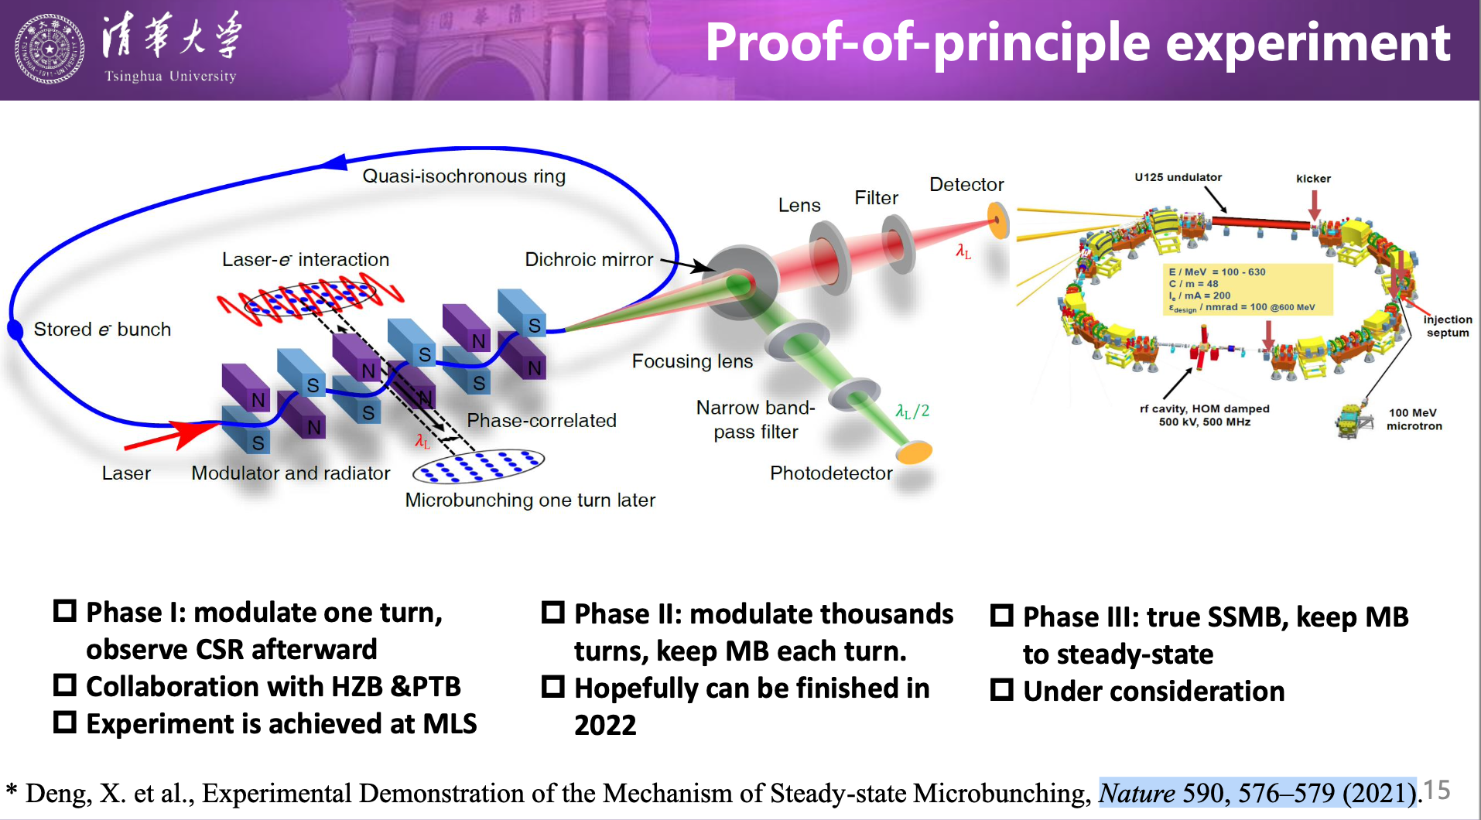
EUV Lithography – SSMB

Slide 18
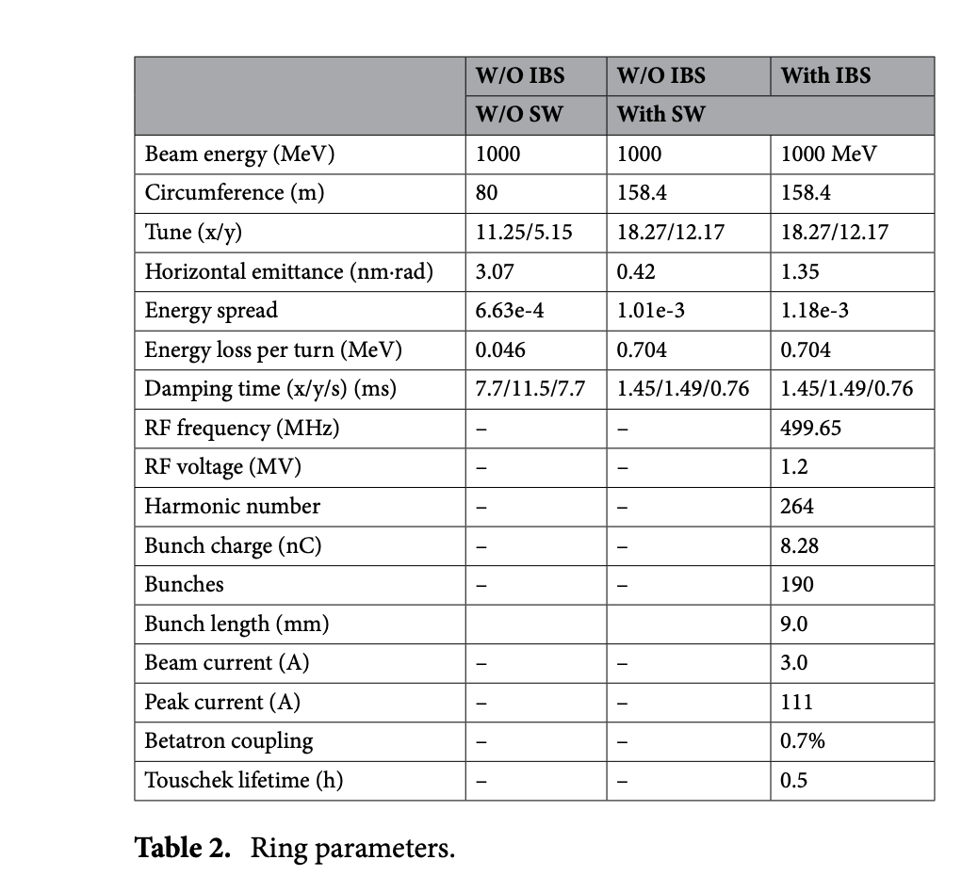
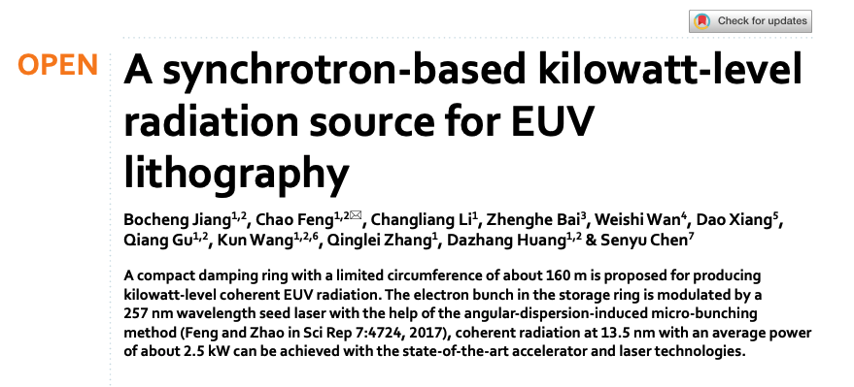
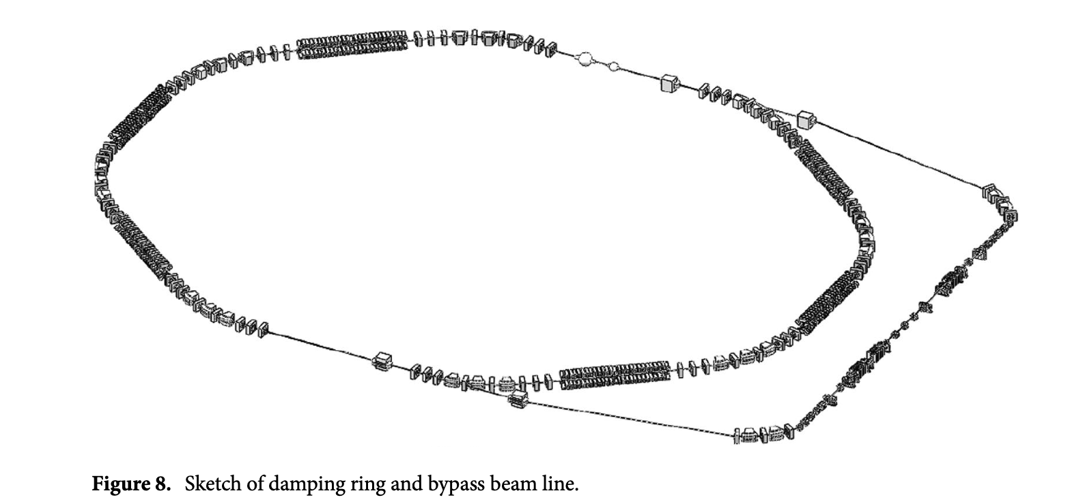
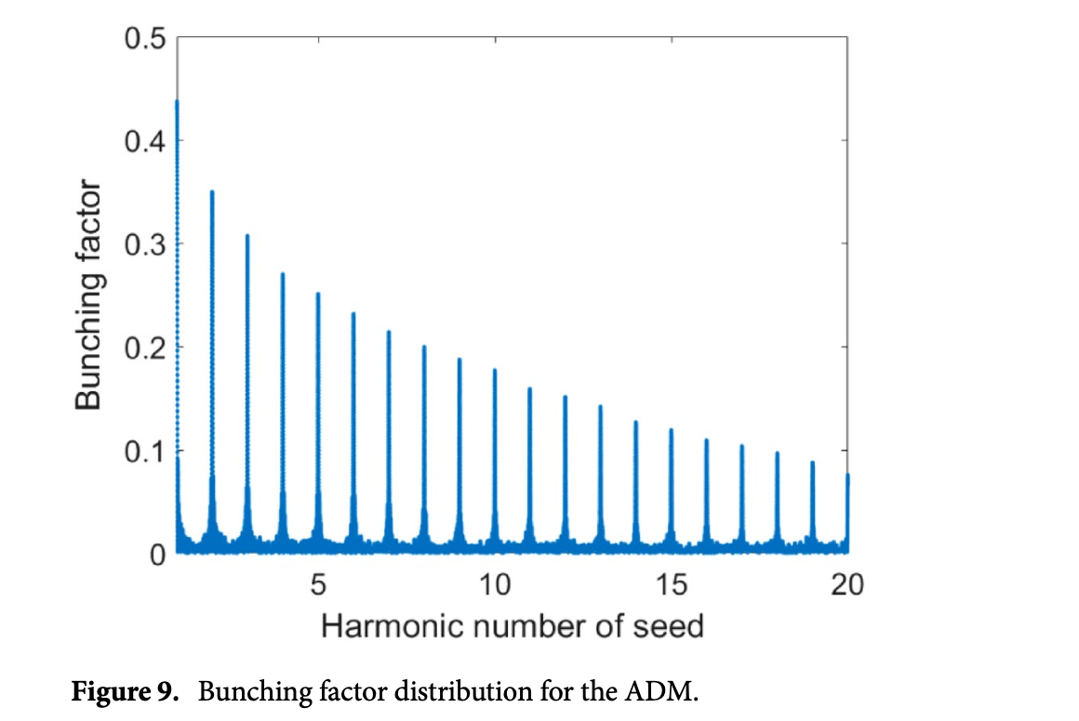
EUV Lithography – CHG@Shanghai

Slide 19
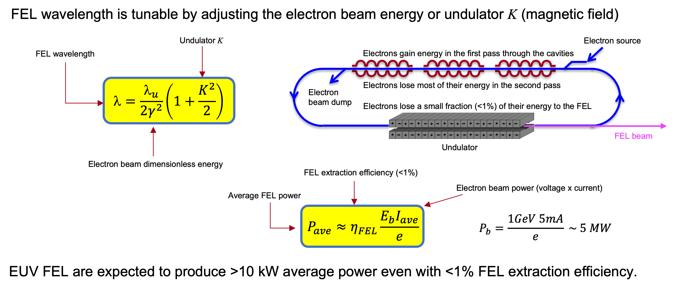
EUV Lithography – FELs
From: 2022 Source Workshop, Dinh Nguyen et al.

Slide 20
EUV Lithography – FELs
SASE Very high gain, starting from noise, single-pass operation, temporally chaotic
FEL Amplifier High gain, coherent seed from a laser, single-pass operation
FEL Oscillator Low gain, high feedback, multi-pass operation, TEM₀₀ transverse profile
RAFEL High gain, low feedback, small # of passes, lower coherence than Oscillator

Slide 21
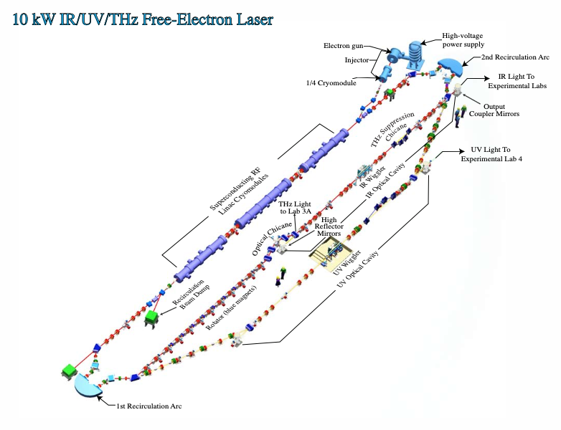
EUV Lithography – FEL Oscillator
Parameter | Value
Beam energy | 135 MeV
Bunch charge | 60 pC
Average current | 4.5 mA
Bunch rep rate | 75 MHz
FEL efficiency | 0.7%
Wavelength | 372 nm
G. Neil et al., “Sustained kW lasing in an FEL with same cell energy recovery” PRL 84, 662 (2000)
S. Benson et al., “High power operation of the JLAB IR FEL driver accelerator, in Proceedings of the 22nd Particle Accelerator Conference, PAC-2007, Albuquerque, NM (IEEE, New York, 2007), pp. 79–81.
D. Douglas et al., “High average power UV FEL Experiments at JLAB” IPAC Conf., New Orleans, LA 2012

Slide 22
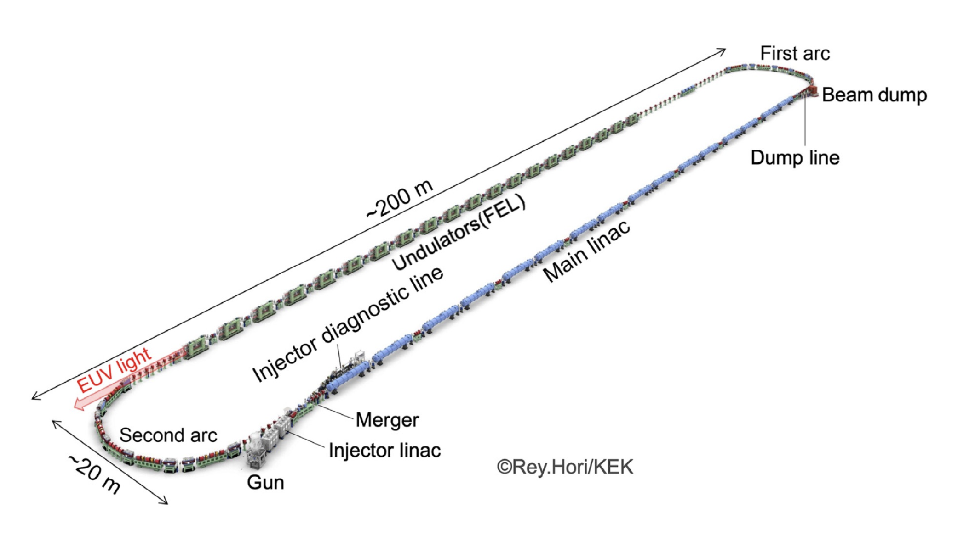
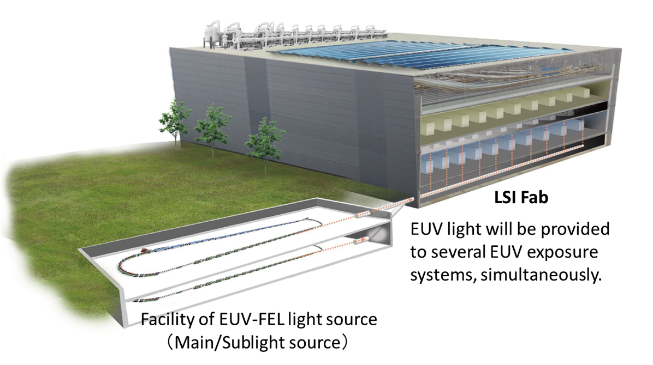
EUV Lithography – SASE
H. Kawata et al., . Micro/Nanopattern. Mater. Metrol. 021210-1 Apr–Jun 2022 • Vol. 21(2)

Slide 23
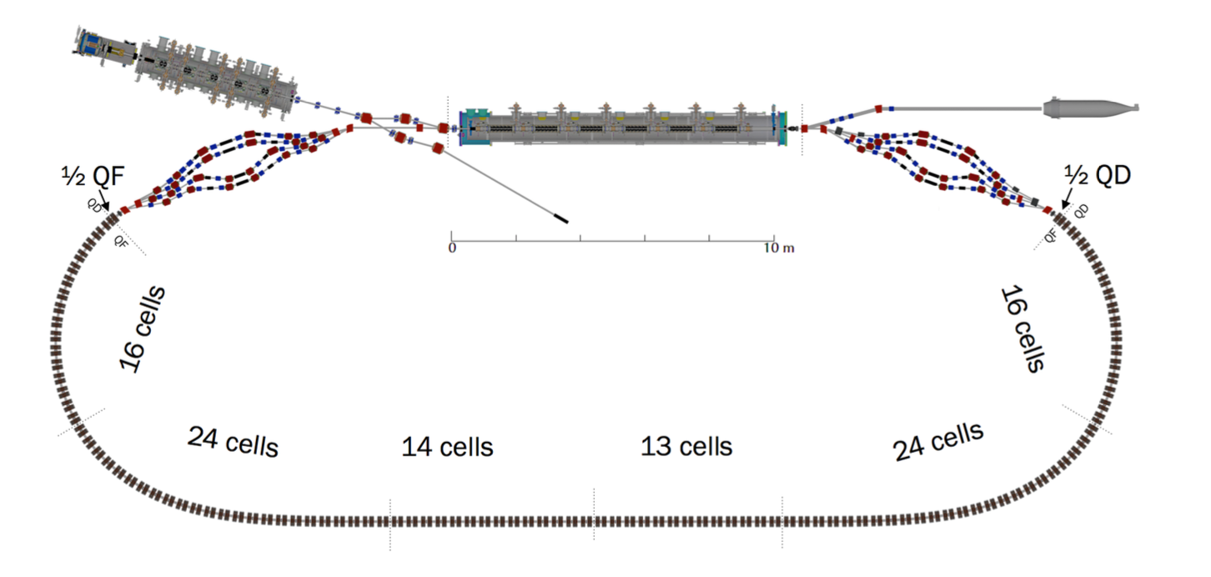
EUV Lithography – CBETA??
Undulator/RAFEL

Slide 24
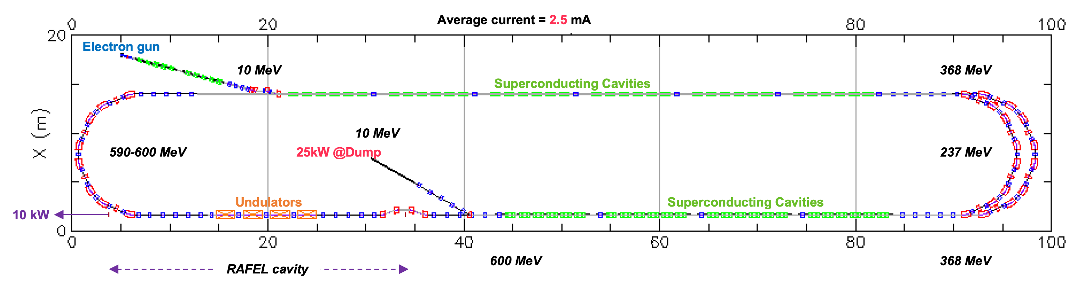
EUV Lithography – RAFEL
Parameter | Value
Beam energy | 600 MeV
Bunch charge | 100 pC
Bunch rep rate | 25 MHz
Pulse energy | 0.4 mJ
Average power | 10 kW
From: 2022 Source Workshop, Dinh Nguyen et al.

Slide 25
EUV Lithography – Accelerators
There are a number of accelerator-based solutions for generating kW-levels of EUV light for lithography
FELs are the most mature
Multiple countries and multiple companies are pursuing various options
Onshoring, CHIPS Act and ever-increasing demand drive the need for more throughput and higher performance in chip manufacturing

Slide 26
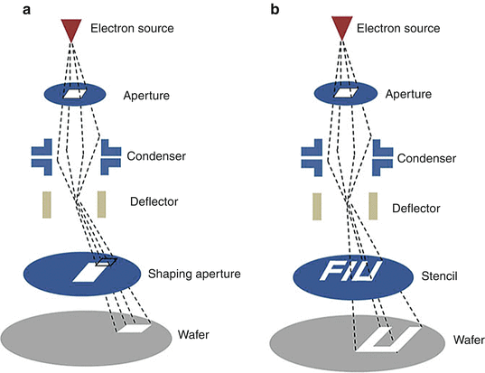
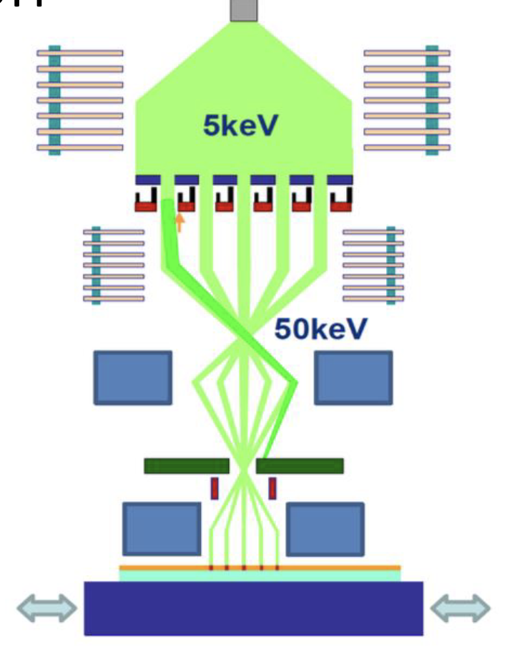
Lithography - Multi-Beam Electron Systems

Slide 27
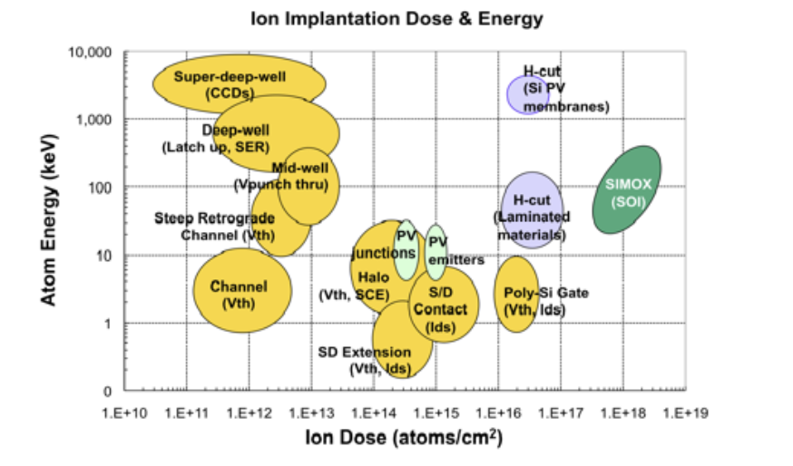
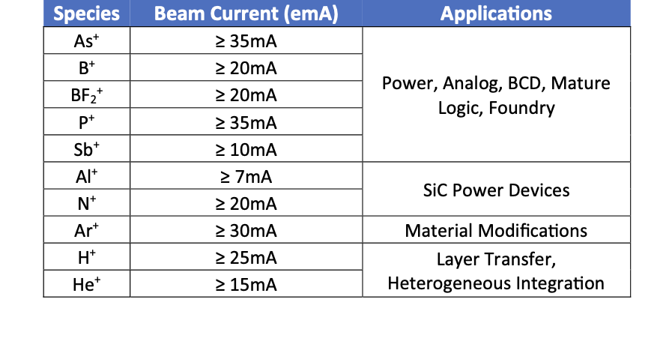
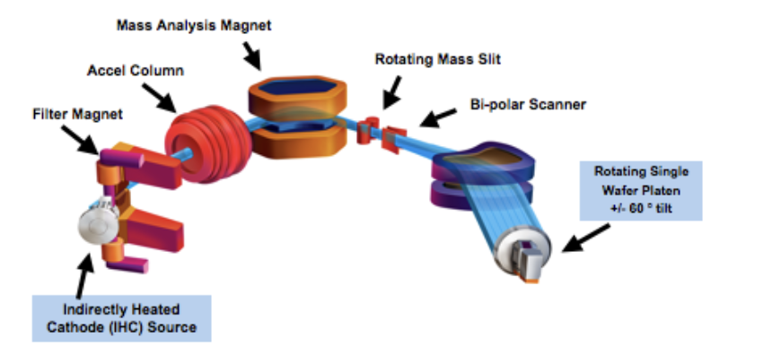
Ion Implantation for Chip Production

Slide 28
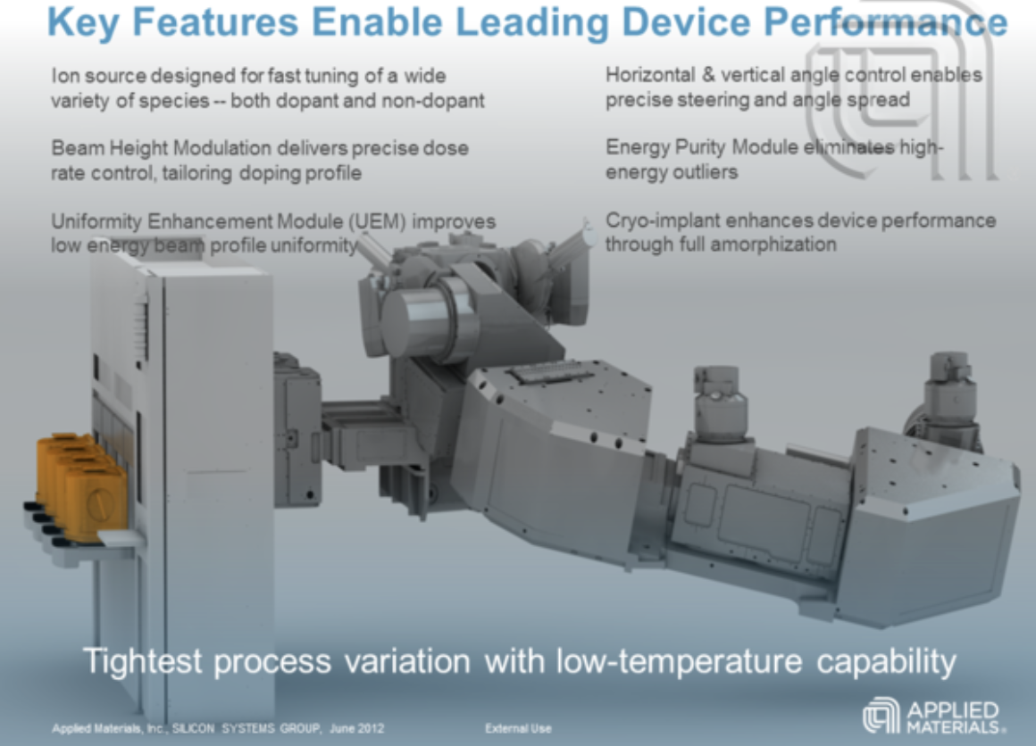
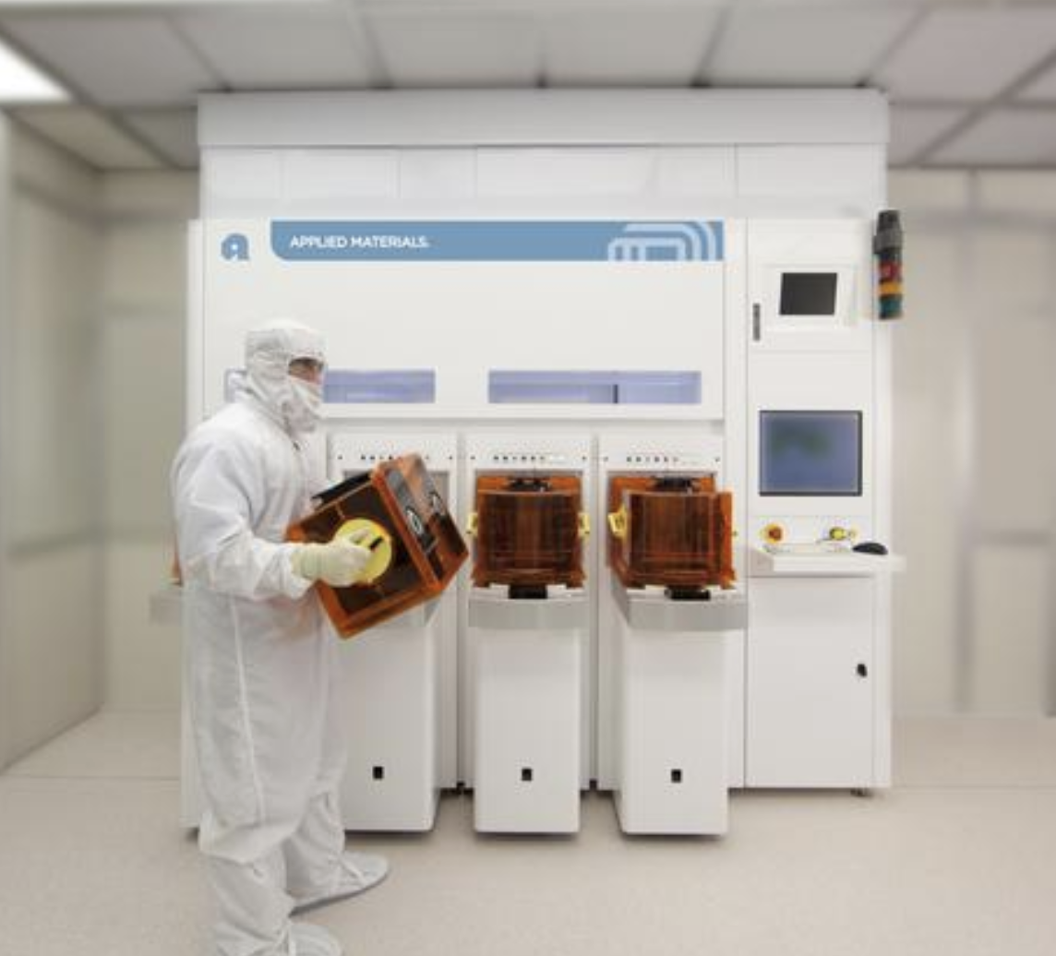
Ion Implantation for Chip Production

Slide 29
Accelerators for Chip Manufacturing
Ion Implantation Systems
Electron Beam Lithography
Electron Beam Inspection Systems
(hopefully) accelerator-based light sources

Slide 30
Accelerator Job Opportunities –Large Companies
Company (Location) | Field
Applied Materials (Santa Clara CA) | Ion Implanters, semi equipment
KLA Tencor (Milpitas, CA) | Electron beam and optical inspection for chips
ASML (Netherlands; CA) | Lithography, EUV sources, e-beam systems
Thermo Fisher (San Jose, CA) | Electron microscopy, inspection systems
Axcelis Technologies (Beverly, MA) | Ion Implantation
Varian/Siemens (Palo Alto, CA) | Radiation therapy systems
CPI (Palo Alto, CA) | Klystrons

Slide 31
Accelerator Job Opportunities –Small Companies
Company (Location) | Field
xLight, Inc (Palo Alto) | Industrial accelerators
Multibeam Corp (Santa Clara) | Ebeam lithography
ViewRay (Mountain View, CA) | Radiation therapy/MRI
Radiabeam (Santa Monica, CA) | NC RF linacs, accelerator components/systems
Reveam (Atlanta, GA) | Food irradiation systems
Xelera Research (Ithaca, NY) | Accelerator components, design
Start your own company!

