Slide 1
TFPX module testing at Cornell
05-01-23

Slide 2
Comparisons only for chip 12
Chip 13: columns 244, 245 masked by hand
  ENABLE -> 0,0,0……0
  HITBUS -> 0,0,0,……0. forgot this.

Slide 3
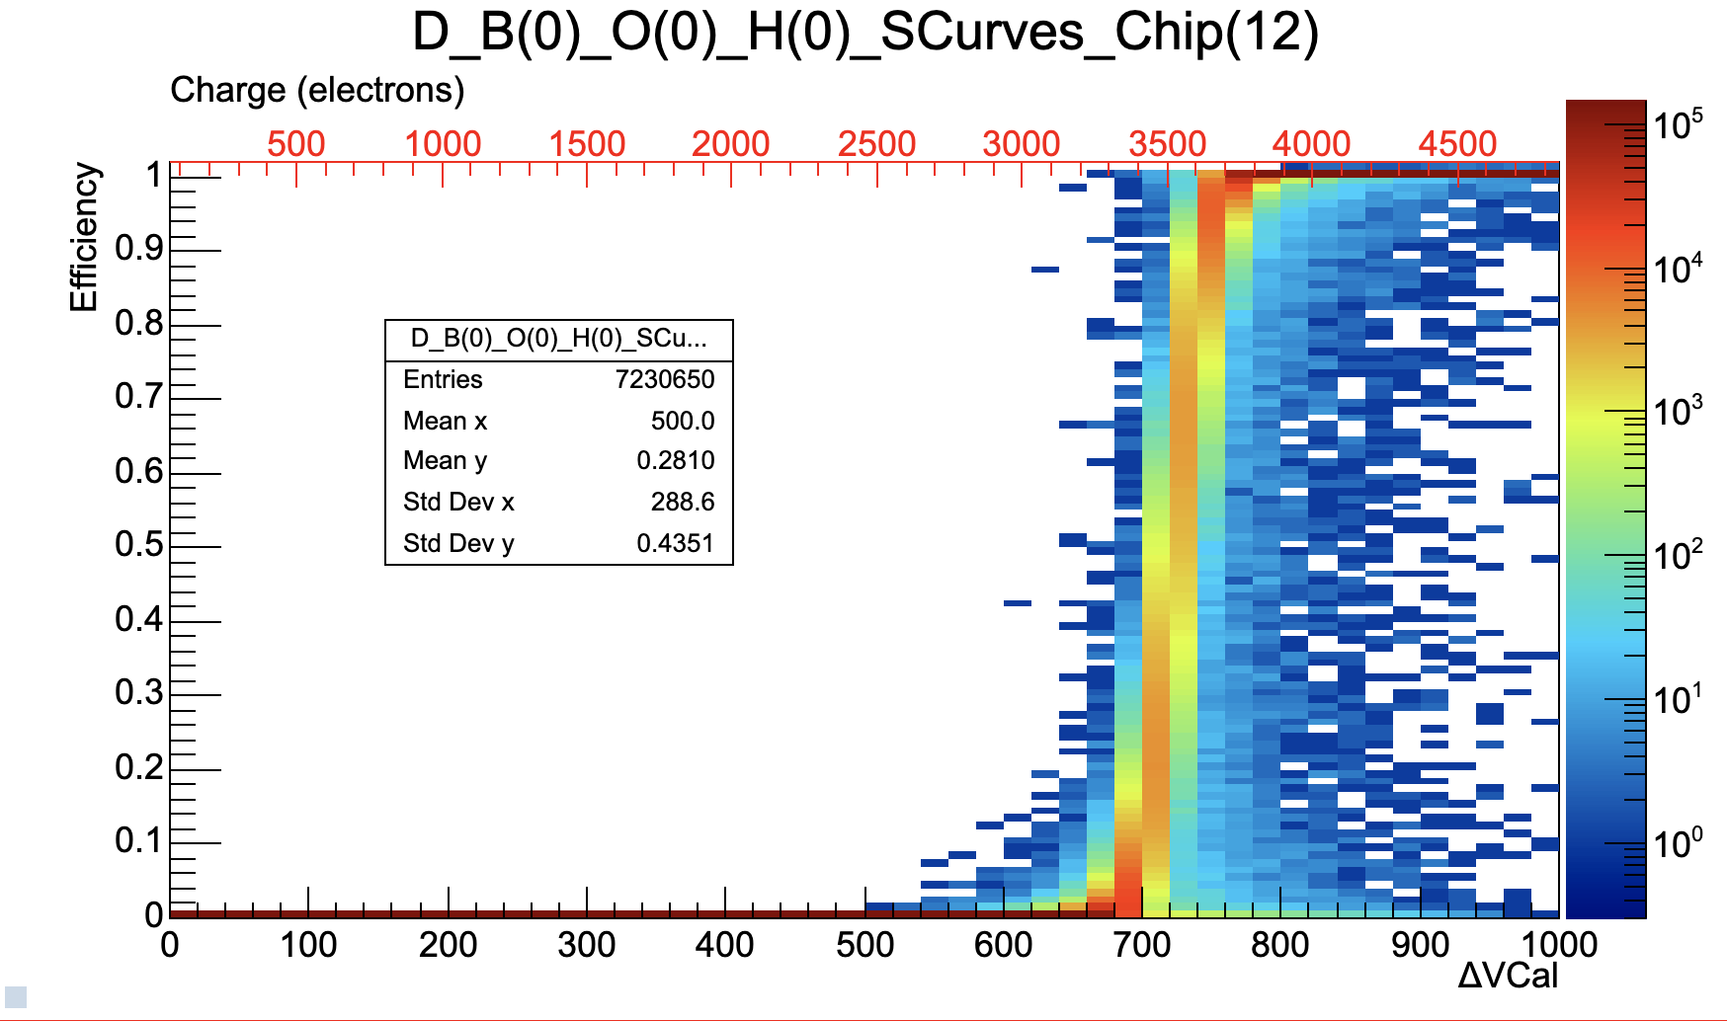
@3500e-

Slide 4
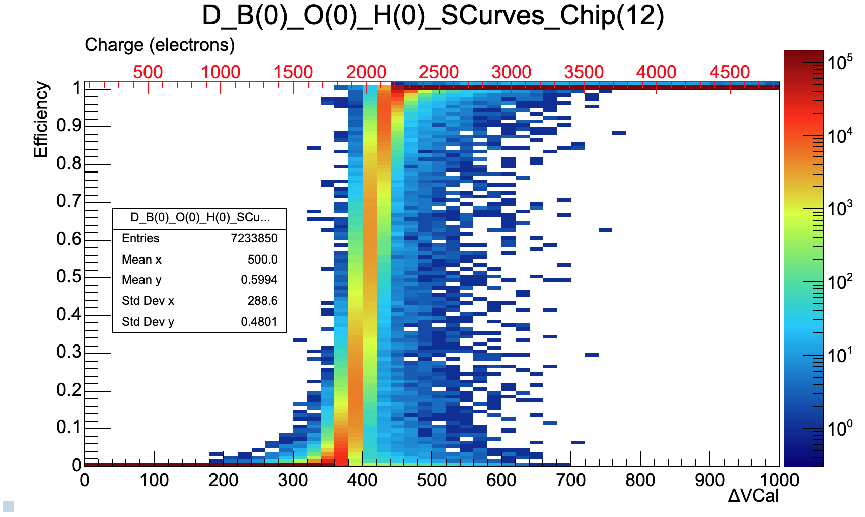
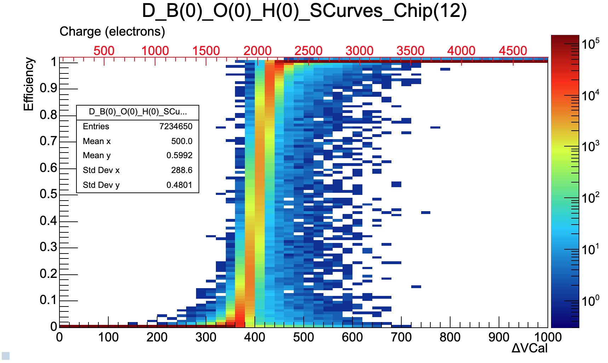
@2000e-
JM
RW

Slide 5
@1500e-

Slide 6
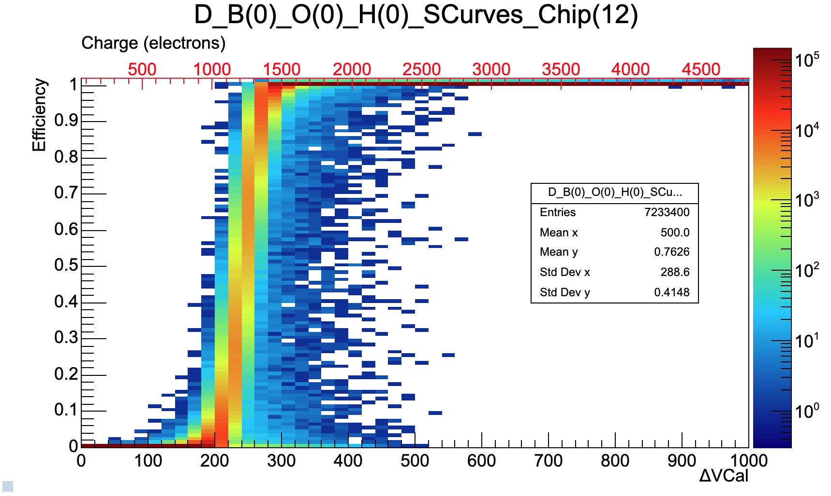
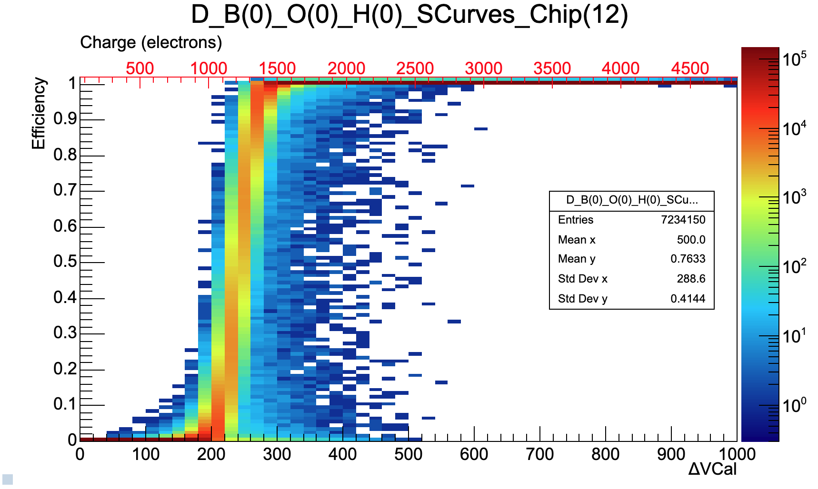
@1200e-
JM
RW

Slide 7
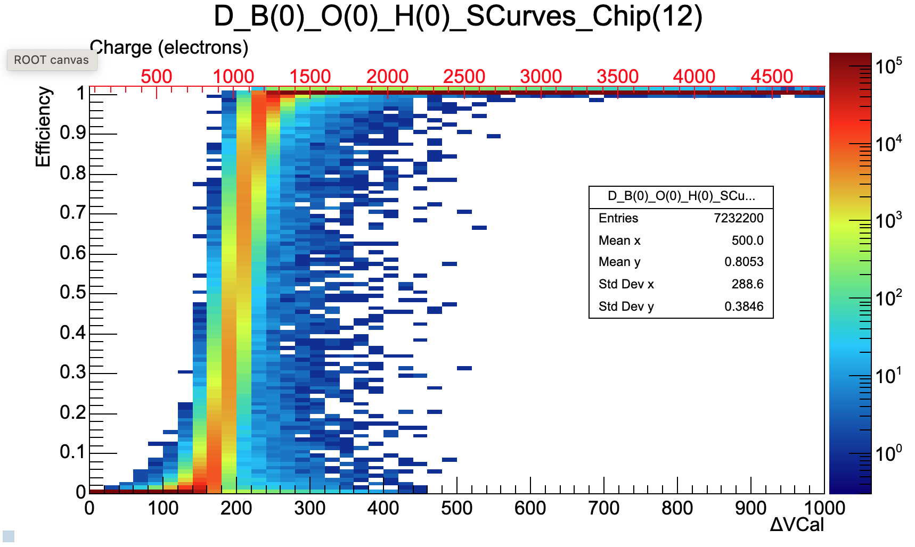
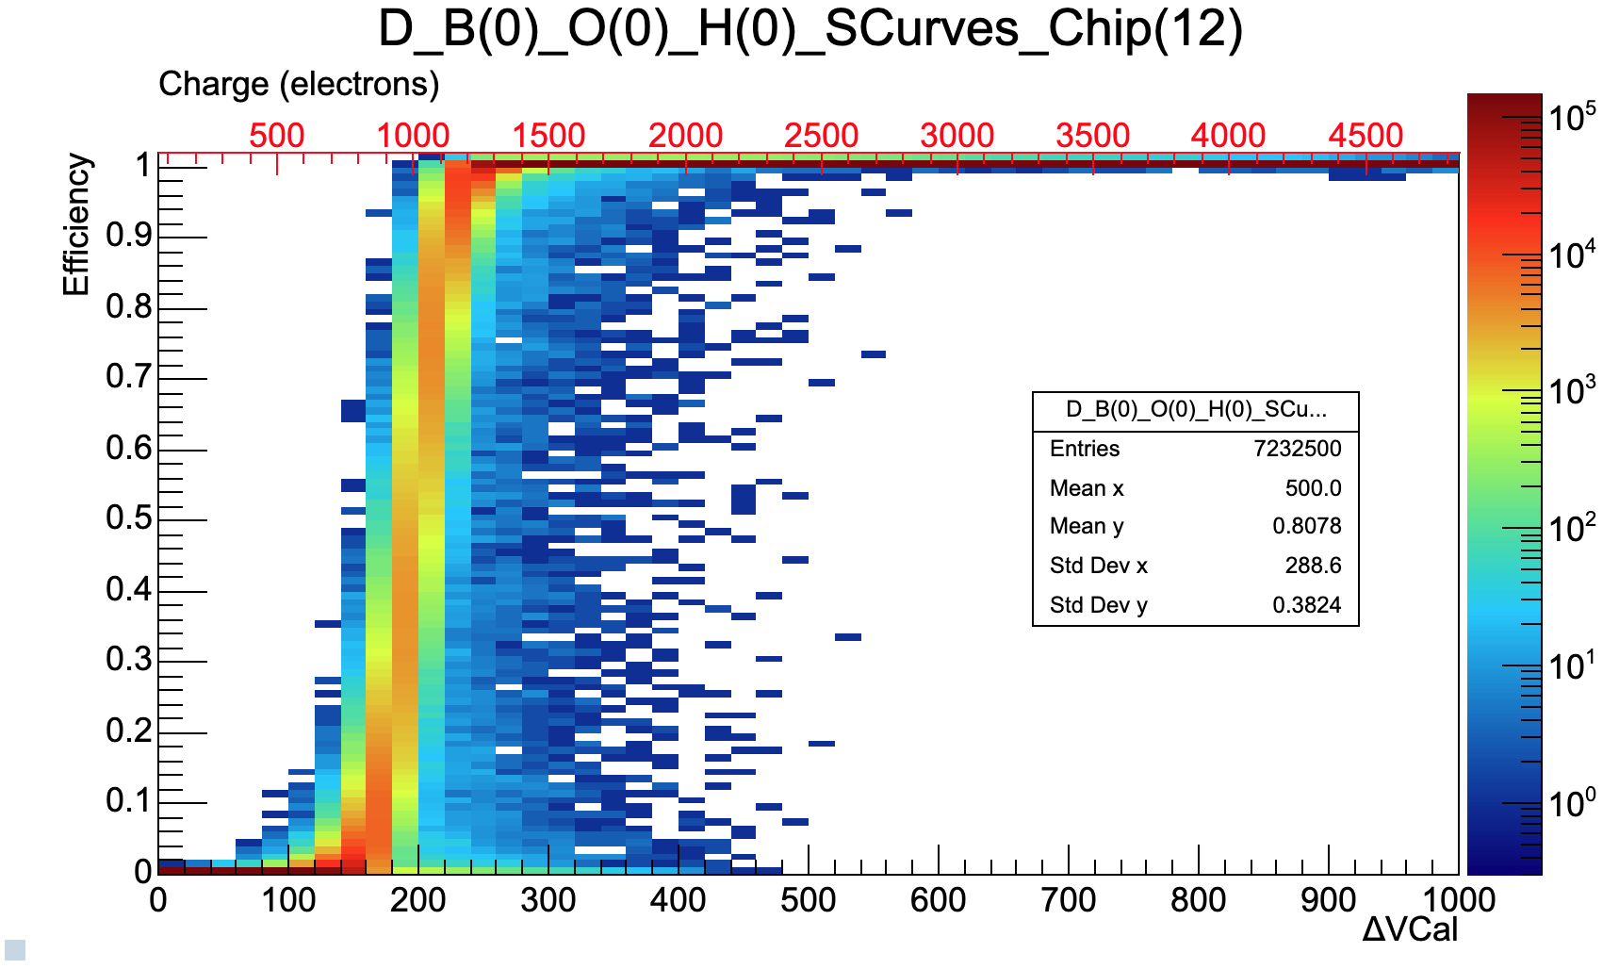
@1000e-
JM
RW

Slide 8
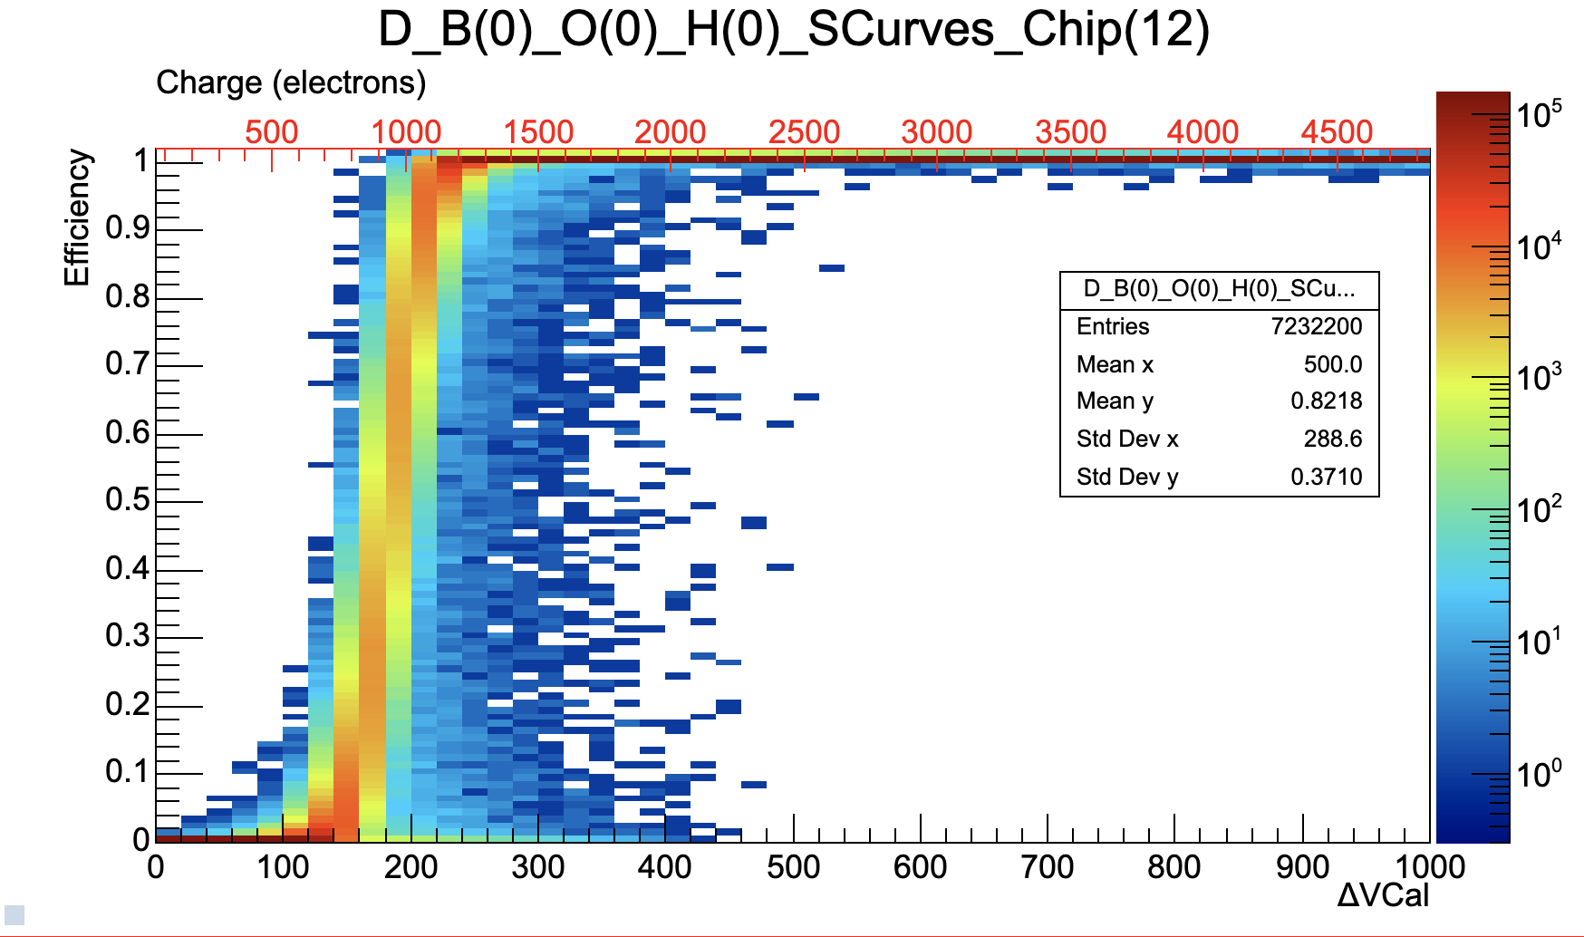
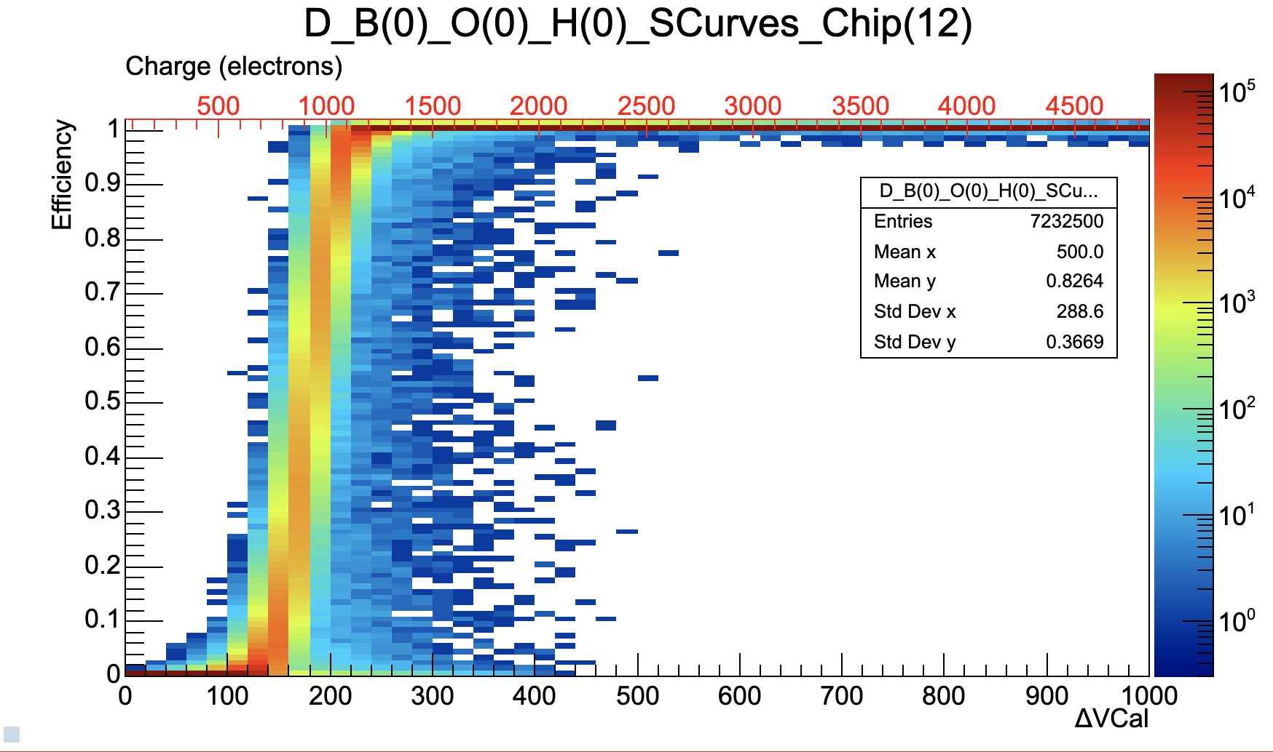
@900e-
JM
RW

Slide 9
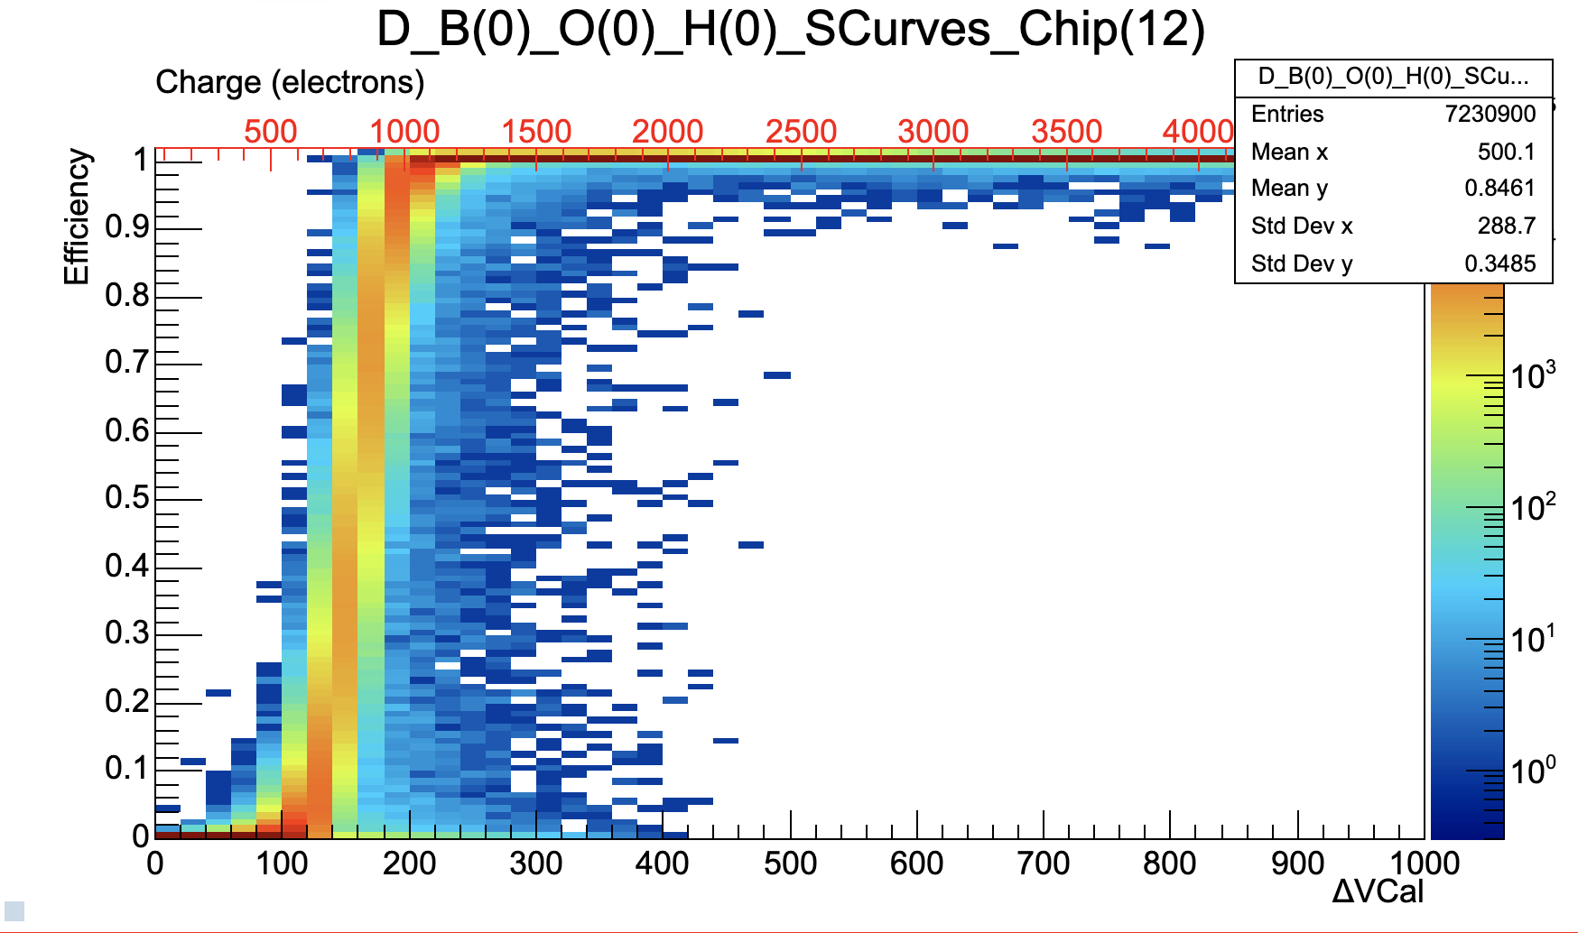
@800e-
JM
RW

Slide 10
@700e-
876 masked pixels

Slide 11
@600e-
1792 masked pixels

Slide 12
Conclusion
Test program can be run in more that one testing session, without a big penalty - sometimes none
Next:
Rerun tests after 2000 with HITBUS adjust and then compare

