Slide 1
TFPX module testing at Cornell
04-11-23

Slide 2
Test program
Comparison v11 and v12
1) IV curve
2) pixel alive
2a) Noise
3) thradj @3500 e-)
4) threqu
5) Scurve
6) [Noise]
7) thradj @2000
7a) threqu
8) Scurve
9) [Noise]
10)thradj @1500
10a)threqu
11) [Scurve]
12)Noise
13)thradj @1200
13a)threqu
14) Scurve
15)Noise
16)Scurve
17) Gain
Adjust
TargetThr
Vthreshold_LIN
In .xml and noise.xml files

Slide 3
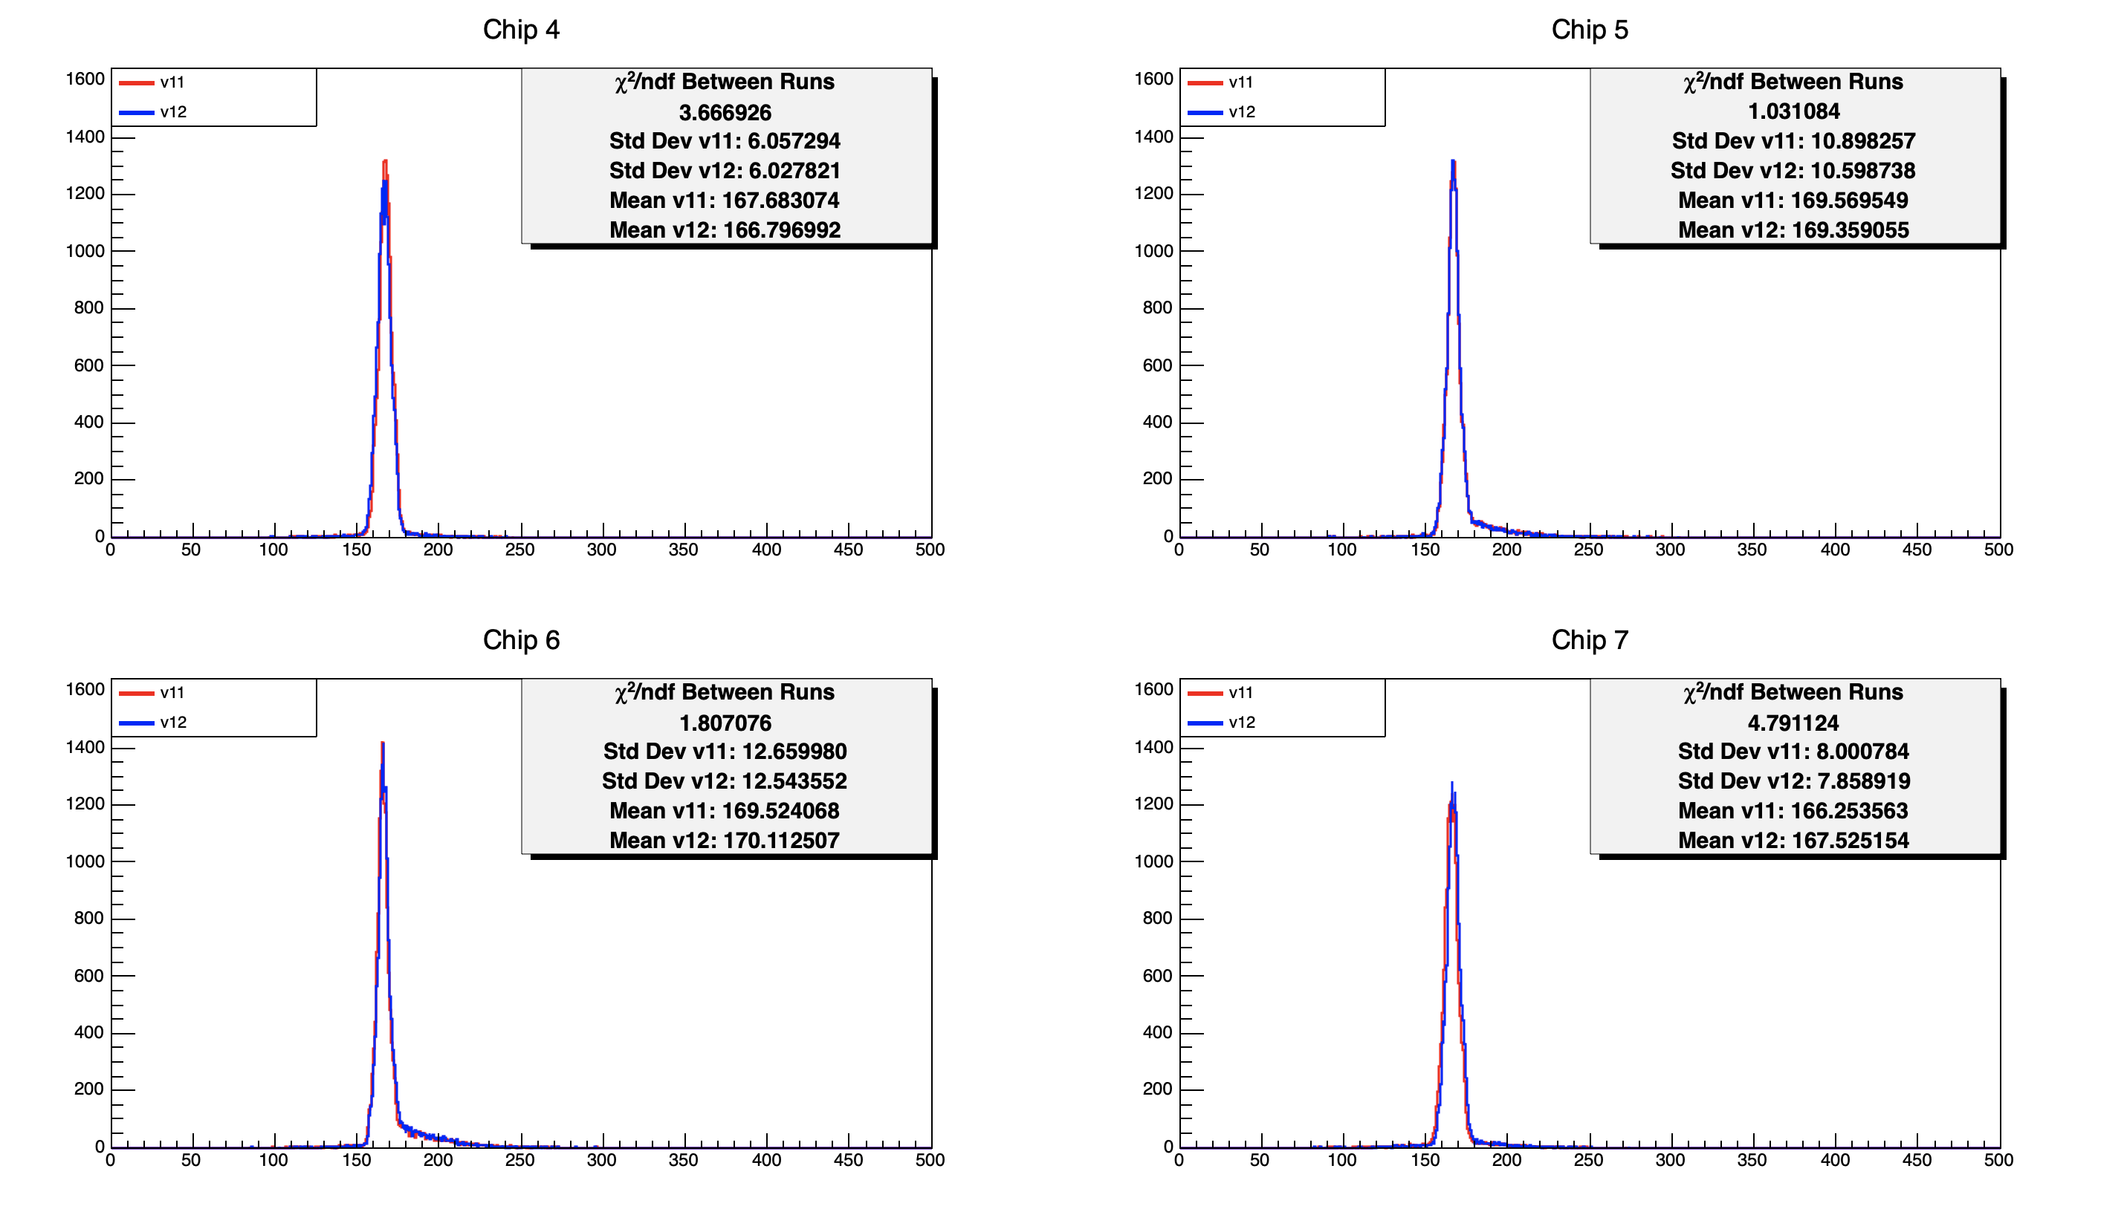
@2000e-

Slide 4
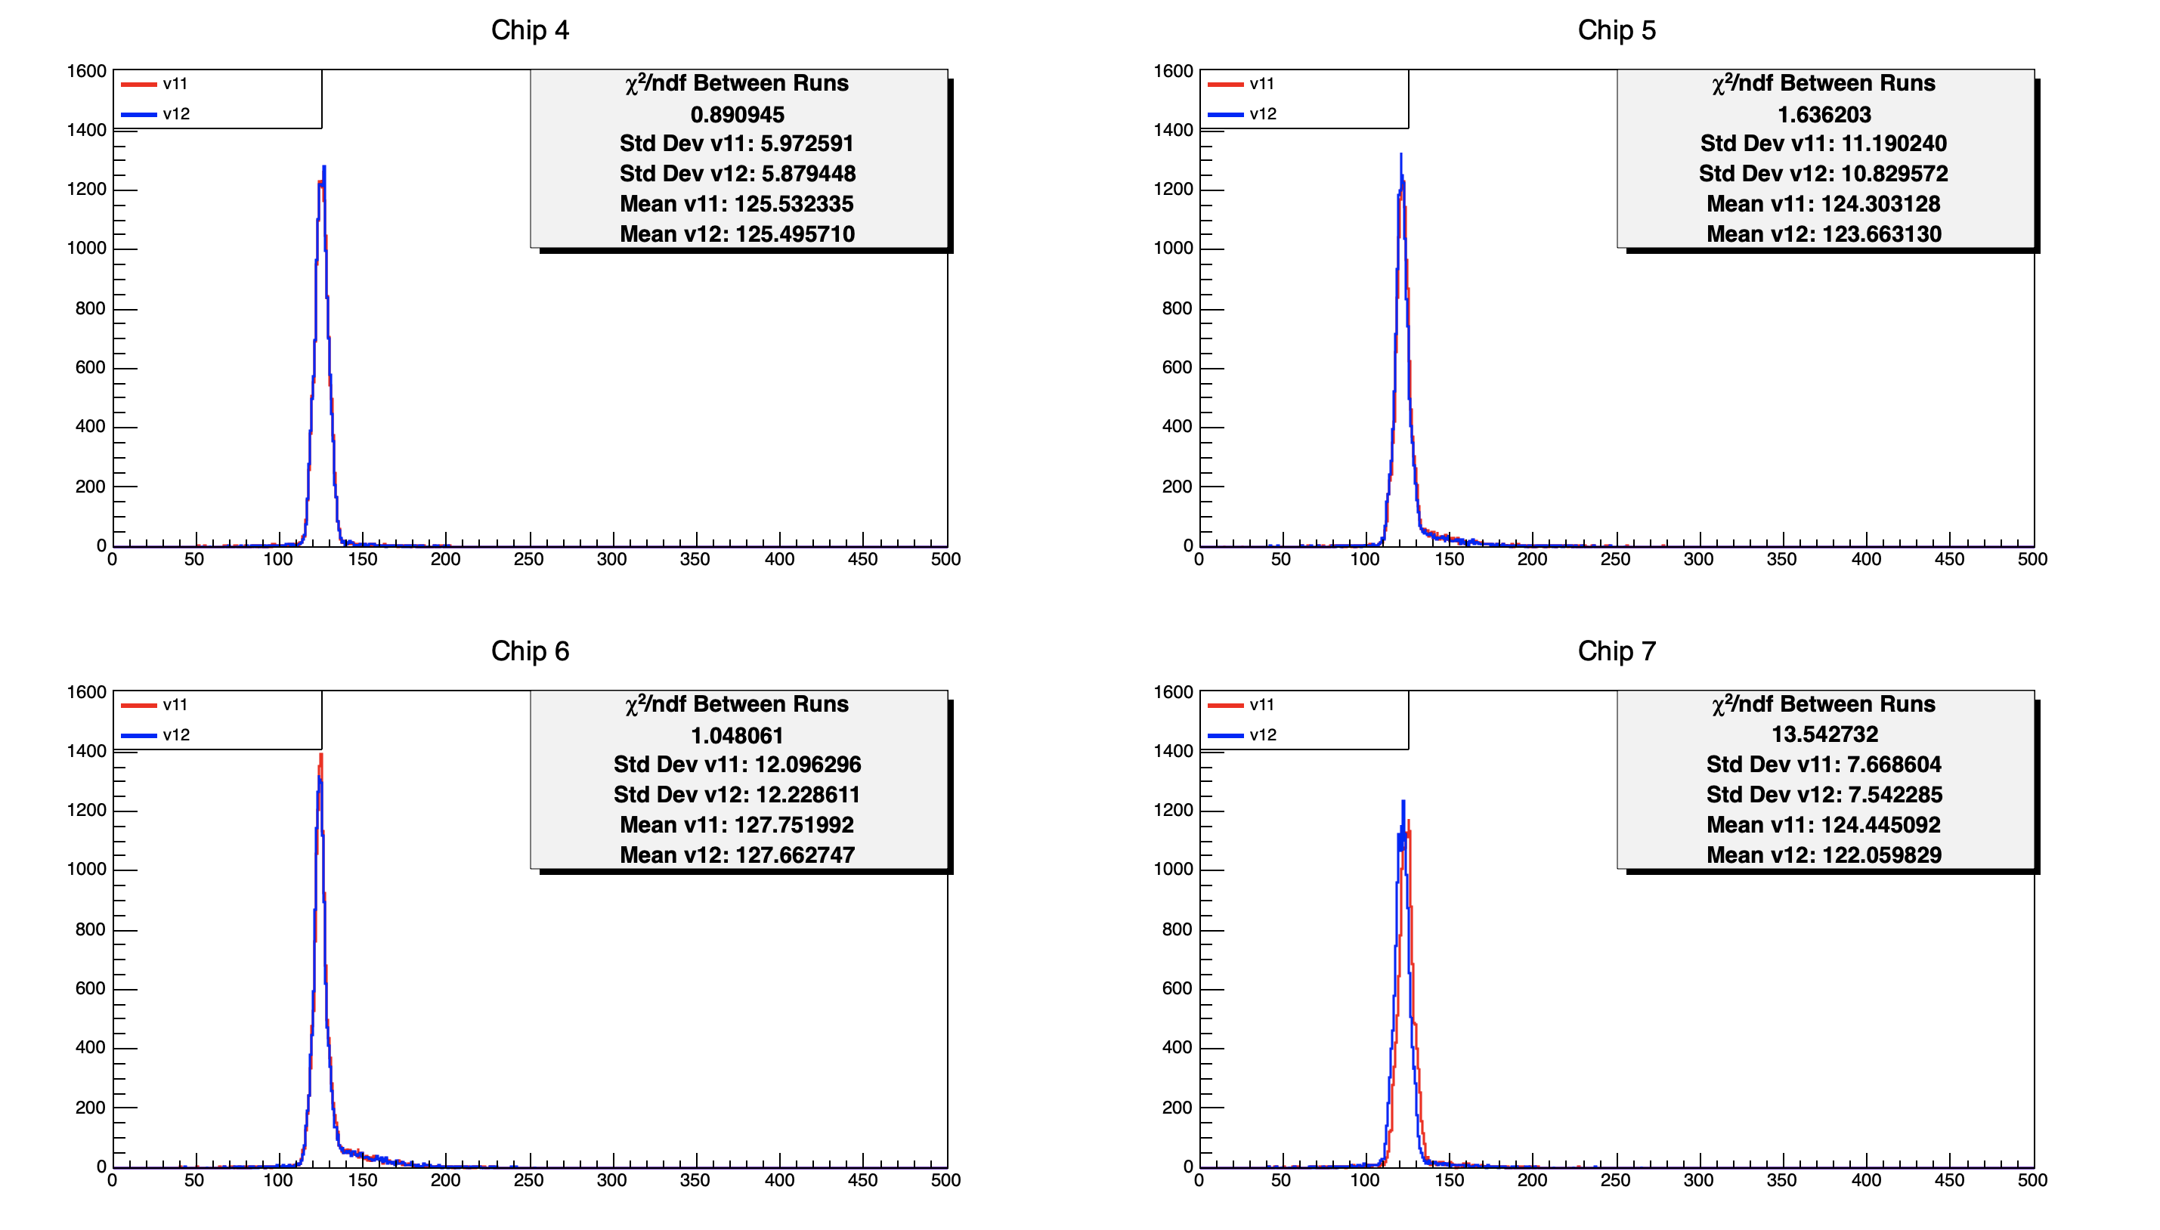
@1500e-

Slide 5
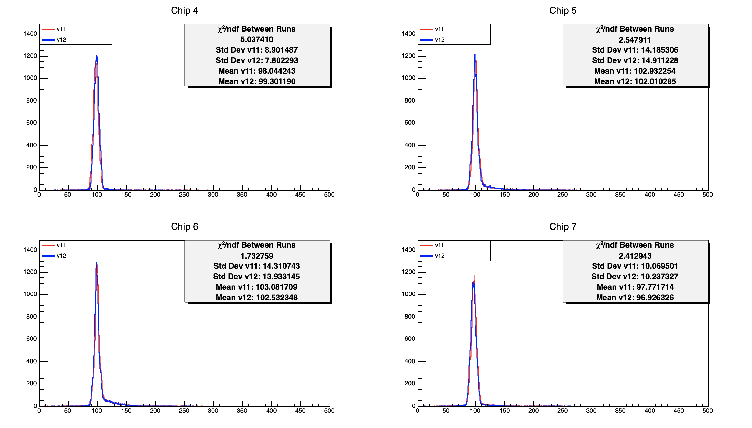
@1200e-

Slide 6
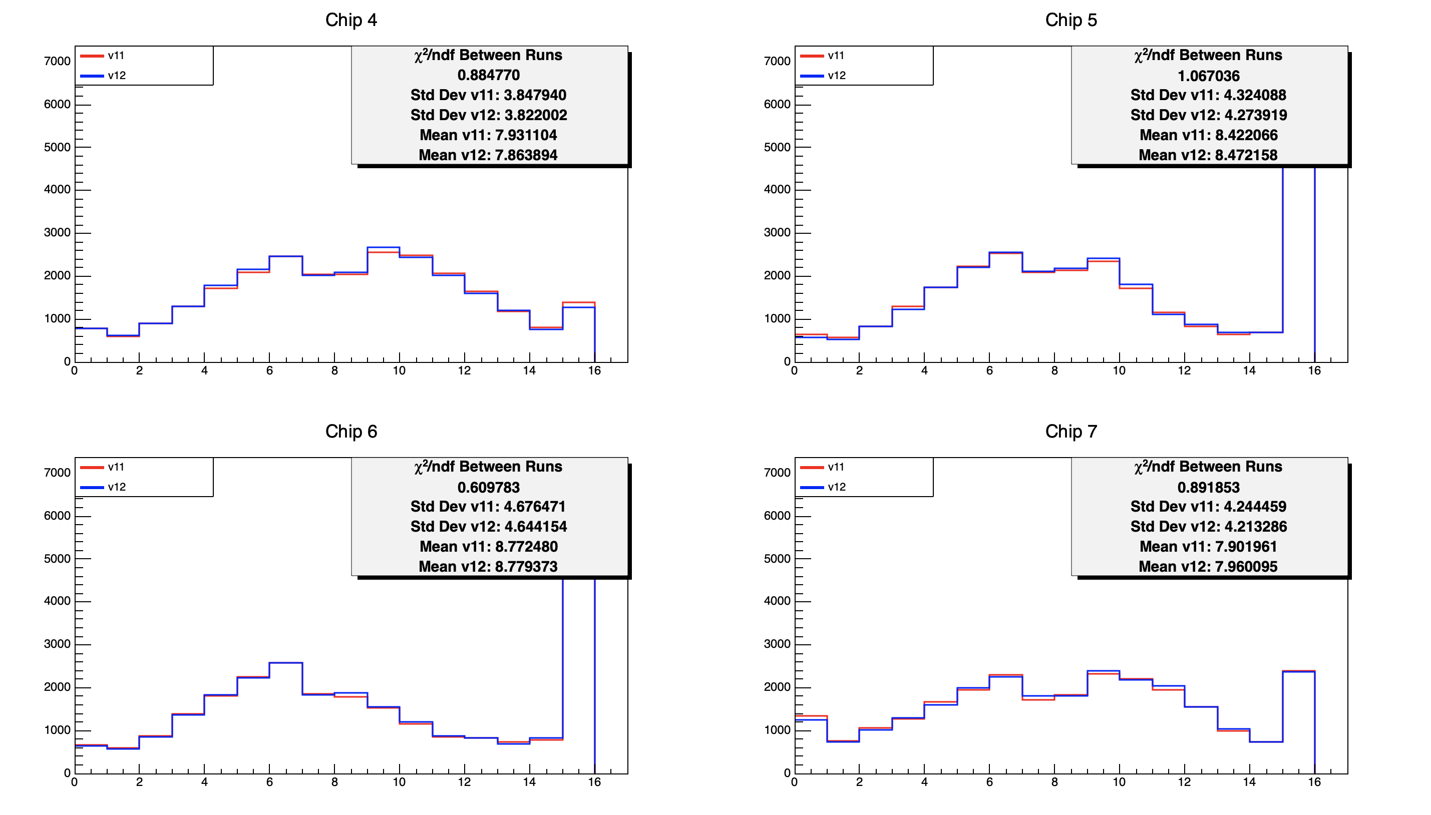
TDAC @3500

Slide 7
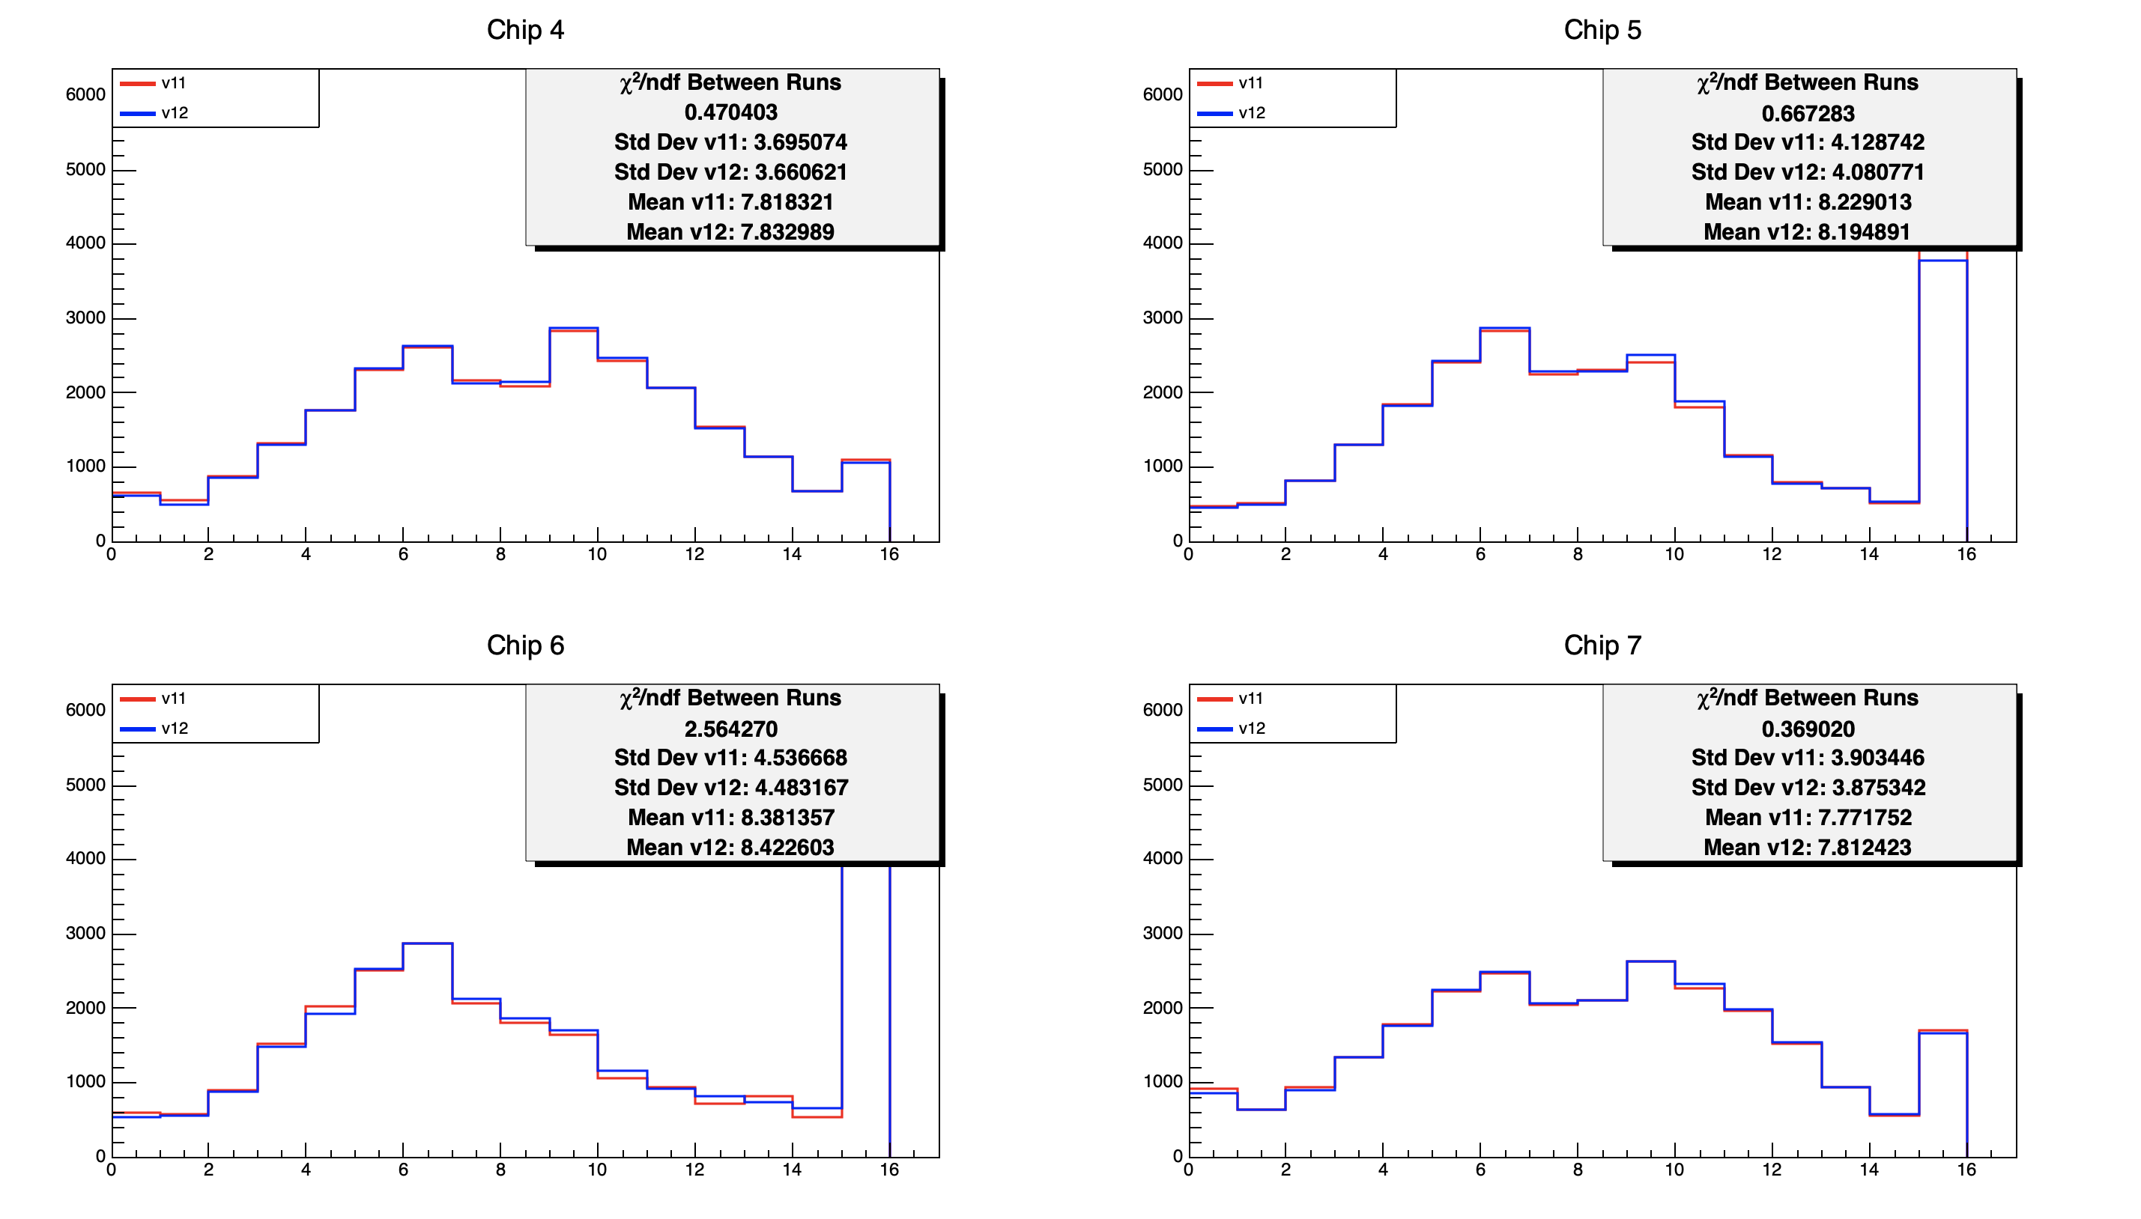
TDAC @2000

Slide 8
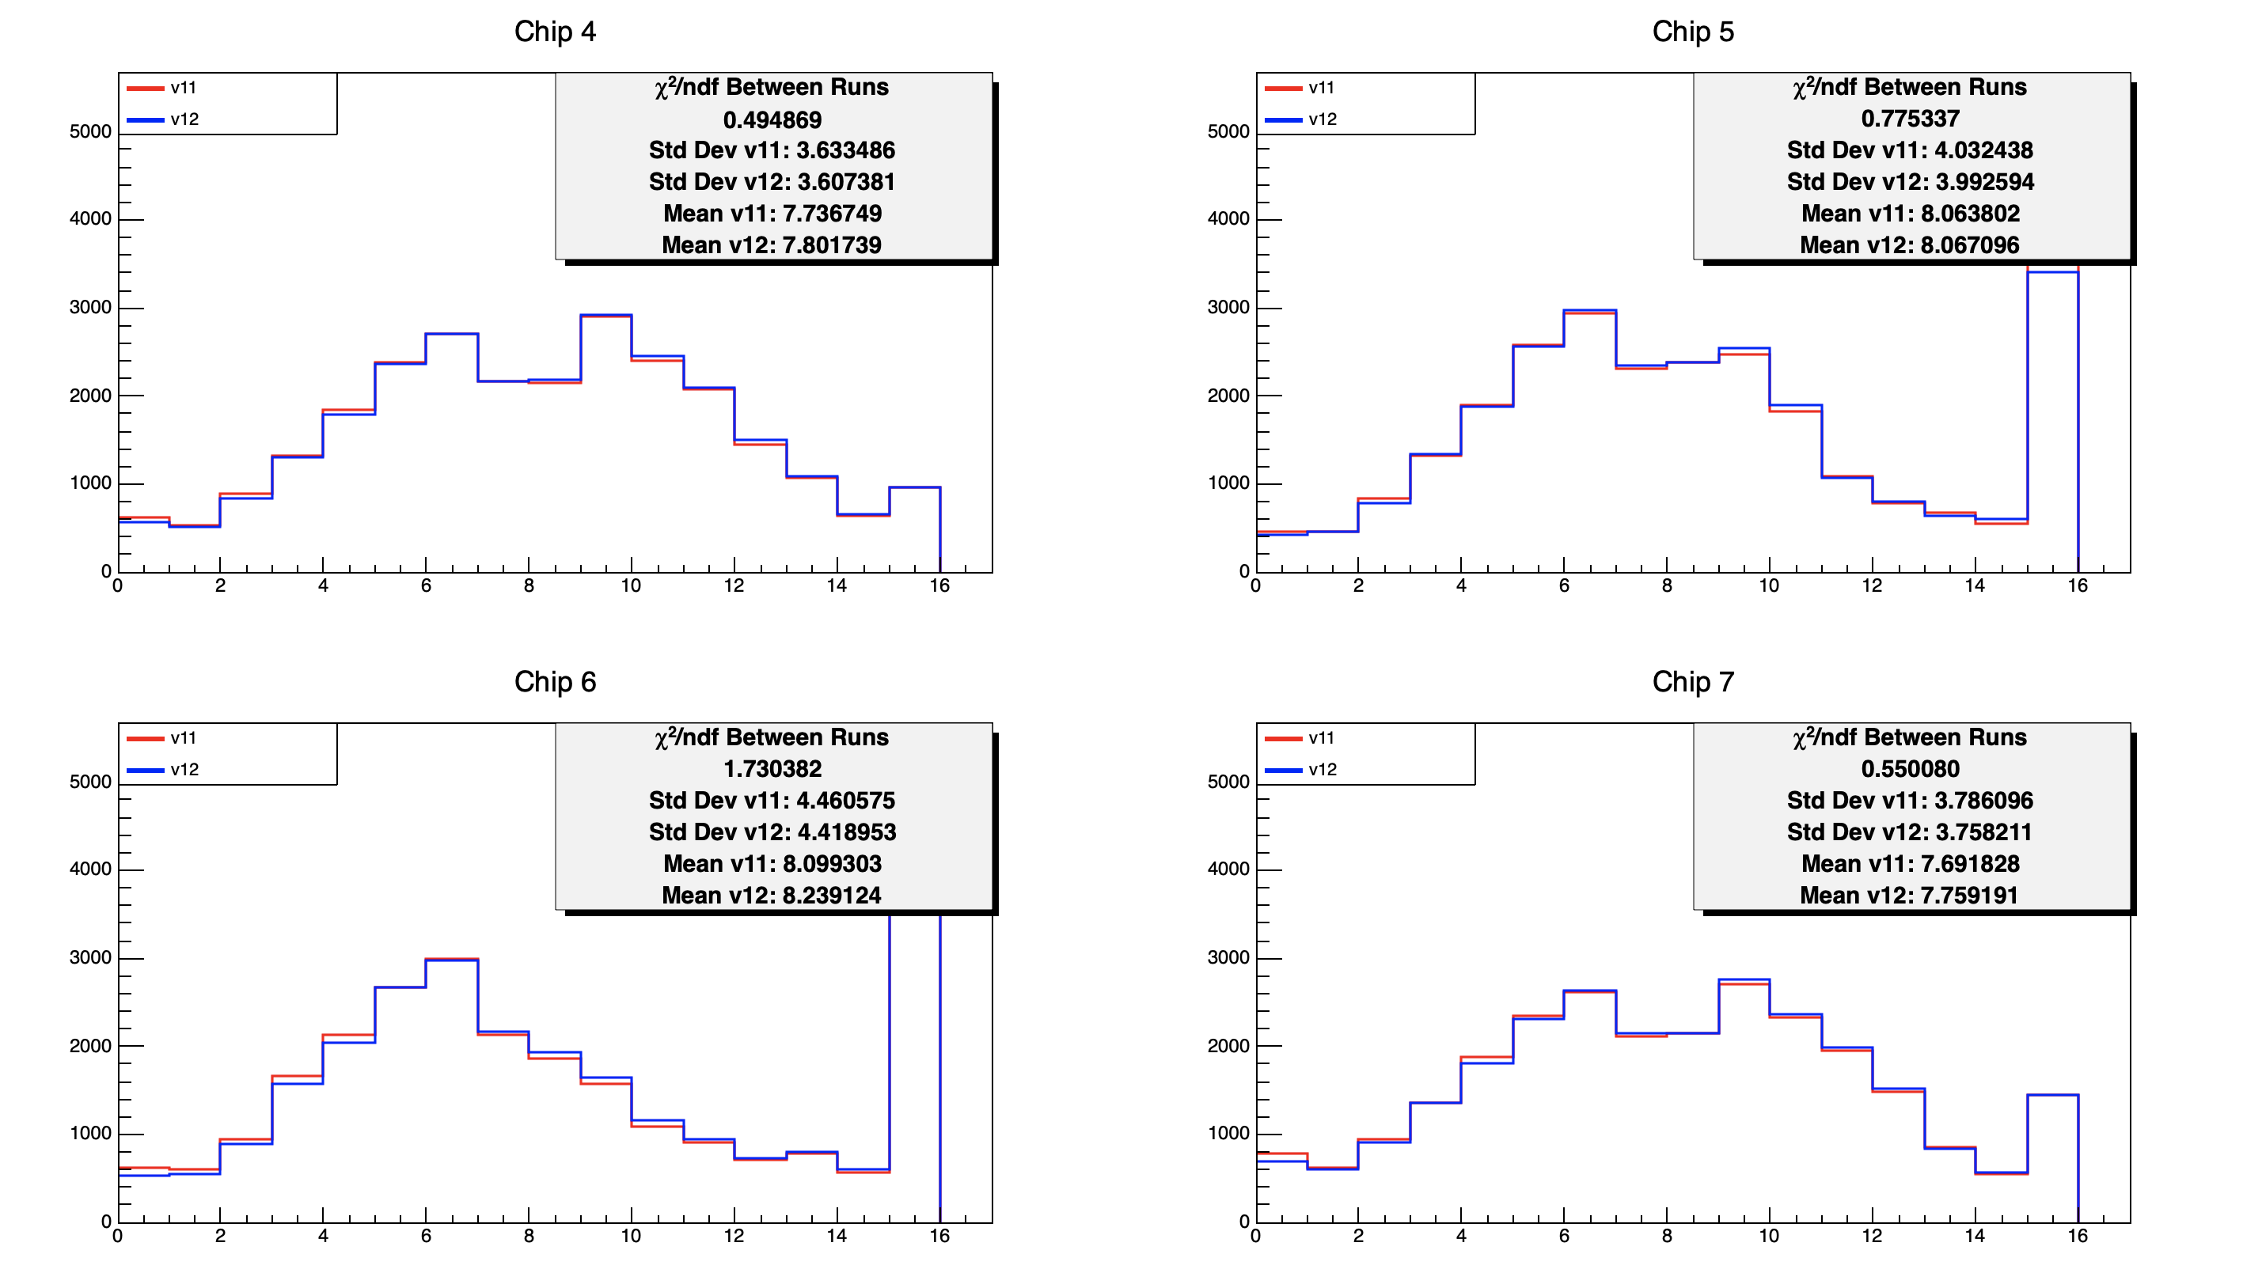
TDAC @1500

Slide 9
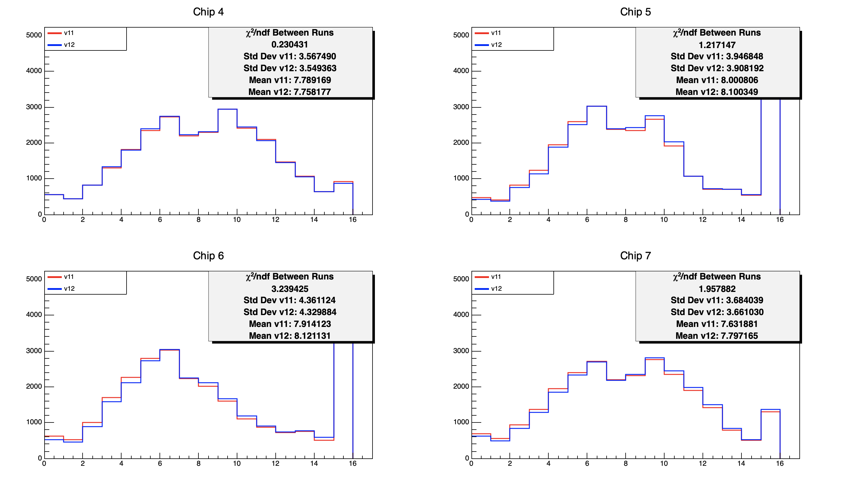
TDAC @1200

Slide 10
Noise scan
Chip | # Pixel masked
 | @1500e |  | @1200e
 | v11 | v12 | v11 | v12
4 | 1 | 2 | 109 | 80
5 | 72 | 73 | 470 | 581
6 | 5 | 8 | 191 | 188
7 | 9 | 7 | 137 | 156
I did not try to go lower In threshold

