Slide 1
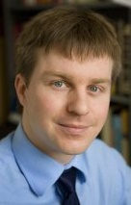
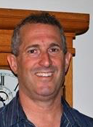
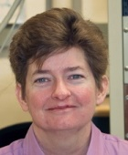


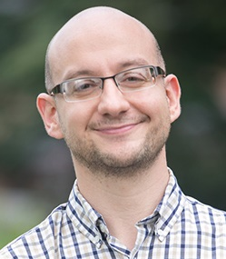
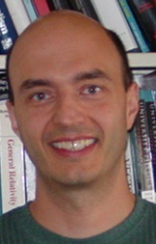
Beam Production
Jared Maxson, Asst. Professor, Cornell University
theme leaders
Richard
Hennig
U. Florida
Jamie
Rosenzweig
UCLA
Melissa
Hines
Cornell
Kyle
Shen
Cornell
Ivan
Bazarov
Cornell
Pietro
Musumeci
UCLA
Siddharth Karkare
ASU
Jared
Maxson
Cornell
Tomas
Arias
Cornell.
Optimal outcome: Methods for x100 brighter electron sources through better photocathodes, enabling better X-ray sources, colliders and electron imaging.

Slide 2
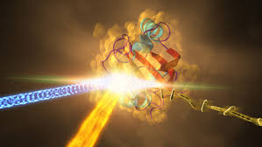
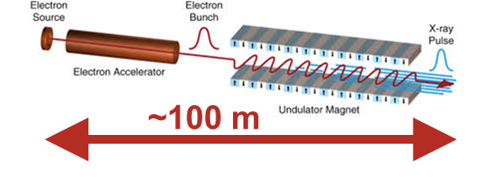
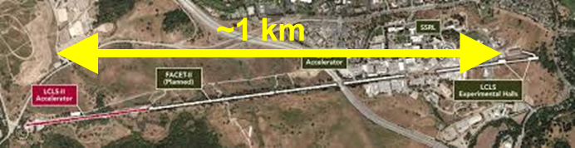
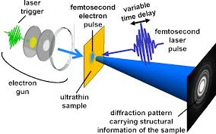
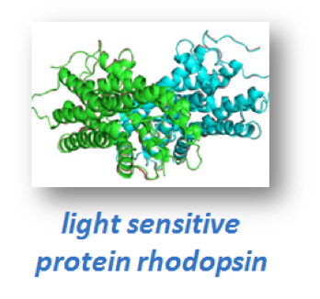
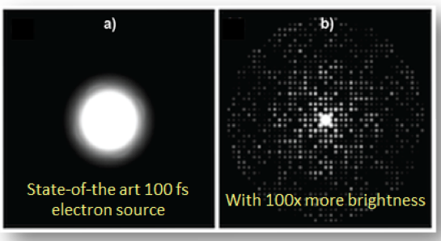
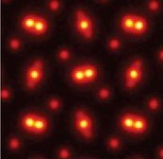

Why Brighter Sources?
Most impactful areas:
1. Transformed X-Ray Free Electron Lasers
100X brighter
AND
LCLS @ SLAC
Higher power and photon energy x-rays
Compact XFELS
2. Mesoscale Ultrafast Electron Diffraction
By 2026: Develop electron sources to enable these applications
Today
100XBrighter
3. Time-resolved atomic resolution STEM
Brighter photoemission sources
fs motion

Slide 3
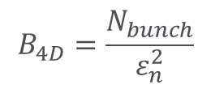



Electron Beam Brightness
Beam Brightness, B = Charge density in phase space
$$B_{4D}=\frac{N_{bunch}}{ε_{n}^{2}}$$
$$x$$
$ε_{n}$ - Emittance
$$p_{x}$$
According to Liouville’s theorem
Brightness remains invariant for Hamiltonian systems (Linacs)
Source determines the maximum possible brightness

Slide 4

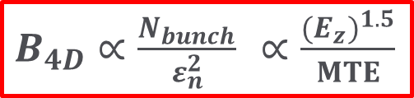

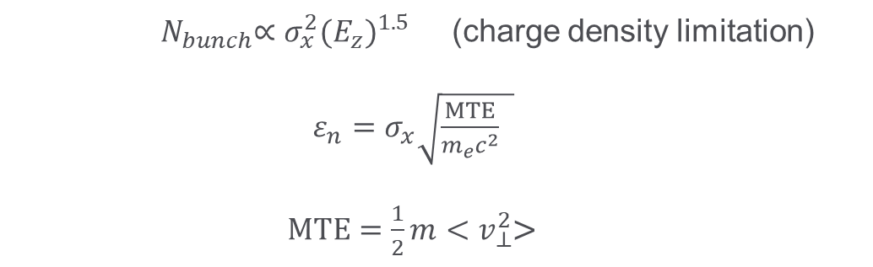

Maximum Beam Brightness
I. Bazarov et al., Phys. Rev. Lett. 102, 104801 (2009)
E_{z} (5-100MV/m)
$$B_{4D}∝\frac{N_{bunch}}{ε_{n}^{2}}$$
Laser spot size
Photocathode
${ N}_{bunch}∝σ_{x}^{2}{{(E}_{z})}^{1.5}$ (charge density limitation)
$ε_{n}=σ_{x}\sqrt{\frac{MTE}{m_{e}c^{2}} }$
$MTE=\frac{1}{2}m{<v}_{⊥}^{2}$>
$$σ_{x}$$
Laser pulse
Increase $E_{z}$
MTE➔ Mean Transverse Energy
$B_{4D}∝\frac{N_{bunch}}{ε_{n}^{2}}$ $∝\frac{{{(E}_{z})}^{1.5}}{MTE}$
Typical MTE used in photoinjectors is ~500 meV
Space Charge? Brightness limited by photocathode MTE and field gradient
No space charge? Brightness limited by MTE and source size.
Notes:
Space charge only here; include small size too!

Slide 5
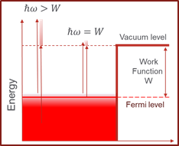
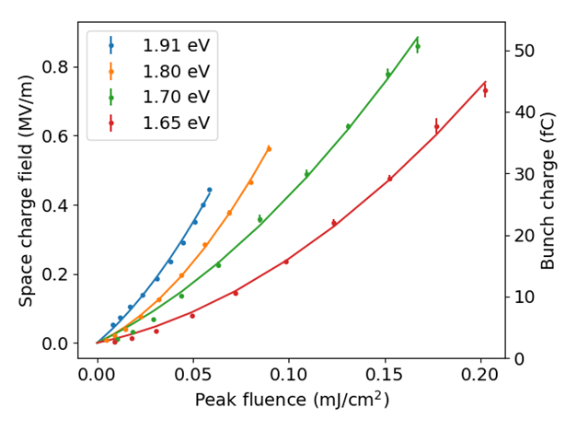
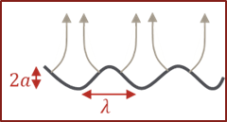
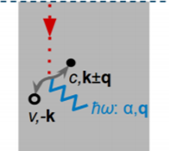
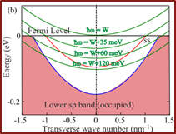
What is MTE limited by?
P. Musumeci et al. Nucl. Instrum. Meth. A, 907, 209 (2018)
Bae et al. Jour. Appl. Phys., 124,. 244903, (2018)
Nangoi et al Phys. Rev. B 104, 115132 (2021)
Excess Energy
Non-linear Photoemission
Surface Non-uniformities
Emit close to threshold and minimize temperature
CBB discovers factors affecting MTE
Need high quantum efficiency
Need atomically smooth surfaces
Many-body Scattering
Band Structure
Need small cross-section of electron-phonon-photon interactions
Need low transverse momentum states
Challenge: Develop materials that satisfy all these criteria
Notes:
Larger energy than necessary—talk to figure.

Slide 6

Interdiscplinary Team
Computational modeling
of electronic structure and emission
Accelerator Testing
Cycle happens on a weekly basis
Demonstrate ‘more than sum of parts’
Materials growth
Materials characterization

Slide 7
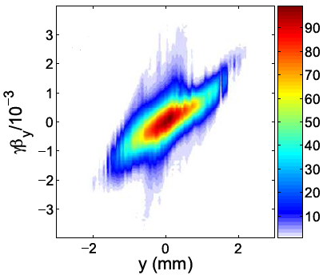


Cross-theme Cohesion
Strong connection to Beam Dynamics and Control:
  Need optimized beam dynamics to conserve low MTE (or emittance)
  In cases with
  significant space charge, or
  aberrations/ field nonlinearities
  Brightness will depend strongly on the beam dynamics!
Several faculty in both themes
Small MTE
Bad
Transport
High density
Low $ε$
Large $ε$

Slide 8
Key Achievements (2016-2022)
1. Demonstration of 5 meV MTE
  – two orders of magnitude higher brightness of low current density applications
Karkare et al Phys. Rev. Lett. 125, 054801(2020) – Editor’s suggestion
2. Effects of non-linear photoemission on MTE
  – limits MTE in for high current density applications
Bae et al. J. Appl. Phys., 124,. 244903, (2018)
  3. Development of ultrasmooth ordered alkali-antimonide films
    – can give low MTE for high current density applications
Parzyck et al, Phys. Rev. Lett. 128, 114801 (2022) – Editor’s suggestion
4. Development of robust coating techniques for vacuum sensitive cathodes
  – essential for protecting vacuum sensitive cathodes in extreme conditions
Patent Pending
5. Sub-nm emittance measurement diagnostics in accelerators
(together with BDC theme)
  – critical for low emittance and high brightness measurements
M. Gordon et al. Phys Rev Accel. Beams, Phys. Rev. Accel. Beams 25, 084001 (2022)
Notes:
These have impacted a lot of research in accelerators and elsewhere

Slide 9
New in 2023—What I’ll tell you today
1. Demonstration of 5 meV MTE
  – two orders of magnitude higher brightness of low current density applications
  NEW: Understanding MTE from polycrystalline materials
Karkare et al Phys. Rev. Lett. 125, 054801(2020) – Editor’s suggestion
2. Effects of non-linear photoemission on MTE
  – limits MTE in for high current density applications
  NEW: Experimental measurements confirm calculations
Bae et al. J. Appl. Phys., 124,. 244903, (2018)
  3. Development of ultrasmooth ordered alkali-antimonide films
    – can give low MTE for high current density applications
    NEW: New alkali antimonide phases and new materials
Parzyck et al, Phys. Rev. Lett. 128, 114801 (2022) – Editor’s suggestion
4. Development of robust coating techniques for vacuum sensitive cathodes
  – essential for protecting vacuum sensitive cathodes in extreme conditions
  NEW: high current / high field tests and new theoretical understanding
Patent Pending
5. Sub-nm emittance measurement diagnostics in accelerators
(together with BDC theme)
  – critical for low emittance and high brightness measurements
M. Gordon et al. Phys Rev Accel. Beams, Phys. Rev. Accel. Beams 25, 084001 (2022)

Slide 10

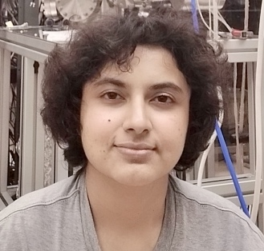

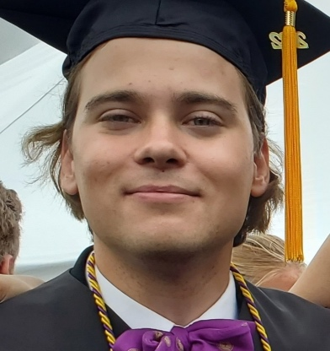


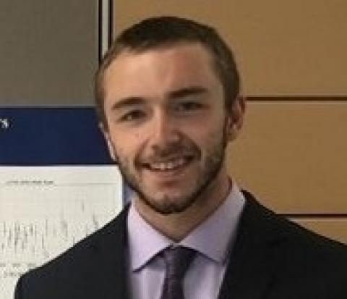



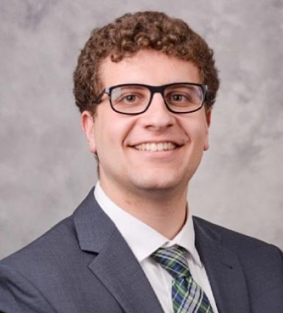
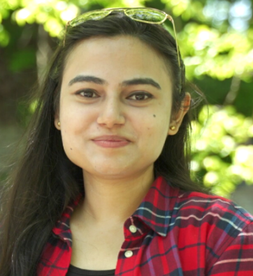
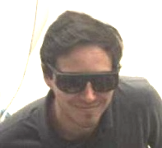
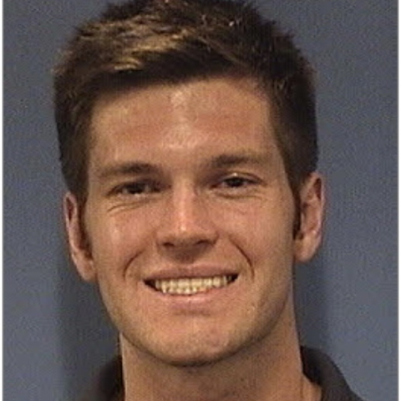



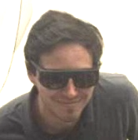
PHC Graduate Students and Postdocs
Vivek Anil,
Cornell
Priyadarshini Bhattacharyya, ASU
Elena Echeverria, Cornell
Azriel Finsterer, Cornell
Daniel Franklin, NIU
David Garcia, UCLA
Jason Gibson, U Florida
Tariqul Hasan, NIU
Mariam Hasany, Cornell
Ali Kachwala, ASU
Gerard Lawler, UCLA
Sam Levenson, Cornell
Joshua Mann, UCLA
Chad Pennington, Cornell
Annabel Selino, Cornell
Tyler Wu, Cornell
Amy Zhu, Cornell
Notes:
Current Students and Postdocs in PHC

Slide 11








Partnerships
Theme PHC is strongly connected to Beam Storage and Transport—we hold regular joint meetings, multiple overlap areas.
National Laboratory and industry partners:
Cathode characterization
Photoinjector Physics
Emittance Diagnostics
Nanofabrication
With theme 3: Space charge simulations with low MTE cathodes
Photocathode
simulation
RF gun load-lock development
Cathodes for semiconductor metrology
Photocathode development
xLight:
High power electron sources
Cathodes for electron
microscopes

Slide 12
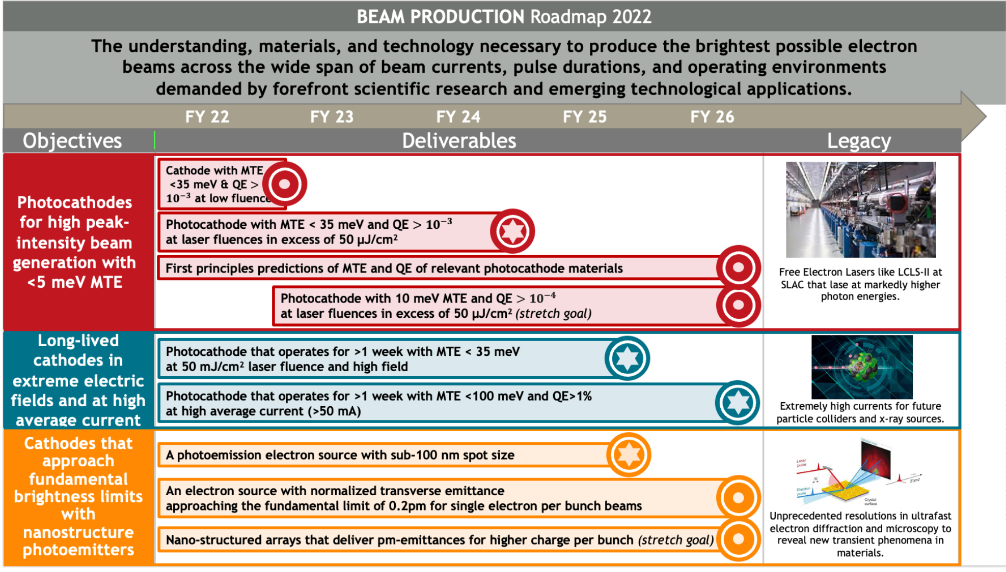
CBB Theme 1 Objectives
current
Objective 5 statement (short format)

Slide 13
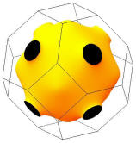
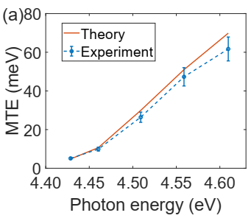
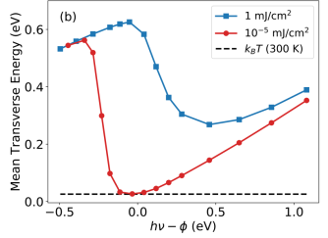
Objective 1
Develop photocathodes for high peak intensity generation with <5 meV MTE
Already demonstrated 5 meV MTE for low peak intensity applications
(Key accomplishment 1)
Photoemission at the threshold
Cooled to LHe (30K)
Atomically ordered flat surface
Good band-structure
Non-linear effects will limit MTE in metals to few 100 meV for large charge densities (theory)
5 meV MTE measured from Cu(100)
Most photoinjectors use MTE ~500 meV
Notes:
Remove deliveres roadmap

Slide 14
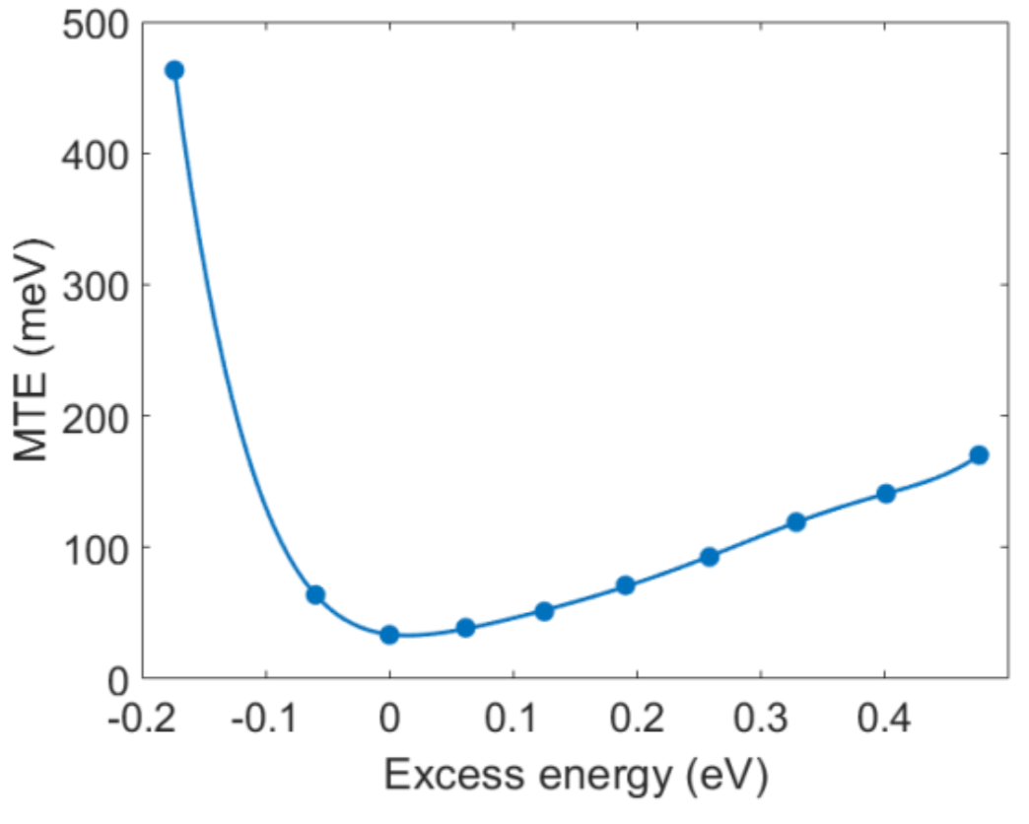
Objective 1
Develop photocathodes for high peak intensity generation with <5 meV MTE
Already demonstrated 5 meV MTE for low peak intensity applications
(Key accomplishment 1)
Use high QE cathodes to minimize laser fluence and non-linear effects
Photoemission at the threshold
Cooled to LHe (30K)
Atomically ordered flat surface
Good band-structure
New 2023: experimental confirmation of theory
C. Knill et al., in prep.
5 meV MTE measured from Cu(100)
Most photoinjectors use MTE ~500 meV
Notes:
Remove deliveres roadmap

Slide 15
Objective 1
Develop photocathodes for high peak intensity generation with <5 meV MTE
Objective 1, Theory Deliverable (1.3): First principles predictions of MTE and QE spectral response for relevant photocathode materials
Lots of new results here. Each are well-integrated with other objectives.
I will call them out as we go along.
New theoretical results on QE and MTE of disordered surfaces (P. Saha et al, JAP 2023)
First-principles calculations of electron transmission through graphene (and other monolayer protection layers)
Excellent DFT agreement with ARPES data from a new alkali antimonide phase.
Theory
Look out for this symbol:

Slide 16
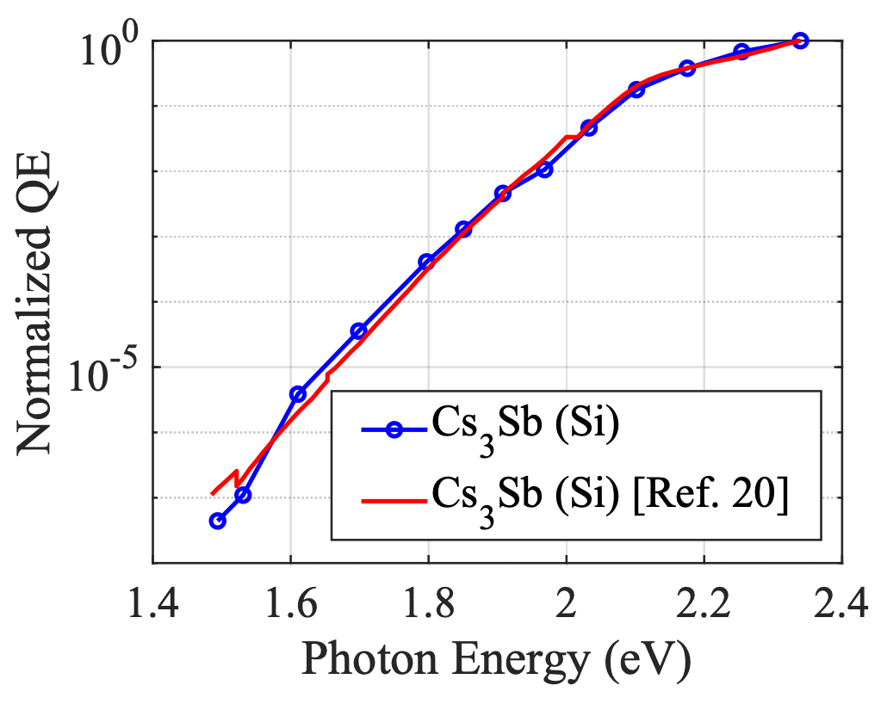
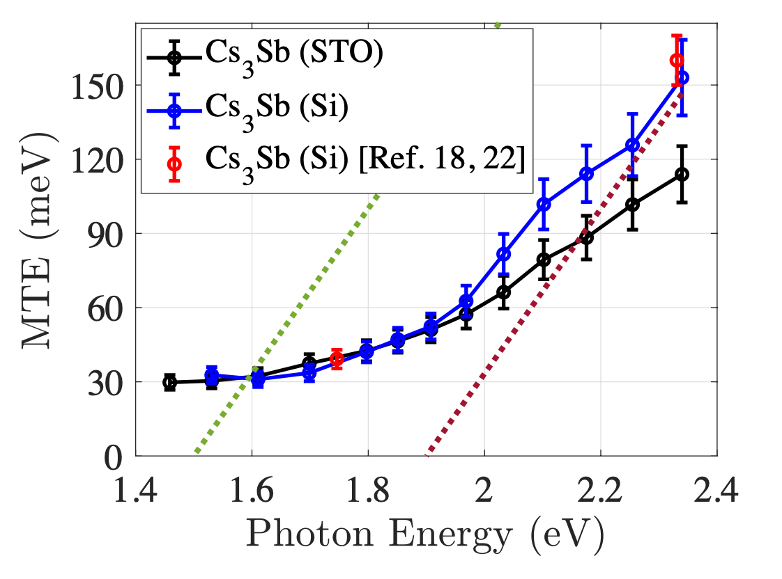
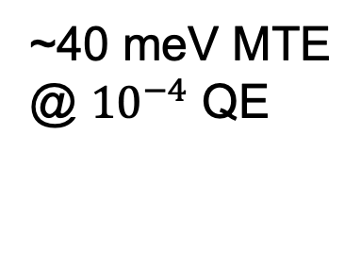
Objective 1
Develop photocathodes for high peak intensity generation with <5 meV MTE
Deliverable 1.1: A photocathode with MTE < 35 meV and QE > 10⁻³ at low or moderate laser fluence and at room temperature
New data: a smaller work function for poly-crystalline Cs₃Sb than anticipated. MTE arises from excess energy of impurity states, not surface roughness
~40 meV MTE
@ ${10}^{−4}$ QE
A. Kachwala, P. Saha, et al., in prep.
Notes:
STO Is very smooth—much smoother than Si film.

Slide 17
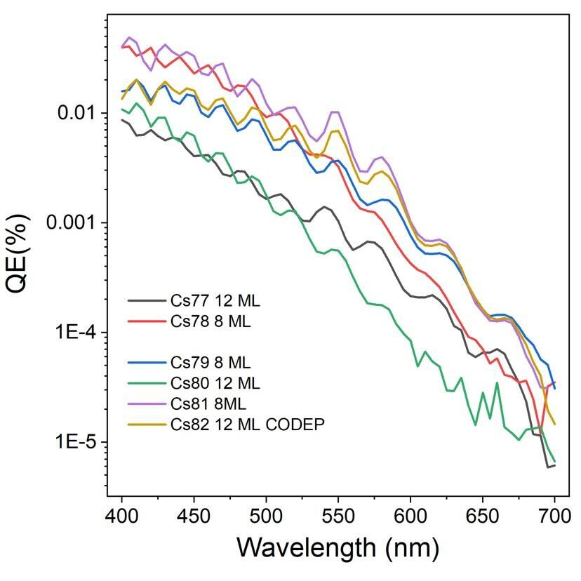
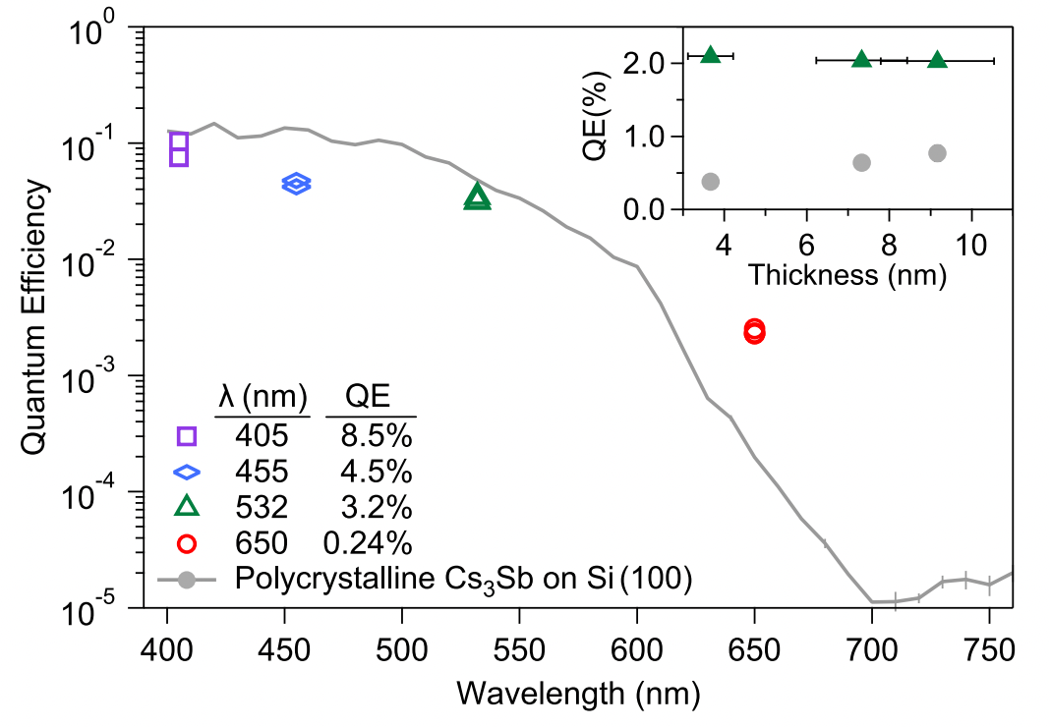
Objective 1
Develop photocathodes for high peak intensity generation with <5 meV MTE
Deliverable 1.1: A photocathode with MTE < 35 meV and QE > 10⁻³ at low or moderate laser fluence and at room temperature
Our emphasis now: single crystal photocathodes, and QE engineering.
High red efficiency
Smooth enough for
optical interference
E. Echeverria
+ C. Pennington
Notes:
Keep transfer and science separate.
Simplify explanation--QE engineering opens the door.

Slide 18
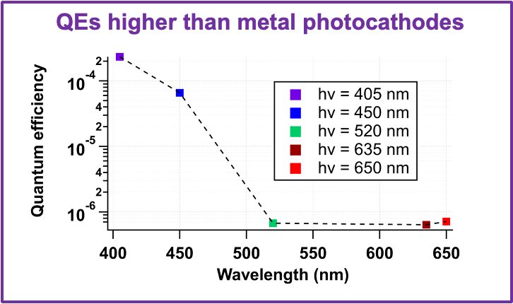
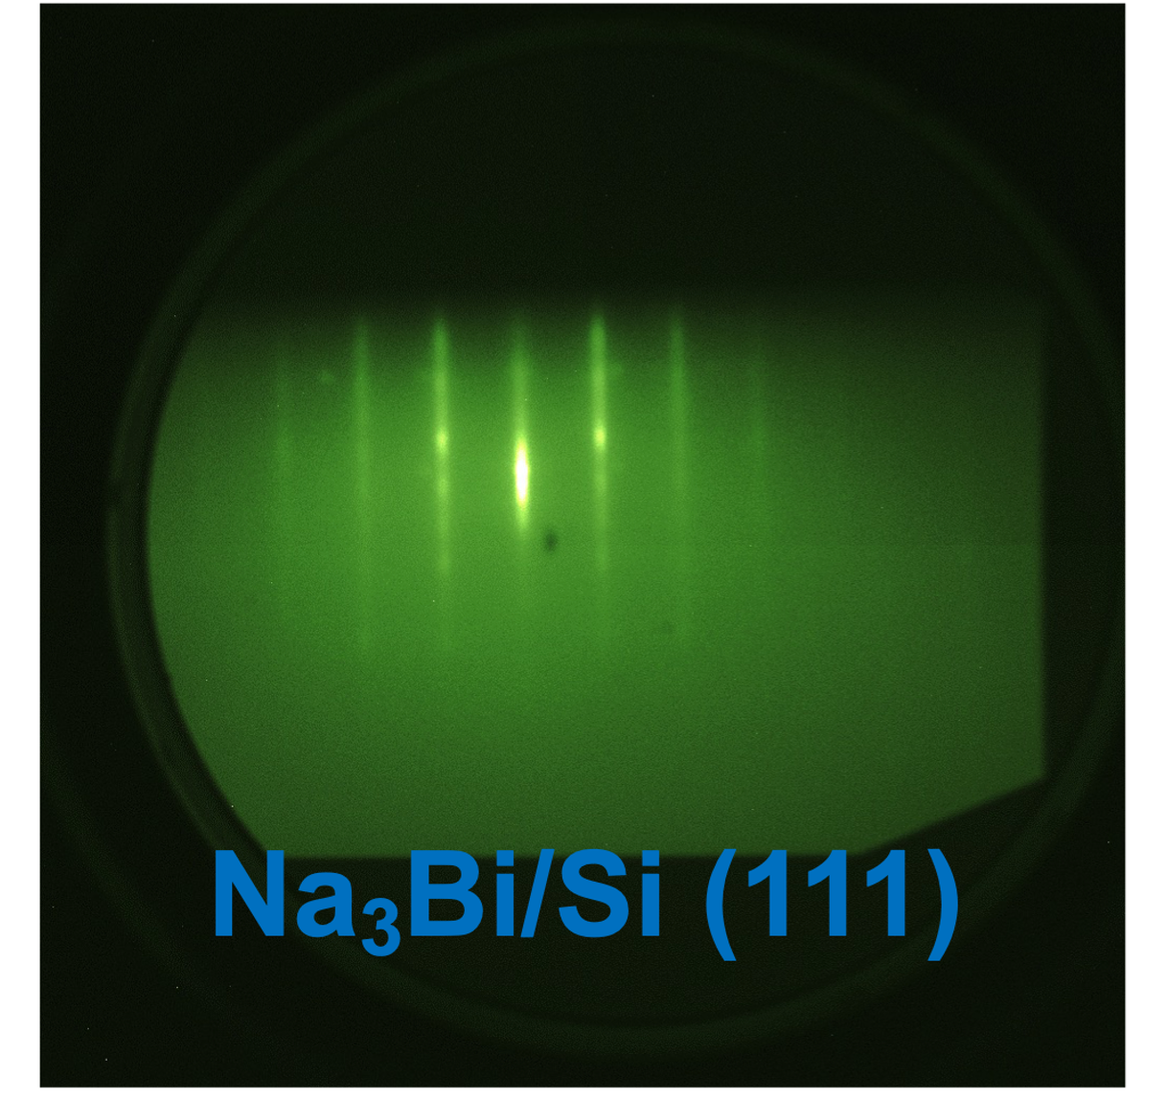
Objective 1
Develop photocathodes for high peak intensity generation with <5 meV MTE
Deliverable 1.1: A photocathode with MTE < 35 meV and QE > 10⁻³ at low or moderate laser fluence and at room temperature
Not just alkali antimonides! A visible light Dirac semimetal emitter: Na₃Bi
Grown at PARADIM facility at Cornell
Work function of 2.5 eV
V. Anil, E. Echeverria, C. Pennington
Notes:
Emphasize work in progress, other dirac semimetals.

Slide 19
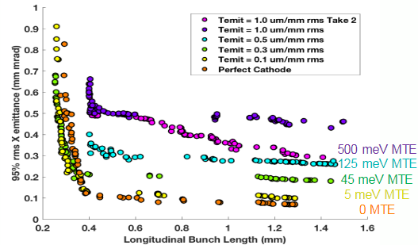
Objective 1
Develop photocathodes for high peak intensity generation with <5 meV MTE
Deliverable 1.2 (Priority): A photocathode with MTE < 35 meV and QE > 10⁻³ at laser fluences in excess of 50 µJ/cm2 by developing cryo-cooled single-crystal, epitaxial alkali antimonides or other materials
Theory
  Theme 3 CBB Result
Nearly doubles x-ray photon energy at LCLS-2-HE
Greater FEL output
Smaller new FELs
Prediction of <20meV MTE even at large laser fluences for ordered alkali-antimonides
(Key accomplishment 2)
Optimizations of a potential injector for LCLS-II HE
Partnership:
Ongoing DOE project with SLAC to transfer cathode recipes for use in the LCLS-2-HE SRF gun. Cathode is robust enough for LCLS-2-HE gun
Notes:
Delete the plot on right and replace with text (bold)
Call out knowledge tranfer here (connect other pieces)

Slide 20
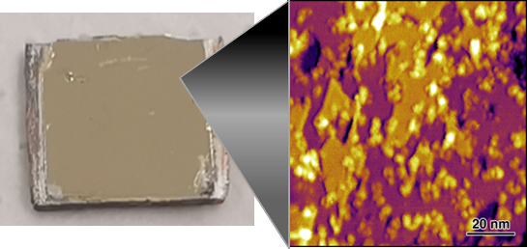
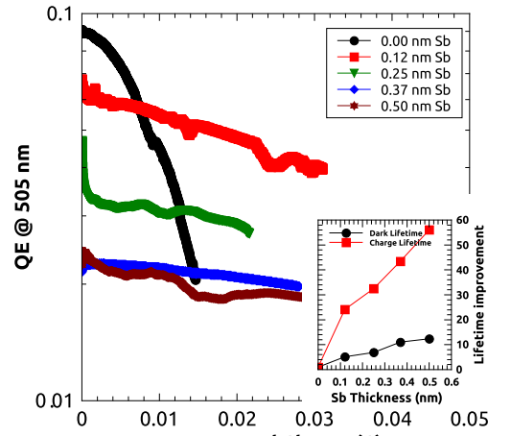
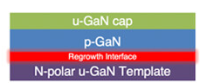
Objective 2
Design materials for long-lived cathodes in extreme electric field and high average current
Protective graphene coatings
Robust activation overlayers
Inert high QE cathodes
Cs-free, air stable cathodes based on GaN heterostructures.
Demonstrated QE of 10⁻³, with MTE of 100 meV.
UHV graphene coating technique to protect an air sensitive thin film of various oxidation-sensitive metals such as Magnesium. Demonstration of protection of an alkali-antimonide film is underway
Cs-Sb based coatings to activate GaAs to negative electron affinity for robust high QE emission
Patent Pending
Notes:
Mention patent.

Slide 21
Objective 2
Design materials for long-lived cathodes in extreme electric field and high average current
We’ve spent significant effort getting a cathode test “ecosystem” up and running in CBB, both for
High Average Current (10s of mA)
High Electric fields (100 MV/m and greater)

Slide 22
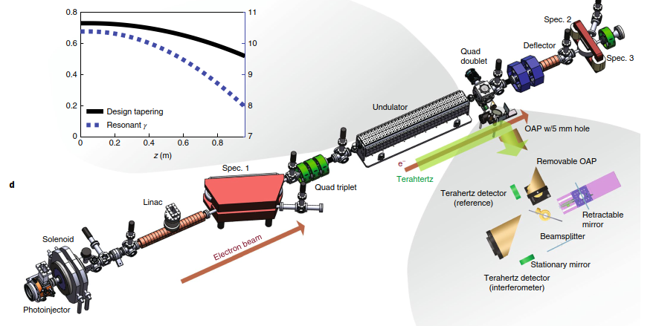
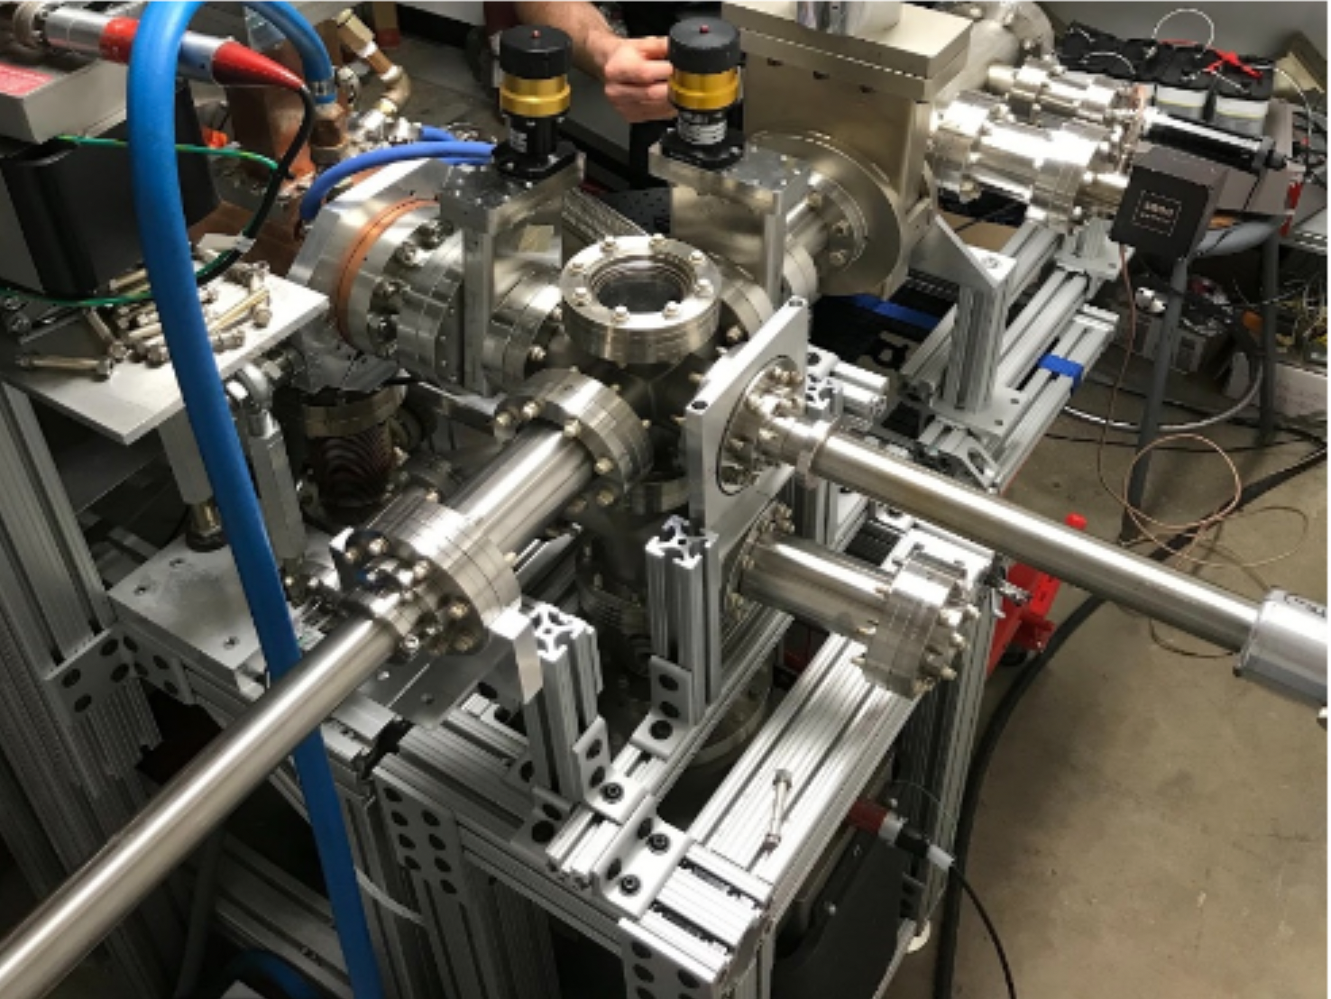
Objective 2
High Field Test Site 1: UCLA Pegasus
NCRF S-band gun capable of up to 100 MV/m. Equipped with load lock for vacuum cathode transfer.
Demonstrated cathode transfer from Cornell.
Cornell alkali antimonide cathodes helped access much higher charge for THz FEL experiments.
More tests planned this year.

Slide 23
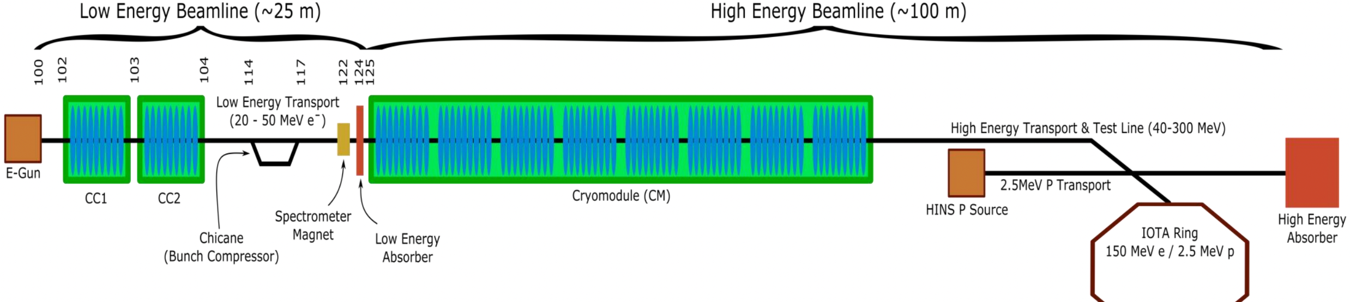
Objective 2
High Field Test Sites at Collaborating National Labs
We have ongoing collaborations with FNAL and ANL to test photocathodes in their high gradient guns.
FNAL: FAST/IOTA, and L-band gun and SRF injector
Cathode tests to begin this summer (Cornell and NIU photocathodes)

Slide 24
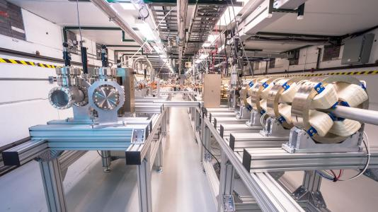
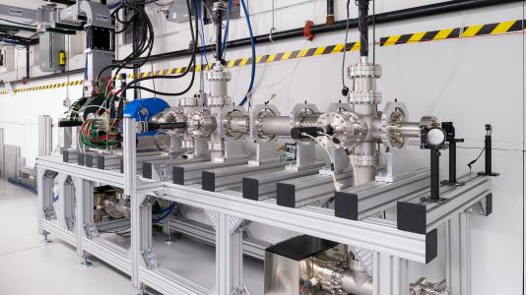
Objective 2
High Field Test Sites at Collaborating National Labs
We have ongoing collaborations with FNAL and ANL to test photocathodes in their high gradient guns.
Argonne Wakefield Accelerator Facility: Various high gradient guns
AWA Drive and Witness Linacs
AWA cathode test stand
BDC talk will discuss beam dynamics studies upcoming at UCLA, FNAL, ANL

Slide 25




Objective 2
High Field Test Site 2: UCLA CYBORG (in commissioning)
NCRF cryogenic (65 K) c-band (~6 GHz) very high field (>120 MV/m) test station.
Will be upgraded to include vacuum load lock.
YAG or DRZ screen
Dipole
Alignment Laser
Gun
Solenoid
Doublet
UV (250-350nm)
Faraday Cup
Gun Cryostat
G. Lawler

Slide 26

Objective 2
High Average Current Test Site: HERACLES @ Cornell
The only university test-setup for very high average current photocathode tests (multiple 10s of mA)

Slide 27


Objective 2: More robust coatings for GaAs
In-gun testing is a must. Example: Sb-Cs-O activation for GaAs in HERACLES
Test chamber lifetime (vacuum poisoning): 5-10x longer than traditional activation (Cs-O).
Lifetime in gun only ~50% improved—ion back bombardment has similar effects on the Cs and the Cs-Sb-O.
Low Current
High Current (1 mA)
Cs-O
alone
J.K. Bae et al, AIP Advances, 2023

Slide 28



Objective 2: A more robust alkali antimonide
Alkali antimonides are full of surprises: A “new” phase of Cs-Sb is a more robust high efficiency visible light photocathode. Cs₃Sb --> Cs₁Sb
STM: Atomically Flat
ARPES matches Theory!
Good QE and >10x lifetime!
Theory
C. T. Parzyck, C. A. Pennington, W. J. I. DeBenedetti, J. Balajka, E. Echeverria, J. K. Nangoi, V. Anil, A. Galdi, in prep.
Notes:
Too much time on flatness.

Slide 29

Objective 2: A more robust alkali antimonide
Alkali antimonides are full of surprises: A “new” phase of Cs-Sb is a more robust high efficiency visible light photocathode. Cs₃Sb --> Cs₁Sb
STM: Atomically Flat
Theory prediction of Phase diagram
Good QE and >10x lifetime!
Theory
J. Gibson and A. Hire
C. T. Parzyck, C. A. Pennington, W. J. I. DeBenedetti, J. Balajka, E. Echeverria, J. K. Nangoi, V. Anil, A. Galdi, in prep.

Slide 30





Objective 2: Understanding Graphene Protection
New theoretical result: understanding the transmission of electrons through graphene and other 2DM.
Lippman Schwinger Eqn for QM Scattering
Theory
Graphene
hBN
NbSe₂
Transmission
1
Transmission
1
1
Reflection
T. Wu
Reflection
Reflection
Transmission
0
0
0
0
E (eV)
0.5
0
E (eV)
0.5
0
E (eV)
0.5

Slide 31
Objective 3
Approach fundamental brightness limits with nanostructured photoemitters
Can we obtain the quantum limit of emittance/brightness by manipulating emission area along with low MTE?
I will focus on the first deliverable, as it is presently the main focus of our activities, and enables the other two.

Slide 32



Objective 3
Approach fundamental brightness limits with nanostructured photoemitters
Deliverable 3.1 (priority): A photoemission electron source with sub-100 nm spot size
Recent developments:
Commissioned the PEEM at ASU in conjunction with a tunable wavelength pulsed laser to get sub-40 nm spatial resolution
Current Status/Plans:
Test performance of immersion lens based focusing
Resolve issues with plasmonic focusing and work function nano-patterning
Performed first tests of plasmonic focusing and work function nano-patterining
Impact: 10x improved resolution for UED
End user: JOEL/IDES and HiRES at LBNL
Plasmonic focusing spiral structures show emission hotspots due to nanofabrication imperfections
Cu patch on Pt observed in PEEM under 260nm illumination.
Surface impurities cause work functions to be inverted
2023: New design to eliminate hotspots
2023: New prep method to reduce contamination

Slide 33



Objective 3
Approach fundamental brightness limits with nanostructured photoemitters
New in 2023: Understanding emittance growth in plasmonic nano-emitter arrays
Plasmonic grooves enhance light absorption and localize emission. Edge fields can grow emittance.
Leads to emittance asymmetry!
C. Pierce et al., PRA, 2023.
Notes:
Nanoscale geometry affects how well the beam focuses

Slide 34


















Our Output: Highly Trained Scientists
Academia
Industry
National Lab/Gov
Matt Andorf, Research Assoc., Cornell
Jan Balajka, Postdoc, TU Wien
Oksana Chubenko, Faculty, NIU
Alice Galdi, Faculty, U Salerno
Siddharth Karkare, Faculty, ASU
Jared Maxson, Faculty, Cornell
J. Kevin Nangoi, Postdoc, UCSB
Jai Kwan Bae, Postdoc SLAC
Alex Bernstein, NSA
Will DeBenedetti, Postdoc, LANL
William Li, Postdoc, BNL
Jorge Giner Navarro, Researcher, CIEMAT
Chris Knill, R&D Scientist Honeywell
Erik Skibinski, PhD
Nathan Majernik, Staff Scientist SLAC
Joshua Paul, Postdoc, Argonne
Pallavi Saha, Postdoc, BNL
Eylene Pirez, Head Digital Media, Geodesic Pictures
Dulanga Somaratne, PhD

Slide 35
CBB Legacy
Convergence Science
Photoemission sources: a branch of the new discipline, accelerator materials.
Knowledge
Deeper understanding of fundamental photoemission processes relevant to electron sources
Workforce
Training several graduate students in the field of accelerator physics (electron sources) – an area of critical need for current and future accelerator projects
Technology and applications
By 2026: Develop and deploy transformative electron source technology for:
  Free Electron Lasers
  Particle colliders Macro-molecule single-shot UED
  Atomic scale time-resolved electron microscopy
Growing Convergence Research
NSF Big Idea
Understanding the Rules of Life
NSF Big Idea
Quantum Leap
NSF Big Idea
Notes:
Power of Accelerator Materials…

