Slide 1
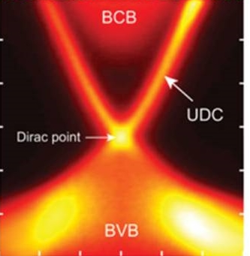
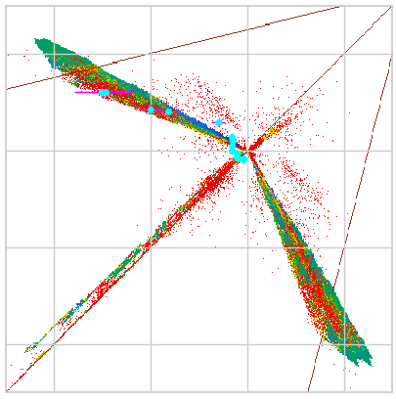
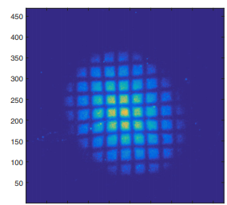
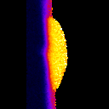
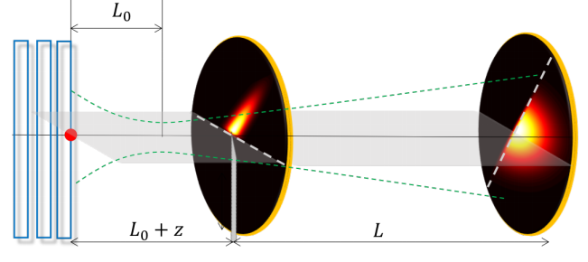
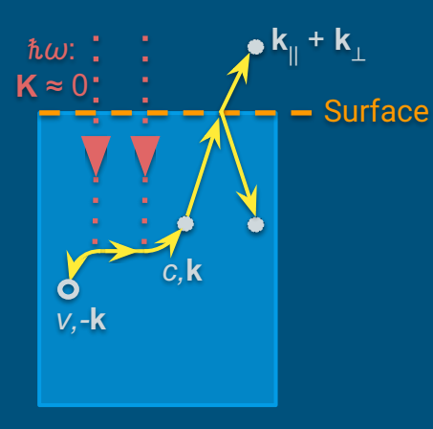
CBB EAB meeting
Charge
J. Ritchie Patterson
Center Director

Slide 2

Code of Conduct
All participants are expected to conduct themselves professionally and create a welcoming environment free from discrimination, harassment, or retaliation.
Disruptive or harassing behavior of any kind will not be tolerated, including inappropriate language or behavior, unwelcome jokes or comments, unwanted attention or touching, actions or statements based on personal characteristics, offensive images, photography without permission, and stalking.
Respect one another.
Report violations the director, managing director, or a theme leader.
Witnesses are empowered to intervene and encouraged to report concerns.
Personal safety and comfort is a top priority.

Slide 3
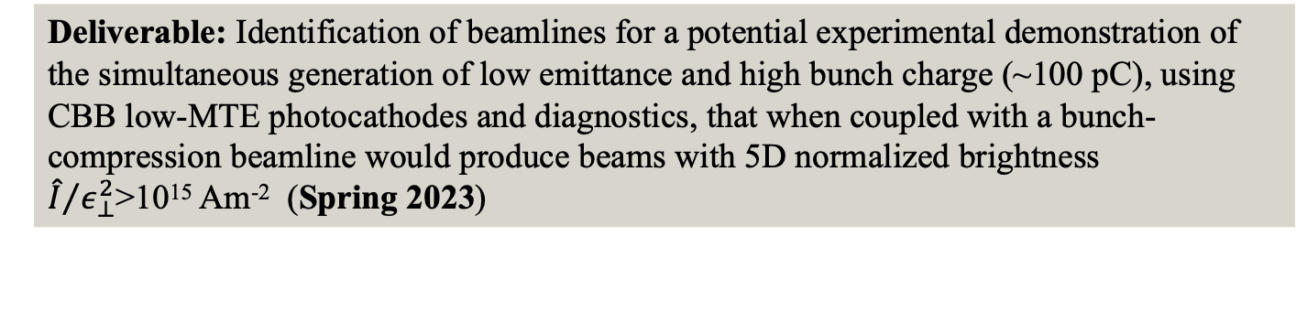
Charge
Knowledge Transfer: New, improved plan
  In keeping with NSF practices,
  it values both knowledge and technology transfer.
  New understanding is important, even if there isn’t immediate “tech”
  Now identifies priority tech transfer items
  Each reflects a priority research deliverable.
  Please comment on the suitability of the plan.
Follow up on “potential experimental demonstration of the simultaneous generation of low emittance and high bunch charge (~100 pC)”
This year’s deliverable was to determine the feasibility of such a test; we’ve done that and now seek your advice on the value of pursuing it.
Deliverable: Identification of beamlines for a potential experimental demonstration of the simultaneous generation of low emittance and high bunch charge (~100 pC), using CBB low-MTE photocathodes and diagnostics, that when coupled with a bunch-compression beamline would produce beams with 5D normalized brightness ${\hat{I}}/{ε_{⊥}^{2}}$>10¹⁵ Am⁻² (Spring 2023)
Full text

Slide 4
Charge (con’t)
Today’s presentations: drafts for the NSF Site Visit in July
Convey achievements and legacy.
Please suggest improvements.

Slide 5
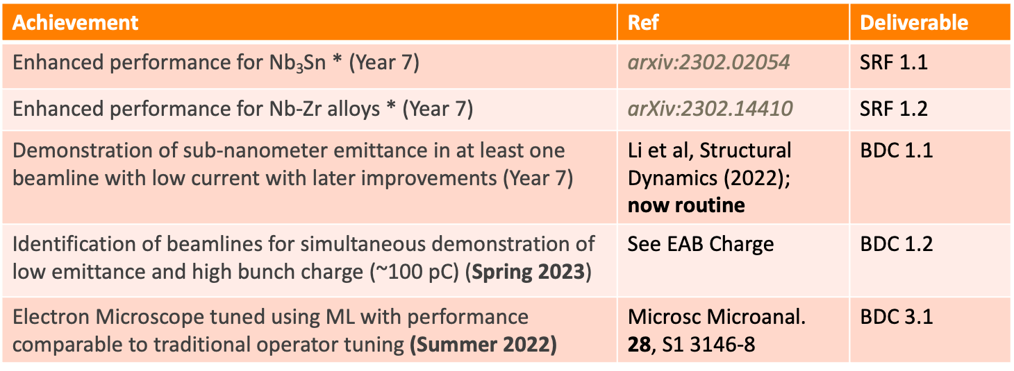
Met Deliverables 1
Achievement | Ref | Deliverable
Enhanced performance for Nb₃Sn * (Year 7) | arxiv:2302.02054 | SRF 1.1
Enhanced performance for Nb-Zr alloys * (Year 7) | arXiv:2302.14410 | SRF 1.2
Demonstration of sub-nanometer emittance in at least one beamline with low current with later improvements (Year 7) | Li et al, Structural Dynamics (2022); now routine | BDC 1.1
Identification of beamlines for simultaneous demonstration of low emittance and high bunch charge (~100 pC) (Spring 2023) | See EAB Charge | BDC 1.2
Electron Microscope tuned using ML with performance comparable to traditional operator tuning (Summer 2022) | Microsc Microanal. 28, S1 3146-8 | BDC 3.1
* Annual deliverable

Slide 6
Met Deliverables 2
Achievement |  | Deliverable
More collaborative papers or proceedings than PIs * (Year 7) |  | Workf. Dev. 1.4
Participation in CBB research by women and non-binary scientists exceeds nat’l physics metrics at all levels * (Year 7) |  | Diversity 1.1
Participation by underrepresented racial and ethnic groups exceeds national physics metrics at all levels* (Year 7) |  | Diversity 1.2
CBB knowledge shared through journal articles, conference proceedings, etc. |  | KT 1.1
Strong engagement with the accelerator and end use communities |  | KT 1.2

Slide 7
CBB Legacy
Legacies: Convergence Research, Knowledge,
Technology, Workforce, and Team Science
Convergence Research Legacy:
the discipline of Accelerator Materials
Growing Convergence Research
NSF Big Idea
Wire for high field magnets
Surfaces for SRF cavities
Photocathode design
Long effort in High Energy Physics
Accelerator Materials
CBB foci
Other topics?
CBB regularly participates in materials conferences,
eg APS March Meeting, Materials Research Society
CBB trainees are evenly divided between
Accelerator Science and Accelerator Materials
To mark this, CBB is planning an international conference in Accelerator Materials

Slide 8
CBB post 2026
Aspiration:
Continue collaborative research and student training
Proposal submissions to date:
New NSF Directorate for Technology, Innovation & Partnership
“advances use-inspired and translational research in all fields of science and engineering, giving rise to new industries and engaging all Americans in the pursuit of new, high-wage STEM jobs”
Two proposals submitted,
both related to semiconductor manufacturing
DOE RENEW to engage HBCUs in CBB
NSF “home”
for Acc. Sci.??

Slide 9
CBB post 2026 (con’t)
Other planned submissions:
DOE Traineeship including CBB accelerator faculty at Cornell, ASU,
U. Chicago and UCLA. Due 6/5
An NSF Research Traineeship in Accelerator Materials
Under discussion
DOE GARD, Stewardship/ARDAP, NP, BES
Individual PIs or small groups. These currently provide about half of our accelerator research support
DOE Energy Frontier Research Center in Accelerator Materials
In development

Slide 10

Charge in a nutshell
Are KT deliverables well-chosen?
Is the plan to deliver 100pC with small emittance feasible? Is it worth pursuing?
What is your advice on our Site Visit presentations?
Gaining the fundamental understanding needed to transform the brightness of electron beams available to science, medicine and industry.

