Slide 1
Team Science, Education, and Diversity
Melissa A. Hines

Slide 2
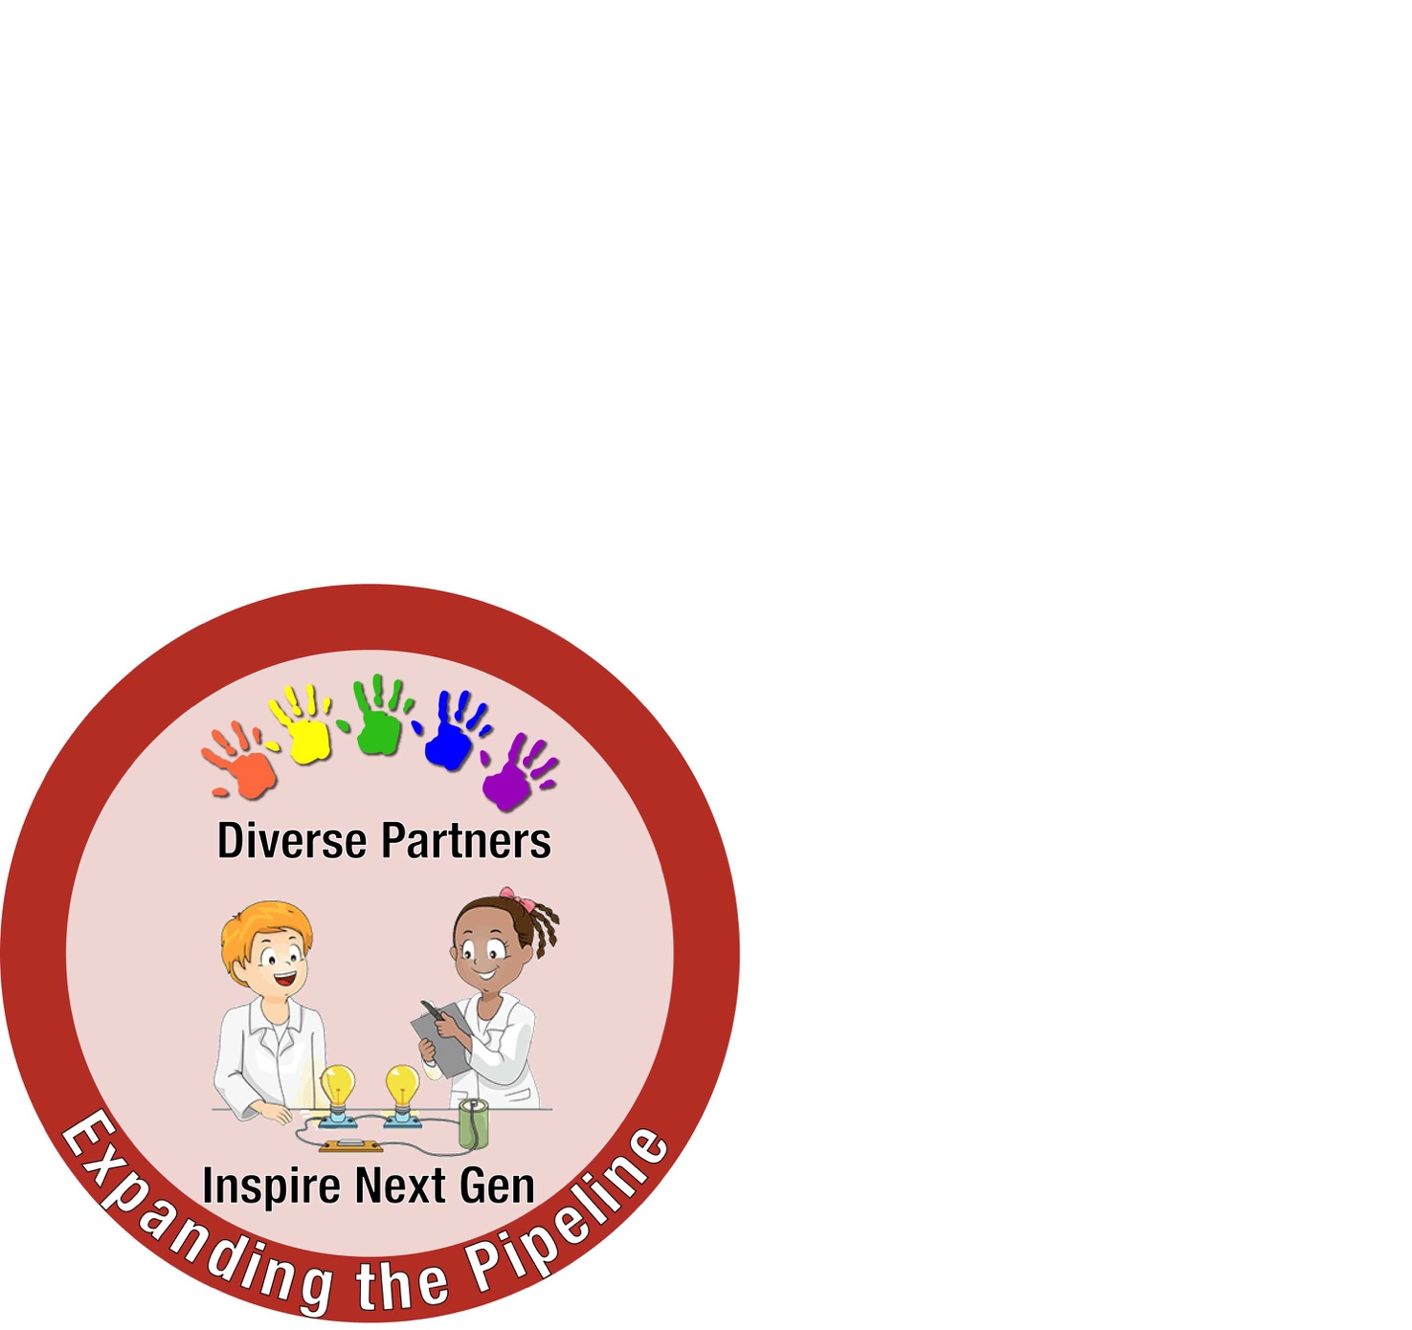
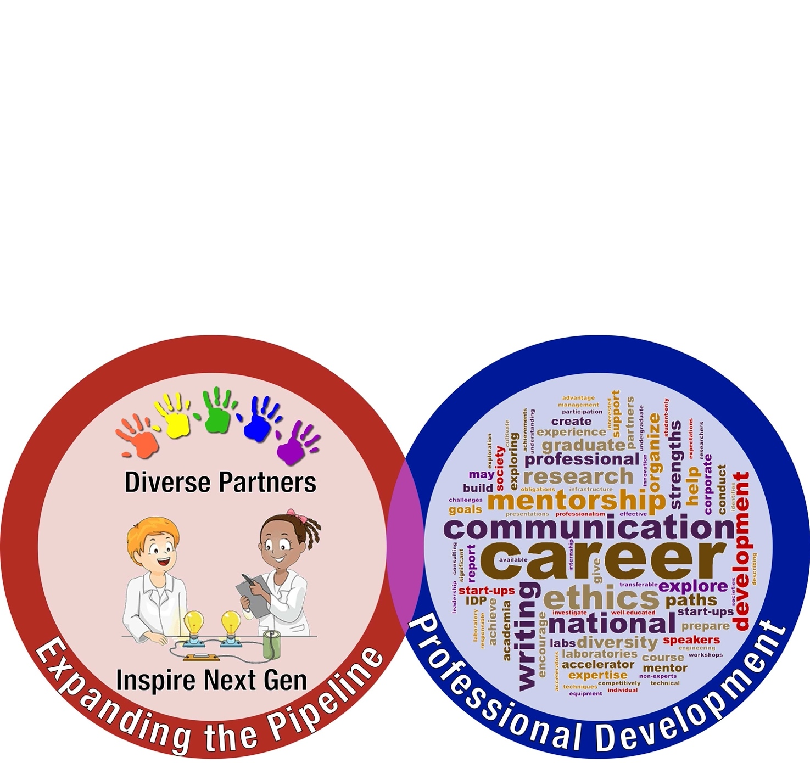
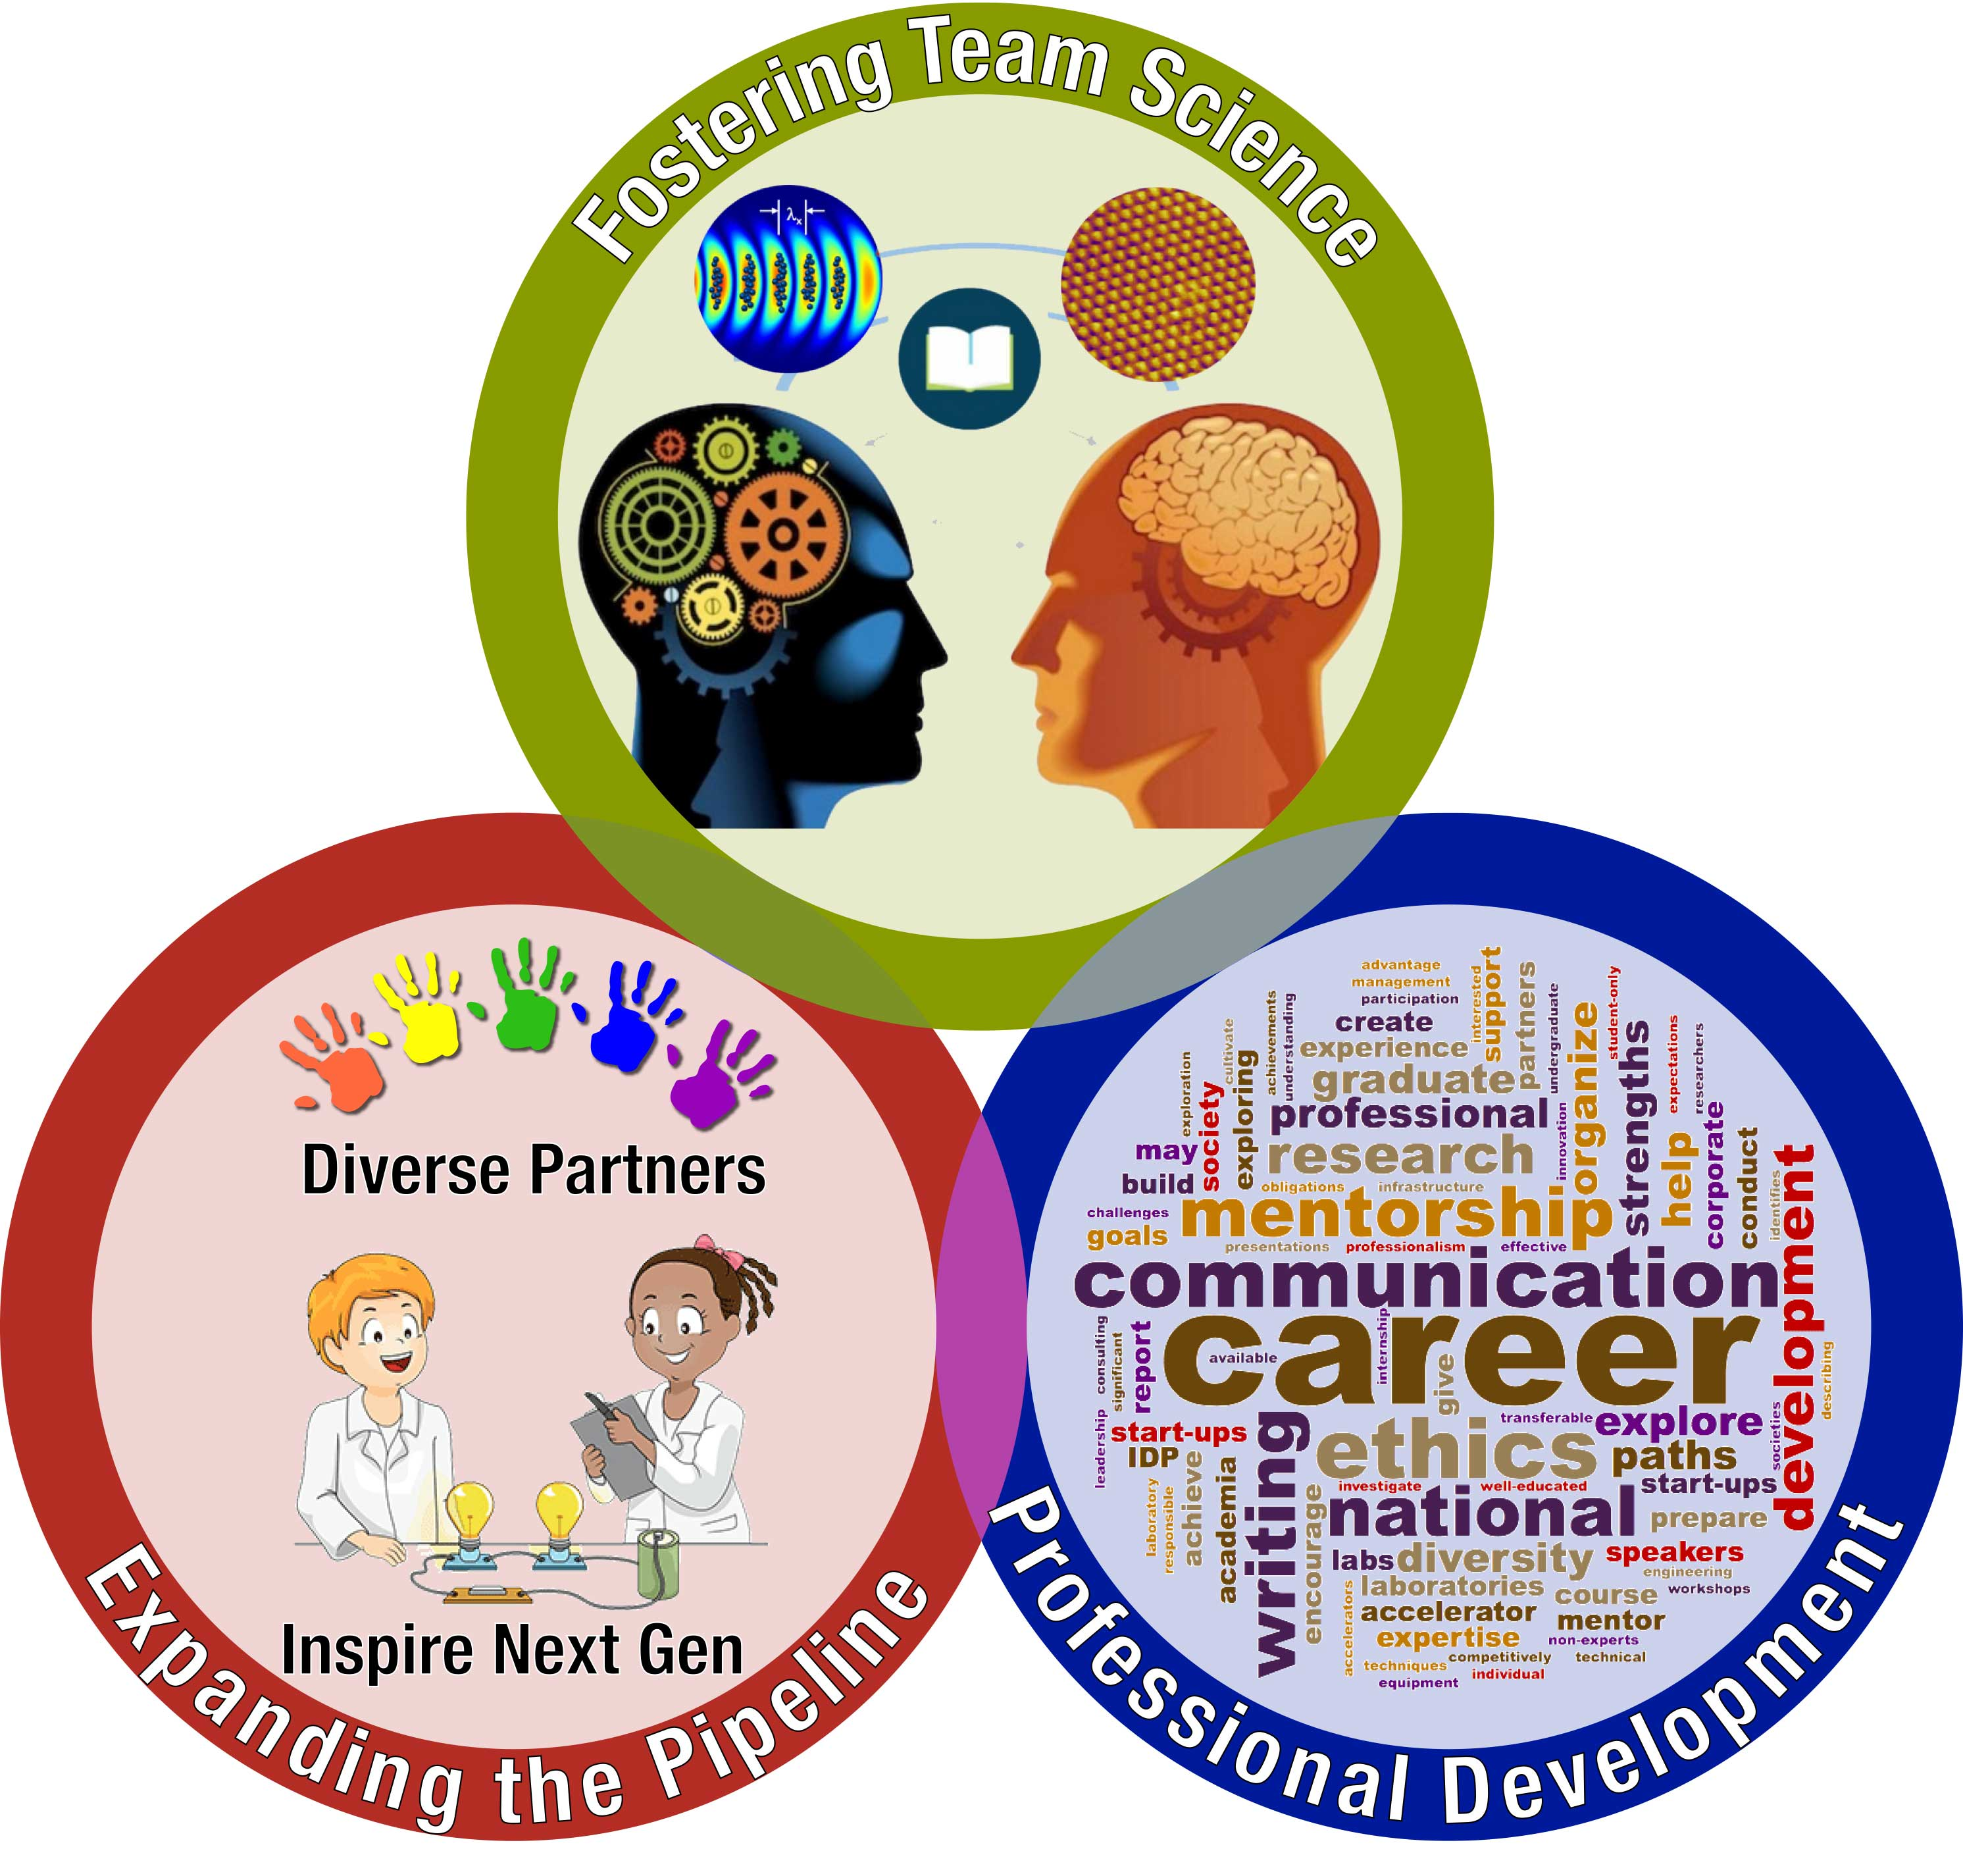
Our Mission

Slide 3
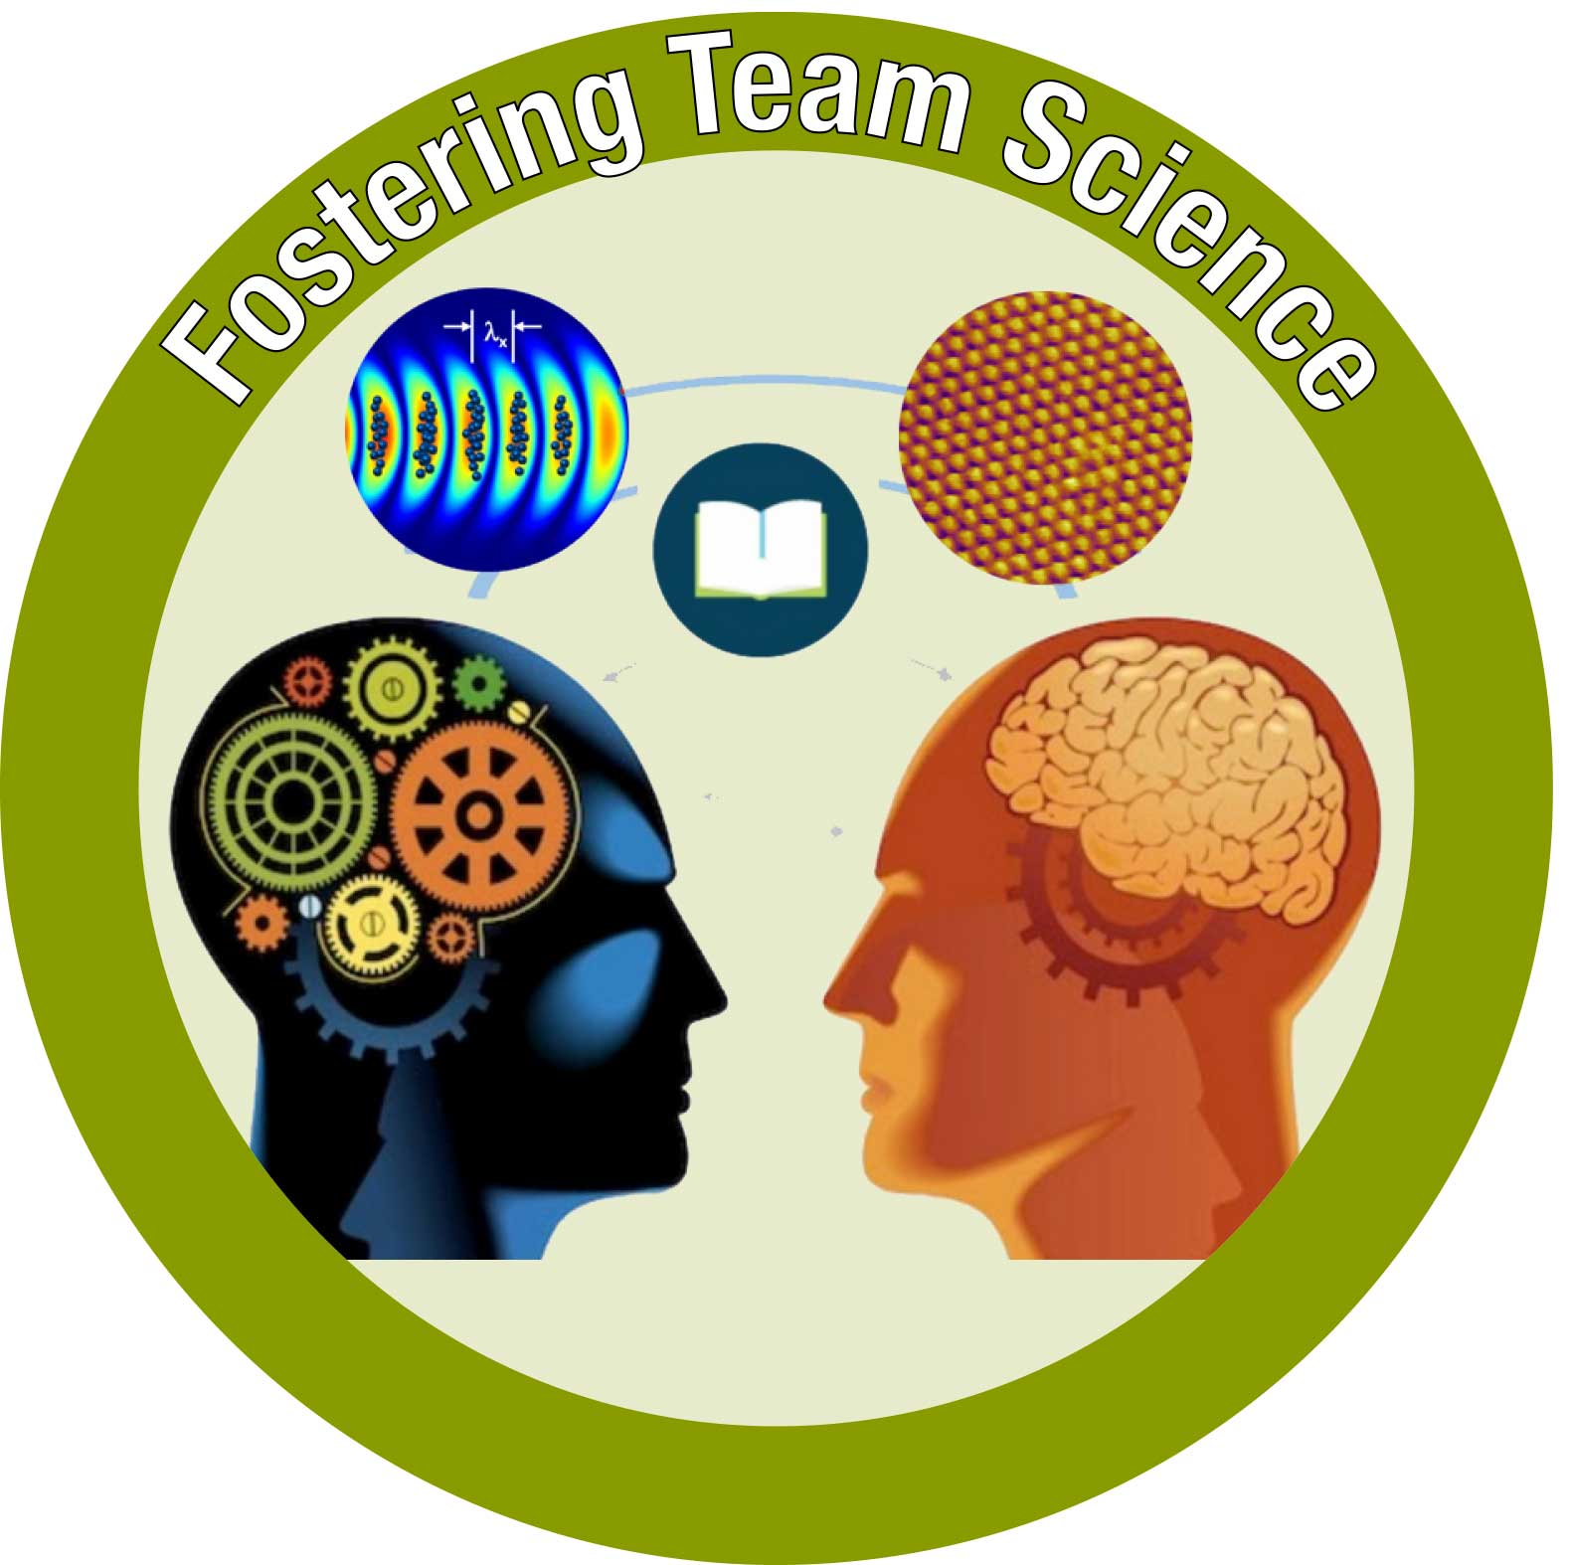
The Science of Team Science
Challenge: Unite researchers from disparate fields, including many far from accelerator science

Slide 4
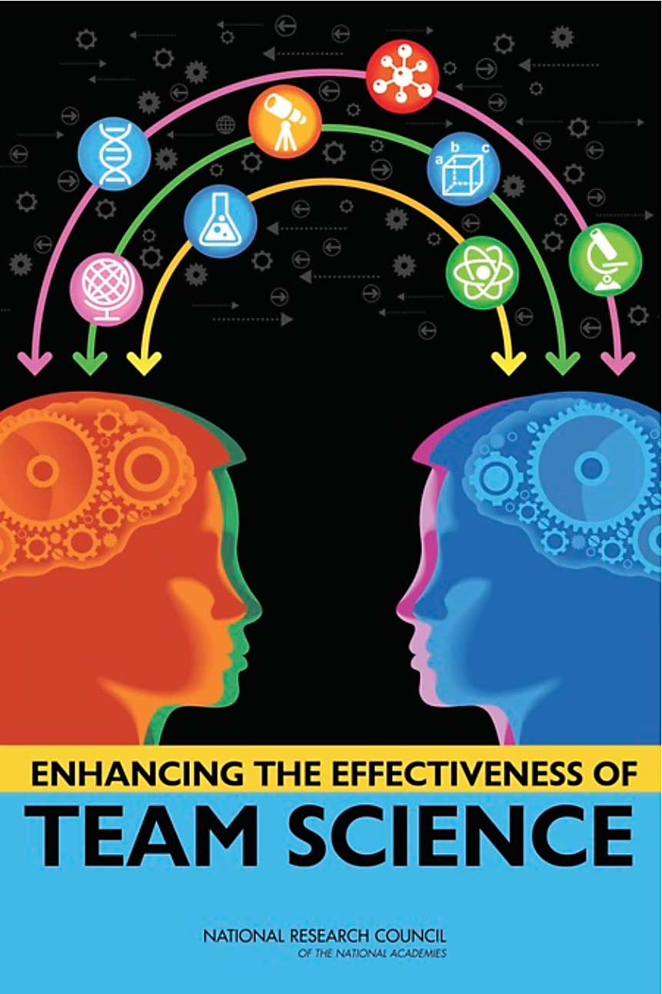
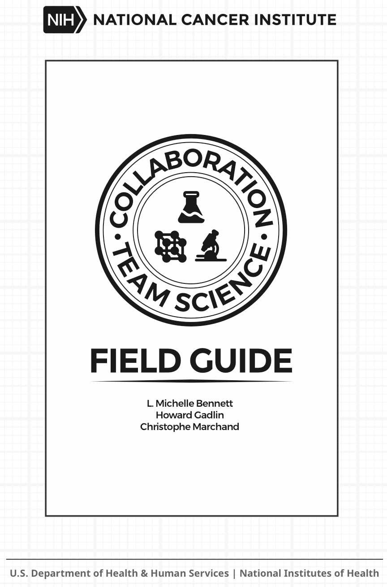
The Science of Team Science
Dr. Kara Hall, Natl. Cancer Inst.
Dir. of Sci. of Team Science Team
Former CBB EAB Member
NRC Report (2015)
NIH Field Guide (2010)
Our challenge: How to make disparate researchers a team, quickly and efficiently?

Slide 5
Team Science Objectives and Goals
Objective: Use team science to enable all participants — faculty, postdocs, and students — to be successful in convergence research.
1. Effective communication practices across all aspects of research and administration
2. Shared goals and shared recognition
3. Strong leadership and transparent decision making

Slide 6
Our Communication Needs
Within CBB, we need to communicate…
Ongoing science
  What’s new? Where can collaborators add value?
  What’s happening across the Center?
  What’s happening around the world?
Background science, vocabulary, and our prior work
Our mission to new members
Our progress to the world
Policies, procedures, and expectations

Slide 7
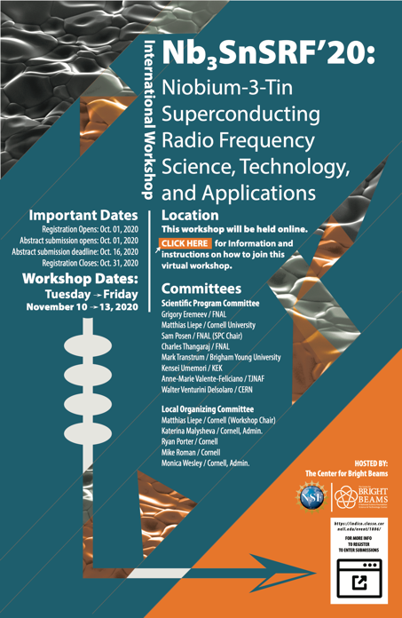
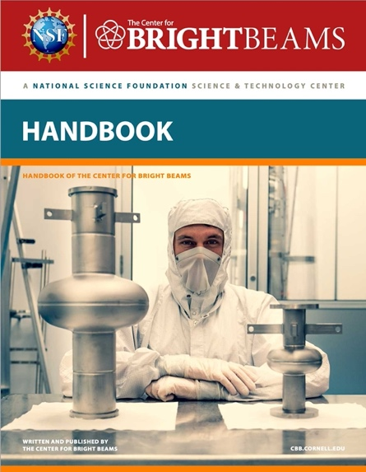
Communicating across Space and Time
39 talks + 140 people
Notes:
SnSRF 2020 : 39 talks, ~140 registered participants

Slide 8
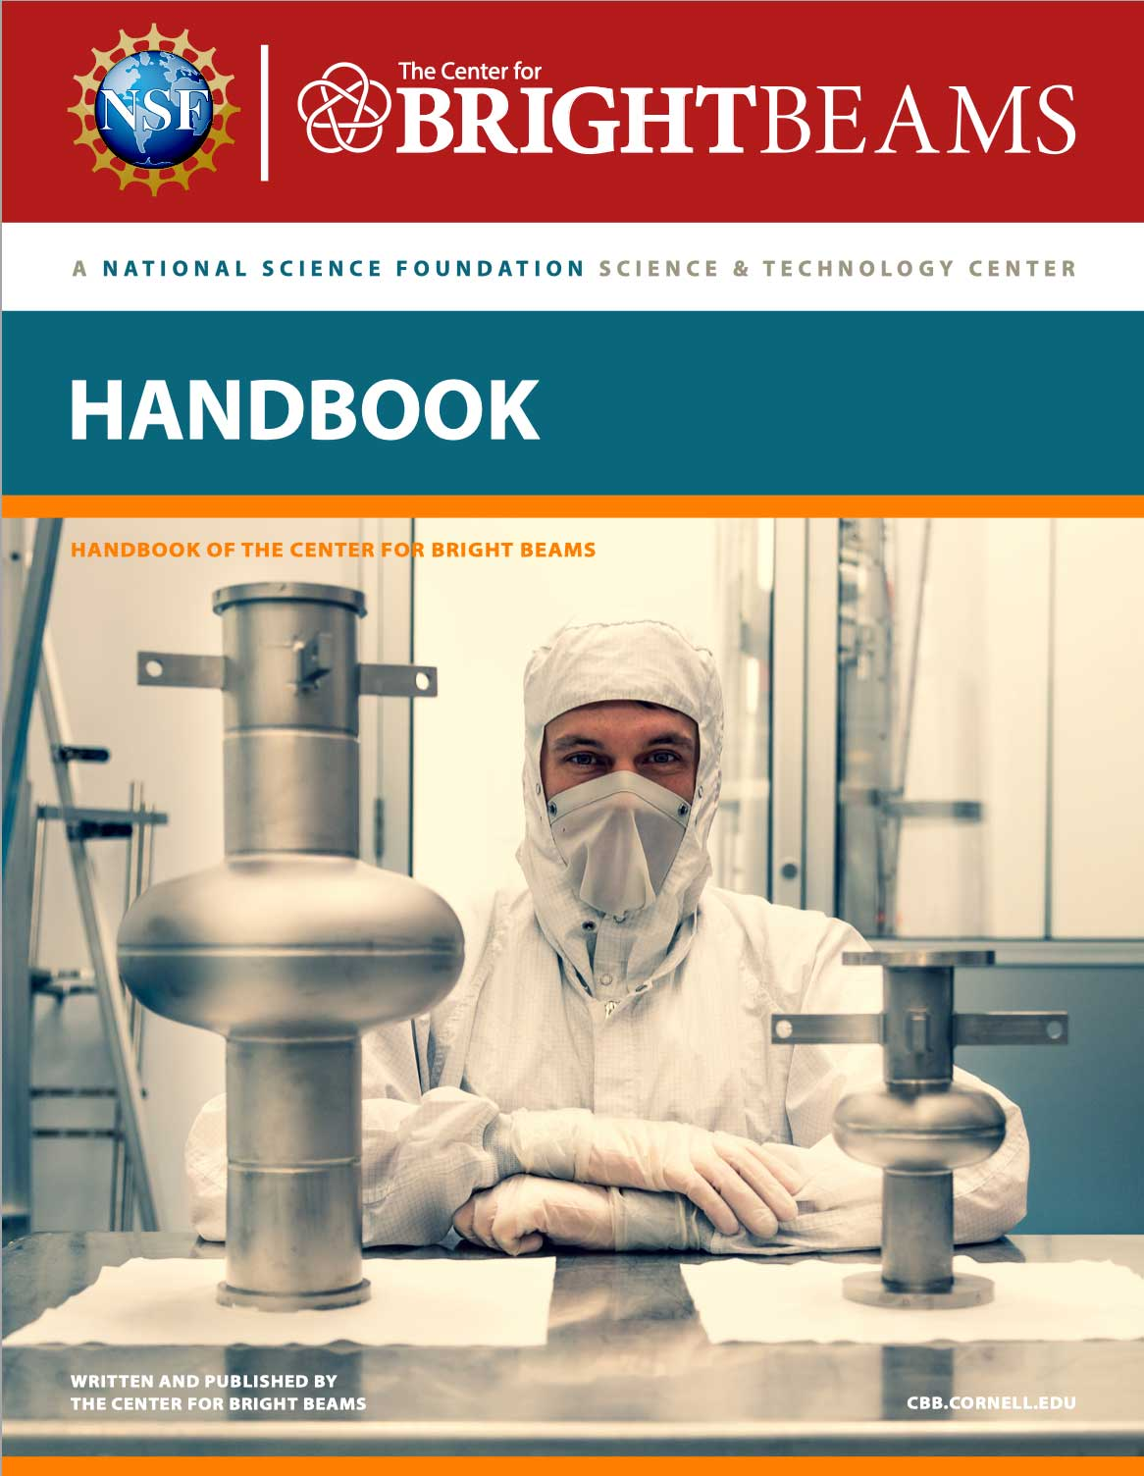
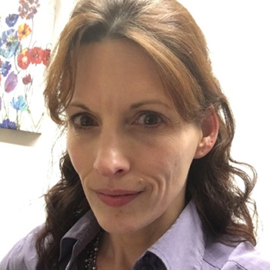
Communicating to New Members
CBB has a formal onboarding process
CBB has a printed (& electronic) handbook
• Meeting and letter
• What is CBB?
• Our expectations (& benefits!)
• Gather demographic info
• Electronic resources & passwords
• Videoconferencing
• About the Center
  Who are we?
  What are we?
  Professional Development
• Finding information
YouTube channel
• Getting things done
  Travel reimbursements
  Using Indico, Box, etc.
• Interacting with industry
Joan Curtiss
CBB Managing Director

Slide 9
Team Science Objectives and Goals
Objective: Use team science to enable all participants — faculty, postdocs, and students — to be successful in convergence research.
1. Effective communication practices across all aspects of research and administration
2. Shared goals and shared recognition
3. Strong leadership and transparent decision making

Slide 10
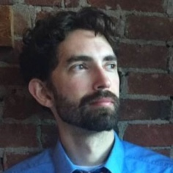
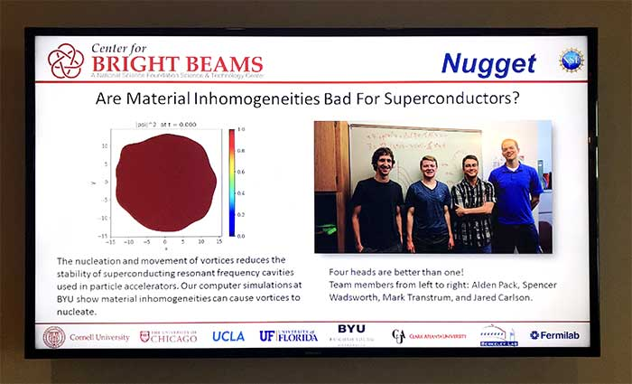
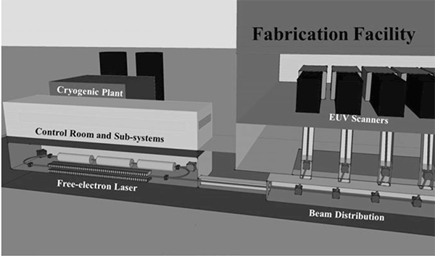
Shared goals & Shared recognition
Communicating broader impacts & needs to new members
Making CBB a truly
multi-institutional center
• Frequent talks from industry and national labs
• Industry participation at annual symposium
• Pedagogy talks at Annual Meeting
• International Workshops
• Rotating venue for seminars, symposia, etc.
• Student/postdoc research visits
• CBB Weekly News
Multi-PI authorship on 53% of manuscripts
so far in 2023!
FELs in Future Semiconductor Fabs? — Erik Hosler (GlobalFoundries)

Slide 11
Team Science Objectives and Goals
Objective: Use team science to enable all participants — faculty, postdocs, and students — to be successful in convergence research.
1. Effective communication practices across all aspects of research and administration
2. Shared goals and shared recognition
3. Strong leadership and transparent decision making

Slide 12
Strong leadership & Transparent decision making
Active Oversight by
Director and Executive Committee
Transparent processes for decision making
Clearly defined expectations, roles, and responsibilities
Annual reports from everyone
(Faculty, PDs, and GSs)
Annual oral proposal + Q&A for each
project (≤ 1 FTE) to entire theme
during Annual Collaboration Day
Annual written proposal for each
project submitted to Director
Written evaluation of each proposal
by unconflicted evaluators
assigned by Director
Onboarding process for new participants
(Faculty, PDs, and GSs)
CBB Handbook
Reminders in CBB Weekly News

Slide 13
Is Team Science Working?

Slide 14
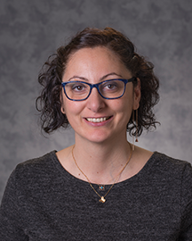
Evaluation of All Activities
Four key questions:
Implementation (Formative): Is the Center
attaining its long and short term goals?
Effectiveness: Are key CBB outputs
(e.g., recruitment, student training, professional
development) operating effectively?
Impact: What short term outcomes (e.g., interdisciplinary team science competence, scientific knowledge, technical skills, retention, publication, awards) are associated with participation in CBB? What is the value-added of participation in CBB?
Institutionalization: How and to what extent are elements of CBB becoming institutionalized at partner institutions?
Meltem Alemdar and Lizanne DeStefano
Georgia Tech

Slide 15
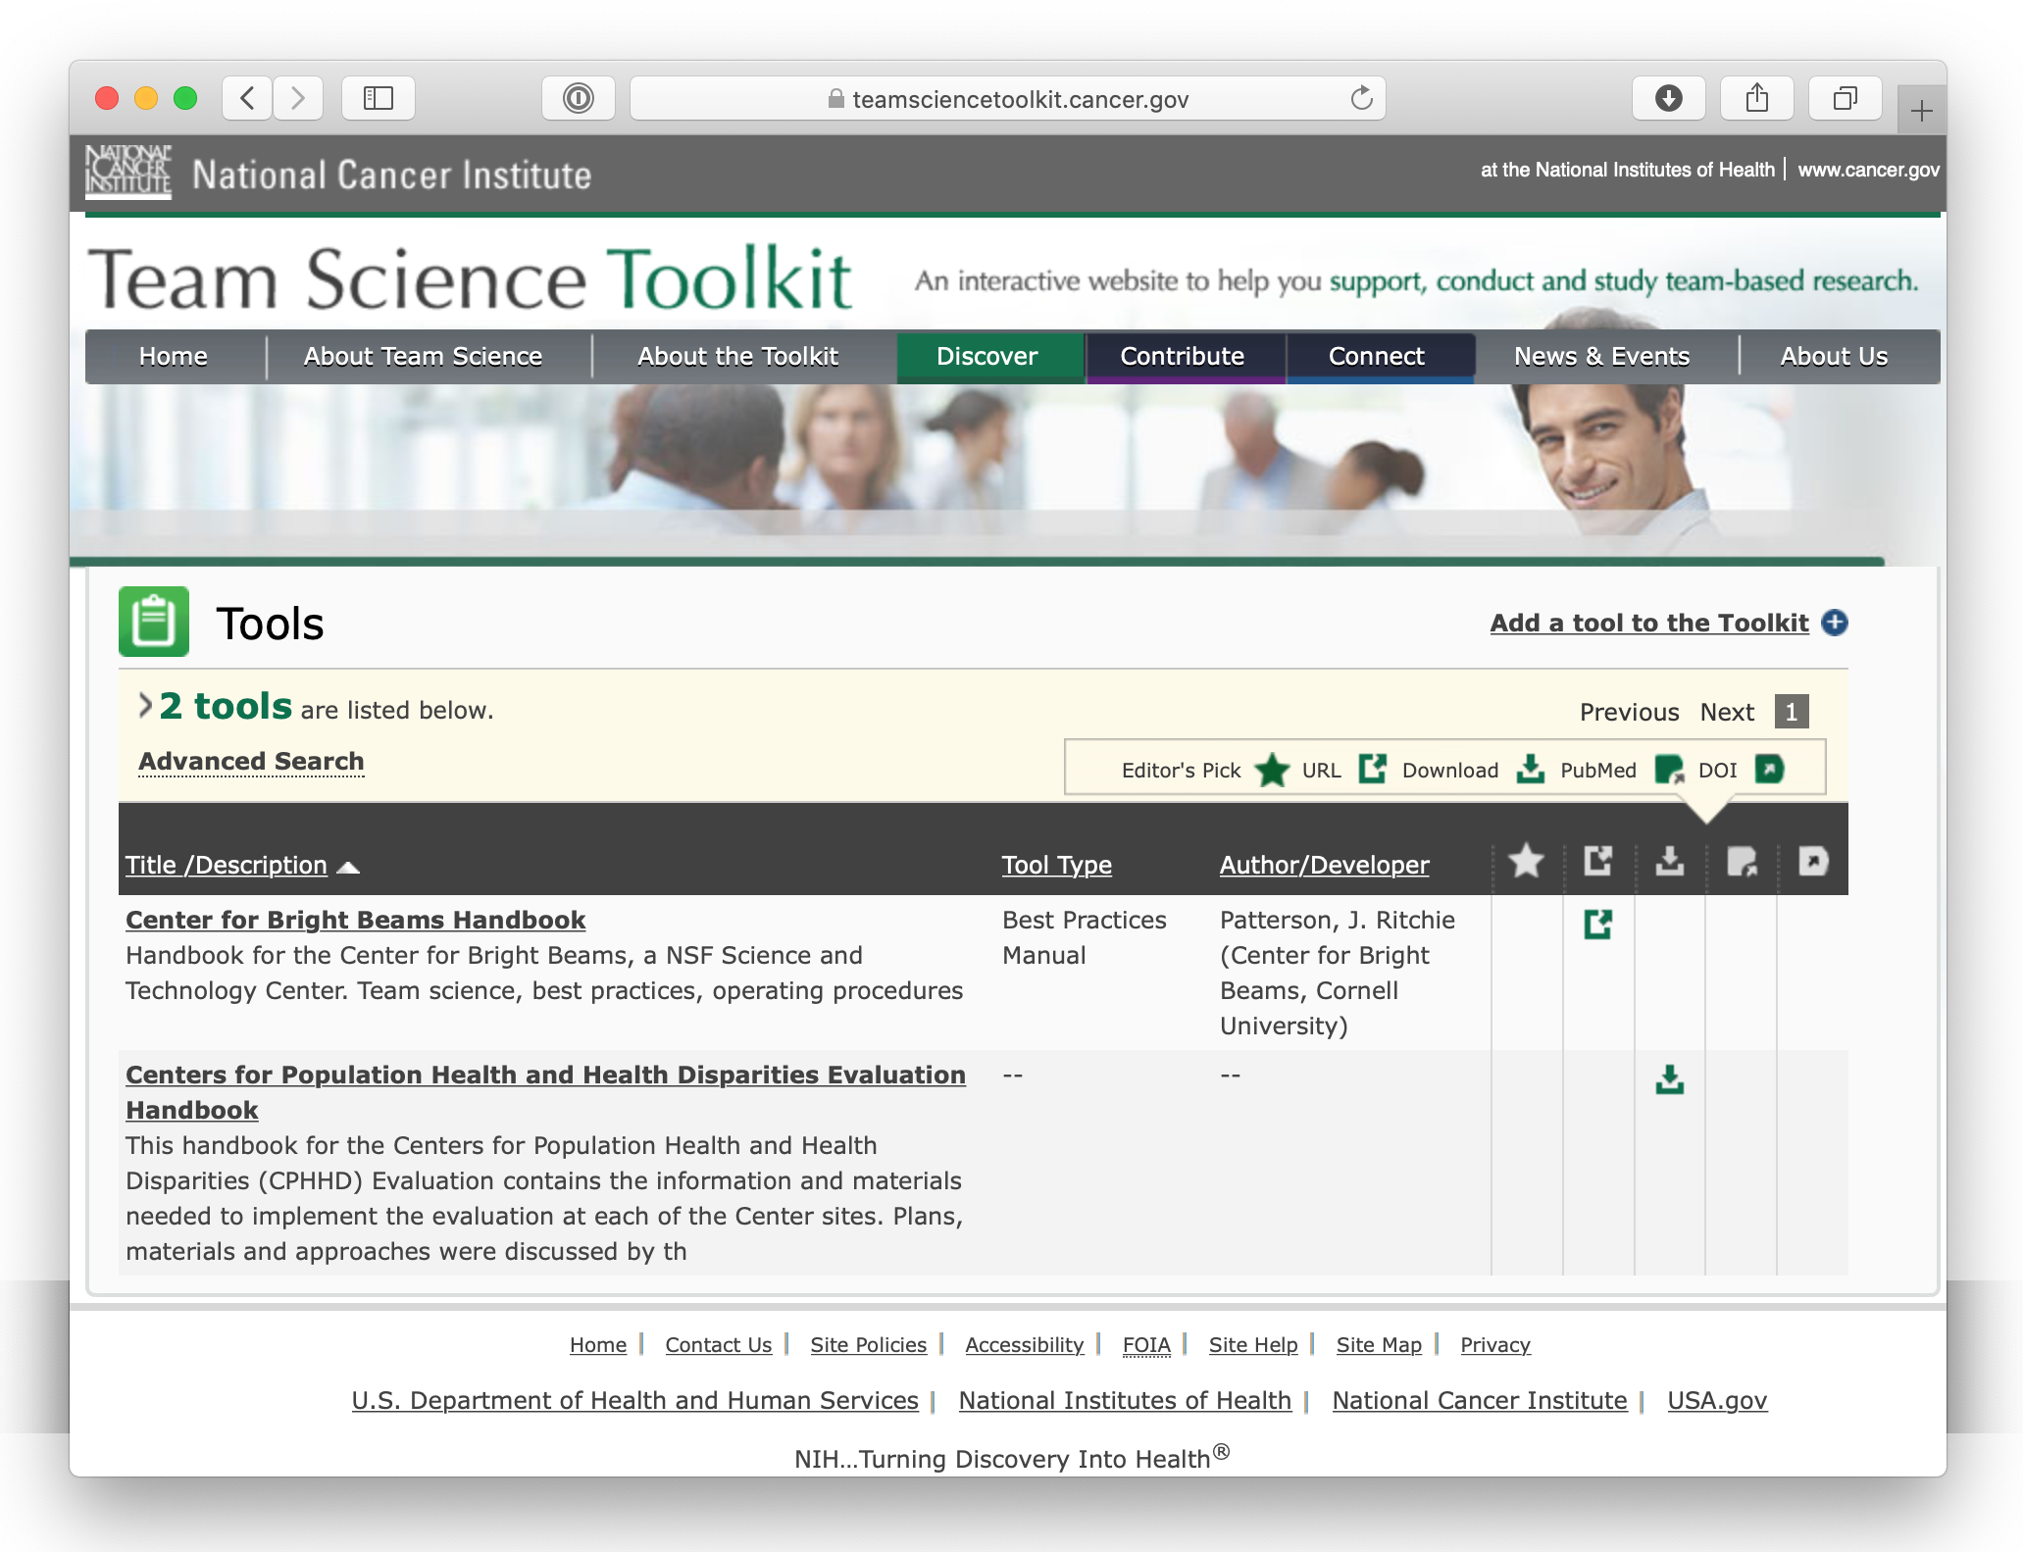
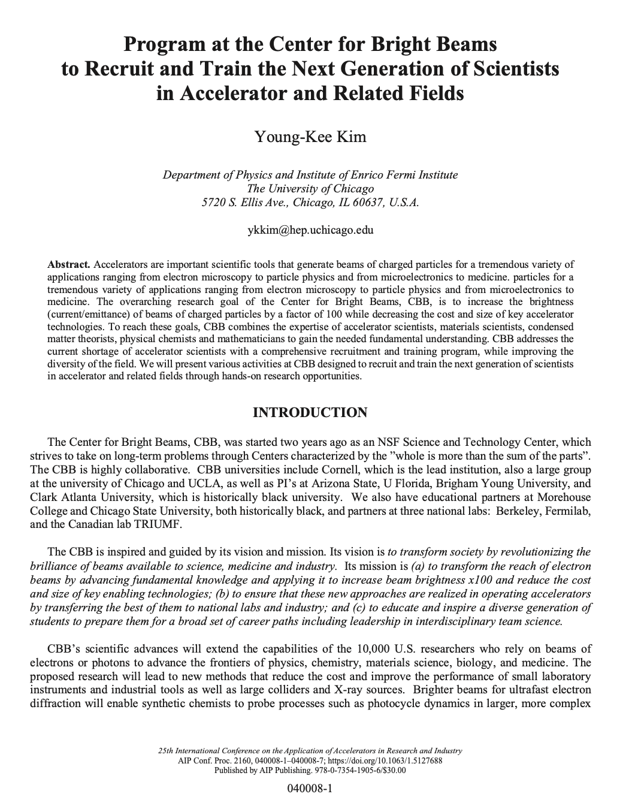
Dissemination of our Team Science Insights
Online thru the NCI Team Science Toolkit
Through Conferences and
Conference Proceedings
AIP Conference Proceedings 2160, 040008 (2019).

Slide 16

Professional Development
Goal: Produce the next generation of leaders in accelerator science and related fields

Slide 17
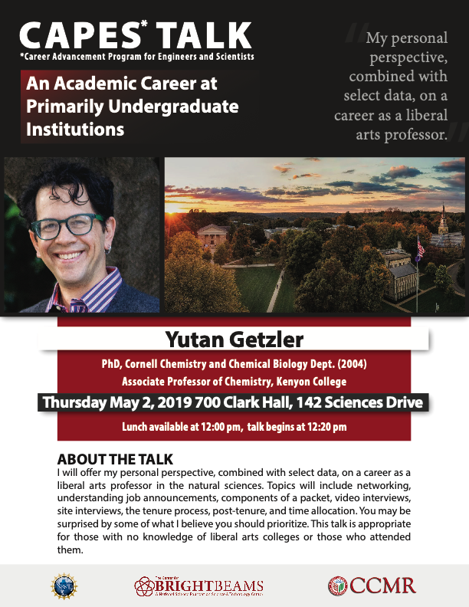
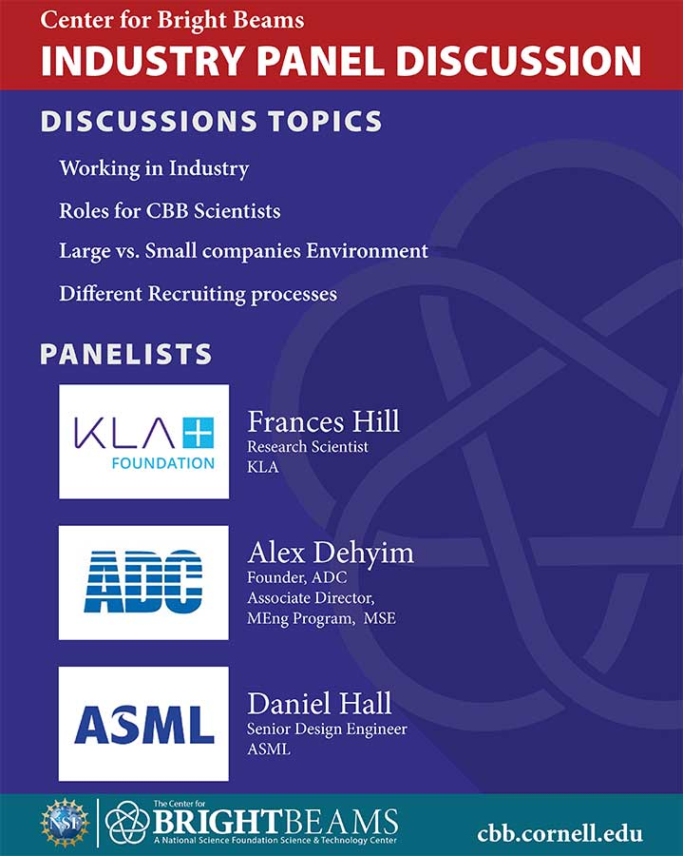
Career Exploration and Planning
All CBB students are required to annually update their IDP and discuss with advisor.
Written plan that outlines career goals
Includes concrete steps to achieve these goals
People who develop and implement strategies to pursue career-specific goals achieve greater career success as measured by salary, promotions, and level of responsibility
Individual Development Planning
http://myIDP.sciencecareers.org
Also career exploration
talks & panels

Slide 18
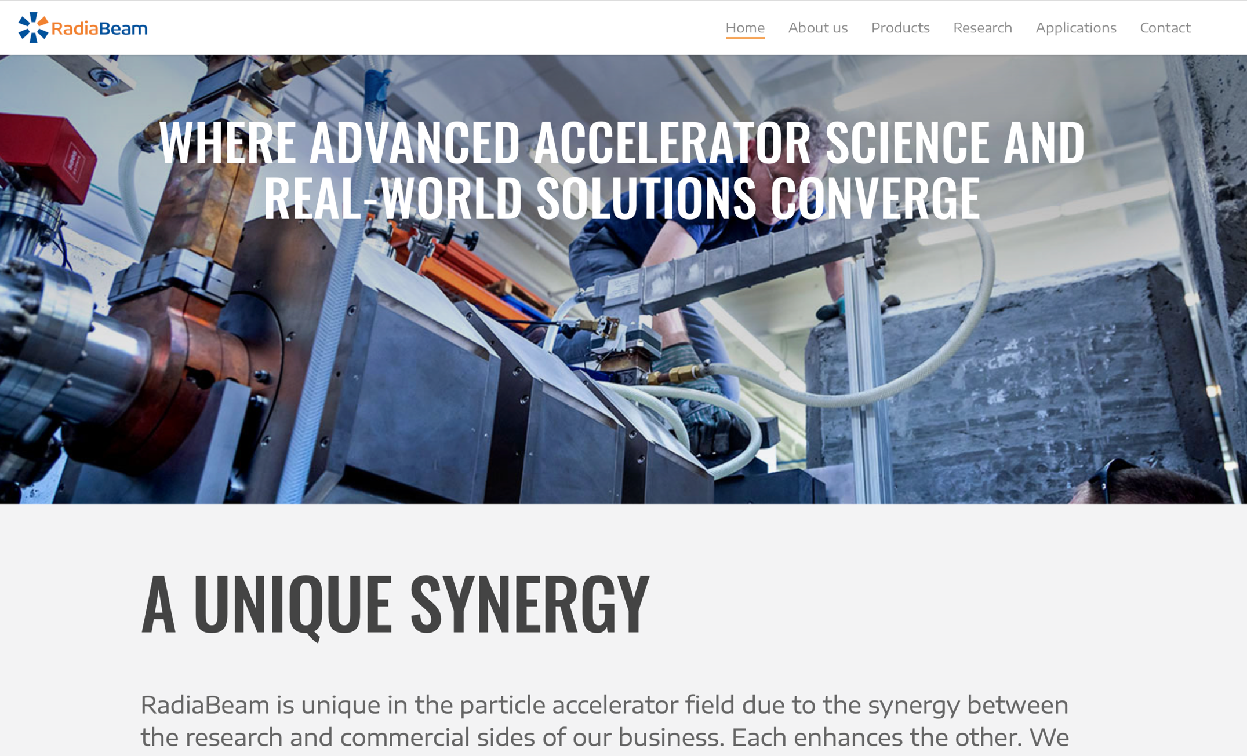
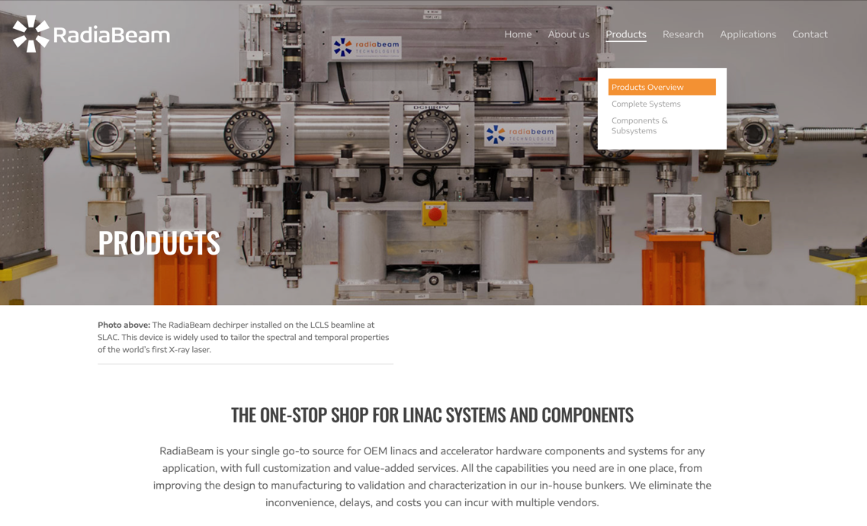
2022: Field Trip to RadiaBeam in Santa Monica CA
RadiaBeam — The one-stop shop for linac systems and components

Slide 19
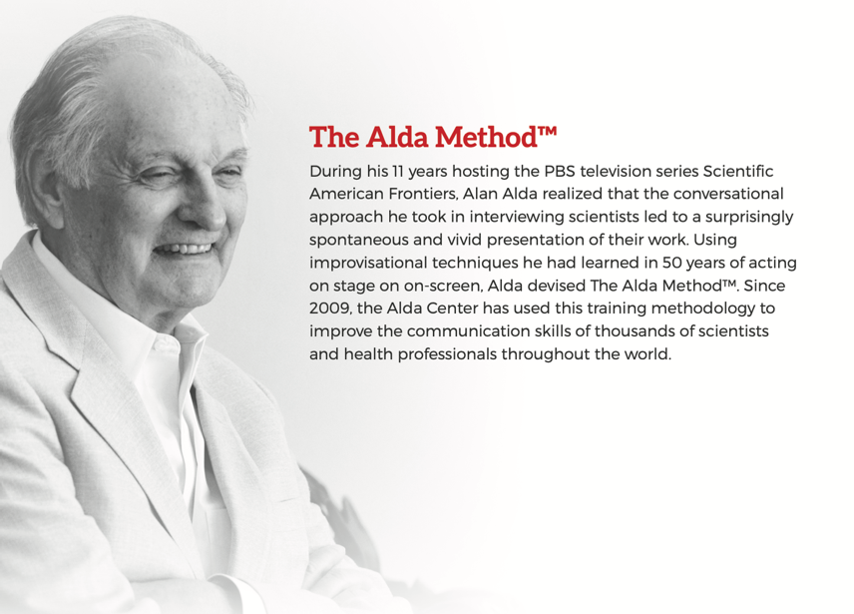
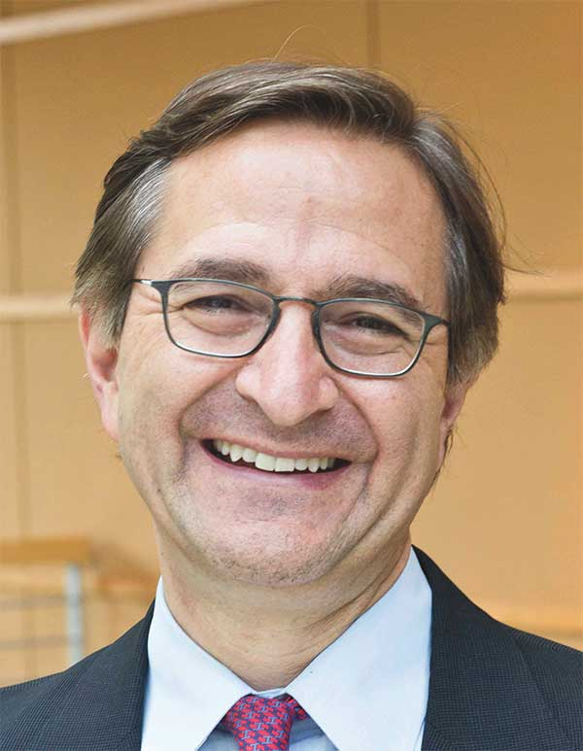
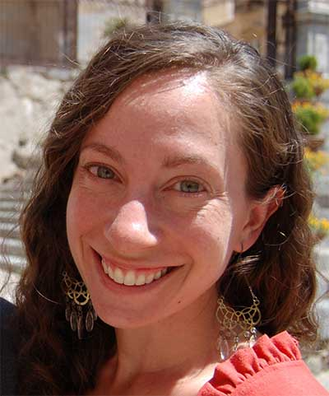


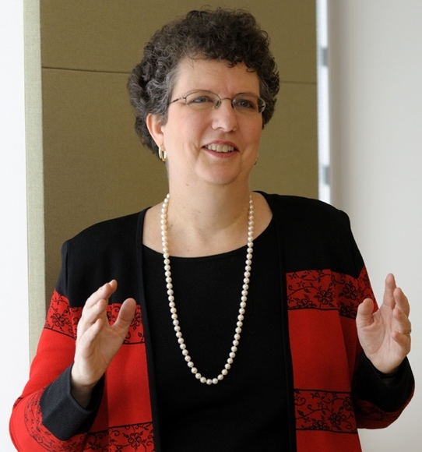
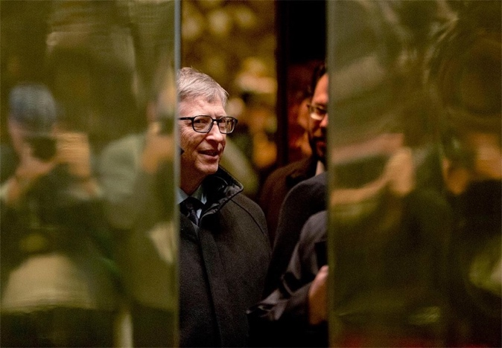
Professional Development Workshops (~2/yr)
Alda Workshop on Science Communication
Grant Writing
Workshop
Evaluating Startup Ideas
Prof. Steve Kaplan and Starr Marcello
Polsky Center for Entrepreneurship and Innovation
Univ. of Chicago
Elevator Speech Workshop
Fostering Research Integrity
Prof. C. K. Gunsalus
Director of the National Center for Professional and Research Ethics

Slide 20
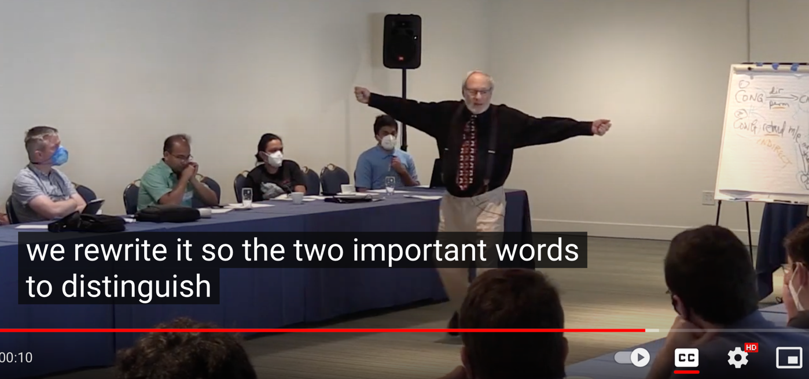
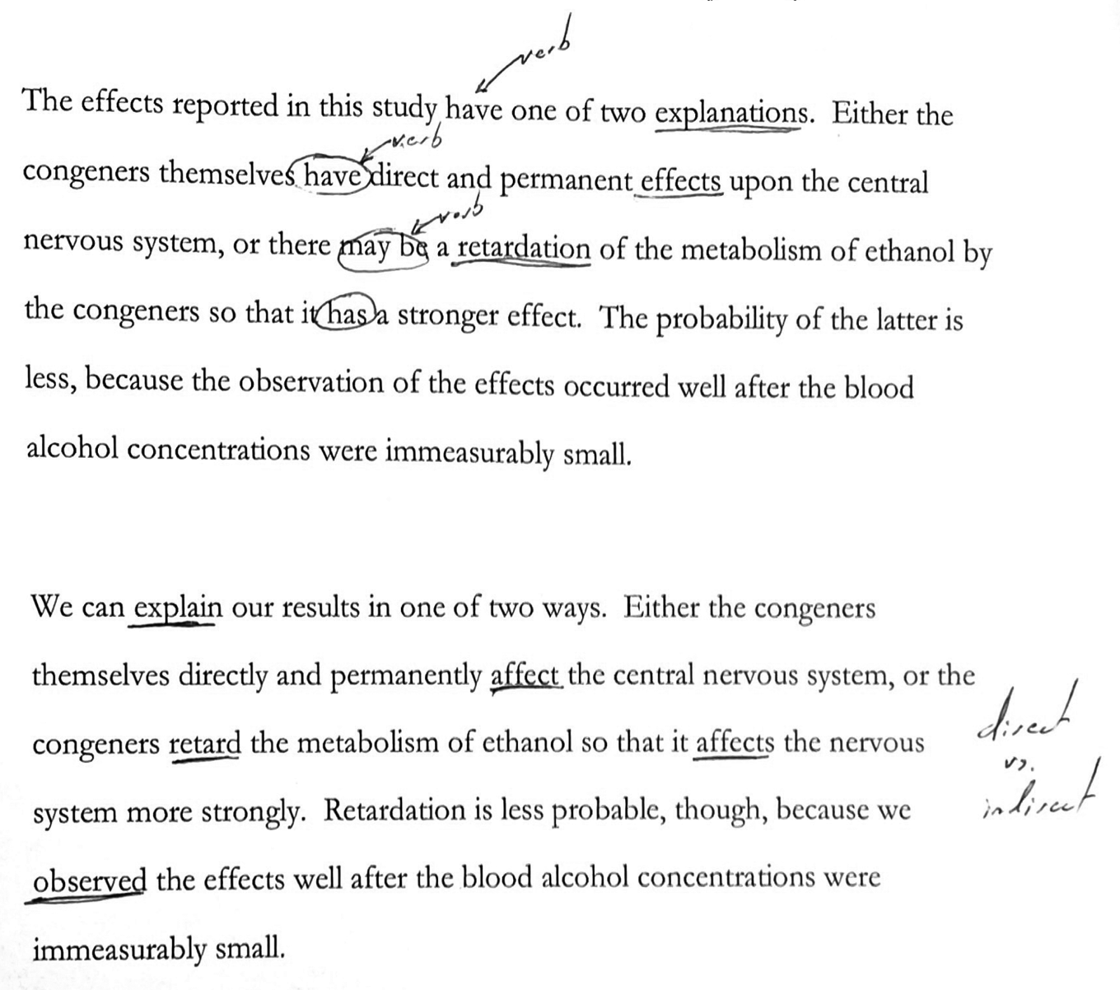
2022: The Problems with Scientific Writing
Performing a “Have-ectomy”
Also ran workshop on “Time Management for Projects” plus two half-day workshops on “Project Management for the Casual Project Manager ”
Both based on student request!
George D. Gopen
Professor of the Practice of Rhetoric
Duke University
Author of “The Science of Scientific Writing”
American Scientist 78, 550 (1990)
https://www.jstor.org/stable/29774235

Slide 21
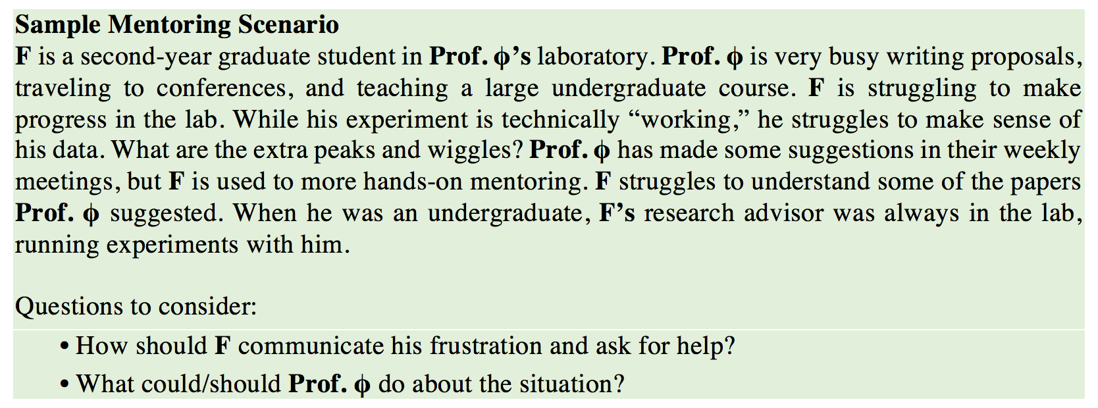
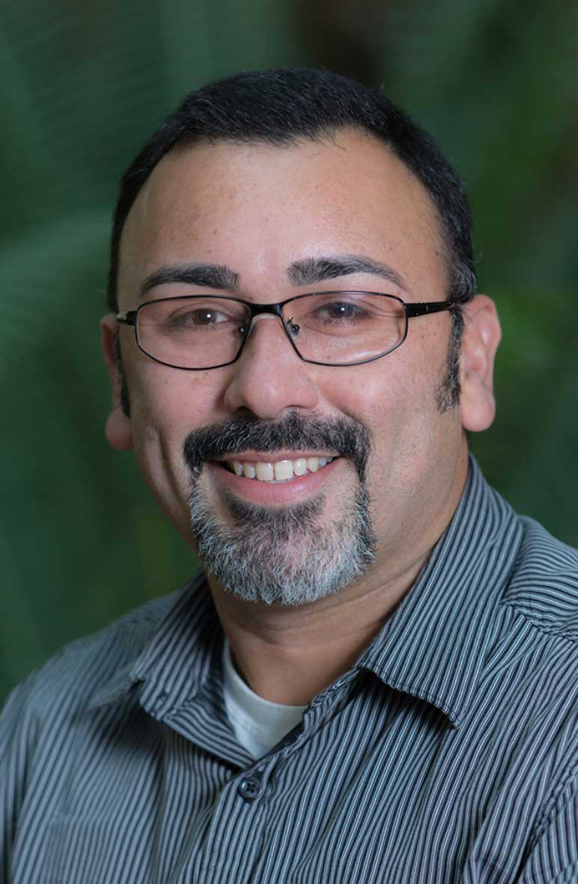
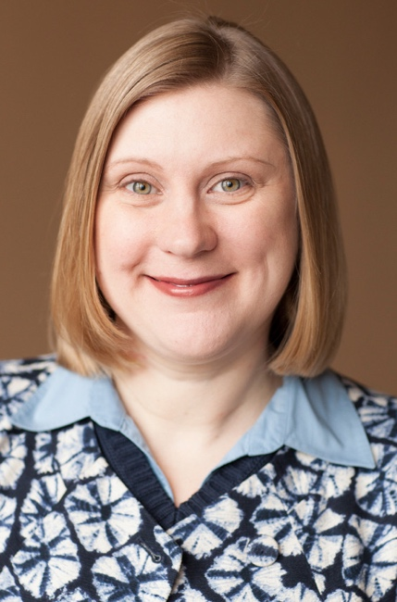
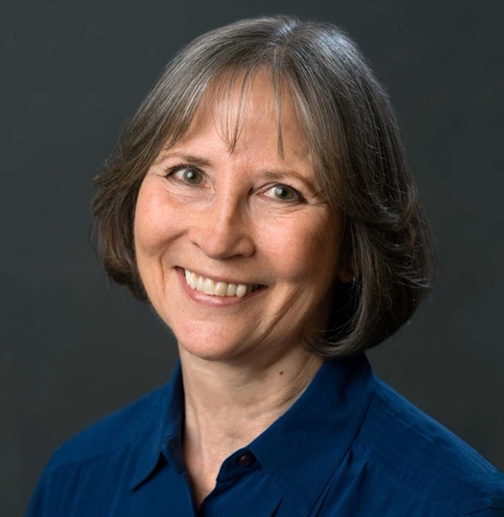
Annual Case-Based Mentoring Workshops
Prof. Kermin Martínez-Hernández
St. John Fisher College
Dr. Colleen McLinn
Cornell University
Workshops from NRMN,* CIMER,† and CIRTL‡ based on case studies
Prof. Pam Tolbert
Dept. of Organizational Behavior
Cornell University
*National Research Mentoring Network
†Center for the Improvement of Mentored Experience in Research
‡Center for the Integration of Teaching, Research, and Learning

Slide 22
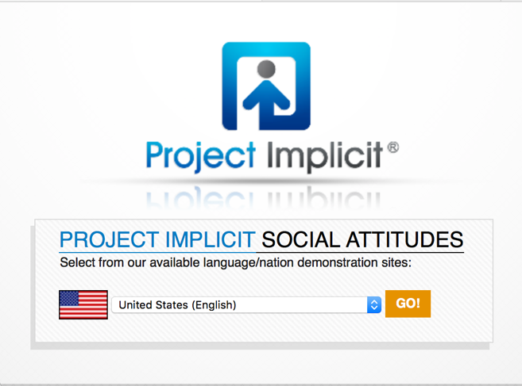

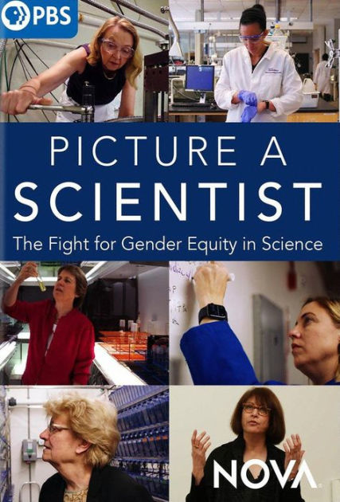
Diversity, Equity, and Inclusion Training
CBB
Sponsorship
Program
https://implicit.harvard.edu/implicit/
All CBB participants required to complete Implicit Bias diagnostic.
Avoiding Unconscious Bias in STEM
Dr. Maydianne Andrade

Slide 23
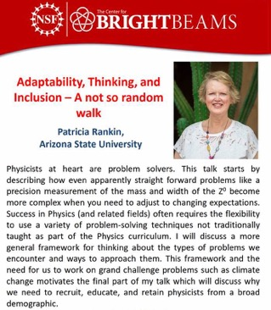
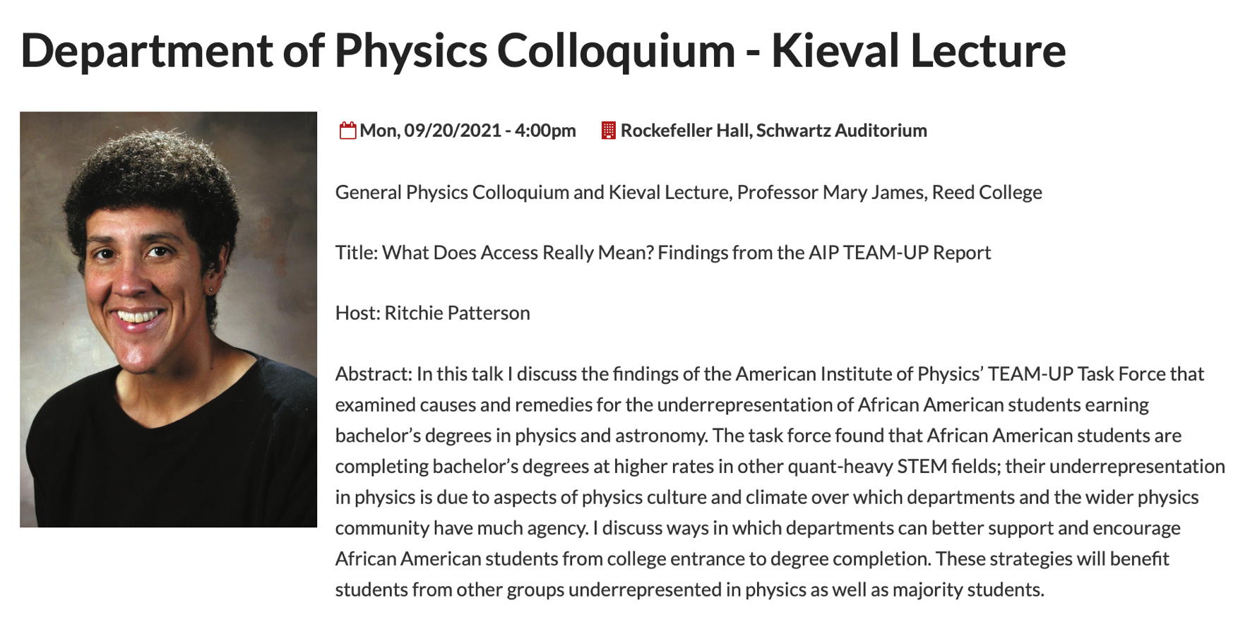
2022 Diversity, Equity, and Inclusion Training
Mary James, Reed College
AIP TEAM-UP Task Force findings on the causes of and remedies for underrepresentation of African-American students.
Foster a sense of belonging
Foster a physics identity
Academic support
Personal support
Leadership and structures

Slide 24
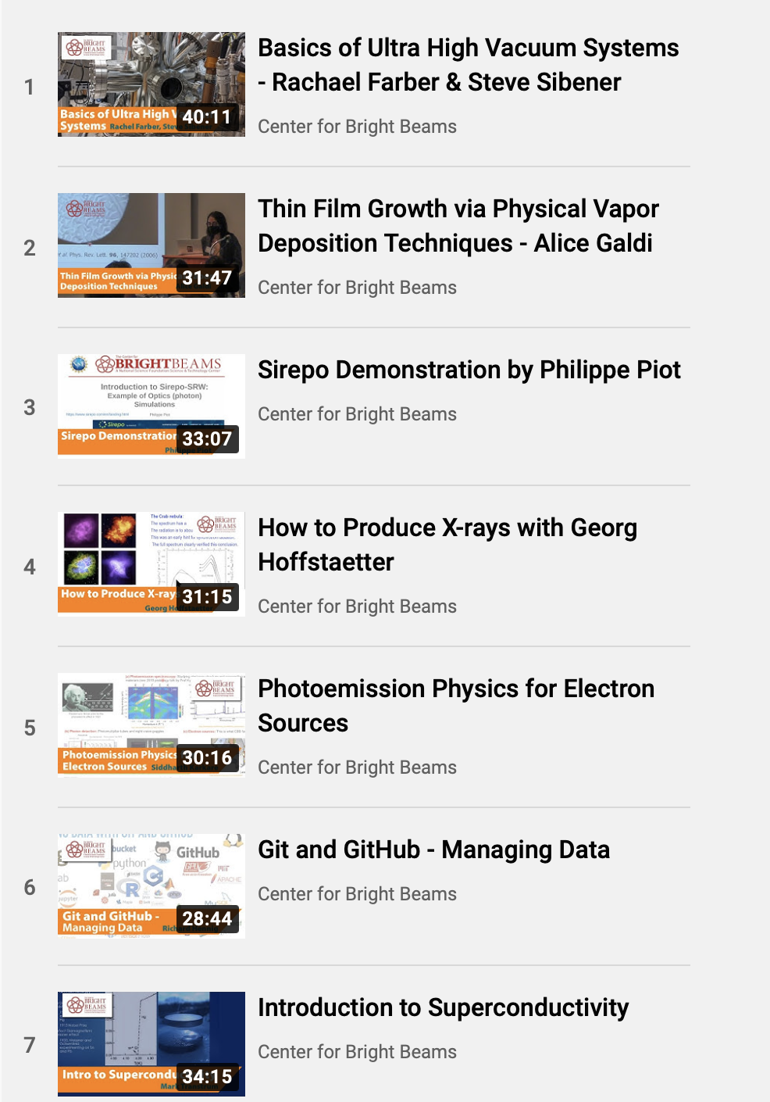
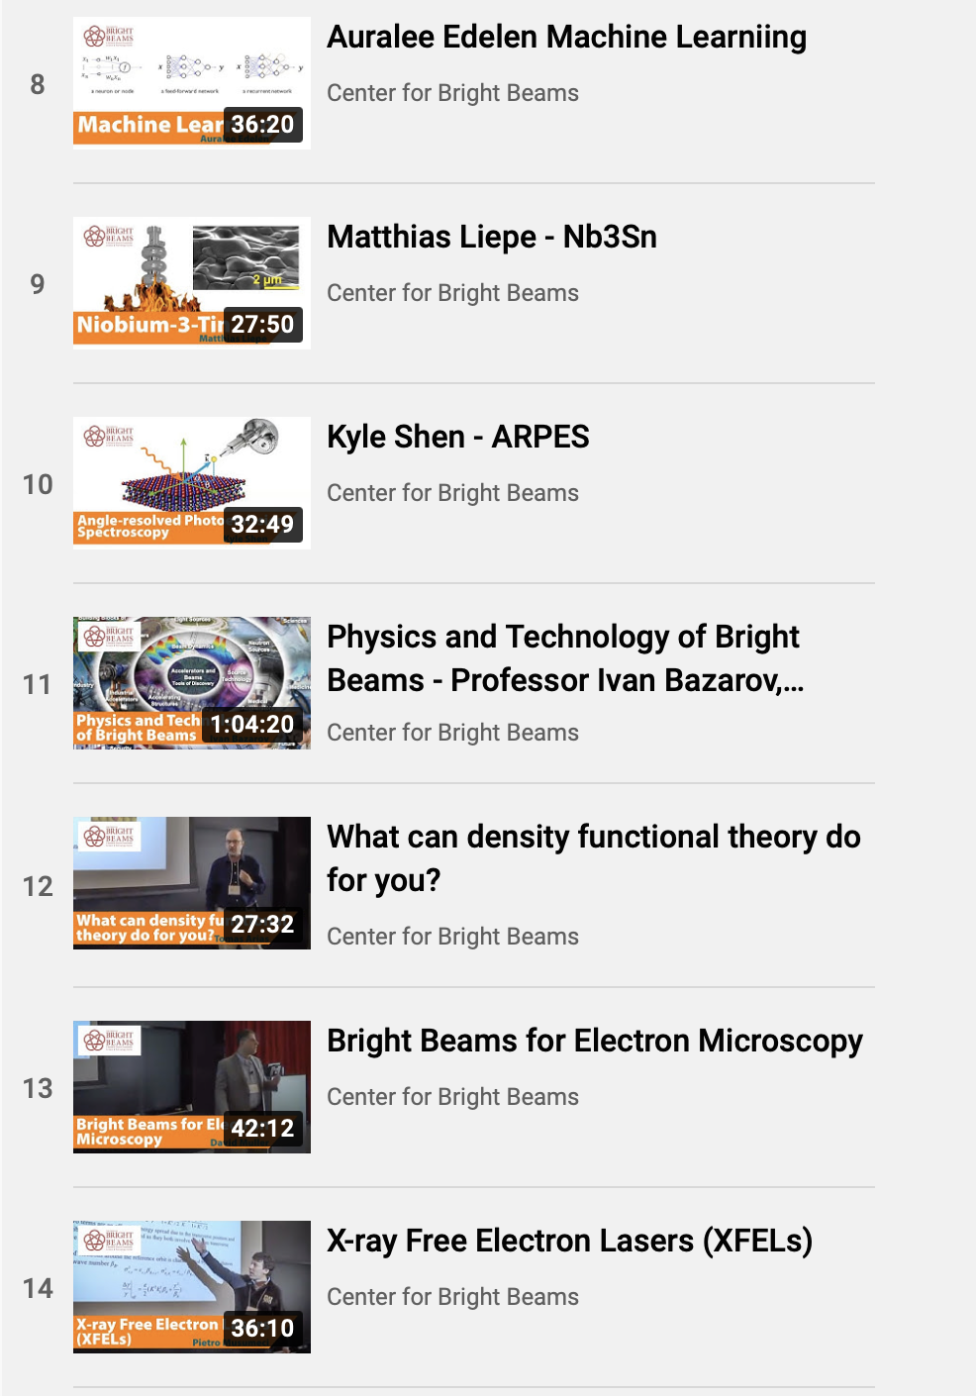
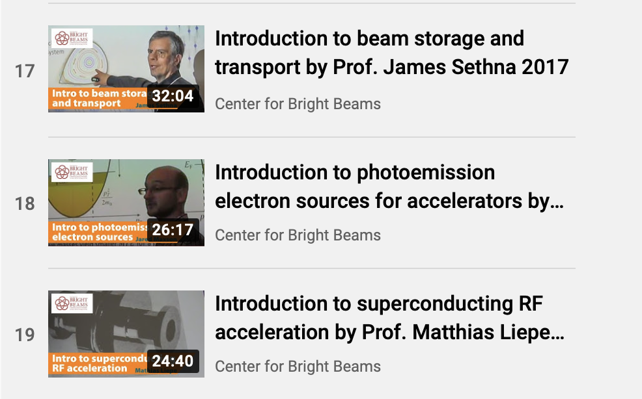
Pedagogy Talks at Annual Meeting
Every annual meeting features three 30-minute pedagogy talks which are videorecorded.

Slide 25
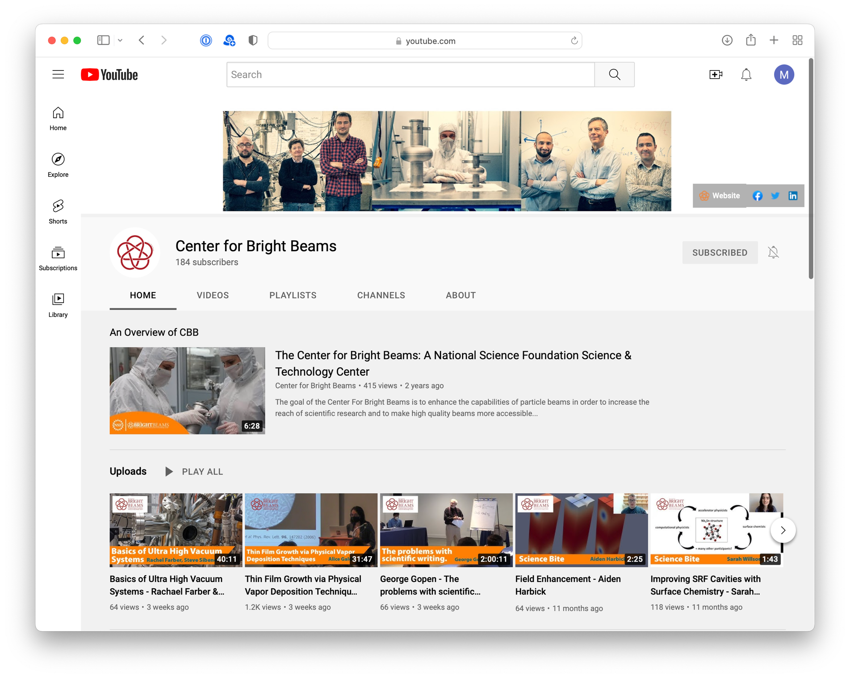
Archiving Our Pedagogy: CBB YouTube Channel
Over 20,000 views to date!
Visit the CBB YouTube
channel online at
http://bit.ly/CBB_YouTube

Slide 26
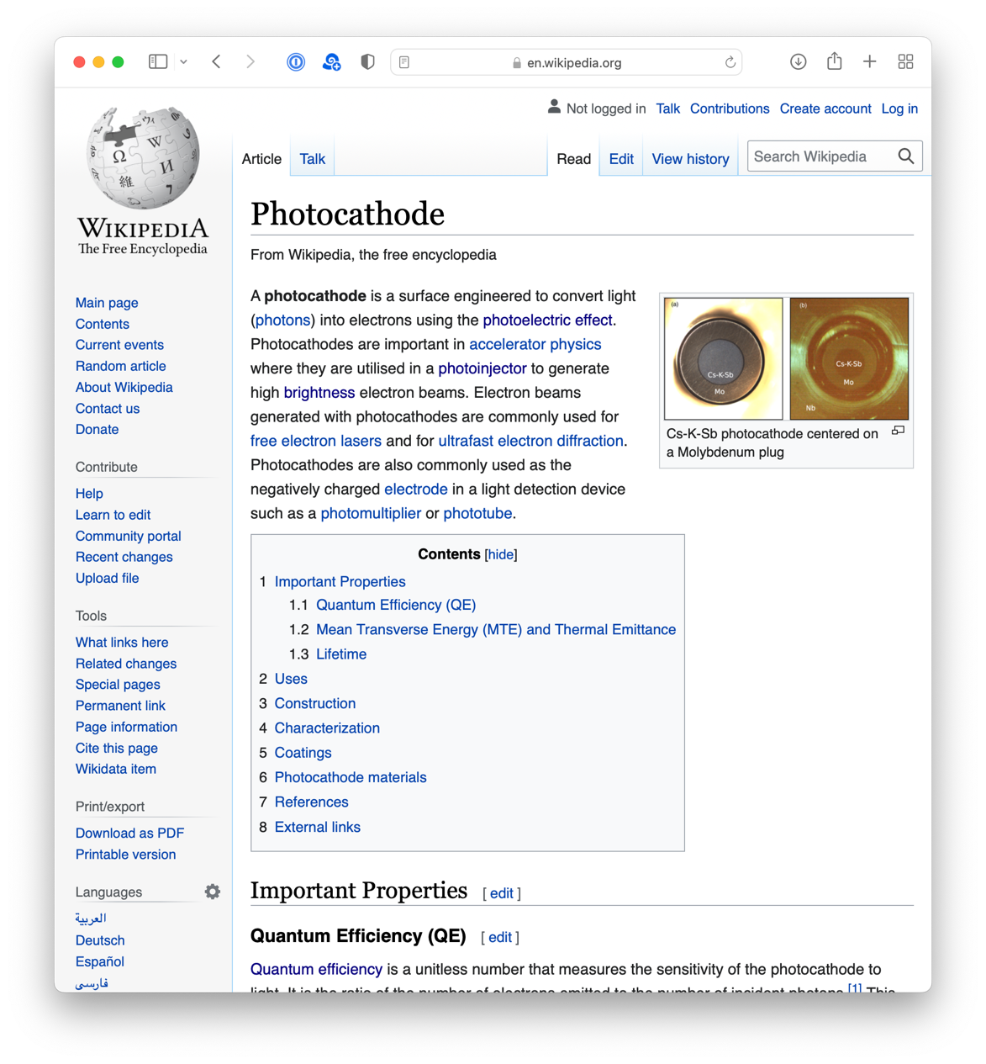
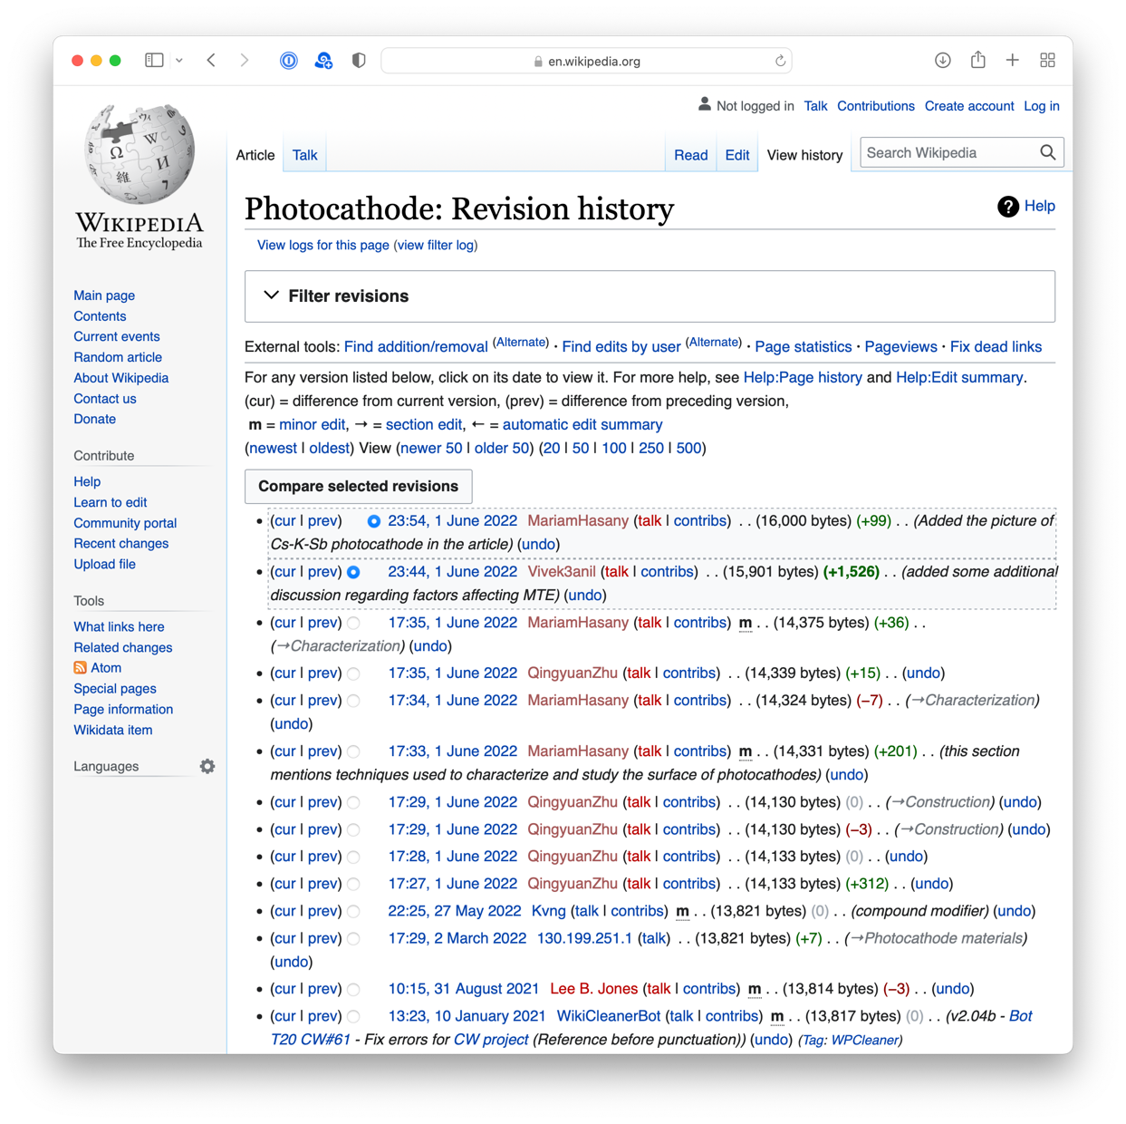
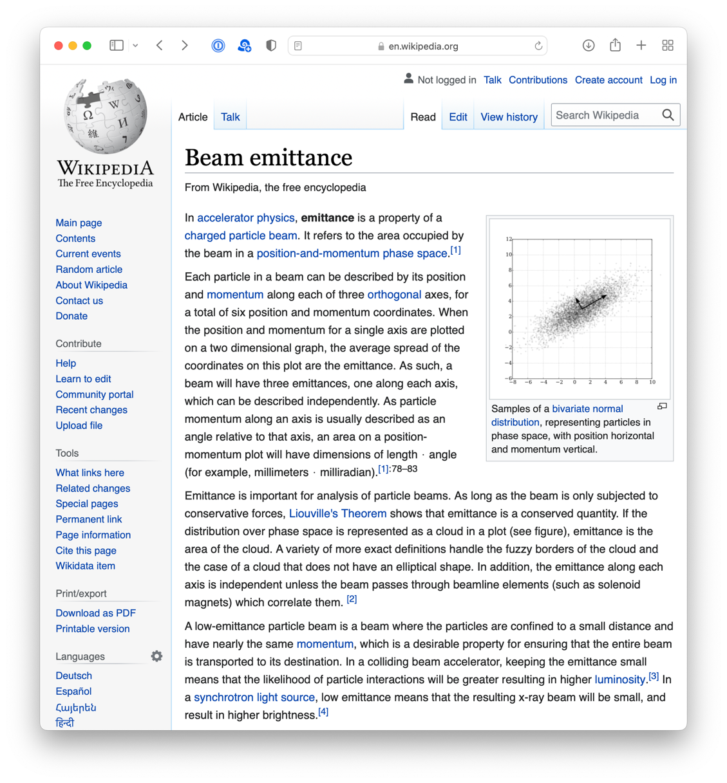
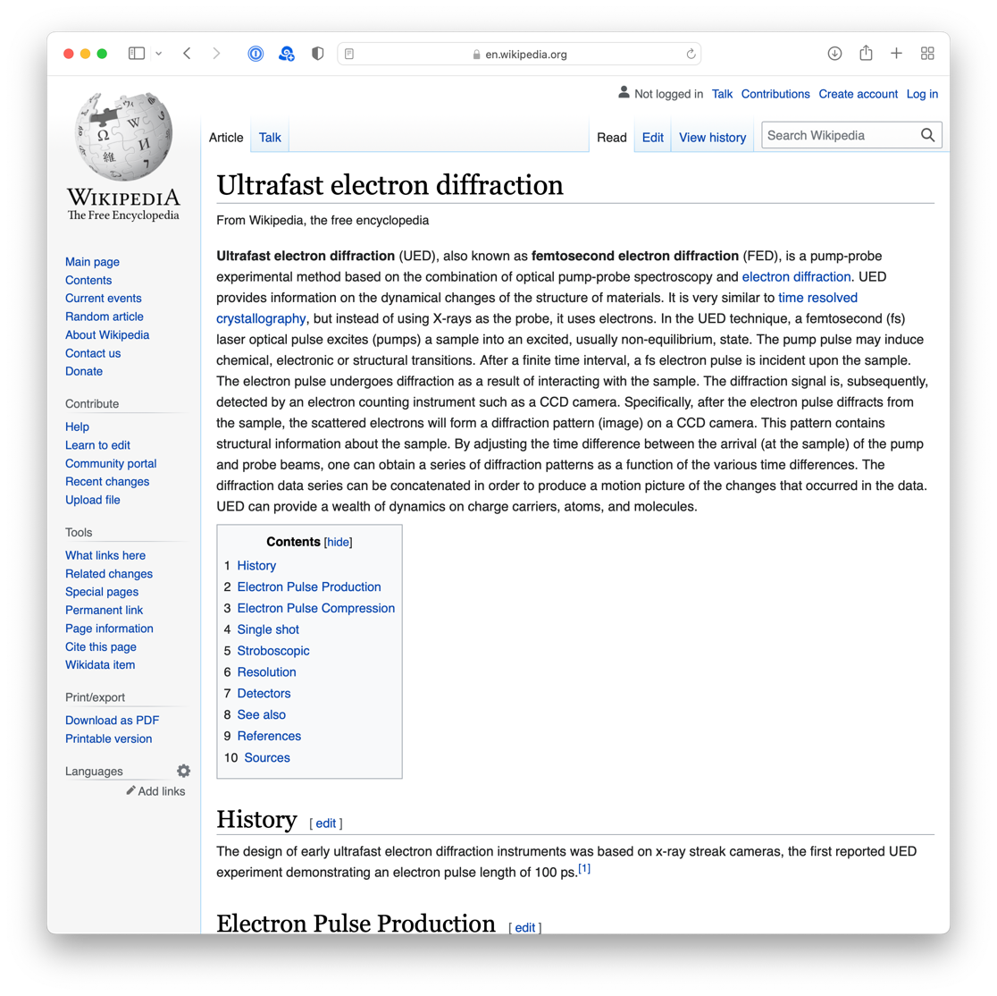
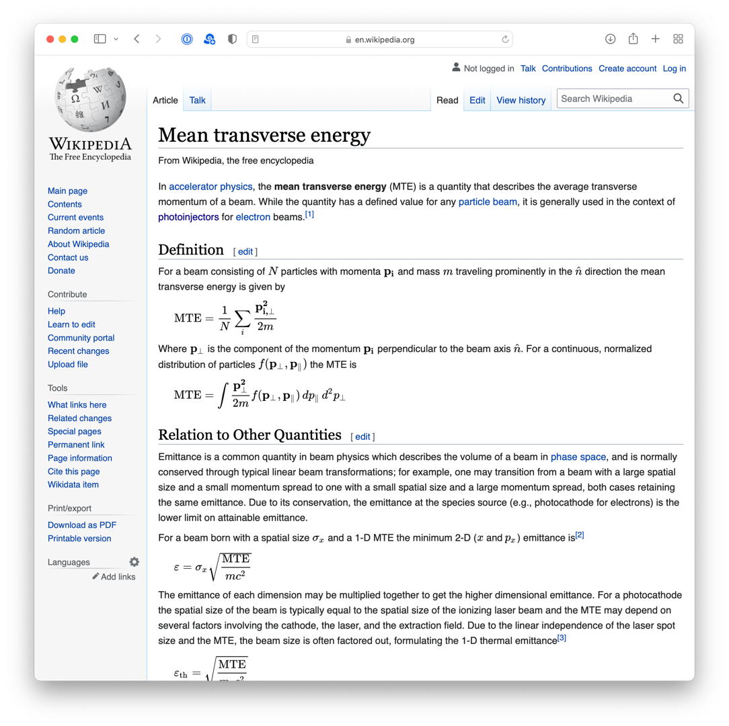
Advancing Accelerator Training: Wikipedia Edit-a-Thon
New entry!
Group activity for Grad Students
2022 Annual Meeting @ UCLA

Slide 27
Many Leadership Opportunities for GSs & PDs
Run by CBB PD committee
Grad student committee runs
Grad-to-Grad meetings
Other leadership opportunities include annual meeting, outreach activities, professional development workshops and more!

Slide 28
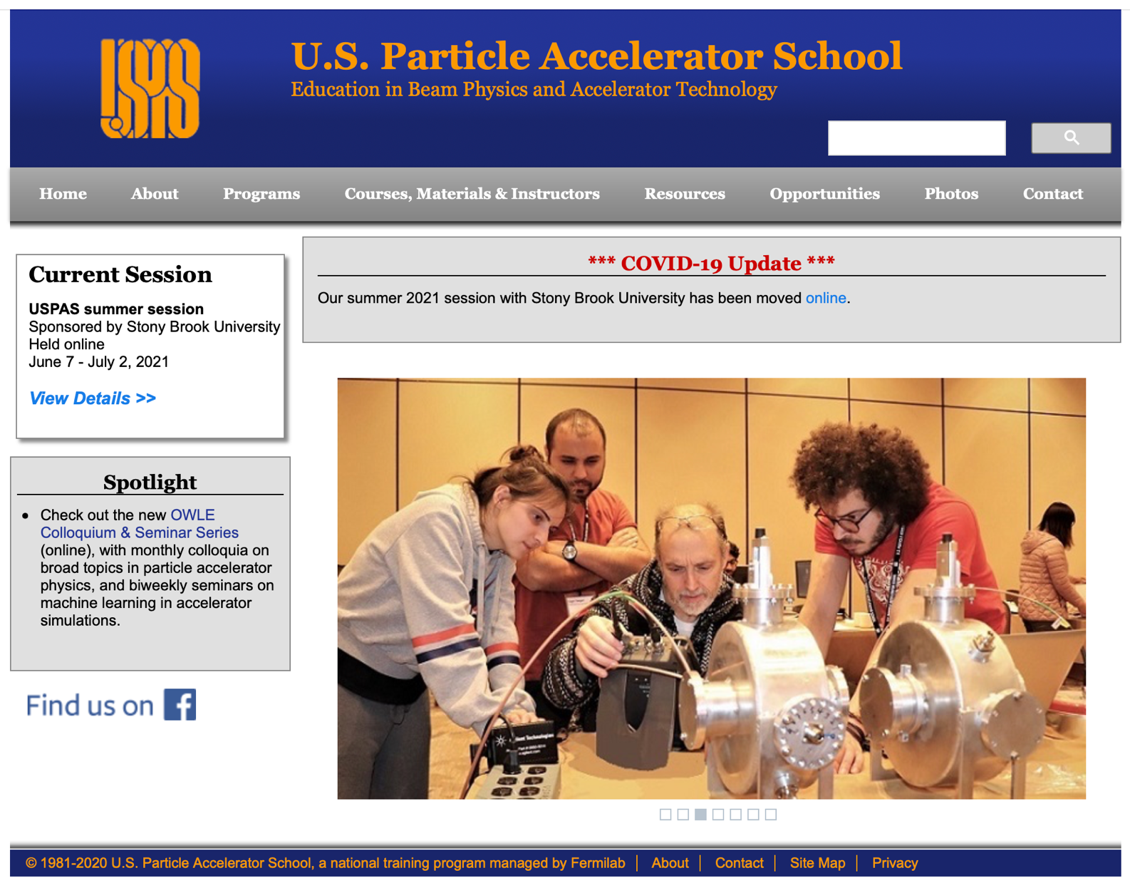
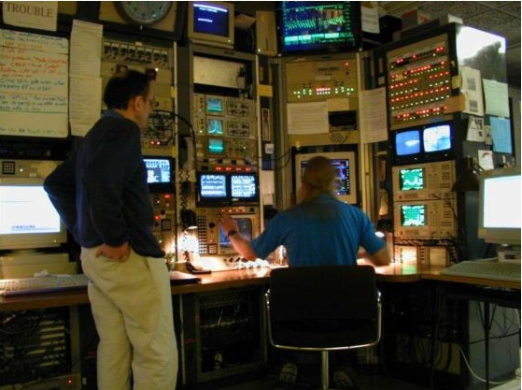
Accelerator Physics Training
US Particle Accelerator School
Also hands-on accelerator training
3 GS last year
(32 to date)!
13 GSs & PDs
last year!
At Argonne Wakefield Accelerator, CESR, LBNL’s low energy RHIC electron cooling (LEReC), MEDUSA Ultrafast Electron Diffraction Beamline, TEmeter, CBETA, SRF cavity testing, SAMURAI, and MOTHRA

Slide 29
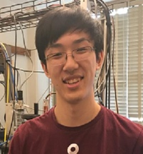
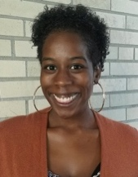
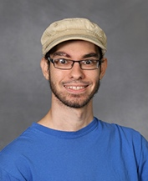
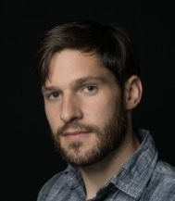


































Our Output to Date: 51 Highly Trained Scientists
12% URM & 18% Female!
Notes:
8/41 URM (19.51%)
9/41 Female (21.95%)
1/41 Disability (2.44%)
1/41 First Gen (2.44%). We didn’t start tracking first generation college student status until late in year 4.

Slide 30

Expanding the Pipeline
Goal: Attract the next generation of students to STEM and accelerator physics

Slide 31


Expanding the Pipeline: K-12 Students
+
(English and Mathematics)
Our goal: Help K-12 education by developing experiments aligned with the curriculum while strengthening GS communication skills

Slide 32


Learning Ohm’s Law with the Resistance Tube
Electricity and electrical circuits are difficult concepts to teach, in part because electrical components are “black boxes.” A 100 Ω resistor looks just like a 100 KΩ resistor. How are they different? And why does it matter?
To address this, CBB graduate students Nathan Sitaraman and Kevin Nangoi worked with NYC teacher Rony Yarden to develop a hands-on module, the Resistance Tube, that can be used to meet NYS standards for both middle school and high school students.
The Resistance Tube module includes teacher lesson plans, a resistance presentation that teachers can modify, student activity sheets, an instructional video on YouTube, as well as all materials needed for the experiments.
CBB grad student Kevin Nangoi working with Harlem Children’s Zone 7th graders on Resistance Tube activities.
Currently have 4 classroom modules and 3 pandemic modules

Slide 33

Modules are Available Through Lending Library
Any teacher in the nation can borrow our modules free of charge!
We are a small school composed of students from immigrant families — mostly from Afghanistan, Pakistan, Palestine, and Syria. This [Resistance Tube] kit will go a long way! Thank you!
— CA Middle School Teacher
CBB modules reached 403 K-12 students
between April 2021- May 2022

Slide 34



In-person outreach has resumed!
Expanding Your Horizons at
Cornell and U. of Chicago
Outreach at
Binghamton High School
Teacher workshop at ASU

Slide 35

Expanding the Pipeline: REU & Undergraduate Research
This experience has made me realize how much of a community effort research is today.
— Maya Caskey
Eliza Walters
Michelle Kwok
Maya Caskey
5 URM undergraduates participated in Summer 2022 research
17 undergraduates in total participated in Summer 2022 research,
including 9 female students
Students hosted at Cornell, U. Chicago, U. of New Mexico, UCLA, and Arizona State U.
Cumulative Total: 87 summer undergrads (48 female/non-binary & 31 URM)

Slide 36

Where does our pipeline lead?
Updated slide in progress
• 20 undergraduates now in grad school
• 7 undergraduates working in industry
… and many still completing undergrad degree

Slide 37






Expanding the Pipeline: Diverse Partnerships
The Atlanta University Center Consortium is the largest contiguous consortium of African Americans in higher education in the United States.
Xiao-Qian (Larry)
Wang
Clark Atlanta Univ.
Lycurgus (Curg)
Muldrow
Morehouse College
Archie Peters
Chicago State Univ.
George Japaridze
Clark Atlanta Univ.

Slide 38




CBB Success Stories: Clark Atlanta Partnership
Cornell Summer 2017
MS, CAU, May 2019
Now HS Physics Teacher
in Atlanta GA
Cornell Summer 2017
Cornell Summer 2018
MS, CAU, May 2019
Now Math Teacher
in NYC
Brianna Harris
Clark Atlanta U.
Mariah Brown
Clark Atlanta U.
At Cornell, 2017-2020
MS, CAU, Fall 2019
Working towards PhD
At Cornell, 2018-2019
PhD, CAU, Summer 2019
Now Analytical Chemist at US Food and Drug Administration
Aron Tesfamichael
Clark Atlanta U.
Frank Ikponmwen
Clark Atlanta U.

Slide 39



Building New Bridges to HBCUs
Partner on DOE Renew Proposal
Proposed Section on Accelerator Physics
National Society of Black Physicists
Prof. Paul Gueye
Michigan State University
Dr. Elena Echeverria
Cornell University
Prof. Willie Rockford
Chair of Physics
Morgan State University

Slide 40



Expanding Our Partnerships: UPR and UNM
UPR Mayagüez: Prof. Sudhir Malik, Physics
UPR Rio Piedras: Prof. Jorge Colon, Chemistry
UNM Prof. Sandra Biedron, Elec. & Comp. Eng.

Slide 41
Progress towards Diversity Indicators
CBB Annual Goal: Meet or exceed national diversity of the field of physics at all levels.
CBB Ultimate Goal: Equal representation at all levels within our lifetimes
Data for females are from American Institute of Physics, 2019 www.aip.org/statistics/reports/women-among-physics-and-astronomy-faculty
Data for URMs are from American Physical Society, 2019, www.aip.org/statistics/reports/trends-physics-phds-171819 URM includes Black, Hispanic, and Native American/Pacific Islander.

Slide 42
Diversity Trends over Time
Female and Non-Binary
Underrepresented Minority
Data for females are from American Institute of Physics, 2019 www.aip.org/statistics/reports/women-among-physics-and-astronomy-faculty
Data for URMs are from American Physical Society, 2019, www.aip.org/statistics/reports/trends-physics-phds-171819 URM includes Black, Hispanic, and Native American/Pacific Islander.

Slide 43



WORKFORCE DEVELOPMENT Roadmap
Effective CBB collaborations across disciplines and institutions.
FY 22
FY 23
FY 24
FY 25
FY 26
OBJECTIVES
DELIVERABLES
APPLICATIONS
Use team science to enable all participants – faculty, postdocs, and students – to be successful in convergence research
Effective communication practices across all aspects of research and administration
Shared goals and shared recognition
Strong leadership and transparent decision-making
CBB collaborators discussing research developments.
More annual collaborative papers or proceedings than PIs
Cultivate an intellectually diverse scientific workforce prepared to lead in their chosen field and foster an appreciation for accelerator science
Faculty, postdocs & students with the skills necessary to accomplish CBB goals become leaders in their fields and appreciate research challenges in accelerator sciences
CBB grad students and postdocs
at work in the lab.
Monitor and evaluate
the efficacy of the workforce development and diversity plans
Center programming that evolves to meet the needs of Center members
based on an external evaluation designed to provide formative information
Middle school educational modules that change student attitudes toward science, improve teacher satisfaction and confidence, and have a positive impact on the graduate student network formation
University of Florida researchers demonstrating dye-sensitized solar cells to area middle school teachers.
REU programs that support undergraduate students
and provide them with a valued research experience

Slide 44



DIVERSITY Roadmap
Measurable impact on the participation of underrepresented groups in sciences and technology, particularly in accelerator science.
FY 22
FY 23
FY 24
FY 25
FY 26
Objectives
Deliverables
Applications
Train researchers from underrepresented groups
Participation in CBB research by women and non-binary scientists exceeds national physics metrics at all levels annually
Participation in CBB research by members of underrepresented racial and ethnic groups exceeds national physics metrics at all levels annually
CBB Master’s student, Mariah Brown with Dean Taylor.
Provide opportunities for diverse groups of undergraduates to conduct research in accelerator science
REU programs engage four diverse undergraduates annually
and provide them with a valued research experience
CBB recruiting event in Puerto Rico.
Stimulate a broad pipeline of middle school students interested in STEM fields
Middle school outreach efforts engage diverse students, change student attitudes toward science,
improve teacher satisfaction & confidence, & have positive impact on grad student network formation
CBB graduate student works
with students at the Harlem Children’s Zone.

Slide 45
CBB Legacy
Our most enduring legacy will be our students and postdoctoral scholars who will become the next generation of leaders in science and engineering.
Our legacy will also include a set of best practices for fostering Team Science in the physical sciences, which we are disseminating to others.

Slide 46
Our Mission

