Slide 1
Physics-Informed Machine Learning for Particle Accelerators
Christopher M. Pierce

Slide 2
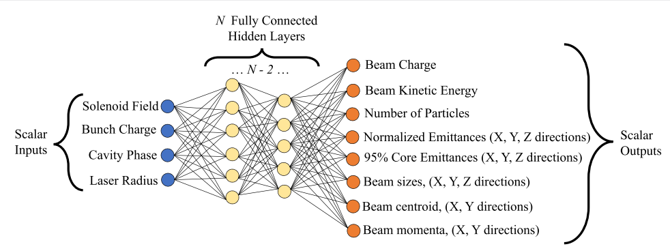
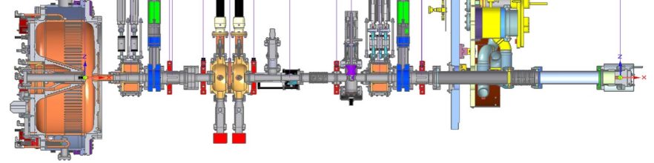
Surrogate Models – Fast, Differentiable, Data-Driven
Gupta, L., Edelen, A., Neveu, N., Mishra, A., Mayes, C., & Kim, Y. K. (2021). Machine Learning: Science and Technology, 2(4), 045025.
SURROGATE MODEL
A blackbox model mapping system inputs to outputs. Often used when the exact workings of the system are difficult to know or expensive to calculate.

Slide 3
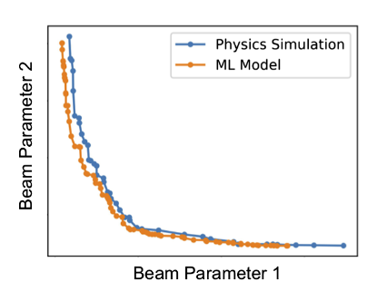
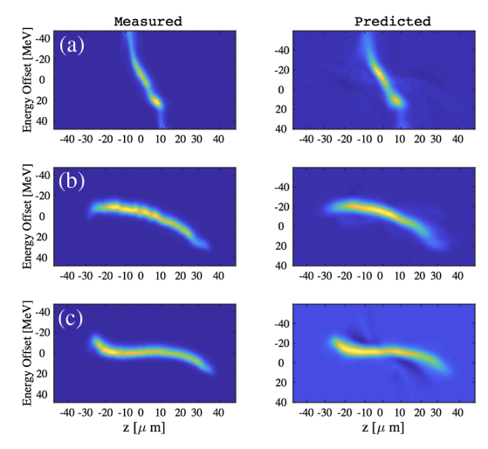
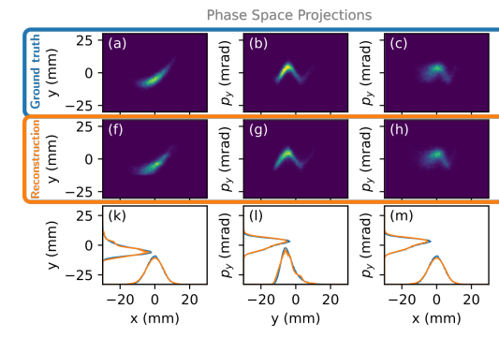
Surrogate Models – Fast, Differentiable, Data-Driven
SPEED
GRADIENT INFO
DATA-DRIVEN
Physics-based simulations are expensive
Efficiently query precalculated results over wide range of parameters
${10}^{3}−{10}^{6}$ speedup
Many existing codes are incompatible with auto-diff
Surrogate models inherently make gradient calculations easy (IE neural nets)
Training surrogates may be less costly than re-engineering existing tools
Physics-based simulation tools have difficulty incorporating real-world data
Surrogates treat data from machine and simulation on “same level”
Naturally combine types of data to produce better model
Edelen, A., Neveu, N., Frey, M., Huber, Y., Mayes, C., & Adelmann, A. (2020). PRAB, 23(4), 044601.
Roussel, R., Edelen, A., Mayes, C., Ratner, D., Gonzalez-Aguilera, J. P., Kim, S., ... & Power, J. (2022)..
Emma, C., Edelen, A., Hogan, M. J., O’Shea, B., White, G., & Yakimenko, V. (2018). PRAB, 21(11),.
Incorporating Data from SLAC into Model of Longitudinal Phase Space
Optimization Sped up ${10}^{6}$x
Phase Space Reconstruction by Differentiable Modeling

Slide 4
Surrogate Models – Fast, Differentiable, Data-Driven
Karniadakis, G. E., Kevrekidis, I. G., Lu, L., Perdikaris, P., Wang, S., & Yang, L. (2021). Nature Reviews Physics, 3(6), 422-440.
THE PROBLEM
The (relative) difficulty of acquiring data for accelerator physics problems makes building surrogate models hard. Simulation tools are expensive and data collection at real machines is even more expensive.
PHYSICS PRIORS - A SOLUTION?
We already know the governing equations of charged particles in a beamline. Instead of making models re-learn this info from first principles, can we impose it as a constraint? Can make cheaper models?

Slide 5
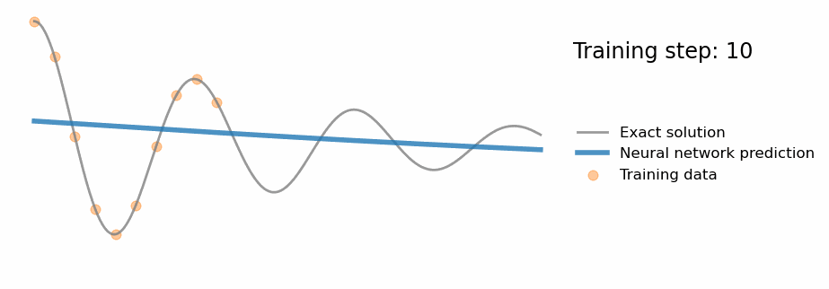
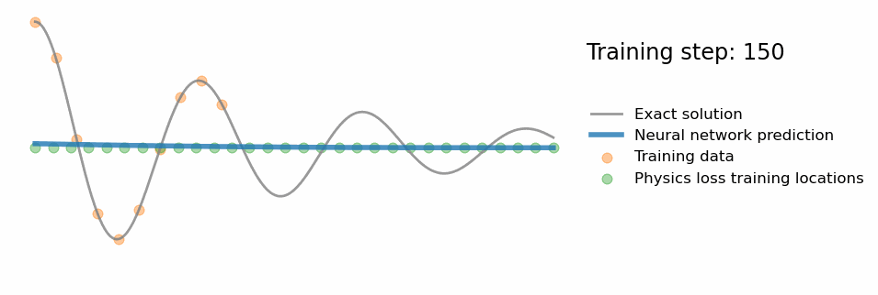
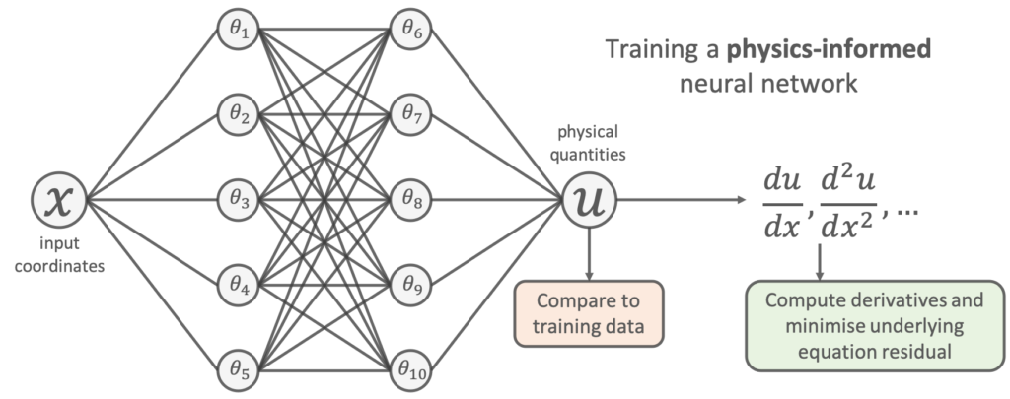
Physics Informed Neural Networks Primer
Without Priors
With Priors
https://benmoseley.blog/my-research/so-what-is-a-physics-informed-neural-network/
PHYSICS INFORMED NEURAL NETWORK (PINN)
Neural networks are a “universal approximator” and can represent solutions of ODEs and PDEs. Train the neural network with a loss that represents the ODE or PDE residual at a set of “collocation points.”
Opportunity to Reduce Data Requirements for Accelerator Surrogates

Slide 6
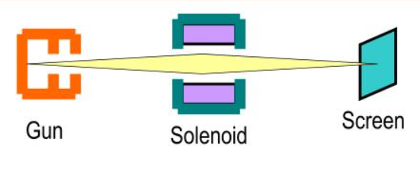
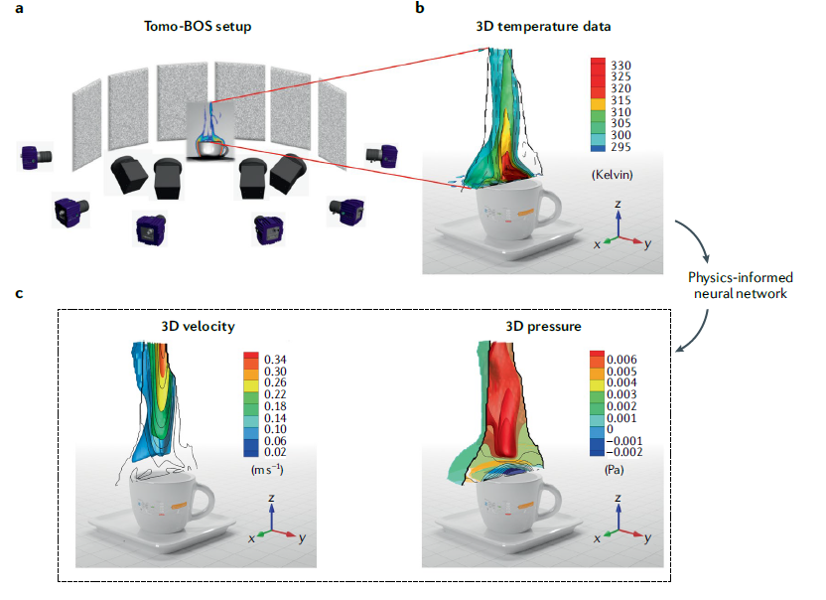
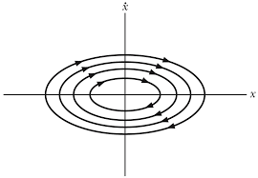
Ongoing and Future Work
INVERSE PROB.: PHASE SPACE MEASUREMENT
Given images of a charged particle beam for different accelerator settings, reconstruct the initial phase space. Important for measurements of real world system. PINN-based methods could be the first general method of reconstructing beams w/ intense space charge forces. Demonstrated in non-accelerator system.
$$k=1$$
$$k=2$$
$$k=3$$
Phase Space
Karniadakis, G. E., Kevrekidis, I. G., Lu, L., Perdikaris, P., Wang, S., & Yang, L. (2021). Nature Reviews Physics, 3(6), 422-440.
Screen Image
Screen Images
PINN w/ Knowledge of Solenoid Lens
Initial Beam Dist.

Slide 7
PINNs for Accelerator Physics
WHICH PDE TO USE AS A PRIOR IN ACCELERATOR PHYSICS?

Slide 8
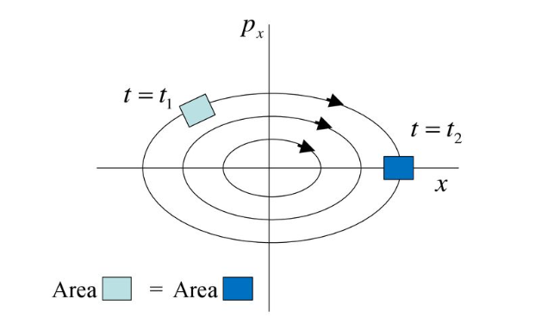
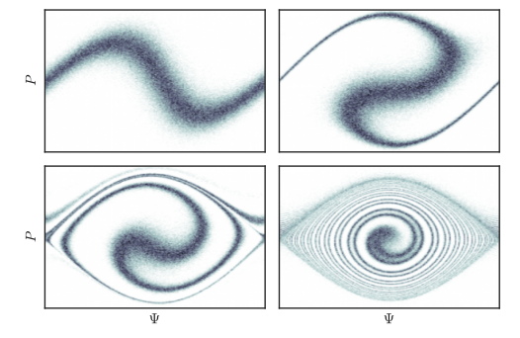
PINNs for Accelerator Physics
VLASOV EQUATION
$$\frac{∂f}{∂s}+ \frac{∂r}{∂s}\frac{∂f}{∂r}+ \frac{∂p}{∂s}\frac{∂s}{∂p}=0$$
$$∇^{2}φ+ρ=0$$
Consider the multi-particle phase space distribution function f(r, p, s) with s the independent variable. Only considering long range force, it obeys the Vlasov equation. It is a generalization of Liouville’s Theorem. Space charge is calculated in self-consistent manner.
G.A. Krafft Old Dominion University Slides
J. Math. Phys. 57, 042905 (2016)

Slide 9
Progress on PINN Surrogate Modeling
A FIRST TEST OF PHYSICS-INFORMED PRIORS
Physics priors should improve sample efficiency and generalization of surrogate models. Put that to test with a direct comparison of two systems:
Conventional neural network of the kind already used in accelerator physics
Physics-informed network with strong priors
“Knobs” are: magnet/cavity settings, laser parameters, etc
Time-Like Coordinate
($t$ or $s$)
“Knobs”
($α$, $β$, $γ$, …)
Conventional Surrogate Model
Measurable Quantities
MODEL B
Phase-Space Coordinate
($x$, $p_{x}$, $y$, $p_{y}$)
PINN
Phase Space Density
Measurable Quantities
MODEL A
“Conventional” Surrogate Model
“Knobs”
($α$, $β$, $γ$, …)
Physics-Informed Surrogate Model
Will the benefits of a PINN outweigh the complexity of modeling the beam instead of the observables?

Slide 10
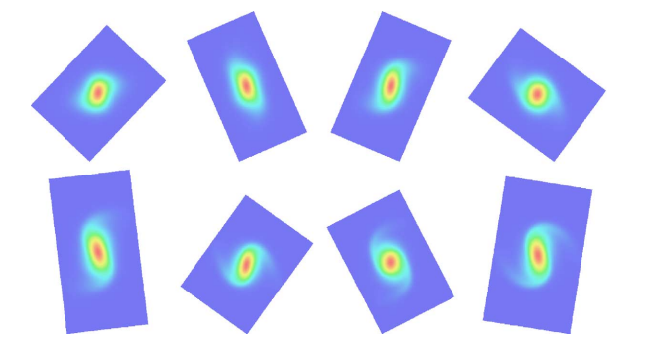
Progress on PINN Surrogate Modeling
A TOY ACCELERATOR SYSTEM
Which accelerator system to choose? I claim that beam transport in a uniform focusing channel is an ideal test system:
Few dimensions (2D) makes training the PINN much less costly
Doesn’t have longitudinal coordinate, which we expect to pose some challenges for PINN (distribution not centered at z=0, Pz=0)
Trivial beamline elements makes for simple implementation
Space charge should lead to complex behavior
Beam with Space Charge, Uniform Focusing Channel
Sonnendrücker, E., Filbet, F., Friedman, A., Oudet, E., & Vay, J. L. (2004 Computer Physics Communications, 164(1-3), 390-395.

Slide 11
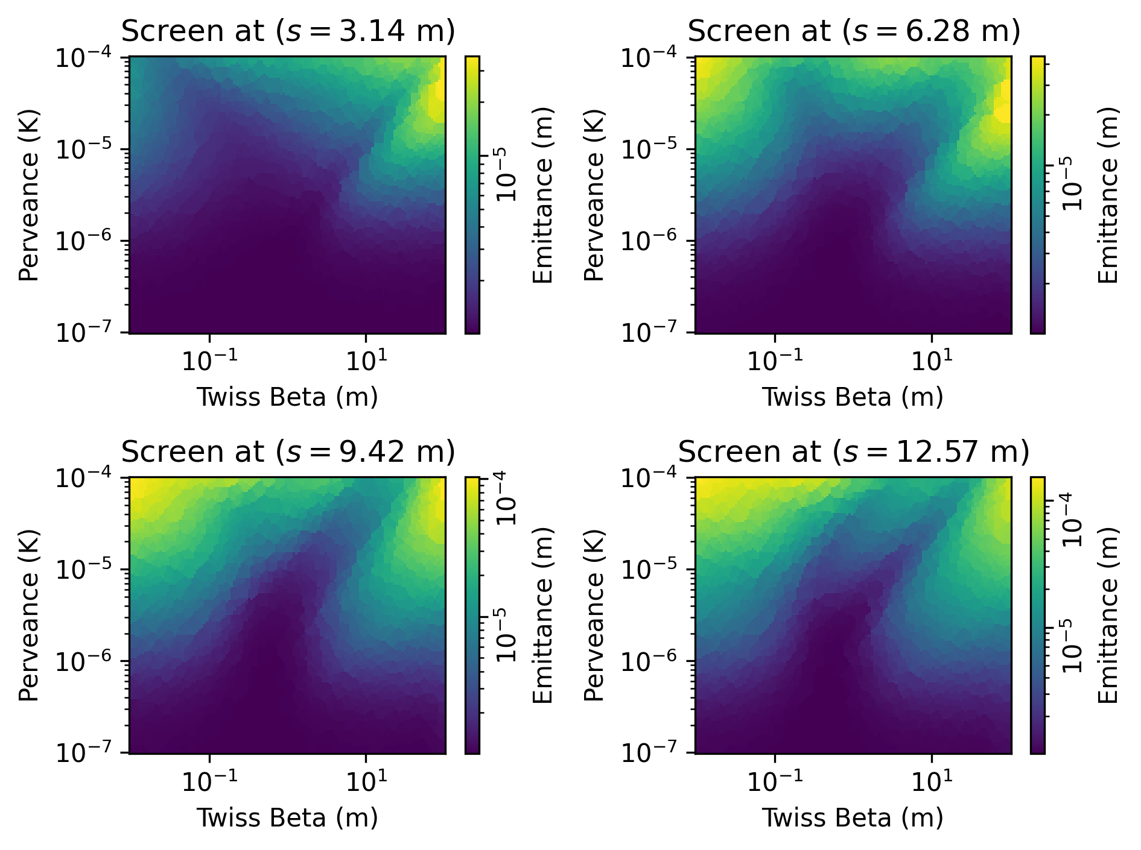
Progress on PINN Surrogate Modeling
EMITTANCE GROWTH IN FOCUSING CHANNEL
For purposes of study, calculate emittance growth as beam parameters are varied. Done using a PIC code.
Twiss Beta: Gaussian beam’s aspect ratio at s=0m
Perveance (K): Unitless measure of charge density normalized to beam energy.

Slide 12
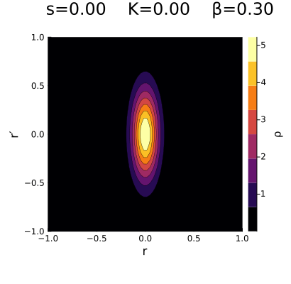
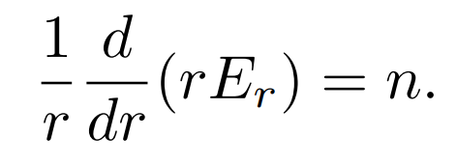
Progress on PINN Surrogate Modeling
FIRST STEPS AT FOCUSING CHANNEL PINN
The PDE describing the beam in phase space is the Vlasov Eqn.
This is coupled with the Poisson Eqn. to give the space charge forces Er (K is perveance)
Ignore space charge for now. Using this as the loss term in the PINN with $ρ\left(s=0, r, r^{′}\right)$ as a boundary condition, a NN can be trained to represent the function $ρ(s, r, r^{′})$.
Neural network represents density at every point along focusing channel

Slide 13
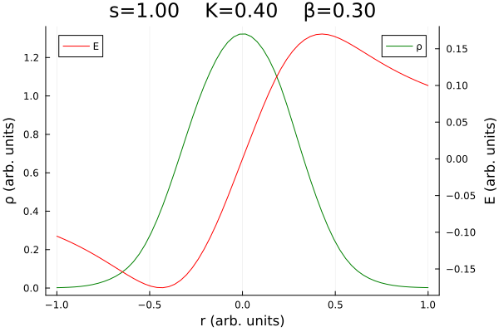
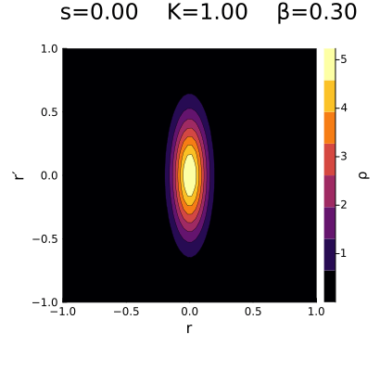
Progress on PINN Surrogate Modeling
INCLUSION OF SPACE CHARGE FORCES
Self-consistent space charge forces can be “trained” at same time as the PINN for beam density by introducing second NN that represents $E_{r}(s, r)$.
Optimize parameters for both networks at the same time using the coupled loss function.
Results in the expected tune depression and nonlinear focusing forces.

Slide 14
Progress on PINN Surrogate Modeling

Slide 15
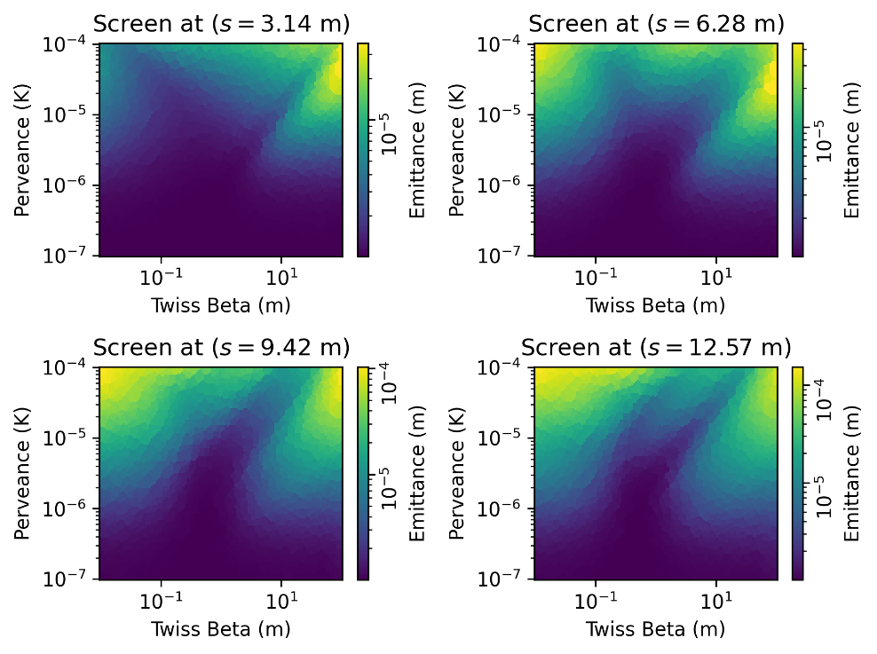
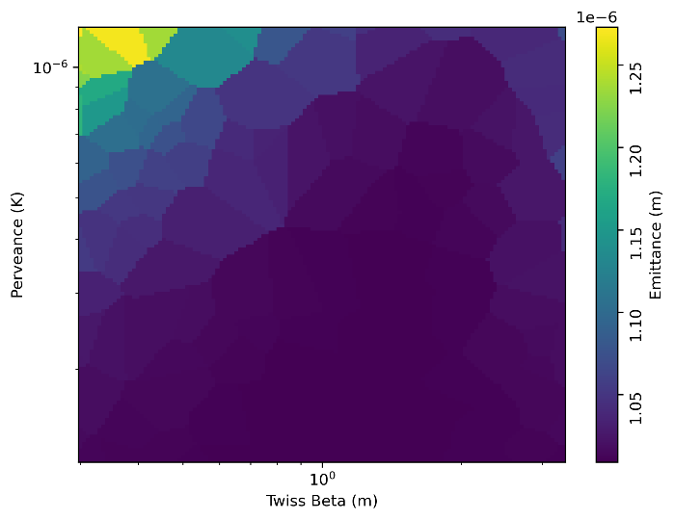
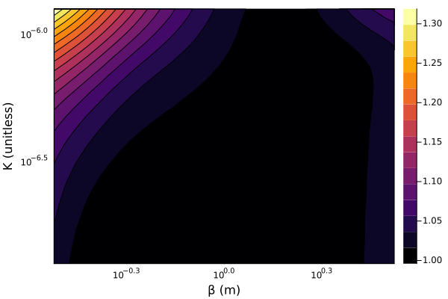
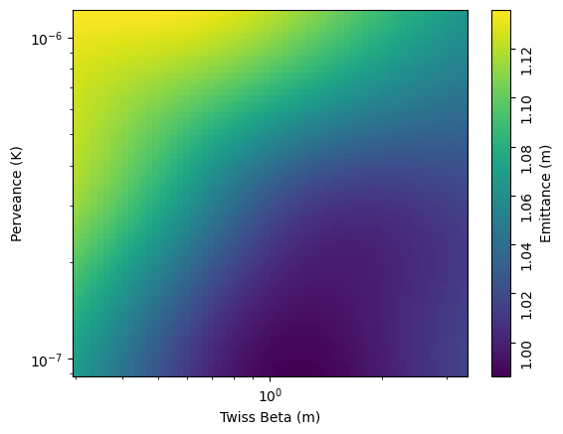
Progress on PINN Surrogate Modeling
2x better accuracy than baseline model w/ few datapoints!
Particle Tracking
PINN (no data): 0.007 mm-mrad MAE!
NN (n=32): 0.015 mm-mrad MSE

Slide 16
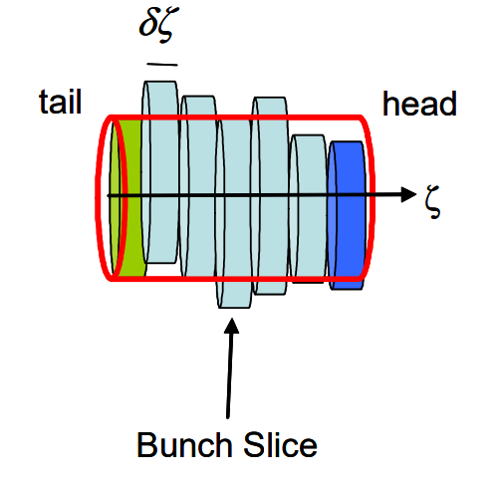
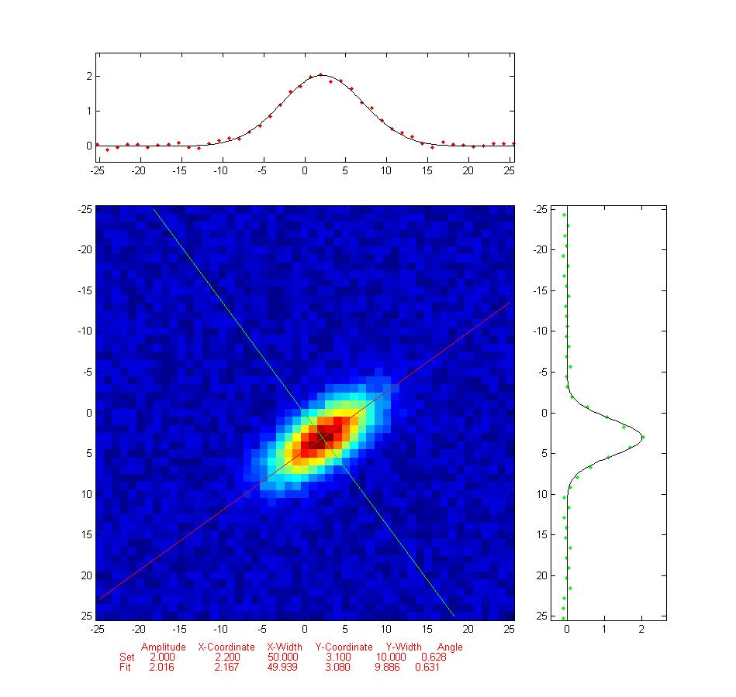
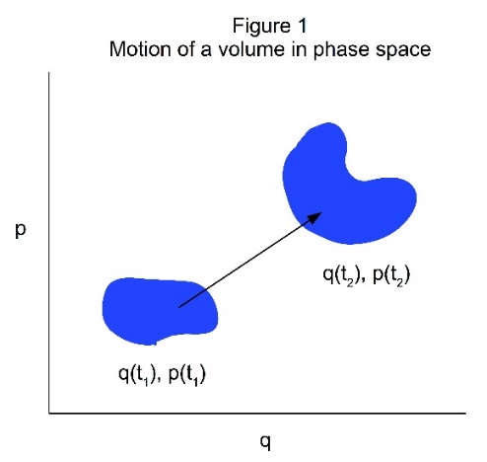
Ongoing and Future Work
SURROGATE MODELING W/ LONGITUDINAL COORDINATE AND REAL-WORLD DATA
Next in complexity is surrogate modeling of axisymmetric bunched beams. This includes modeling longitudinal phase space which comes with some challenges related to picking colocation points.
USPAS Lecture Notes, Lecture 5 Beam Dynamics with Space Charge, William Barletta (2010)
INDUCTIVE BIASES FOR ACCELERATOR MODELS
Neural network models of particle distributions should:
Fall off quickly away from origin with some length scale related to beam’s second order statistics.
Move by shearing and rotations
Longitudinal phase space tracks a “reference particle” who’s motion is easily calculated
Hamiltonian motion exists in phase space w/ Symplectic geometry and associated symmetries

Slide 17
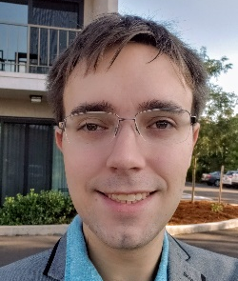
Acknowledgments
UNIVERISTY OF CHICAGO
ACCELERATOR PHYSICS GROUP
SLAC ACCELERATOR MACHINE LEARNING GROUP
Young-Kee Kim
Juan Pablo Gonzalez Aguilera
Auralee Edelen
Ryan Roussel
FUNDING SOURCES
This work was supported by the U.S. National Science Foundation under Award PHY-1549132, the Center for Bright Beams. Additional support for computing resources comes from the UChicago Research Computing Center Midway3 Cluster.

Slide 18
PINNs for Accelerator Physics
BACKUP SLIDES

Slide 19
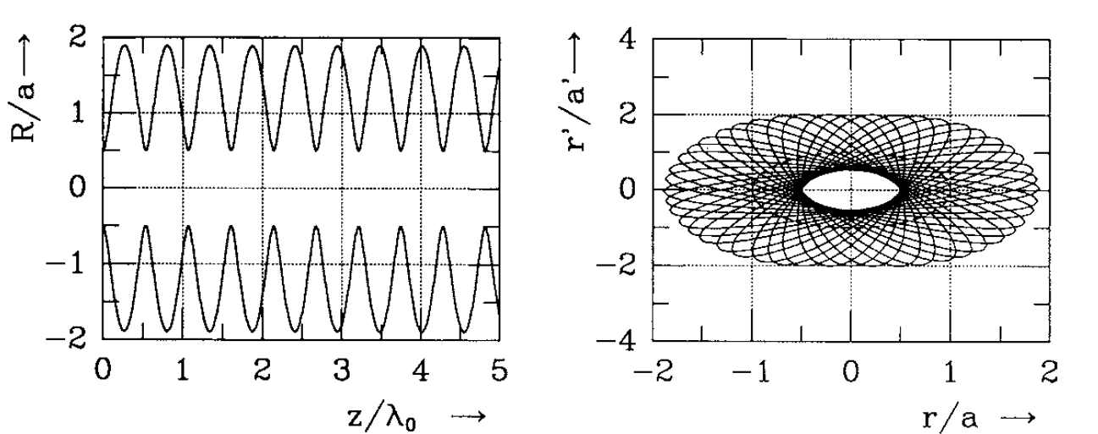
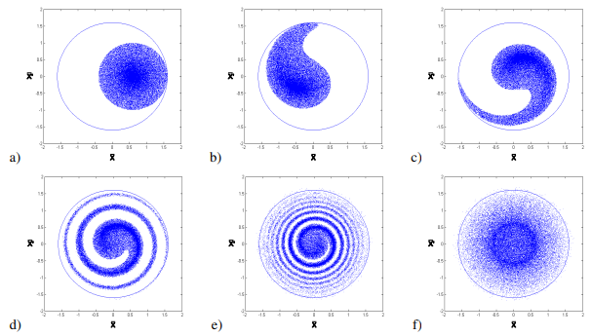
Uniform Focusing Channel Extras
UNIFORM FOCUSING CHANNEL BASICS
EFFECTS OF SPACE CHARGE
The envelope of the particle beam oscillates with wavevector $k$ that depends on focusing strength and beam longitudinal momentum.
If beam density is constant along phase space trajectories, the density will not change. The beam is “matched” to the channel.
Linear space charge forces oppose focusing and result in smaller “depressed” wavevector.
Nonlinear forces cause particles at different amplitudes to experience different periods of oscillation. Results in emittance growth. In extreme cases results in “filamentation.”
Tecker, F. (2021). Injection and Extraction. arXiv preprint arXiv:2108.11160.
Unmatched
Reiser, Martin. Theory and Design of Charged Particle Beams, n.d.
Matched
Depressed $k$ and Nonlinear Forces

Slide 20
Varying PINN Knobs

Slide 21
Varying PINN Knobs

