Slide 1
Establishing a Relativistic Ultrafast Electron Diffraction & Imaging Facility in the UK
Julian McKenzie (on behalf of the RUEDI team)
Physics and Applications of High Brightness Beams
21st June 2023 San Sebastian, Spain

Slide 2
Contents
Introduction to RUEDI
Science Themes
Project formation
Timescales
Key aspects of RUEDI:
Imaging / Electron Microscopy
Ultrafast diffraction beamline
Temporal diagnostics
Laser pumps
Overall concept overview
Summary

Slide 3
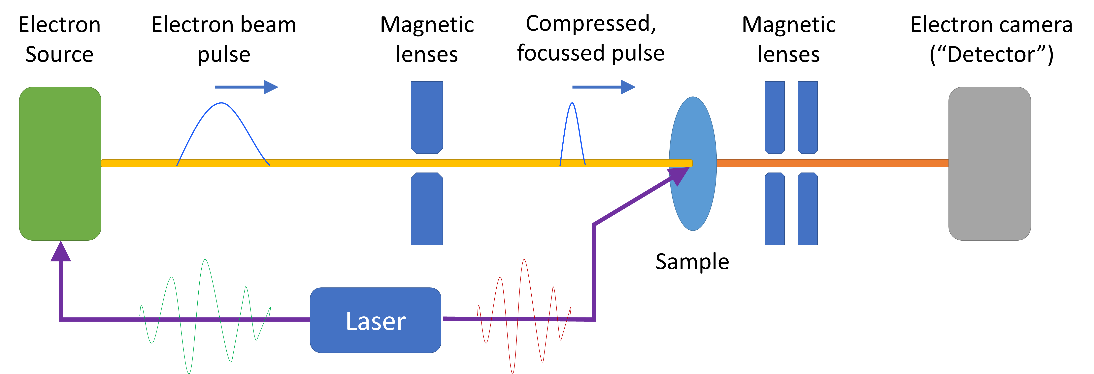
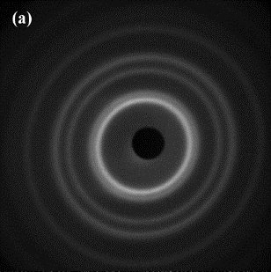
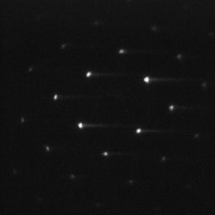
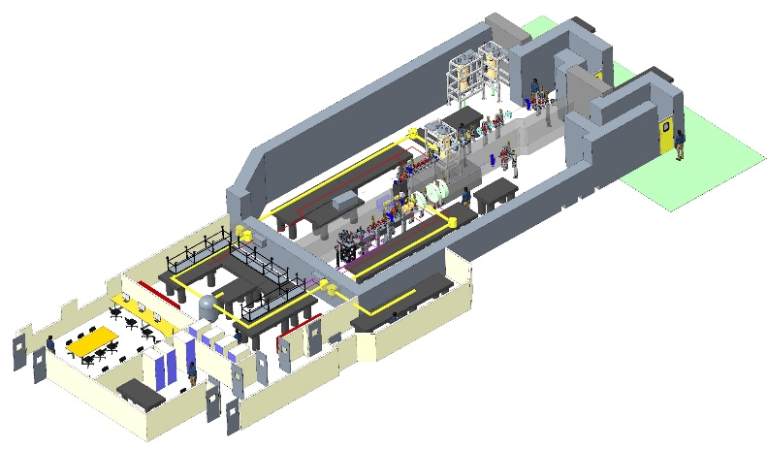
The RUEDI Facility Proposal
Proposal for a new UK National User Facility
Relativistic Ultrafast Electron Diffraction & Imaging (RUEDI)
MeV UED and UEM
Time-resolved pump-probe experiments in both real and reciprocal space
With a large variety of pumps and sample environments
To enable a large range of science
Pumps:
Wide variety of laser wavelengths, THz, TW, keV ion source
Environments:
Solid, liquid cells, liquid/gas jets, plasmas, cryogenic (down to mK level)

Slide 4
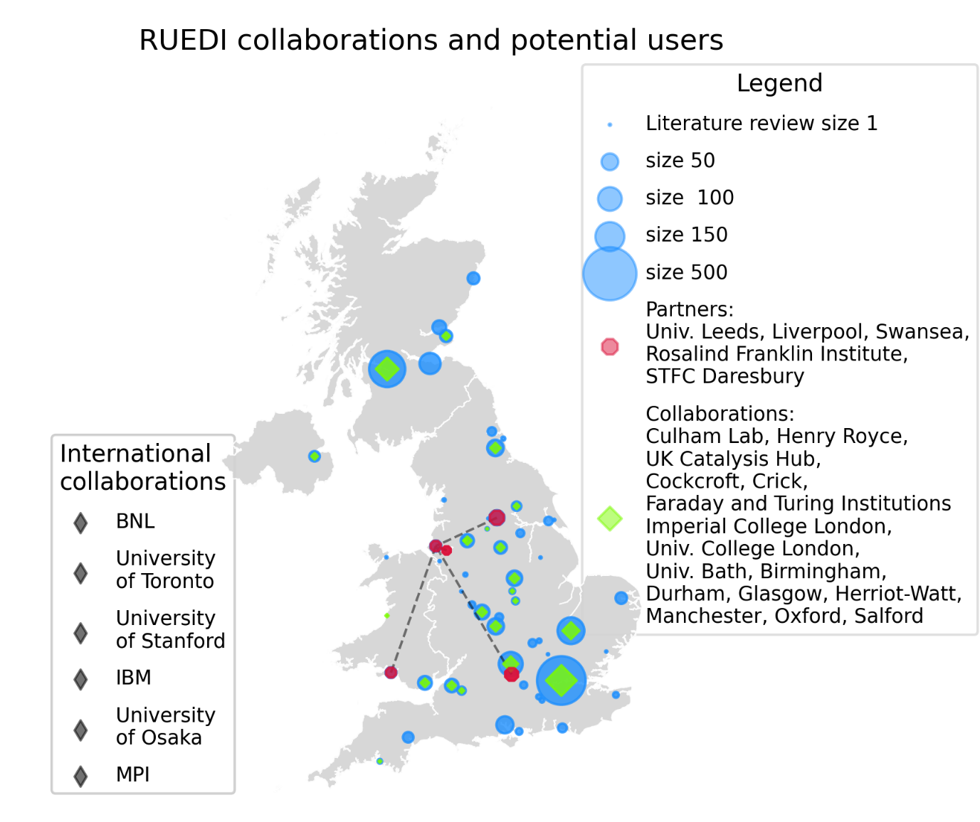
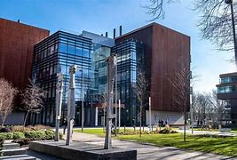
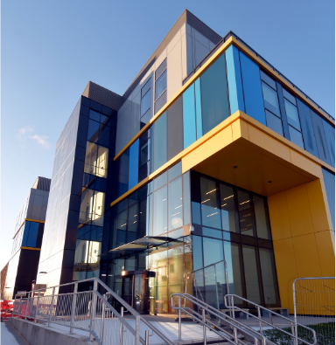
The RUEDI National Project
Lead institute (University of Liverpool – Prof. Nigel Browning)
And main partners: (RFI – Prof. Angus Kirkland)
Daresbury Laboratory
The Materials Innovation Factory
Harwell Campus Hub
Cockcroft Institute
Other science theme leads:
UK Infrastructure Fund:

Slide 5
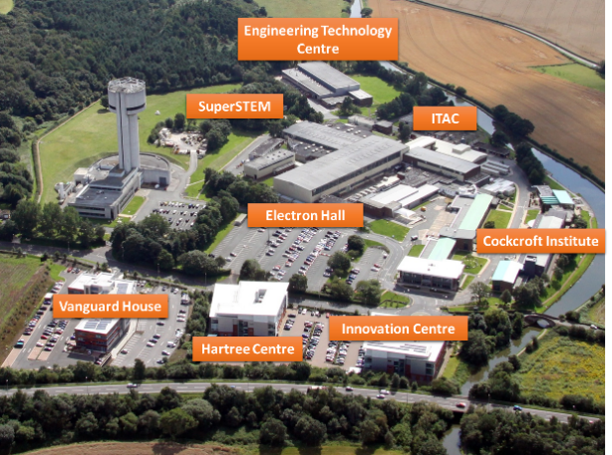
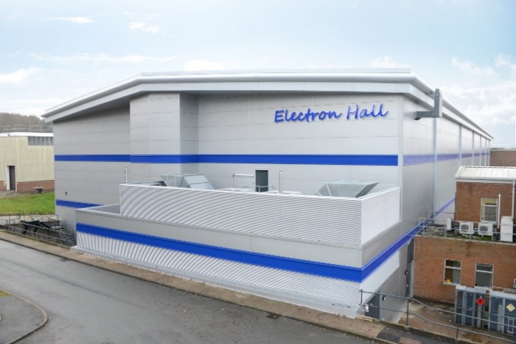
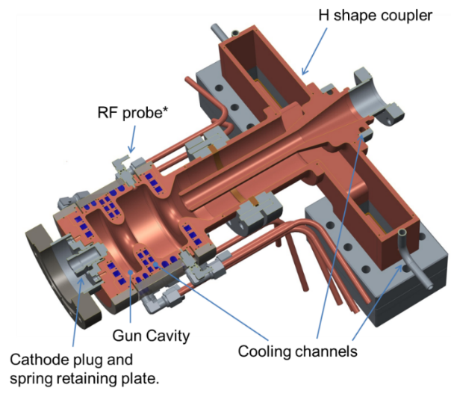
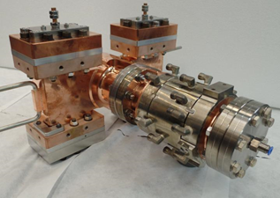
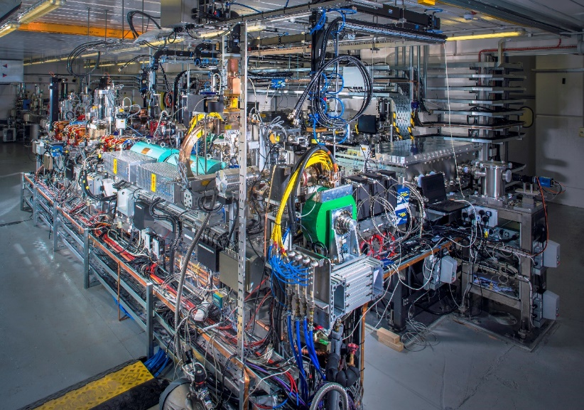
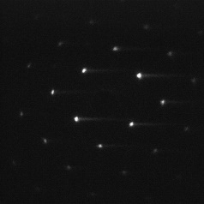
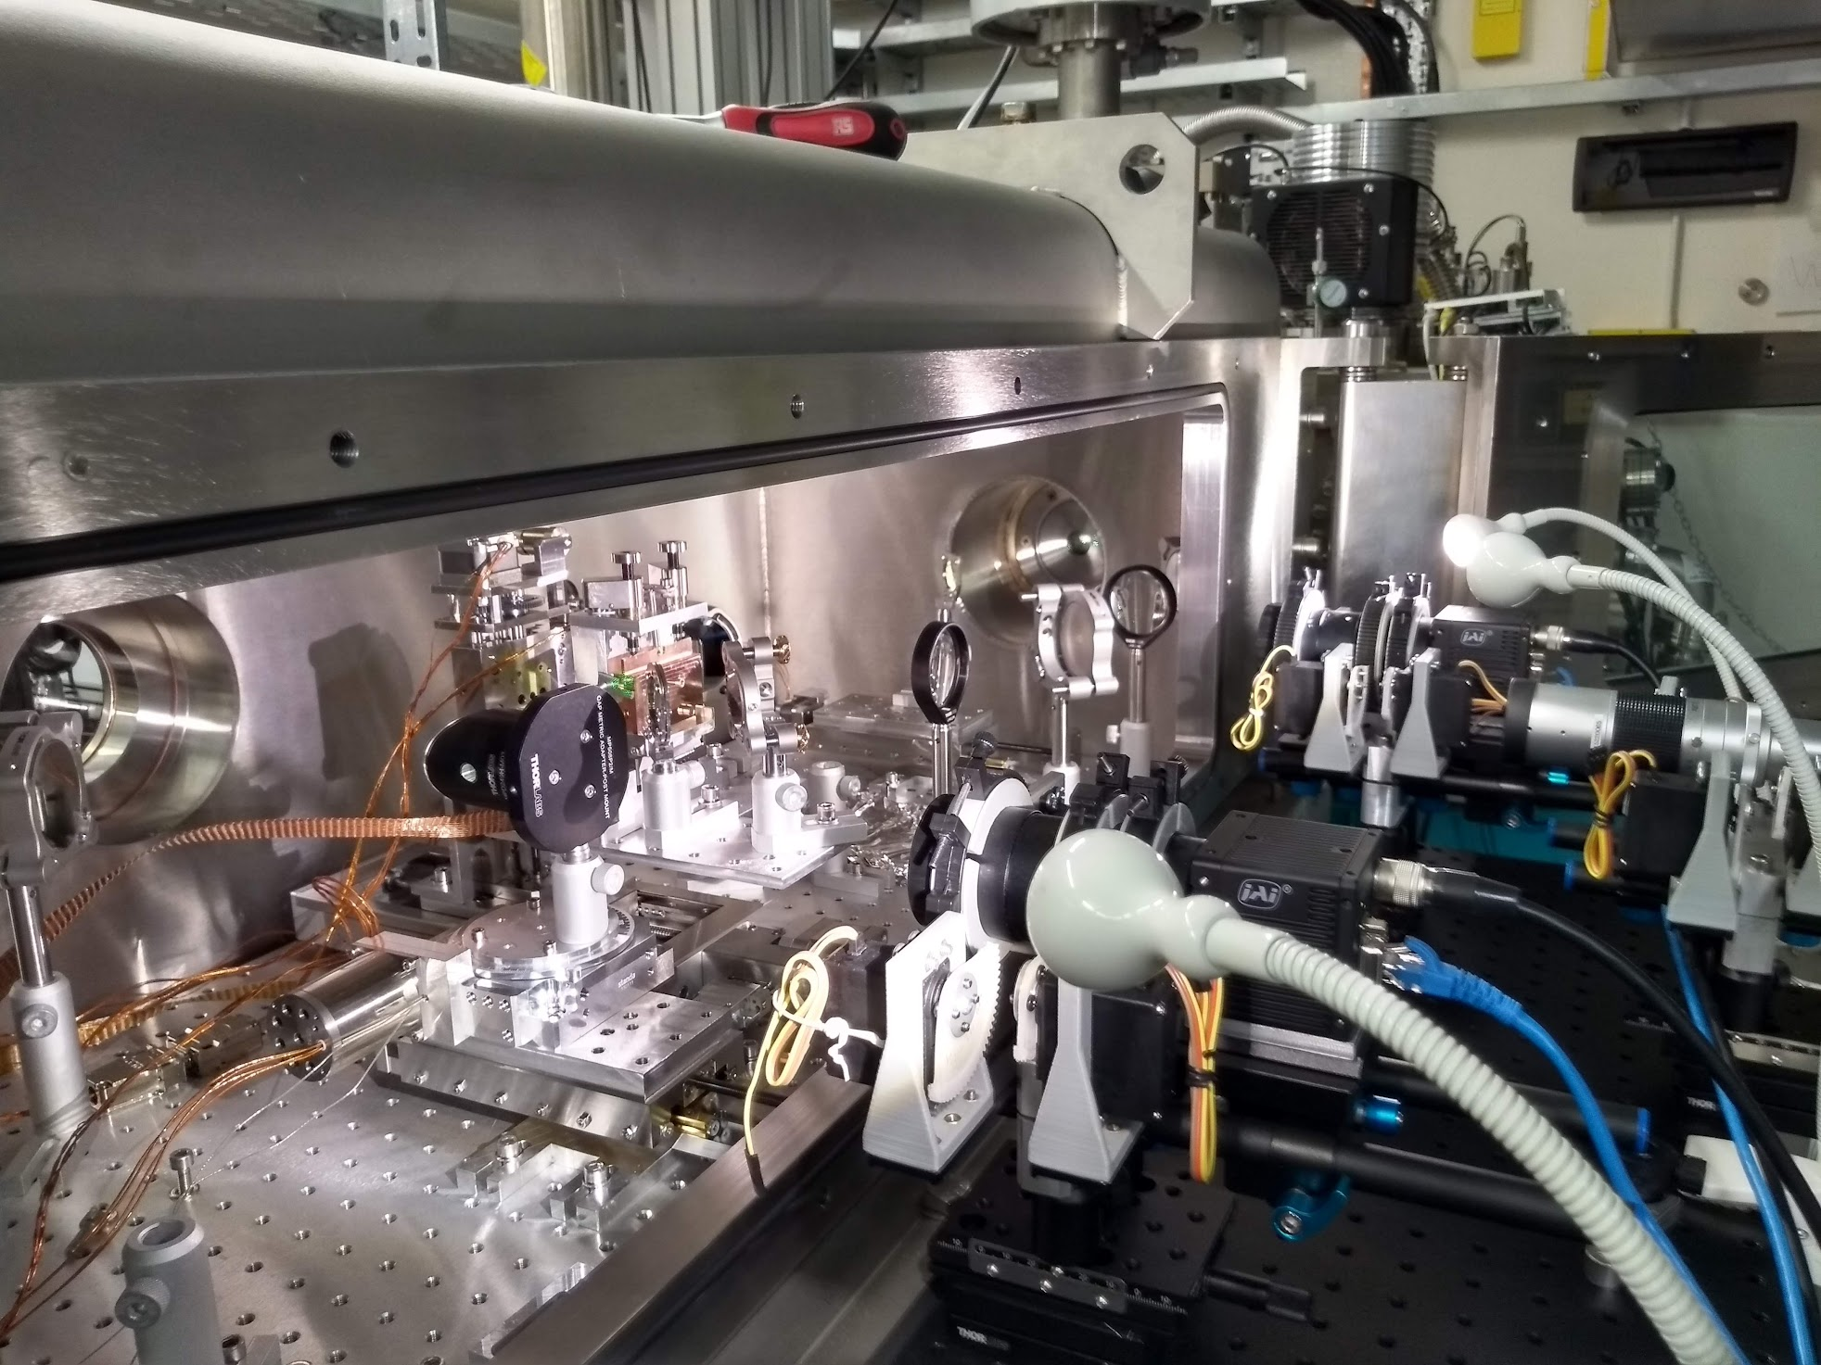
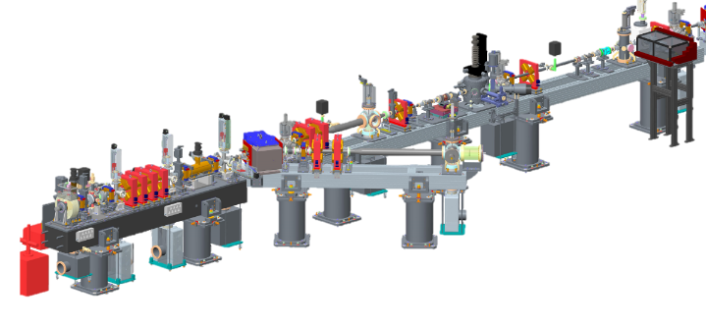
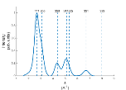
Leveraging STFC Daresbury Expertise
Site host in existing building
Femtosecond photoinjector development
Design, build, and operation of particle accelerator facilities
Measurement of dynamics of relativistic electrons with laser-driven THz sources, and high power TW lasers
MeV ED experience
Proof-of principle static MeV electron diffraction on VELA
5

Slide 6
Timeline
TODAY
2018
2025
2026
2027
2028
2029
2030
2031
2019
2020
2021
2022
2024
2023
Initial funding
Capital funding
Ops
Initial bid
Infrastructure Fund Bid
Bid
Science case
Funding decision!
CDR
TDR
Final design
Construction
Commissioning
Users
Assume 5-year operation cycles after commissioning
With capital for upgrades on same timescales

Slide 7
Enabling Science
Mostly Imaging
Biosciences
Town hall meetings held throughout 2022
Identified experiments and requests electron parameters, pump sources and sample environments
Photosynthesis & energy transfer
Cardiac disease related dynamics
Virology & infection
Biological self-assembly/toxicity
Mostly Diffraction
Materials in Extremes
Dynamics of Chemical Change
Astrophysics & warm dense matter
Advanced manufacturing
Nuclear fission/fusion/space
Response to shocks
Chemical complexity across scales
Hydrogen bonding
Pulse radiolysis
Heterogenous catalysis
Energy Generation, Conversion & Storage
Quantum Materials & Processes
Ultrafast low-energy optical switching
Magnetic textures & skyrmions
Topological superconductors
Thermoelectric energy harvesting
Photocatalysis & induced electro-chemistry
Defect kinetics in solar cells
Ion solvation kinetics in batteries
Kinetics of glasses
Notes:
Dynamics of Chemical Change
Chemical complexity across scales
Hydrogen bonding
Pulse radiolysis
Heterogenous catalysis
Materials in Extremes
Astrophysics & warm dense matter
Advanced manufacturing
Nuclear fission/fusion/space
Response to shocks
Quantum Materials & Processes
Ultrafast low-energy optical switching
Magnetic textures & skyrmions
Topological superconductors
Thermoelectric energy harvesting
Energy Generation, Conversion & Storage
Photocatalysis & induced electro-chemistry
Defect kinetics in solar cells
Ion solvation kinetics in batteries
Kinetics of glasses
Biosciences
Photosynthesis & energy transfer
Cardiac disease related dynamics
Virology & infection
Biological self-assembly/toxicity
(Artificial Intelligence/Data Science)
(example experiments, which university leading)

Slide 8
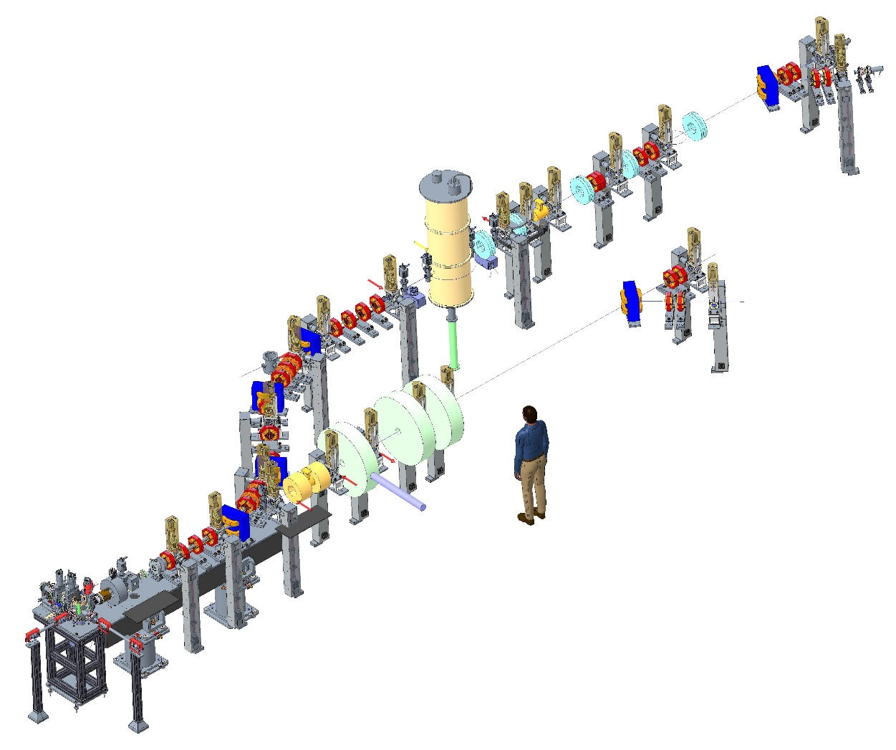
Facility concept
Ultrafast diffraction line
10-100s fs scale
Up to 400 fC
Stroboscopic + Single-shot
Current concept is one gun feeding two separately shielded beamlines
Microscopy/
Imaging line
S-band photoinjector 4 MeV
10s of nm rad emittance
ps scale
200fC - 20pC
Stroboscopic + Single-shot

Slide 9
Best spatial resolution
Ultrafast diffraction line
Microscopy/
Imaging line
S-band photoinjector
ps scale
200fC - 20pC
Stroboscopic + Single-shot

Slide 10
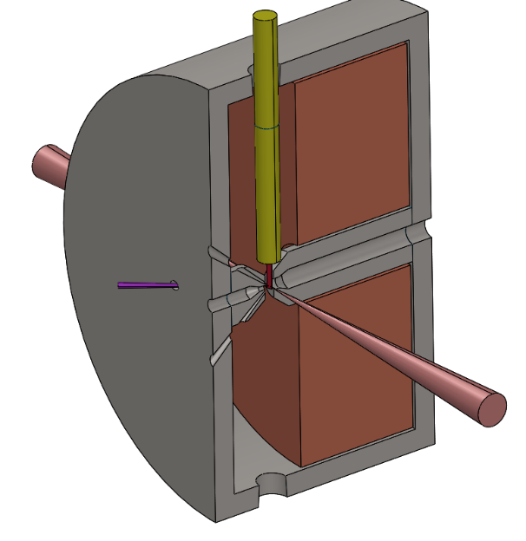
Imaging Beamline
Objective lens
The key to the whole system
Sample stage loading
e-beam
DETECTOR
yoke
coils
pump laser entry
Electrons from source
e-beam
Objective lens
pump laser entry
pump laser entry
Imaging lens system
Series of magnetic lenses
Aiming for 6500x magnification
Comparing round lenses (solenoids)
vs quadrupole quintuplets
Round lens limited to 2 MeV beam energy at 1.7 T peak field
Quadrupoles have worse aberrations
Samples inserted into middle
Multiple pump laser entry ports
Compatible with commercial TEM sample stages (enabling experiments in solid, liquid, cryogenic, heating etc)
Detector
16-64 MegaPixel
direct electron
~6.5um pixel size
Dechirper cavity to reduce energy spread (see next slide)

Slide 11
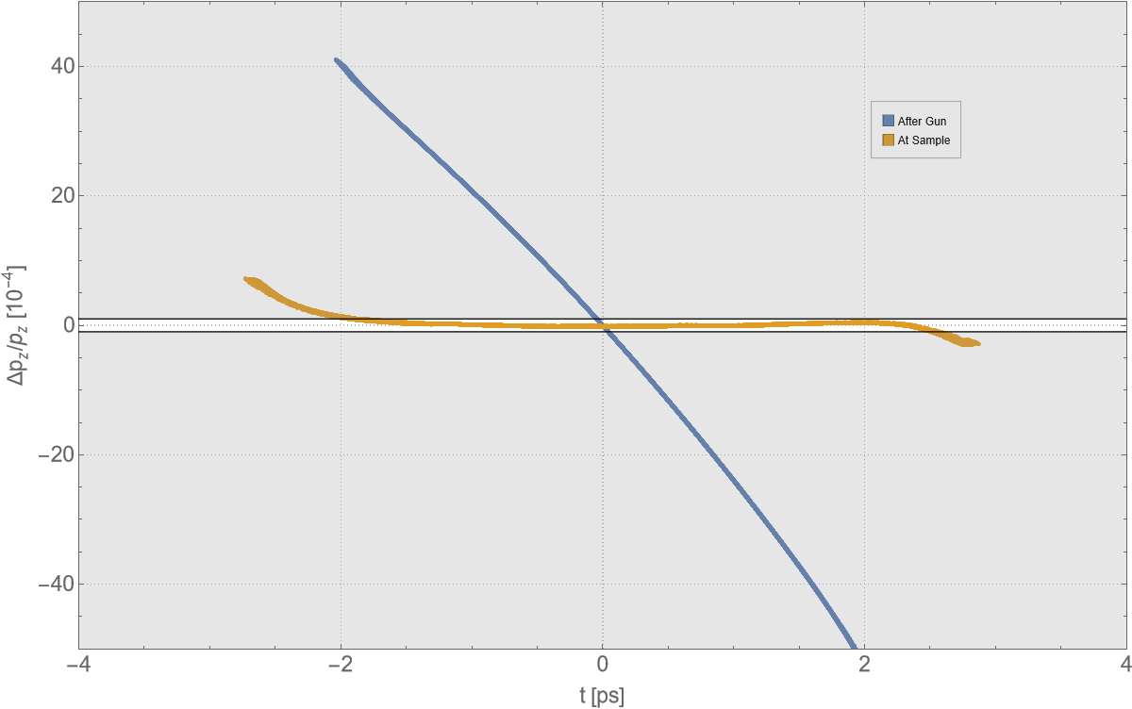
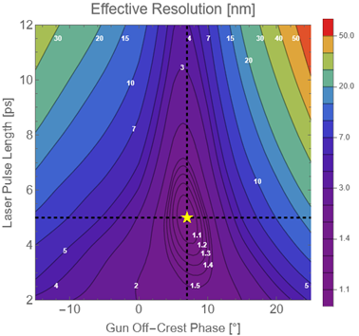
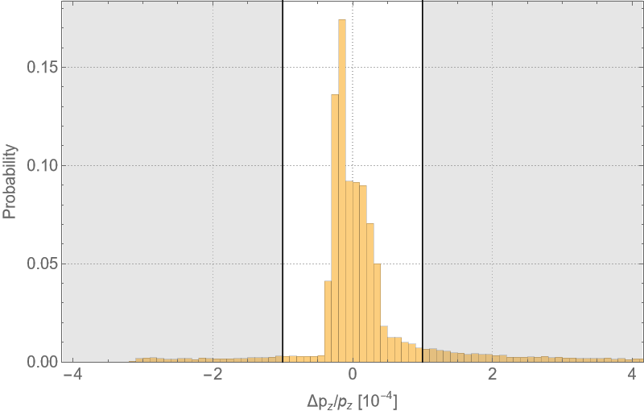
Microscopy Resolution
Poster yesterday
Resolution limit simplified…
RF dechirper cavity
Also used to decelerate from 4 to 2 MeV
$$r=\sqrt{{\left(C_{s}α^{3}\right)}^{2}+{\left(C_{c}α{δγ}/γ\right)}^{2}}$$
C_{s} = Spherical aberration (~10mm @ 2MeV)
𝛼 = objective aperture collection semi-angle
C_{c} = Chromatic aberration (~10mm @ 2MeV)
𝛿𝛾/𝛾 = relative beam energy spread
Blue – pre-dechirper
Yellow – post-dechirper
For 1nm resolution, need <10⁻⁴ relative energy spread
Also need ~10s nm rad level emittance to be able to focus beam down to ~10µm samples
Stroboscopic mode (10^6 electrons) has potential to reach down to 1nm resolution
Single-shot mode (10^8 electrons (20pC)) has resolution limited to 50 – 100 nm range, and hard to focus beam onto small samples
11

Slide 12
Best temporal resolution
Ultrafast diffraction line
10-100s fs scale
Up to 400 fC
Stroboscopic + Single-shot
Microscopy/
Imaging line
S-band photoinjector

Slide 13
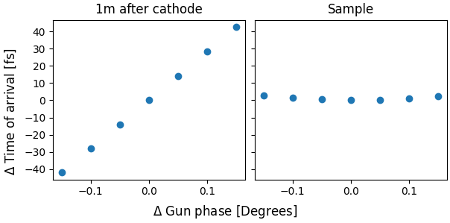
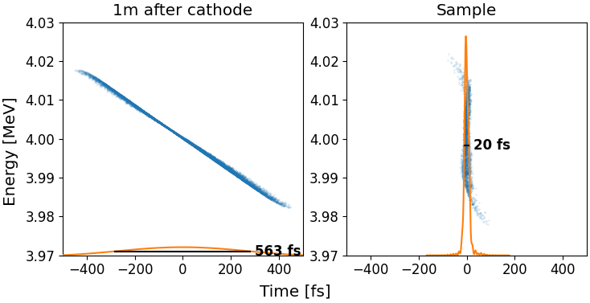
Ultrafast diffraction beamline
Poster yesterday
Jitter suppression
Aim to provide ultrashort bunches with small time of arrival jitter
$$R_{t}=\sqrt{{{Δt}_{electron}}^{2}+{{Δt}_{laser}}^{2}+{{Δt}_{jitter}}^{2}+{{Δt}_{velocity}}^{2}}$$
Four dipole arc to separate beamline, completely tuneable to both signs of R56
Bunch compression
Simultaneously achieve:*
Jitter suppression
Bunch compression
*H.W. Kim et al, "Towards jitter-free ultrafast electron diffraction
technology", Nature Photonics, Vol. 14, Pages 245–249,
2020.

Slide 14
Ultrafast Diffraction Beamline
Cryogenic (down to mK)
Gas/liquid jets
Best sample control and diagnostics
Interchangeable sample chambers
Option for detector with hole to allow shot by shot measurements on non-diffracted beam
Lenses post-sample to magnify image (and for streaking diagnostics)
Electrons from source
Final focus lenses
Solenoidal lens
Quadrupole
Pump lasers
THz
diagnostic
RF TDC
THz
diagnostic
Large variety of pump laser wavelengths/energies/durations
Bunch length monitoring via RF Transverse Deflecting Cavity + THz
RF Beam Arrival Monitor
14

Slide 15
Concept Electron Beamline Layout
Ultrafast diffraction line
10-100s fs scale
Up to 400 fC
Stroboscopic + Single-shot
Microscopy/
Imaging line
S-band photoinjector 4 MeV
10s nm rad emittance
ps scale
200fC - 20pC
Stroboscopic + Single-shot

Slide 16
High Brightness Beams Challenges
Ultra-low emittance (nm-rad level)
Ultrashort pulses (fs-scale)
Low temporal + spatial jitter (fs-scale)
Low energy beams:
Non-relativistic ballistic/velocity effects
Space-charge dominated beam transport
Diagnostics of:
Low charge bunches (fC level)
Small transverse bunches (um-scale)
Ultrashort bunches (fs-scale)
Minimise dark current (high signal-to-noise ratio)

Slide 17
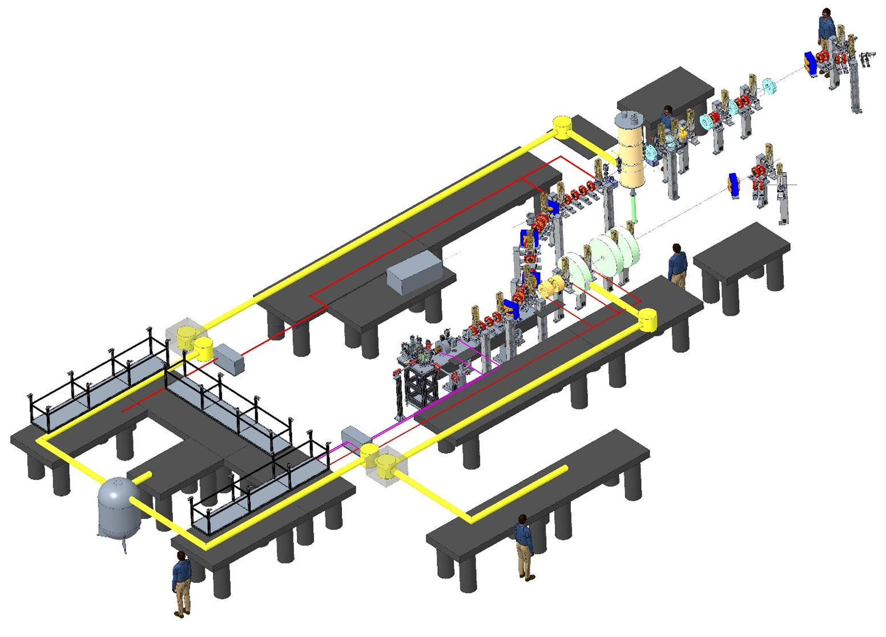
Laser Systems
All fed by same oscillator for synchronisation
Ultrafast diffraction
Standard frequency conversions:
200nm - 5um
OPAs + harmonic generation
Unique features:
Ultrashort 10fs
THz
TW
HHG
Laser room
Gun
Microscopy
R&D/Prep room

Slide 18
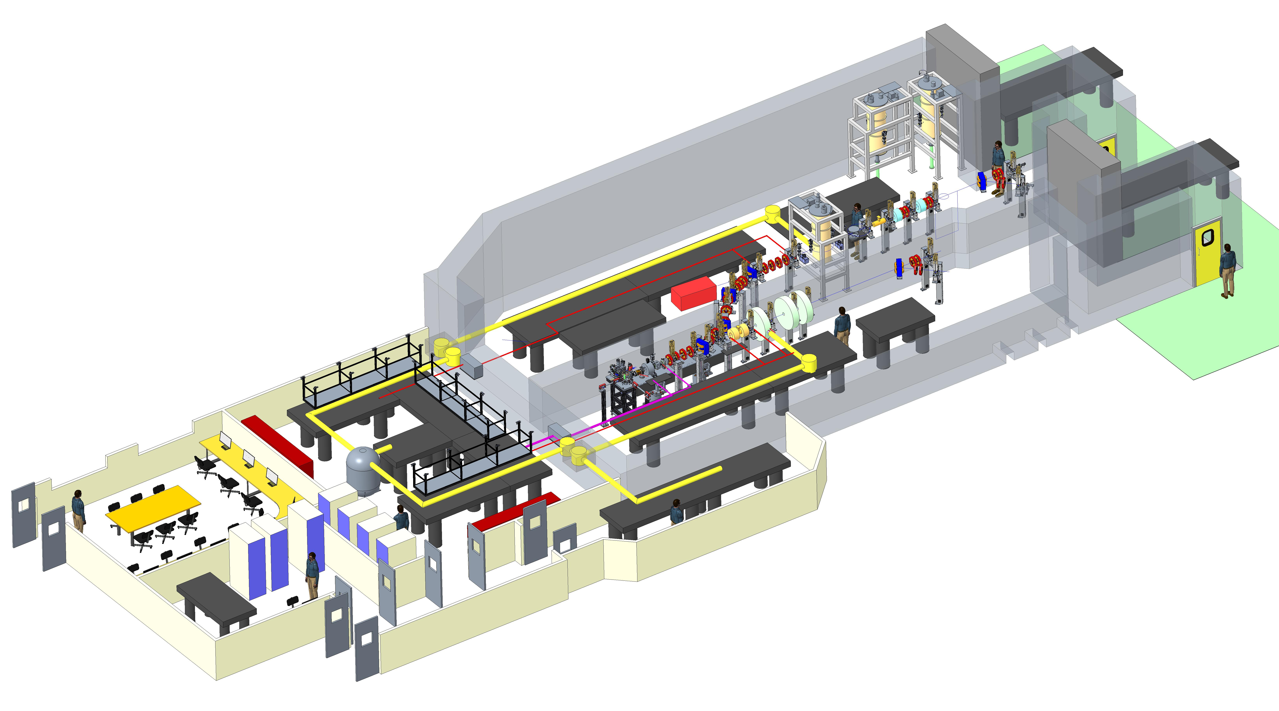
Facility Conceptual Design
Ultrafast diffraction beamline
Laser rooms
Control room
Photoinjector and microscopy beamline
To be located in the Daresbury Laboratory Electron Hall.

Slide 19
Summary
RUEDI is a proposed UK National User Facility
For time-resolved pump-probe experiments
Ultrafast Electron Diffraction & Imaging
To probe both real and reciprocal space
Large variety of sample environments
Wide range of laser pumps, including 10fs, THz, TW, HHG
Currently halfway through design stage
Capital funding decision expected end of this year

Slide 20
Acknowledgements
Nigel Browning
Angus Kirkland
Yoshie Murooka
Jan Nugara
Will Bryan
Simon Maskell
B. Layla Mehdi
Sven Schroeder
Carsten Welsch
Oznur Apsimon
Gwyndaf Evans
Dwayne Miller
Ian Robinson
Jasper Van Thor
Lee Kelsall
Alberto Acuto
Maulik Patel
and more…
Alex Bainbridge
James Bebbington
Rachael Buckley
Jim Clarke
Louise Cowie
Graham Cox
Joe Crone
Mike Ellis
Aaron Farricker
Omair Ghafur
Anthony Gilfellon
Clive Hill
Phil Hornickel
Ben Hounsell
Frank Jackson
James Jones
Nirav Joshi
Daniel Lake
Storm Mathisen
Russell McLean
Boris Militsyn
Bruno Muratori
Tim Noakes
Tom Pacey
Suzanna Percival
Lewis Reid
Mark Roper
Yuri Saveliev
Ben Shepherd
Rob Smith
Calum Tollervey
Andrew Vick
Alan Wheelhouse
Fatih Yaman
and more…
Daresbury Laboratory

