Slide 1

Exploring the Impact of Radiation Field on Beam Brightness
Afnan Al Marzouk, Dept. of Physics, Northern Illinois University
Supervisor: Philippe Piot

Slide 2
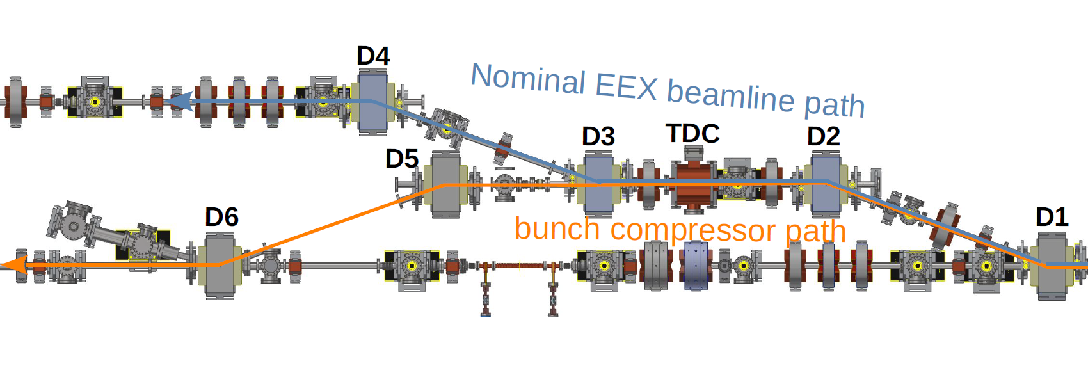
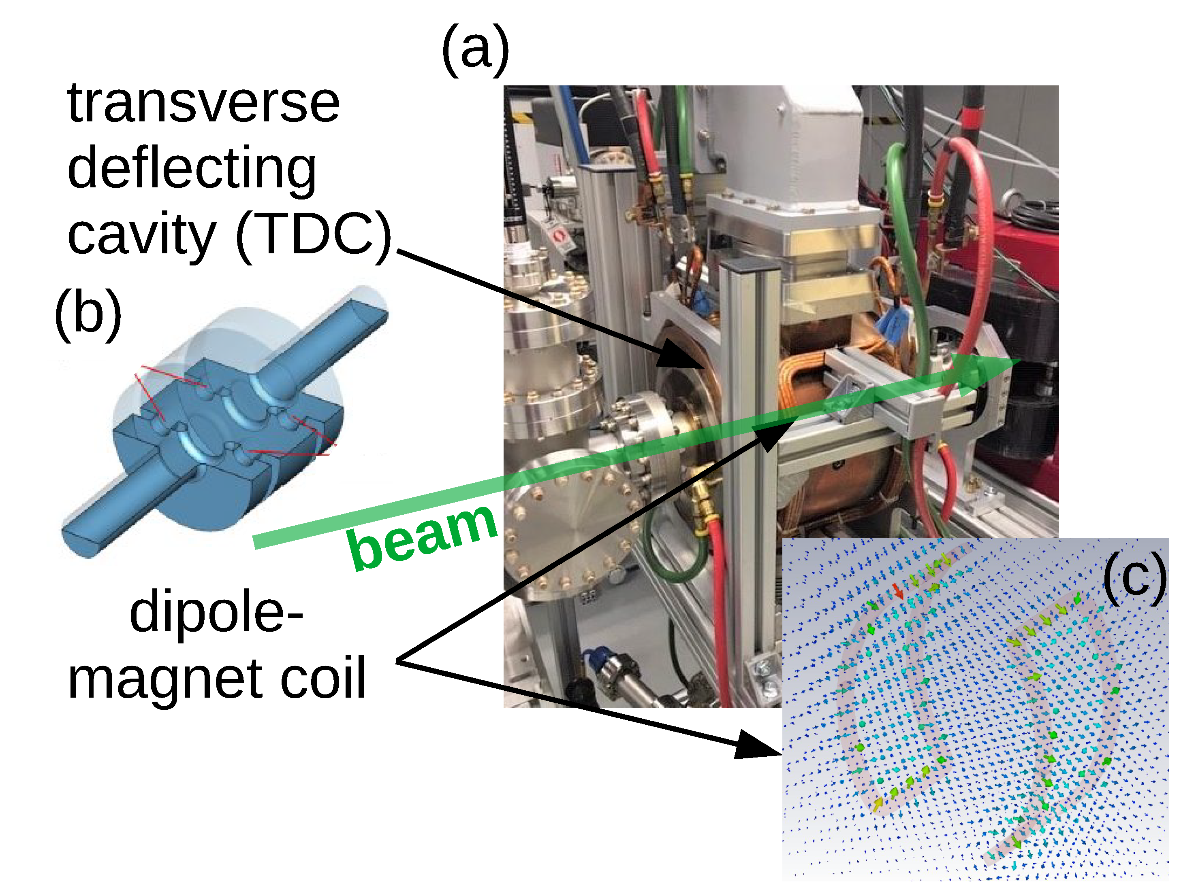
Objectives
Increase the 5D brightness without significantly degrading the emittances → bunch compression in magnetic chicane.
The transport of a beam with an optimized 4D brightness in bending systems without degradation of the 4D brightness → straight merger in ERLs.
Performed numerical simulations → first-principle LW3D program, with a focus on the impact of Coherent Synchrotron Radiation (CSR) on beam dynamics.

Slide 3
Bunch Compression
Increase beam brightness by decreasing bunch length and increasing the peak current.
Principles of magnetic bunch compression chicanes:
  consists of four dipoles.
  beam with a chirp (ideally linear)
  → lowers the energy of the head and
  increase it for the tail.
  path length difference between the
  head and the tail.
Main issue is the coherent
synchrotron radiation (CSR).
ICFA Beam Dynamics Newsletter, No. 38
Notes:
High brightness electron beams are essential for many current applications such as FELs and beam-driven wakefield accelerators. These bright beams have to be very short bunches (<100 fs) of high currents (a few kilo amps). To get such bunches is through bunch compression. One way to compress longitudinally is the magnetic bunch compression chicane which usually consists of four dipoles. The principle of a magnetic chicane is to have an energy chirp introduced by RF acceleration which ideally will be a linear correlation; lowering the energy in the head and increasing it in the tail. That creates different path lengths through the chicane where the lower energy head takes a long path, and the higher energy tail takes a shorter path; then the bunch length will be compressed. The main problem here is the coherent synchrotron radiation (CSR) emitted by the bunch as it travels through the chicane, which can impact the bunch.

Slide 4
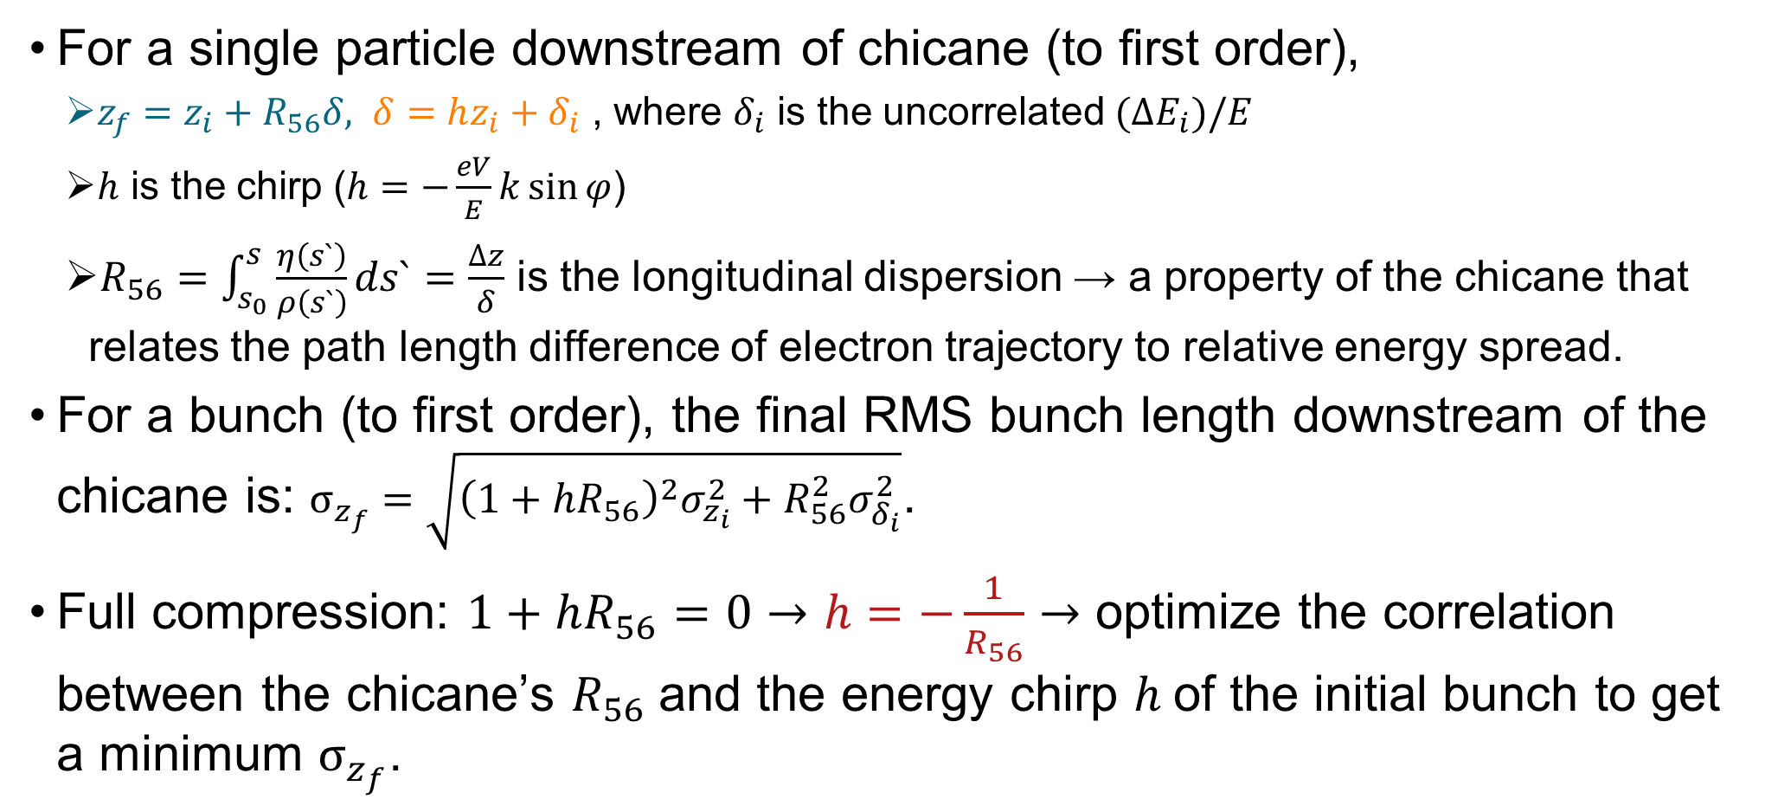
Magnetic Bunch Compression Chicane
For a single particle downstream of chicane (to first order),
  $z_{f}=z_{i}+R_{56}δ, δ=hz_{i}+δ_{i}$ , where $δ_{i}$ is the uncorrelated $(ΔE_{i})/E$
  $h$ is the chirp ($h=−\frac{eV}{E}k\sin{φ}$)
  $R_{56}=\int_{s_{0}}^{s}{\frac{η\left(s`\right)}{ρ\left(s`\right)}ds`}=\frac{∆z}{δ}$ is the longitudinal dispersion → a property of the chicane that relates the path length difference of electron trajectory to relative energy spread.
For a bunch (to first order), the final RMS bunch length downstream of the chicane is: $σ_{z_{f}}=\sqrt{{\left(1+hR_{56}\right)}^{2}σ_{z_{i}}^{2}+R_{56}^{2}σ_{δ_{i}}^{2}}$.
Full compression: $1+hR_{56}=0→h=−\frac{1}{R_{56}}→$ optimize the correlation between the chicane’s $R_{56}$and the energy chirp $h$of the initial bunch to get a minimum $σ_{z_{f}}$.
Notes:
the R56 should match with the bunch’s energy chirp h

Slide 5
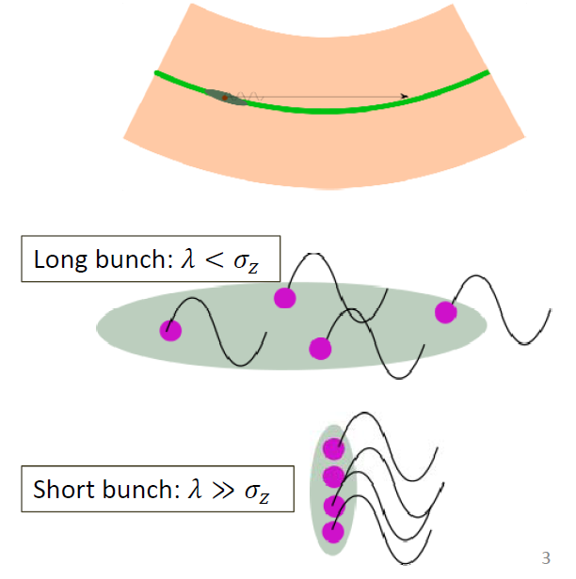
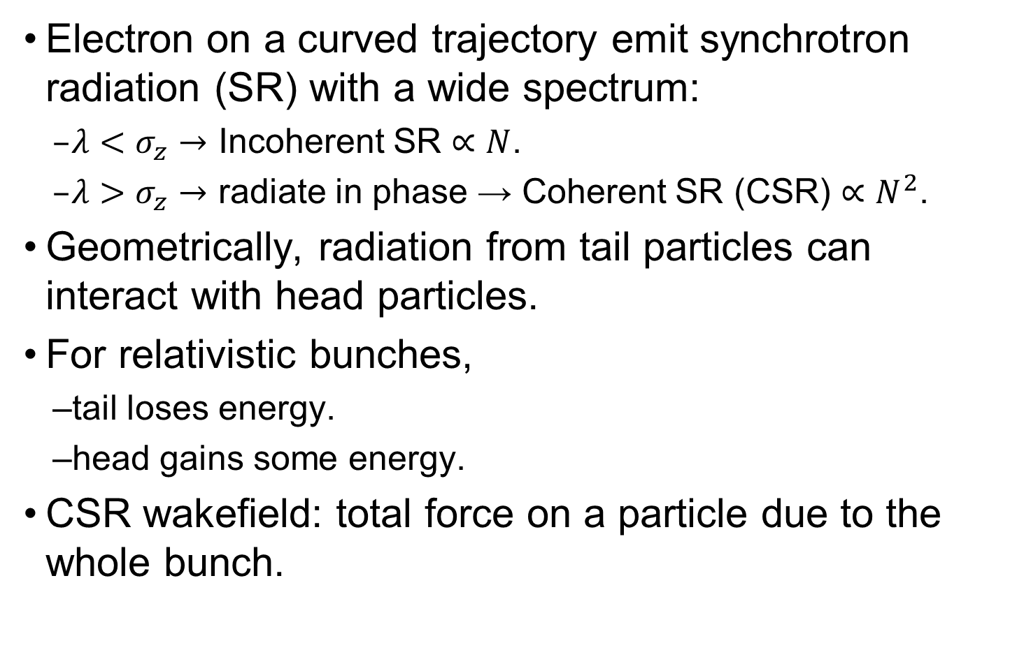

Coherent Synchrotron Radiation (CSR)
Electron on a curved trajectory emit synchrotron radiation (SR) with a wide spectrum:
  $λ<σ_{z}→$ Incoherent SR $∝N$.
  $λ>σ_{z}→$ radiate in phase → Coherent SR (CSR) $∝N^{2}$.
Geometrically, radiation from tail particles can interact with head particles.
For relativistic bunches,
  tail loses energy.
  head gains some energy.
CSR wakefield: total force on a particle due to the whole bunch.
Pictures from: Peter Williams talk in ERL2019 "Beyond the Limits of 1D Coherent Synchrotron Radiation.“
Notes:
When the bunch length of the radiating electron beam is short compared to the SR wavelength, the individual electrons radiate in phase.
Geometrically, as the bunch moves on an arc,

Slide 6
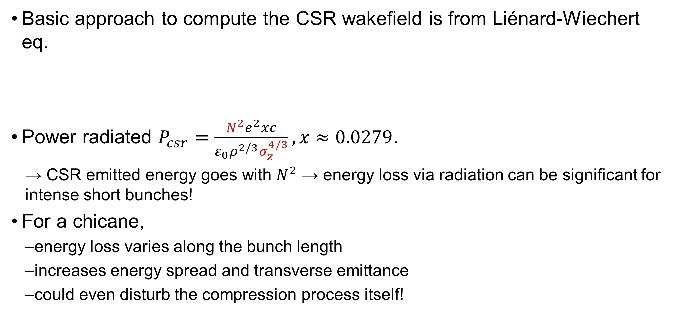
Impact of CSR
Basic approach to compute the CSR wakefield is from Liénard-Wiechert eq.
Power radiated $P_{csr}=\frac{N^{2}e^{2}xc}{ε_{0}ρ^{2/3}σ_{z}^{4/3}}, x≈0.0279$.
  → CSR emitted energy goes with $N^{2}$ → energy loss via radiation can be significant for intense short bunches!
For a chicane,
  energy loss varies along the bunch length
  increases energy spread and transverse emittance
  could even disturb the compression process itself!
Notes:
and total energy loss is proportional to the square of the number of electrons per bunch ~typically 10⁶ to 10¹⁰).
The CSR power also depends on longitudinal distribution of charge.

Slide 7
Computational CSR
Basic approach to compute the CSR wakefield is from LW eq.
One of the most challenging problems in accelerator
physics, especially in 3D.
Early efforts focused on making approximations and
reducing the dimensionality of the problem.
  the 1D model → gives overall insight. Validity?
  Similarly, the 2D model.
There are some 3D models, but not first-principle.
Picture from: Peter Williams talk in ERL2019 "Beyond the Limits of 1D Coherent Synchrotron Radiation.“
Notes:
Computing CSR in detail within a bunch, especially in three dimensions, is one of the most challenging problems in accelerator physics. It has only been pursued recently because of the seemingly high computational cost. The earliest efforts focused on making approximations and reducing the dimensionality of the problem. So the 1D model is widely used, The 1D model is good to give an overall sight of CSR. But, as it assumes a line charge and ignores the transverse coordinates, their domain of validity is questioned. Until which transverse size these models are valid?
The bunch distribution is projected onto the central trajectory, Any change in longitudinal distribution due to CSR is neglected, Ultrarelativistic approximation made, Assumes infinitely long drifts before and after the dipole. A bunch whose transverse size is large wrt its emitted radiation cone ‐> possible for CSR to “miss” due to the offset
then the 2D model, and not long ago the 3D model. First-principle simulations in 3D will give better understanding of CSR in the bunch compression chicane and it’s impact on beam brightness.

Slide 8
The LW3D Code
First-principle large-scale code (Developed by R. Ryne in 2012) → computes the 3D fields directly from 𝑁 particles in a bunch using LW eq.
Fields are computed on a 3D grid points from the retarded positions at chosen timesteps.
The initial code is not self-consistent → fields do not interact with the particles.
The self-consistent LW3D code is currently under development.
Advantages:
  explore limitations of the 1D and 2D CSR models
  benchmark and validate faster 3D CSR codes
Notes:
The only CSR code from first-principle.
These simulations will also allow to explore the limitations of the 1D and 2D models and benchmark the faster 3D models.
There are some 3D models currently, but first-principle simulations are important for the validation of different models.

Slide 9
Motivation: Bunch Compression at AWA
AWA: Argonne Wakefield Accelerator
No experiment were performed, yet!

Slide 10
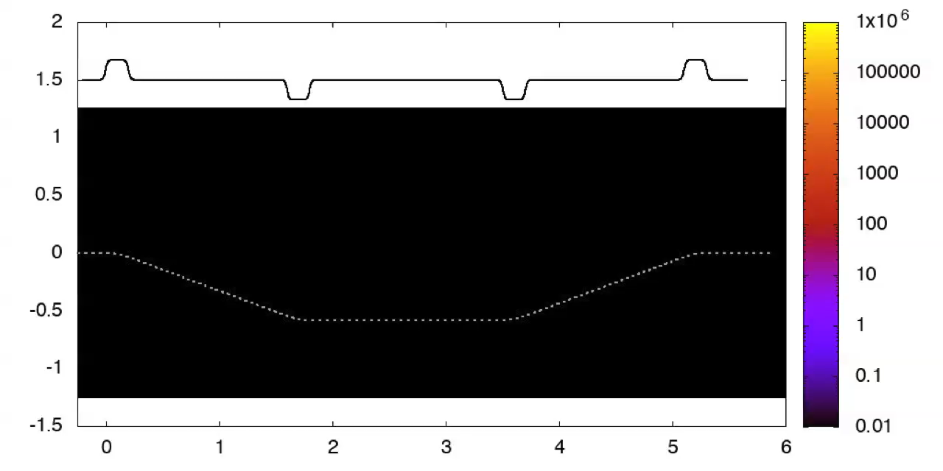
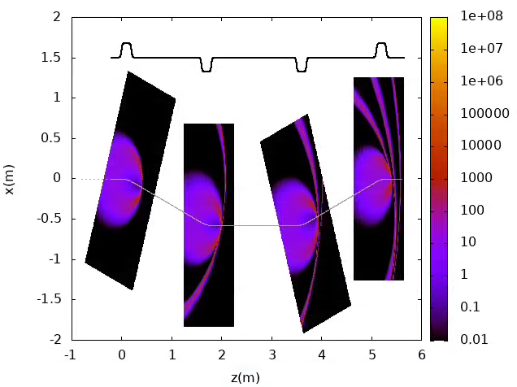
LW3D Simulations of AWA Chicane
Radiation wavefronts (no kick applied to the bunch).
x (m)
z (m)
Courtesy of R. Ryne

Slide 11
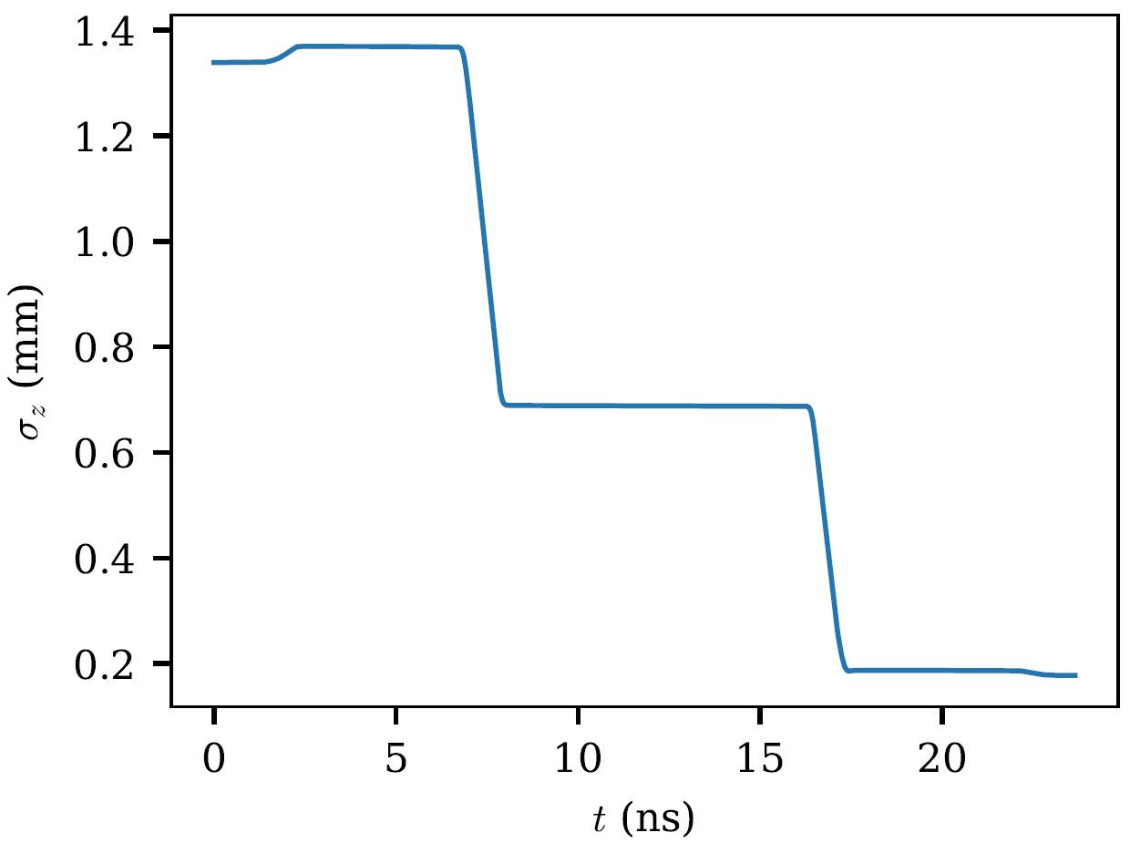
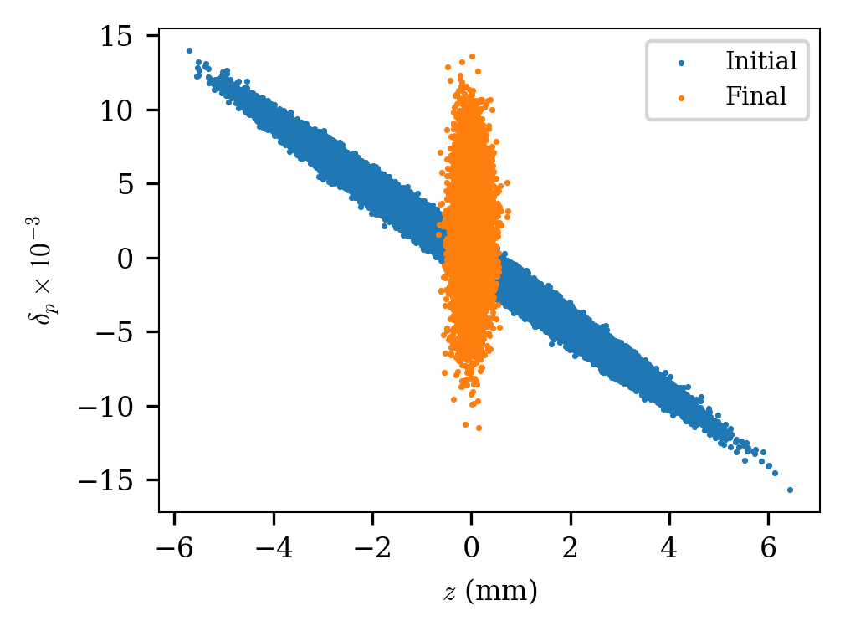
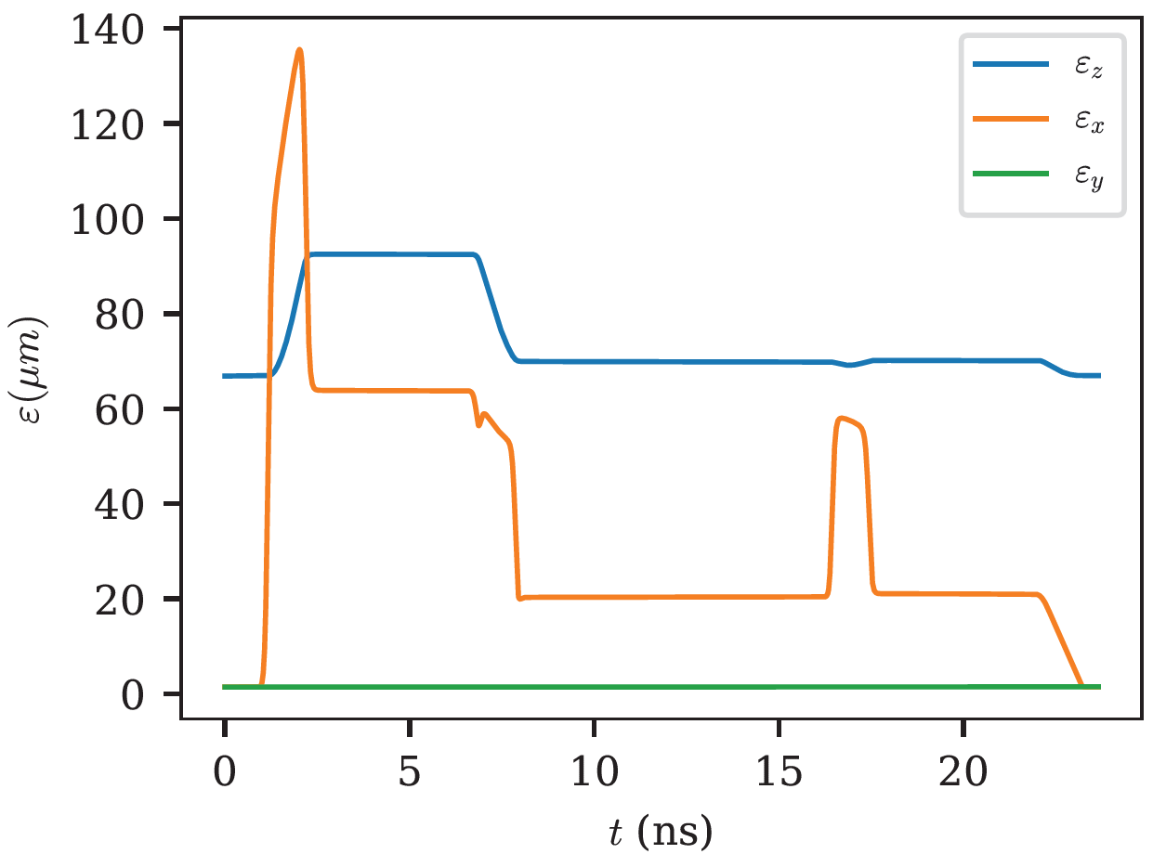
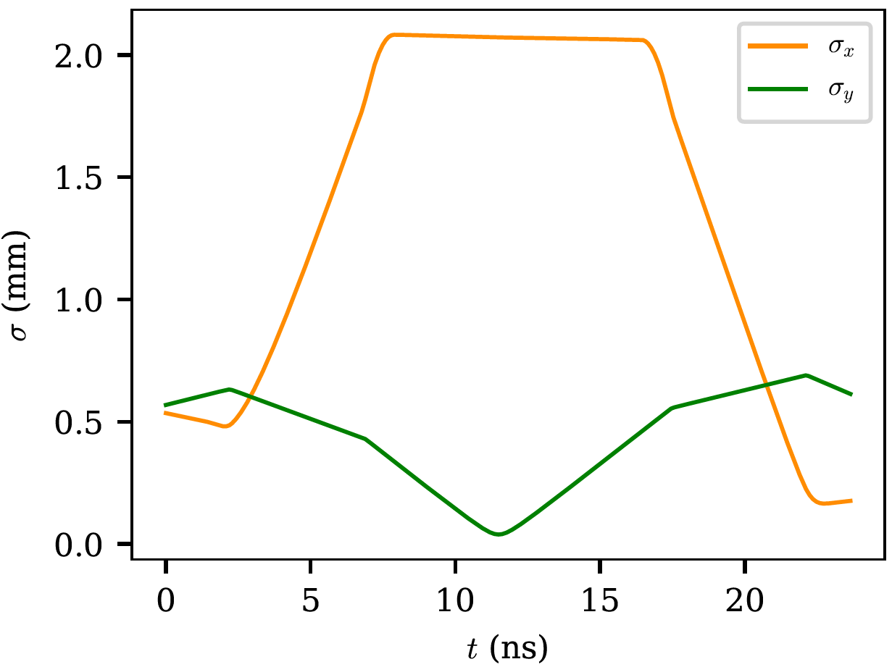
LW3D Simulations of AWA Chicane
Showed compression by a factor of 7.5

Slide 12
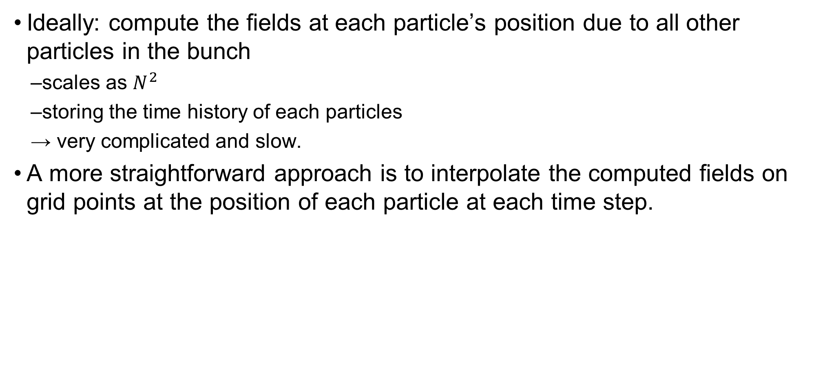
The Self-Consistent LW3D Code
Ideally: compute the fields at each particle’s position due to all other particles in the bunch
  scales as $N^{2}$
  storing the time history of each particles
  → very complicated and slow.
A more straightforward approach is to interpolate the computed fields on grid points at the position of each particle at each time step.

Slide 13
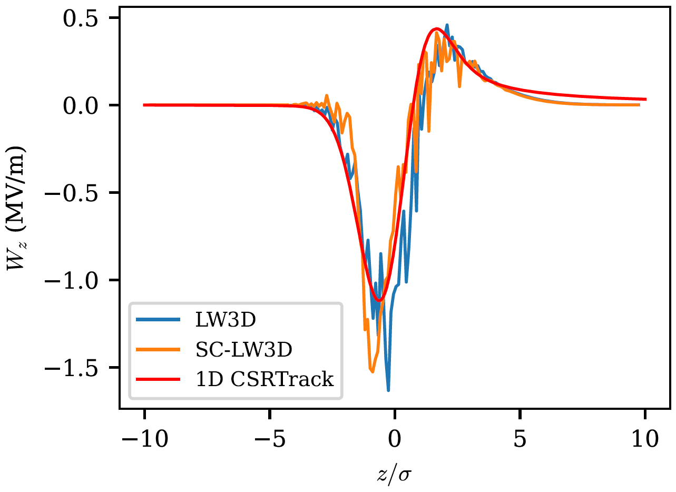
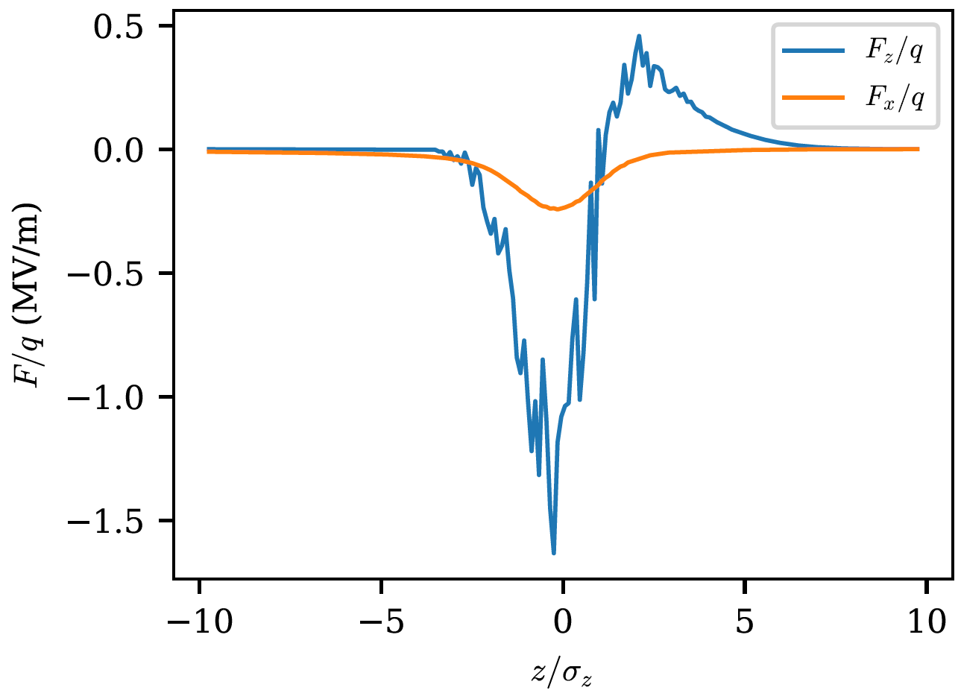

SC-LW3D Simulations of a Single Dipole
$σ_{z}=σ_{x}=100 μm,∆γ=0$
Noise is due to discreetness, can be smoothed by increasing $N$.
Notes:
We generally observed that a significant bending-plane transverse Lorentz force while the vertical force is insignificant. The longitudinal wakefield remains the major source of phase-space dilution given its larger magnitude |Fz| ∼ 6 × |Fx|.

Slide 14
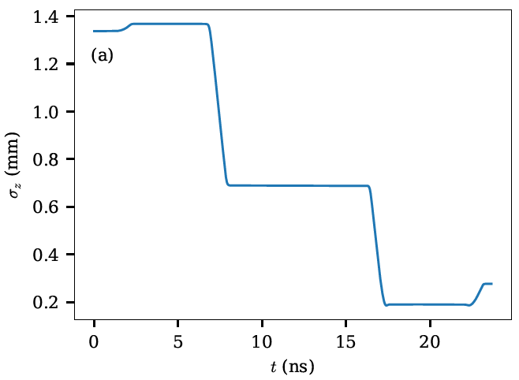
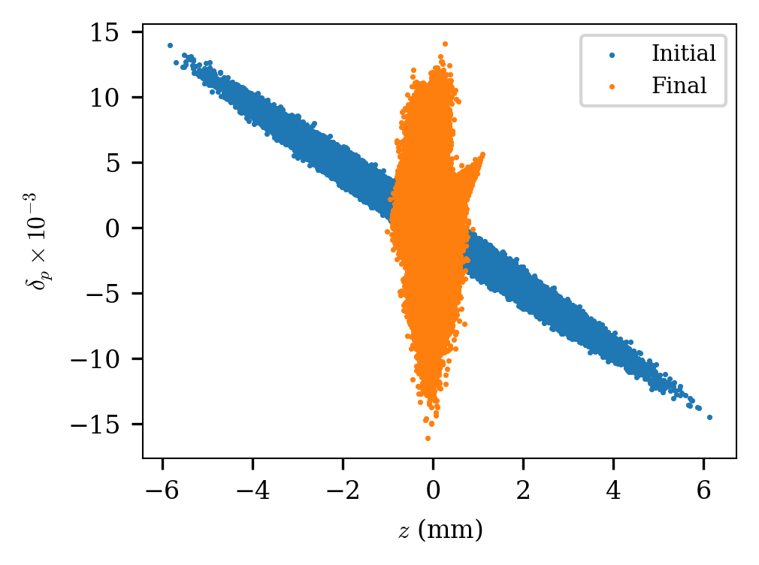
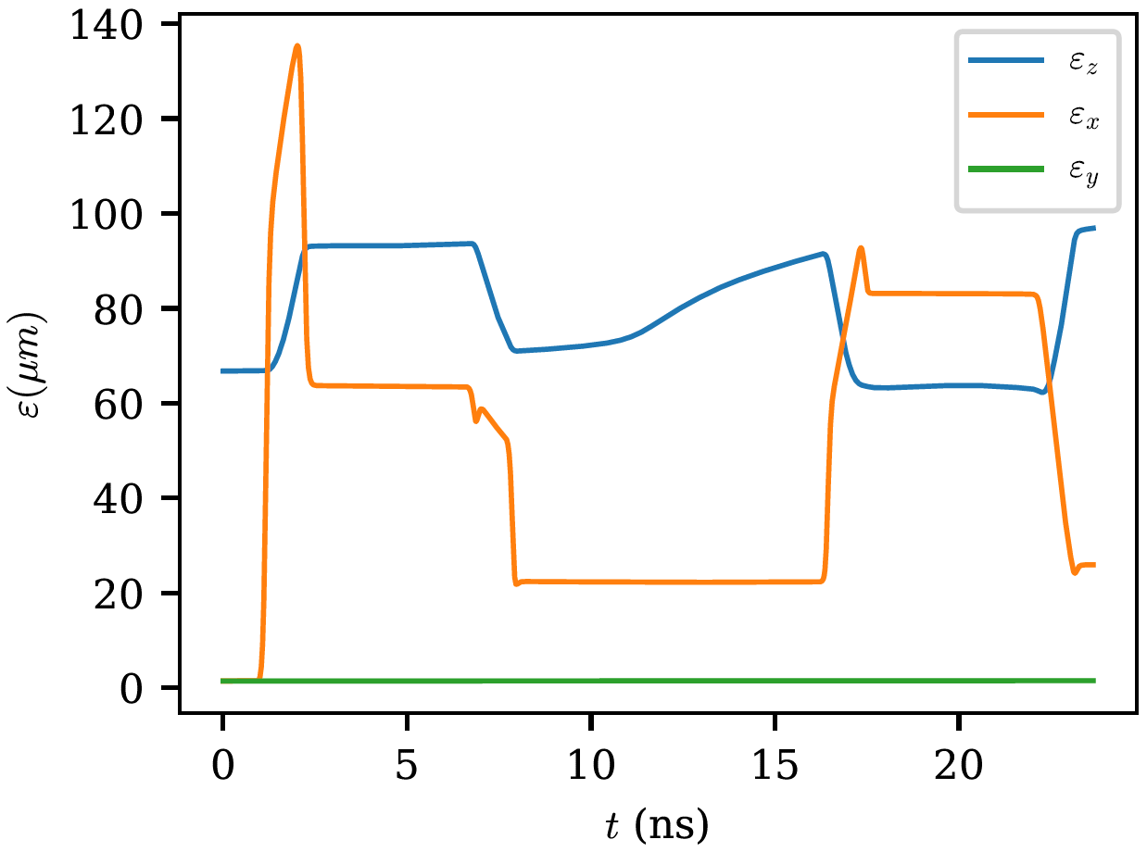
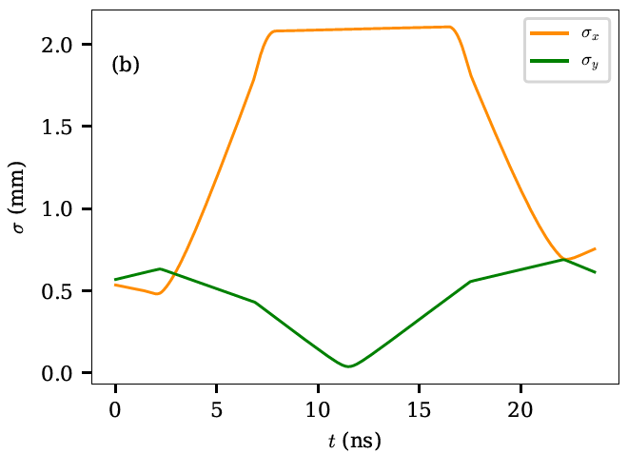
SC-LW3D Simulations of AWA Chicane
Simulations are not optimized.
  over compression.
  dilution of the bending-plane emittance.
Next steps: optimize incoming Twiss parameters and retune the chirp to minimize the bending-plane emittance growth.
Notes:
The final bunch length 277 μm (∼ 50% larger than the one simulated without self-interaction). The bunch length evolution indicates that the self-interaction dynamically affects the LPS chirp and ultimately results in an over compression. The longitudinal waist appears in the final dipole magnet where the bunch is expected to be the smallest and CSR effects are the most prominent.
The final distribution looses its Gaussian characteristic and displays the standard bifurcated LPS distribution often observed in CSR calculations.
The evolution of the transverse beam size along the bunch compressor; the beam remains below ≤ 2.2 mm in the
high dispersion point while the vertical beam-size evolution was set to provide a symmetric beta function with respect to the center of the chicane. The evolution of the emittances indicates that for the selected beam parameters, the compression is accompanied with a significant bending-plane emittance dilution. Further optimization will be performed following the prescription.

Slide 15
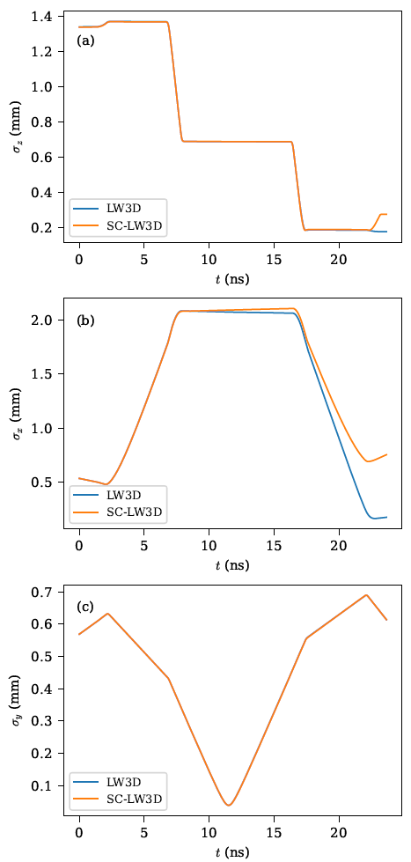
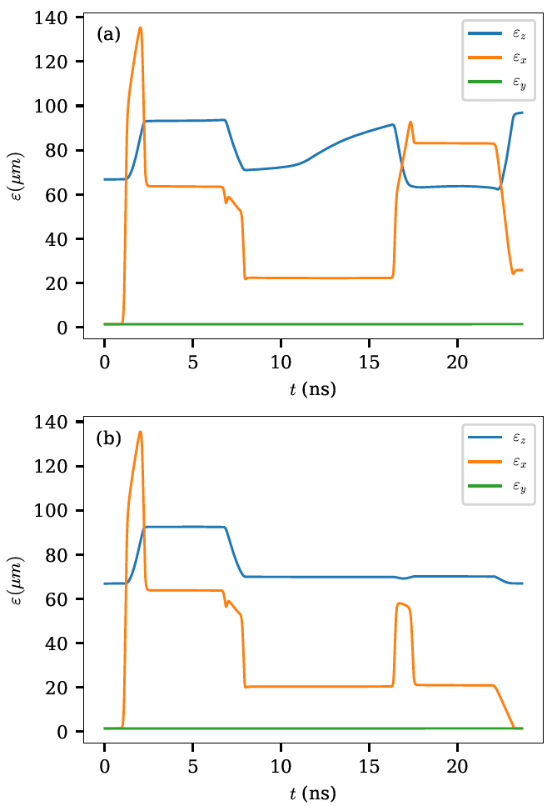
SC-LW3D Simulations of AWA Chicane

Slide 16
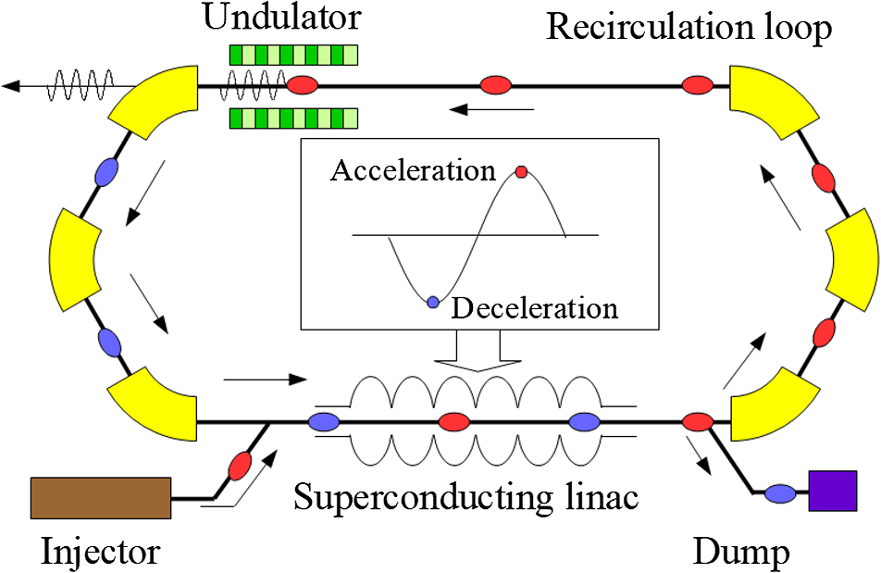
Beam Dynamics of a Straight-Merger Beamline
Concept was originally proposed for the separation of a multi-species beam in 1983 [J. A. Macdonald et al., https://doi.org/10.1109/TNS.1983.4332970].
Recently proposed for electron-beam merging and separation in energy-recovery linacs (ERLs) [K. E. Deitrick et al., https:// doi:10.18429/JACoW-LINAC2018-THPO010].
  reduces the bending of the injected beam
  by an order of magnitude.
Picture from: H. Kawata et al., https://doi.org/10.1117/1.JMM.21.2.021210
Notes:
All merger designs in established and upcoming machines involve significant bending of the injected beam – even using a so-called straight merger bends the injected beam several degrees.
Proposed for ERLs to merge the injected bunch onto the linac axis with minimal bending and beam degradation.
Dipole field is set to compensate for the kick provided by TDC.
In an ERL, a low-energy “fresh” bright bunch is generally injected into a superconducting linac for acceleration using the fields established by a decelerated “spent” beam traveling on the same axis.

Slide 17
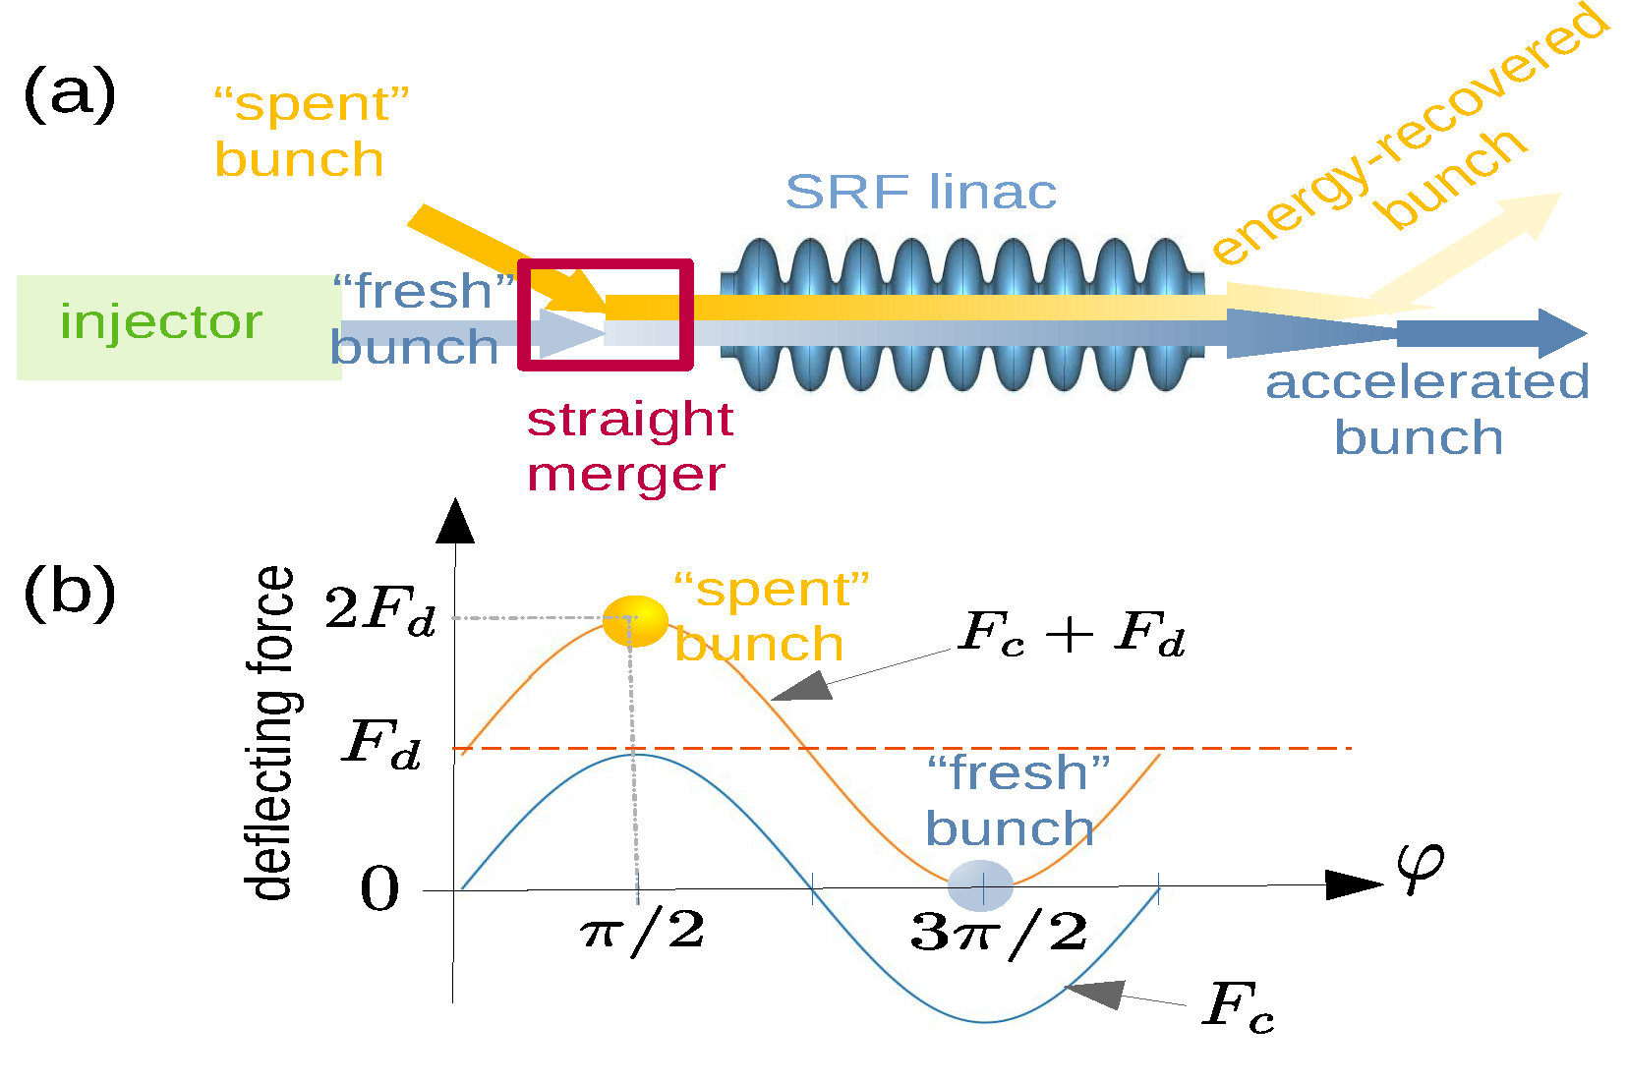
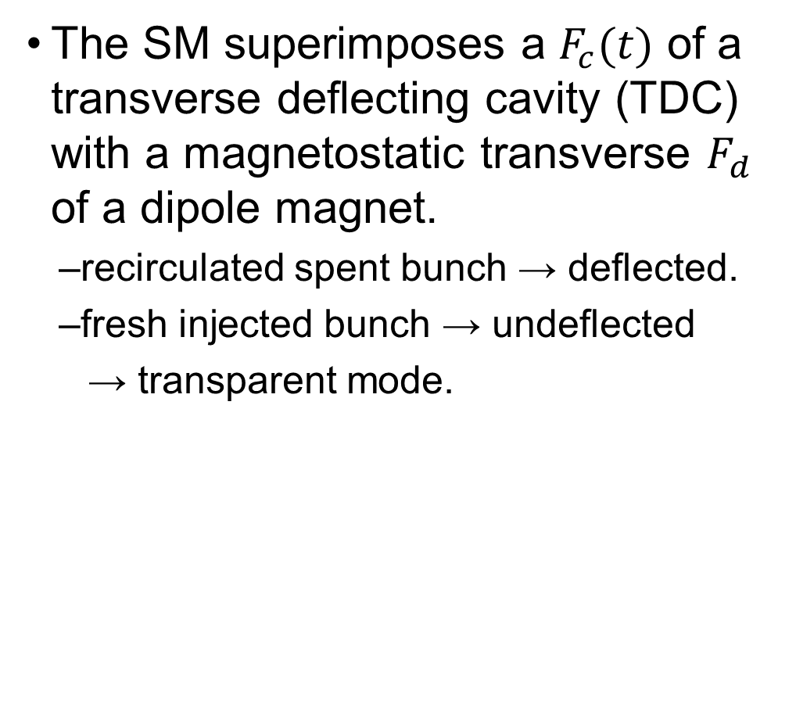
Beam Dynamics of a Straight-Merger Beamline
The SM superimposes a $F_{c}(t)$ of a transverse deflecting cavity (TDC) with a magnetostatic transverse $F_{d}$ of a dipole magnet.
  recirculated spent bunch → deflected.
  fresh injected bunch → undeflected
    → transparent mode.
Notes:
Proposed for ERLs to merge the injected bunch onto the linac axis with minimal bending and beam degradation.
Dipole field is set to compensate for the kick provided by TDC.

Slide 18
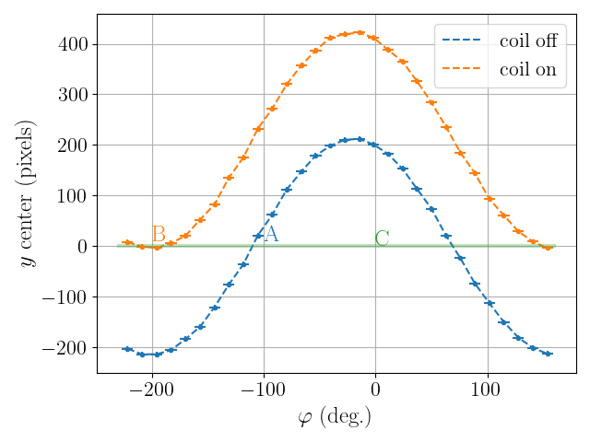
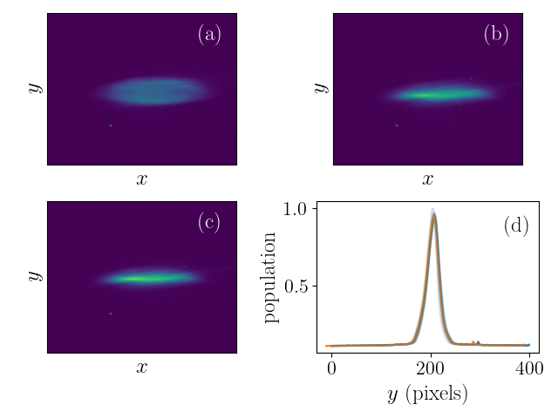

PoP SM Experiments at AWA
A SM system was proposed and recently tested at AWA:
  three-cell (1/2+1+1/2-cell) TDC cavity operating on the TM_{110,𝜋} mode at $f_{0}=1.3$GHz.
  surrounded by a dipole magnet composed of two coils.
  beam energy is up to 40 MeV.
Successfully commissioned and acquired some preliminary data.
Details in: A. Al Marzouk et al., https://doi.org/10.18429/JACoW-NAPAC2022-MOPA72
Notes:
Measurement of the beam vertical displacement as a function of the TDC phase (with an arbitrary phase offset). The letter labels respectively indicate the cases of (A) TDC operated at zero crossing with dipole magnet off, (B) SM operated in the transparent mode, and (C) horizontal line corresponds to both the TDC and dipole magnet being turned off.
Our goal: study detailed beam dynamics of the merger concept and its ability to conserve the beam brightness of the fresh bunch.

Slide 19
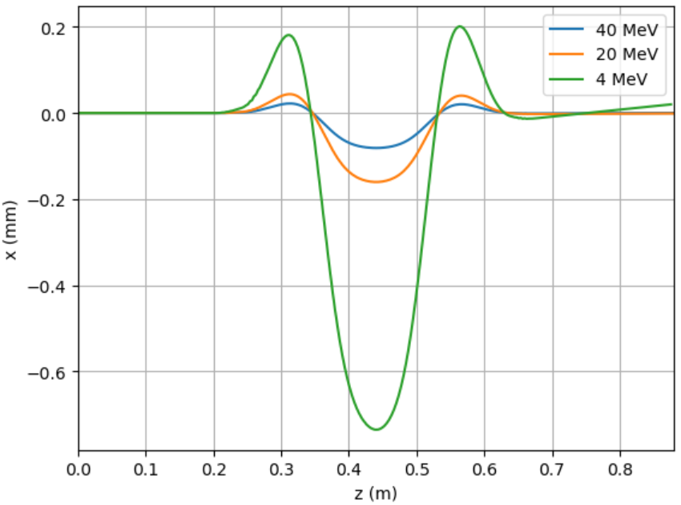
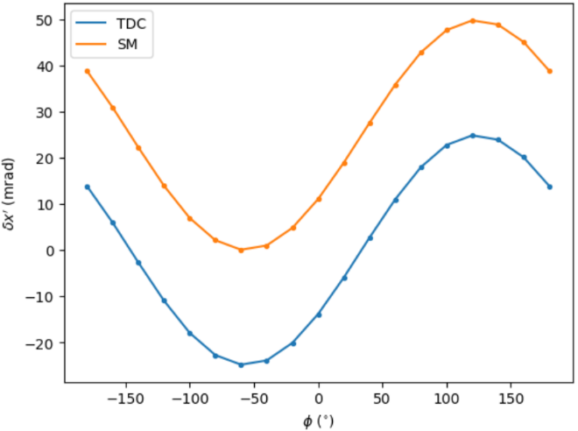
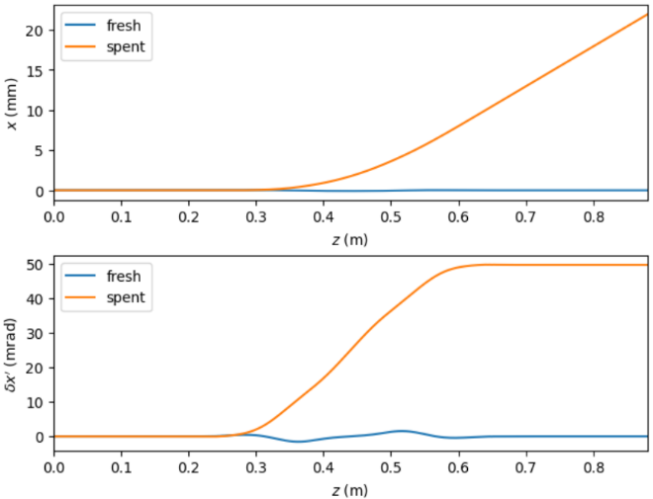
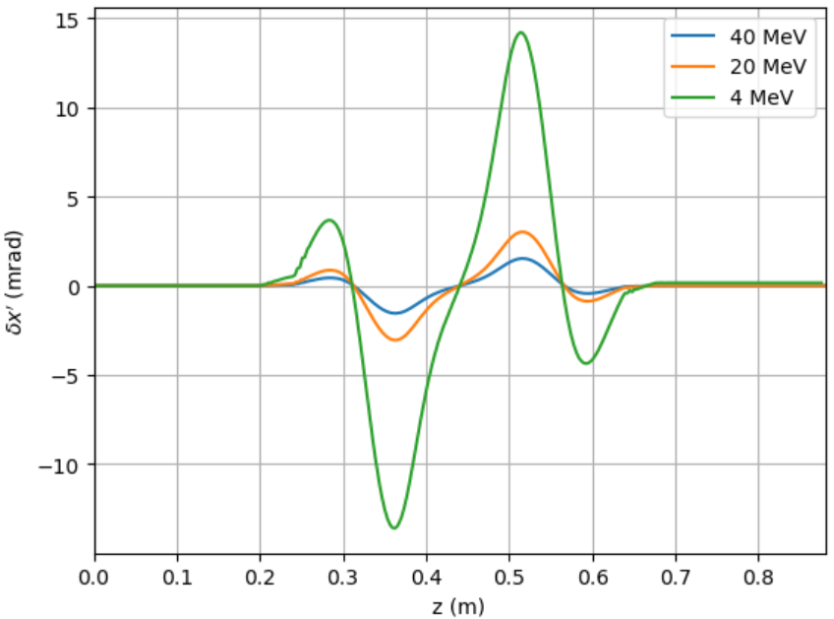

LW3D Simulations of the SM at AWA
Imported the 3D field maps of the TDC and dipole magnet.
A 1-nC bunch of 40 MeV and $σ_{z}=1.34$mm (a peak current of ≃ 90 A).
  a dipole field of about 15 mT can compensate the TDC fields.

Slide 20
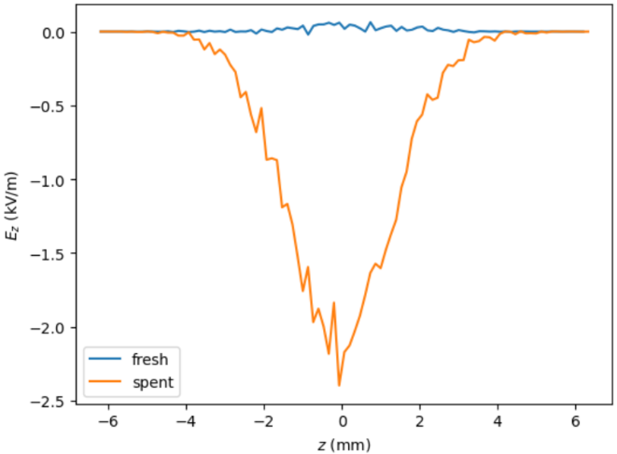
LW3D Simulations of the SM at AWA
CSR wakefields downstream of the SM:
  wake of the spent bunch is much larger than that of the fresh bunch.
CSR impact on the bunch may vary depending on the peak current.
  for the peak currents anticipated in electron
  coolers, CSR will be insignificant.
  in beam-driven accelerators applications
  where the SM merges or extracts a drive bunch,
  it will be a major effect.

Slide 21
Conclusions and Outlooks
Performed first-principle simulations of CSR for the bunch compressor at AWA.
The self-consistent LW3D is in progress, we showed some CSR impact.
Future work: optimization of the beam parameters to minimize the impact of CSR on the beam dynamics; CSR effects on shaped beam needed for enhanced beam-driven wakefield acceleration.
SC-LW3D study of the straight merger and phase-space exchangers.
Acknowledgments
Supervisor: P. Piot. Collaborators: R. D. Ryne, C. E. Mitchell, J. Qiang.
This work was support by the U.S. National Science Foundation under award PHY-1549132 to Cornell University and NIU.
This research used resources of the National Energy Research Scientific Computing Center; a DOE Office of Science User Facility supported by the Office of Science of the U.S. Department of Energy under Contract No. DE-AC02-05CH11231 using NERSC award BES-ERCAP0020725.

