Slide 1


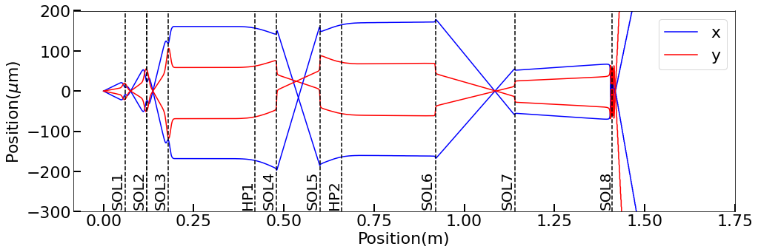
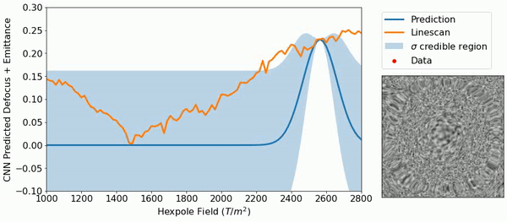
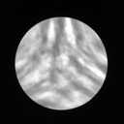
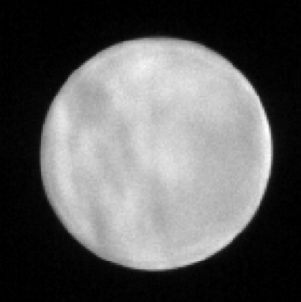
Center for
BRIGHT BEAMS
Physics-informed Bayesian Optimization of an Electron Microscope*
Desheng Ma1, Chenyu Zhang1, Zhaslan Baraissov1, Cameron J. Duncan 2, Adi Hanuka3, Auralee L. Edelen3,
Jared M. Maxson2, David A. Muller1
¹ School of Applied and Engineering Physics, Cornell University, Ithaca, 14853, NY, USA
² Cornell Laboratory for Accelerator-Based Science and Education, Cornell University, Ithaca, NY, 14853, USA
³ SLAC National Laboratory, Menlo Park, 94025, CA, USA
A National Science Foundation Science & Technology Center
10 mrad
10 mrad

Slide 2
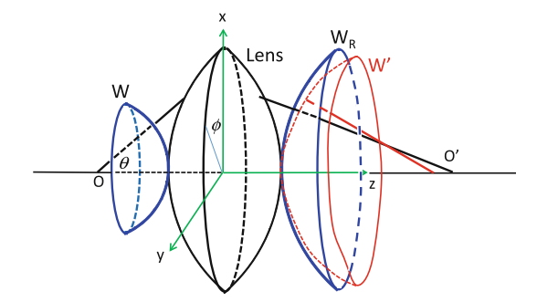
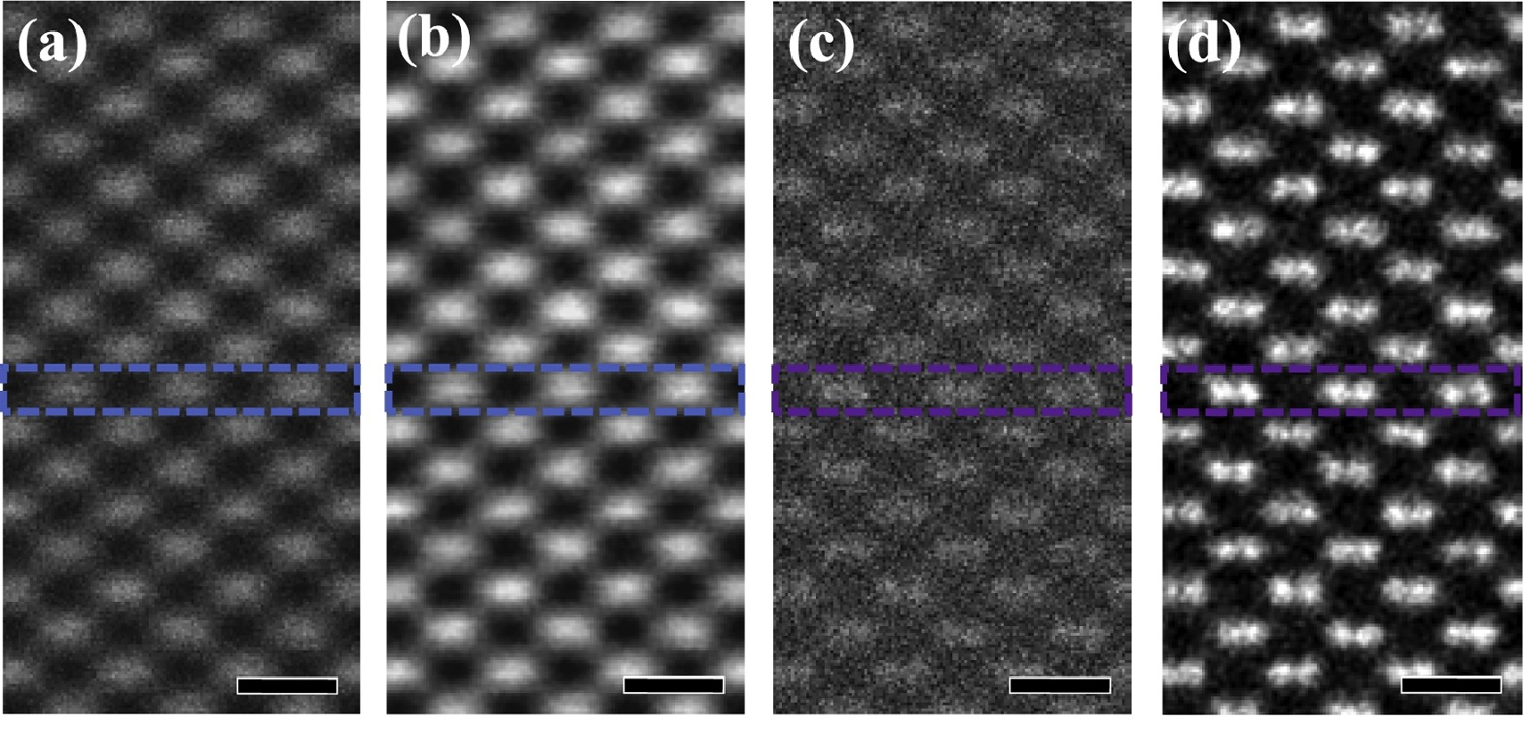
Probe Aberration and Aberration Corrector
Schematic of actual wavefront W’ and spherical wavefront W_{R}
Atomic resolution image of Si <110> without (a),(b) and with (c), (d) aberration corrected.
Aberration is the deviation of light/beam rays through a lens system, causing image blur/distortion.
Aberration function describes the difference between the actual wavefront and a spherical wavefront.
Aberration correctors in electron microscopy is a large set of multipole electron-optical elements to reduce aberration.
  A typical aberration corrector is a hexapole corrector up to 3rd order spherical aberration correction.
Advanced Transmission Electron Microscopy, ISBN 978-1-4939-6605-9
Ultramicroscopy 189 (2018): 46-53.

Slide 3
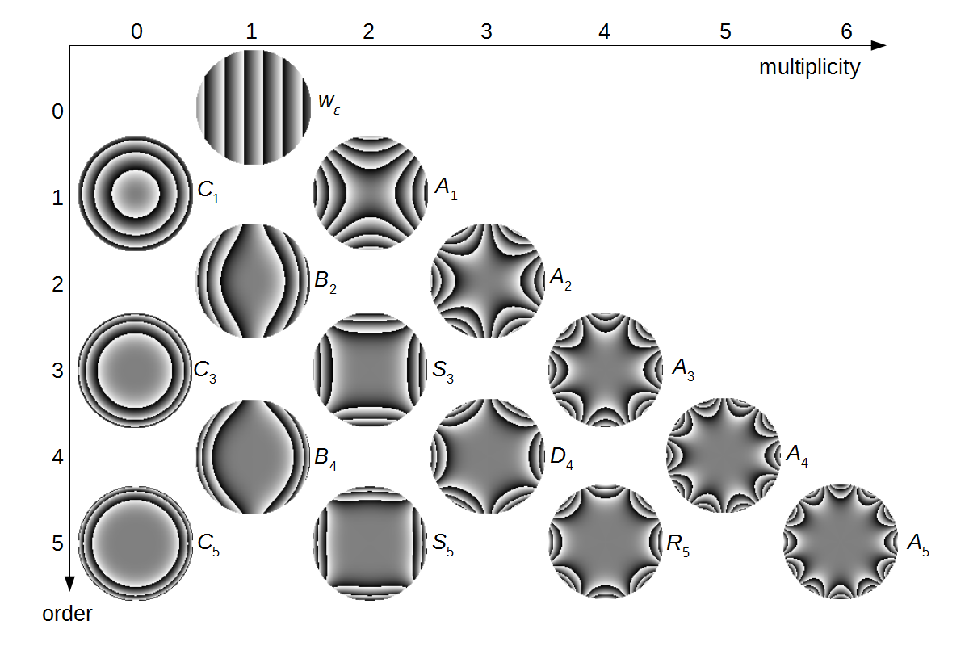
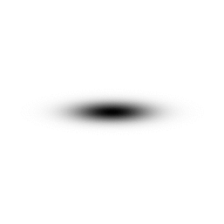







Beam Emittance and Aberration Correction
Aberration correction in electron microscopy.
  Aberration function is unknown.
  Different aberrations are coupled in the imaging system.
  Intrinsic optical instability.
    Need for constant tuning .
Emittance minimization in accelerator physics.
  Area occupied by the beam in phase space.
  Single measurement of beam quality.
  Independent of focus.
  Can be calculated from aberration coefficients*
Solution:
  Emittance minimization is equivalent to aberration correction of the beam.
Minimum aberration
Defocus
Spherical Aberration
$$x$$
$$x$$
$$x$$
$$x′$$
$$x′$$
$$x′$$
Advanced Transmission Electron Microscopy, ISBN 978-1-4939-6605-9
Physical review letters 109.16 (2012): 163901.
* Cueva, Paul. Transforming 4D-Stem Data: From Diffraction to Cepstra & Aberrations to Brightness. Diss. Cornell University, 2021.
Notes:
Talk about the connection between aberration coefficients and emittance.

Slide 4
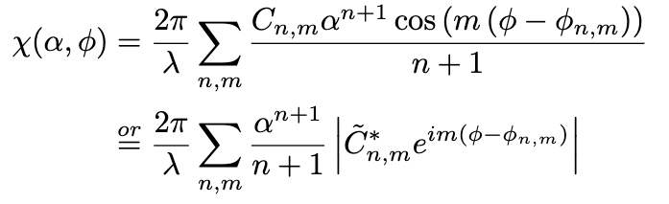
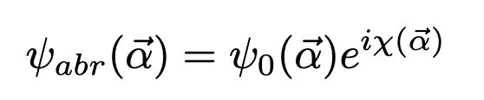
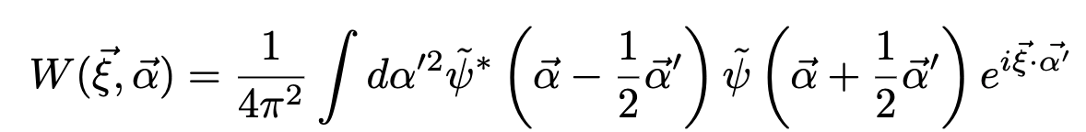



Aberration Correction is Beam Emittance Minimization
Aberration function characterizes the electron beam in its wave function.
Wigner-Weyl transform approximates the shift of the beam to the gradient of the aberration function.
$$⇒$$
We can define the root-mean-square (RMS) emittance of the electron beam with the aberration function.
Notes:
Talk about the connection between aberration coefficients and emittance.

Slide 5
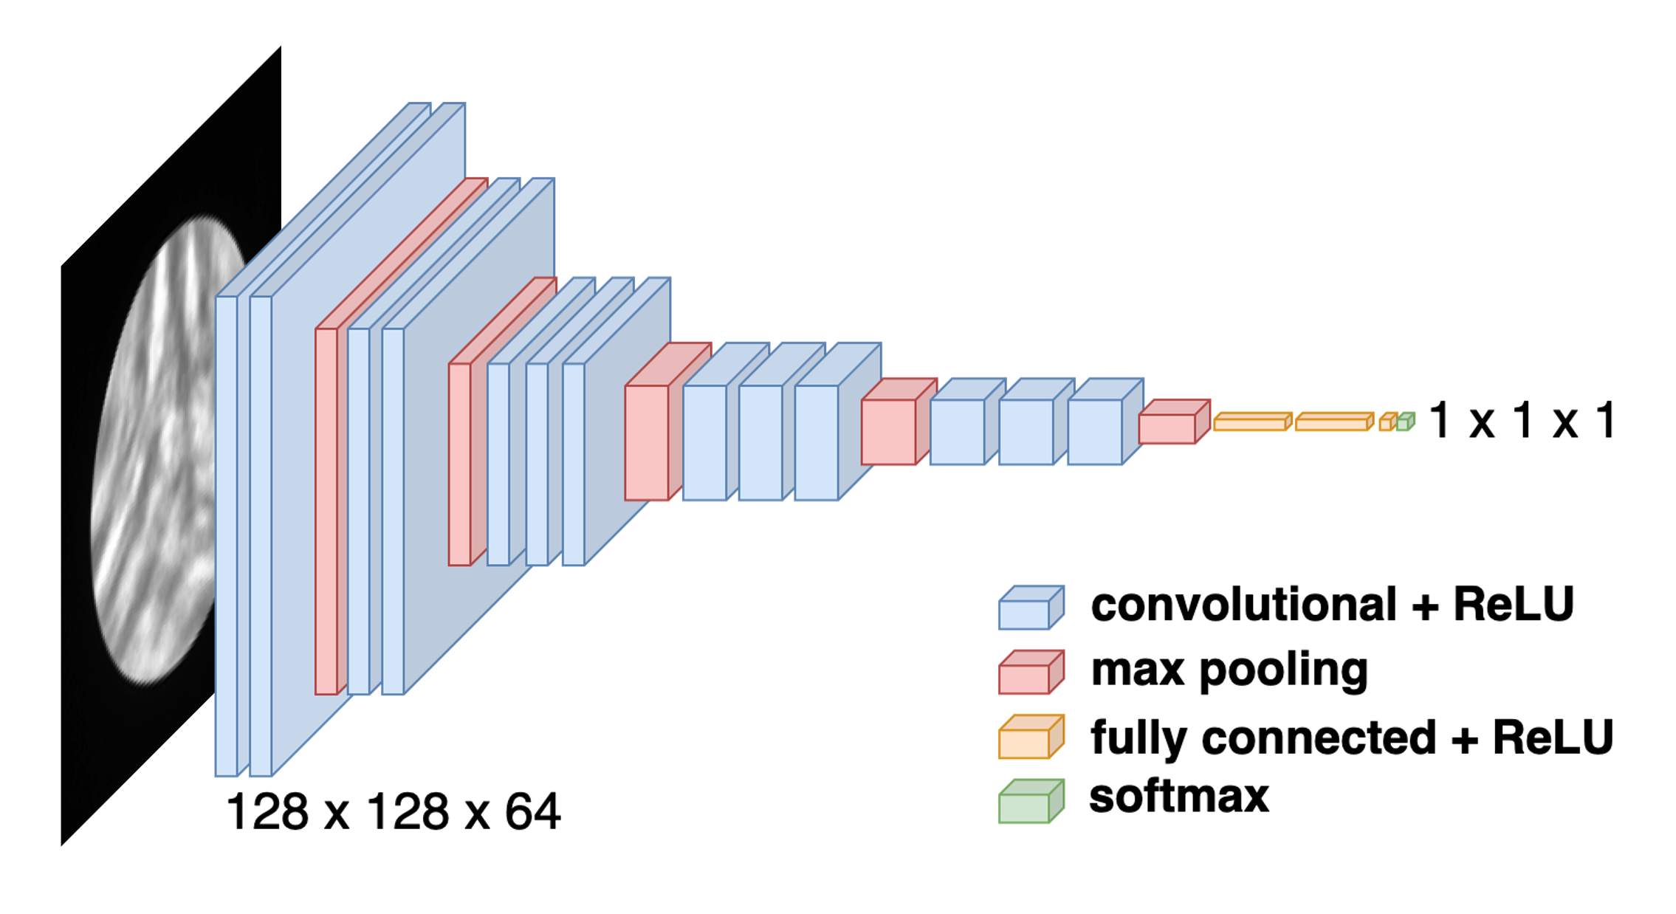

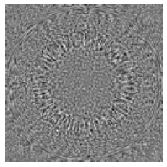

Emittance v.s. Ronchigram: A Deep Learning Approach
Architecture of a VGG16 network.
Convolutional Neutral Network learns from Ronchigrams to predict single values of Emittance.
Training dataset
  Training data:
    25,000 simulated Ronchigrams with known aberration coefficients.
    Ronchigram simulator
      http://ronchigram.com/
  Training label:
    Directly calculated emittance from known aberration coefficients.
Outcome: A black-box function mapping Ronchigrams to emittance that can be optimized.
https://ieeexplore.ieee.org/document/8258115
Extreme cases in the built training dateset
10 mrad
~0 aberration and defocus
1 mm C3 and 1 μm defocus
Notes:
Talk about the connection between aberration coefficients and emittance.

Slide 6
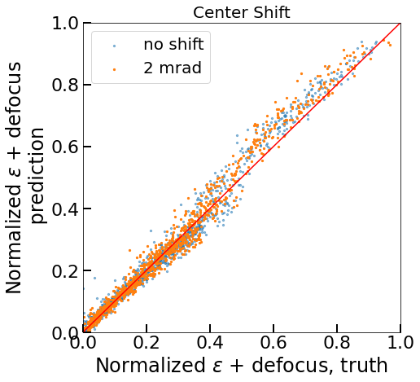
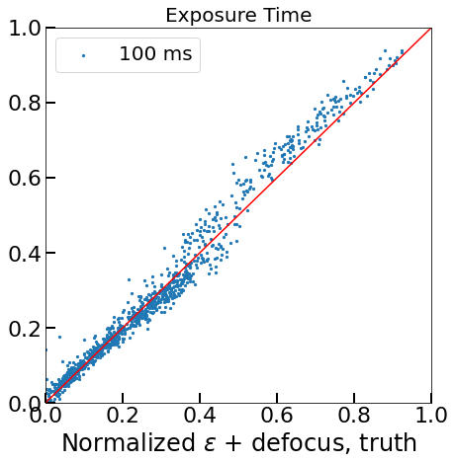
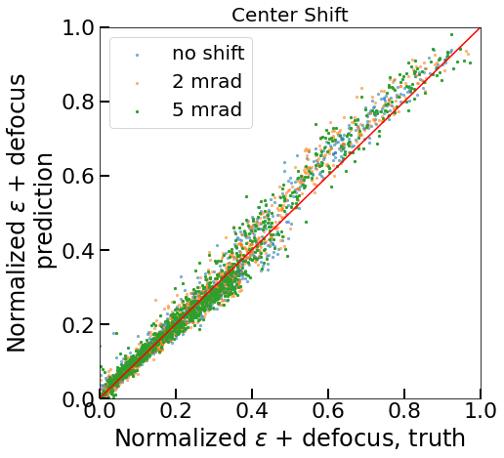
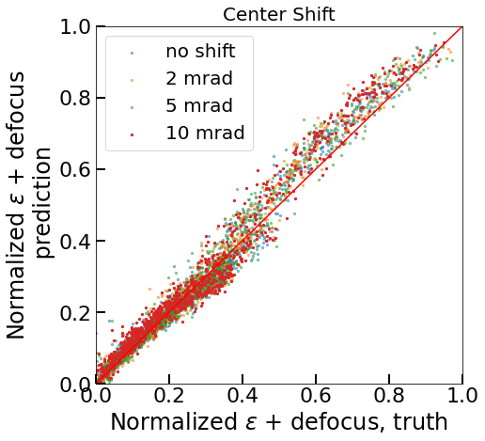
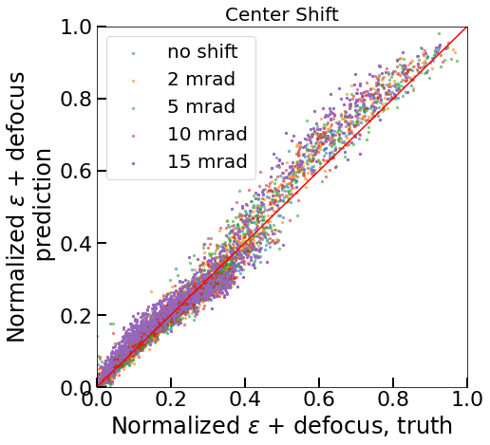
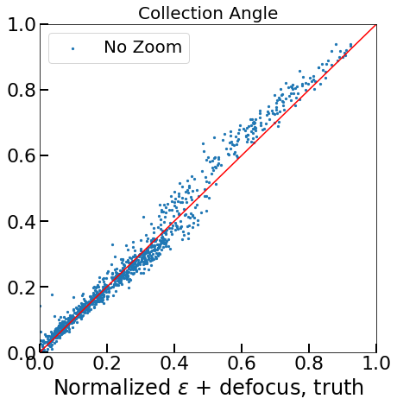
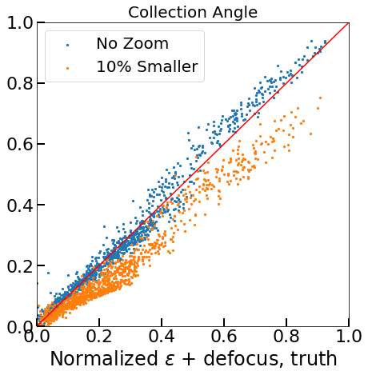
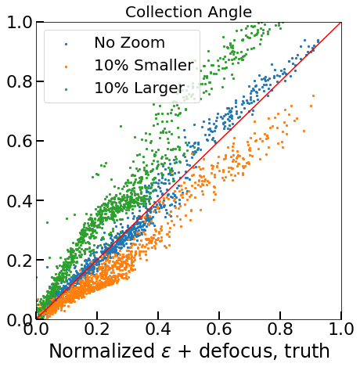
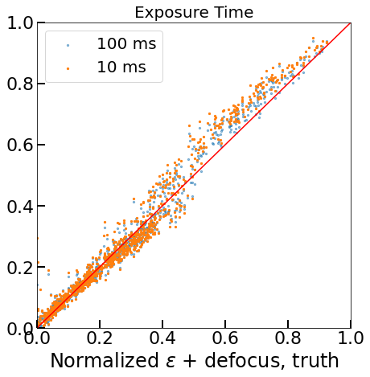
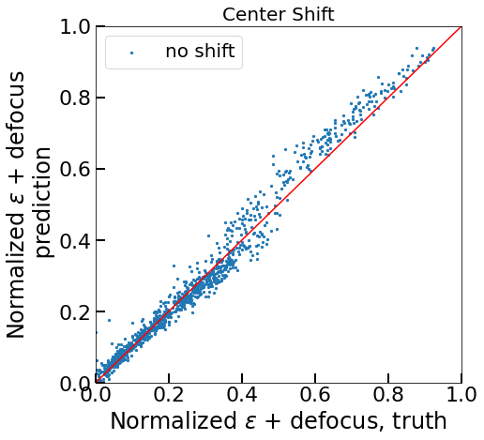
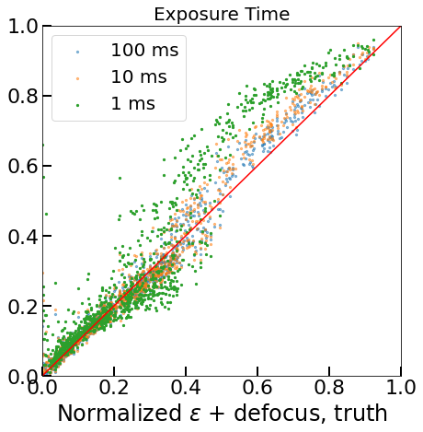
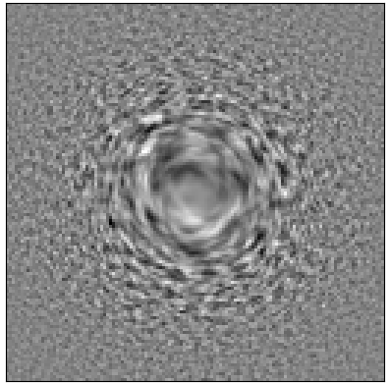
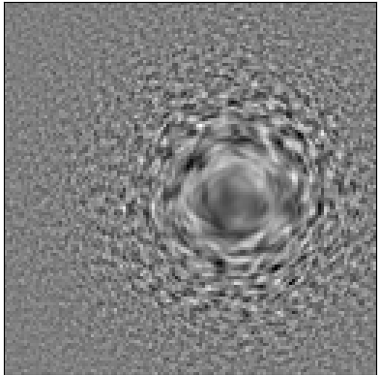
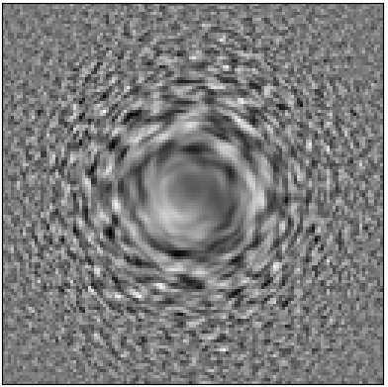
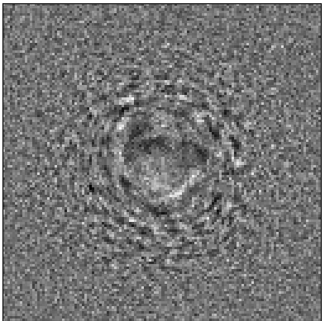
CNN Training – Robustness Check
20 mrad
A new set of simulated data to validate CNN performance.
Robust against changes in acquisition conditions.
Notes:
Talk about the connection between aberration coefficients and emittance.

Slide 7
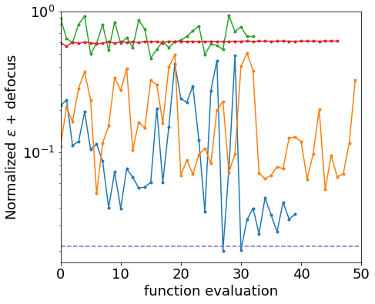
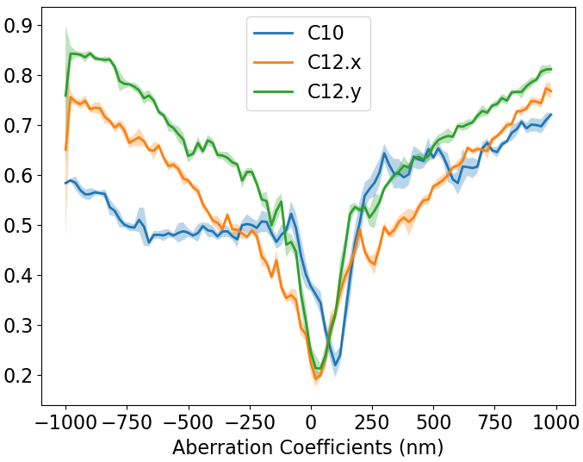
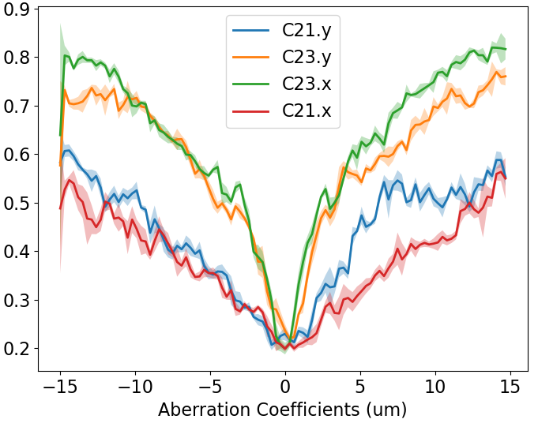
CNN Performance Validation on NION UltraSTEM
Control of the microscope enabled by Nion Swift*.
Images collected from Ronchigram camera.
Each iteration:
  200 ms acquisition time
  + few ms computing time
The trained CNN accurately captures the increase of emittance as a result of increased aberration.
Together with the trained CNN, Bayesian optimization is able to automate aberration correction effectively.
CNN response when changing single aberration coefficient
*Nion Swift: https://nionswift.readthedocs.io/en/stable/
Notes:
Talk about the connection between aberration coefficients and emittance.

Slide 8
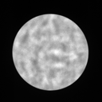
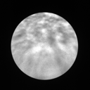
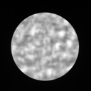
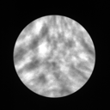
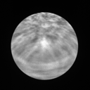
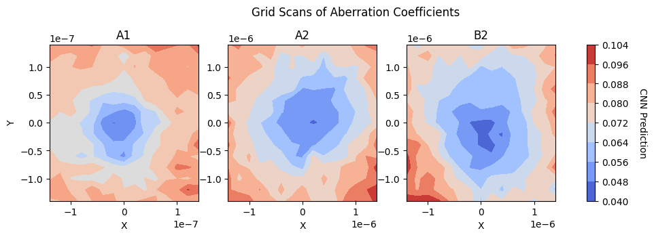
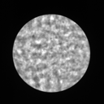
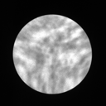
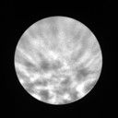
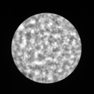
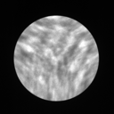
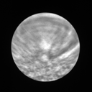
CNN Performance Validation on Spectra 300
A1
A2
B2
A1 | A2* | B2**
50 nm | 250 nm | 500 nm
-50 nm | -250 nm | -500 nm
100 nm | 500 nm | 1000 nm
-100 nm | -500 nm | -1000 nm
* Defocus set to 20 nm to increase visual variation
** Defocus set to 10 nm to increase visual variation
10 mrad
CNN captures the emittance growth with increase of aberration and agrees with the trend of ground truth.
Ronchigrams from Spectra 300 are hand collected.
Notes:
We can do it 5/10 measurements to get the mean/std of the aberration coefficients and see how big the error bars could be

Slide 9
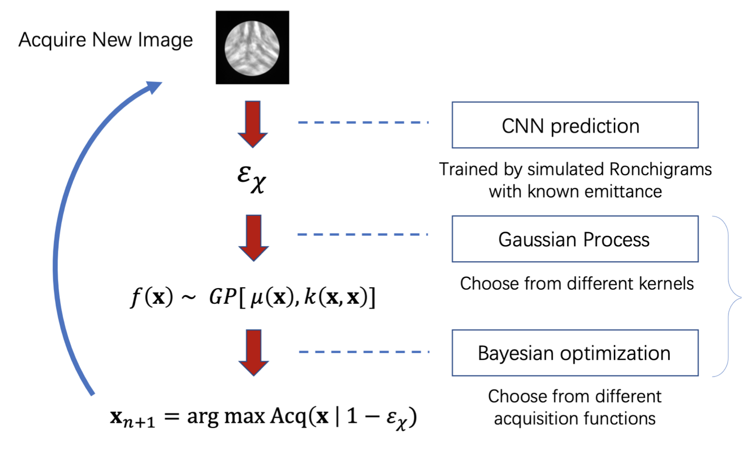
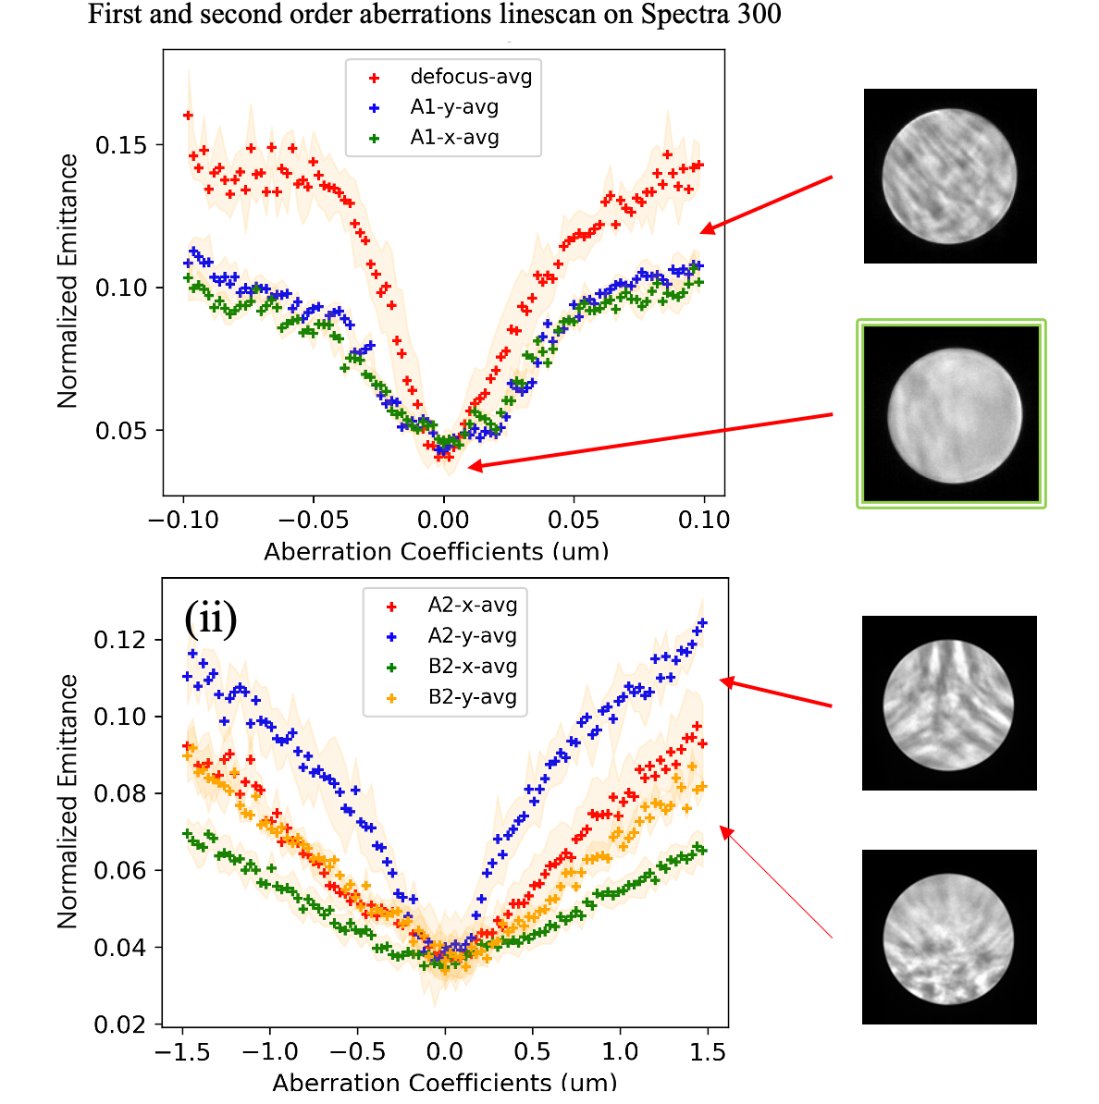
Fully Automated Aberration Corrector Tuning
Bayesian optimization is a global optimization method.
A Gaussian Process (GP) is used for the surrogate model.
Kernel and length scale reflect data correlation assumption.
Acquisition function decides exploration v.s. exploitation
Notes:
Talk about the connection between aberration coefficients and emittance.

Slide 10
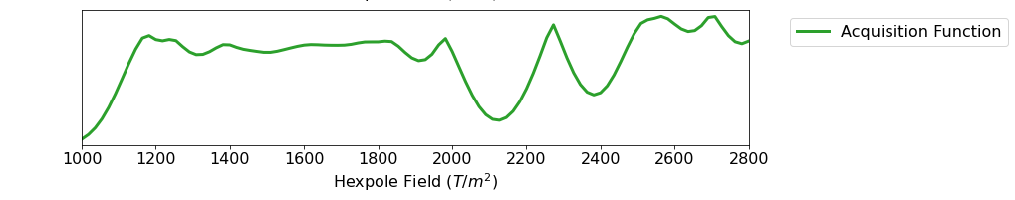
Bayesian Optimization for Automated Tuning
Bayesian optimization is a global optimization method.
A Gaussian Process (GP) is used for the surrogate model of the unknown function.
Kernel and length scale reflect how we assume the data points to be correlated.
Acquisition function is the key to the balance between exploration and exploitation
Notes:
Talk about the connection between aberration coefficients and emittance.

Slide 11
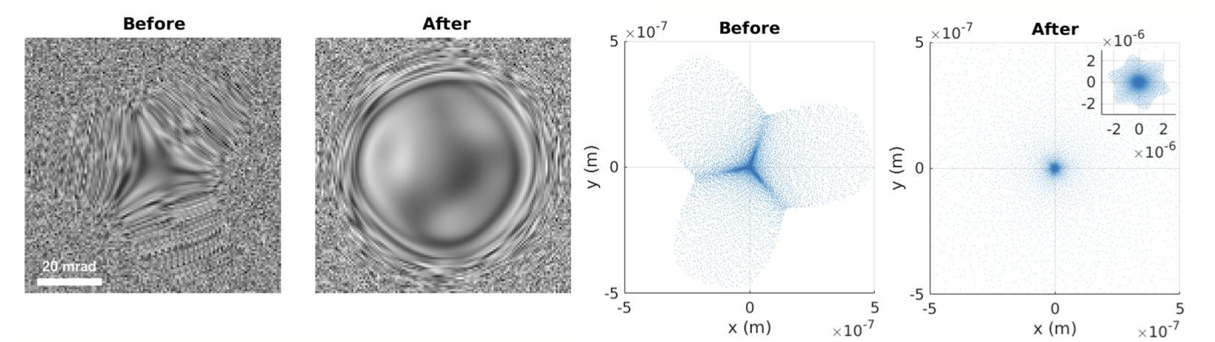
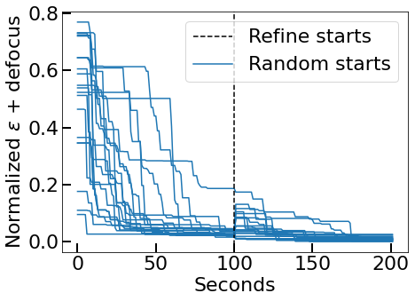
Simulation Study: General Particle Tracer (GPT)
Overview of the corrector simulation model
Hexapole corrector model simulated by general particle tracer (GPT).
Bayesian Optimization returns the optimal set of magnetic lenses’ strength.
Two step tuning with aperture applied on the fine tuning step.
HP: Hexapole SOL: Solenoid
Optimization process from random starting points.
Iterations
Notes:
Talk about the connection between aberration coefficients and emittance.

Slide 12
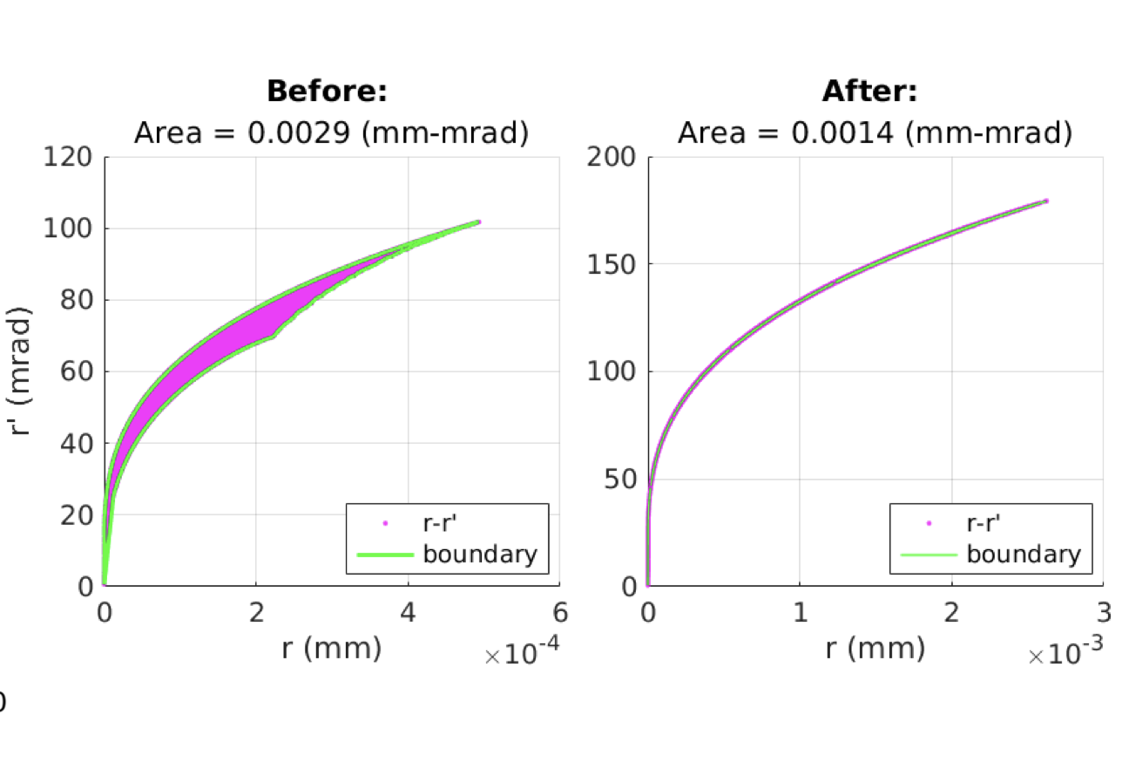
Simulation Study: General Particle Tracer (GPT)
Overview of the corrector simulation model
Hexapole corrector model simulated by general particle tracer (GPT).
Bayesian Optimization returns the optimal set of magnetic lenses’ strength.
Two step tuning with aperture applied on the fine tuning step.
HP: Hexapole SOL: Solenoid
Optimization process from random starting points.
Notes:
Talk about the connection between aberration coefficients and emittance.

Slide 13
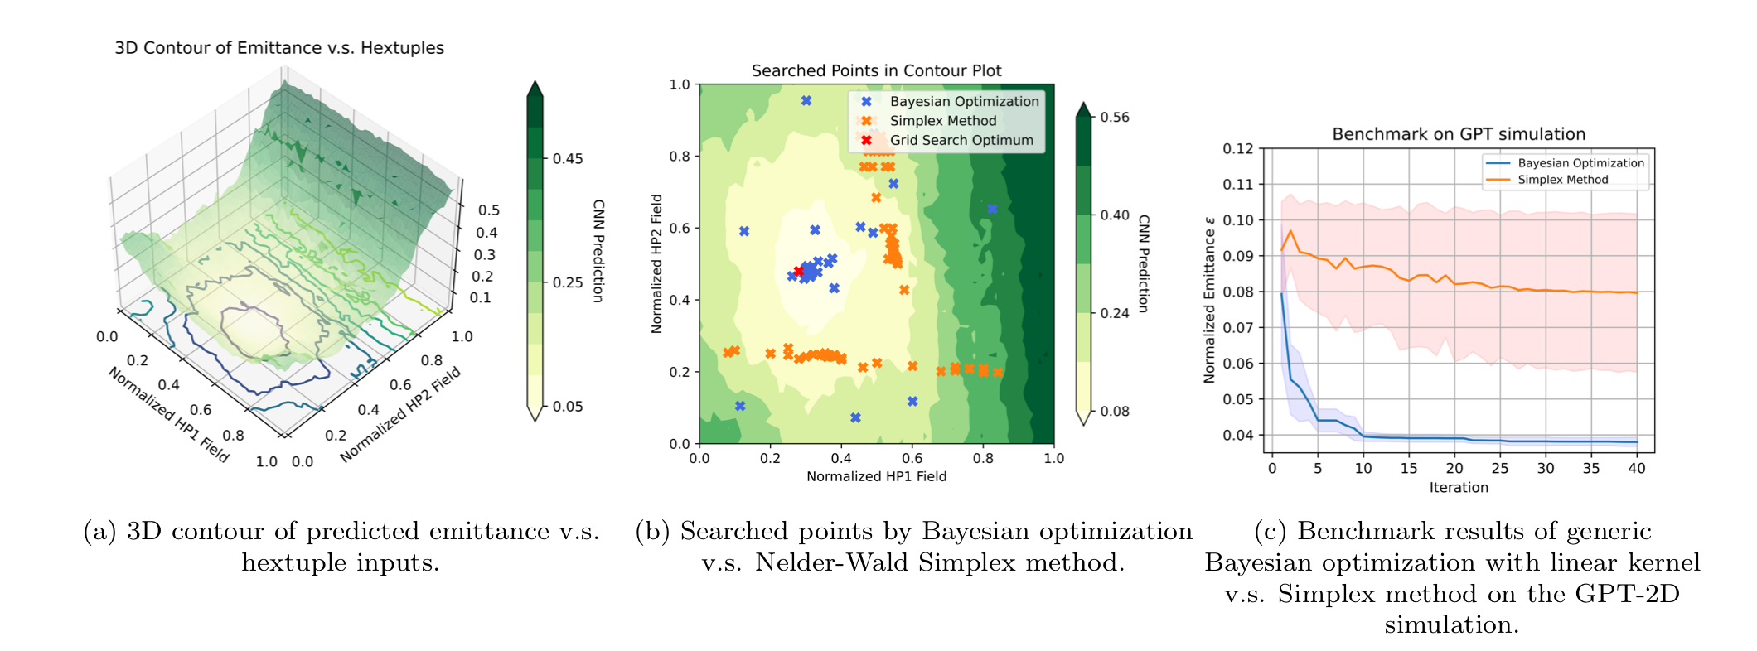

Benchmark on Simulation Study: GPT-2D case
* Contour plot of CNN predicted emittance v.s. H1 and H2
* Mean and standard deviation obtained from 20 repetitions
* Simplex with 3 sets of initial points are shown. All trapped locally.
Bayesian optimization converges more quickly in terms of the number of function evaluations.
Bayesian optimization is more efficient at converging to the global optimum.
Notes:
Talk about the connection between aberration coefficients and emittance.

Slide 14





How to be Physics-informed?
$$h=$$
$K←K^{\frac{1}{2}}hK^{\frac{1}{2}}$
Deep kernel underperforms in short term, but outperforms in long term.
Option 1. Embed Hessian estimated from simulation
Option 2. Let a deep kernel learn the correlations by itself.
Notes:
Talk about the connection between aberration coefficients and emittance.

Slide 15


Next?
ThermoFisher Spectra 300 S/TEM
ThermoFisher Titan Cryo S/TEM
Software compatibility
  Python and packages
  Interaction with factory GUI
  …
Hardware communication
  Network protocols
  Port forwarding
  …
Notes:
Talk about the connection between aberration coefficients and emittance.

Slide 16

Next?
Notes:
Talk about the connection between aberration coefficients and emittance.

Slide 17






Summary
Beam Emittance is an effective metric to optimize for aberration correction in electron microscopy.
A well designed and trained deep learning model can effectively predict emittance from Ronchigrams.
Automated aberration correction is possible and realized by Bayesian Optimization.
Next:
  Tests on more machines, e.g., Titan Cryo-S/TEM and Spectra 300 S/TEM.
  A Hysteresis-addressed model.
  Integration with authentic factory interfaces.
Simulated Ronchigrams before and after tuning
20 mrad
Ronchigrams collected from Nion before and after tuning
20 mrad
This work is funded by the Center for Bright Beams, an NSF STC (NSF PHY-1549132).
This work made use of the Cornell Center for Materials Research Shared Facilities which are supported through the NSF MRSEC program (DMR-1719875).
Notes:
Talk about the connection between aberration coefficients and emittance.

