Slide 1
Background on Physics Priors for Scientific Machine Learning
Christopher M. Pierce

Slide 2
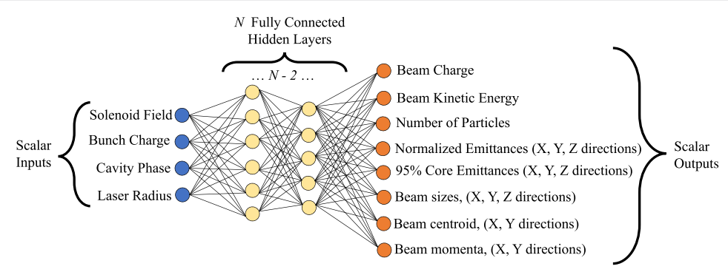
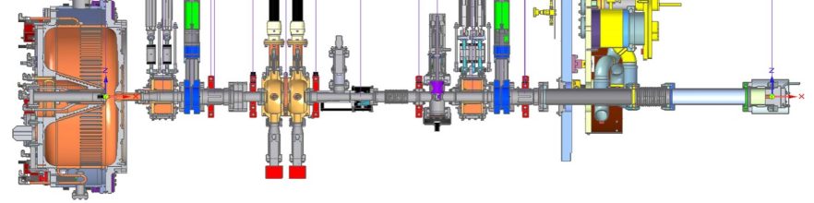
Surrogate Models – Fast, Differentiable, Data-Driven
Gupta, L., Edelen, A., Neveu, N., Mishra, A., Mayes, C., & Kim, Y. K. (2021). Machine Learning: Science and Technology, 2(4), 045025.
SURROGATE MODEL
A blackbox model mapping system inputs to outputs. Often used when the exact workings of the system are difficult to know or expensive to calculate.

Slide 3
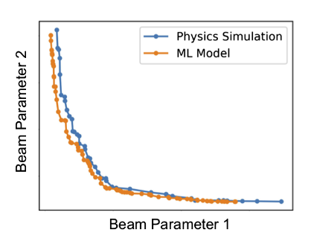
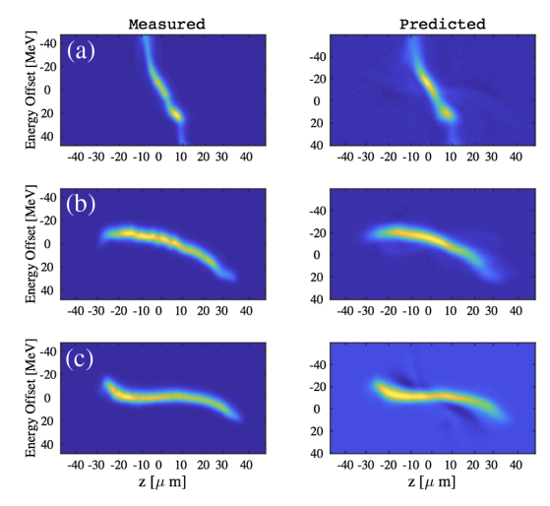
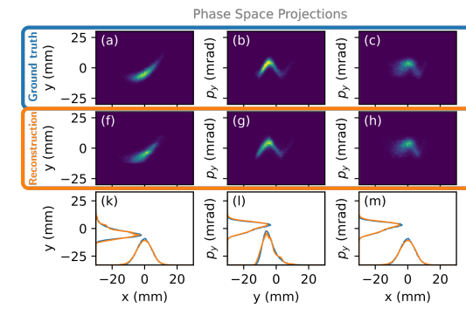
Surrogate Models – Fast, Differentiable, Data-Driven
SPEED
GRADIENT INFO
DATA-DRIVEN
Although accurate, physics-based simulation tools are expensive. Surrogate models may efficiently query results calculated using a code over a wide set of parameters. They can also interpolate into the areas between datapoints. All of this at a speed ${10}^{3}−{10}^{6}$ faster than typical particle tracking codes.
Many physics-based simulation tools are not capable of calculation gradients of outputs with respect to parameters such as magnet settings. Gradient information is important for optimization, sensitivity analysis, and new emerging ML techniques. Surrogate models, especially those made with neural networks tend to be inherently capable of gradient calculations.
Physics-based tools don’t have a clear way of incorporating data from real-world machines into their calculations. This data could make up for imperfections in the tools input such as errors in magnet locations and strengths, or difficult to measure settings such initial pulse distributions. Surrogate models are naturally data driven and open new opportunities to tune simulations to real systems.
Edelen, A., Neveu, N., Frey, M., Huber, Y., Mayes, C., & Adelmann, A. (2020). PRAB, 23(4), 044601.
Roussel, R., Edelen, A., Mayes, C., Ratner, D., Gonzalez-Aguilera, J. P., Kim, S., ... & Power, J. (2022). arXiv preprint arXiv:2209.04505.
Emma, C., Edelen, A., Hogan, M. J., O’Shea, B., White, G., & Yakimenko, V. (2018). PRAB, 21(11), 112802.
Incorporating Data from SLAC into Model of Longitudinal Phase Space
Optimization Sped up ${10}^{6}$x
Phase Space Reconstruction by Differentiable Modeling

Slide 4
Surrogate Models – Fast, Differentiable, Data-Driven
Karniadakis, G. E., Kevrekidis, I. G., Lu, L., Perdikaris, P., Wang, S., & Yang, L. (2021). Nature Reviews Physics, 3(6), 422-440.
THE PROBLEM
The (relative) difficulty of acquiring data for accelerator physics problems makes building surrogate models hard. Simulation tools are expensive and data collection at real machines is even more expensive.
PHYSICS PRIORS - A SOLUTION?
We already know the governing equations of charged particles in a beamline. Instead of making models re-learn this info from first principles, can we impose it as a constraint?

Slide 5
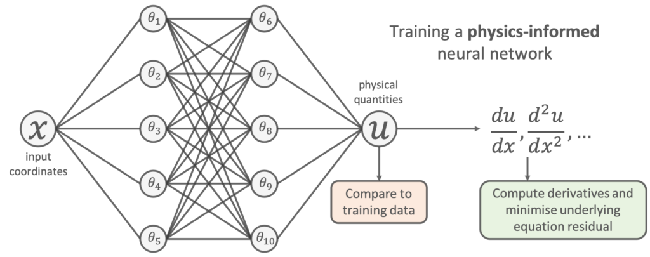
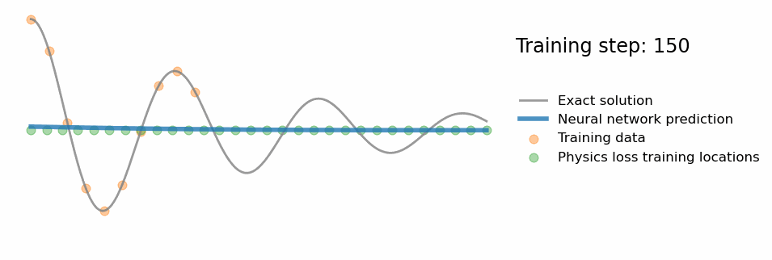
Physics Informed Neural Networks Primer
https://benmoseley.blog/my-research/so-what-is-a-physics-informed-neural-network/
PHYSICS INFORMED NEURAL NETWORK (PINN)
Neural networks are a “universal approximator” and can represent solutions of ODEs and PDEs. Train the neural network with a loss that represents the ODE or PDE residual at a set of “collocation points.”
Opportunity to Reduce Data Requirements for Accelerator Surrogates

Slide 6
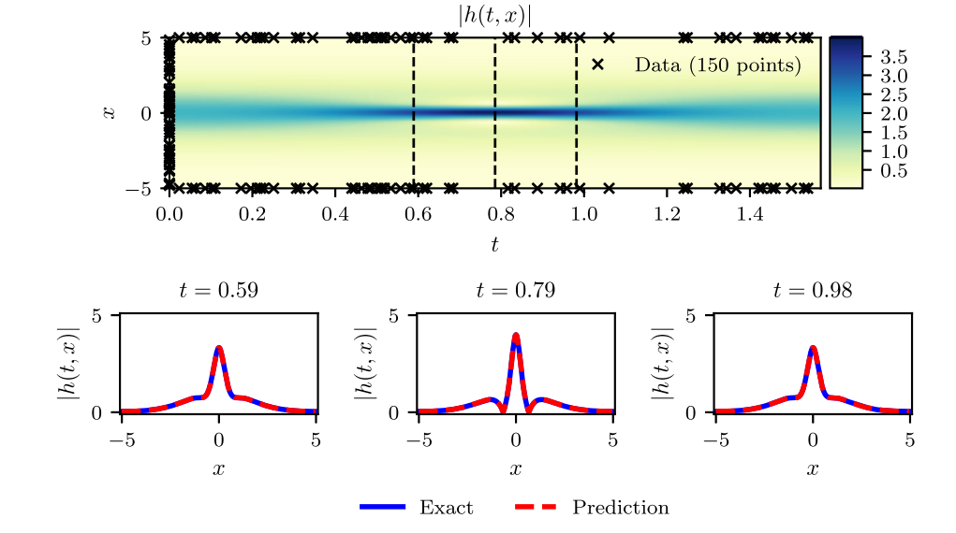
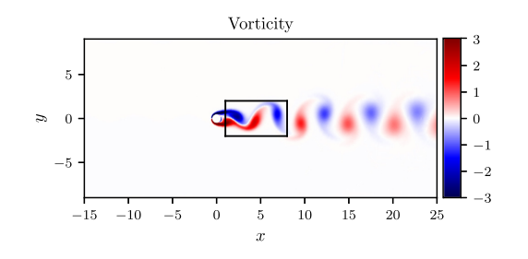
Physics Informed Neural Networks Primer
Schrodinger Eqn.
Navier Stokes Eqn.
Raissi, M., Perdikaris, P., & Karniadakis, G. E. (2019). Journal of Computational physics, 378, 686-707.
PDE SOLVERS
Neural networks are natural suited to high dimensional input spaces and can efficiently solve PDEs. Parameters such as magnet settings in an accelerator can be encoded as additional input dimensions.

Slide 7
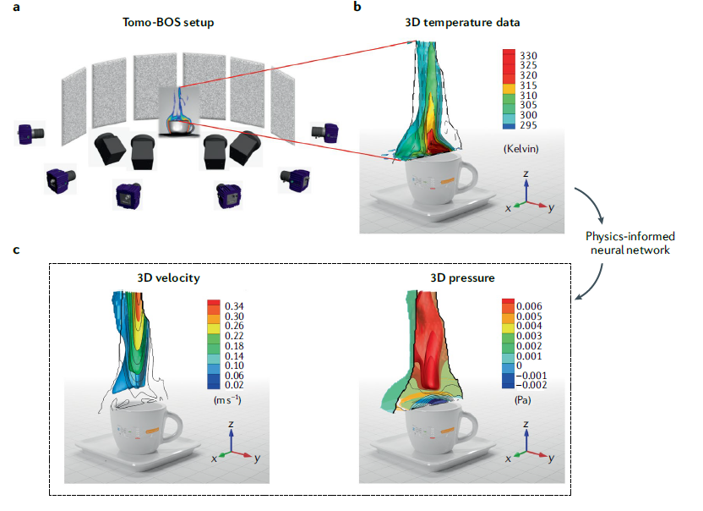
Physics Informed Neural Networks Primer
TRAINING ON NOISY, REAL DATA
PINNs already encode a lot of physics in them. When trained on data from the real world which may be noise or have missing information, they show success in making realistic prediction of dynamics. Missing or difficult to measure parameters can be estimated using this method.
Opportunity for Building Models from Real-World Accelerator Data
Karniadakis, G. E., Kevrekidis, I. G., Lu, L., Perdikaris, P., Wang, S., & Yang, L. (2021). Nature Reviews Physics, 3(6), 422-440.

Slide 8
PINNs for Accelerator Physics
WHICH PDE TO USE AS A PRIOR In ACCELERATOR PHYSICS?

Slide 9
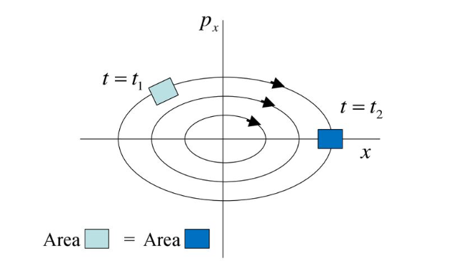
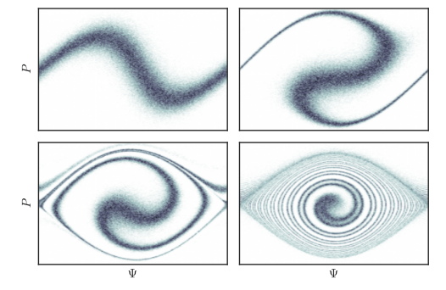
PINNs for Accelerator Physics
VLASOV EQUATION
$$\frac{∂f}{∂s}+ \frac{∂r}{∂s}\frac{∂f}{∂r}+ \frac{∂p}{∂s}\frac{∂s}{∂p}=0$$
$$∇^{2}φ+ρ=0 (\text{Rest} \text{Frame}\text{)}$$
Consider the multi-particle phase space distribution function f(r, p, s) with s the independent variable. Only considering long range force, it obeys the Vlasov equation. It is a generalization of Liouville’s Theorem. Space charge is calculated in self-consistent manner.
G.A. Krafft Old Dominion University Slides
J. Math. Phys. 57, 042905 (2016)

Slide 10
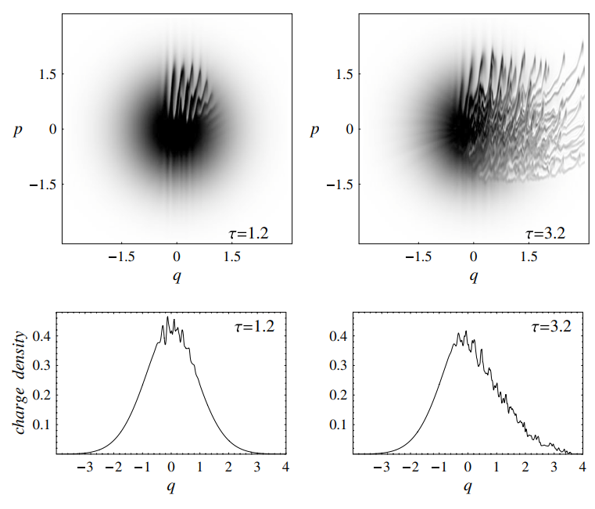
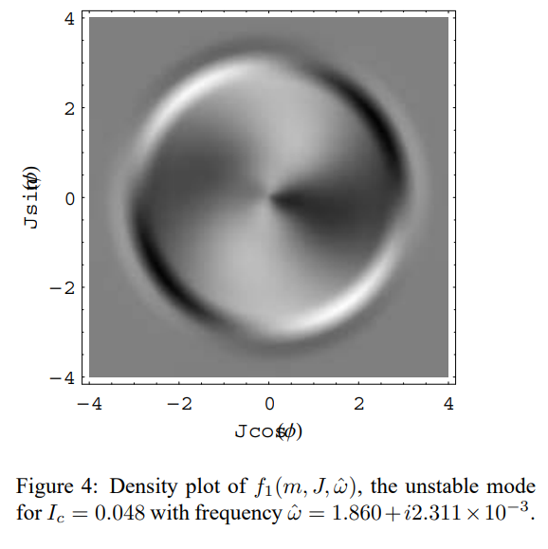
PINNs for Accelerator Physics
DIRECT VLASOV SOLVERS
PERTURBATIVE SOLVERS
Capture the full dynamics of the accelerator. Expensive to run, especially in more than one physical dimension. A prohibitive number of grid points in the solver tends to be required.
Used in stability problems for rings and implemented by a variety of codes. Start with stationary particle distribution. Assume an analytical form to a perturbation added to the distribution and plug into Vlasov equation.
Venturini, M., Warnock, R., Ruth, R., & Ellison, J. A. (2005). PRSTAB, 8(1), 014202.
Warnock, R., Stupakov, G., Venturini, M., & Ellison, J. A. (2004). Linear Vlasov analysis for stability of a bunched beam.

Slide 11
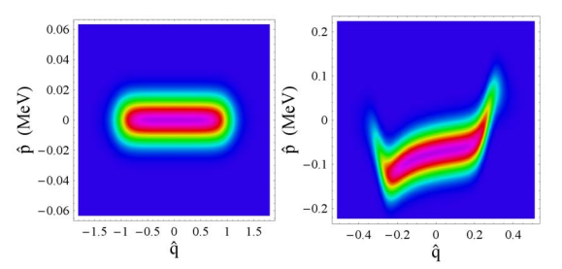
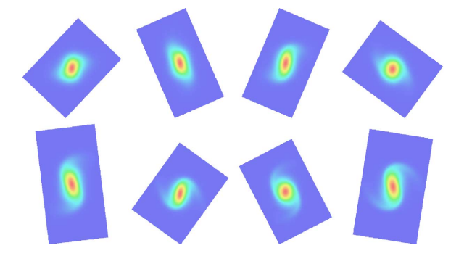
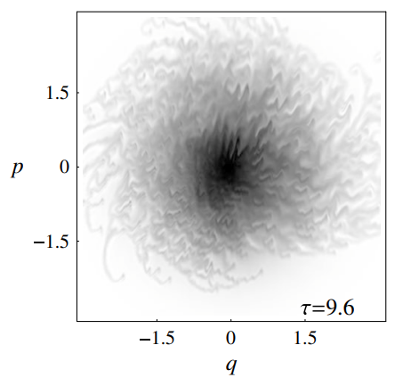
PINNs for Accelerator Physics
SOME POSSIBLE TEST SYSTEMS
Interested in areas where existing Vlasov solvers have been used / have lots of space charge / have reasons that make conventional physics simulations expensive
XFEL Longitudinal Phase Space Calculations
Beam with Space Charge, Uniform Focusing Channel
Beam Instabilities / CSR
Venturini, M., Warnock, R., & Zholents, A. (2006). (No. SLAC-PUB-12169). SLAC National Accelerator Lab., Menlo Park, CA (United States).
Sonnendrücker, E., Filbet, F., Friedman, A., Oudet, E., & Vay, J. L. (2004 Computer Physics Communications, 164(1-3), 390-395.
Venturini, M., Warnock, R., Ruth, R., & Ellison, J. A. (2005). PRSTAB, 8(1), 014202.
Would Love Input and Suggestions on Interesting Systems to Study!

