Slide 1
Welcome to Long Island!

Slide 2
The AAC Workshop Series
AAC`22 is the 20th in the series of workshops
Long-term research in advanced accelerator physics and technology
Development of capabilities for the basic sciences, from photon science to high energy physics
Development of compact accelerators for industrial, medical and security applications

Slide 3
The AAC Workshop Series
Your conference hosts this year:
Brookhaven’s Accelerator Test Facility
The Laboratory for Laser Energetics at the University of Rochester
Stony Brook University
The conference would not have been possible without the support of IEEE and its Council on Superconductivity

Slide 4
A Special Thank You to our Other Sponsors

Slide 5
Some Program Highlights
21 Invited Presentations over the next 5 days
Wednesday morning’s 8:30AM session will focus on outcomes from the HEP Snowmass Community Planning Process and conclude with a panel discussion
8 Working Groups
Laser-Plasma Wakefield Acceleration
Computation for Accelerator Physics
Laser and High-Gradient Structure-Based Acceleration
Beam-Driven Acceleration
Beam Sources, Monitoring, and Control
Laser-Plasma Acceleration of Ions
Radiation Generation and Advanced Concepts
Advanced Laser and Beam Technology and Facilities

Slide 6
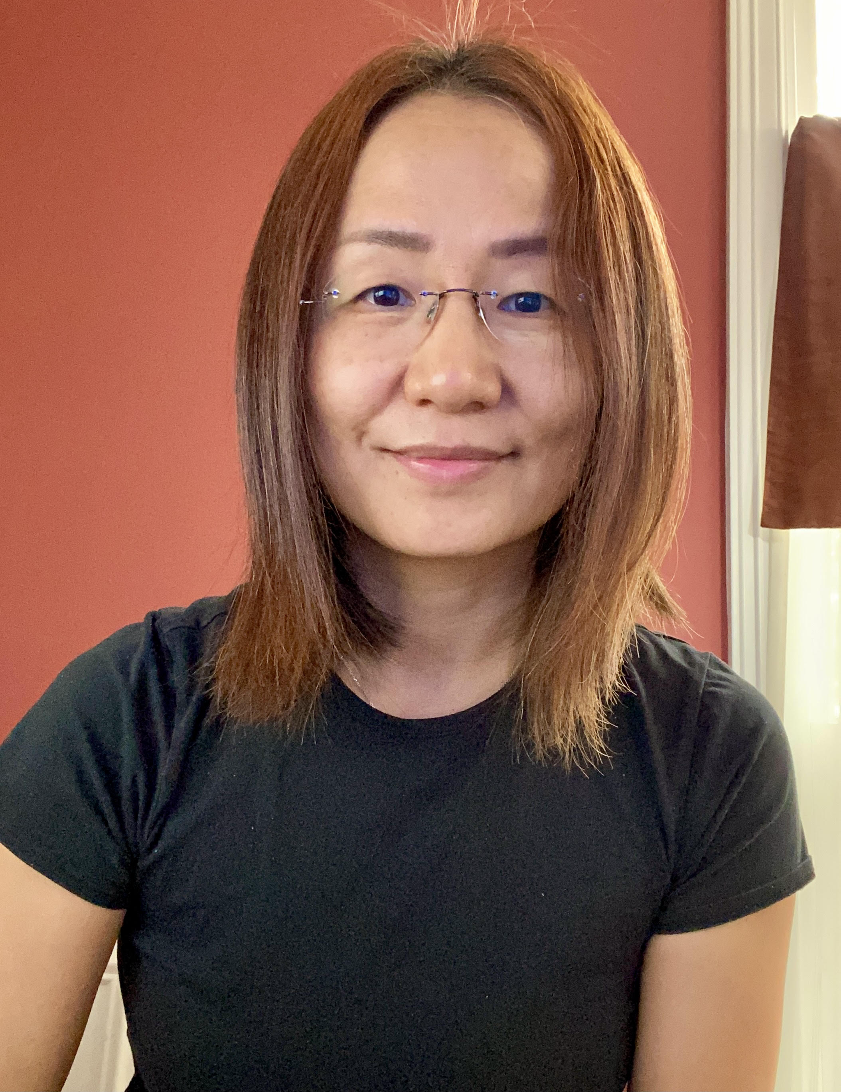
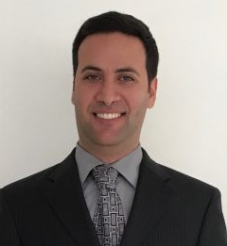
Program Highlights (continued)
2 Student Tutorials at 5pm today:
Yine Sun (ANL) - Bunch Shaping in Electron Linear Accelerators
Navid Vafaei-Najafabadi (SBU) - Particle Trapping and Beam Loading Physics in Plasma-Based Accelerators

Slide 7
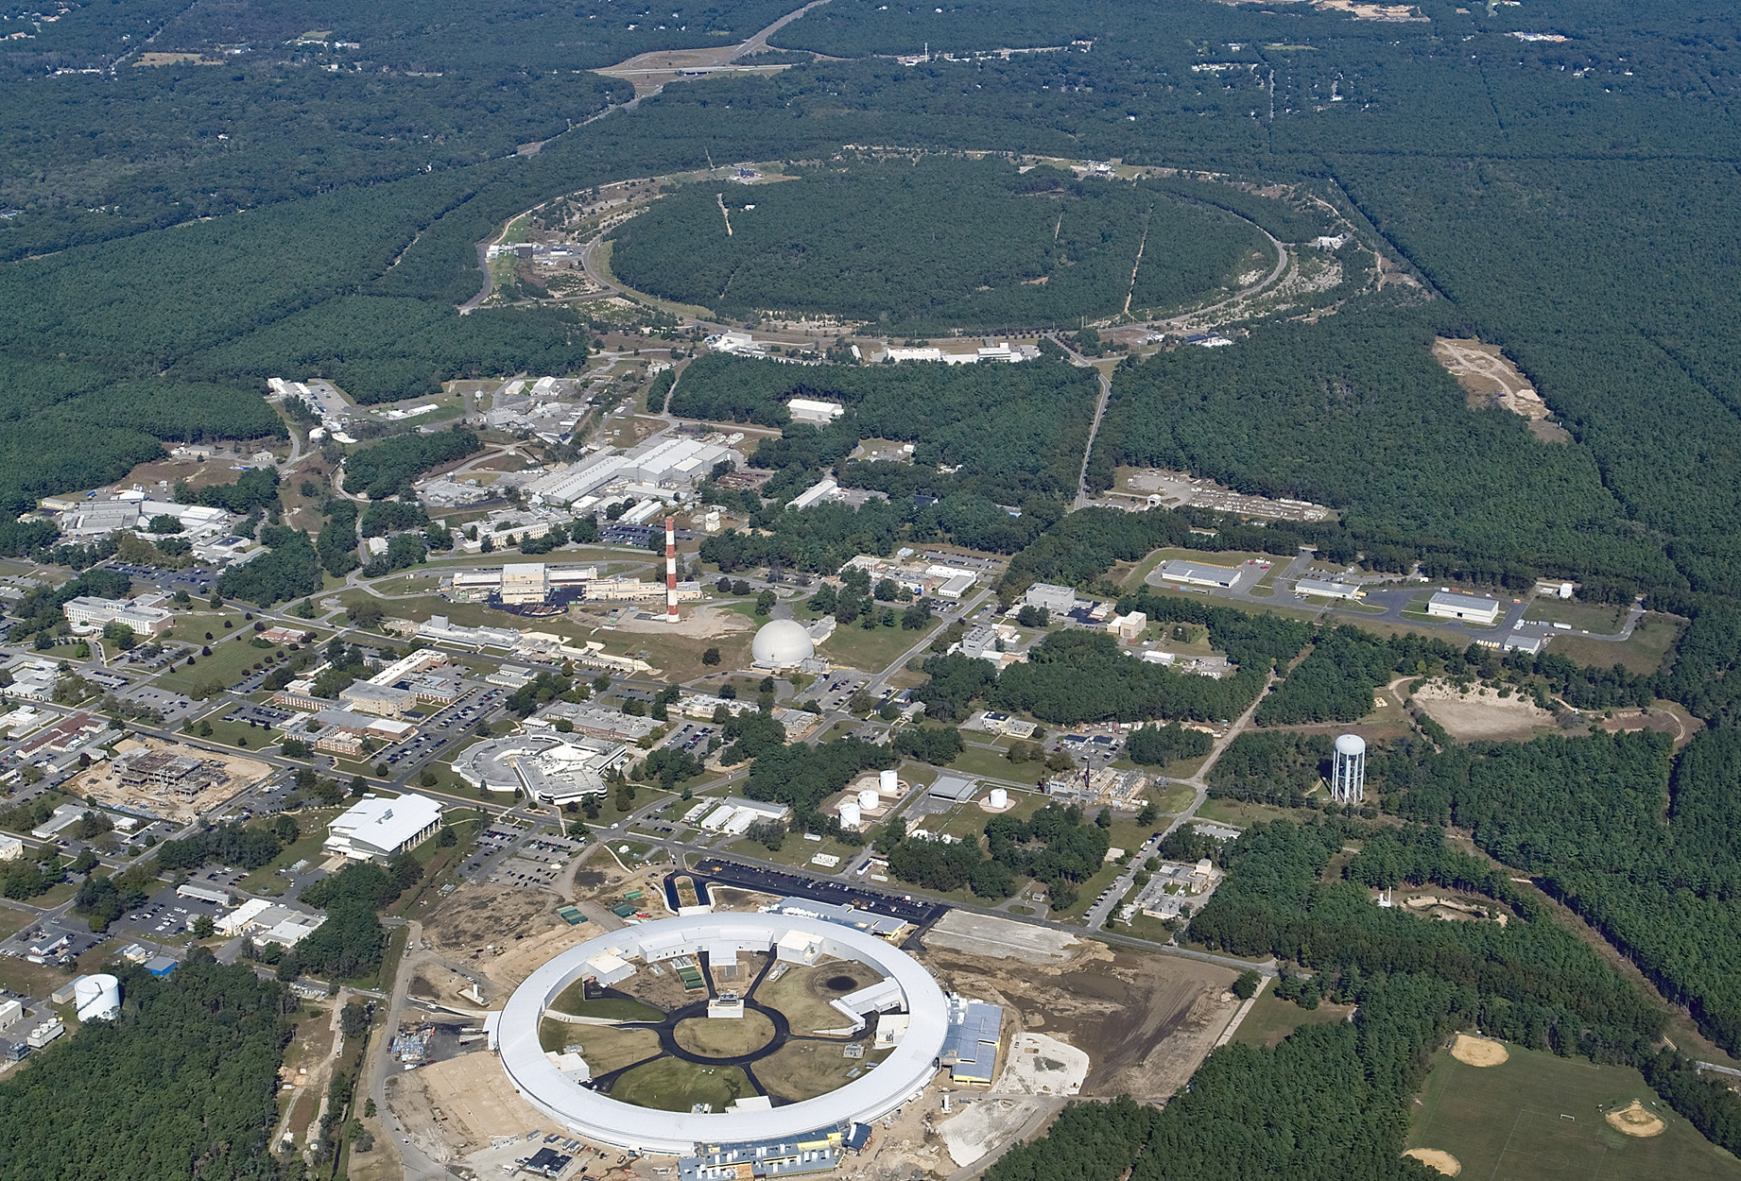
Program Highlights (continued)
Poster Session and Reception – Tuesday 5pm
Brookhaven Laboratory Tour Wednesday Afternoon
Buses depart promptly at 3:15pm
Conference Banquet and AAC Prize Awarded - Thursday Evening 6pm

Slide 8
Practical Matters
The COVID-19 situation
Suffolk County is currently rated as “Medium Risk” according to the US Centers for Disease Control
We ask everyone to be respectful of others masking and distancing choices
If you aren’t feeling well, please refrain from coming to the sessions
Please let us know if this will impact your contribution by responding to any of the emails you’ve been sent
In the case of fire, hotel staff will direct all participants to the exits
Dinner choices
A special note from the hotel that the Terrace Room will provide a lite dinner menu Monday-Wednesday evenings
A great time and location to meet with colleagues
It is also Long Island Restaurant Week!

Slide 9
Enjoy the Workshop!

