Slide 1
Fulfilling the mission of Brookhaven ATF as a Doe Flagship user facility in Accelerator Stewardship
AAC 2022
Igor Pogorelsky (ATF)
co-authors: M. Babzien, M. Fedurin, W. Li, M. N. Polyanskiy and M. A. Palmer (ATF)
N. Vafai-Najafabadi (Stony Brook University)
The Accelerator Test Facility

Slide 2
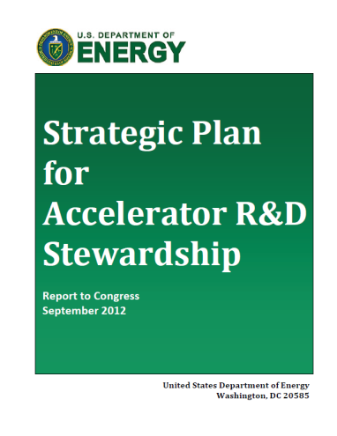
ATF: Designated a DOE National User Facility in 2015
It is a flagship facility in Accelerator Stewardship
Accelerator R&D Stewardship Mission:
  Support fundamental accelerator science and technology R&D
  Disseminate accelerator knowledge and training
Program Implementation:
  Facilitate access to national laboratory accelerator facilities and infrastructure for industrial and U.S. government agency users/developers of accelerators and related technology
  Support basic R&D necessary for sustained innovation across a broad range of accelerator applications

Slide 3
ATF Research Capabilities

Slide 4
Scope of ATF research
  Novel electron acceleration techniques
  R&D for smaller, more cost-effective accelerators
    Laser and beam driven plasma and dielectric wakefield acceleration
    Direct laser acceleration
    Inverse free-electron lasers…
  Ion generation and acceleration
    Supersonic hydrogen gas jets provide capabilities for generating mono-energetic multi-MeV proton beams
  High-brightness radiation sources
  New techniques to produce electromagnetic radiation from THz to X-rays:
    FEL R&D
    Inverse Compton scattering
    THz radiation from dielectric structures…
  Electron beam instrumentation and manipulation
  Sophisticated longitudinal and transverse beam manipulation capabilities
    Wide range of beam parameters enabling development and testing of advanced accelerator hardware, beam diagnostics and detectors
  Ultrafast Electron Diffraction/Microscopy
  Technique for characterizing materials that is complementary to x-ray sources
    Experimental station for diffraction and imaging studies with MeV-class electron beams

Slide 5
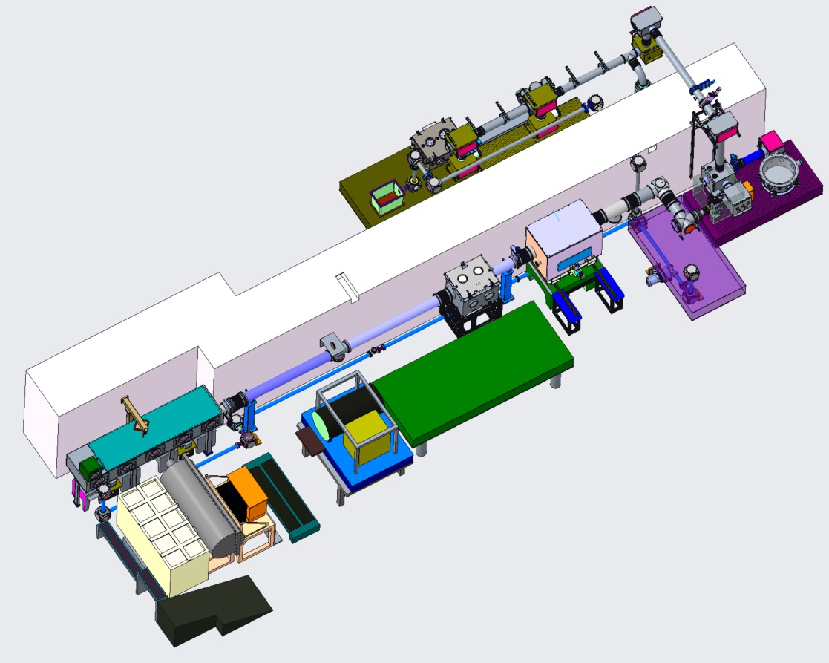
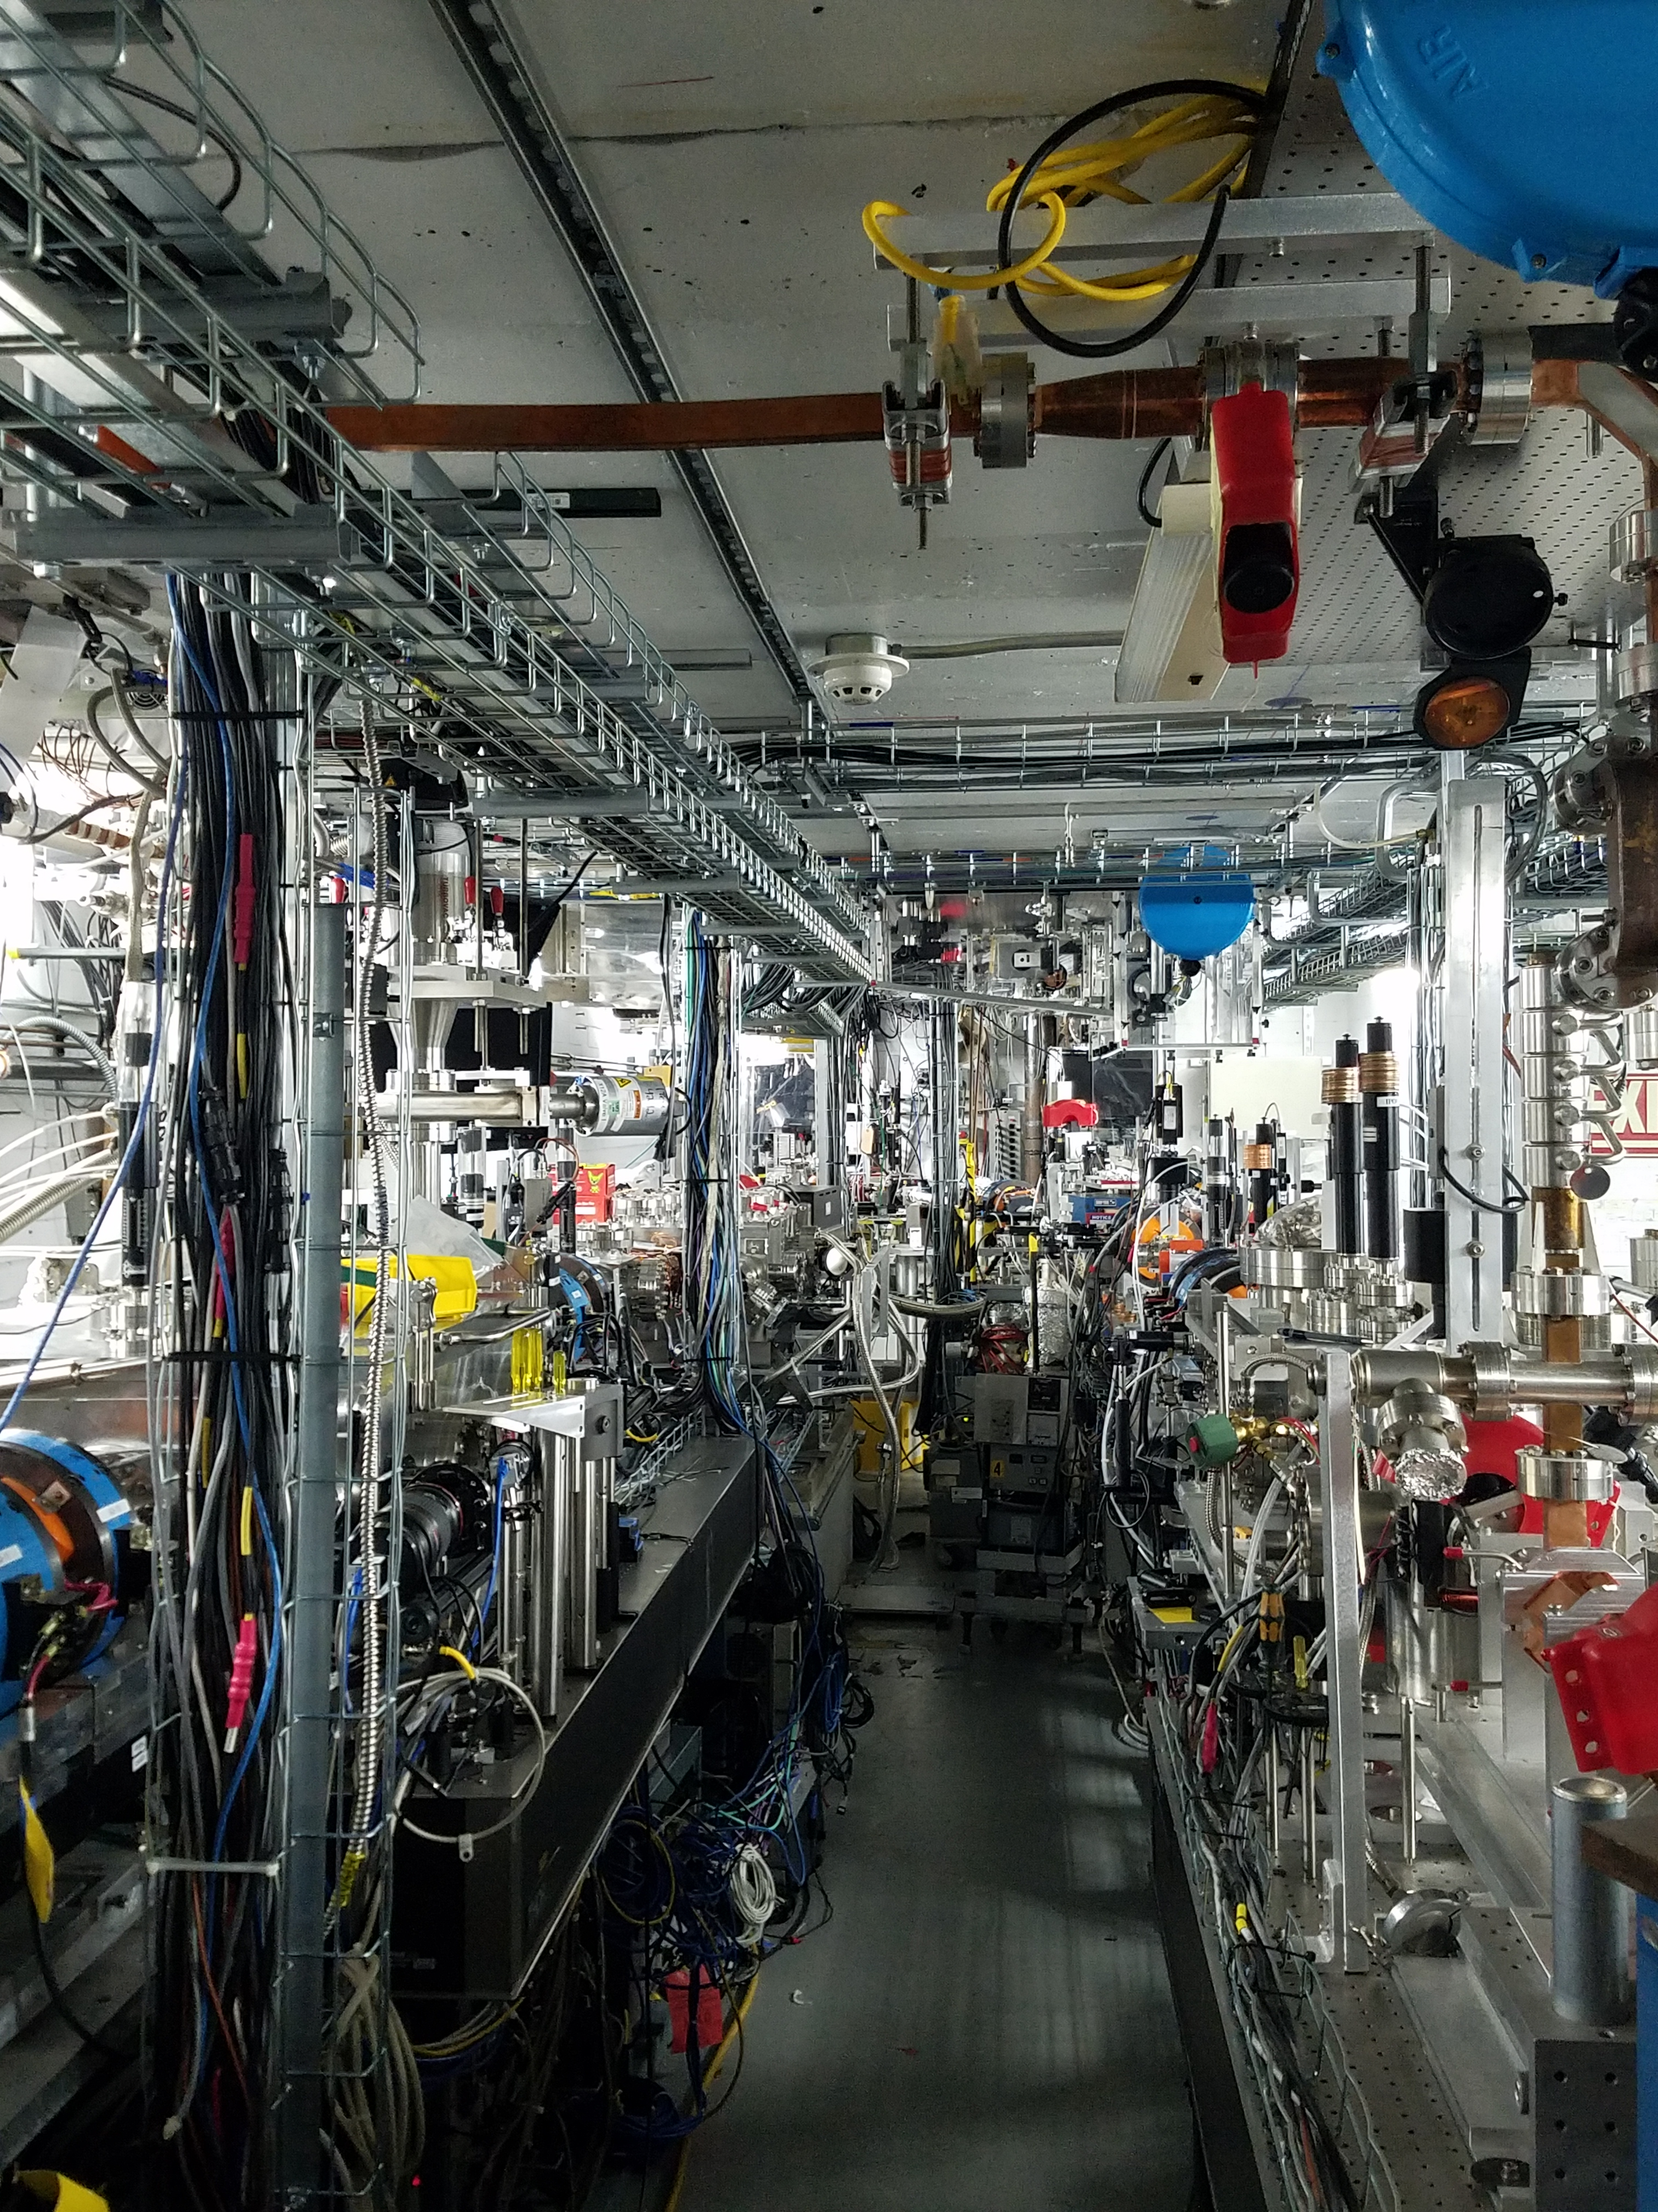
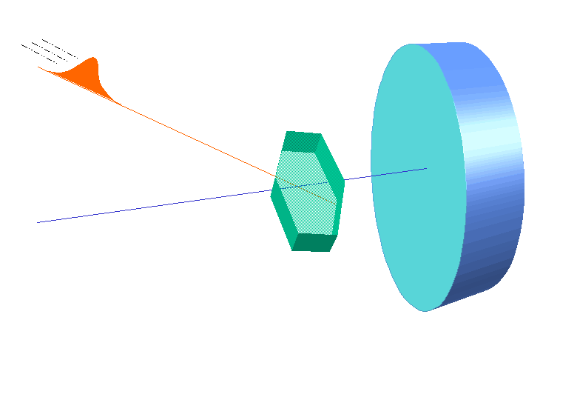
Major Facility Upgrade Thrusts
guided by the ATF Science Planning process
Laser R&D program
  CO₂ laser power upgrade to ≥25 TW peak power with pulse-width <500 fs
  First femtosecond multi-TW LWIR laser!
  This would enable a world-leading research program into advanced particle acceleration
  Completing in vacuum NIR and LWIR laser beam transport to user experiments
  to ensure the best beam quality
Electron Beam
  Continue to move towards providing 10 fs compressed bunches
  Exploit and expand short bunch diagnostic capabilities
UED/UEM
  Focus on unique UED measurement options for users
    Wavelength flexible OPA pump laser
    Improved system performance
  Apply AI/ML techniques to both beam line tuning and real-time
  structural analysis
In-vacuum laser transports to experiments
UED principle
ATF experimental hall with two electron beamlines
5

Slide 6
Outline
Motivation for multi-TW ultra-fast LWIR
State of art in picosecond CO₂ laser technology
Path to femtoseconds via nonlinear post-compression
Simulations
Experimental results
Outlook

Slide 7
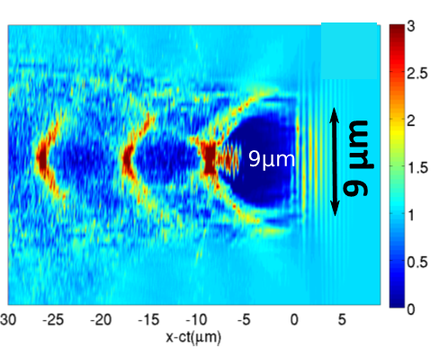
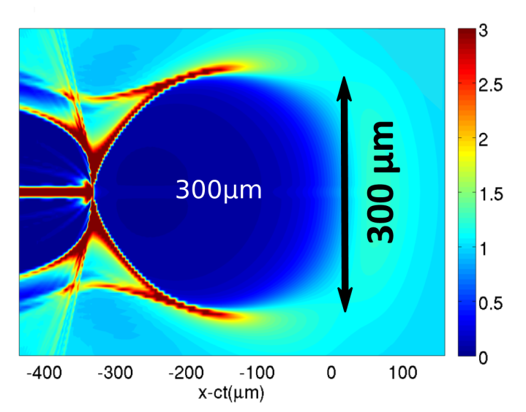
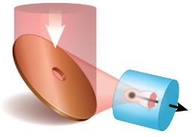

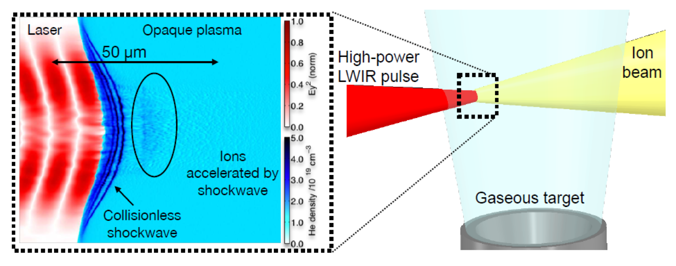
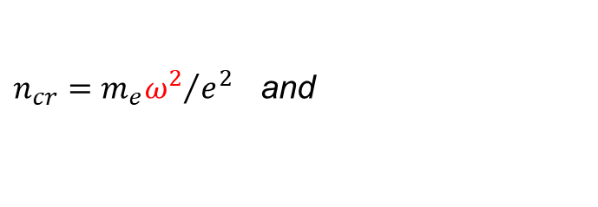
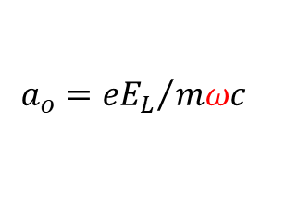
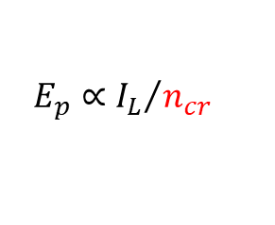
Motivation for multi-TW ultra-fast LWIR
λ_{drive}= 0.8 µm 25 TW, 30 fs
λ_{drive}= 10 µm 25 TW, 500fs
CO₂
A proposed two-color LWFA with ionization injection opens opportunity for ultra-low beam emittance .
10TW, 0.5 ps
TiS
LWFA
n_{e}/n₀
n_{e} = 2x10¹⁹cm⁻³
n_{e} = 10¹⁶cm⁻³
ε_{n}=50 nm
simulations courtesy G. Shvets
Collisionless Shock Wave Acceleration
1 MeV protons with 1 TW CO₂ laser focused
to 10¹⁶ W/cm² thanks to
$$a_{o}={eE_{L}}/{mωc}$$
TNSA
Ion Acceleration
CSWA
need CO₂ because
$$E_{p}∝{I_{L}}/{n_{cr}}$$
$n_{cr}={m_{e}ω^{2}}/{e^{2}}$ and

Slide 8
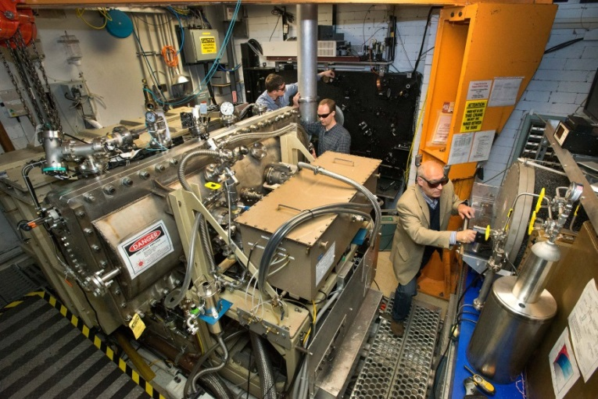


State of art in LWIR laser technology
Advanced features
Solid-state laser based front-end
High-pressure, mixed-isotope CO₂ amplifiers
Chirped-pulse amplification in gas laser
Leading-edge parameters
Shortest multi-TW LWIR pulse
Clean, single-pulse output
BNL LWIR
Laser System
OPA seed pulse generator
Stretcher
CO₂
CO₂
Compressor
5 TW
2 ps
High-pressure, isotopic
gas amplifiers

Slide 9
5 TW, 2 ps LWIR laser
Polyanskiy et al. OSA Continuum 3, 459 (2020)
Notes:
Accelerators & ultrafast lasers
How lasers
Unique features
Techniques
Overview of history
Plans

Slide 10
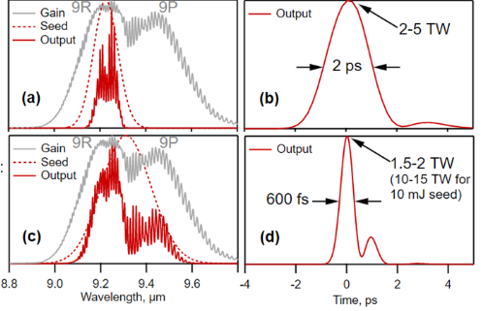
Can we do better than 2 picoseconds?
Possible routes to
ultra-fast CO₂ lasers:
Strong, broadband seed pulse
Nonlinear post-compression (NLPC)
Gain spectrum allows to amplify 500 fs pulses.
However, bandwidth narrowing over >12 decades of amplification brings the pulse to 2 ps.
Providing a several mJ seed pulse for the final amplifier allows productive use of two rotational bands bringing the output pulse to 500 fs.
Such broadband seed pulse can be produced by OPCPA or by Raman conversion of a near-IR-pulse followed by a difference frequency generation illustrated below.
See talk of William Li on ATF R&D towards generating such seed pulses.
,
5 Tw
Current:
Seed <1 μJ
Regen ×10¹²
Final ×10³
20 Tw
Prospect:
Seed 5-10 mJ
Final ×10³
500 fs

Slide 11
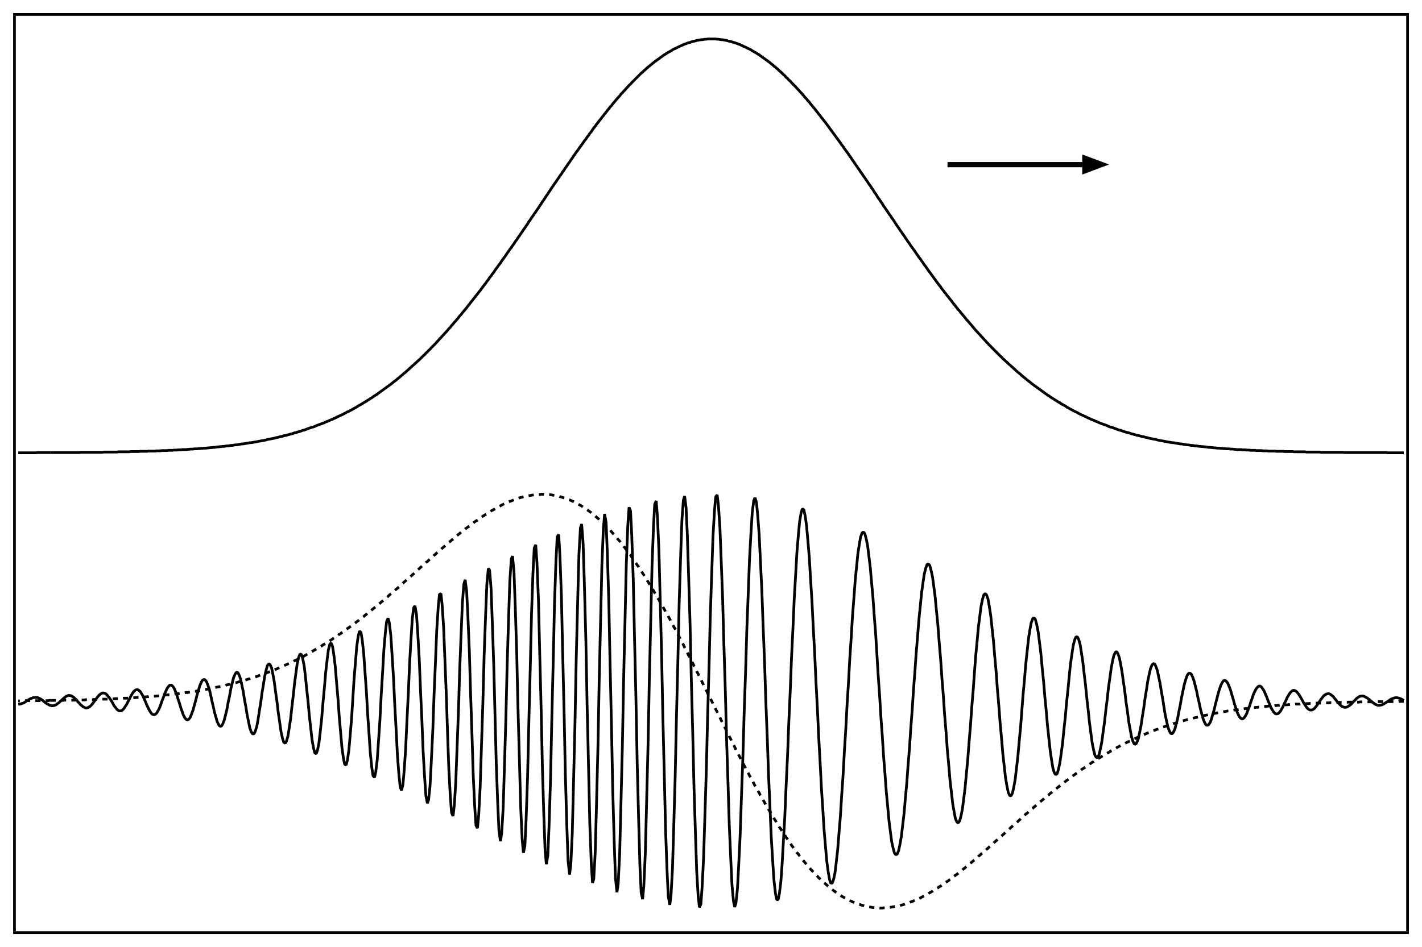

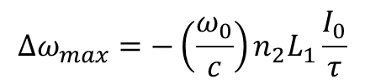


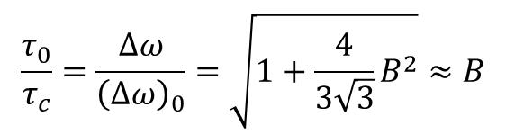
Can we do better than 2 picoseconds?
Possible routes to
ultra-fast CO₂ lasers:
Strong, broadband seed pulse
Nonlinear post-compression (NLPC)
  Self-phase modulation due to Kerr effect in a nonlinear material results in a quasi-linear frequency chirp.
  A chirped pulse gets compressed in a material with a negative group dispersion.
,
n(t) = n₀ + n₂I(t)
$$τ_{0} =∆ω_{max}(GVD) L_{2}$$
Self-phase
modulation
Dispersive compression
compressible linear chirp
$$∆ω_{max}$$
$$\frac{τ_{0}}{τ_{c}}=\frac{∆ω}{{\left(∆ω\right)}_{0}}=\sqrt{1+\frac{4}{3\sqrt{3}}B^{2}}≈B$$
$$∆ω_{max}=−\left(\frac{ω_{0}}{c}\right)n_{2}L_{1}\frac{I_{0}}{τ}$$
= $B$

Slide 12
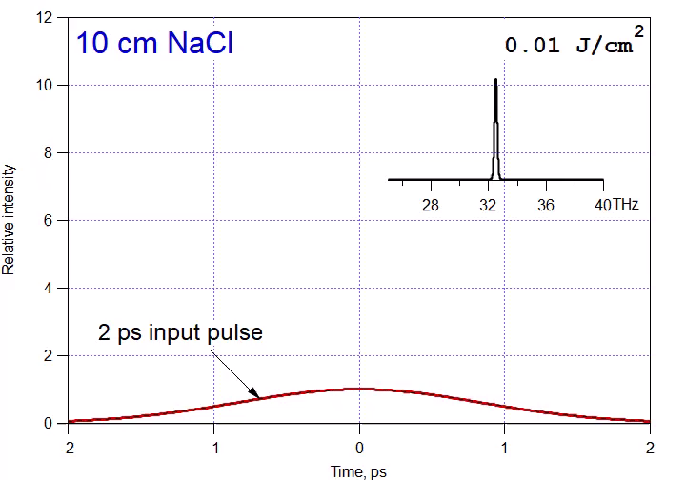
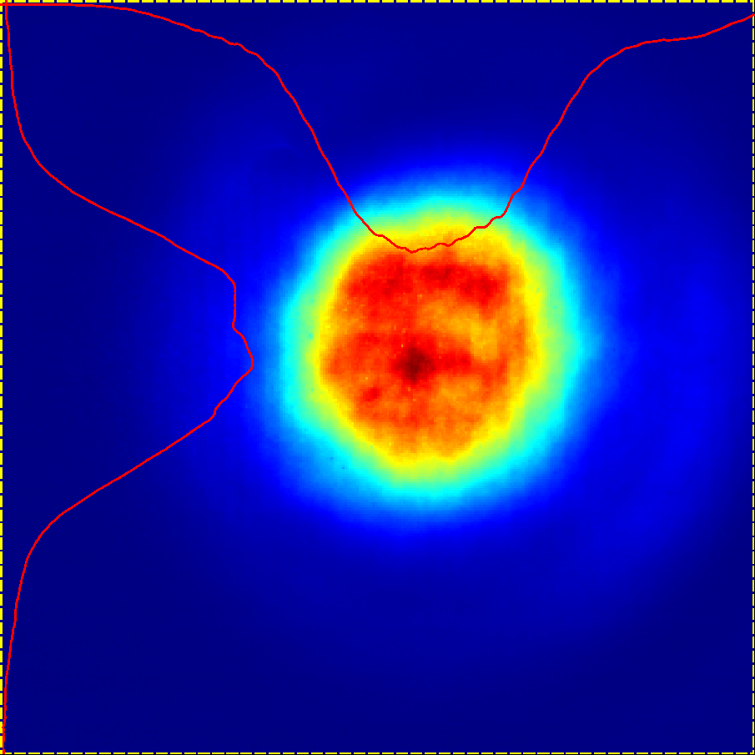
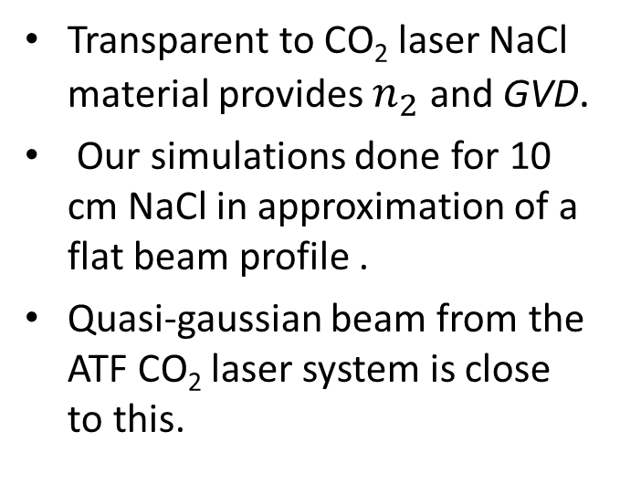
Simulations for our initial experiment
Transparent to CO₂ laser NaCl material provides $n_{2}$ and GVD.
Our simulations done for 10 cm NaCl in approximation of a flat beam profile .
Quasi-gaussian beam from the ATF CO₂ laser system is close to this.
Down to 80 fs pulse compression predicted.

Slide 13
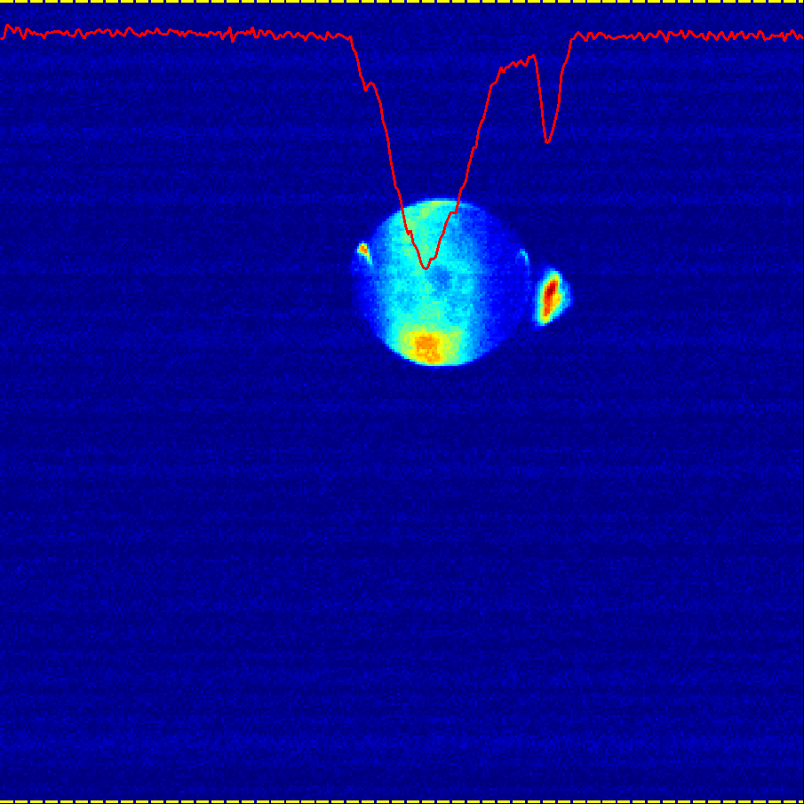
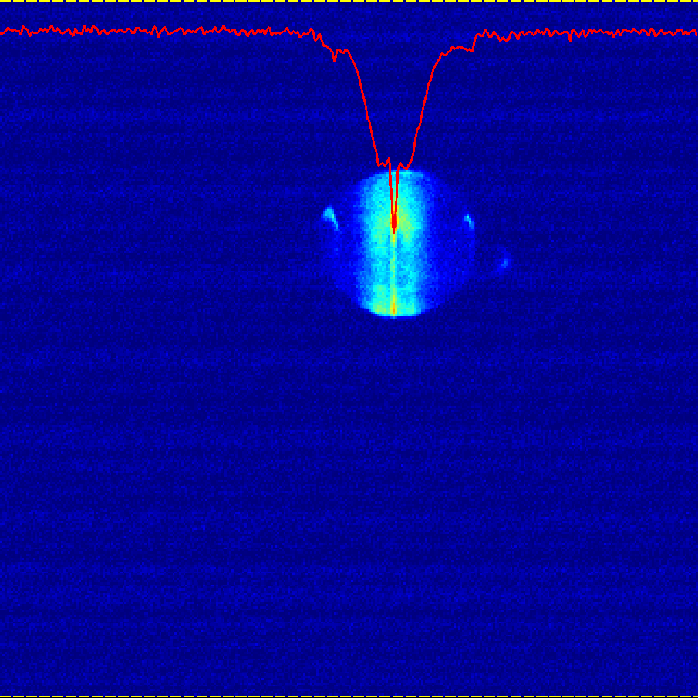
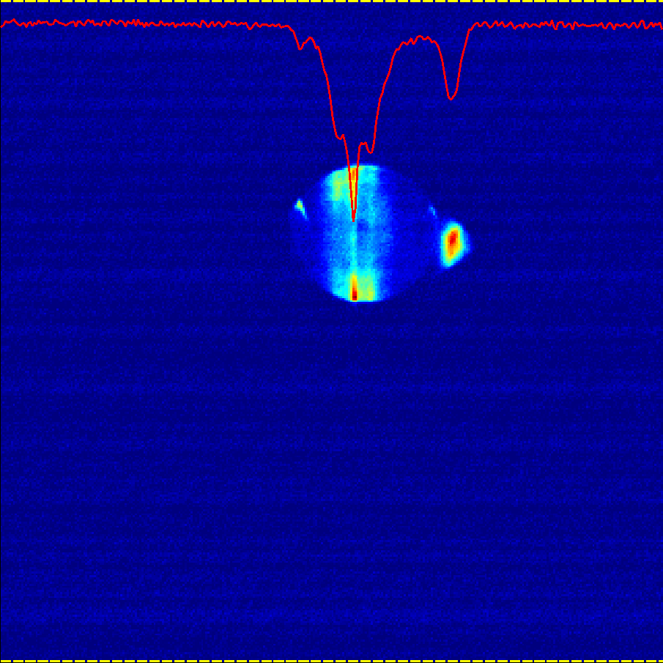
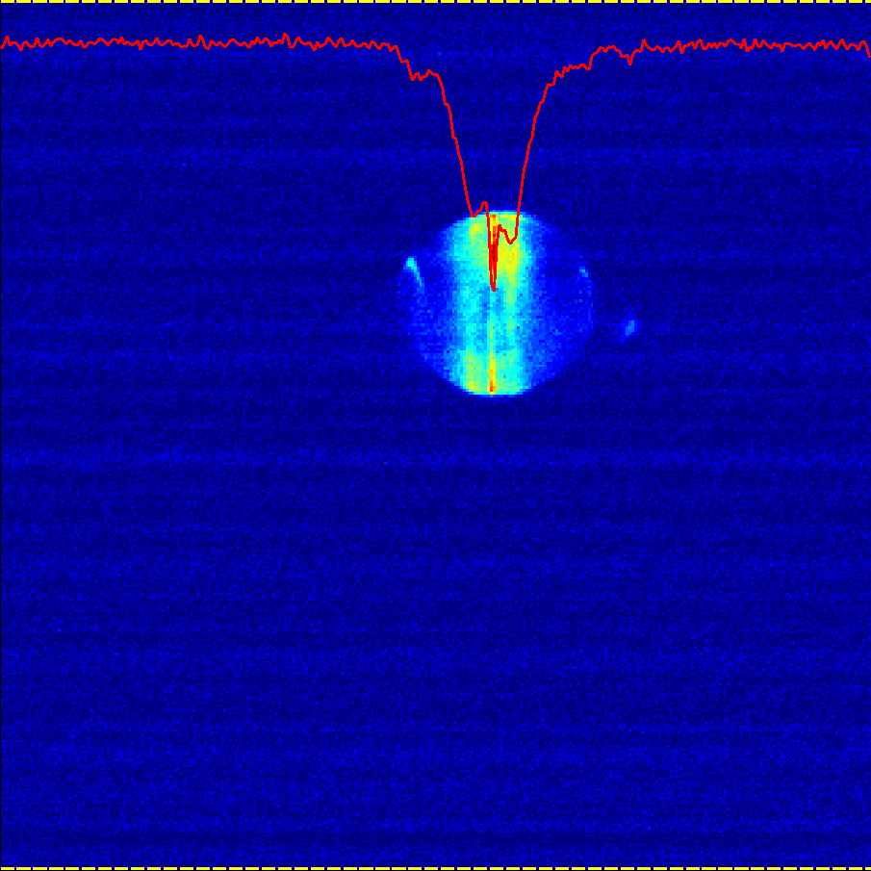
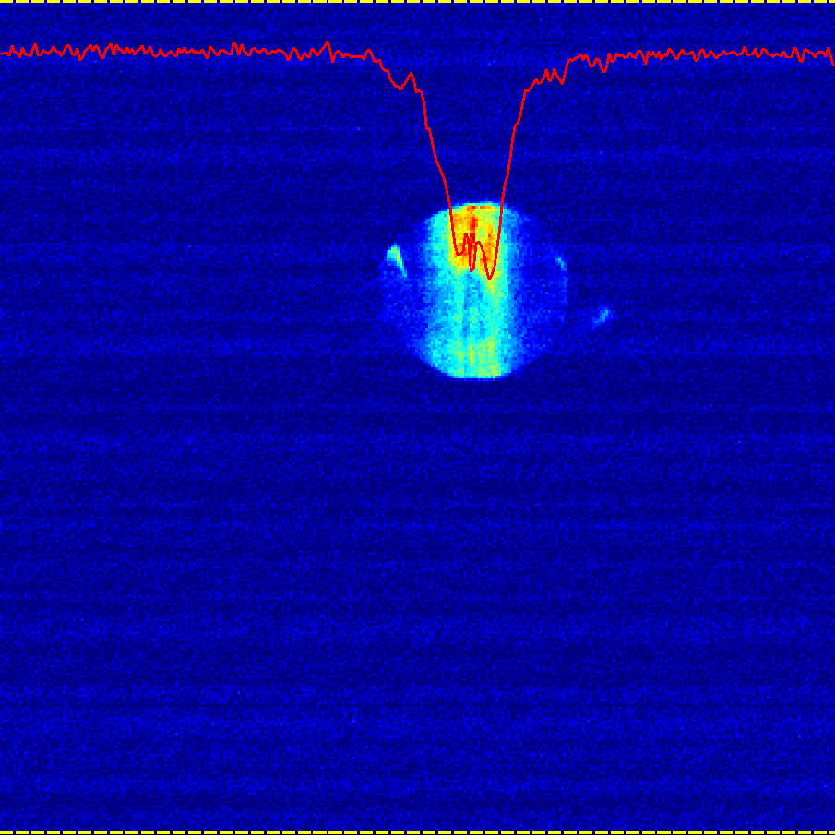
Results from initial NLPC test with a single bulk (10 cm thick) NaCl crystal
0.3 J/cm²
0.4 J/cm²
0.6 J/cm²
Autocorrelation traces versus laser fluence

Slide 14
More simulations
Compressed pulses and their autocorrelation functions
over-compression
under-compression
Two observations:
Compression highly critical to laser intensity
best compression
Autocorrelation function considerably enhances the pedestal
Time, ps

Slide 15
Path to improvement
B>>1 is needed to see an appreciable pulse compression.
However micro-filamentation and color center formation may hinder the process at B>3.
We can suppress micro-filamentation by segmenting the nonlinear material.
Opportunities for improving efficiency of energy conversion to femtoseconds :
  using flat-top beams,
  NLPC staging,
  beam size manipulation between NLPC stages,
  and possible combination of different NLPC materials.

Slide 16
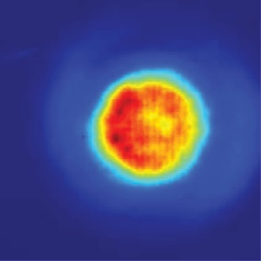


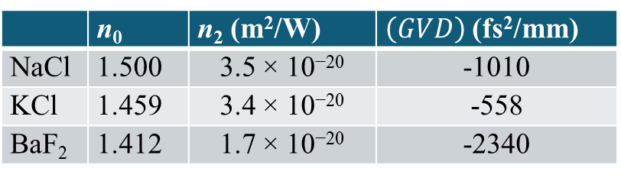
Two-stage NLPC by separating chirping and compression
Material properties at 9.2 μm
 | n₀ | n₂ (m²/W) | $\left(GVD\right)$ (fs²/mm)
NaCl | 1.500 | 3.5 × 10⁻²⁰ | -1010
KCl | 1.459 | 3.4 × 10⁻²⁰ | -558
BaF₂ | 1.412 | 1.7 × 10⁻²⁰ | -2340
5cm
5cm
Laser output
at the NLPC
13 mm
5 mm
13 mm
well-controlled Gaussian distribution 14 m after the aperture
compressed from 2 ps to 290 fs
100 mm

Slide 17
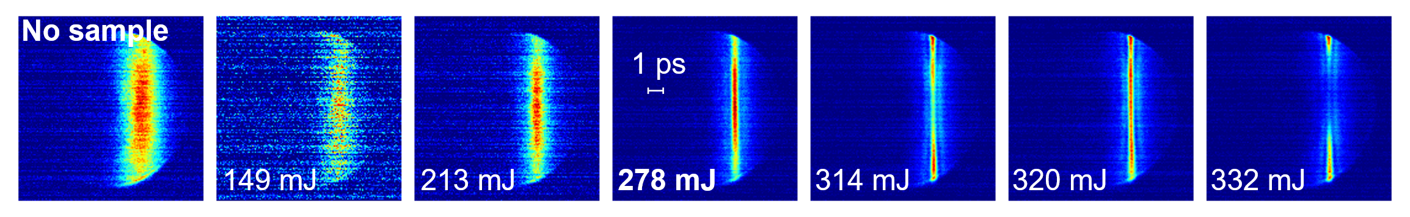
LWIR laser R&D towards 10+ TW, <1 ps
Autocorrelation
τ_{pulse} = 290 fs
Low-energy demo
Polyanskiy, et al. Opt. Express 29, 31714 (2021)
Full-energy design
Funding:
US DOE Accelerator Stewardship Program grant, B&R #KA2601020
BNL Laboratory Directed Research and Development grant #20-010

Slide 18
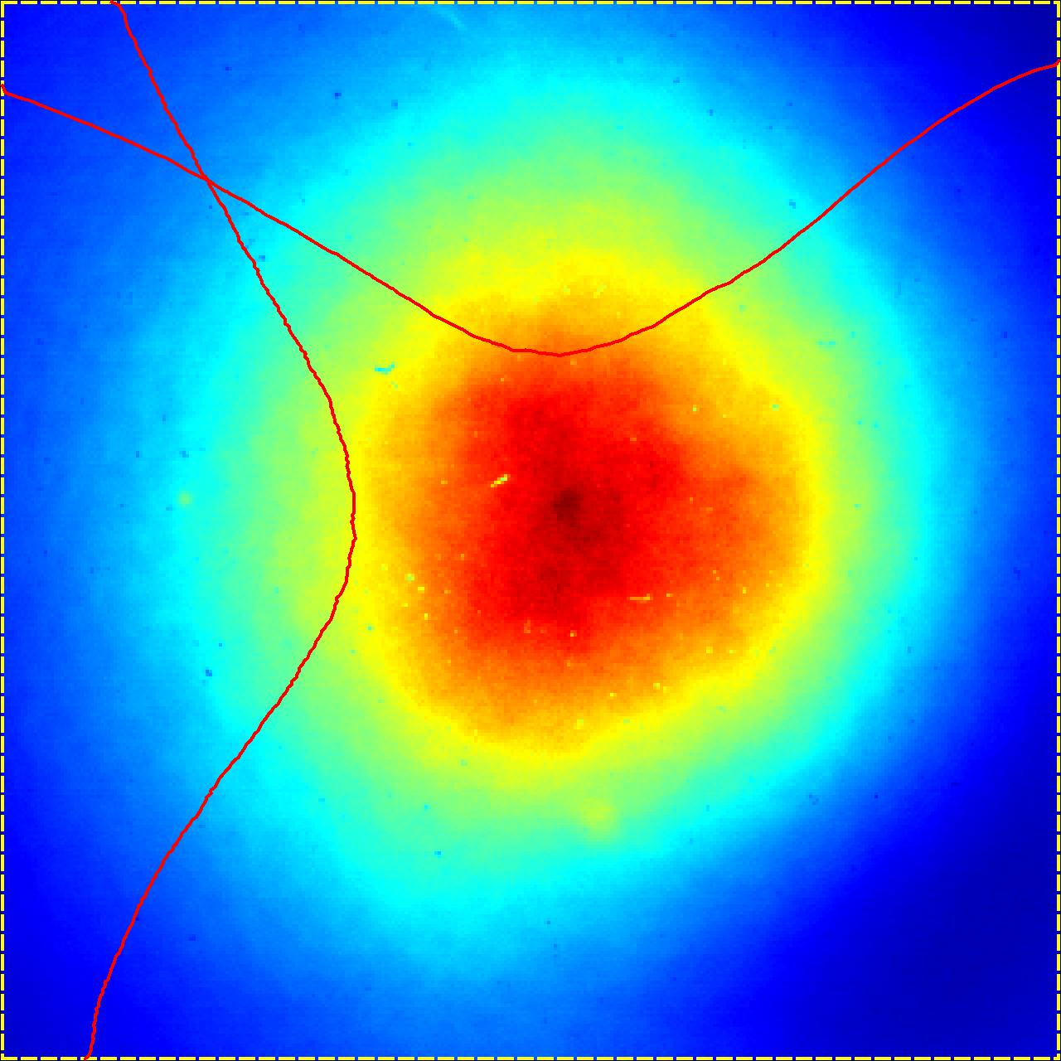
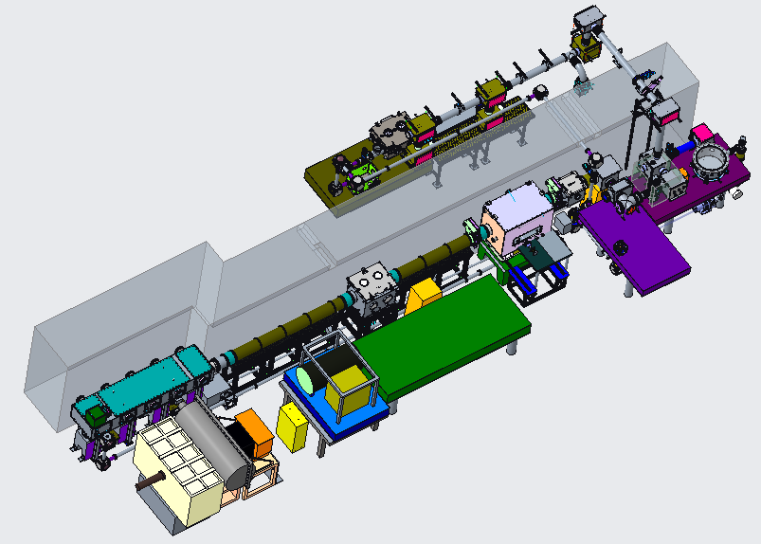
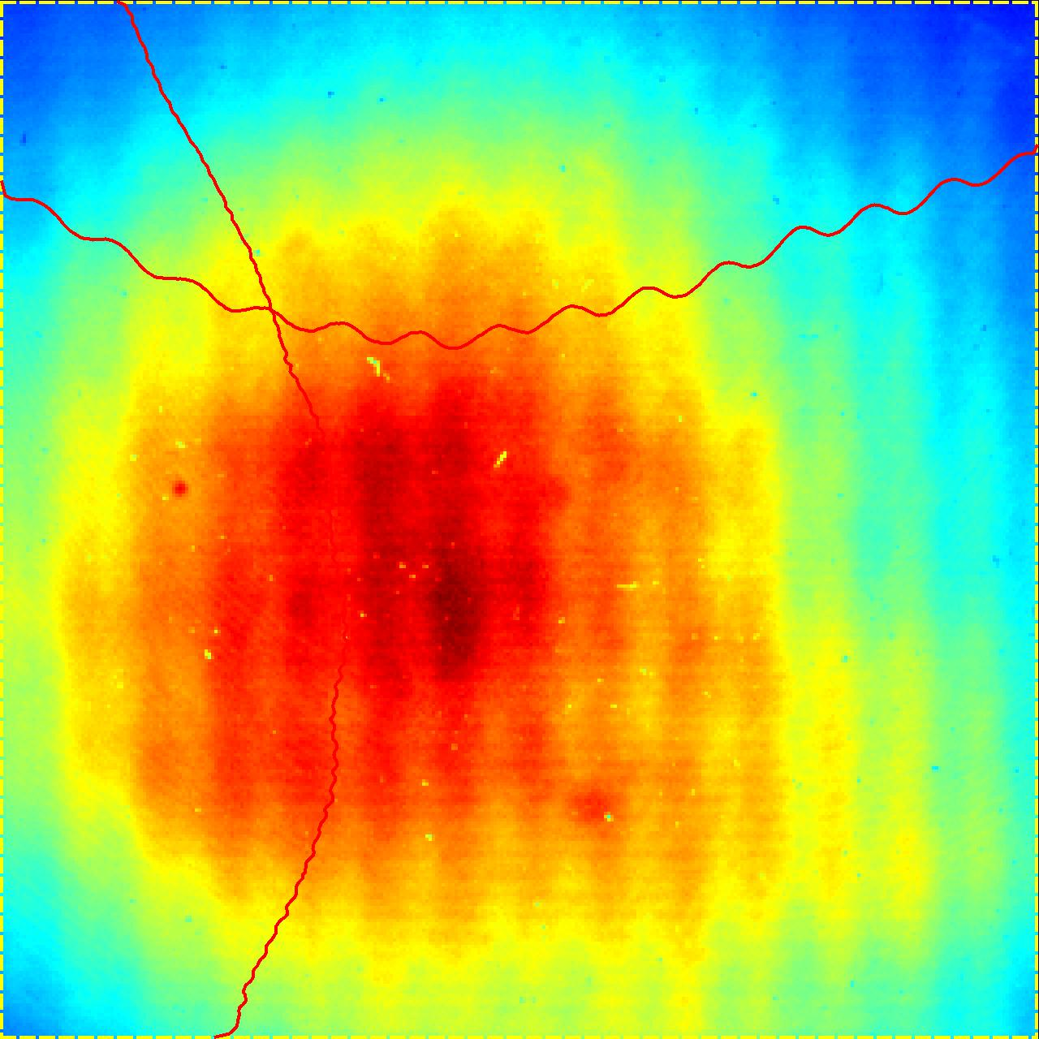
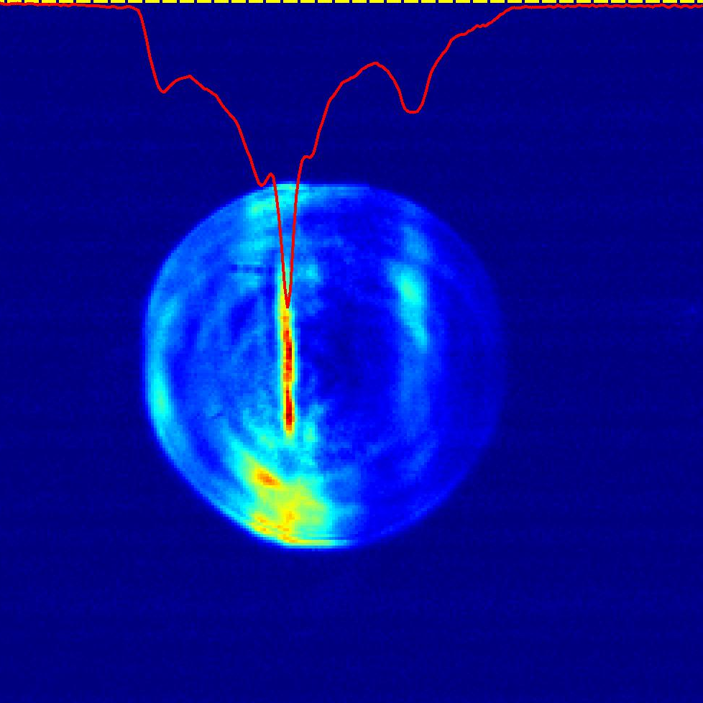
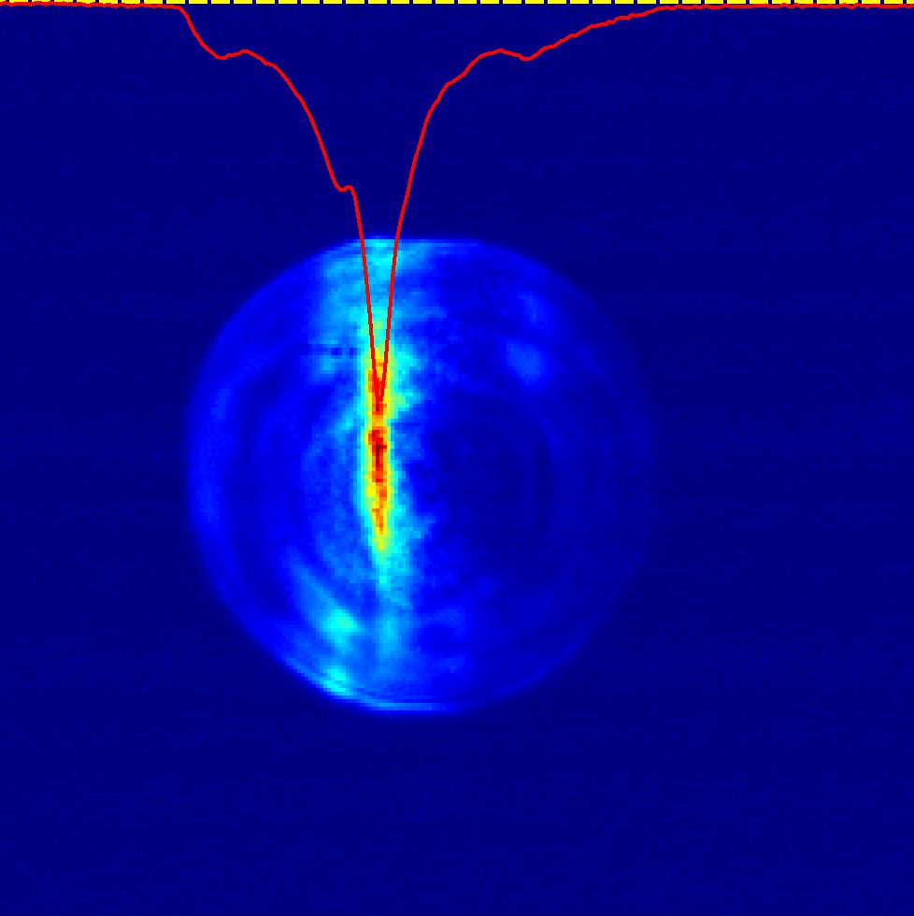
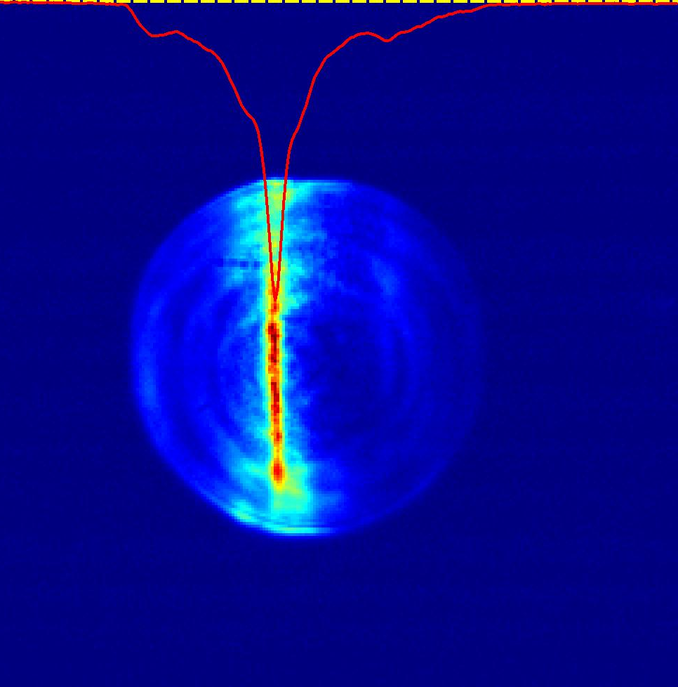
Full Scale Experiment
Spatial filtering requires putting the experimental setup in vacuum.
Two chambers for inserting NLPC optical elements within LWIR beam transport line.
Preliminary results obtained.
2ps
Autocorrelation traces

Slide 19
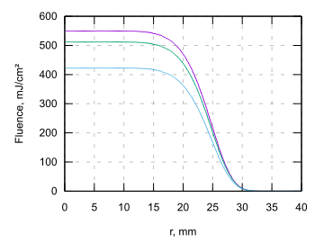
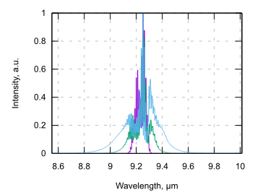
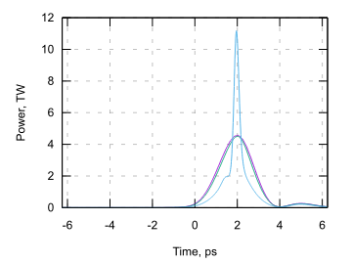
Our goal: Entire 10J beam compression to <500fs, >10TW (supported by simulations)
input beam
after KCl
after BaF2
350 fs
Assumptions:
an ideal super-Gaussian (8th order) beam
beam size (1/e^2 radius = 27.5mm)
input energy 10J (~4.5TW)
KCl+BaF2 (50 mm thick each)
B-integrals of both components are ~3

Slide 20


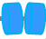
Path to Petawatt pulses of 2 optical cycles
1) Combining two compression techniques
Strong, broadband seed pulse
+
Nonlinear post-compression (NLPC)
200 mJ
300 fs
10 J
500 fs
20 TW
5 J
50 fs
100TW
200 mJ
100 ps
10 mJ
100 ps
14 J
100 ps
,
Stretcher
LWIR converter
CO₂
SPA Compressor
NIR fs laser
NLPC
High-pressure, isotopic
amplifier
Simulations of post-compression

Slide 21
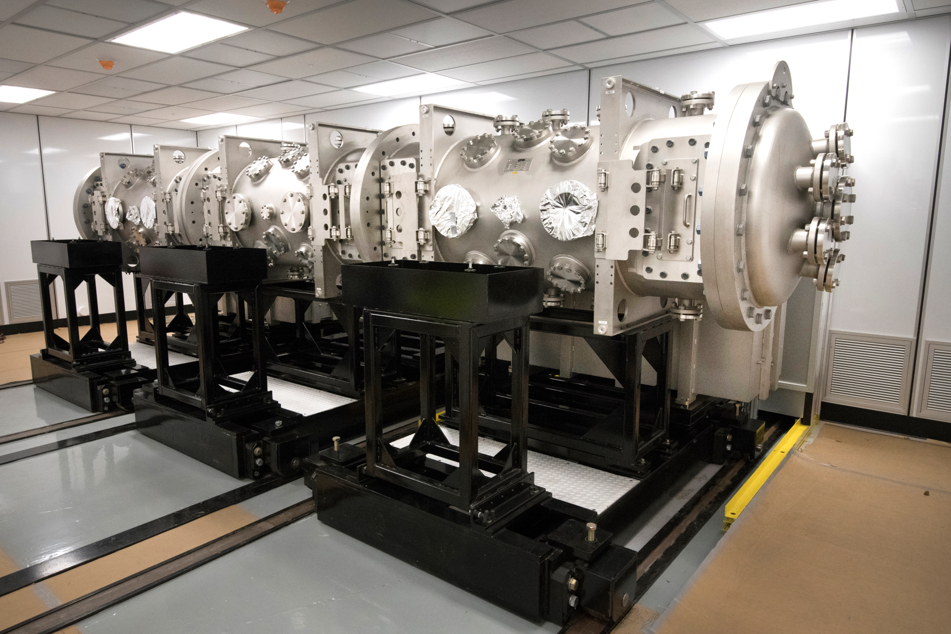
Path to Petawatt pulses of 2 optical cycles
2) Bigger laser amplifier might allow to reach PW !
,
70 J
8-meter CO₂ laser amplifier at BNL for future upgrades

Slide 22
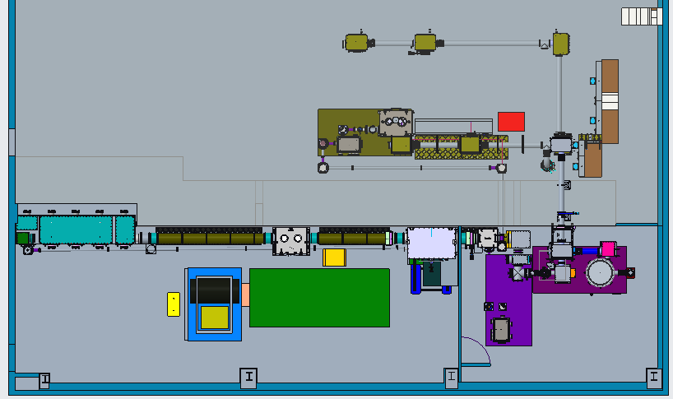
Ongoing LWIR Beam Transport Upgrade
Future upgrade to BL2
ICS
LWFA
Linac Experimental Hall
with two beamlines
Ion
Acceleration
Polarization Rotator
CPA Compressor
LWIR Laser Room

Slide 23
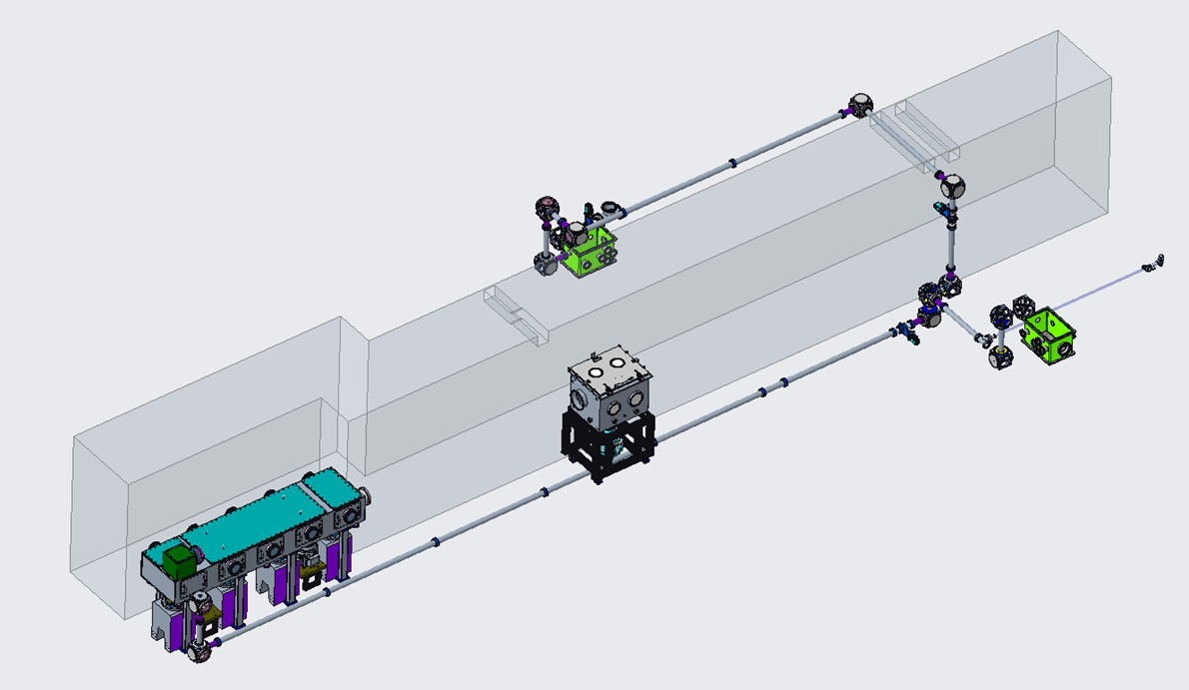
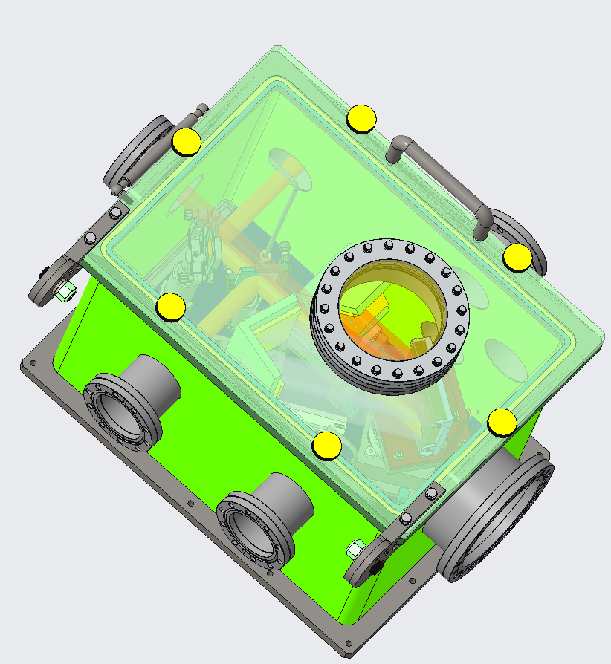
NIR Vacuum Transport
NIR vacuum transport runs along the ceiling in the ebeam experimental hall
NIR compressor
Alternate location for NIR compressor
NIR vacuum transport runs along the floor in the laser rooms
LWIR Components removed for clarity

Slide 24
Summary of laser upgrades
CO₂ Vacuum transport will deliver high quality TW beam to experiments for stronger particle acceleration.
A platform is provided to test the next stages of pulse compression (i.e. non-linear pulse compression) in the LWIR.
Polarization rotator will provide adjustable polarity from horizontal to vertical, and circular.
LWIR vacuum transport to BL2 planned.
NIR vacuum transport & compressor will improve beam stability and optics lifetime.

Slide 26
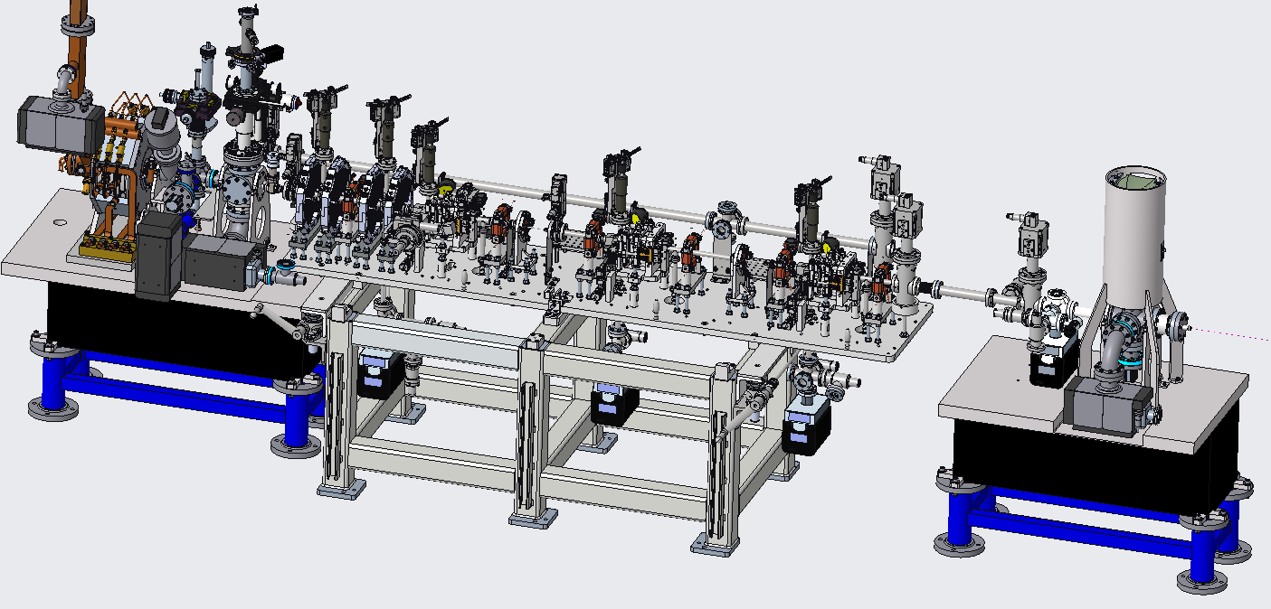
UED with recently installed microscope
LDRD funded project: Demonstration of feasibility of sub-nm, picosecond electron microscope for the life sciences
Objective is to obtain tissue sample images with minimal sample degradation due to high speed, short duration pulse
UEM

Slide 27
Thank you!

