Slide 1
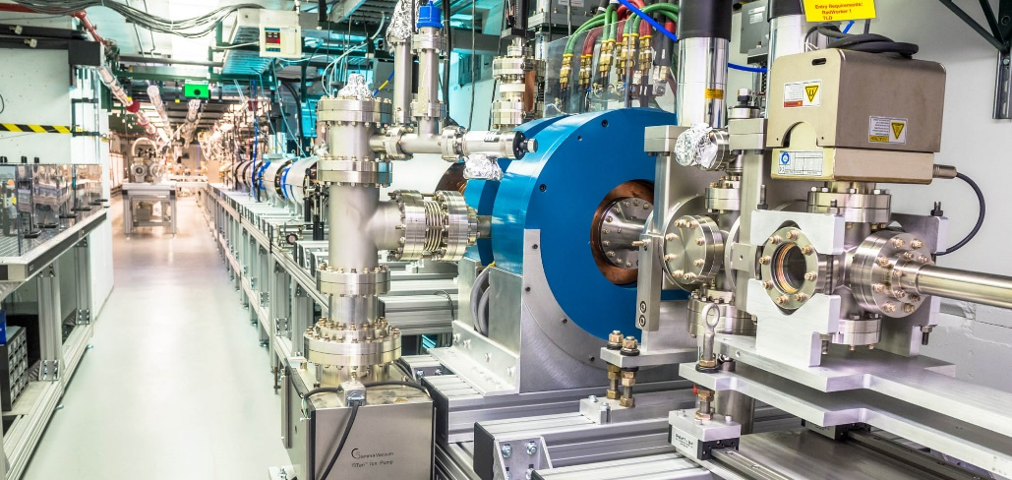

The Argonne Wakefield Accelerator
Beam Test Facility for Novel Accelerator Research
The awa facility
https://www.anl.gov/awa
John power
Working Group 8
Advanced Laser and Beam Technology and Facilities
Argonne National Laboratory
Nov 7, 2022
Hauppauge, NY

Slide 2
What I hope you learn today …
outline
What type of FACILITY is AWA?
What type of SCIENCE do we do at AWA?
What CAPABILITIES does AWA have?
How can you COLLABORATE with AWA?

Slide 3
What I hope you learn today …
outline
What type of facility is AWA?
What type of science do we do at AWA?
What capabilities does AWA have?
How can you collaborate with AWA?

Slide 4
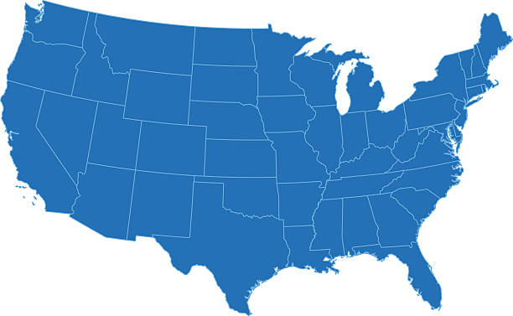
Awa is a USA beam test facility
Large-scale beam test facilities*
O(100) MeV energy particle beams
O(10) Petawatt drive lasers
Particle Beam
Laser Beam
Beam test facilities mission
Providing experimental test beds for the experimental validation emerging accelerator science
Developing the S&T needed to enable the next generation of science facilities and accelerator applications.
Educating and training future scientists and engineers.
*Not an exhaustive list of facilities
U.S. advanced and novel accelerator beam test facilities
[C. Clarke et al 2022 JINST 17 T05009, https://iopscience.iop.org/article/10.1088/1748-0221/17/05/T05009 ]

Slide 5




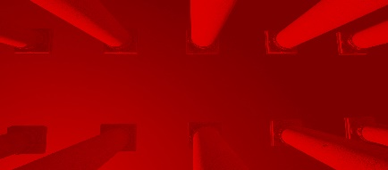





USA beam test facilities
Demonstrating the viability of emerging accelerator science ultimately relies on experimental validation.
FAST/IOTA
Particle Beam
FACET-II
AWA
BELLA
ELL
ATF
UT³
Laser Beam
U.S. advanced and novel accelerator beam test facilities
[C. Clarke et al 2022 JINST 17 T05009, https://iopscience.iop.org/article/10.1088/1748-0221/17/05/T05009 ]
National Laboratories
Universities

Slide 6
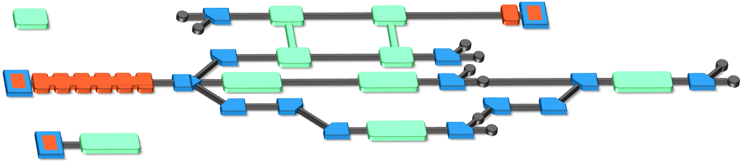
the Awa Facility
Beam Test Facility to enable novel acceleration
Witness RF photoinjector (15 MeV)
Provides two-beam capability
Bright beams for low-energy experiments
Drive RF Photoinjector (65 MeV)
  single bunch: 100nC
  bunch train: 600 nC
Experimental Switchyard
Highly reconfigurable
6D phase space manipulation
Argonne Cathode Test Stand (2-4 MeV)
Cathode research and diagnostics
Physics of high-gradient breakdown

Slide 7
What I hope you learn today …
outline
What type of FACILITY is AWA?
What type of SCIENCE do we do at AWA?
What CAPABILITIES does AWA have?
How can you COLLABORATE with AWA?

Slide 8
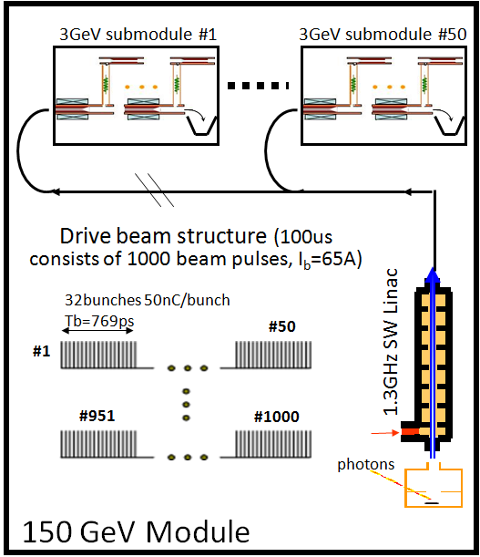
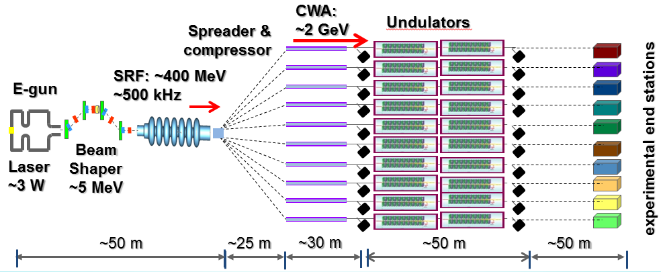
The Argonne Wakefield accelerator
AWA SCIENCE Developing the Accelerator Science & Technology (AS&T) of electron beam production, beam manipulation and novel acceleration for electron beam-driven wakefield acceleration for a future applications.
enabling
GV/m STRUCTURE WAKEFIELD acceleration (SWFA)
to produce
bright GeV-class electron beams
18 km
SWFA 3 TeV linear collider
e⁻
e⁺
future applications
Long-term
  Multi-TeV e+e- linear collider
  Higg’s Factory
Mid-term
  XFEL light sources
  Inverse Compton sources
Near-term
  Compact accelerators for societal applications
    Industrial
    Security
    Medical applications
IP
3TeV
0.2 km
SWFA XFEL
8

Slide 9
The Argonne Wakefield accelerator
AWA SCIENCE: long term and midterm targets
10GeV stepping-stone facility
TeV e+e- linear collider
0.5 GeV demonstrator
Compact light source
50% of RF-beam efficiency
Advanced beam manipulation techniques
Roadmap
GV/m level of gradient
Cost effective, ultracompact structures
XFEL Light Source
GW power RF
– GHz sources
GW power RF
– GHz sources
High power MW – THz sources

Slide 10
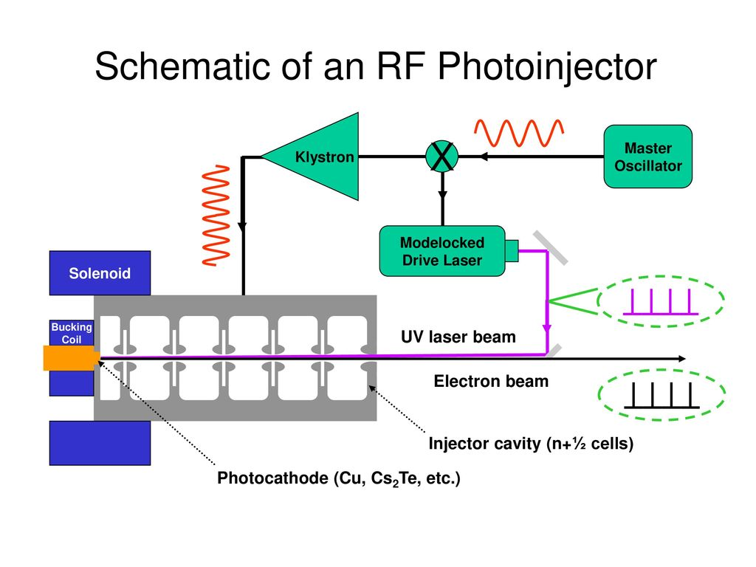
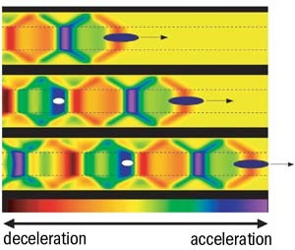
The Argonne Wakefield accelerator
AWA SCIENCE: themes
THEME 3
THEME 2
THEME 1
Beam Production
Beam Manipulation
Advanced Accelerator
e.g. SWFA
APPLICATION
e.g. RF Photoinjector
e.g. Double Emittance Exchange
Beam shaping & control.
Beam Diagnostics.
Electron sources
  High-brightness
  High-intensity
SWFA & PWFA
  High-Gradient
  High-Efficiency

Slide 11

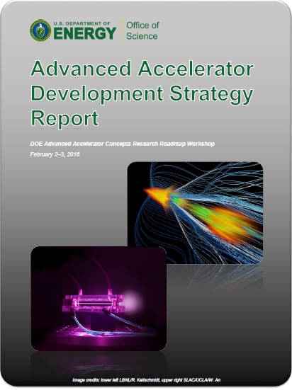
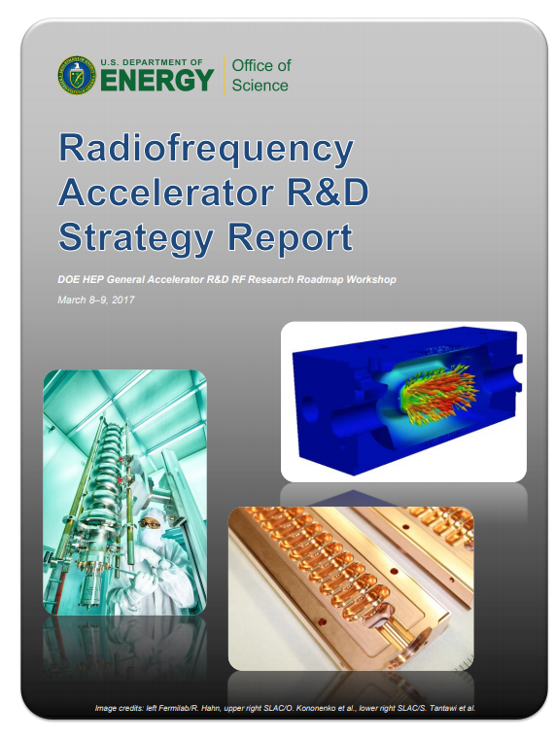
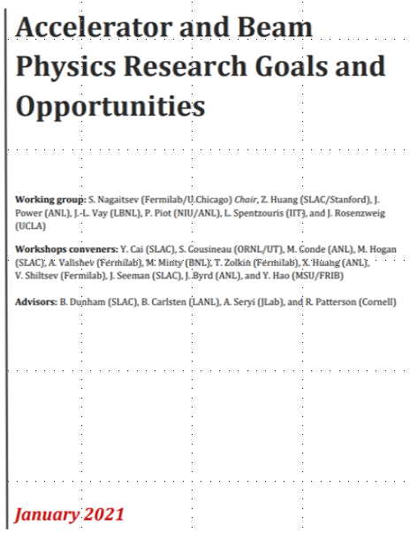
The Argonne Wakefield accelerator
AWA SCIENCE: DOE-GARD
Research areas (GARD Roadmaps)
2015: General Accelerator R&D.
Beam-driven wakefield acceleration (T1-T3)
Structure Wakefield Acceleration (SWFA)
  Collinear Wakefield Acceleration (CWA)
  Two-Beam Acceleration (TBA)
Plasma Wakefield Acceleration (PWFA)
RF Acceleration Technology (T1)
100’s MV/m NCRF short-pulse structures
100’s MW NCRF short-pulse power source
Accelerator and Beam Physics (T2-T3)
6D phase space manipulation
Electron cooling
Novel diagnostics (Single-shot, AI/ML Virtual, etc.)
Electron sources (T3)
Photo and field emission. High brightness beams.
Machine Learning (T2-T3)
ML for machine control, virtual diagnostics and physics
2016: Advanced Accelerator Concepts Roadmap
2017:
Radiofrequency Roadmap
?
2023:
Accelerator and Beam Physics Roadmap
2023:
P5 guidance

Slide 12
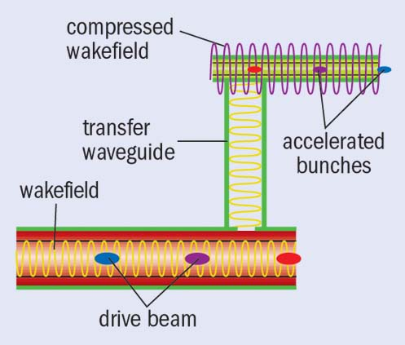

Novel accelerator research
THEME 1
Advanced Accelerator
Two Types of Structure Wakefield Acceleration
Collinear Wakefield Acceleration
Two Beam Acceleration*
drive beam
main beam
*Plenary: Session 4, Tuesday 10:30AM. Xueying Lu, Breakdown insensitive acceleration regime in structure wakefield acceleration

Slide 13
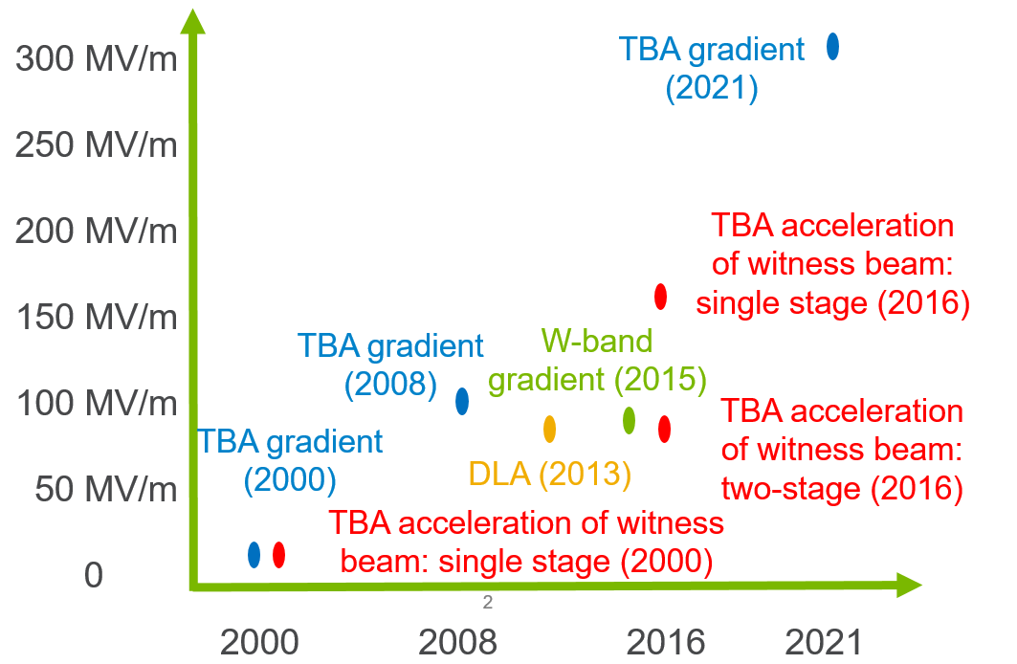
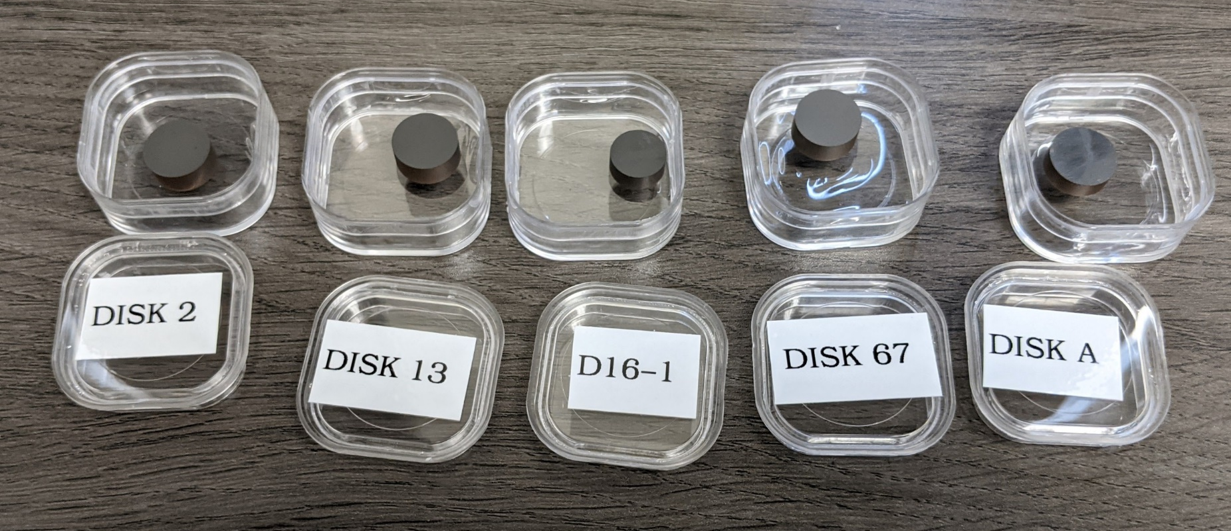
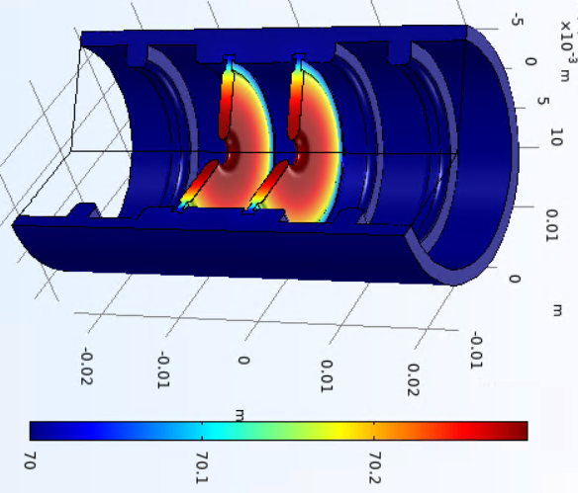
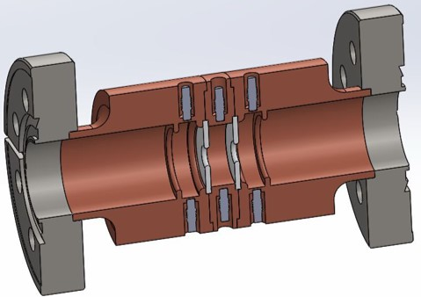
Novel accelerator research
THEME 1
Advanced Accelerator
Two Beam Acceleration in the short-pulse regime
High gradient acceleration with novel structures
Accelerator
Acceleration Gradient
  300 MV/m single-cell metallic
  400 MV/m RF gun
  100 MV/m Dielectric Disk Accelerator
examples
[Shao et al., IPAC22, FROXSP2 (2022)]
[Tan, et al., PRAB 25, 083402 (2022)]
[Friemire et al., submitted to PRAB]
Multipactor Suppression
Cryogenic Dielectric Corrugated accelerator
Dielectric disk accelerator
WG3 Monday 4PM, Ben Freemire
High Power Test Results of X-Band Dielectric Disk Accelerating Structures
WG3 Monday 4PM, Sarah Weatherly
Simulation Results of a Clamped Multicell Dielectric Disk Accelerating Structure
WG3: Tuesday, 3:30PM, Chunguang Jing
Evaluation of DLC (diamond-like carbon) Coating on Multipactor Suppression
WG3 Monday 4:30PM, Chunguang Jing Cryogenic Dielectric Accelerating Structures

Slide 14
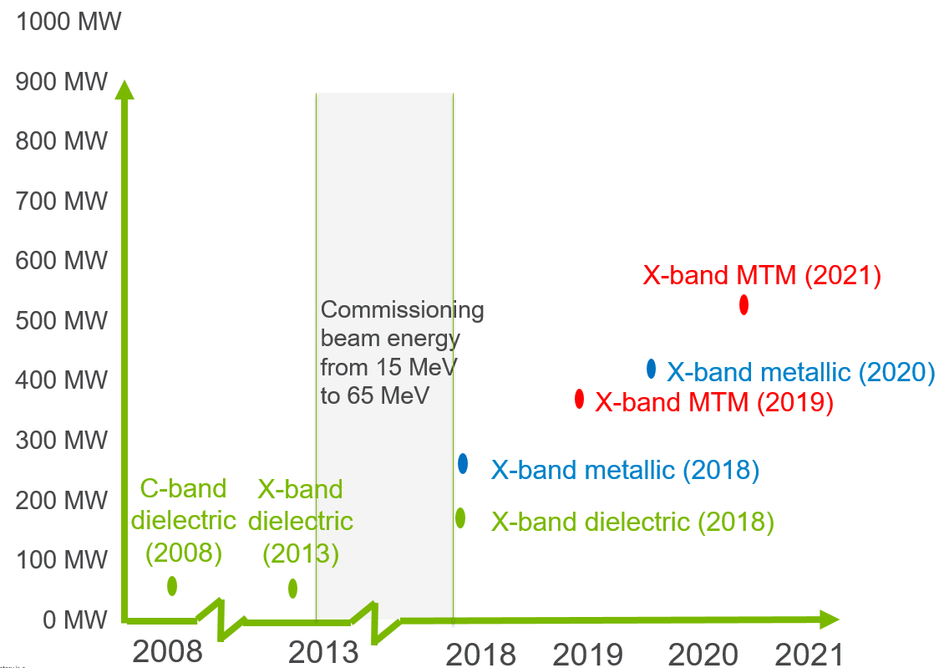
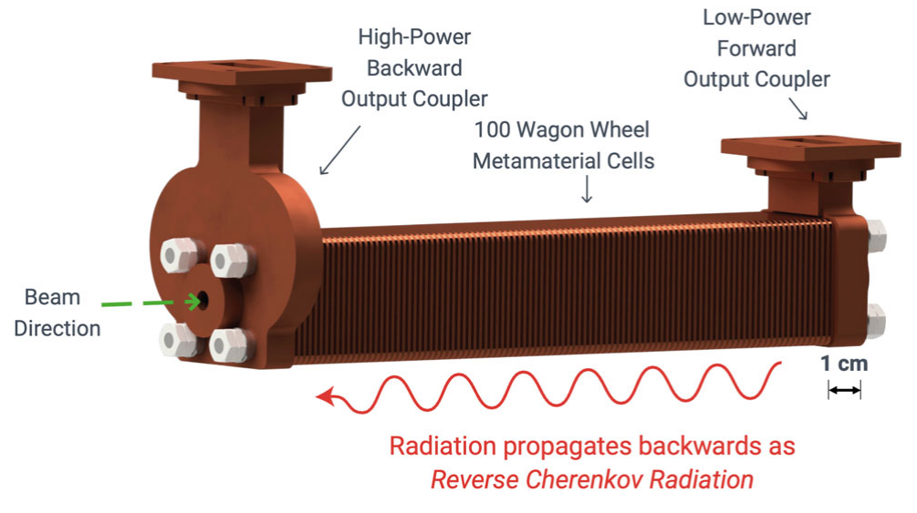
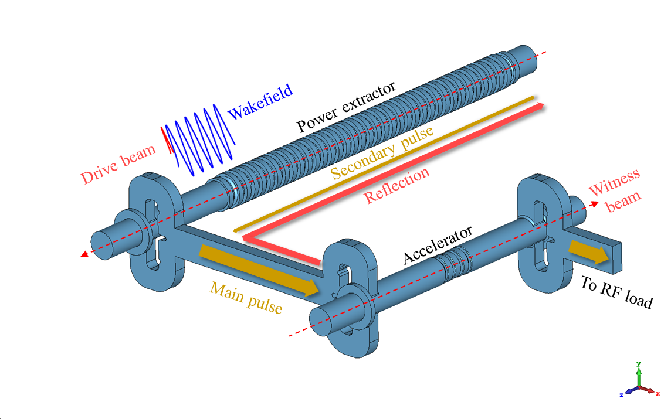
Novel accelerator research
THEME 1
Advanced Accelerator
Two Beam Acceleration in the short-pulse regime
High Power RF generation
Power Extraction and Transfer Structure (PETS)
565 MW Metamaterial PETS
520 MW Metallic PETS
[Picard et al., PRAB 25, 051301 (2022)]
[unpublished]
Metamaterial PETS
PETS
examples
Metallic PETS

Slide 15

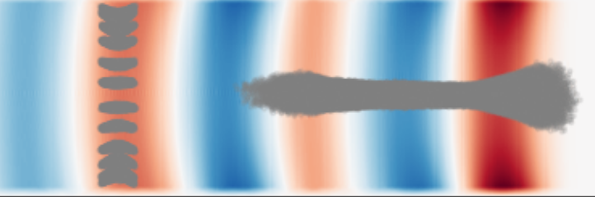
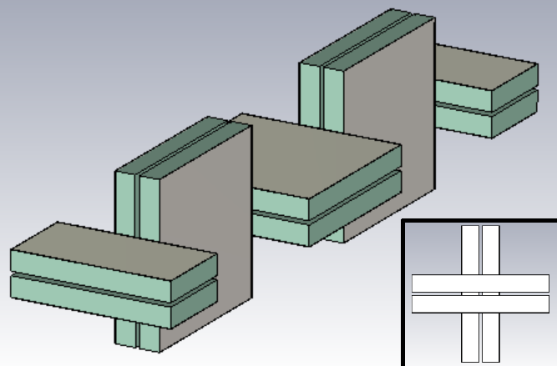
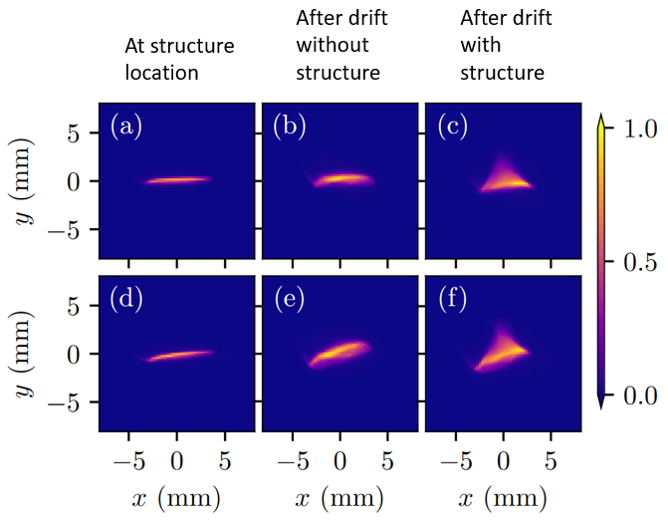
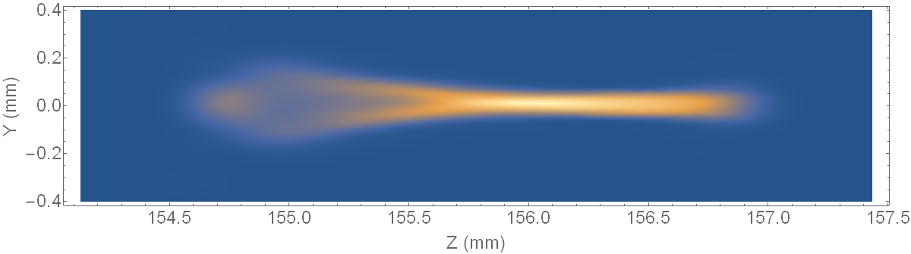
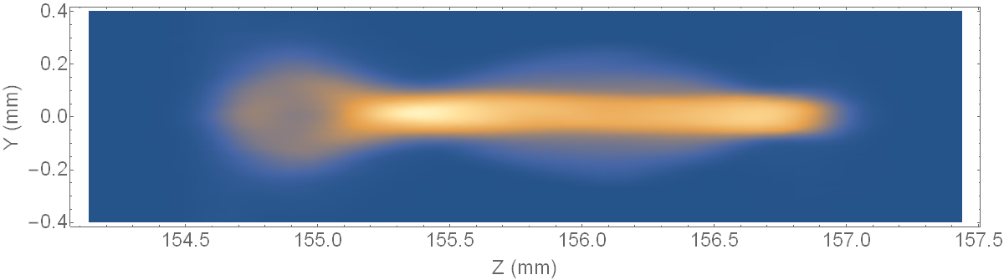
Accelerator and beam physics
THEME 2
Beam Manipulation
Conserving beam brightness
accelerating
structure
drive beam
Beam instability mitigation
main
beam
external focusing
Beam instability:
Skew-quadrupole wakefield
WG4 Monday 2:30PM, Walter Lynn
Transverse Stability in an Alternating Gradient Planar Dielectric Wakefield Structure
WG4 Monday 2:15PM, Walter Lynn
Observation of Skewed Electromagnetic Wakefields in an Asymmetric Structure Driven by Flat Electron Bunches

Slide 16
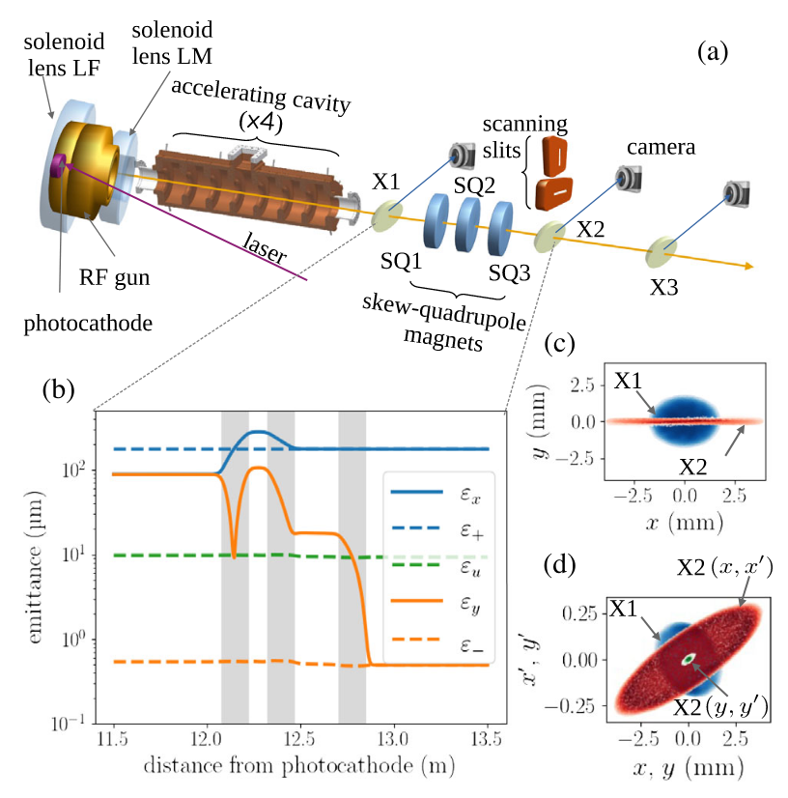
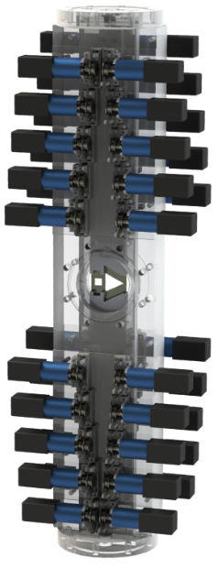
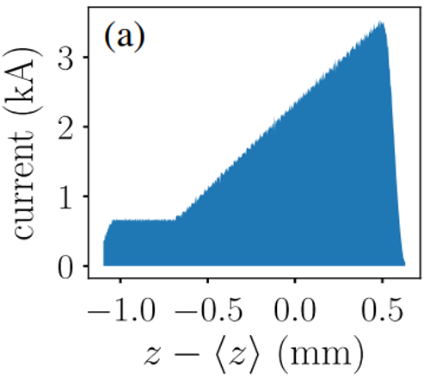
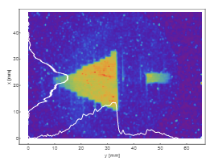
Accelerator and beam physics
THEME 2
Transverse: Flat-beam
Beam Manipulation
Bunch shaping
[Xu et al., PRAB 24, 051303 (2021)]
Current research focus
Transverse and longitudinal bunch control
Longitudinal: door-step
[Tan et al., PRAB 24, 051303 (2021)]
tail
simulations
head
TDC #1
Mask
Quad
(Hor. Focusing)
TDC #2
WG5 Monday 1:50 PM, Nathan Majernik
Beam shaping using an ultra-high vacuum multileaf collimator and emittance exchange beamline
+ V
+ V
WG4/5 Tuesday 3:48 PM, Seongyeol Kim
Longitudinal bunch shaping using transverse deflecting cavities at Argonne Wakefield Accelerator Facility

Slide 17
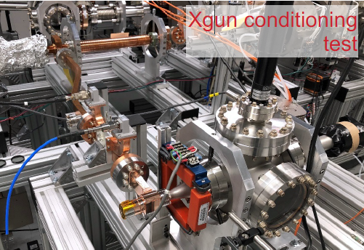
Accelerator and beam physics
THEME 3
Beam Production
Sub-GV/m X-band photocathode gun
400 MV/m
X-band photocathode gun
1.5 Cell X-band photocathode gun
IRIS DISK
COAXIAL RF-INPUT
COUPLER
WGs 3+5: Tuesday, 1:50pm Gongxiaohui Chen
Report on experimental results of a sub-GV/m photocathode gun
WGs 3+5: Tuesday, 1:30pm Sergey Kuzikov
Development of High Brightness Photoinjector for AWA
[W.H. Tan, et al., “Demonstration of sub-GV/m Accelerating Field in a Photoemission Electron Gun Powered by Nanosecond -Band Radiofrequency Pulses”, PRAB 25, 083402 – Published 24 August 2022]
[Shao et al., IPAC22, FROXSP2 (2022)]

Slide 18
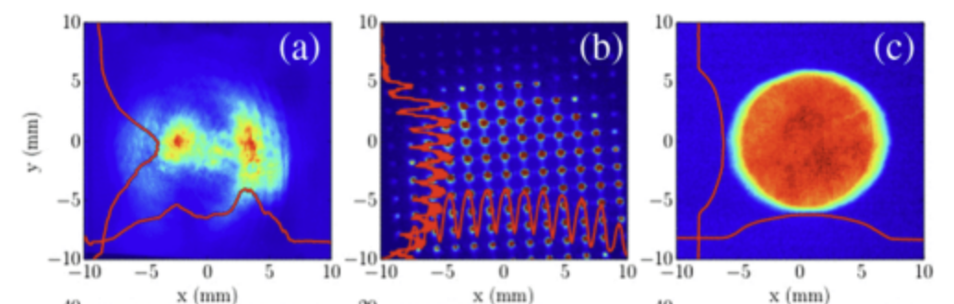
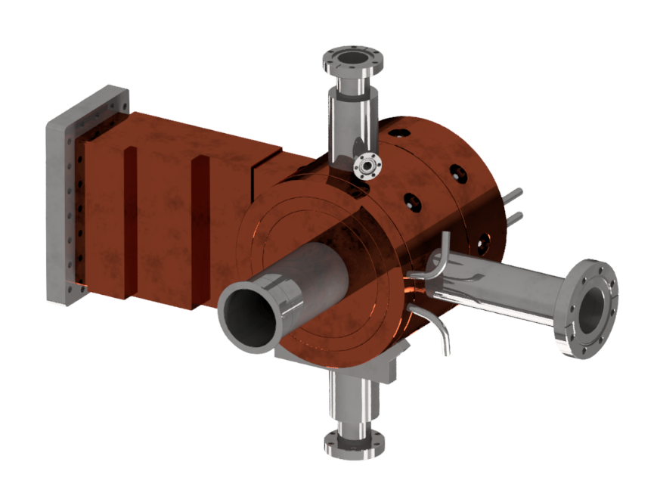
THEME 3
Accelerator and beam physics
Beam Production
Bright beams
[Halavanau et al., PRAB 20, 103404 (2017)]
Laser shaping for beam control
  Transverse: Multi-Lens Array (MLA)
  Longitudinal: : Temporal shaping via frequency-conversion (SOD and TOD) process
[T. Xu et al., NAPAC22, MOPA78 (2022)]
Intense beams
World’s high Q photocathode gun
Intense drive bunches
    High-quantum-efficiency cathodes
    Beam dynamics in intense space-
    charge regime
    Generation of bunch train

Slide 19


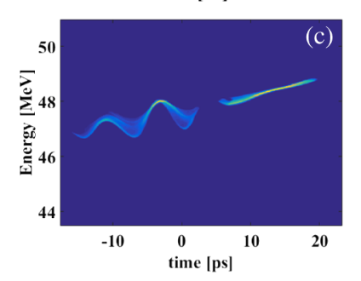
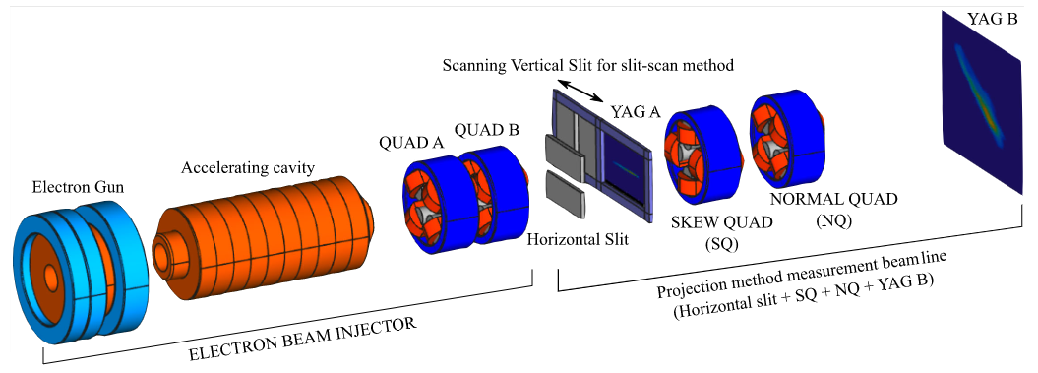
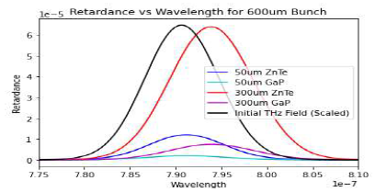
THEME 3
Accelerator and beam physics
Precision diagnostics
Beam Production
Single-shot phase-space-mapping methods
  Longitudinal phase space ("live" measurement of drive- and main-bunch dynamics)
  Transverse phase space
[Gao et al., PRAB 21, 062801 (2018)]
drive
bunch
main
bunch
experiment
Longitudinal profile
  Phase-diversity electro optic sampling (achieve sub-picosecond resolution over a long time-window, an open problem for single-shot techniques)
DWFA inserted
[G. Ha et al., PRAB 24, 012802 (2021)]
Poster: Tuesday, 5PM, Spencer Kelham
Numerical Studies of Phase Diversity Electro-Optic Sampled Relativistic Electron Bunches

Slide 20
What I hope you learn today …
outline
What type of FACILITY is AWA?
What type of SCIENCE do we do at AWA?
What CAPABILITIES does AWA have?
How can you COLLABORATE with AWA?

Slide 21
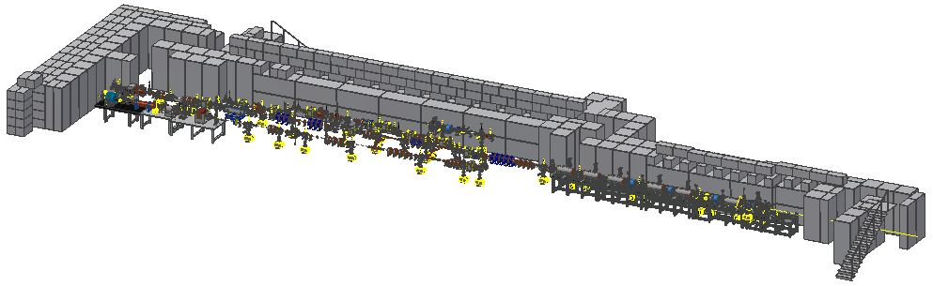
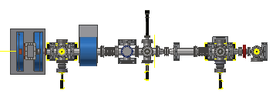

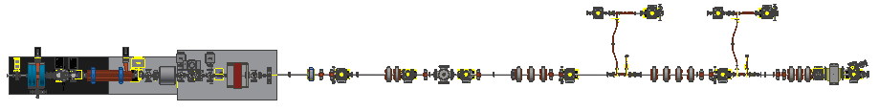
the Awa Facility
5 Zones
Zones 2-5 are experimental areas
Zones 2, 4, and 5 have ~ 1 m experimental area
Zones 3A & 3B are fully re-configurable
AWA Bunker
EXPERIMENTAL AREA
ACT
Drive
AWA Vacuum and Experimental Zones
Witness

Slide 22

AWA capabilities - current
6D PHASE SPACE MANIPULATION BEAMLINES
Laser Shaping
(α-BBO, multi-splitter, MLA, SLM, etc)
Double emittance exchange beamline
Flat beam transformer
L-band photo-gun
(Cs₂Te)
Single bunch parameters | Value
Charge [nC] | 0.1 – 100
Energy [MeV] | 6 – 63
Rep. rate [Hz] | 0.5 – 10
Bunch length [mm] | 0.1 - 3
Transverse emittance [µm] | 0.5 - 240
Peak Current [kAmps] | 0.5 - 25
Special operations | Value
Bunch train | Modulation freq. [GHz] | 1.3 – 10³
 | Charger per bunch [nC] | <70
Longitudinal shaping | Shape | Arbitrary
 | Charge [nC] | <5
Flat beam | Charge [nC] | <5
 | Emittance ratio | <150
Transverse shaping | Available type | Dot-array Hollow
*Available energy and rep. rate are not continuous.
*The range showing all range. Actual range depends on charge level.

Slide 23
AWA capabilities: continuous improvements
Improving beam quality and stability
Adding facility capabilities
Operating hours
UPGRADES
CONTINUOUS UPGRADES
PROJECT ---------------------------------------------------------------------------------- FINISH
Photocathode laser (Vitara Oscillator & MPA): --------------------------------------------------------- completed 2020
RF symmetrized Photocathode Gun: ----------------------------------------------------------------------------- 2023
RF symmetrized Accelerating Cavities: --------------------------------------------------------------------------- 2024
Photocathode Laser Room Temp Ctrl: --------------------------------------------------------------------- completed 2021
EPICS control system w/ APS controls group ----------------------------------------------------------- completed 2022
Digital LLRF controls w/ APS and LBL LLRF groups ---------------------------------------------------------- 2024
High Power RF system w/ APS RF group (2 new klystrons) ------------------------------------------------ 2025

Slide 24
What I hope you learn today …
outline
What type of FACILITY is AWA?
What type of SCIENCE do we do at AWA?
What CAPABILITIES does AWA have?
How can you COLLABORATE with AWA?

Slide 25

the awa facility: uses a collaborator model
A balanced between in-house and collaborative research
Advanced Accelerator
students?
Collaborator R&D is synergistic with AWA R&D
Beam Manipulation
Beam Production
in-house
program
collaborators
program
AWA welcome collaborators

Slide 26

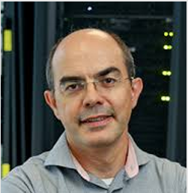

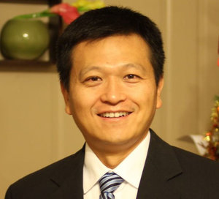



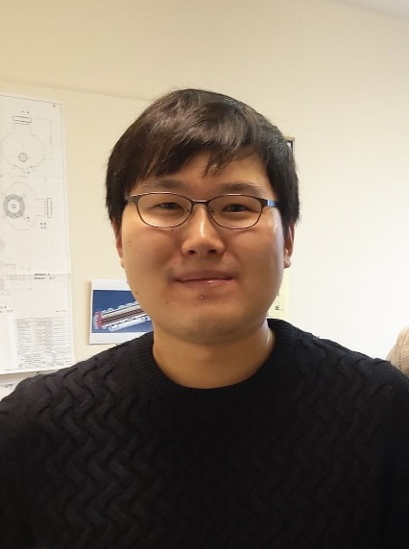


Contact anyone at AWA to initiate a collaboration
https://www.anl.gov/awa
AWA Facility Manager
Beam
Physics
Mech. & Civil Engineering
At AAC
Advanced Accelerator Concepts
Advanced Accelerator Concepts
Eric Wisniewski
Philippe Piot
NIU/ANL
Scott Doran
STRONG INDUSTRY
CONNECTIONS
STRONG UNIVERSITY
CONNECTIONS
Chunguang Jing
Euclid/AWA
AWA group
Xueying Lu
NIU/ANL
Making things work
NATIONAL LABORATORY
Group Leader
Controls & RF Systems
Beam
Physics
Advanced Accelerator Concepts
Charles Whiteford
John Power
Seong-Yeol Kim
Wanming Liu
26
Gonxiaohui Chen

Slide 27





















AWA Collaborator Program

Slide 28
The AWA facility: summary
Seeking a path to the next generation of accelerators
A HEP-GARD beam test facility
  Developing electron beam-driven wakefield acceleration
  Future applications (multi-TeV LC, XFEL, …)
Science
  Beam production (high brightness and high intensity)
  Beam manipulation (longitudinal and transverse bunch shaping)
  Advanced Accelerators (SWFA and PWFA)
Capabilities
  65 MeV Drive, 15 MeV witness and 3 MeV ACT beamlines
  Double emittance exchanger, laser shaping, round-flat transformer, …
Collaborations
  AWA facility operates a collaborator model
  Open for collaborations
    https://www.anl.gov/awa

Slide 29
Monday
Tuesday
WG8: Monday, 1:50PM
The Argonne Wakefield Accelerator Beam Test Facility for Novel Accelerator Research
Speaker: John Power
WG5: Monday, 1:50PM
Beam shaping using an ultra-high vacuum multileaf collimator and emittance exchange beamline
Speaker: Nathan Majernik
WG4: Monday, 2:15PM
Observation of Skewed Electromagnetic Wakefields in an Asymmetric Structure Driven by Flat Electron Bunches
Speaker: Walter Lynn
WG4: Monday, 2:30PM
Transverse Stability in an Alternating Gradient Planar Dielectric Wakefield Structure
Speaker: Walter Lynn
WG3: Monday, 3:30PM
High Power Test Results of X-Band Dielectric Disk Accelerating Structures
Speaker: Ben Freemire
WG3: Monday, 4:00PM
Simulation Results of a Clamped Multicell Dielectric Disk Accelerating Structure
Speaker: Sarah Weatherly
WG3: Monday, 4:30PM
Cryogenic Dielectric Accelerating Structures
Speaker: Chunguang Jing
Plenary 4: Tuesday, 10:30AM
Breakdown insensitive acceleration regime in structure wakefield acceleration
Speaker: Xueying Lu
WG3: Tuesday, 1:30PM
Development of High Brightness Photoinjector for AWA
Speaker: Sergey Kuzikov
WG3: Tuesday, 1:50PM
Report on experimental results of a sub-GV/m photocathode gun
Speaker: Gongxiaohui Chen
WG3: Tuesday, 3:30PM
Evaluation of DLC (diamond-like carbon) Coating on Multipactor Suppression
Speaker: Chunguang Jing
WG4+5: Tuesday, 3:48PM
Longitudinal bunch shaping using transverse deflecting cavities at Argonne Wakefield Accelerator Facility¶
Speaker: Seongyeol Kim
Poster: Tuesday 5:00PM
Numerical Studies of Phase Diversity Electro-Optic Sampled Relativistic Electron Bunches
Speaker: Spencer Kelham

Slide 30
Backup slides

Slide 31
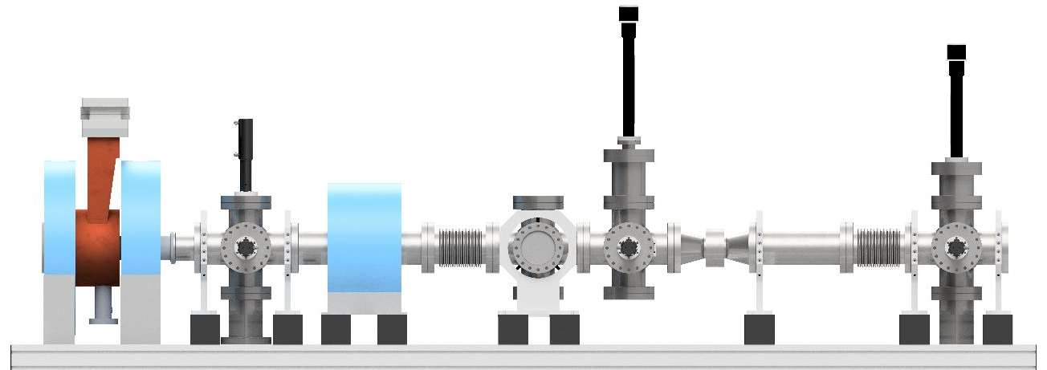
ABP-AAC symbiosis
THEME 3
Beam Production
Argonne Cathode Test Stand
NCRF gun characterization of novel photocathodes
NCRF gun characterization of field emission cathodes
NCRF breakdown studies: location, lifetime, …
Laser
input
BPM
Faraday cup
& YAG
Collimator
& slit
Faraday cup
& YAG

Slide 32
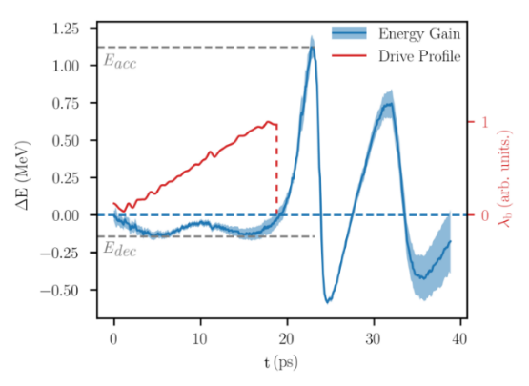
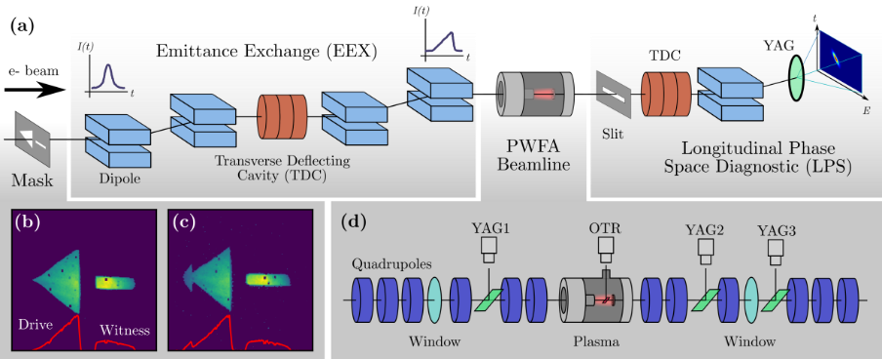

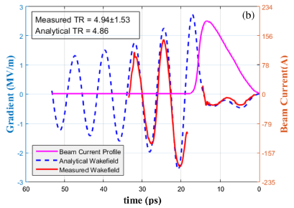

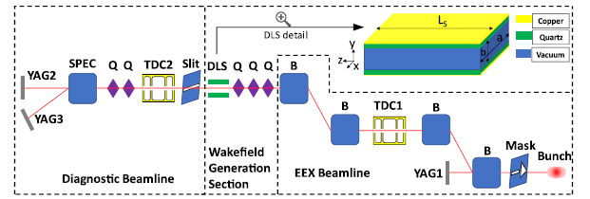
Integrating it all together
Recent results on transformer ratio enhancement
R=7.9
Enhanced transformer ratio
(TR>5) demonstrated using
shaped beam via phase-
space exchanger
So far TR performances
realized at the expense of
peak field
Current research focus:
Demonstrate high TR with
high-accelerating field
(AWA-IIT-NIU collaboration)
[Roussel et al., PRL 120, 044802 (2020)]
R=5
[Gao et al., PRL 124, 114801 (2018)]
41

