Slide 1
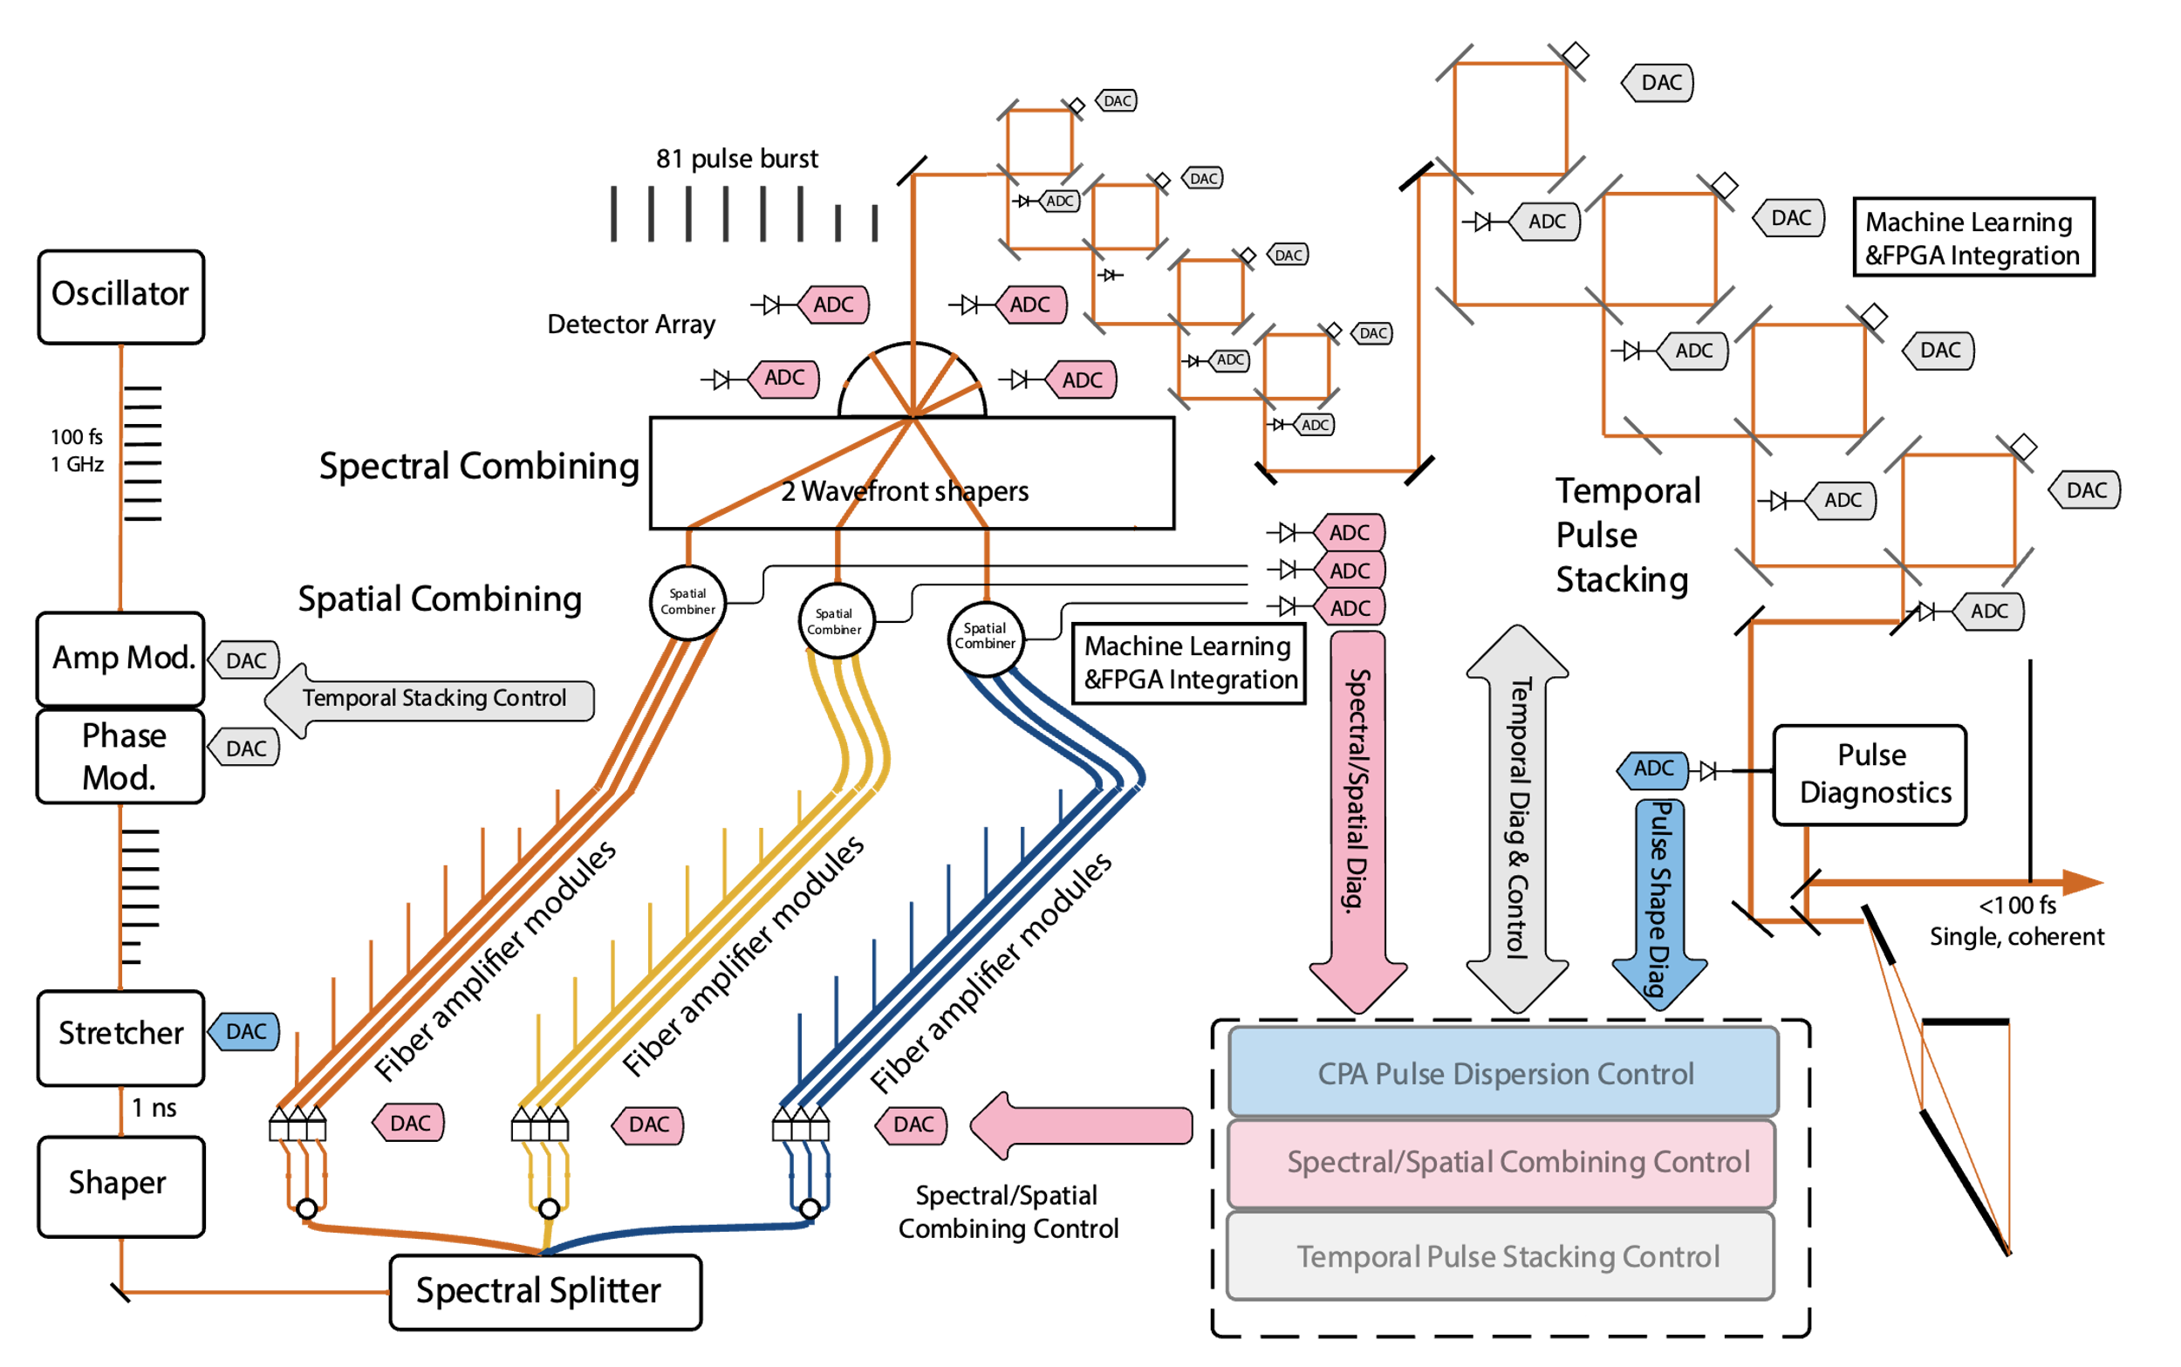
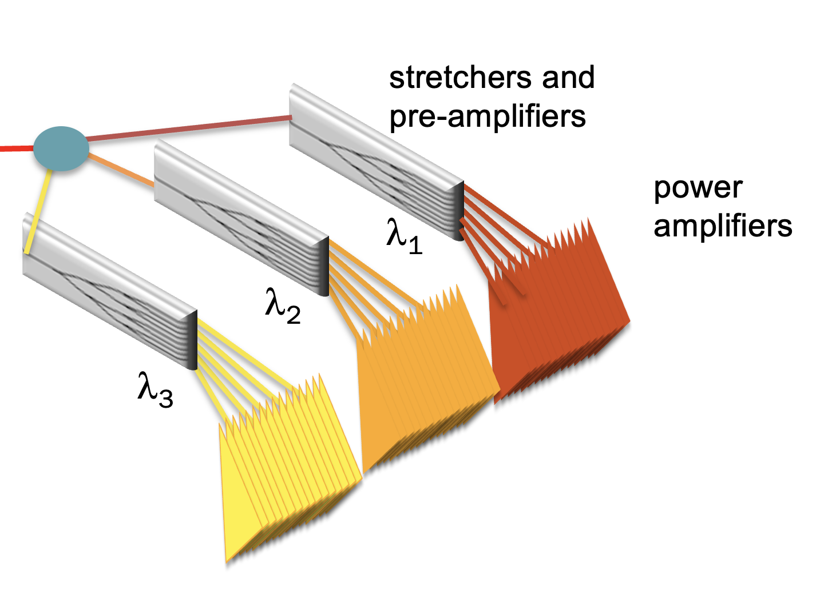
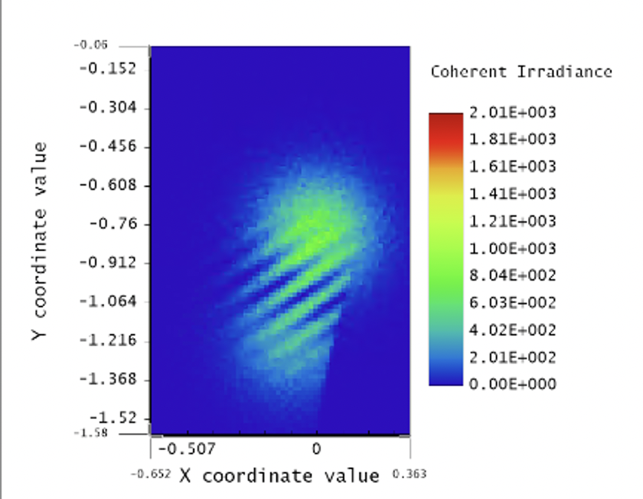
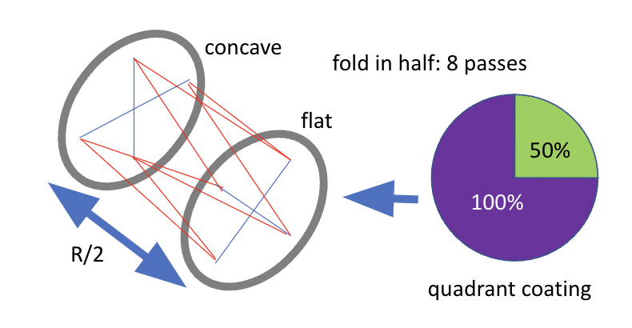
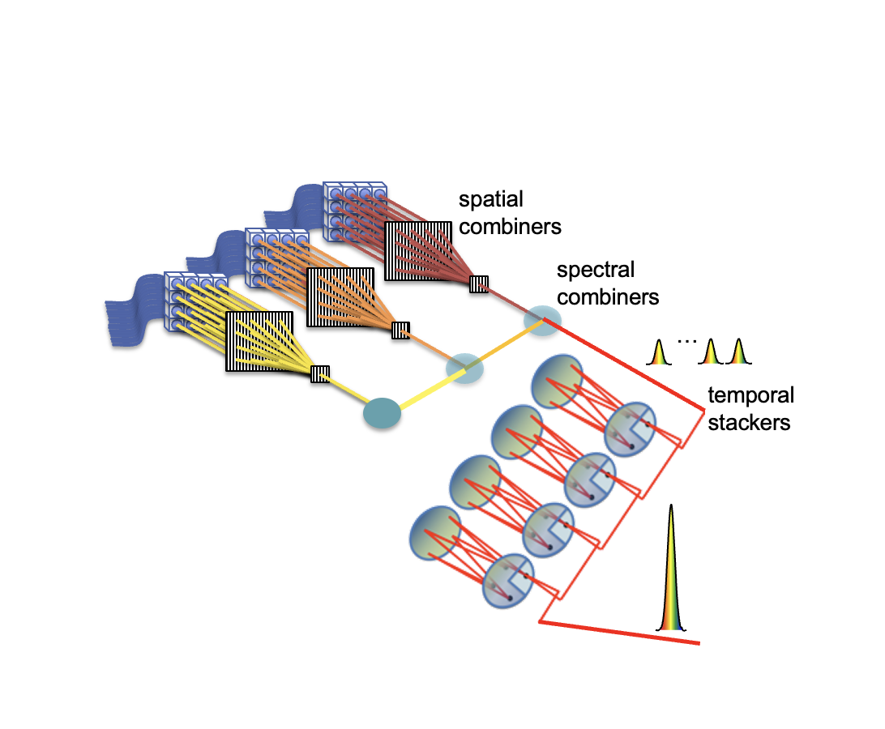
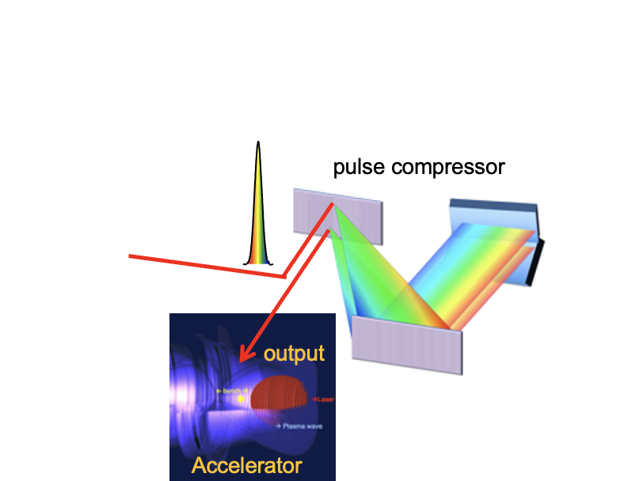
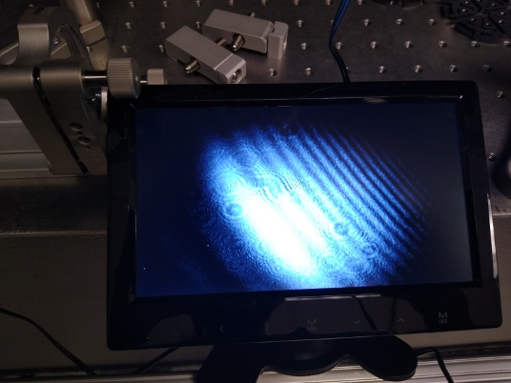
Systemic Control for Coherently-Combined High Energy Fiber Laser
Mahek Logantha^{1,2}, T.Zhou², Q. Du², R. Wilcox², C. B. Schroeder^{1,2}
¹University of California-Berkeley, ²Lawrence Berkeley National Laboratory
Correspondence: mlogantha@berkeley.edu
BACKGROUND
INTEGRATED CONTROLS SYSTEM
High-impact laser plasma accelerators (LPA) applications such as scientific discovery, medical radiation therapy, industrial and security screening require LPAs operating at kilohertz repetition rates or higher while today’s LPAs are limited to a few hertz repetition rates. We are coherently combining short pulse fibers to achieve highly stabilized high energy ultrashort pulses at high repetition rates. One key challenge in reaching this objective is developing a precise feedback control system for the required pulse stability and quality.
Proposed control system of a coherent combining high average power laser system
Credit: Q. Du, M. Logantha
OBJECTIVE
We will integrate complex, multi-layer control points by using state-of-the-art digital hardware and algorithms including machine learning to meet accelerator:
stability
precision
The optical system needs to be theoretically modeled in enough detail before the controller can be implemented on a digital platform such as an FPGA for real-time performance ­– requiring a thorough understanding of both the relevant physics and control system theory. To achieve the ideal energy, we are aiming for a beam of 200 mJ at a 5kHz repetition rate.
TIMELINE
PRELIMINARY HERRIOTT CELL WORK (TEMPORAL COMBINING)
Develop controls for
– fiber-based pulse generation
– amplifier chain operating at high output power
1
spectral
splitter
Zemax Quad-Mirror Simulation:
Confirms interference of incoming/outgoing beam
No aberration analysis in this mode
Proposed Herriott Cell viability for stacking to increase temporal system:
Stability
Compactness
Extend controls to multiple, parallel spectral channels
Power amplifiers will be combined into one beam
Used Zemax simulation and experiment to establish proof-of-concept
2
Quad-Mirror Herriott Cell Setup
Optimize overall system performance
Drive accelerator experiment with resultant pulse
Output will be highest energy from ultrafast fiber laser
Theoretical Focusing Point Calculations Plotted:
Q parameter comparison
Periodic focusing
Experimental confirmation of interference
3
ACKNOWLEDGEMENTS This work was supported by the Director, Office of Science, Office of High Energy Physics, of the U.S. Department of Energy under contract no. DE-AC02-05CH11231
Notes:
Herriott Cell
Compact setup for long cavity length
Insensitive to mirror misalignment
No beam diffraction effects
, especially compressed pulse quality
$R\left(z\right),$radius of curvature
$z_{R},$Rayleigh range
$z,$path length
$w,$beam waist
$λ,$wavelength
Feedback control includes:
– thermal drifts
– multi-GHz stretched-pulse programming

