Slide 1
9.3 microns
Toward next-generation CO₂ laser for particle accelerators
Misha Polyanskiy, Igor Pogorelsky, Marcus Babzien,
Rotem Kupfer, William Li, Mark Palmer
2022-11-10
AAC, Long Island, NY
Notes:
Very special instrument
Novel methods of particle accel.
All the important things

Slide 2
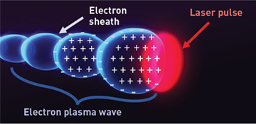


Motivation for LWIR
(example: LWFA)
λ ≈ 1 µm
10 – 20 µm
wake
Laser
200 µm
λ ≈ 10 µm

Slide 3
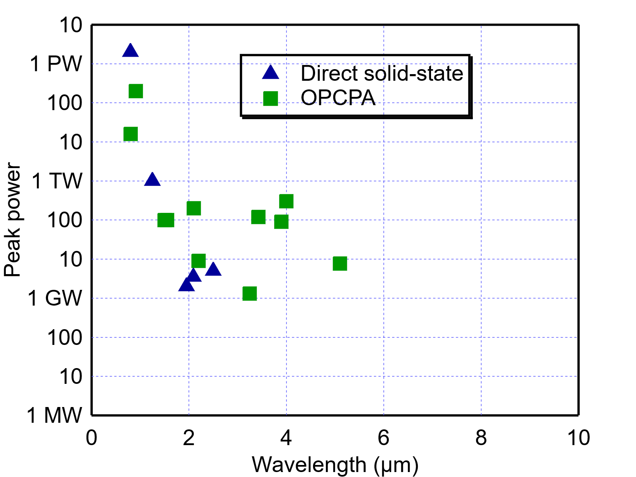
Why CO₂ laser amplifiers?
NIR
SWIR
MWIR
LWIR
5 TW
CO₂ laser
amplifiers
50 MW
Compilation: Sara Bucht (LLE)
Notes:
Large and complex machines
Applications in
Two bunches of e-
Polygon pattern
Nuclear reaction
Combination e-hv
--- 3 ---

Slide 4
State of the art
Chirped-pulse amplification
Solid-state seed
High-pressure, mixed-isotope CO₂ amplifiers
Polyanskiy et al. OSA Continuum 3, 459 (2020)

Slide 5
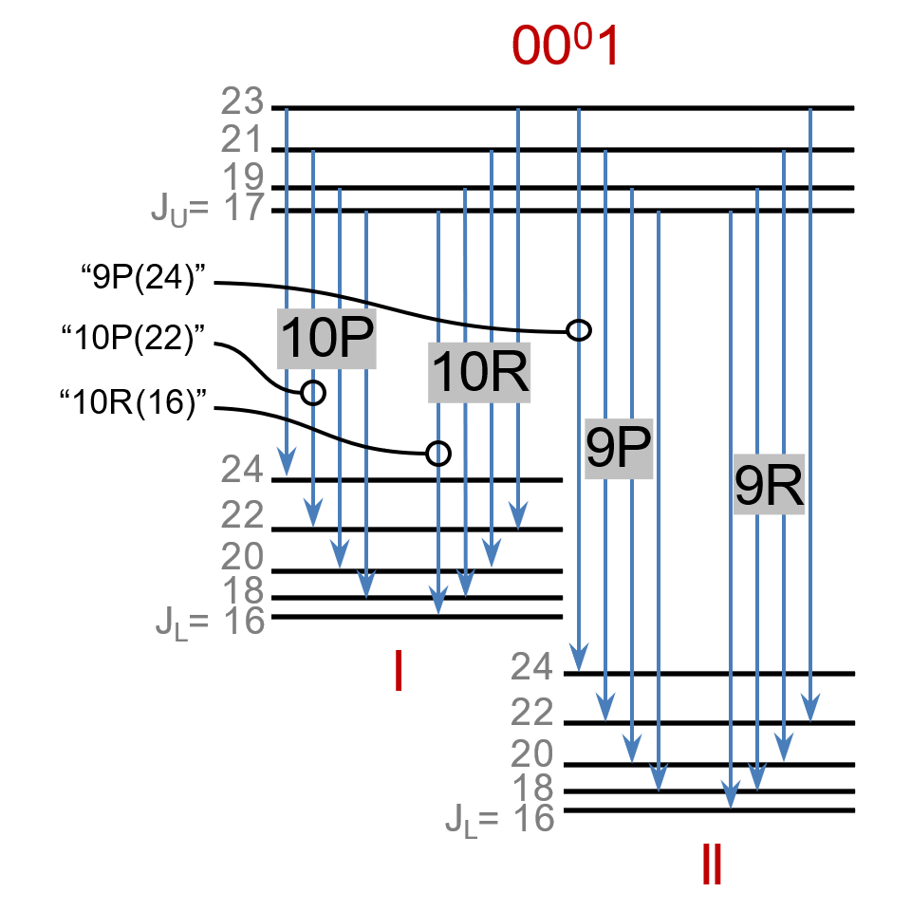
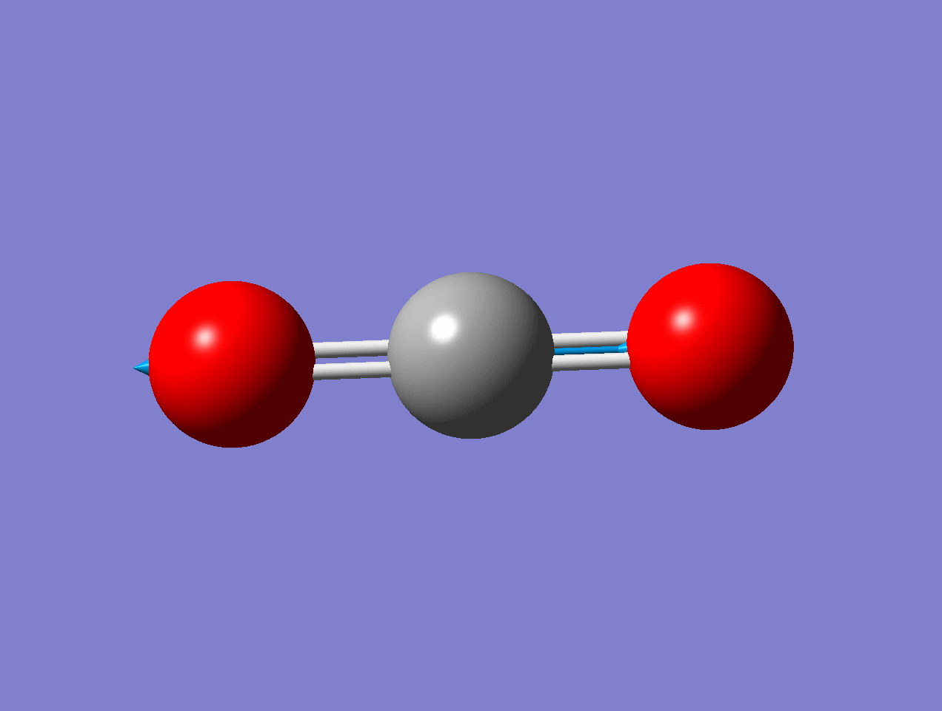
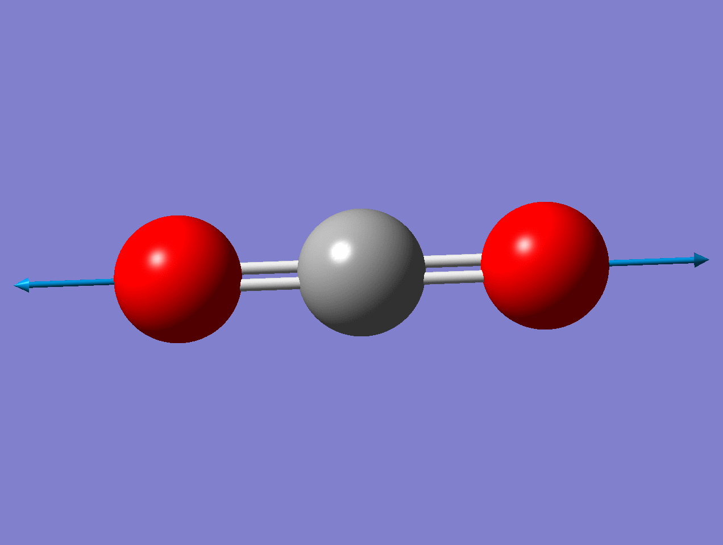
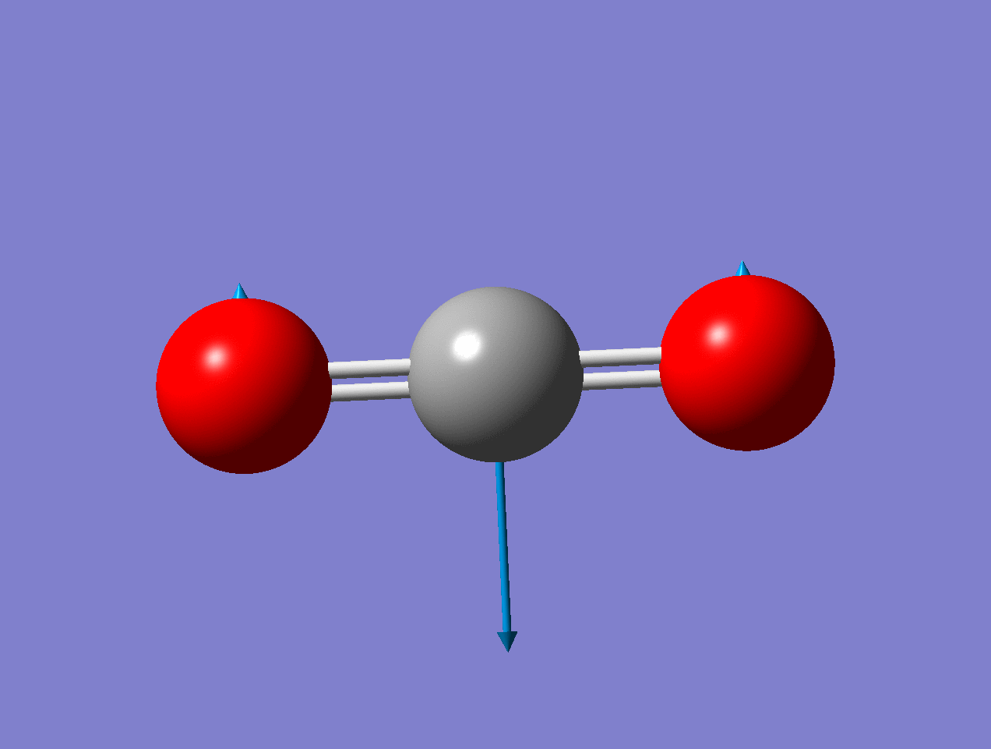
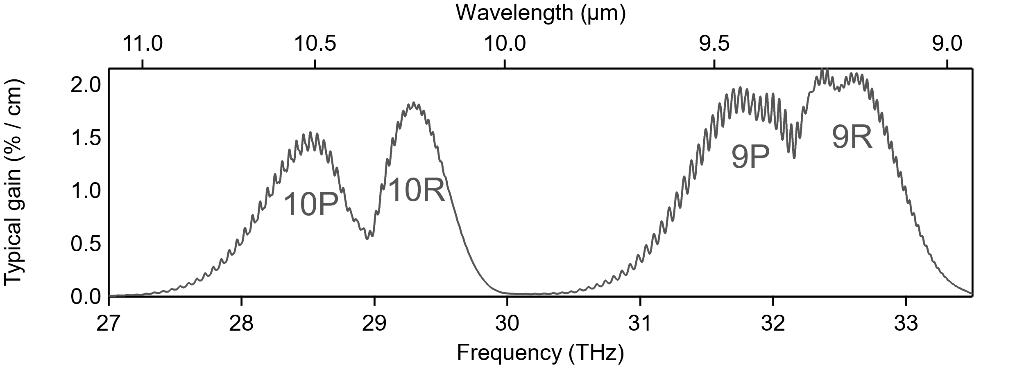
Gain spectrum
P(CO₂+N₂+He) ≈ 10 atm
¹⁶O : ¹⁸O ≈ 50 : 50
C¹⁶O₂ : C¹⁶O¹⁸O : C¹⁸O₂ ≈ 25 : 50 : 25
9.3 µm
9.2 µm

Slide 6
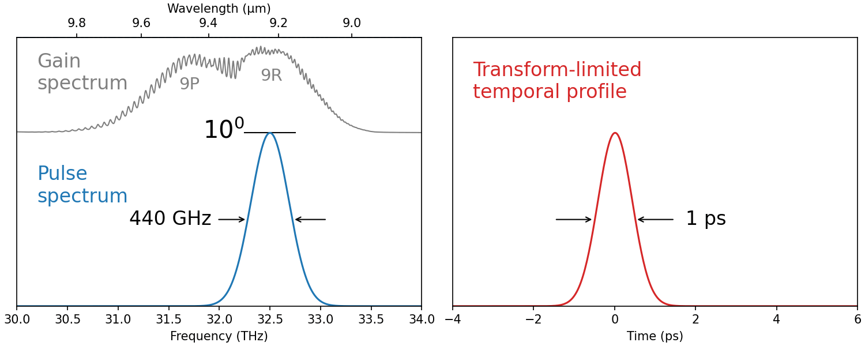
Amplification on 9R branch (10¹¹x)

Slide 7
A_{total} = 10¹¹
2 000x
5 000x [net amplification]
10 000x [losses]
0.1 * 0.9^15 * (1-0.04)^(8*16) = 1e-4

Slide 8
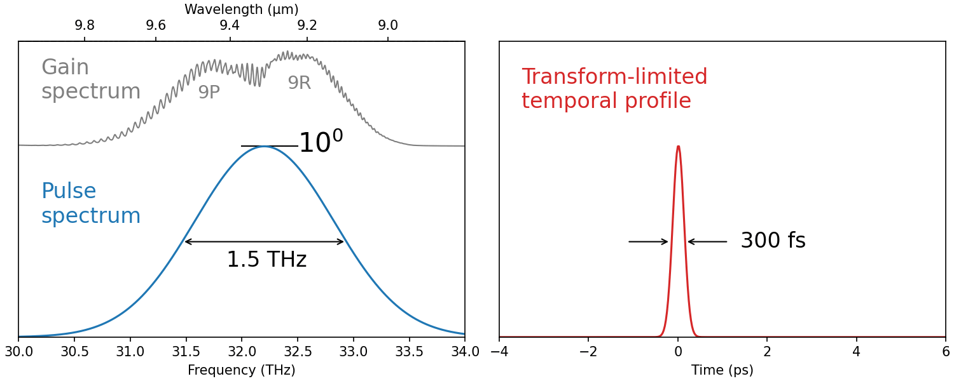
Amplification on 9R & 9P branches (10¹¹x)

Slide 9
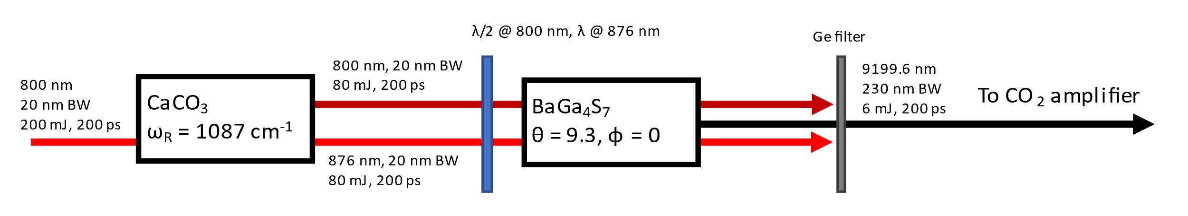
A_{total} = 2 000
2 000x
mJ+
10 mJ
seed laser
Raman
DFG
William Li – AAC’22 WG8
Raman-based wavelength conversion for seeding and optical pumping of CO₂ laser amplifiers

Slide 10

Amplification on 9R & 9P branches (2000x)

Slide 11
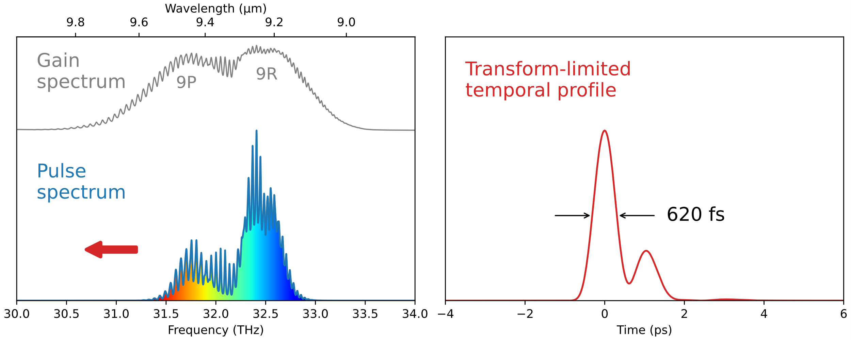
Amplification on 9R & 9P branches (2000x)

Slide 12
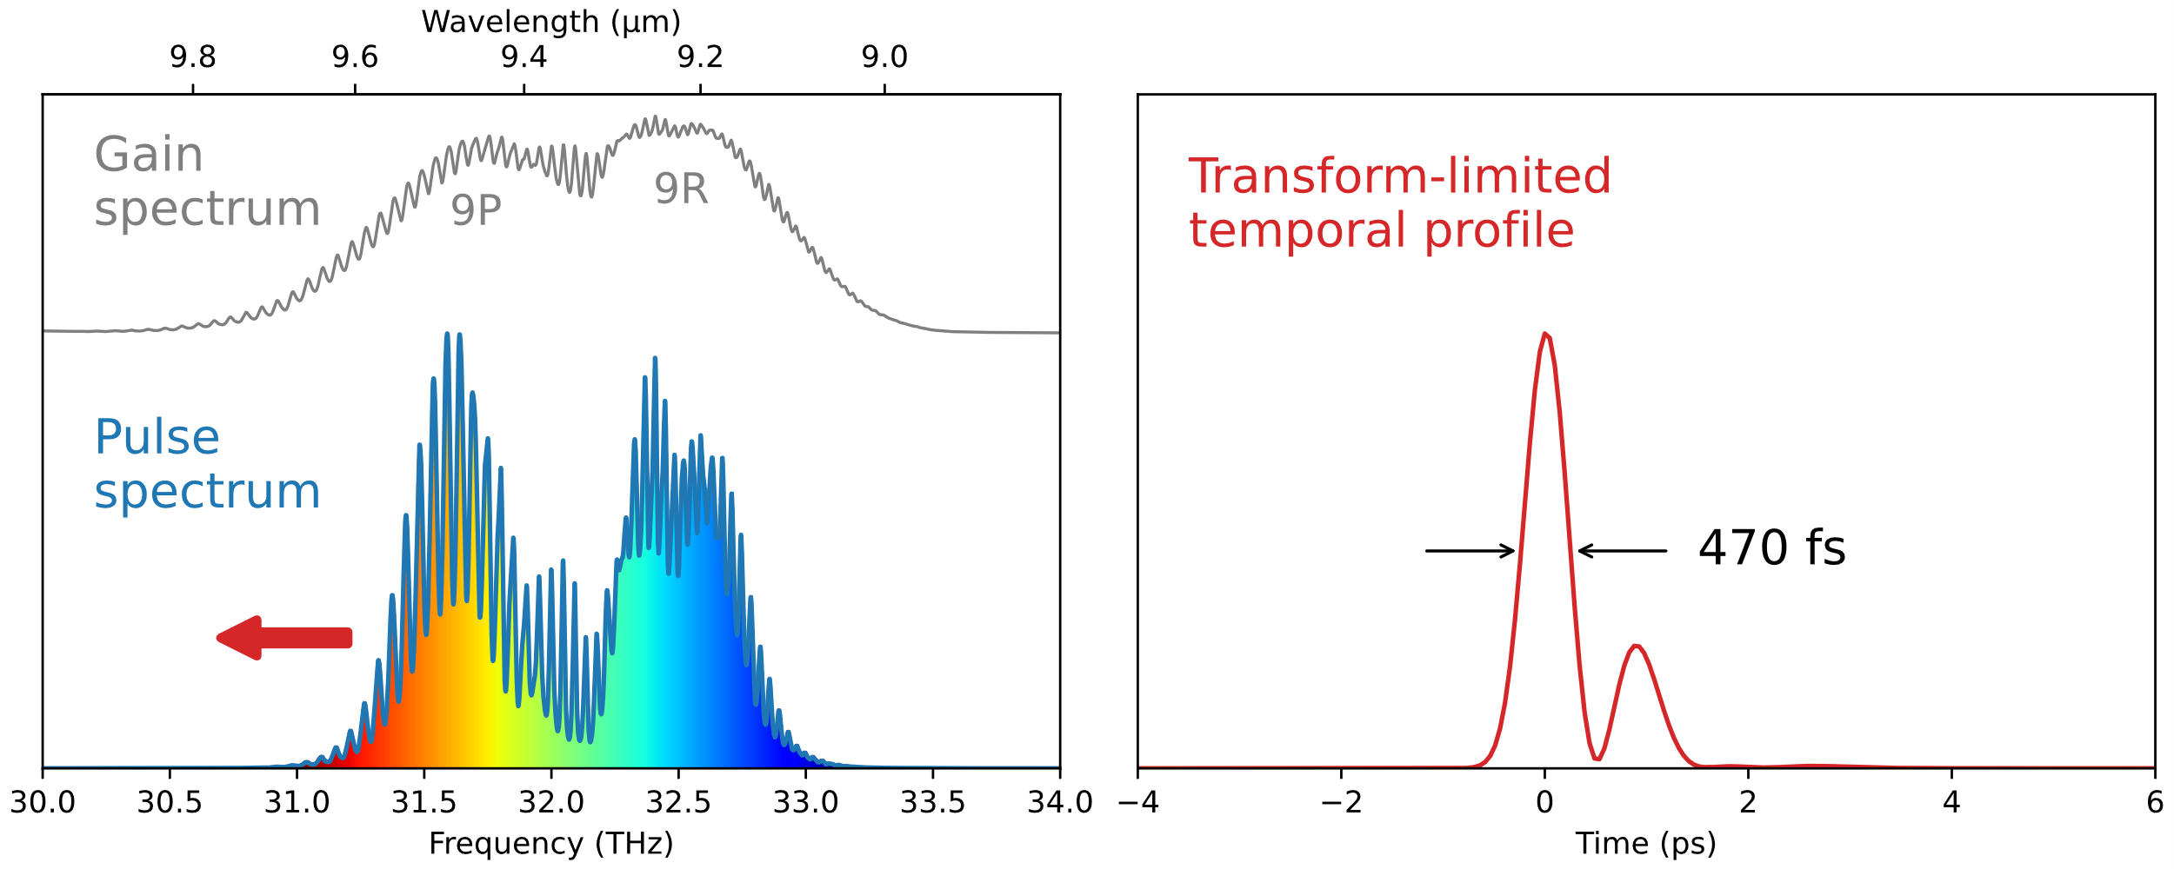
Amplification on 9R & 9P branches (2000x)

Slide 13
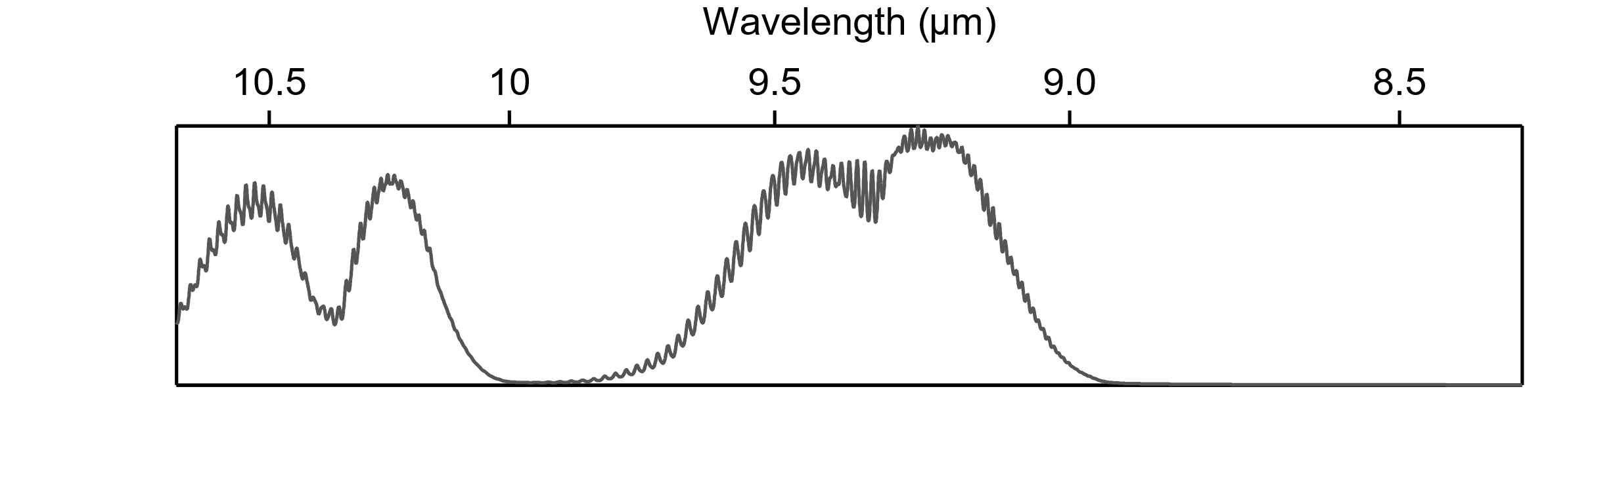
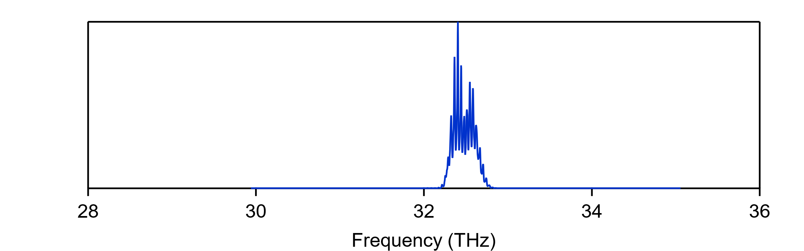
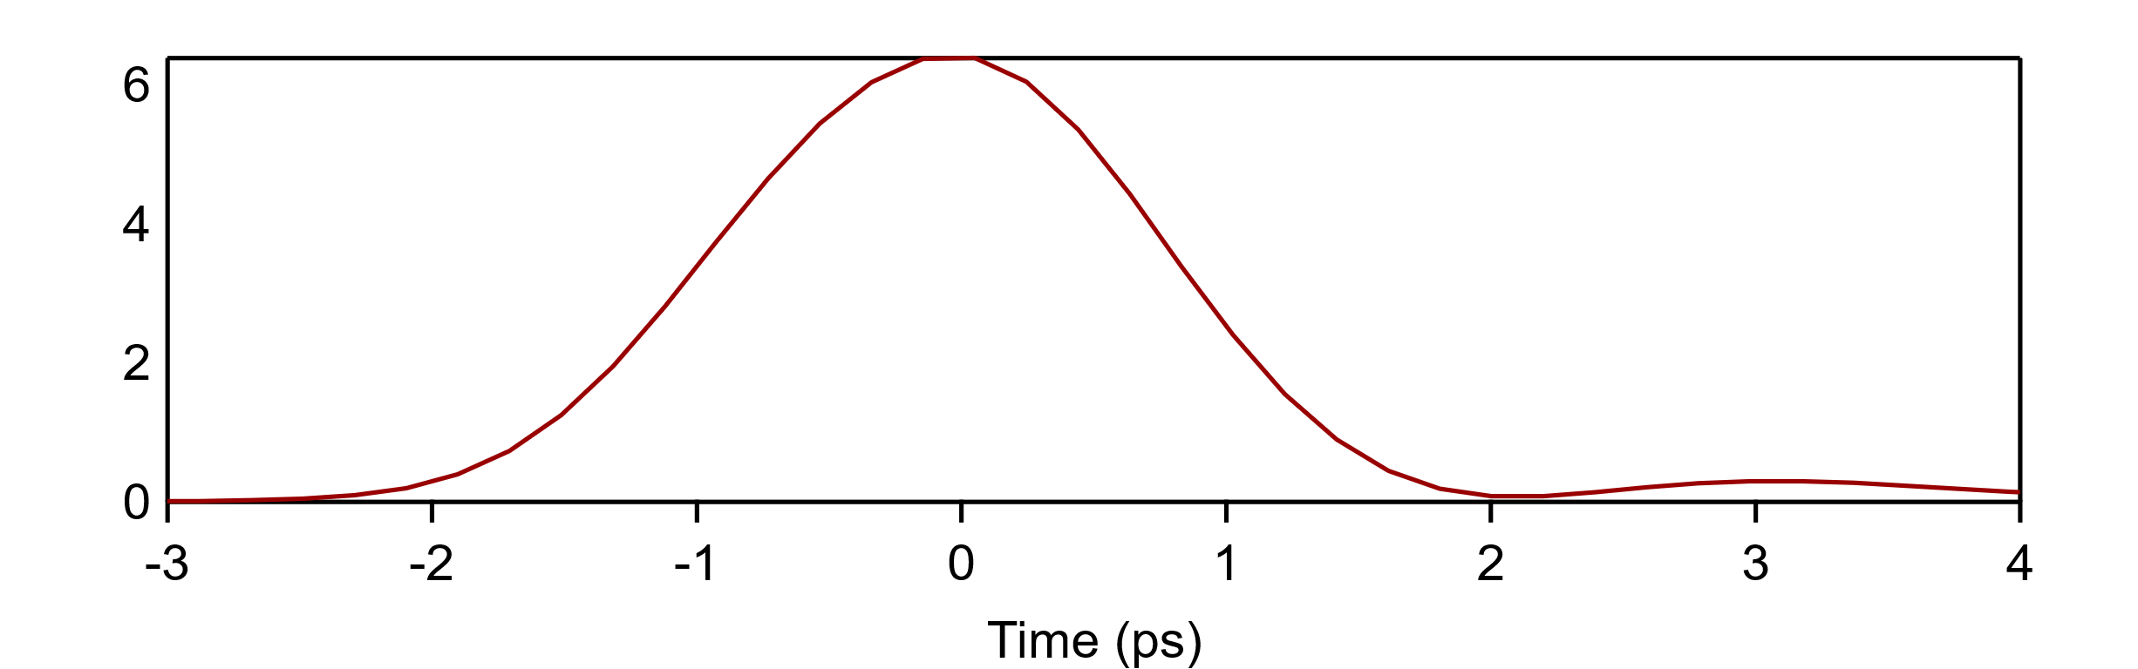
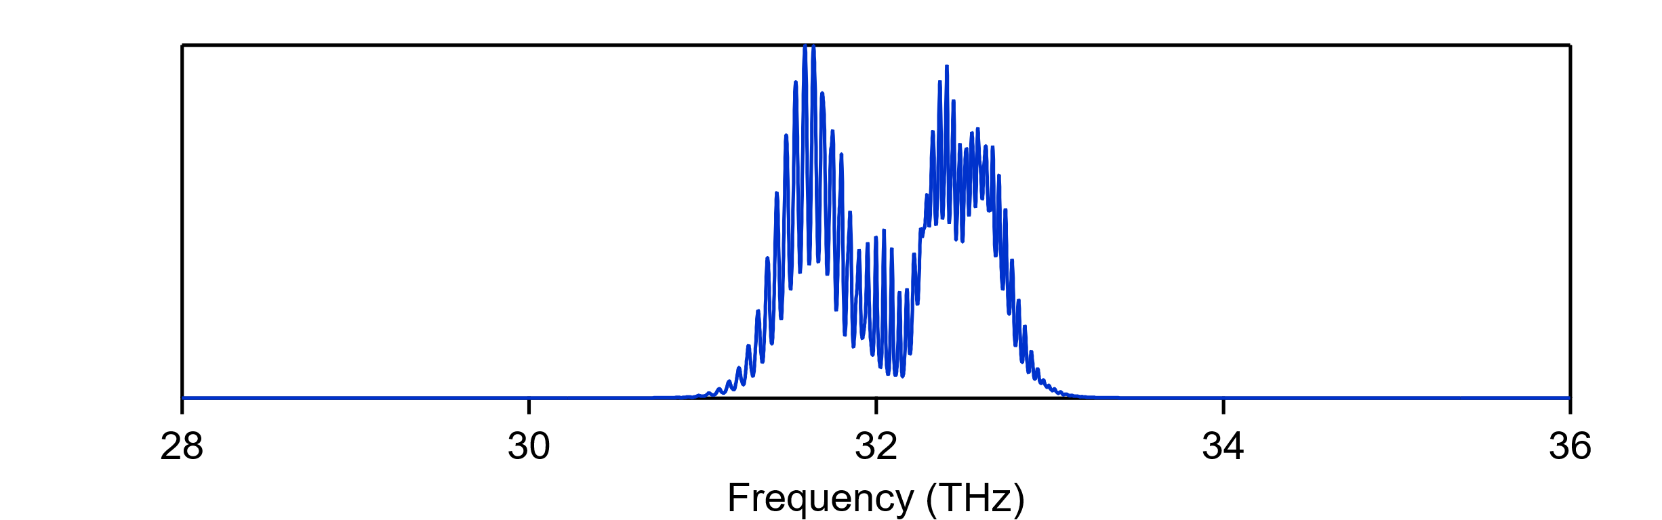
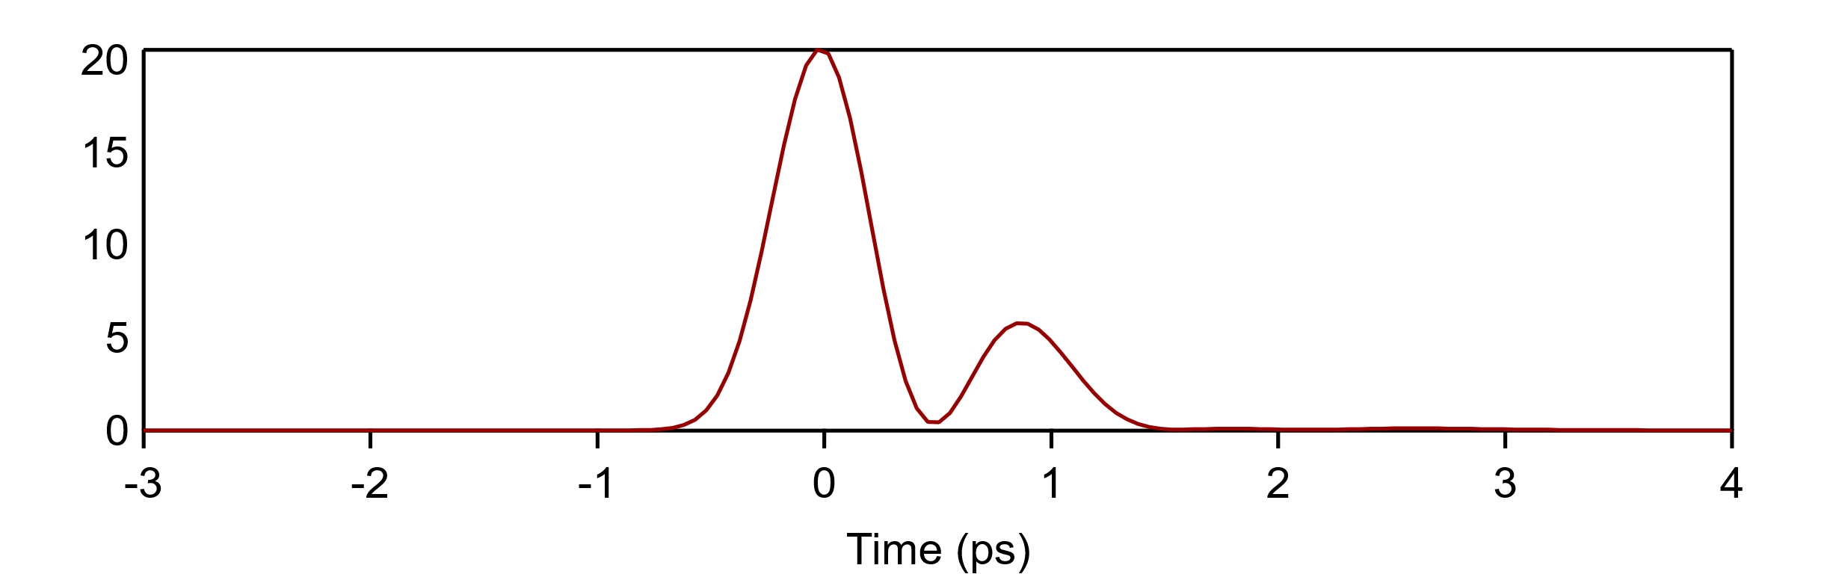
9R
Gain spectrum
With 20% contingency
9P
Now
(µJ seed)
9.2 μm
2 ps
5 TW
Power (TW)
mJ seed
9.3 μm
500 fs
15 TW
Polyanskiy et al. Photonics 8, 101 (2021)

Slide 14
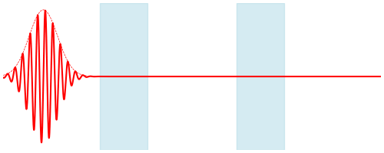
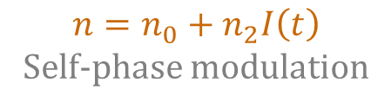
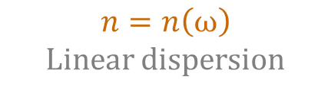
Post-compression
Igor Pogorelsky AAC’22 WG 6
Opportunities for advanced accelerator research with femtosecond long-wavelength lasers
$$n=n_{0}+n_{2}I\left(t\right)$$
Self-phase modulation
$$n=n\left(ω\right)$$
Linear dispersion
 | n₀ @ 9.2 µm | n₂ 10⁻²⁰ J/m² | GVD fs²/m
NaF | 1.253 | 0.6 | -3150
BaF₂ | 1.412 | 1.7 | -2340
KCl | 1.459 | 3.4 | -558
NaCl | 1.500 | 3.5 | -1010
KBr | 1.528 | 4.3 | -303
CsI | 1.740 | 12 | -89.2
AgCl | 1.984 | 17 | -650
AgBr | 2.168 | 20 | -192
ZnS | 2.211 | 25 | -2240
Self-phase modulation (SPM)
Funding:
US Department of Energy Accelerator Stewardship Program grant, B&R #KA2601020, KW010102

Slide 15
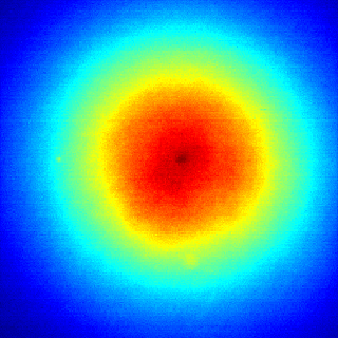
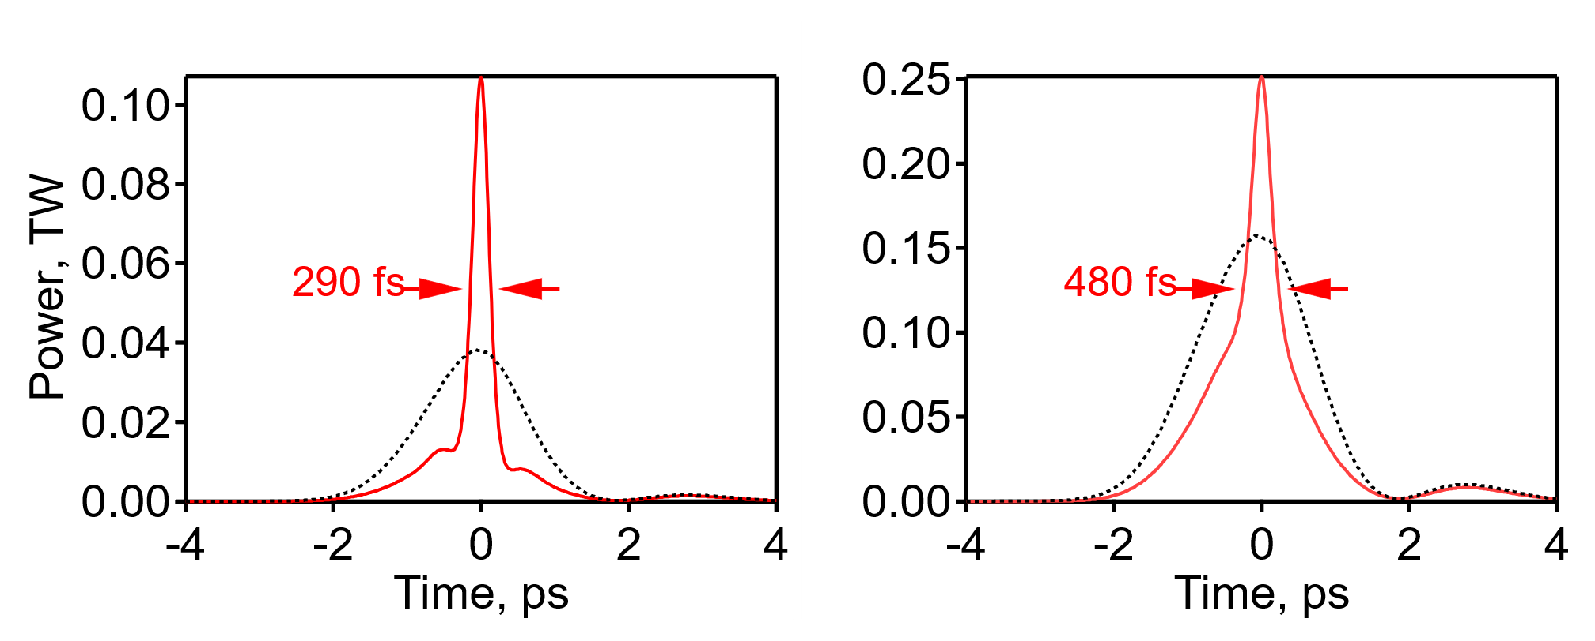
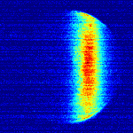
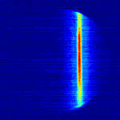
Proof of principle @ 2 ps
Polyanskiy et al. Opt. Express 29, 31714 (2021)
2 ps
Ø 12.8 mm
5 mm dia.
beam center
Whole beam
In (~2 J)
Out (280 mJ)
out
out
2 ps
290 fs
in
in
Autocorrelation
278 mJ

Slide 16
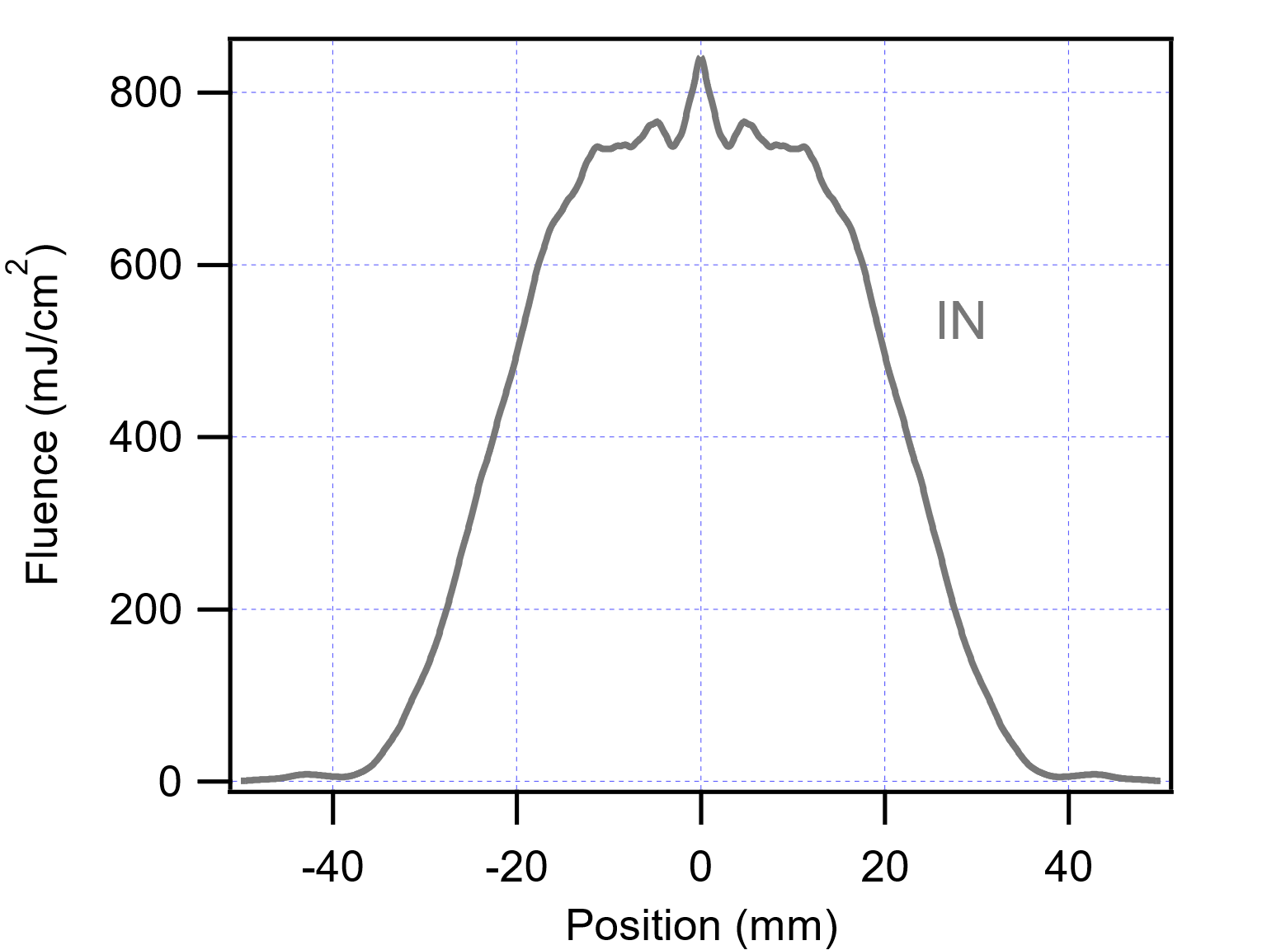
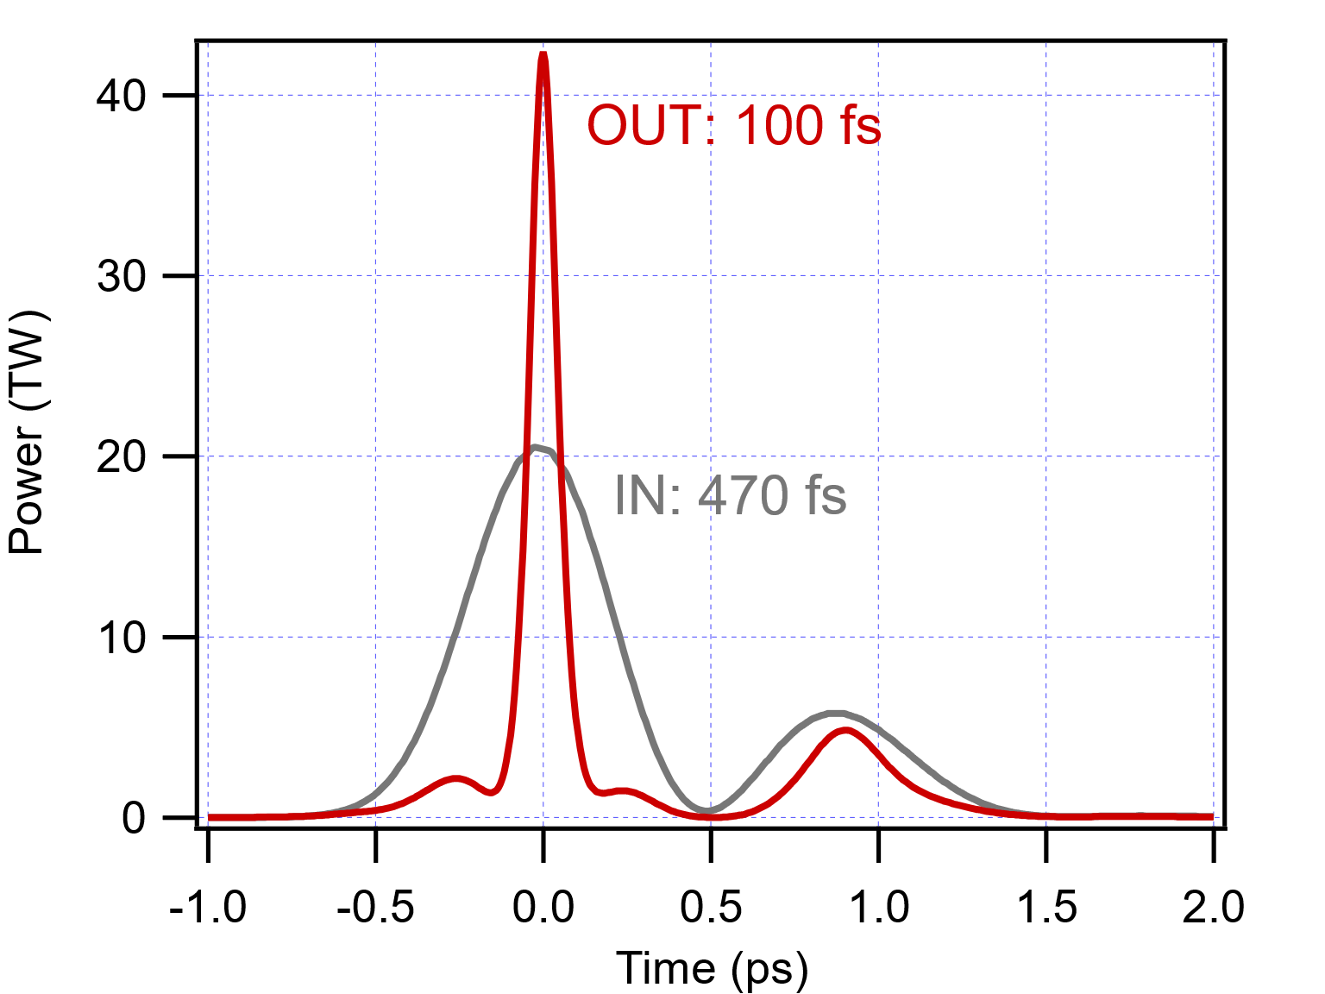
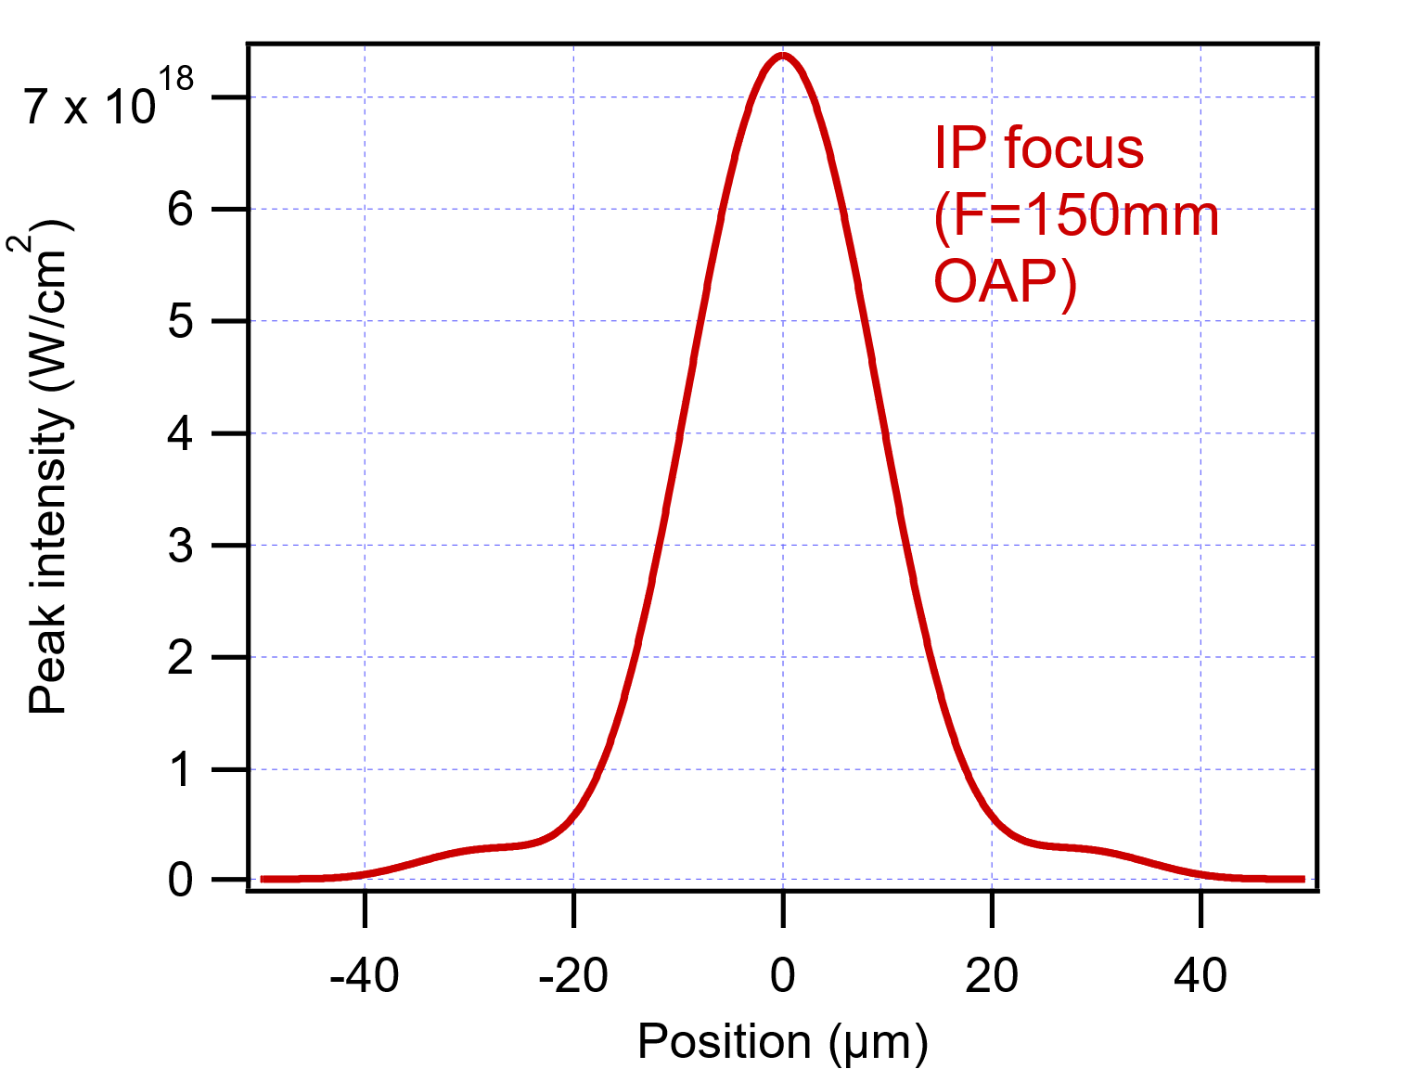
500 fs → 100 fs at full energy
Input beam profile
Temporal pulse structure
Beam focus (IP)

Slide 17
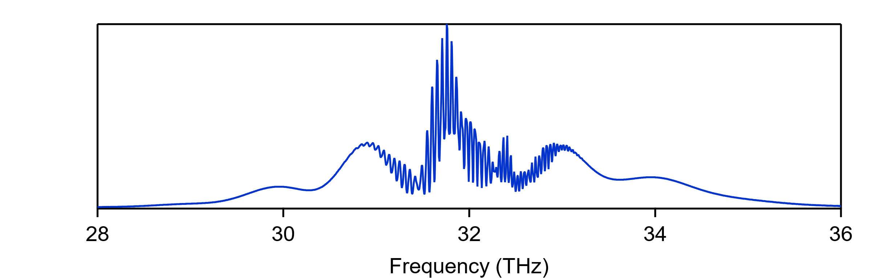
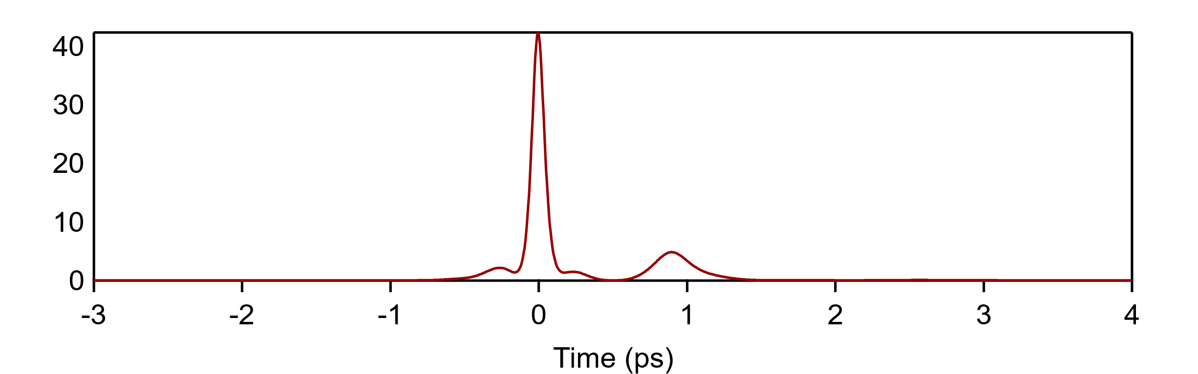
9R
Gain spectrum
With 20% contingency
9P
Now
(µJ seed)
9.2 μm
2 ps
5 TW
mJ seed
9.3 μm
500 fs
15 TW
Power (TW)
Post-compression
100 fs
25 TW
1 optical cycle = 31 fs

Slide 18
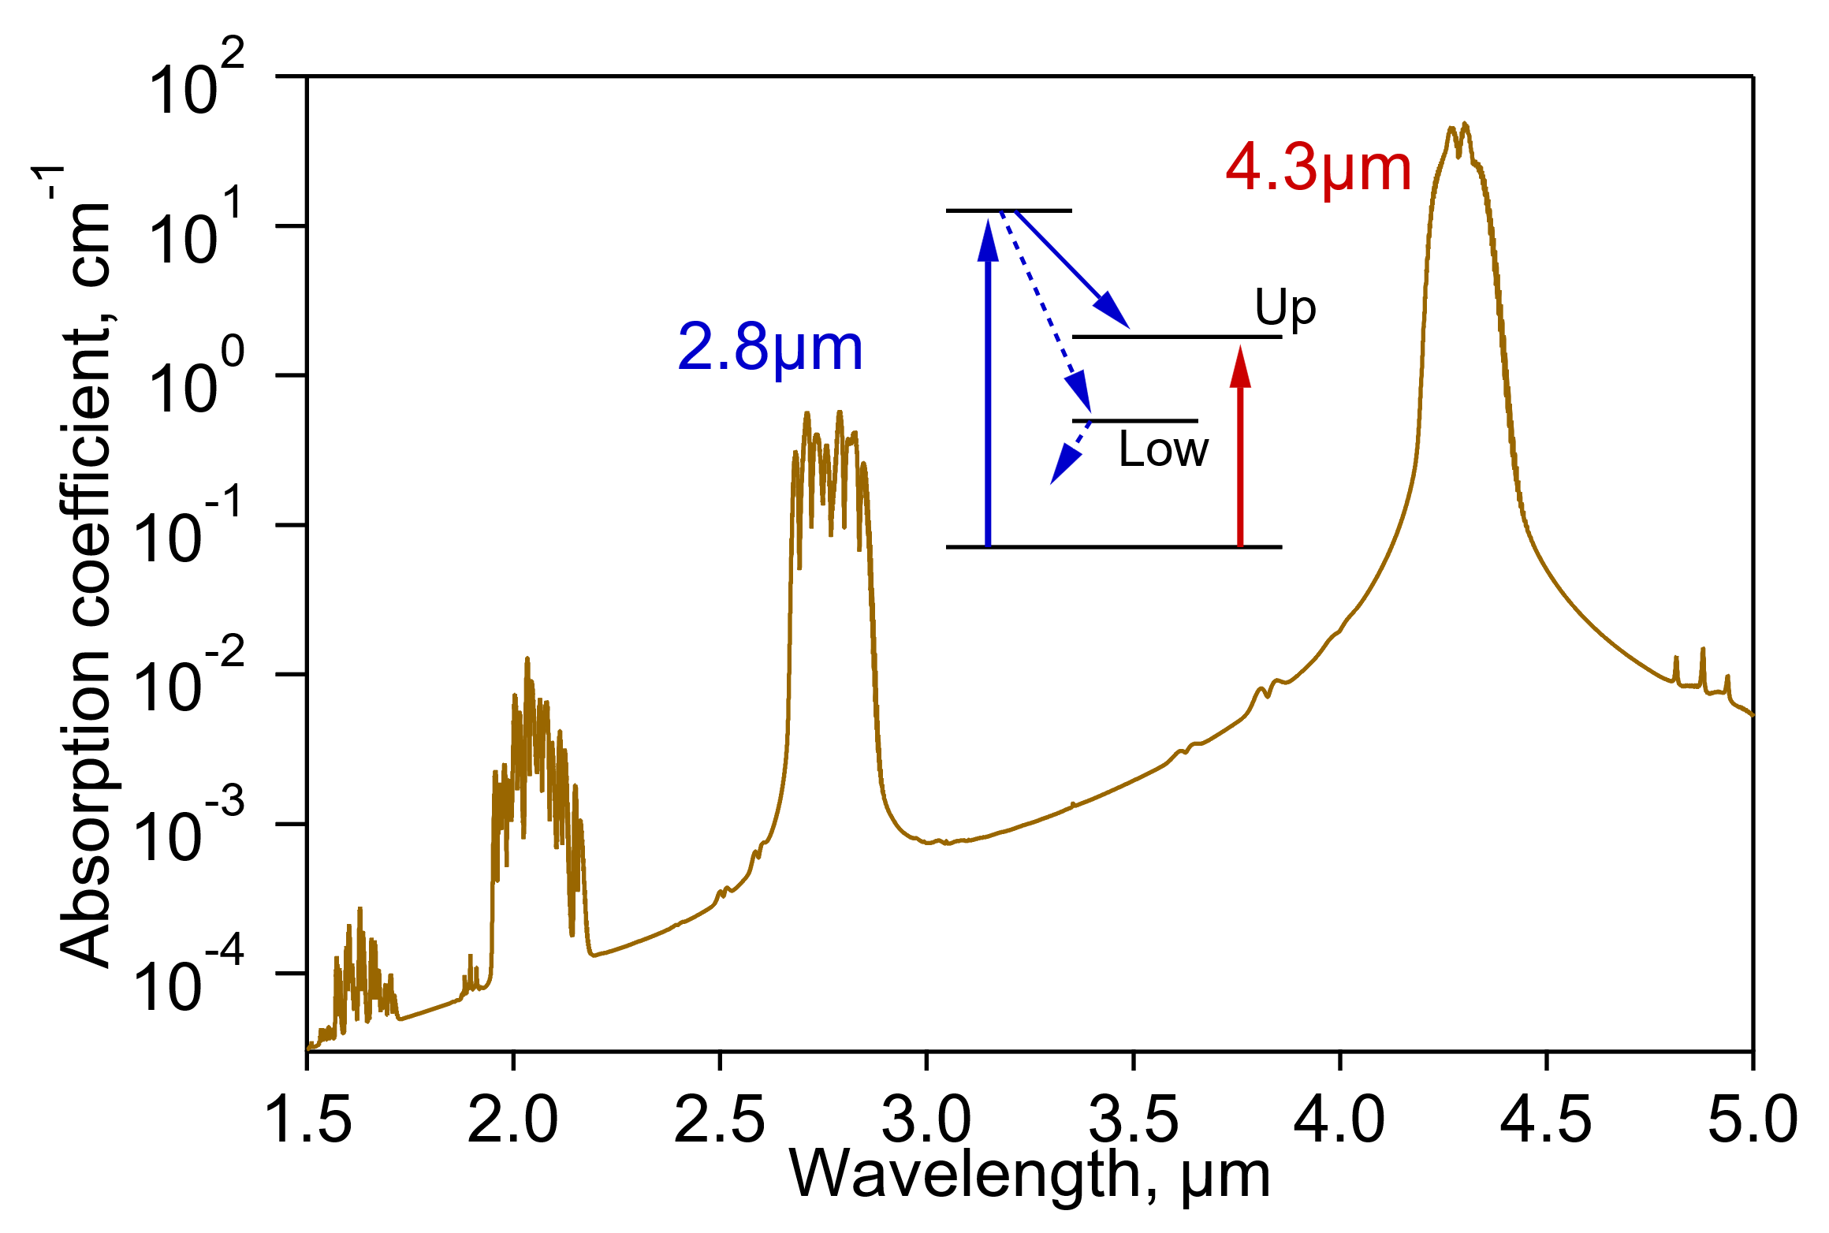
Optical pumping of CO₂ amplifiers
Sergei Tochitsky – AAC’22 WG8
Status and prospects of optically pumped high-pressure CO₂ amplifiers
24/7 operation
High repetition rate
High CO₂ concentrations
4.3 µm: Fe²⁺: ZnSe
2.8 µm: GaSb diode
Required pump energy
(~100 mJ/cm³, <few µs)
Pre-amplifier: ~1 J
Final amplifier: ~1 kJ
R&D
Long-term
goal

Slide 19
State of the art: 5 TW @ 9.2 μm, 2 ps
  Solid-state seed (μJ)
  High-pressure, mixed-isotope CO₂ amplifiers
  CPA
Next gen: 25 TW, @ 9.3 μm, 100 fs
  Solid-state seed **mJ**
  Post-compression
  Optical pumping (next-next gen)
Notes:
Limited by voltage
Alternating current
Always see accelerating field
Short but intense bunches
Most modern accelerators
--- 6 ---

