Slide 1
Working Group 7
Radiation Generation and Advanced Concepts
John Palastro (Rochester) and Julia Mikhailova (Princeton)
34 submissions, 22 talks, 12 posters
4 joint sessions with WG 2, WG 4, WG 5, WG 8
Plenary speakers:
Angelo Biagioni – “First SASE and Seeded FEL Lasing Based on a Beam-driven Wakefield Accelerator”
Agostino Marinelli – “Plasma-based Attosecond X-ray Pulses”

Slide 2
WG 7 Areas of Interest
Radiation generation relevant to advanced accelerators:
betatron radiation by electrons oscillating in plasma-ion fields,
undulator radiation, plasma-based free-electron lasers,
Compton and Thomson scattering, coherent transition radiation, Bremsstrahlung,
THz and high-harmonic generation in plasmas;
Radiation with unique properties:
ultra-short pulses, polarization-controlled, multi-color, and spatiotemporally structured beams, light with orbital angular momentum;
Applications of radiation sources:
Diagnostics of materials and dynamic systems, radiography, tomography, pump-probe methods;
Improved laser or electron beam performance for radiation applications:
phase-space manipulation and cooling, space-time structuring.

Slide 3
WG 7 Themes in 2022
FEL-based X-ray Sources and Alternatives
Emission from Wakefields
Compton and Thomson Scattering
Radiography Using X-Ray and Electron Beams
Electron Beam Manipulation and Cooling
Positron Sources and QED Studies
Low-Frequency Radiation Sources

Slide 4
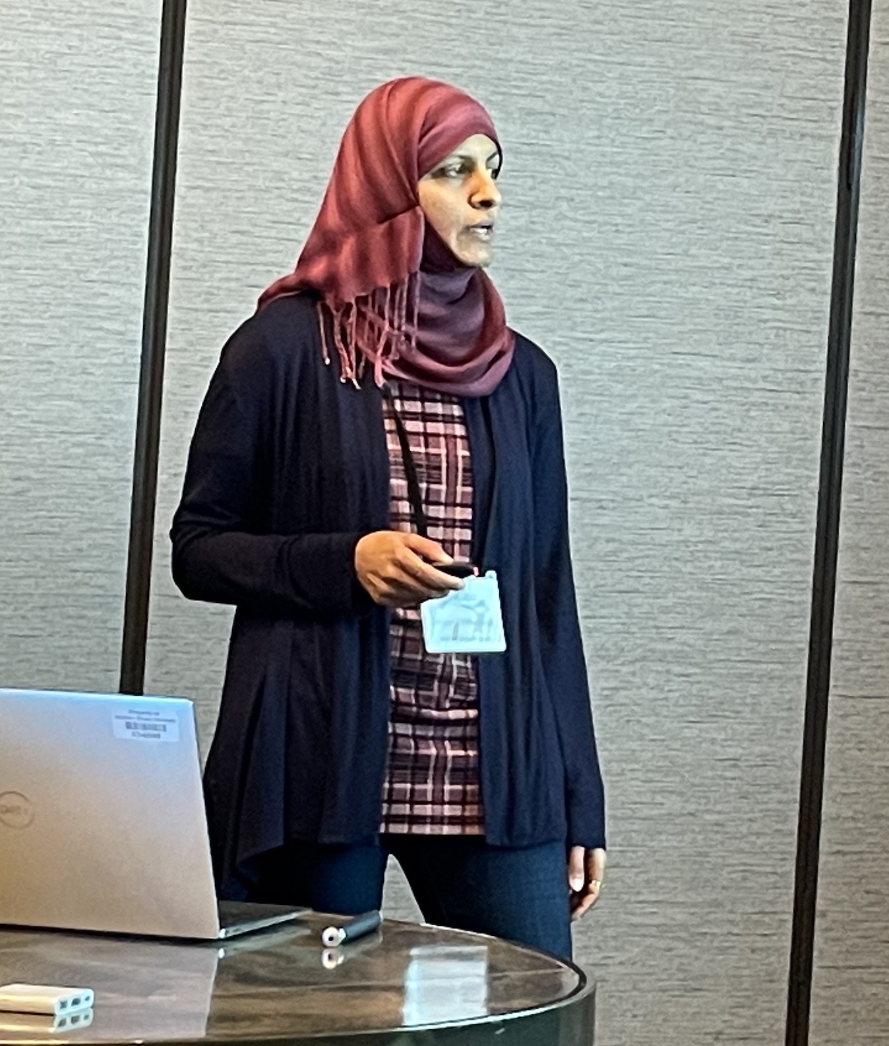
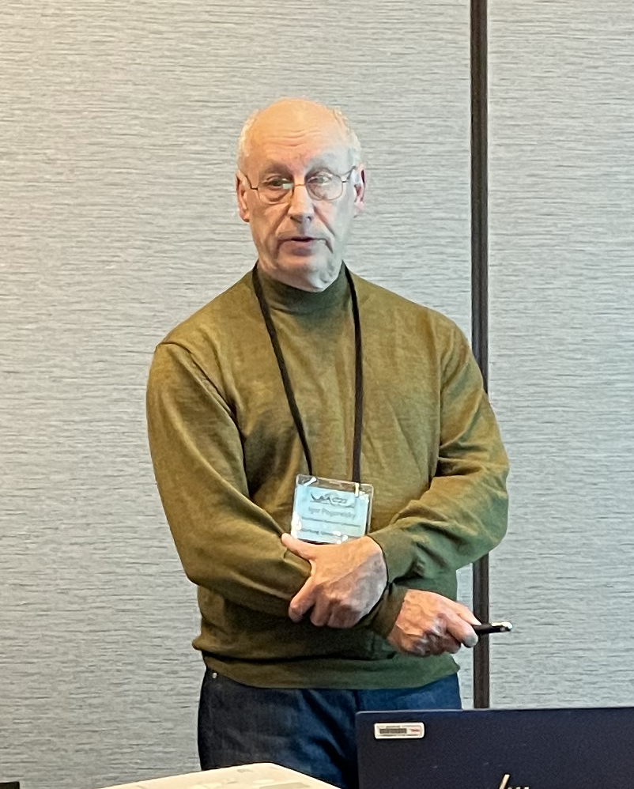
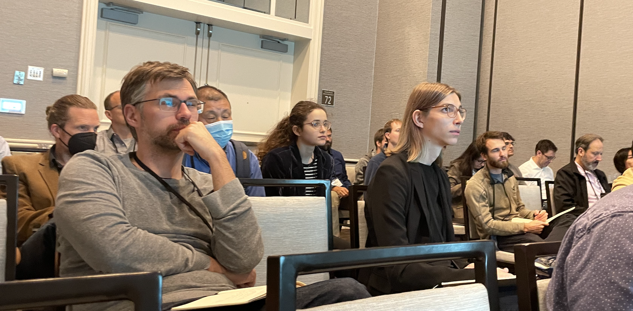
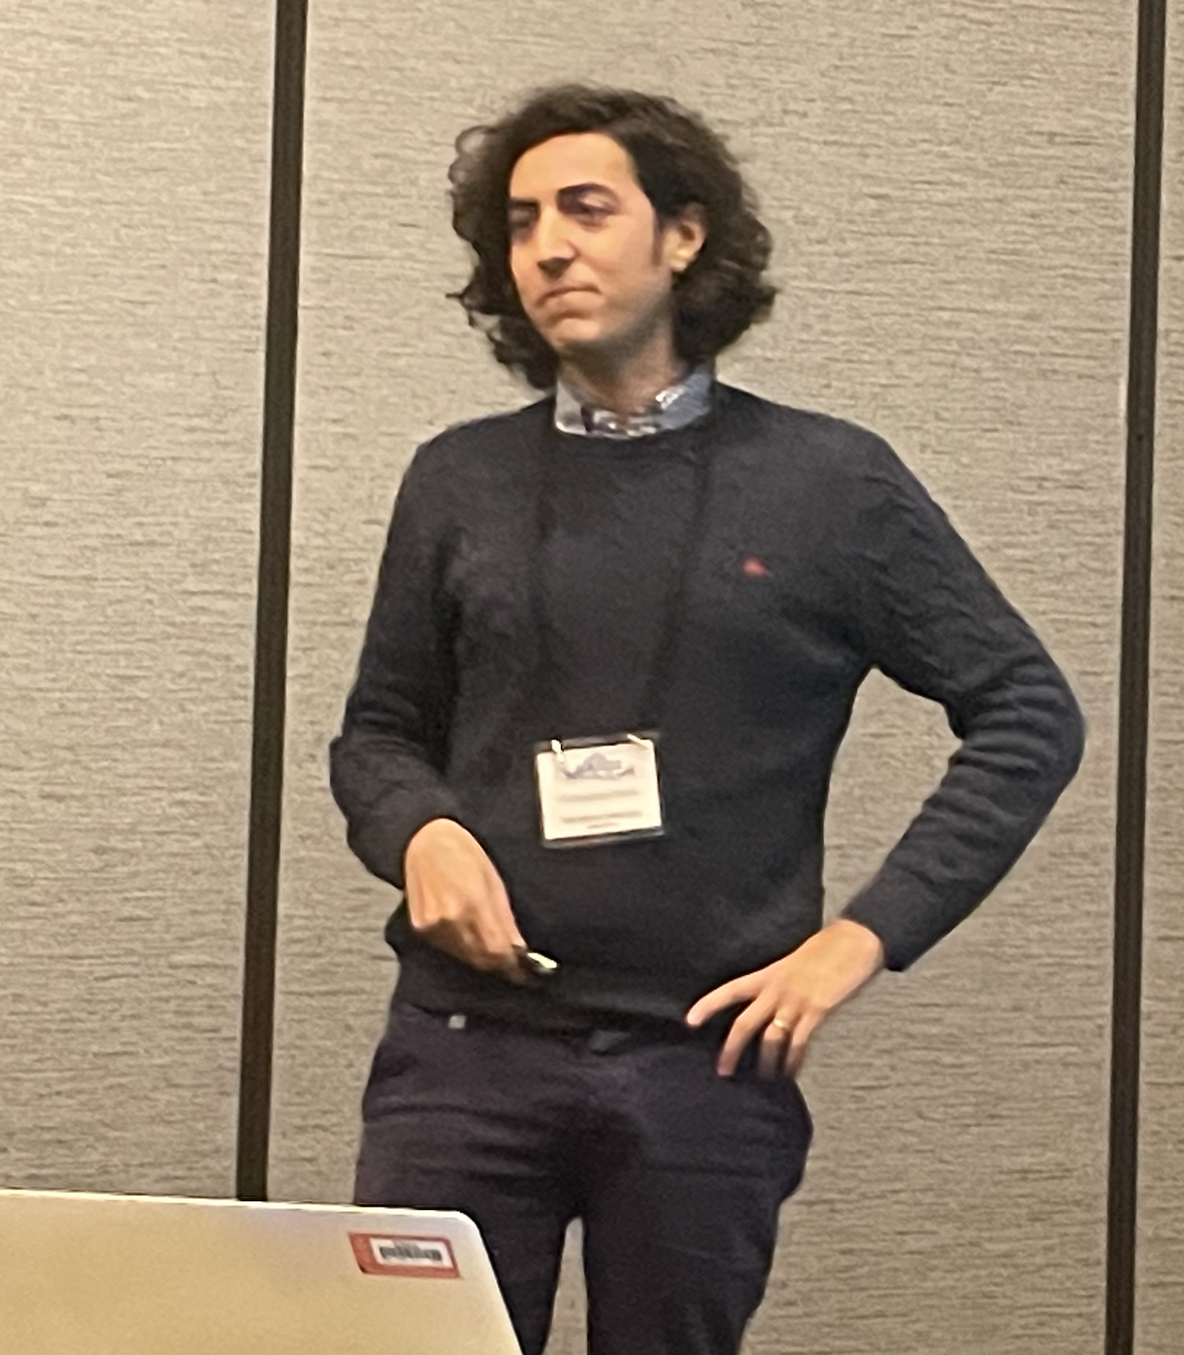
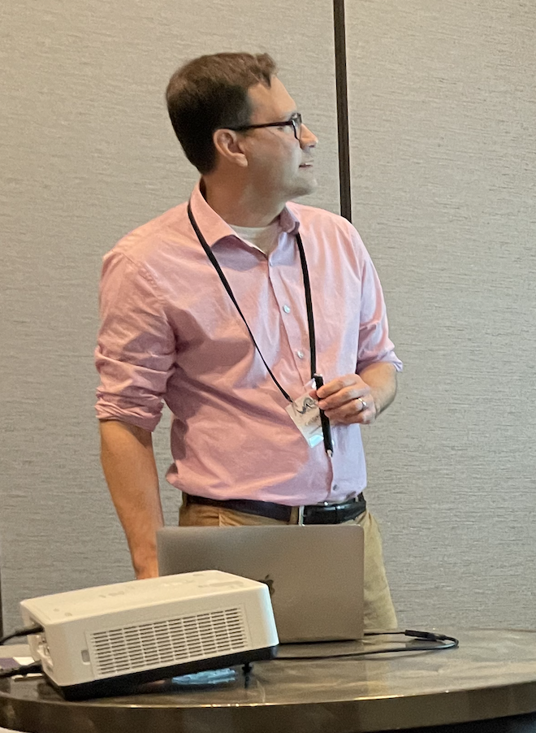
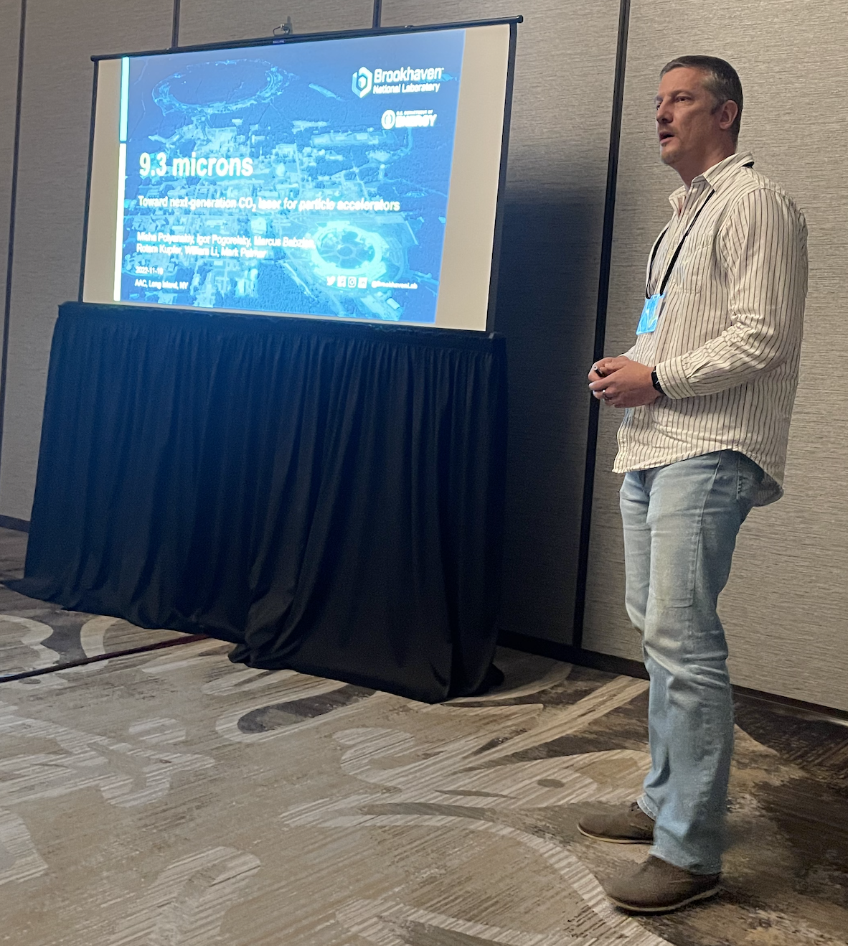
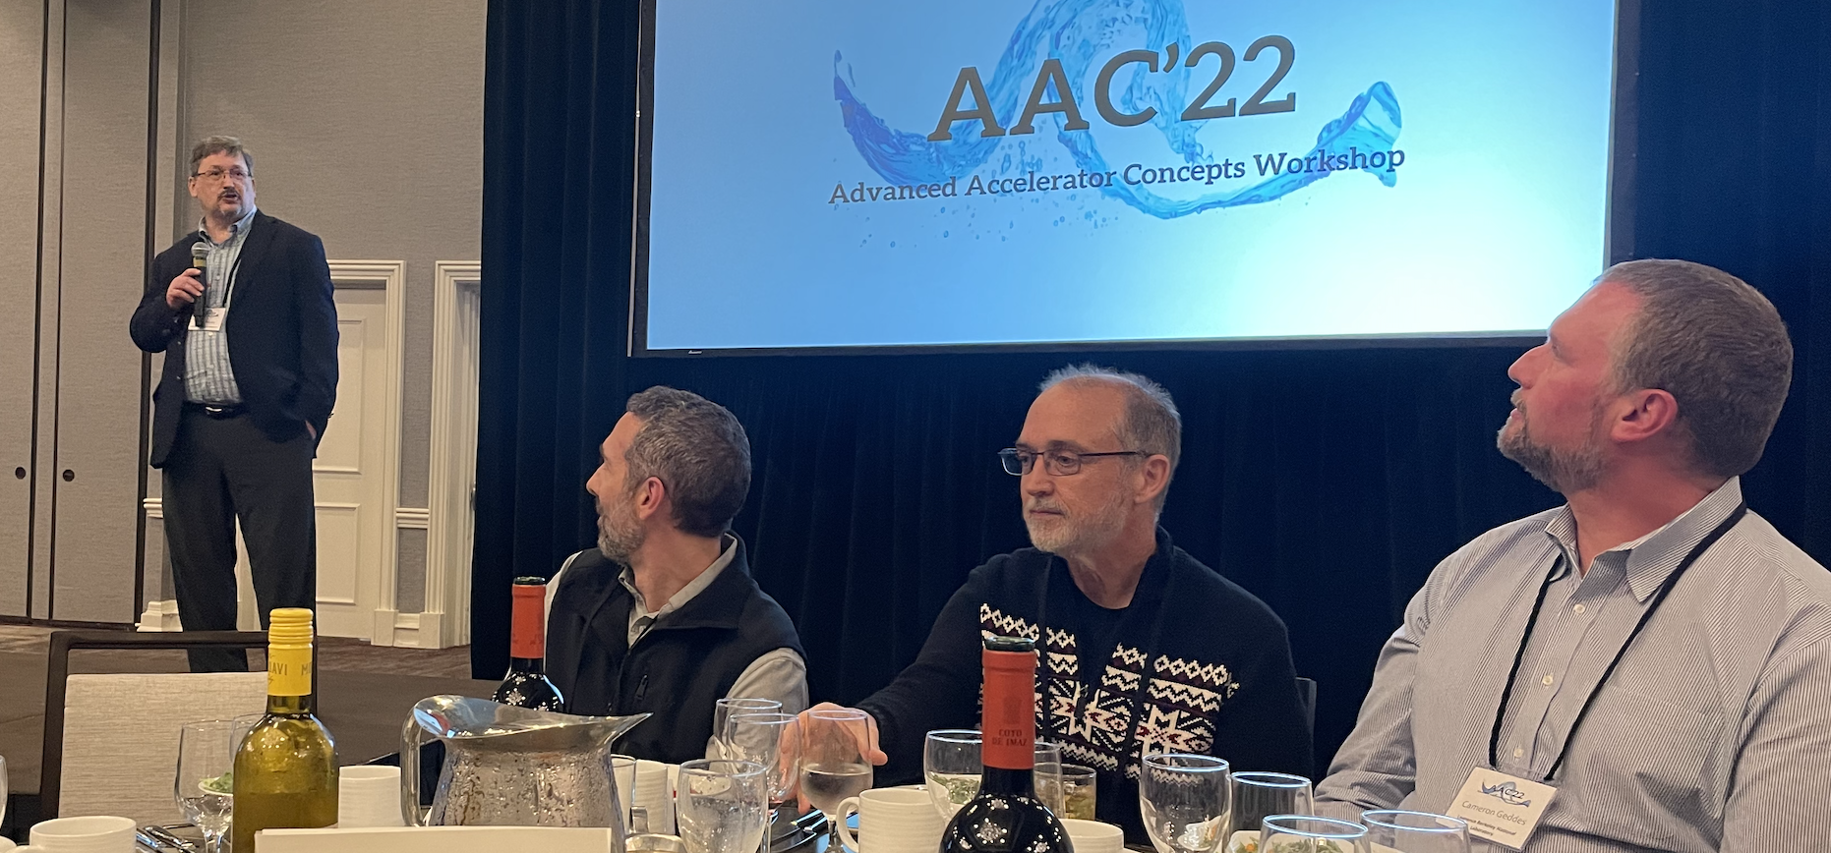
WG 7 people in 2022

Slide 5
1. FEL-based X-ray Sources and Alternatives

Slide 6
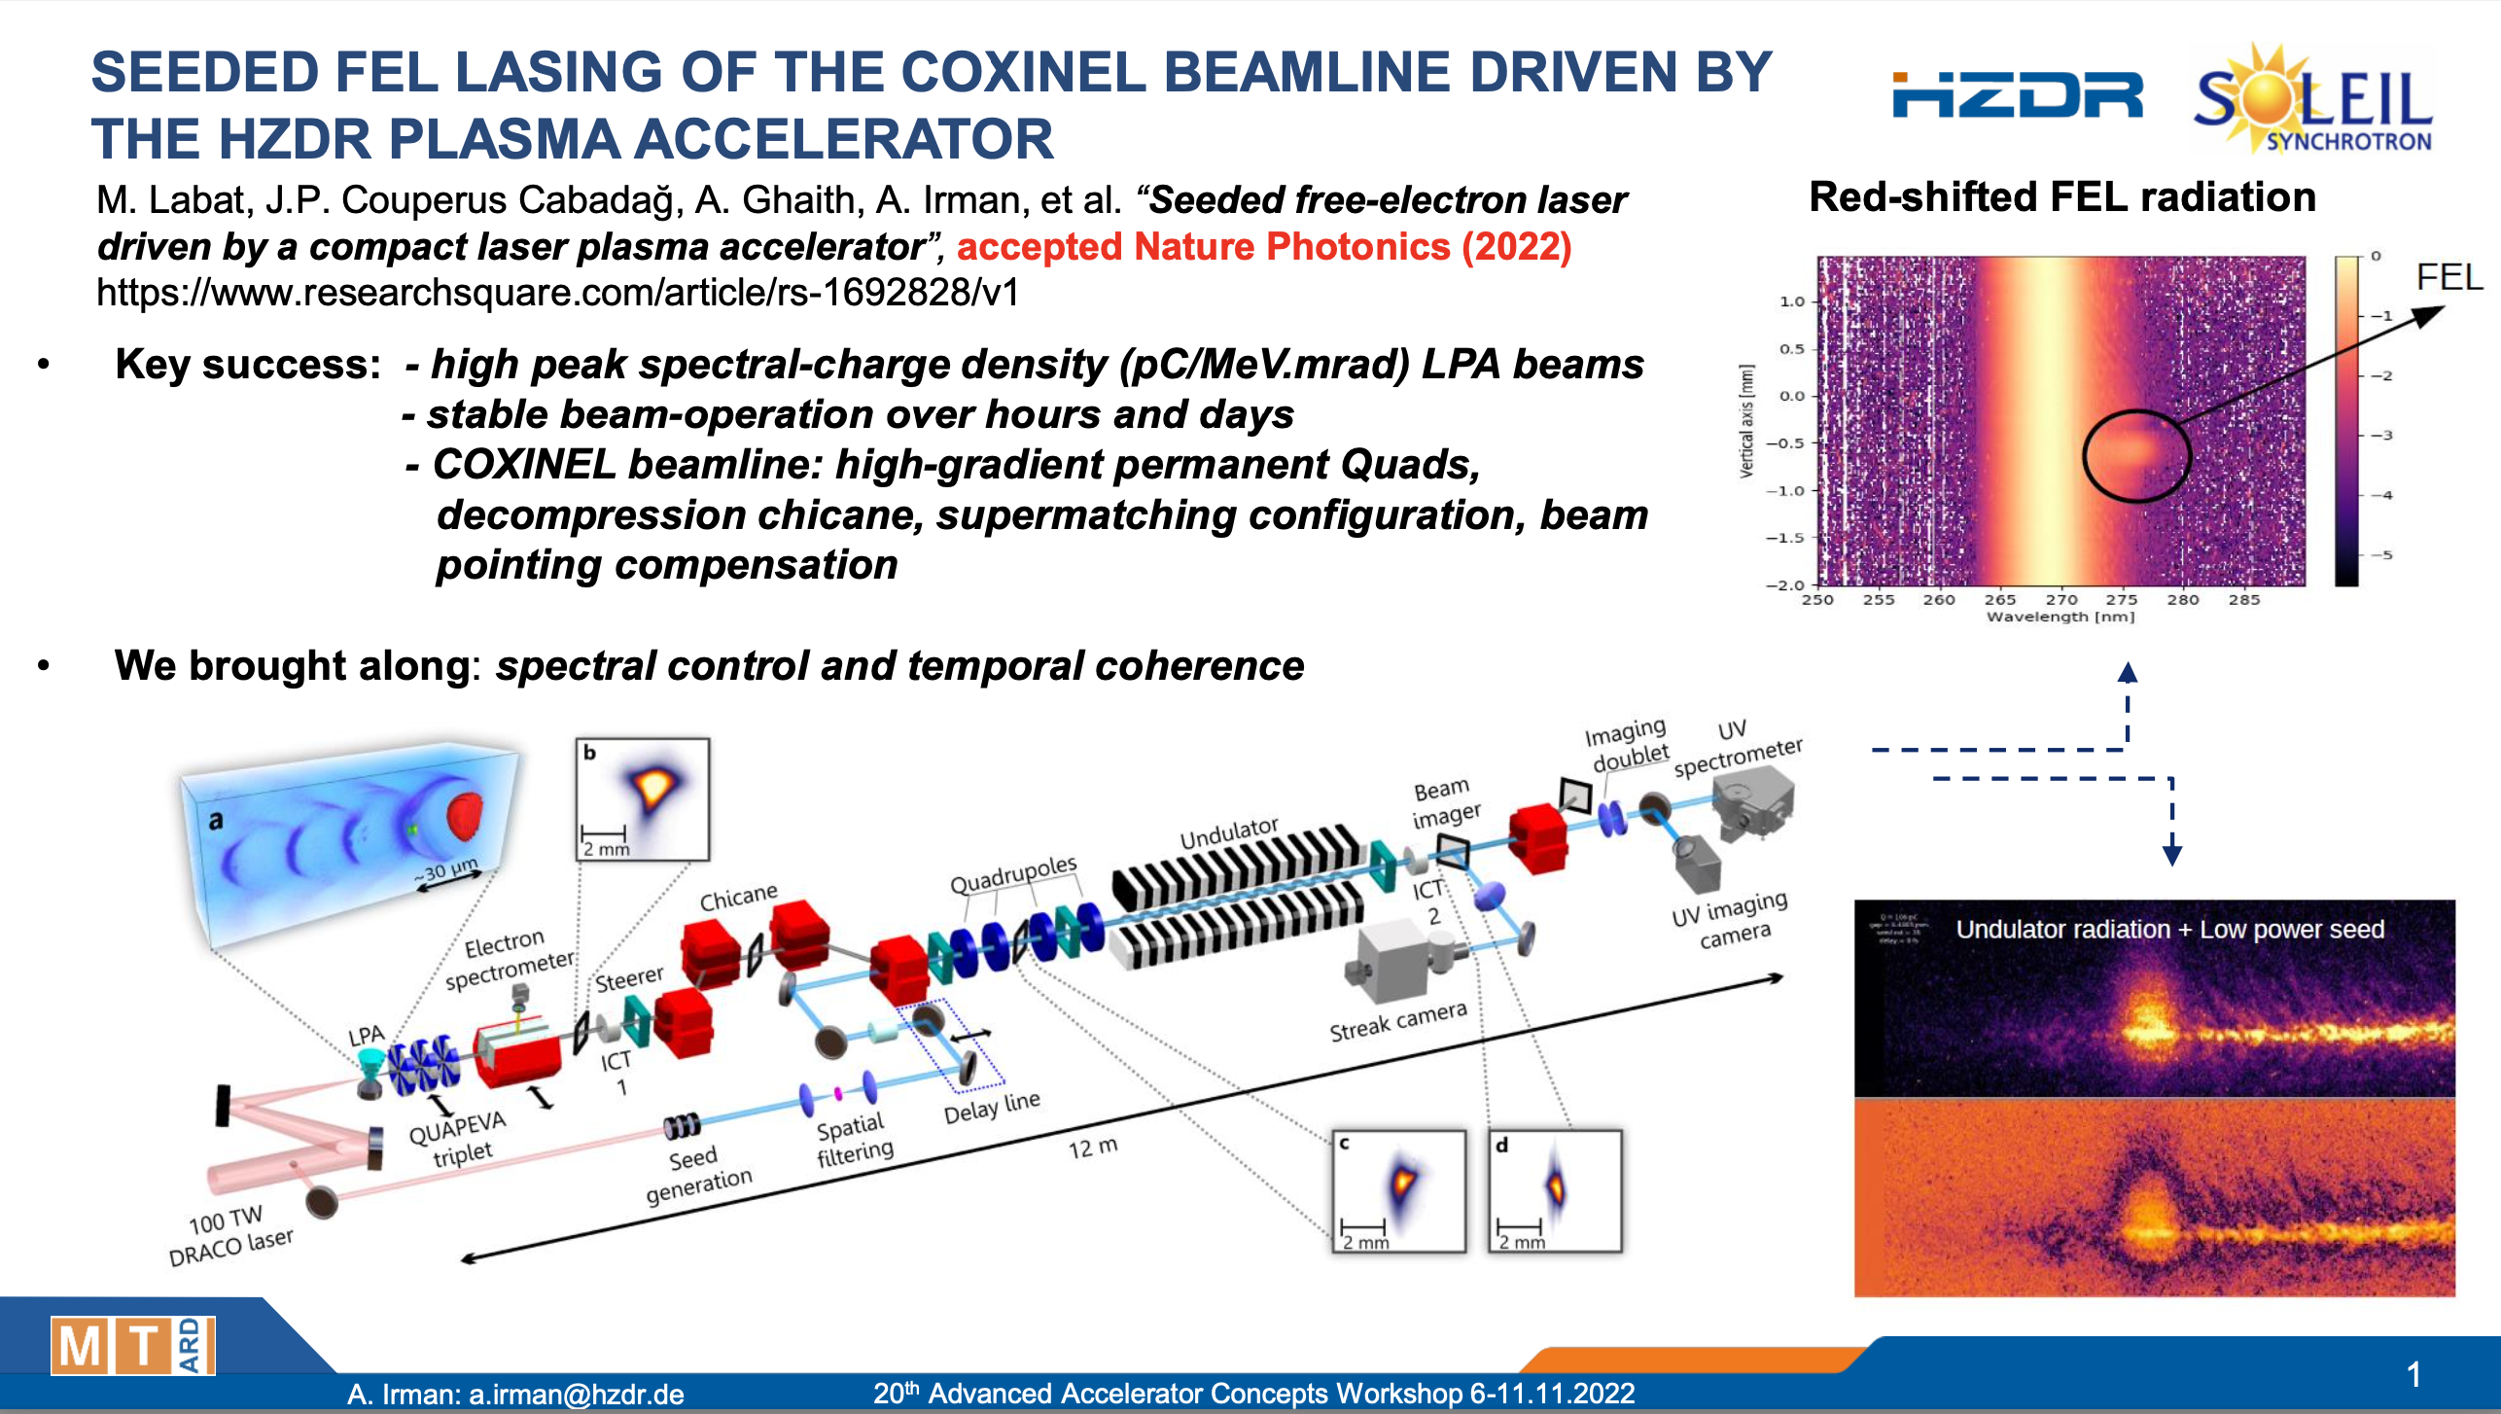
Notes:
This was report on the commissioning of the COXINEL beamline driven by the HZDR plasma accelerator and demonstration of FEL lasing at 270 nm in a seeded configuration.
Helmholtz-Zentrum Dresden-Rossendorf

Slide 7
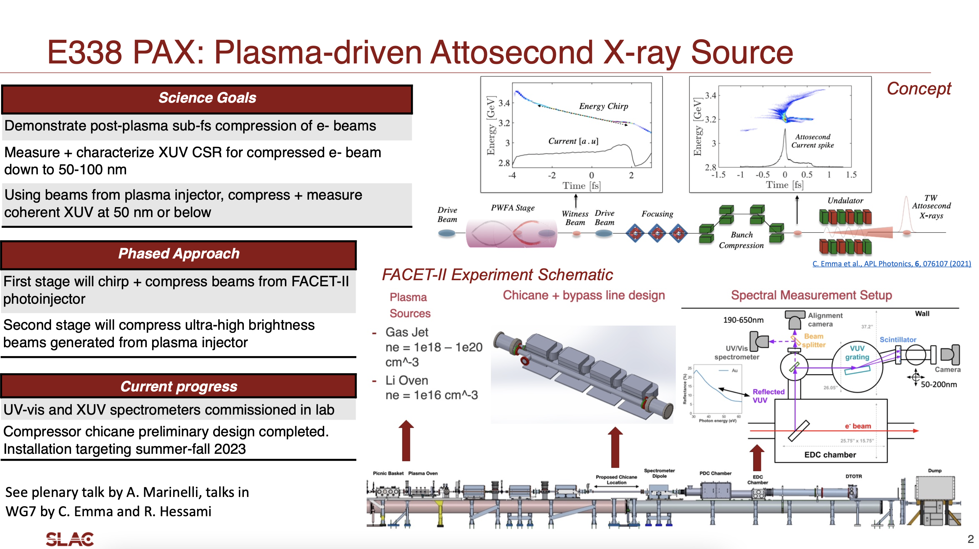
Claudio Emma et al
Notes:
The report on ongoing Plasma-driven Attosecond X-ray source experiment (PAX) at FACET-II aiming to produce coherent soft x-ray pulses of attosecond duration using a Plasma Wakefield Accelerator [1].
chirp and compress high-brightness electron bunches to nm-scale lengths. The resulting charge distribution can emit coherently in the soft X-ray range, resulting in few-cycle pulses with TW peak powers.
As a future upgrade to this concept, we investigate scaling to shorter soft X-ray wavelength by cascading undulators tuned to higher harmonics of the fundamental in a coherent harmonic generation (CHG) configuration. This configuration leverages the increase in the bunching factor of the higher harmonics to produce radiation at the fifth and tenth harmonics, corresponding to radiation wavelengths of 2 nm and 1 nm. In this contribution, we consider two CHG schemes. The first consists of using three 20 period-long undulator stages tuned to the fundamental, the fifth harmonic, and the tenth harmonic respectively, while the second consists of 20 periods at the fundamental, then 40 at the tenth harmonic. We demonstrate in both of these schemes using undulators with retuned fundamental frequencies can produce TW-scale pulses of fifth and tenth harmonic radiation with tens of attosecond-scale pulse lengths, an order of magnitude shorter than current state-of-the-art attosecond XFELs.

Slide 8
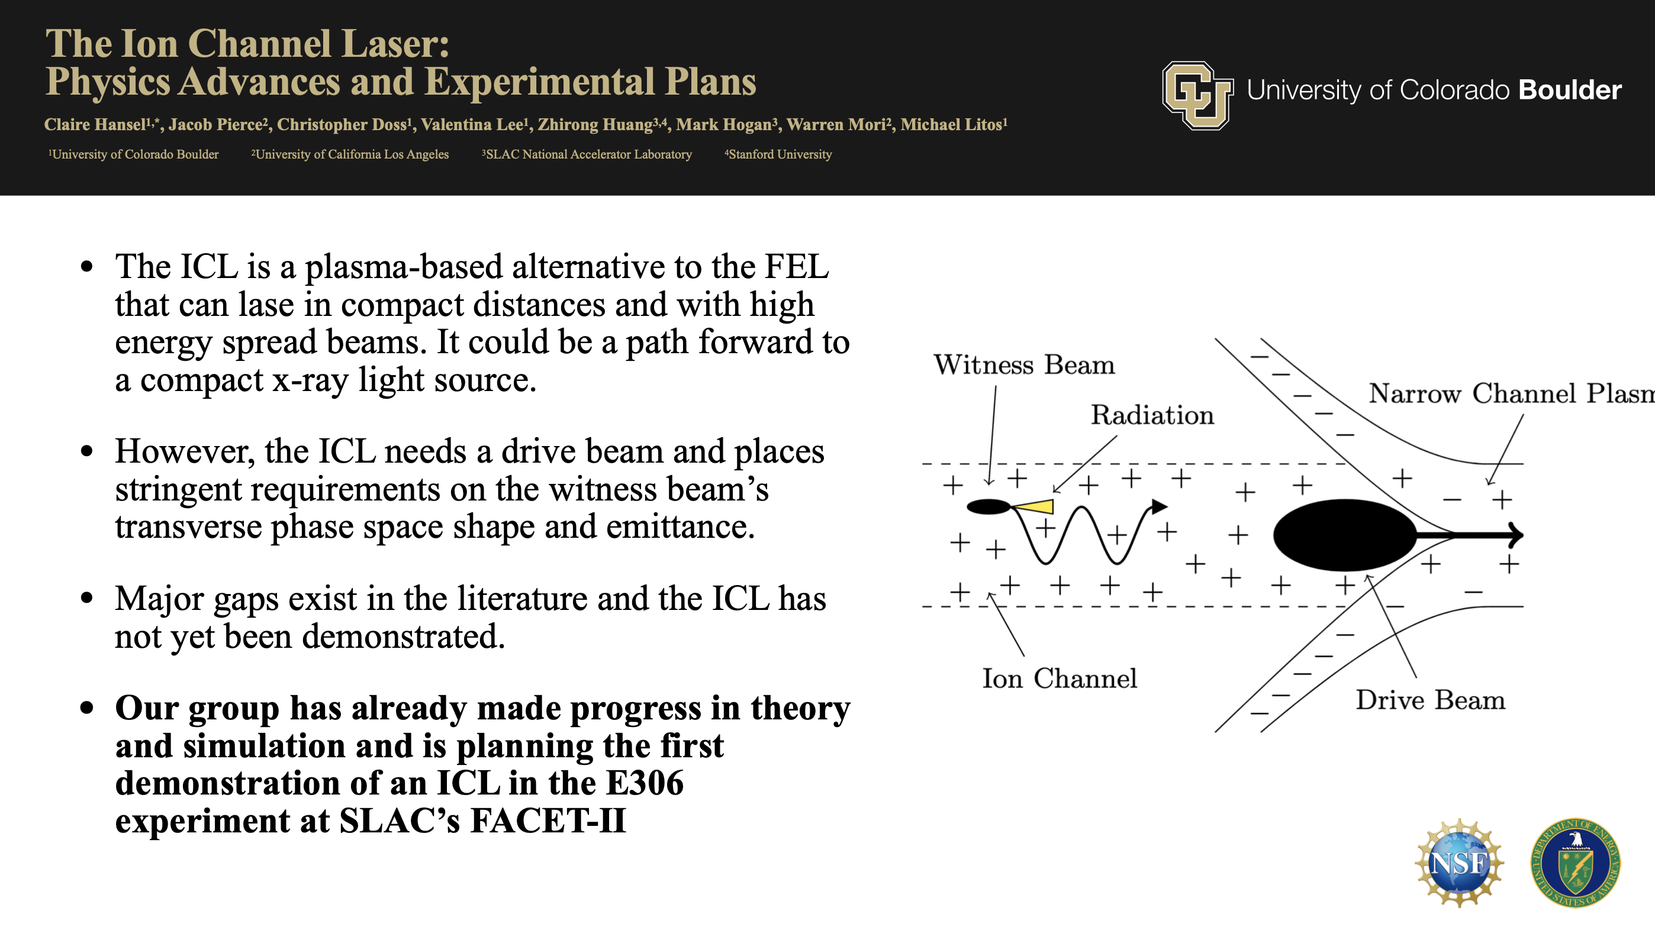
Notes:
The ion channel laser (ICL) is an alternative to the free electron laser (FEL) that uses the electric fields in an ion channel rather than the magnetic fields in an undulator to transversely oscillate a relativistic electron beam and produce coherent radiation.

Slide 9
2. Emission from Wakefields

Slide 10
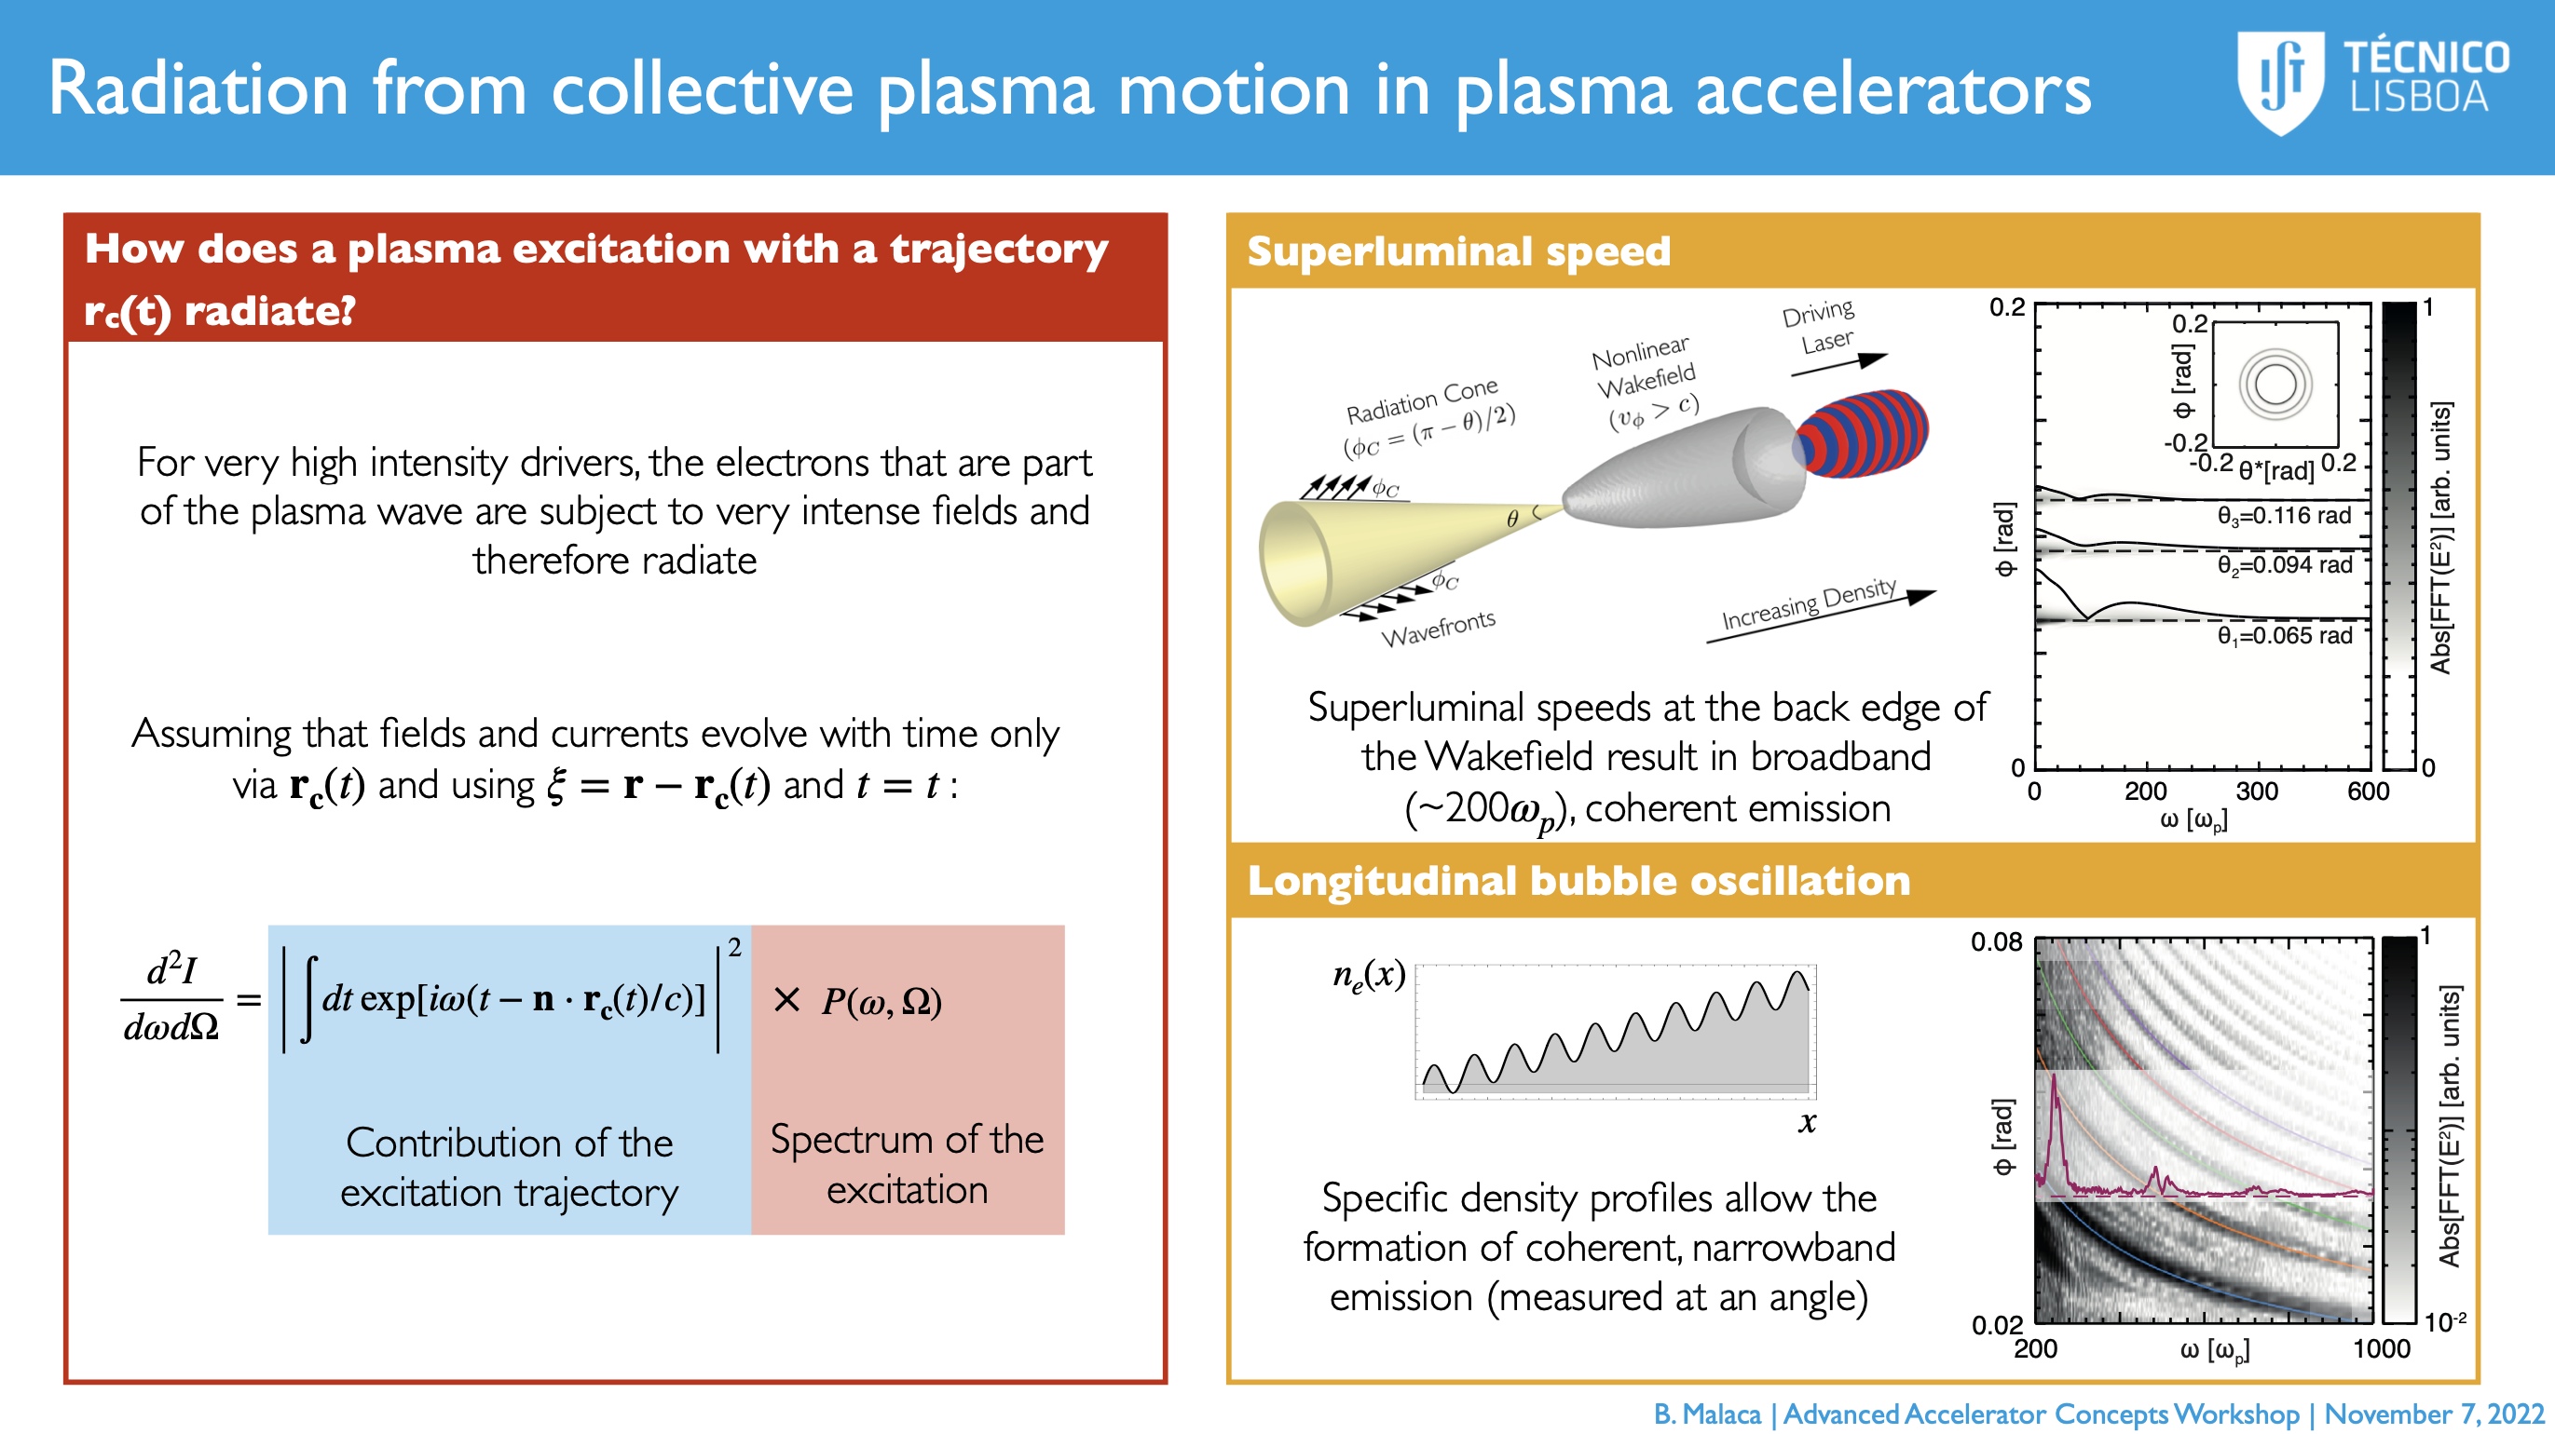

Slide 11
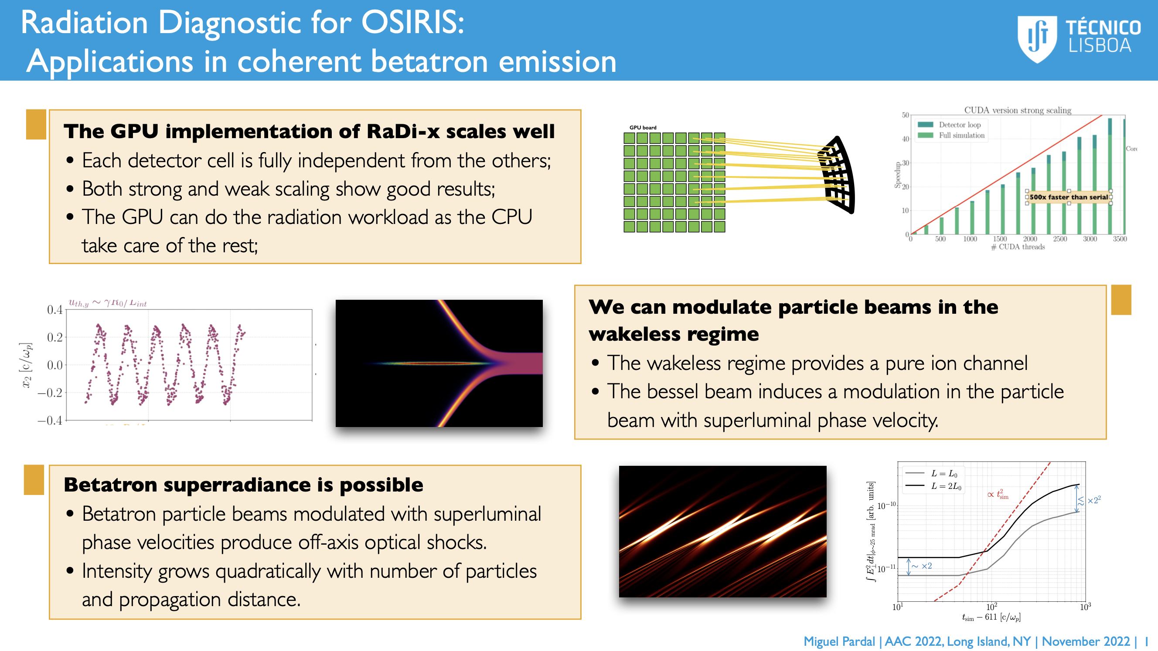

Slide 12
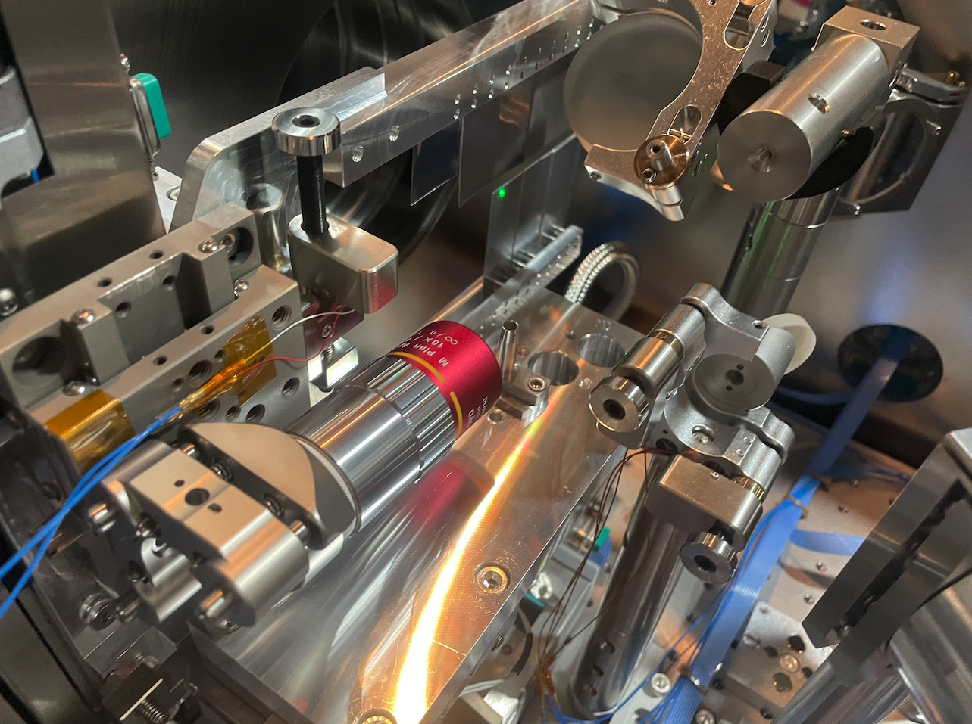
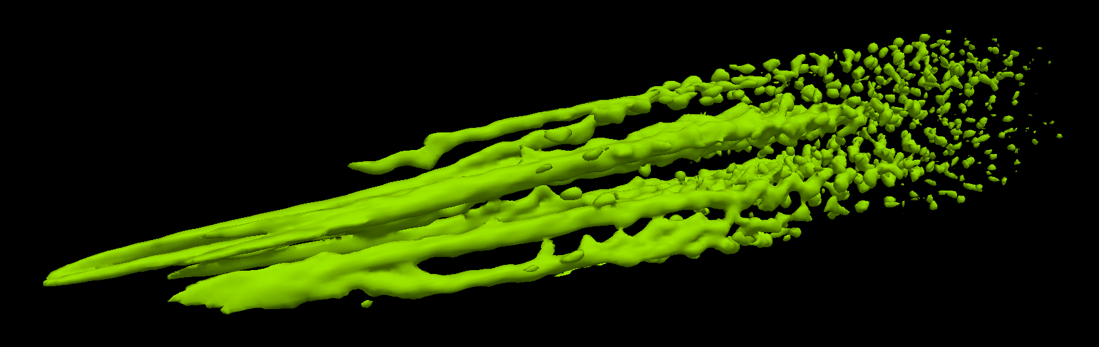
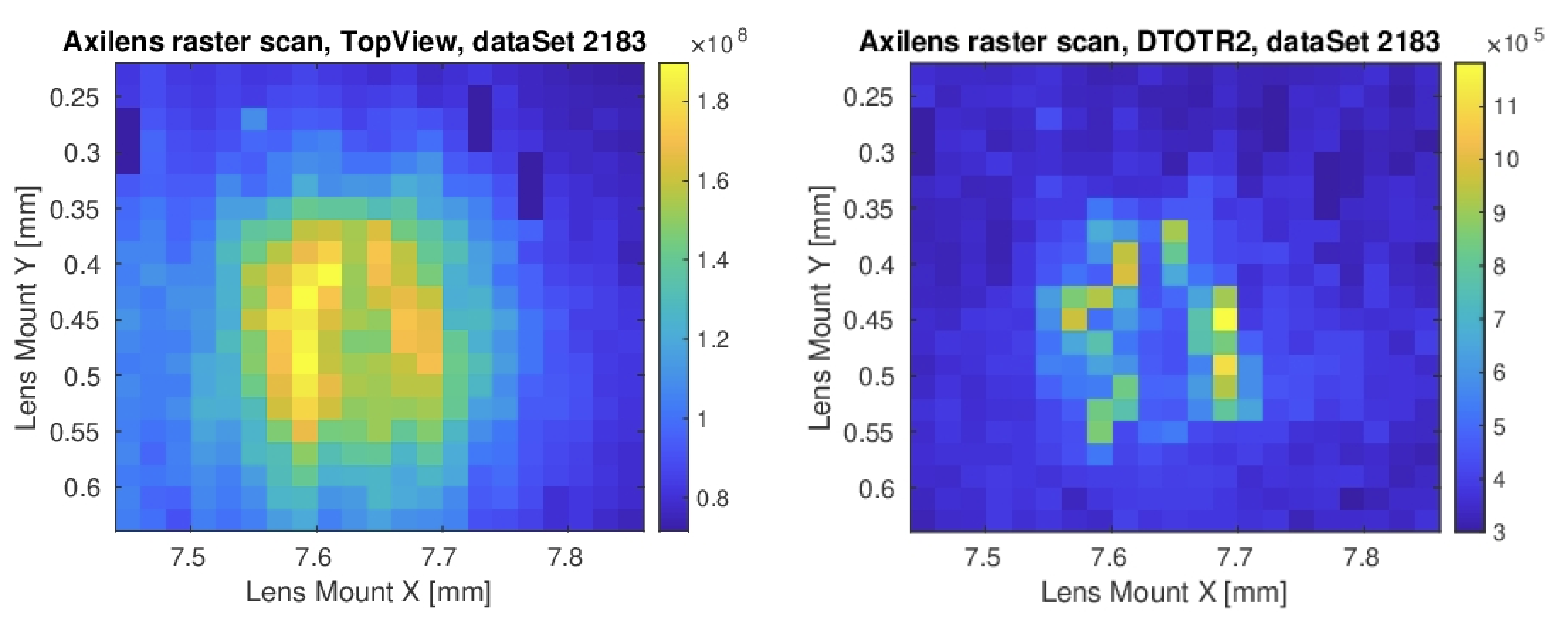
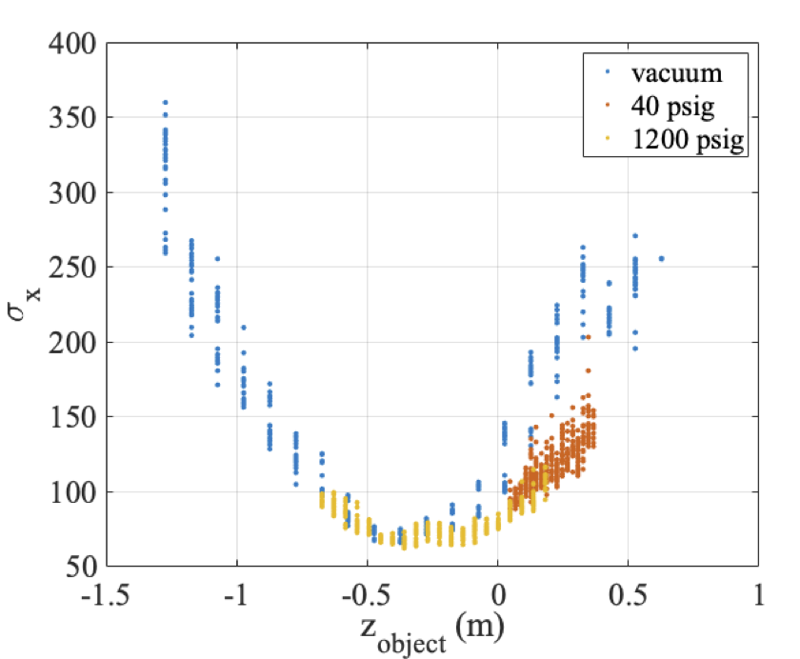
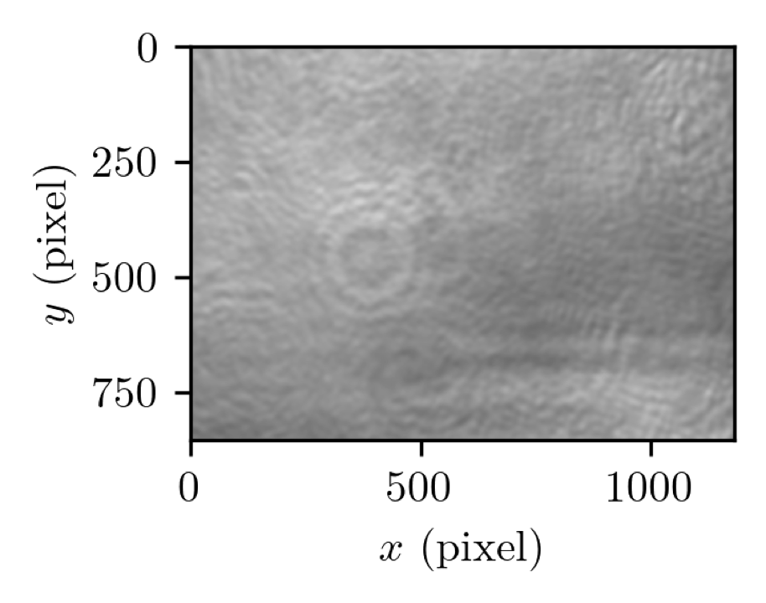
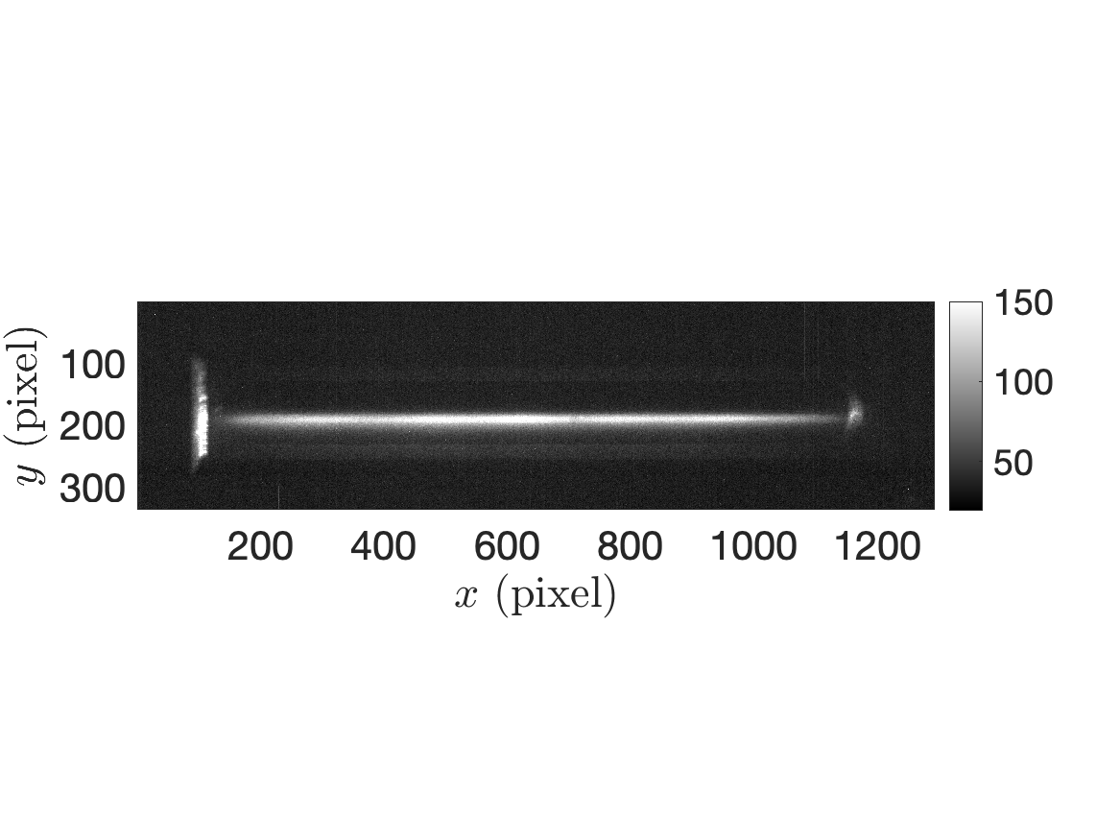
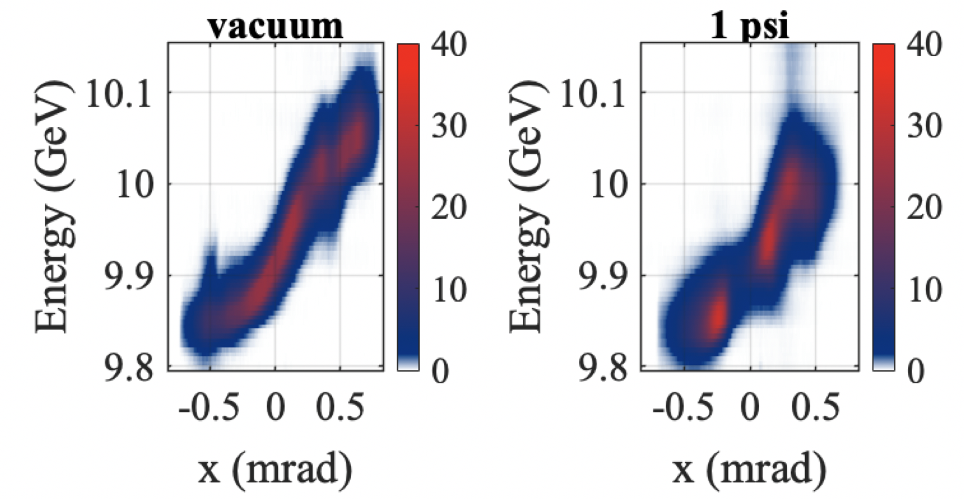
FACET-II E-305: Beam filamentation and bright gamma-ray bursts – First results
Knetsch et al
Study of relativistic streaming instabilities with the FACET-II electron beam
Solid targets
Top view
Alignment and synchronisation
e-beam
High resolution imaging spectrometer
Gas jet
shadowgraphy
Ionizing laser
Ion. front
Laser-ionized high pressure gas jet
Good progress on setup commissioning
First experiments reveal important observables and the path forward
Notes:
Electron beam filamentation in underdense plasmas. No gamma ray (betatron emission) amplification found.

Slide 13
3. Compton and Thomson Scattering
Notes:
Incoherent

Slide 14

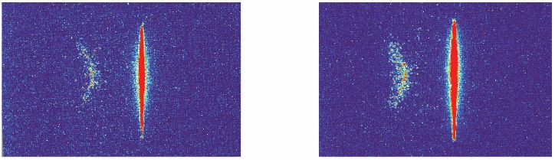
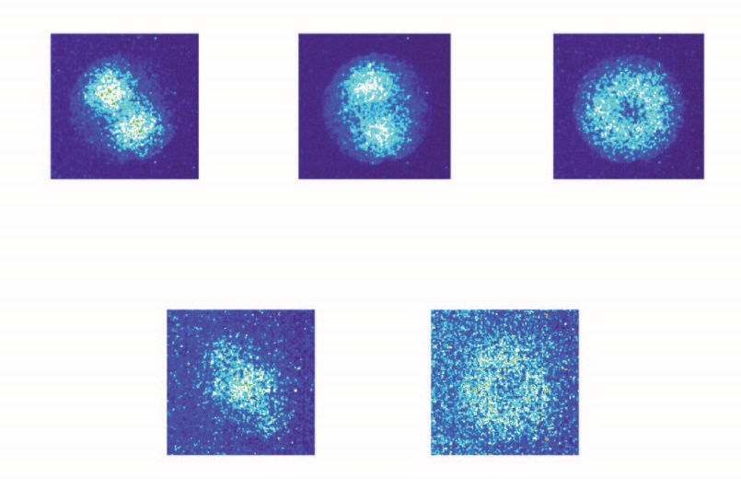
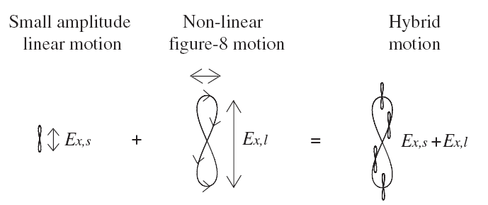
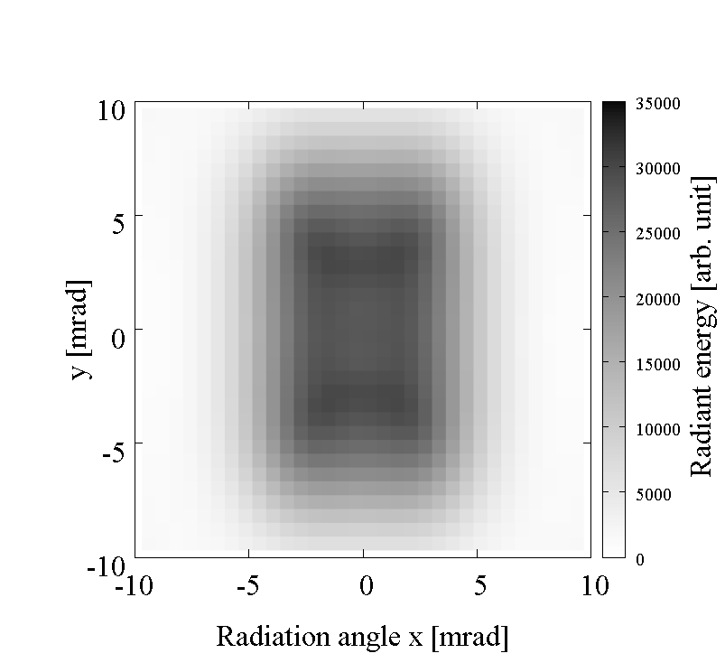
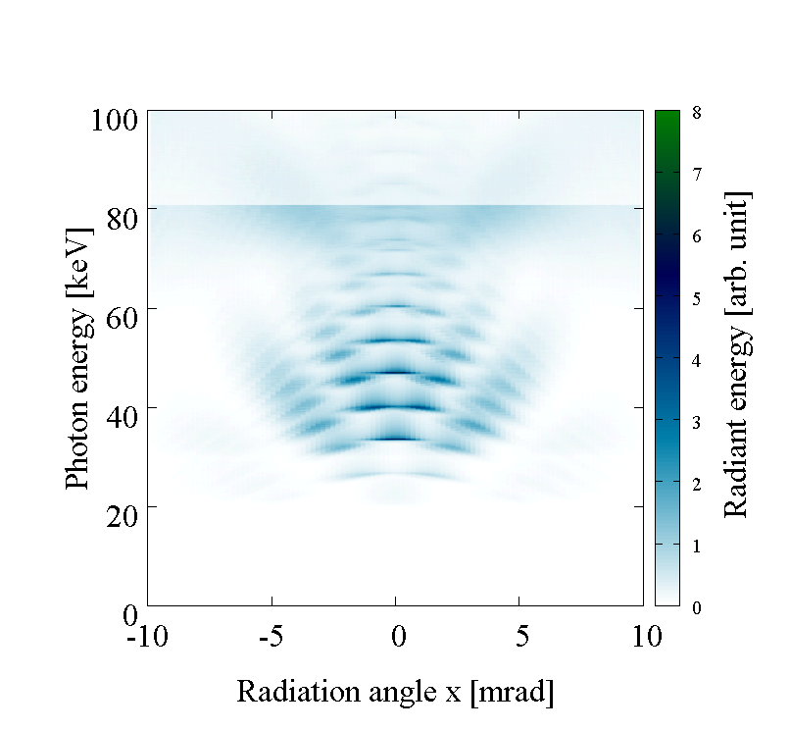
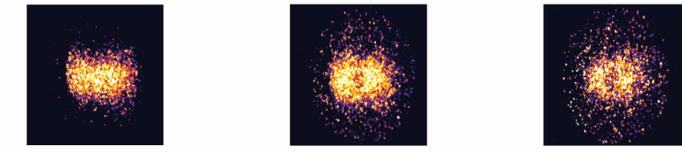
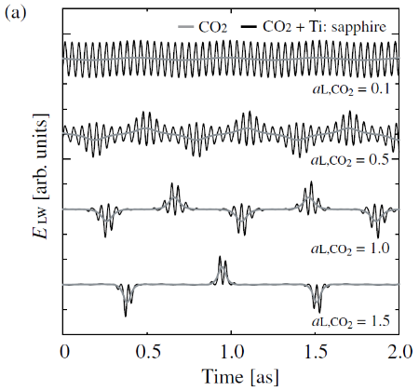
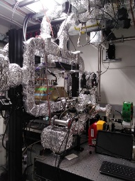
✪ Applications: Photon activation (with AuNP) as Medicine & Radiography of high Z materials
✪ Strong field physics: Bi-harmonic Compton interaction with ATF’s CO₂ laser
✪ Hard X-ray optics developments: DDS measurement & Focusing or Collimation, NSLS II 150keV
✪ X-ray OAM investigation: Higher order harmonics by circular polarized CO₂ laser
Status report of
nonlinear Inverse Compton Scattering study BNL-ATF, UCLA-PBPL
Yusuki Sakai, et al
Linear, 2rd Elliptical, 2nd Circular, 2rd
Linear, 3rd Circular, 3rd
OAM X-Ray: Higher order harmonics
CO₂ laser energy a_{L} = 0.7 (1.5 J) & a_{L} = 1(3J)
Single shot DDS measurement
No-Filter Au-100μm Au-200μm
Observation of Hard X-ray at hv = 87.5 keV in a single shot
IN PARALLEL
Construction of
University scale linac
Linear ICS, UCFEL
R&Ds of guns
A few cycle X to Gamma –ray production by Bi-harmonic interaction

Slide 15
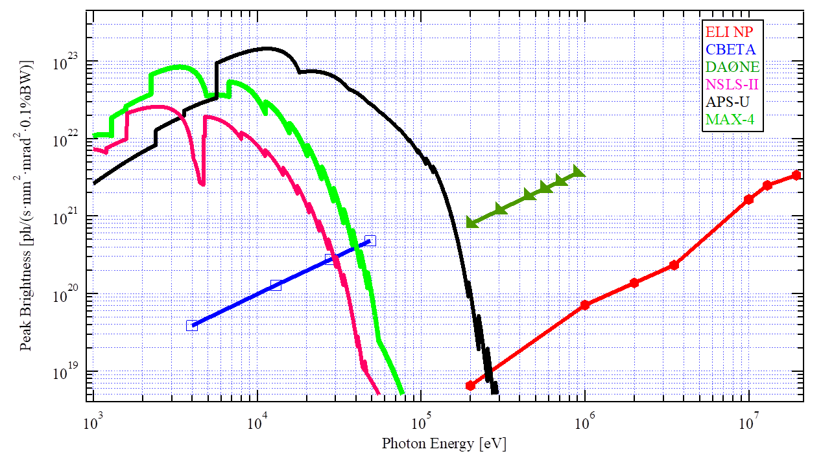
high-brilliance COMPTON LIGHT SOURCES based on CO₂ LASERs
I. Pogorelsky (ATF), M. N. Polyanskiy (ATF), T. Shaftan (NSLS II)
A new approach to synchrotron light sources with “laser undulator” where a multi-MHz solid state lasers are replaced with a multi-stage CO2 laser system operating in a pulse-burst regime at 10kHz cumulative repetition rate.
Based on concrete examples of DAΦNE and CBETA RF accelerators, they show 4-5 orders of magnitude increase in x-ray ICS peak brightness while preserving average brightness.
Such ICS sources can be used for pump-probe experiments.
5-50 ps
Multi-pass
(pulse multiplier)
The Accelerator Test Facility

Slide 16
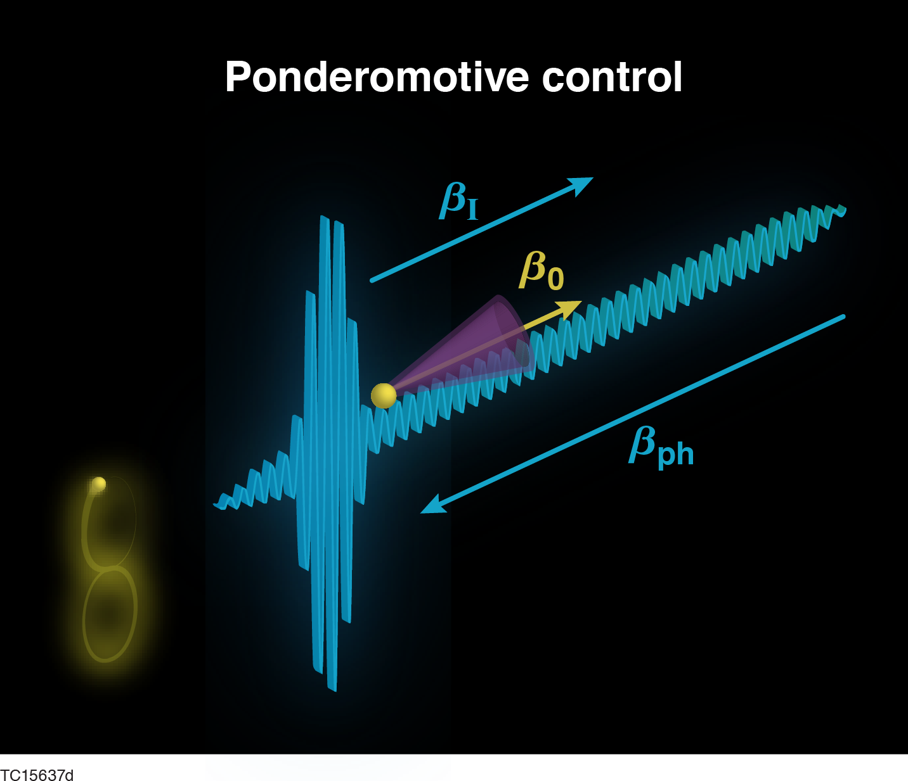
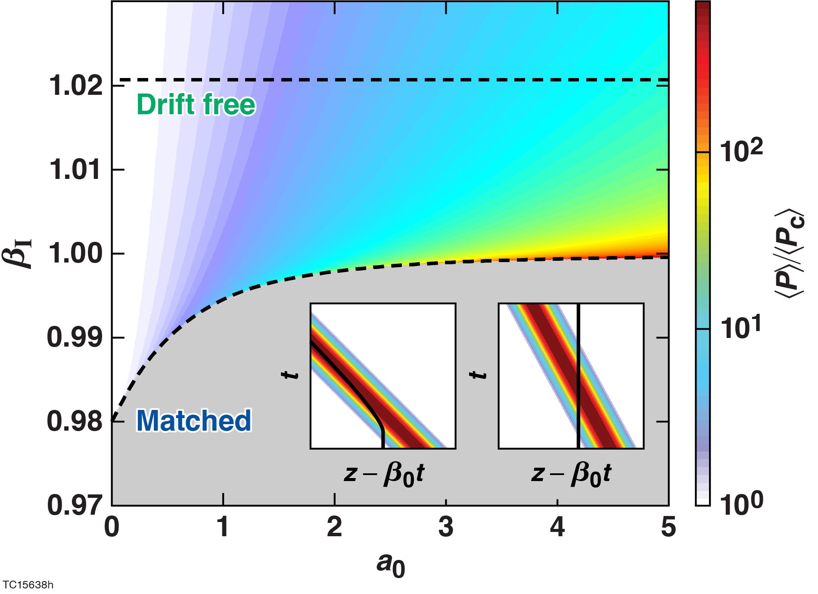
Vacuum laser acceleration in a flying focus pulse can enhance the radiation properties of nonlinear Thomson scattering
D. Ramsey, A. Di Piazza, M. Formanek, P. Franke, D. Froula, B. Malaca, M. Pardal, T. Simpson,
K. Weichman, J. Vieira, and J.P. Palastro
Accelerating electrons against the phase velocity enables a novel regime of nonlinear Thomson scattering that increases the radiated power by orders of magnitude
D. Ramsey et al., Phys. Rev. E (2022)

Slide 17
4. Using X-Rays and Electrons for Diagnostics.
Radiography

Slide 18
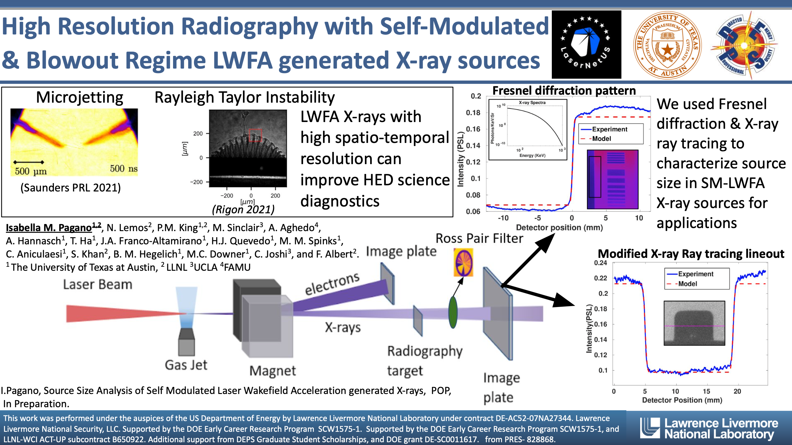
Notes:
Using Inverse Compton Scattering x-rays(keVs) for radiography.

Slide 19
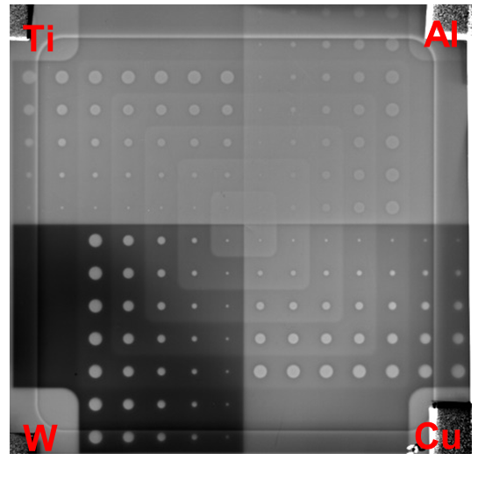
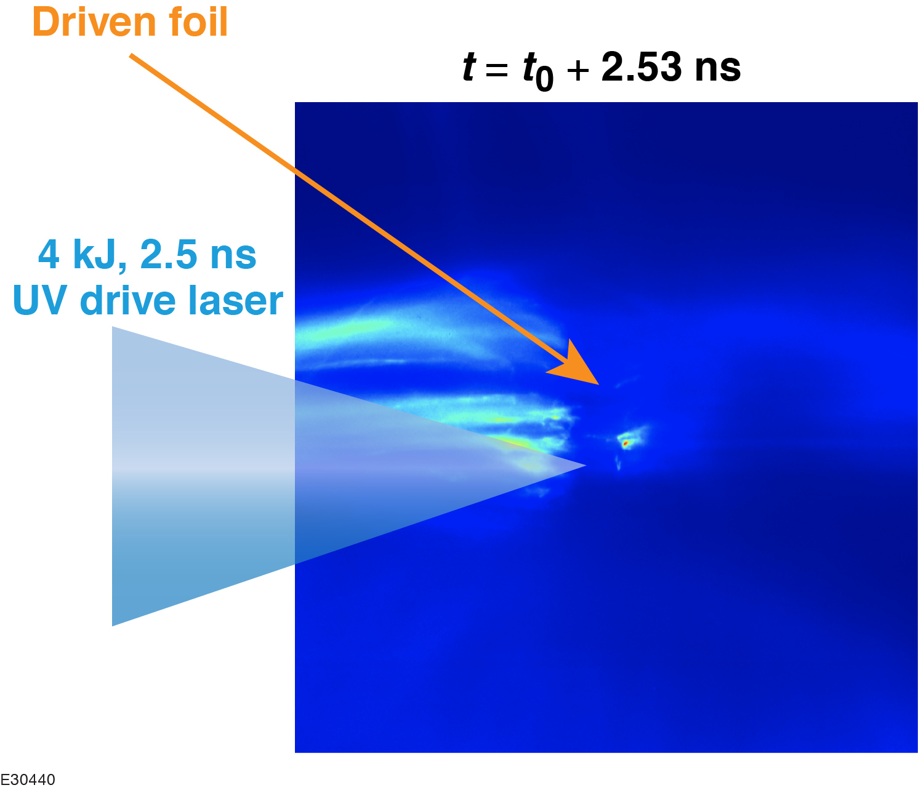
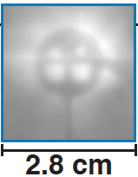
Laser-Plasma-Accelerator–Driven Electron Radiography on the OMEGA EP Laser
J. L. Shaw et al.
Experiments on OMEGA EP demonstrated contact and projected eRad using the electron beam from a laser-plasma accelerator with resolutions as low as 100 μm*
These experiments have also shown the potential capability of this platform to radiograph plasma-generated fields and driven, dynamic targets
Future work will seek to upgrade the platform to um-scale resolutions and to capitalize on this capability to help better understand hohlraum physics
Notes:
Make sure I know the definition of areal density. Just the density of a 2D object. Just mass per unit area!

Slide 20
5. Electron Beam Manipulation and Cooling

Slide 21
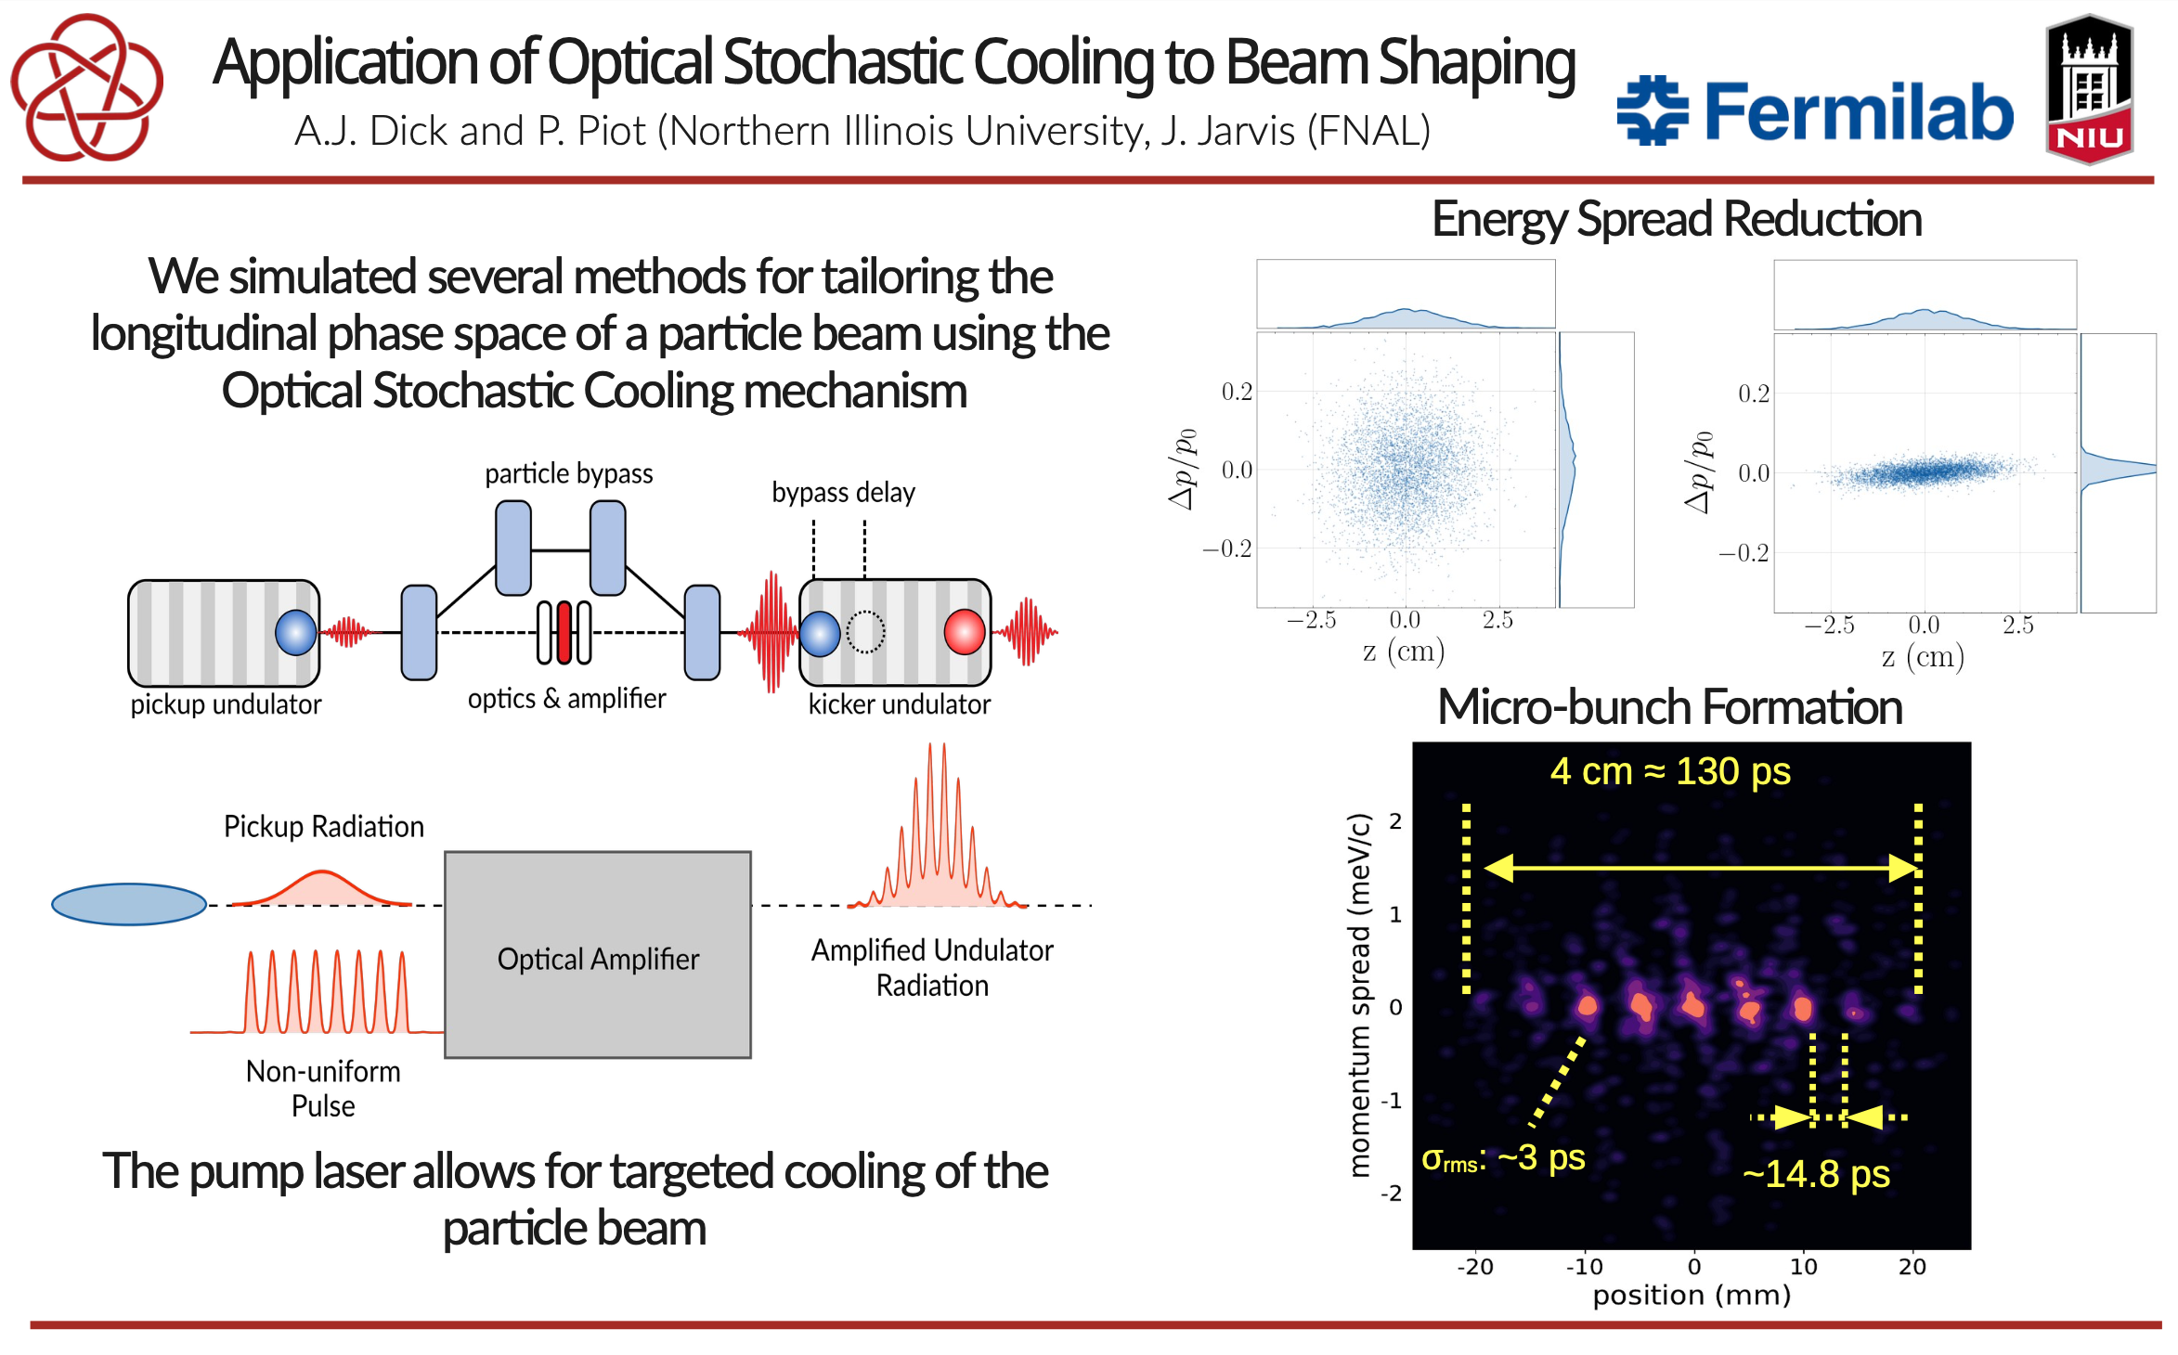

Slide 22
Plasma-accelerator-based linear beam cooling systems
Carl Schroeder (LBNL), et al. – WG7
Linear damping system (m stages)
Injector
Plasma linac
Plasma linac
BDS & IP
Single damping system stage
10 GV/m
radiator
Plasma accelerator
Horizontal normalized emittance [m rad]
radiator length
coupling distance
plasma length
Vertical normalized emittance [m rad]
  Ultra-high accelerating gradients (plasma accelerators) enable linear damping systems.
    >GV/m enables <km damping systems to reach ~nm vertical emittance
    Final (asymptotic) normalized transverse 4D emittance independent of beam energy in damping system
Propagation along damping system [m]

Slide 23
6. Positron Sources and QED Studies

Slide 24
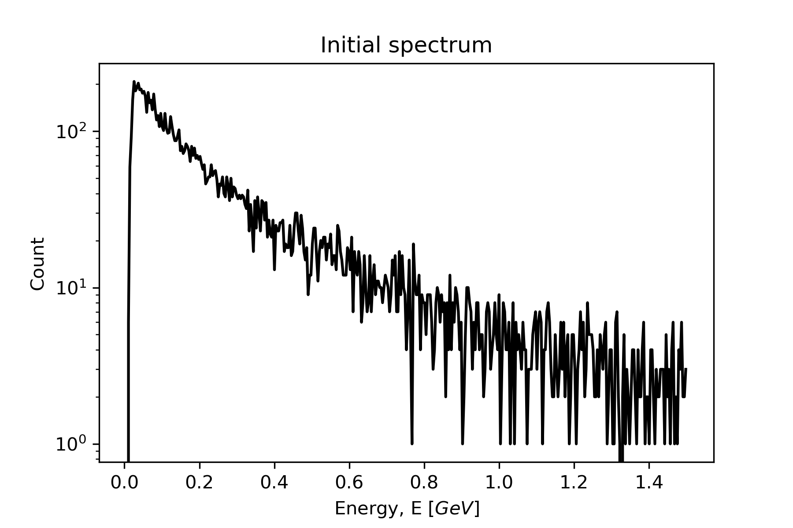
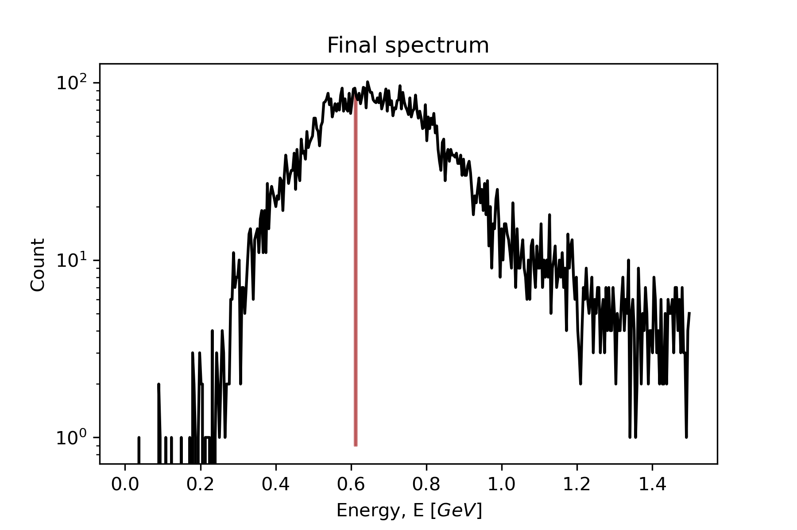
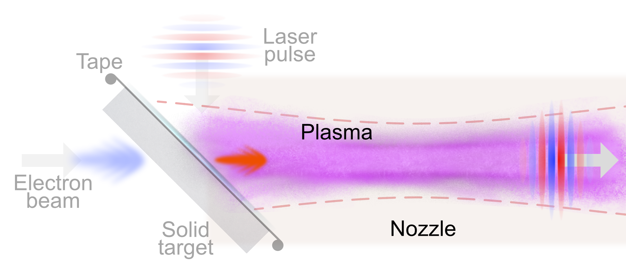
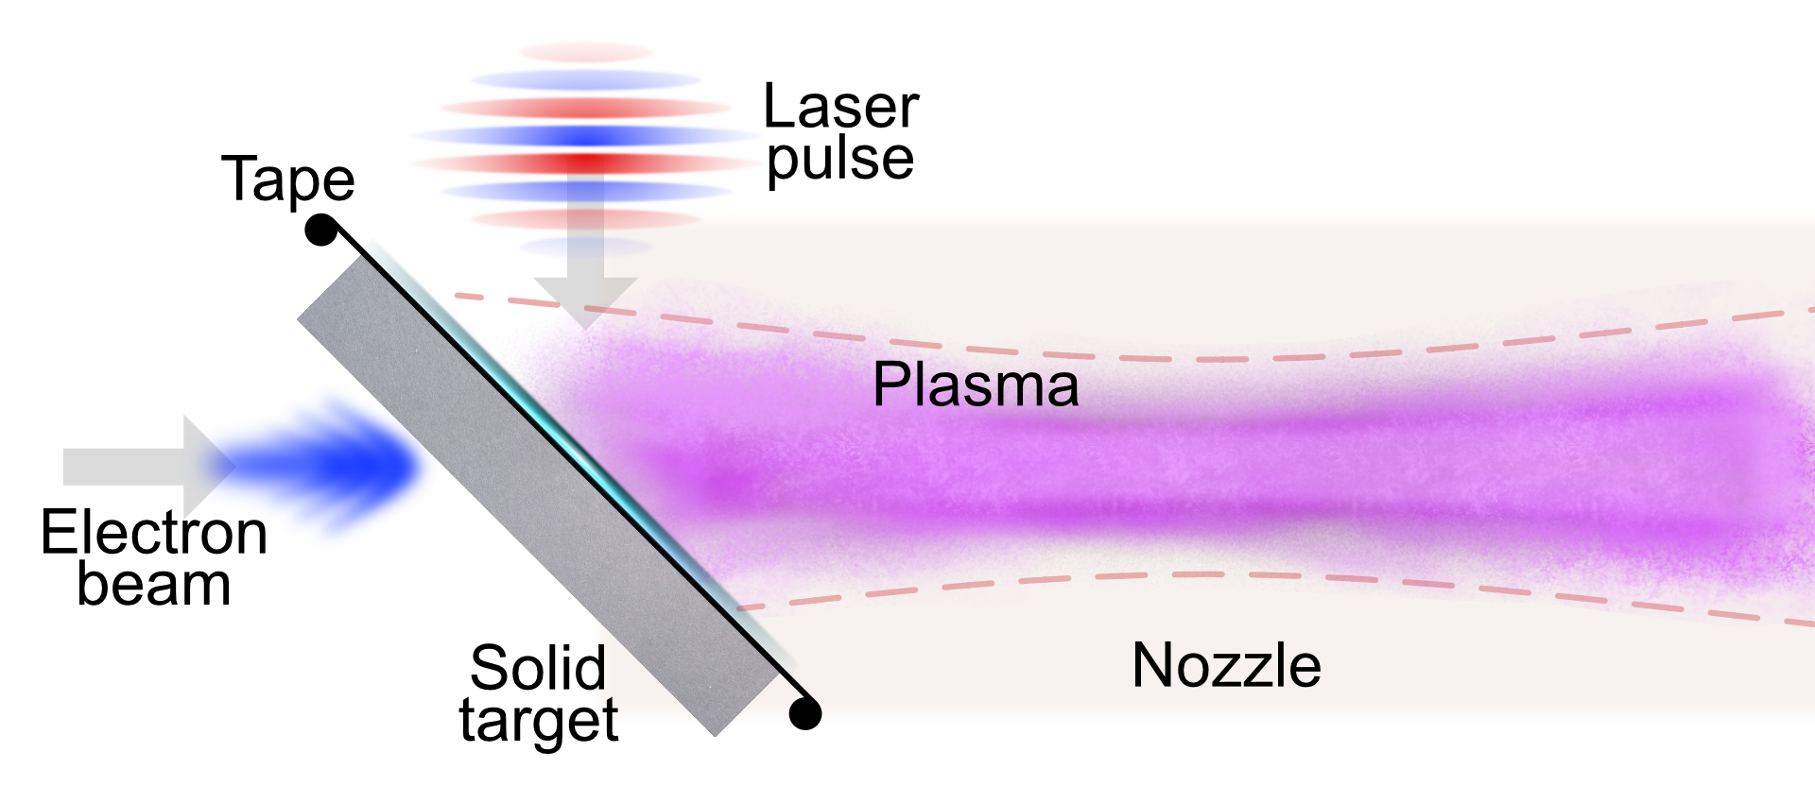
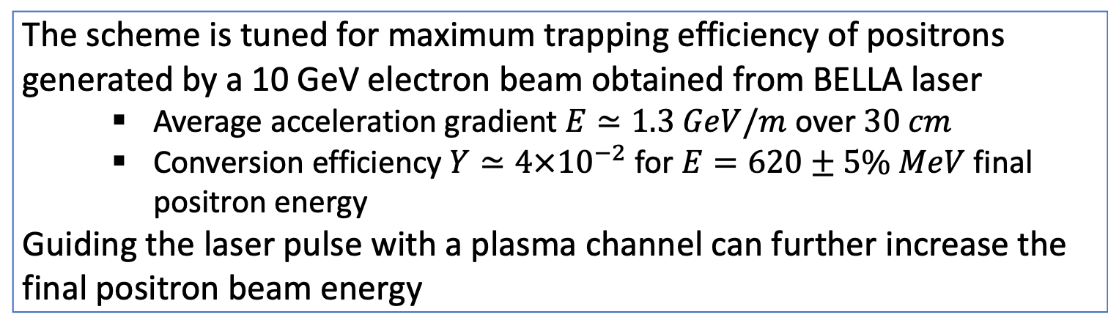
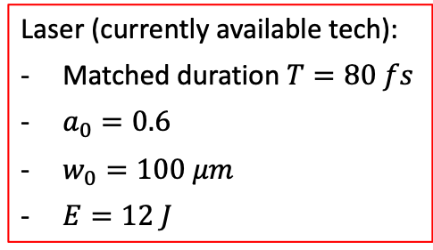
A compact laser-plasma based setup for positron production and collection
Incoming laser pulse impinges on Plasma Mirror at 45° and generates a wake. With proper synchronization of the pulse, positrons are trapped and accelerated
Davide Terzani et al (LBNL)
Positron propagation in linear wakefield
The scheme is tuned for maximum trapping efficiency of positrons generated by a 10 GeV electron beam obtained from BELLA laser
  Average acceleration gradient $E≃1.3 GeV/m$ over $30 cm$
  Conversion efficiency $Y≃4×{10}^{−2}$ for $E=620±5\% MeV$ final positron energy
Guiding the laser pulse with a plasma channel can further increase the final positron beam energy
Laser (currently available tech):
Matched duration $T=80 fs$
$a_{0}=0.6$
$w_{0}=100 μm$
$E=12 J$
Notes:
A main limitation of the existing schemes is the lack of compactness: positrons escape from the side.
Key feature: plasma stage close to production point
We can dissect the scheme in three parts:
e- solid
laser on PM
e+ collection and acceleration

Slide 25
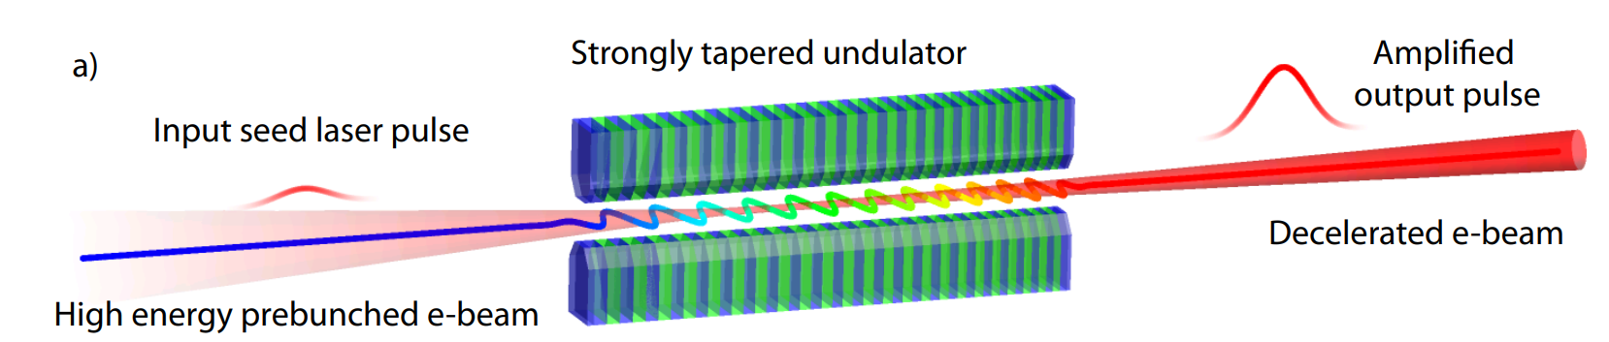

Polarized positron sources based on high repetition rate FEL/IFEL cavity
Pietro Musumeci et al (UCLA)
Polarized positron production open challenge for next linear collider
Inverse-Compton-Scattering-based approach requires very high average power lasers and can benefit from high efficiency FEL technology
GREENS program at FAST facility aimed at demonstrating TESSA technology at visible wavelengths
  First experiments would open up path to investigate high repetition rate TESSA, high average power cavity and gamma ray production

Slide 26
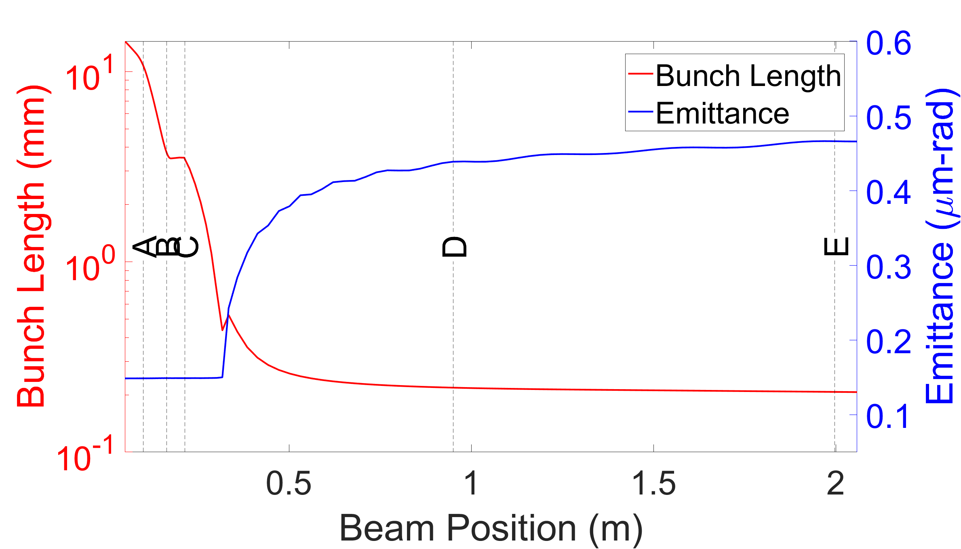
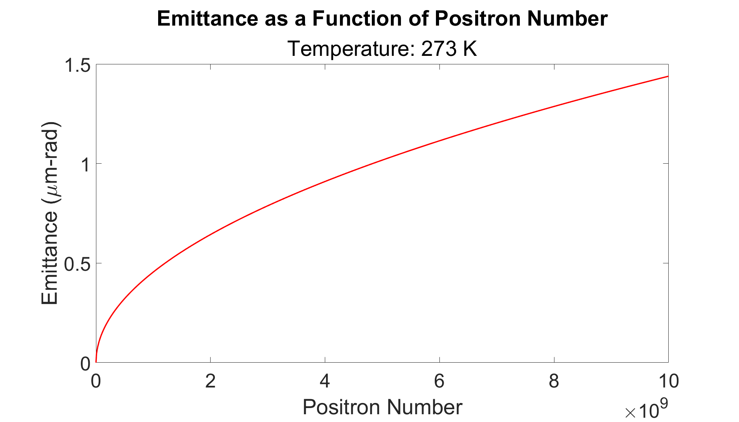
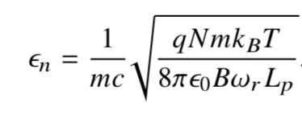
Positron Source
Rafi Hessami et al (SLAC)
  Using the kind of positron production developed for GBAR, we can produce positron beams with emittances of nanometers to a few microns in a beamline only a few meters long
Positron trap from 0 to A
Electrostatic accelerator from B to C
S-band cavity from D to E

Slide 27
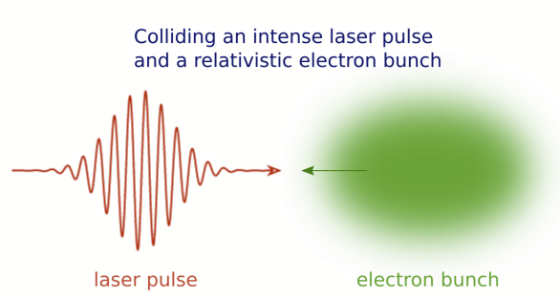

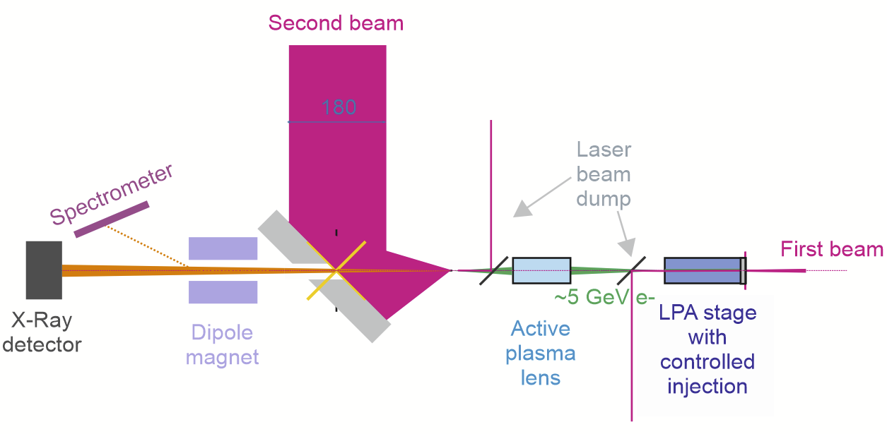
Strong Field QED experiment design study performed for BELLA 2nd beamline
S. S. Bulanov, M. Turner, C. Benedetti, A. Gonsalves, K. Nakamura, D. Terzani,
J. van Tilborg, C. B. Schroeder, C. G. R. Geddes, E. Esarey
BELLA PW 1st beamline:
~20 J laser pulse energy to produce LWFA electron with energies ~5 GeV
BELLA PW 2nd beamline:
~20 J pulse energy together with a short focal length OAP to reach a₀ > 10
Nonlinear quantum parameter 𝜒 >1
Is possible with proven technologies:
laser a₀ = 42,
laser pulse focal spot size w₀ = 2.5 um,
electron beam energy = 4 GeV,
electron bunch size = 2.5 um.
Number of positrons = 5 x 10⁻³ * #electrons
𝜒 =1.7
The interaction leads to:
electron beam energy loss ~40%
positron beam charge ~ several pC
positron energy at peak ~ 400 MeV
number of photons per electron ~ 10
Notes:
“all-optical” laser-electron collision experiments
electron bunches colliding with counter-propagating laser pulses produce gamma-rays via nonlinear Thomson or inverse multiphoton Compton scattering.
producing high-energy photons, which in turn transformed into electron-positron pairs in the electromagnetic field of the laser pulse

Slide 28
7. Low-Frequency Radiation Sources

Slide 29
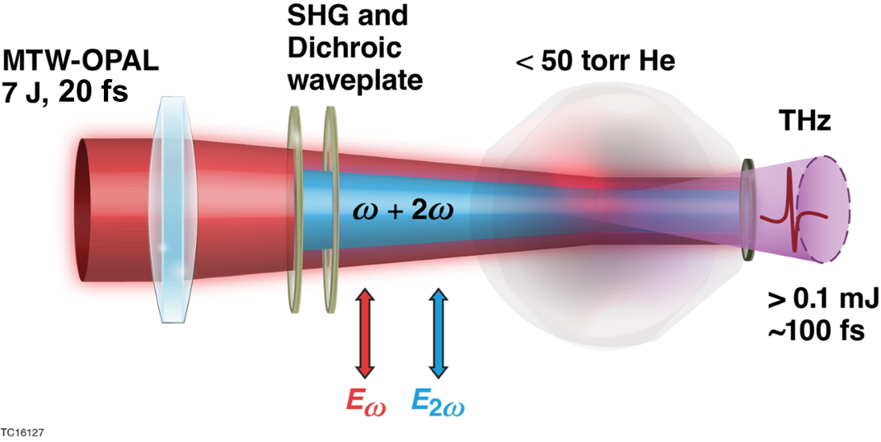
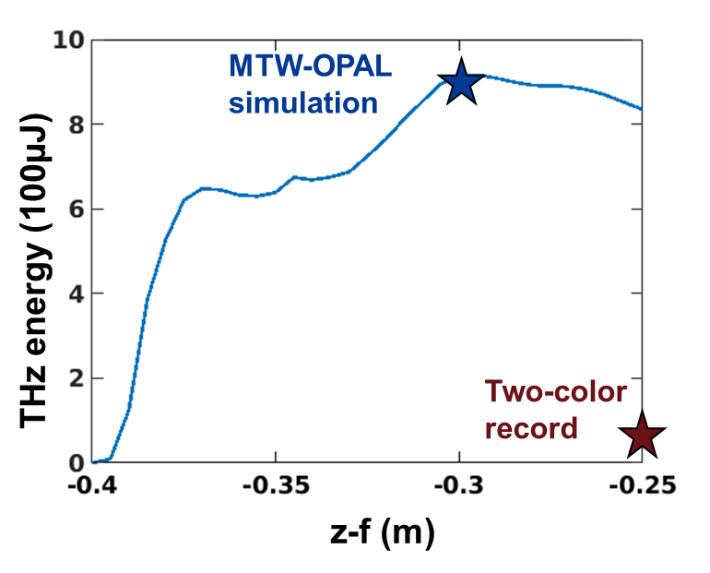
High-energy two-color terahertz generation
Summary
High-energy THz sources can be used as pumps to access novel physics regimes or as probes to study HED material properties
A laser pulse composed of a first and second harmonic can drive a time-dependent current of photoionized electrons which generates broadband terahertz (THz) radiation
A high-ionization potential, low-density gas optimizes THz generation driven by 100 TW class lasers by mitigating beam breakup and enhancing the photocurrent
Simulations suggest that a 100 TW class laser (top right) can drive near-single-cycle THz pulses with nearly 1 mJ of energy (bottom right) in low-density helium
Tanner Simpson
tsim@lle.rochester.edu

Slide 30
Omega-P R&D, Inc.
Presentation at 2022 Advanced Accelerator Concepts Workshop
HIGHLY-EFFICIENT 20-MW L-BAND MULTI-BEAM KLYSTRON*
Vladimir E. Teryaev, Budker Institute of Nuclear Physics, 630090 Novosibirsk, Russia
Nikolay Solyak, Fermi National Accelerator Laboratory, Batavia, IL 60510-5011
Xiangyun Chang and Jay L. Hirshfield, Omega-P R&D, Inc., New Haven, CT 06511
Abstract of talk: A relatively new concept for a high-power L-band RF amplifier is described, namely a Two-Stage Multi Beam Klystron (TS-MBK) operating with 12 hollow beamlets.** This configuration allows for a remarkably high RF electronic efficiency of up to 90%, with a compact electro-mechanical layout. The conceptual design described here is for an 87% efficient, 1.0 GHz, 20 MW peak-power TS-MBK. Development of this tube or other related L-band versions for future advanced accelerators should presage significant savings in operating costs.
_______________________
*Sponsored in part under DOE Phase I SBIR grant #DE-SC0022580, awarded 9/29/2022.
**V. E. Teryaev, S. V. Shchelkunov, J. L. Hirshfield, “90% efficient two-stage multibeam klystron: modeling and design study,” , IEEE Trans. Electron Devices 67 (12), Dec. 2020.

Slide 31
PARTICLE ACCELERATOR RESEARCH FOUNDATION – PARF
Presentation for Advanced Accelerator Concepts Workshop AAC2022
ELECTRON CYCLOTRON RESONANCE ACCELERATOR eCRA
ELECTRON CYCLOTRON RESONANCE ACCELERATOR eCRA*
Xiangyun Chang, Yong Jiang and Jay L. Hirshfield; PARF, New Haven, CT
Mikhail Fedurin, Mark Palmer, and Warren Stern; BNL, Upton, NY
Summary: Solutions [1] of the single-particle equations of motion for electrons in the fields of an idealized TE₁₁₁ microwave cavity in an external magnetic field near cyclotron resonance show acceleration rates that substantially exceed the limits for the CARA interaction [2]. We have dubbed this new accelerator “eCRA.” In this presentation, new simulation results are presented for a realistic TE₁₁₁ eCRA cavity geometry and finite space-charge beams that confirm the idealized solutions. The new features include cavity openings for RF inputs, beam injection, and pumping; RF input coupling factors that maximize efficiency; a thin window for exit of the accelerated beam; realistic magnetic field profiles; finite diameter multi-Ampere beams; and transient beam dynamics to model pulsed operation. We present several eCRA examples for a copper cavity with RF input power at each of the two ports of 12.5 MW, wherein 100 keV beams of 4.4 – 9.0 A are shown to be accelerated to 1.9 – 3.5 MeV, giving pulsed beam powers of 11 - 18 MW and efficiencies of 44 – 72%. As an example, these parameters augur well for successful design of an eCRA-based x-ray source to replace widely-used Co-60 gamma sources now in use for sterilization, using available technology. Many other applications have been identified for MW-class eCRA beams with energies in the range 1-10 MeV [3].
_________________________
[1] S.V. Shchelkunov, X. Chang, J.L. Hirshfield, Phys. Rev. Accel. Beams 25, 021301 (2022).
[2] J.L. Hirshfield, C.B. Wang, Phys. Rev. E 51, 2446 (1995).
[3] Basic research needs workshop on compact accelerators for security and medicine: Tools for the 21st century, 2019, Michael Fazio, chair; Office of Science, US Department of Energy.
*This work was sponsored in part by Brookhaven National Laboratory LDRD grants 22-075 and 23-060.

Slide 32
Thank you!

