Slide 1
Working group 5 summary report
Yine Sun and Sam Barber

Slide 2
Contributed talks
Title | author
Low-emittance high-energy muon source based on plasma wakefield acceleration | Vladimir Shiltsev
Beam shaping using an ultra-high vacuum multileaf collimator and emittance exchange beamline | Nathan Majernik
Stabilization and manipulation of laser-driven plasma acceleration with a weak auxiliary laser pulse | Michael Downer
Online Correction Of Laser Focal Position Via Deployable Machine Learning Models | Nathan Cook
A Compact Source of Positron Beams with Small Thermal Emittance | Rafi Hessami
Sub-fs beam generation at the UCLA Pegasus Laboratory | Pietro Musumeci
A Non-Invasive, Single-Shot Emittance Diagnostic, Using Edge-Radiation and a CNN Based Inference Model | Robbie Watt
Experimental results for machine learning based diagnostics and optimization at FACET-II | Claudio Emma
Simulating electron beams in RF cavities with beam loading | David Bruhwiler
Coherent 3D microstructure of laser-wakefield-accelerated electron bunches | Maxwell LaBerge
Electron source bunch length characterization based on chicane-decompressed coherent transition radiation emission | Jeroen Van Tilborg
Plasma-photonic diagnostic of plasma-based accelerators | Andrew Sutherland
Single-shot, transverse self-wakefield reconstruction from screen images | Nathan Majernik

Slide 3
Posters
Initial Results from a Laser-Heated Thermionic Cathode | Heather Andrews
High-bandwidth image-based predictive laser stabilization via optimized Fourier filters | Joseph Natal
A Compact Source of Positron Beams with Small Thermal Emittance | Rafi Hessami
Measurement of coherent substructures within laser-wakefield-accelerated electron beams | Maxwell LaBerge
Compact high-resolution multi-GeV electron spectrometer for PW-laser-driven plasma accelerators | Xiantao Cheng
Numerical Studies of Phase Diversity Electro-Optic Sampled Relativistic Electron Bunches | Spencer Kelham
Active non-perturbative Stabilization of the laser-plasma-accelerated electron beam source | Curtis Berger

Slide 4
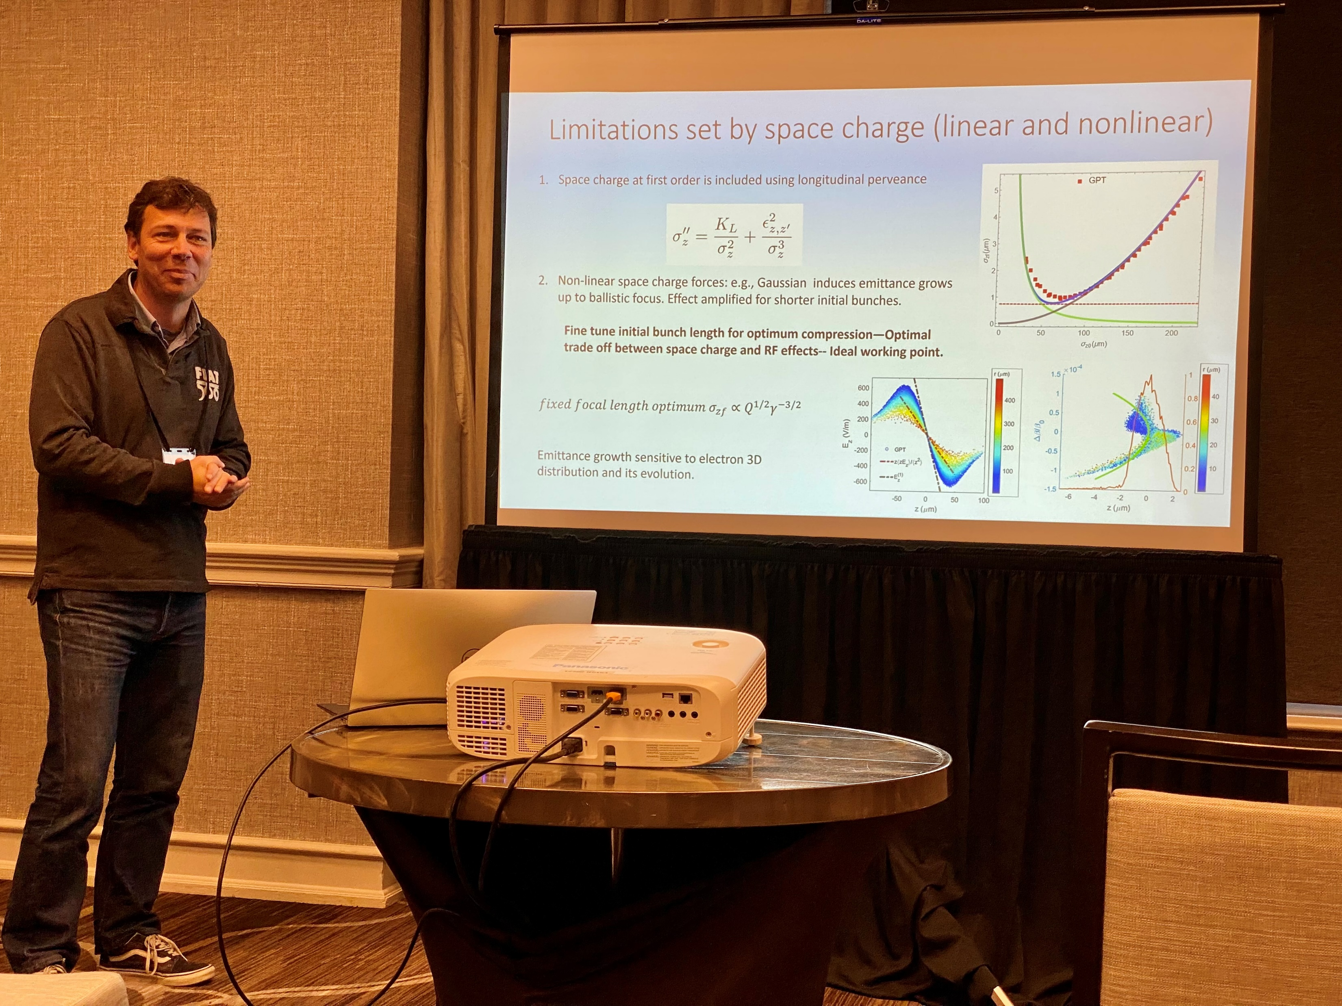
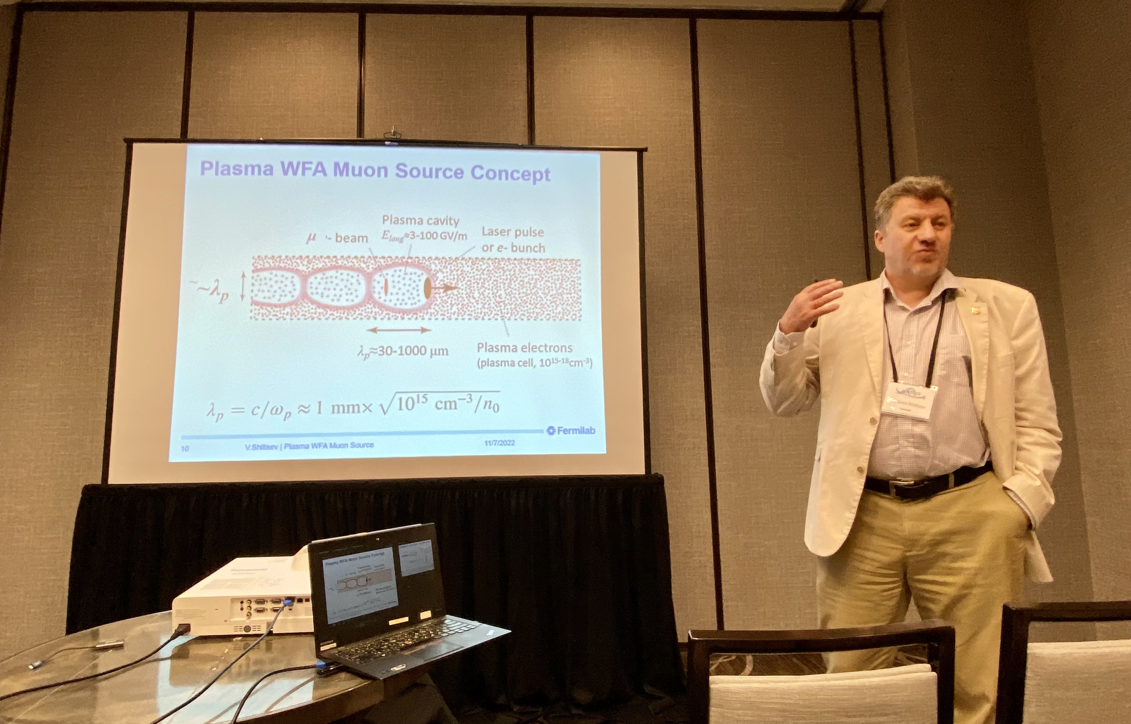
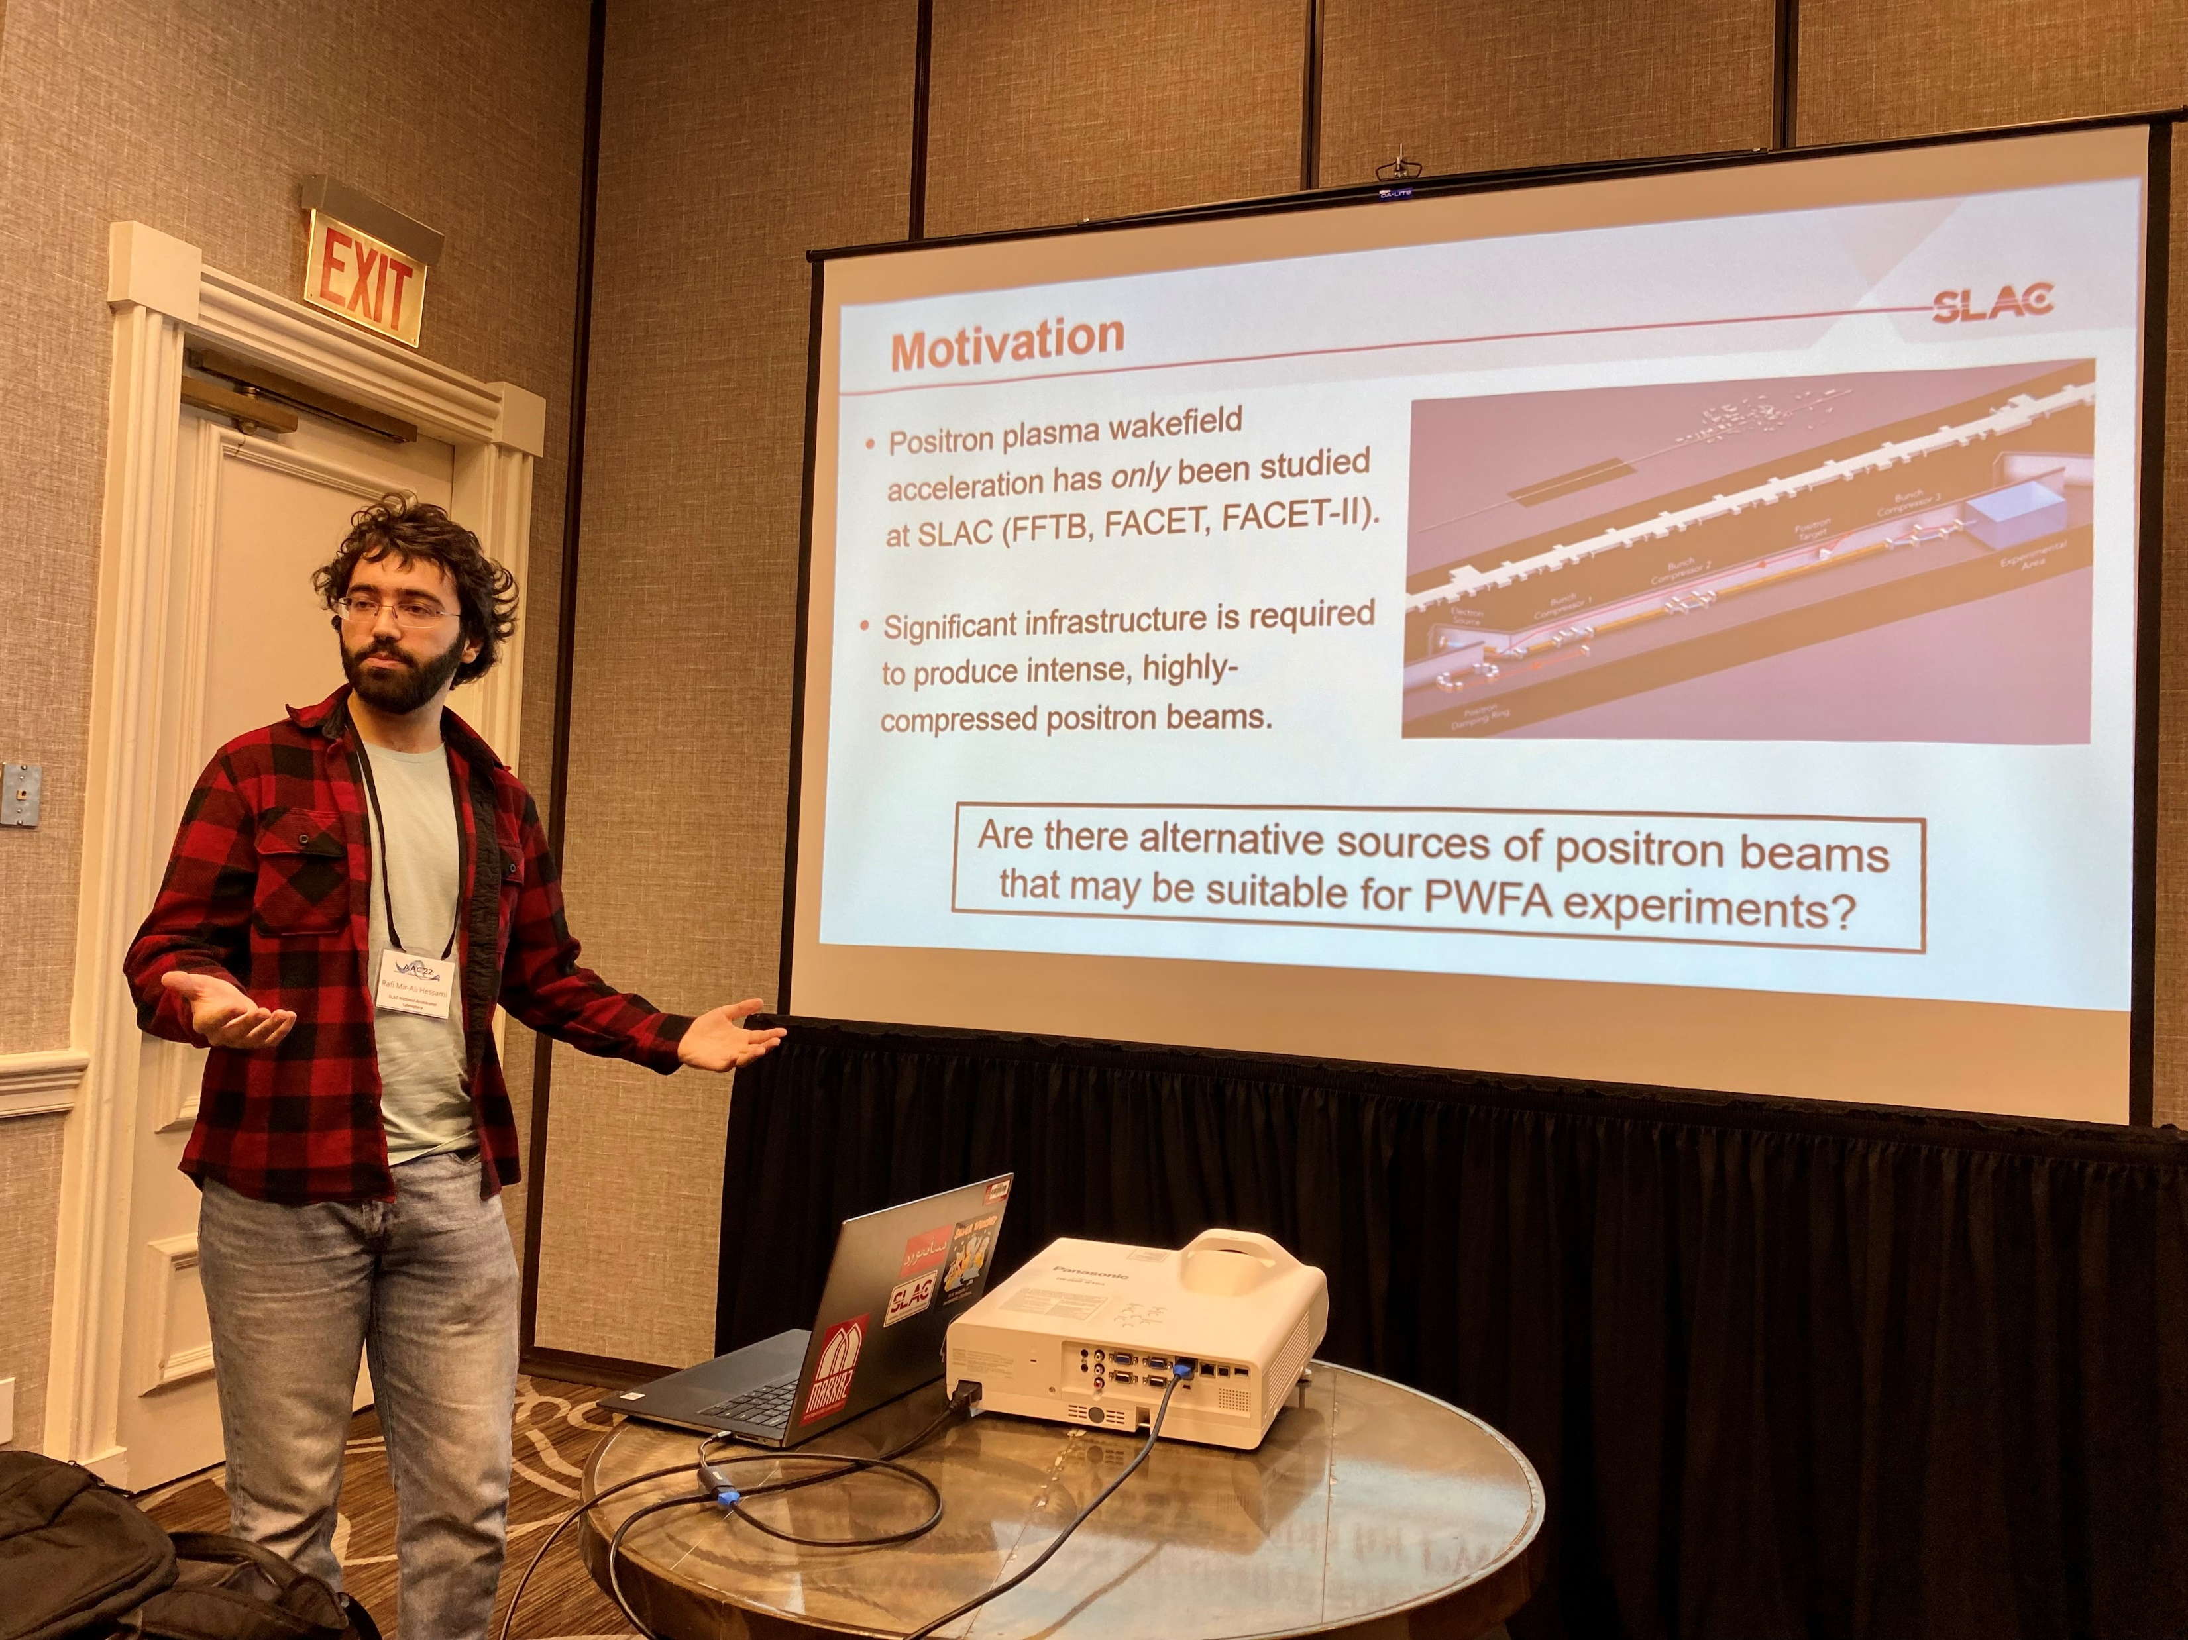
Sources

Slide 5
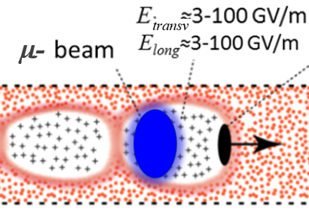

Plasma-WFA Muon Source (V.Shiltsev)
Strong focusing and E_{z} in plasma wakefields allow compact O(10 cm) 10 GeV muon source
Max norm. emittance of μ‘s
https://iopscience.iop.org/article/10.1088/1748-0221/17/05/T05010/meta
captured in the bubble is about ε_{n}≈0.1λ_{p} (25 μm at n_{p}=10¹⁶ cm⁻³)
Challenges: a) acceleration of μ+ , b) small muon cross-sections via photoproduction or proton-nucleon need solid targets in the wake; c) wake loading by secondaries e+, e-, π
Might work with external injection of ~1mm³ muon bunches

Slide 6
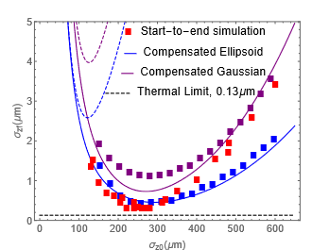
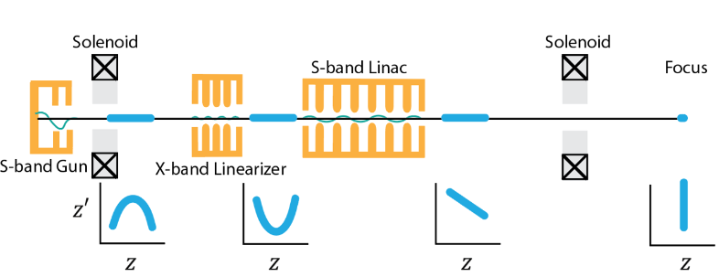
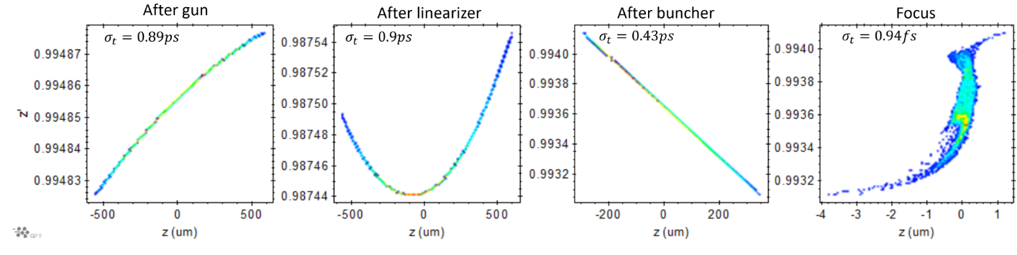
Summary: Ultrashort Beam generation at PEGASUS.
Single shot UED temporal resolution determined by the bunch length at ballistic focus.
Competing non-linear effects limiting the shortest achievable bunch length.
Overcome non-linearities with laser shaping of electron beam and higher harmonic compensation.
Bunch lengths in attosecond to sub-fs regime (for 10-100 fC charge) achievable.
Implemented X-band and took measurements of LPS linearization—reduced energy spread.
Seeking novel bunch length diagnostic to measure sub-fs bunches. Developments underway.

Slide 7
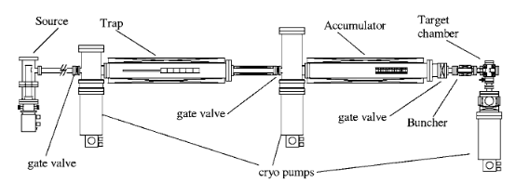

GBAR’s Method of Making Positrons
  The GBAR experiment uses an MeV linac operating at pair production threshold.
    About 10⁸ e⁺/s
  The ILC uses electron or photon beam on target.
    About 10¹⁴ e⁺/s
Neon moderator
This is not a replacement for traditional positron beam production from targets.
The GBAR antimatter gravity experiment,
P. Perez et al., Hyperfine Interactions 233, 21-27 (2015)
Notes:
Highlight it’s good for R&D

Slide 8
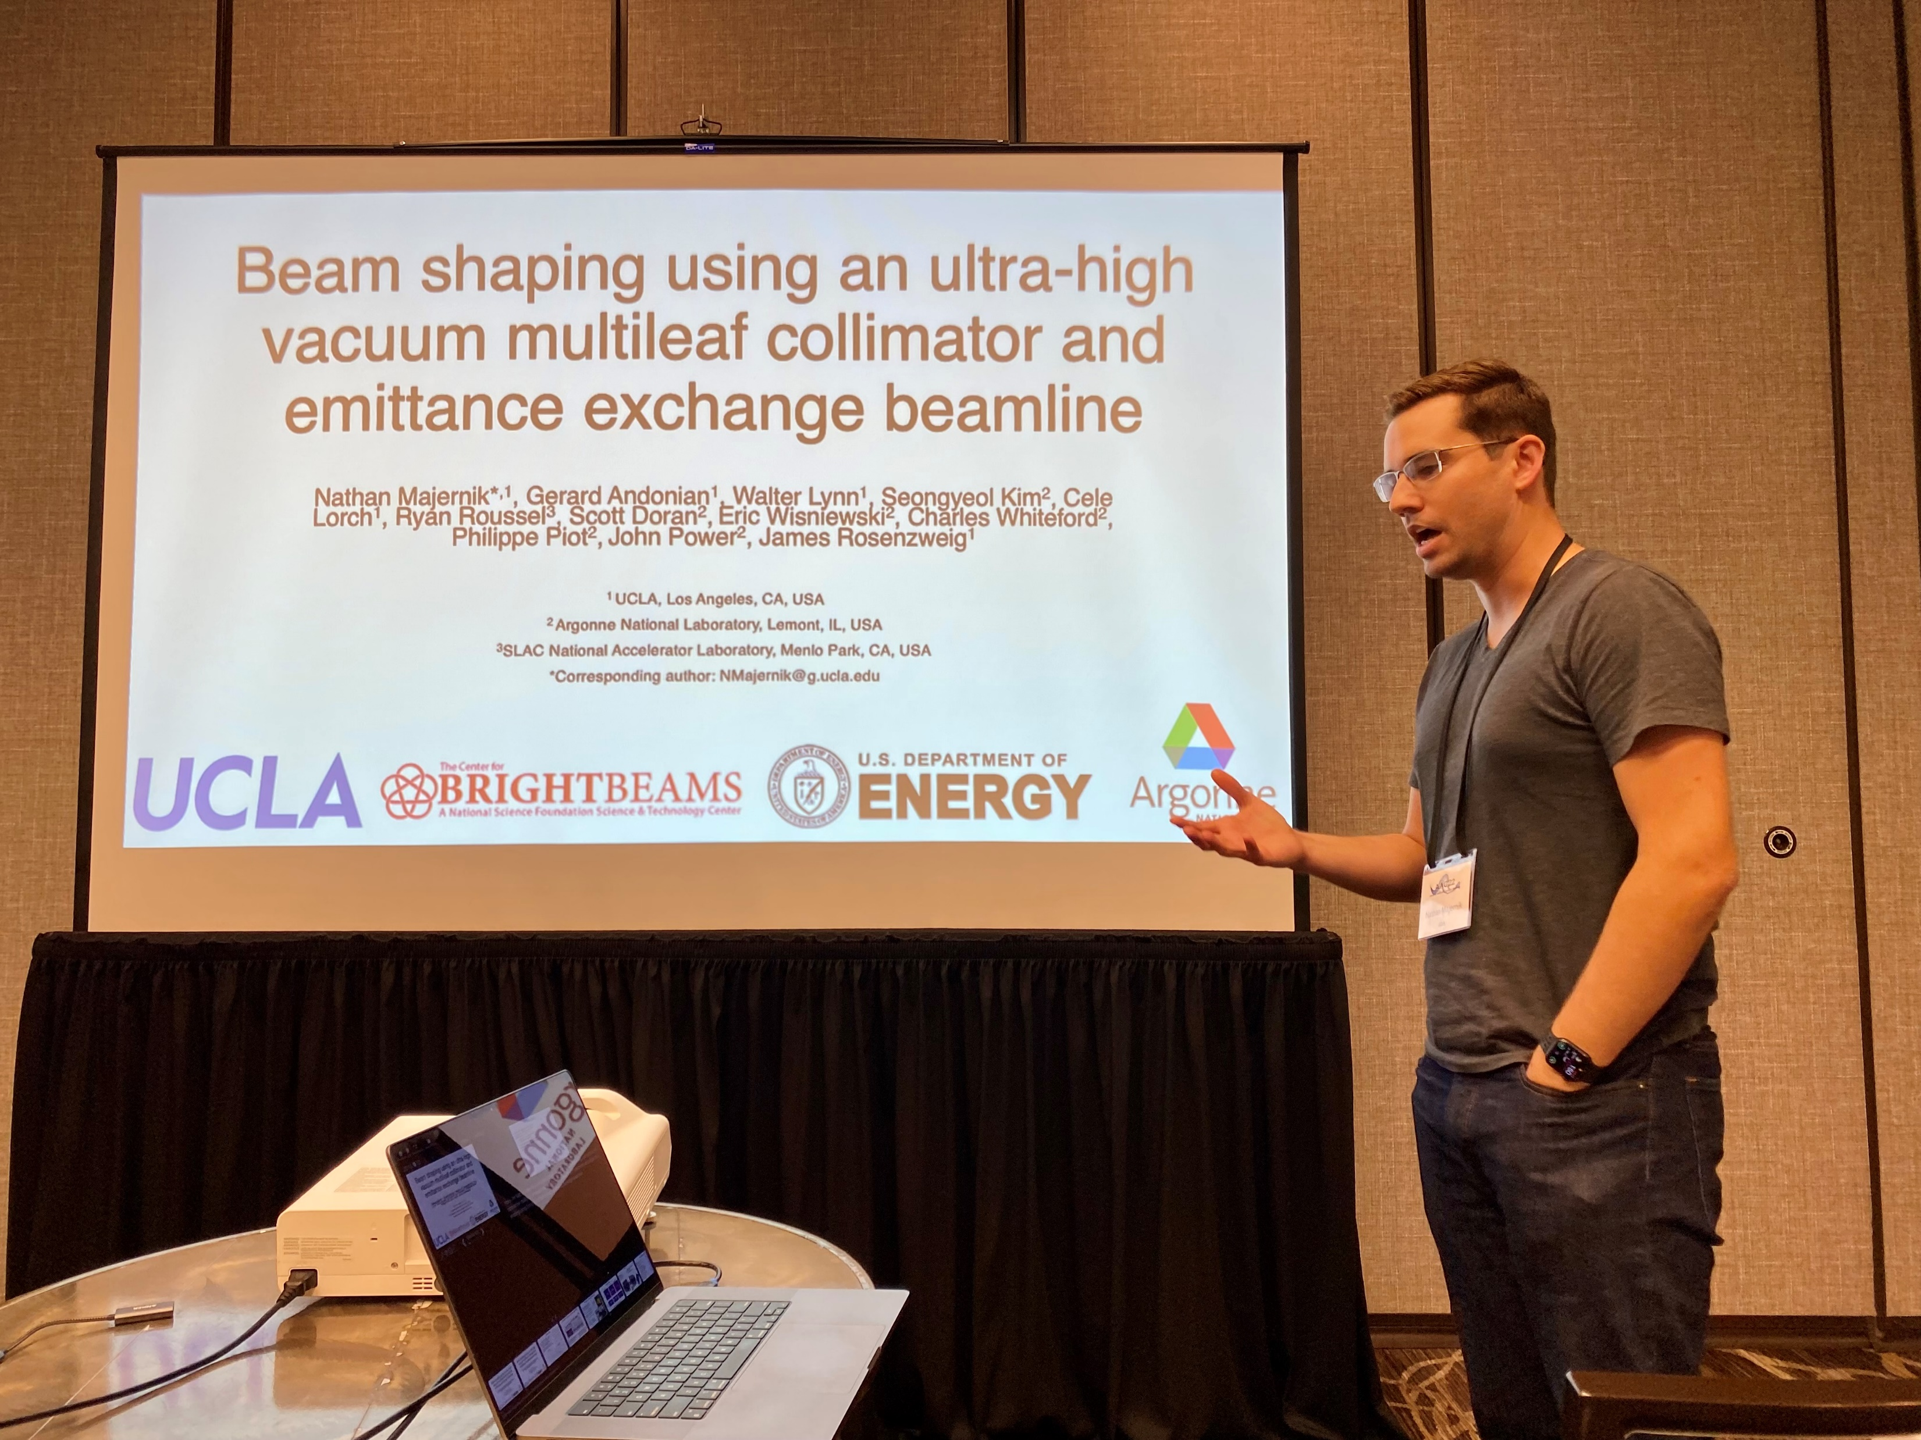
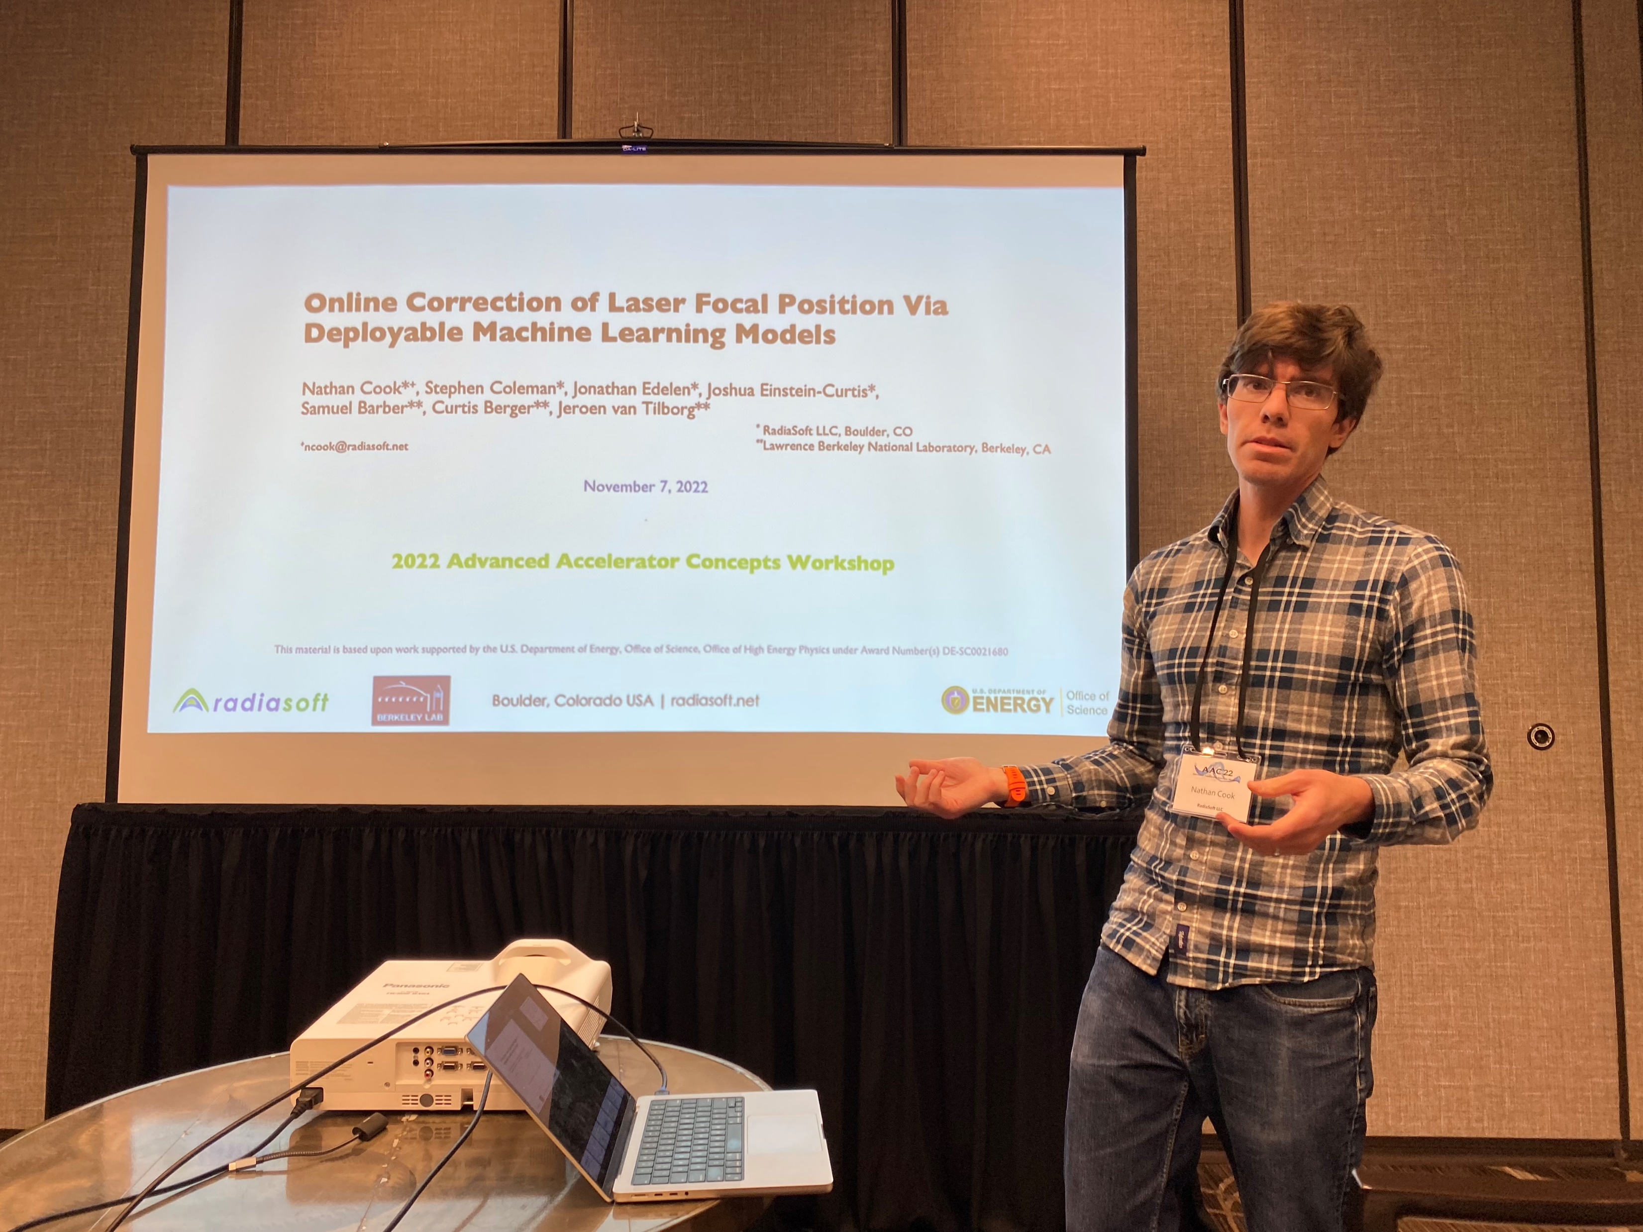
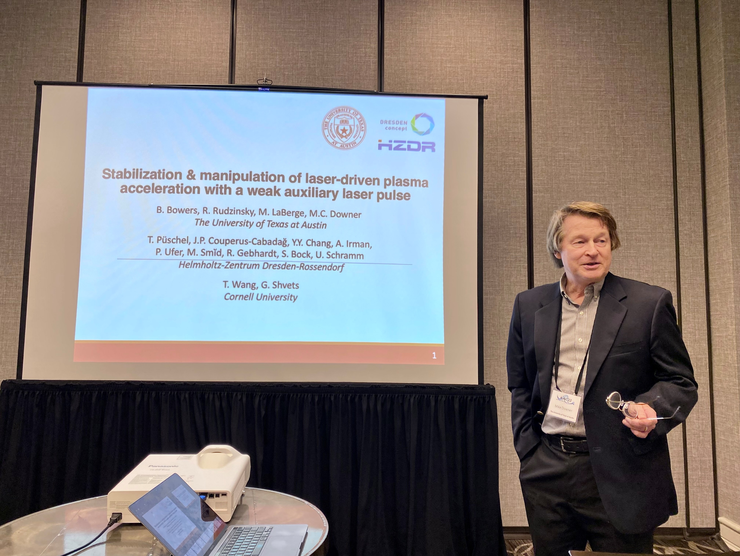
control

Slide 9
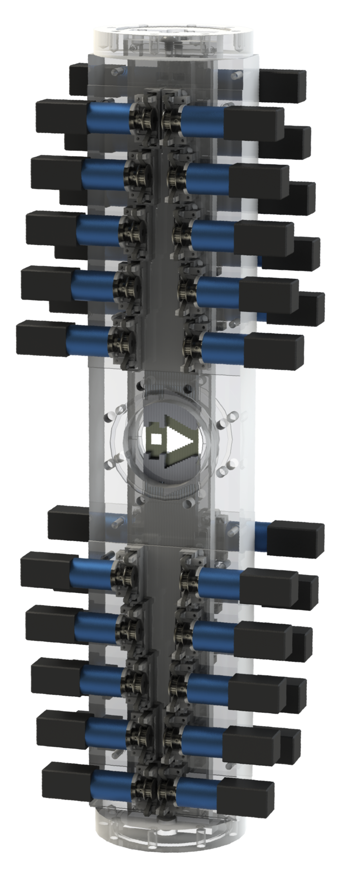
Beam shaping using an ultra-high vacuum multileaf collimator and emittance exchange beamline
Replaced laser cut tungsten masks with UHV-compatible multileaf collimator in EEX beamline
Functionally identical to existing masks
Permits real-time, nearly arbitrary control over drive and witness bunch shaping
Demonstrated ability to create wide range of beams and also control fine detail
Triangle
Doorstep
Bowtie
Resonant drivers
Mask shadow
Post-EEX current profile

Slide 10



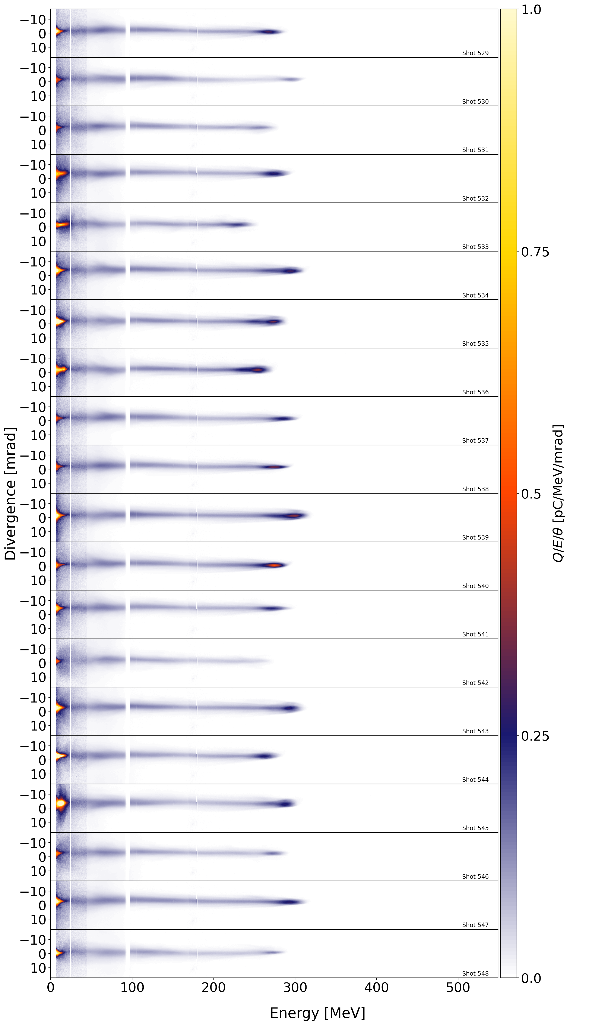
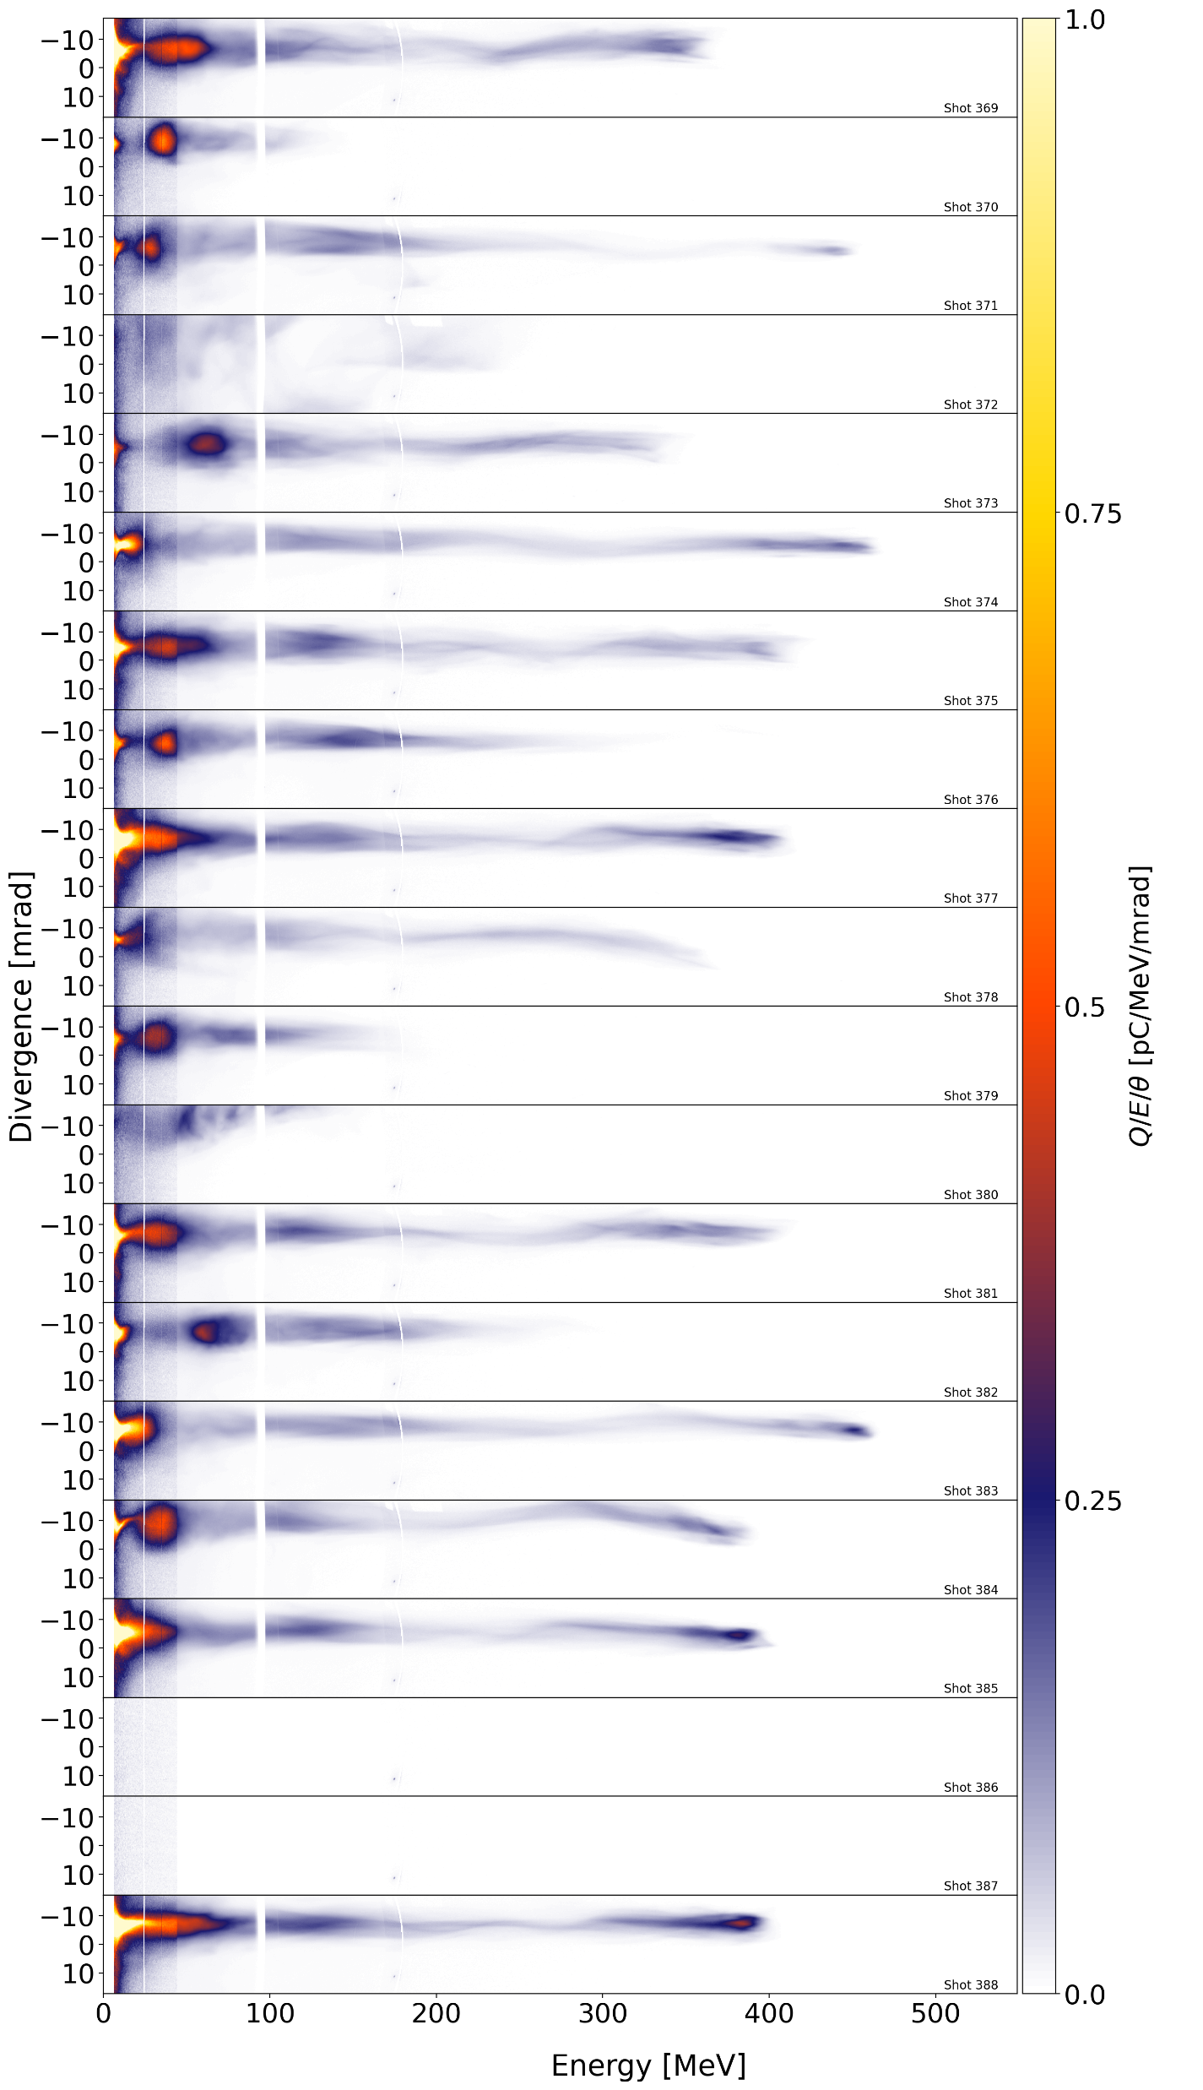
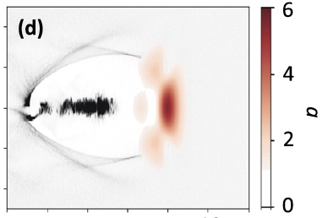
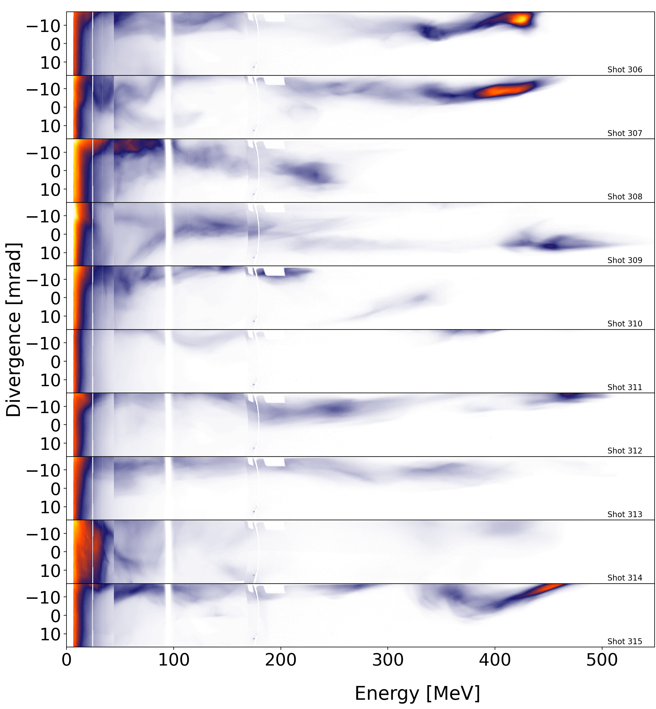
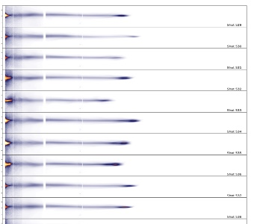
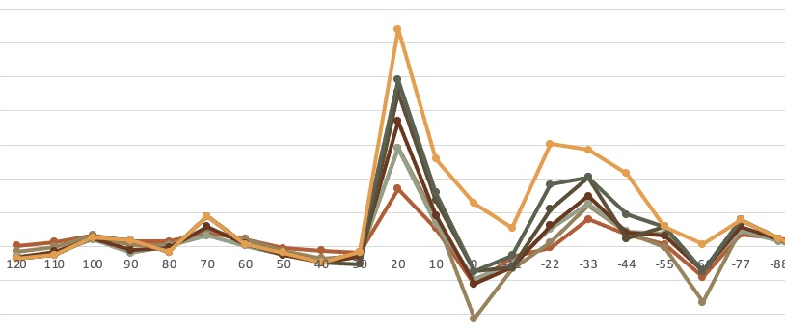
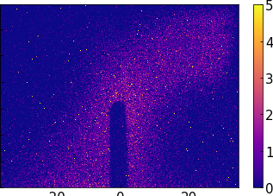
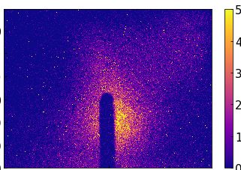
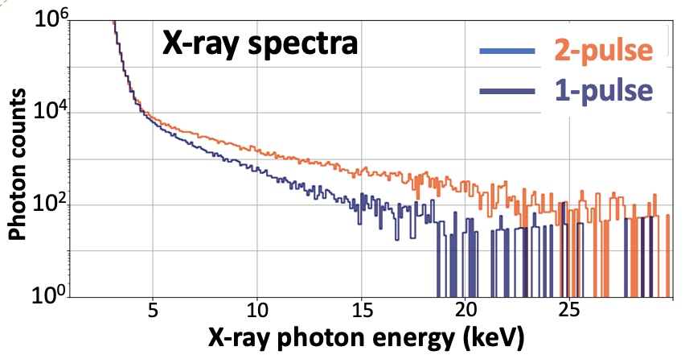
Stabilization & manipulation of laser-driven plasma acceleration with a weak auxiliary laser pulse
B. Bowers, R. Rudzinsky, M. LaBerge, M.C. Downer
The University of Texas at Austin
Püschel, Couperus, Chang, Irman, Ufer, Smid,
Gebhardt, Bock, Schramm ---HZDR
T. Wang, G. Shvets
Cornell U.
10% of LWFA drive pulse energy
causes 90% of LWFA fluctuations
Weak (10% ℇ_{drive} ) auxiliary pulse at 25 ≲ ∆t ≲ 45 fs
enhances E_{e}, Q_{e}, betatron X-rays, etc. via DLA.
transverse drive
beam profile
mask blocks
outer edge
1-pulse
2-pulse (∆t₀ = 25 fs)
∆t
aux
drive
Full Drive Pulse
Masked Pulse
Multiple LWFA
properties optimized
at same ∆t
% improve-
ment
Divergence (mrad)
Q/E/𝜃 (pC/MeV/mrad)
Divergence (mrad)
100
75
50
25
0
0
200
400
0
200
400
auxiliary pulse delay (fs)
Electron energy (MeV)
0
200
400
0
200
400
40
X-ray brightness
40
X-ray brightness
Electron energy (MeV)
20
20
Vertical (mrad)
Vertical (mrad)
Brightness (arb. u.)
Removing the troublesome 10%
stabilizes LWFA performance
Brightness (arb. u.)
0
0
-20
0
20
-20
0
20
Horizontal (mrad)
Horizontal (mrad)

Slide 11
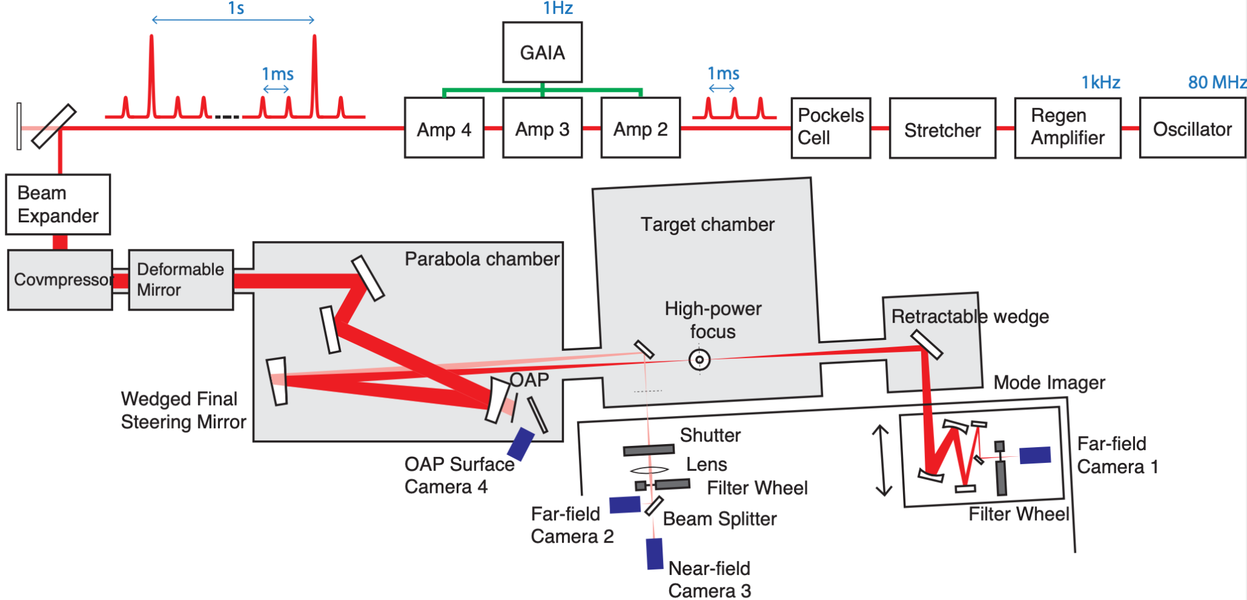
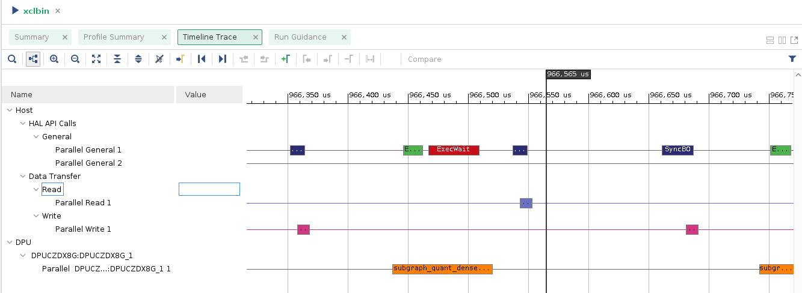
Deployable Models for Fast Laser Focal Position Control
Developed laser focal position corrector at high rep rate
  Non-perturbative upstream wavefront sensor informs focal position
  Neural network improves diagnostic correlation
  Linear stage adjusts position of transmissive lens
Simulated correction projects 10x improvement at 25 Hz
  Both maximum deviation and variance show comparable improvement
Deployment on FPGA with kHz processing speeds
  Framework permits straightforward re-training and re-deployment
Fast corrections from upstream sensor

Slide 12
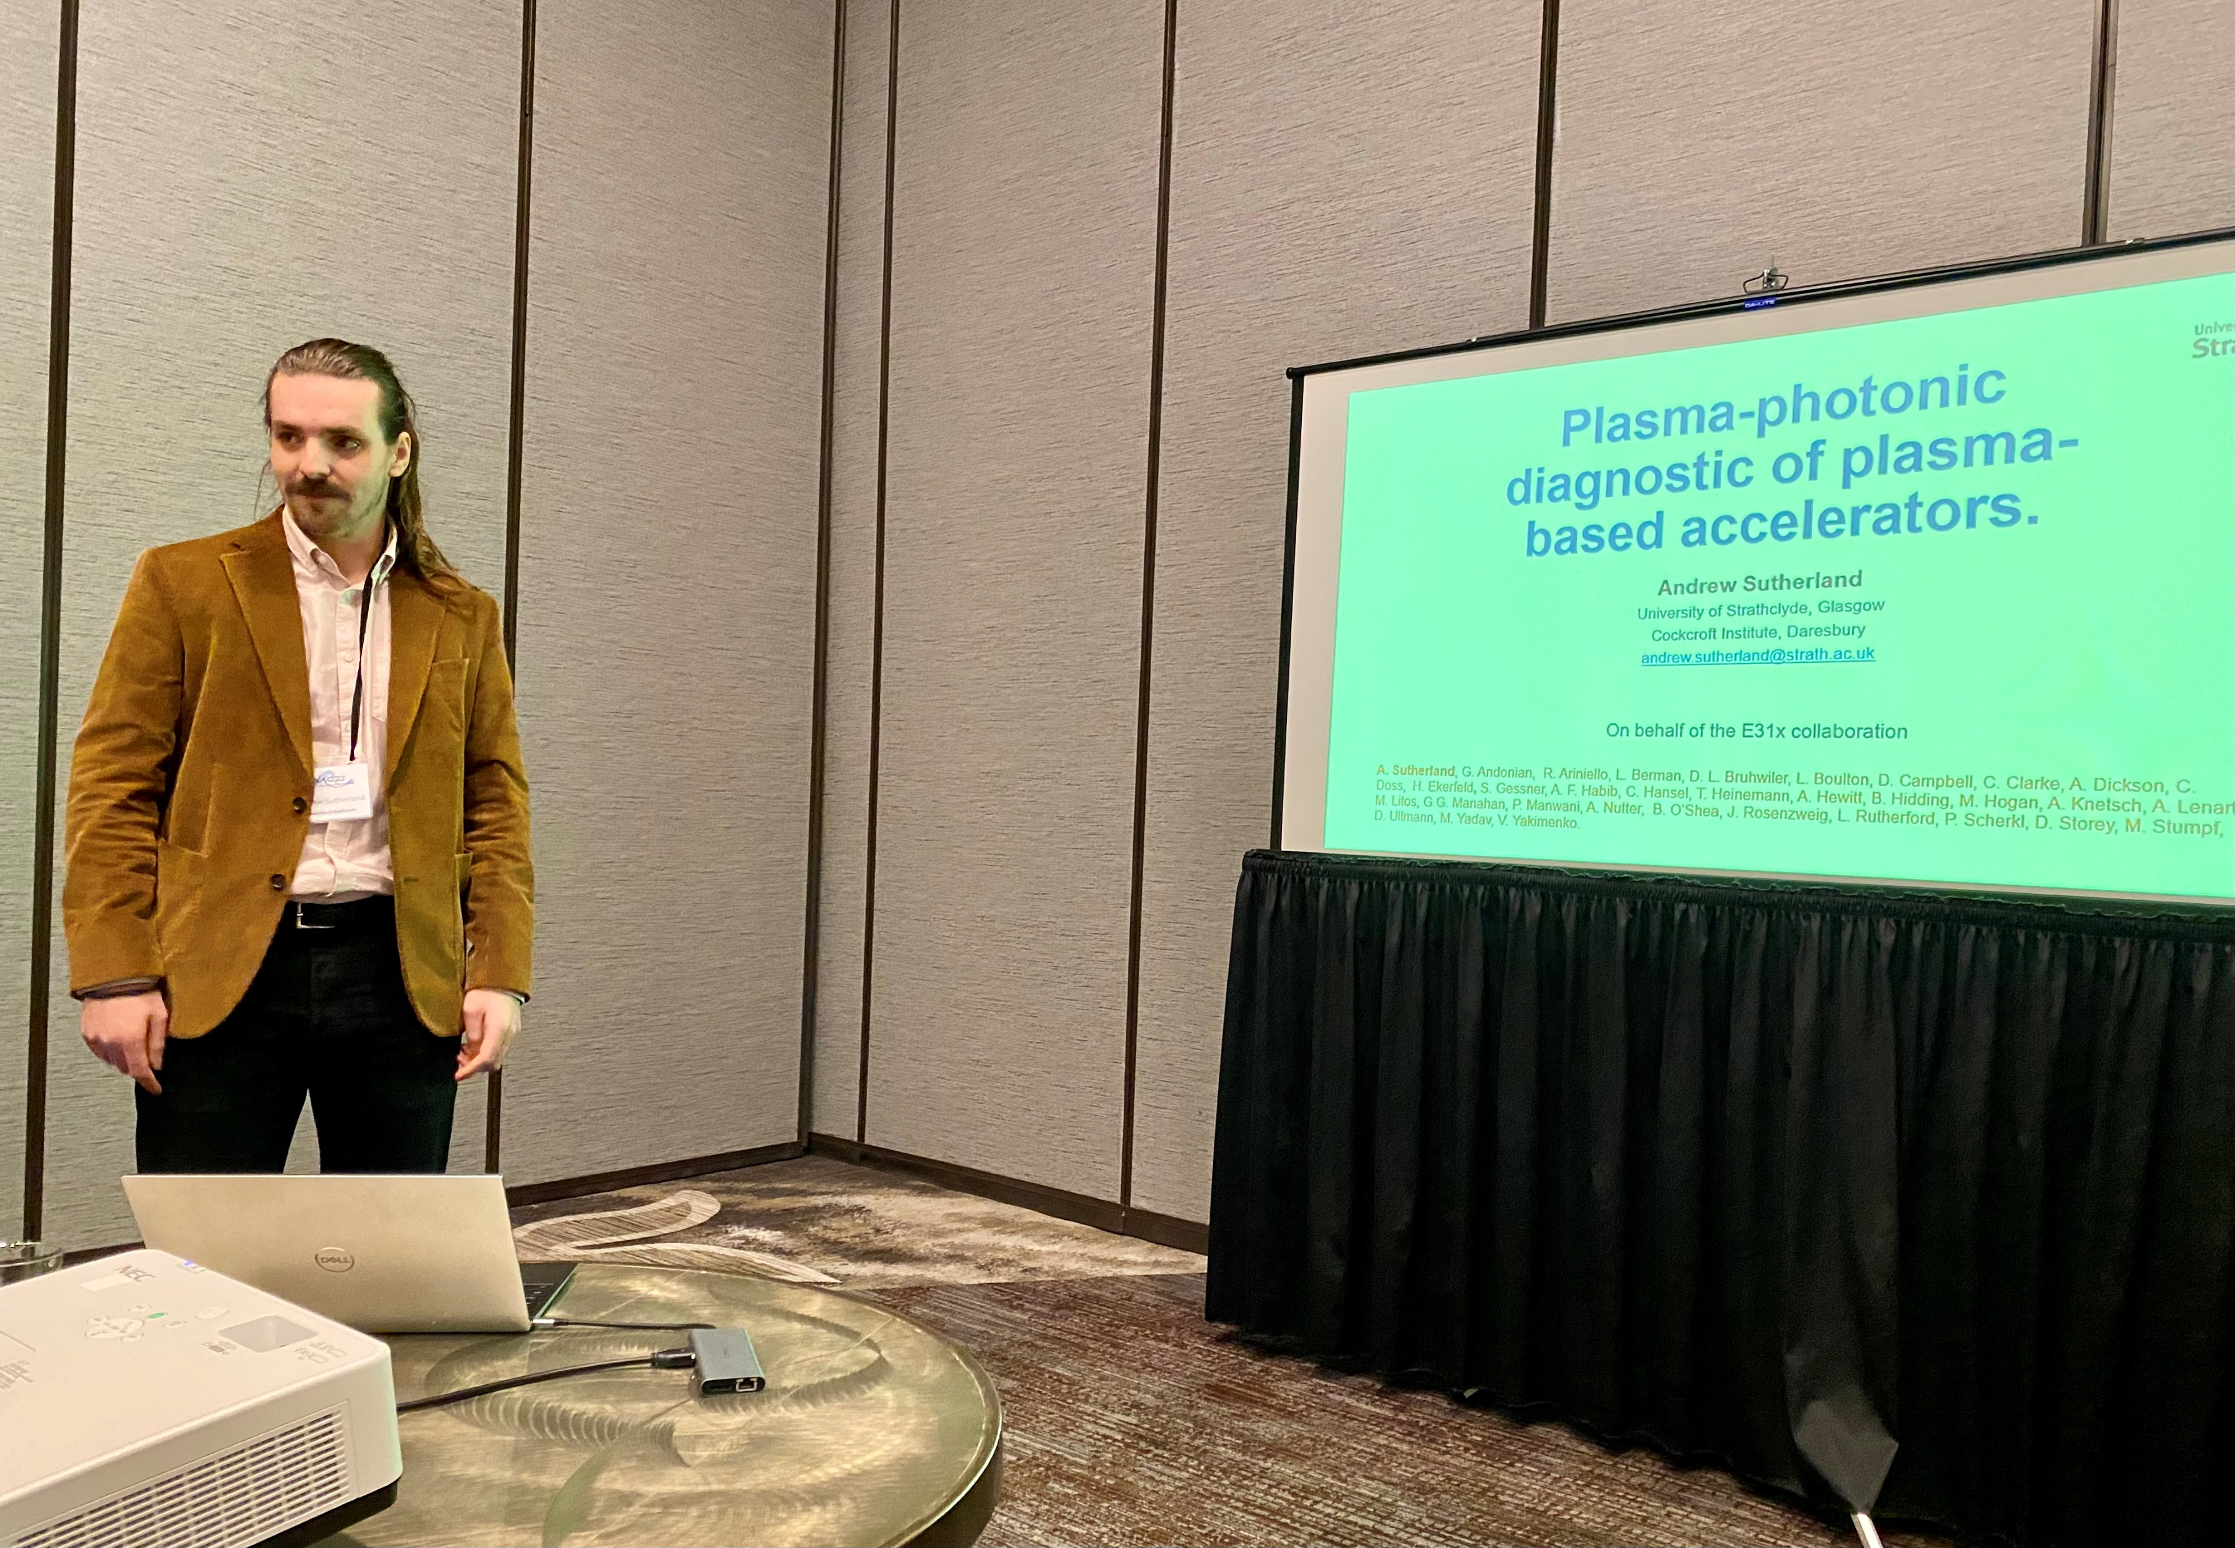
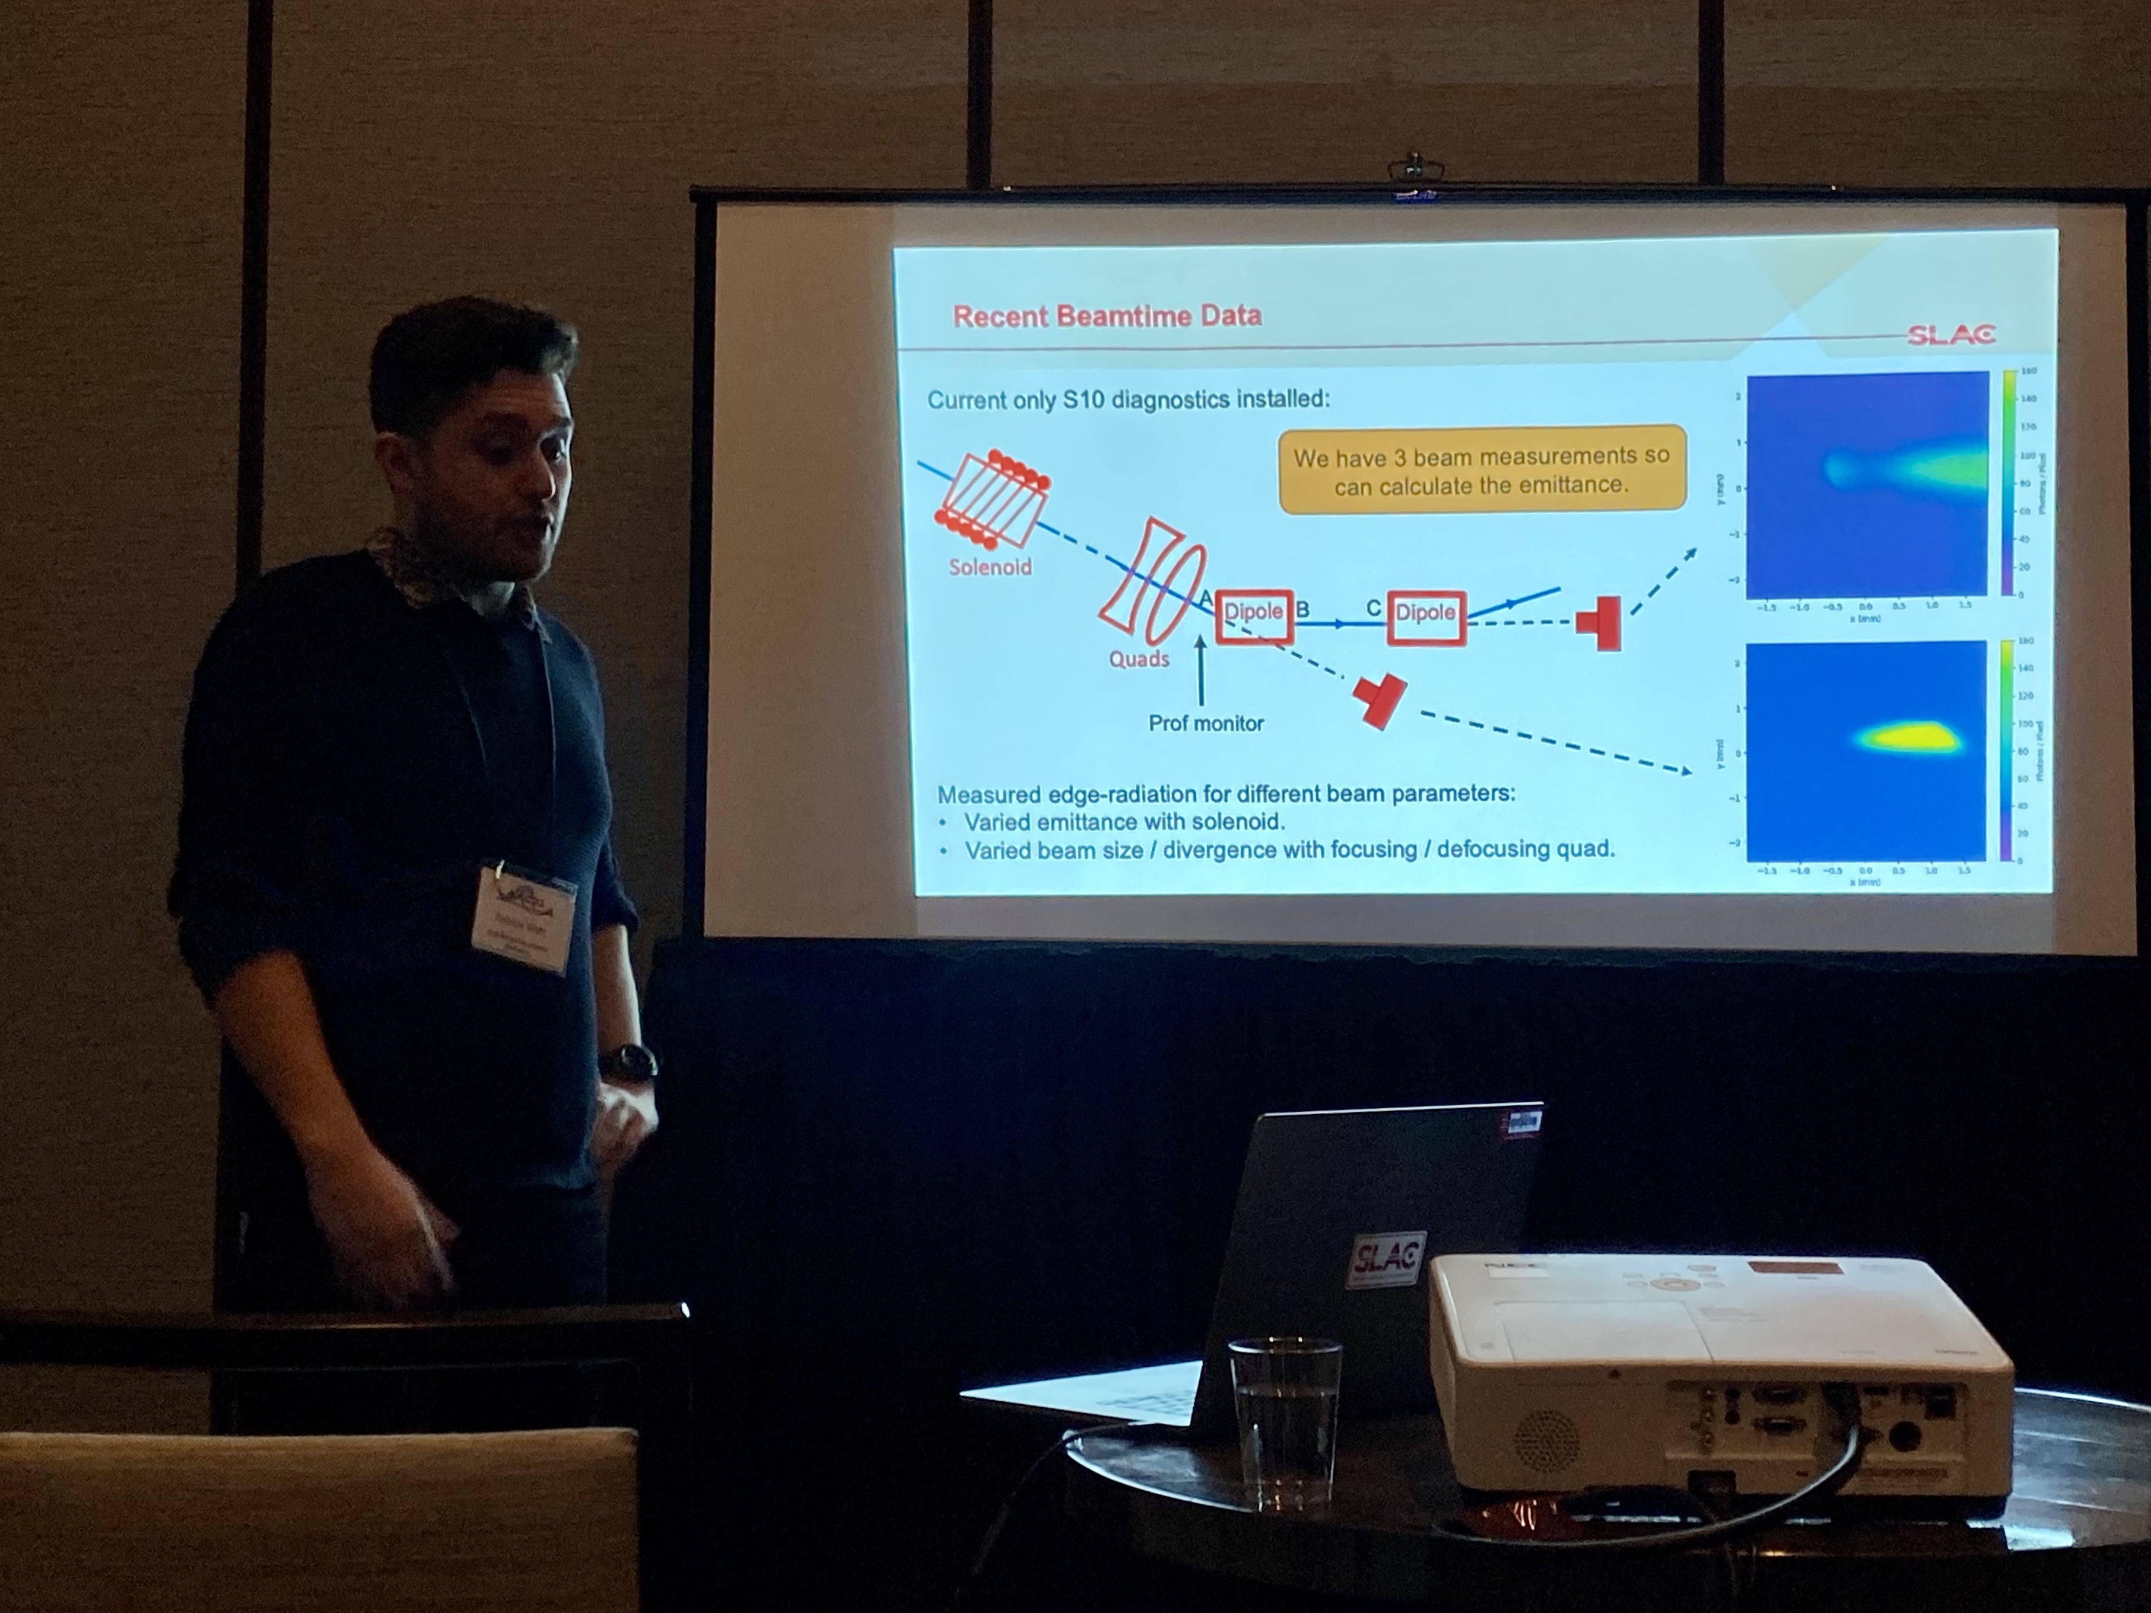
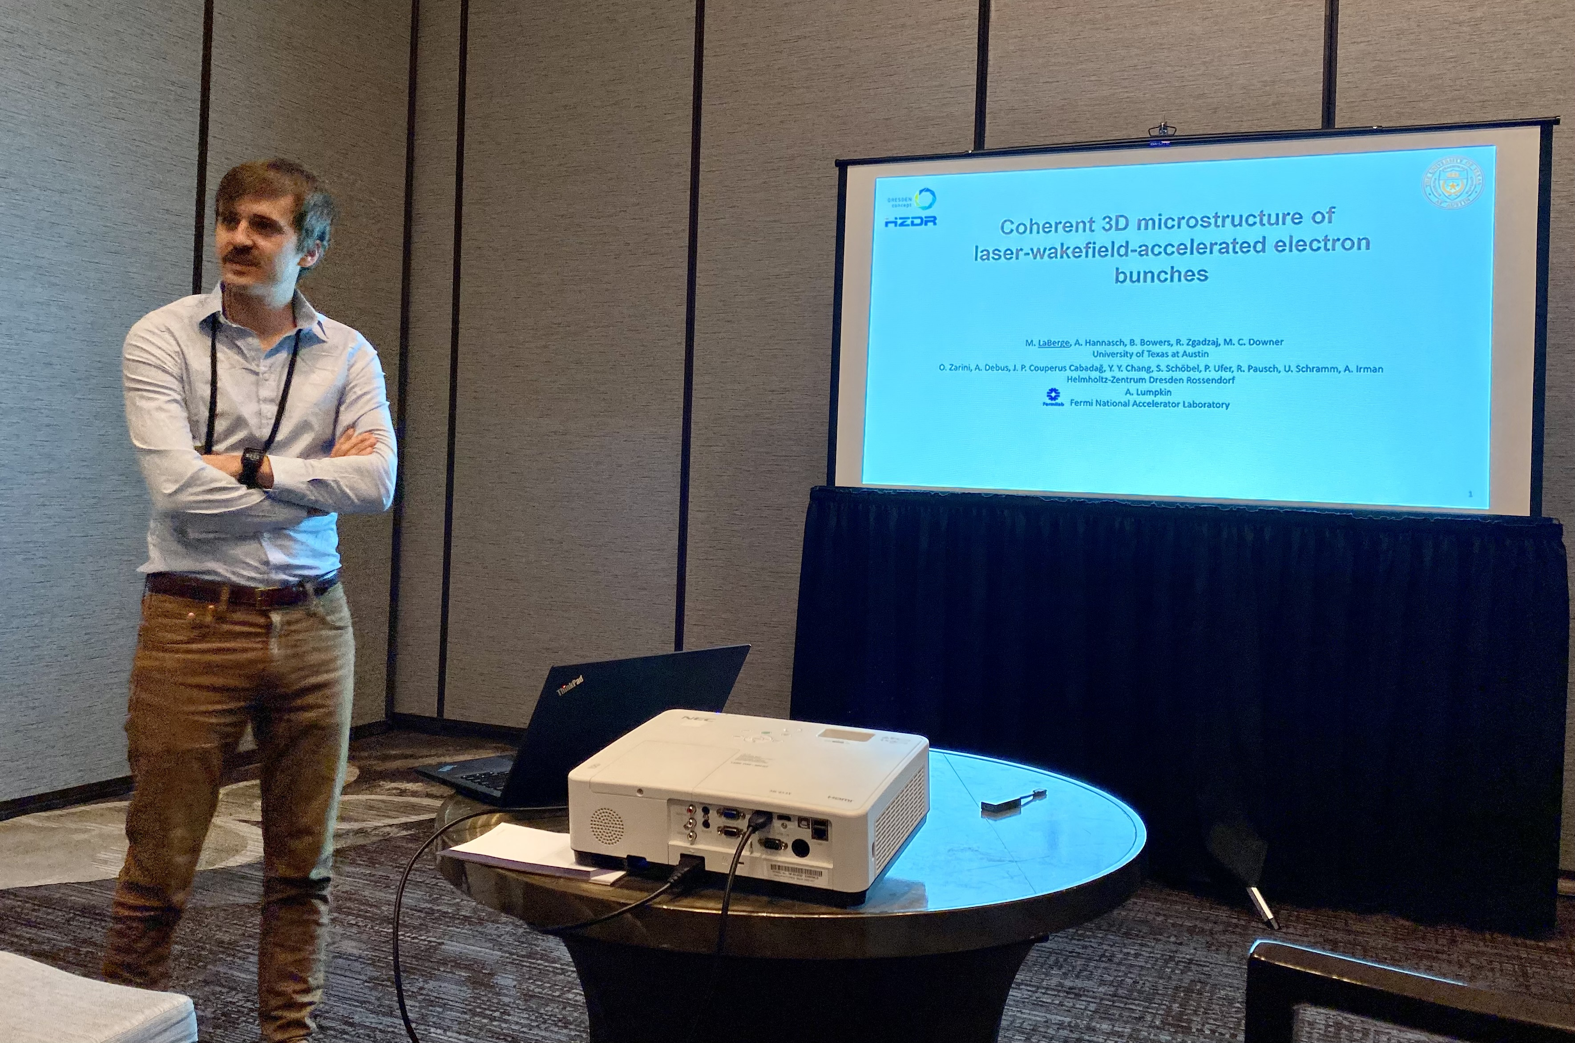
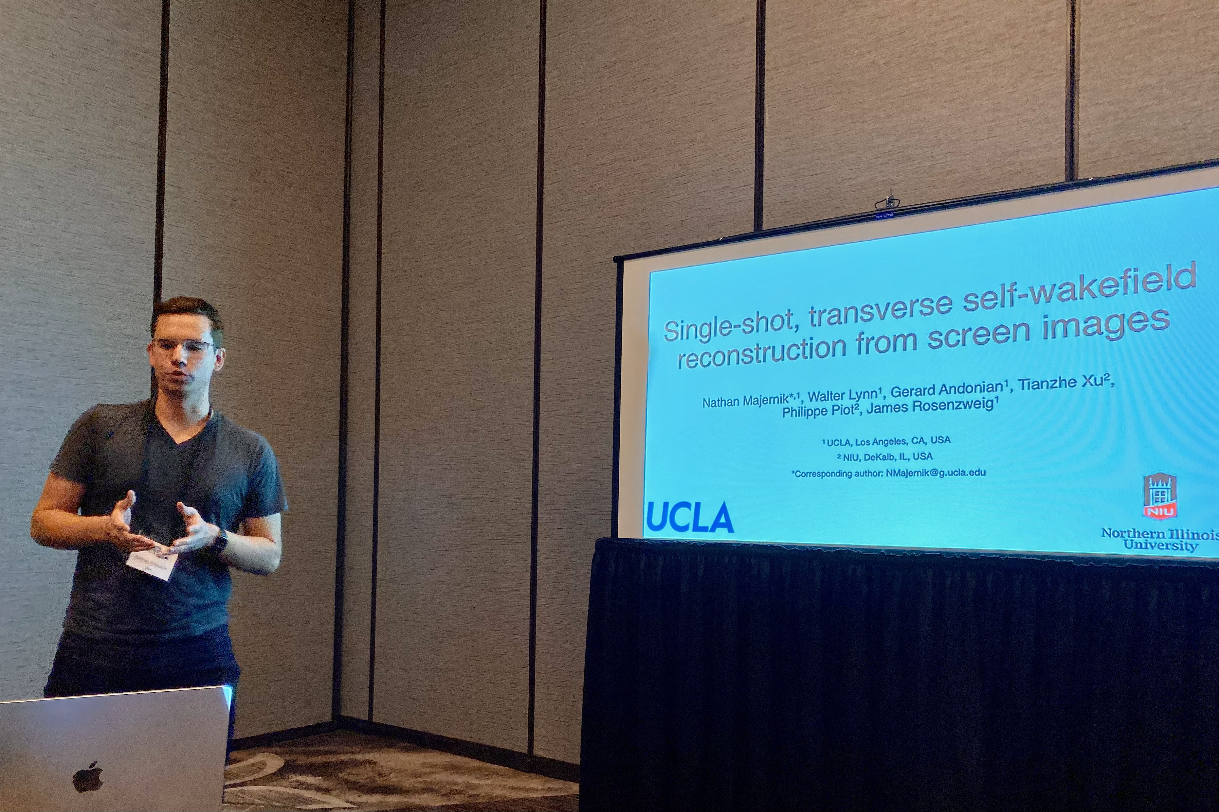
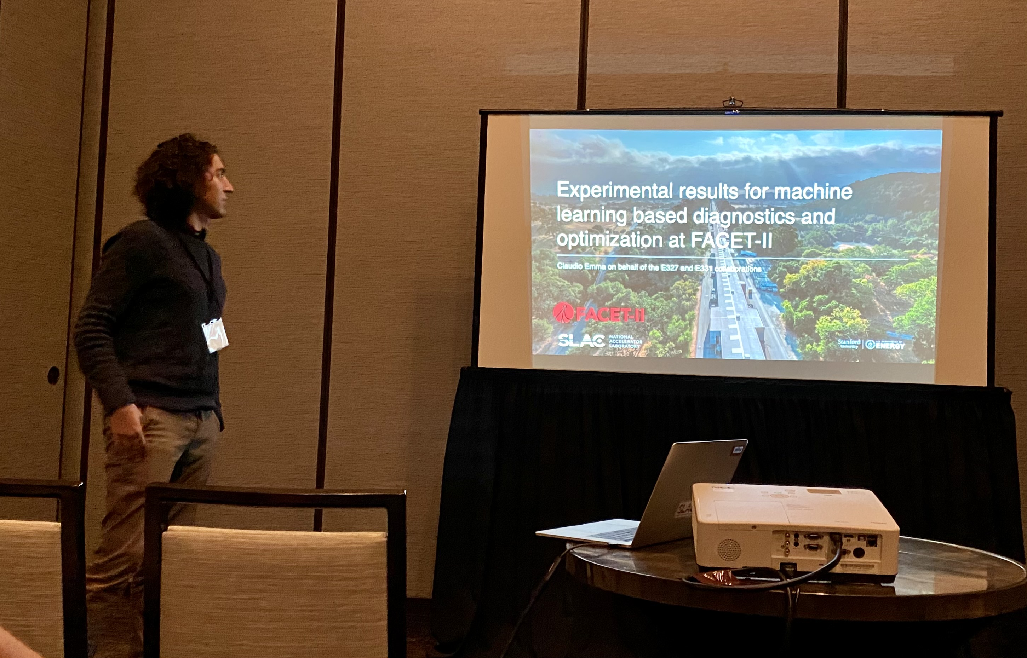
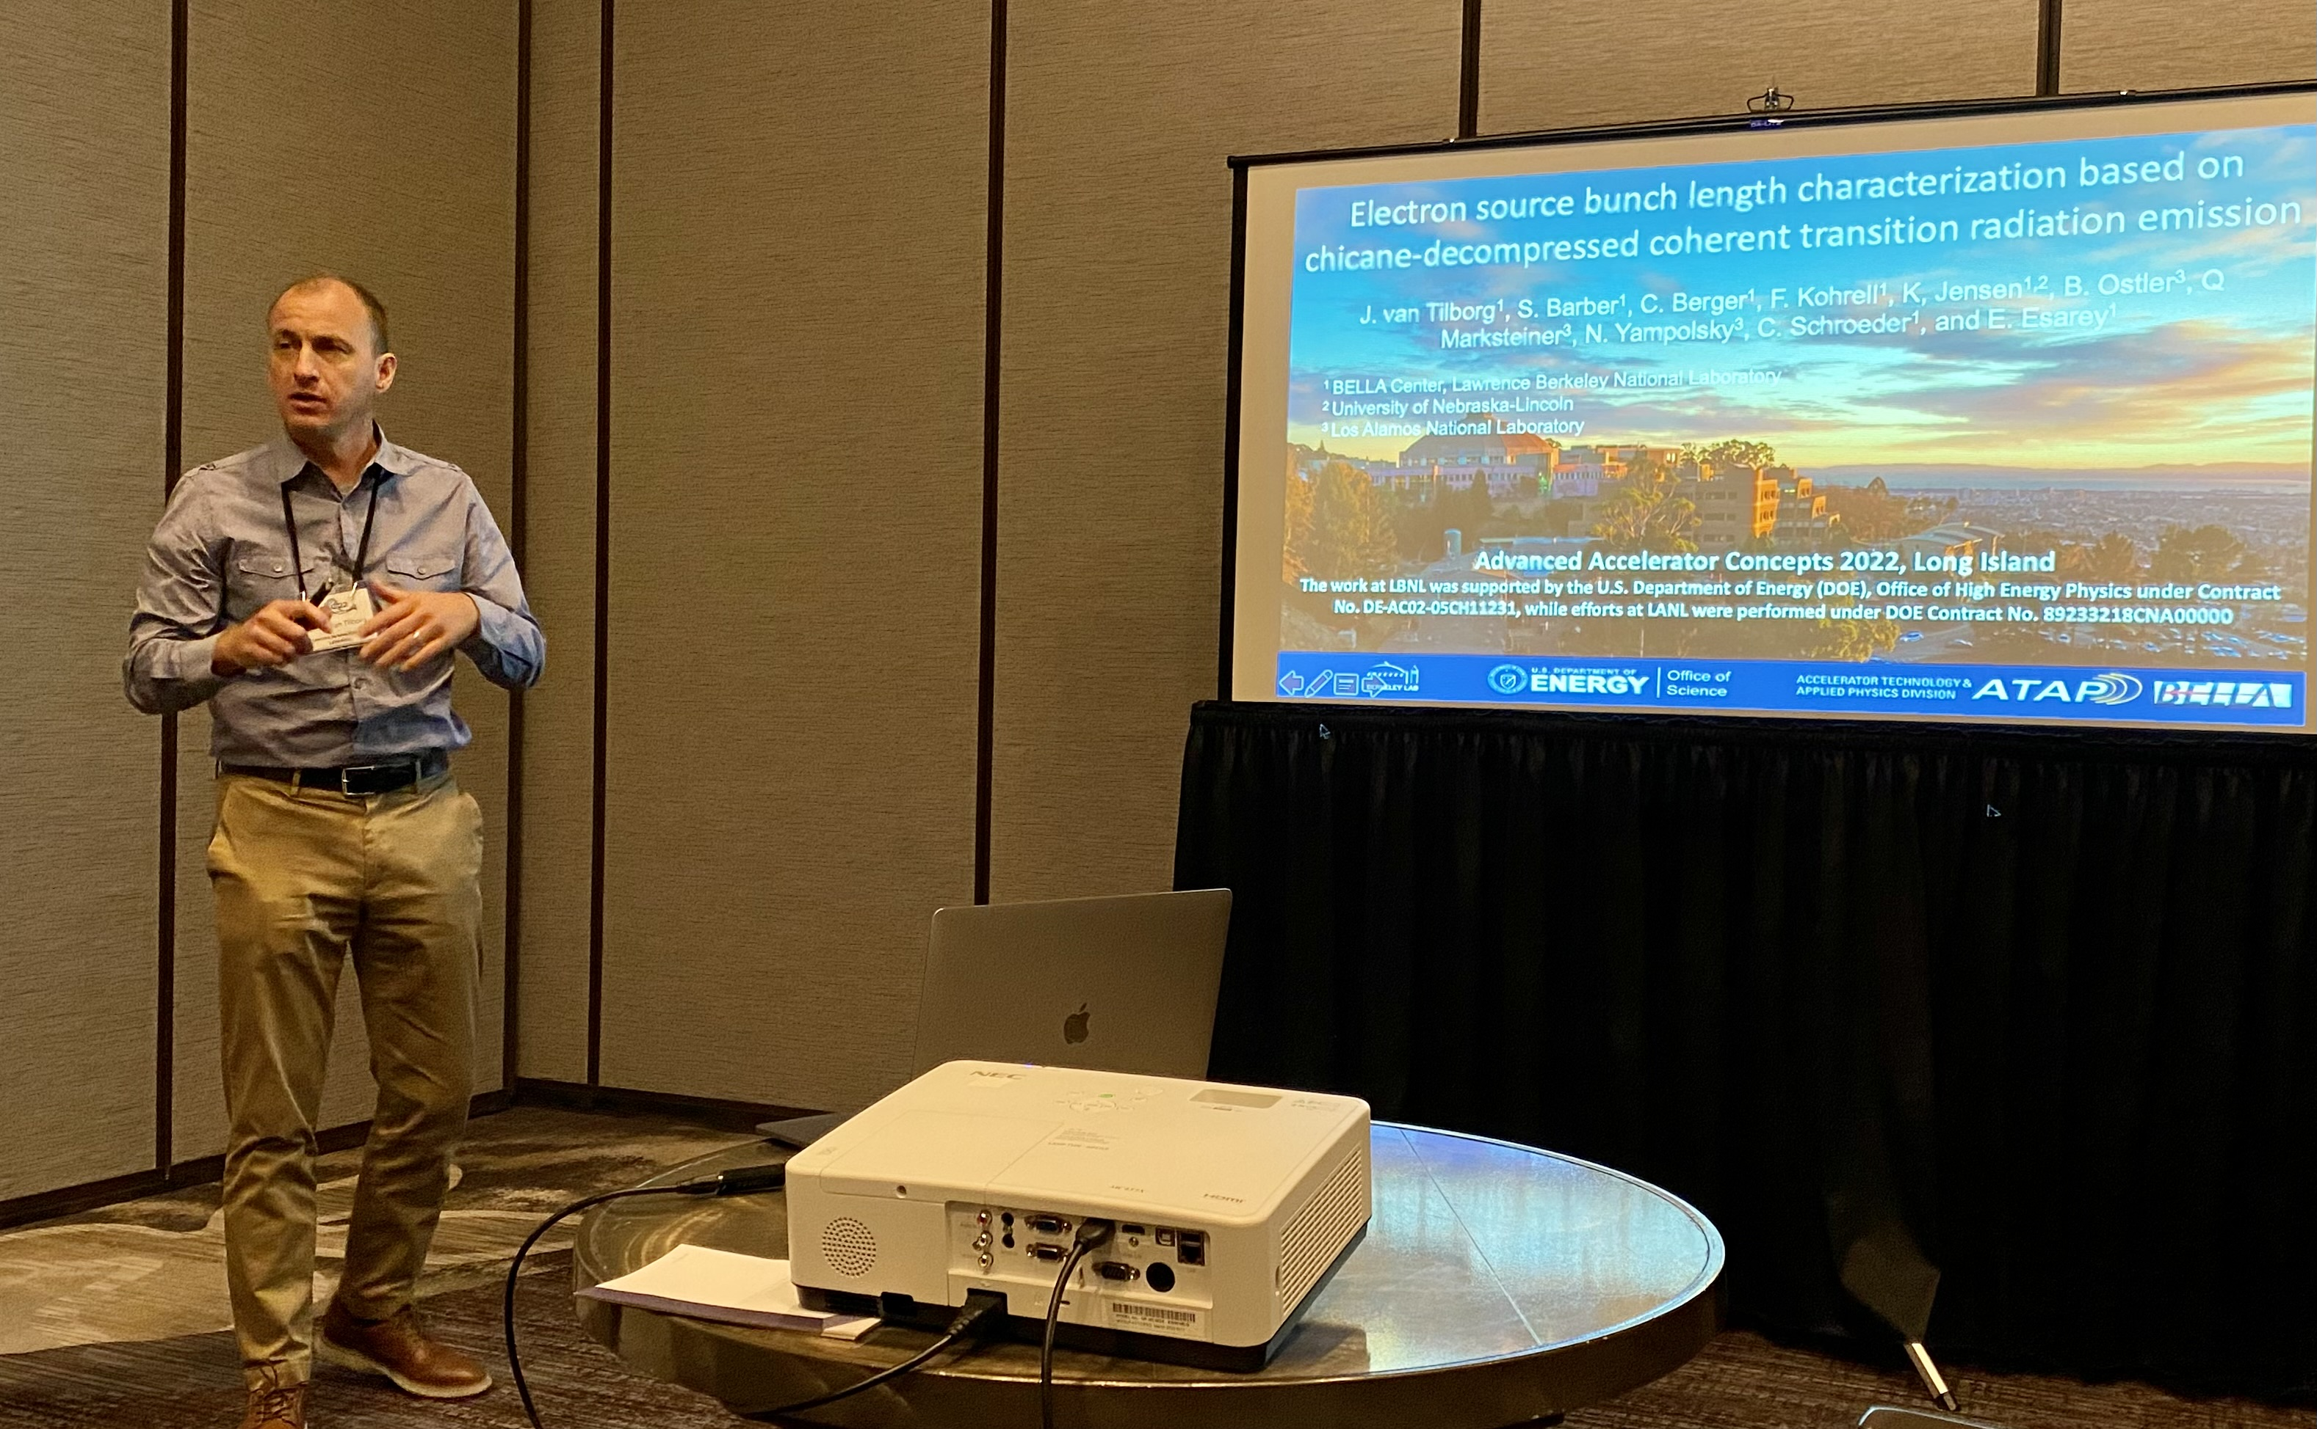
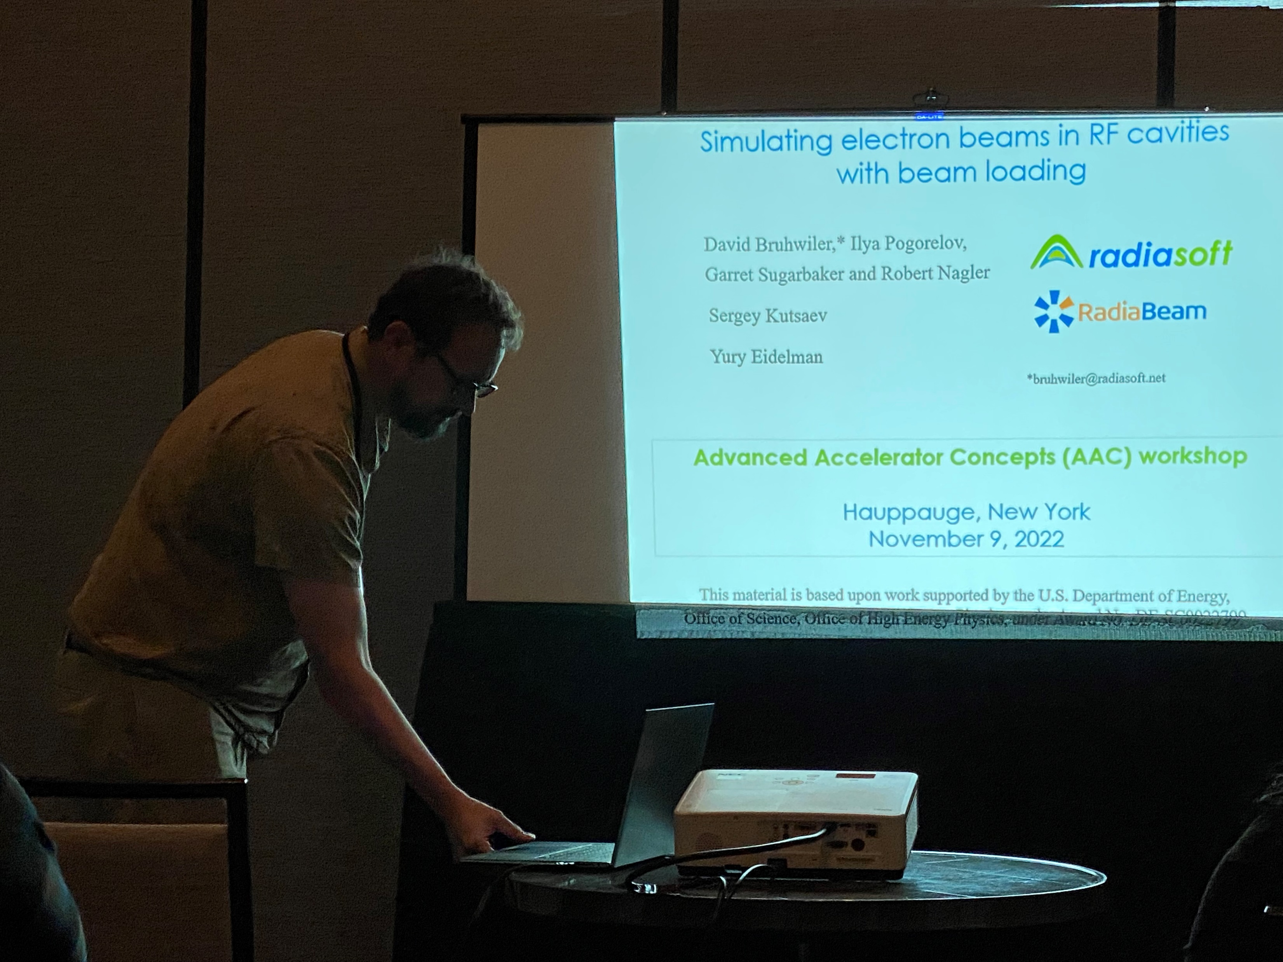
monitoring

Slide 15
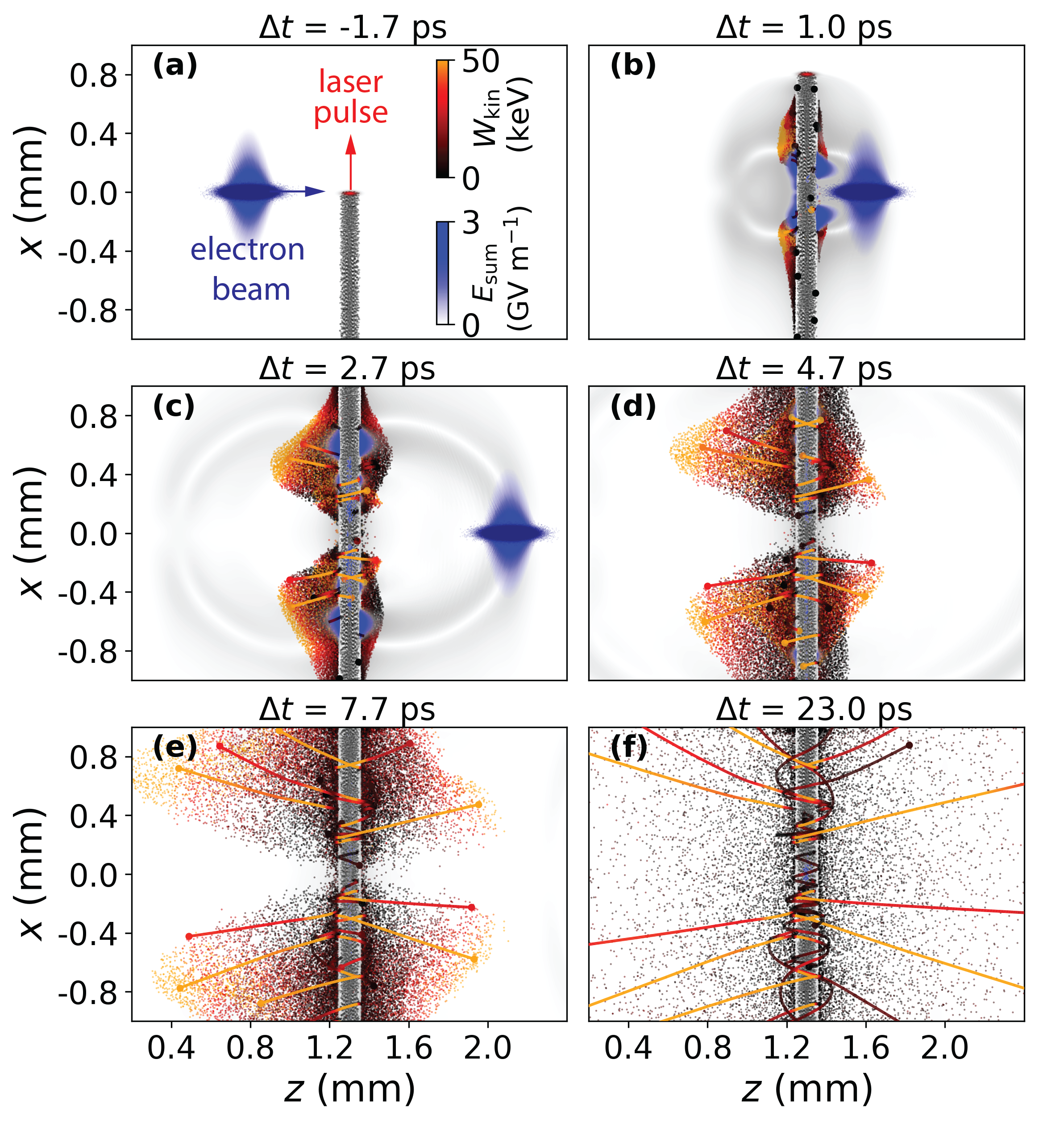
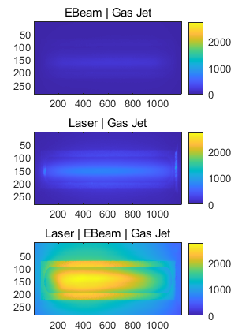
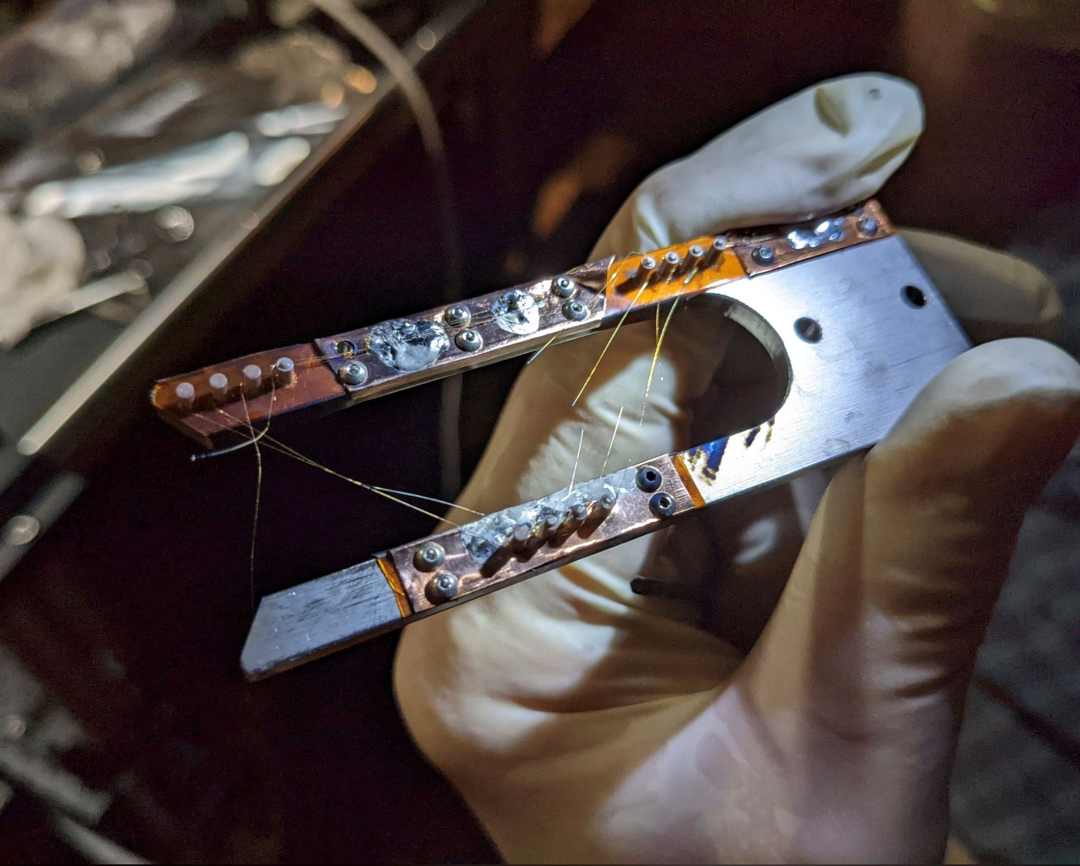
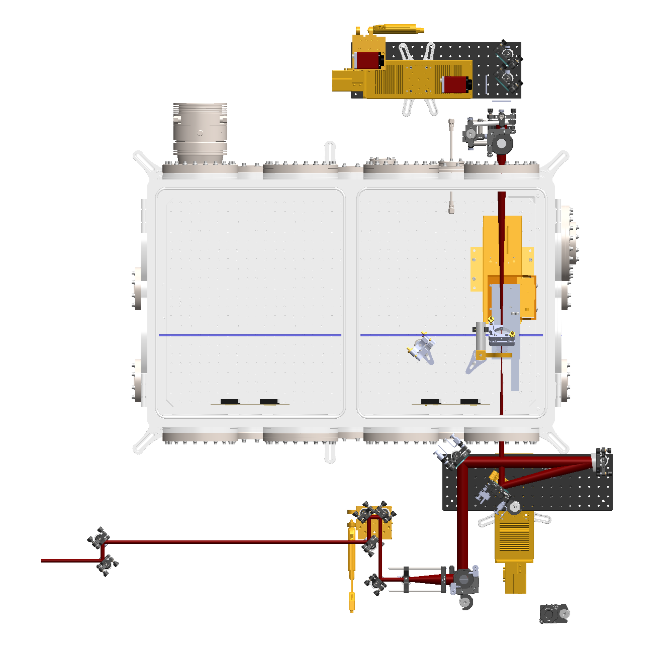
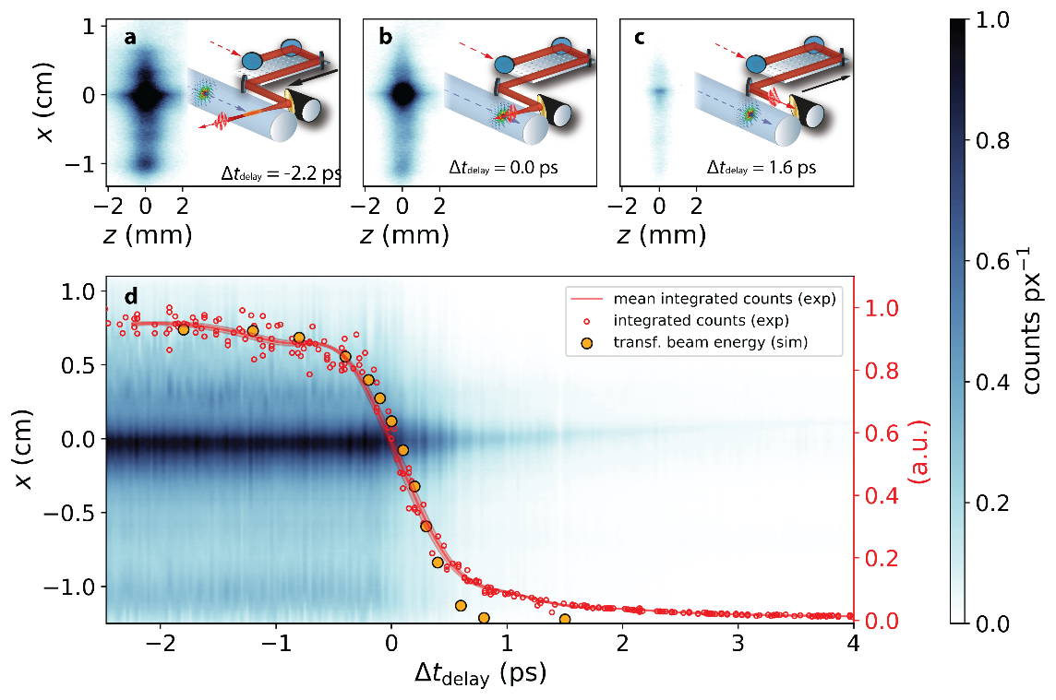
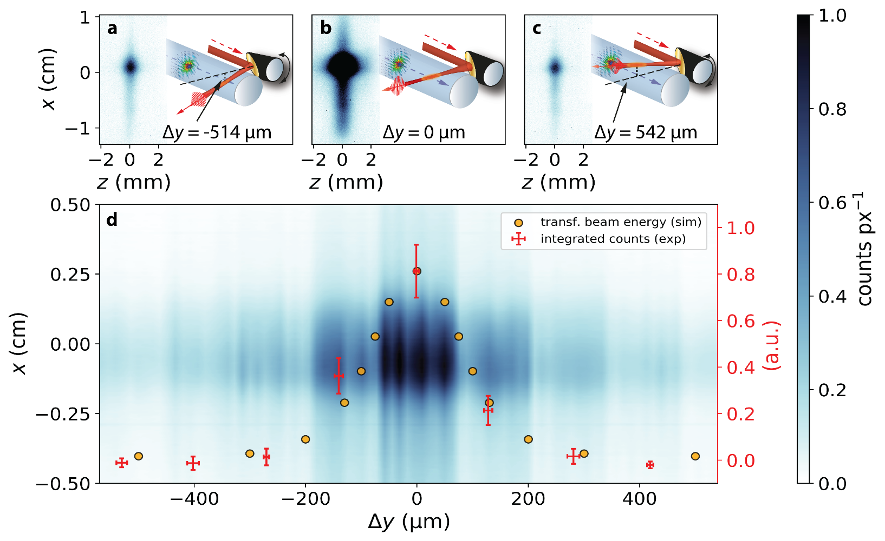
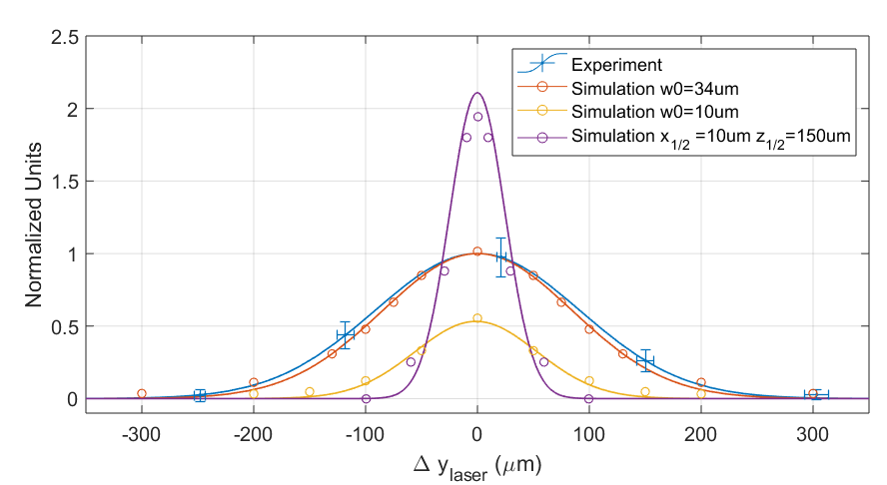
Plasma-photonic diagnostic of plasma-based accelerators
The key commission tool for experiments in the IP picnic basket area. Beamtime for experimentation expected in 2023
“Diagnostics become consumables”
Energy imparted into plasma manifests as additional afterglow light

Slide 16

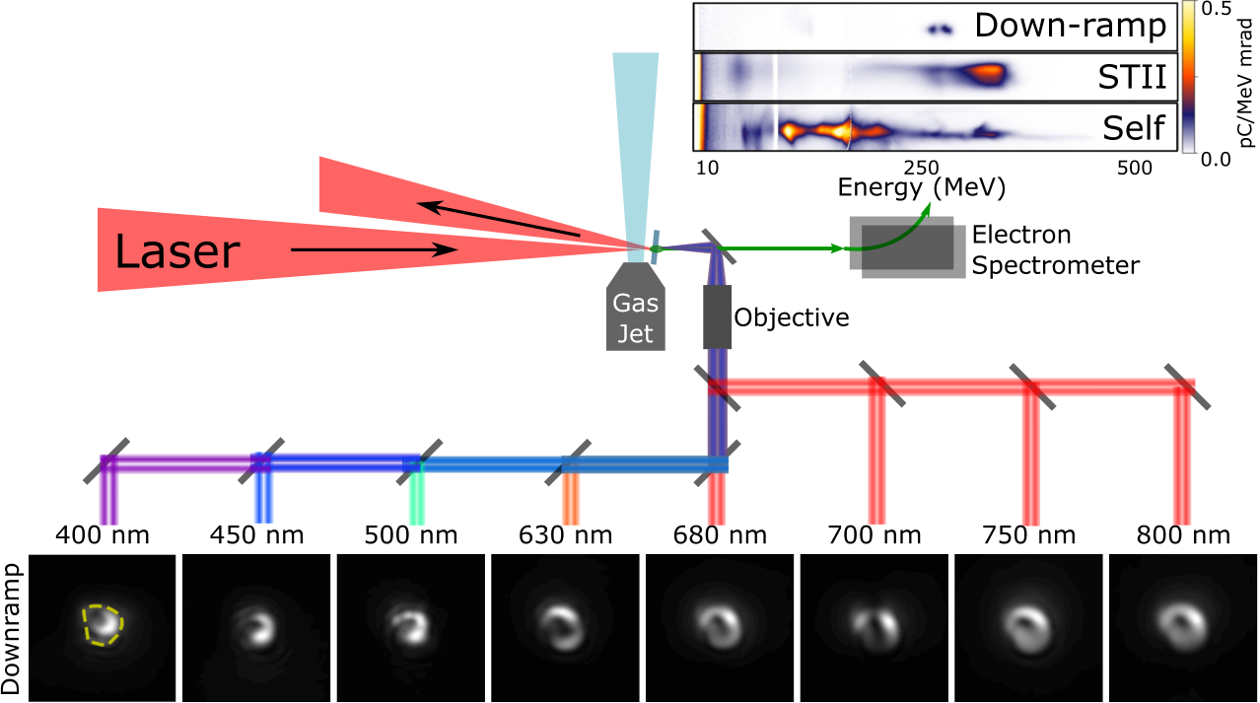
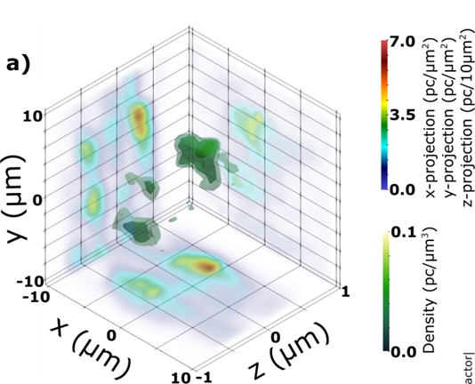
Coherent 3D microstructure of
laser-wakefield-accelerated electron bunches
M. LaBerge, A. Hannasch, B. Bowers, R. Zgadzaj, M. C. Downer
University of Texas at Austin
O. Zarini, A. Debus, J. P. Couperus Cabadağ, Y. Y. Chang, S. Schöbel, P. Ufer, R. Pausch, U. Schramm, A. Irman
Helmholtz-Zentrum Dresden Rossendorf
A. Lumpkin
Fermi National Accelerator Laboratory
Using multispectral COTR imaging, we identify coherent structures in LWFA accelerated electron beams
In the right conditions, we can use these images to reconstruct the coherent portion of the beam

Slide 17
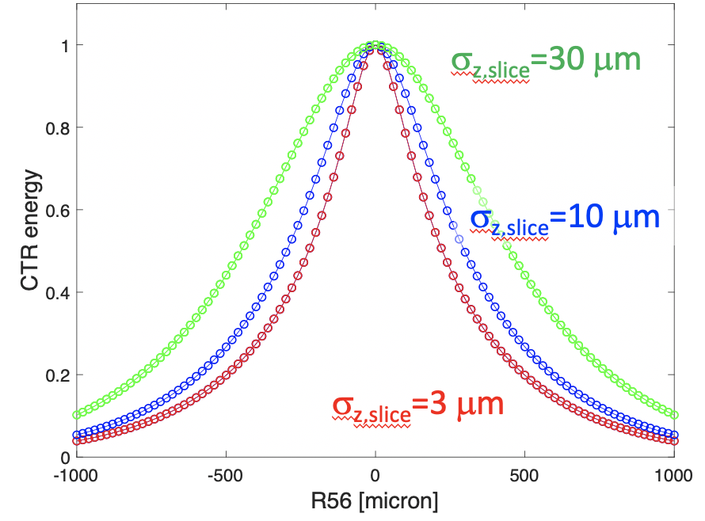
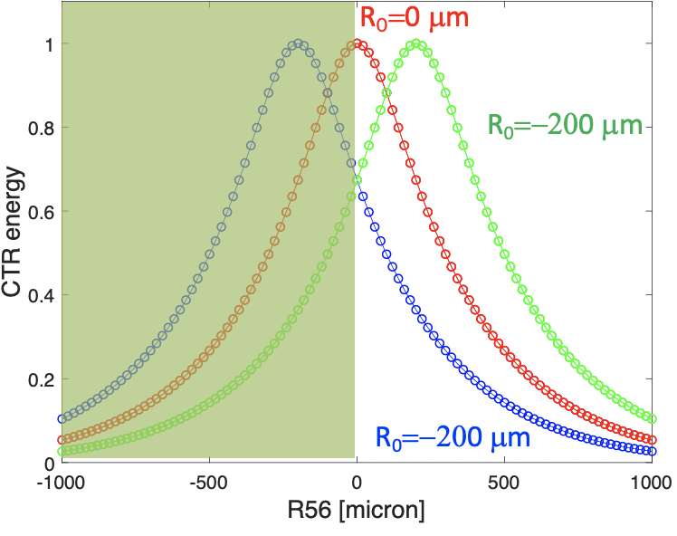
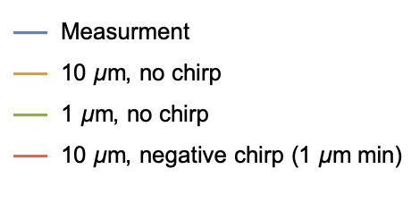
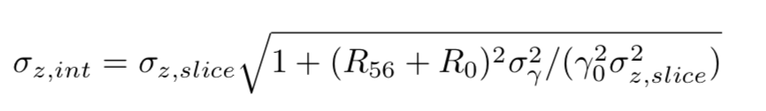
BELLA Center LPA diagnostic: triplet-focused chicane-decompressor scans on CTR screen
J. van Tilborg, S. Barber et al (LBNL)
Versus bunch length
Versus source z-γ correlation
- Chicane-scanned CTR retrieves bunch length for energy-spread beams
- Could reveal source z-γ correlations
- Demo experiment at BELLA Center’s 100TW HTU LPA beamline
- Future: LPA parameters scans to optimize longitudinal emittance
Experimental demonstration
CTR energy ~ 1/σ_{z}

Slide 18
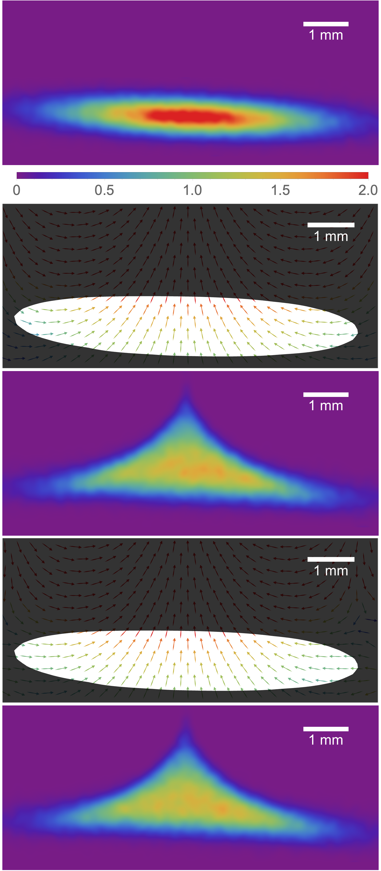
Single-shot, transverse self-wakefield reconstruction from screen images
Without-structure screen image
Difficult but important to measure transverse self-wakes (streakers, BBU, etc.)
Introduce a method to reconstruct from a single screen image; no additional hardware
Benchmarked against simulation and applied to experimental data
Reconstructed wakes
Reconstructed final beam
Ground truth wakes
Ground truth final beam

