Slide 1
WG3
Laser and High-Gradient Structure-Based Acceleration
Summary Presentation
Conveners: Sergey Belomestnykh (FNAL), Xueying Lu (Northern Illinois University)

Slide 2
WG3
The purpose of Working Group 3 is to discuss recent advances in externally-powered structure-based accelerators, both laser and rf driven. The capability to accelerate particles at higher accelerating gradients and efficiencies is essential for reduction of size and cost of future accelerators for science and industry. This includes the future multi-TeV e+e- collider for High Energy Physics, free-electron lasers (FELs) for Basic Energy Sciences and National Security, industrial accelerators for Energy and Environmental Applications, and accelerators for other applications (direct material investigation, medical field, nanotechnology, etc.).
The working group welcomes presentations on the following topics:
Recent developments in novel accelerating structures with new geometries, new materials (dielectric, metamaterial, hybrid, etc.), new fabrication technologies (additive manufacturing, micromachining, etc.), frequencies from microwave to THz and optical spectrum, and operating conditions from normal conducting to cryogenic and superconducting.
Recent advances in understanding rf breakdown and quench phenomena at different frequencies and materials, and other physics limitations to the accelerating gradient.
Recent advances in improving the accelerating efficiency, such as understanding of sources of microwave dissipation and pathways, development of ultra-low rf loss material, heavy beam-loading compensation.
Demonstration of high accelerating gradients and efficiencies.
The group will also try to address specific issues such as novel structure-beam interaction schemes (IFEL, undulator-mediated, etc.), high efficiency electromagnetic power source development, optimizing novel accelerating structures using advanced algorithms, beam dynamics and collective effects associated with reduced beam apertures, optimizing power coupling schemes to the structures, increasing wall-plug-to-beam efficiency, and integrated particle source designs.

Slide 3
WG3 submissions and summary outline
2 plenary talks
17 presentation in 6 WG sessions (one joint session with WG5)
2 student posters
5 contributed posters
Topics covered in WG3 sessions:
  High-gradient radio frequency structures & RF sources (10)
  Joint session with WG5 on injectors (2+1)
  Laser / THz structures (4)
  Plasmonic wakes in a semiconductor (1)

Slide 4
High-gradient radio frequency structures
DDA structures and dielectric properties
High-gradient copper structures
Application of high-gradient structures to proton acceleration
RF cavity needs for future Muon Accelerators
High efficiency RF sources

Slide 5

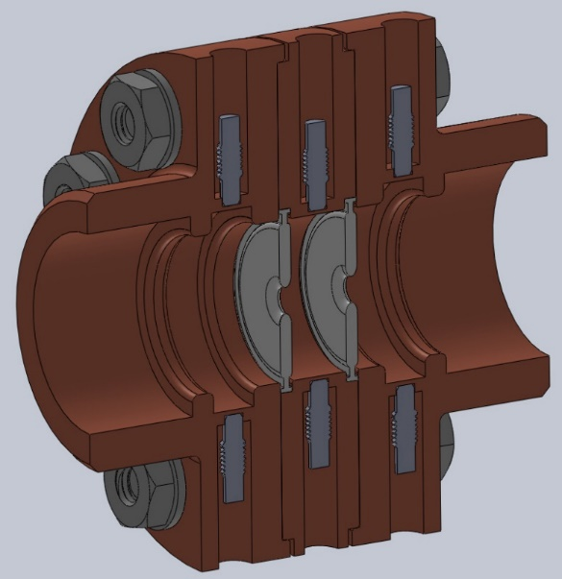
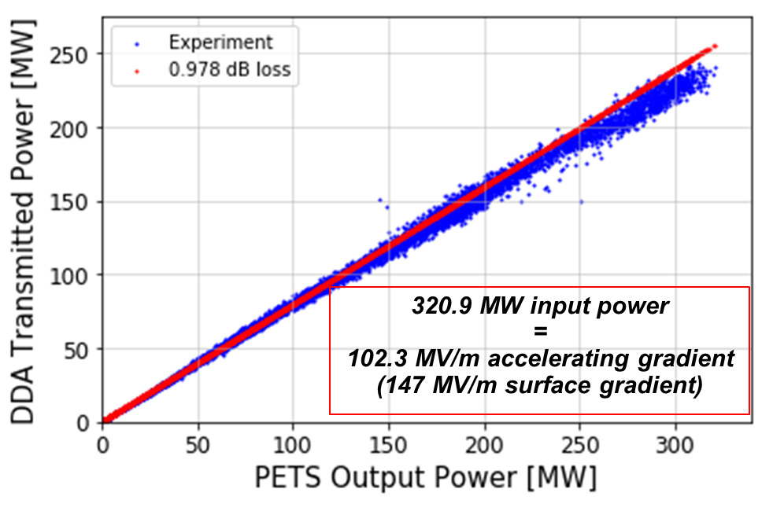
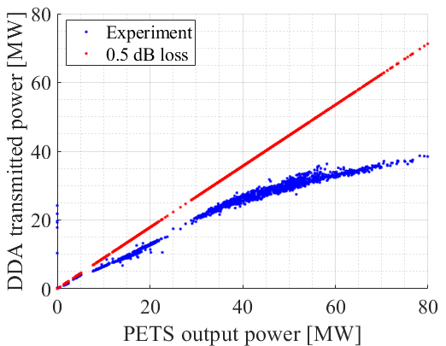
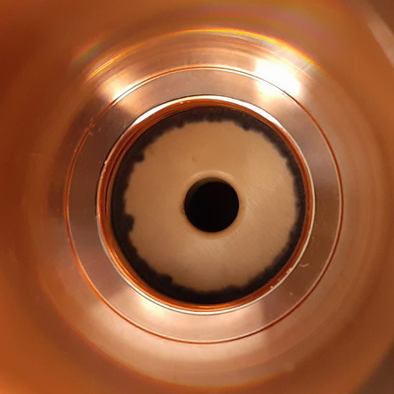
High Power Test Results of X-Band Dielectric Accelerating Structures
B. Freemire – Euclid Beamlabs
Two single cell 11.7 GHz dielectric disk structures tested at high power
Clamped structure reached >100 MV/m accel. grad. (input power limited)
  No evidence of multipactor or breakdown
Brazed structure limited by breakdown/multipactor at braze joint (triple junction) caused by field enhancement
Multi-cell and additional brazed structures in production, to be tested

Slide 6


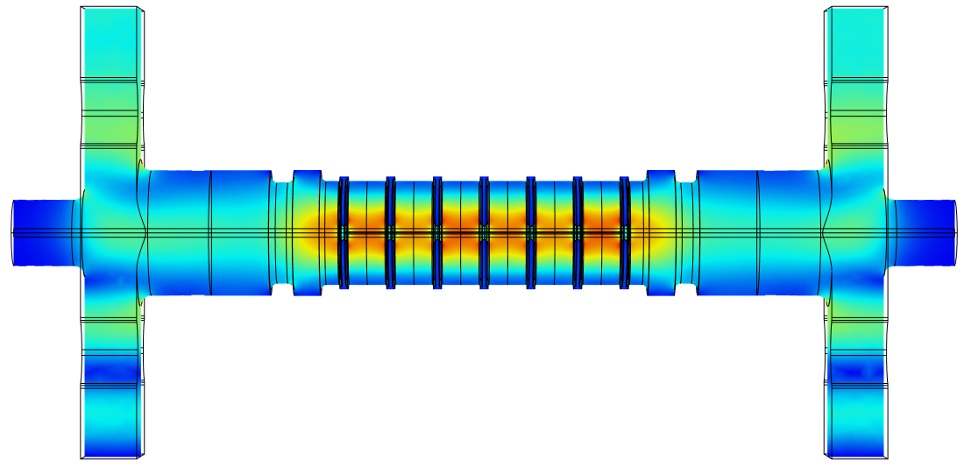
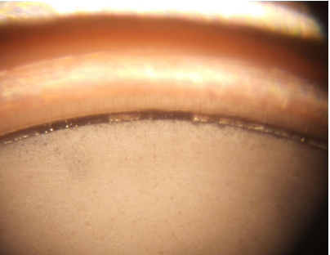
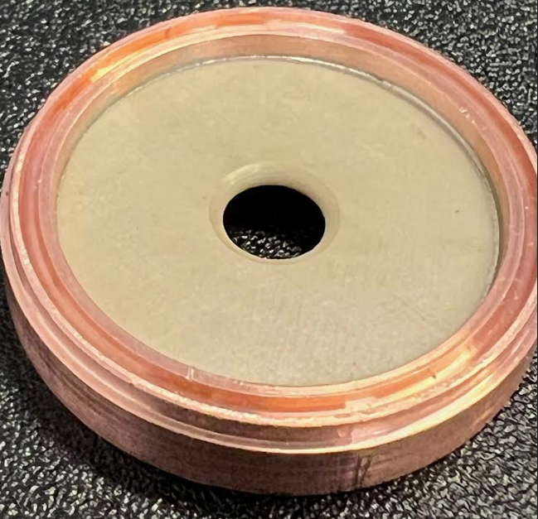
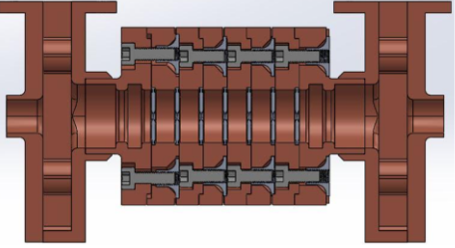
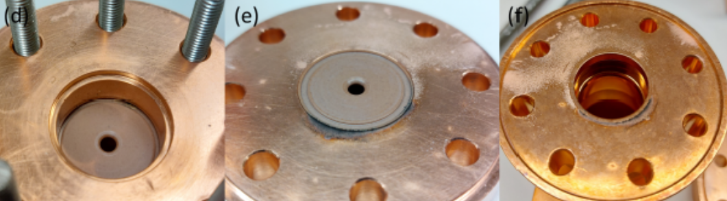

Simulation Results of Dielectric Disk Accelerating Structures
Sarah Weatherly, IIT
Dielectric Disk Accelerators are high gradient accelerator structures with large shunt impedances
Goals for research
  Produce large accelerating gradient
  Test thresholds of materials used in structure
New brazed single cell structure being fabricated
  Accelerating gradient 150 MV/m
  Issues with brazing during fabrication
  High power testing early next year
Gapping in braze material
Path of beam
Successful brazing test
After successful high power test of single cell clamped structure, a clamped multicell structure has been designed, simulated and fabricated
Accelerating gradient 108 MV/m
New engineering design for better assembly to avoid damage
High power testing later this year
Damage from previous high power clamped testing:
Notes:
Make it clear that the tests are coming up (near term)

Slide 7
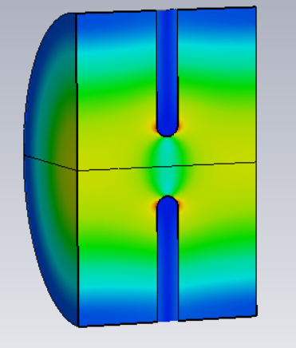
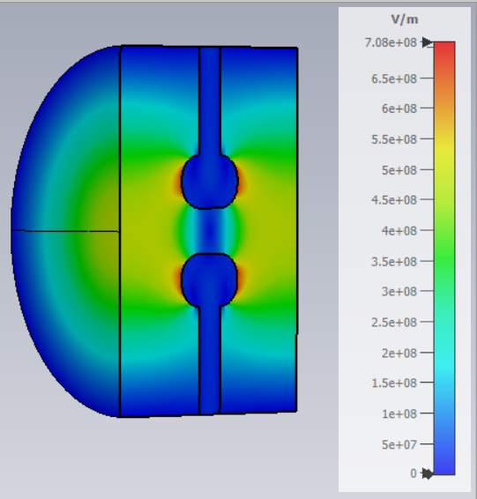
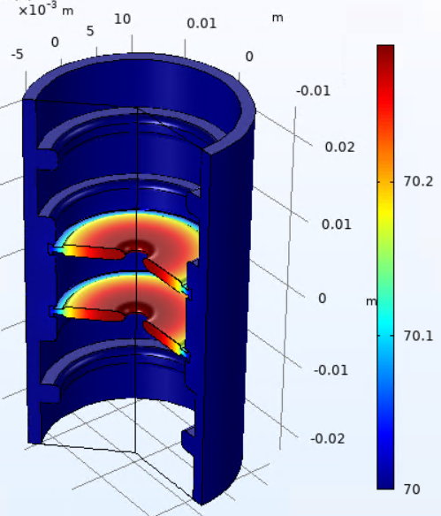
Dielectric Accelerators at Cryogenic Temperature
Chunguang Jing, Euclid Techlabs,LLC
Dielectric accelerator shows surprisingly high shunt impedance at cryogenic temperatures.
Challenges remain as in conventional dielectric accelerators, i.e., breakdowns due to variety of micro gaps.
Worth to explore. The first step is to characterize different dielectric materials at low temperature.
Structure (X-band) | Temp, K | aperture | epsilon | R_{sh} , MΩ/m
DDA (dielectric disk accelerator) | 300 | 2.6 | 50 | 181
DDA | 77 | 2.6 | 50 | 463
DDA with 2 mm nose, E_{s} /E_{a} = 2.5 | 77 | 2.6 | 50 | 550
The thermal simulation of the X-band DCA prototype under 100 MV/m of gradient and 28 W of heat load.
Note: Room temperature copper conductivity 5.8E7 S/m, cryogenic conductivity is 3e7 S/m;
Dielectric loss at room temperature is 1e-4, at cryogenic temperatures is 3e-6.

Slide 8
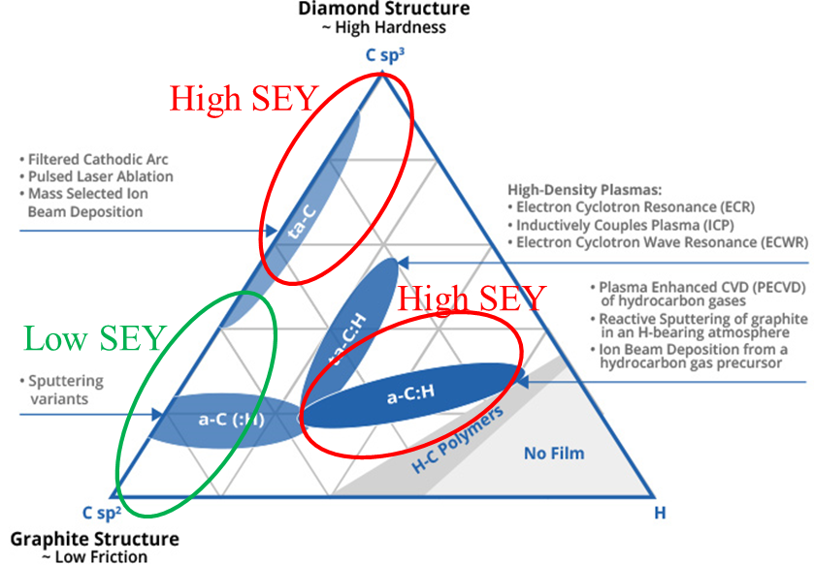
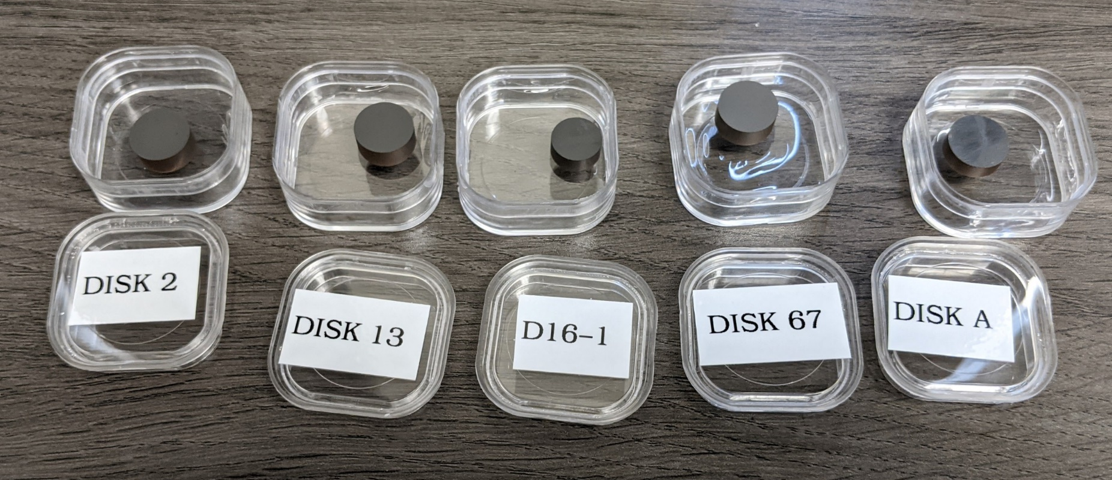
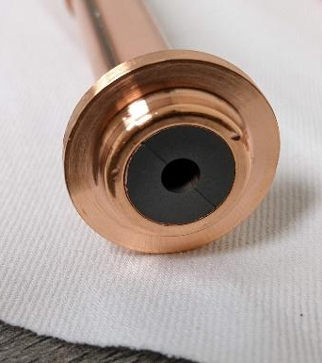
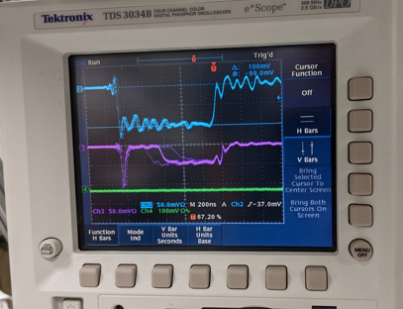
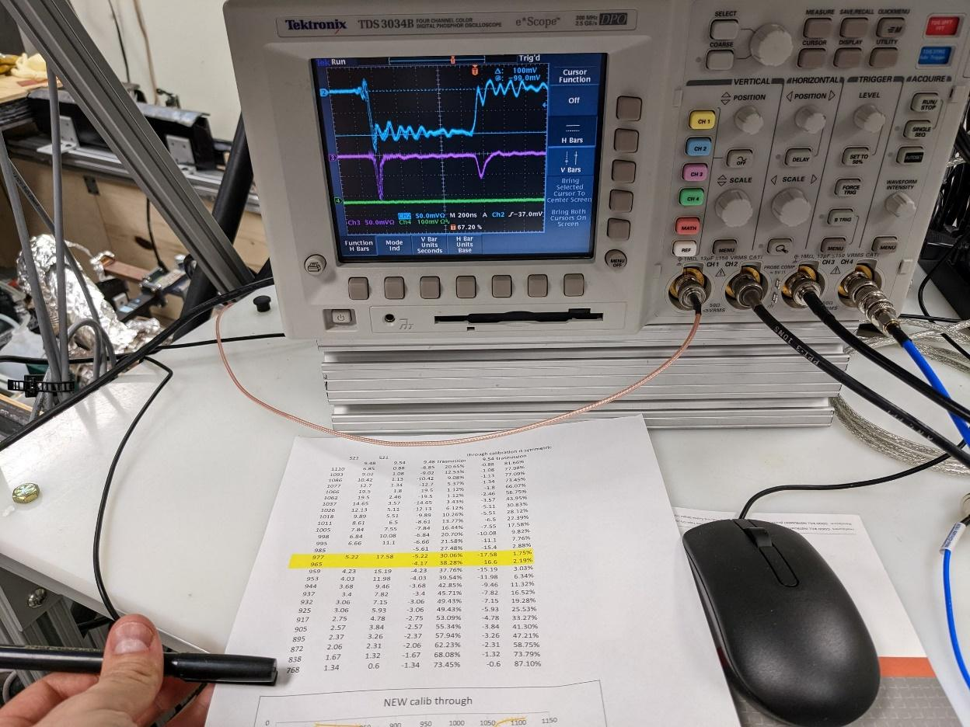
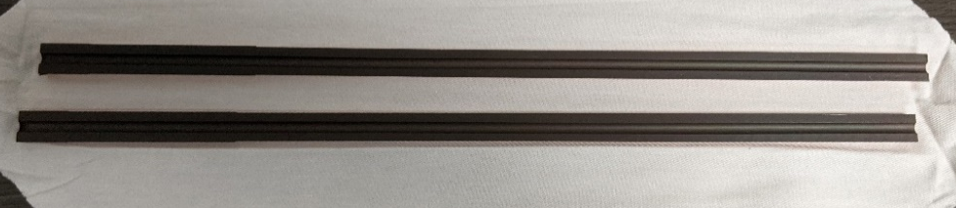
Evaluation of Multipactor Suppression in Dielectric Accelerators by DLC Coating
Chunguang Jing, Euclid Beamlabs, LLC
Solving multipactor using the approach of Split DLA and DLC coating is promising. It reduces the SEY. And it has either no impact on or slightly improved loss tangent on the coated ceramics. This may be an ultimate solution.
RF breakdowns currently limits the final demonstration.
If success, it will be a game changer for ultracompact linac for industrial applications.

Slide 9
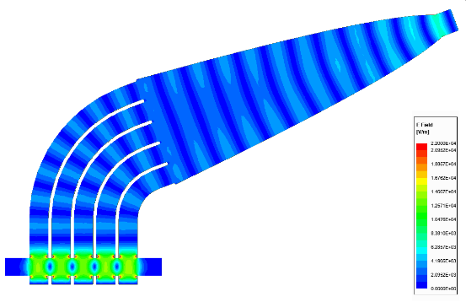
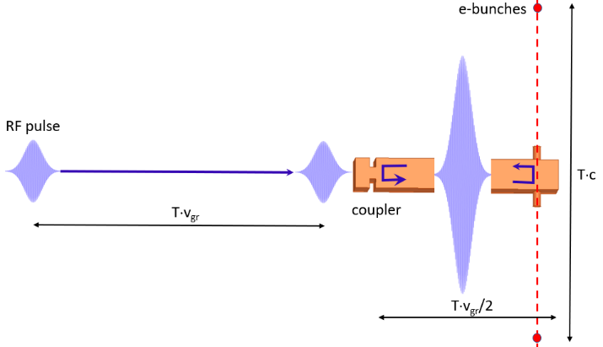
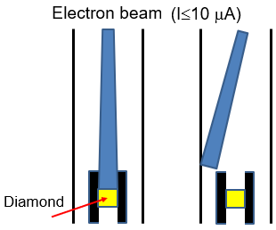
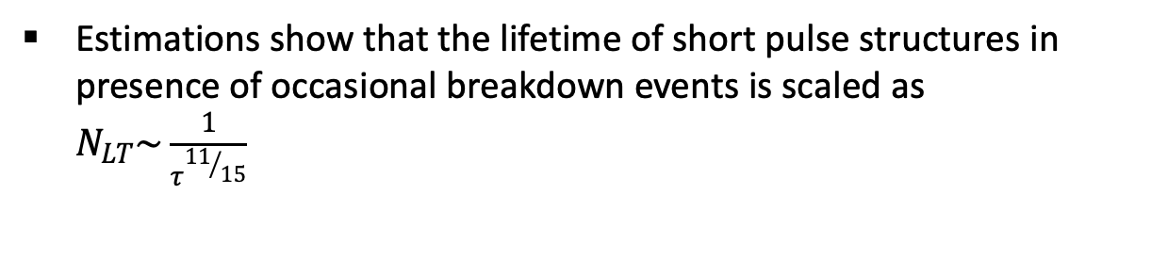
Short Pulse High Gradient Accelerating Structures
S. Kuzikov – Euclid Techlabs
Short-pulse structures show prospects to achieve ~GV/m gradients. Such structures can have high RF-to-beam efficiencies that are comparable with efficiencies of classical long pulse structures.
Estimations show that the lifetime of short pulse structures in presence of occasional breakdown events is scaled as $N_{LT}\sim \frac{1}{τ^{{11}/{15}}}$
High repetition rate (MHz or sub-GHz), short pulse RF sources are necessary. For sources based on Q-switching effect we propose RF switches based on electron induced conductivity in diamond.
The synergistic effect of short pulse technology and cryogenic technology would allow reaching world record gradients.

Slide 10
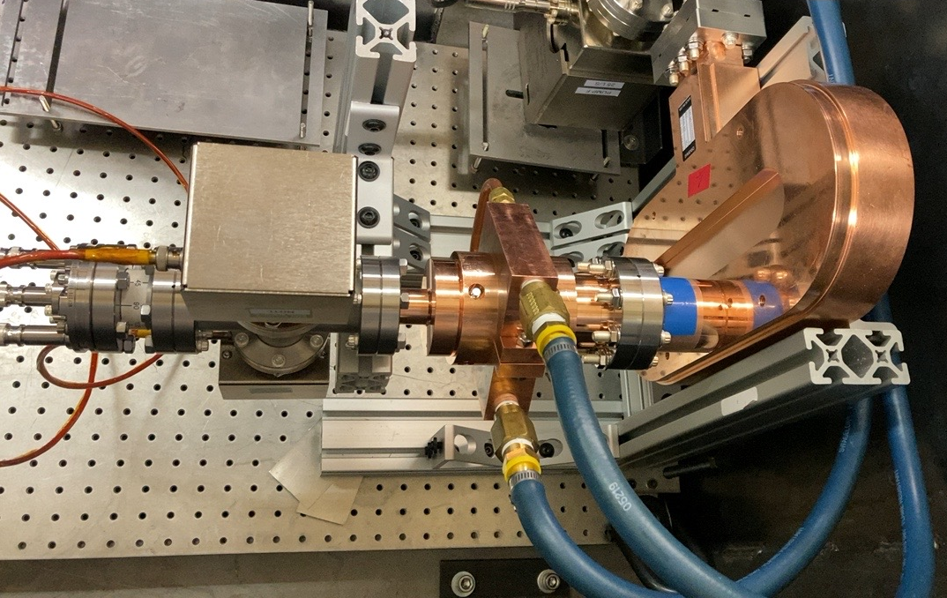
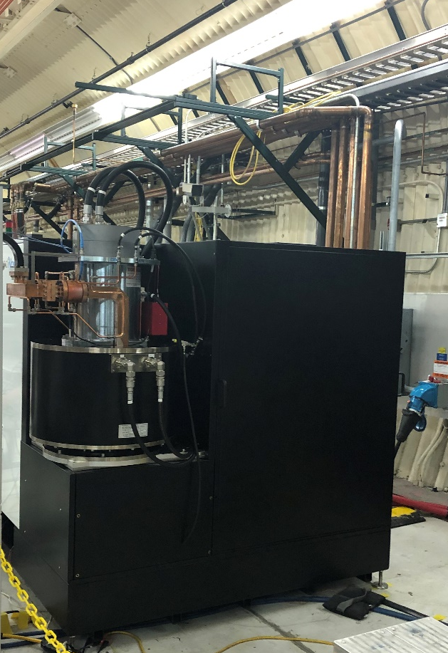
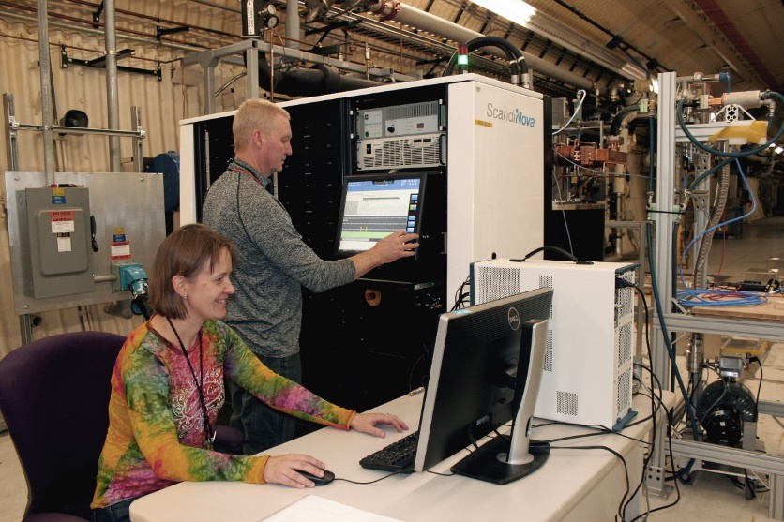
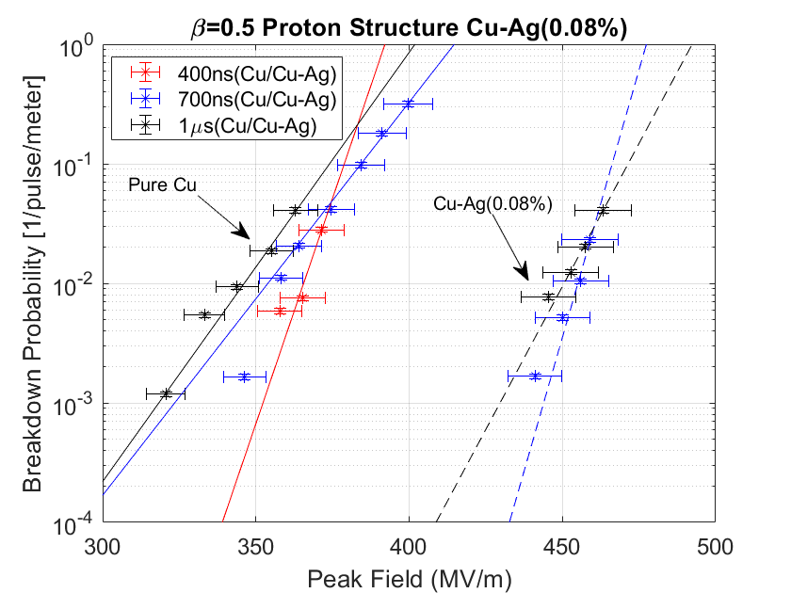


LANL C-band Engineering Research Facility (CERF-NM)
E. Simakov – LANL
CERF-NM was built with $3M of LANL’s internal infrastructure investment.
Powered with a C-band Canon klystron
Conditioned to 50 MW
Frequency 5.712 GHz
300 ns – 1 µs pulse length
Rep rate up to 200 Hz (typical 100 Hz)
Nominal bandwidth 5.707-5.717 GHz
cavity
mode launcher

Slide 11
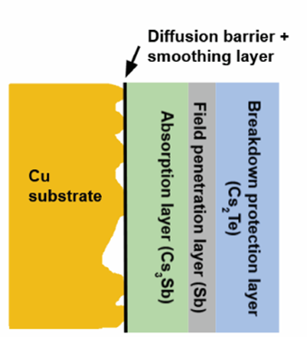
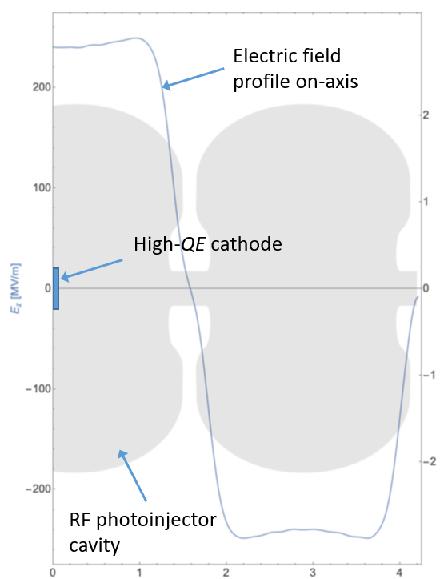
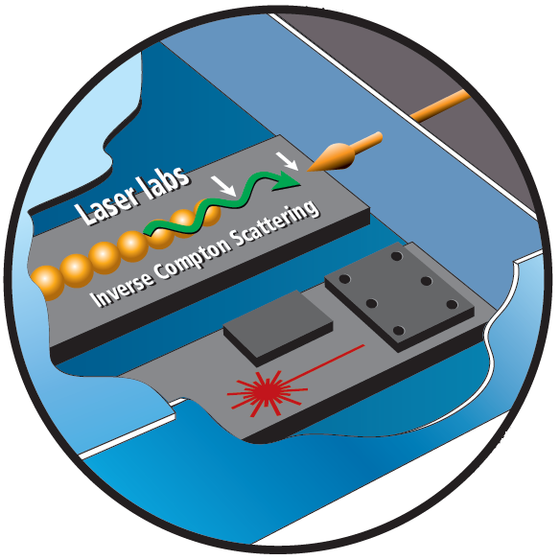
CARIE: Cathodes And Rf Interactions In Extremes
E. Simakov – LANL
A new three-year project was funded at LANL to demonstrate operation of high-quantum-efficiency cathodes in a high-gradient RF injector.
Project builds upon LANL’s expertise in high-gradient C-band and high-QE photocathodes.
The proposed heterostructured cathode will include multiple layers to ensure atomic flatness of the surface, high QE, and the ability to withstand high electric fields with no breakdown.
Target beam parameters: 250 pC, 0.1 μm*rad, B_{5D} = 10¹⁶ A/m².

Slide 12
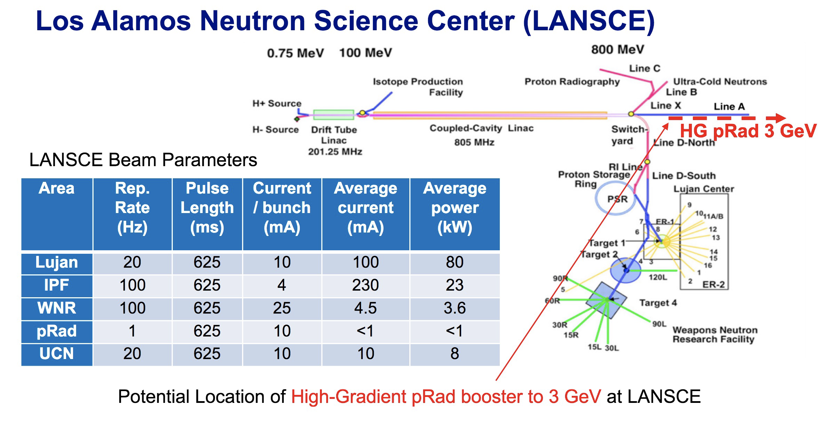
High-Gradient 3-GeV Booster for Enhanced Proton Radiography at LANSCE
Yuri Batygin and Sergey Kurennoy, Los Alamos National Laboratory, NM 87545, USA

Slide 13
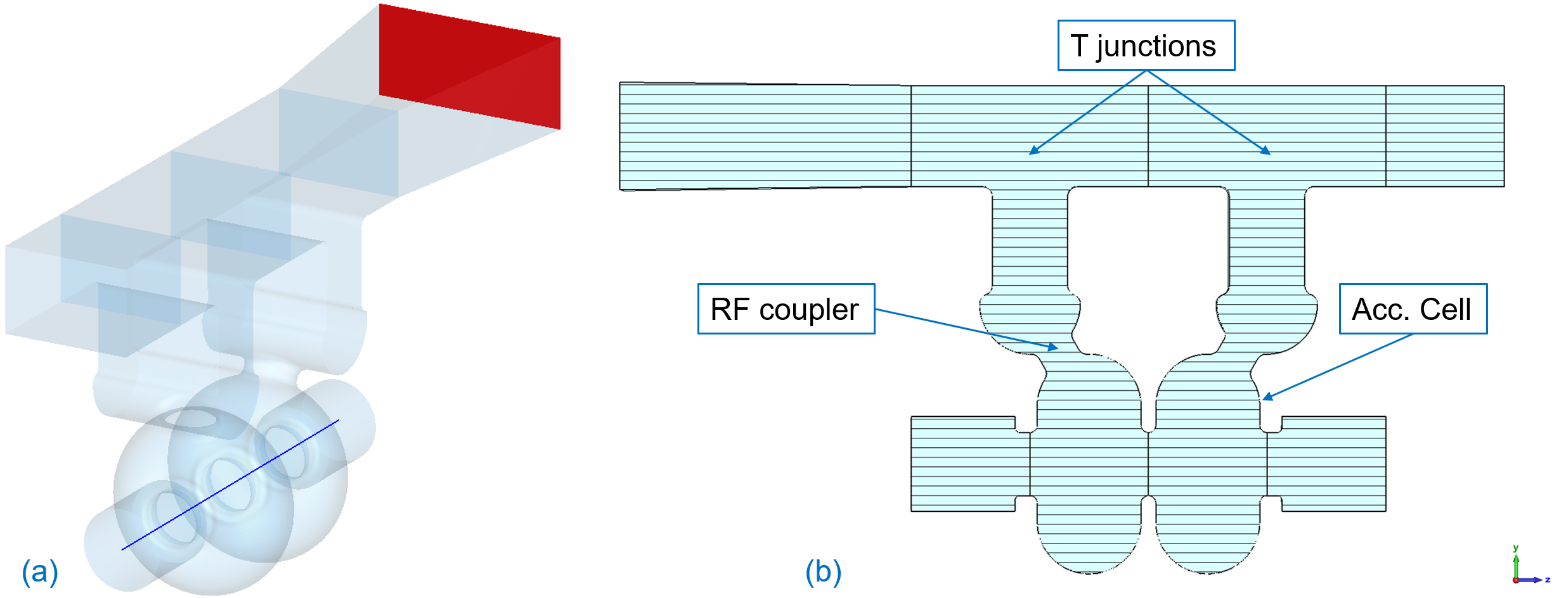
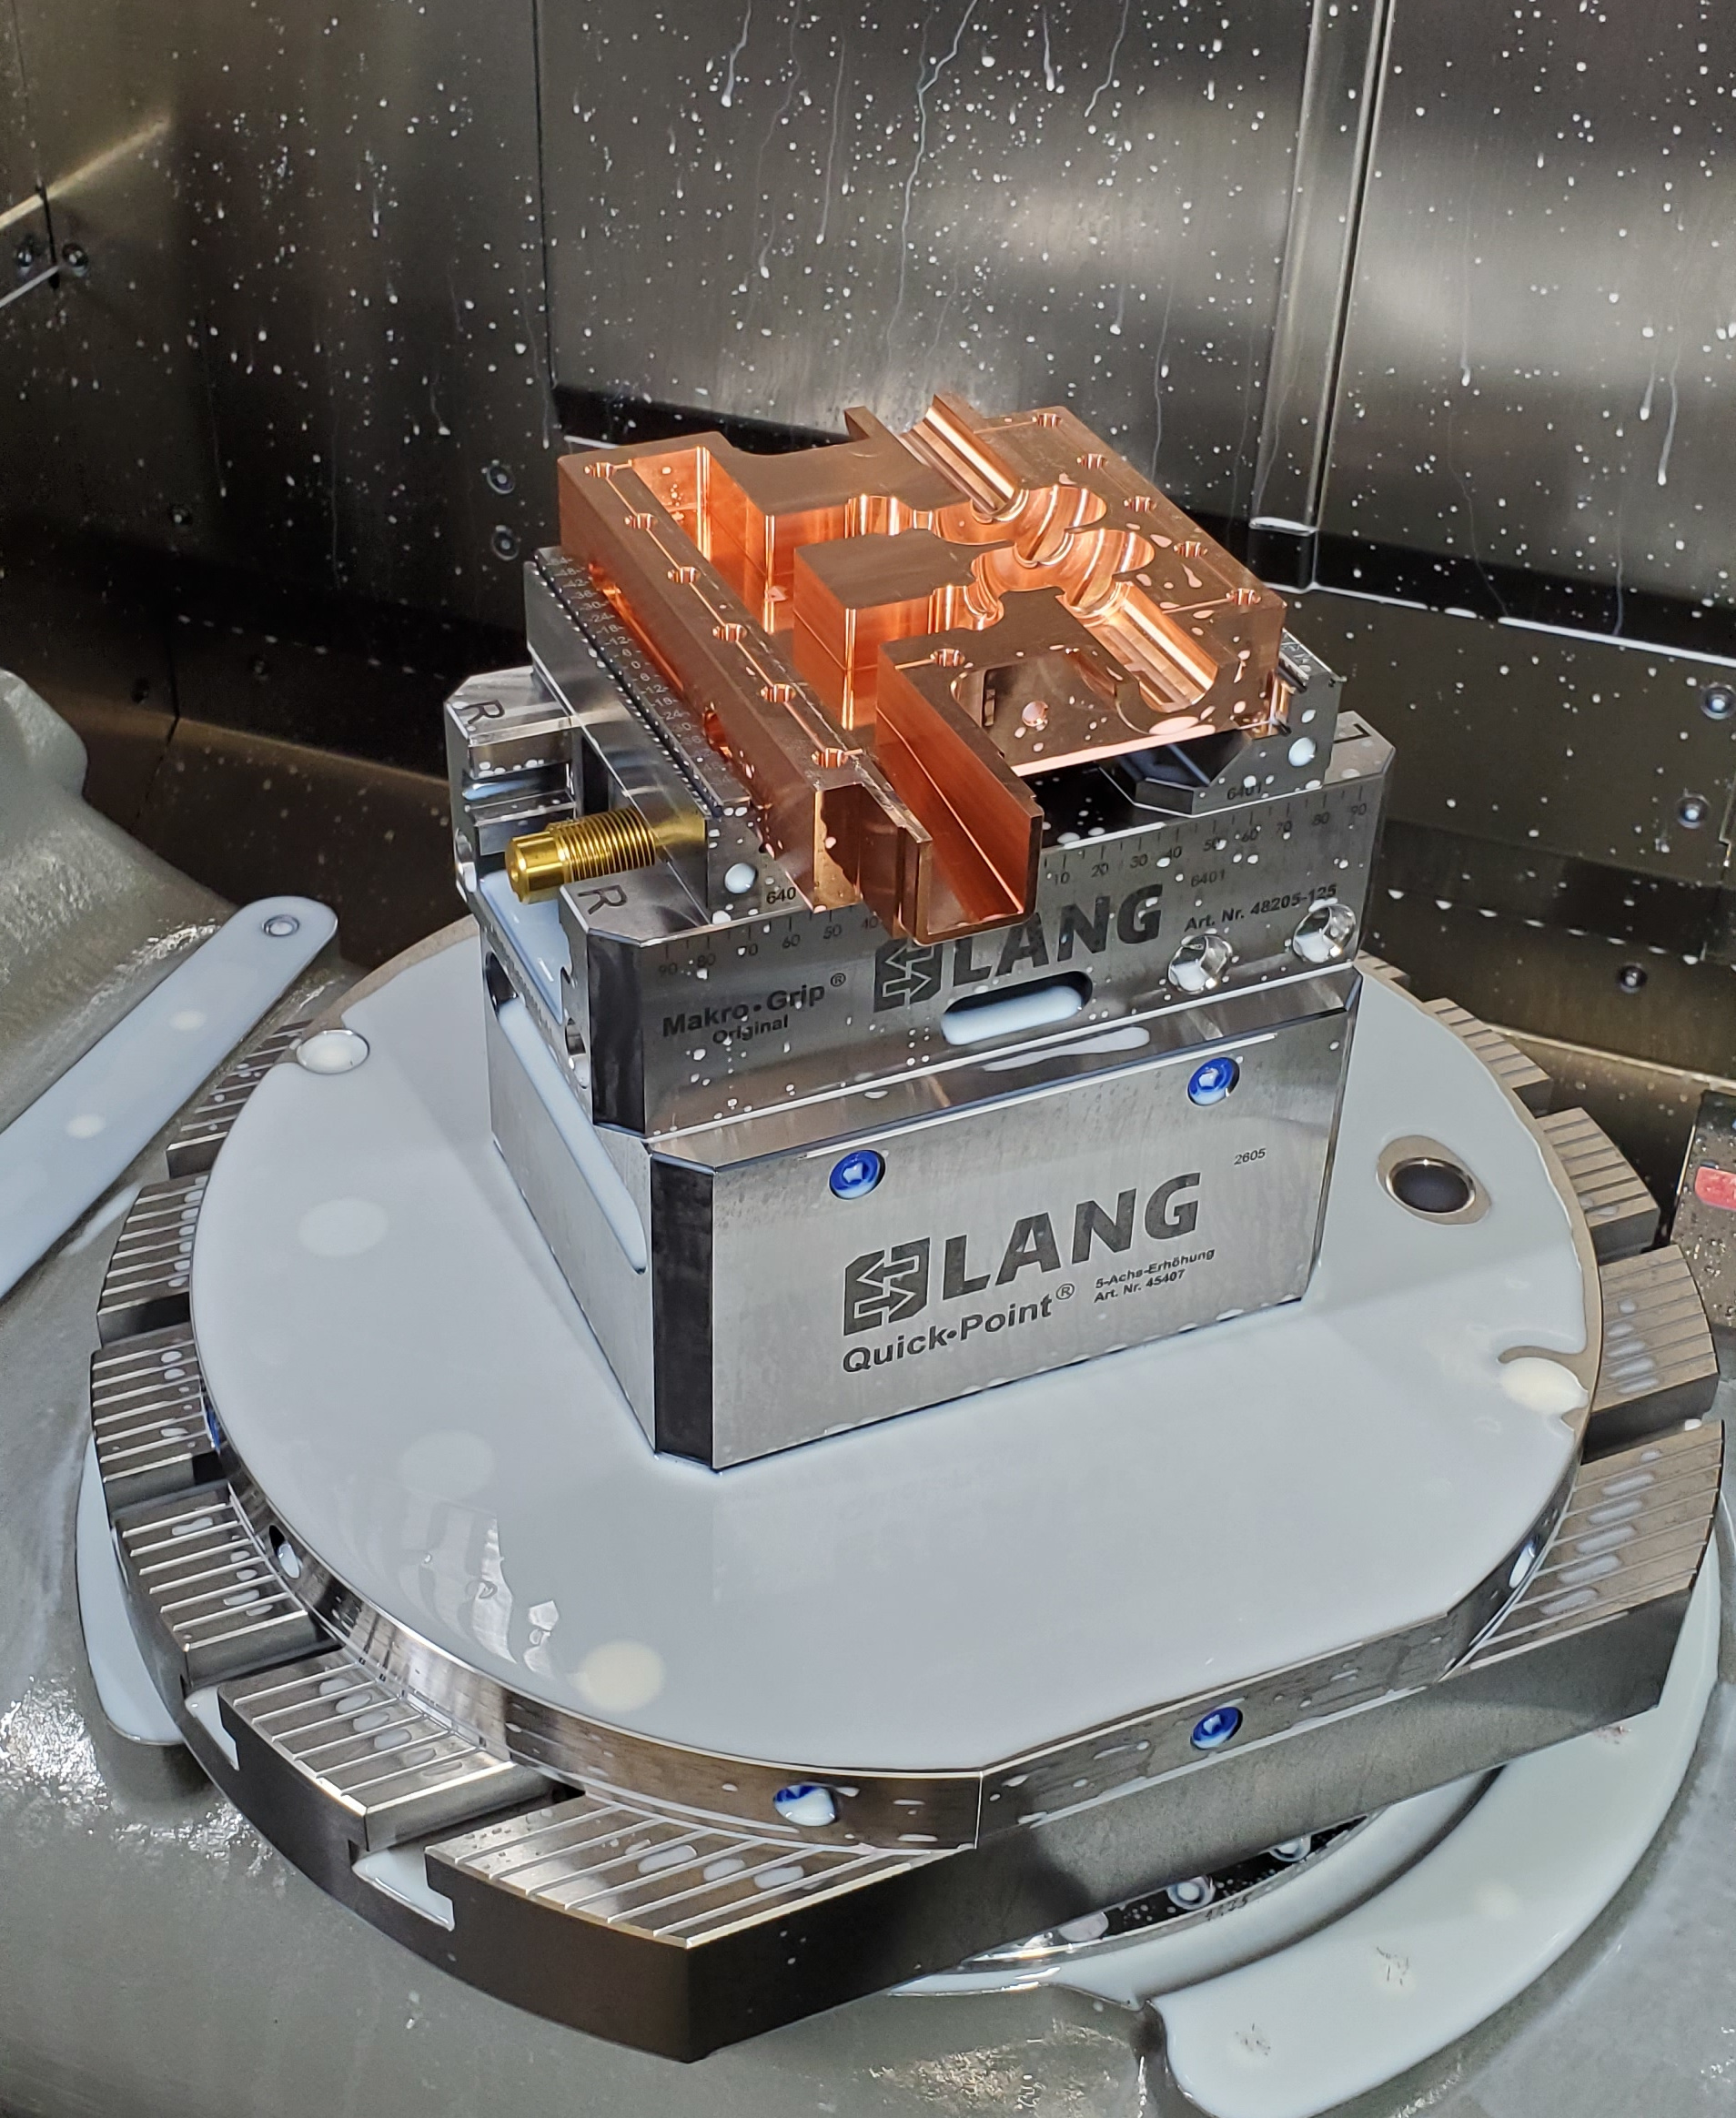
HG Structures for 3-GeV Proton Radiography Booster
S. Kurennoy, Y. Batygin, and E. Olivas, LANL
High-gradient (HG) booster linac for proton radiography (pRad) is designed to increase the beam energy from 800 MeV to 3 GeV. HG normal-conducting cavities will work since pRad needs very short beam pulses at low duty.
We are developing standing-wave π-mode S- and C-band structures with distributed RF coupling for protons with β = 0.84-0.97 (800 MeV to 3 GeV).
Short 2-cell C-band test cavity for β = 0.93 was designed for 5.712 GHz. It is delivered to LANL and will be tested soon at the C-band RF test stand.
2-cell π-mode test cavity for β = 0.93 (1.6-GeV protons): inner vacuum volume with standard WG187 port (red).

Slide 14
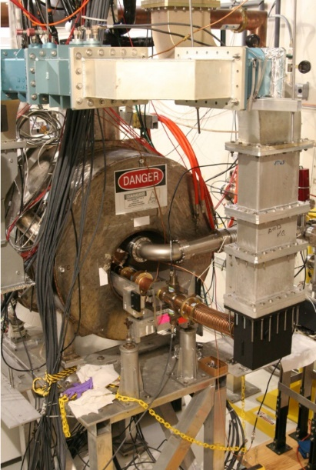
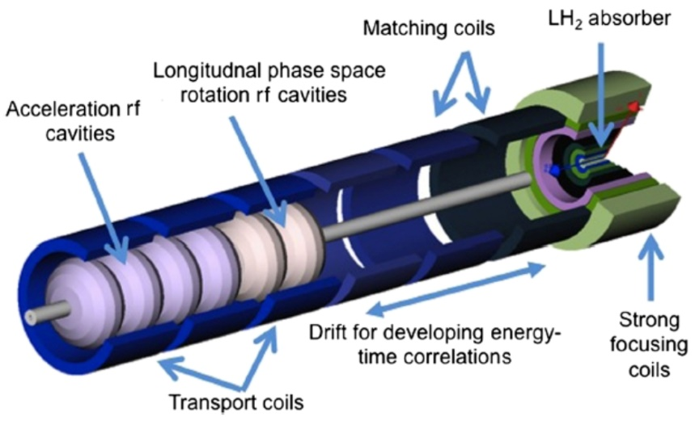
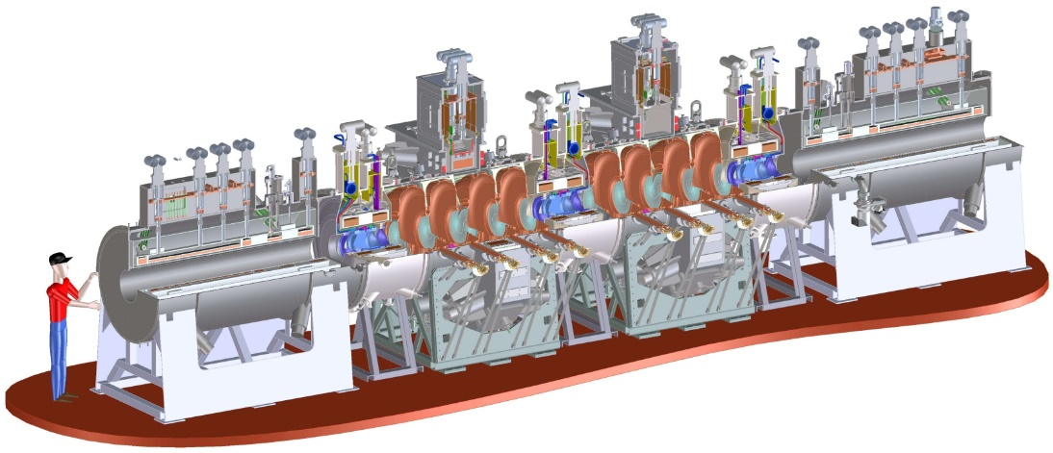
RF Cavity Needs for Future Muon Accelerators
B. Freemire – Euclid Beamlabs
Significant R&D has been done for many critical systems:
  Proton driver, target system, beam cooling & acceleration, collider ring
Technology largely demonstrated for Neutrino or Higgs Factories
Cooling channel & acceleration designs for multi-TeV collider need additional development
  Experimental demonstration is critical
Benefits of cold copper cavities, short RF pulses, travelling wave SRF cavities, unconventional cavity materials… could significantly advance feasibility

Slide 15
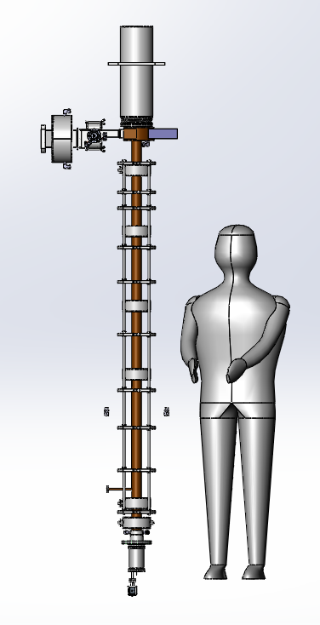
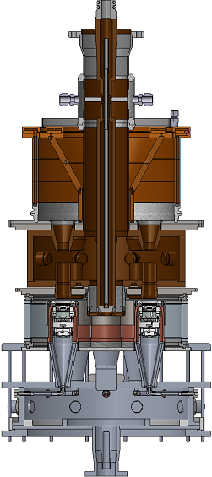
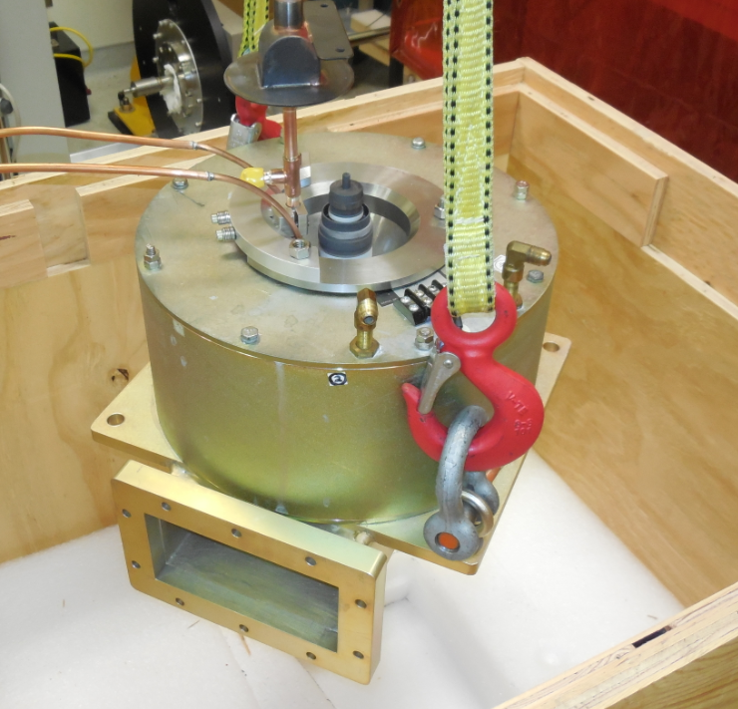
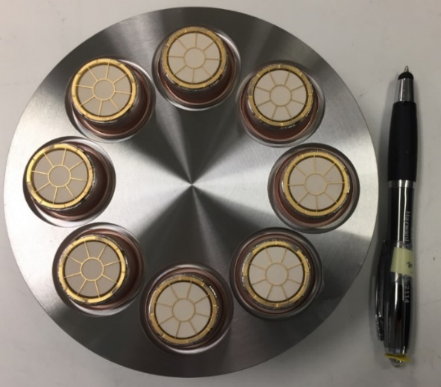
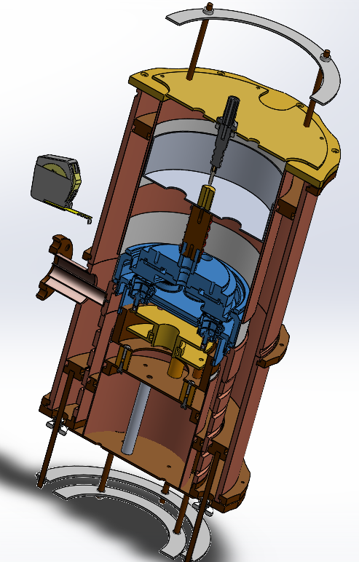
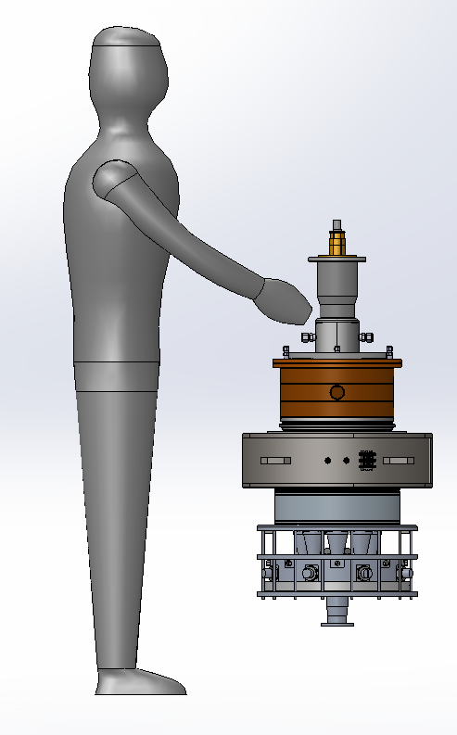
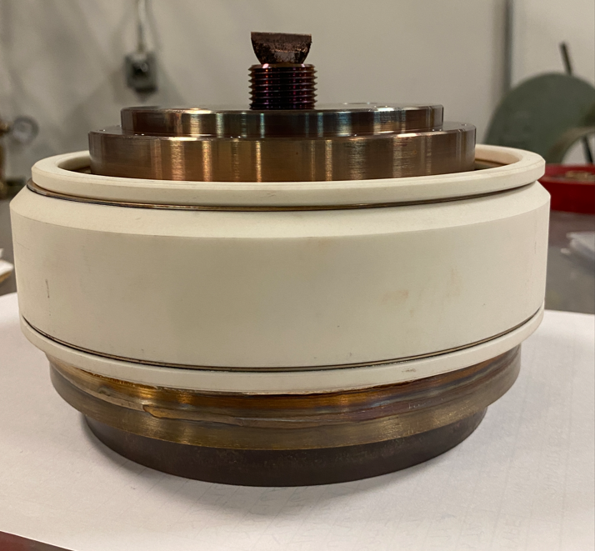
High efficiency RF source development
L. Ives – Calabazas Creek Research
RF system is one of the major cost drivers (both capital and operations) for accelerator projects – developing high-efficiency, low-cost RF sources becomes more and more important. The company is developing several new RF sources:
Magnetron System: 100 kW (10 kW ave.), 1.3 GHz Amp/Phase Control, 80+% efficiency, $1/Watt – Completed
High Efficiency Klystron: 100 kW CW, 1.3 GHz, 78% (Core Oscillation method), Freq/Pwr Scalable – Test in January 2023
Triode-base RF sources: 200 kW CW, 350–700 MHz, $0.5/Watt, compact – MB Triode in test
Multiple Beam IOT: 700 MHz, 200 CW kW, 80% – Drawings and fabrication in progress, Test in spring 2023
Klystron
Multi-Beam triode
MB IOT
Magnetron

Slide 16
Joint session with WG5 on injectors

Slide 17
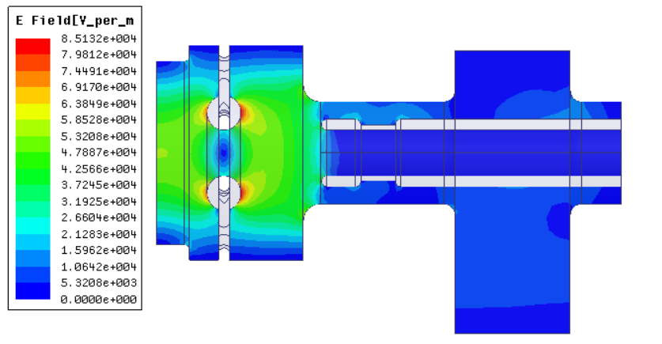
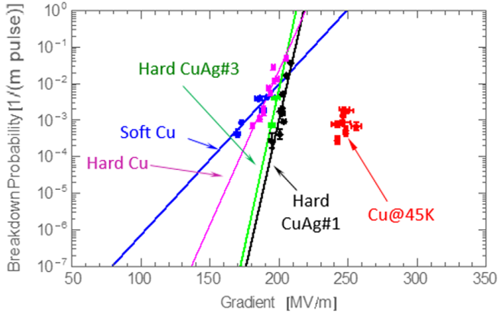
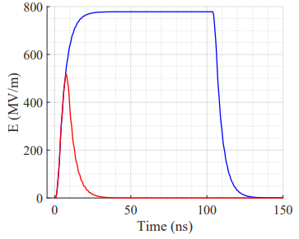
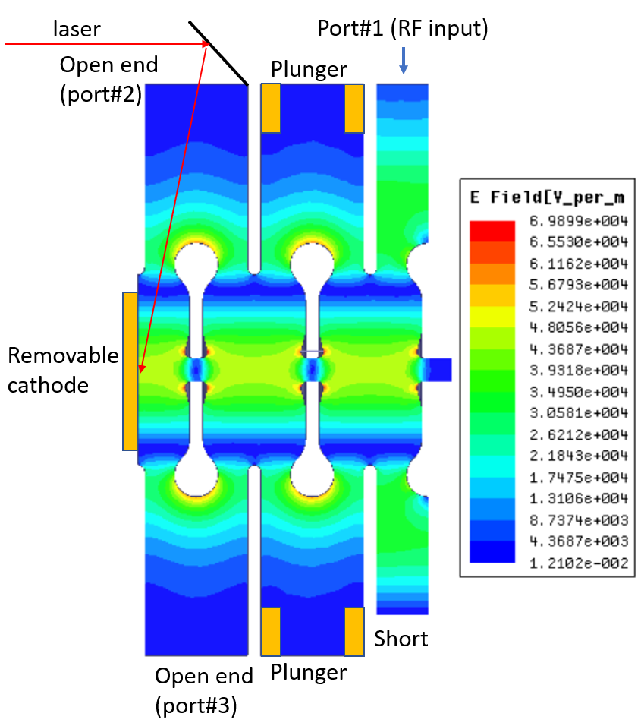
Development of High Brightness Photoinjector for AWA
S. Kuzikov – Euclid Techlabs
We have plans to modify RF design of the short pulse 11.7 GHz photoinjector at AWA to increase gradient and energy gain and to improve compatibility with the solenoid.
Breakdown rate vs gradient [1]
Cathode gradient when driven by long (blue) and short (red) pulses. The power is 300 MW and the rising/falling is fixed at 3 ns.
[1] A. D. Cahill et al. High gradient experiments with X-band cryogenic copper accelerating cavities, 2018.
At 45 K for the 11.7 GHz gun the cathode gradient could be as high as more than 500 MV/m, maximum surface electric field might be as high as 750 MV/m. The BDR ~10⁻⁶ is expected.

Slide 18
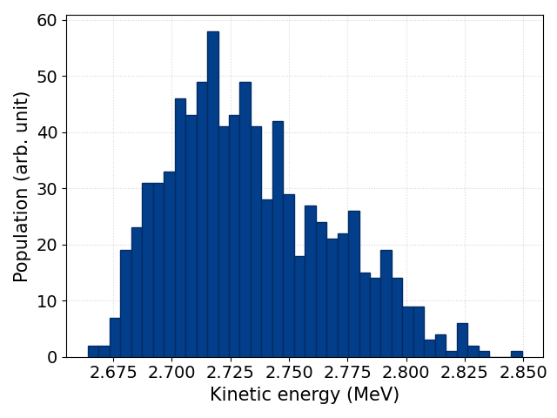
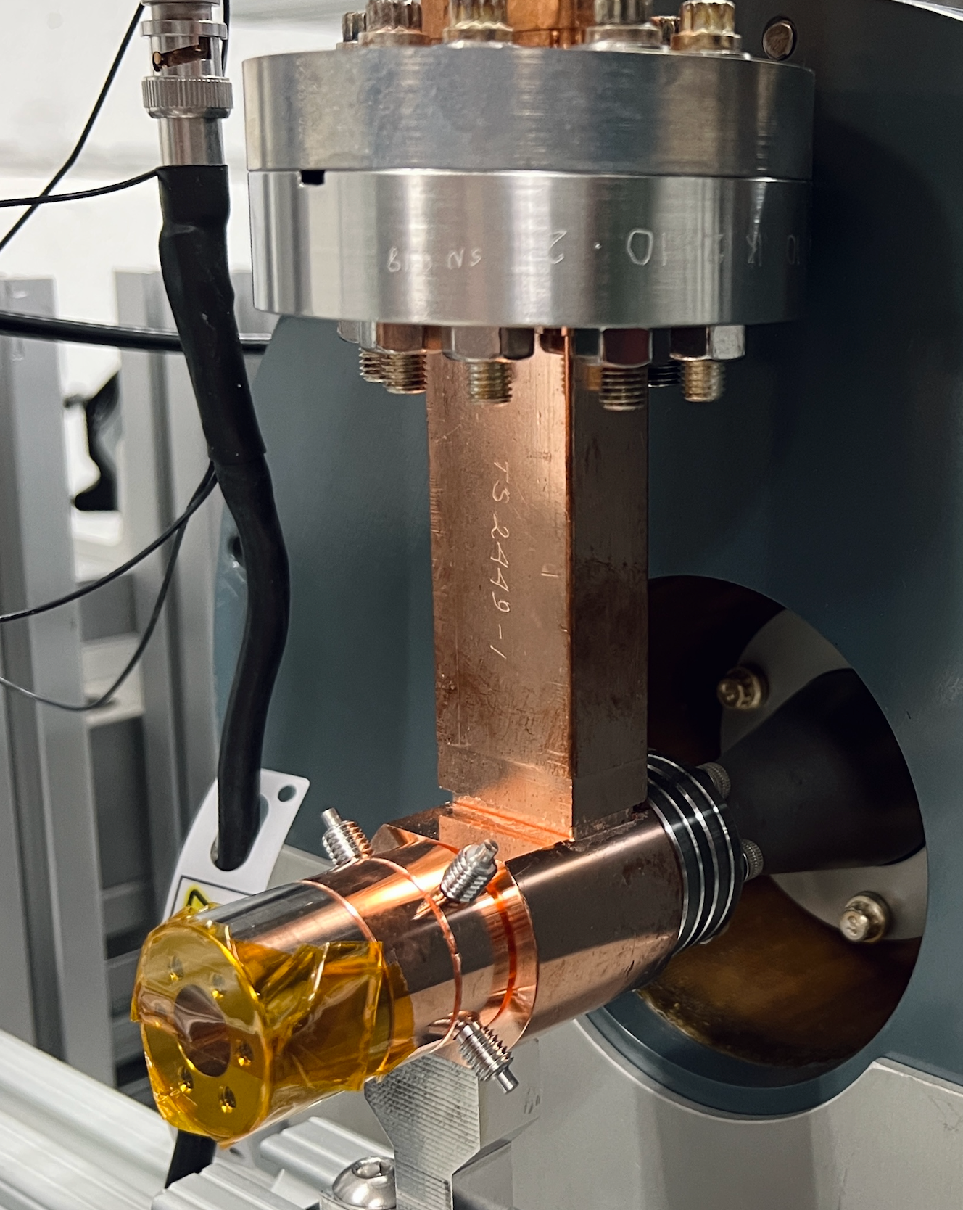
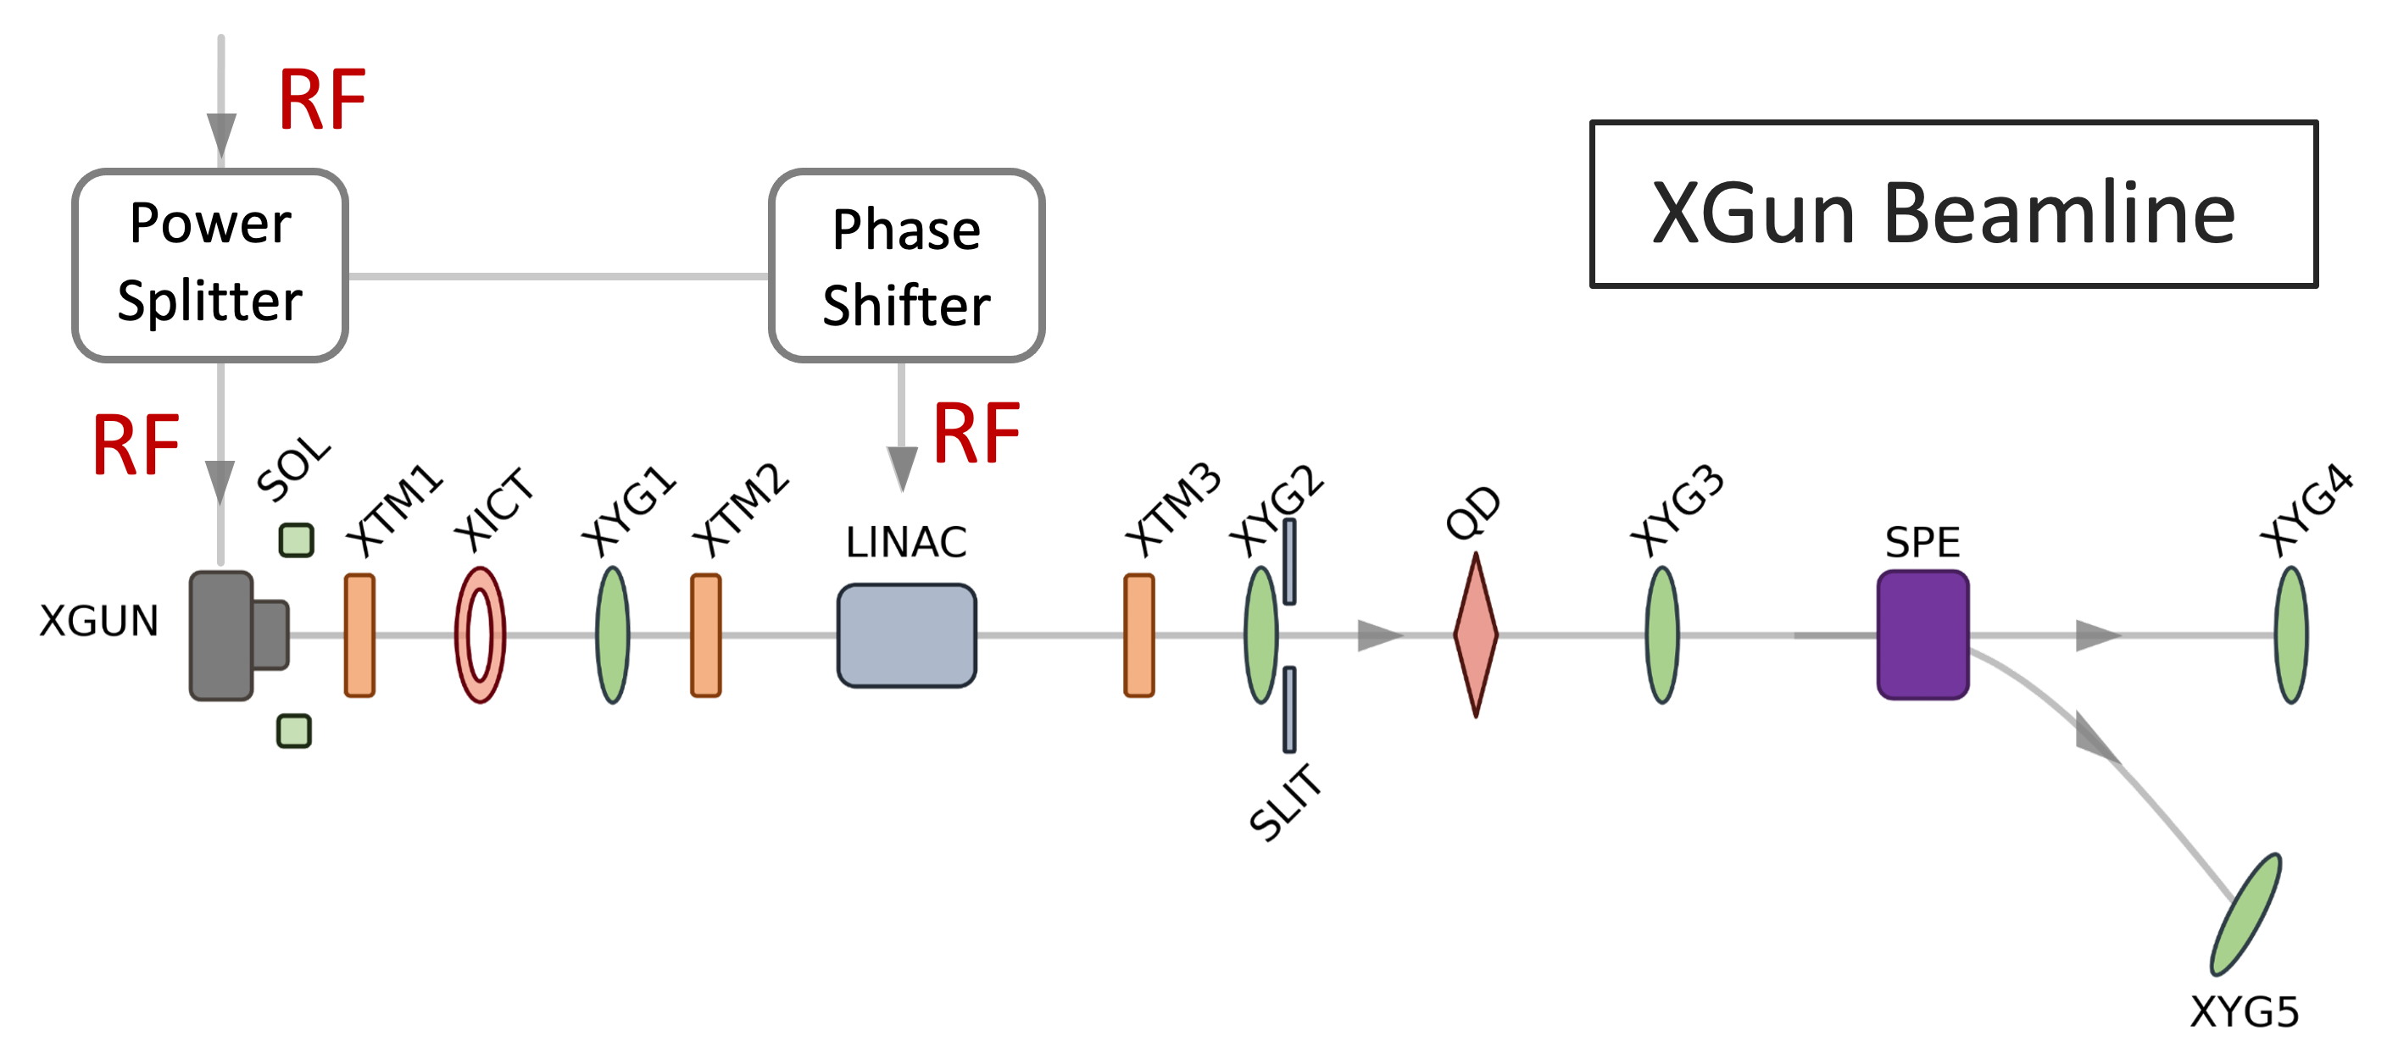

X-Band high-gradient Photoinjector
Gongxiaohui Chen, ANL
Highlights
Xgun RF Conditioning
Beam Characterization
1st beam test (Xgun only):
Energy was measured by the spectrometer dipole at 340 MV/m.
Beam energy stability was characterized ~3% fluctuation.
1000 shots as total
Short rf pulse operation (9 ns).
Xgun fully conditioned within 70k pulses.
Gradient reached 388 MV/m.
After fully conditioned, no dark current observed.
~3% fluctuation
RF
2nd beam test (Xgun and LINAC):
A LINAC was installed in the beamline
Total power splits between the Xgun and the LINAC.
Optimized emittance can achieve ~0.2 $μ$m from the simulation.
Preliminary emittance was measured by quad scan at relatively low gradient and non-optimized beam conditions:
  $ε_{n,x}=5.58 μm$
  Kinetic energy: 5.9 MeV
Future work: more studies are planned under LDRD.

Slide 19




Summary: Ultrashort Beam generation at PEGASUS.
P. Denham, P. Musumeci, UCLA Department of Physics and Astronomy
Single shot UED temporal resolution determined by the bunch length at ballistic focus.
Competing non-linear effects limiting the shortest achievable bunch length.
Overcome non-linearities with laser shaping of electron beam and higher harmonic compensation.
Bunch lengths in attosecond to sub-fs regime (for 10-100 fC charge) achievable.
Implemented X-band and took measurements of LPS linearization—reduced energy spread.
Seeking novel bunch length diagnostic to measure sub-fs bunches. Developments underway.

Slide 20
Laser / THz structures

Slide 21



THz Generation Summary
Pavle Juranic, PSI
2D results from 3-D printed structure are promising, and we are looking to move the structure to 3D and collect and collimate the THz beam. Observed coherence effect in 2D case.

Slide 22


ACHIP@ARES
Willi Kuropka, DESY
DLA
ARES normal conducting S-band linac commissioning has been successful and continues towards sub-fs bunches
  Almost all design electron beam parameters demonstrated
  Comprehensive accelerator R&D program, including external users
  PolariX transverse deflecting structure commissioning starting Q1 2023
Dielectric laser acceleration experiment
  Spatial and temporal overlap of laser and electron beam has been established on dielectric laser accelerator
  Will be continued in coming months
13 mm

Slide 23








Modulation of dense electron beams in nanostructures:
A simulation study in preparation of the FACET-II E-336 experiment
A. Knetsch, Laboratoire d’Optique Appliquée
Transverse beamlet formation for beam overfilling nanotube target
Dependence divergence on nanotube size
Dependence kick on target tilt
s = 0.5 mm
s = 2 mm
See also WG4 presentation
by Robert Ariniello “Wakefield Acceleration in Nanostructures: The E336 Experiment at FACET-II”

Slide 24





Energy Modulation in a Commercial Grating Structure
S. Crisp, UCLA
Commissioned a new optical system combining pulse front tilt with Spatial Light Modulator
Built and characterized new commercially based structures
Demonstrated modulation using these commercial structures
On the way:
  MeV energy gains via longer interactions lengths
  Soft tuning utilizing Alternating Phase Focusing
WG3 Student poster award winner
4mm
4mm

Slide 25
Plasmonic Wakes in a Semiconductor
Tom Katsouleas, Maxime Pindrys
University of Connecticut
Aakash Sahai
University of Colorado, Denver

Slide 26

Can the carrier electrons of a doped semiconductor support a plasma-like wakefield?

Slide 27


Carrier electrons act like a free plasma if driven above a threshold to overcome Coulomb collisions:
$\frac{I}{kA}.\left(\frac{1 ps}{τ}\right)\text{1/}\text{3}.(\frac{λ_{mfp}}{10 nm}$)^{1/6} $≳2$
Threshold

Slide 28
Thank you!

