Slide 1
Coherent Stacking of Few Cycle Pulses from a Gain-Managed Nonlinear Amplifier for CPA-free Energy and Power Scalable Drivers of High-Intensity Laser-Matter Interactions
Lauren Cooper*, Tayari Coleman*, Siyun Chen^, Mathew Whittlesey*, Alex Rainville*, Pavel Sidorenko†, Frank Wise†, and Almantas Galvanauskas*
* Department of Electrical Engineering, University of Michigan, Ann Arbor, MI
^ Lawrence Berkeley National Laboratory, Berkeley, CA
† Department of Applied and Engineering Physics, Cornell University, Ithaca, NY

Slide 2
Acknowledgements
Thank you to the contributors to this project:
The Center for Ultrafast Optics at the
University of Michigan:
Chris Pasquale
Yanwen Jing
Mingshu Chen
Lawrence Berkeley National Laboratory:
Tong Zhou
Dan Wang
Qiang Du
Russell Wilcox
Deepak Sapkota
Mahek Logantha

Slide 3
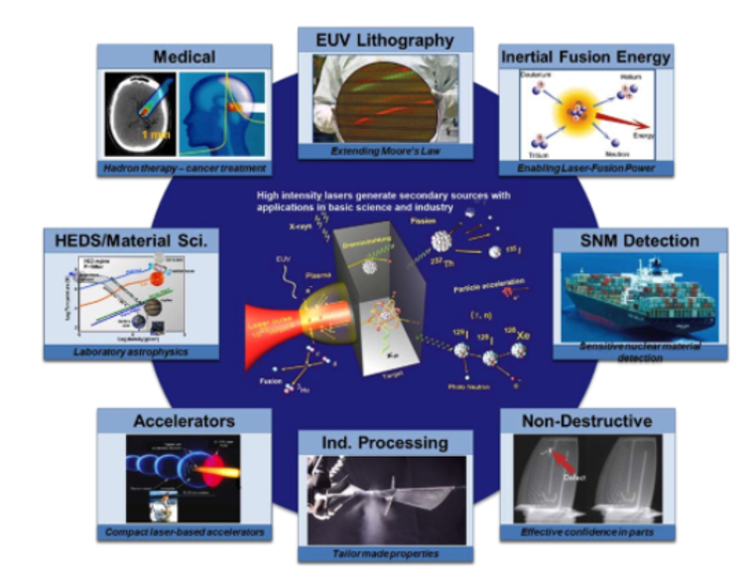
High Power Ultrafast (Several Cycle) Lasers as Tools for Science
Many applications require ultrafast (<30fs) and multi-kW power lasers, including:
High harmonic generation and attosecond science
Laser plasma accelerators and secondary radiation (X-rays, gamma rays, neutrons, ion acceleration) sources for material science, biomedical, homeland security, nuclear detection, etc.
Most current high power, short pulse applications are driven by Ti:Sapphire lasers
Hz class rep-rate
Limited thermal management
Wall plug efficiency <1%
…Need new laser method for producing several-cycle ultrashort pulses at high average powers!
Spinka, Thomas M. and Constantin Haefner, “High Average Power Ultrafast Lasers”, Optica, 2017

Slide 4
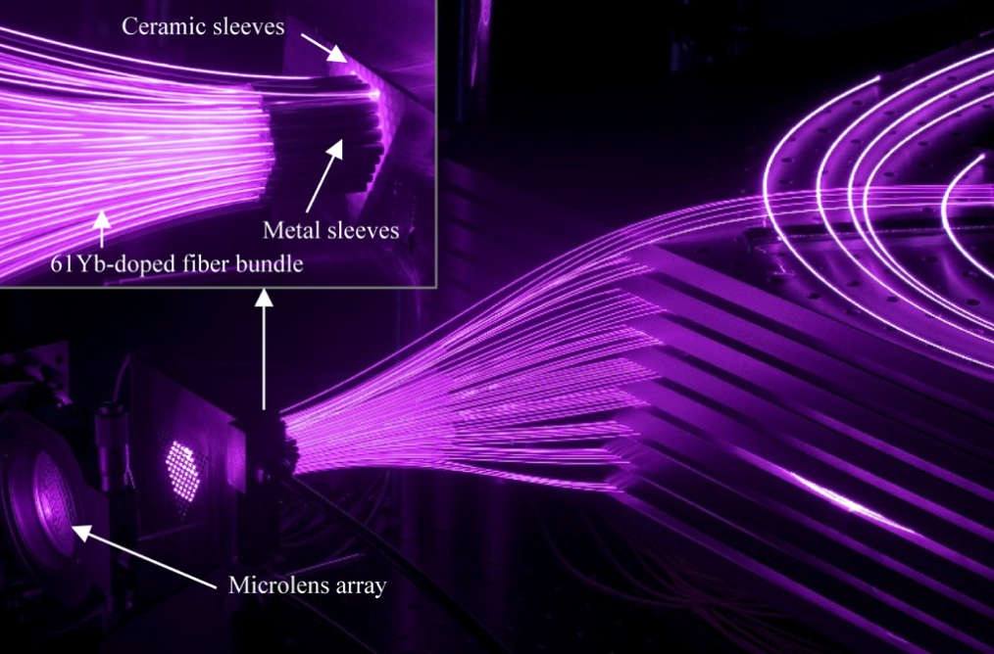
Coherently Combined Fiber Lasers Offer a Power and Energy Scalable Solution
Fiber laser arrays have improved capabilities for high power applications:
Can provide multi-kW average powers at 10s % WPE
Spatial coherent combining allows further power and pulse energy scaling
Coherent pulse stacking amplification (CPSA) extends capabilities still further:
100x reduction in fiber array size
Current Yb-doped fiber laser technologies limited to ~100fs due to gain narrowing, while <30fs needed in some applications
Example: 61-fiber-laser combining system at Ecole Polytechnique (1kW, >250fs)

Slide 5
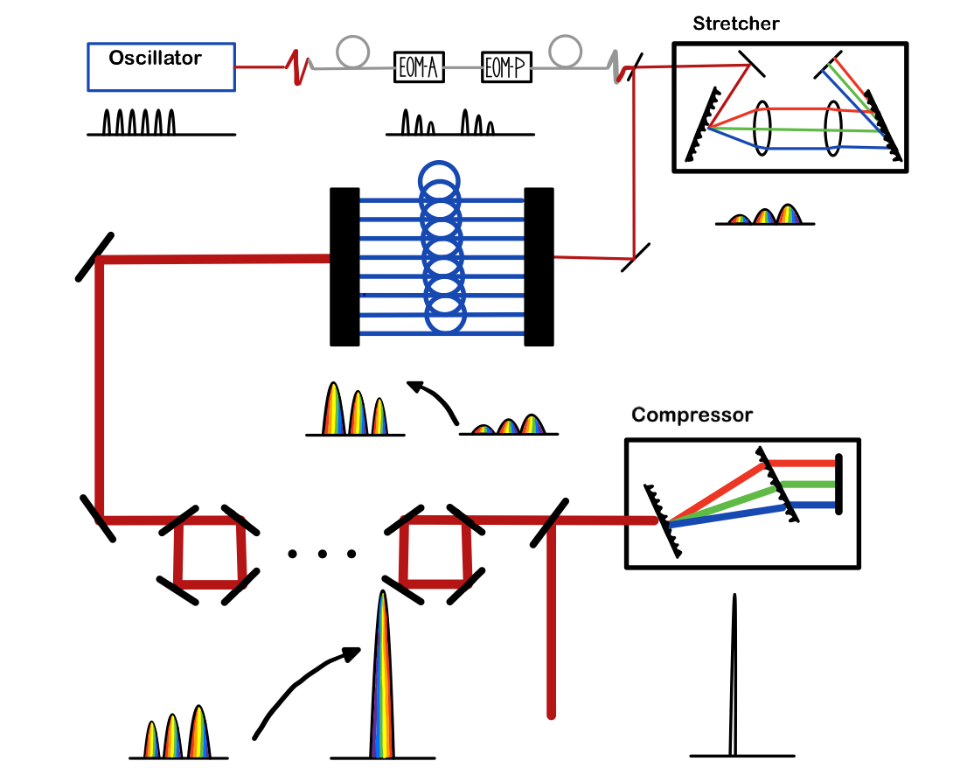
Coherent Pulse Stacking Amplification uses Chirped Pulses to Achieve High Pulse Energies
Temporal and spatial combining allows highly scalable system.
Extension of CPA by ~100 times
Reduces array size needed for high energy 100x
Demonstrated with 300fs
Currently demonstrated 4 spatial channels + CPSA generating:
20mJ at 2kHz combined and stacked*
Tong Zhou, John Ruppe, Cheng Zhu, I-Ning Hu, John Nees, and Almantas Galvanauskas, "Coherent pulse stacking amplification using low-finesse Gires-Tournois interferometers," Opt. Express 23, 7442-7462 (2015)
* Alex Rainville et al., “Development of Coherent Spatially and Temporally Combined Fiber Laser LPA Driver Concept – Progress of the kW-Average and TW-Peak Power System Demonstration”, Presentated at AAC 2022 (Monday)

Slide 6
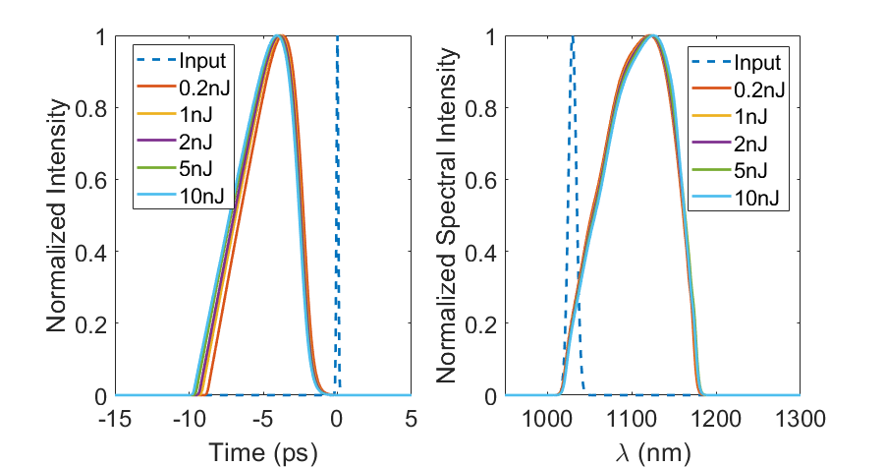
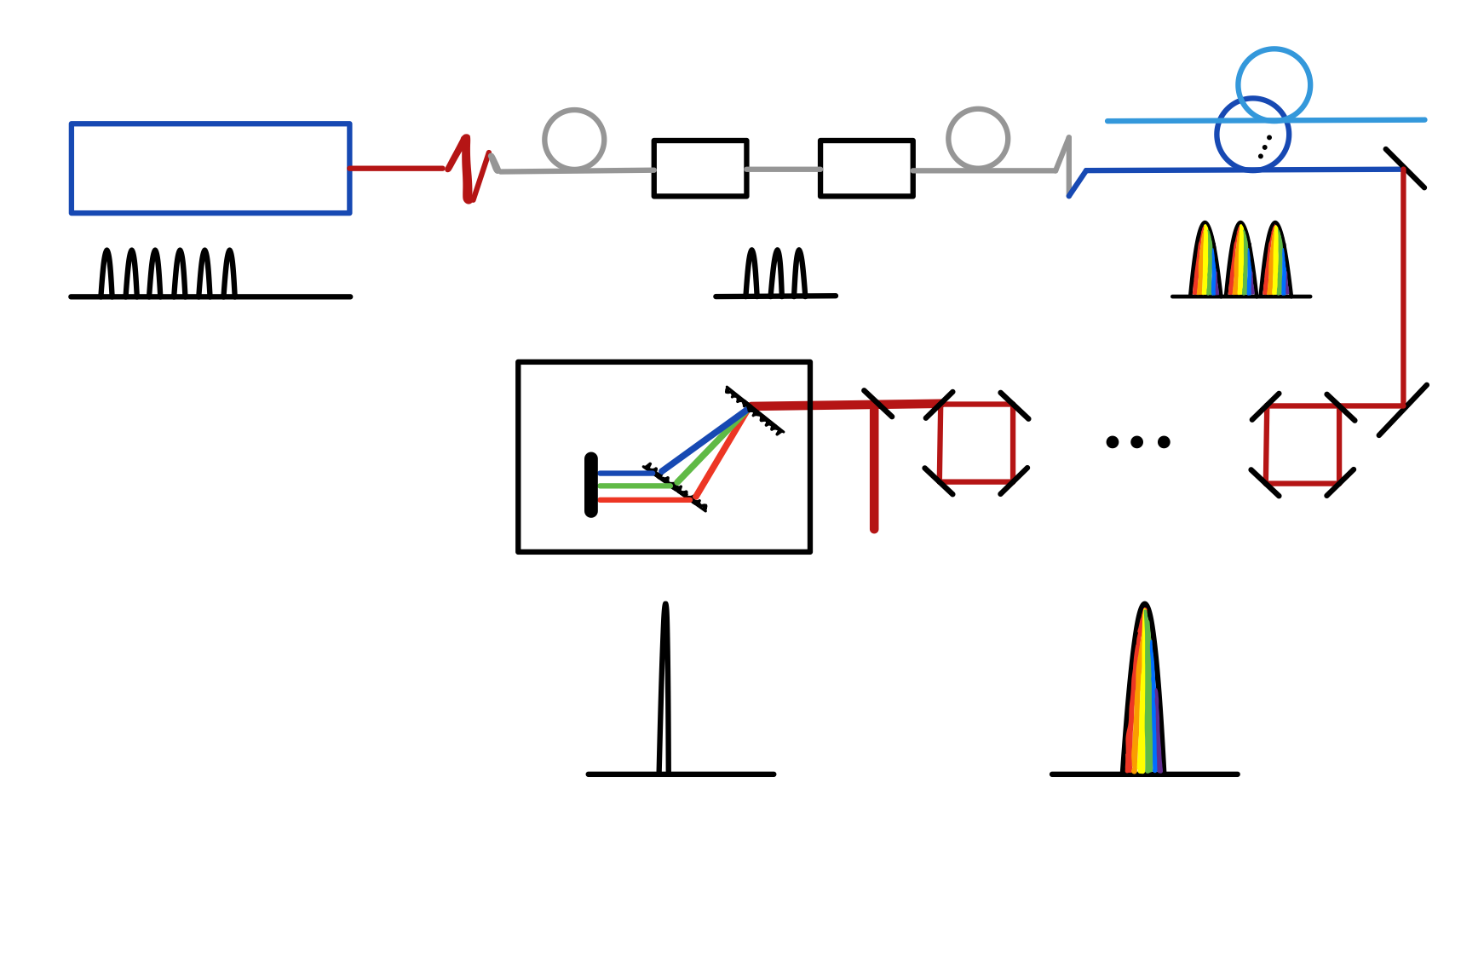
We Propose CPA-Free CPS Using Gain-Managed Nonlinear Amplifiers
Gain-managed nonlinear fiber amplifiers are key to obtaining high energy, short pulses
2 OOM increase in energy with sub 30fs bandwidth
An “attractor” is formed, which allows different pulses to evolve to same temporal and spectral shape
We can further scale up energies using CPS:
Spatially Combined Array
Oscillator
EOM-A
EOM-P
Compressor

Slide 7
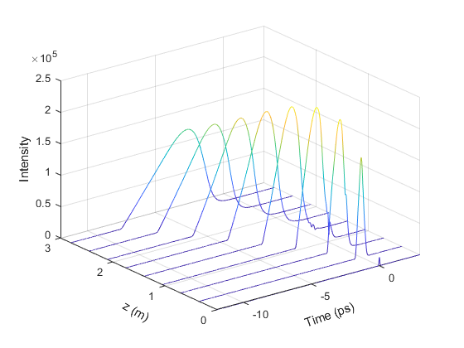
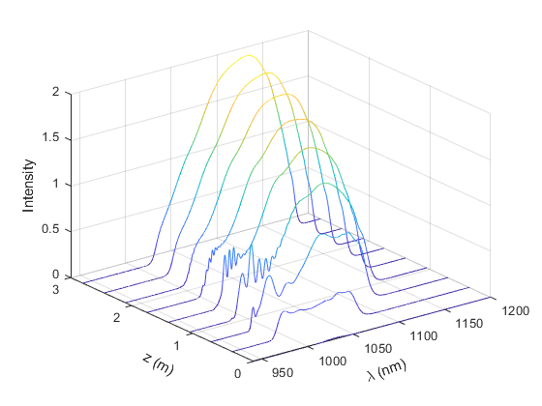
Gain Managed Nonlinear Amplification
To follow a pulse through a gain-managed nonlinear amplifier:
0m: 200fs pulse input with 0.5nJ energy
1m: Pulse broadens temporally due to dispersion, and spectrum broadens due to SPM; begins to break down
2m: Pulse begins to evolve past break down as the gain spectrum shifts
3m: Pulse evolves to smooth spectral shape with largely linear chirp.
Pavel Sidorenko, Walter Fu, and Frank Wise, “Nonlinear ultrafast fiber amplifiers beyond the gain-narrowing limit”, Optica 6, 1328-1333 (2019)

Slide 8
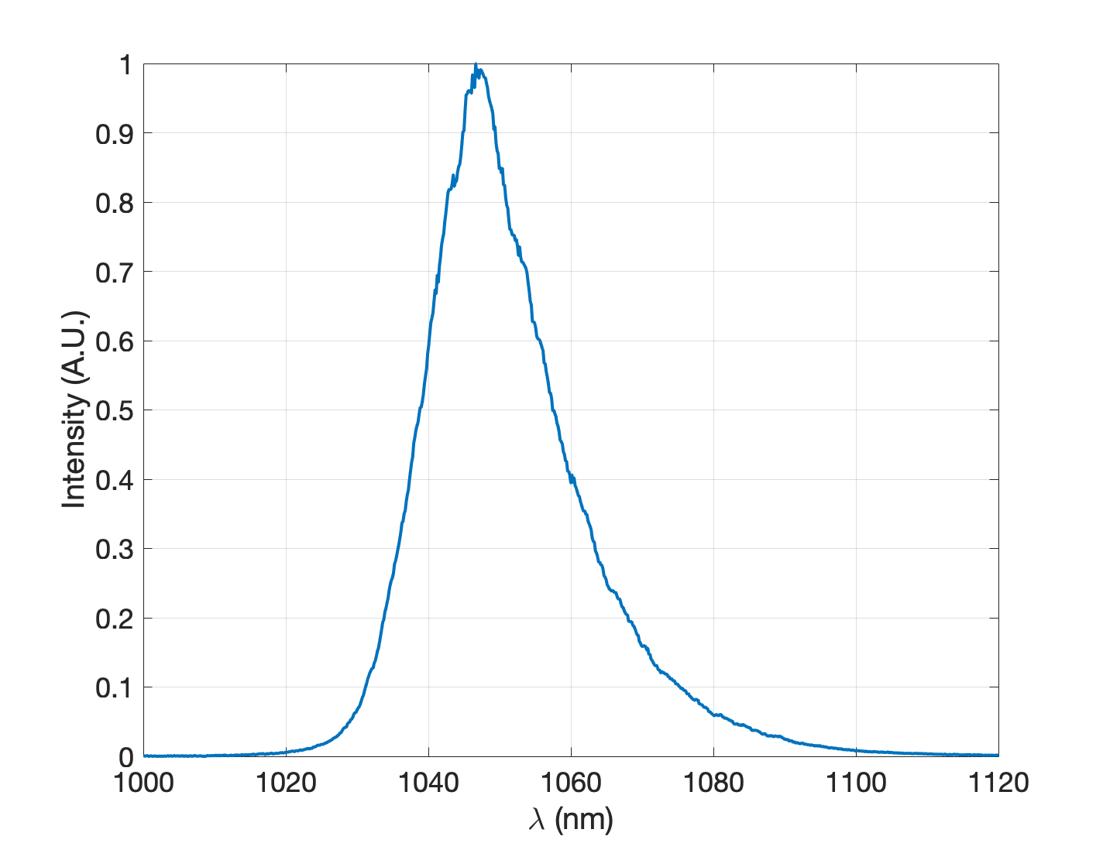
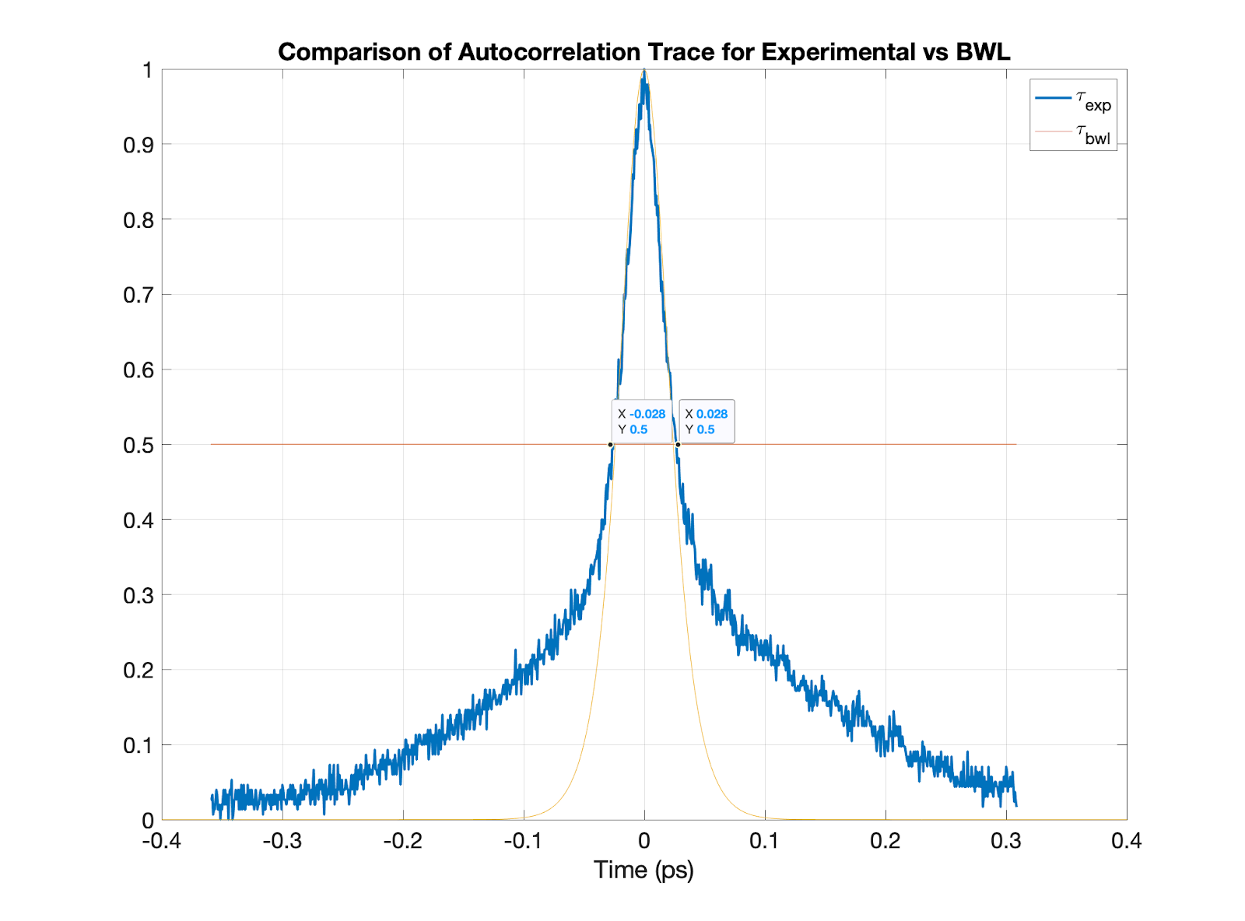
GMN Amplifier Results
Using
3m of Yb 25/250 fiber
200fs bandwidth limited input pulse
0.5 nJ pulse energy
40 MHz oscillator
Operating in the GMN regime we observed AC duration of 56fs, which corresponds to 40fs deconvolved duration.

Slide 9
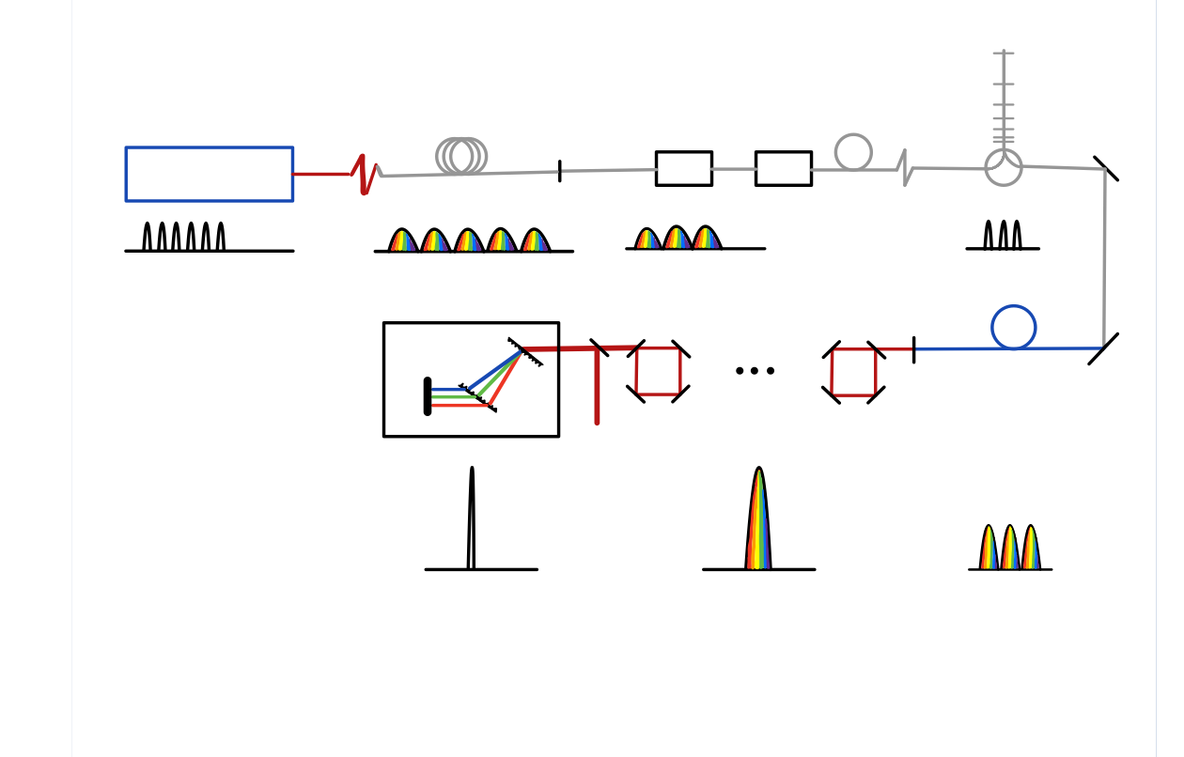
Experimental Setup
On-Going Experiment:
50um LMA fiber to scale to 4µJ energy/pulse and sub 30fs pulse durations
Using 9 pulses and 4 stacking cavities to stack to 10s µJ energy/pulse (initially)
FB Compressor
1GHz
1nJ
~100fs
1GHz
<1nJ
~10ps
10m fiber
(stretcher)
10MHz
0.1nJ
~100fs
Oscillator
EOM-A
EOM-P
50um LMA Amp
10MHz
>30µJ
~30fs
10MHz
10s µJ
~3ps
10MHz
4µJ
~3ps

Slide 10
Conclusion
We are pursuing a new concept of nonlinear fiber amplification with coherent pulse stacking.
Pathway to several-cycle ~10-30fs and 10-100µJ pulses.
Further scalable in power and energy using coherent spatial combining.
GMNA results with 40fs have been demonstrated.
Future plans to scale the energies per pulse to 4µJ as well as to stack the output of the GMN amplifier to 10s-100s µJ.
This work is supported by the Department of Energy
“RESEARCH OPPORTUNITIES IN ACCELERATOR STEWARDSHIP” grant and DOE Advanced Accelerator Stewardship Grant FP00012984

