Slide 1
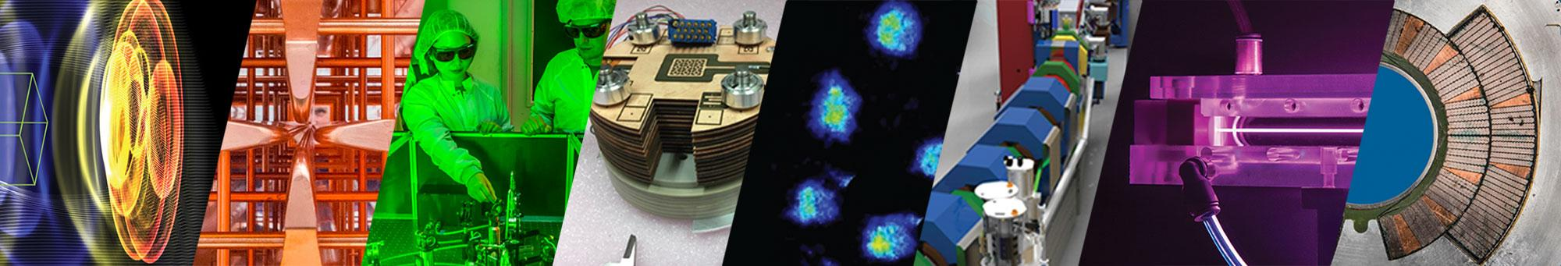


Design Optimization of Permanent-Magnet Based Compact Transport Systems for Laser-Driven Proton Beams
J. T. De Chant*, K. Nakamura, Q. Ji, L. Obst-Huebl, S. Steinke, S. Barber, A. M. Snijders,
T. Schenkel, J. van Tilborg, C. G. R. Geddes, C. B. Schroeder, and E. Esarey
11/11/2022
*
AAC 2022
The work was supported by Laboratory Directed Research and Development (LDRD) funding from LBNL provided by the Director, and the U.S. Department of Energy Office of Science, Offices of Fusion Energy Sciences and High Energy Physics under Contract No. DE-AC02-05CH11231.Work was also supported by the US Department of Energy, Office of Science, High Energy Physics under Cooperative Agreement award number DE-SC0018362.

Slide 2


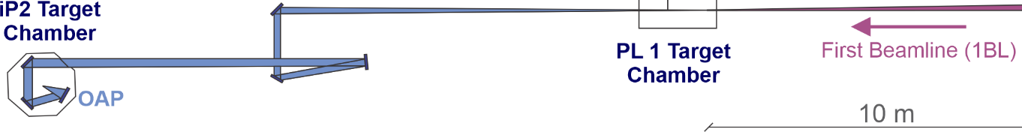
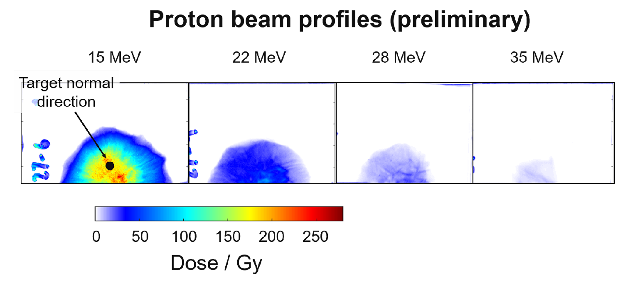
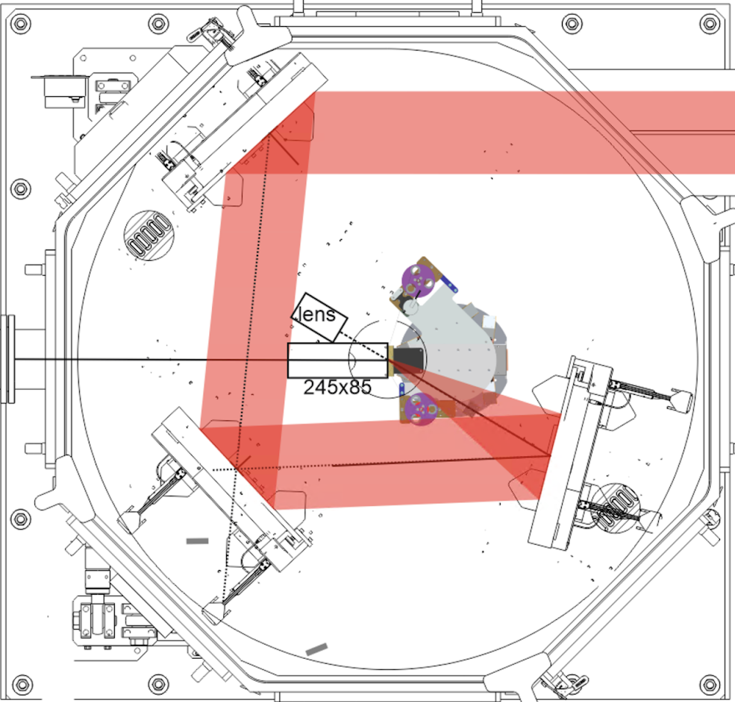

Compact proton beam transport system is needed for application experiments at the new BELLA PW iP2 experimental area
Wall
2.5 m
Short focal length OAP
Difficult to transport due to:
Broadband energy spectra
Large divergence up to ~25°

Slide 3
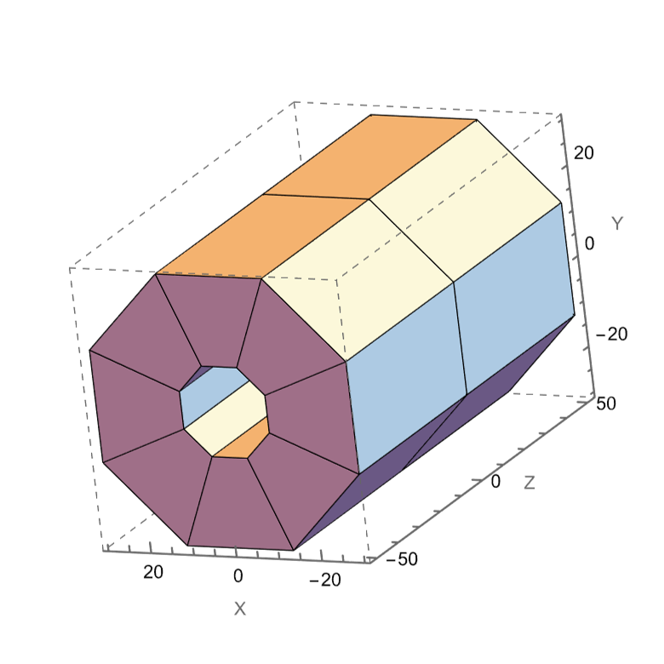
Permanent magnet quadrupoles (PMQs) are compact, high field gradient focusing elements with a large bore
Strong focusing gradient (100s T/m) with a large bore (6-30 mm) needed for collection efficiency
Compact transversely and longitudinally and no large cryostat required (like in stronger SC magnets)
Not easily tunable due to fixed gradient
We have performed a design study to explore different transport systems for iP2 proton beams
Modeled in Radia
PMQ parameters
Inner radius | 10 mm
Outer radius | 30 mm
Bulk magnetization (NdFeB) | 1.29 T
Field Gradient | 110 T/m

Slide 4
Beam transport systems were designed using COSY Infinity while performance was evaluated with particle tracking
Radia
To provide base design of permanent magnet
COSY Infinity
Matrix-based charged particle transport calculation code
Particle Tracking
Homemade MATLAB script for particle tracking to evaluate performance
Permanent magnet quadrupole doublet
(30 MeV 24 MeV 36 MeV)
x
z
y
z

Slide 5
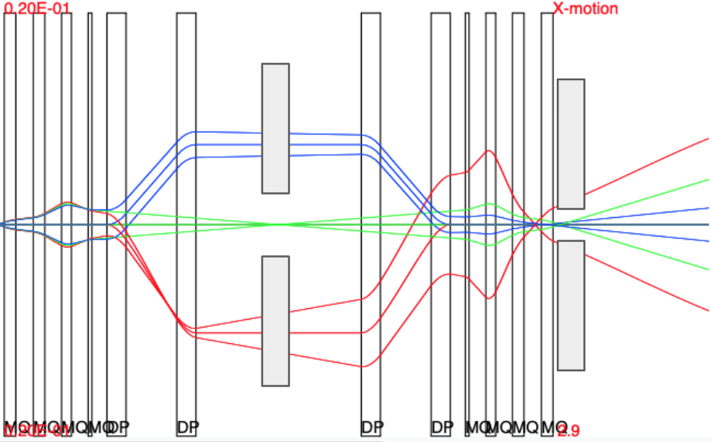
More complex configurations were explored to improve beam quality and tunability at sample site
Quartet
Quartet Chicane Quartet
x
z
x
z
y
z
Improves symmetry of beam spot
Energy selection
Reduced aberrations
This work allows us to respond to need from users more effectively

Slide 6
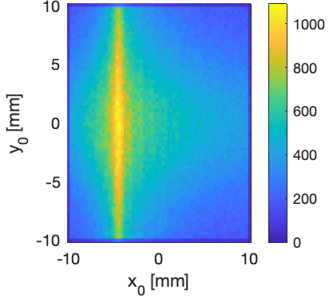
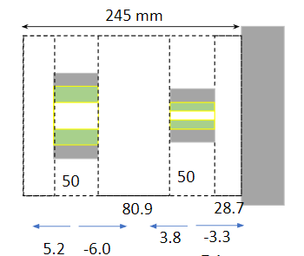
A 10 MeV collimating transport system will be implemented for radiation biology experiments
Wall
2.5 m
Charge distribution at sample site
x
Dipole
PMQ
PMQ
Short focal length OAP
Uniform dose dist.
ions
Ion Energy

Slide 7
Summary
Compact proton transport beamline is needed for application experiments at the new BELLA PW iP2
Beam transport systems were designed using COSY Infinity
Performance was evaluated with particle tracking
More complex configurations were explored to improve beam quality and tunability
A 10 MeV collimating transport system will be implemented for radiation biology experiments
The work was supported by Laboratory Directed Research and Development (LDRD) funding from LBNL provided by the Director, and the U.S. Department of Energy Office of Science, Offices of Fusion Energy Sciences and High Energy Physics under Contract No. DE-AC02-05CH11231.Work was also supported by the US Department of Energy, Office of Science, High Energy Physics under Cooperative Agreement award number DE-SC0018362.

Slide 8
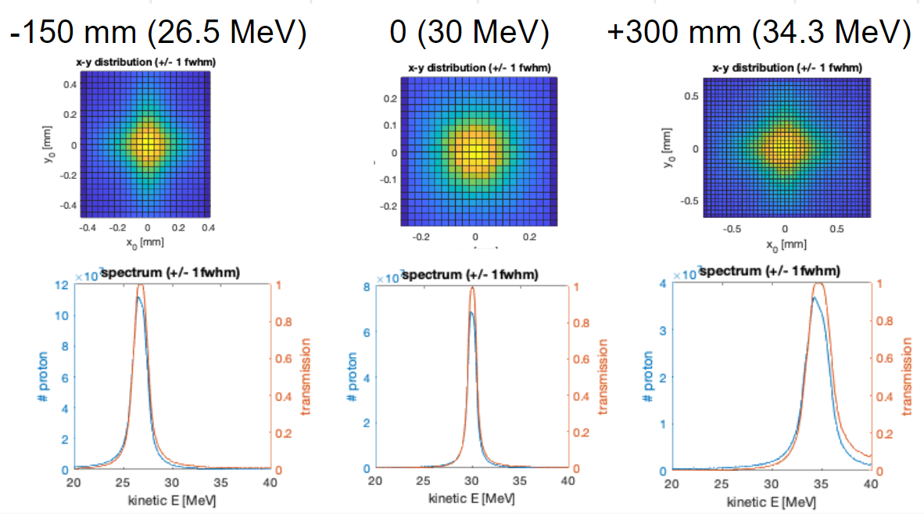
Various configurations were explored to determine which is best for applications; each require different desired beam properties
Doublet
Triplet
Quartet
x
z
y
z
Energy tunability
 | η (%) | n_{pk} (10⁹/mm²) | δE (MeV) | σ_{x} (mm) | σ_{y} (mm)
Doublet | 2.2 | 18 | 0.75 | 0.84 | 0.03
Triplet | 2.5 | 25 | 0.85 | 0.13 | 0.17
Quartet | 1.3 | 6.6 | 1.2 | 0.34 | 0.35
This work allows us to respond to need from users more effectively

Slide 9
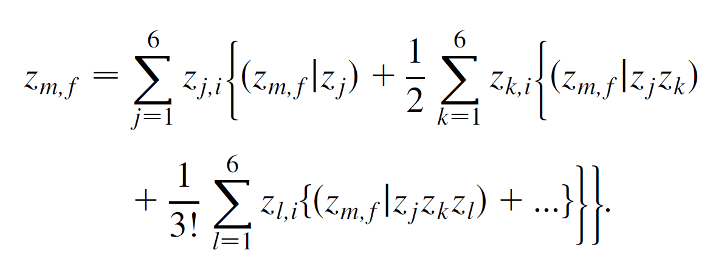
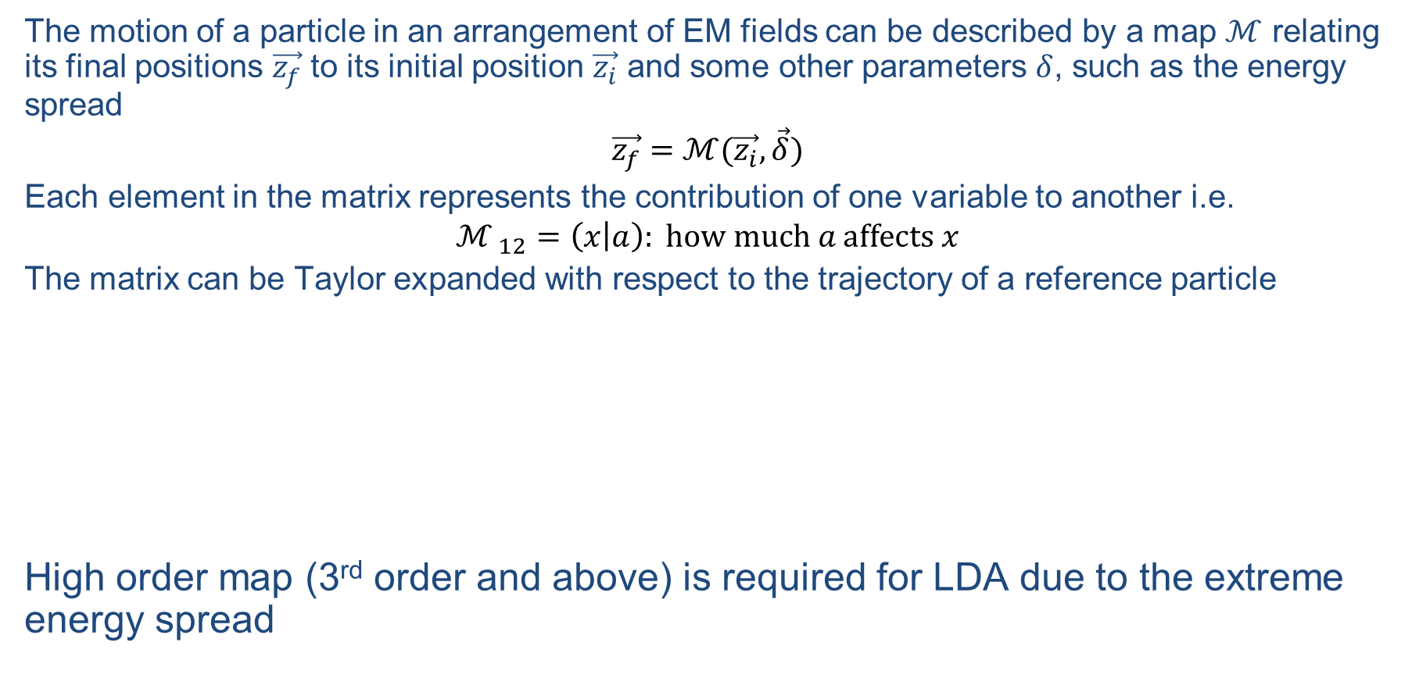
High order transfer maps are required due to large momentum spread of the LD beam
The motion of a particle in an arrangement of EM fields can be described by a map $ℳ$ relating its final positions $\vec{z_{f}}$ to its initial position $\vec{z_{i}}$ and some other parameters $δ$, such as the energy spread
$$\vec{z_{f}}=ℳ(\vec{z_{i}},\vec{δ})$$
Each element in the matrix represents the contribution of one variable to another i.e.
$${ℳ }_{12}=\left(x | a\right): \text{how} \text{much} a \text{affects} x$$
The matrix can be Taylor expanded with respect to the trajectory of a reference particle
High order map (3rd order and above) is required for LDA due to the extreme energy spread

Slide 10
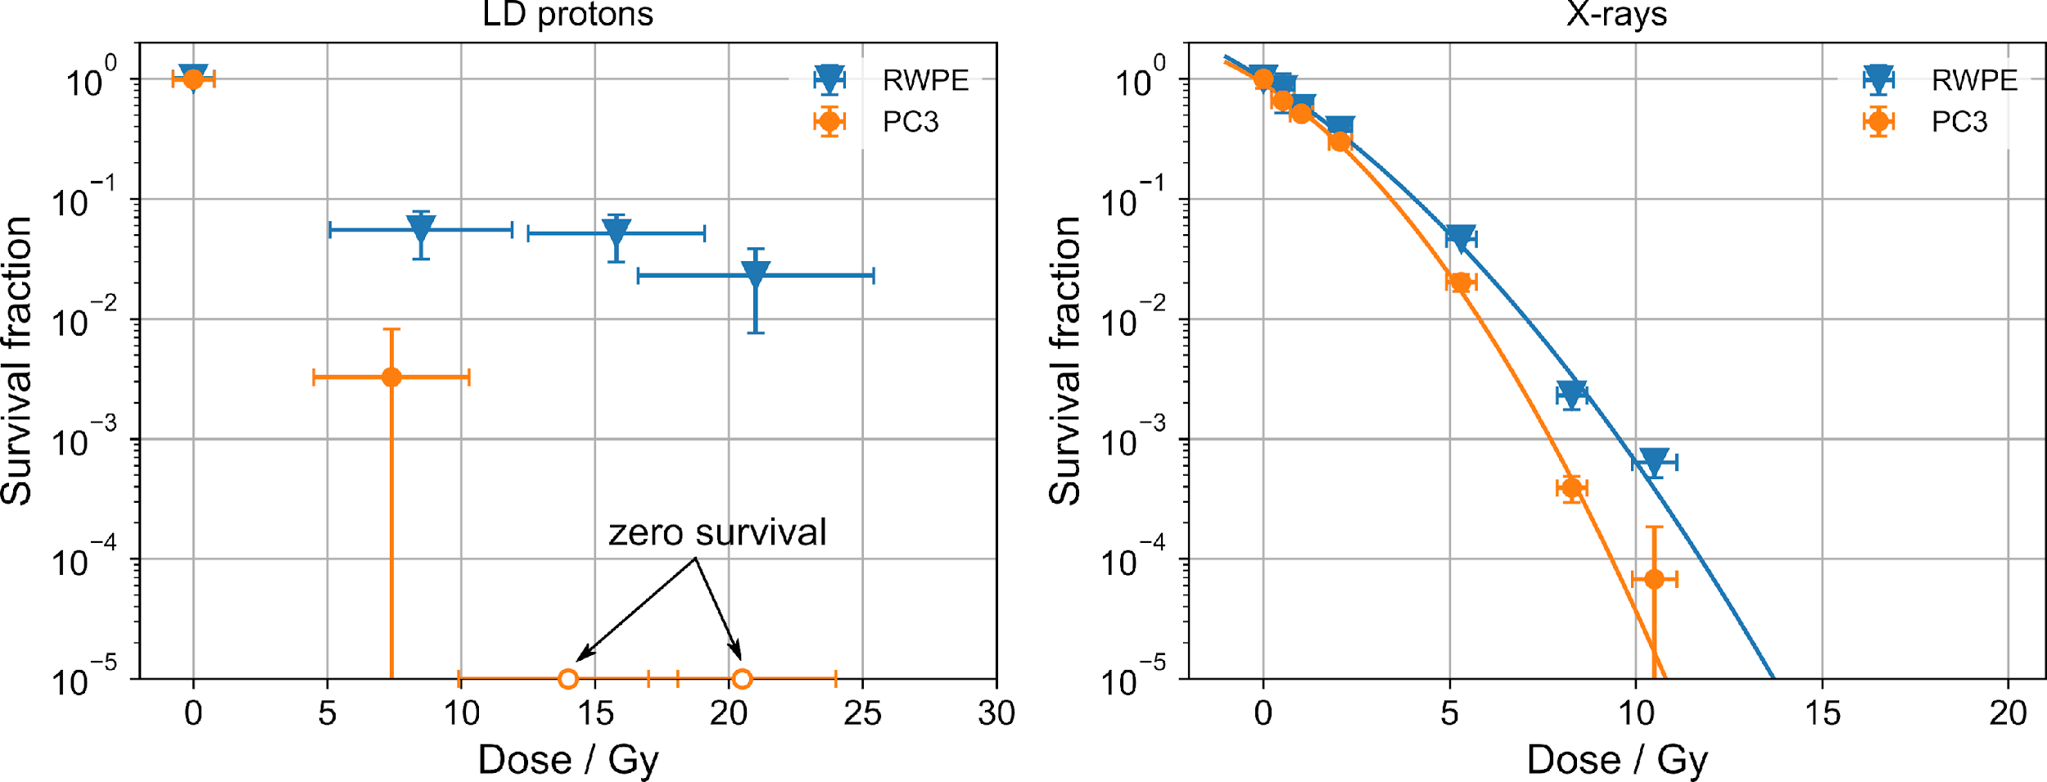
Main result of previous RadBio campaign: first demonstration of healthy tissue sparing under laser-proton irradiation
Laser-driven protons
Reference X-rays
normal
normal
tumor
tumor
High differential sparing of healthy cells versus tumor cells when irradiated with laser-driven protons
(~10⁷ Gy/s)
Low differential sparing of healthy cells versus tumor cells when irradiated with X-rays (0.02 Gy/s)
J. H. Bin, L. Obst-Huebl, et al., Sci. Rep. 12, 1484 (2022)

Slide 11
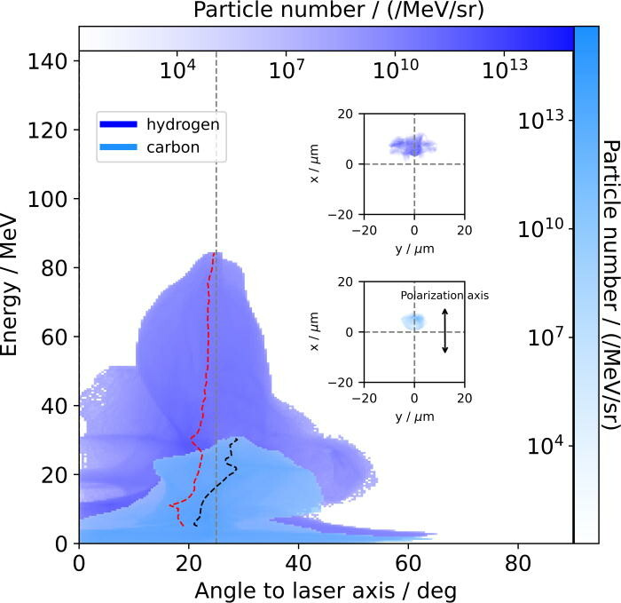
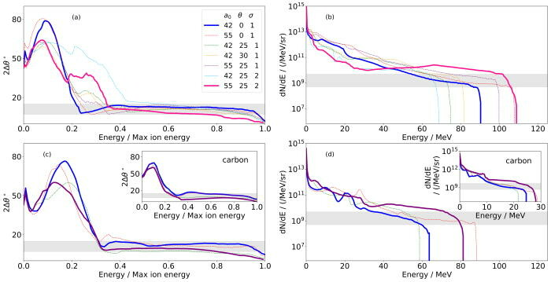
Magnetic Vortex Acceleration may yield a better beam with less transport difficulties
Initial simulation work done by Hakimi et al. at BELLA shows improvement in the in divergence by using an alternative acceleration scheme

Slide 12
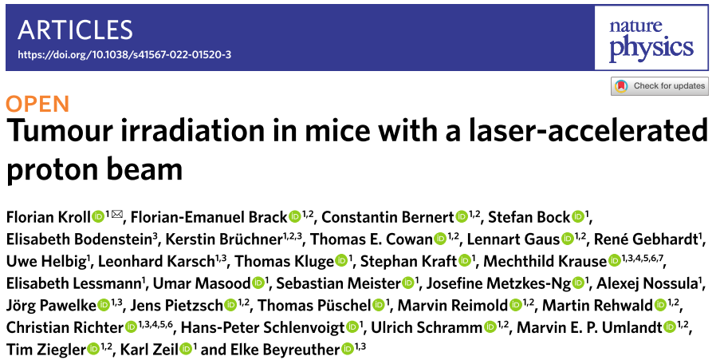
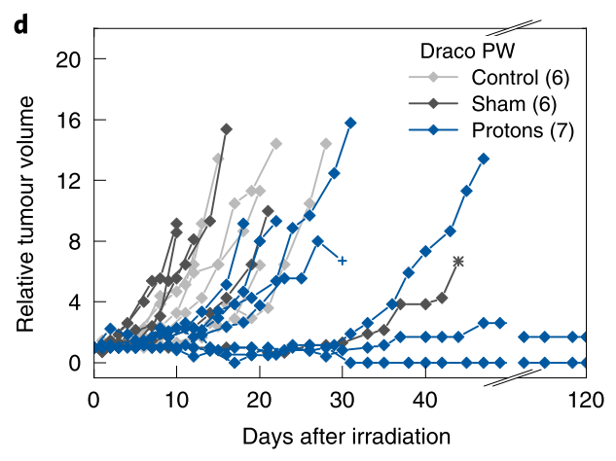
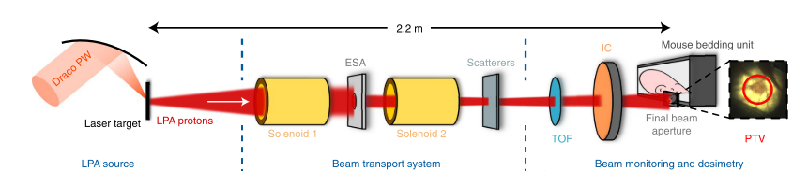
Recently, the first small animal tumor irradiations were conducted for the first time with laser-accelerated protons
Kroll F, Brack F, Bernert C, et al. Tumor irradiation in mice with a laser-accelerated proton beam. Nat Phys. 2022;18(March):13-16. doi:10.1038/s41567-022-01520-3

Slide 13
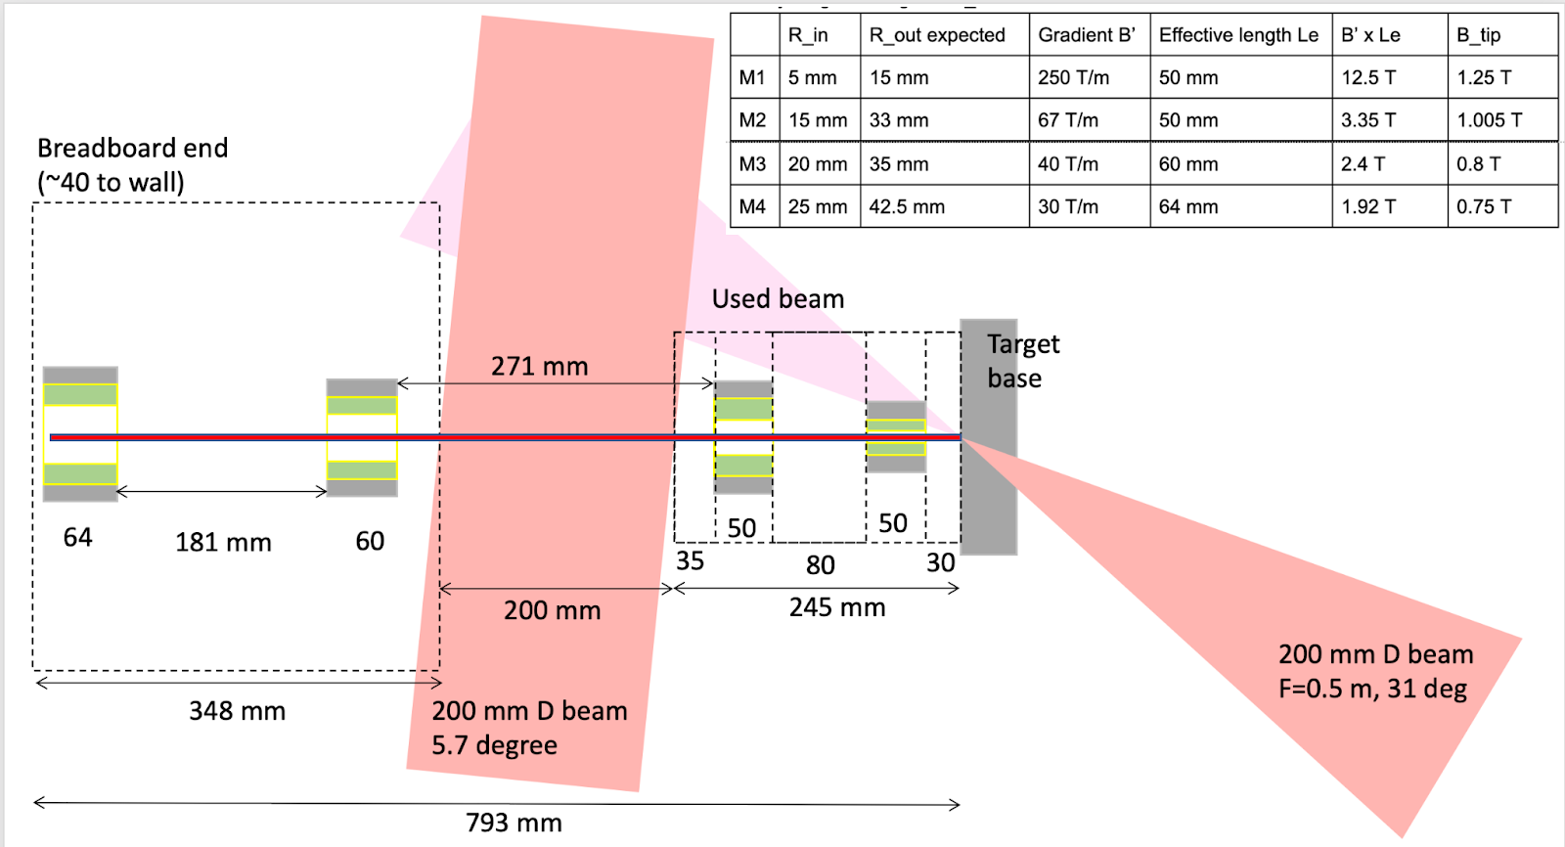
Future design to collimate 30 MeV ion beams
*dipoles not shown

Slide 14
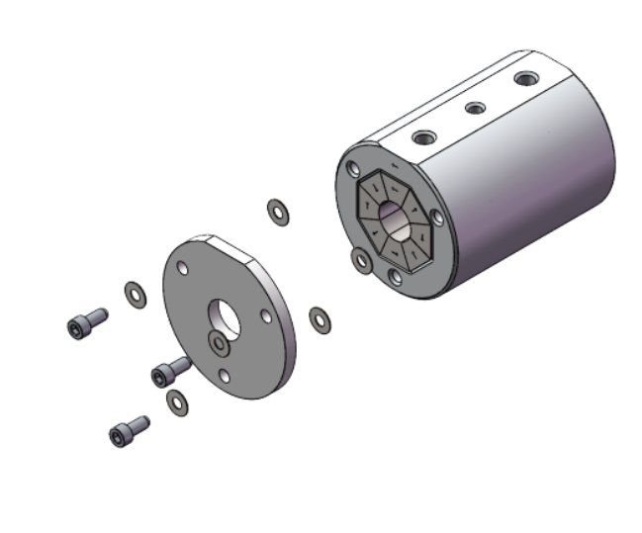
PMQ Housing and ablation shield

Slide 15
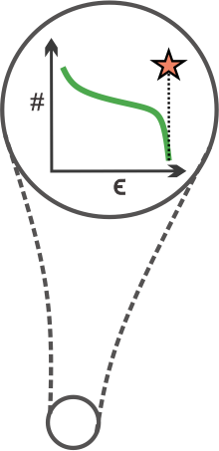
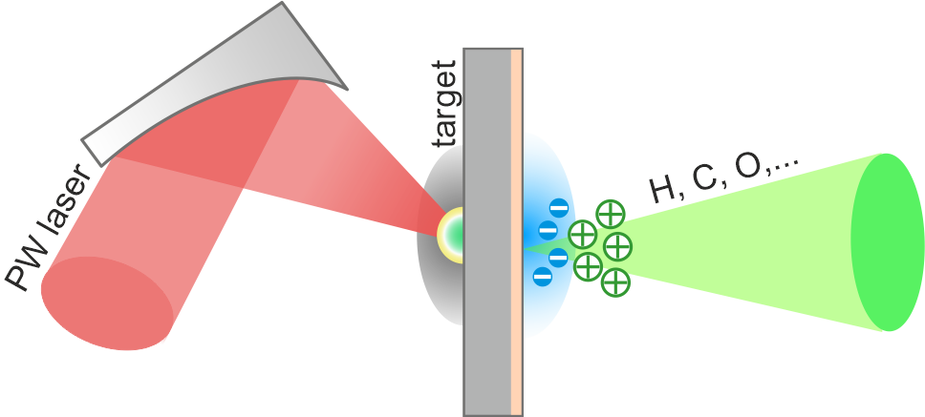
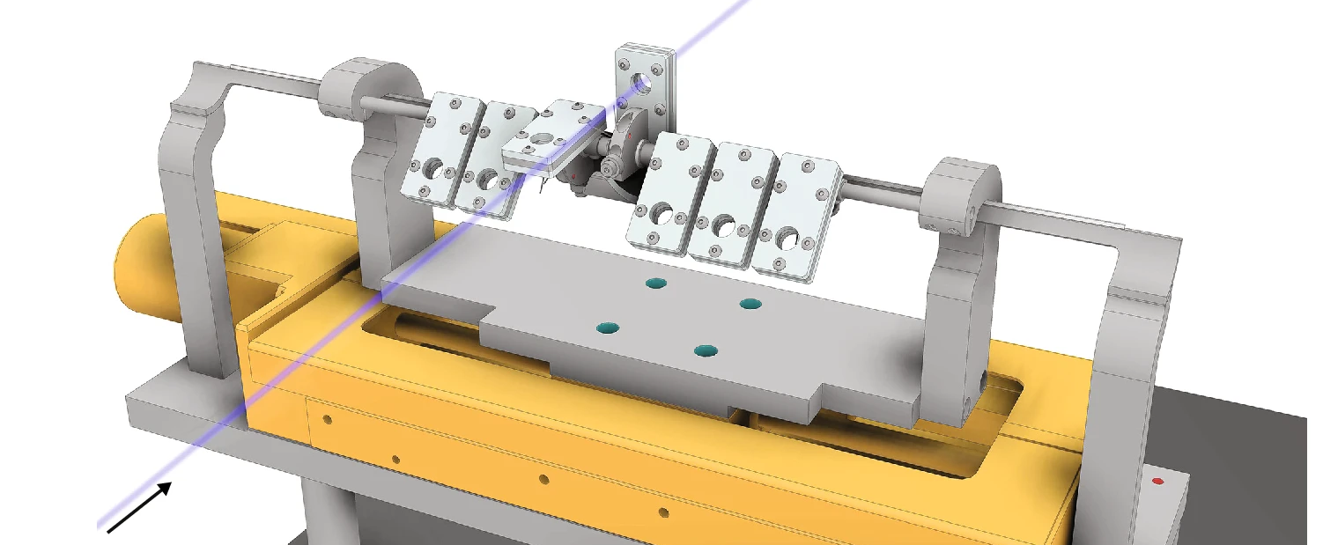
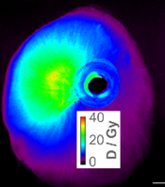
Laser Driven (LD) ion beams have desirable properties for applications but are difficult to transport effectively
Applications
Warm dense matter experiments
(e.g. isochoric heating)
Radiobiological studies
(e.g. FLASH proton therapy)
S. C. Wilks et al. Phys. Plasmas 10.1063/1.1333697, Macchi et al. Rev. Mod. Phys. 10.1103/RevModPhys.85.751
nm - μm
J. Bin et al., Sci Rep 12, 1484 (2022)
25°
10¹³ ions/shot
~ps pulse duration
B. Mahieu et al. Nat Comm. 2018
High intensity laser
>10²¹ W/cm²
Use high intensity lasers (>10²¹ W/cm²) to accelerate ions
Produce large amount of ions per shot (10¹³ ions/shot) with ultra-short pulse duration (~ps) at source
Difficult to transport due to:
Continuous broadband energy spectra up to a cutoff energy (expected >50 MeV for iP2)
Large initial divergence (up to ~25°) at the source

