Slide 1
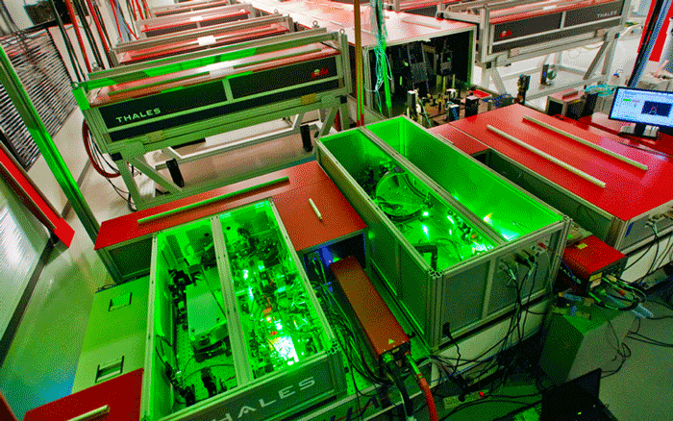
High-bandwidth image-based predictive laser stabilization via optimized Fourier filters
Joseph Natal*, Sam Barber, Fumika Isono, Curtis Berger, Anthony Gonsalves, Matthias Fuchs, Jeroen Van Tilborg
BELLA center, LBNL
*Work performed at BELLA Center, currently PhD student at University of Nebraska

Slide 2
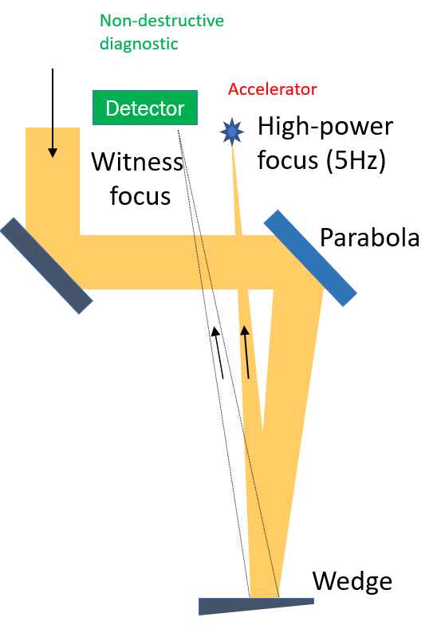
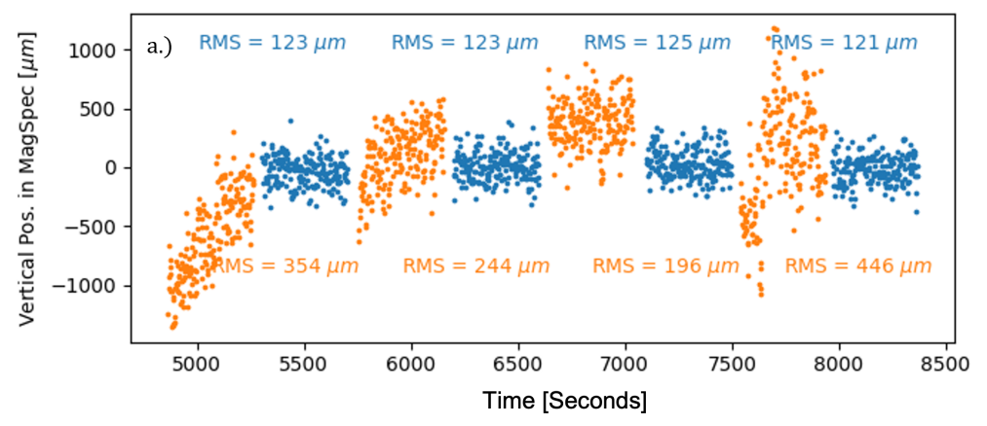
Laser Pointing Stabilization at BELLA Hundred-Terawatt Undulator
kHz laser beam pointing fluctuations
Isono et al, High Power Laser Sci. Eng. 9, e25 (2021)
e-beam active stabilization on downstream diagnostic
High-power non-perturbative laser delivery diagnostics at the final focus of 100-TW-class laser pulses
Enabled by kHz background pulse train
Feedback on / off
C Berger et al, PRAB, submitted

Slide 3
Predictive Laser Pointing Stabilization via Fourier Filters
PID control algorithms are industry-standard, but lack disturbance rejection bandwidth (5-10% of the sampling frequency)
Blank Slide
Fourier filters are short-window discrete-time Fourier transform coefficients
Fourier filters augment PID control by eliminating vibrations (e.g. HVAC, chillers, etc.) up to half the sampling frequency

Slide 4
Algorithm Overview
Fourier filters “predict” by extrapolating beam position at the next time step from the amplitude and phase information acquired
A phase shift of 180° to the predicted signal results in destructive interference
Blank Slide

Slide 5
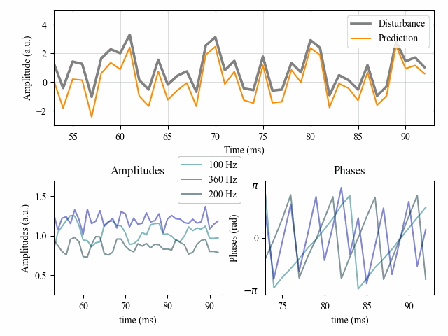
Algorithm Overview
Fourier filters “predict” by extrapolating beam position at the next time step from the amplitude and phase information acquired
A phase shift of 180° to the predicted signal results in destructive interference
Blank Slide

Slide 6
Algorithm Overview
Fourier filters “predict” by extrapolating beam position at the next time step from the amplitude and phase information acquired
A phase shift of 180° to the predicted signal results in destructive interference
Blank Slide

Slide 7
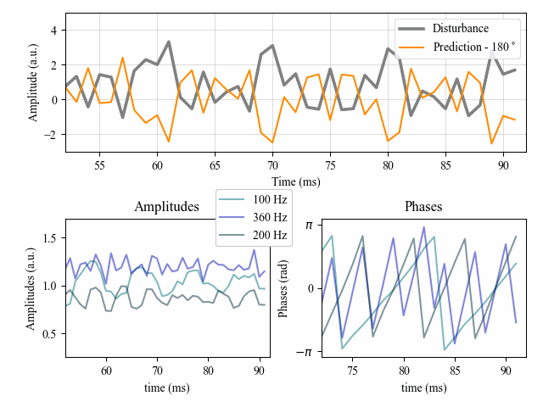
Algorithm Overview
Fourier filters “predict” by extrapolating beam position at the next time step from the amplitude and phase information acquired
A phase shift of 180° to the predicted signal results in destructive interference
Blank Slide

Slide 8
Algorithm Overview
Fourier filters “predict” by extrapolating beam position at the next time step from the amplitude and phase information acquired
A phase shift of 180° to the predicted signal results in destructive interference
Does it work in practice?
Blank Slide

Slide 9
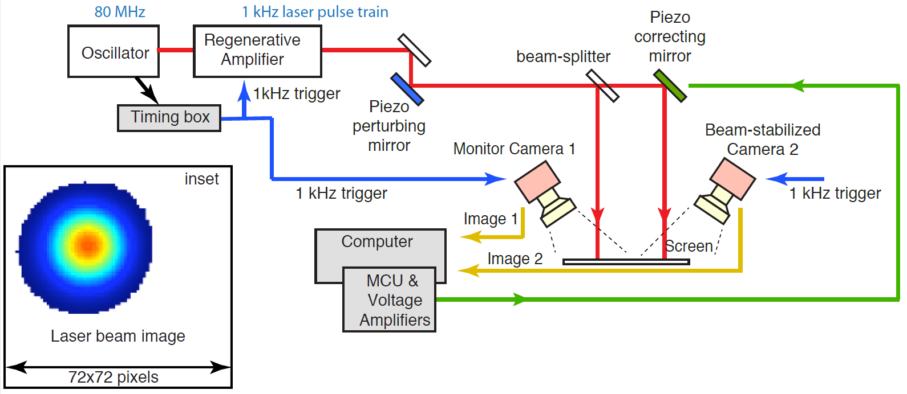
Experimental Setup
We propose an image-based (CMOS) fast feedforward system (< 1 ms loop time)
A data-driven model learns the piezo-electric mirror’s transfer function which compensates for hysteresis (~5 seconds)
Blank Slide

Slide 10
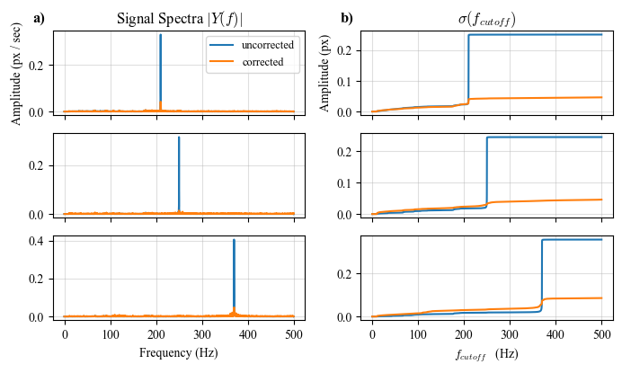
Experimental Results
Blank Slide
J. Natal, Appl. Optics, under review
Stabilization at 210, 250, and 370 Hz exhibits 5x reduction in RMSE

Slide 11
Conclusion and Outlook
A laser pointing stabilization method is presented which augments traditional control algorithms by overcoming bandwidth limitations
Accessible hardware with machine learning enables enhanced control that should be leveraged at current and future laser facilities
Next steps: implementation and testing at full power
Blank Slide

Slide 12
Conclusion and Outlook
A laser pointing stabilization method is presented which augments traditional control algorithms by overcoming bandwidth limitations
Accessible hardware with machine learning enables enhanced control that should be leveraged at current and future laser facilities
Next steps: implementation and testing at full power
Blank Slide
Thank You

