Slide 1
Energy Modulation in a Commercial Dual Grating Dielectric Laser Accelerator
S. Crisp, A. Ody, P. Musumeci
Sophie Crisp
AAC 2022
November 9th, 2022
Notes:
Add the logos

Slide 2
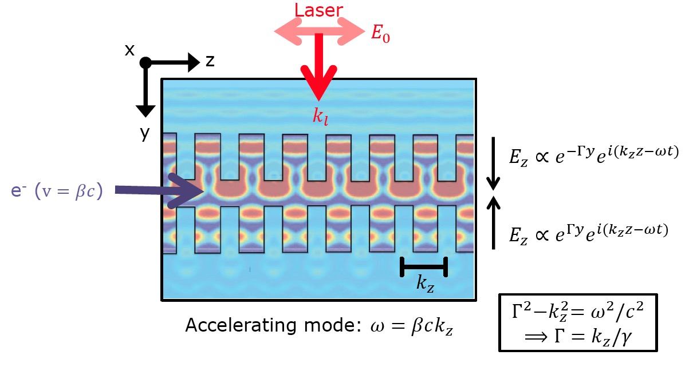
Dielectric Laser Accelerators
Use scale-invariance of Maxwell equations and shrink down the size of particle accelerators by 4 orders of magnitude.
Leverage technology in two areas:
Solid state lasers
Semiconductor fabrication

Slide 3
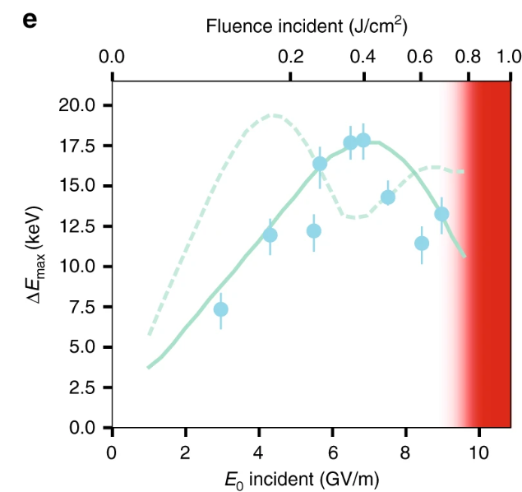
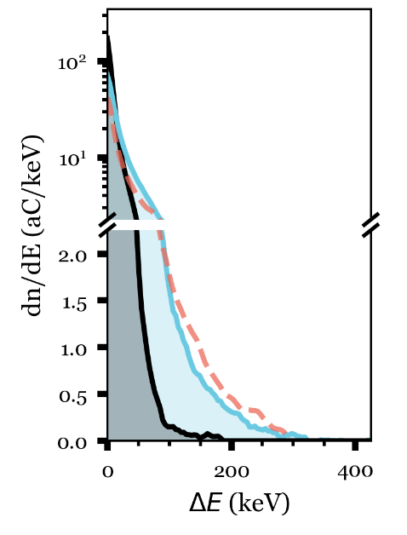
Previously, Record Energy Gain, Gradient Reached at UCLA
Laser, ~100fs
315 keV energy gain
700 um Interaction Length
1.8 GeV/m Peak Gradient
$$θ_{PFT}$$
E₀
k₀
y
e-
z
g (= 400, 800 nm)
D. Cesar et al. Opt. Exp., 2018
D. Cesar et al. Communications Physics, 2018
Notes:
PFT imperative to accelerating over long length scales. Previously, 315keV was measured. We seek to reach 1MeV, which will require a much longer interaction. Longer interactions require a number of changes, some simple, like increasing the energy via a new laser, and some more complicated, obtaining a structure longer than 1mm with the requisite gap, 800 nm, and compensating for dynamic effects in this energy regime.
Our goal is to extend this interaction length beyond 1mm, and towards 2cm. This requires

Slide 4
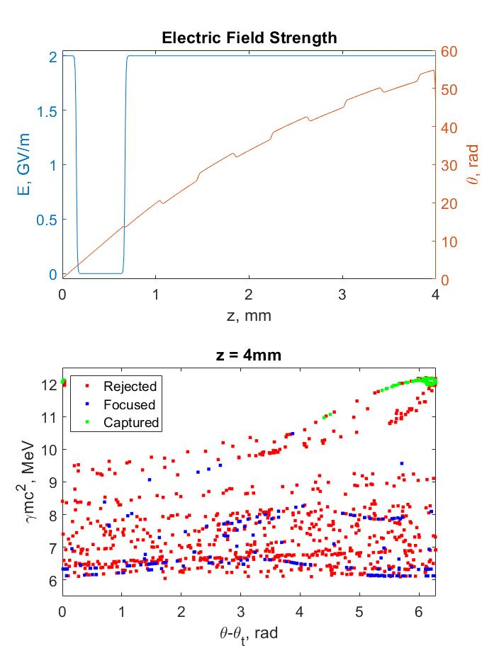
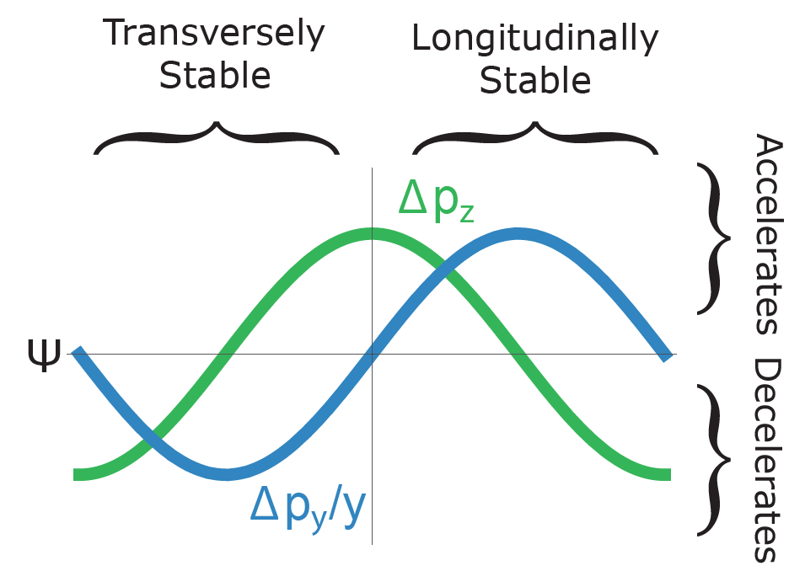
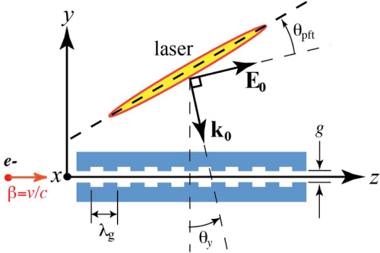
Limiting Factors for MeV Energy Gain
Laser-electron interaction time
Total structure length
Dynamic effects – over longer lengths, e- will defocus
4mm
4mm
1mm

Slide 5
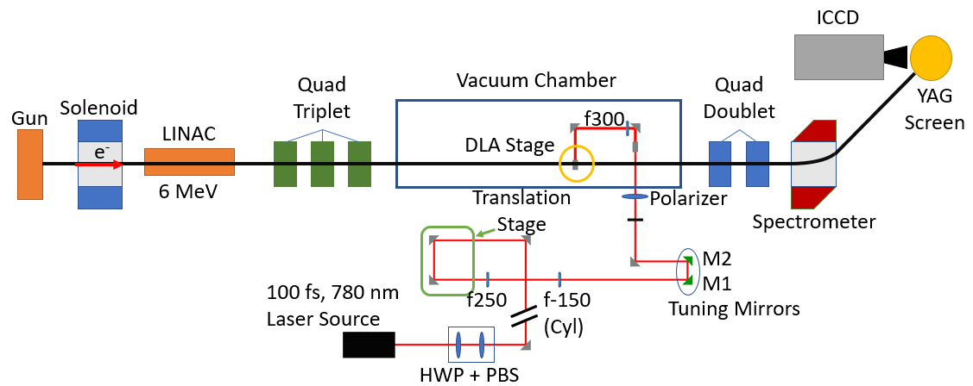
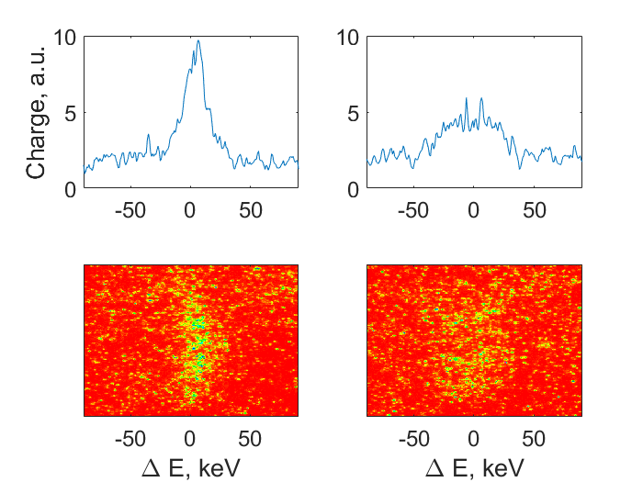
Experiments Take Place at the Pegasus Beamline
Sample electron spectra:
Notes:
Beam emittance: Hopefully down to 10nm
Beam energy out the gun: 3.5 MeV; can double energy to 7 MeV
Beamline sits in a 10m bunker

Slide 6
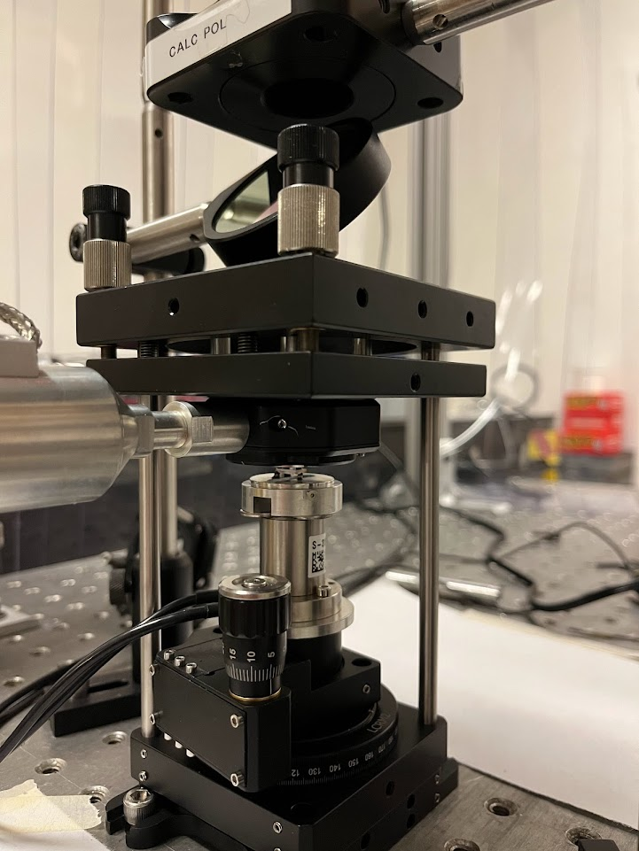
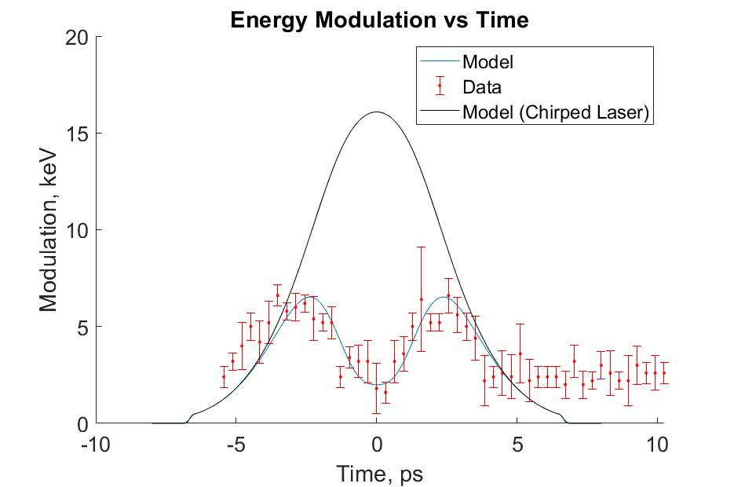
First Modulation from this Commercial Grating Structure
Parameter | Value
Beam Energy | 6 MeV
Energy Spread (FWHM) | 17 keV
Beam Charge | 1 pC
Beam rms size at DLA | 75 um
Bunch Length | .25 ps
Laser Pulse Duration (FWHM) | 100fs
Laser spot size at DLA (FWHM) | 1.34 mm x 412.5 um
Laser Energy | 1.8 mJ
DLA gap (Optically Estimated) | 1.2 um
Structure Factor (Estimated) | 0.05
On the way:
MeV energy gains via longer interactions lengths
Soft tuning utilizing Alternating Phase Focusing

Slide 7
Acknowledgements
Thank you to:
Pietro Musumeci (UCLA)
Alexander Ody (UCLA)
Joel England (SLAC)
Kenneth Leedle (Stanford)
Eric Cropp (UCLA)
David Cesar (SLAC)
Notes:
Stanford, SLAC logos

