Slide 1



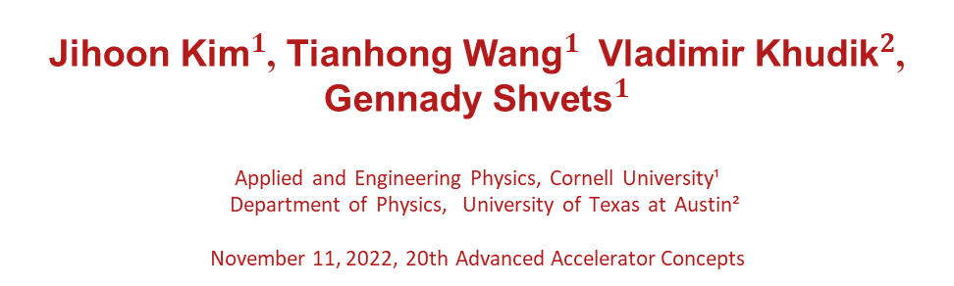
Phase- and polarization-controlled electron self-injection into laser plasma accelerators
Kim et al., Phys. Rev. Lett. 127, 164801 (2021)
Kim et al., arXiv:2111.03014 (2022)
${\text{Jihoon} \text{Kim}}^{1}$, ${\text{Tianhong} \text{Wang}}^{1}$ ${\text{Vladimir} \text{Khudik}}^{2}$, ${\text{Gennady} \text{Shvets}}^{1}$
Applied and Engineering Physics, Cornell University¹​
Department of Physics, University of Texas at Austin²​
November 11, 2022, 20th Advanced Accelerator Concepts

Slide 2










Acknowledgements
https://shvets.aep.cornell.edu/
Shvets Plasma Group
Prof. Gennady Shvets
Dr. Roopendra Rajawat
Given
Chen
Joshua
Luoma
Polina Blinova
Dr. Tianhong
Wang
Current Affl:
Applied Materials
Dr.Vladimir Khudik
Supported by the Accelerator Stewardship Program
(PM : Dr. Eric Colby)

Slide 3
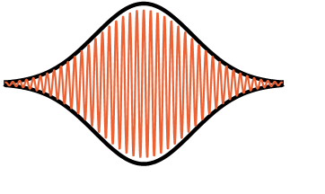
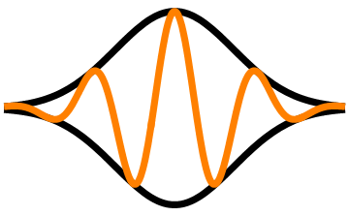
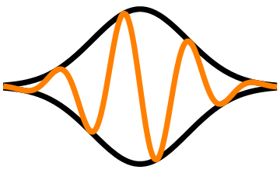
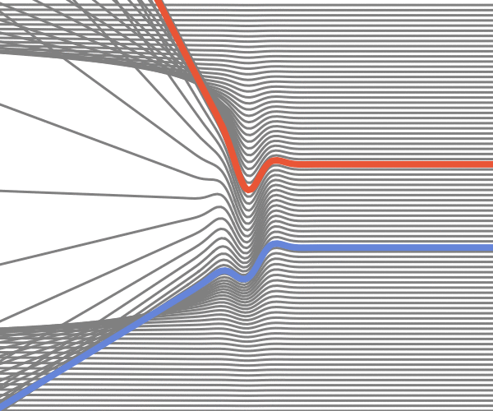






Carrier Envelope Phase Effect:
Envelope does not describe the whole picture!
Many Cycle pulse
Few-Cycle pulse
$$φ_{CEP}=0$$
$$φ_{CEP}=−\frac{π}{2}$$
Carrier Envelop Phase(CEP) Period:
$$T_{CEP}=\frac{2πc}{ω_{L}}\frac{1}{v_{ph}−v_{g}}≈\frac{λ_{L}}{c}{\left(\frac{ω_{L}}{ω_{p}}\right)}^{2}$$
$$\frac{v_{g}}{c}≈1−\frac{1}{2}\frac{ω_{p}^{2}}{ω_{L}^{2}}$$
$$z$$
$$z$$
$$\frac{v_{ph}}{c}≈1+\frac{1}{2}\frac{ω_{p}^{2}}{ω_{L}^{2}}$$
$$ξ=x−ct$$
$$ξ=x−ct$$
Asymmetric Response!
Kostyukov et al,
PRL 103 035001, 2009
Notes:
Many cycle, slow envelope
Few cycle, comparable envelope and phase
CEP: 2009 kostyukov, \lambda/(v_ph-v_g)

Slide 4
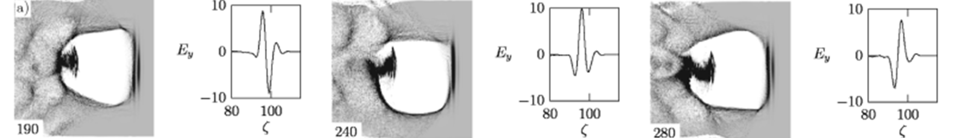
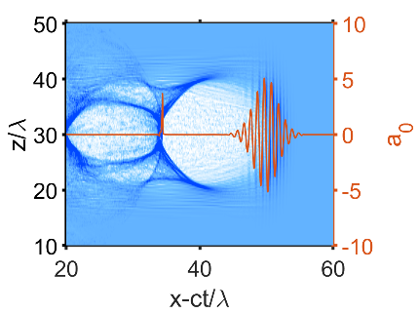
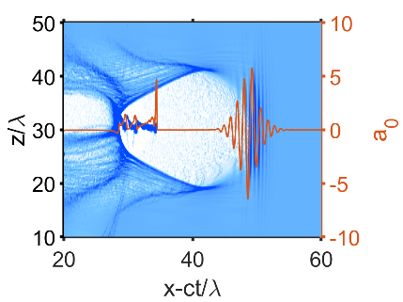
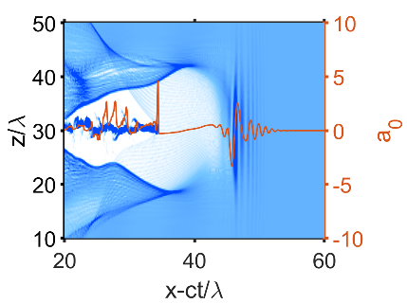
Laser-Wakefield Accelerators exhibit CEP dependence
Near Single Cycle Pulse (NSC)
Self-Steepening pulse
Kostyukov et al,
PRL 103 035001, 2009
NSC: Periodically Undulating Bubble
Self-Steepened Pulse: Expanding and Undulating Bubble
Does CEP affect the self-injection process? If so, How?
Notes:
Many cycle, slow envelope
Few cycle, comparable envelope and phase
CEP: 2009 kostyukov, \lambda/(v_ph-v_g)

Slide 5
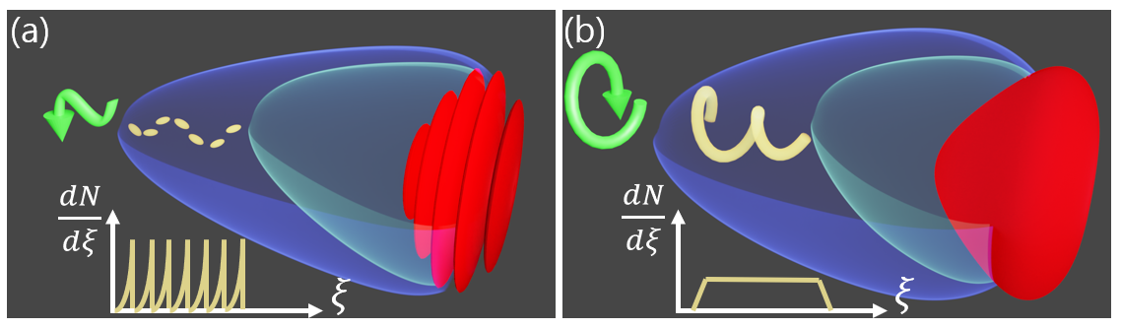
Steepened or Near-Single-Cycle Pulses lead to CEP and Polarization Dependent Injection
Linearly Polarized
Circularly Polarized
Periodic Injection, Spiked current
Continuous Injection, Flat current
Notes:
Linear: Periodic injection, spiked current
Circular: continuous injection, flat current

Slide 6
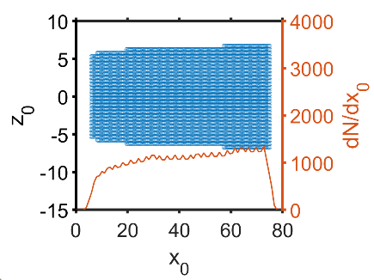
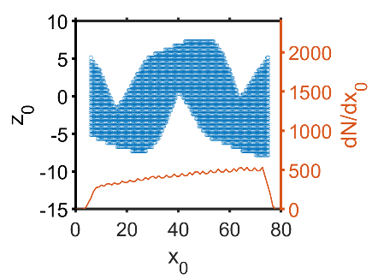
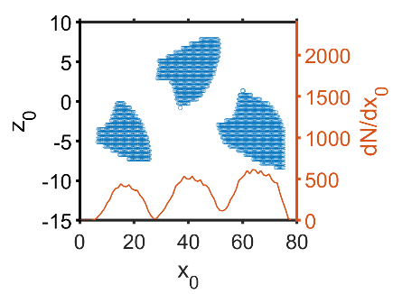
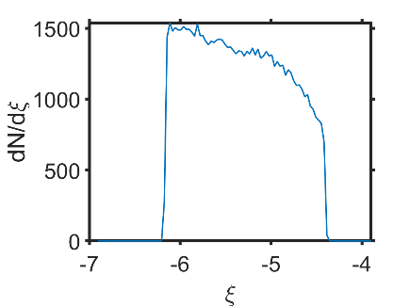
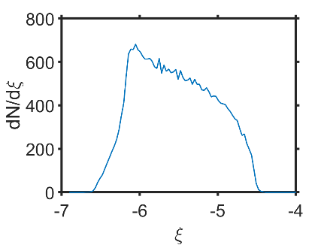
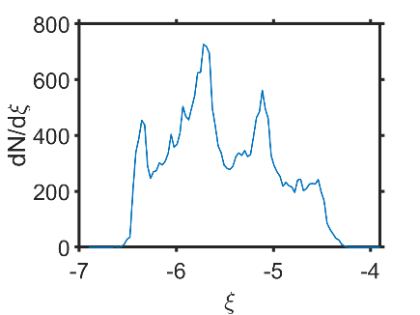


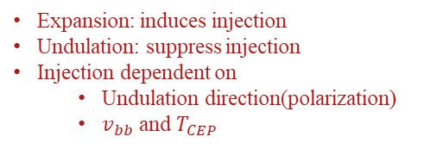






Polarization dependent injection process in EPUB
$$R\left(t\right)$$
$$z$$
$$R\left(t\right)$$
$$R(0)$$
$$v_{b}$$
$$z$$
$$z_{u}$$
c
$$v_{b}$$
$$y$$
$$Δξ$$
$$x$$
Kim et al, Phys. Rev. Lett. 127, (2021)
Kim et al., https://arxiv.org/abs/2111.03014
$$ξ$$
Expansion
$$v_{bb}$$
Expansion+Helical Undulation
Expansion+Linear Undulation
Injected Particles
$$Δξ=\frac{\left(c−v_{bb}\right)T_{CEP}}{2}$$
Injection
rate
Current
Expansion: induces injection
Undulation: suppress injection
Injection dependent on
  Undulation direction(polarization)
  $v_{bb}$ and $T_{CEP}$
Notes:
Put references.
Show top->Schematic on right->Bottom 1 2 3
Expansion + CP

Slide 7
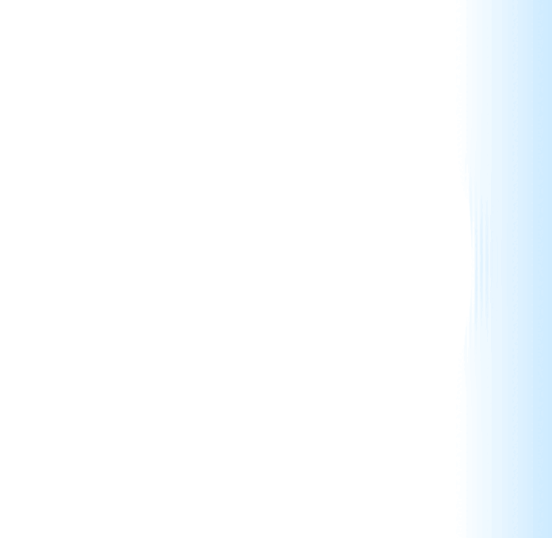
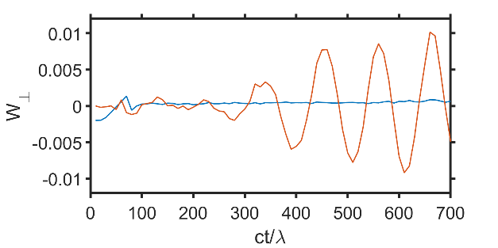
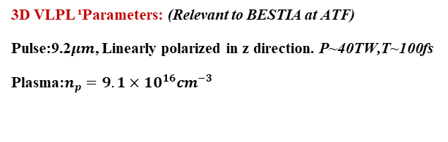



Periodic injection by few-cycle driven LWFA
3D VLPL ¹Parameters: (Relevant to BESTIA at ATF)
Pulse:9.2$μm$, Linearly polarized in z direction. P~40TW,T~100fs
Plasma:$n_{p}=9.1×10^{16}cm^{−3}$
$$0.9mm$$
(a)
$$3.2mm$$
(b)
$$6.4mm$$
$$0.9mm$$
$$3.2mm$$
$$6.4mm$$
On-axis transverse wake near bubble rear
¹PUKHOV, A. (1999). Three-dimensional electromagnetic relativistic particle-in-cell code VLPL (Virtual Laser Plasma Lab). Journal of Plasma Physics, 61(3), 425-433. doi:10.1017/S0022377899007515
Notes:
Propagation->steepening and undulation
Periodic injection, from alternating locations
High current periodically modulated spieks
Monoenergetic peak
Use animation.

Slide 8
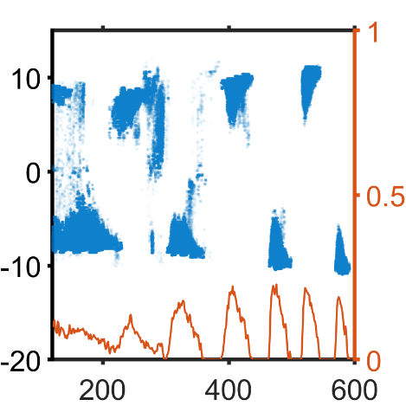
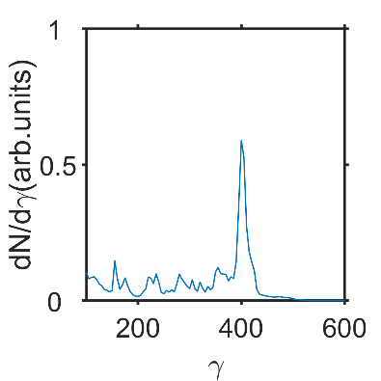
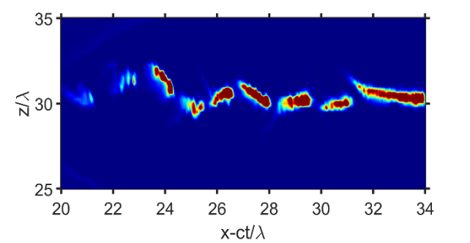
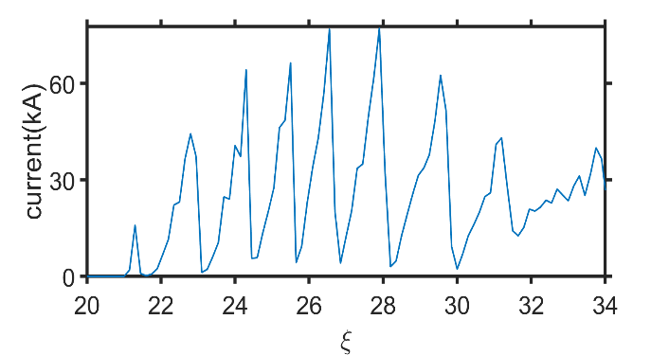




Injected Bunch forms high-current periodically modulated beams
(b)
$$6.4mm$$
Monoenergetic peak at 200MeV
Almost 50% of energy transferred into 2 J of electron beam energy!
$$Δx\sim v_{b}T_{CEP}/2$$
dots: x-z position from which electrons are injected from , lines: injection rate
$$q\sim 12nC$$
$$Δξ\sim Δξ_{theory}\sim 40fs$$
Injected electrons form distinct current peaks with regular periodicity
  Due to periodic injection from background plasma
Appreciable fraction of them collapse to monoenergetic peak at 6.4mm
Notes:
Propagation->steepening and undulation
Periodic injection, from alternating locations
High current periodically modulated spieks
Monoenergetic peak
Use animation.

Slide 9
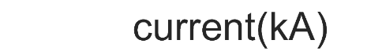
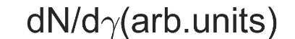
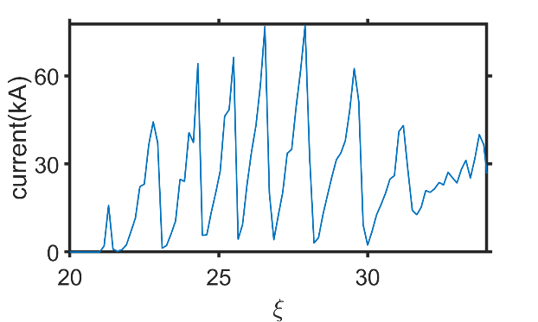
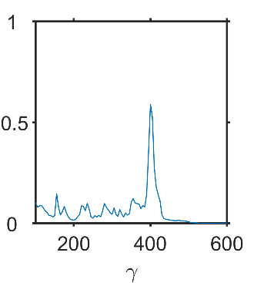

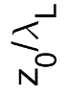
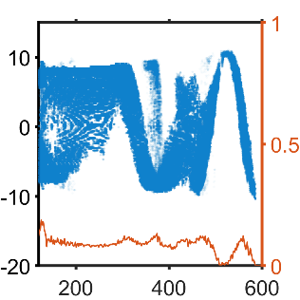
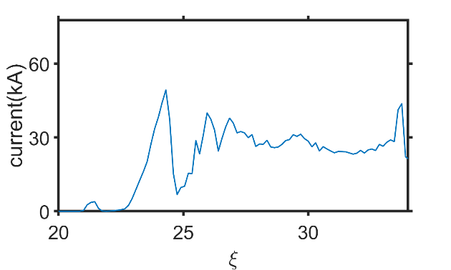
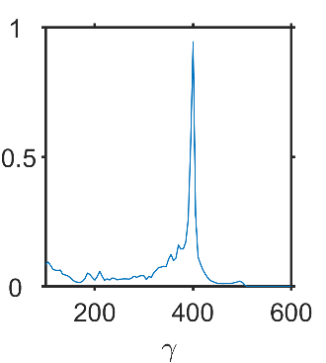
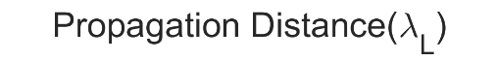
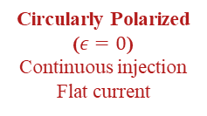

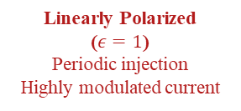
Bunching control via laser polarization
dots: injected electron initial position
lines: injection rate
Linearly Polarized
($ε=1$)
Periodic injection
Highly modulated current
Circularly Polarized
($ε=0$)
Continuous injection
Flat current
$$γ$$
Notes:
LP to CP: change in bunching.
Injection switch from periodic to continuous for LP ->Elliptical->CP
Current also switch from periodic to continuous
Spectra changes due to different beam loading
Delete one of the elliptical…
Use pictures.(or elliptical). Use larger pictures.

Slide 10
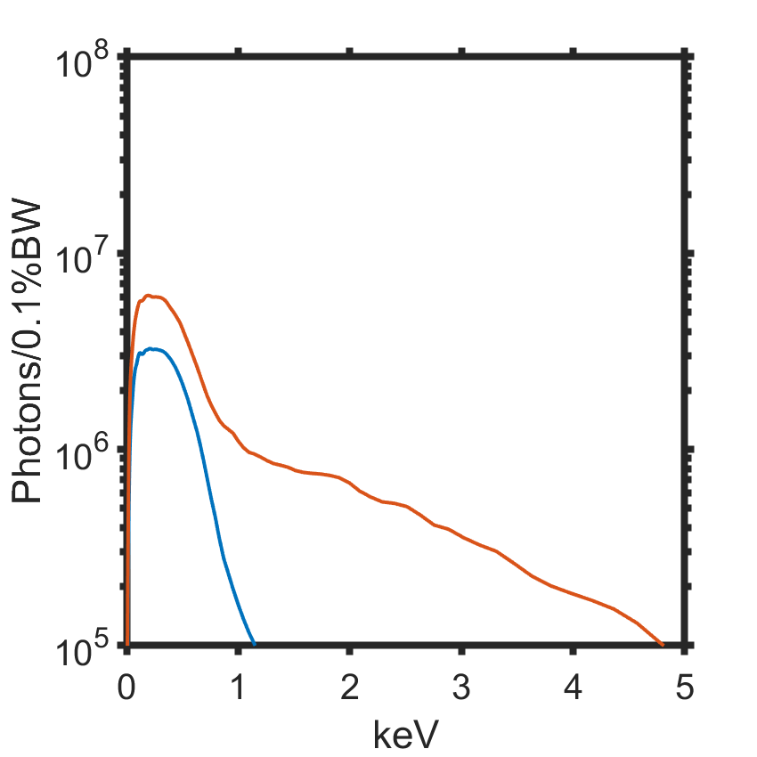
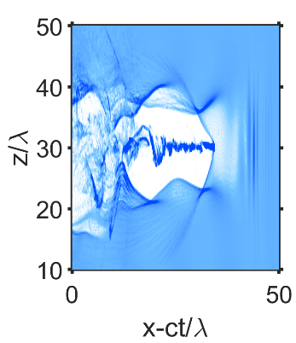
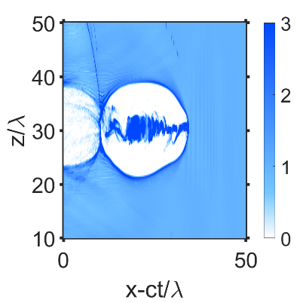
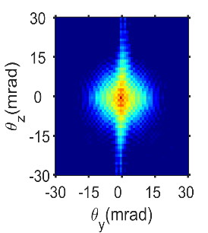
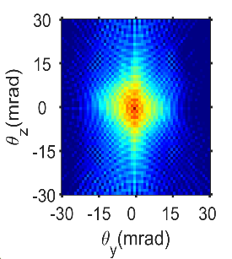
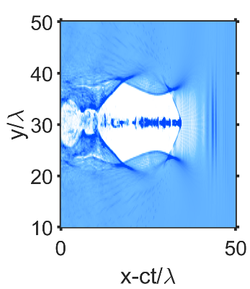
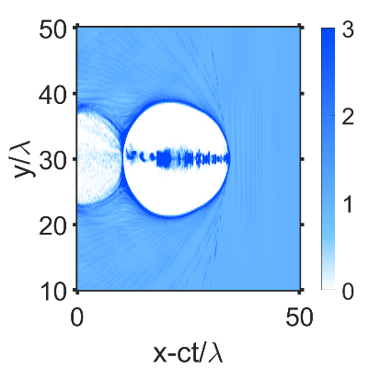


What happens at later time? Transition to Plasma Wakefield Accelerator
9.2mm
13.8mm
(a)
9.2mm
13.8mm
$$Δθ_{z}$$
Laser Polarization
Plane
$$Δθ_{y}$$
Asymmetry present after pulse depletion in polarization direction
Huge radiation boost in PWFA stage
  Elongation in laser polarization direction still visible
Notes:
Many cycle, slow envelope
Few cycle, comparable envelope and phase
CEP: 2009 kostyukov, \lambda/(v_ph-v_g)

Slide 11
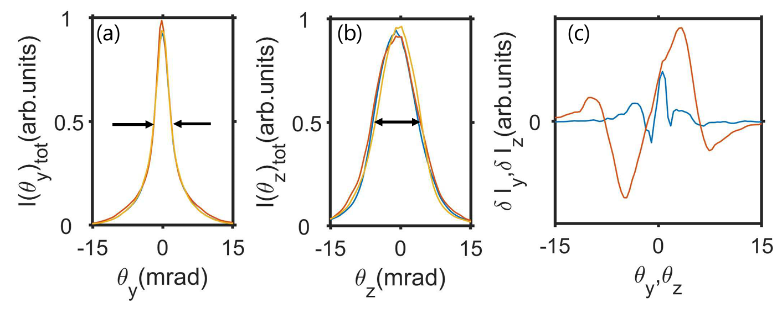
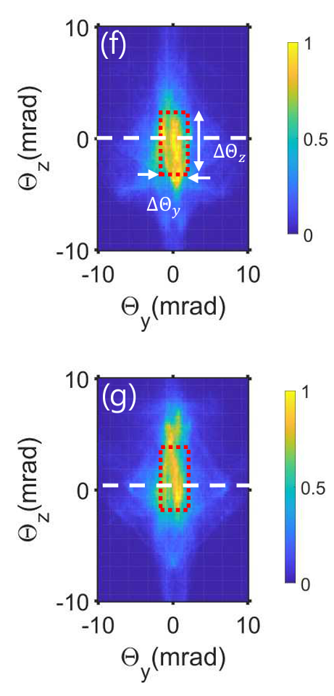
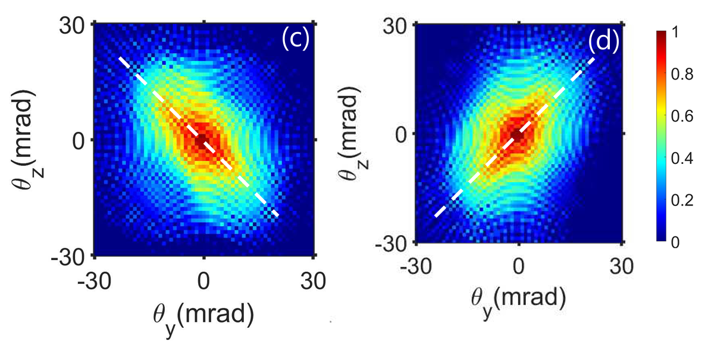




CEP Observables: Betatron Radiation and Beam pointing
Linear Polarization:
Radiation and injected bunch asymmetry
Circular Polarization: Radiation asymmetry
Integrated betatron distribution
Electron Beam pointing
Betatron intensity distribution
$$φ_{CEP}=0$$
$$φ_{CEP}=0$$
Phase-dependence of
betatron radiation
$$φ_{CEP}=\frac{π}{2}$$
$$φ_{CEP}=\frac{π}{2}$$
Integrated intensity distribution shows CEP-dependent asymmetry in polarization direction
Electron bunch deflection is CEP dependent
Intensity elongated in a particular direction and rotates with CEP
Notes:
Many cycle, slow envelope
Few cycle, comparable envelope and phase
CEP: 2009 kostyukov, \lambda/(v_ph-v_g)

Slide 12
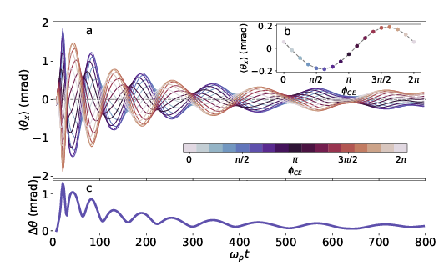
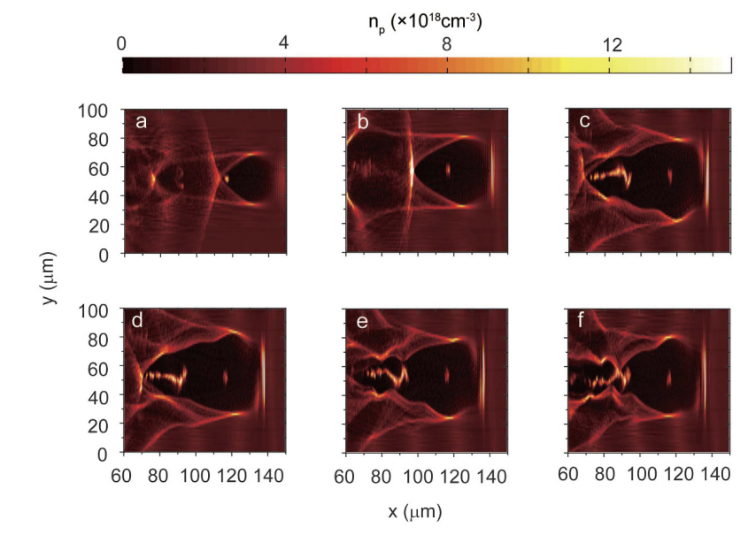
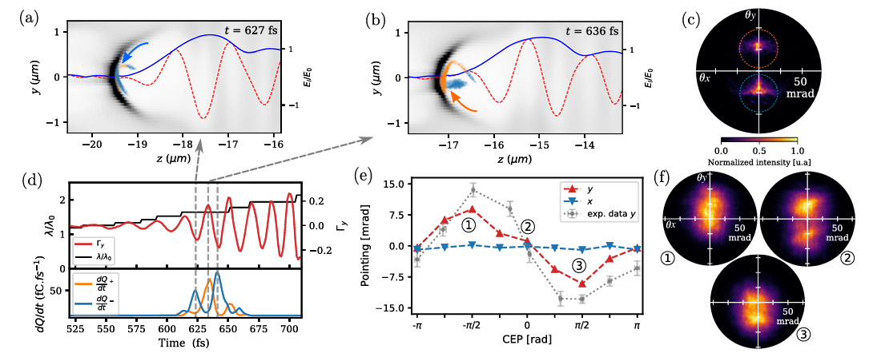
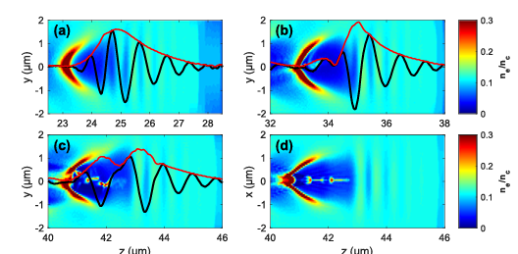


CEP dependent physics are ubiquitous!
NSC Pulses
Multi-cycle Pulses
60fs 8.6J Ti:Sapphire pulse
3.5fs 2.5mJ Ti:Sapphire pulse
23fs, 2.5J Ti: Sapphire pulse
PHYSICAL REVIEW X 12, 011036 (2022)
arXiv:2206.06133
Sci Rep 6, 30491 (2016)
5.7fs 1.5mJ Ti:Sapphire pulse
5fs 2mJ Ti:Sapphire pulse
AIP Advances 10, 095310 (2020)
PHYSICAL REVIEW X 11, 021055 (2021)
Sci Rep 12, 10855 (2022)
Notes:
Many cycle, slow envelope
Few cycle, comparable envelope and phase
CEP: 2009 kostyukov, \lambda/(v_ph-v_g)

Slide 13
Summary
Carrier-Envelope-Phase(CEP) can be important in laser-plasma wakefield
  Periodic bubble undulation according to CEP
Analytical model predicts polarization dependent periodic injection process
  Circular Polarization = continuous injection and flat current
  Liner Polarization = periodic injection and spiky current
Huge charge accelerated with high efficiency = PWFA!
CEP-dependent observables: Betatron Radiation and electron beam pointing
CEP physics is visible in a wide range of parameters!
Kim et al, Phys. Rev. Lett. 127, (2021)
https://arxiv.org/abs/2111.03014
Notes:
Advertise paper: arxiv and prl

Slide 14


Injection conditions from Hamiltonian
Backup Slides

Slide 15







Electron injection from background of particles
Linearly polarized laser
Circularly polarized laser
Hamiltonian estimated for particles entering bubble at its edge
$$R\left(t\right)$$
c
$$R(0)$$
$$ΔH_{thresh}$$
$$z_{u}$$
$$v_{b}$$
c
$${ΔH}_{exp}^{(1)}$$
$$ΔH^{(1)}$$
$$ΔH^{(1)}=H_{osc}^{(1)}+H_{exp}^{(1)}$$
$$ΔH_{exp}^{(1)}=1.35εR_{0}^{3}$$
$$ΔH_{osc}^{(1)}=0.16z_{osc}ω_{CEP}\sin\left(ω_{CEP}t_{enter}\right)R_{0}^{2}$$
Salehi et al, PRX 11 021055, 2021
Injection
Injection
Periodic injection predicted
Bubble exhibits finite undulation at all time
No “turning on and off” of injection
Polarization dependent injection predicted: Circular->Continuous, Linear->Periodic

Slide 16



Slide 17


Slide 18


