Slide 1
Summary of the Snowmass’21 Accelerator Frontier
Steve Gourlay, Tor Raubenheimer, Vladimir Shiltsev
AAC Workshop, November 9, 2022

Slide 2
What is Snowmass?
“Snowmass is a particle physics community study”
https://www.snowmass21.org/
Provides input to P5 (Particle Physics Project Prioritization Panel) which develops a strategy for the US HEP program
1.5-2 yrs
Snowmass
~5-7 yrs of
hard work
P5 Strategy
~ 1 yr
DOE/NSF program

Slide 3
Snowmass’21
July 16-26 Seattle, WA

Slide 4
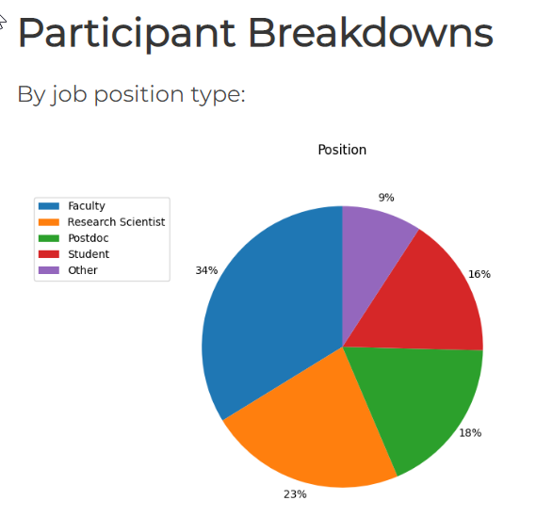
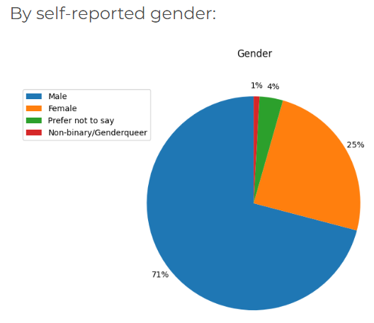
Snowmass’21 in Numbers
Participants:
Number of in-person participants: 743
Number of virtual participants: 654
Total number of participants: 1397
Events:
Number of conference dinner attendees: 380
Number of LIGO/Hanford trip attendees: 53
Number of Mariners baseball game attendees: 65
Contributions:
Letters of Interest: >1000
Contributions to proceedings: 548

Slide 5
Snowmass’21: Frontiers and Topical Groups
10 Frontiers | 80 Topical Groups
Energy Frontier | Higgs Boson properties and couplings, Higgs Boson as a portal to new physics, Heavy flavor and top quark physics, EW Precision Phys. & constraining new phys., Precision QCD, Hadronic structure and forward QCD, Heavy Ions, Model specific explorations, More general explorations, Dark Matter at colliders
Frontiers in Neutrino Physics | Neutrino Oscillations, Sterile Neutrinos, Beyond the SM, Neutrinos from Natural Sources, Neutrino Properties, Neutrino Cross Sections, Nuclear Safeguards and Other Applications, Theory of Neutrino Physics, Artificial Neutrino Sources, Neutrino Detectors
Frontiers in Rare Processes & Precision Measurements | Weak Decays of b and c, Strange and Light Quarks, Fundamental Physics and Small Experiments. Baryon and Lepton Number Violation, Charged Lepton Flavor Violation, Dark Sector at Low Energies, Hadron spectroscopy
Cosmic Frontier | Dark Matter: Particle-like, Dark Matter: Wave-like, Dark Matter: Cosmic Probes, Dark Energy & Cosmic Acceleration: The Modern Universe, Dark Energy & Cosmic Acceleration: Cosmic Dawn & Before, Dark Energy & Cosmic Acceleration: Complementarity of Probes and New Facilities
Theory Frontier | String theory, quantum gravity, black holes, Effective field theory techniques, CFT and formal QFT, Scattering amplitudes, Lattice gauge theory, Theory techniques for precision physics, Collider phenomenology, BSM model building, Astro-particle physics and cosmology, Quantum information science, Theory of Neutrino Physics
Accelerator Frontier | Beam Physics and Accelerator Education, Accelerators for Neutrinos, Accelerators for Electroweak and Higgs Physics, Multi-TeV Colliders, Accelerators for Physics Beyond Colliders & Rare Processes, Advanced Accelerator Concepts, Accelerator Technology R&D: RF, Magnets, Targets/Sources
Instrumentation Frontier | Quantum Sensors, Photon Detectors, Solid State Detectors & Tracking, Trigger and DAQ, Micro Pattern Gas Detectors, Calorimetry, Electronics/ASICS, Noble Elements, Cross Cutting and System Integration, Radio Detection
Computational Frontier | Experimental Algorithm Parallelization, Theoretical Calculations and Simulation, Machine Learning, Storage and processing resource access (Facility and Infrastructure R&D), End user analysis
Underground Facilities and Infrastructure Frontier | Underground Facilities for Neutrinos, Underground Facilities for Cosmic Frontier, Underground Detectors
Community Engagement Frontier | Applications & Industry, Career Pipeline & Development, Diversity & Inclusion, Physics Education, Public Education & Outreach, Public Policy & Government Engagement
30 Frontier conveners, ~250 Topical Group conveners,
>40 Inter-Frontier Liaisons, ~25 Early Career Liaisons

Slide 6
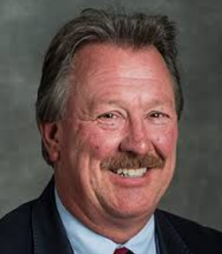
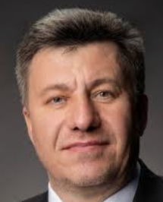
Snowmass’21 Accelerator Frontier
Co-Conveners
Steve Gourlay (LBNL)
Tor Raubenheimer (SLAC)
Vladimir Shiltsev (FNAL)
Focus
Understand the most important questions for the field of AS&T
Identify promising opportunities and tools to address them
Consider a mix of large, mid, and small scale accelerators as well as R&D
Provided information to P5 to help develop a strategy for US HEP

Slide 7
AF Topical Groups – See Snowmass21.org
AF1: Beam Physics and Accelerator Education
AF2: Accelerators for Neutrinos
AF3: Accelerators for EW/Higgs
AF4: Multi-TeV Colliders
AF5: Accelerators for PBC and Rare Processes
AF6: Advanced Accelerator Concepts
AF7: Accelerator Technology R&D
RF
Magnets
Targets & Sources

Slide 8
Goals of the AF Topical Groups
Each AF Working group will address the overall questions:
What accelerators & tools needed to advance the physics?
What is currently available (state of the art) around the world?
What new accelerator facilities could be available on the next decade (or next-next decade)?
What is the readiness and needed R&D to enable these future opportunities?
What are the time and cost scales of the R&D and associated test facilities as well as the time and cost scale of the facility?
The last two are hard questions with big impact on strategy development → created Implementation Task Force to develop metrics for guidance

Slide 9
European Planning
ESPP describes strategy for particle physics in Europe and their contributions world-wide
Immediate outcome → Accelerator R&D Task Forces reporting to Lab Directors Group (LDG) and CERN Council → report January, 2022
Address the question of what are the most promising Accelerator R&D activities for HEP
Snowmass AF participants are active on all the LDG panels

Slide 10
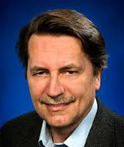
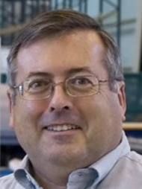
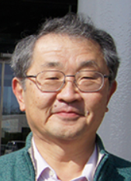
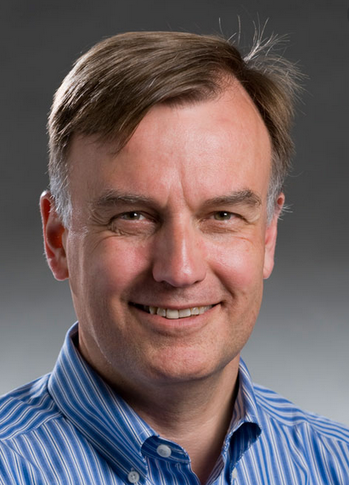
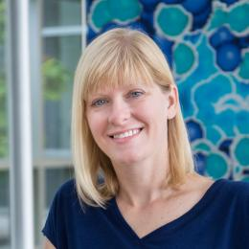
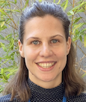
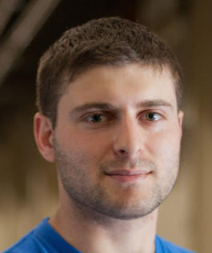
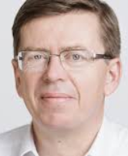
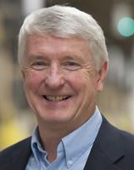
AF Implementation Task Force
Key question for Snowmass’21 Accelerator Frontier to address: “…What are the time and cost scales of the R&D and associated test facilities as well as the time and cost scale of the facility?”
A large number of possible accelerator projects: ILC, Muon Collider, gamma-gamma and ERL options, a large circumference electron ring, a large circumference hadron ring, and advanced concepts amongst others.
Comparison of the expected costs (using different accounting rules), schedule, and R&D status for the projects.
The ITF comprises of 12 world-renowned accelerator experts from Asia, Europe and US and two representatives of the Snowmass Young; it was chaired by Thomas Roser (BNL) and charged with developing metrics and processes to facilitate a comparison between projects
Thomas Roser (BNL, Chair)
Philippe Lebrun (CERN)
Steve Gourlay (LBNL)
Tor Raubenheimer (SLAC)
Katsunobu Oide (KEK)
Jim Strait (FNAL)
Sarah Cousineau (ORNL)
Marlene Turner (LBNL)
Spencer Gessner (SLAC)
Vladimir Shiltsev (FNAL)
Reinhard Brinkmann
(DESY)
John Seeman (SLAC)

Slide 11
Example of report from the ITF (on arxiv.org)
 | CME (TeV) | Lumi per IP (10^34) | Years, pre-project R&D | Years to 1st physics | Cost range (2021 B$) | Electric Power (MW)
FCCee-0.24 | 0.24 | 8.5 | 0-2 | 13-18 | 12-18 | 280
ILC-0.25 | 0.25 | 2.7 | 0-2 | <12 | 7-12 | 140
CLIC-0.38 | 0.38 | 2.3 | 0-2 | 13-18 | 7-12 | 110
HELEN-0.25 | 0.25 | 1.4 | 5-10 | 13-18 | 7-12 | 110
CCC-0.25 | 0.25 | 1.3 | 3-5 | 13-18 | 7-12 | 150
CERC(ERL) | 0.24 | 78 | 5-10 | 19-24 | 12-30 | 90
CLIC-3 | 3 | 5.9 | 3-5 | 19-24 | 18-30 | ~550
ILC-3 | 3 | 6.1 | 5-10 | 19-24 | 18-30 | ~400
MC-3 | 3 | 2.3 | >10 | 19-24 | 7-12 | ~230
MC-FNAL | 6-10 | 20 | >10 | 19-24 | 12-18 | O(300)
MC-IMCC | 10-14 | 20 | >10 | >25 | 12-18 | O(300)
FCChh-100 | 100 | 30 | >10 | >25 | 30-50 | ~560

Slide 12
State of Large-Scale Facilities
LBNF / DUNE Phase 1 will continue until early 2030’s
At that point, US could pursue LBNF Phase 2 or Energy Frontier
Multiple global options exist for Higgs factories that could be constructed: (ILC, FCC-ee, CEPC, CLIC)
Interest in mid-TeV colliders has declined but 10+ TeV is important
Environmental efficiency (carbon footprint) is increasingly important
LBNF Phase 2 would provide infrastructure for strong Muon Collider R&D program
Technology development is providing potential improvements, e.g. C³, HELEN, High Q₀ SRF, High η RF, … but need accelerator designs
European and Asian milestones will impact US choices
Technology and physics R&D is progressing and will provide options for accelerators in future decades

Slide 13
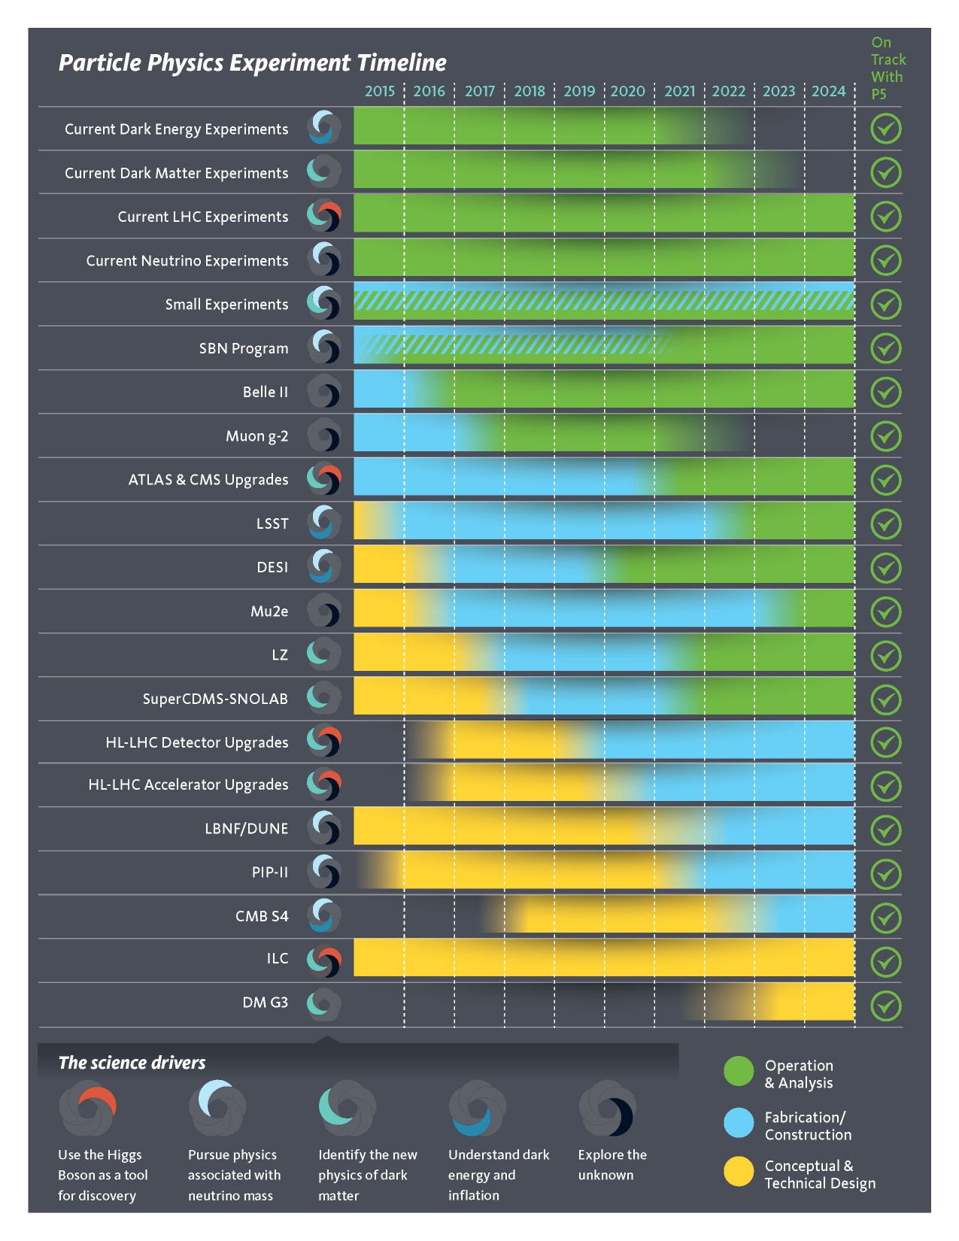
Proposals for P5 Consideration
P5 2014
In 2014 P5 considered a large suite of large and medium scale proposals
Most of these are in some state of progress
Relatively few new proposals are ready for consideration now → need to support R&D aimed at proposal develop...

Slide 14
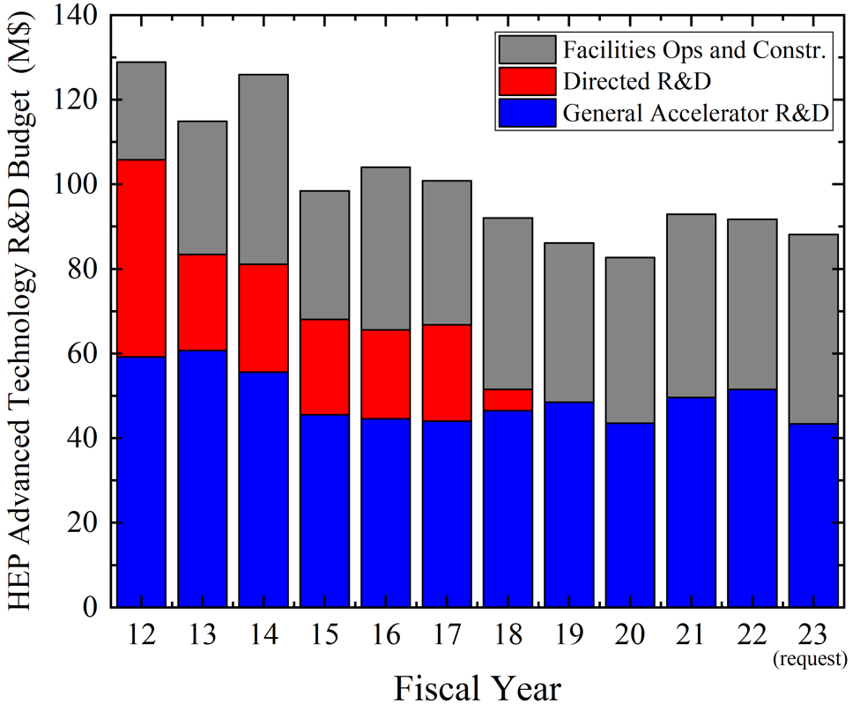
Future Colliders R&D Program – New Initiative
Completed:
US ILC
US LARP (LHC)
US MAP (Muon)
Accel. Test Facilities
Proposed
for FY24-30:
Future Colliders
.......
Integrated program:
FCCee, ILC, C^3, HELEN, Muon Collider, etc
https://arxiv.org/abs/2207.06213

Slide 15
AF Messages for Large-Scale Facilities
Options for the next US engagement include Intensity or Energy frontier
We need an integrated future collider R&D program (a focused R&D program in OHEP) to engage in the design and to coordinate the development of next generation collider projects such as: ILC, CLIC, FCCee, CCC/HELEN, multi-TeV Muon Collider.
We have and need to keep an active R&D program in labs and universities aimed at general accelerator R&D that is critical in developing technologies and options for future HEP accelerators (but does not develop accelerator proposals).

Slide 16
Where is the Opportunity for AAC?
Lots of great ideas!
Continue to publish excellent work
Work at understanding how new ideas could be implemented in real accelerators
Develop self-consistent parameter sets, e.g. parameters that address known physics limitations
Everybody is overwhelmed so engage the broader community
Solidify demonstrations, pushing beyond conceptual demonstration into pragmatic regimes
Illustrate the performance and cost benefit of new approaches that provides clear motivation for AAC
Engage DOE OS in broader impact and needs of AAC

Slide 17
Accelerator Costs - more than just length
Developed the PWFA-LC model to understand issues and cost scaling
Costed bottoms up using ILC WBS → linac was 50% ILC w/o plasma cells (25% savings)

Slide 18
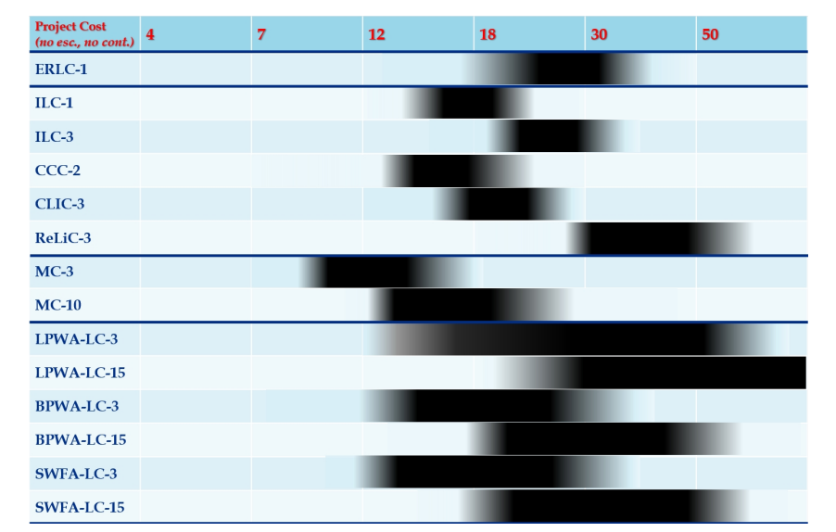
ITF Parametric Costing Model

Slide 19
Summary
Snowmass was very exciting with great participation across the field
Strong interest in options for US accelerators especially from ‘younger’ generation
Collider R&D program aimed at near-term proposals seemed to gain traction….P5 will evaluate
AAC has an opportunity to develop self-consistent parameter sets and illustrate the performance and cost benefits while continuing to publish excellent science

Slide 20
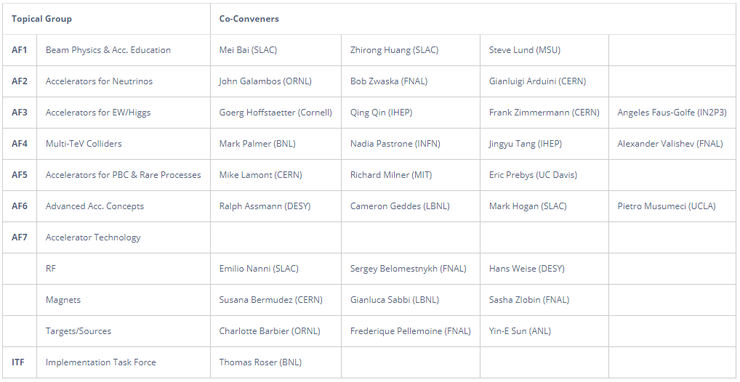
Thanks to the AF TG Convenors and Participants!
Questions?

