Slide 1
The DOE HEP General Accelerator Research & Development (GARD) Program -- A Retrospective View
L.K. Len

Slide 2
Disclaimer
I do not represent DOE Office of High energy Physics
I do not speaks for the HEP GARD Program
Any opinion expressed is my own

Slide 3
Types of Accelerator R&D at DOE
Near-term R&D — to optimize operating facilities or planned new facilities / projects.
Medium-term R&D — to bring new concepts to practice so that they can be considered for the design of new facilities.
Long-term R&D — to explore and develop new concepts for future accelerator facilities and applications.
To understand the types and scope of R&D supported by GARD, it is informative to look back at how the program evolves.

Slide 4
HEP/GARD: History and Evolution (1)

Slide 5
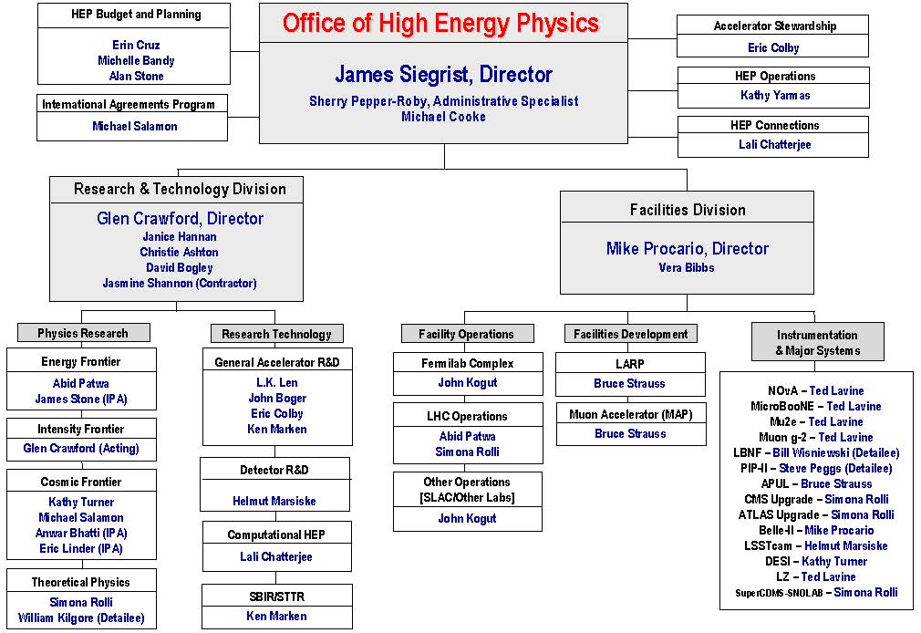
HEP/GARD: History and Evolution (2)

Slide 6
HEP/GARD: History and Evolution (3)
Moved to ARDAP
Directed
R&D

Slide 7
Program Management
Adv. Tech R&D
- Acc. Science
- Acc. Development
- Directed R&D
- SBIR/STTR
GARD
Directed
R&D
SBIR/STTR
Collectively Managed
More flexible
Separately Managed
PM Control
Accountability

Slide 8
The HEP GARD Program
GARD funds medium and long term accelerator R&D primarily aimed at supporting the High Energy Physics mission.
Medium term (directed) accelerator R&D refers to work performed in the support of possible new facilities or upgrades to existing ones. This applies to facilities that possess a reasonable conceptual idea for implementation.
Long-term (generic) accelerator R&D refers to the development of ideas and underlying technologies that could support facilities for which we do not currently have an integrated implementing concept.
GARD Research Thrusts:
Advanced Accelerator Concepts
Accelerator and Beam Physics
Includes beam instrumentation and controls
Particle Sources and Targets
RF Acceleration Technology
Includes RF sources, NCRF and SRF R&D
Superconducting Magnets and Materials
Other - Facility Ops, DOE Accelerator Traineeship, US-Japan and ILC Cost-reduction R&D Programs

Slide 9
GARD Thrust Management
Thrusts are not fenced
Program maintains budget discretion

Slide 10
GARD Research – % By Thrusts (2021)

Slide 11
GARD Funding History
Accelerator Stewardship
Spun off

Slide 12
GARD Funding History

Slide 13
GARD Research Funding History

Slide 14
Research Opportunities
GARD & Stewardship user/test facilities available users and collaborators:
— ATF and FACET-II are National User Facilities.
New users can join existing collaborations or submit experimental proposals for PAC approval.
— AWA, BELLA, FAST-IOTA, NLCTA, Magnet/SRF Test Stands:
New users can collaborate with lab in-house research programs/groups
For BELLA, users can also participate through FES (BELLA-I and LaserNetUS)
 | Acc & Beam Physics | Adv Acc Concepts | Particle Src & Targetry | RF Acc Technology | Supercon Mag/Mat’l | User & Test Facility Ops
ANL | ✓ | ✓ |  | ✓ |  | ✓
BNL | ✓ | ✓ |  |  | ✓ | ✓
FNAL | ✓ |  | ✓ | ✓ | ✓ | ✓
LBNL | ✓ | ✓ |  | ✓ | ✓ | ✓
SLAC | ✓ | ✓ |  | ✓ |  | ✓

Slide 15
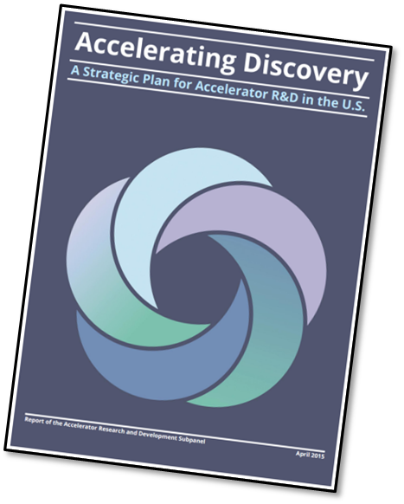
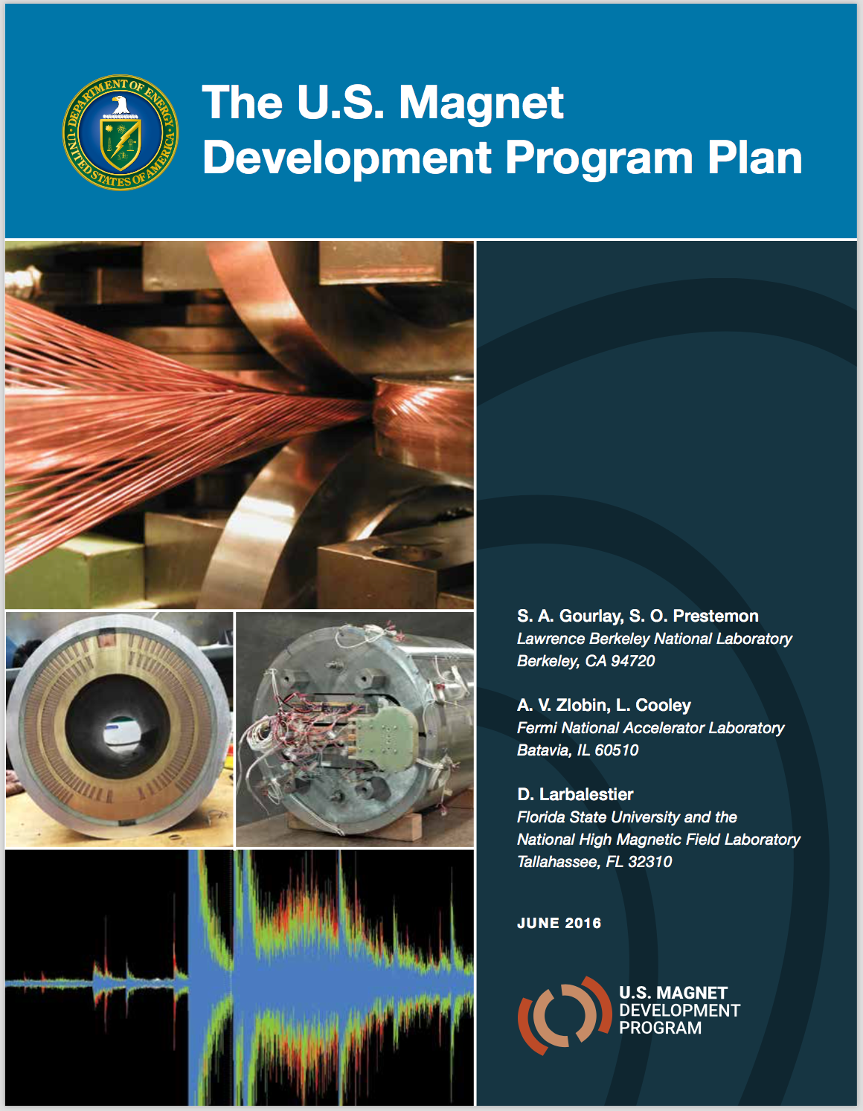
GARD Strategy
Supports DOE-HEP Mission —Carry out R&D that will advance the state-of-the-art in particle accelerators, which will lead to new, more capable facilities.
Executes P5 Strategy —Recommends that GARD focus on Advanced Technology R&D strategy to increase performance and dramatically improve cost effectiveness.
HEPAP Accelerator R&D Subpanel (ARDS) —Provided prioritization advice on medium and long term accelerator R&D.
GARD Research Roadmaps —Provide challenging, HEP-relevant topics, goals and timeline with milestones:
Advanced Accelerator Development Strategy Report
U.S. Magnet Development Program Plan (and subsequent update)
RF Accelerator R&D Strategic Report
Coming soon –Accelerator and Beam Physics Report and Particle Sources and Targetry Workshop

Slide 16
Specific Strategy Recommendations
HEPAP P5 Subpanel – The 2014 P5 recommended moving forward with a focused Advanced Technology R&D strategy.
Play a leadership role in superconducting magnet technology focused on the dual goals of increasing performance and decreasing costs
Pursue accelerator R&D with a focus on outcomes and capabilities that will dramatically improve cost effectiveness for mid-term and far-term accelerators
HEPAP Accelerator R&D Subpanel (ARDS) – The 2015 ARDS (charged by HEPAP to identify the most promising accelerator research areas to support the advancement of HEP) rolled out its report with 25 recommendations.
Provides prioritization advice to GARD on accelerator R&D towards the Next Steps [Medium-term] and Further Future [Long-term] accelerators
Advanced Accelerator Concepts: 6
Accelerator and Beam Physics: 4
Particle Sources and Targetry: 1
RF Acceleration Technology: 5
Superconducting Magnets and Materials: 9

Slide 17
ARDS Recommendations: AAC
Supports development of the most promising concepts toward far-term accelerators as envisioned by P5
Vigorously pursue particle-driven plasma wakefield acceleration of positrons at FACET in the time remaining for the operation of the facility. Between the closing of FACET and the operation of a follow-on facility, preserve the momentum of particle-driven wakefield acceleration research using other facilities.
Support LWFA experiments on BELLA at the current level.
Reduce funding for direct laser acceleration research activities.
Convene the university and laboratory proponents of advanced acceleration concepts to develop R&D roadmaps.
Hasten the realization of the accelerator of P5’s medium-term vision for discovery: a very high-energy proton-proton collider, and the realization of the accelerator of P5’s long-term vision for discovery: a multi-TeV e+e- collider.
Develop, construct, and operate a next-generation facility for PWFA research and development, targeting a multi-TeV e+e- collider, in order to sustain this promising and synergistic line of research after the closure of the FACET facility.
✔

Slide 18
Roadmap Development Process
Begins with preparatory workshops organized by the research community
Involves a broader community participation
Gathers input from researchers supported by GARD as well as other related programs
Identifies HEP program needs
Explores potential synergies with other GARD thrusts and other related programs
Avoids duplications
Culminates with a DOE-organized workshop with a committee consisting of members of agency and GARD stake-holders
Extracts HEP-relevant research scope from input from preparatory workshops
Prioritizes recommended research
Develops research timeline with goals and milestones
Generates a strategic research roadmap report for the GARD thrust
PIs and program managers can use report to articulate for research funding support.

Slide 19
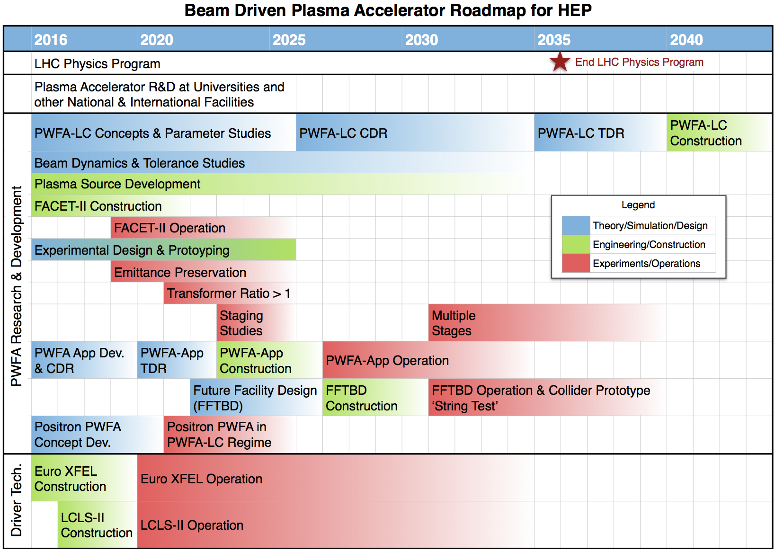
AAC – Research Roadmaps (PWFA)
Completed
in 2021 - now
operating
New Grant
Awards

Slide 20
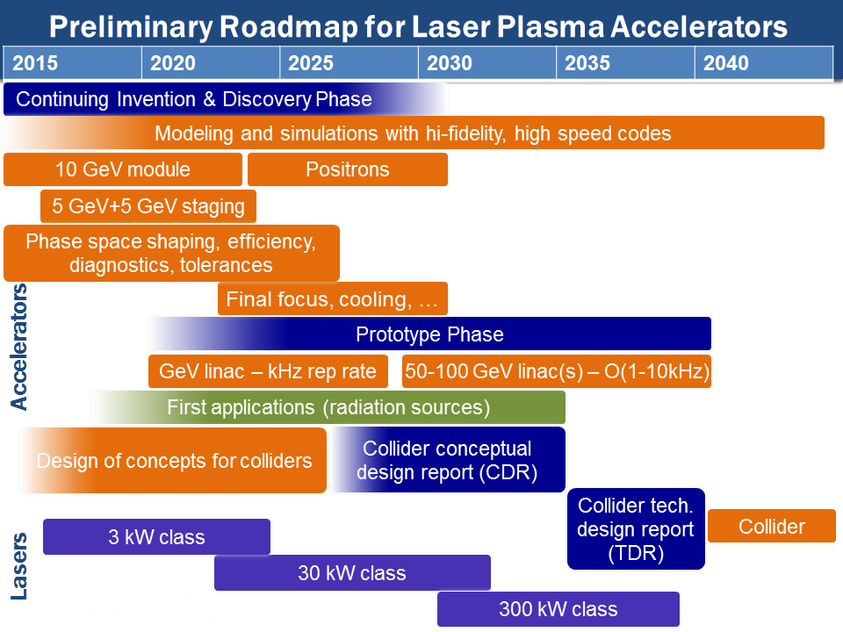
AAC – Research Roadmaps (LWFA)
BELLA 2nd
Beamline - 2021
installed
New Grant
Awards

Slide 21
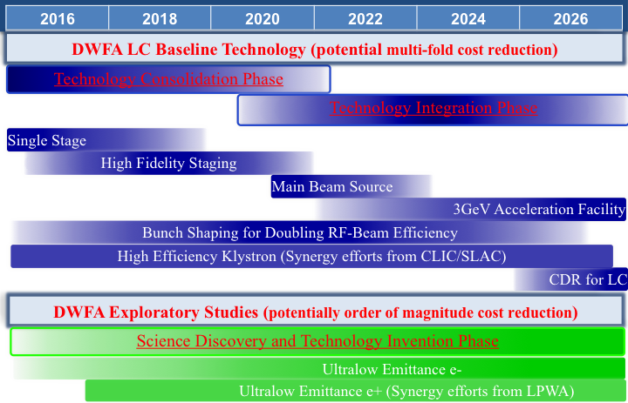
AAC – Research Roadmaps (DWFA)
Continuing
facility
upgrading
New Grant
Awards

Slide 22
Benefits of AAC Roadmap Exercise
Identifies common challenges in the thrust:
Higher energy staging of electron acceleration with independent drive beams, equal energy, and 90% beam capture;
Understanding mechanisms for emittance growth and developing methods for achieving emittances compatible with colliders;
Completion of a single electron acceleration stage at higher energy;
Demonstration and understanding of positron acceleration; and
Continuous, joint development of a comprehensive and realistic operational parameter set for a multi-TeV collider, to guide operating specifications for AAC.
Presents a clear view of current and future needs
Provides an easy way to check progress
Allows PIs to identify areas where they can contribute
Aligns research strategy with the HEP program

Slide 23
Funding Opportunities
HEP Funding Opportunity Announcement webpage: https://science.osti.gov/hep/Funding-Opportunities Annual (or quasi-annual) FOAs include—
Research Opportunities In High Energy Physics (aka: HEP Comparative Review FOA) (This is the main FOA for HEP grantees)
Continuation of Solicitation for The Office of Science Financial Assistance Program (HEP uses this only for special requests)
Early Career Research Program
Research Opportunities in Accelerator Stewardship
DOE Traineeship In Accelerator Science & Engineering
Quantum Information Science
SciDAC
and National Lab Announcements include—
U.S.-Japan Science and Technology Cooperation Program In High Energy Physics
Artificial Intelligence and Machine Learning

Slide 24
How to help?
Participate in HEP process—
Provide sound programmatic input and feed back
Get involved in HEP strategy planning: —Snowmass —P5 (Particle Physics Project Priority Panel) —HEPAP (High Energy Physics Advisory Panel) and its subpanels —GARD workshops: basic needs, research roadmaps, or refresh
Contribute to realize GARD Roadmap goals: —submit good proposals via DOE Funding Opportunity Announcement —exploit GARD user/test facilities —collaborate with GARD programs at the labs
Help maintain GARD program quality: —participate in HEP program reviews —agree to review GARD proposals, either as a mail-in or panel reviewer

Slide 25
Summary
The GARD program
has evolved through consolidation and spin-off
supports a broad spectrum of R&D in accelerator science and technology
implements recommendations from advisory panels (within budget & prog. constraints)
develops and refreshes research roadmaps for its research thrusts
develops user/test facilities and supports their operations
encourages collaboration and exploitation of its facilities at the Labs
encourages taking advantage of all Funding Opportunities
welcomes input that can improve the overall program

Slide 26
Thank you!

Slide 33
GARD vs Accelerator Stewardship
GARD (General Accelerator Research and Development)
— Funds accelerator R&D primarily aimed at supporting the High Energy Physics mission. However, very often the long-term generic work will also benefit other applications, and, in a sense, this can be regarded as “accelerator stewardship” (lower case!)
Accelerator Stewardship
— It is a separate, congressionally-authorized program that funds R&D that predominantly impact non-HEP applications, and that has an identified non-HEP stakeholder.

