Slide 1
Opportunities and Issues with the Unitary Particle Pusher
  Daniel Gordon, Bahman Hafizi, Dan Younis
Advanced Accelerator Concepts Workshop, Hauppauge, NY
November 6-11, 2022
Distribution A. Approved for public release.

Slide 2
Quick Survey
This work extends:
D. Gordon et al., AIP Proc. 1812, 050002 (2017)
D. Gordon et al., Comp. Phys. Comm. 258 107628 (2021)
Other literature on improving the particle advance:
J.-L. Vay, Phys. Plasmas 15, 056701 (2008)
A. Arefiev et al., Phys. Plasmas 22, 013103 (2015)
Higuera and J. Cary, Phys. Plasmas 24, 052104 (2017)
F. Li et al., J. Comp. Phys. 438, 110367 (2021)

Slide 3
Issues with ultra-relativistic particle advances
In the ultra-relativistic region we have a new type of accuracy condition
(F = F_{E} + F_{B})
Because of the commutators, no scheme that factorizes electric and magnetic contributions to the Lorentz force can overcome this limit (e.g., Boris scheme).
Namely, something like this will never work well:
(new momentum) = (add impulse) (rotate about B) (add impulse) (old momentum)

Slide 4


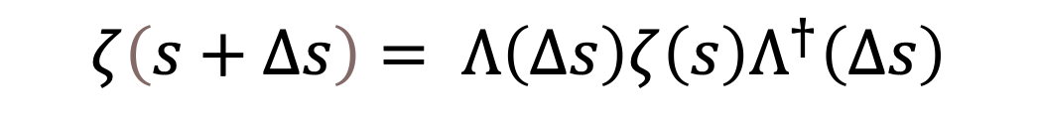
Special Unitary Particle Pusher
By making use of the spinor representation of a four-vector, an exact time translation in an arbitrary uniform field can be compactly written
spinor form of the four-momentum
time translation operator
Minkowski-type angle
$$ζ\left(s+∆s\right)= Λ\left(Δs\right)ζ\left(s\right)Λ^{†}\left(∆s\right)$$

Slide 5
Conservative Expansion Method
We would like to exactly conserve certain quantities
Since this is exact it respects all invariants;
however truncation does not
This form does respect invariants to round-off
Invariance of Minkowski norm
Invariance of energy in static B-field
Invariance of γ – p_{z} in a plane wave

Slide 6

Specific Expansions
Quadratic in time step, no special functions or roots, invariance properties accurate to round-off.
N.b. overall advance is quartic.
These are merely 2x2 matrix operations, easy to program
Interesting note: in a plane wave Ψ∙Ψ = 0, and the lowest order truncation is actually exact!
Lowest order - exact in a plane wave

Slide 7


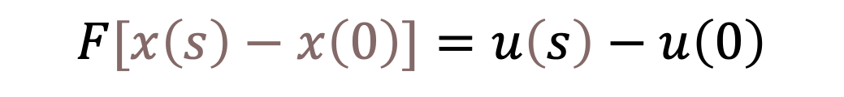
Position Update
Spinor representation of spacetime coordinate:
Exact solution:
$$λ\left[θ\left(s\right)−θ\left(0\right)\right]+[θ\left(s\right)−θ\left(0\right)]λ^{†}=ζ\left(s\right)−ζ\left(0\right)$$
Compare with vector form (cf. Schwinger 1951 eq. 3.3):
$$F[x\left(s\right)−x\left(0\right)]=u\left(s\right)−u\left(0\right)$$
(Li et al. use a Taylor expansion of this)
There are some pathologies in the exact expressions, best to use expansion

Slide 8
Possible Issues
Notice round-off can affect diagonal. So far no noticeable issues.
Kinetic energy can come out negative since energy and momentum are updated independently, or put another way, γ ≥ 1 only holds to within a round-off error. So far no noticeable issues.
Is there a directional bias? Since the whole formulation is Lorentz invariant, any directional bias can only be due to round-off error.

Slide 9
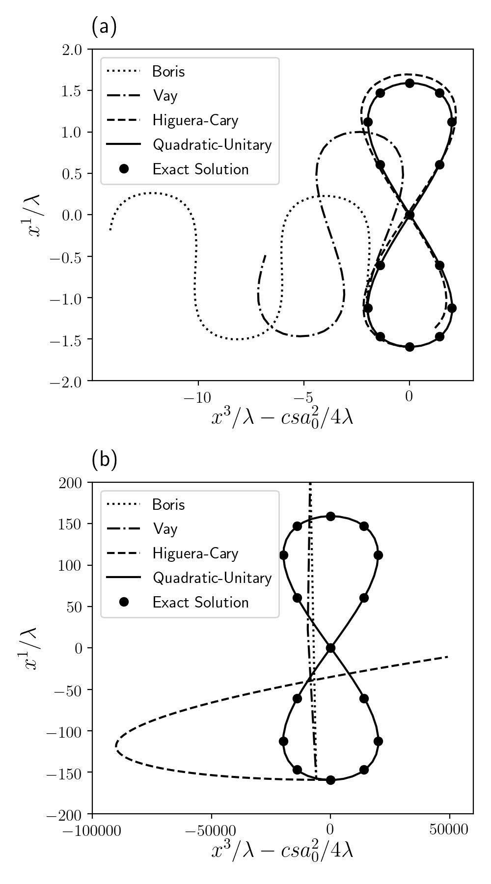
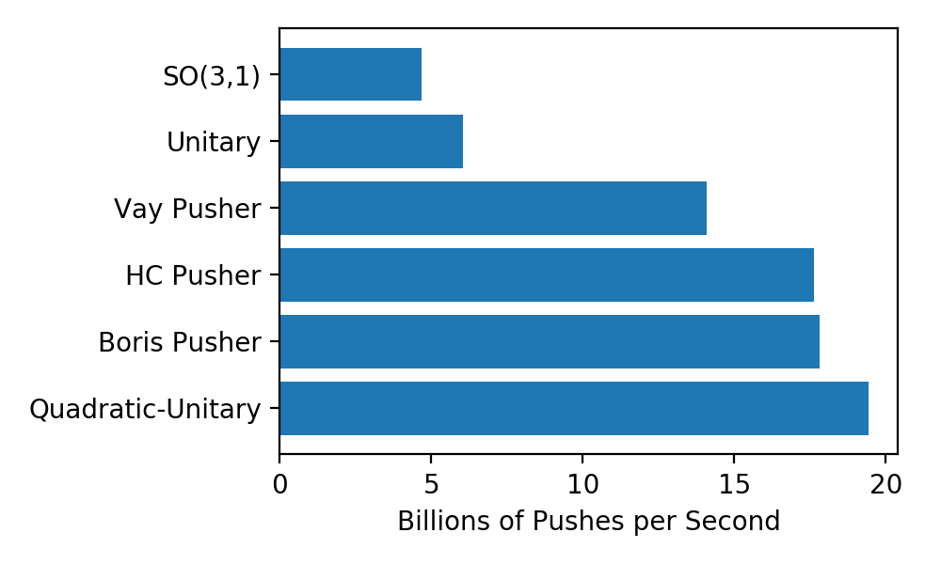
Comparison of Various Methods
Performance on Titan V
a=10
(prescribed fields)
a=1000
63 steps per period in the particle’s frame

Slide 10
Test case for tunneling ionization of H-like argon
Steps to go through 360 deg of phase

Slide 11
Synchronizing particles for PIC applications
Require a time dilation estimate for each particle
In the spinor view we have
In general this leads to a root-finding problem. A simple estimate is
This is used in all that follows, but a more accurate estimate is being put in

Slide 12
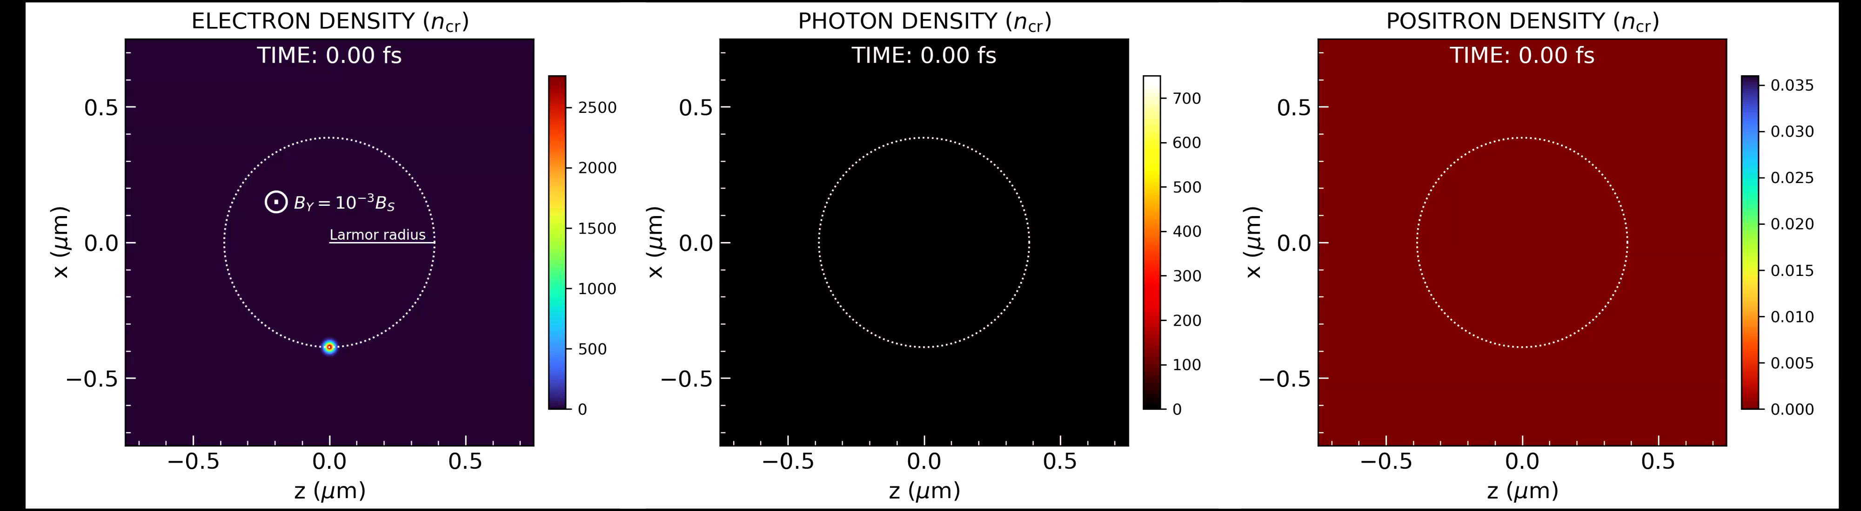
turboWAVE QED Module Example: uniform QED-scale magnetic field
Load Gaussian electron bunch with γ=1000 into B=B_{S}/1000

Slide 13
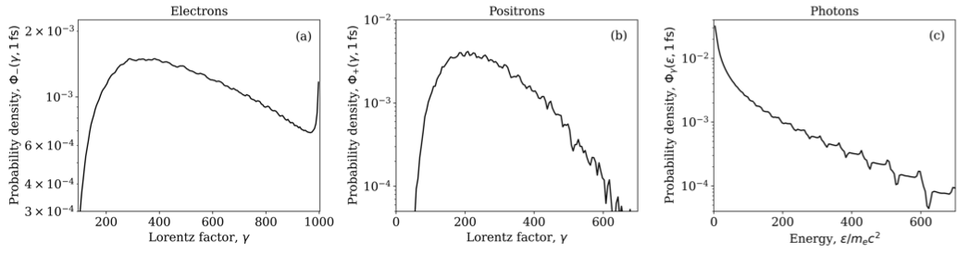
turboWAVE QED Module Benchmarking
Cf. similar figure in J. Comp. Phys. 260, 273 (2014)

Slide 14
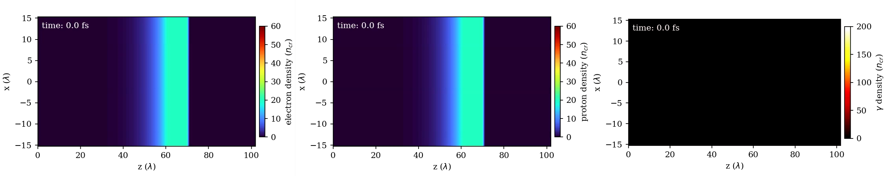
QED-PIC example with unitary pusher
Example showing gamma generation with multi-PW pulse and thin target
Laser parameters
a = 380, I = 2e23 w/cm²
λ = 1 um, τ = 30 fs, r = 5 um
Plasma parameters
Pre-plasma = 40 um
Slab = 10 um
n = 20n_{crit}

Slide 15
Summary
Unitary Pusher has been developed and implemented in turboWAVE
This respects important invariance properties even when truncated
Pusher is fast
QED-PIC simulations are a natural application
So far everything working satisfactorily
Time dilation estimate is being improved

