Slide 1
Energy Modulation in a Commercial Dual Grating Dielectric Laser Accelerator
Sophie Crisp
AAC 2022
November 9th, 2022
Notes:
Add the logos

Slide 2
Acknowledgements
Thank you to:
Pietro Musumeci (UCLA)
Alexander Ody (UCLA)
Joel England (SLAC)
Kenneth Leedle (Stanford)
Eric Cropp (UCLA)
David Cesar (SLAC)
Notes:
Stanford, SLAC logos

Slide 3
Outline
Motivation: Why Dielectric Laser Accelerators
Overview: Progress and plans for multi-MeV energy gain
Results: Modulation in a commercial grating structure

Slide 4
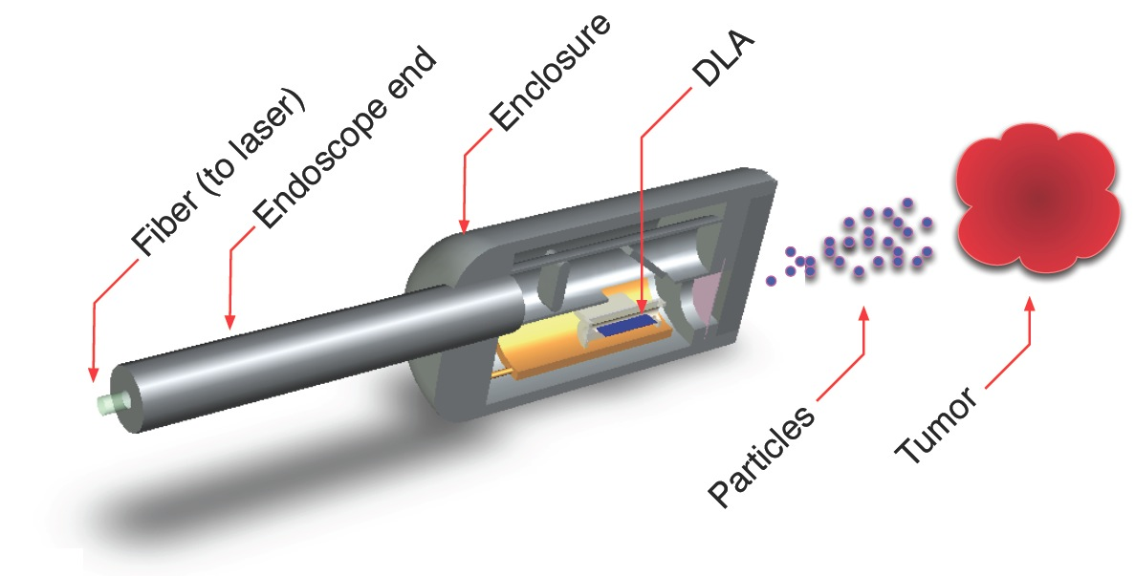
The Case for Smaller Accelerators
Many applications for a compact, ultrafast source:
Catheterized high energy electron source
UED/UEM Source
Compact incoherent x-ray source
Why DLA?
Silicon manufacture is ubiquitous
High damage threshold leads to GeV/m gradients
Laser technology readily available
Inexpensive
England et al., Rev. Mod. Phys. 86, 1337 (2014)
England et al., “Dielectric Laser Accelerators”, Snowmass AF6 Meeting (2020)
Notes:
DLA Features:
Compactness (cm Scale)
Efficiency (solid state lasers)
Bunch Format (fC charge, MHz rep rate)
Attosecond Time Scale – intrinsic optical bunching
DLA for HEP:
Works for positrons, better bremsstrahlung, efficiency
https://indico.fnal.gov/event/45651/contributions/197917/attachments/134830/166994/Snowmass_AF6_DLA_England.pdf
Linear Collider:
Key Advantages of Dielectric Laser Accelerator
Linear acceleration mechanism in a static structure with vacuum channel.
Critical technologies (laser development, nanofab) already near LC requirements.
Unique bunch format (fC charge at 10 to 50 MHz rep rate) with beamstrahlung loss ~ 1%
High fiber laser efficiencies (30 to 50% wallplug) facilitate modest power consumption.
tors (DLA) for e+e- linear collider (LC):
Primary Challenges for a DLA Collider:
Small beam apertures à challenge with regard to wakes, halo, and long-distance transport.
Need high-rep (10 – 50 MHz) low charge (fC) normalized emittance (< 1 nm) e- and e+ sources.
Funding for this area of research is not directly focused on HEP applications.
Takeaway Points:
DLA has compelling advantages that position it as a competitive LC technology
Requirements of a LC impose major technical challenges for all advanced concepts
DLA’s challenges are distinct from other concepts but not necessarily less surmountable

Slide 5
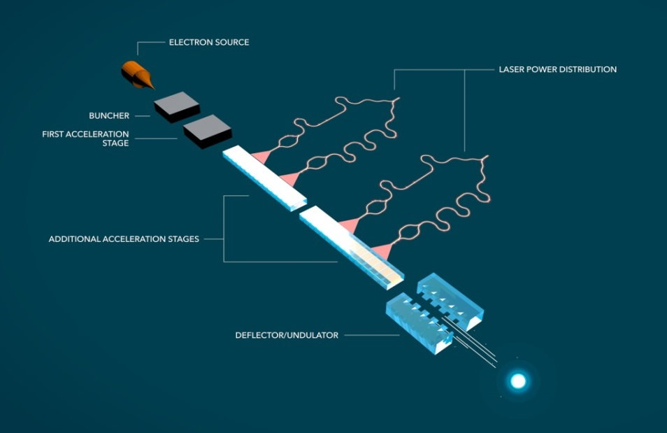
Overview of a Dielectric Laser Accelerator
Hirano et al., “A compact electron source for the dielectric laser accelerator”, Appl. Phys. Lett. (2020)
Schonenberger et al., “Generation and Characterization of Attosecond Microbunched Electron Pulse Trains via Dielectric Laser Acceleration”, Phys. Rev. Lett. 123, 264803 (2019)
Black et al., “Net Acceleration and Direct Measurement of Attosecond Electron Pulses in a Silicon Dielectric Laser Accelerator”, Phys. Rev. Lett. (2019)
Niedermayer et al., “Three Dimensional Alternating-Phase Focusing for Dielectric-Laser Electron Accelerators”, Phys. Rev. Lett., 125, 164801 (2020)
Sapra et al., “On-chip integrated laser-driven particle accelerator”, Science, 367, 6473 (2020)
From SLAC newsroom: “$13.5M Moore Grant to Develop Working ‘Accelerator on a Chip’ Prototype” (November 19, 2015)
Notes:
Aim to achieve entirely on-chip electron source to relativistic electron
So far, each step is being researched independently
Relativistic regime demonstration remains critical to demonstrate scalable accelerator
This is a quick overview of the final concept design of a Dielectric Laser Accelerator. The idea is that you have an entirely on chip electron source by way of nanotips, then a buncher and first accel stage. The buncher and first accel are separated because in the non-relativistic regime maintaining the laser field in sync with the electrons as they swiftly accelerate is extremely difficult. In fact, the part of ACHIP tasked with pursuing this regime is aiming for energy doubling within the next year, from around 100 to 200 keV, but this will merely be a proof of concept for future non-relativistic work. After this, the relativistic regime will require a complex waveguide system to allow power distribution to the accelerator structure. The actual relativistic acceleration component is the subject of this presentation, but research into power distribution is also ongoing.
In Practice, the relativistic structures we are going to talk about today are mostly dual grating structures, illuminated on top by a pulse front tilted IR laser. This PFT provides the necessary phase velocity matching, such that a slice of the electrons travelling through the structure will feel the effects of the laser pulse. These structures tend to be judged by their total energy gain, their ability to couple the incoming laser power to the electron acceleration, and finally when dynamic effects come into play, by their capture rate.

Slide 6
Single Side Illuminated Long Interaction DLA Geometry
Overhead
Laser, ~100fs
DLA
DRZ
$$θ_{PFT}$$
E₀
k₀
e-
y
x
g (= 400, 800 nm)
e-
z
z

Slide 7
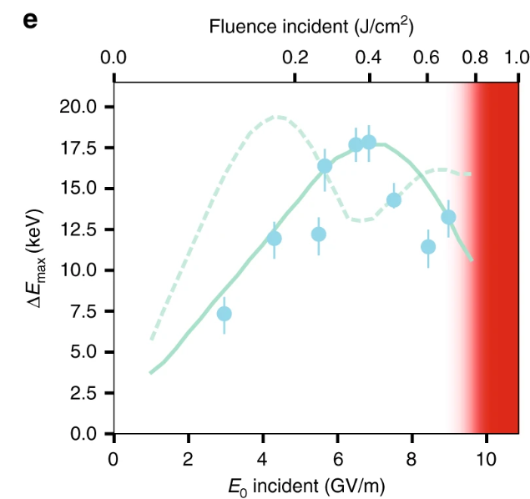
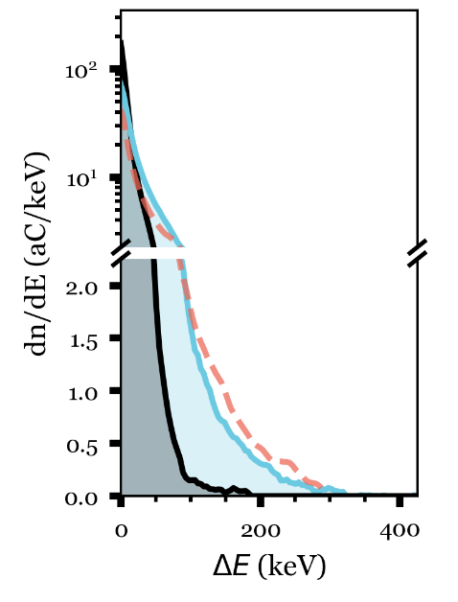
Previously, Record Energy Gain, Gradient Reached at UCLA
315 keV energy gain
700 um Interaction Length
1.8 GeV/m Peak Gradient
E₀
k₀
D. Cesar et al. Opt. Exp., 2018
D. Cesar et al. Communications Physics, 2018
Notes:
PFT imperative to accelerating over long length scales. Previously, 315keV was measured. We seek to reach 1MeV, which will require a much longer interaction. Longer interactions require a number of changes, some simple, like increasing the energy via a new laser, and some more complicated, obtaining a structure longer than 1mm with the requisite gap, 800 nm, and compensating for dynamic effects in this energy regime.
Our goal is to extend this interaction length beyond 1mm, and towards 2cm. This requires

Slide 8
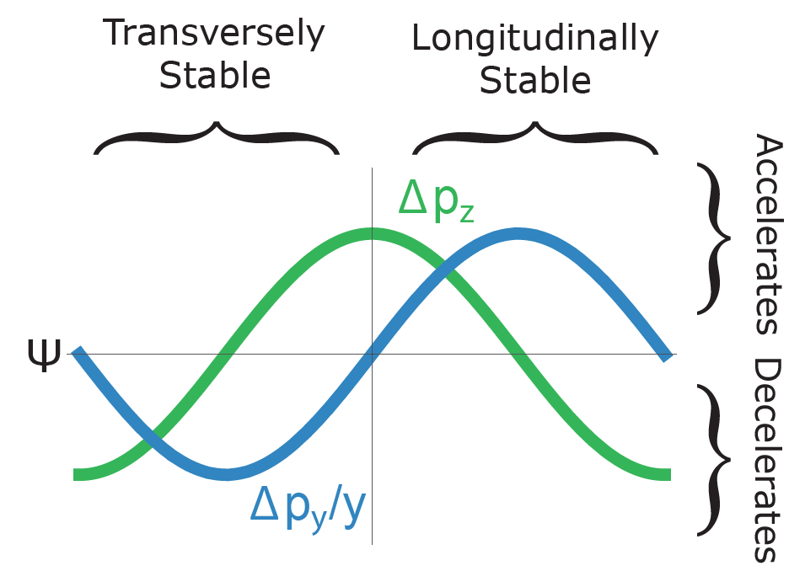
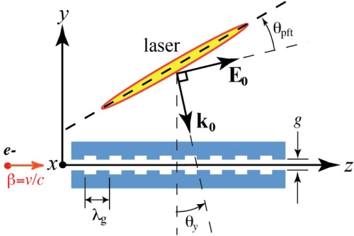
Limiting Factors for MeV Energy Gain
Laser-electron interaction time
Total structure length
Dynamic effects – over longer lengths, e- will defocus
1mm

Slide 9
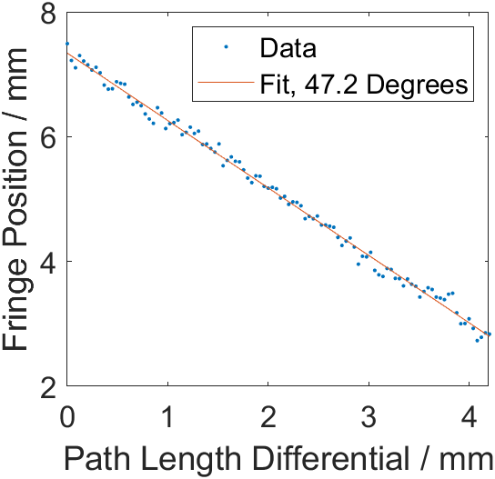
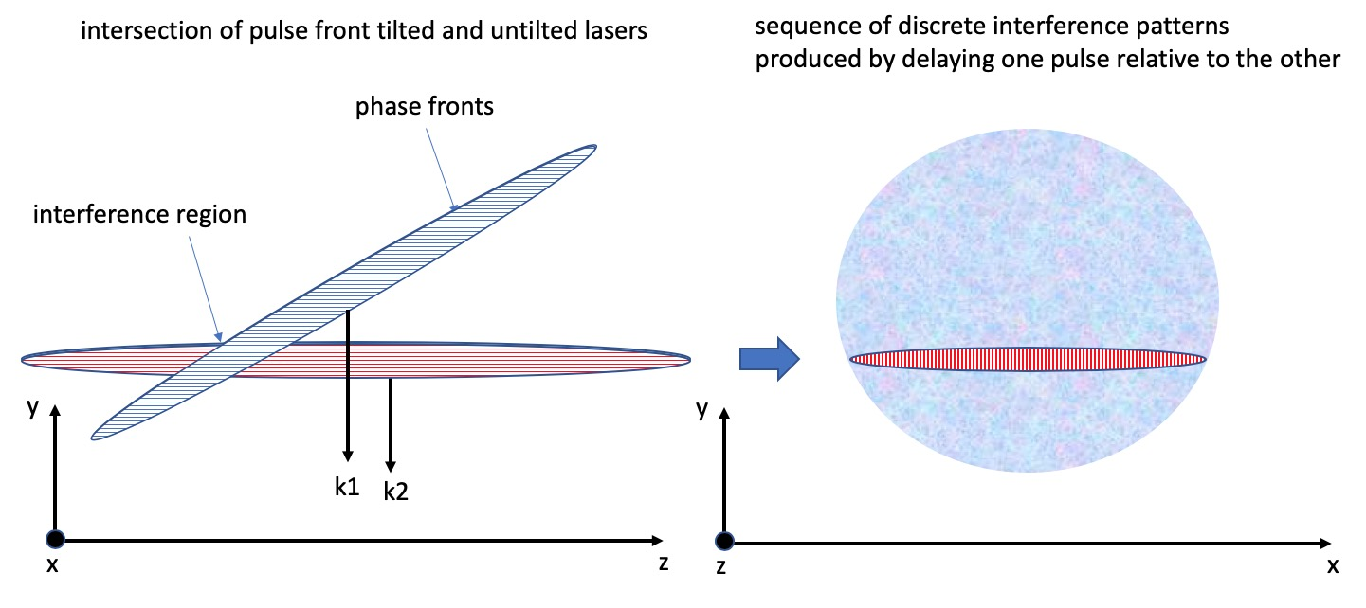
Pulse Front Tilt Measurement Over 4.2mm
Pulse front tilt (PFT) created by grating imaged onto DLA plane
Angle determined by system magnification -> lens positions controlled by desired overall magnification and damage concerns
Fringe Position
Graphic: Joel England
Notes:
Fringe Movement
Interferometry
How SLM works

Slide 10
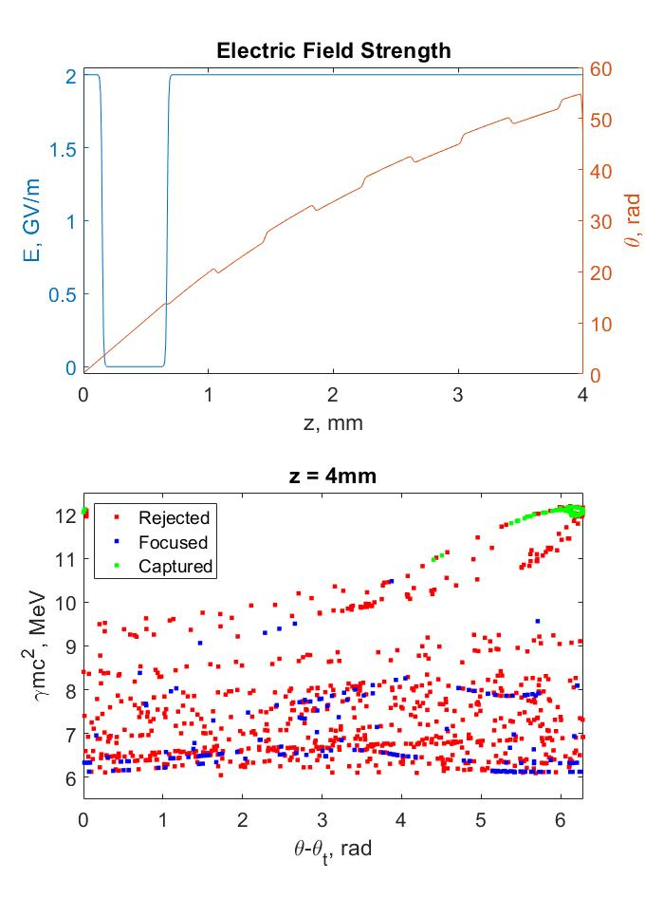
Alternate phase focusing allows acceleration over mm-scale interactions
Spatial Harmonic based simulation code to test possible phase and amplitude modulation
Based on Ody, A et al., NIMA, 1013, 165635 (2021) and Niedermayer et al., Phys. Rev. Lett., 121, 214801 (2018)
Parameter | Value
Initial Energy | 6.5 MeV
Emittance | 0.5 nm
Laser Wavelength | 780 nm
Peak Field | 2 GV/m
Buncher Length | 0.15 mm
Resonant Phase | -$π$/4
Energy Gain | 4.8 MeV
Percent Capture | <7%
Notes:
Ody, A et al., NIMA, 1013, 165635 (2021)
Site uwe, too
If there is no phase modulation, capture rate is 0; some particles are focused, but none reach the top energy

Slide 11
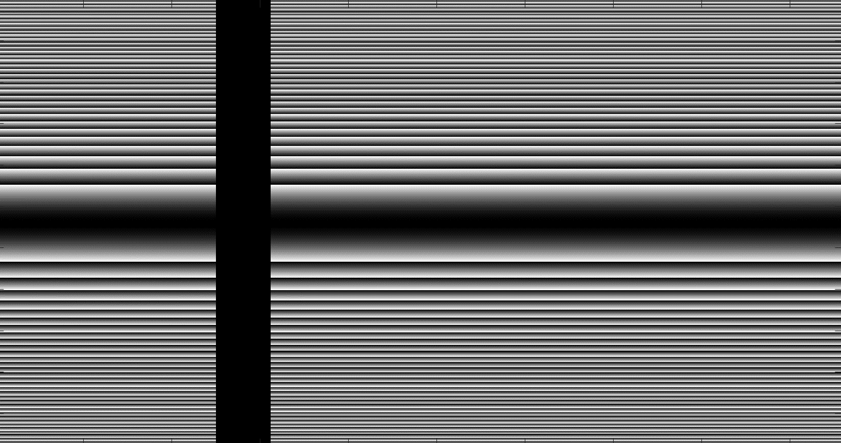
Soft Tuning of Phase and Amplitude
Grating profile is imaged onto spatial light modulation (SLM), and then sample plane, for requisite pulse front tilt
Liquid crystal mask is imaged in the electron travel direction, so any profile can be transported to the electrons
By not imaging in the transverse dimension, we can introduce amplitude modulation
Drift
Fresnel Lens
Grating
Lens
SLM
20mJ
Ti:Sapphire
12 m
Transport
DLA Plane
Telescope

Slide 12
Ingredients for a Multi-MeV DLA Experiment
Structure
Pulse front tilt demonstrated over 4.2mm
Alternating phase focusing (APF) scheme to compensate for defocusing effects
Spatial light modulator to allow soft tuning of phase and amplitude profile
Z

Slide 13
Extending Structure Length Proved Non-Trivial
Thin film interference shows bonding was non-uniform, introducing many microns of separation

Slide 14
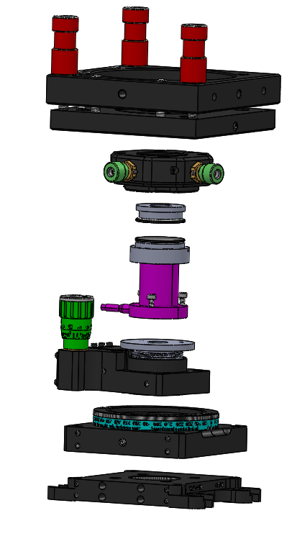
4mm Grating Structures Have Been Assembled
Commercial gratings are mounted entirely independently
Lower grating is mounted on a 3-piezo stage with 12um total travel, to nm precision alignment
Grating periodicity: 800nm
Course x’,y’,z’
Course xy,z
Fine x,y,z, x’,y’,z’ (12um range)
Relative Rotation
4mm
4mm
Notes:
Explain why we’ve gone down the route of assembling the structures ourselves – difficulty of bonding the structures; only functional structures were Peralta’s. In correspondence with Stanfrod on how best to go about this route. Hoping to put this assembly in the box for live alignment.
Flatness established via coarse cage alignment and 3 12 um range PI piezos by removing visible fringes
Lack of fringes indicates <0.02 mrad flatness, 20 nm deviation along 1 cm window

Slide 15
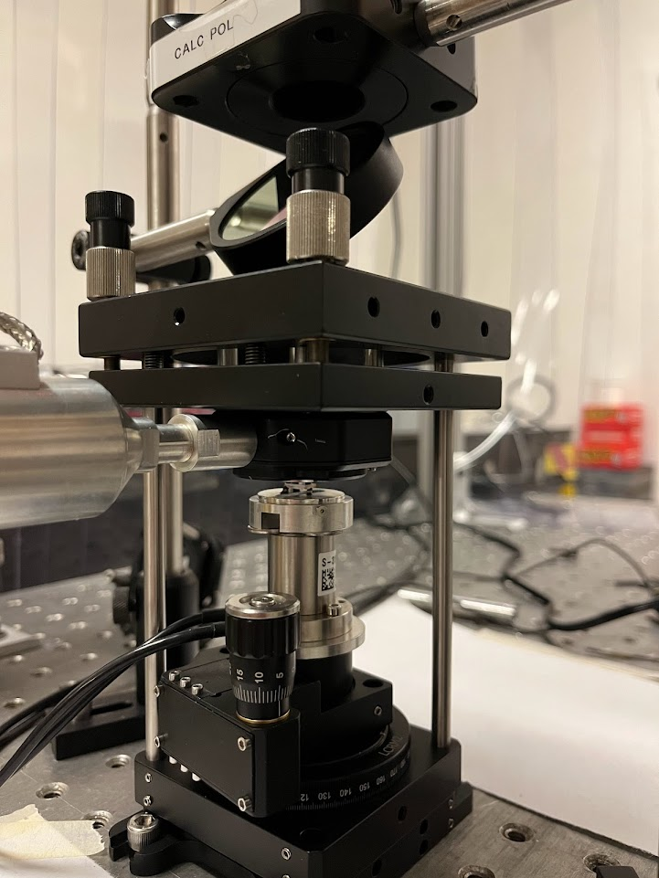
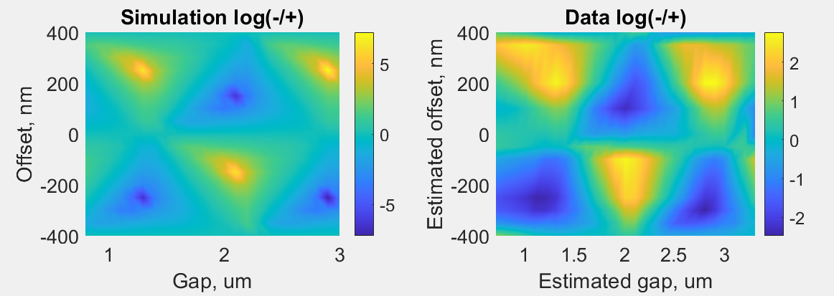
Structures are Characterized Optically
Diffraction based diagnostic using the ratio of m = $±$ 1 diffraction orders
Notes:
Only two plots, plus structure factor sim (define structure factor)

Slide 16
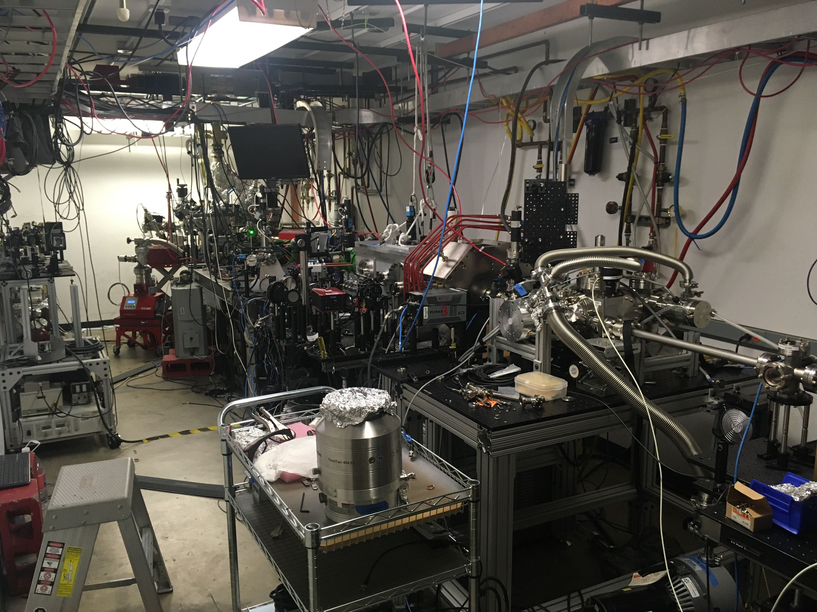
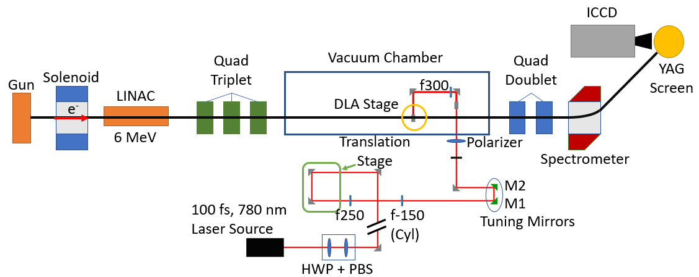
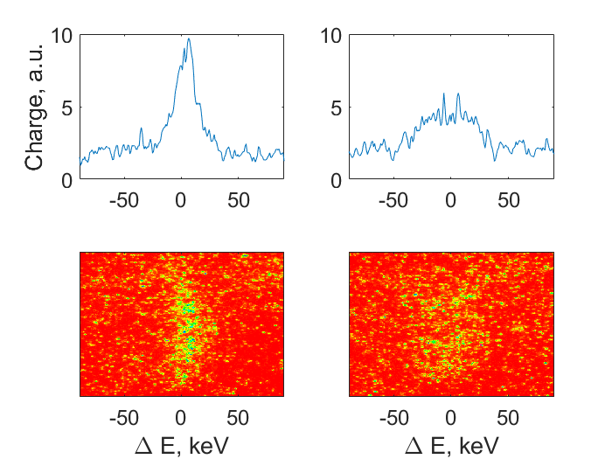
Experiments Take Place at the Pegasus Beamline
Sample electron spectra:
20 mJ
Notes:
Beam emittance: Hopefully down to 10nm
Beam energy out the gun: 3.5 MeV; can double energy to 7 MeV
Beamline sits in a 10m bunker

Slide 17
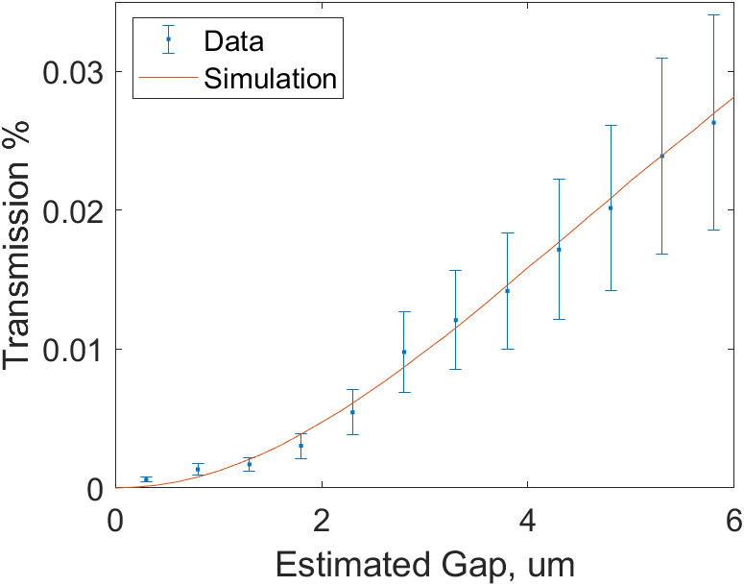
Structures are Characterized via Electron Transmission
Estimated gap extracted by relative transmission of electron beam
So if we start with 1pC, ~8fC gets through an 800nm gap, on the order of 50,000 electrons
Notes:
Only two plots, plus structure factor sim (define structure factor)

Slide 18
10/20/2022: Commercial Structure Modulates Electron Energy
A small, but noticeable increase in RMS at the spectrometer indicates a laser-electron interaction

Slide 19
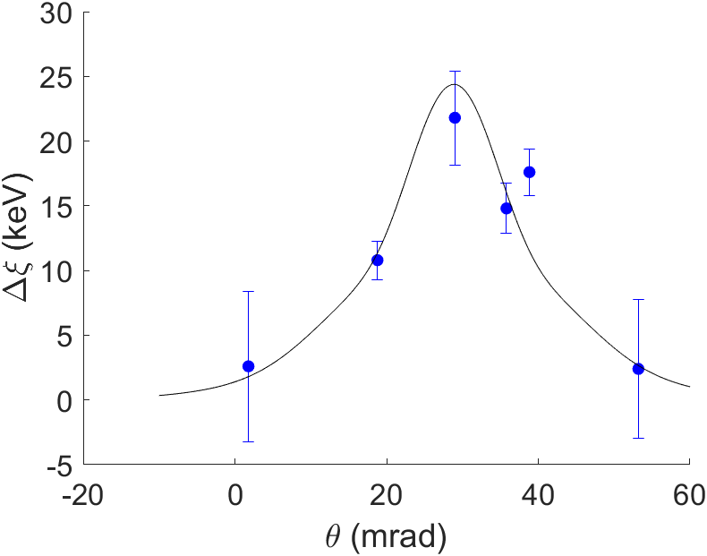
Phase Matching in the Ballistic Model
E₀
k₀
$$θ$$
$k_{g}−\frac{ω_{l}}{cβ}+$ $\frac{ω_{l}}{c}\sin{θ}=0$
For a 780 nm laser and 800nm grating, phase advance over a grating period is satisfied by $θ=29$mrad

Slide 20
The Kerr Effect Could Be to Blame
The “Kerr effect”
Results from a change in refractive index due to applied electric field

Slide 21
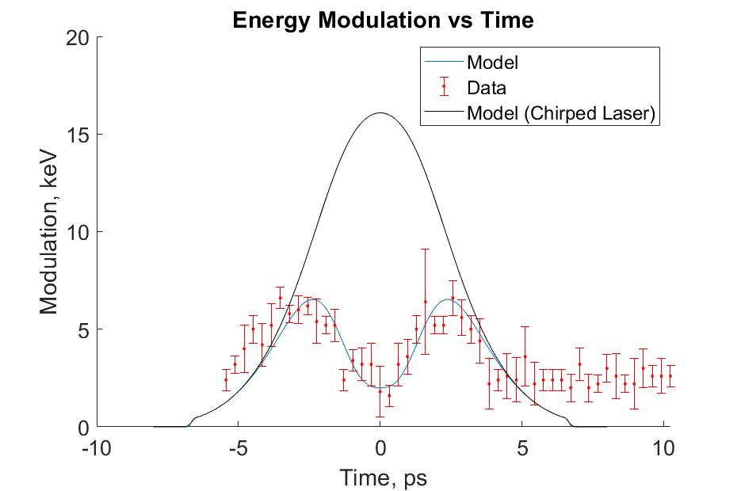
First Modulation from a 500 Euro DLA
Parameter | Value
Beam Energy | 6 MeV
Energy Spread (FWHM) | 17 keV
Beam Charge | 1 pC
Beam rms size at DLA | 75 um
Bunch Length | .25 ps
Laser Pulse Duration (FWHM) | 100fs
Laser spot size at DLA (FWHM) | 1.34 mm x 412.5 um
Laser Energy | 1.8 mJ
DLA gap (Optically Estimated) | 1.2 um
Structure Factor (Estimated) | 0.05

Slide 22
Estimated Gap Size During Experiment was Larger than Expected
Post run optical measurements indicated a gap of at least 1.2 um
This would explain the lower than expected energy modulation

Slide 23
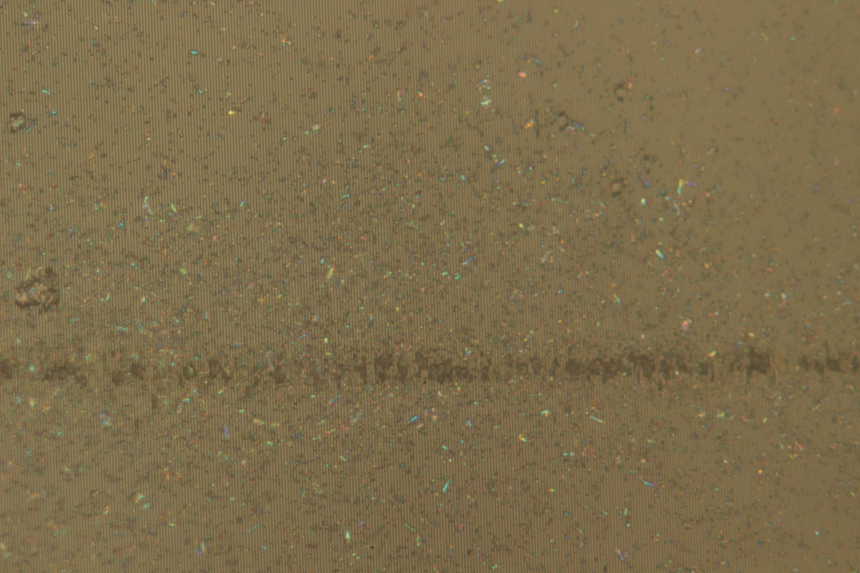
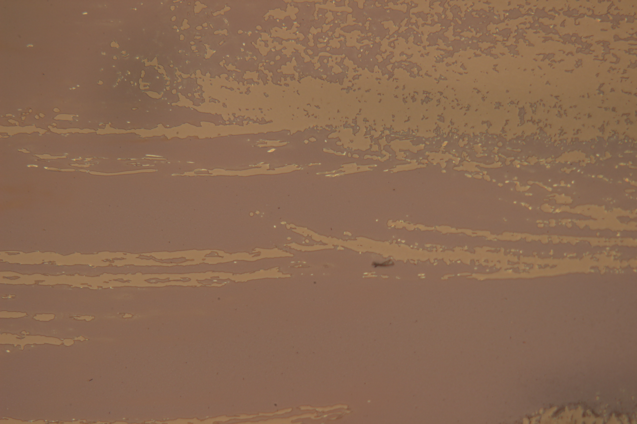
Structure Damage is Under Investigation
a
b
a. Full structure view
b. Inside the structure
c. Focusing on the glass
d. Looking at the same spot as c, focusing on the grating plane
Damage appears at a fluence of 140mJ/cm²
^{(more tests needed)}
c
d

Slide 24
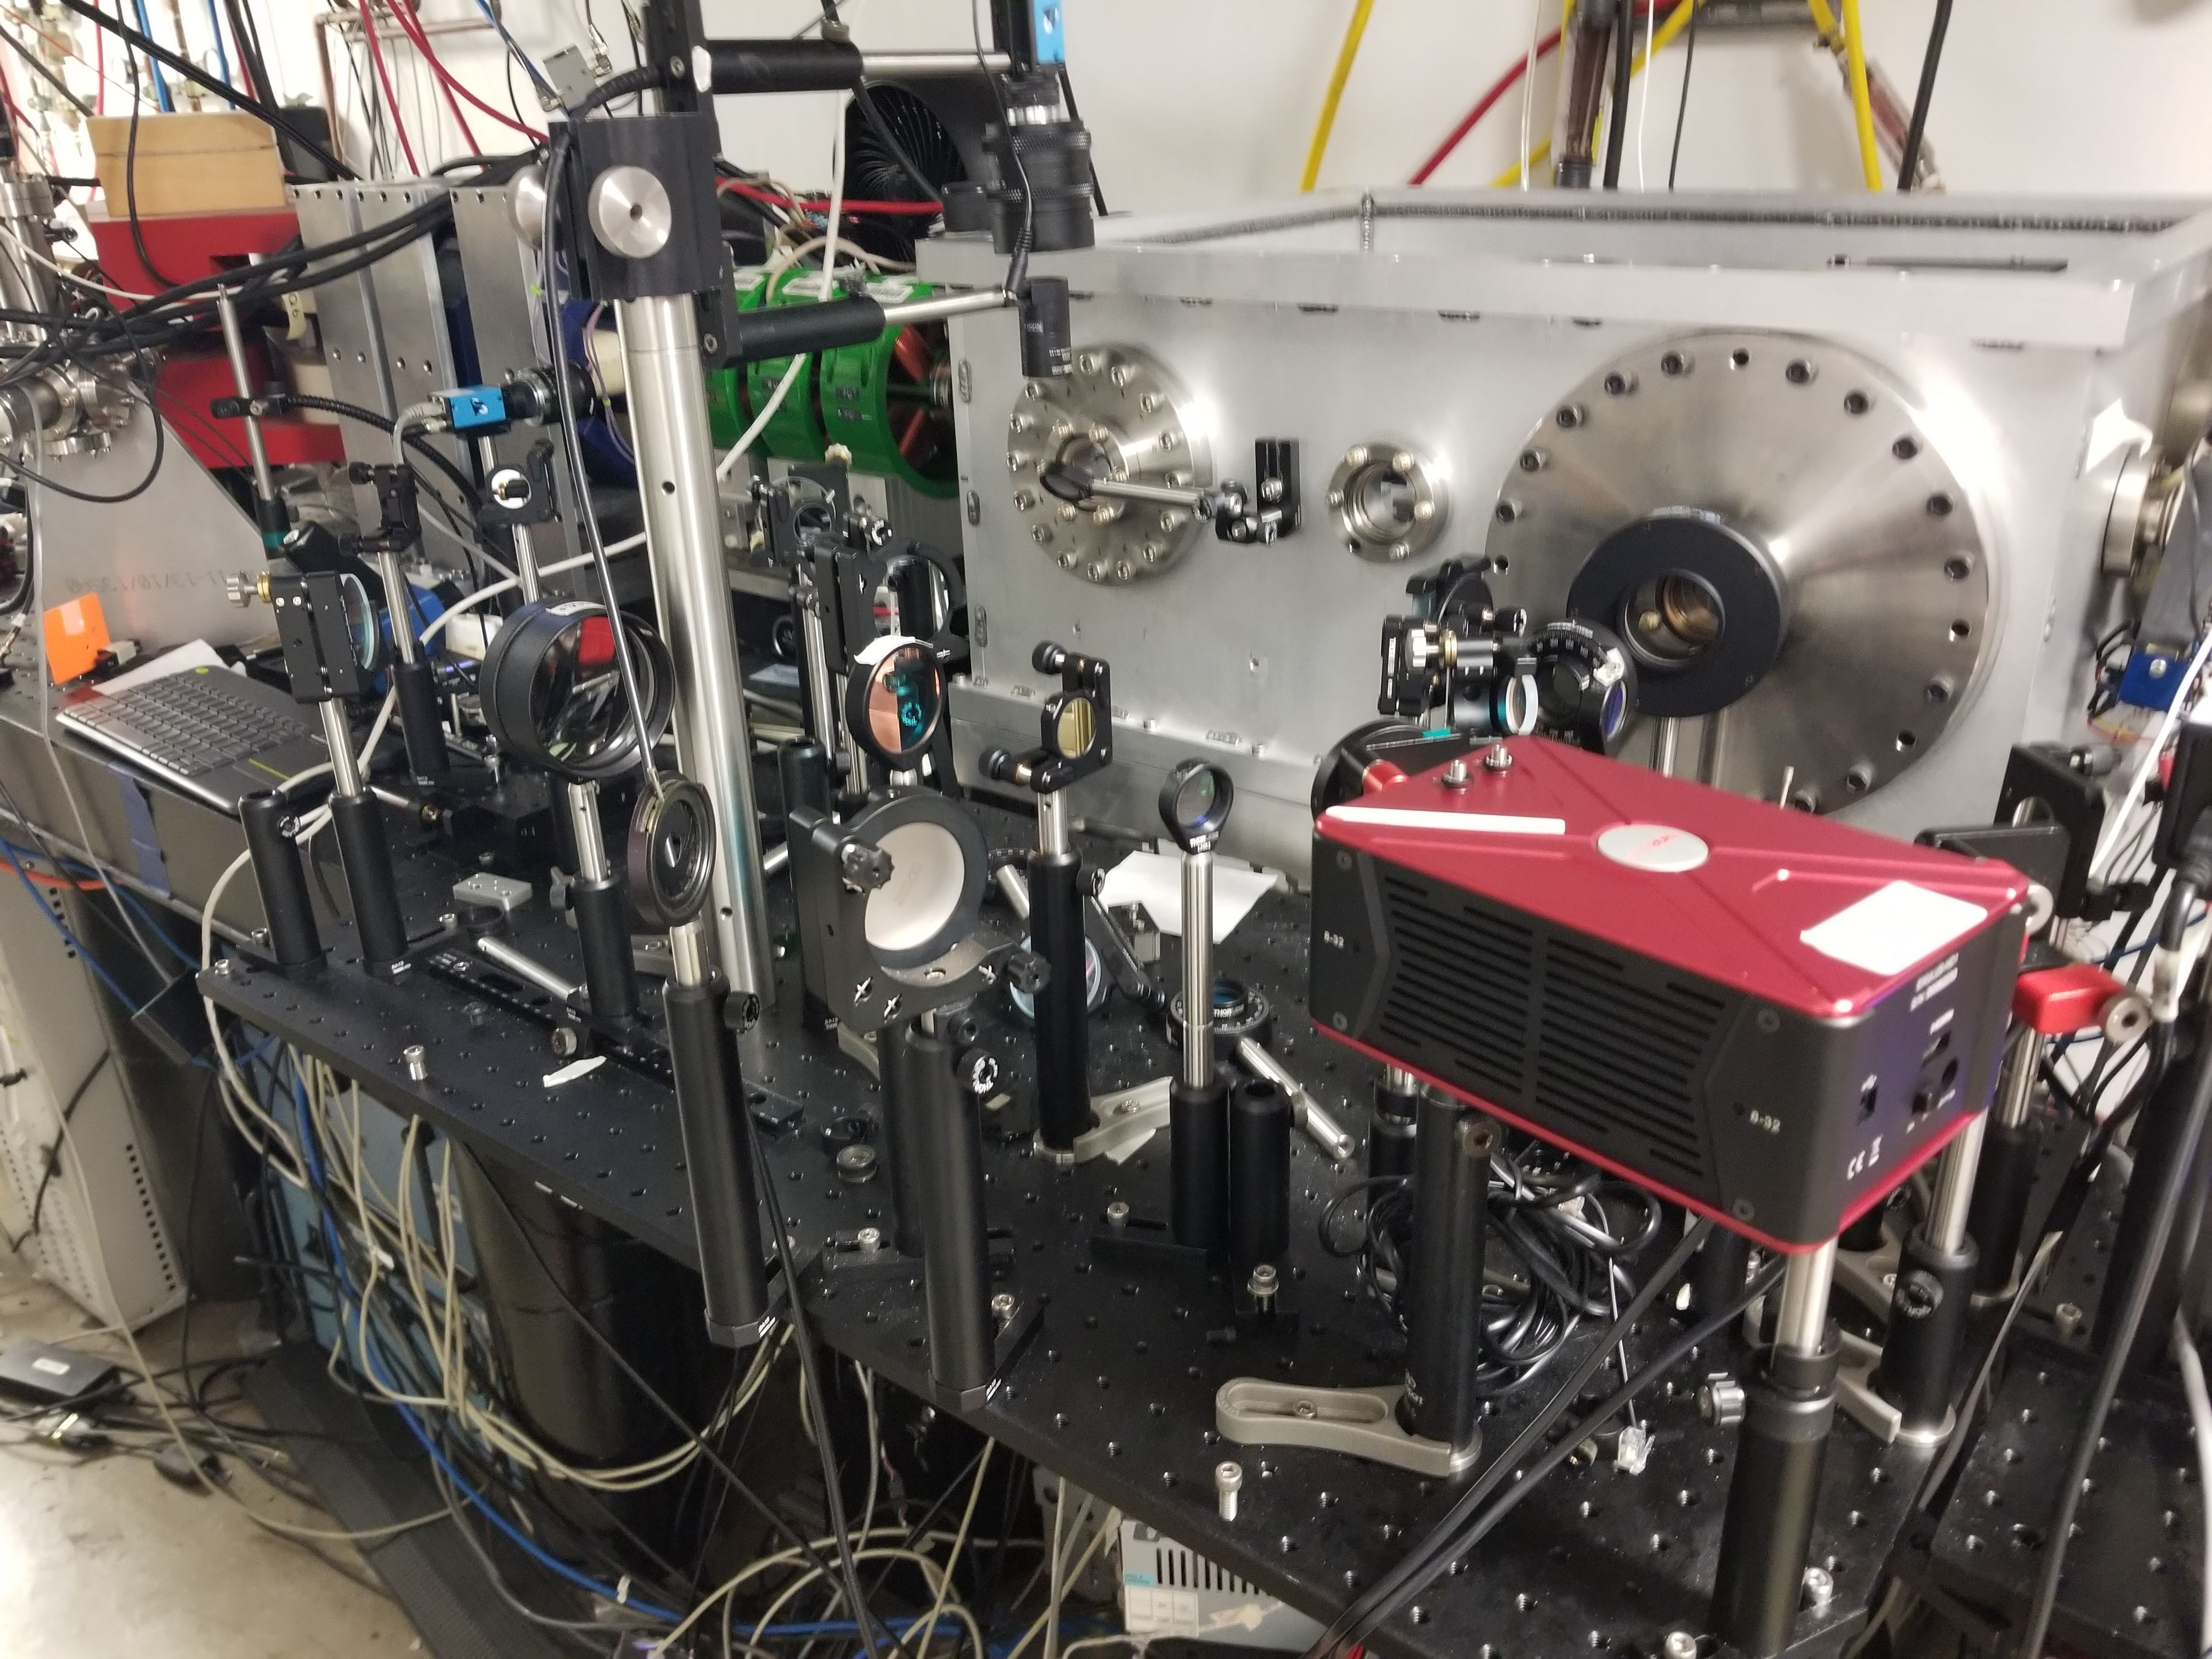
Conclusion
Commissioned a new optical system combining pulse front tilt with Spatial Light Modulator
Built and characterized new commercially based structures
Demonstrated modulation using these commercial structures
On the way:
MeV energy gains via longer interactions lengths
Soft tuning utilizing Alternating Phase Focusing

