Slide 1
Development of High Brightness Photoinjector for AWA
S.V. Kuzikov, Euclid Techlabs, LLC, Bolingbrook, IL
11/09/2022

Slide 2

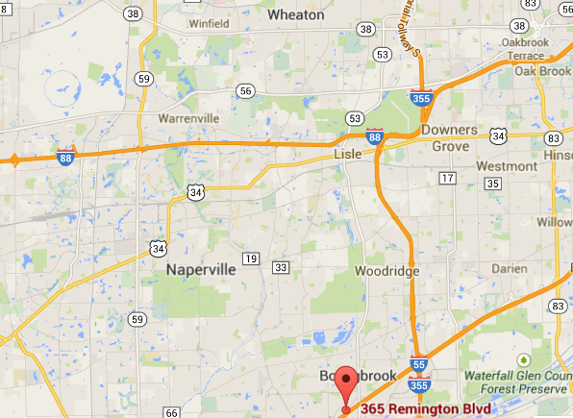
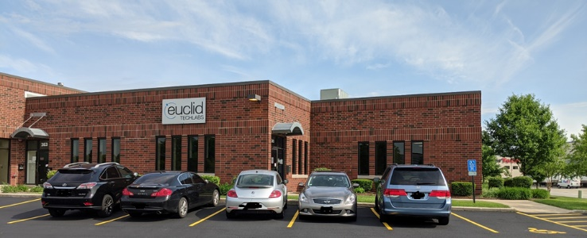

Euclid Techlabs/Euclid Beamlabs
Euclid Techlabs, LLC is a research and development company specializing in linear particle accelerators, ultrafast electron microscopy, and advanced material technologies. The company was formed in 2003. Euclid Beamlabs LLC, formed in the winter of 2014, is a sister (spin-off) company of Euclid Techlabs LLC, particularly to commercialize industrial accelerator and related advanced material technologies developed at Euclid Techlabs. Euclid has developed expertise and products in several innovative technologies: time-resolved ultra-fast electron microscopy; ultra-compact linear accelerators; electron guns with thermionic, field emission or photo-emission cathodes; fast tuners for SRF cavities; advanced dielectric materials; HPHT and CVD diamond growth and applications; thin-film for accelerator technologies; Present: 27 people research staff (researchers, engineers, technicians) and 5 administrative. 16 PhDs in accelerator physics and material science, 32 staff. 2 labs: Bolingbrook, IL (accelerator R&D lab) and Beltsville, MD (material science lab). Long term collaborations with National Labs and Institutes: ANL, Fermilab, BNL, Jlab, LBL, SLAC, LANL, NIST, NIU, IIT, etc.
BNL
NIST
Fermilab
Euclid
UMD
Euclid
Argonne
NRL, JLab
www.euclidtechlabs.com

Slide 3
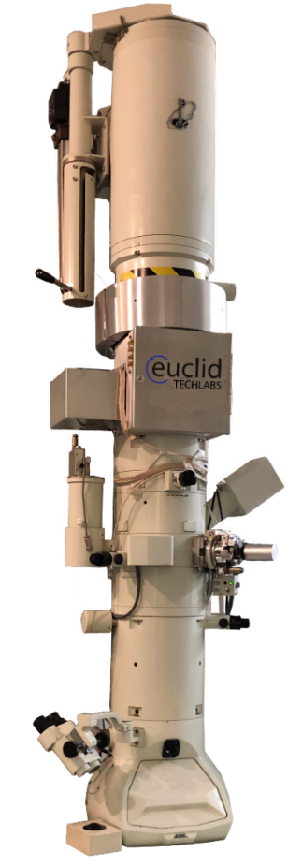
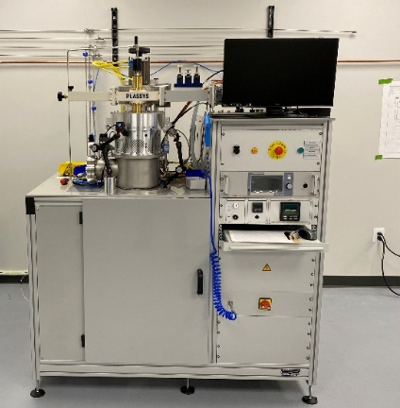
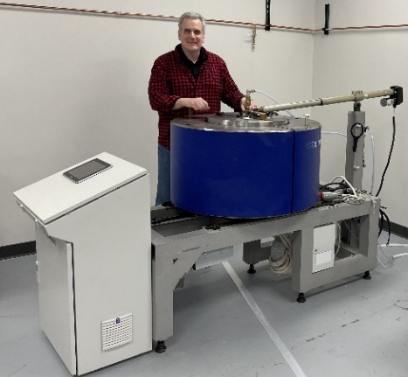

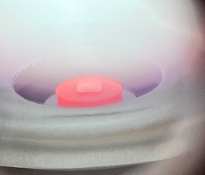
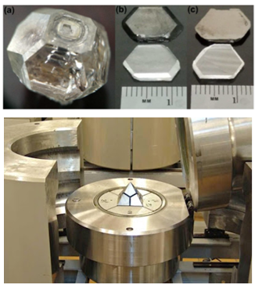
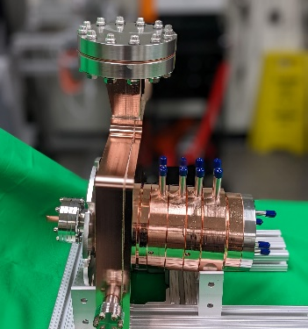
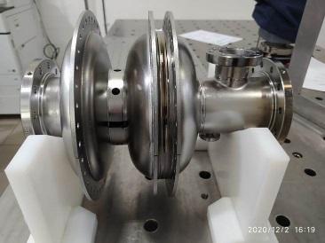
Products & Capabilities Snapshot
Products
UltraFast Pulser (UFPTM) for TEM
Dislocation free diamond for Xray optics
Compact X-Ray Source
NCRF and SRF electron sources
Low loss ceramics (linear and non-linear)
LINAC
RF window
In flange BPM
Capabilities
Femtosecond Laser Ablation System
Thin Film Deposition Lab
EM Testing Lab
Radiation Shielding/Testing Lab

Slide 4
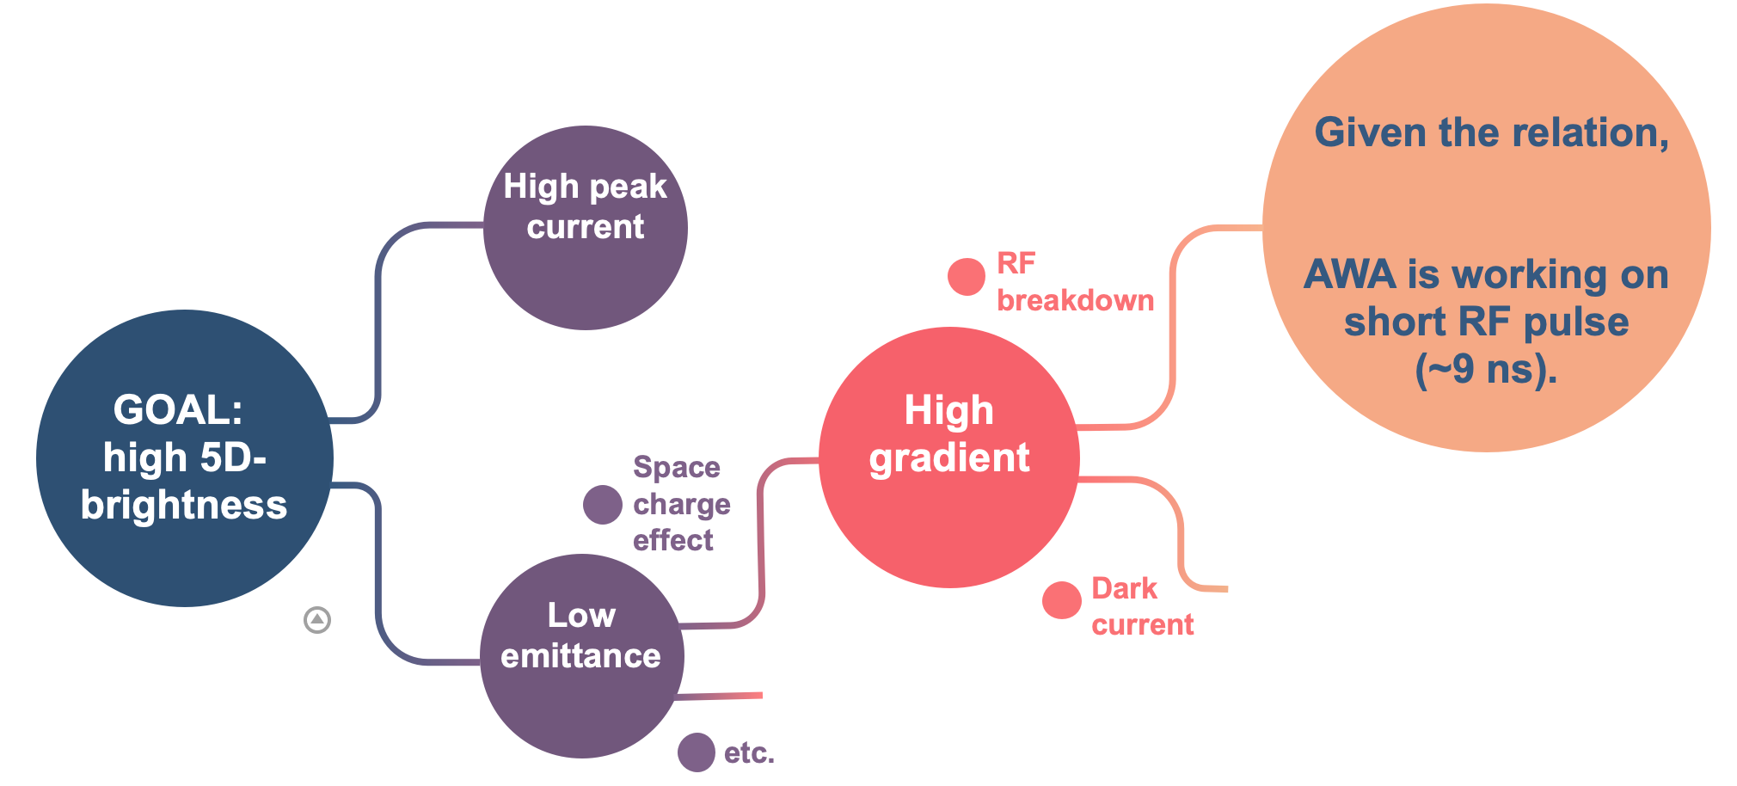

Our approach to high brightness
$BDR∝E^{30}τ^{5}$ ^{[2]}
9 ns, 300 MW
[1] I. V. Bazarov et. al., Phys. Rev. Lett. 102, 104801 (2009).
[2] A. Grudiev et. al., Phys. Rev. ST-AB, 12, 102001 (2009).

Slide 5
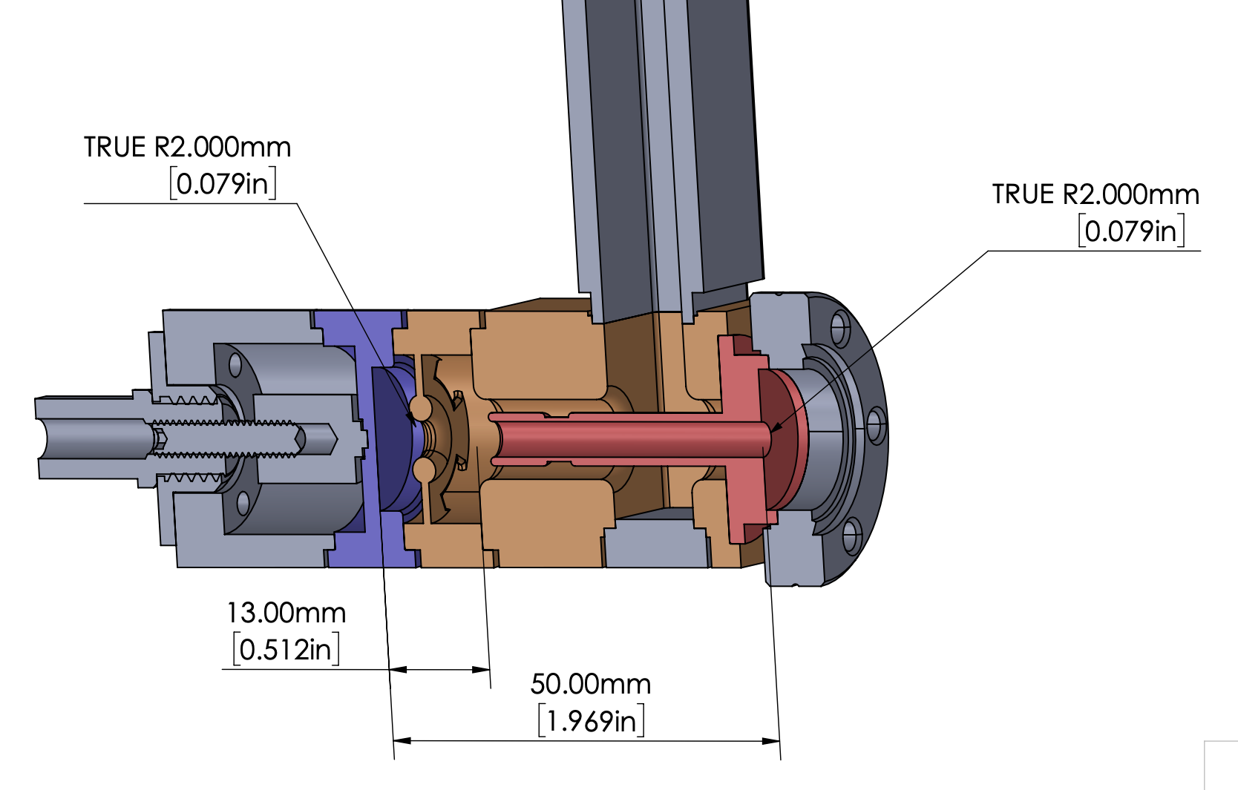
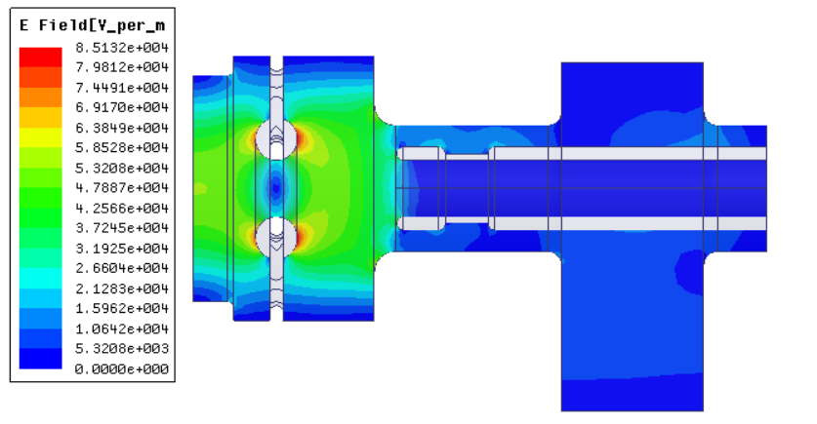
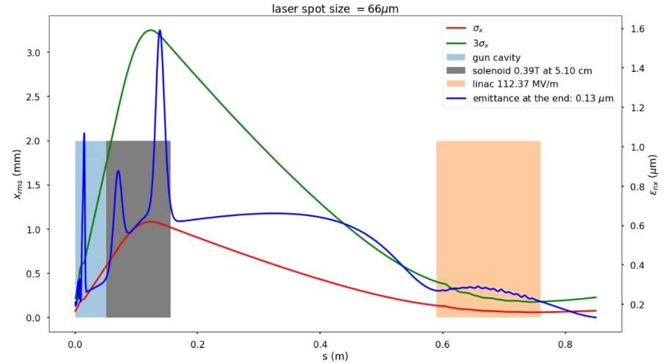
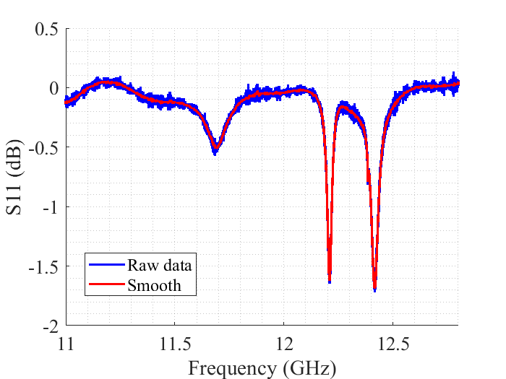
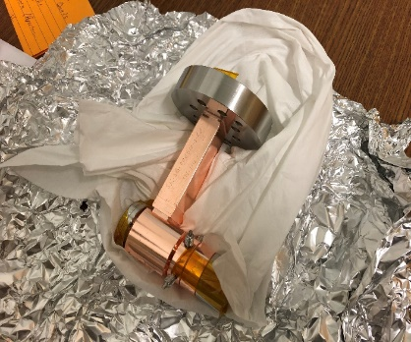


RF Gun Design
RF
11.7 GHz field structure (Q≈200)
11.7 GHz field structure at axis for 100 MW of incident power
π-mode
0-mode

Slide 6
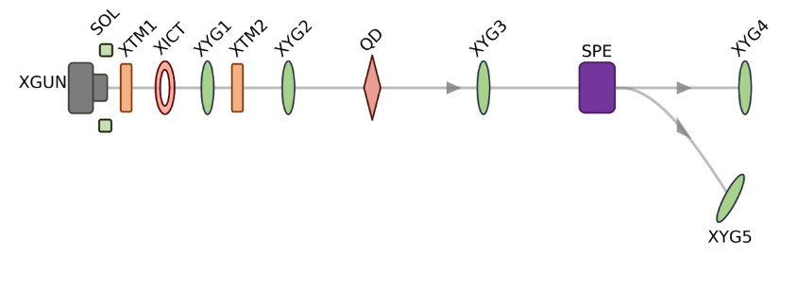
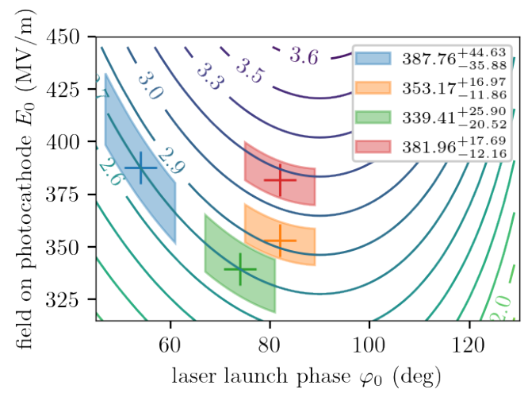
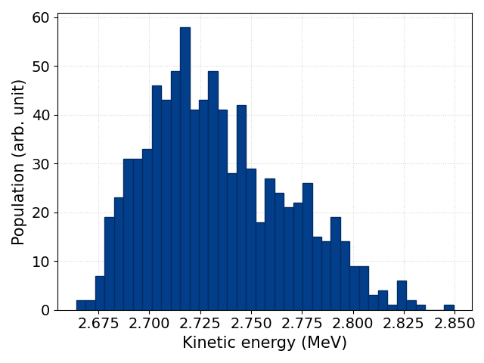
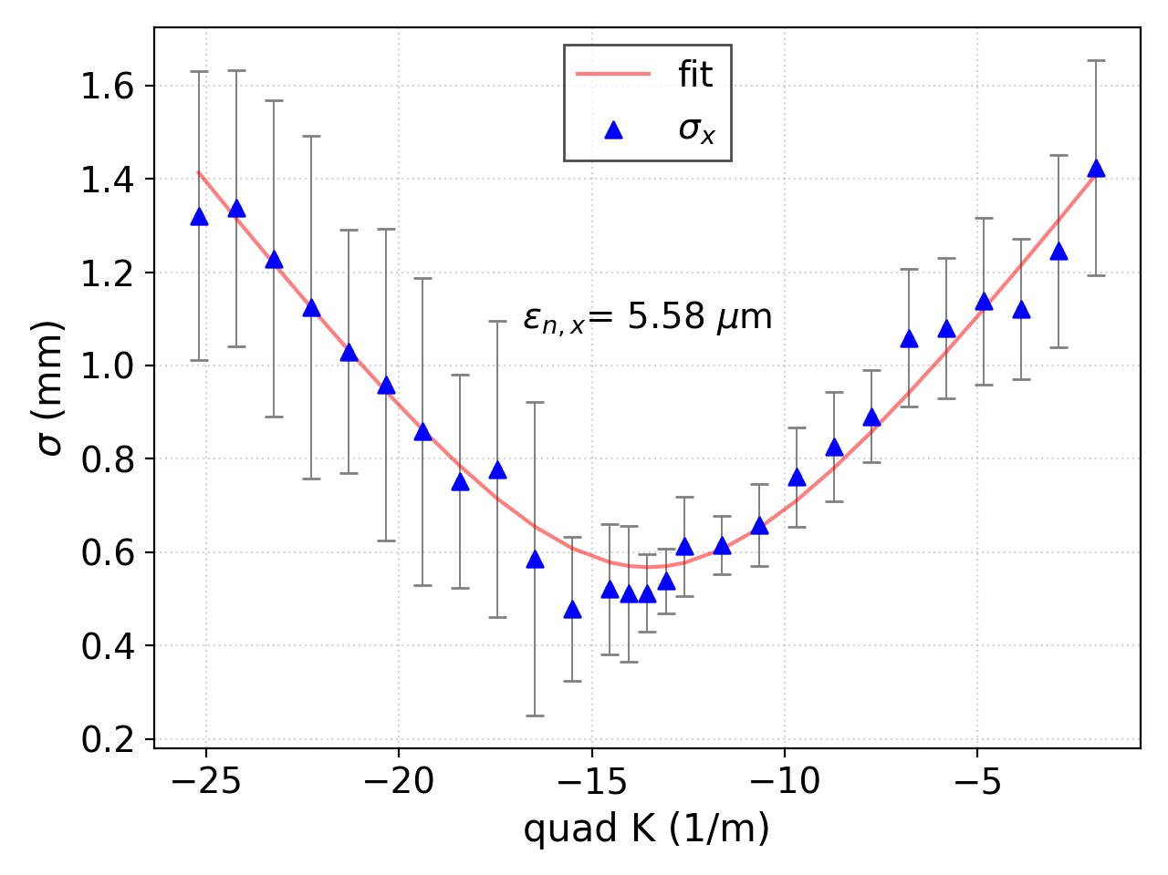
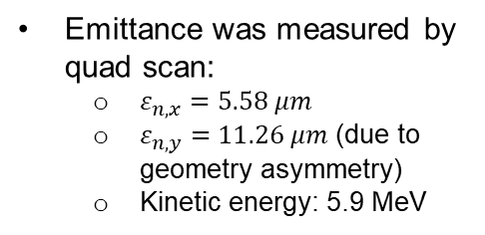
High-Gradient Test and Beam Energy Characterization
For details see the next talk by Chen Gongxiaohui (AWA).
1000 shots as total
~3% fluctuation
Simulated kinetic-energy isoclines as function of RF gun operating conditions K(E₀, φ₀) and retrieved operating points (“+” symbols). The shaded areas represent the uncertainty on the measured φ₀ and inferred E₀ values.
Energy measured by the spectrometer dipole
~3% fluctuation, likely due to the drive charge instability.
Max achieved gradient is 388 MV/m from the beam energy measurement
Emittance was measured by quad scan:
  $ε_{n,x}=5.58 μm$
  $ε_{n,y}=11.26 μm$ (due to geometry asymmetry)
  Kinetic energy: 5.9 MeV

Slide 7
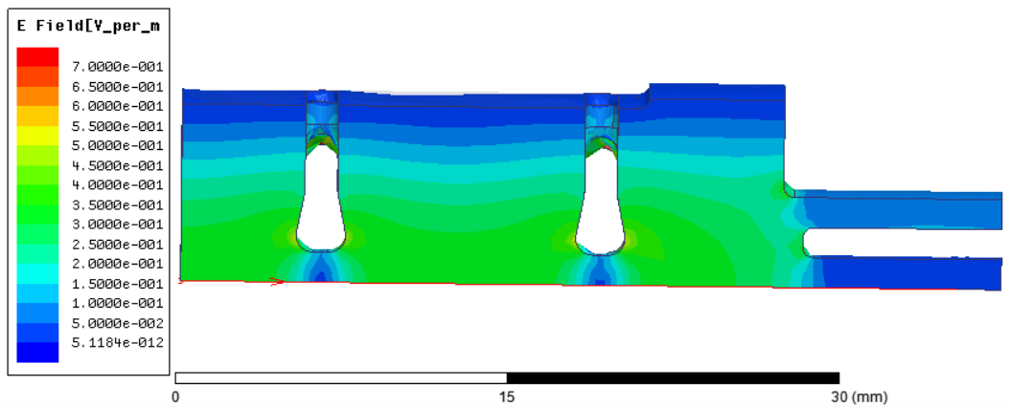
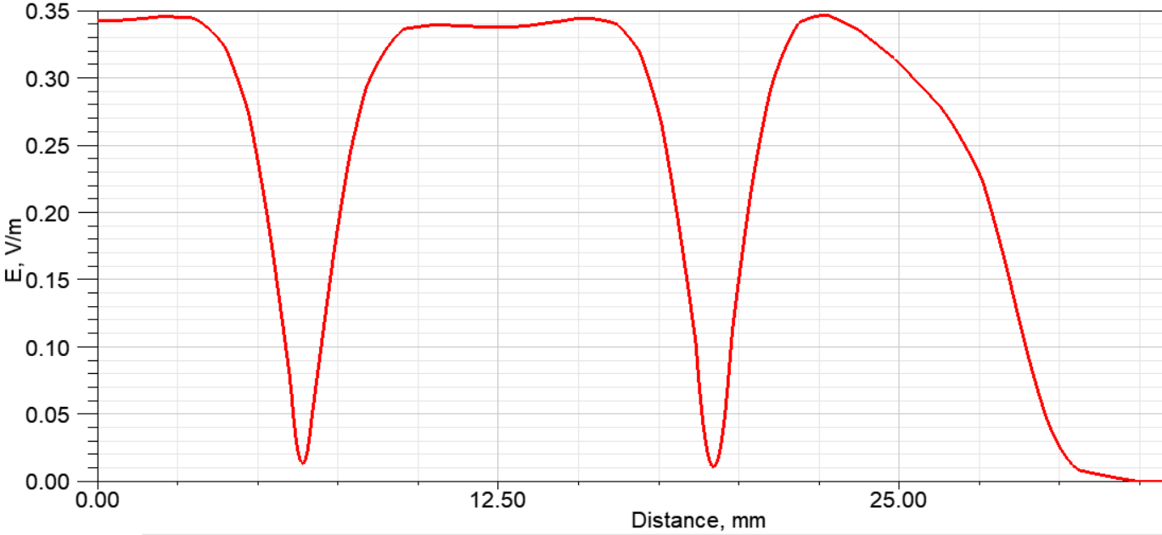
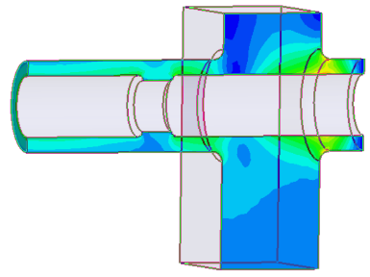
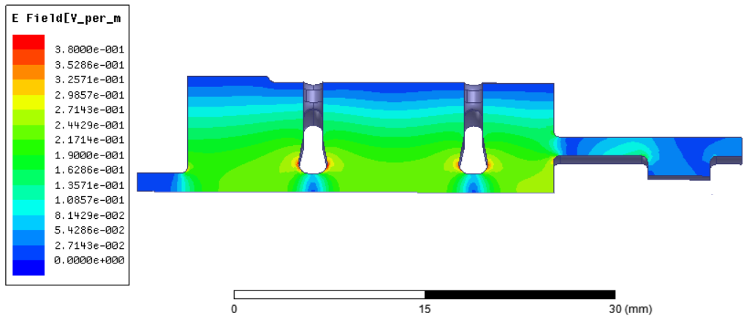
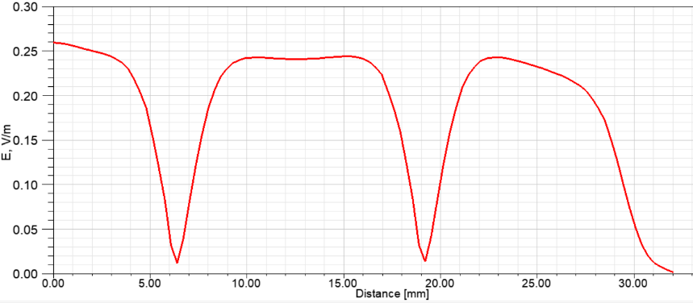
Developed RF design (2,5 cells)
RF coupler
TEM
Cathode
1) RF coupler interferes to place solenoid close to the cathode.
E-field at gun’s axis
Solenoid
Backing solenoid
RF coupler
Cathode
E-field at gun’s axis
2) RF coupler provides much more freedom.

Slide 8
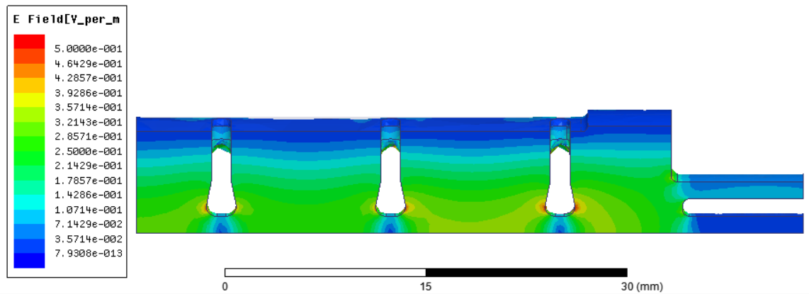
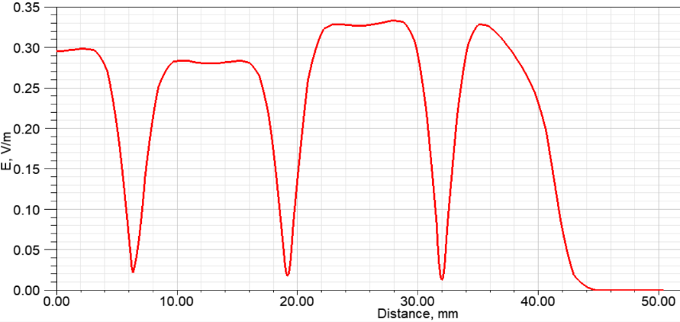
3,5 cell RF Design
RF
Field balance is more vulnerable to size tolerance in comparison with 2,5 cell design.

Slide 9
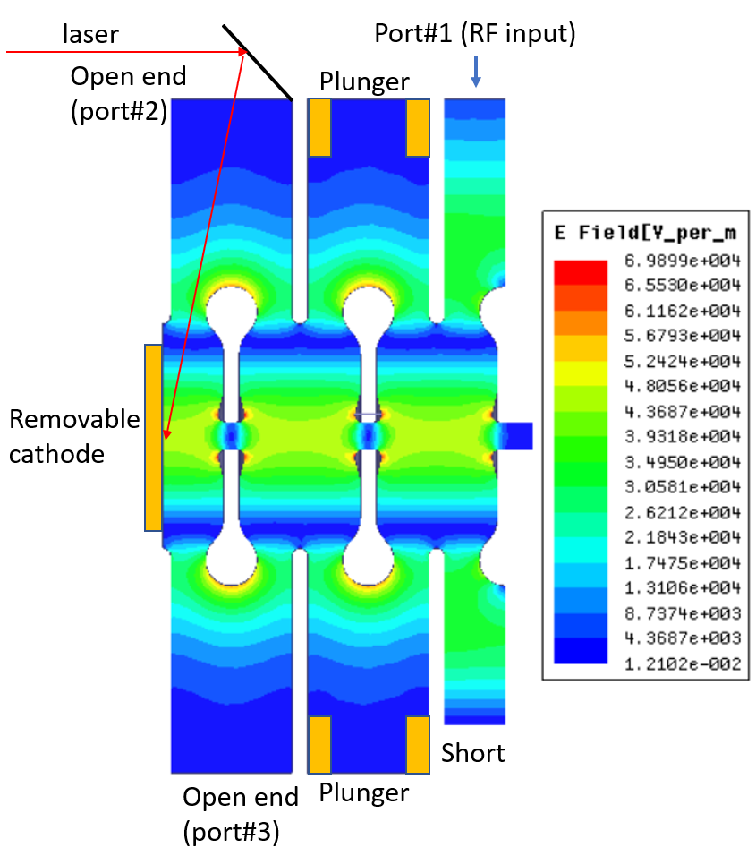
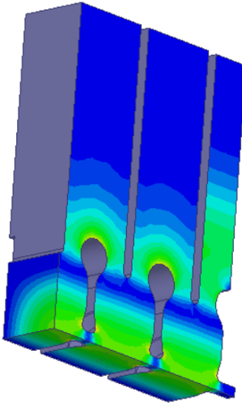
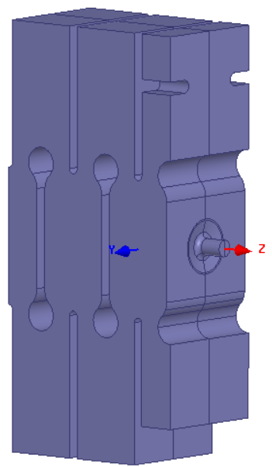
11.7 GHz RF Gun with Strongly Coupled Cells on π-Mode

Slide 10
Advantages:
1. High-gradients and fully symmetric RF field distribution to minimize emittance;
2. Strong side coupling, in order to provide excellent field flatness, necessary mode separation and suppression of HOMs (for open version);
3. Design allows easy laser beam access to cathode and easy fine tuning;
4. Brazeless design and removable cathode.
Disadvantages:
Larger transverse size;
In case of open design some RF power can penetrate outside of gun.

Slide 11
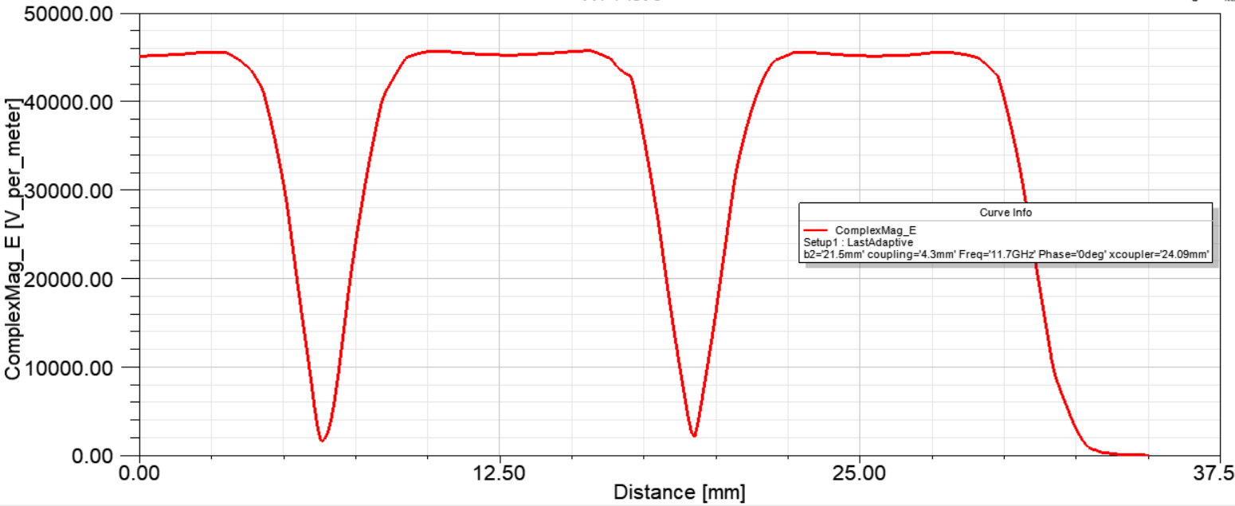
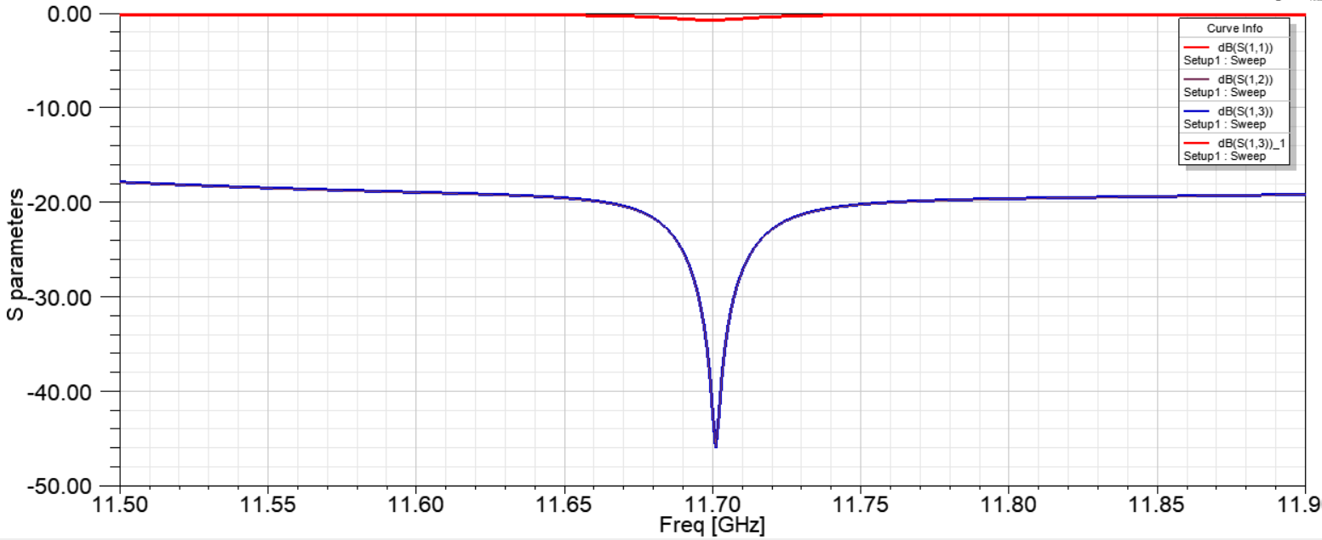
E-field distribution at gun’s axis
S₁₁, S₁₂ and S₁₃ parameters

Slide 12
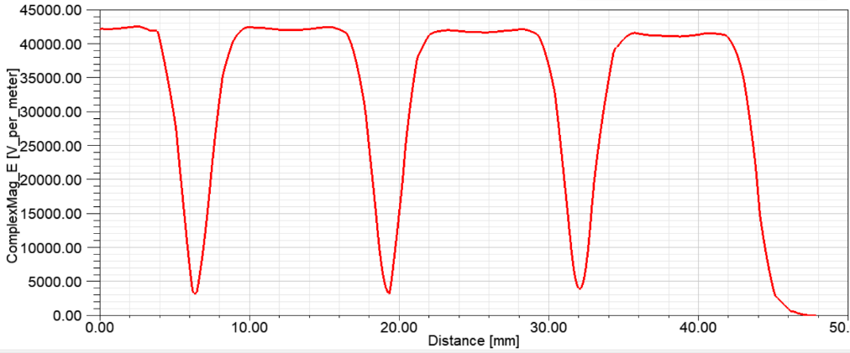
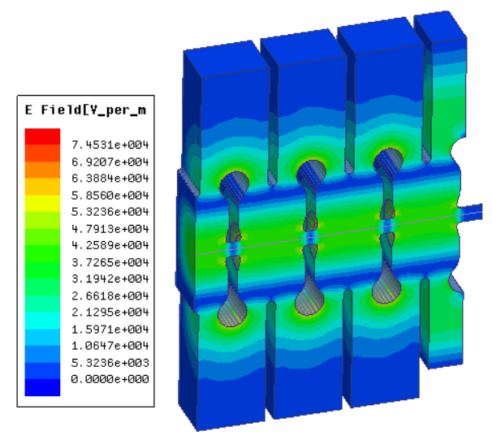
3,5 Cell Gun
RF
E-field at axis
S₁₁ vs frequency

Slide 13
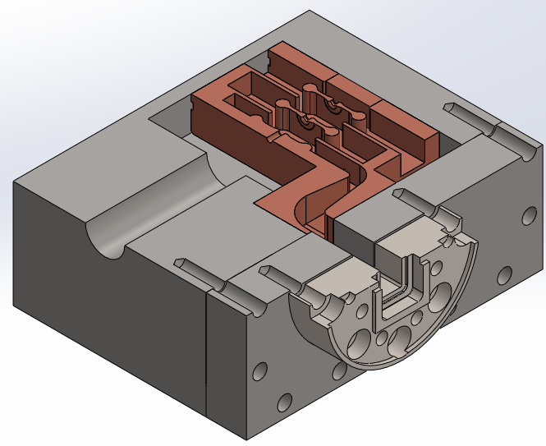
Brazeless engineering design of 2,5 cell gun
Copper
Stainless steel

Slide 14
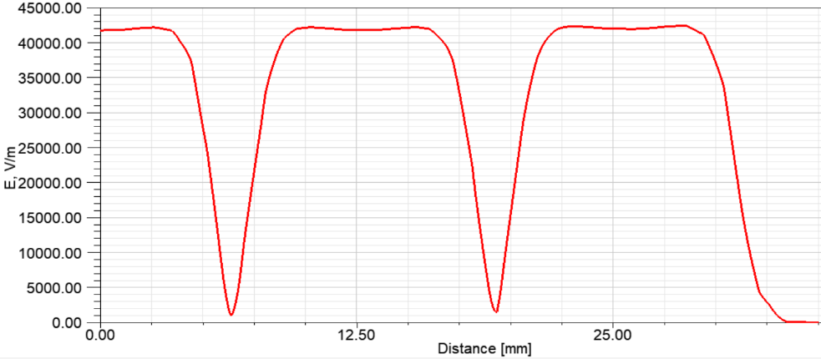
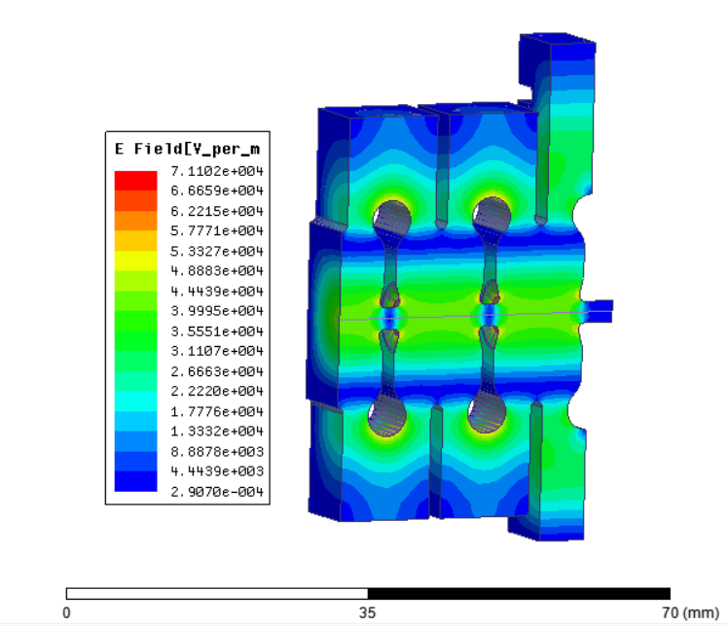
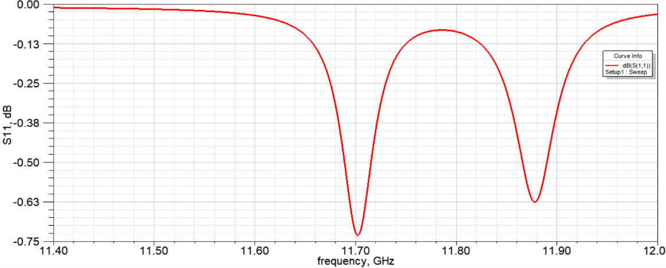
Fully closed 11.7 GHz RF design
E-field at axis
S₁₁ vs frequency

Slide 15
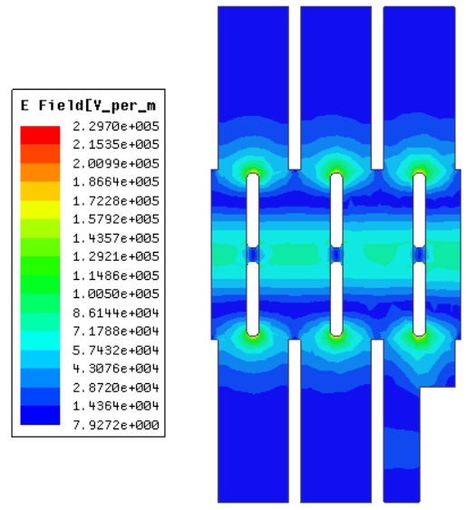
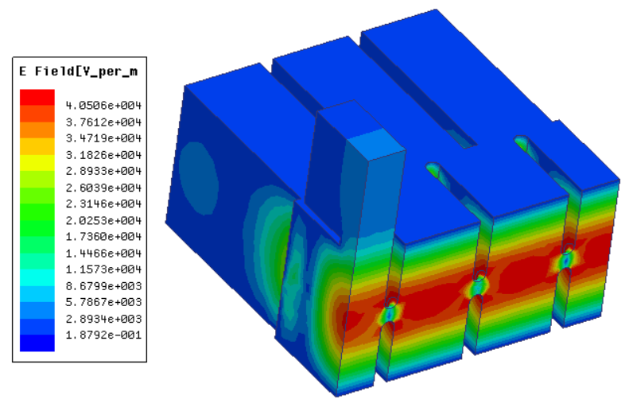
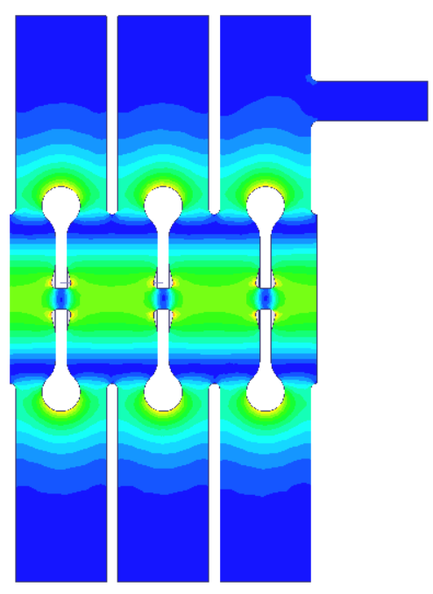
Coupler Designs
RF
RF
RF
“Classical” design
Designs based on superinduced field asymmetry

Slide 16
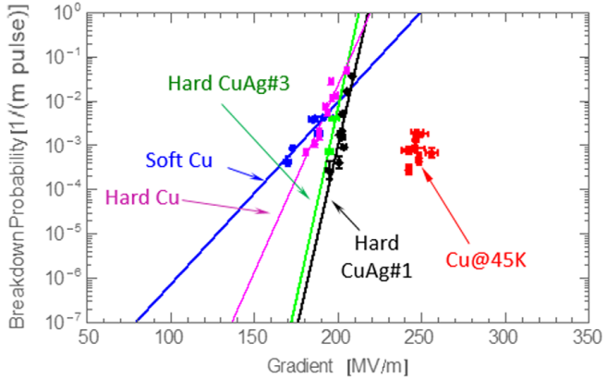
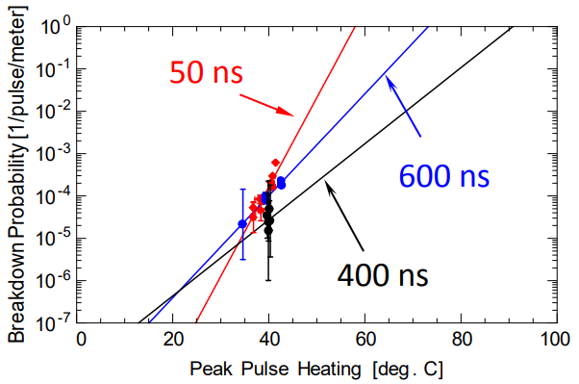
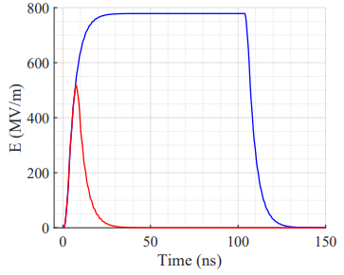
A Short Pulse Gun at Cryogenic Temperatures
Breakdown rate vs gradient [1]
Peak pulse heating is a reasonably good predictor of the breakdown probability [2].
Comparison of the transient cathode gradient when driven by long (blue) and short (red) pulse. The input power is f300 MW and the rising/falling is fixed at 3 ns.
1. A. D. Cahill et al. High gradient experiments with X-band cryogenic copper accelerating cavities, 2018.
2. V.A. Dolgashev, Recent High Gradient Tests at SLAC, 2016.
For the 11.7 GHz 9 ns gun the cathode gradient at 45 K could be as high as more than 500 MV/m, maximum surface electric field might be as high as 750 MV/m.

Slide 17
Conclusion
We have plans to modify current RF design of the short pulse 11.7 GHz photoinjector at AWA to increase energy gain, reduce emittance, and to improve compatibility with the solenoid.
Alternatively, we can be focused on a new design based on strongly coupled rectangular cross-section cells. This flexible new design promises lots of benefits.
An additional opportunity to increase the gradient substantially is to operate a short pulse gun at cryogenic temperatures. AWA facility is an excellent test site to achieve a new high gradient world record.

