Slide 1
Short Pulse High Gradient Accelerating Structures
Sergey V. Kuzikov
Euclid TechLabs, LLC, Bolingbrook, IL
Outline:
Short pulse high-gradient acceleration concept:
  Breakdown threshold
  Efficiency
  Lifetime
Experiments with nanosecond X-band components;
THz single-cycle structures;
Mm- and cm- single-cycle structures:
a) GV/m wakefield structures
b) multi-mode wakefield structures.

Slide 2

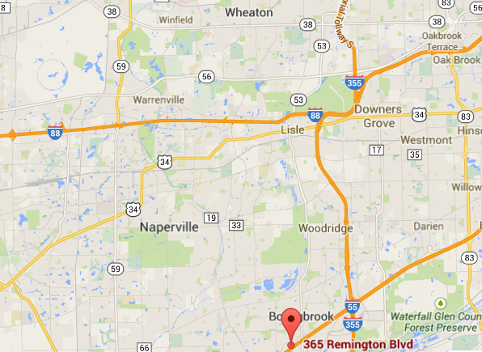
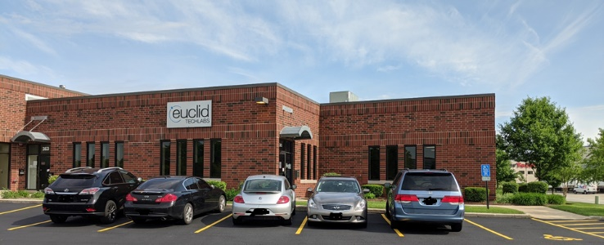

Euclid Techlabs/Euclid Beamlabs
Euclid Techlabs, LLC is a research and development company specializing in linear particle accelerators, ultrafast electron microscopy, and advanced material technologies. The company was formed in 2003. Euclid Beamlabs LLC, formed in the winter of 2014, is a sister (spin-off) company of Euclid Techlabs LLC, particularly to commercialize industrial accelerator and related advanced material technologies developed at Euclid Techlabs. Euclid has developed expertise and products in several innovative technologies: time-resolved ultra-fast electron microscopy; ultra-compact linear accelerators; electron guns with thermionic, field emission or photo-emission cathodes; fast tuners for SRF cavities; advanced dielectric materials; HPHT and CVD diamond growth and applications; thin-film for accelerator technologies; Present: 27 people research staff (researchers, engineers, technicians) and 5 administrative. 16 PhDs in accelerator physics and material science, 32 staff. 2 labs: Bolingbrook, IL (accelerator R&D lab) and Beltsville, MD (material science lab). Long term collaborations with National Labs and Institutes: ANL, Fermilab, BNL, Jlab, LBL, SLAC, LANL, NIST, NIU, IIT, etc.
BNL
NIST
Fermilab
Euclid
UMD
Euclid
Argonne
NRL, JLab
www.euclidtechlabs.com

Slide 3
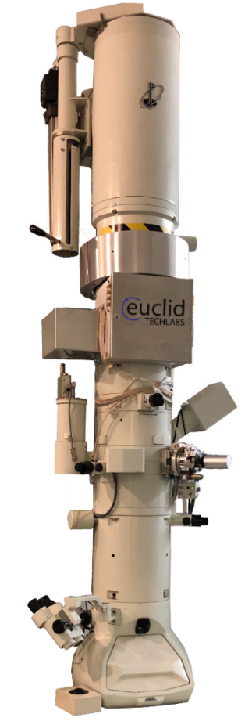
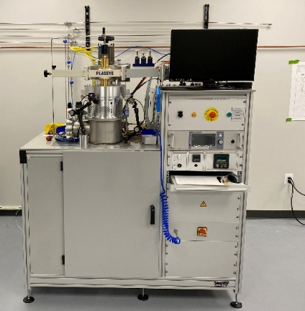
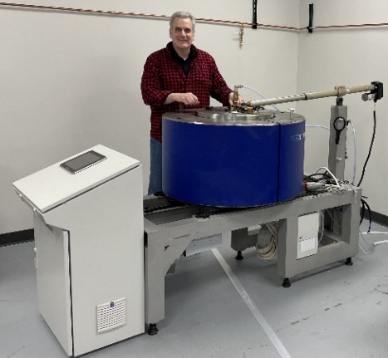

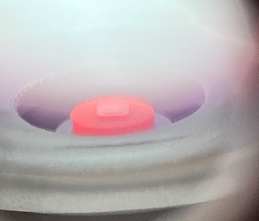
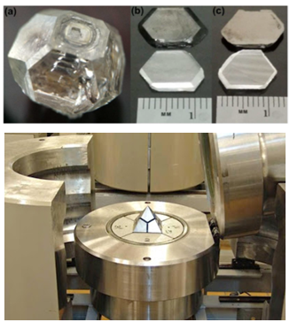
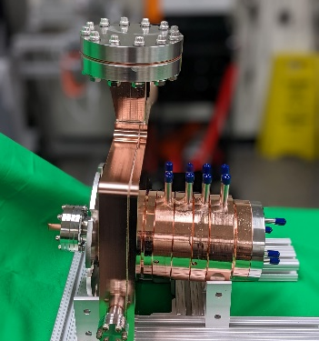
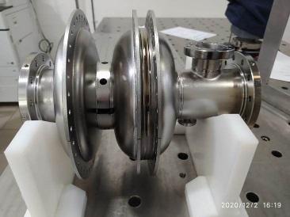
Products & Capabilities Snapshot
Products
UltraFast Pulser (UFPTM) for TEM
Dislocation free diamond for Xray optics
Compact X-Ray Source
NCRF and SRF electron sources
Low loss ceramics (linear and non-linear)
LINAC
RF window
In flange BPM
Capabilities
Femtosecond Laser Ablation System
Thin Film Deposition Lab
EM Testing Lab
Radiation Shielding/Testing Lab

Slide 4
Pulse Length Scaling & Challenges
Feeding by short, high repetition rate pulses, in order to avoid breakdown and excessive pulse heating according to scaling laws:
Accelerating fields more than 100 MV/m have already been obtained at ~100 ns pulses in X-band. Extrapolating scaling law one must conclude that in order to reach 1 GV/m, as short as ~ 1 ps (1 THz width) pulses are needed.
Challenges:
Broad band systems are necessary;
High repetition rate;
High efficiency;
Structure lifetime must be large enough.

Slide 5
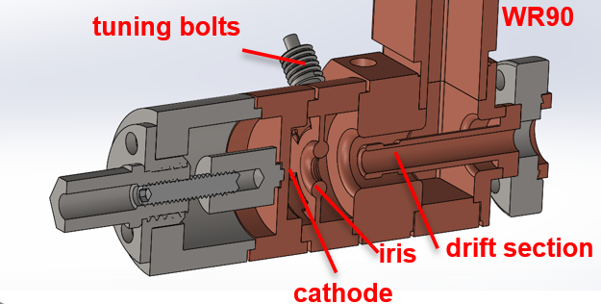
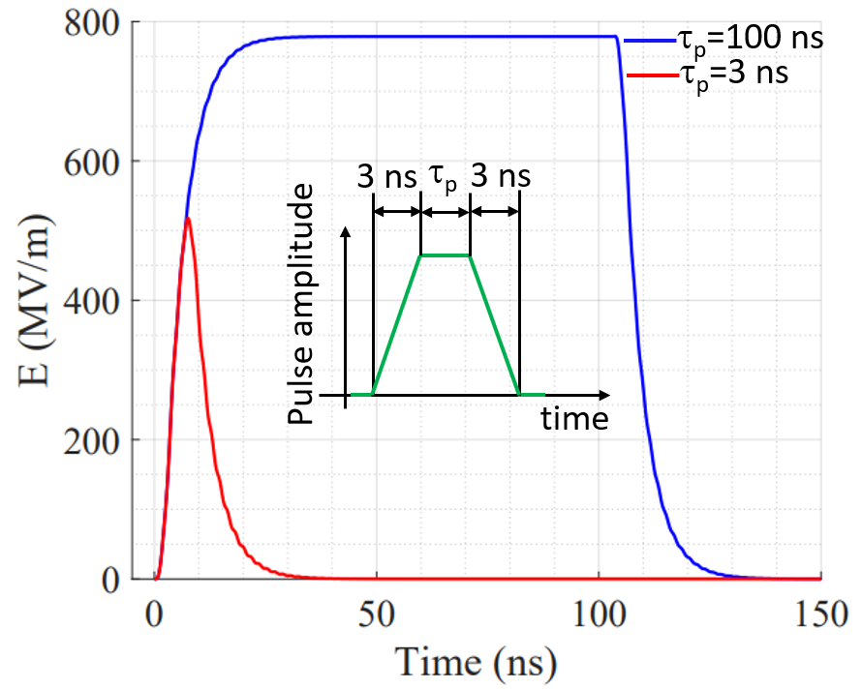
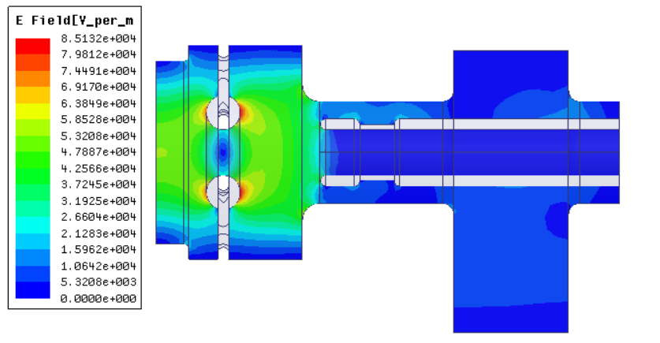
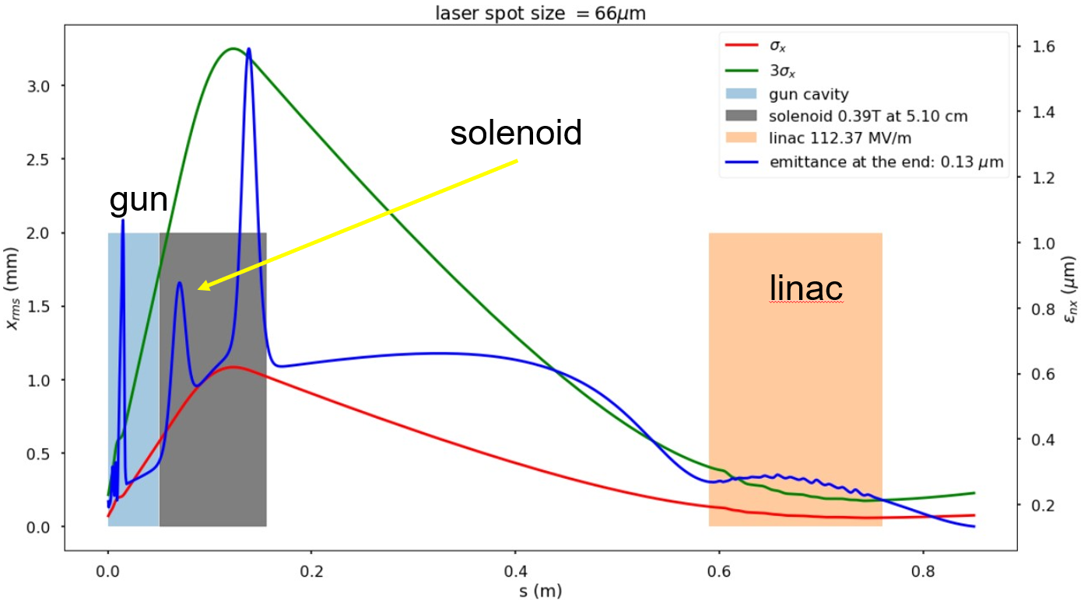
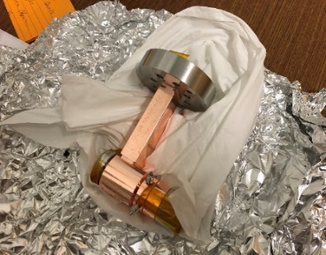
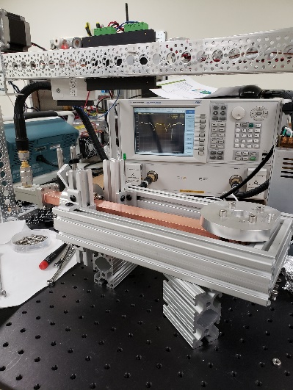
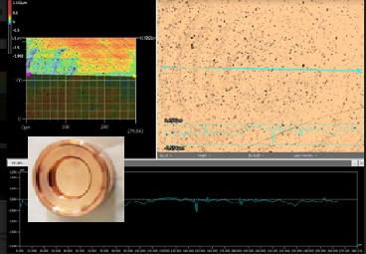
High-Gradient X-Band Gun Fed by 9 ns RF Pulses
RF
11.7 GHz field structure

Slide 6
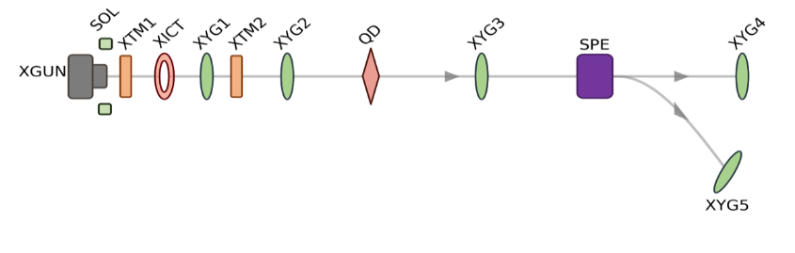
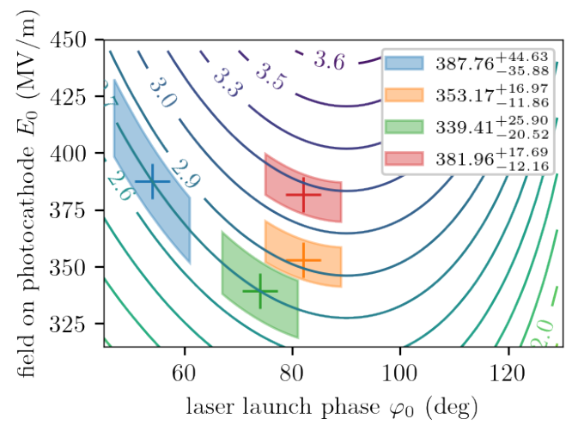
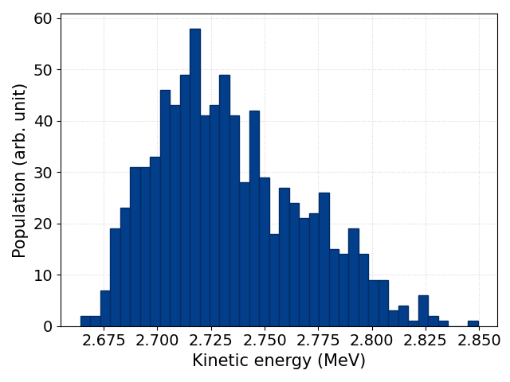
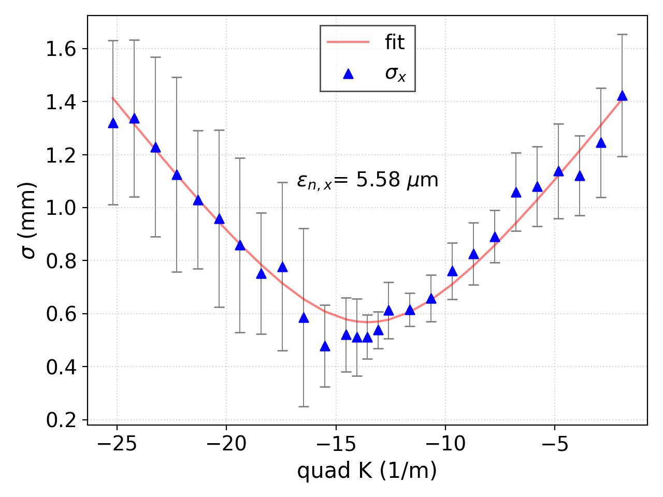
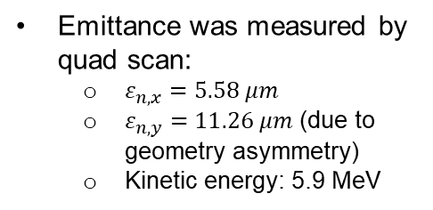
High-Gradient Test and Beam Energy Characterization
BDR~10⁻⁶ , 100 pC
Low average dark current
1000 shots as total
~3% fluctuation
Simulated kinetic-energy isoclines as function of RF gun operating conditions K(E₀, φ₀) and retrieved operating points (“+” symbols). The shaded areas represent the uncertainty on the measured φ₀ and inferred E₀ values.
Energy measured by the spectrometer dipole
~3% fluctuation, likely due to the drive charge instability.
Max achieved gradient is 388 MV/m from the beam energy measurement
Emittance was measured by quad scan:
  $ε_{n,x}=5.58 μm$
  $ε_{n,y}=11.26 μm$ (due to geometry asymmetry)
  Kinetic energy: 5.9 MeV

Slide 7
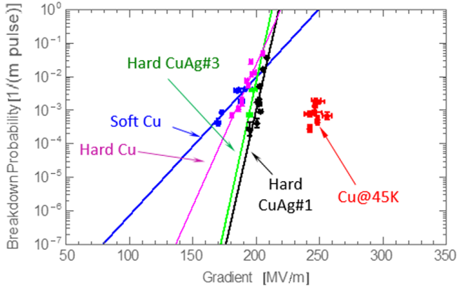
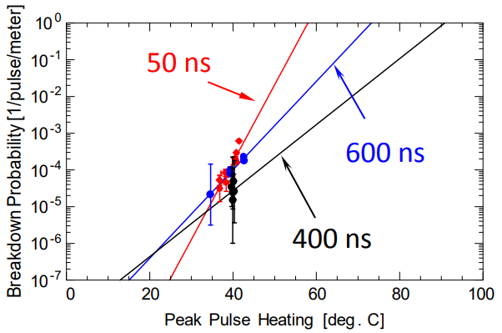
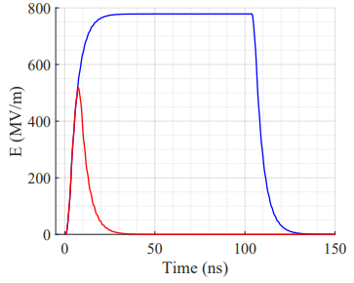
A Short Pulse Gun at Cryogenic Temperatures
Breakdown rate vs gradient [1].
Peak pulse heating is a reasonably good predictor of the breakdown probability [2].
Comparison of the transient cathode gradient when driven by long (blue) and short (red) pulse. The input power is f300 MW and the rising/falling is fixed at 3 ns.
1. A. D. Cahill et al. High gradient experiments with X-band cryogenic copper accelerating cavities, 2018.
2. V.A. Dolgashev, Recent High Gradient Tests at SLAC, 2016.
For the 11.7 GHz 9 ns gun the cathode gradient at 45 K could be as high as more than 500 MV/m, maximum surface electric field might be as high as 750 MV/m.

Slide 8
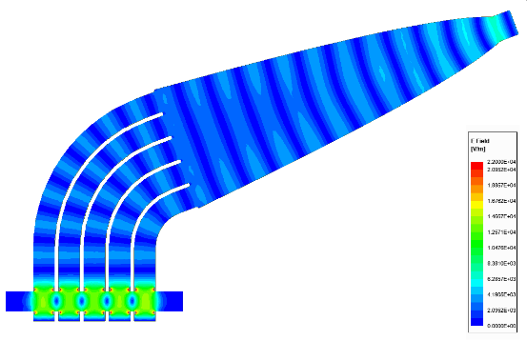
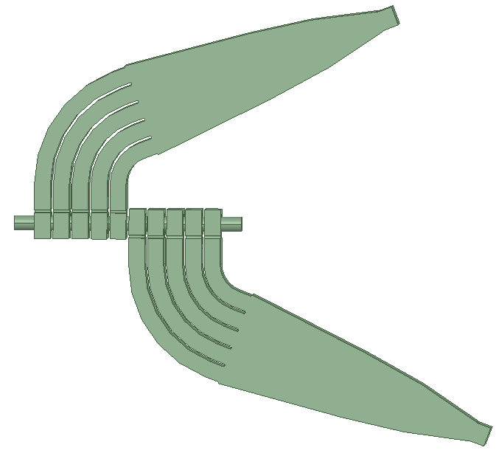
A Nanosecond Accelerating Structure with Individually Fed Cells
The TM₀₁₀ accelerating cells are powered individually!
This principle allows:
- to mitigate the influence of RF breakdown if appears in one cell;
- to increase the shunt impedance due to the smaller than usual beam channel;
- to reduce sensitivity to the tolerances on the size of the cells.
Power | 150 MW
RF pulse length | 10 ns
Q-factor | 350
Accelerator type | π-mode
Bending angle | 69.2°
Beam channel | ∅10 mm
Shunt impedance | 44 MΩ/m
Surface E_{max} | 750 MV/m
Surface B_{max} | 0.8 MA/m
Parameters of the 11.7 GHz, 300 MV/m, 5-cell structure (T=300 K).
a)
b)
c)
splitter
Bent delay waveguides
5 independent cells
5-cell side coupled accelerating structure: E-field structure of the operating mode at 11.7 GHz (a), several structures assembly (b), S₁₁ for the feeding antenna (c).

Slide 9


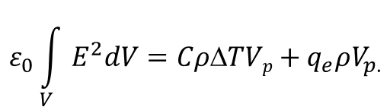

Estimations for Structure Lifetime
Because the luminosity is required to be high, the repetition rate for a short-pulse structure must be increased by factor of pulse length reduction. It could be as high as sub-MHz level.
$$BDR=E^{30}τ_{0}^{5}$$
for a long-pulse structure.
τ₀
long-pulse structure
$BDR$_{N}$={NE}^{30}τ^{5}=E^{30}τ^{4}τ_{0}$
for N short pulses, i.e.
$E\sim \frac{1}{τ^{2/15}}$.
1
2
3
…
N
short-pulse
structure
Let us take BDR_{N}=BDR and assume that in case of breakdown event all RF power stored in a cell can be deposited in material erosion:
τ
τ=τ₀/N
micro-pulses
$$ε_{0}\int_{V}{E^{2}dV={CρΔTVp+q}_{e}ρV_{p.}}$$
macro-pulse
To “kill” the structure completely one need evaporating as much material as:
$\frac{V_{p}^{total}}{V}=\frac{1}{Q}=\frac{1}{πfτ}$.
Eventually, the full number of macro- pulses to destroy the structure:
$$N_{LT}≈\frac{1}{πfτ}\frac{V}{V_{p}}\frac{1}{{BDR}_{N}}\sim \frac{1}{τ^{{11}/{15}}}.$$

Slide 10
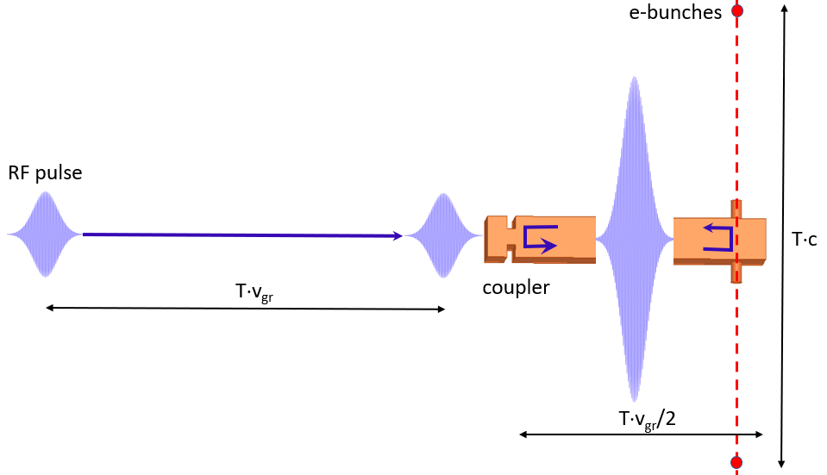
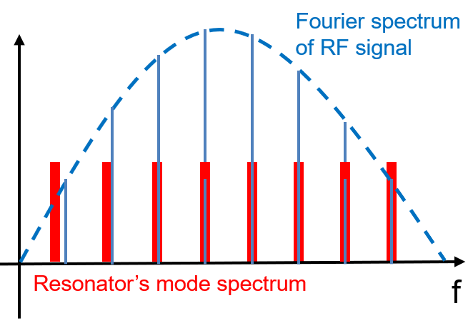
High-Efficiency Short Pulse Acceleration
E_{acc}
Delay waveguide
TE₁₀
time
Field in accelerating gap
Fourier spectrum of pulses and eigen mode spectrum of resonator
Resonator with equidistant mode spectrum.
Frequency | 10 GHz | 10 GHz
Waveguide type | WR90 | WR90
RF pulse duration | 1 ns | 0.5 ns
RF pulse period | 10 ns | 5 ns
Peak RF power | 170 MW | 140 MW
Power gain | 47 | 55
Bunch charge | 1 nC | 3.5 nC
Efficiency | 0.7% | 6%
Steady state traveling RF pulse (blue) and the feeding RF pulse (red).
Power gain (blue) and field enhancement in accelerating gap (red)
500 MV/m accelerating structure

Slide 11
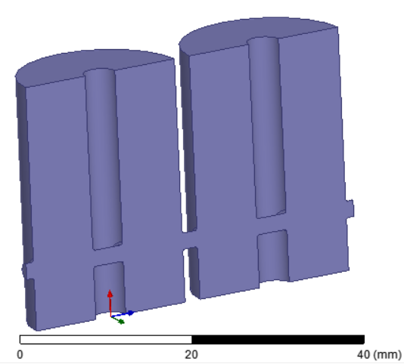
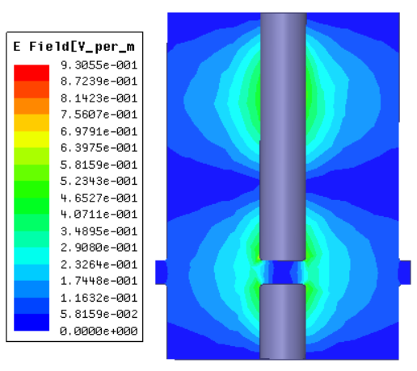
Coaxial Travelling Wave Structure
TEM travelling wave delay lines
Beam
channel
E
E
E-field
Frequency dispersion is almost absent!
Power gain (~20) depends on losses in delay waveguides,
It can be increased using special coating or working at cryogenic temperatures.

Slide 12
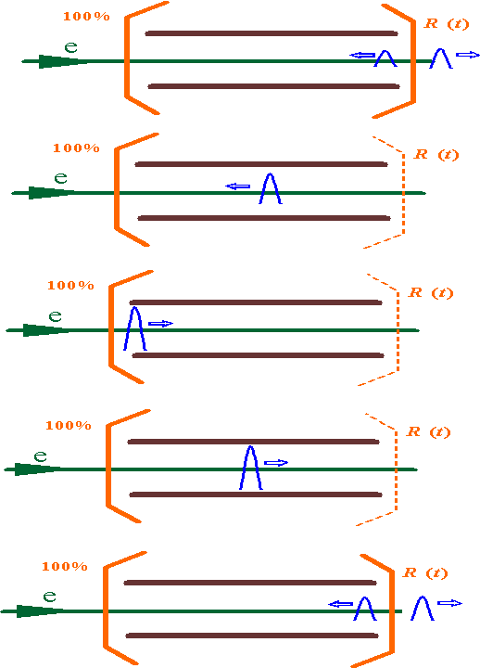
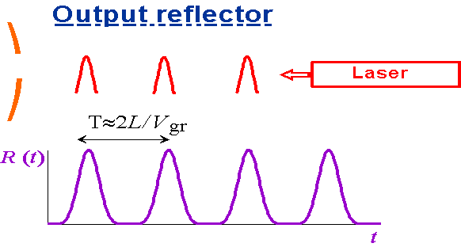
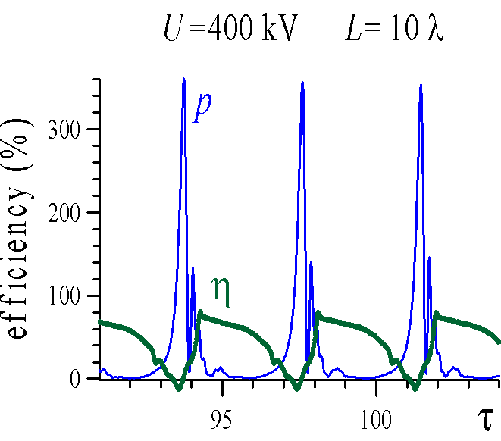
High-Power Short-Pulse RF Sources
BWO with Q-switching:
- Stationary pulse-periodic generation of short rf pulses.
- RF pulses are phase locked by Q-modulation shape.
Q-switched BWO : Efficiency = 60-70%
peak rf power = 350 %
G. G. Denisov, S. V. Kuzikov, A. V. Savilov. Q-switching in the electron backward-wave oscillator, Physics of plasmas 18, 103102 (2011).
S.V. Kuzikov, A.V. Savilov, Parametric Phase Locking in an Electron RF Oscillator, Phys. Rev. Lett. 110, 174801 (2013).

Slide 13
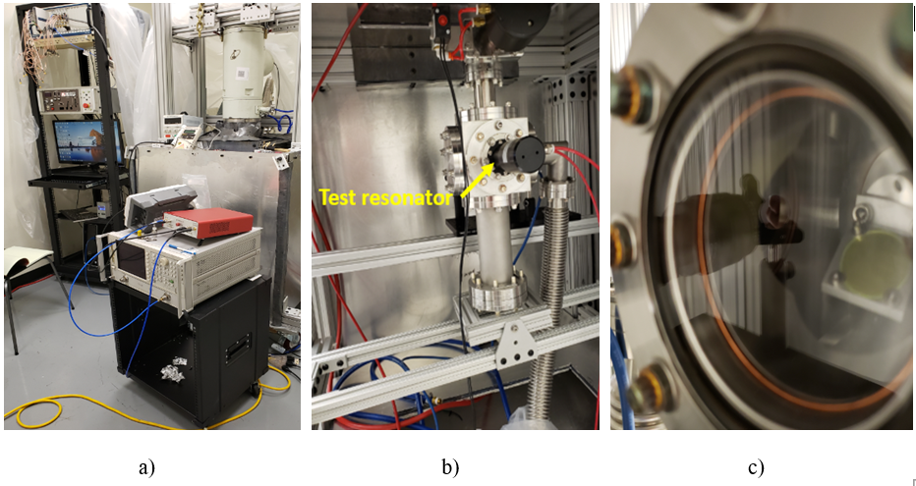
RF Modulation by Electron Beam and AC Bias Voltage
Electron beam
(I=1-7 μA)
VBS test stand with installed test resonator: a – overall view, b – test resonator in vacuum chamber installed in the bottom, c – view through quartz window to YAG-screen.
Diamond
Avalanche effect
Beam on
(50% of time)
Beam off
(50% of time)
VBS beam modulation (5 Hz)
Bias (3 kV) modulation frequency is 100 Hz.

Slide 14
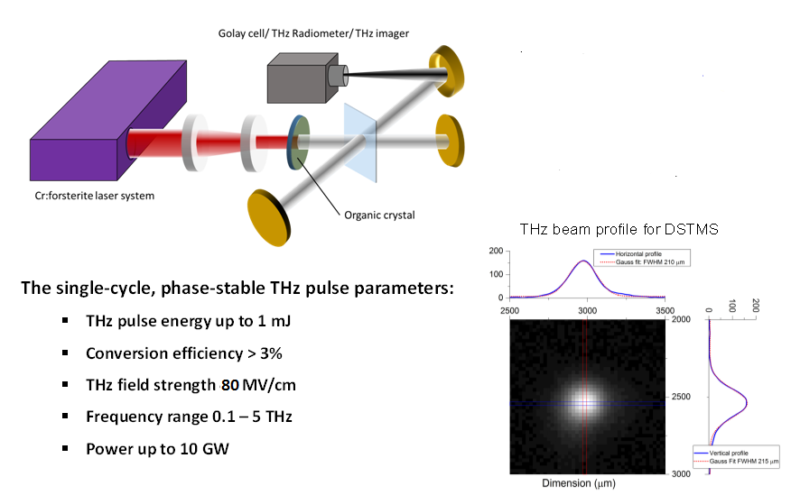
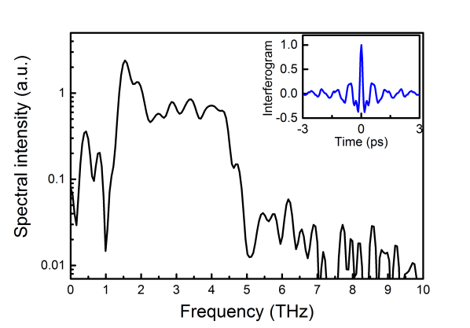
Generation of mJ Single THz Pulses with Electric Field Exceeding 80 MV/cm*
Emitted Terahertz spectrum
*C. Vicario et al. Optics Letters, Vol. 39, Iss. 23, 2014.
High-fields have been produced by optical rectification in a large-size organic crystal by a powerful pump lasing. The phase-locked single-cycle pulses carry peak fields of more than 80 MV/cm at diffraction limited spot size. The scheme has 3% conversion efficiency.

Slide 15
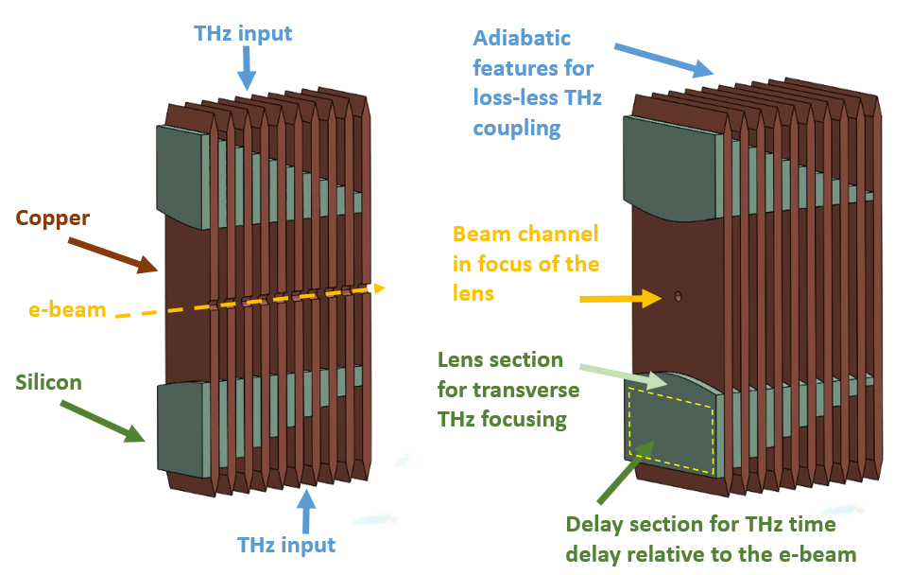
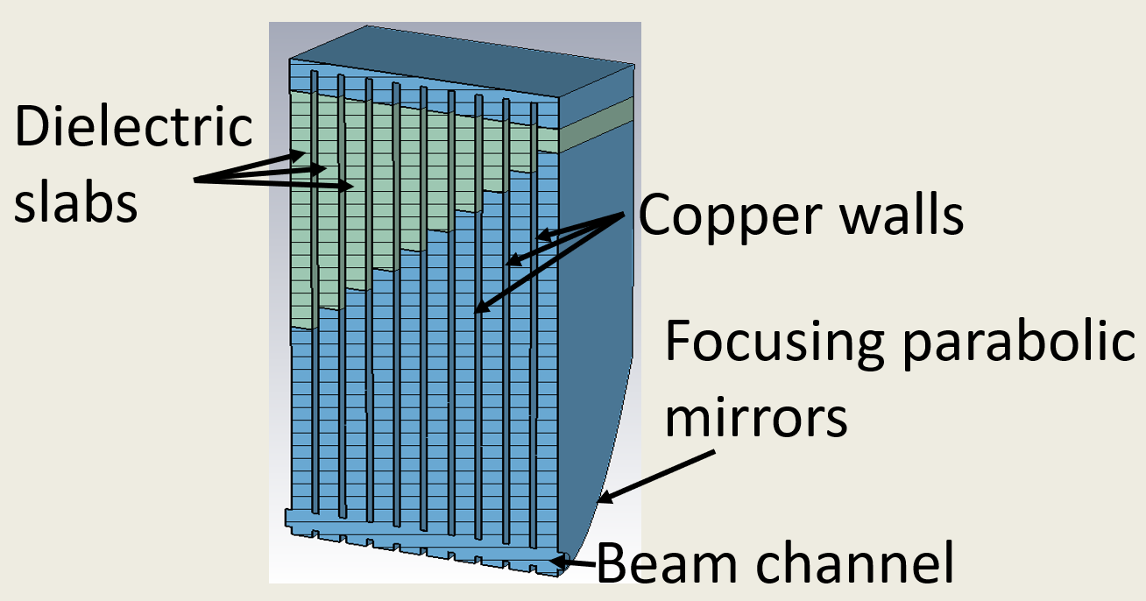
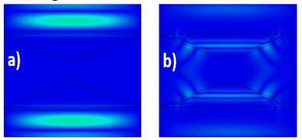
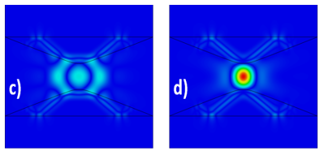
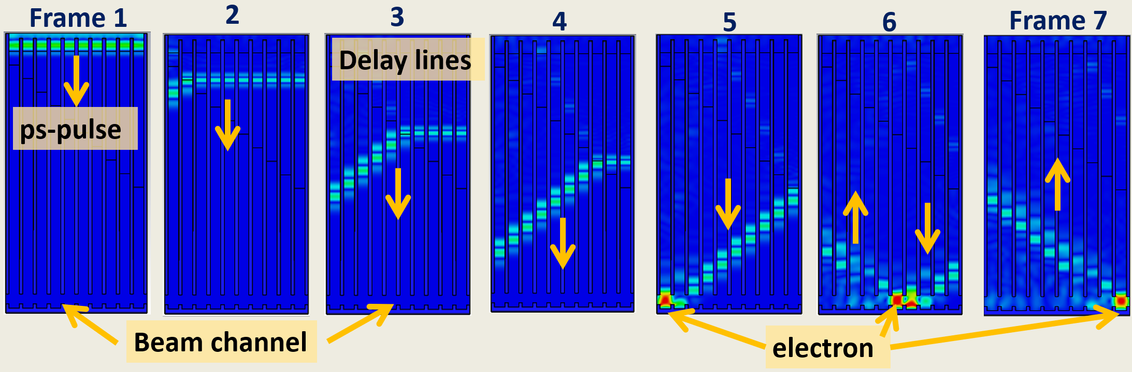
Multi-Cell Accelerating Structures Driven by Focused THz Pulses
E-field distributions at the lens while focusing the short THz pulse, for the time correspondent to THz pulse arrives to lens (a), for time when focusing begins (b), for time when focusing is close to maximum (c), and in maximum of focusing (d).
Timing of THz pulses in the structure.

Slide 16

Single Cycle Wakefield Accelerating Structure
Witness beam
High current drive beam

Slide 17
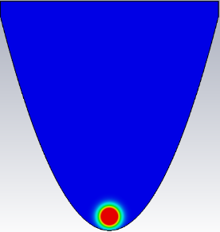
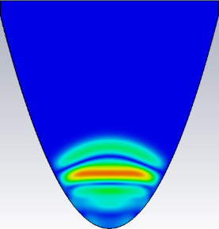
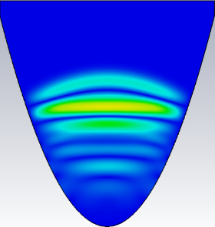
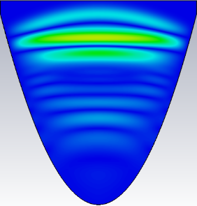
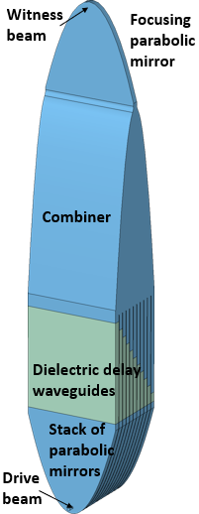
A Wakefield Single-Cycle Accelerating Structure
a)
b)
a)
b)
c)
d)
Shape of the single-cycle wake (a) and spectrum of this wake (b) at the output of the parabolic mirror with a length of 9.6 mm and an aperture of 150 mm generated by a 50-nC, 5-mm-long (Gaussian) single bunch.
Excitation of a single-cycle wake in a gap with a parabolic shape. Time flows evenly as a-b-c-d.
Single-cycle acceleration cell.

Slide 18
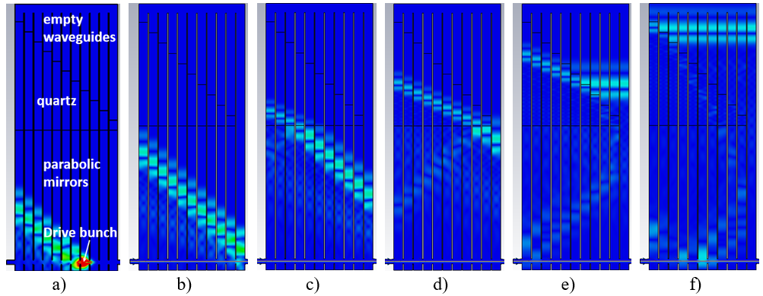
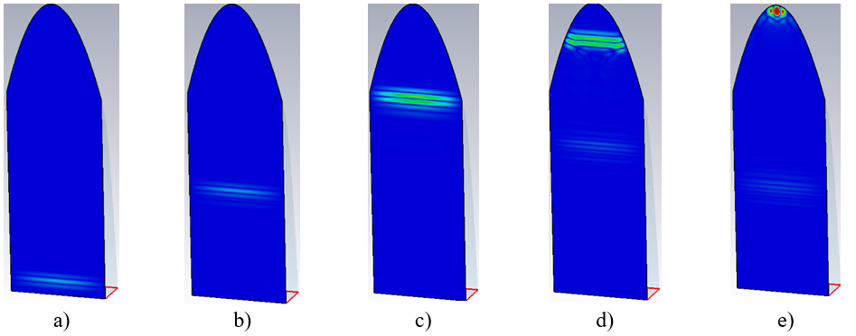
Field excitation by a single bunch in parabolic mirrors, and evolution of this field in the delay line waveguides. The bunch travels from left to right.
Field shapes for the pulse entering the pulse combiner (green curve), for the pulse at the entrance of the focusing parabola (pink curve), and at the focus of the final parabolic mirror for 50 nC.
Parameters
Bunch charge, nC | 50 | 150 | 250
Number of bunches | 5 | 2 | 1
Number of cells | 11 | 20 | 11
Accelerating field, MV/m | 170 | 470 | 570
Summation of pulses in the combiner and focusing of the resulted single-cycle pulse by the parabolic mirror. Time flows evenly from left to right.
Parameters of the accelerating structures.

Slide 19
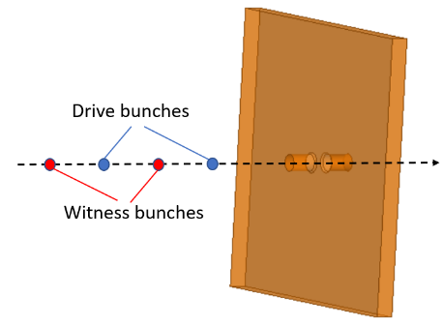





A Multi-Mode Wakefield Accelerating Structure
S.V. Kuzikov et al, Phys. Rev. Lett. 104, 214801 (2010). S.V. Kuzikov et al. Phys. Rev. Lett. ST Accel. Beams, Vol. 13, No.7, 071303 (2010).
E-field mode structures in a slice of the square resonator: a – TM_{1,1,0} , b – TM_{3,3,0}, c - TM_{5,5,0}, d- TM_{7,7,0}, e – TM_{9,9,0}.
Enlarged portion of the previous figure.
Field patterns at the time points shown in Fig. 5: a – point A, b – point B, c – point C, d – point D.
E-field in the middle of the resonator with mode spectrum correction excited by 100 bunches.

Slide 20
Conclusion
Short-pulse structures show prospects to achieve ~GV/m gradients. Its can have high efficiencies that are comparable with efficiencies of classical structures.
Breakdown threshold (theoretical and experimental) study for ultra short RF pulses is needed. The temperature dependence is also extremely interesting.
High repetition rate, short pulse RF sources are necessary. So far experiments with wakefield class structures are only available.
The synergistic effect of short pulse technology and cryogenic technology would allow reaching world record gradients as well as high efficiency due to a higher wall conductance.

