Slide 1
THz generation from 3-D printed structures in accelerators
Pavle Juranić, Raziyeh Dadashi, Uwe Niedermeyer, and Rasmus Ischebeck
AAC Workshop, Long Island, NY, 2022

Slide 2
Outline
Introduction: Smith Purcell radiation
Previous work and results: THz radiation in a 2-D case.
Expanding the concept to 3-D
Manufacturing: 3-D printing for 3-D structure
Conclusions and outlook

Slide 3
Smith-Purcell radiation
Electrons passing by metallic or dialectric periodic structures cause radiation to be emitted from those structures. Wavelength of that radiation λ is determined by the formula:
Radiation direction
θ
e⁻
a = periodicity of the structure
m = mode order
β = normalized electron velocity

Slide 4
Using and abusing the radiation
If the electron bunch length is significantly smaller than the periodicity of the structure the SP radiation is emanating from, the radiation effect starts to add coherently. The emitted energy of the radiation should increase as the square of the bunch charge.
So, we have a way to control the wavelength of the radiation with a periodic structure, and as long as the bunch is short, we can have a coherent addition of radiation fields. It could, theoretically be possible to have a small dielectric structure capable of producing fairly strong THz radiation at selectable wavelengths.
The THz radiation generated from the accelerator electron beam would be intrinsically synchronized to the FEL beam, and could maybe save

Slide 5
Proof of principle: the 2D case
First experiments done by Benedikt Hermann et al (ACS Photonics 9, 2022 (1143-1149)).
Inverse designed THz radiatior, optimized 2D design, and the final structure build on the 2D design
Experimental setup at SwissFEL with 30 fs bunches and a periodicity of 900 μm.

Slide 6
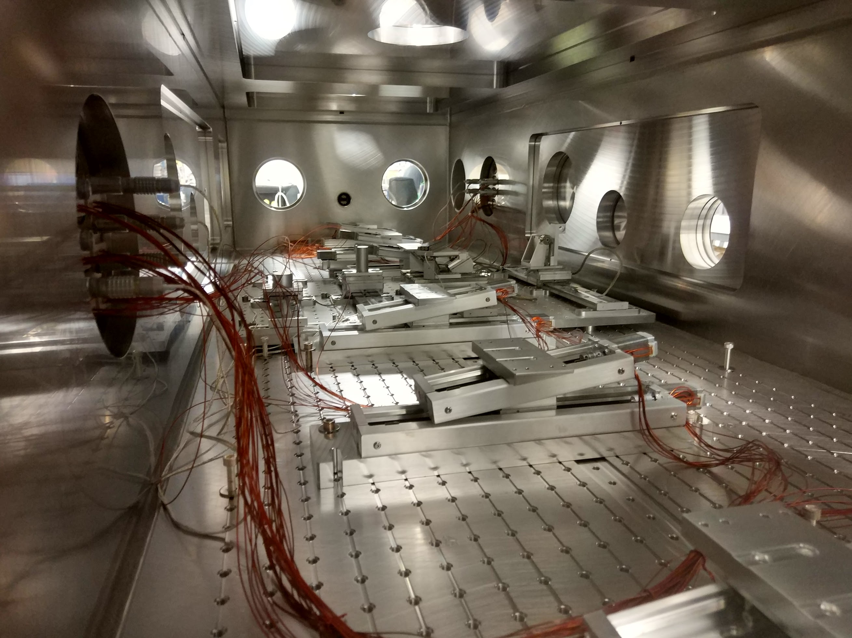
What it looked like
ACHIP Experimental chamber

Slide 7
Nice results
Data
ACS Photonics 2022, 9 (1143-1149)
Note: these results are from a 3-D printed structure with dimensions of 6.5 x 6 x 45 mm. It was literally printed from PMMA in a 3-D printer in a few hours, baked a bit to get it outgassed and vacuum ready, and then stuck onto a goniometer stage in a vacuum chamber along the electron beam.

Slide 8
What was really measured?
e⁻
100 mm
Looking at the experimental geometry, the diode captured less than half of what the lens collimated, and the lens itself captured only about 5/9 of the radiation emitted by the THz radiator, in only one direction. Assuming equal radiation in both directions, the total energy radiated at 11 pC of charge would have been 0.036 pJ for this 2-D setup in the most conservative scenario.
45 mm
25 mm
12 mm
Schotky Diode
Lens/collimator
THz structure

Slide 9
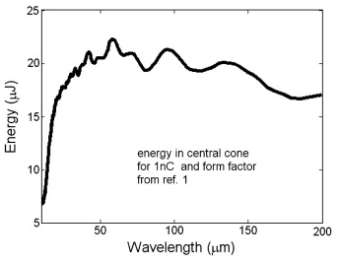
Expectation for 3-D?
Assuming we could harness the energy in all directions instead of just the horizontal direction, we would be able to get at least 1 nJ of energy, under the most conservative assumptions. How does this compare to a current accelerator-based THz source?
THz undulator at FLASH:
1 nC of charge gets about 18 μJ of energy at 150 μm wavelength.
Extrapolating a hypothetical 3-D THz structure to 1 nC of charge, we would get about 10 μJ of energy for a 45 mm length structure, for 900 μm wavelength.
Again, this is a 3-D printed piece of plastic that we built in a day. So you can see why we were interested.
Gensch et al, Infrared Physics & Technology 51, 2008 (423-425)

Slide 10

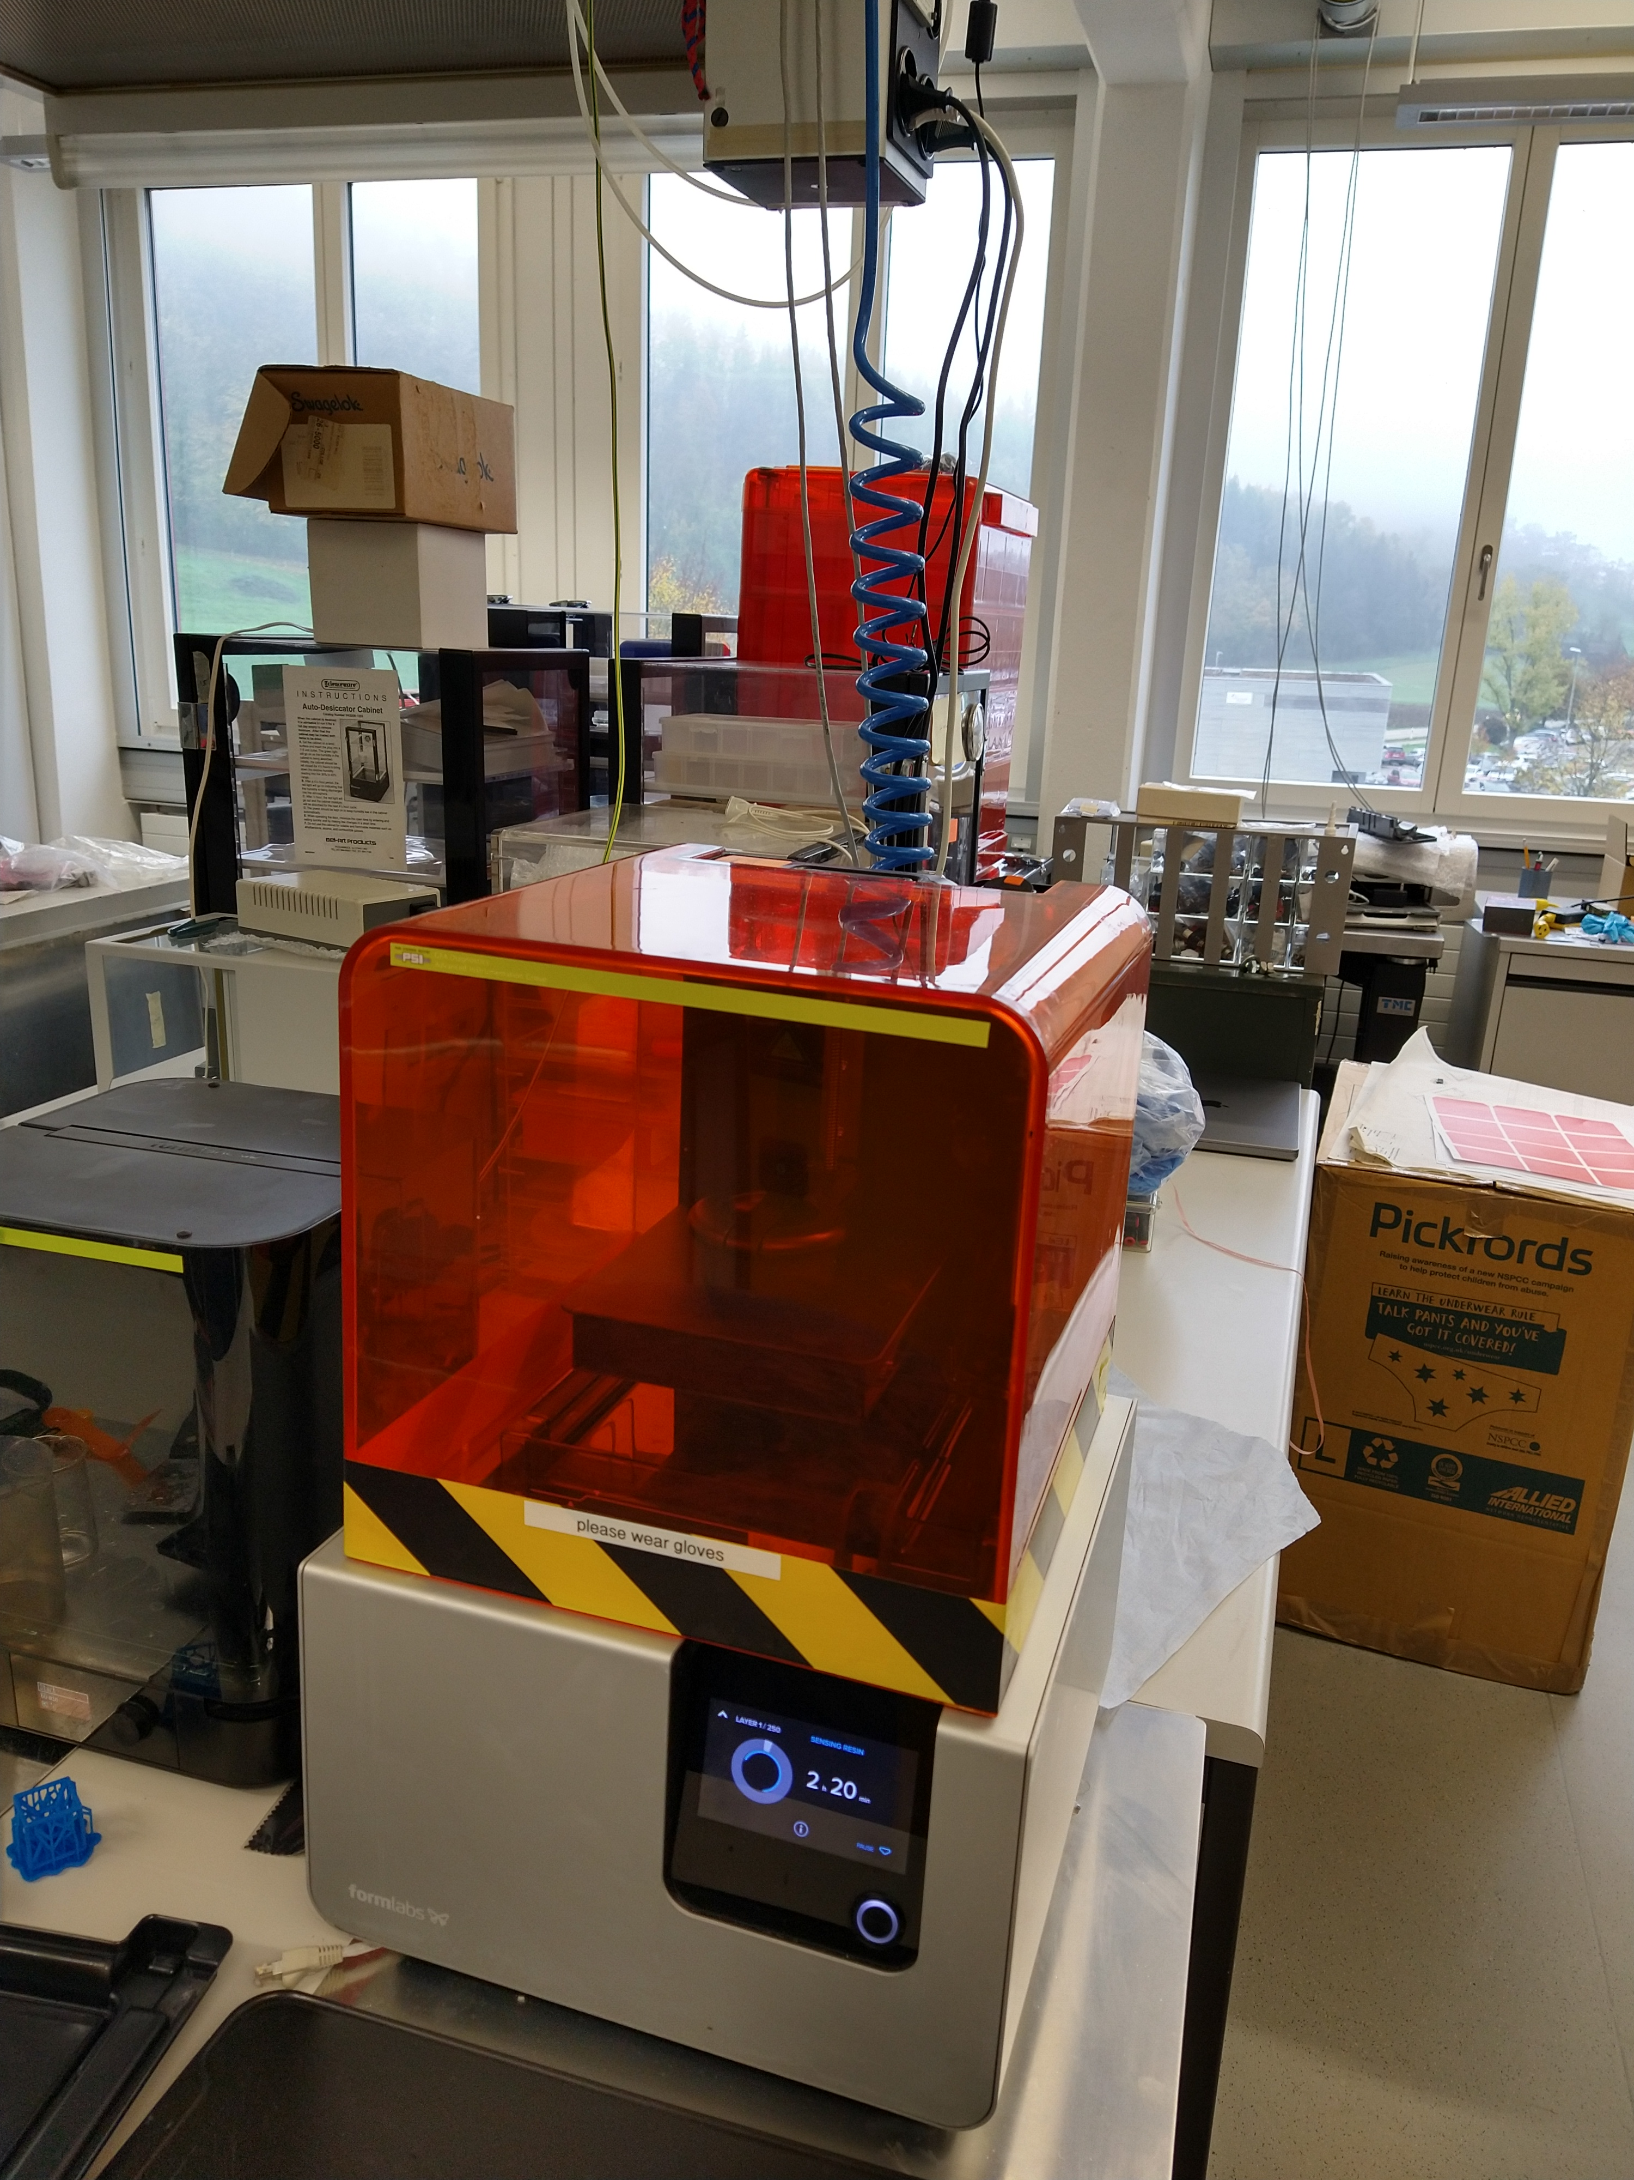
3D printers
Ours. 140 micron spot size.
Cost between $3800 and $6000. We have an older one.

Slide 11
3D structure preliminaries
Started off as an idea with a cylindrical structure, but evolved into a conical structure when Prof. Uwe Niedermeyer started looking at the generation.
The structure shape would capture the THz generation from all directions, and then collimates and sends it out forwards, where it is then reflected out of the vacuum chamber.
Several parameters become interesting: the refractive index of the material, manufacturing tolerances, and so on.

Slide 12
Preliminary modelling
Models showing the propagation of the electron through the structure and the generation of THz in the structure for two different refraction indecies. A larger index of refraction leads to improved THz radiation generation. It is all about absorption.

Slide 13
Absorption visualized
Absoprtion coefficient (cm⁻¹)

Slide 14
Prototype structures
We are testing the production of the structures to see how well we can make them.

Slide 15
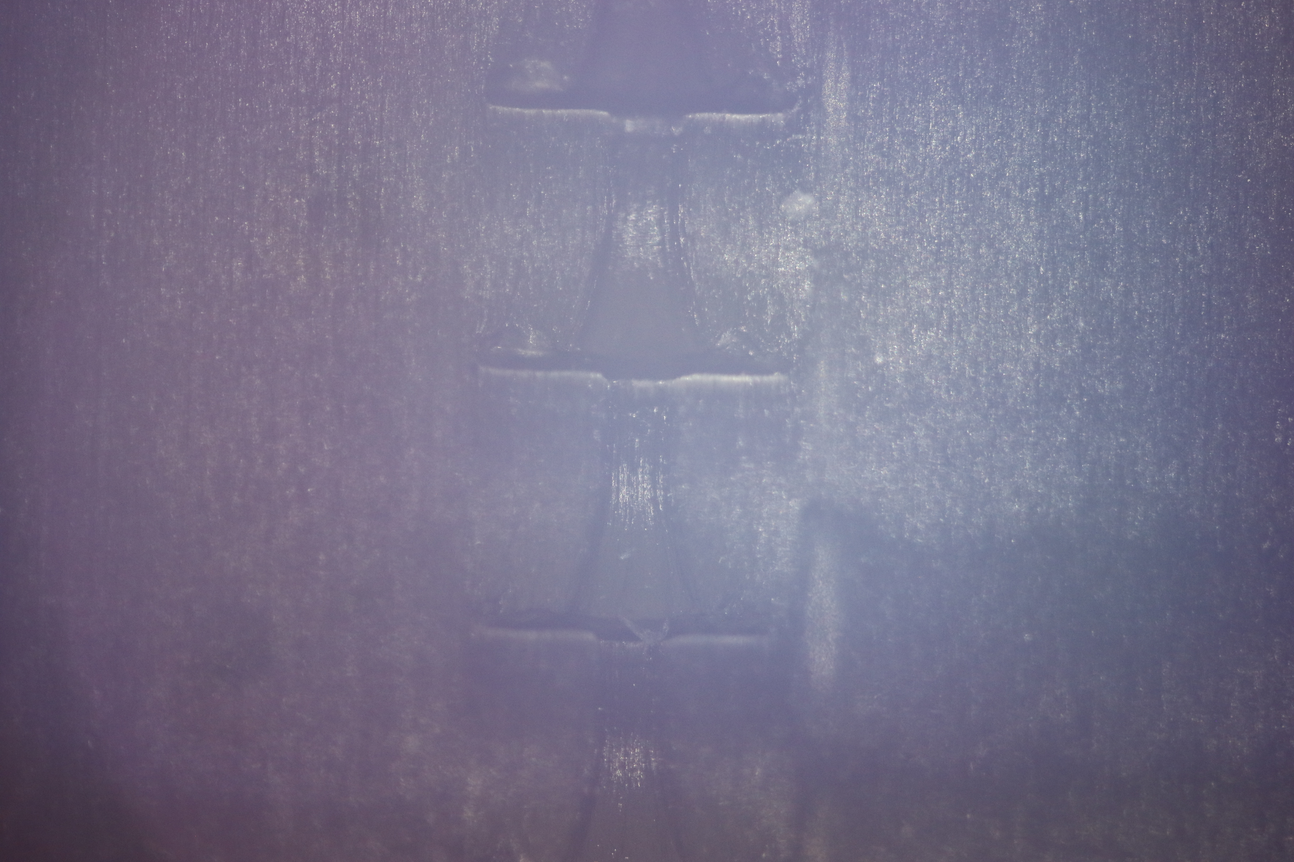
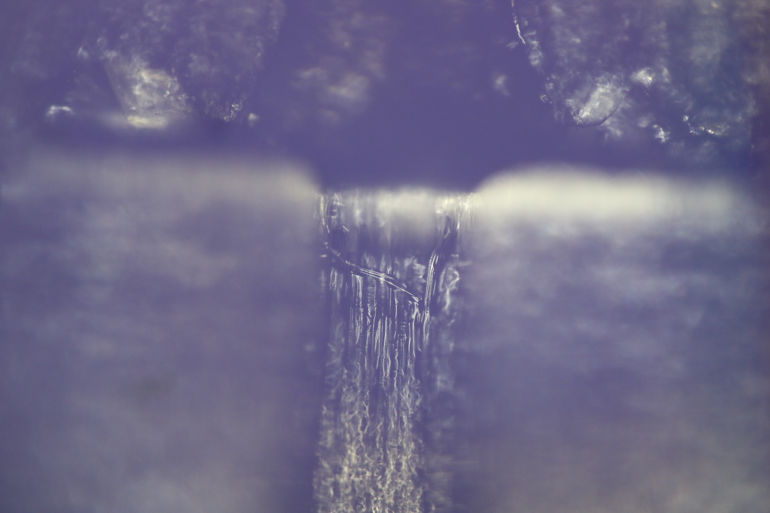
Under the miscope
It seems a bit rough, but we will keep working on it. An alternative would be to construct a 3-D printed half-cones, and have the structure etched with e-beam lithography. One can purchase this service as well—not too expensive. Then we attach two half-cones together and apply a gold coating for THz reflection.

Slide 16
Summary and outlook
New idea for a THz generating structures based on 3-D printed PMMA and PMMA alloy materials.
Could be tailored for wavelengths based on structure geometry. We already demonstrated 0.3 THz (0.9 mm), but the 3-D printers can go to a resolution of almost an order of magnitude smaller structures. We can get even lower with e-beam etching.
The 3-D idea is just starting, so it will take a while. If anyone is interested, we have a fellowship position at PSI open to explore this.

Slide 17
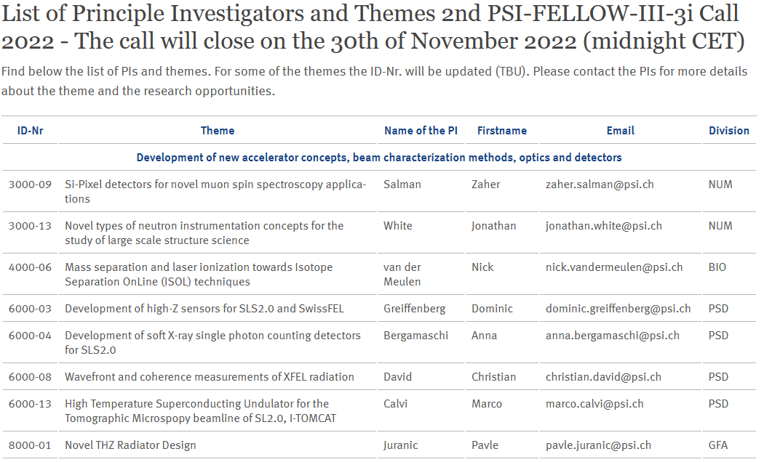
PSI fellowship
https://www.psi.ch/en/psi-fellow/list-of-principle-investigators-and-themes

Slide 18


Acknowledgments (they gave us money and employment)

Slide 19
Wir schaffen Wissen – heute für morgen
My thanks go to
Benedikt Hermann
Markus Baldinger
ACHIP collaboration

