Slide 1
High Efficiency RF Source Development
Lawrence Ives,
Calabazas Creek Research, San Mateo, CA. USA
100 kW, 1.3 GHz Magnetron w/ Phase and amplitude control
Magnetron frequency/phase control with varactors
100 kW, High efficiency, L-Band klystron
350 – 700 MHz, 200 kW Power Grid Tube RF sources
700 MHz Multiple Beam IOT
.

Slide 2

A 100 kW, 1.3 GHz Amplitude and Phase Controlled Magnetron for Accelerators
Michael Read¹, R. Lawrence Ives¹, Brian Chase², John Reid², Chris Walker³ and Jeff Conant³
[1] Calabazas Creek Research Inc., San Mateo, CA 94404
[2] Fermi National Accelerator Laboratory Batavia IL 60510-5011
[3] Communications and Power Industries LLC, Beverly, MA, USA 01915
Funded by the US Department of Energy under SBIR grant DE-SC0011229

Slide 3
Fermilab Approach
Externally phase lock the magnetron,
Achieve amplitude control by phase modulating the locking signal to transfer power to side bands
  Side bands are rejected by high Q accelerator cavity
  Power into the cavity = Magnetron power less the side band power

Slide 4
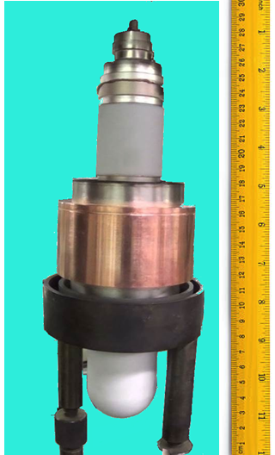
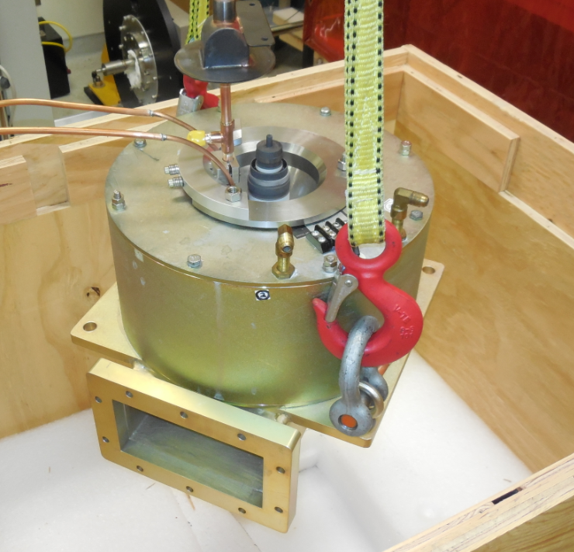
CPI Magnetron
1.30 GHz
100 kW peak
10 kW average
1.5 ms pulsewidth

Slide 5
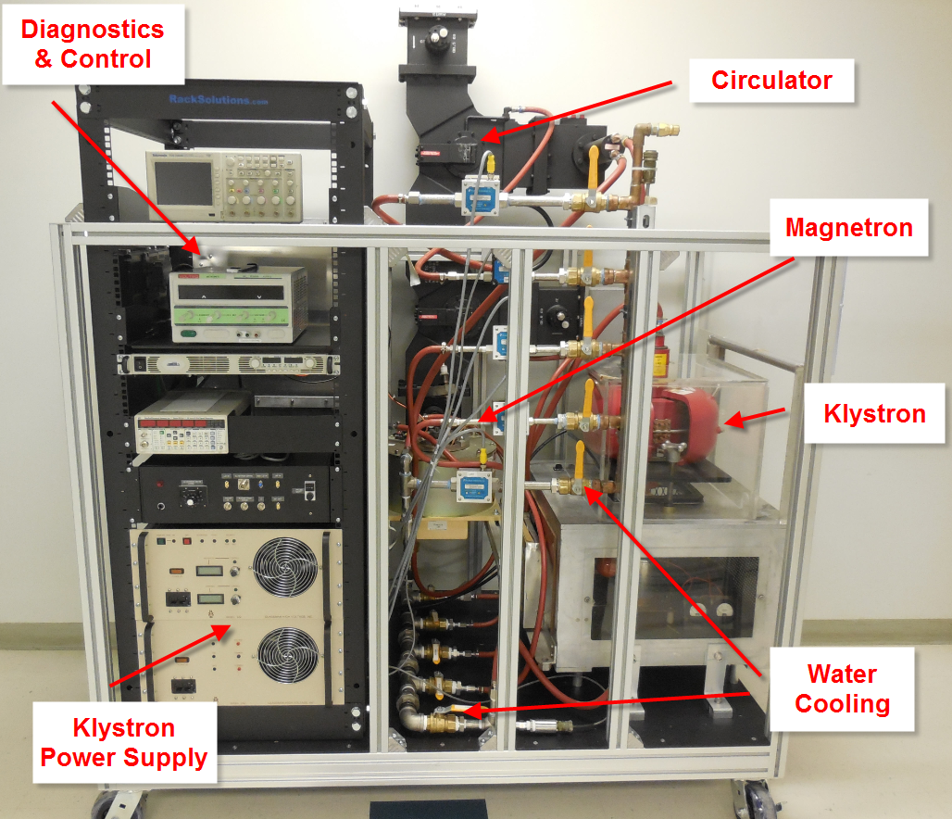
Packaged Magnetron System

Slide 6
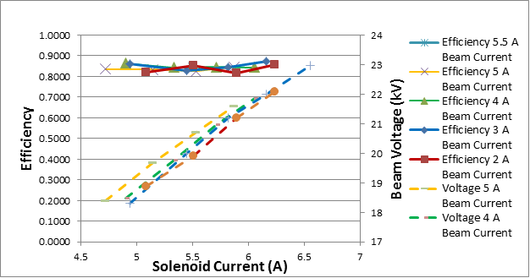
Efficiency
Efficiency varied between 81% and 87%, depending on parameters

Slide 7
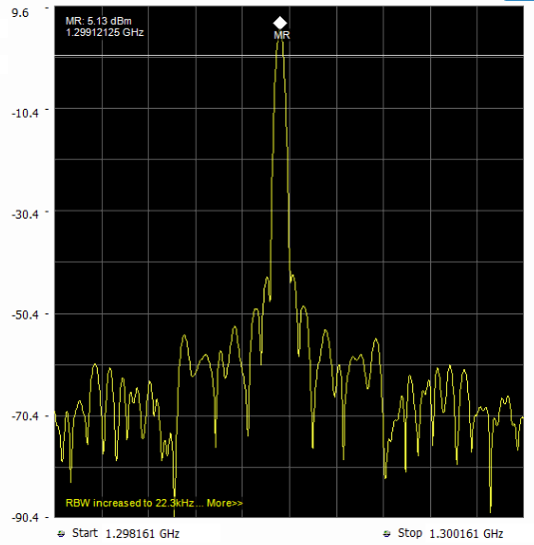
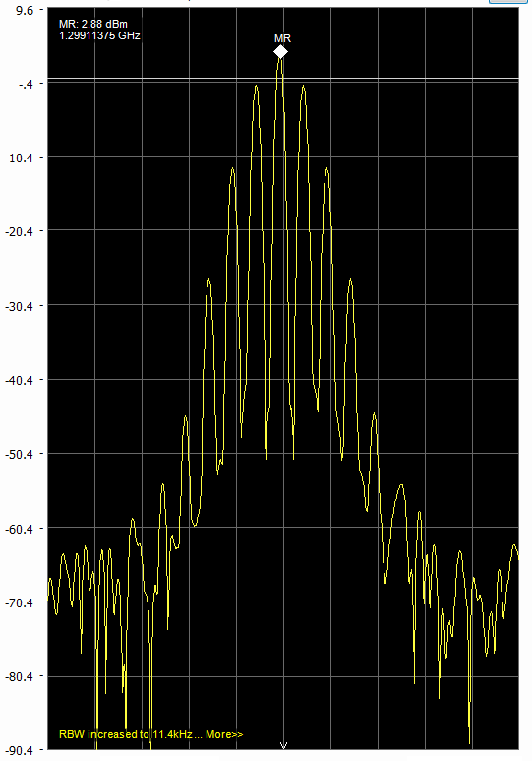
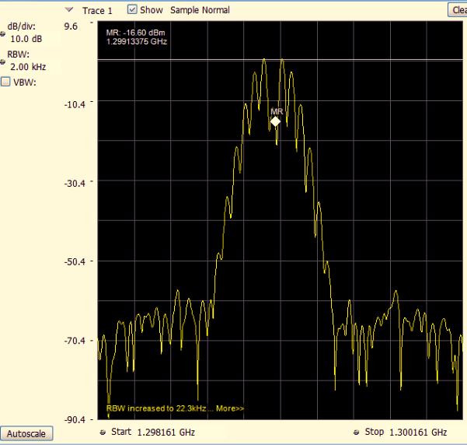
Phase Modulation
50 kHz Phase Modulation
9.6
0.0
-10.4
-20.4
-30.4
-40.4
-50.4
-60.4
-70.4
-80.4
2 MHz
1 MHz
2 MHz
No Modulation
60° Modulation
122° Modulation

Slide 8
Magnetron Amplitude vs Phase Modulation
Theory:

Slide 9
Cost for 100 kW System
(Exclusive of high voltage supply)
Magnetron | $40,000
500 W SS amplifier | $17,000
Circulator w waveguide | $20,000
Controls | $10,000
Packaging | $10,000
Total | $97,000
Magnetron System Cost ~ $1/Watt
(Klystron cost ~ $4/Watt)

Slide 10
A 1.3 GHz 100 kW Ultra-high Efficiency Klystron
Poster: 2.09 Wednesday 5:00 PM
Michael Read¹, Aaron Jensen², R. Lawrence Ives¹, Thomas Haberman¹, David Marsden¹, and George Collins¹
[1] Calabazas Creek Research Inc., 490 Port Drive San Mateo, CA 94404
[2] Leidos, Center for EM Manager DEOST, Billerica, MA 01821
Communications & Power Industries, LLC, Palo Alto, CA 95304
Funded by the US Department of Energy under SBIR grant DE-SC0017789.

Slide 11
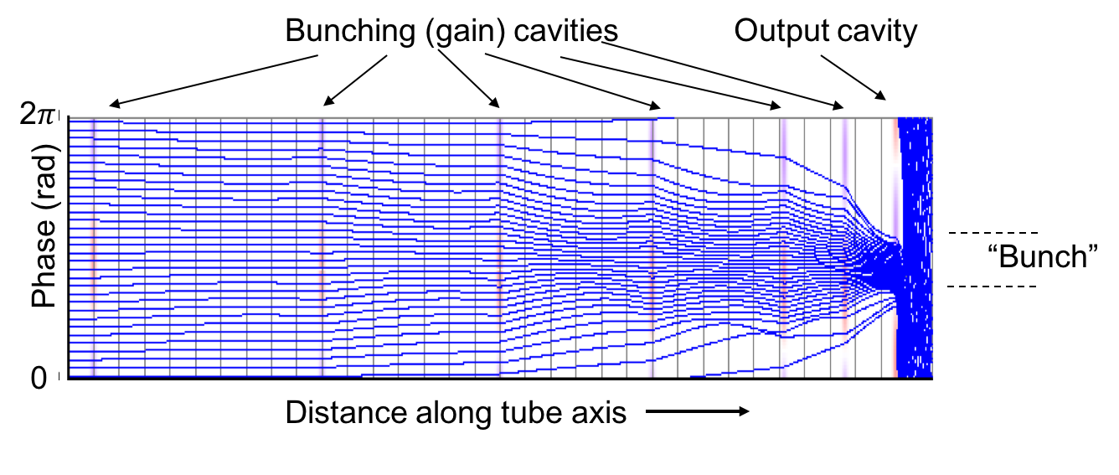
Core Oscillation Method (COM)*
Cavity spacing set wider than the normal bunch oscillation length
Antibunch particles monotonically approach the central bunch
Circuits are long
* A. Yu.Bajkov, D.M.Petrov “Problems of creation powerful and super- power klystrons with efficiency up to 90%”, International University Conference “Electronics and Radio physics of Ultra-high Frequencies”, St. Petersburg, May 24–28, 1999, pp. 5–8.

Slide 12
Design Parameters
COM design with 7 cavities
Parameters
  Voltage 53.5 kV
  Current 2.46 A (0.2 micropervs)
  Beam diam 0.6 cm
  Drift tube diam 1.0 cm
  RF structure length 205 cm

Slide 13
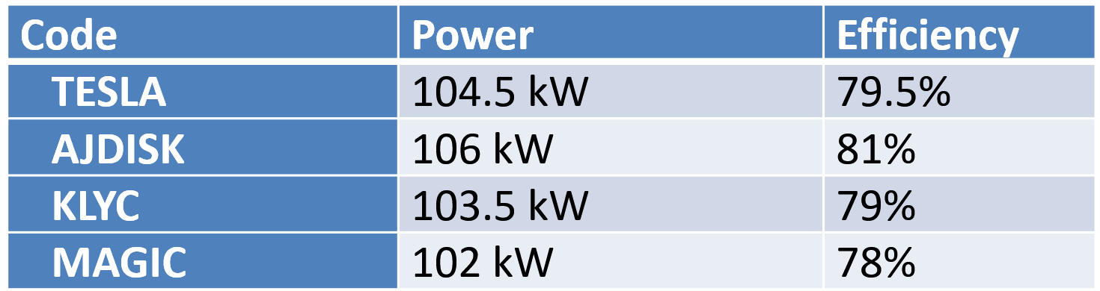
Simulation Summary

Slide 14
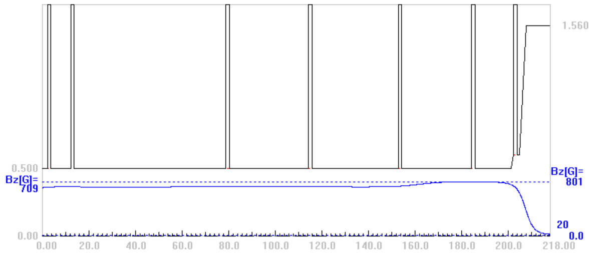
Cavity Locations and B-Field Profile
P = 104.5 kW
η = 79.5%
2.2 m

Slide 15
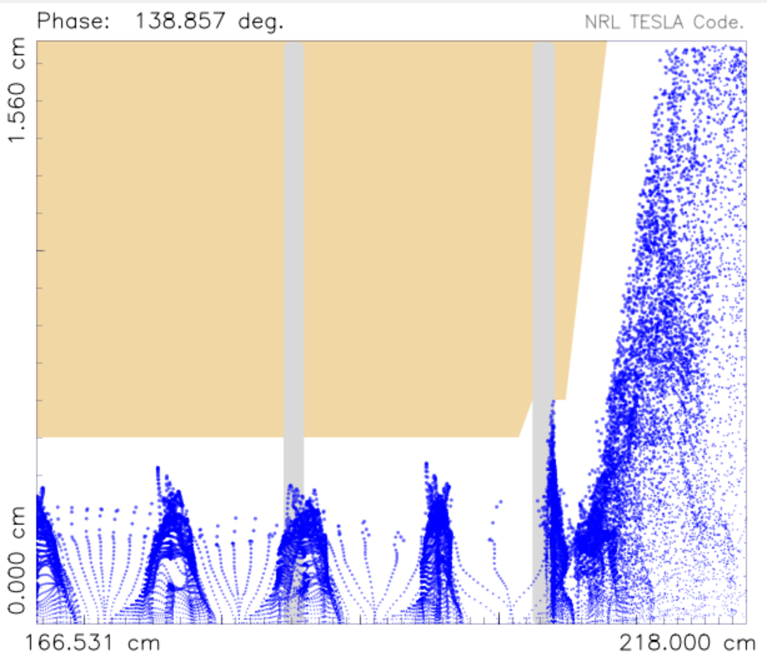
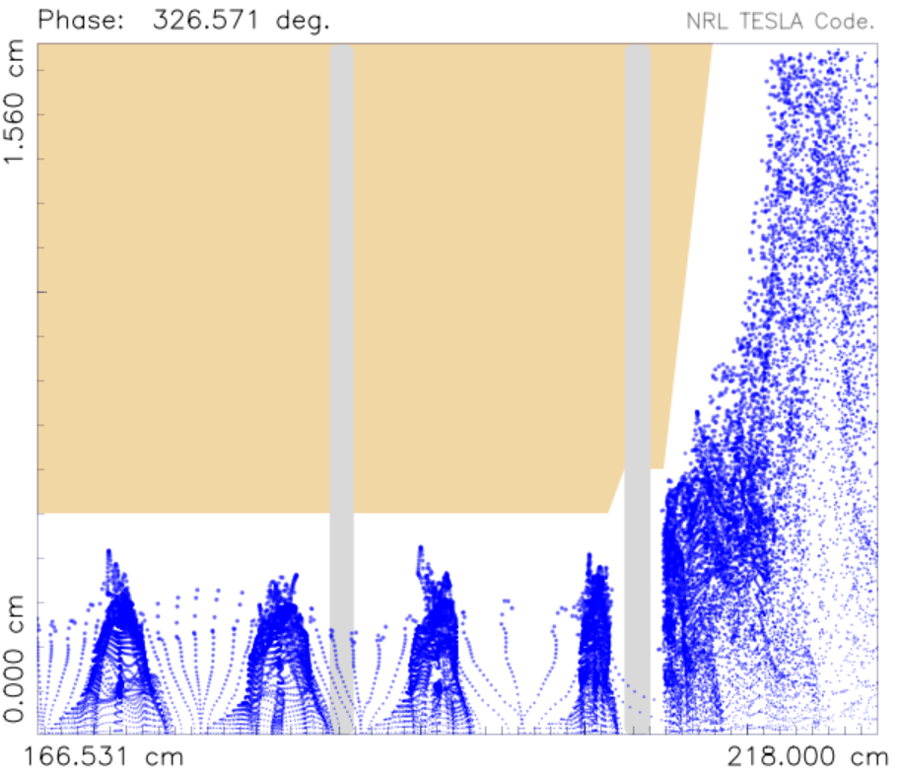
Beam Trajectories Near Output
Phase with most interception
Phase with least interception
~ 200 W/cm² over ~ 5 mm

Slide 16
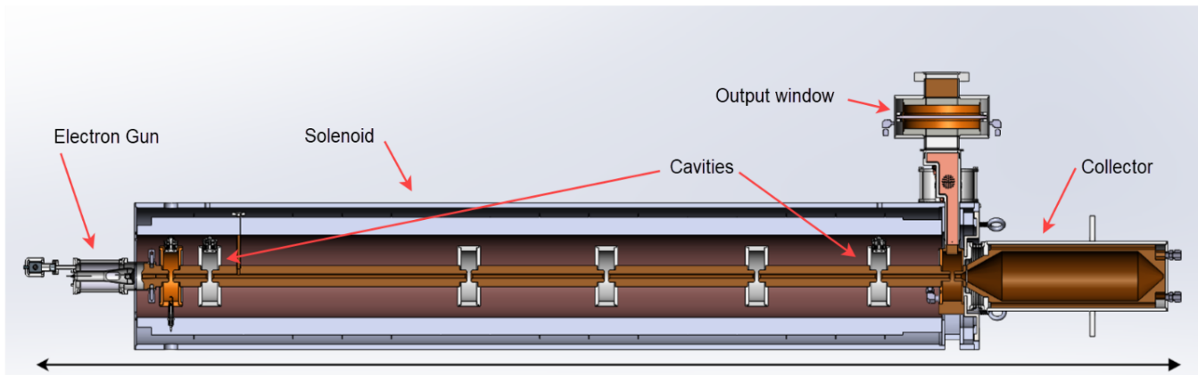
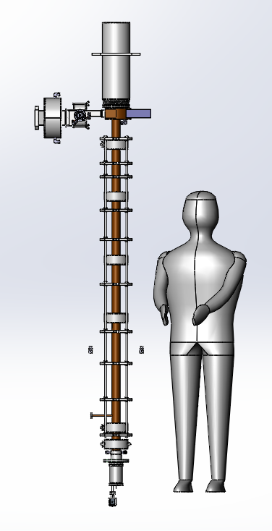
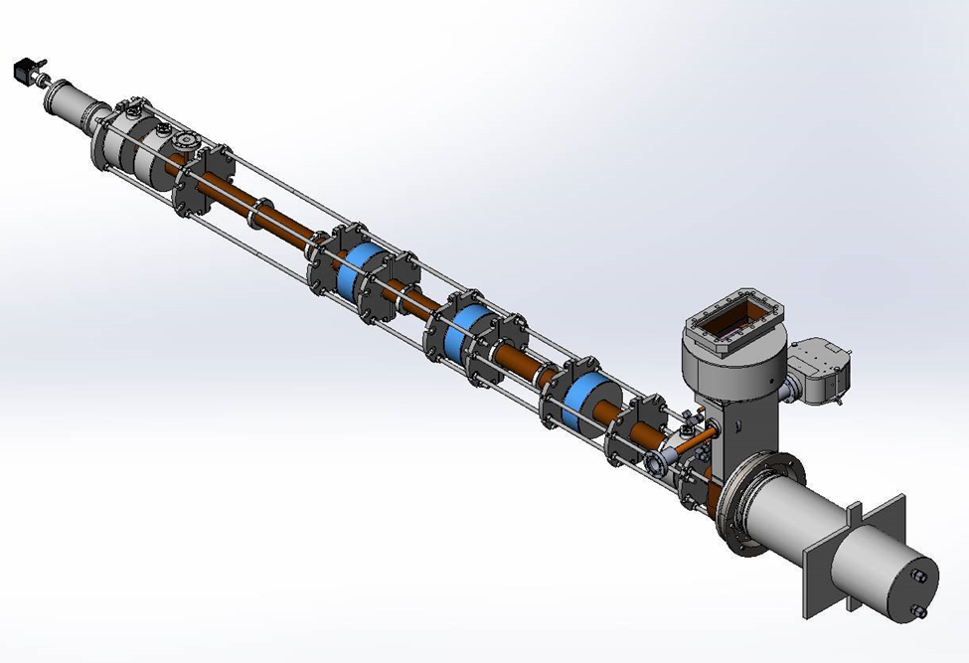
Solid Models of Klystron
279 cm

Slide 17
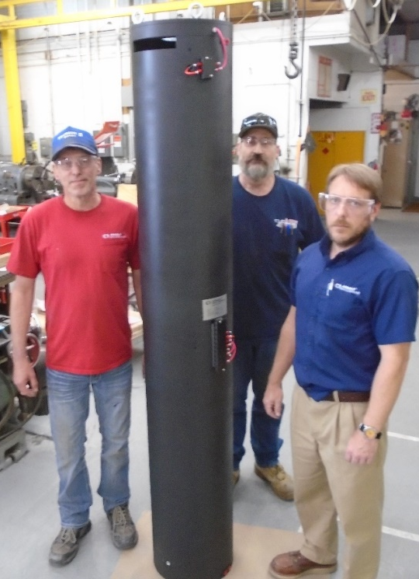
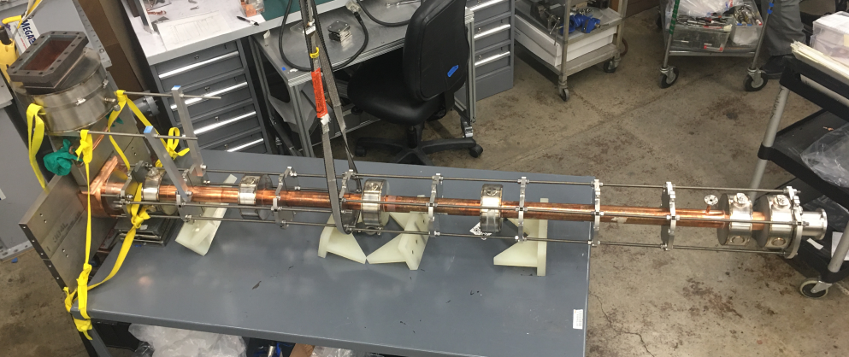
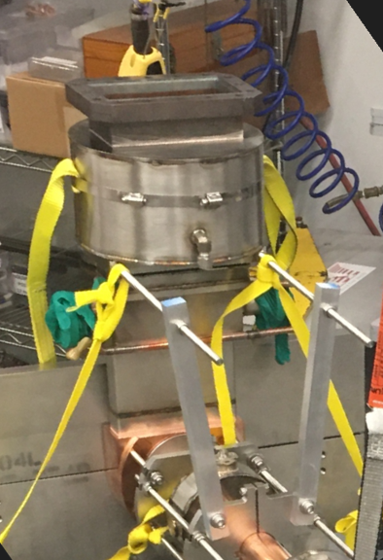
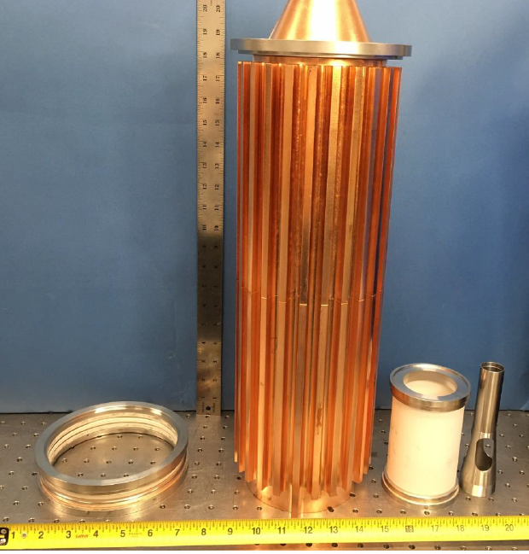
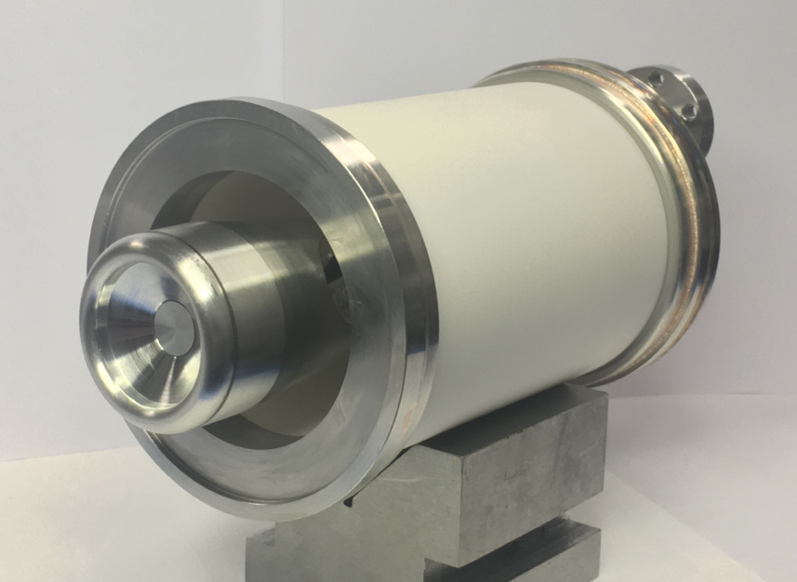
Partial Seal-in

Slide 18
High Efficiency Klystron Summary
Seven Cavity COM design
Simulation of ‘as built’ klystron predicts 78.2% efficiency
Final seal in next two weeks
Testing to start January 2023

Slide 19
Multiple Beam Power Grid Tubes for High
Frequency and High-Power Operation
Lawrence Ives, Michael Read,
David Marsden, Thuc Bui
Calabazas Creek Research, San Mateo, CA. USA
Ricky Ho, Nileshwar Chaudar,
Christopher McVey, Tom Cox
Communications & Power Industries, LLC
Palo Alto, CA 94304 USA
James M. Potter
JP Accelerator Works
Los Alamos, NM USA
This research funded by DOE SBIR Grant DE-SC0018838
.

Slide 20
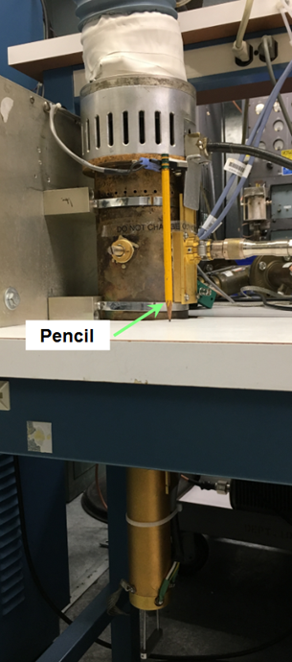
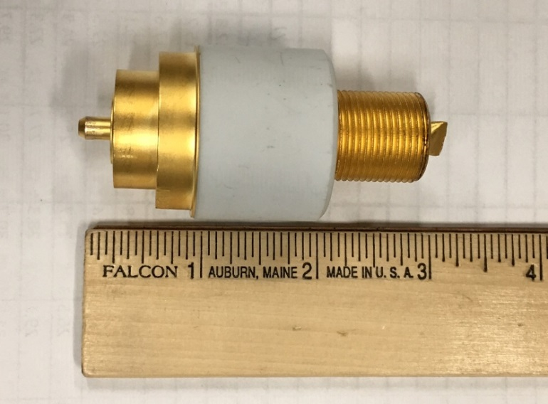
25 kW 425 MHz
Triode-based RF Source
YU-176 Triode
Efficiency 90% (Class C)

Slide 21
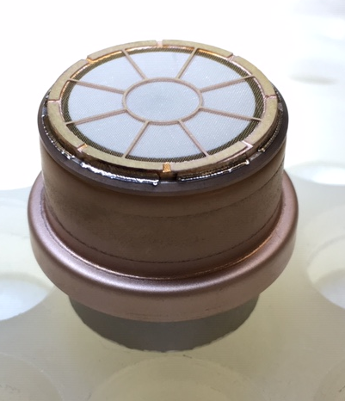
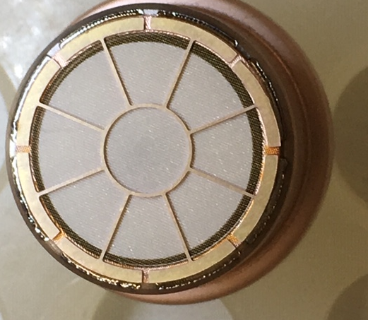

YU-176 Grid Cathode Assembly
Features
Oxide cathode
- $916 factory cost
Grid
- cut from commercial tungsten screen
- brazed to tungsten supports
Integral ceramics and vacuum seals
Beam power – 28 kW
Total cost - $1,500

Slide 22
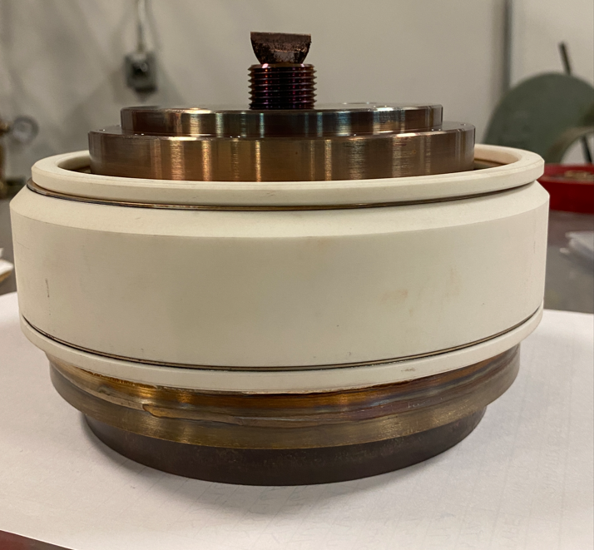
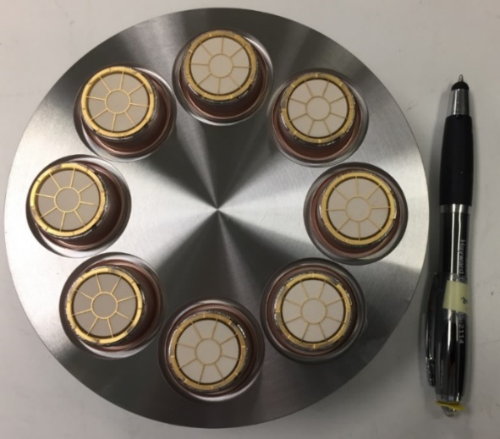
Beam Power for 200 kW RF Source
Eight YU-176 grid cathode assemblies
230 kW of beam power

Slide 23
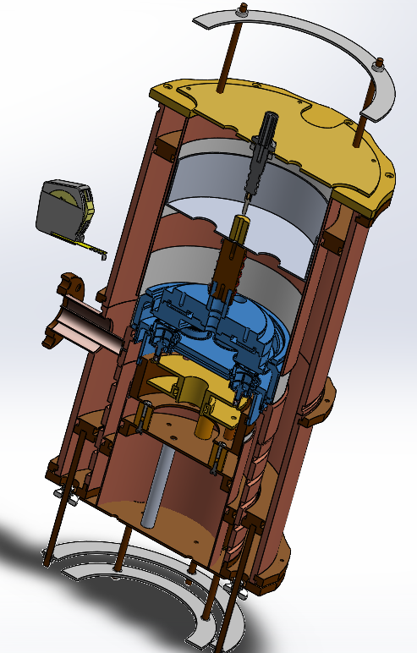
350 MHz Cavities
MB triode tube installs from top (blue)
Single input cavity below tube
Upper and lower output cavities with coax output between
Upper cavity is frequency tuning element
Lower cavity is variable output coupling element

Slide 24
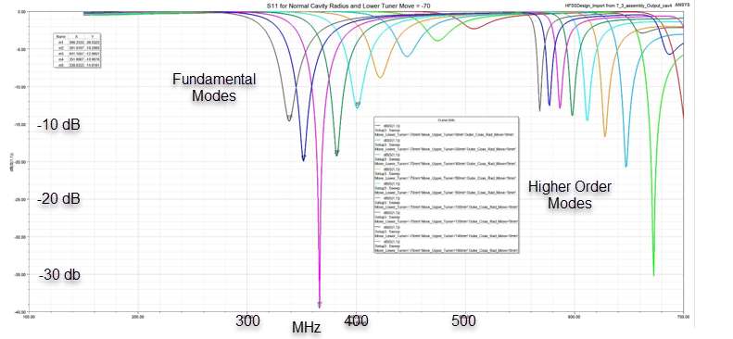
Output Cavity Simulation
Tuning range for output cavity (325 – 500 MHz)

Slide 25
Gain Issue
Gain ~14 dB for triode based sources
200kW RF source requires 6.5 kW driver
Driver: Single-beam triode driver - Same length as multi-beam source with smaller diameter

Slide 26
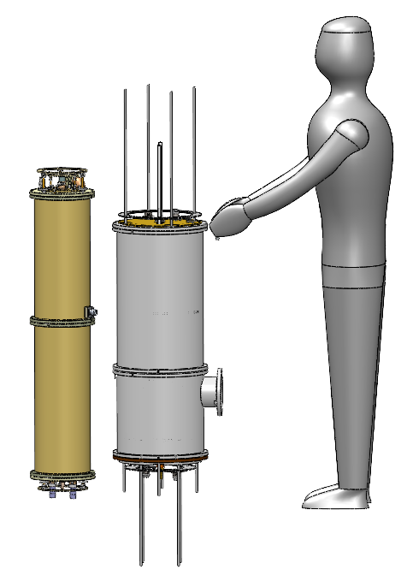
200 kW, 350 MHz RF System
Net Gain 28 dB
Net Efficiency ~80?%

Slide 27
200 kW CW RF Source Cost
350 – 700 MHz
Estimated cost: $100K for 200 kW source and driver
Triode-based system $0.50/Watt ~72%
Klystron: ($4/W) 50-65%
MBIOT: ($2-$4/W) 65-75%
Solid State: ($4/W) ~60%

Slide 28
MB Triode Assembly Status and Scheduled
MB Triode assembly completed and testing in progress (grid to cathode resistance, peak emission, current division, cutoff voltage)
Once tube is successfully verified, will assemble the multiple beam cavities for testing in early 2023

Slide 29
HIGH-EFFICENCY, HIGH AVERAGE POWER INDUCTIVE OUTPUT TUBES
H.P. Freund,¹ R.L. Ives,¹ M. Read,
T. Bui¹, T. Habermann¹, David Marsden¹,
Paul Krzeminski², Takuji Kamura²
¹Calabazas Creek Research, San Mateo, CA
²Communications & Power Industries, LLC, Palo Alto, CA
Work supported by the US Department of Energy Grant No. DE-SC0019800

Slide 30
Goals and Approach
Goals:
Output power 200 kW CW
Frequency 700 MHz
Number of beams eight
Efficiency 80+%
Reduce size and cost
Approach
Include 3rd harmonic drive power to increase efficiency
Implement compact input coupler to reduce size and cost
Use molybdenum grids to reduce cost and risk

Slide 31
3rd HARMONIC TEST CASE
Simulated annular beam at 700 MHz with:
  37 kV/6.67 A
  Annular Beam with inner/outer radii = 5.128 cm/8.079 cm
  I_{avg}/I_{p} = 0.15 → τ_{width}/τ_{pulse} = 0.3
  R/Q = 100 Ω
  Q = 84.6 (loaded)
  Cavity Radius = 9.009 cm
  Cavity Length = 9.144 cm
  Gap Length = 3.1 cm (centered in the Cavity)
  Solenoid Field = 126 G (Brillouin Field)
Simulation results indicate:
  Optimal performance when the phase of the 3rd harmonic relative to the fundamental is π
  Efficiency is enhanced from 84.4% to 86.3%

Slide 32
NEMISIS MBIOT SIMULATON
Eight beam configuration circulating the cavity at the midpoint
  f =700 MHz
  30 kV/6.67 A
  R/Q = 186 Ω, Q = 120
  L_{cavity} = 9.144 cm, L_{gap} = 3.9 cm (centered)
Perveance ≈ 1.3 μP
Peak efficiency with the 3rd harmonic
  Peaks for phase shift of π radians
  Peak efficiency ≈ 94%
  Expect to reach wallplug efficiency above 80%

Slide 33
METAL GRID DESIGN
Current IOTs use pyrolytic graphite (PG) grids
Difficult to fabricate
Expensive
Relatively low yield
MBIOT beam power distributed over multiple beams
Reduced power loading
Thermomechanical analysis predicts good performance
Significantly cheaper and higher yield
Beam Optics Analyzer thermomechanical analysis with beam interception and cathode radiation

Slide 34
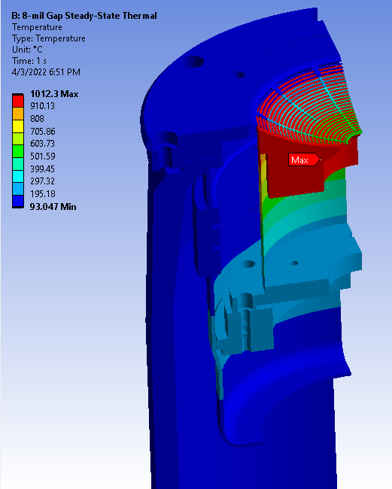
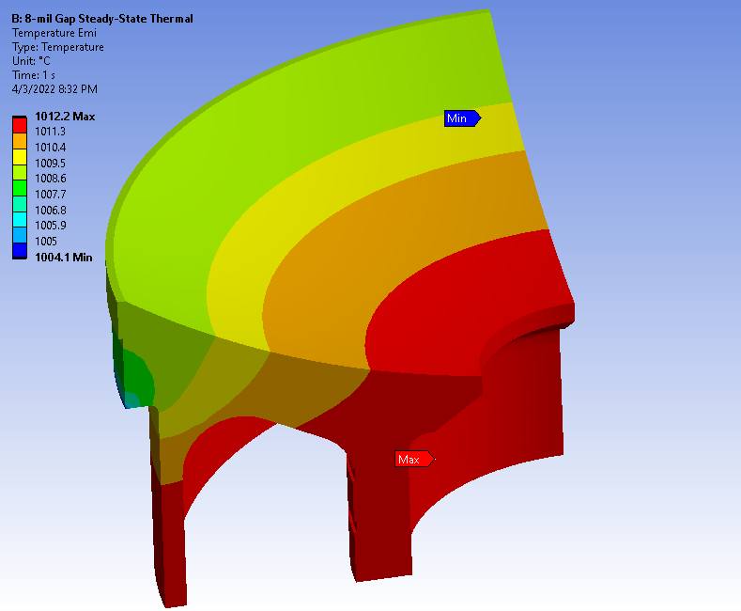
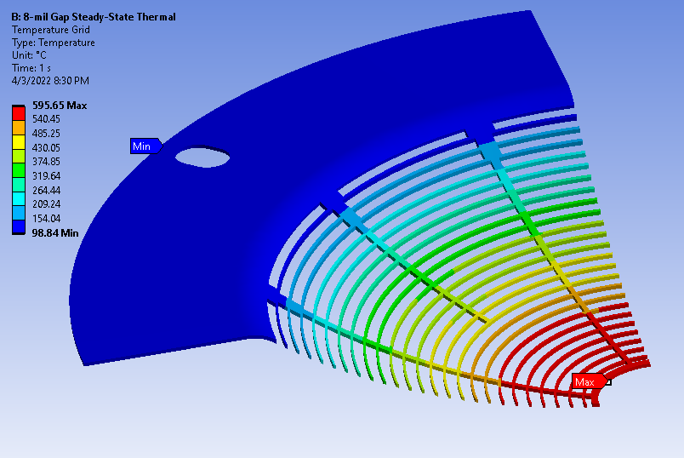
Temperatures
Moly grids considerably cooler than PG grids
Emitter
Grid

Slide 35
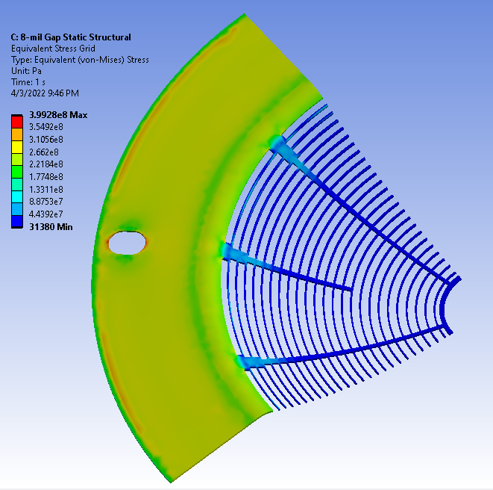
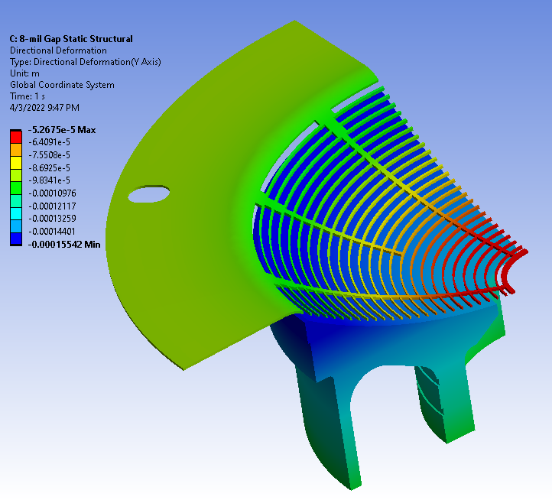
Thermal Stress & Axial Displacement
Highest stress is on the grid rim, but still below Moly tensile strength
At temperature, grid OD moves closer to the emitter 1.9 mils, ID closer 3.3 mils
Compensation required for increased thermal expansion

Slide 36
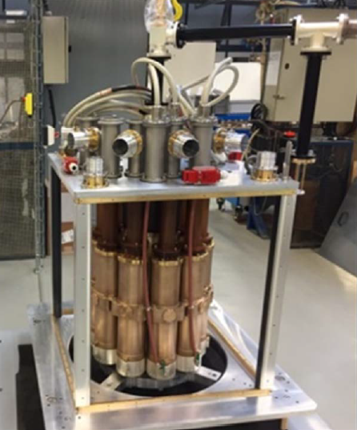
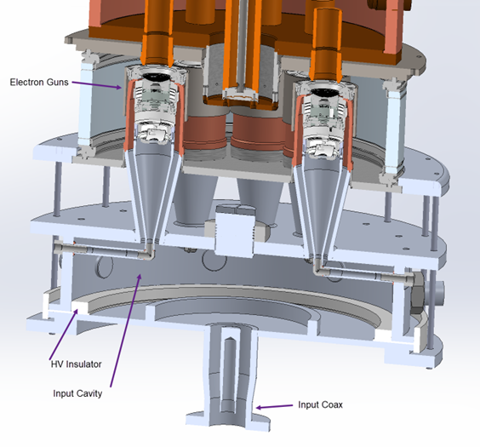
Input Coupler
Input Coupler for CPI/Thales and L3 MBIOTS large and complex
CCR input coupler design much simpler
Input coupler for CCR MBIOT
Input coupler for CPI/Thales MBIOT

Slide 37
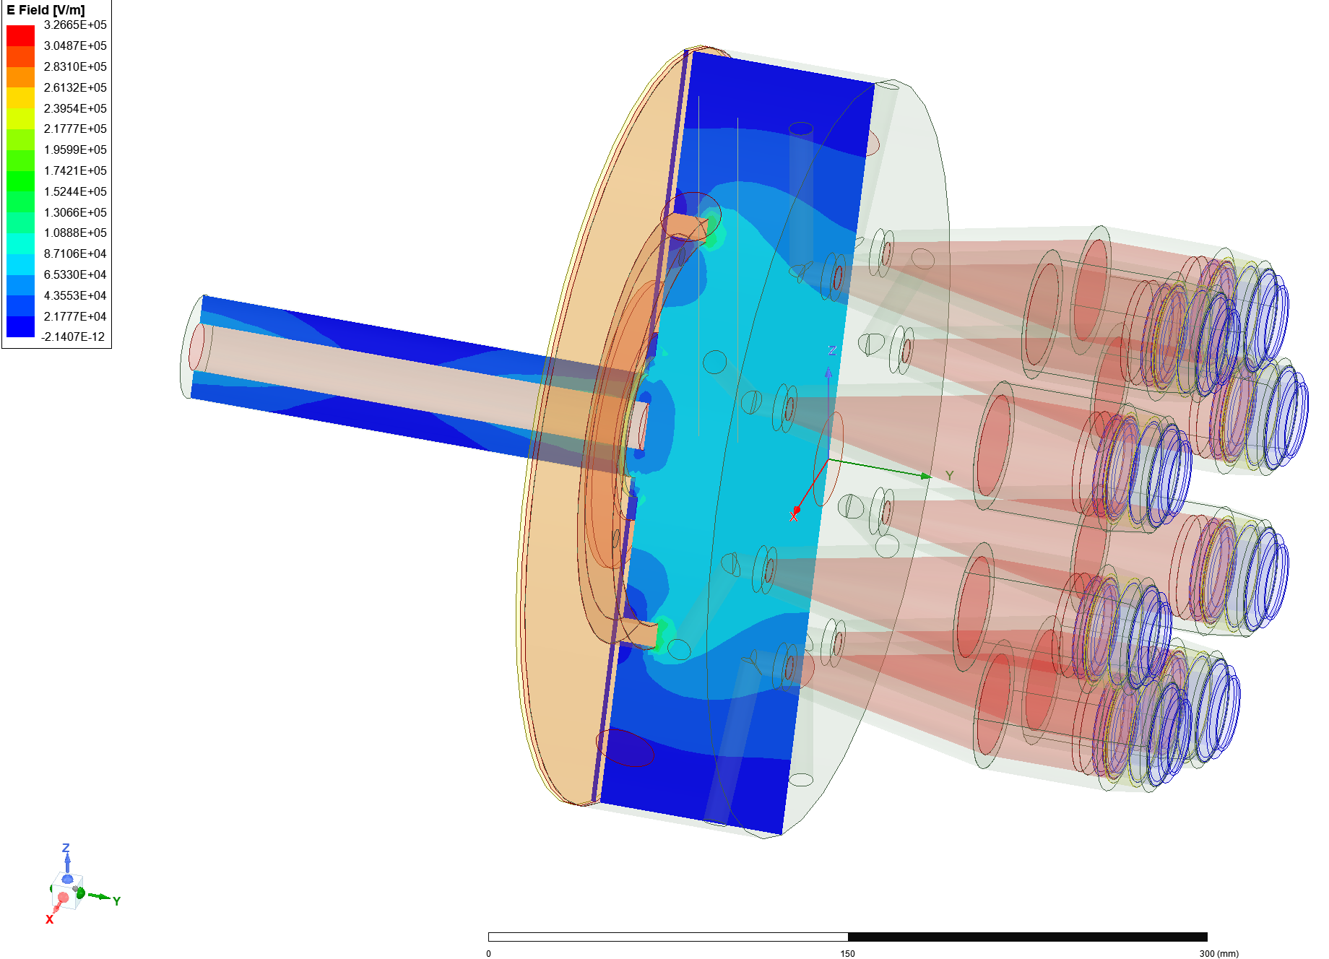
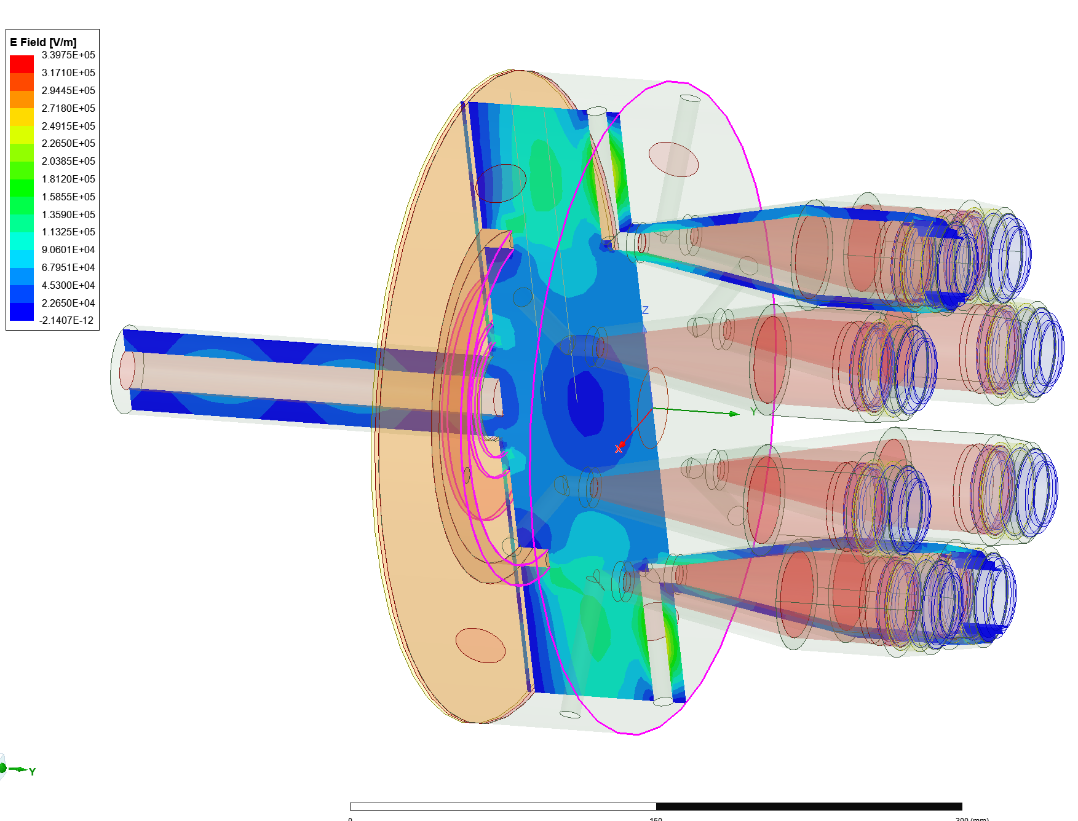
Input Coupler
Challenge – develop coupler transmitting fundamental and 3rd harmonic
Incorporated structures/tuners specific to each frequency
700 MHz
2100 MHz

Slide 38
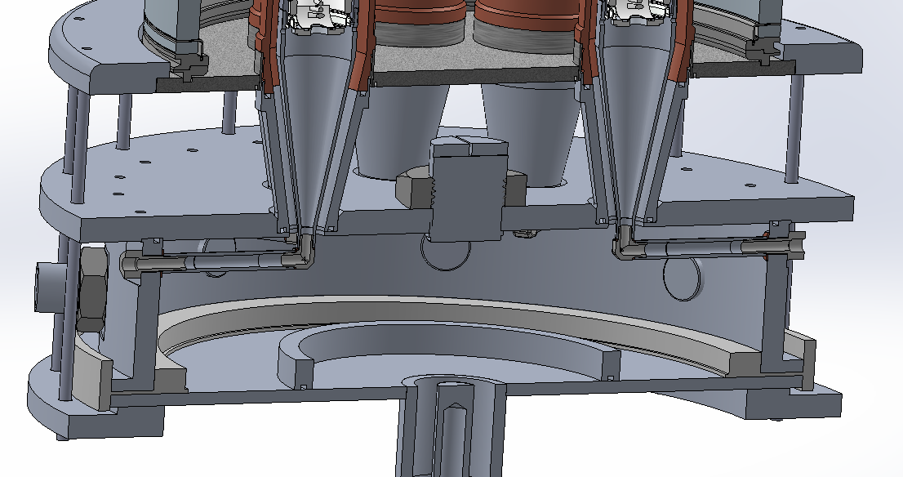
Input Cavity Tuning
Top
Side
Annular
Note – Input cavity is at atmospheric pressure

Slide 39
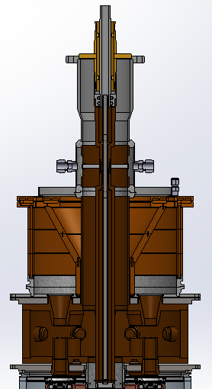
MBIOT Design
Coaxial output window
Single collector for all beams
Simple output cavity

Slide 40
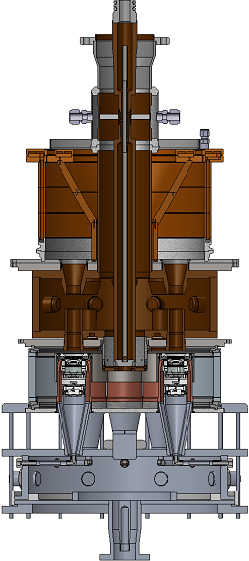
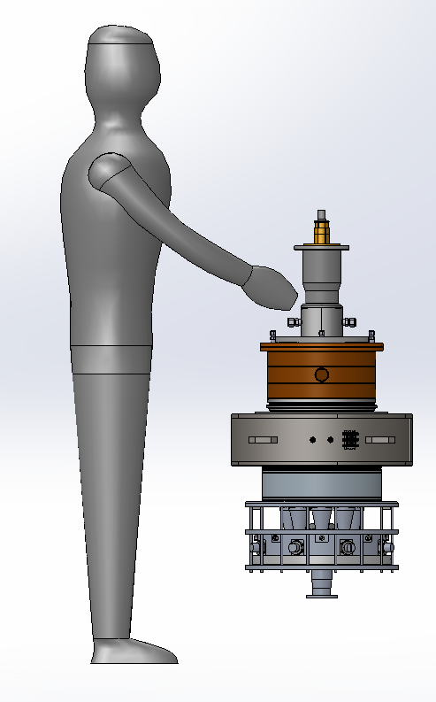
200 kW, 700 MHz MBIOT
Computational design complete
Drawings and parts procurement in progress
Tests scheduled for spring 2023

Slide 41
MBIOT Status and Summary
Investigating three improvements
Adding 3rd harmonic drive to improve efficiency
- is efficiency gain achieved
- does improvement justify the cost
Replacing PG grids with molybdenum grids
Simplifying the input coupler
Status
Most drawings completed
Long lead time parts are on order
Expect to start assembly in January 2023
Testing scheduled for spring 2023

Slide 42
Summary
RF Sources and Key Features
Magnetron System 100 kW 1.3 GHz Amp/Phase Control 80+% efficiency $1/Watt Completed
High Efficiency Klystron 100 kW CW 1.3 GHz 78% Freq/Pwr Scalable Test in January 2023
Triode-base RF sources 200 kW CW 350–700 MHz $0.5/Watt compact
MB Triode in test
Multiple Beam IOT 700 MHz 200 CW kW 80% Drawings and fabrication in progress Test in spring 2023

Slide 43
New RF Source Development
RF Sources and Key Features
Magnetron System 100 kW 1.3 GHz Amp/Phase Control 80+% efficiency $1/Watt Completed
High Efficiency Klystron 100 kW CW 1.3 GHz 78% Freq/Pwr Scalable Test in January 2023
Triode-base RF sources 200 kW CW 350–700 MHz $0.5/Watt compact
MB Triode in test
Multiple Beam IOT 700 MHz 200 CW kW 80% Drawings and fabrication in progress Test in spring 2023

