Slide 1
Simulation Results of Dielectric Disk Accelerating Structures
Thanks to support from:
-SBIR Phase 2 (Euclid Beamlabs)
-GARD University Proposal (NIU-IIT)
-Chicagoland Accelerator Science Traineeship (NIU-IIT)
.
Sarah Weatherly
Illinois Institute of Technology
November 8, 2022

Slide 2
Outline of Talk
Introduction
Brazed Single Cell DDA Structure
Clamped Multicell DDA Structure
Future Works

Slide 3
Introduction

Slide 4
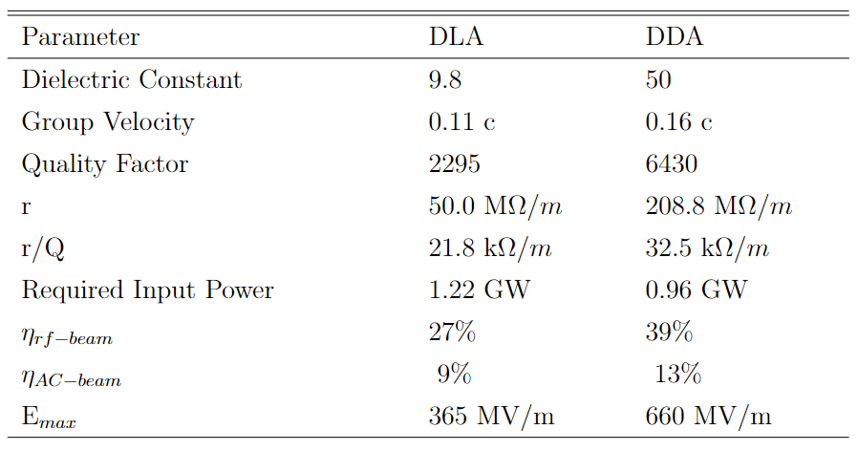
Dielectrics in Accelerating Structures
Dielectric slows down speed of EM field to match it to velocity of beam
Dielectric Loaded Accelerator (DLA) vs Dielectric Disk Accelerator (DDA)
(a)
(b)
DLA
DDA
J. Shao, C. Jing, J. G. Power, M. Conde, and D. Doran, “Study of a dielectric disk structure for short pulse two-beam acceleration,” in Proceedings of IPAC2018, Vancouver, BC, Canada, Summer 2018.
Notes:
Point out rf beam eff more
DDA is tunable (like normal metal) unlike DLA, also easier to manufacture
Remake the table
300 MV/m accelerating gradient
Almost always copper (convective metal)
DLA - hard to connect dielectric to copper
Need to slow down EM wave to match the beam speed, so we use the dielectric material
Dielectric matches beam velocity and wave velocity

Slide 5
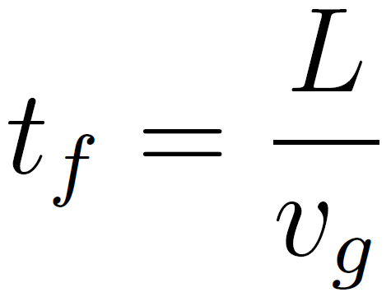
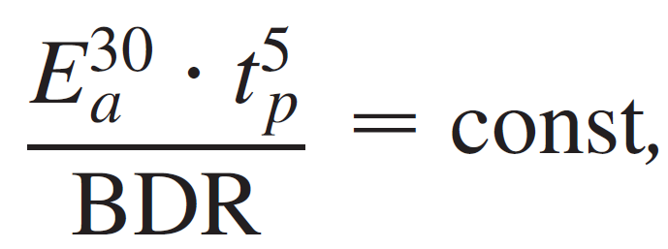
Motivation for Research
Improve RF to beam Power Efficiency
Better efficiency = smaller footprint = cheaper to build
500 MeV Demonstrator
High power linear electron accelerator
Production of high energy beam with short footprint using Advanced Accelerator Concepts (AAC) structures.
Need high accelerating gradient.
Demonstrate Short Pulse Accelerating (~10 ns)
High gradient production requires high power (hundreds of MW) but this can cause breakdown
Breakdown rate is proportional to pulse length
Short filling time allows structure to see flat top of pulse
Large group velocity
A. Grudiev, et. al., “New local field quantity describing the high gradient limit of accelerating structures,” Phys. Rev. ST Accel. Beams,vol. 12, p. 102001, Oct 2009.
Notes:
Go more into detail on this slide
Short footprint will mean it will be cheaper to create (civil engineering), simpler to construct
Need short filling time so beam experiences flat top of rf pulse to accelerate it
HIgh power because it is short time
Need short filling time to make it work
We want short accelerator (so high gradient in structure)
Issue with high gradient leads to breakdown. To decrease breakdown, we need to have short pulse, to have short pulse we need to have large group velocity
More info about 500 mev demo
Electron linear accelerator
To accelerate a beam with AAC to very high energy
Requires a lot of AAC to be achieved, lots of little things working together
Milestone being work towards (on path to AAC accelerator)
(No real structures built yet, all research and prototypes)
Will significantly shorten length of accelerator needed (high gradient)

Slide 6
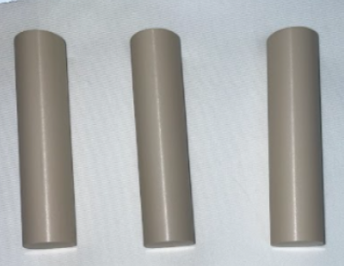
Components Testing
One goal of research is to test thresholds of materials used, such as the dielectrics.
The ceramic selected to be used brazed single cell and clamped multicell is barium titanate (BaTiO3). Clamped single cell (previous talk) used is Calcium Titanium Lanthanum Aluminum Oxide.
Ceramic was chosen for high dielectric constant and low loss tangent
Notes:
Two materials that were used
Different ceramics because there were supply chain issues so we switched
is its ratio of the capacitance of the capacitor with the test material as the dielectric to the capacitance of a capacitor using vacuum as the dielectric

Slide 7
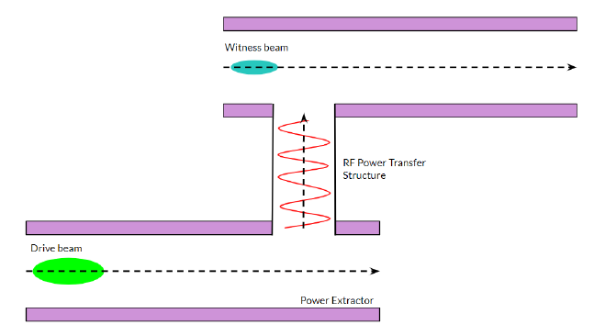
Structure Based Wakefield Accelerators
Two Beam Acceleration (TBA) - when the drive beam and witness beam are on two different beam lines. The RF power generated by drive beam is transferred to witness beam.

Slide 8
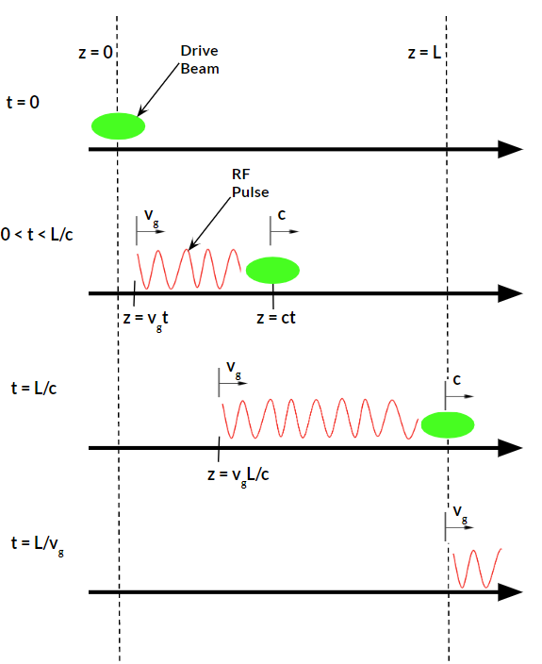
Power Extraction and Transfer Structure (PETS)
Relativistic wakefield power extractors are made up of two parts: deceleration section and section that extracts EM wave.
When decelerated, drive beam produces RF packet moving in same direction.
Drive beam travels close to c while the RF packet travels at the group velocity of the structure. (vg = 0.22c)
Notes:
Group velocity is only a fraction of the speed of light

Slide 9
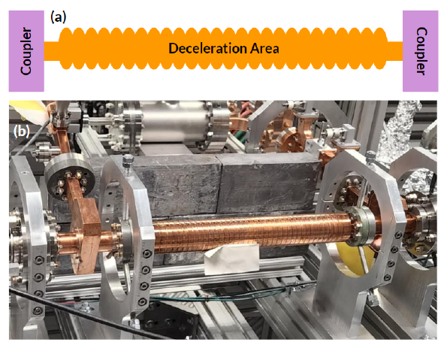
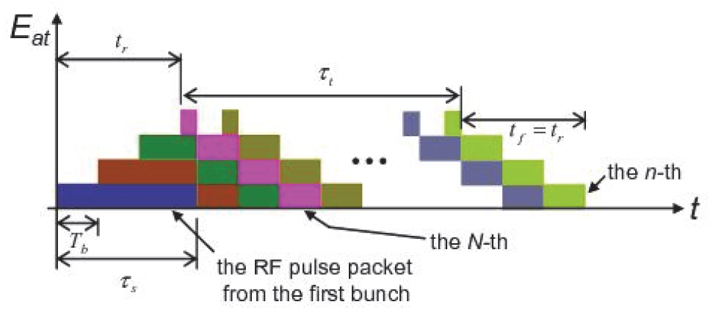
Power Extraction and Transfer Structure (PETS)
AWA has developed and tested different types of PETS: metallic, dielectric, and metamaterial.
Capable of generating large amounts of RF power.
For DDA experiment, brazed metallic PETS was used to generate high power.
Working frequency at 11.7 GHz.
C. Jing, et al., “High frequency high power RF generation using a relativistic electron beam,” in Proceedings of IPAC 2012, New Orleans, Louisiana, USA, Summer 2012.
Notes:
This is not conventional tech, it is a test piece and now can be used to get high frequency high power for experiments
Large amounts of PEAK (not average) RF power

Slide 10
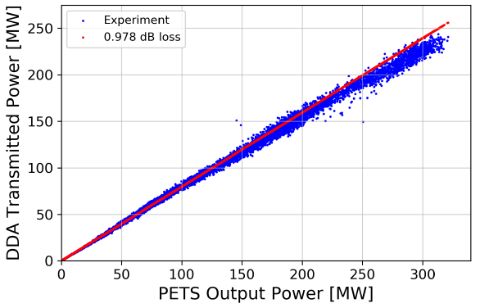
Final Results from Single Cell Clamped Structure
Reached 321 MW of effective input power from PETS
171 RF pulses above 300 MW
Maximum charge 430 nC
Accelerating gradient of 102 MV/m
Linearity sign of no breakdown or multipacting.
No RF, vacuum, or optical signals of breakdown observed
Successfully ran up to maximum available RF power.
Notes:
Non linearity can mean multipacting or breakdown
Vacuum would be worse with breakdown (pressure goes up with arcing)

Slide 11
Single Cell Brazed Dielectric Disk Accelerator

Slide 12
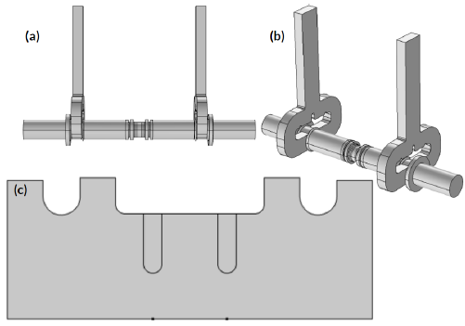
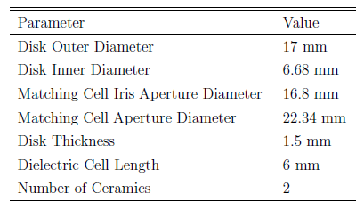
Prototype 4 - Brazed Single Cell Structure
Brazed prototype to see if brazing could work for DDA, avoided issues encountered in the past
Flat against copper, no right angle in copper at joint
Notes:
Point out why this one looks different
Different couplers because this brazed and brazed structures are tested in air (not in vacuum chamber like clamped)
These are SLAC style couplers

Slide 13
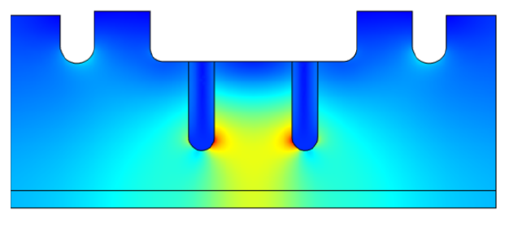
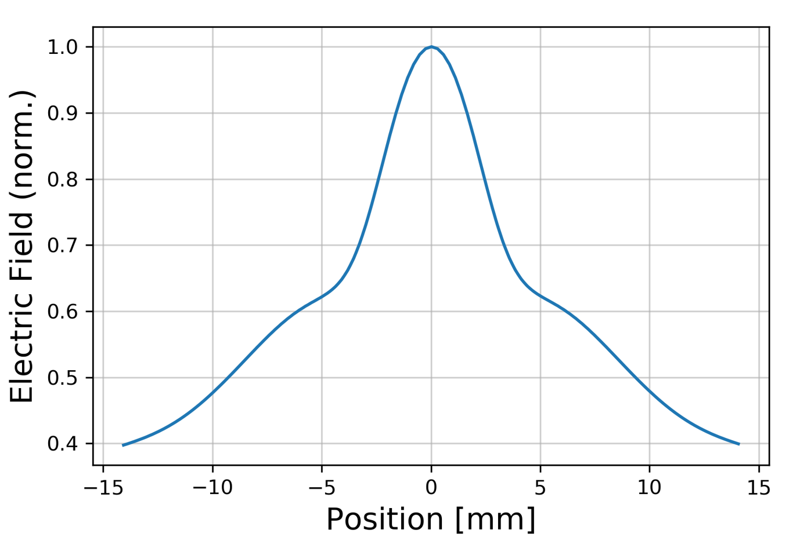
Results of Simulations
Parameter | Value
Accelerating Gradient at 400 MW | 152 MV/m
Field Enhancement Factor | 2.7
Group Velocity | 0.15 c
Quality Factor | 16,000
r | 60.7 MΩ/m
r/Q | 3.80 kΩ/m
S11 10 dB Bandwidth | > 650 MHz
S21 3 dB Bandwidth | > 800 MHz
Maximum over one RF period.
Notes:
Change e on axis so that it is over the whole DDA
Itis of ceramic has changed so that the impedance of the cell is different and there is no peak in matching cell
Max surface field/ accelerating gradient = 1.44

Slide 14
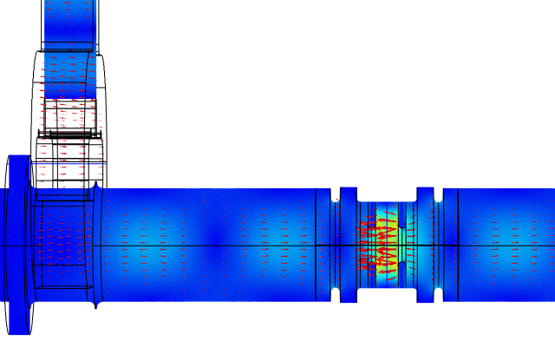

Slide 15
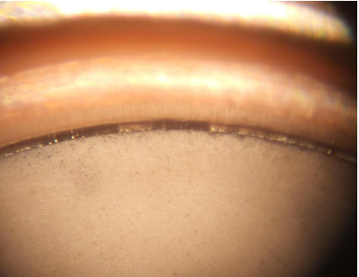
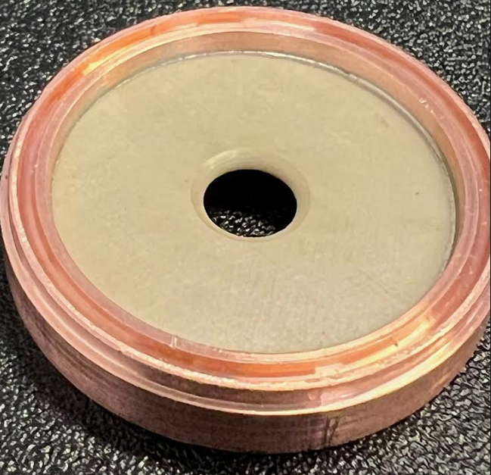
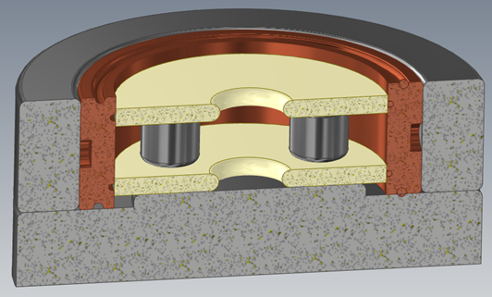
Fabrication
Before
Fabrication being conducted now
Difficulties during brazing tests
Metalization and brazing of ceramics had to redone in order to have even seal around the whole joint
After

Slide 16
Multicell Dielectric Disk Accelerator

Slide 17
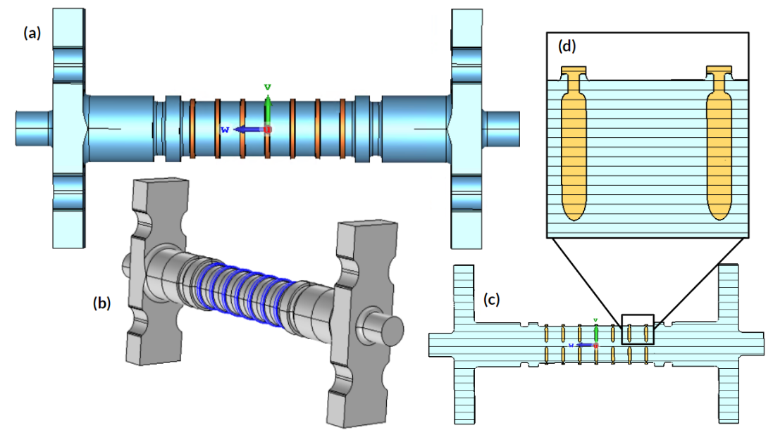
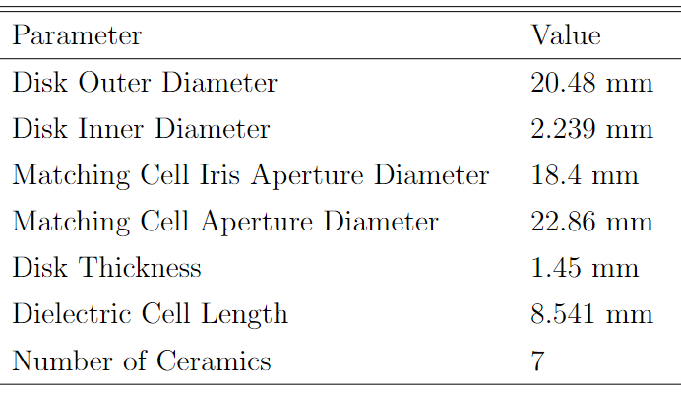
Clamped Multicell Structure
Due to success of first clamped structure, multicell will also be clamped
Special head detail similar to clamped single cell
7 ceramic = six dielectric cells
~20 cm
Notes:
Not full scale, but it is a step up from what we were seeing

Slide 18
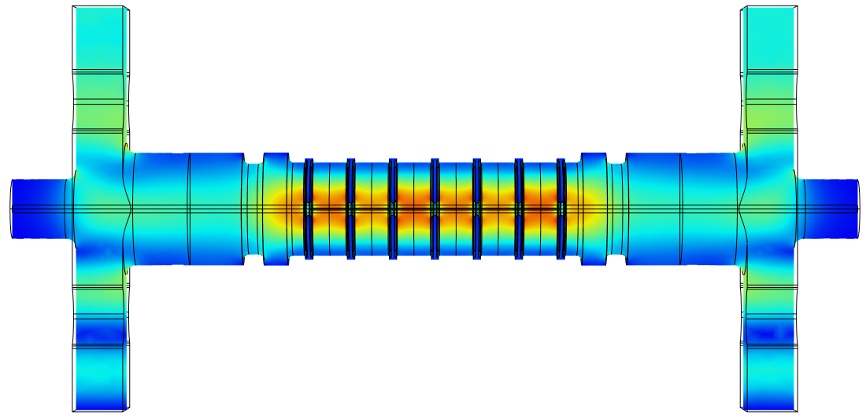
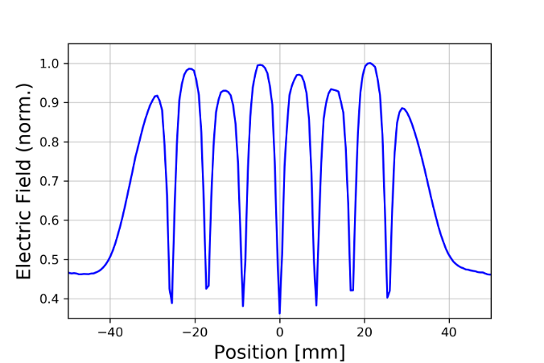
Results of Simulations
Parameter | Value
Accelerating Gradient at 400 MW | 108 MV/m
Field Enhancement Factor | ~1.5
Group Velocity* | 0.24 c
Quality Factor | 18,900
r | 172 MΩ/m
r/Q | 9.10 kΩ/m
S11 10 dB Bandwidth | > 800 MHz
S21 3 dB Bandwidth | > 800 MHz
Maximum electric field over one RF period.

Slide 19
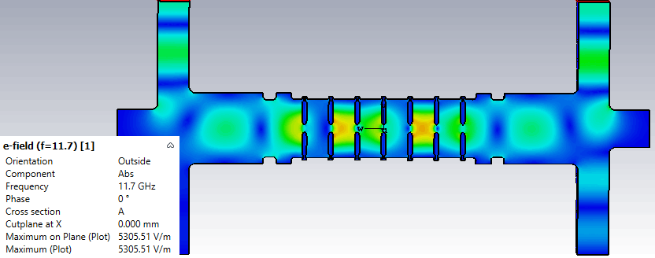

Slide 20
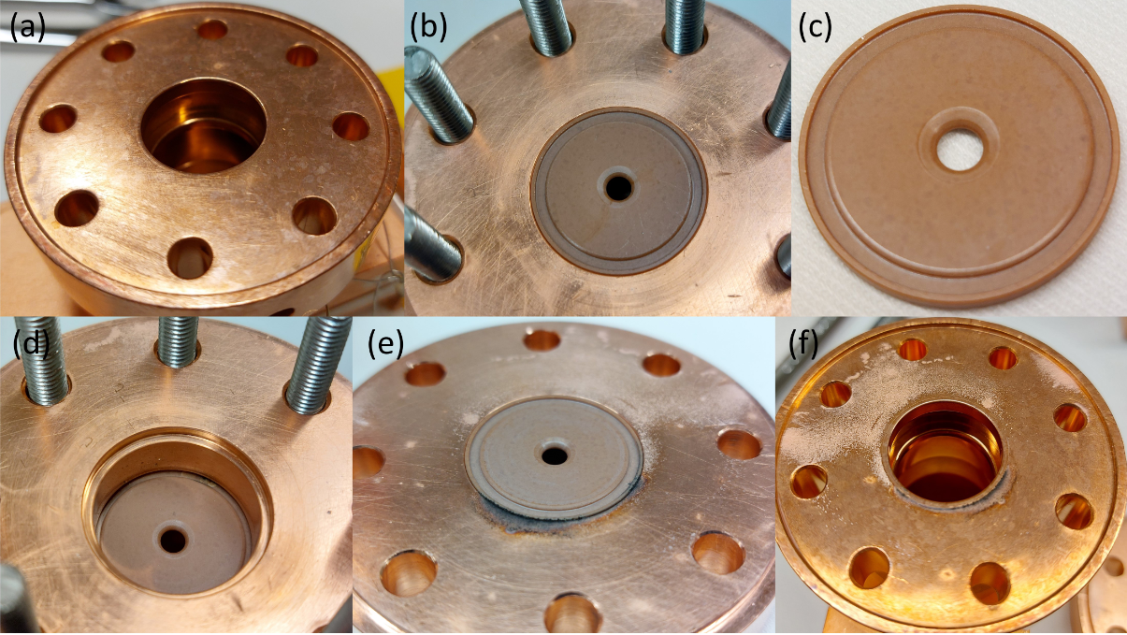
Single Cell Clamped Post-Experiment Visual Inspection
Damage found outside of RF volume of structure, potentially due to RF leakage from uneven clamping.
Notes:
Refer to the letter when we are talking about it.
Spend more time talk about this slide
Top row is upstream cell, bottom is downstream cell
Emphasis that this is not dielectric breakdown, it is arching between components because of poor clamping
Put in better picture from paper
Add highest field that these pieces were seen (look at CST)
Max surface field/ accelerating gradient = 1.44
Peak field was on ceramic (we see that the ceramic can withstand high field), we already know copper can handle a lot of

Slide 21
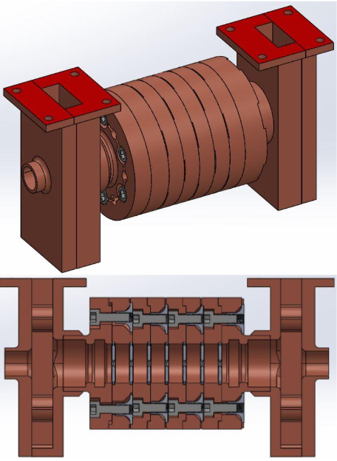
Engineering Design
Due to clamping issues from single cell, more sophisticated clamping mechanism was designed.
Compact enough to fit into vacuum chamber.
Copper is annealed so that the ceramic can bite into it.
Notes:
Multi-cell is larger but had to be compact enough to fit in structure
Correct amount of torque will be applied to each bolt

Slide 22
Comparison of Prototypes
Brazed
Possibility of enhanced breakdown rate
Simpler geometry makes optimization simpler
Larger Simulated Accelerating Gradient
152.3 MV/m
Smaller Shunt Impedance
r = 60.74 MΩ/m
r/Q = 3.8 kΩ/m
Clamped
Ease of assembly
No brazing
Smaller Simulated Accelerating Gradient
108 MV/m
Larger Shunt Impedance
r = 184.4 MΩ/m
r/Q = 19.2 kΩ/m
Experimental evidence that a clamped structure can handle high power exposure
Notes:
Multi-cell is larger but had to be compact enough to fit in structure
Correct amount of torque will be applied to each bolt

Slide 23
Comparison of Prototypes
Simulated Parameters | Single Cell Brazed | Multicell Clamped
Accelerating Gradient at 400 MW | 152 MV/m | 108 MV/m
Field Enhancement Factor | 2.7 | 1.5
Group Velocity | 0.15 c | 0.24 c
Quality Factor | 16,000 | 18,900
r | 60.7 MΩ/m | 172 MΩ/m
r/Q | 3.80 kΩ/m | 9.10 kΩ/m
S11 10 dB Bandwidth | > 650 MHz | > 800 MHz
S21 3 dB Bandwidth | > 800 MHz | > 800 MHz
Mechanical Parameters | Single Cell Brazed | Multicell Clamped
Ceramic Outer Diameter | 17 mm | 20.48 mm
Disk Inner Diameter | 6.68 mm | 2.24 mm
Disk Thickness | 1.5 mm | 1.45 mm
Dielectric Cell Length | 6 mm | 8.541 mm
Number of Ceramics | 2 | 7
Notes:
Multi-cell is larger but had to be compact enough to fit in structure
Correct amount of torque will be applied to each bolt

Slide 24
Future Plans

Slide 25
Future Plans
Brazed Single Cell and Multicell DDA structure is being fabricated and will be high power tested at AWA.
Optimized multicell DDA structure will be designed, fabricated, and used to accelerate electron beam.
Current results indicate DDA structures are viable candidates for short pulse, high gradient beam acceleration.

Slide 26
Thank you for listening!
Questions?
Poster: Tuesday 5 pm

Slide 27
Extra Slides

Slide 28
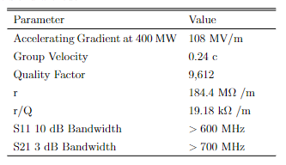
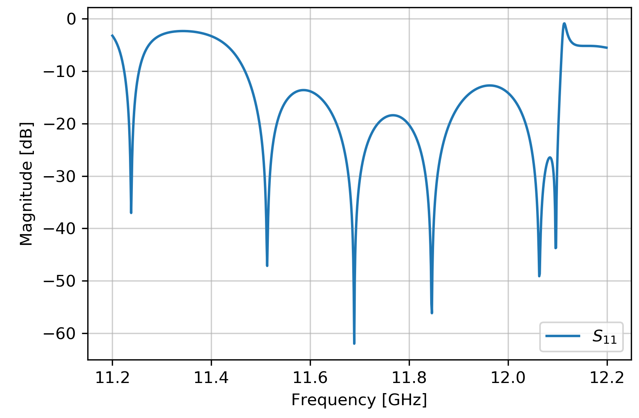
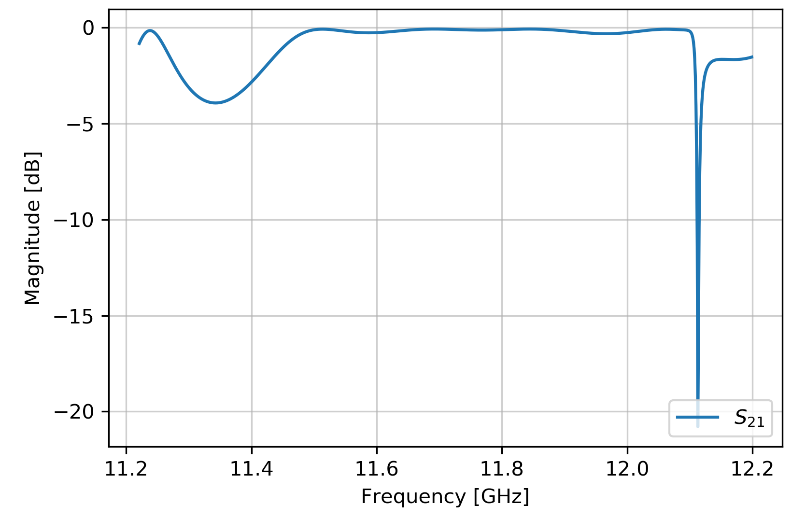
Results of Simulations
Notes:
Semi-degenerate trapped modes because there are more cells

Slide 29
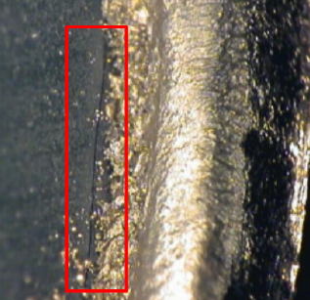
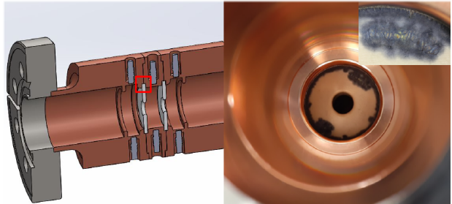
Damage of first two prototypes

Slide 30
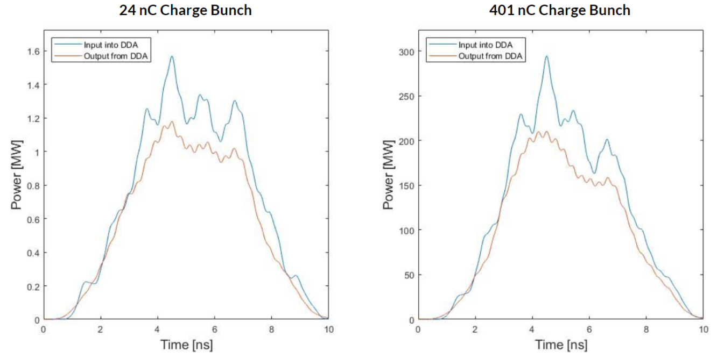
Processed Waveforms
Notes:
As you seen on the next slide, these are good because they agree well with the transmission plot on the next page
Not smooth on the top, can see the bunches with the spikes but there are also other issues with wakefields and other things that caused this, working on fixing this (new splitters do not produce satellite pulses). Lot of imperfections (not like a klystron - that is a smooth single).

Slide 31
Single Cell Dielectric Disk Accelerator

Slide 32
Objectives of Research
Goal
High Gradient, short pulse, while exploring threshold of dielectric ceramic
Ceramic was chosen for high dielectric constant and low loss tangent
Methodology
Multiple prototypes test
Single cell, Proof of concept
Two Beam Acceleration Scheme
Notes:
Elliptically rounded (better than normal rounding) to avoid field enhancement
Point out this is vacuum (rf geometry) and not the engineering design of structure
We did single cell to do proof of concept (we are doing this to make sure that it works before scaling up)

Slide 33
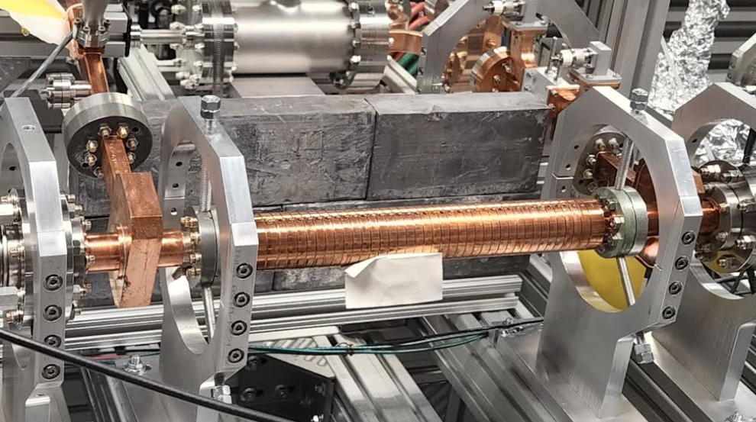
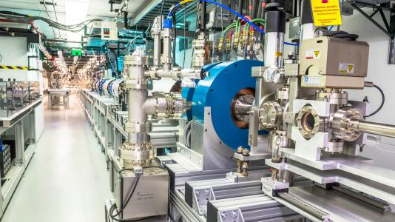
AWA and PETS
Argonne Wakefield Accelerator (AWA)
Linear accelerator at ANL in the High Energy Physics division
~34 m long research linear accelerator
Very high charge drive beam (~400 nC)
Power Extractor and Transfer Structure (PETS)
Relativistic wakefield power extractors are made up of two parts: deceleration section and section that extracts EM wave.
When decelerated, drive beam produces RF packet moving in same direction.
Used to produce high RF power for DDA tests
Image courtesy of AWA.

Slide 34
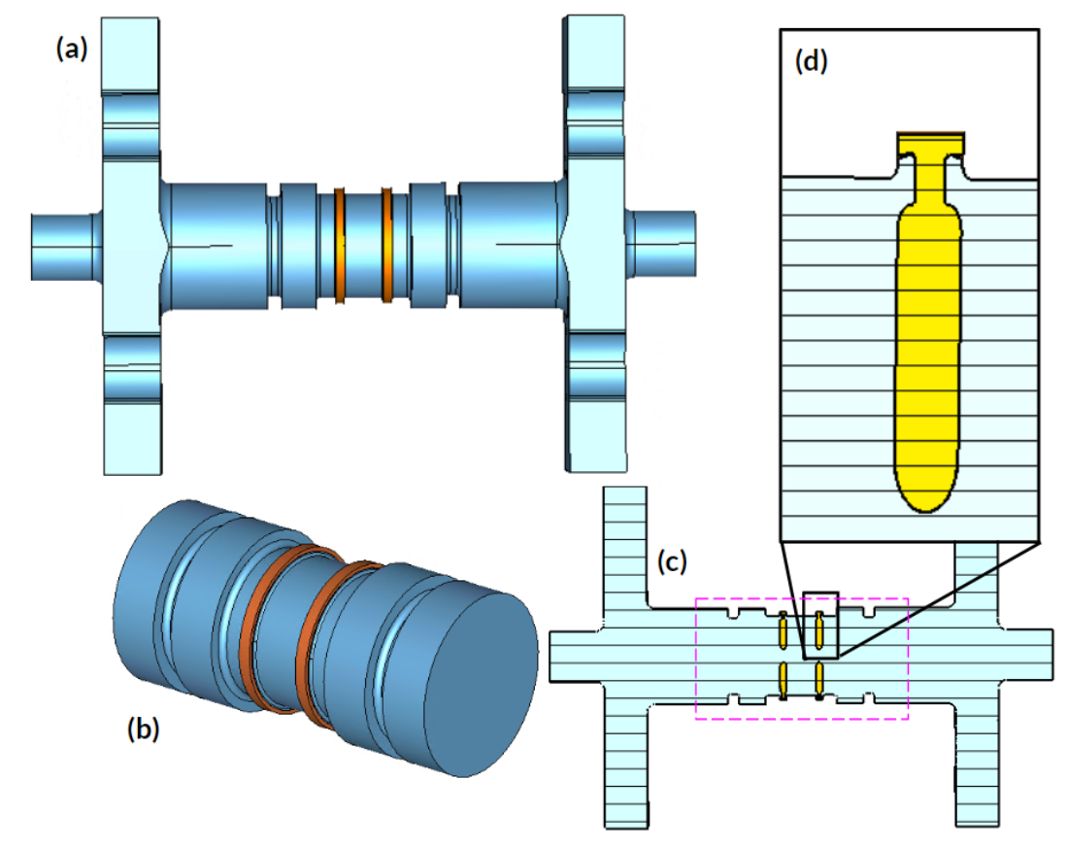
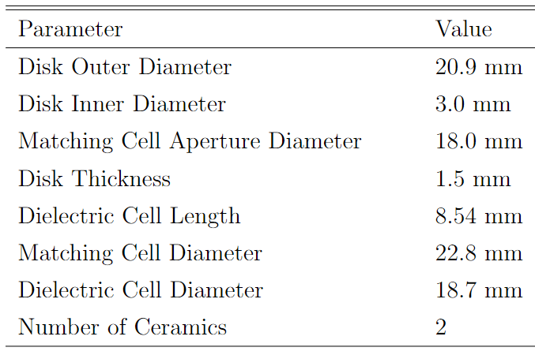
Clamped Single Cell Structure
To avoid complications with brazing, this prototype was clamped
Special head detail
Elliptically Rounded edges
High Dielectric Constant = 50, low loss ceramics
Notes:
Elliptically rounded (better than normal rounding) to avoid field enhancement
Point out this is vacuum (rf geometry) and not the engineering design of structure
We did single cell to do proof of concept (we are doing this to make sure that it works before scaling up)

Slide 35
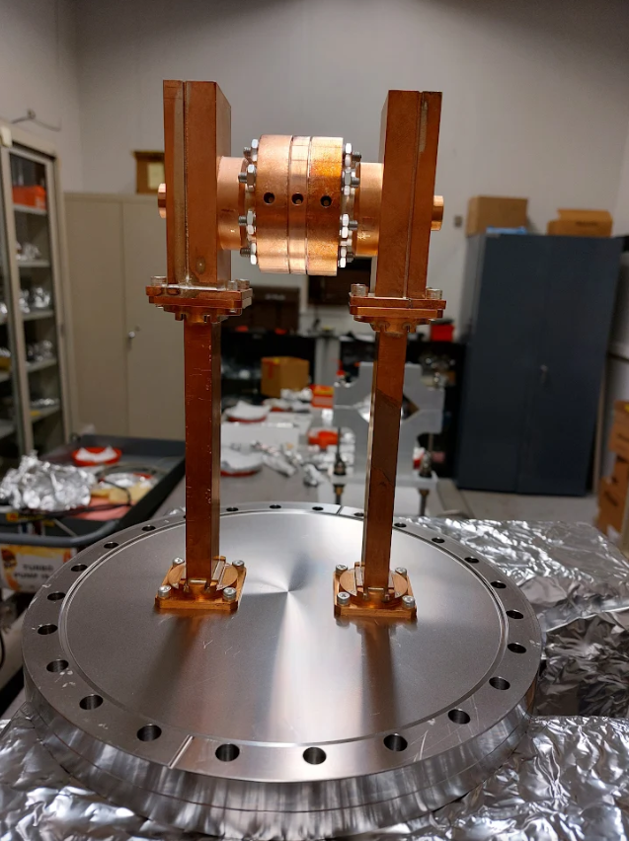
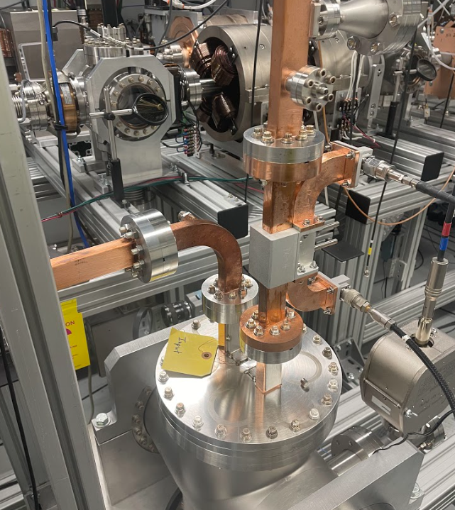
RF Power from the PETS
RF Power transmitted from the DDA
Notes:
PETS is beam driven power extractor
8 pulses, length of pulse is 6 picoseconds, drive train is about 5 ns, rf pulse is slightly longer (like 10 second)
Laser pulse is 6 picoseconds with determines the pulse length (and there are 8), 7*769ps = entire length of bunch length (5 or 6 ns)

Slide 36
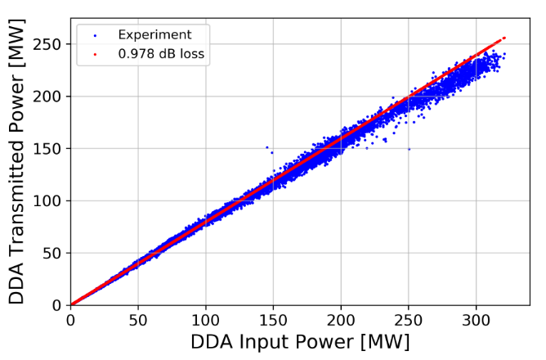
Results from Single Cell High Power Experiment
Reached 320.9 MW of effective input power
171 RF pulses above 300 MW
Accelerating gradient of 102 MV/m
Linearity sign of no breakdown or multipacting.
No RF, vacuum, or optical signals of breakdown observed
Successfully ran up to maximum available RF power.
PRAB in preparation on results

Slide 37
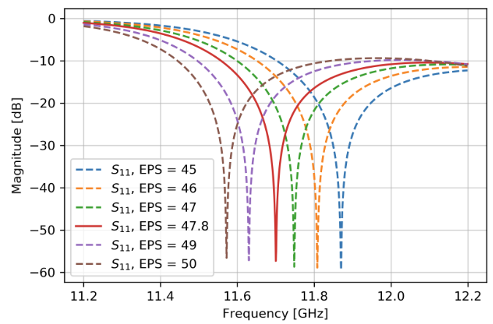
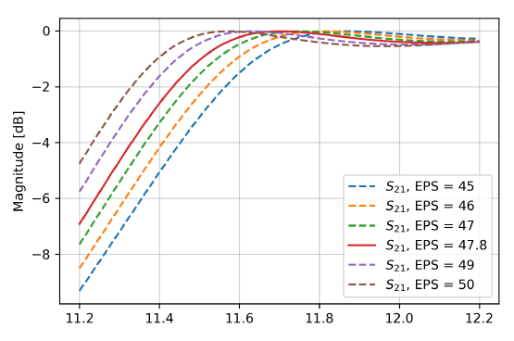
Tolerance Studies
When designing, simulations were done to test the tolerances of the rf design, such as dielectric constant of the ceramic being used.
Notes:
In design phase we want to make good s params
Optimization done for better figures of merit

Slide 38
Results of Simulations
Parameter | Value
Accelerating Gradient at 400 MW | 108 MV/m
Group Velocity | 0.24 c
Quality Factor | 9,612
r | 184.4 MΩ/m
r/Q | 19.18 kΩ/m
S11 10 dB Bandwidth | > 600 MHz
S21 3 dB Bandwidth | > 700 MHz
Maximum electric field over one RF period.
Notes:
this is all cst results

