Slide 1
High-Gradient Accelerating Structures for 3-GeV Proton Radiography Booster
Sergey Kurennoy, Yuri Batygin, and Eric Olivas
LANL, AOT Division
Advanced Accelerator Concepts Workshop, Long Island, NY, USA
November 10, 2022
LA-UR-22-31724

Slide 2
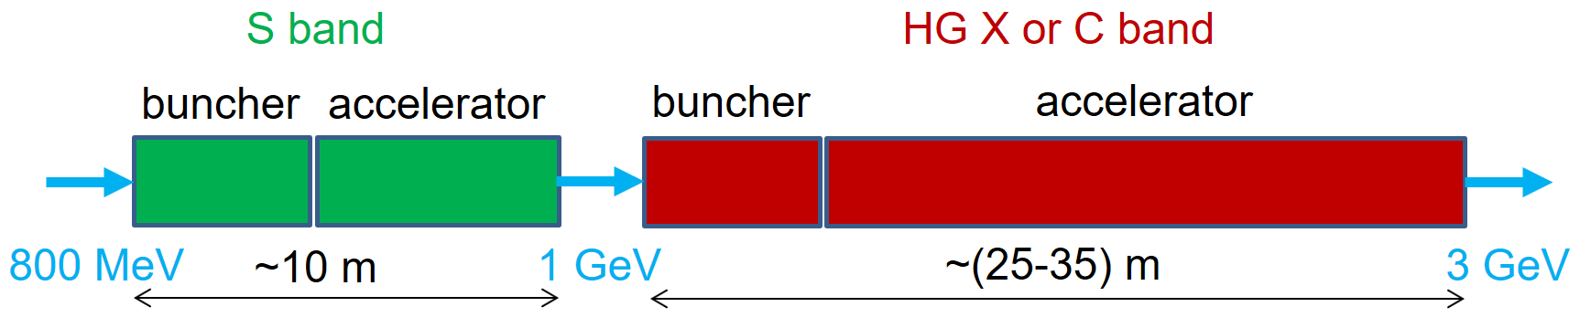
Compact High-Gradient Booster for
Enhanced Proton Radiography
What: High-gradient (HG) linear accelerator (linac) after the existing LANSCE linac to increase the proton beam energy from 800 MeV to 3 GeV.
Why: This increases proton radiography (pRad) resolution 10 times.
How: Compact 3-GeV high-gradient pRad booster:
  Will be based on S- & C-band HG structures adapted for protons (v/c = 0.84 – 0.97). Prototype high-gradient proton C-band cavities will be tested at LANL.
  Will have an optimal beam-physics design based on front-to-end modeling.
  Fits the site and can be used in parallel with the existing 800-MeV pRad.
  Can be the first-ever high-gradient normal-conducting proton linear accelerator.
(Linac16)

Slide 3
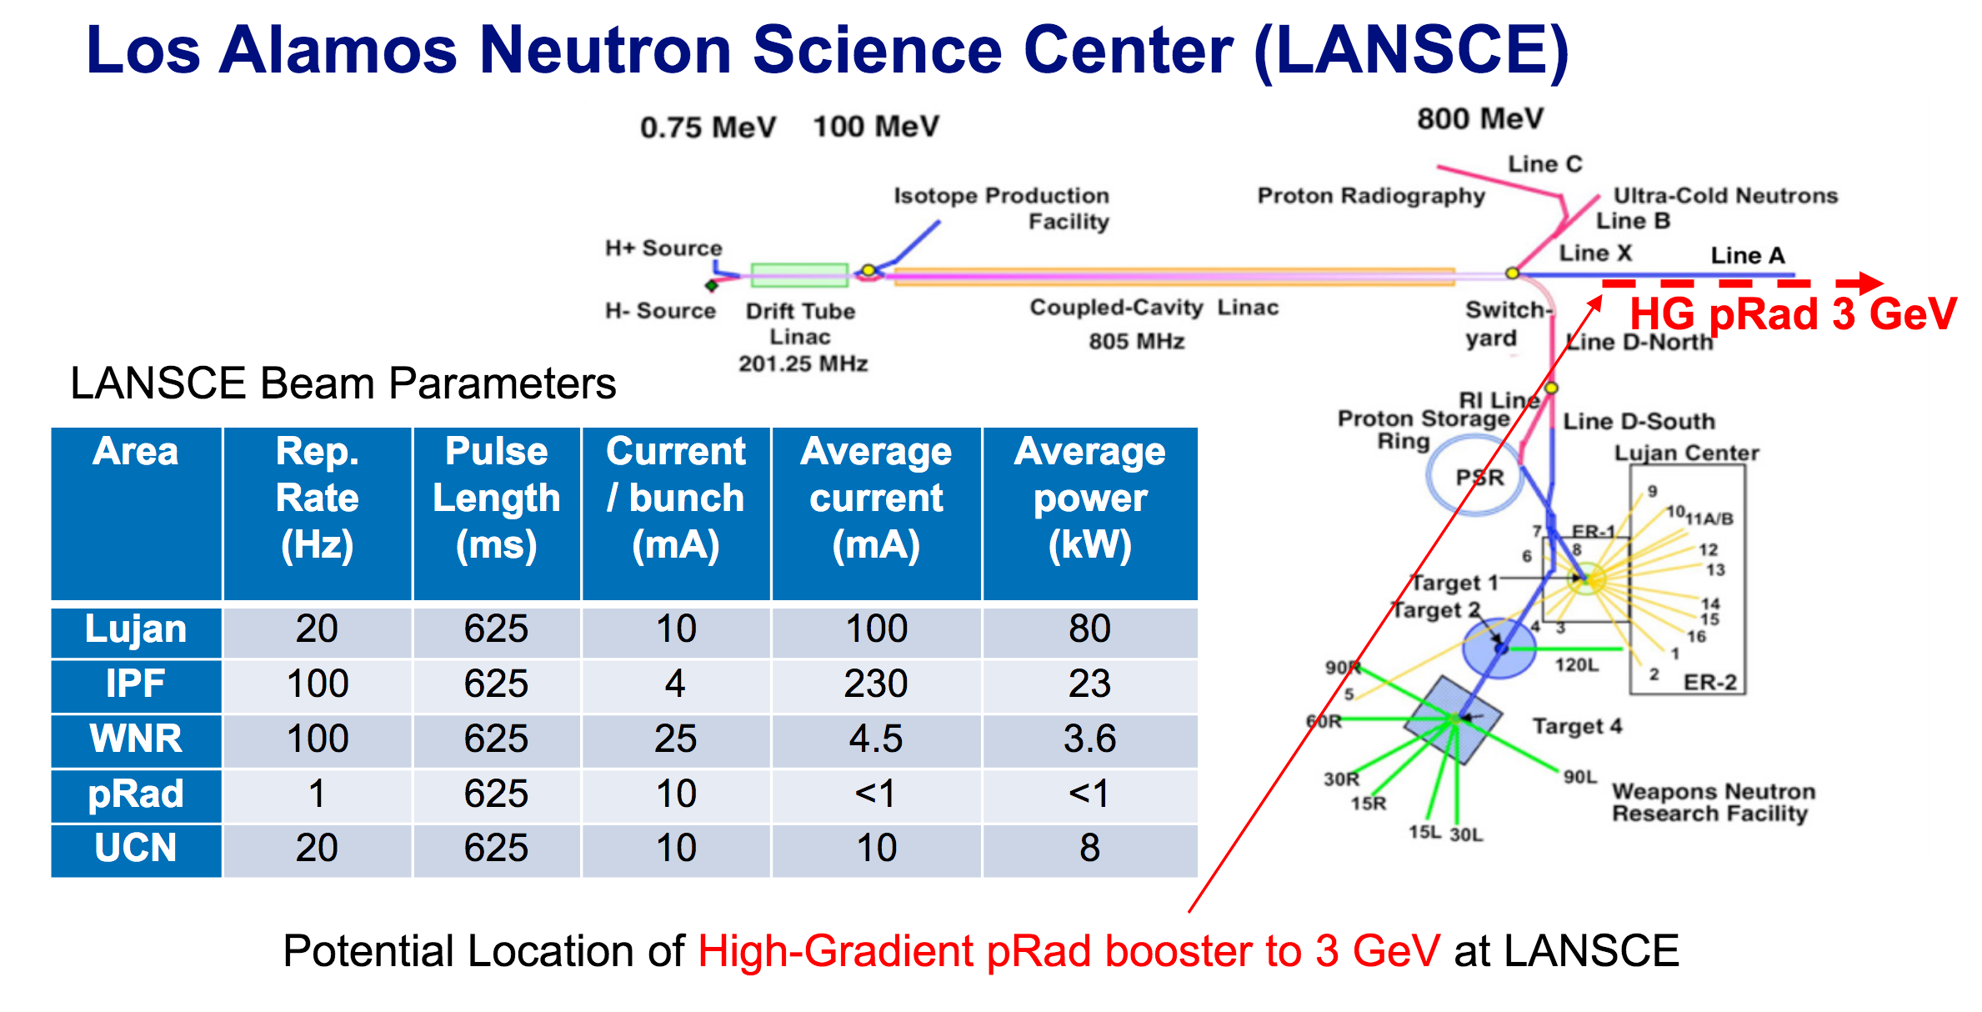
Area | Rep. Rate (Hz) | Pulse Length (μs) | Current / bunch (mA) | Average current (μA) | Average power (kW)
Lujan | 20 | 625 | 10 | 100 | 80
IPF | 100 | 625 | 4 | 230 | 23
WNR | 100 | 625 | 25 | 4.5 | 3.6
pRad | 1 | 625 | 10 | <1 | <1
UCN | 20 | 625 | 10 | 10 | 8

Slide 4
HG pRad Booster – Requirements
Booster must satisfy pRad needs and fit the LANSCE site:
  provide 1 to 20 short beam pulses (<80 ns) separated by variable intervals of 0.2-2 µs. Each short beam pulse contains proton bunches following at 5 ns (f_{b} = 201.25 MHz bunch repetition frequency) and produces one radiograph.
  very low duty: one pulse train per event; a few events per day.
  reduce relative energy spread at 3 GeV as ~1/p for good radiography quality: from Δp/p = 10⁻³ at 800 MeV → 3.3∙10⁻⁴ at 3 GeV.
Development of accelerator structures that support such a design:
  HG structures so far have only been designed for electrons -> adapt for protons.
  beam magnetic focusing scheme defines minimal allowable cavity apertures.
  added L-band buncher & de-buncher + drifts to reduce beam energy spread.
  standing-wave accelerator structures with distributed coupling are chosen.
High peak power (~10s MW) RF sources (klystrons) that can support the required beam structure. Variable single RF pulse up to 50 µs.
80 ns
RF pulse up to 50 µs
0.2-2 µs intervals
1-20 beam pulses

Slide 5
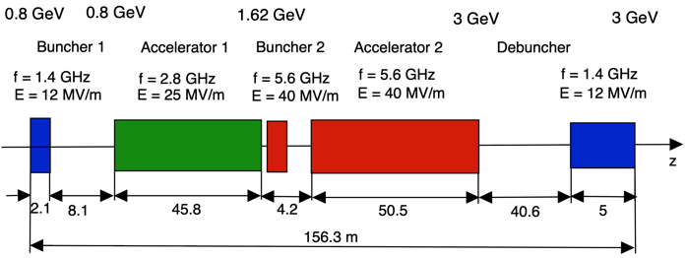
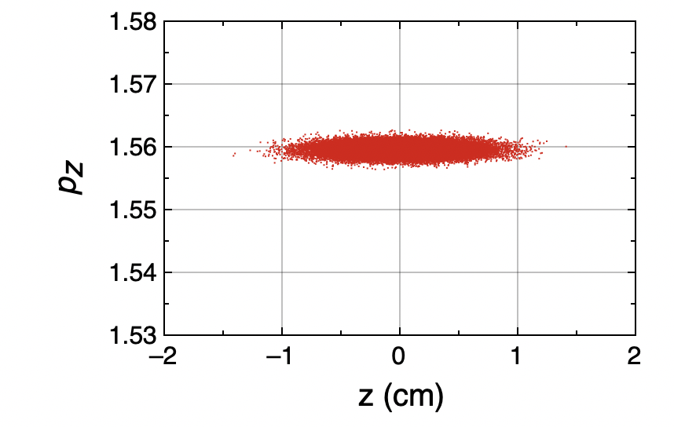
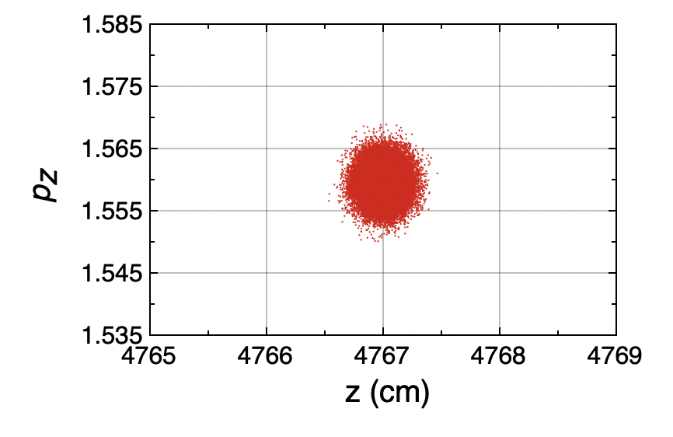
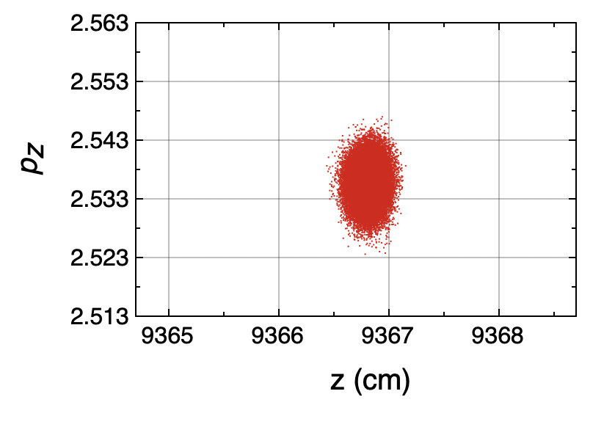
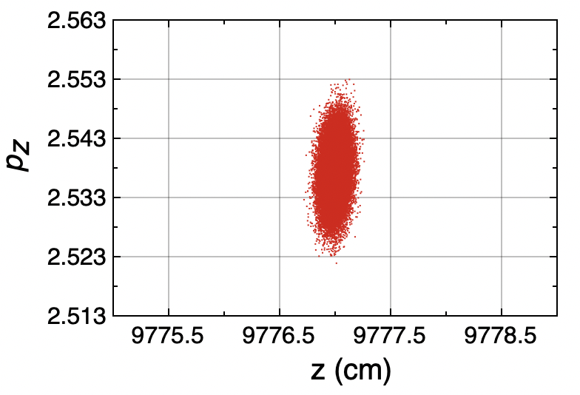
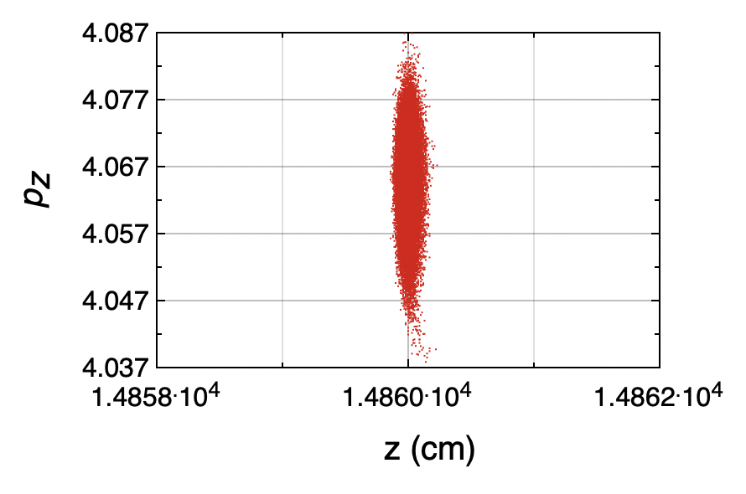
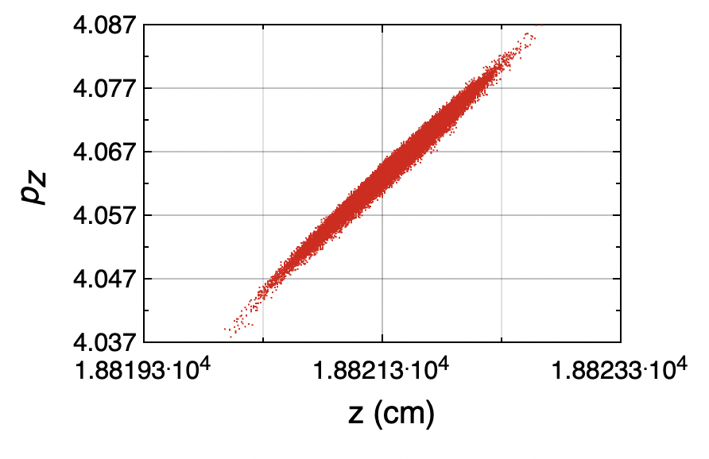
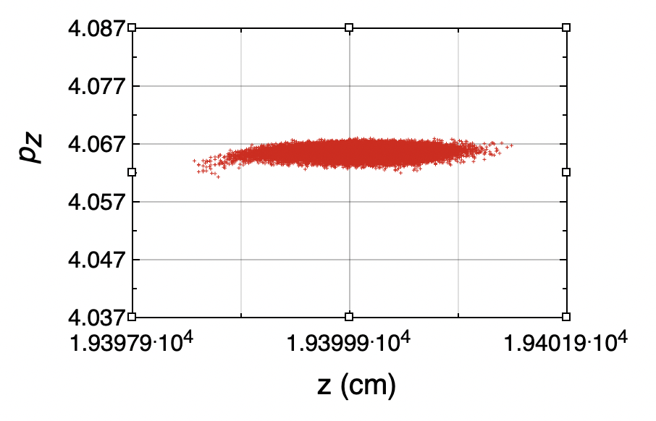
Layout of 3-GeV Booster
Evolution of Longitudinal Phase Space
The booster with reduced gradients needs bends to fit into existing buildings but saves RF

Slide 6
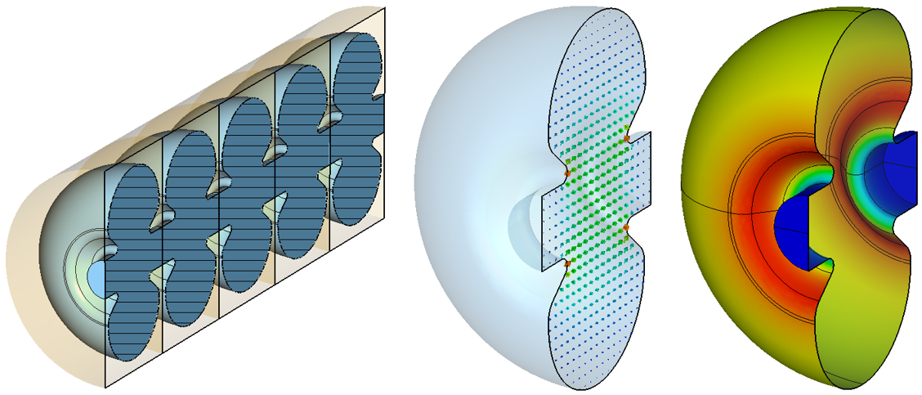
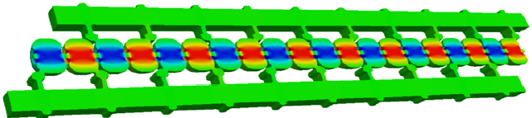
High-Gradient Structure Development
Re-entrant cavity shapes were optimized to achieve high efficiency.
Cavity Parameters at Gradient E
f | β | a, mm | E, MV/m | E_{max}/E | Zʹ, MΩ/m | Pʹ, MW/m
L | 0.84 | 8 | 12 | 4.3 | 68.6 | 2.1
S | 0.84 | 8 | 25 | 4.23 | 69.9 | 8.9
S | 0.93 | 6.5 | 25 | 4.1 | 83.4 | 7.5
C | 0.93 | 6.5 | 40 | 3.63 | 76.9 | 20.8
C | 0.97 | 5 | 40 | 3.63 | 96.9 | 16.5
L | 0.97 | 5 | 12 | 4.6 | 77 | 1.9
Bare S-band (14 f_{b} = 2817.5 MHz) structure for β=0.84: 5-cell structure section (left); electric field within a cell; current distribution on the cell inner surface (right).
Reducing gradient saves RF($)!
Work is in progress on designing distributed coupling structures. TW – backup.
T-junctions
RF couplers
Ref: S. Tantawi et al. PRAB, 23, 092001 (2020)

Slide 7
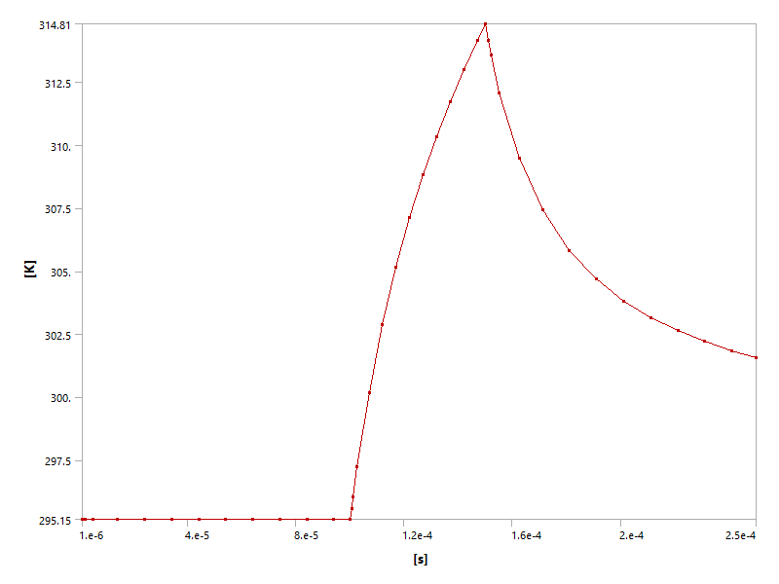
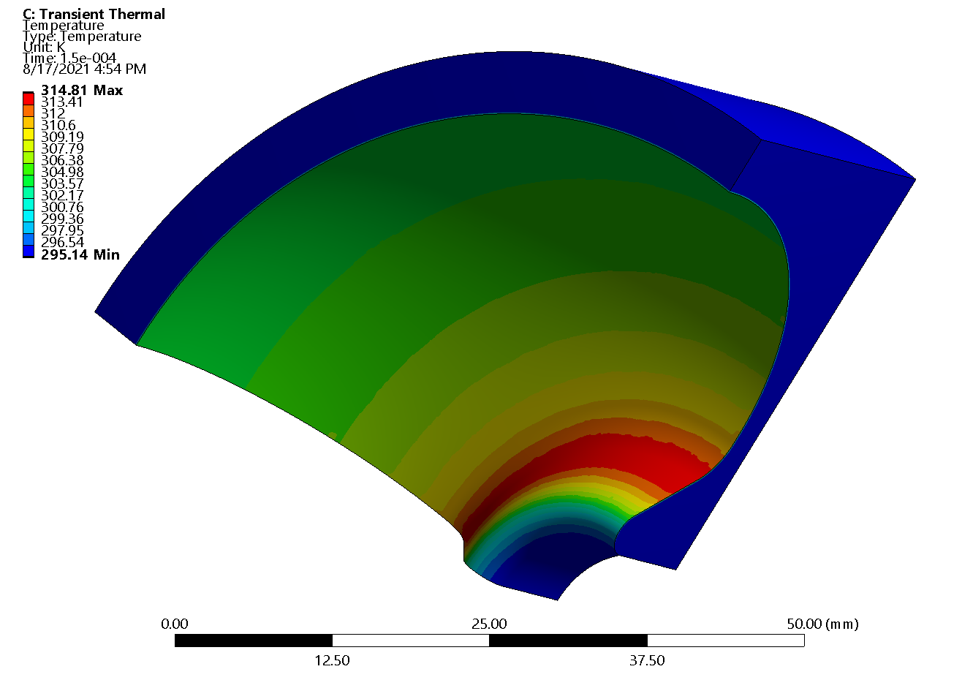
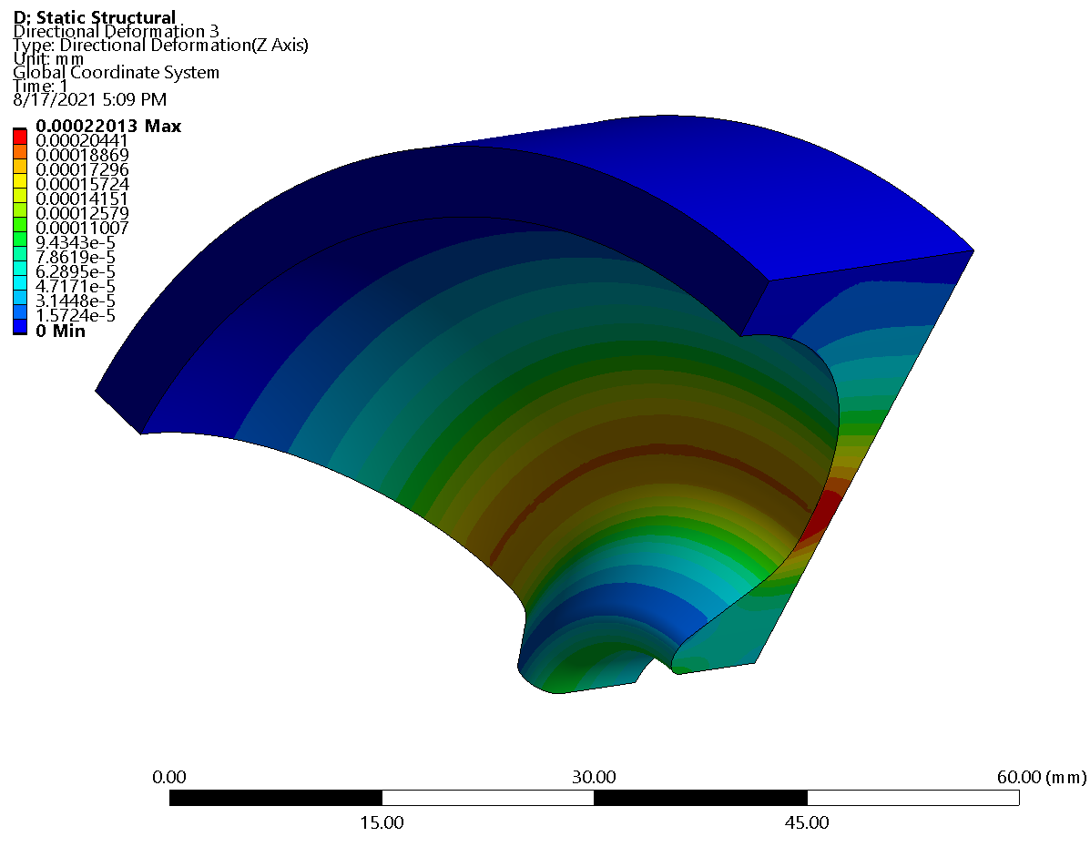
HG Cavity Thermal-Stress Analysis
Preliminary thermal-stress analysis was performed for S-band cavity. Nominal frequency f = 2817.5 MHz (L: 1408.75 MHz; C: 5635 MHz)
Cavity Parameters at Gradient E
ΔT_{max}=20K
50-µs pulse
f | β | a, mm | E, MV/m | E_{max}/E | Zʹ, MΩ/m | Pʹ, MW/m
L | 0.84 | 8 | 18 | 4.3 | 68.6 | 4.7
S | 0.84 | 8 | 36 | 4.23 | 69.9 | 18.5
S | 0.93 | 6.5 | 36 | 4.1 | 83.4 | 15.5
C | 0.93 | 6.5 | 80 | 3.63 | 76.9 | 83.2
C | 0.97 | 5 | 80 | 3.63 | 96.9 | 66
L | 0.97 | 5 | 18 | 4.6 | 77 | 4.2
P ~ E²
Δt_{pulse}, µs | ΔT_{max}, K | Δz_{max}, µm | Δf_{max}, MHz
50 | 20 | 0.22 | -
100 | 28 | 0.44 | -
1000 | 88 | 4.6 | -0.48
Δz_{max}=0.22µm
50-µs pulse
Thermal-structural analysis of S-band cavity for β=0.84: temperature distribution and deformation after 50-µs pulse.

Slide 8
HG pRad Booster – RF power
Total peak RF power estimates (room temperature operation)
Booster | L, m | E_{S}, MV/m | P_{S}, GW | E_{C}, MV/m | P_{C}, GW
Design 1 | 92.5 | 36 | 0.42 | 100 | 1.9
Design 2 | 156.5 | 25 | 0.3 | 40 | 0.75
IPAC21
NAPAC22
Cryo-cooled operation (LN₂) can reduce the RF power by factor 2-3 and is well suited for pRad booster: < 50-µs single RF pulse, a few events per day. If some nitrogen is evaporated due to structure heating (we estimated this fraction below 10⁻³, even after full 50-µs pulse); if needed, it can be refilled before the next event. Cool!
High-peak-power klystrons (>20 MW) with a variable pulse length 2-50 µs at very low duty factor (single pulse) are feasible but require development. Available S- and C-band klystrons produce up to 50-MW peak with pulses 1-3 µs and rep rates ~100 Hz. Multi-beam L-band (1.3 GHz) klystrons at DESY produce 10-MW peak with 1.5-ms pulse at 10 Hz.
Modulators for such klystrons will also need development.

Slide 9
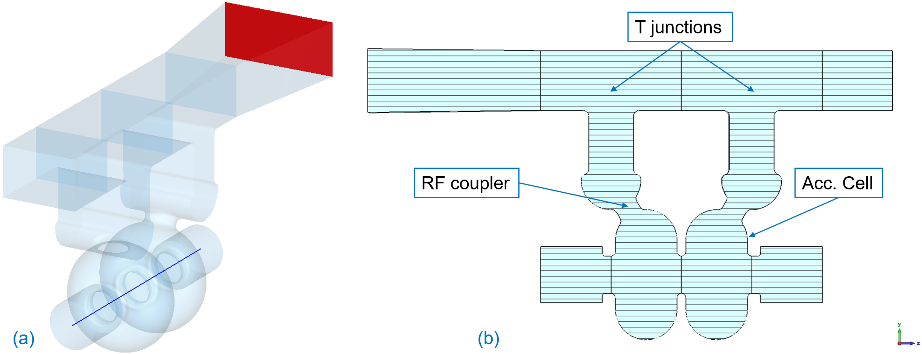
Test cavity with distributed coupling
C-band 2-cell π-mode test cavity for β = 0.93 (1.6-GeV protons): (a) inner vacuum volume with standard WG187 port (red); (b) vertical cross section.
The test cavity was designed for 5.712 GHz (not 5.635 GHz), to be tested at the existing LANL C-band RF test stand: 50-MW klystron with <1 µs pulse at 100 Hz.
Simplified cell shape – no noses (not efficient for large beam apertures: a = 6.5 mm, r = 21.9 mm; a/r = 0.3); reduces E_{max} by 37%.
Large RF couplers: each delivers one-half of the RF power fed into waveguide.

Slide 10
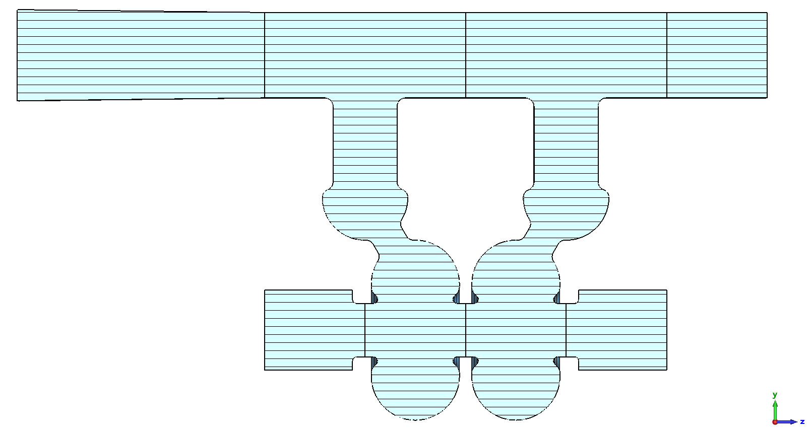
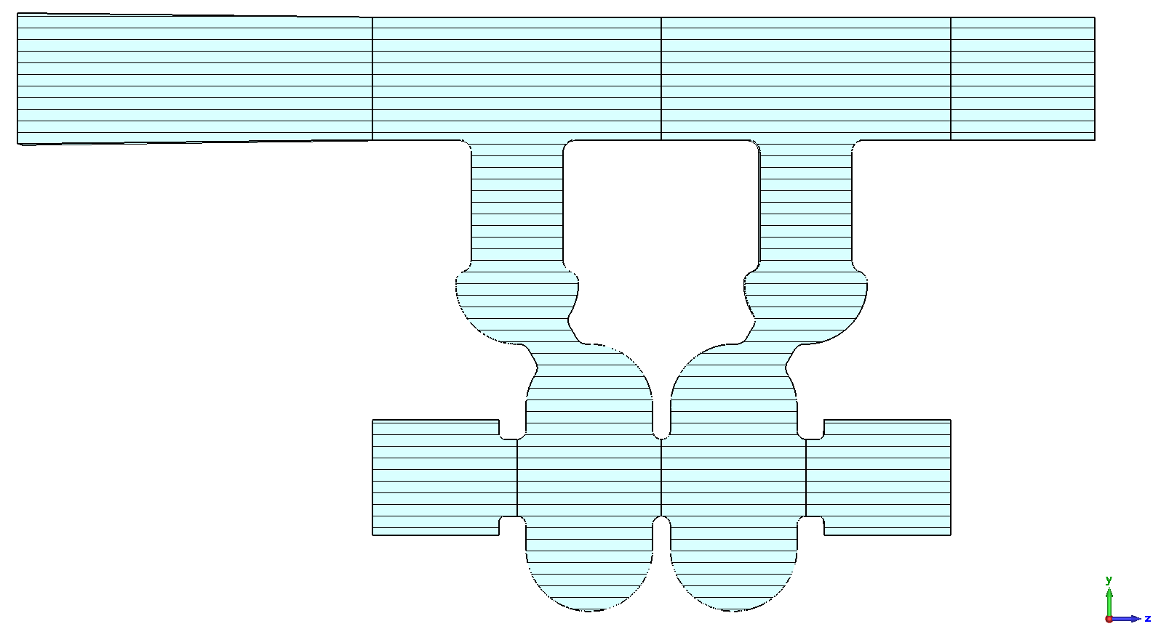
Test cavity with distributed coupling – parameters
A
B
Comparison of two cavity types. f = 5.712 GHz; ideal Cu; E₀T = 80 MV/m
Re-entrant cavity, A | EM quantity, unit | Simple cavity, B
0.7429 | T | 0.7346
12,746 | Q₀ | 13,150
10,764 | Q_{ext} | 11,006
3.98 | P, MW | 4.37
3.67 | E_{max} / E₀T | 2.32
2.10 | Z₀H_{max} / E₀T | 2.29
78.6 | Z′_{eff}, MΩ/m | 71.4
81.5 | P′, MW/m | 89.6

Slide 11
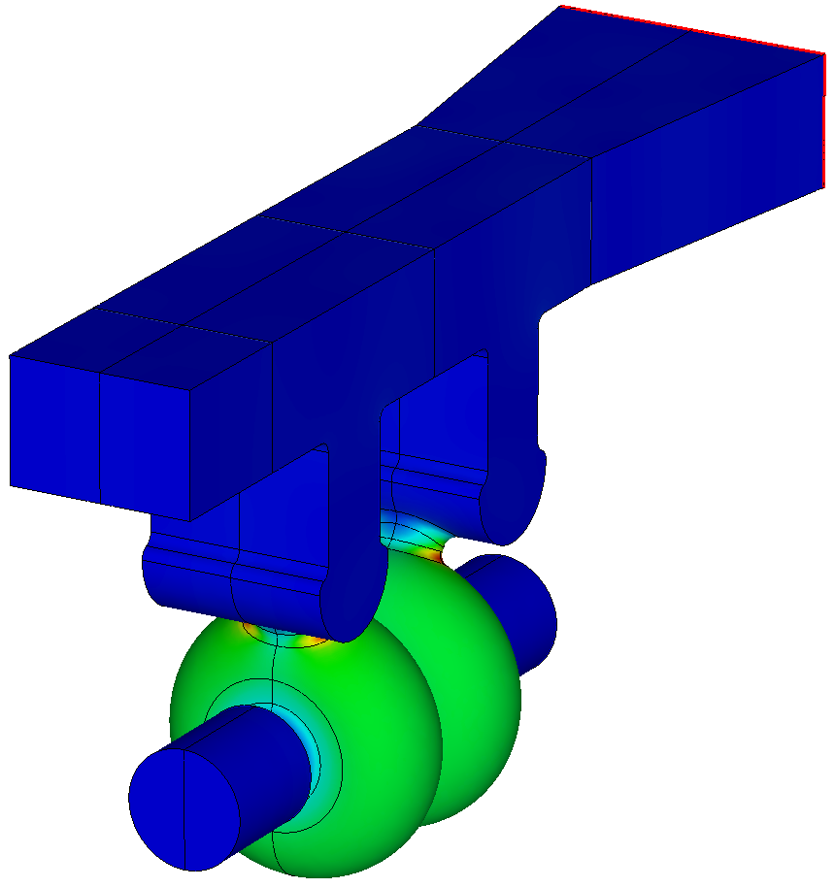
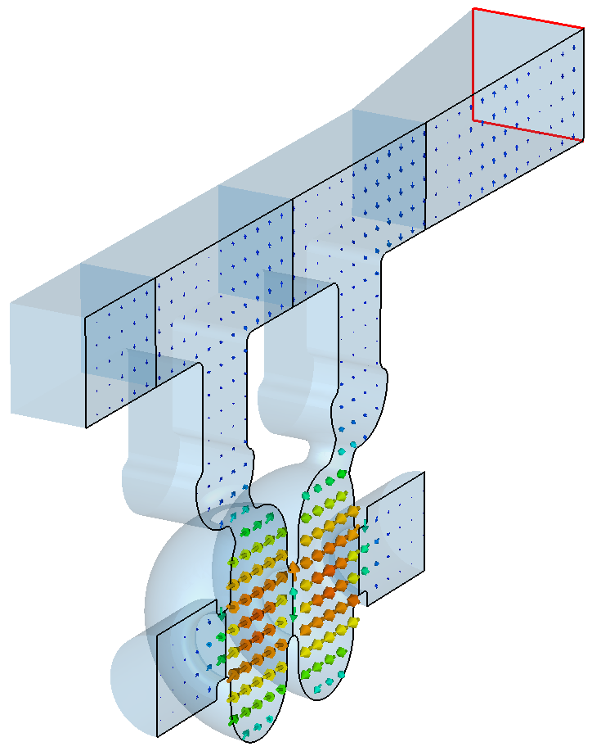
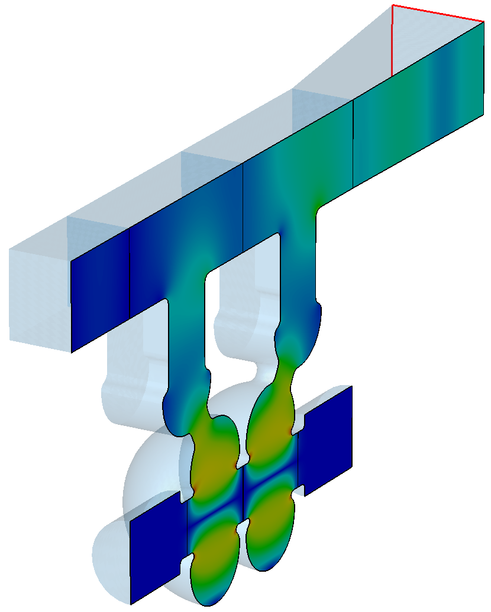
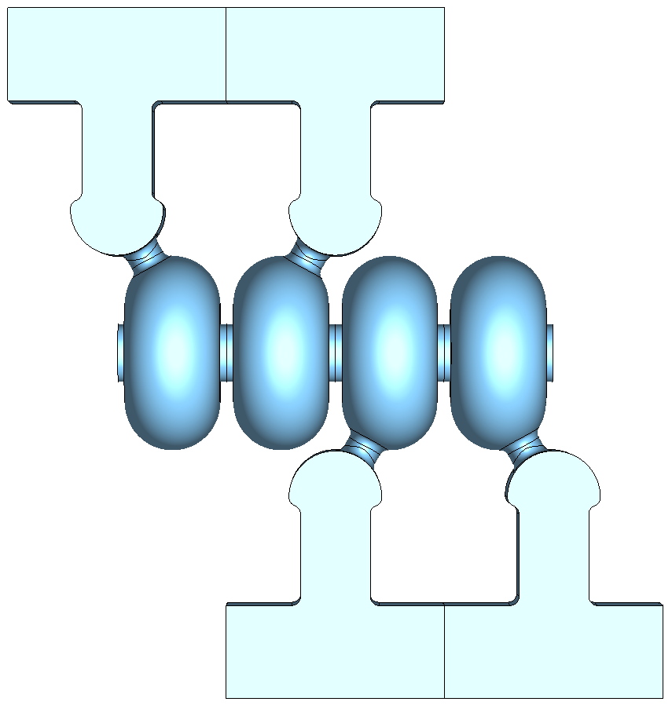
Fields and power flow in the test cavity
|J_{surf}|
E-field in cut plane
Power flow snapshot
CST calculated fields and power in the test cavity

Slide 12
Structure with distributed RF coupling – one period
λ_{g}/2
L_{c}
L_{c}
WG width w changes with β
λ_{g}/2
WG width w is chosen to feed the π-mode and to match the structure and WG periods

Slide 13
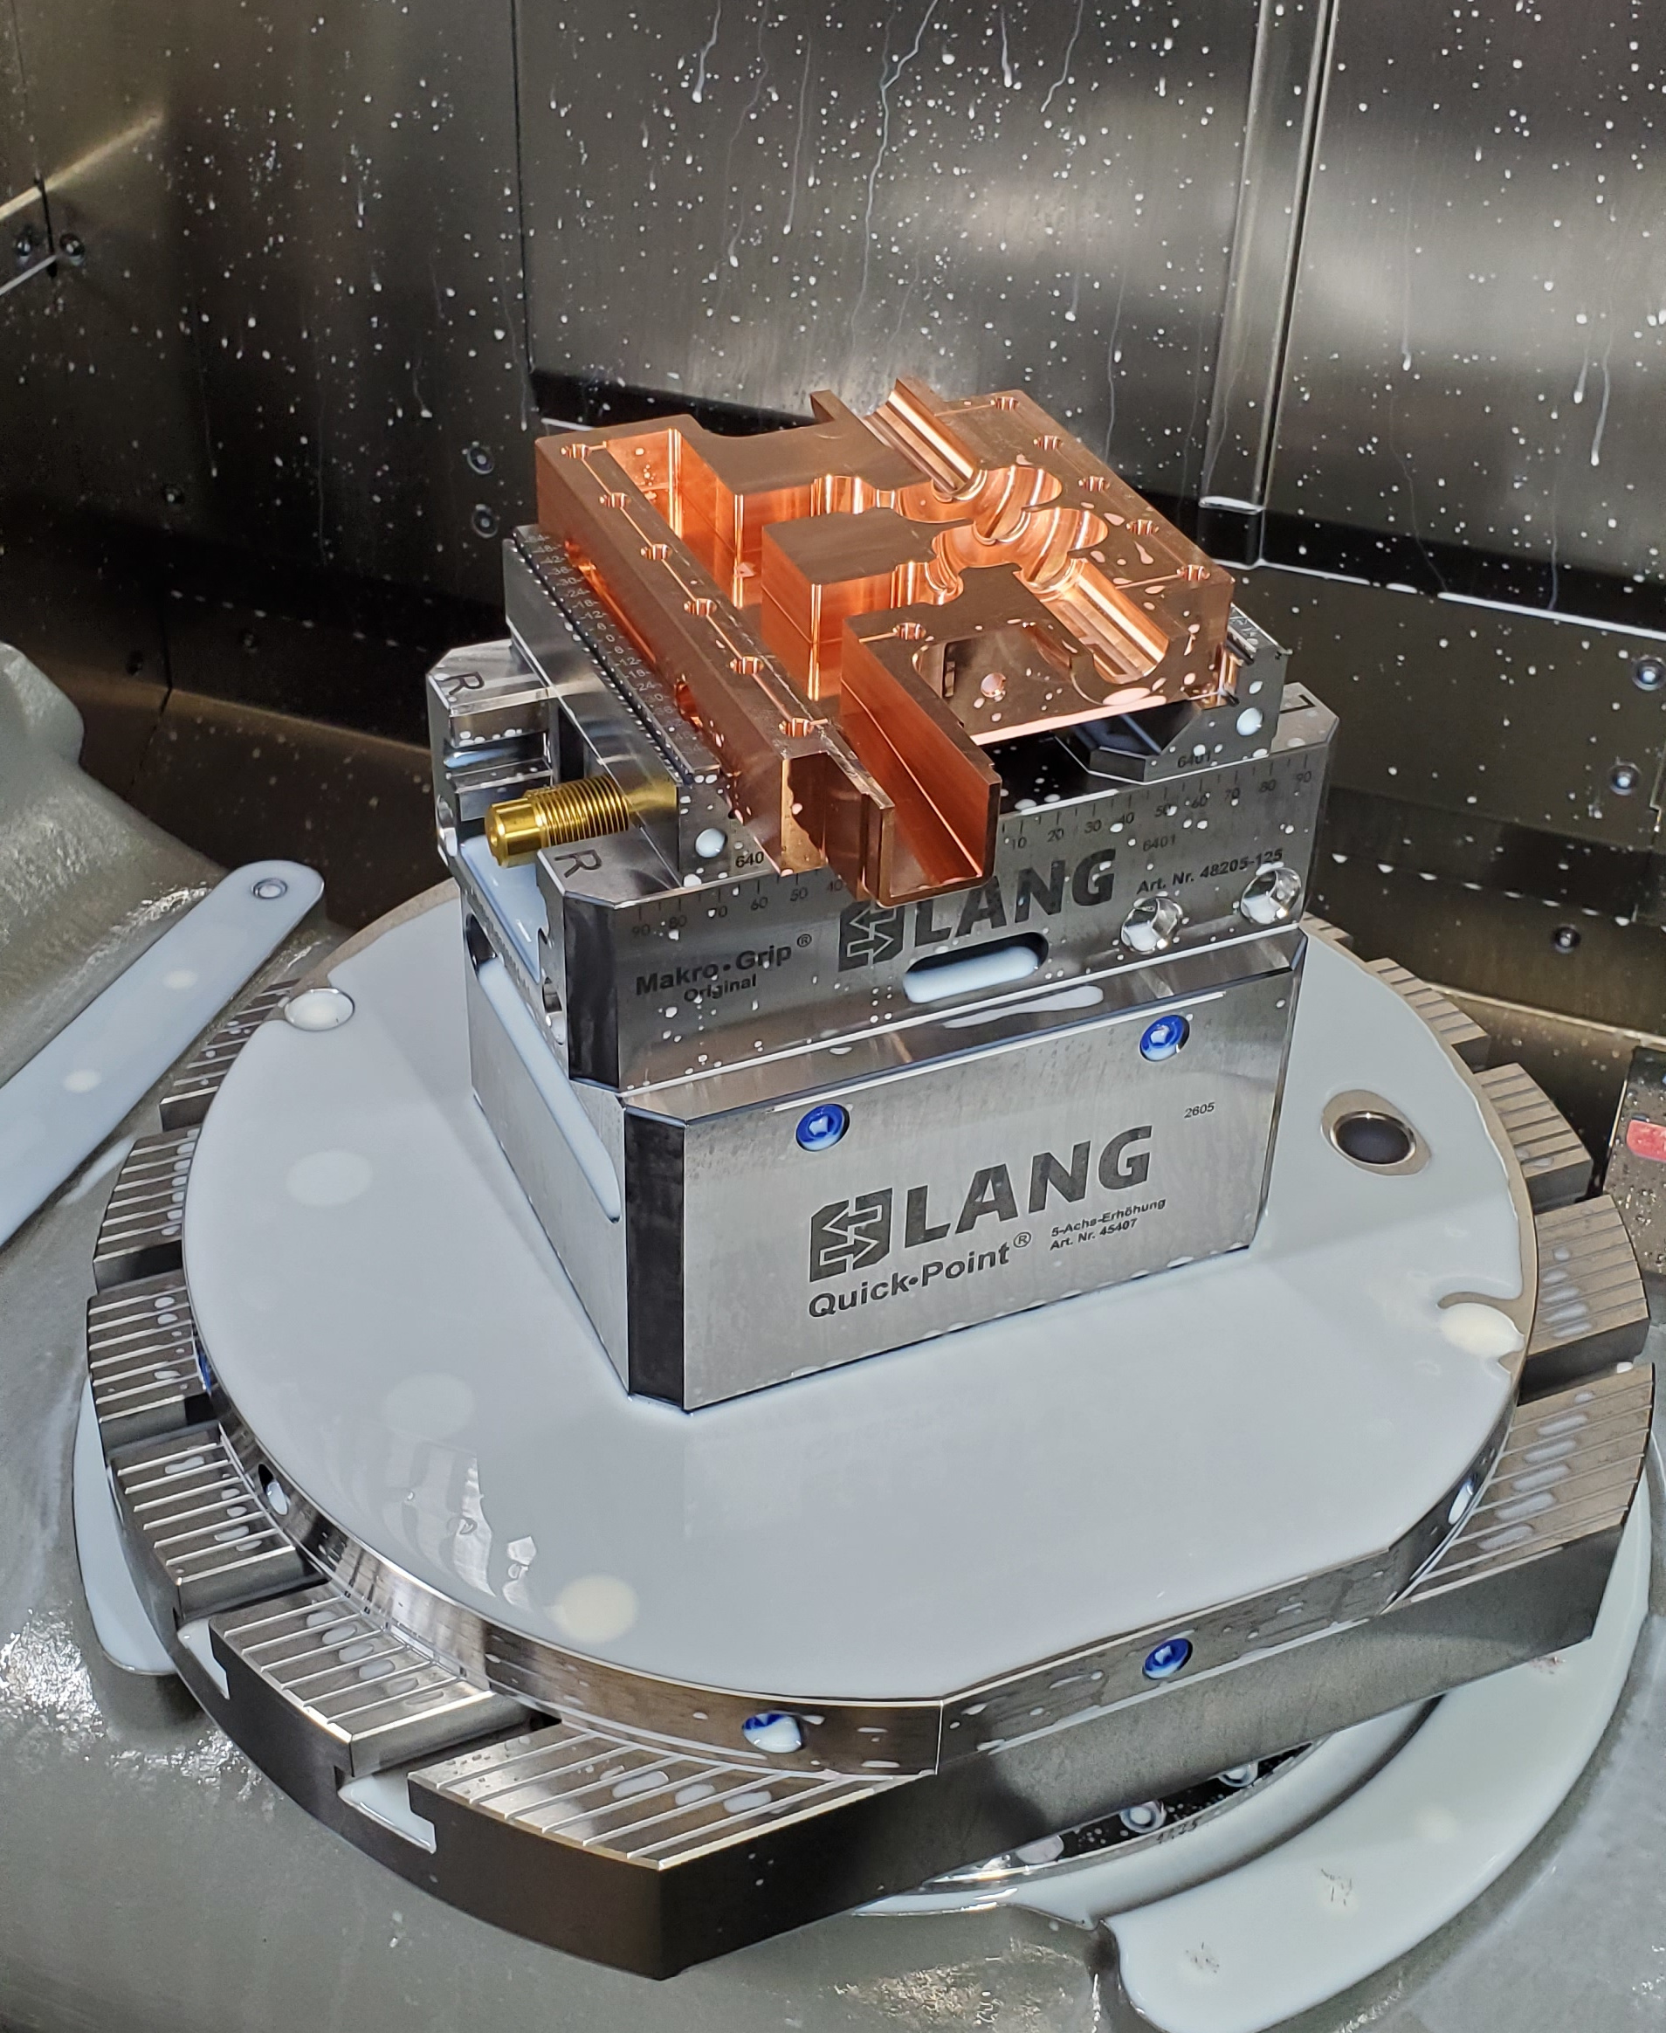
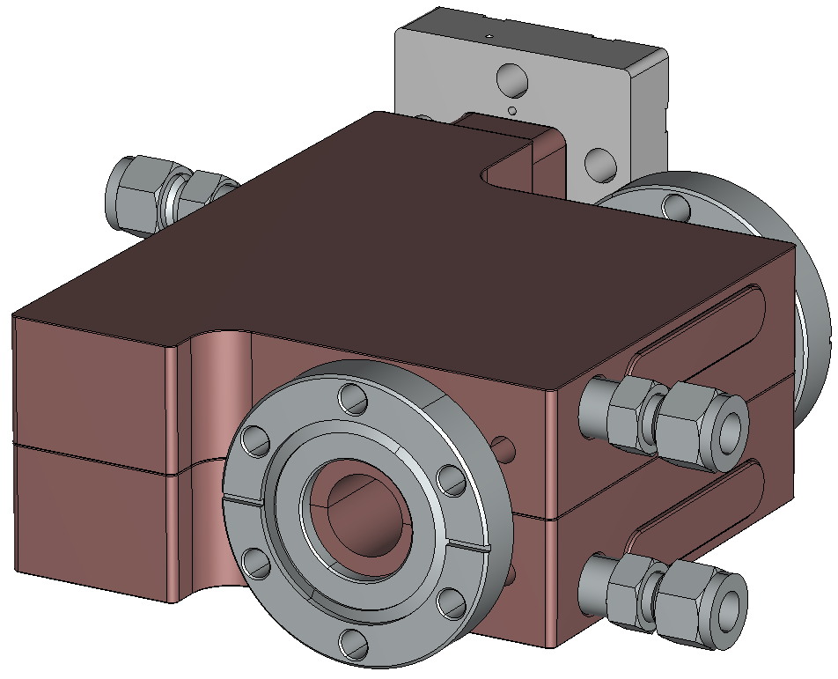
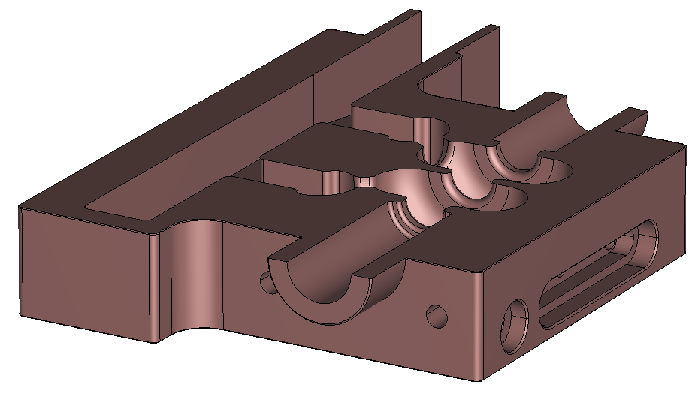
Test cavity is fabricated
Ph. Borchard, Dymenso, LLC
C-band test cavity: CAD model and machined half-structure (picture top right)

Slide 14
Summary
A high-gradient (HG) booster linac for enhanced proton radiography (pRad) at LANSCE is designed to increase the beam energy from 800 MeV to 3 GeV. It is a unique application of HG normal-conducting cavities for protons made possible by pRad requirements of very short beam pulses at low duty.
We continue development of high-gradient structures for the pRad booster. Our focus is on standing-wave π-mode S- and C-band structures with distributed RF coupling adapted for protons with β = 0.84-0.97 (beam energy from 800 MeV to 3 GeV).
A short 2-cell C-band test cavity for β = 0.93 with distributed coupling was designed for frequency 5.712 GHz. The cavity is fabricated and delivered to LANL, and it will be tested soon at the LANL C-band RF test stand.
This work is supported by the LANL LDRD program

