Slide 1
High-Gradient 3-GeV Booster for Enhanced Proton Radiography at LANSCE
Yuri Batygin and Sergey Kurennoy
Los Alamos National Laboratory, Los Alamos, NM 87545, USA
20th Advanced Accelerator Concepts Workshop (AAC’22)
November 6-11, 2022
LA-UR-22-31608

Slide 2
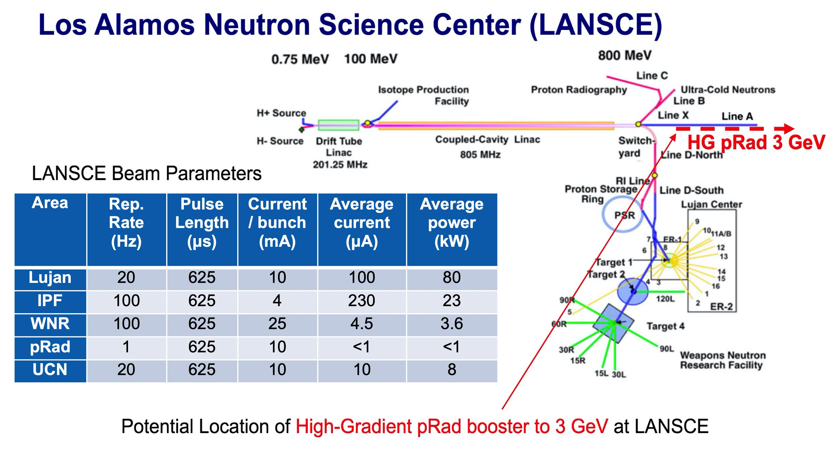

Slide 3
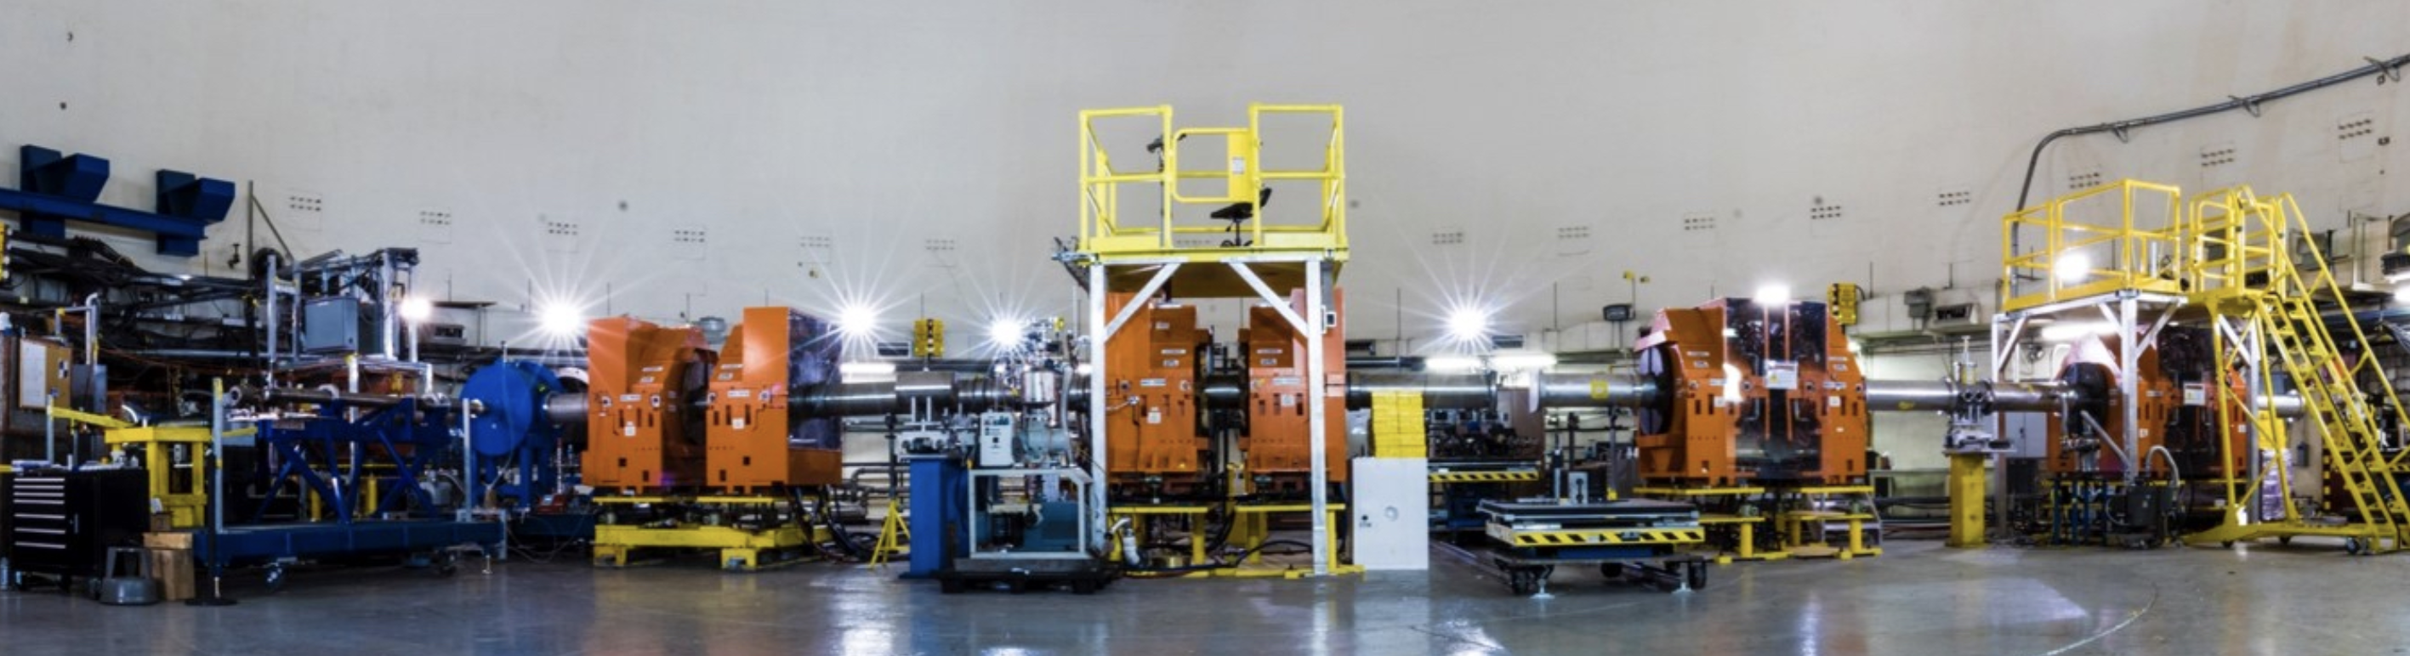
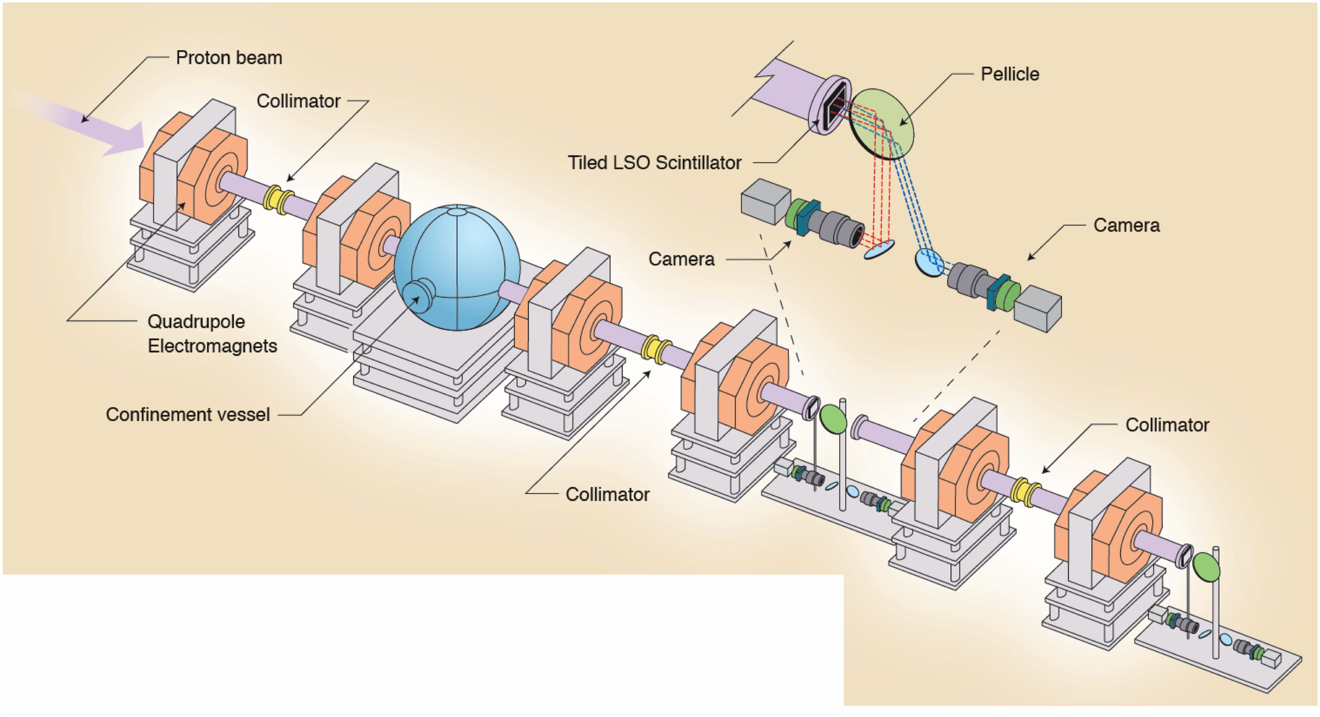
Proton Radiography at LANL
Proton Radiography (pRad) was developed at the Los Alamos National Laboratory in the mid-1990s as a multi-pulse flash technique for deep-penetrated hydro test objects study. It utilizes an 800-MeV proton beam from Los Alamos linear accelerator with a beamline for beam imaging.
Experimental area of the 800-MeV LANSCE Proton Radiography Facility
Layout of Proton Radiography Beamline at LANSCE, LANL Report LA-UR-13-24376 (2013).

Slide 4
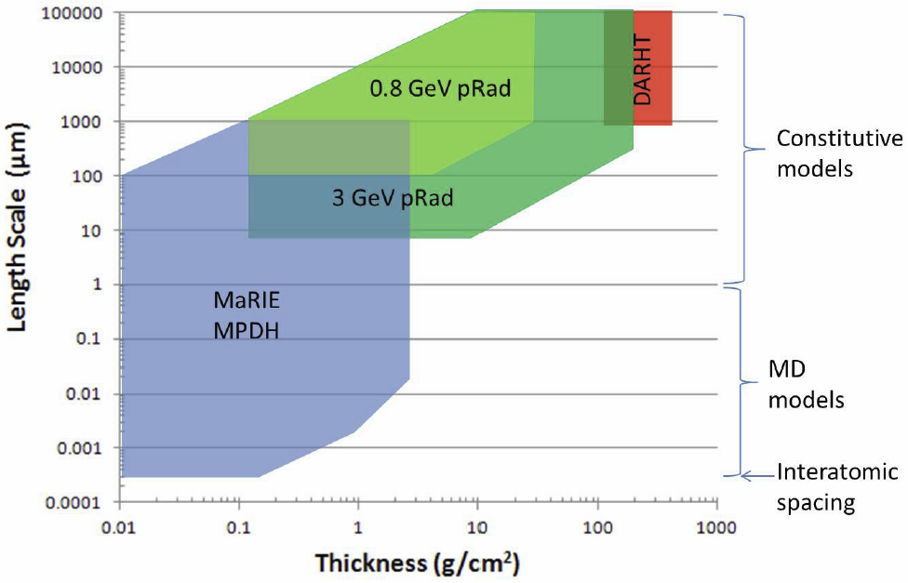
Radiographic Capabilities of the 3-GeV Proton Radiography
Increasing the proton energy from the present 800 MeV to 3 GeV improves the radiography resolution by a factor of 10. It will bridge the gap between the existing DARHT facility, which covers large length scales for thick objects, and future high-brightness light sources like MaRIE and DMMSC, which can provide the finest resolution.
Design of 3 GeV pRad booster is supported by LDRD 20210004ER.
The object thickness and length scale regimes at existing and planned LANL facilities [LANL Report LA-UR-13-24376 (2013)].

Slide 5
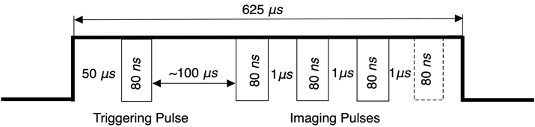
Parameters of Existing and Upgraded pRad Beams
Parameter | Existing | Upgraded
Energy (GeV) | 0.8 | 3
FWHM momentum spread, dp/p | 1 x 10⁻³ | 3.3 x 10⁻⁴
Beam current / bunch (mA) | 10 | 19
Protons per pulse | 5 x 10⁹ | 9.5 x 10⁹
Time structure of LANSCE pRad beam

Slide 6
Design Issues for High-Gradient pRad Booster
1. Adaptation of high-gradient structures for protons
2. Prevention of beam loss and preservation of transverse acceptance
3. Mitigation of strong RF defocusing due to high gradient
4. Selection of appropriate magnetic focusing
5. Matching of the 800-MeV output LANSCE beam to high gradient
structure
6. Beam debunching after linac is required to ensure low-momentum spread
of the beam

Slide 7
Beam Loss and Transverse Acceptance
Utilization of high RF frequencies (short RF wavelength λ) results in reduction of beam aperture a (typically, in accelerators, a/λ ~0.1). This results in reduction of accelerator acceptance and possible beam losses. To insure small beam losses, transverse acceptance of the proposed structure should not be smaller than that in existing LANSCE.
Normalized (energy-independent) transverse acceptance of accelerating structure
Particle momentum
Aperture radius of accelerator channel
Focusing period
Phase advance of transverse oscillations per focusing period

Slide 8
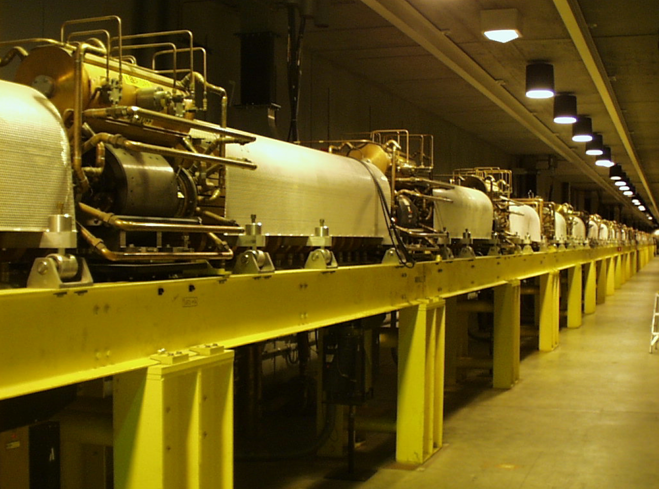
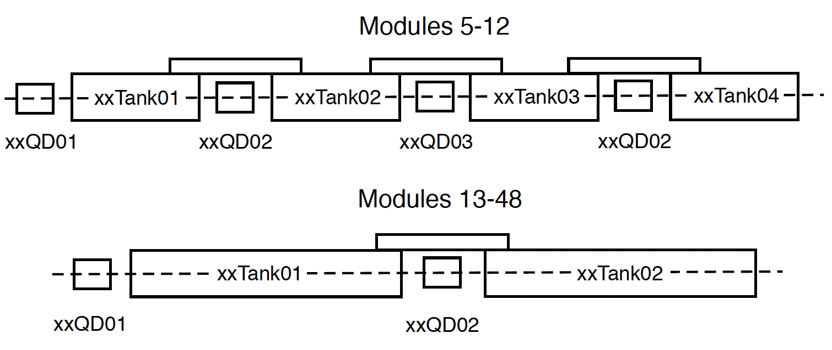
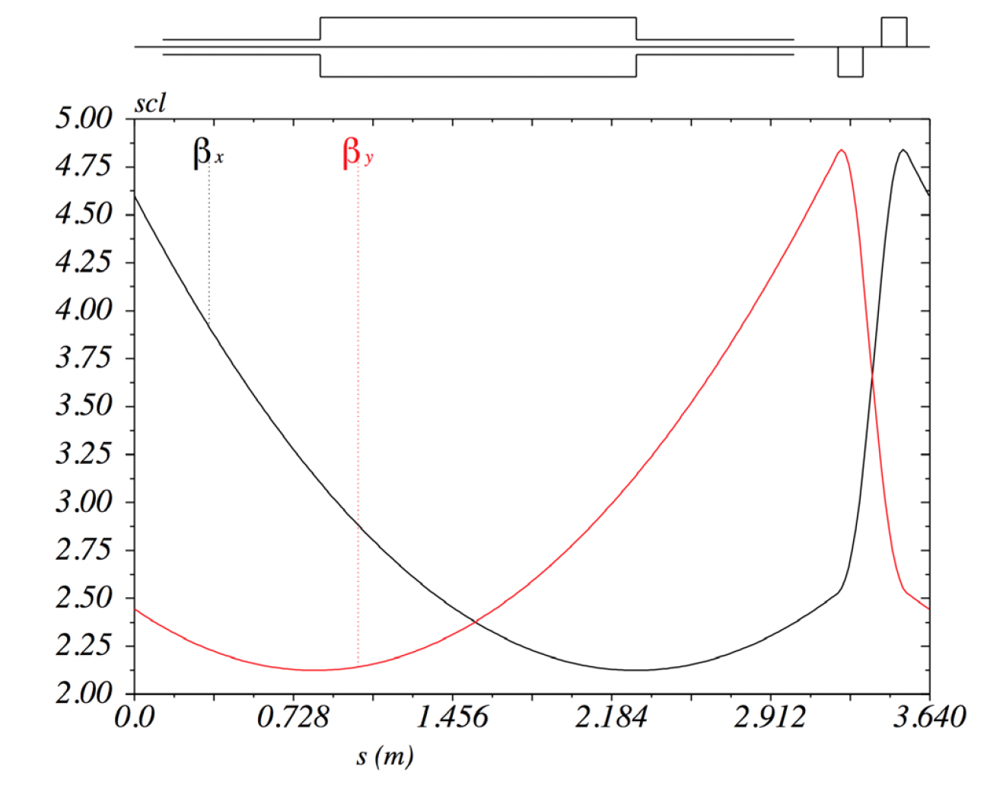
Focusing Structure of Existing 805 MHz Coupled Cavity Linac
LANSCE Coupled Cavity Linac
Transverse acceptance of LANSCE
at 800 MeV:
LANSCE CCL Module Layout and beta-functions.

Slide 9
Selection of RF Frequency
Limitations on acceptance are translated into limitation on accelerator aperture, which, in turn, is translated into selection of RF frequency to provide high value of shunt impedance of the accelerator sections.
The shunt impedance Z_{eff}=E²L/P for various accelerating structures [S.Tantawi et al, PRAB 23, 092001 (2020)].
Minimal aperture

Slide 10
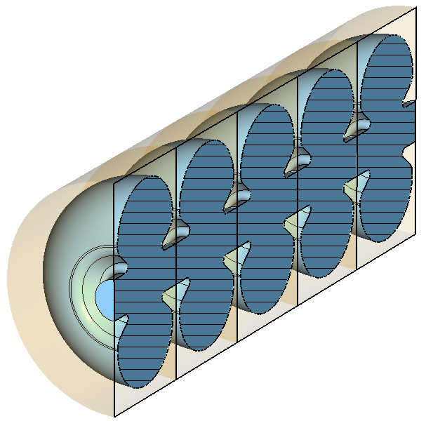
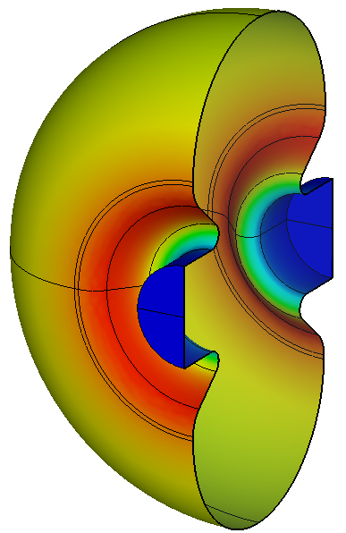
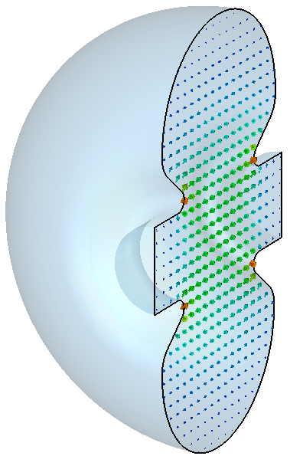
Parameters of RF Structures
(a)
Frequency f (GHz) | Velocity β | Aperture radius, a (mm) | Accel. gradient, E_{o}T (MV/m) | Shunt Imped., R_{sh}T²/L (MΩ/m) | RF Power, P/L (MW/m)
1.40875 | 0.84 | 8 | 12 | 68.6 | 4.7
2.8175 | 0.93 | 6.5 | 25 | 83.4 | 7.5
5.635 | 0.97 | 5 | 40 | 96.9 | 16.5
(c)
(b)
S-band 2.8 GHz cavities for β=0.84: (a) 5-cell structure, (b) electric field (c) surface current
Detailed description of RF structures: S.S. Kurennoy, Y.K. Batygin and E.R. Olivas, “High-Gradient Accelerating Structures for 3-GeV Proton Radiography Booster”, this Workshop (2022).

Slide 11
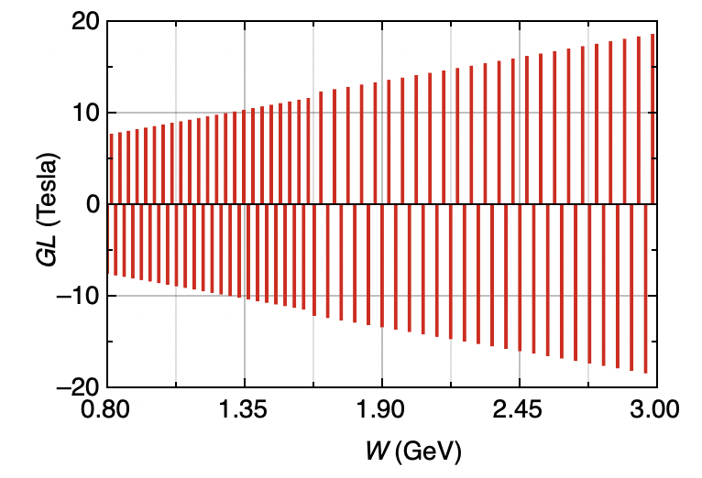
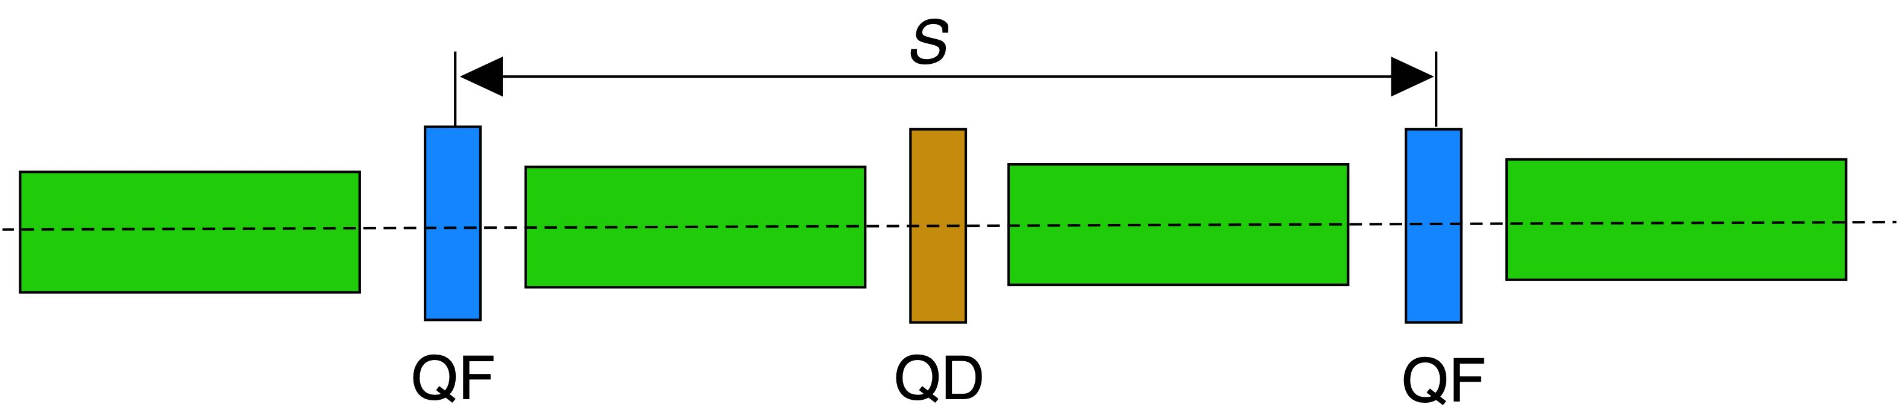
FODO Focusing Structure
Phase advance of longitudinal oscillations per focusing period S is selected to be limited by the value of ~ 70º (1.2 rad):
Focusing strength of quadrupoles versus beam energy

Slide 12
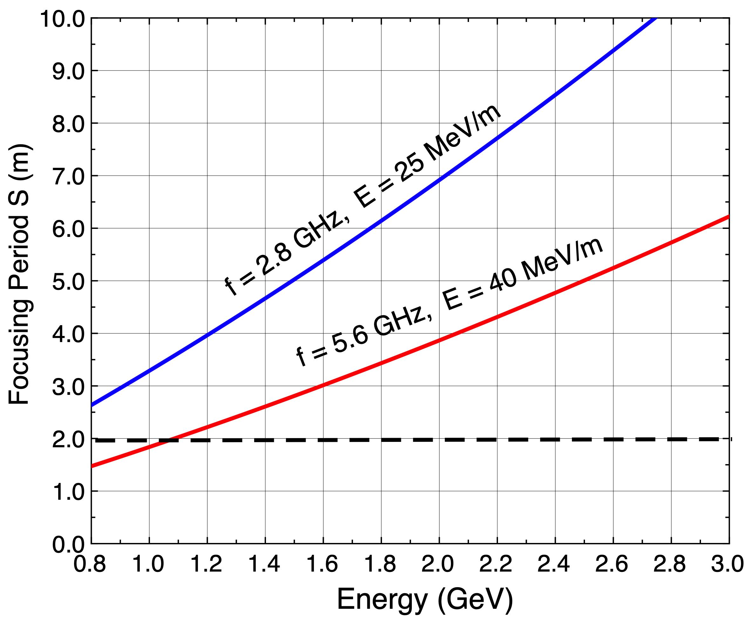
Selection of Focusing Period
Selection of phase advance is translated into limitation of focusing period:
Reducing of the focusing period results in decrease of the average accelerating gradient:
Final selection: S = 2 m. Average gradient:
Required focusing period versus beam energy to mitigate RF defocusing

Slide 13
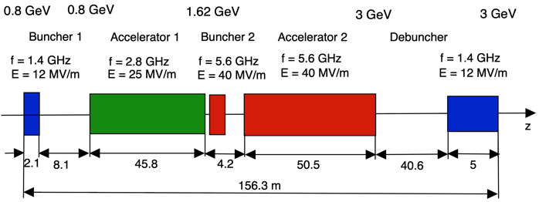
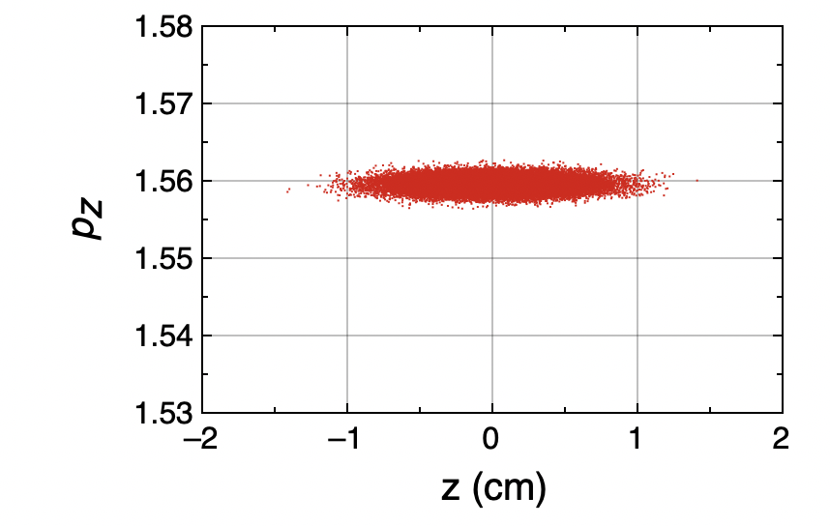
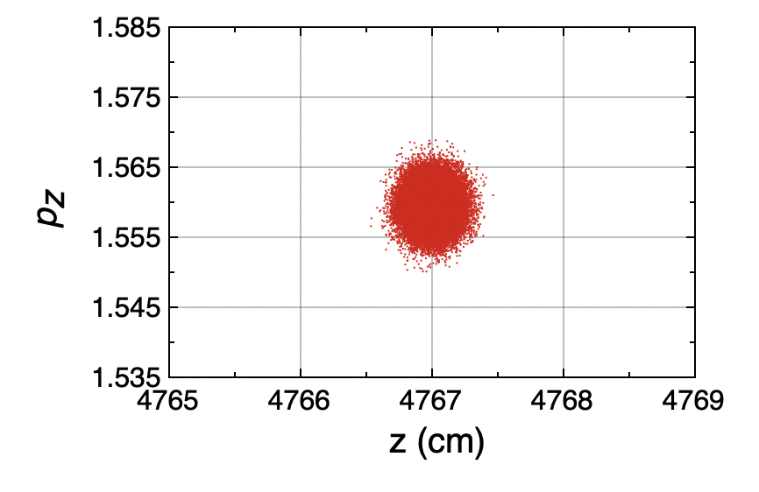
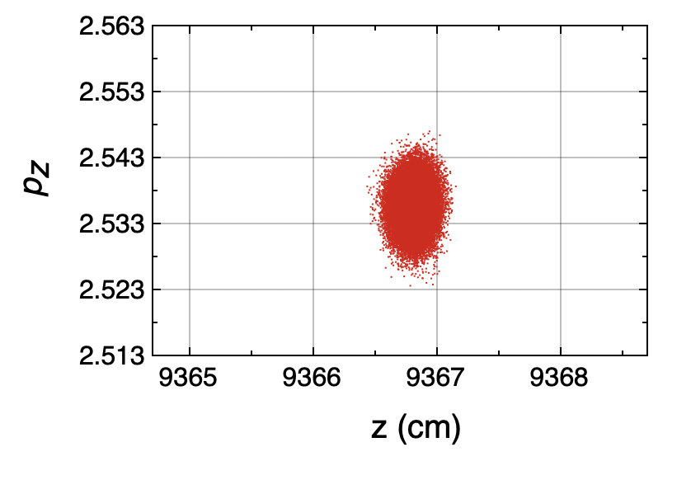
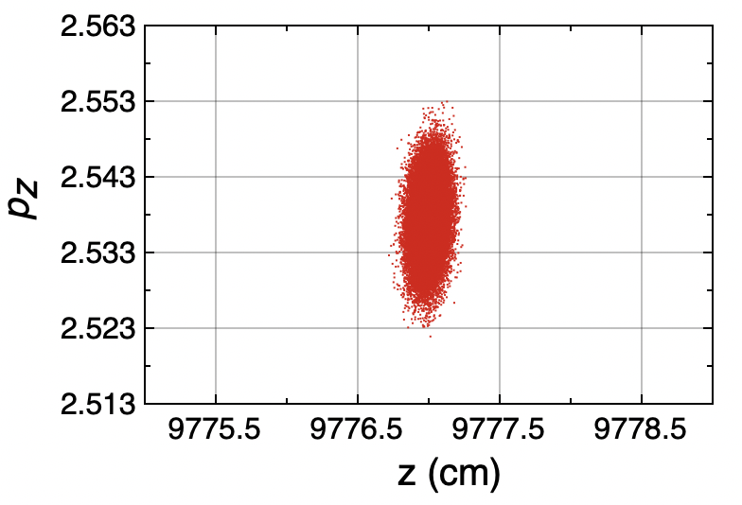
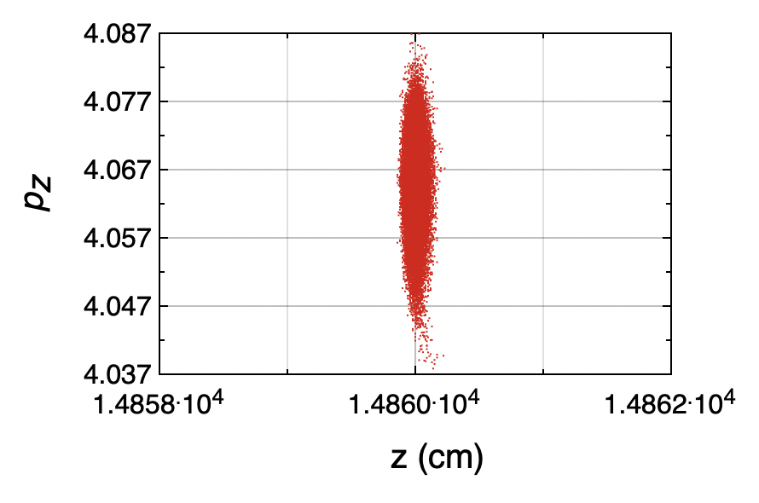
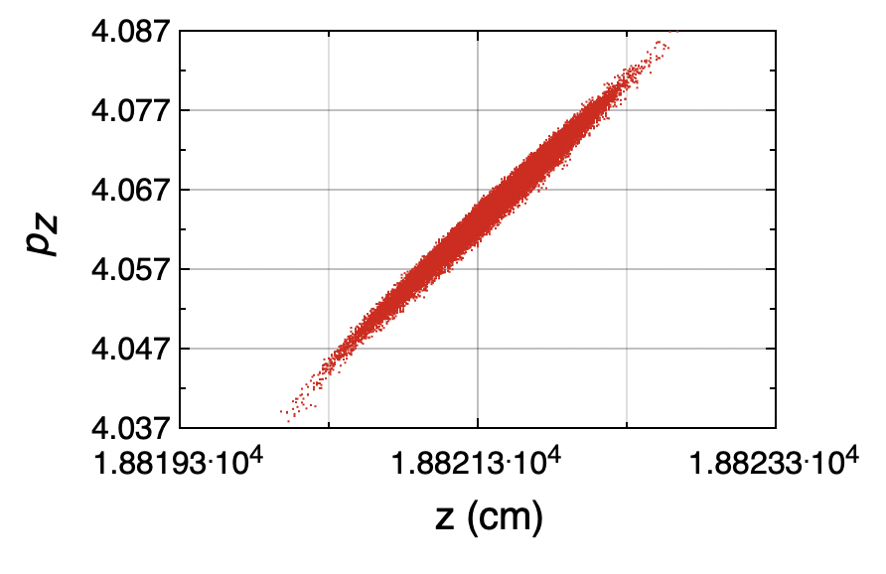
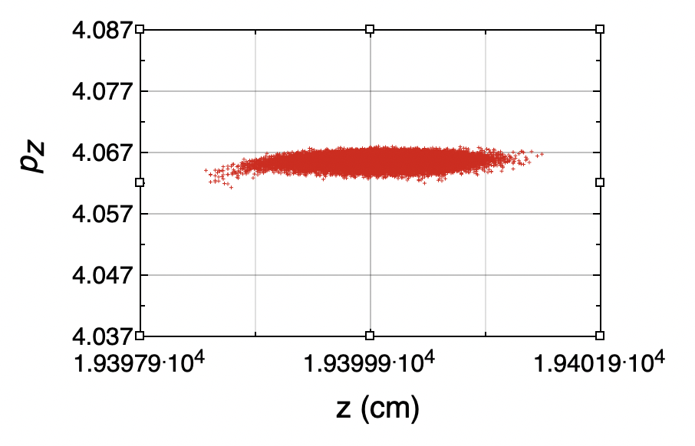
Layout of 3-GeV Booster
Transformation of Longitudinal Phase Space

Slide 14
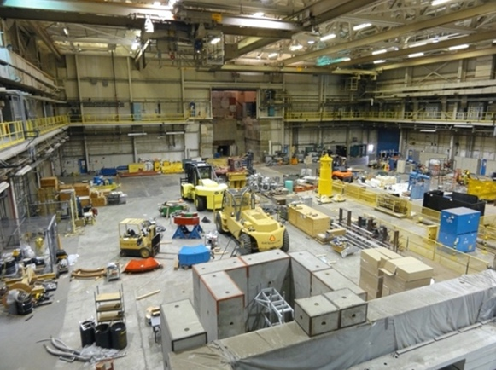
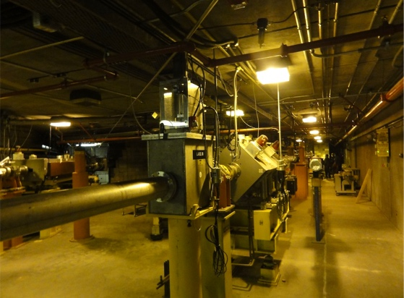
LANSCE Line A and Area A
Line A after the linear accelerator
Experimental Area A

Slide 15
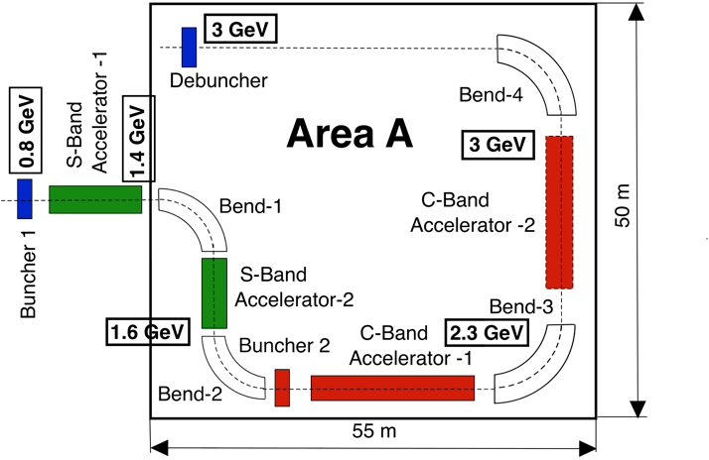
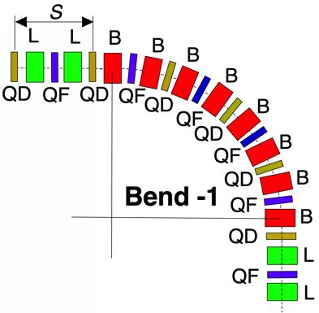
Placement of the Booster in Experimental Area A
Bending arc containing four FODO cells with transverse phase advance per cell 90º: (L) linear accelerator, (B) bending magnet, (QF) x-focusing quadrupole, (QD) x-defocusing quadrupole.
Placement of pRad booster in existing experimental area A.

Slide 16
Summary
1. High-energy accelerator for 3 GeV pRad enhancement is proposed.
2. Accelerator consists of 1.4 GHz buncher, two accelerators based on 2.8 GHz and 5.6 GHz high-gradient accelerating structures and 1.4 GHz debuncher.
3. Utilization of buncher-accelerator-debuncher scheme allows us to combine high-gradient acceleration with reduction of beam momentum spread dp/p from 10⁻³ to 3.3 x 10⁻⁴ .
4. Requirement to provide small beam momentum spread beam results in an accelerator of total length of 156.3 m. Possible location of the pRad booster is in the existing experimental Area A.

