Slide 1
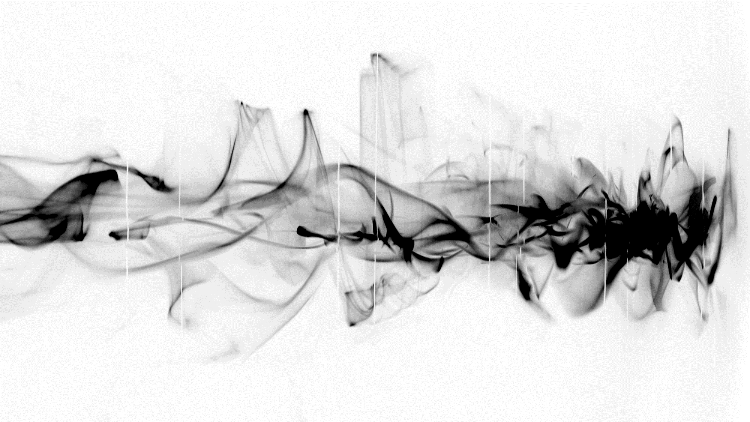
Acceleration beyond 10 GeV of a 340 pC electron bunch in a 10 cm nanoparticle-assisted wakefield accelerator
Constantin Aniculaesei, PhD
constantin.aniculaesei@austin.utexas.edu
Notes:
Many thanks to the organizing committee for inviting me to give this presentation at this wonderful conference.

Slide 2









Extended Team:
Sandra Bruce (UT@A)
Enrico Brunetti (U of Strathclyde)
Andrea Hannasch (UT@A)
Björn M. Hegelich (UT@A & TAU Systems)
MacKenzie Connolly (TAU Systems)
Todd Ditmire (UT@A)
Michael Donovan (TAU Systems)
Theo Douglas (UT@A)
Michael Downer (UT@A)
Alexandro J. Franco (UT@A)
Erhard Gaul (UT@A)
Thanh Ha (UT@A)
Dino A. Jaroszynski (U of Strathclyde)
Lance Labun (TAU Systems)
Ou Labun (UT@A & TAU Systems)
Scott Luedtke (LANL)
Edward McCary (UT@A)
Stephen Milton (TAU Systems)
Isabella Pagano (UT@A & LLNL)
Hernan Quevedo (UT@A)
Hartmut Ruhl (LMU)
Martin L. Ringuette (UT@A)
Ritwik Sain (UT@A)
Michael M. Spinks (UT@A)
Ganesh Tiwari (BNL)
Rafal Zgadzaj (UT@A)
Samuel Yoffe (U of Strathclyde)
Notes:
This work could not have been accomplished without the help of these fantastic people. A special shout-out to Prof. Bjorn Hegelich, who supported all my crazy lab ideas and taught me the meaning of the word “persevere.”

Slide 3
Content:
Electron Wakefield Acceleration basics (indirect and direct acceleration)
Indirect (laser-driven + particle-driven) + direct acceleration
Wakefield Acceleration beyond dephasing
Experimental setup and results
What’s next?
Notes:
This presentation is structured as follows:
A short introduction to the basics of direct and indirect wakefield acceleration is followed by a description of the phenomena happening during and after a laser wakefield accelerator reaches the dephasing length
The experimental results are shown and concluded with some ideas for future work.

Slide 4
Plasma-based electron acceleration basics:
Laser-driven
Particle-driven
Direct Laser Acceleration
INDIRECT
INDIRECT
DIRECT
.
Notes:
Electron acceleration by plasma wakefield accelerators can be achieved in two ways: indirect and direct acceleration.

Slide 5
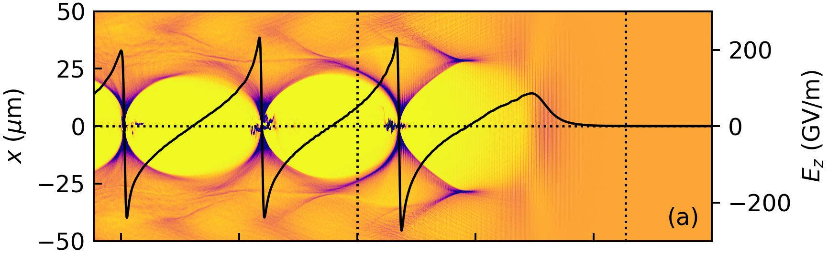

Plasma-based electron acceleration basics:
Laser-driven
Particle-driven
Direct Laser Acceleration
e- bunch
Laser
pulse
Ez field
INDIRECT
DIRECT
1-D linear approximation
$$a^{2}≪1$$
Plasma wave:
electron density perturbation
Ponderomotive force
(radiation pressure)
.
n₀~10¹⁹ -10¹⁸ cm⁻³
Notes:
In indirect wakefield acceleration a laser pulse or

Slide 6
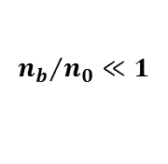
Plasma-based electron acceleration basics:
Laser-driven
Particle-driven
Direct Laser Acceleration
e- bunch
e- bunch
Laser
pulse
Particle
beam
Ez field
Ez field
DIRECT
1-D linear approximation
1-D linear approximation
$$a^{2}≪1$$
$${n_{b}}/{n_{0}}≪1$$
Plasma wave:
electron density perturbation
Ponderomotive force
(radiation pressure)
Plasma wave:
electron density perturbation
Space-charge force
.
n₀~10¹⁹ -10¹⁸ cm⁻³
Notes:
a charged particle beam transfers energy to the plasma waves, which trap and accelerate the background plasma electrons. The significant acceleration fields of the order of 100’s of GV/m and the compactness of the acceleration structure (from a few mm to cm long) are some of the reasons why this scheme makes a possible candidate for the next generation of electron accelerators and radiation sources.

Slide 7
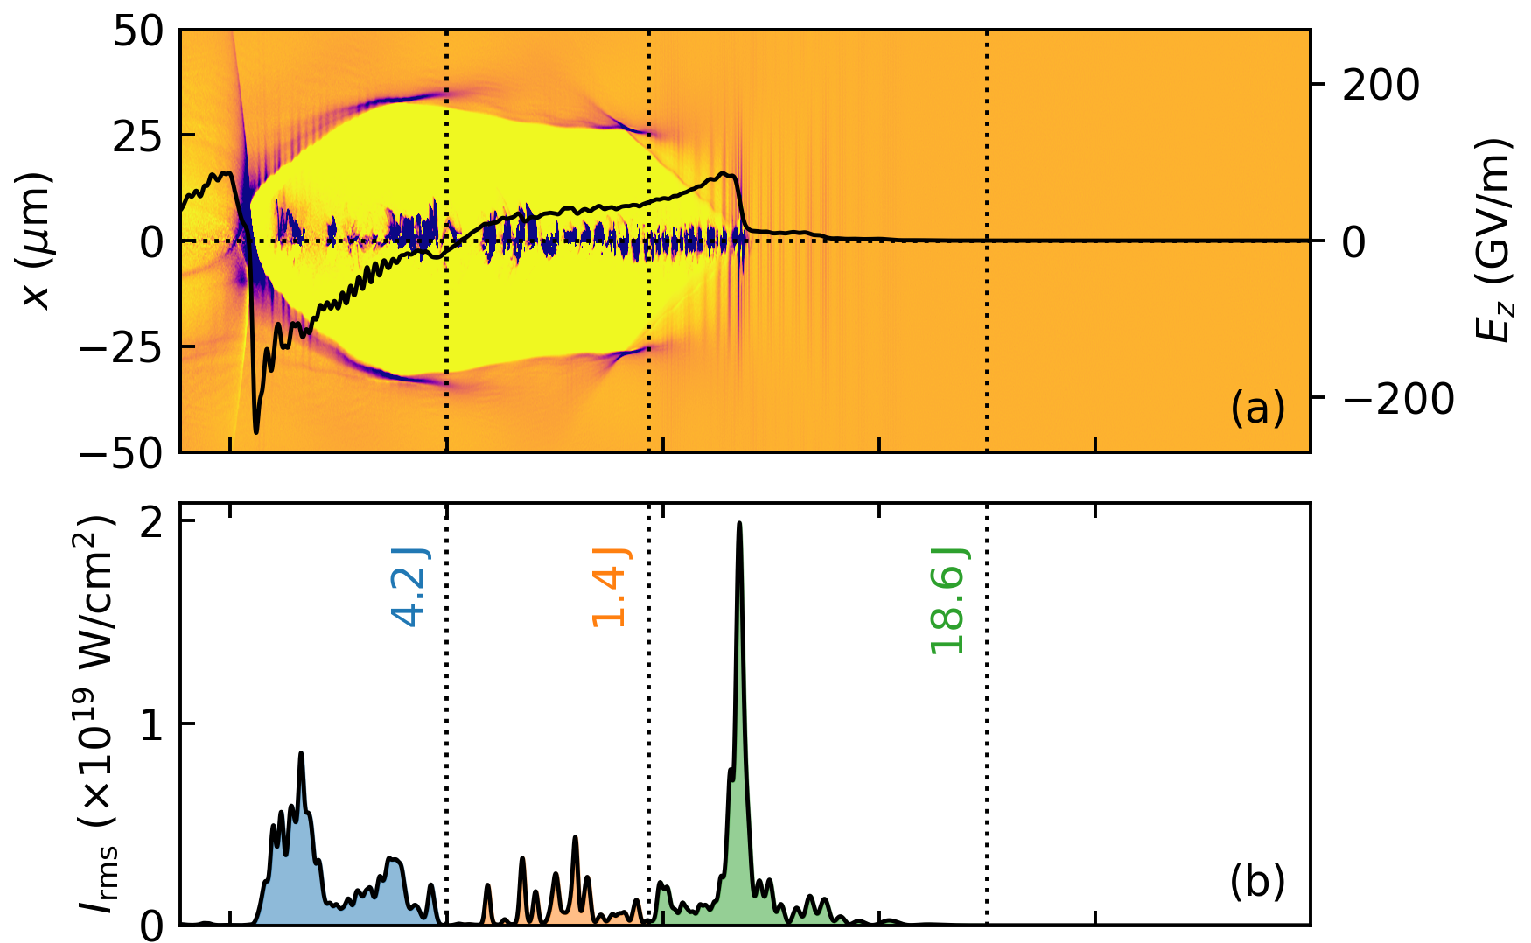
Plasma-based electron acceleration basics:
Laser-driven
Particle-driven
Direct Laser Acceleration
e- bunch
e- bunch
Laser
pulse
Particle
beam
Ez field
Ez field
1-D linear approximation
1-D linear approximation
$$a^{2}≪1$$
$${n_{b}}/{n_{0}}≪1$$
Resonant interaction between electrons and a laser pulse when the laser’s Doppler-shifted frequency
matches the electron betatron frequency.
Plasma wave:
electron density perturbation
Ponderomotive force
(radiation pressure)
Plasma wave:
electron density perturbation
Space-charge force
n₀~10¹⁹ -10¹⁸ cm⁻³
Notes:
Direct Laser Acceleration uses the laser-driven accelerator scheme where the main laser pulse or an additional laser pulse transfers energy directly to the electrons. Transverse betatron oscillation of the electrons is converted into longitudinal electron acceleration through v x B.

Slide 8
Electron Wakefield Acceleration limitations:
Laser-driven
Particle-driven
Direct Laser Acceleration
Dephasing
The accelerators suitable for this scheme are expensive and scarce.
Without electron bunch longitudinal shaping, the transformer ratio is limited to 2 for a symmetric bunch.
Might require a large plasma oven.
More advanced schemes make use of additional lasers and electron injectors which complicates the alignment and synchronization.
The resonance is achieved for a limited time as the electrons gain energy.
The quality of the electron beam is very poor due to strong betatron oscillation.
Proposed schemes require additional lasers – alignment and synchronization issues. Long laser pulses are unsuitable for laser-driven wakefield acceleration.
Laser depletion
Notes:
Each scheme comes with a specific set of issues.
A laser-driven accelerator is limited by dephasing and laser depletion. The dephasing happens when there is a slippage between the accelerated electrons and the accelerating field, which limits the maximum achievable electron energy and even significantly decreases it.
The conventional particle accelerators required for the particle-driven scheme are scarce and expensive, thus limiting the experimental run time. Another limitation is the transformer ratio which limits the amount of energy transferred from the driver beam to the witness beam.
In the DLA, the resonance required for efficient laser-electron energy transfer is lost very fast as the electrons gain energy. Also, the overall electron beam quality is very poor.

Slide 9
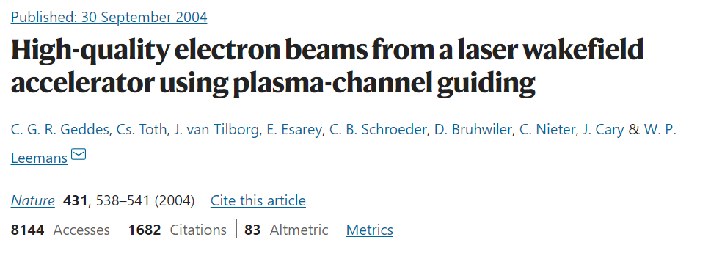
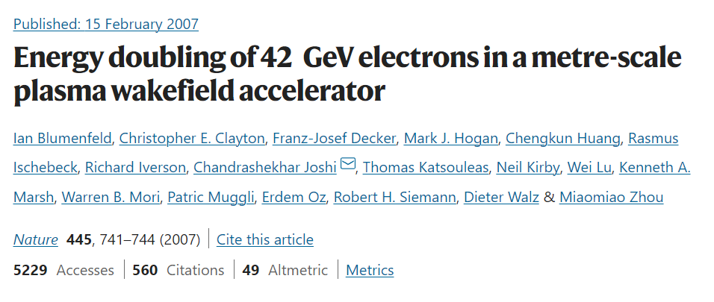
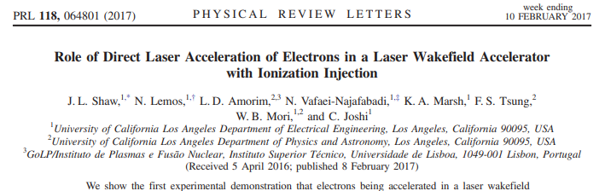
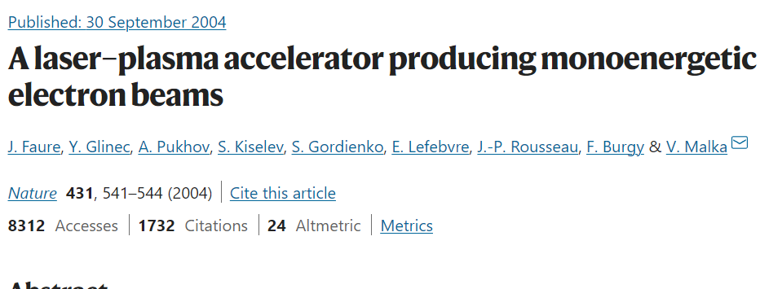
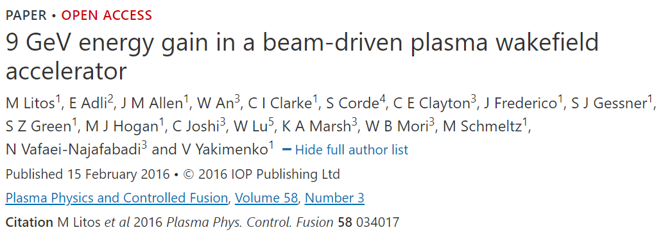
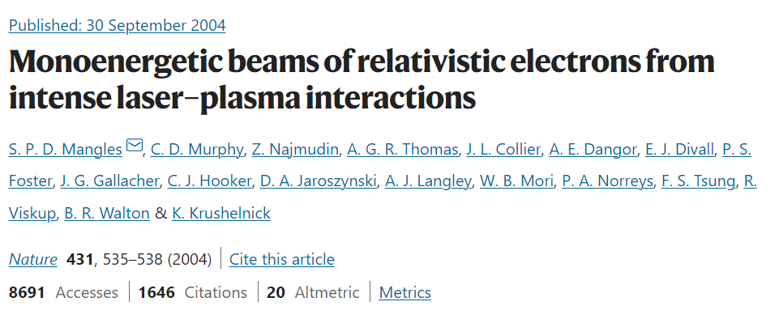
Plasma-based electron acceleration basics:
Laser-driven
Particle-driven
Direct Laser Acceleration
e- bunch
e- bunch
Laser
pulse
Particle
beam
Ez field
Ez field
1-D linear approximation
1-D linear approximation
$$a^{2}≪1$$
$${n_{b}}/{n_{0}}≪1$$
Resonant interaction between electrons and a laser pulse when the laser’s Doppler-shifted frequency
matches the electron betatron frequency.
Plasma wave:
electron density perturbation
Ponderomotive force
(radiation pressure)
Plasma wave:
electron density perturbation
Space-charge force
n₀~10¹⁹ -10¹⁸ cm⁻³
Notes:
Despite these limitations, all three schemes have been experimentally demonstrated, and even more…

Slide 10
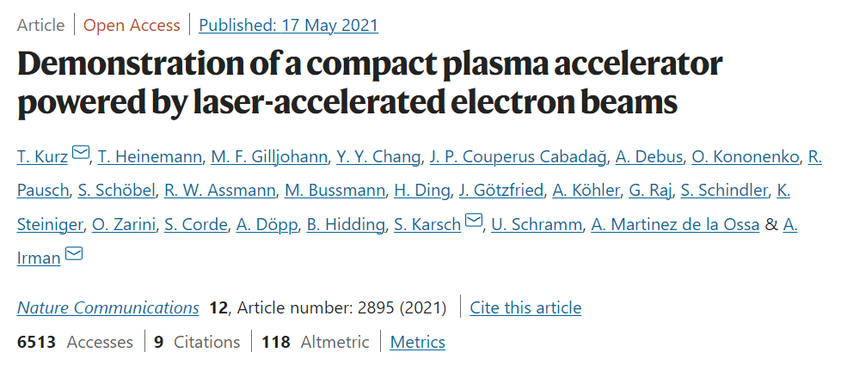
Plasma-based electron acceleration basics:
Laser-driven
Particle-driven
Direct Laser Acceleration
e- bunch
e- bunch
Laser
pulse
Particle
beam
Ez field
Ez field
1-D linear approximation
1-D linear approximation
$$a^{2}≪1$$
$${n_{b}}/{n_{0}}≪1$$
Resonant interaction between electrons and a laser pulse when the laser’s Doppler-shifted frequency
matches the electron betatron frequency.
Plasma wave:
electron density perturbation
Ponderomotive force
(radiation pressure)
Plasma wave:
electron density perturbation
Space-charge force
n₀~10¹⁹ -10¹⁸ cm⁻³
Notes:
a laser-driven and particle-driven accelerator have been demonstrated in one stage, but to my knowledge, nobody has observed until now experimental signatures of all these three schemes present in one wakefield accelerator stage. Why would we want to do that? Well, there are a couple of reasons: to reduce the amount of laser energy dumped in the plasma and downstream, thus increasing the efficiency of the wakefield accelerators, and to combine most of the advantages of these schemes. So, is this combined scheme even possible?

Slide 11
Synergistic Laser-Electron Plasma Acceleration:
The papers predict the Synergistic Laser-Particle Wakefield acceleration.
The driver electron beam overlaps with a laser pulse and draws energy from it while concomitantly guiding the laser.
Controlled PIC parameters (two laser pulses, driver + witness electron bunches, perfect spatial and temporal overlapping, etc.) make this scheme unfeasible experimentally.
New PIC simulations are required where this mechanism is reached naturally.
Notes:
According to these two papers, the answer is yes. A special regime of DLA is created where the electron bunch overlaps with a laser pulse, and a synergistic effect is observed: the electrons draw energy from the laser while simultaneously guiding it. The laser and electron parameters used in these simulations raise very serious challenges for an experimentalist, so we need to find an easier way to achieve this regime of acceleration.

Slide 12
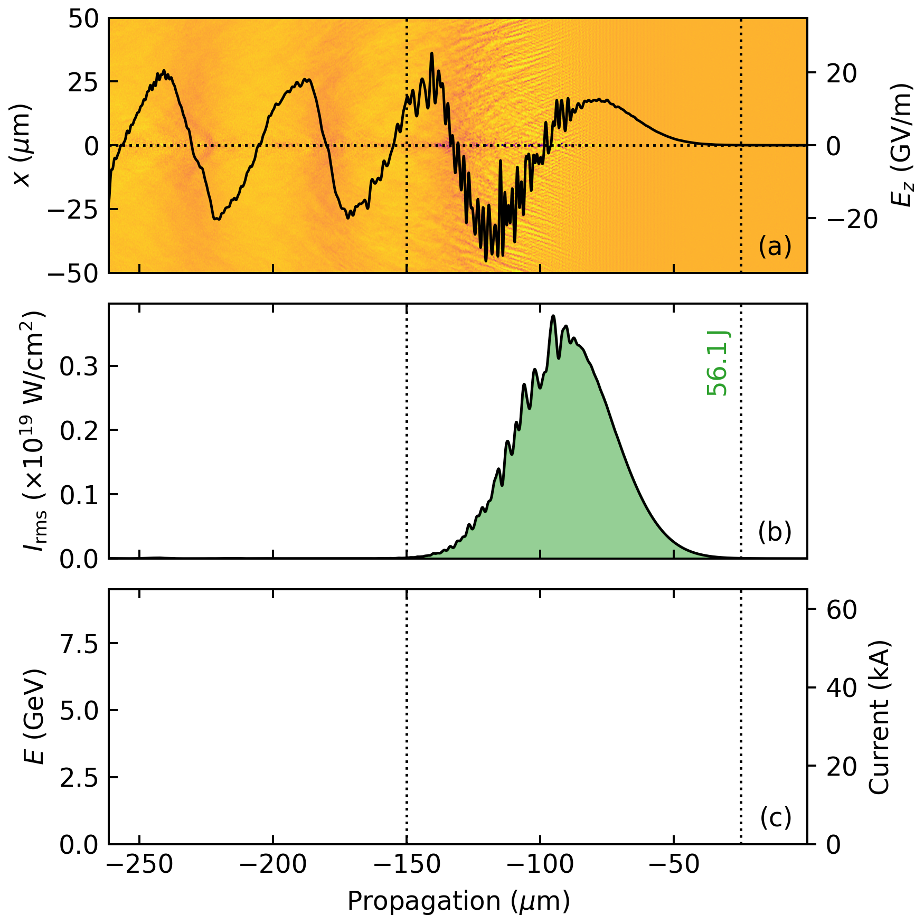
Synergistic LEPA: FBPIC simulations
Azimuthal modes m = 0, 1 included
Gaussian laser pulse
λ = 1057 nm
E = 56.25 J
τ = 140 fs
FWHM transverse size 100 μm
Plasma density 6 × 10¹⁷ cm⁻³
Notes:
We ran extensive PIC simulations to identify parameters suitable for synergistic wakefield acceleration. The laser parameters are similar to Texas Petawatt Laser, except for the laser pulse shape, which is Gaussian. Snapshots of the evolution of the acceleration process are presented here. The top window contains the transverse electron distribution and the on-axis longitudinal field. The middle window contains information about the laser peak intensity and longitudinal distribution. The bottom window shows the electron current and its the energy.

Slide 13
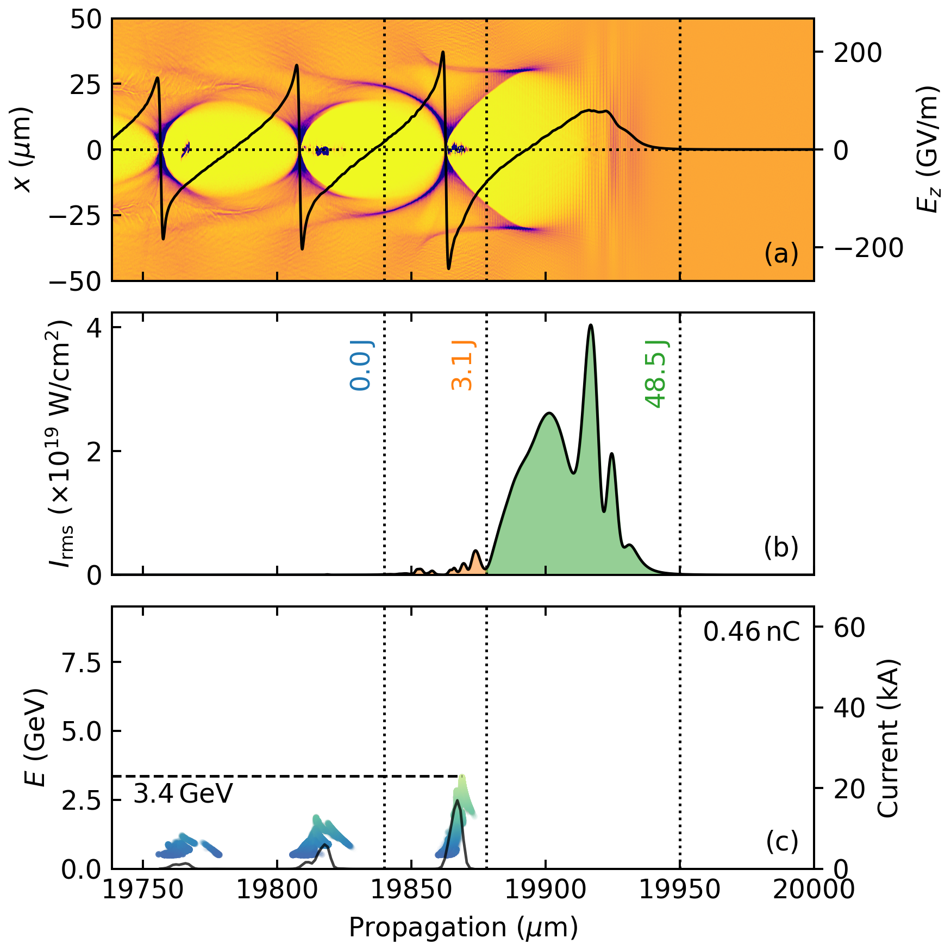
Synergistic LEPA: FBPIC simulations
Azimuthal modes m = 0, 1 included
Gaussian laser pulse
λ = 1057 nm
E = 56.25 J
τ = 140 fs
FWHM transverse size 100 μm
Plasma density 6 × 10¹⁷ cm⁻³
Notes:
The electron beam gains energy very fast after 2 cm of acceleration and

Slide 14
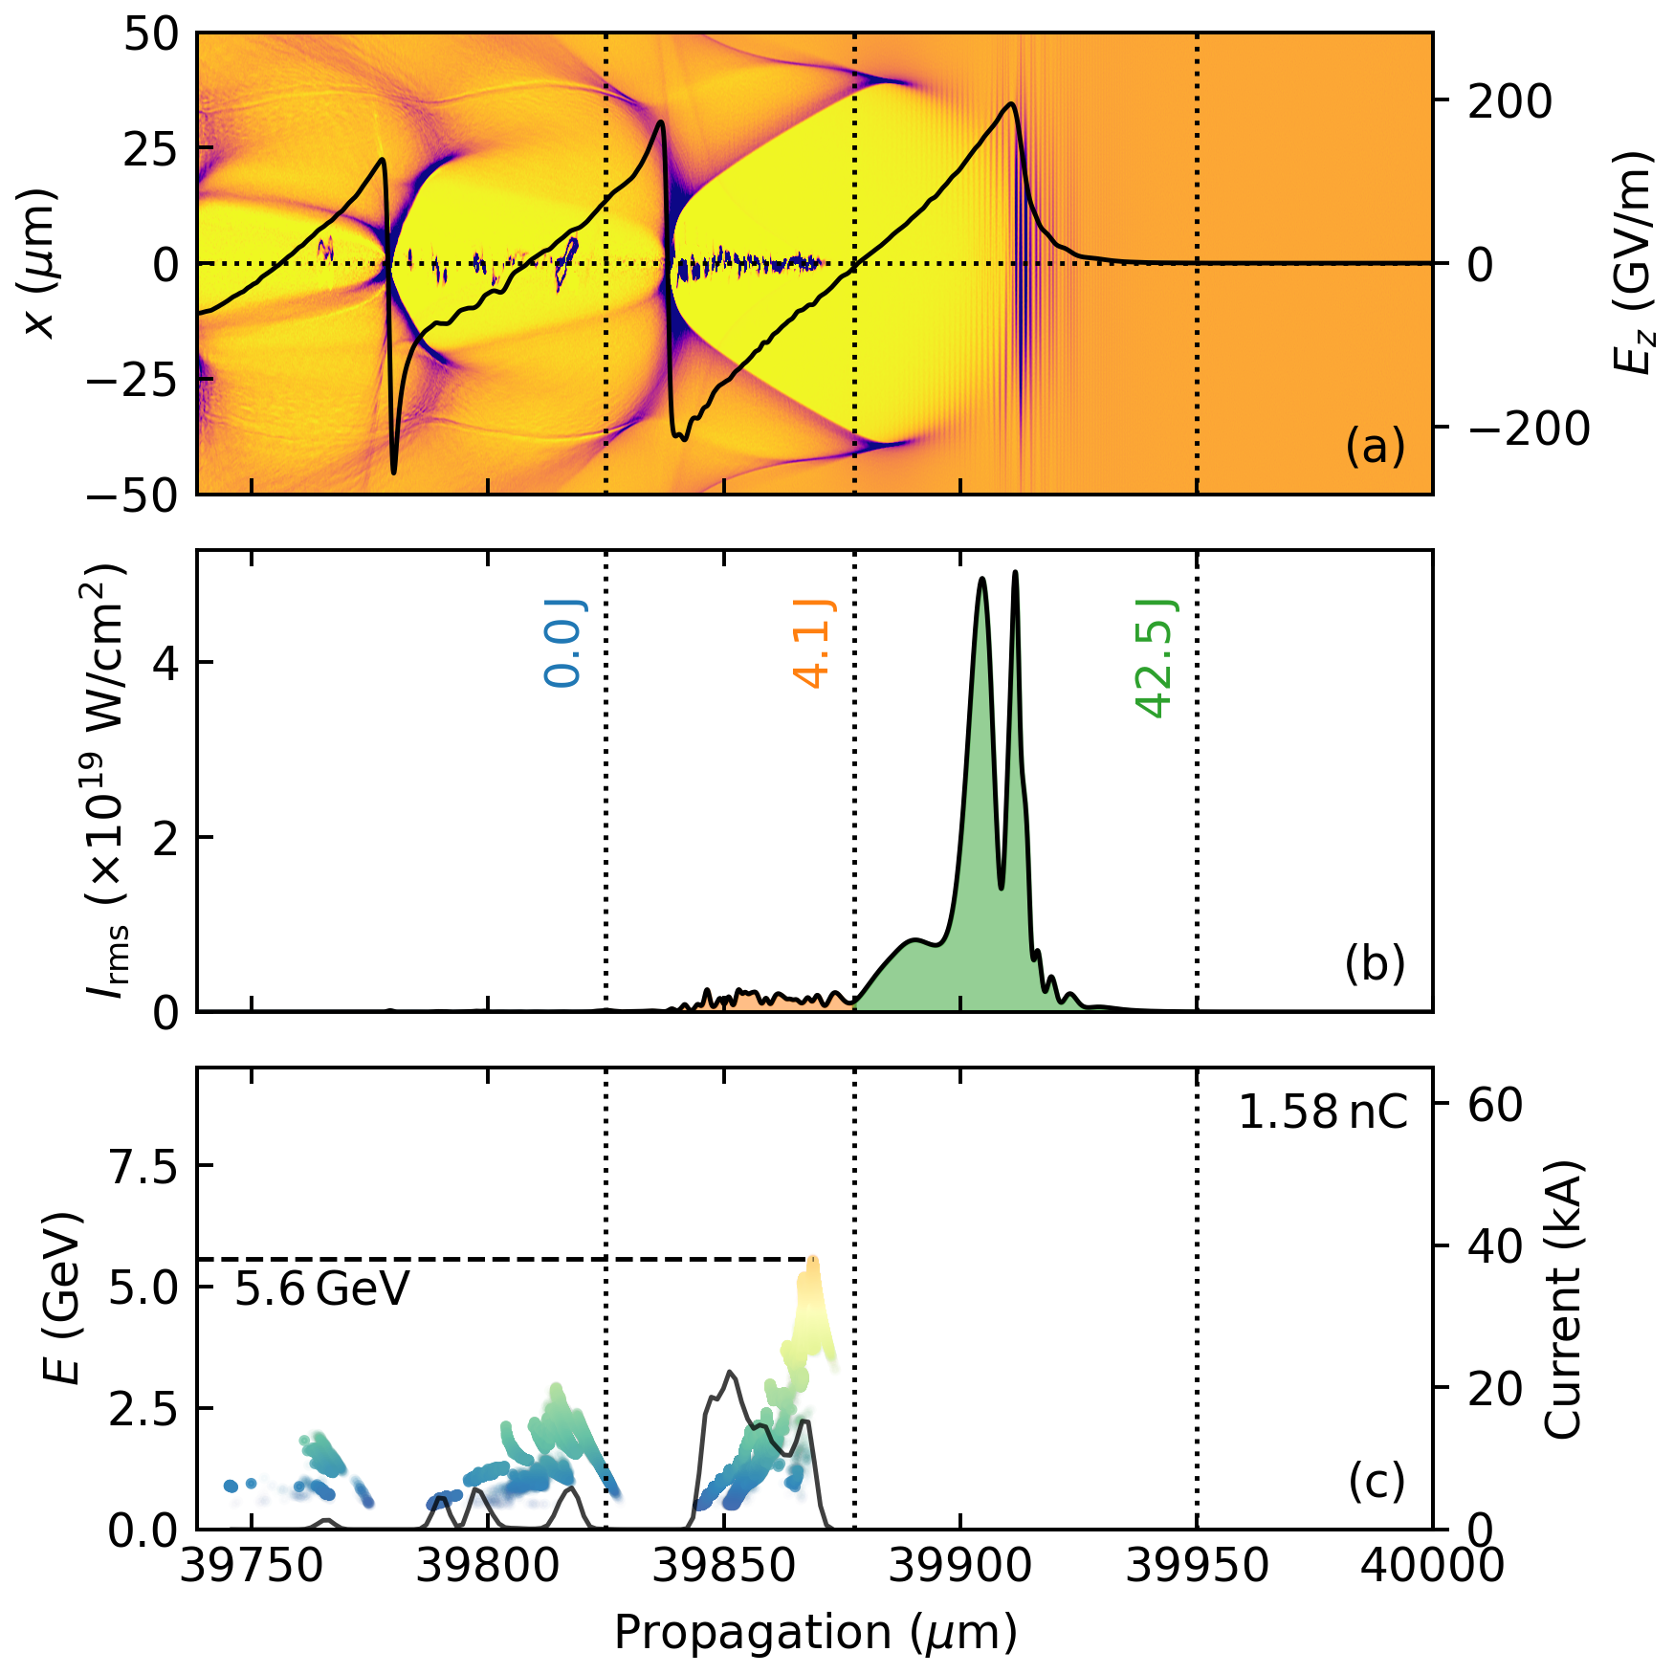
Synergistic LEPA: FBPIC simulations
Azimuthal modes m = 0, 1 included
Gaussian laser pulse
λ = 1057 nm
E = 56.25 J
τ = 140 fs
FWHM transverse size 100 μm
Plasma density 6 × 10¹⁷ cm⁻³
Notes:
after approximately 4 cm reaches the dephasing length. Note the laser pulse distribution as it overlaps more and more with the electron beam.

Slide 15
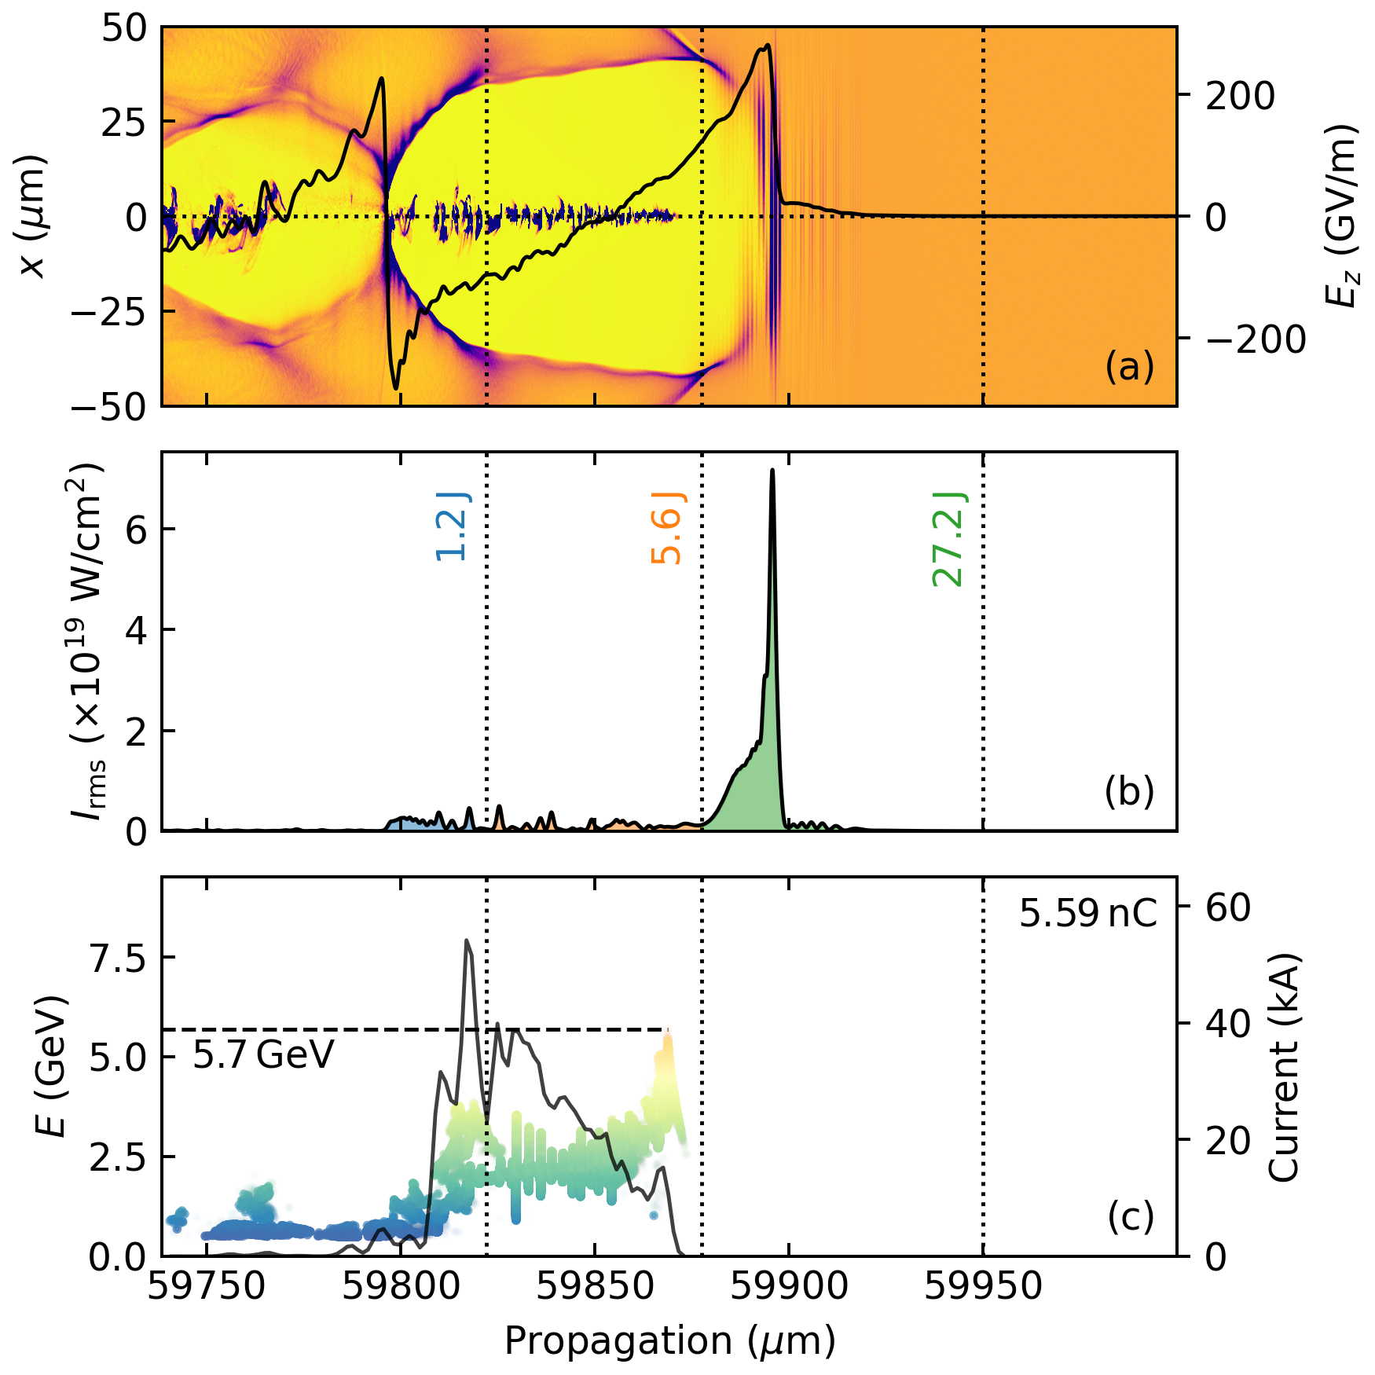
Synergistic LEPA: FBPIC simulations
Azimuthal modes m = 0, 1 included
Gaussian laser pulse
λ = 1057 nm
E = 56.25 J
τ = 140 fs
FWHM transverse size 100 μm
Plasma density 6 × 10¹⁷ cm⁻³
Notes:
The part of the electron beam situated deep in a decelerating field gains energy from the DLA. The nonlinear plasma wave size is much longer than the plasma wavelength, which is a signature of the strong space-charge effect.

Slide 16
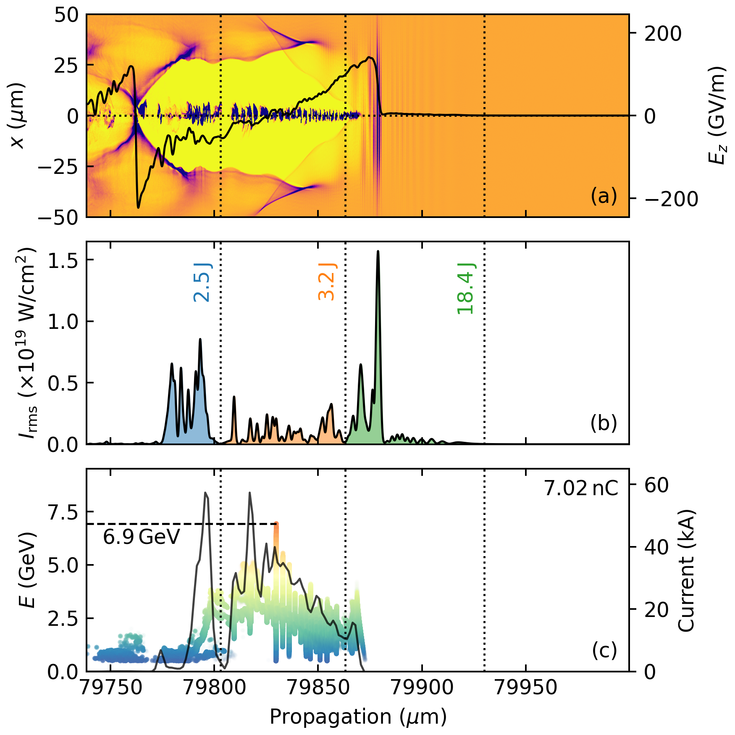
Synergistic LEPA: FBPIC simulations
Azimuthal modes m = 0, 1 included
Gaussian laser pulse
λ = 1057 nm
E = 56.25 J
τ = 140 fs
FWHM transverse size 100 μm
Plasma density 6 × 10¹⁷ cm⁻³
Notes:
By now, the electron beam gains energy from all three mechanisms depending on where it is placed in the bubble. The DLA mechanism is dominant for the electrons found beyond the dephasing point.

Slide 17
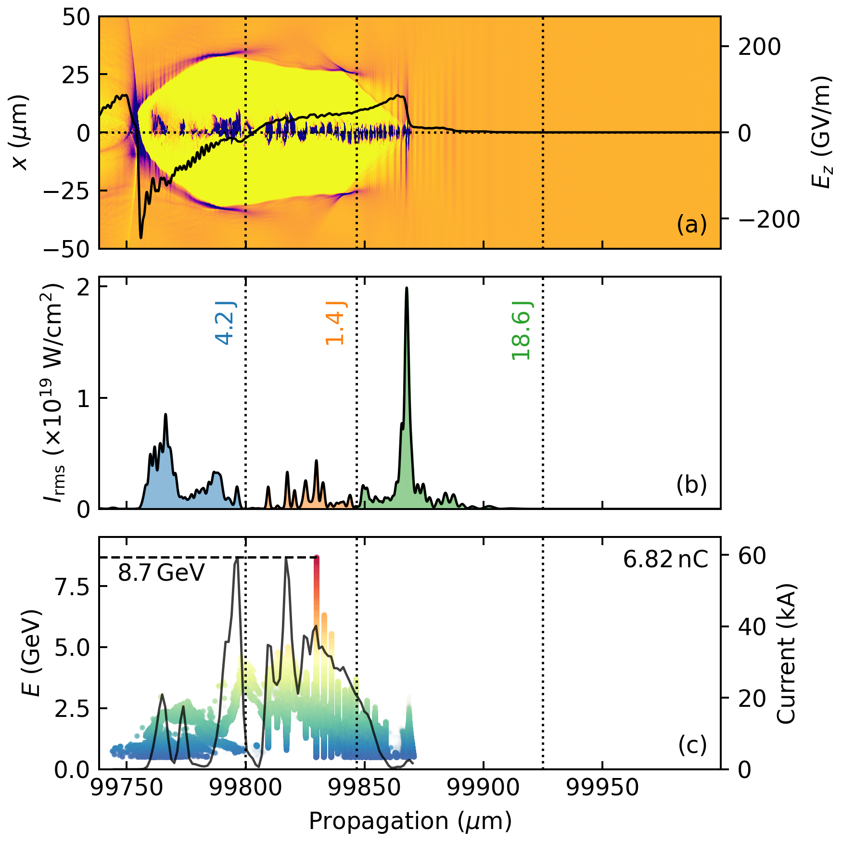
Synergistic LEPA: FBPIC simulations
Azimuthal modes m = 0, 1 included
Gaussian laser pulse
λ = 1057 nm
E = 56.25 J
τ = 140 fs
FWHM transverse size 100 μm
Plasma density 6 × 10¹⁷ cm⁻³
Notes:
Please note the maximum electron energy and the total charge. Something weird in this picture, isn’t it?

Slide 18
Simulations vs. experiments
Many wakefield acceleration experiments run with PW-class lasers, but nobody has observed this effect
Causes?
Solutions:
Most of the experiments avoid reaching the dephasing length
This scheme achievable only for a small range of plasma densities
Much less charge injected in experiments (why?)
Increase the gas cell length beyond the dephasing length
Increase the amount of charge (and charge density)

Slide 19

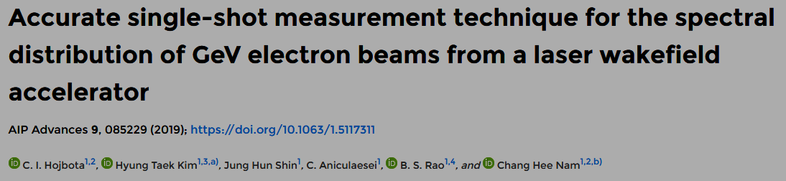
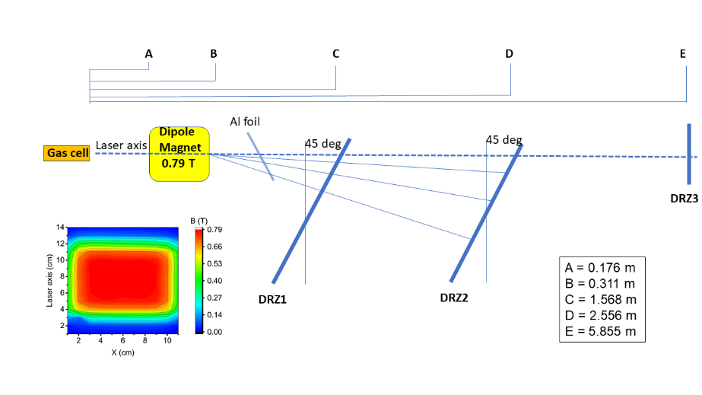
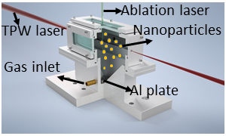
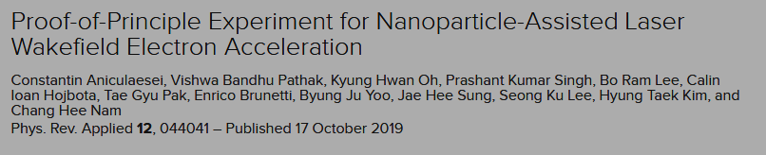
Experimental setup
The Texas Petawatt Laser delivers 130 ± 10 J on target with 45% of the total energy enclosed within 1/e². The FWHM pulse duration is 135±10 fs with a central wavelength at 1057 nm and vertical polarization. An f/50 spherical mirror focuses the laser pulse to an FWHM focal spot of ∼55 µm and a peak intensity of 1.2 × 10¹⁹ W/cm².
To retrieve the electron energy an enhanced version of the “two-screen” method has been used.
Notes:
To experimentally address the “solutions” hypothesis, we designed a new gas cell where helium gas is mixed with aluminum nanoparticles, and its length is much greater than the assumed dephasing length. To retrieve the electron energy with high accuracy, we used the “three-screen method” which is based on the well-known two-screen method.

Slide 20
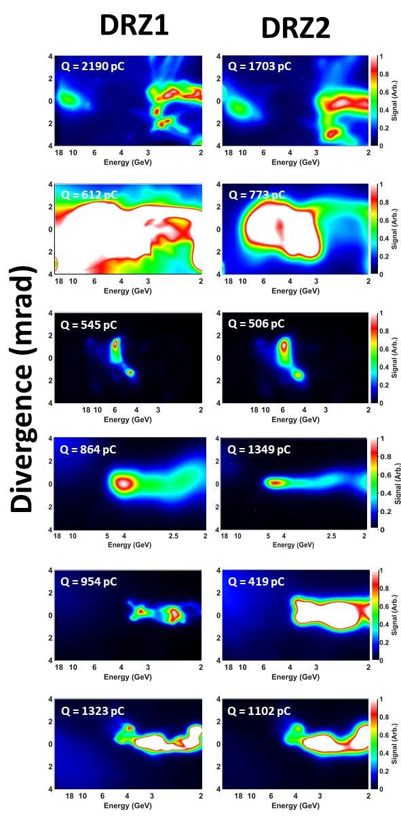
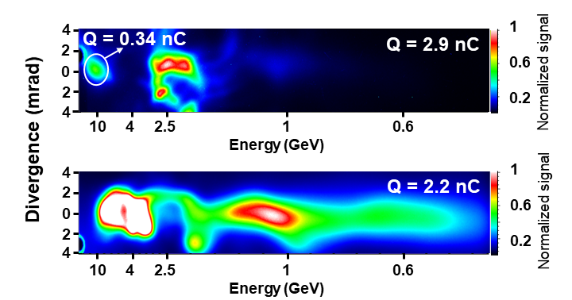
Results
Two shots out of 26 showed a spectrum extending beyond 10 GeV.
Highest energy electron spectrum has the centroid at 10.4±0.6 GeV with 3.4 GeV RMS convolved energy spread, 0.9 mrad RMS divergence, and 340 pC charge.
Notes:
Some of the experimental results are shown here. Among them, we have at least one electron spectrum with features that extend beyond 10 GeV energy. Other interesting shots showed electron bunches with energies well into the 4 GeV range, a few percent energy spread, and less than 0.5 mrad RMS divergence.

Slide 21
What’s next?
More work on theory. Only four papers published on nanoparticle-assisted wakefield acceleration.
How reliable is this scheme? High repetition rate laser required for experiments.
Time and spatially-resolved probing to prove the existence of the mechanism.
Gas jet instead of the gas cell?
Different nanoparticles >> control of charge >> control of the accelerator
Beam slicing to improve the electron beam?
High charge, high energy but high energy spread. Can we still use this scheme for practical applications? Muon beam generation? Strong electron oscillations lead to very bright betatron sources!

Slide 22
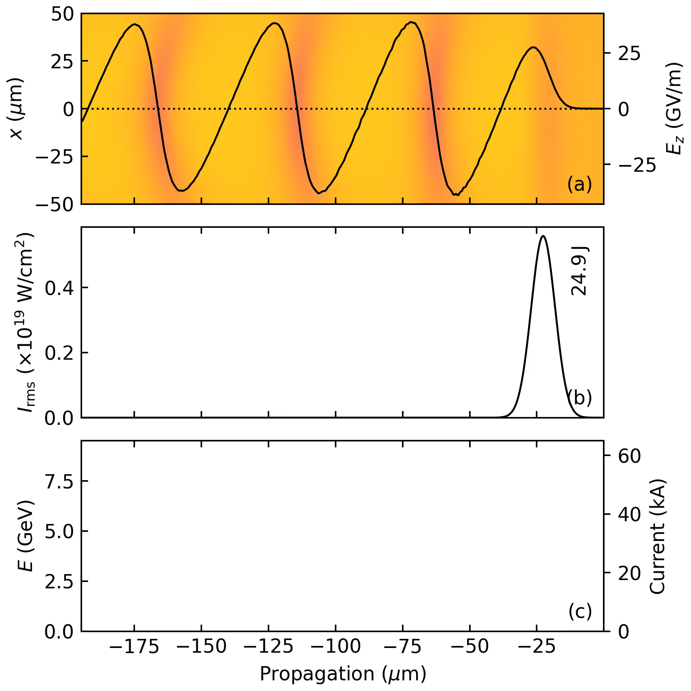

Simulation using BELLA’s parameters
Without nanoparticles
With nanoparticles
Notes:
Related to future experimental work, we ran a series of simulations using the laser parameters of a know laser system: BELLA, at LBNL, but other fairly similar systems are available nowadays. This time the simulations are done with and without nanoparticles. The nanoparticles are introduced as a 200 nm-sized high-density plasma. A electron and laser dynamics are shown in the right figure when we use nanoparticles. Significant charge is injected initially. This charge reaches the dephasing length quickly and starts interacting with the laser. Now the energy transfer from the laser to the electrons is very efficient, and the final electron energy goes beyond 10 GeV.
In the simulation, we see the electron beam gaining continuously energy and reaching the dephasing length after approximately 6 cm of propagation. Later, we observe the transition to particle-driven and DLA, but the energy gain is not significant. The final energy is 7.8 GeV.
From what I showed here the nanoparticle-assisted wakefield acceleration seems to be a promising candidate for the next 10 GeV record!

Slide 23
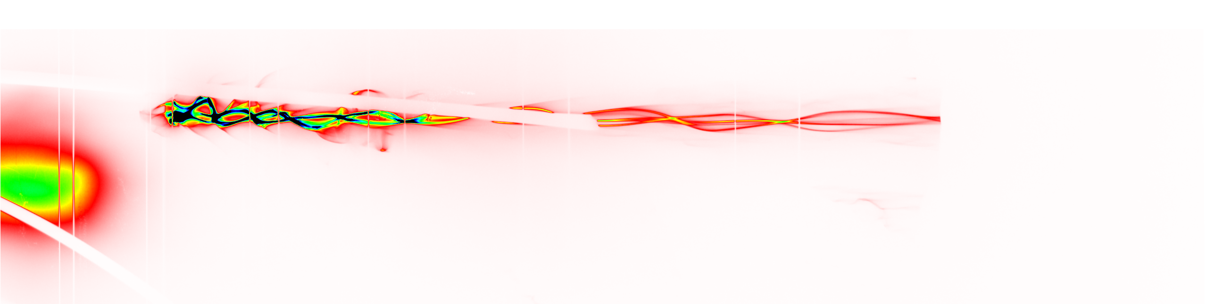
Thank you for your attention
Notes:
I will conclude this talk with a beautiful electron spectrum recorded when nanoparticles were used. Although the art is beautiful, I am more interested in the physics behind this amazing modulated spectrum. Please contact me if you have an idea of how to explain this structure.

