Slide 1
Prospects of Ultralow MTE Photocathodes in Electron Guns
Prof. Siddharth Karkare
(Arizona State University)

Slide 2
Brightness and Emittance
Beam Brightness, B = Charge density in phase space
$ε_{nx}$ - Emittance
$$B=\frac{N}{ε_{nx}ε_{ny}}$$
$$x$$
$$σ_{x}$$
$$ε_{nx}=\frac{σ_{x}σ_{p_{x}}}{mc}$$
$$σ_{p_{x}}$$
$$p_{x}$$
According to Liouville’s theorem
brightness remains invariant for Hamiltonian systems (Linacs and microscopes)
Source determines the maximum possible brightness

Slide 3
Maximum Source Brightness
E_{z} (5-100MV/m)
$$B∝\frac{N}{ε_{n}^{2}}$$
$$N∝σ_{x}^{2}E_{z}^{n}$$
Photocathode
$ε_{n}=\frac{σ_{x}σ_{p_{x}}}{mc}=σ_{x}\sqrt{\frac{MTE}{mc^{2}} }$
$MTE=\frac{1}{2}m{<v}_{⊥}^{2}$>
$$σ_{x}$$
Laser pulse
$B∝\frac{N}{ε_{n}^{2}}$ $∝\frac{E_{z}^{n}}{MTE}$
Brightness limited by photocathode MTE and field gradient

Slide 4
What does MTE depend on?
Excess Energy
Non-linear Photoemission
Surface Non-uniformities
Emit close to threshold and minimize temperature
Factors affecting MTE
Need high quantum efficiency
Need atomically smooth surfaces
Many-body Scattering
Band Structure
Challenge: Develop materials that satisfy all these criteria
Need small cross-section of electron-phonon-photon interactions
Need low transverse momentum states
P. Musumeci et a l, Nucl. Instrum. Meth. A, 907, 209 (2018)

Slide 5
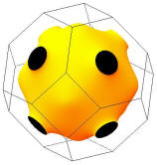
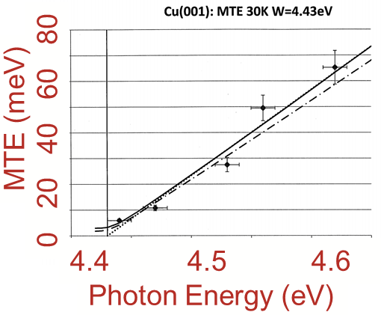
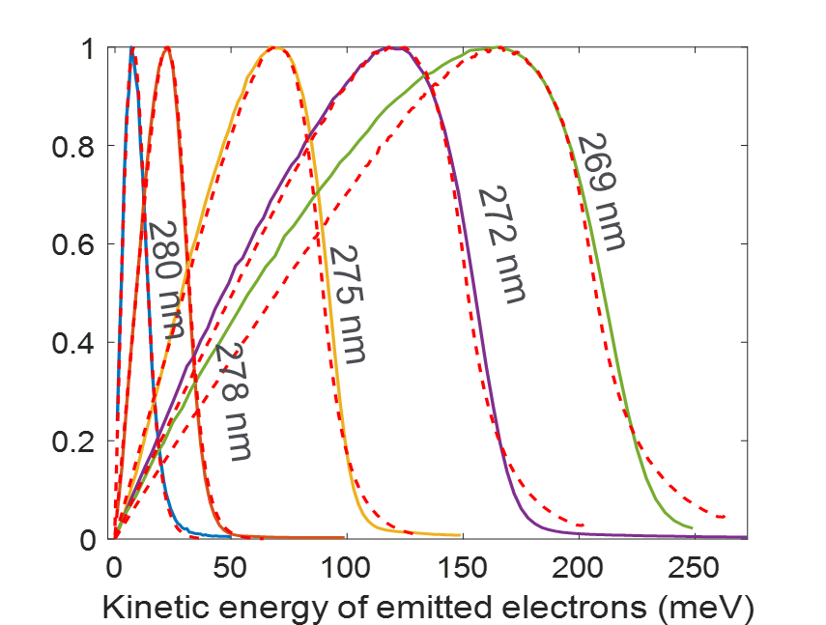
Cu(100) – Smallest MTE measured
5 meV MTE measured from Cu(100)
Most photoinjectors use MTE ~500 meV
Karkare et al, Phys. Rev. Lett. 125, 054801 (2020)
Cu(100)
10 meV total energy spread
More than 1 order of magnitude smaller than any existing electron source
(not just photoemission)
Photoemission at the threshold
Cooled to LHe (30K)
Atomically ordered flat surface
Good band-structure
Great for stroboscopic UED applications and electron spectroscopy,
Enables of ultrafast vibrational spectroscopy in EELS – measure ultrafast phonon dynamics.

Slide 6
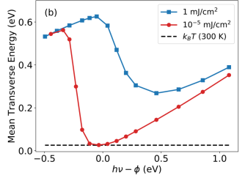
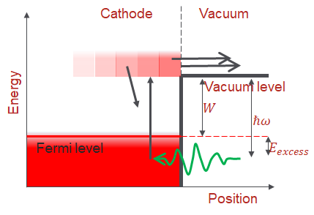
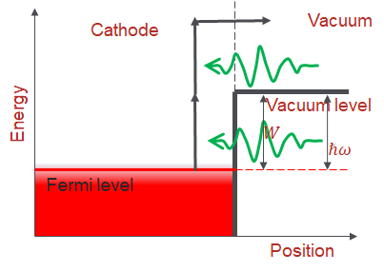
Electron Heating and Multi-photon Emission
Electron Heating
Multi-photon/Above-threshold Emission
Low QE leads to a requirement for high laser power, which heats the electronic system
Electronic temperature reaches 3000K, ie. MTE of ~ 250 meV
Multi-photon photoemission –
Results in very large excess energy

Slide 7
Low Electron Affinity Semiconductors
Low electron affinity semiconductors:
Alkali-antimonides, III-Vs activated to NEA
Cathode
Vacuum
Vacuum level
Very high QE 10⁻²-10⁻⁴ at threshold
Lower multiphoton and heating effects
Already used for high average current applications: ERLs, polarized sources
Energy
Band-gap
$$W$$
$$ℏω$$
Fermi level
$$E_{excess}$$
Position
Calculations show sub-20 meV MTE at large charge densities
Alkali-antimonides show promise

Slide 8
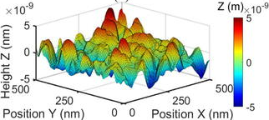
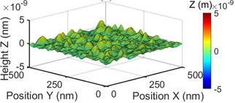
Alkali-antimonide performance
Growth on polycrystalline substrate
650-700 nm
Growth on lattice-matched substrate
Surface roughness issue for Alkali-antimonides is solved via use of lattice matched substrates and new growth recipes
Epitaxy on lattice-matched substrate
Cultrera et al, Phys. Rev. ST Accel. Beams 18, 113401 (2015)
Saha et al, Appl. Phys. Lett. 120, 194102 (2022)
Parzyck et al, Phys. Rev. Lett. 128, 114801 (2022)

Slide 9
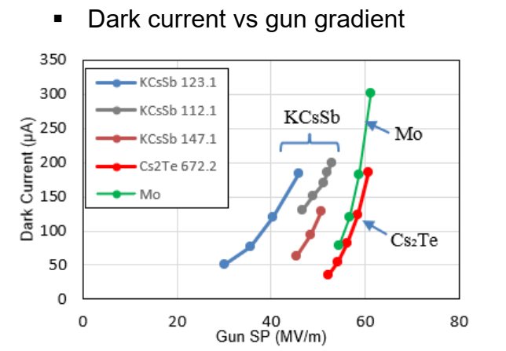
Testing in high field guns
~230 meV MTE in 515 nm at 29 MV/m
- 0.6 eV excess energy
- dark current too high for higher fields
Cathodes grown via sequential deposition:
Very poor surface quality!!!
Development of Multialkali antimonides photocathodes for high brightness photoinjectors, S. Mohanty, on behalf of PITZ & LASA team, (EWPAA 2022), Sep 20 – 22, 2022,Milan
Alkali-antimonides with better surfaces need to be tested at lower excess energies

Slide 10
Challenges for use in High Field Guns
50 MV/m fields or higher, even exceeding 100 MV/m
Absolutely Essential
Ultra-high-vacuum (UHV) ~ 10⁻⁹ -10⁻¹⁰ torr range
UHV cathode transfer, load-lock
Some RF guns already have this – Pegasus gun at UCLA, FAST facility at Fermilab, PITZ RF gun, AWA …
Necessary for lowest possible MTE
Tunable wavelength laser
Cryogenic cooling
Capability to use semiconducting cathode substrates
Facilities development needed to enable these – underway at LANL and UCLA
Need cathode testing facilities with these requirements

Slide 11
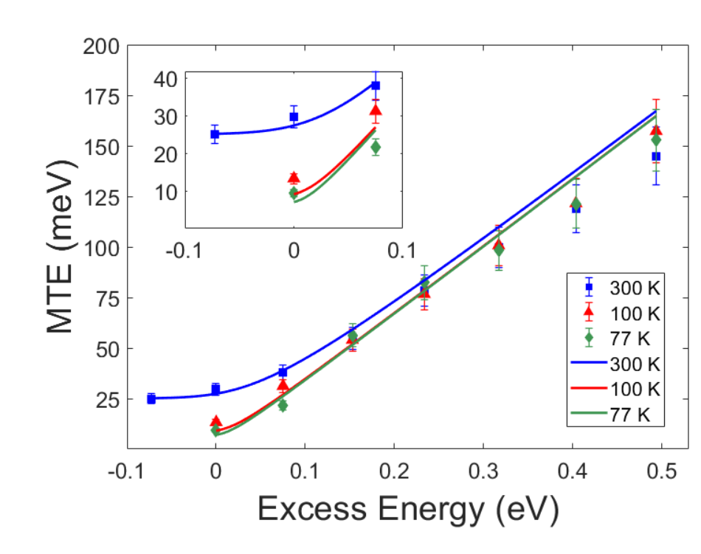
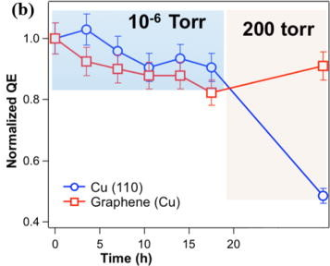
2-D coatings for Robustness
Demonstrated protection in QE for Cu photocathodes without increase in MTE via graphene coatings
Obtaining Gr protected alkali-antimonide surface is challenging!!! – research ongoing
Liu et al, Appl. Phys. Lett. 110, 041607 (2017)
Knill et al, NAPAC 2022.

Slide 12
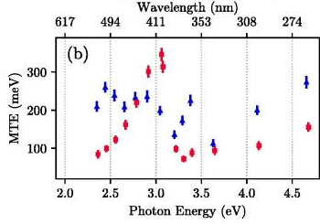
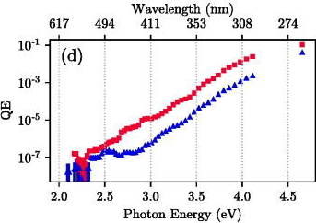
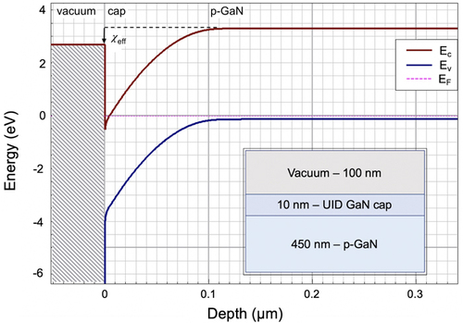
Beyond Alkali-antimonides – Cs₂Te, III-Nitrides…
Cs₂Te
III-N heterostructures – Cs free NEA
50 meV MTE measured at 10⁻³ QE at 300 nm
Perfectly ordered surfaces
Need more growth optimizations and characterization
Could emit in visible light
Extremely robust
Cs₂Te MTE is limited to ~100 meV due to low work function Cs impurities on surface
- Can it be reduced by better growth techniques and control to give phase pure Cs₂Te?
Pierce et al Appl. Phys. Lett. 118, 124101 (2021)
Cultrera et al. Journal of Applied Physics 131, 124902 (2022)

Slide 13
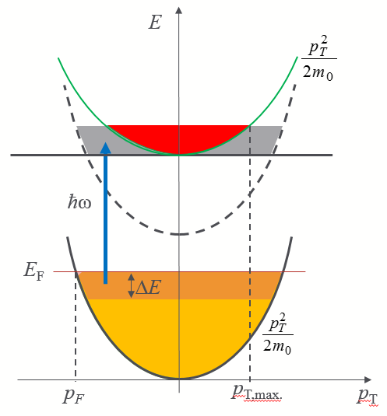
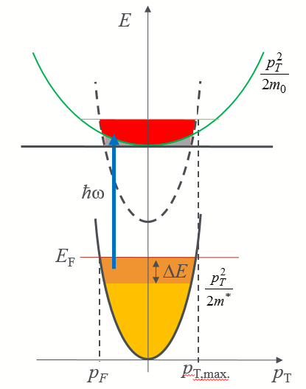
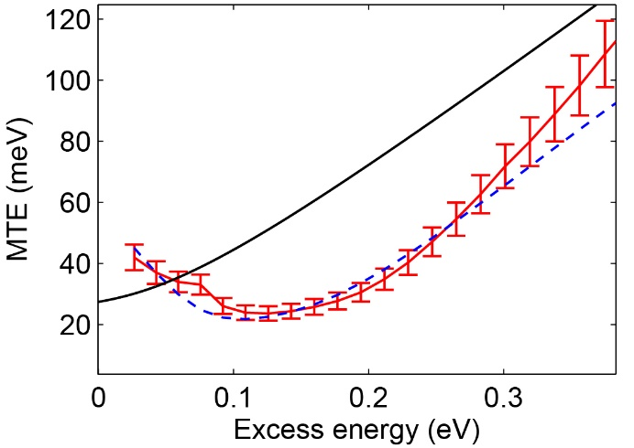
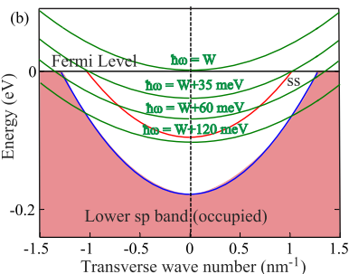
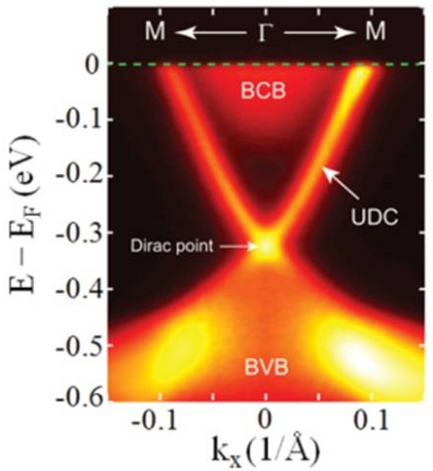
Single crystal emitters – use small momentum spread
Demonstrated for the surface state of Ag(111)
‘Classical’ metal (m* = m₀)
Metal with m* < m₀
Vacuum level
S. Karkare et al. Phys. Rev. B 95, 075439 (2017)
S. Karkare et al. Phys. Rev. Lett. 118, 164802 (2017)
Small effective masses yield smaller $MTE$ for a given excess energy, $ΔE=hν−φ.$
Use other low effective mass materials like topological insulators, Dirac semimetals for near zero MTE?

Slide 14
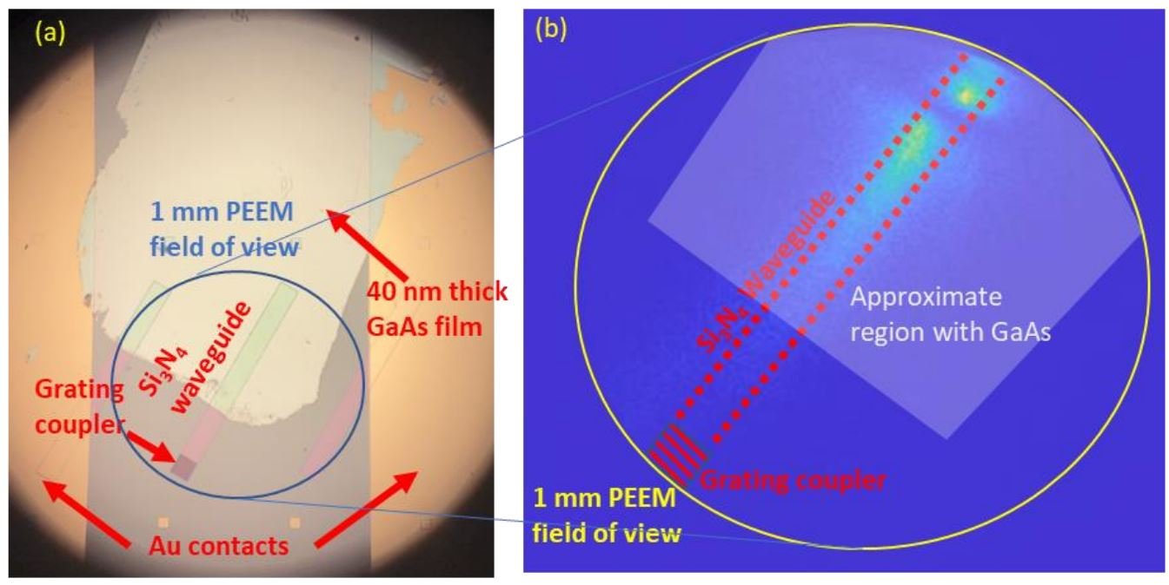
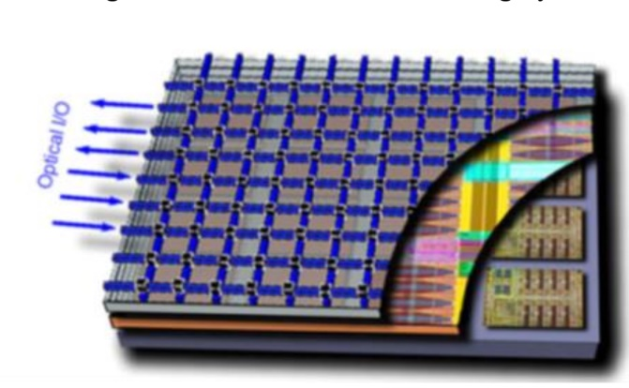
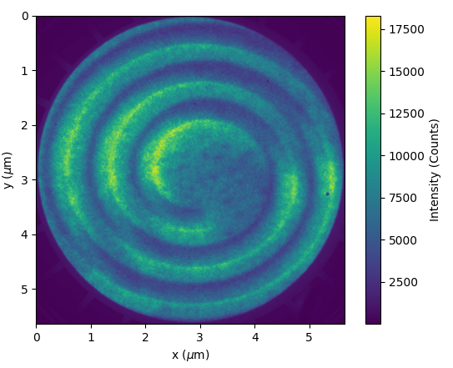
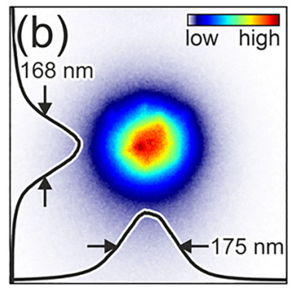
Nano-structured cathodes
Photonics integrated cathodes
Plasmonic nano-structures
Photonics network integrated into the cathode substrate to deliver pulses of light at specific locations at specific times for um-fs scale spatio temporal shaping and patterned beams
Promising for spatio-temporally shaped beams for structure-wakefield applications
Plasmonic surfaces for nano-scale electron emission
Sub-nm scale beams from flat surfaces
Ideal for laser-dielectric acceleration
Ordered arrays for ordered electron beams?
A.H. Kachwala et al, On-Chip Photonics Integrated Photocathodes, NAPAC, Albuquerque, NM (2022) WEPA65
Dreher et al, Nanophotonics 2022; 11(16): 3687–3694

Slide 15
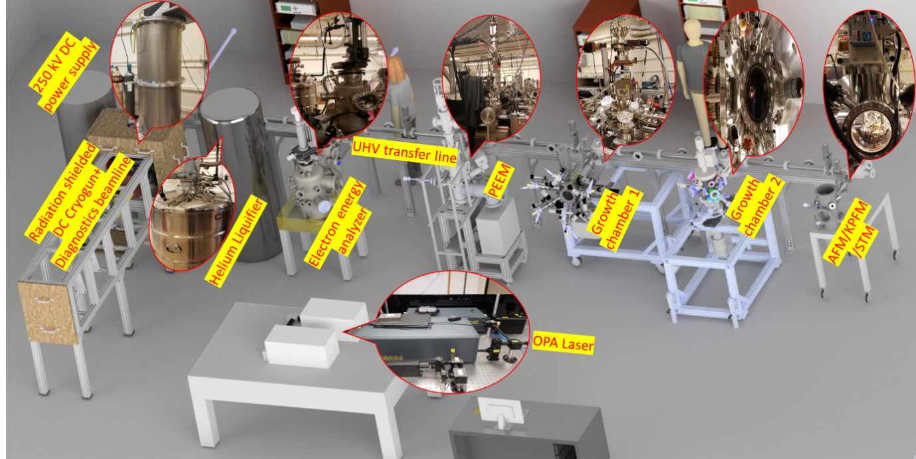
Photoemission and Bright Beams Lab @ ASU

Slide 16
Conclusion
Several Low sub-25 meV cathode technologies have been developed
Testing in high field guns is crucial, lacking but underway
High cathode field and lower MTE efforts need to merge
Can enable 2-3 orders of magnitude brighter electron beams
Nano-structured cathodes for advanced accelerator applications
Immediate Post-doc Opening:
https://academicjobsonline.org/ajo/jobs/22032
Development of ultra-bright nano-structured photoemission electron sources

