Slide 1
Dan Wang, Qiang Du, Tong Zhou, Siyun Chen, Derun Li, Russell Wilcox, Jean-Luc Vay, Eric Esarey, Jeroen van Tilborg, Cameron Geddes
Machine-learning control of coherent combining of fiber lasers for plasma accelerators
Lawrence Berkeley National Laboratory, 1 Cyclotron Rd, Berkeley, CA 94720
20th Advanced Accelerator Concepts Workshop (AAC’22)
November 6-11, 2022
Hyatt Regency Long Island, Hauppauge, NY

Slide 2
Acknowledgements
Collaborators:
LBNL: Russell Wilcox, Qiang Du, Tong Zhou, Siyun Chen, Mahek Logantha, Vamsi Vylta, Christos Bakalis, Mariam Kiran, Bashir Mohammed, Larry Doolittle, Derun Li, Jean-Luc Vay, Eric Esarey, Cameron Geddes, Samuel Barber, Jeroen van Tilborg, Curtis Berger, Remi Lehe, Carlos Serrano, Daniele Filippetto, Gang Huang, Yilun Xu
University of Michigan: Almantas Galvanauskas, Mathew Whittlesey, Alexander Rainville, Lauren Cooper, Hanzhang Pei, et al.
Lawrence Livermore National Laboratory: Michael Messerly, Leily Kiani, David Feng, et al.
SLAC: Zhe Zhang, Xiaobiao Huang, Antonio Gilardi
Funding support:
DOE High Energy Physics and ARDAP, Moore Foundation, Berkeley Lab Foundation

Slide 3
Outline
Why: kHz laser plasma accelerators / fiber laser driver / coherent
combining of fiber lasers
What: Challenges of the control in multi-dimensional fiber laser combining
How: Machine-learning (ML) control addresses the challenges and
shows great potential
Outlook & Conclusion

Slide 4
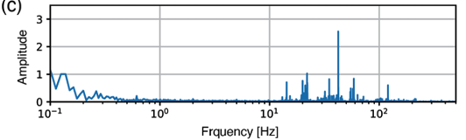
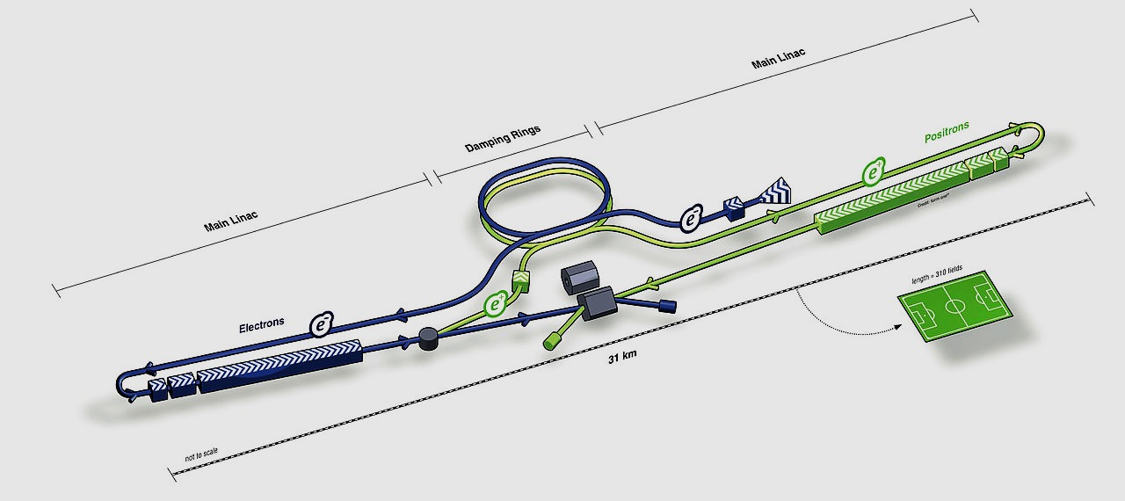
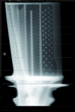
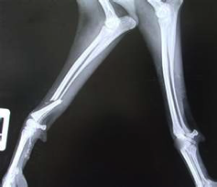
Laser Plasma Accelerators (LPAs) need to increase rep-rates to >kHz
Rapid progress positions LPAs as next generation compact accelerators
Order of magnitude improvement in LPA performance at kHz rates
Fluctuations are faster than current LPA repetition rates (~Hz) [1]
Demonstrated improvements at mJ/kHz (via active feedback) [1,2,3]
kHz-Joule class will enable precision GeV-class LPA
LPA performance, stability and control, precision staging/injection
Enables photon sources at kHz
Accelerator applications require >kHz rates
Key step to 50 kHz class colliders
laser pointing fluctuations typically <100 Hz
Security
Industry
Particle colliders
Security
Radiography Detector
[1] F. Isono et al. High Power Laser Science & Engineering, 9, e10 (2021)
[2] AAC2022 poster by Curtis Berger (LBNL)
[3] AAC2022 poster by Joseph Natal (UNL)
MeV
photons
Medicine
Notes:
Previous progress positions LPAs as next generation accelerators;
Applications needs performance leap – via increasing rep-rates from ~Hz to >kHz

Slide 5
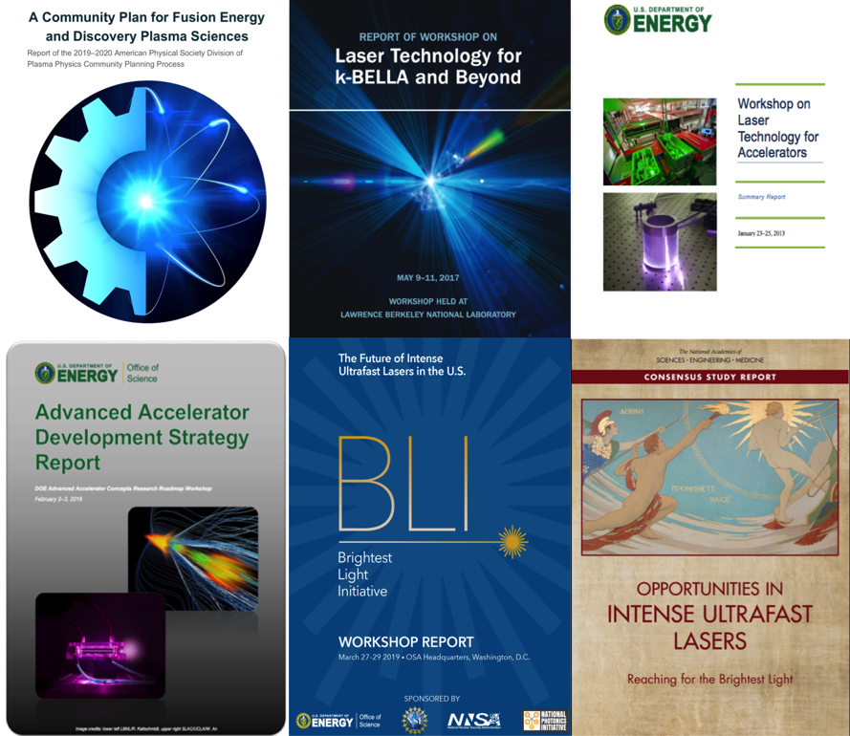
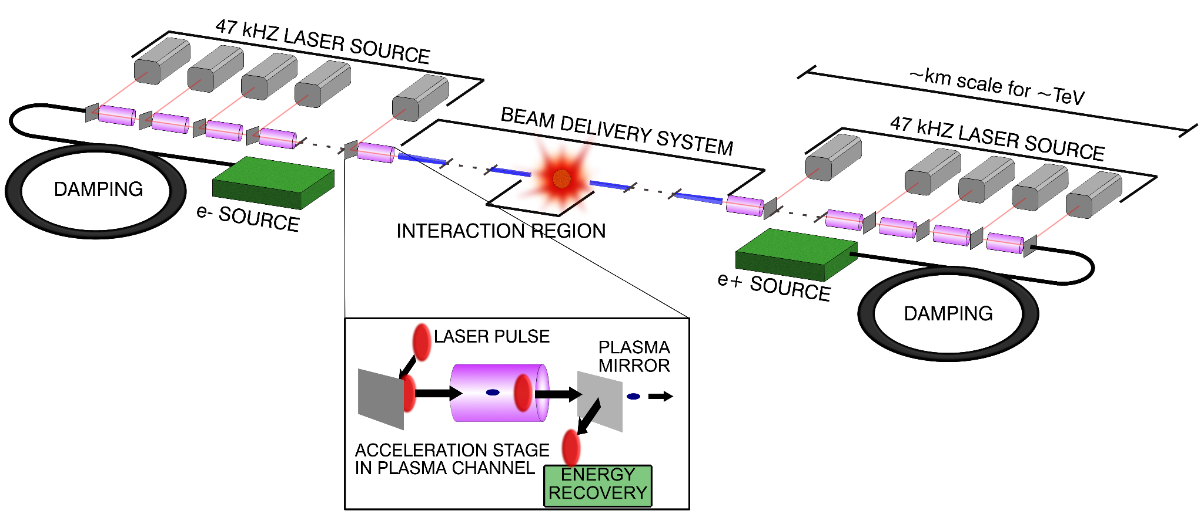
>kHz LPAs need new driver lasers to reach power and efficiency
Laser-Plasma Accelerator Collider (Conceptual)
Planning Emphasis
Leemans & Esarey,
Physics Today (2009)
DOE & National Academies & Community
New requirements on driver lasers for >kHz LPAs
High wall-plug efficiency (~10s%)
High average power capability
Limitation of current Ti:sapphire lasers
Low wall-plug efficiency
Limited thermal handling
Need new laser technology beyond kHz!
Promising: Fiber laser, Tm:YLF bulk, Yb:YAG bulk
Laser parameter | Funded, ongoing | k-BELLA | Hi rep-rate driver | Collider driver
Energy | 0.2 J | 3J | 3J | 6J
Pulse duration | 30fs | 30fs | 30fs | 100fs
Rep-rate | 5 kHz | 1kHz | 10kHz | 50kHz
Average power | 1kW | 3kW | 30kW | 300kW
Notes:
As the laser parameter list in the table, from our ongoing kW lasers, to the road map of kBella, high rep-rate driver, then the collider, as we have the conceptual design back in 2009. This list new …
we are planning a potential stepping stone 3J system called kBELLA

Slide 6
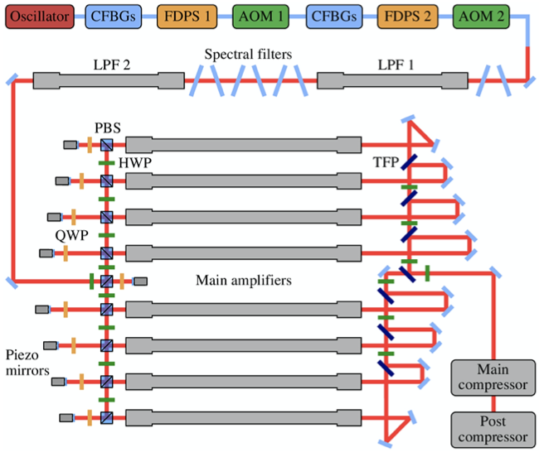
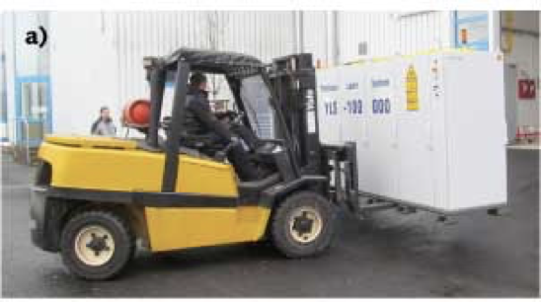
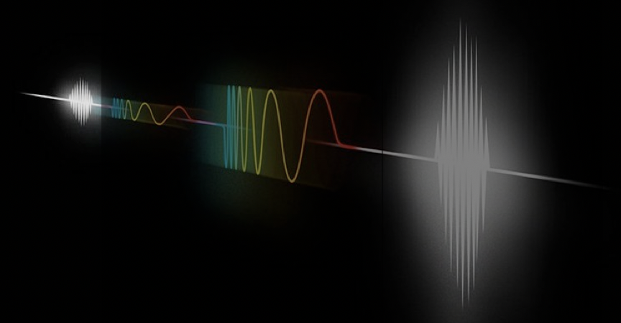
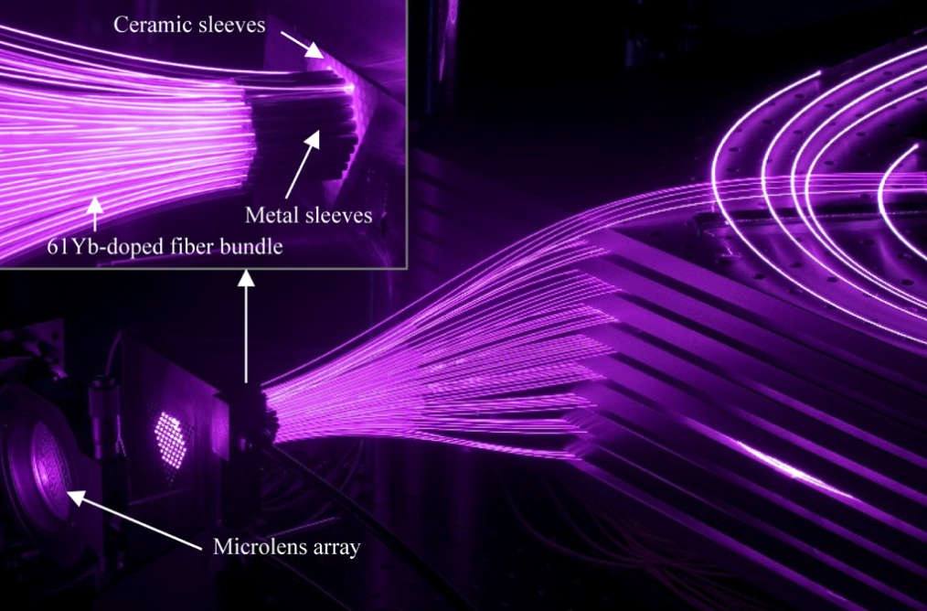
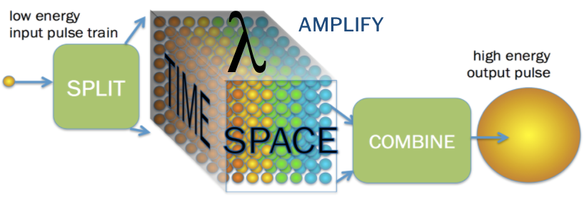
Ultrafast fiber lasers can provide high power at high efficiency
Fiber laser: most efficient high power laser, mature technology
Chirped-pulse implications enables ~10mJ per fiber
Coherent combined fiber lasers rapidly developing worldwide
Commercial fiber laser
from IPG Photonics
(120 kW CW, WPE>45% )
Chirped-pulse amplification, 2018 Nobel Prize (Mourou & Strickland)
Example: 61-fiber-laser combining system (1kW, >250fs)
23mJ, 235fs, 674W combining 12 fibers
10mJ, 120fs, 1kW combining 16 fibers
Stark et al. Optics Letters 44, 5529 (2019)
Stark et al. Optics Letters 46, 969 (2021)
Fsaifes et al. Opt. Express 28, 20152 (2020)
Research Breakthroughs Enabled Large-scale, Multidimensional Fibers
Demonstrated:
Combining in time, space, spectrum [1-3]
Temporally combine 81 pulses (10mJ) [4]
Spatially combine 81 beams [5]
Spectrally combine to 50 fs [6]
Simultaneous spatial & temporal combination [7]
[1] T. Zhou et al. Optics Express 23, 7442 (2015)
[2] T. Zhou et al. Optics Letters 21, 4422 (2017)
[3] W. Chang et al. Optics Express 21, 3897 (2013)
[4] H. Pei et al. ASSL, paper AW4A.4 (2017)
[5] Q. Du et al. Optics Express 29, 5407 (2021)
[6] S. Chen et al, ASSL, paper AW4A.5 (2022)
[7] M. Whittlesey et al, Photonics West, 11981 (2022)
Notes:
lawrence livermore national laboratory

Slide 7
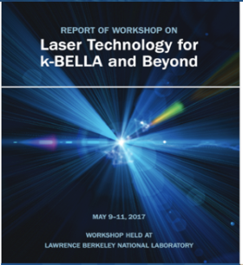
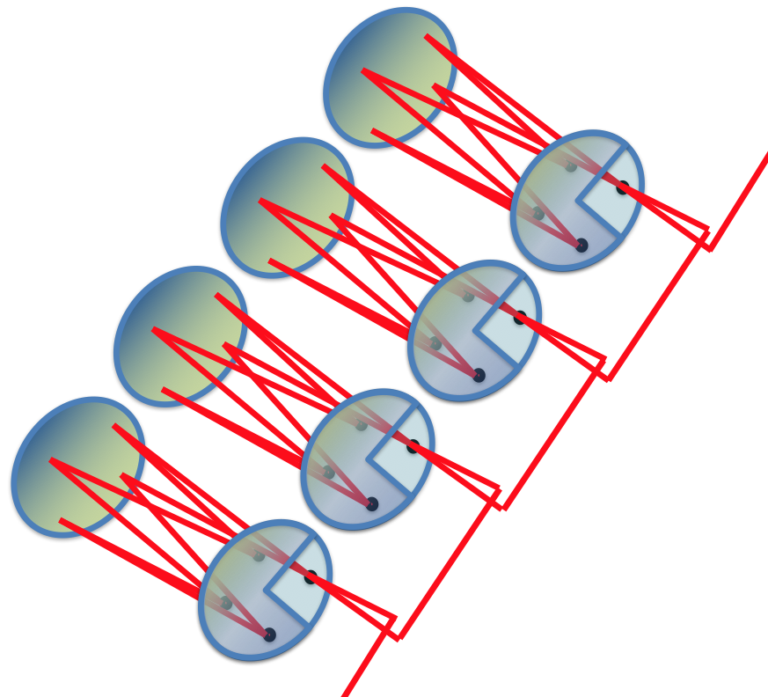
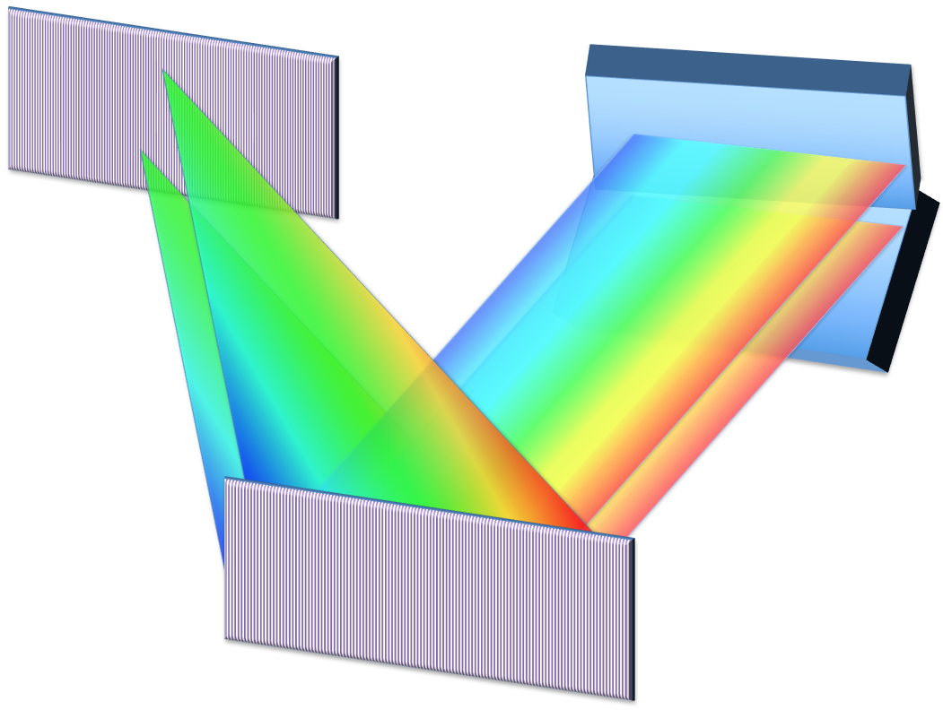
Multidimensionally combining fiber lasers is a path to drive future LPAs
spectral splitter
λ₁
fiber amplifiers (~300)
front end
λ₂
spatial combiners (~100x)
λ₃
spectral combiner (~3x)
Cited by the DOE & National Academies & Community
temporal combiner
(~100x)
pulse compressor
(1ns -100fs)
Talks in this AAC from:
- Siyun Chen (LBNL)
- Lauren Cooper (LBNL/UM)
- Alexander Rainville (UM)
- Yanwen Jing (UM)
Posters in this AAC from:
- Mahek Logantha (LBNL)
- David Feng (LLNL)
Laser Parameter | Spec
Energy per fiber (100-pulse burst) | 10 mJ
Laser driver Energy | 0.5 - 6 J
Pulse duration | 30 - 100 fs
Rep-rate | 1 - 50 kHz
Average power | 3 - 300 kW
output
compressor
Ongoing fundings to build 0.2J/5kHz/1kW system:
- Cameron Geddes, DOE Stewardship (LBNL/UM/LLNL), 2020
- Tong Zhou, DOE ECRP 2020 & Moore Foundation, 2021
7
Notes:
Multidimensionally combining fiber lasers:
oPer fiber: 10mJ (100-pulse burst) at 40kHz (400W) currently achievable
oIn space: combine >100 beams for Joules (100-pulse burst)
oIn time: combine 100 pulses into one pulse
oIn spectrum: combine multiple spectra to 10s fs

Slide 8
Coherence control for combination poses challenges​
spectral splitter
λ₁
fiber amplifiers (~300)
High precision control!
(~10 nm optical length)
front end
λ₂
spatial combiners (~100x)
To address non-observable issue!
– only powers, lose phase info
λ₃
spectral combiner (~3x)
Robust control!
(time variant systems)
temporal combiner
(~100x)
pulse compressor
(1ns -100fs)
Scalable control!
(large dimensionality)
To address non-uniqueness issue!
– many-to-one phase-power mapping
digital control
output
compressor
Qiang Du, DOE ECRP, “Scalable control of multidimensional coherent pulse addition for high average power ultrafast lasers”, 2017

Slide 9
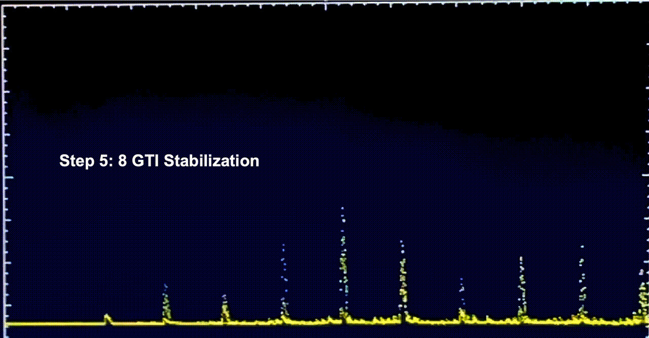
Control tasks: correct phase error to optimize/ stabilize combined power
Noise
Drift
Measurement
spatial combining
temporal combining
Phaser Controller
Laser System
Sensor
free-run.gif
free-run
free-run.gif
Phase Error
Recognition Element
Measurement
Towards ‘controlled.gif’ (not yet)
“combined.png”
“combined.png”

Slide 10
Traditional control solutions can’t address all the challenges
Noise
Drift
Measurement
spatial combining
temporal combining
Phaser Controller
Laser System
Sensor
free-run.gif
free-run
free-run.gif
Phase Error
Recognition Element
Measurement
all are NOT scalable!
Towards ‘controlled.gif’ (not yet)
Traditional Solutions:
1. Reference beam [1]: more complexity
2. Phase Retrieval [2]: slow
3. LOCSET [3]: sinusoidal dither, limited by control bandwidth
4. SPGD [4]: random dither, noisy and slow
“combined.png”
“combined.png”
[1] Steven J Augst, et al., Optics Express, 14(25):12188–12195, 2006
[2] Thomas M Shay. Optics Express, 14(25):12188–12195, 2006.
[3] J. R. Fienup, Appl. Opt. 21(15), 2758–2769 (1982)
[4] Pu Zhou, et al. IEEE Journal of Selected Topics in Quantum Electronics, 15(2):248–256, 2009.

Slide 11
Key idea on pattern recognition is inspired by physics
Diffractive optical elements (DOEs) coherently combine beams spatially into one
Each input beam produces 8-beam subarray; all subarrays form 5x5 array
All input beams combine into one with phase controlled
T. Zhou, et.al., Opt. Lett.43, 3269 (2018)
LOCSET / SPGD uses only combined beam
Side beams fluctuate in intensity as phases drift
Could there be enough info to identify phase errors?
Yes, demonstrated in experiment, required calibration processes & not scalable
Can we take advantage of side beam info in a more general way?
Q. Du, et.al., Opt. Lett.44, 4554 (2019)

Slide 12
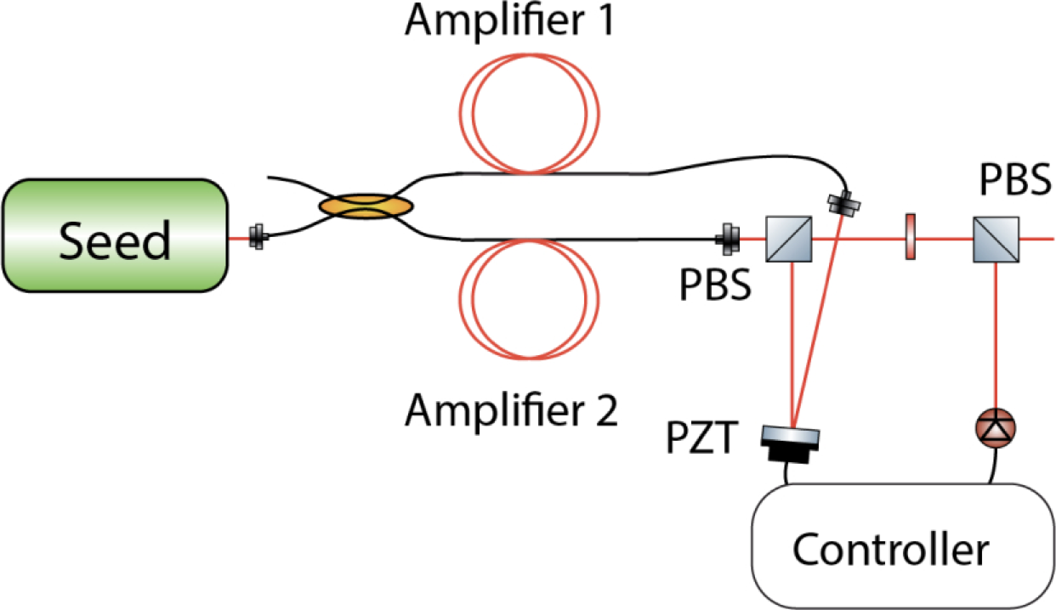
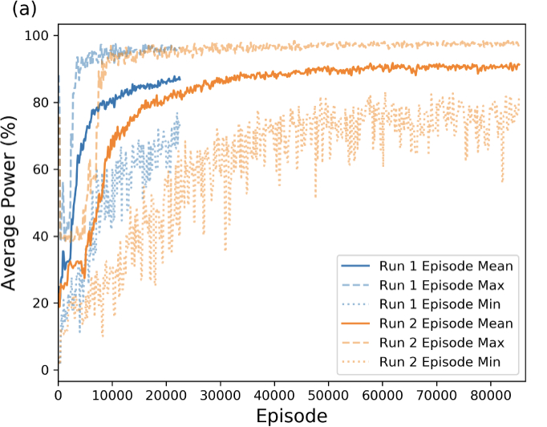
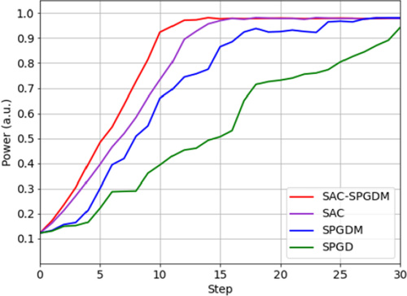
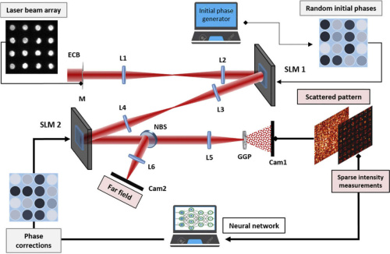
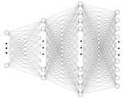
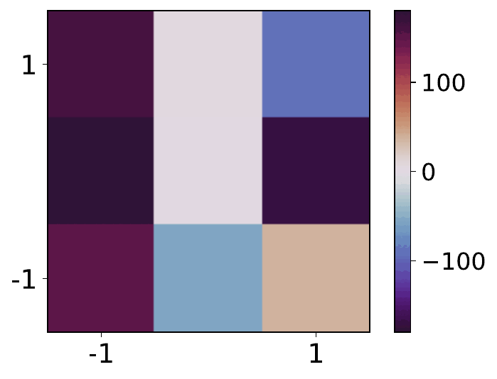
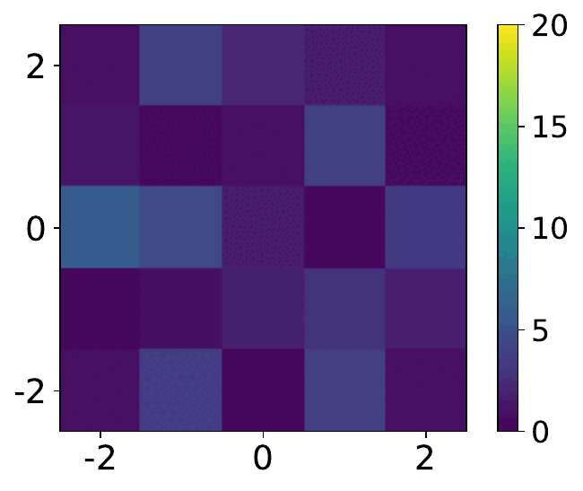
ML controls yields a promising way in laser combining
Our solution with ML in pattern recognition:
ML control in beam combed laser is a hot topic[1-5]:
Phaser Controller
Laser System
Sensor
Phase Error
Measurement
Simulation, 2-beam, reinforcement learning (RL) algorithm [1]
Recognition Element
[1] H. Tünnermann, et al., Opt. Express 27(17), 24223–24230 (2019).
Phase Errors
SPGD or Phase retrieval
Intensity Pattern
SPGD or Phase retrieval
Neural Network (NN)
Simulation: 128-pulse temporal combining [2]
Spatial Light Modulator (SLM) setup:100 lasers spatial combing [3]
Recognition Neural Networks (NN): from pattern to error
[2] A. Abuduweili, et al., Opt. Express 29(16), 26068–26081 (2021).
[3] M. Shpakovych, et al., Opt. Express 29(8), 12307–12318 (2021).
[4] Qi Chang, et al., Opt. Express 29, 34863-34879 (2021)
[5] Mills B, et al., Sci Rep. Mar 25;12(1):5188. (2022)
Non-observable issue addressed!

Slide 13
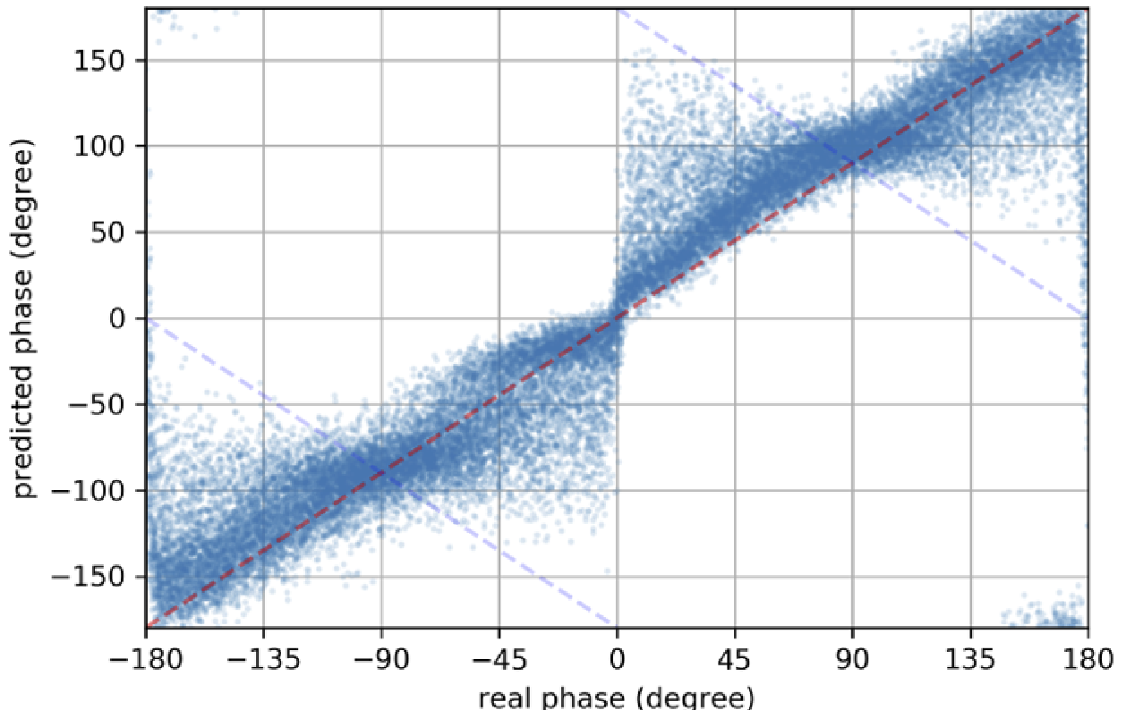
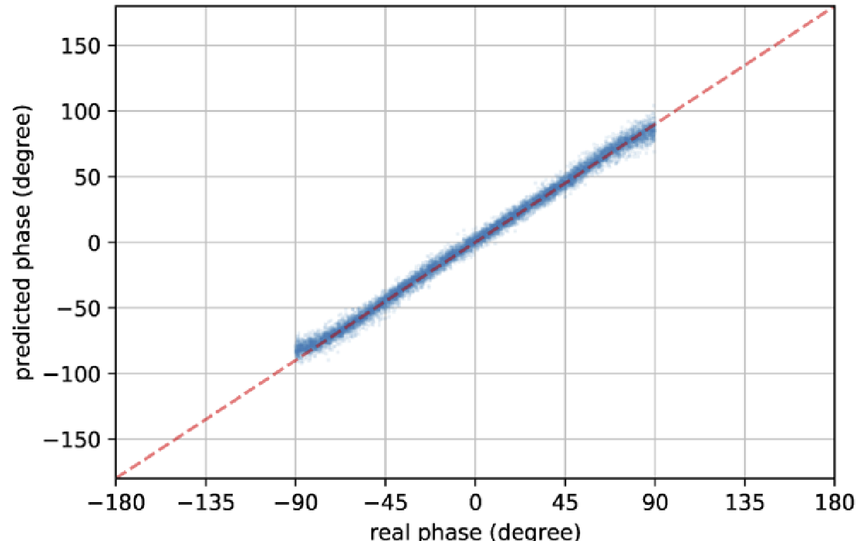
To avoid non-unique phase solution, train NN only within < ± π/2
NN (Intensity) = Phase θ
Predictions of phase:
Intensity goes as cos²(θ) = (cos(2θ)+1)/2, results in two solutions, ambiguity
Trained in full phase range, NN gets confused
Works fine when trained in limited range
But, what about outside the training range?
Notes:
Cos Double Angle Formula

Slide 14
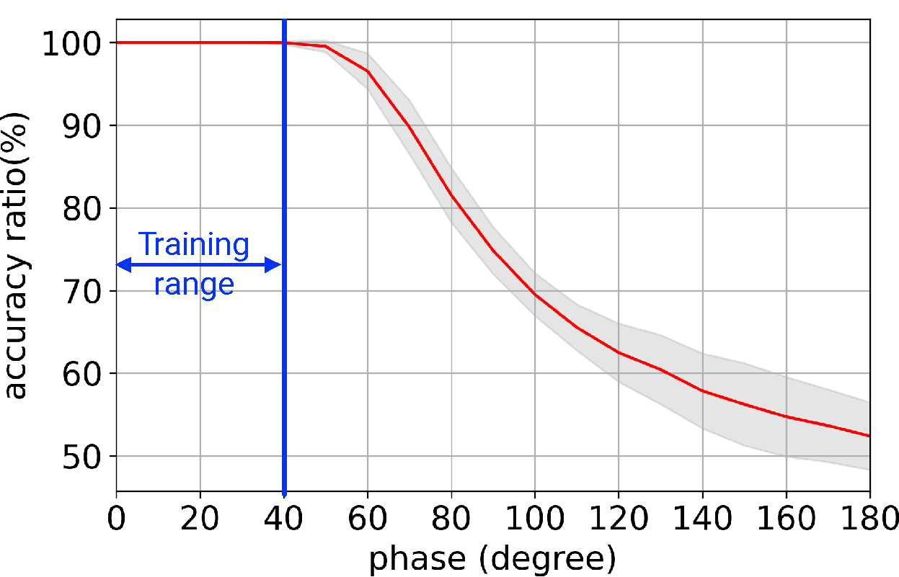
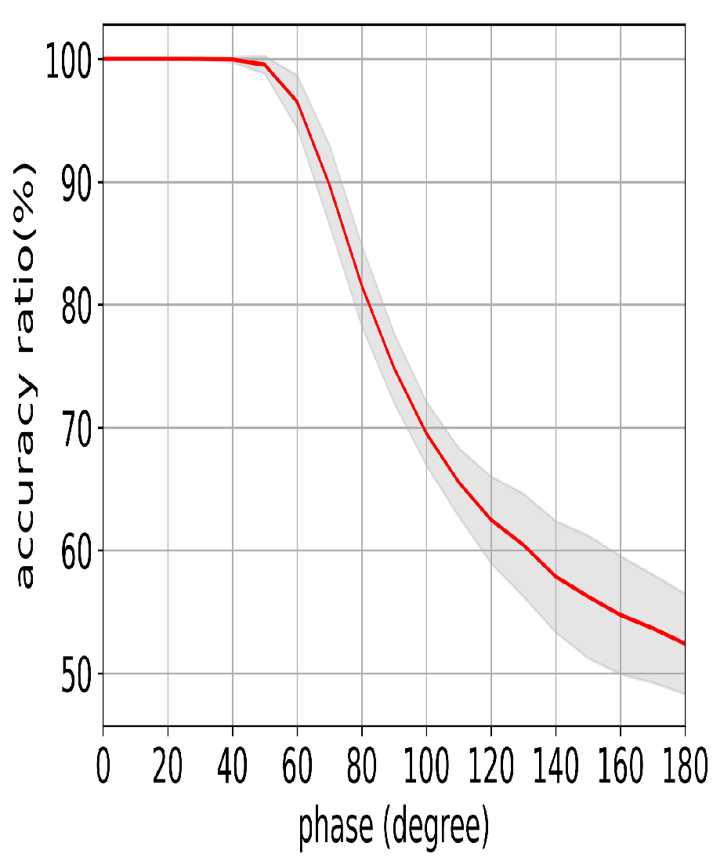
Small training range still works
0 π 2π 3π
Feedback control loop corrects in multiple steps
Anywhere in phase range, better-than-even chance NN guesses the right direction, toward training range
Inside training range, one step to optimal

Slide 15
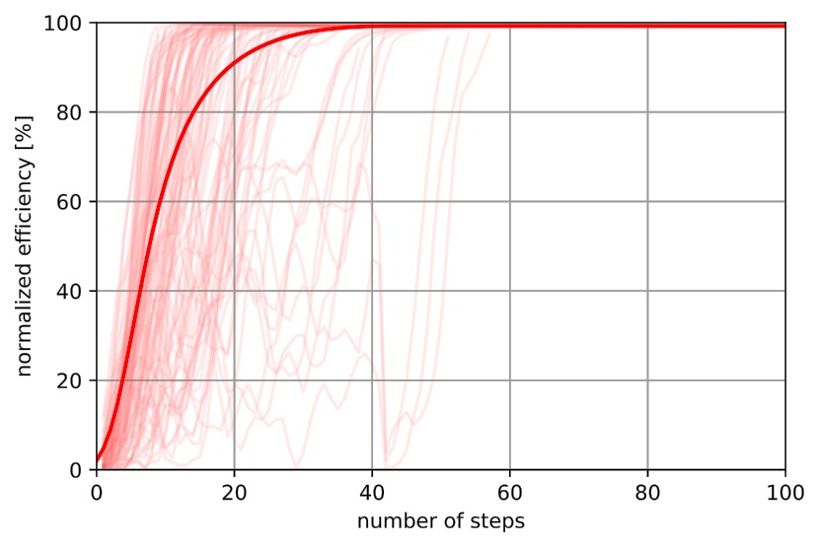
Prediction accuracy usually accumulates, always finds optimal
Simulation:
Wrong predictions
delay convergence
Non-uniqueness issue addressed!

Slide 16
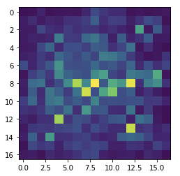
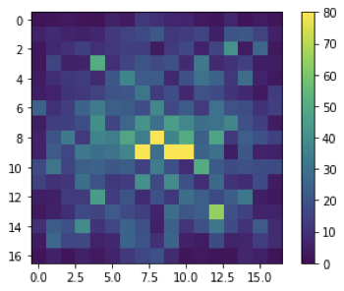
Challenge on time variant system: how to train with noise?
What we just did, works in simulations:
In reality, even with highly stable SLM (spatial light modulator), phases drift away:
Phase Error
Measured Pattern
Neural Network (NN)
pattern drift over 24 hours, with same programmed inputs
No way to label error with unknown noise,
Thus, no labels for NN training!

Slide 17
Innovations: learn in differential space and control deterministically !
NN (X) = Y
NN training: exploration stage
NN operation: correct errors deterministically!
system
A
system
C
dither
correction
Y
X
Y
X
B
T
Phase Space
Pattern
Space
Phase Space
Pattern Space
NN
NN
X = pattern A (before) + pattern B (after)
Y = dither in between*
X = current pattern + target pattern
Y = correction needed
*dither >> noise between two adjacent samples
D. Wang,et al., IEEE Journal of Quantum Electronics, 3204437, (2022)
D. Wang,et al., US patent application submitted, (2021)

Slide 18
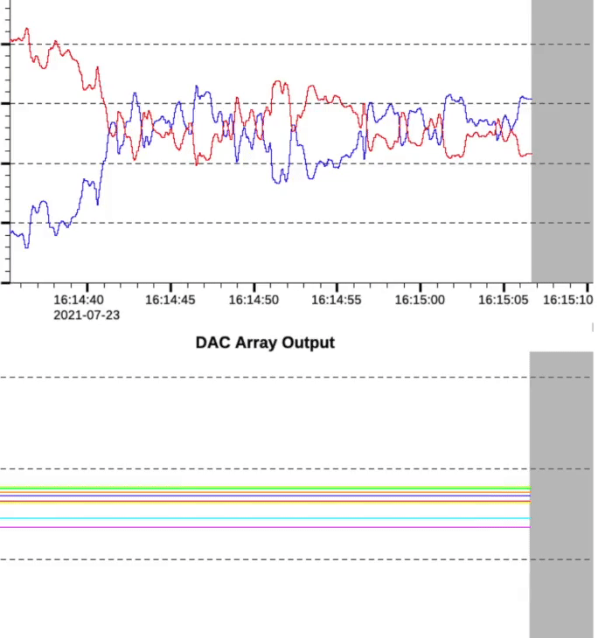
ML control works in experiment
combined beam power
side- beam power
Measured.gif
Q. Du, Opt. Express, 30(8): 12639 (2022)
With NN control:
< 1min exploration time,
< 10s training time
0.4% RMS > 30min
Combining efficiency: 95%
Power (blue:combined power)
time
Robust control!
Control variables
High precision control!

Slide 19
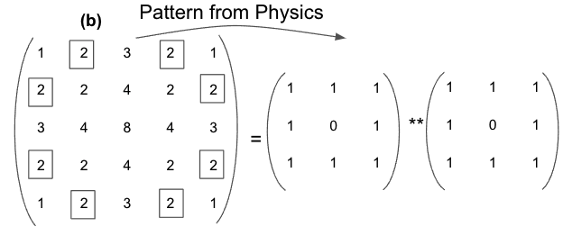
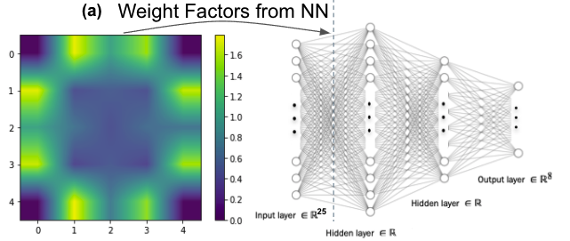
AI discovered the same information-rich beams we chose from physics
5 by 5 diffractive pattern
8 input beams
3 by 3 DOE
“Real Physics”:
– we can use & only use the exactly 8 beams for control
[Q. Du, et.al., Opt. Lett.44, 4554–4557 (2019).]
[T. Zhou, et al., ASSL, AM2A.6 (2018)]
“Black Box” ML:
– 8 out of the 25 diffractive neurons are more important
(findings in 2022)
ML: a tool to help reveal complex physics too difficult to theorize!

Slide 20
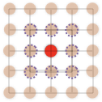
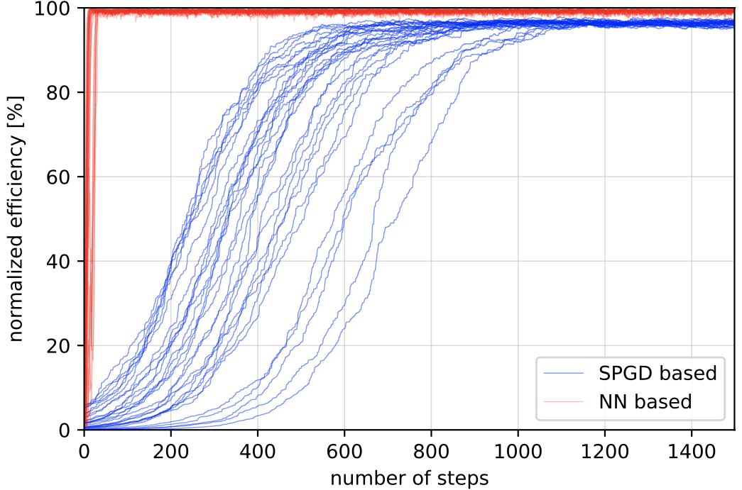
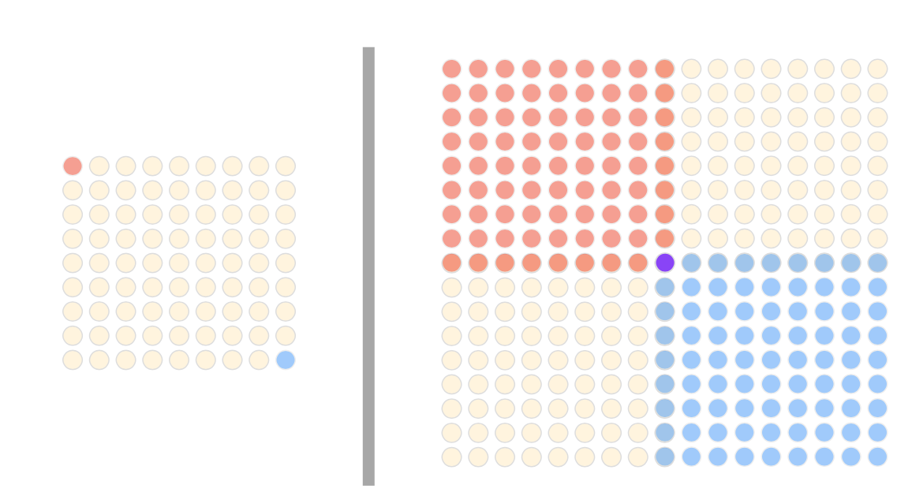
ML control approach also works when scaled by 10x
For the 8-beam spatial combining:
Simulation: 81 beams combining:
our approach scales much better + better performance
8 input beams
3 by 3 DOE
5 by 5 output
NN based
SPGD based
For the 81-beam spatial combining:
Scalable control!
81 input beams
9 by 9 DOE
17 by 17 output
D. Wang, Opt. Express, 29(4), pp 5694-5709 (2021)
Q. Du, Opt. Express, 29 (4), pp 5407-5418 (2021)
D. Wang, IEEE Journal of Quantum Electronics, 3204437, (2022)
Scale of both input and pattern, thus enough information to learn!

Slide 21
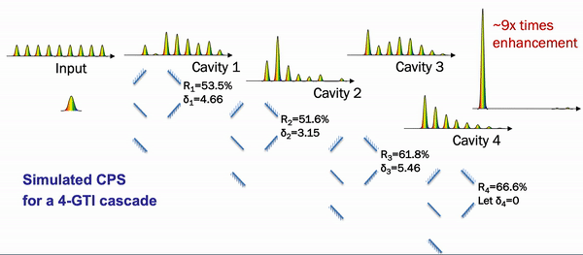
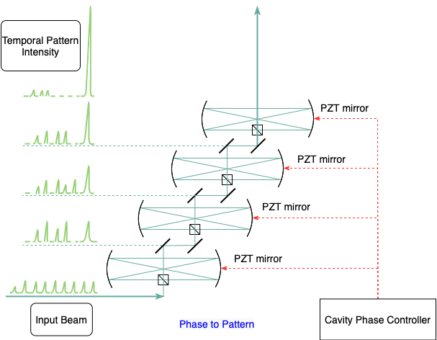
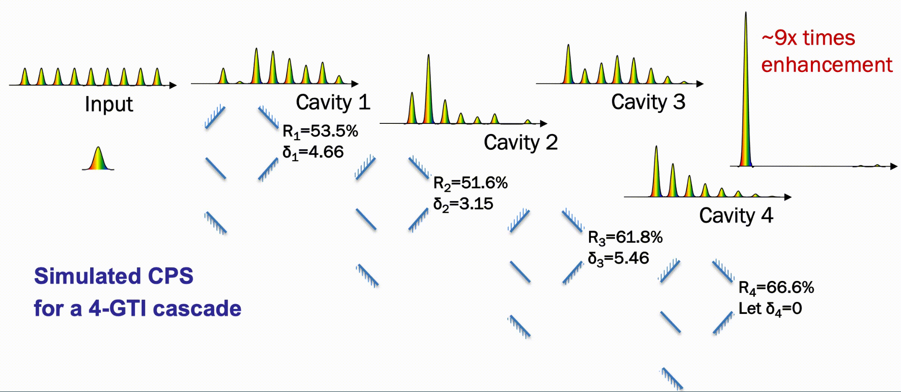
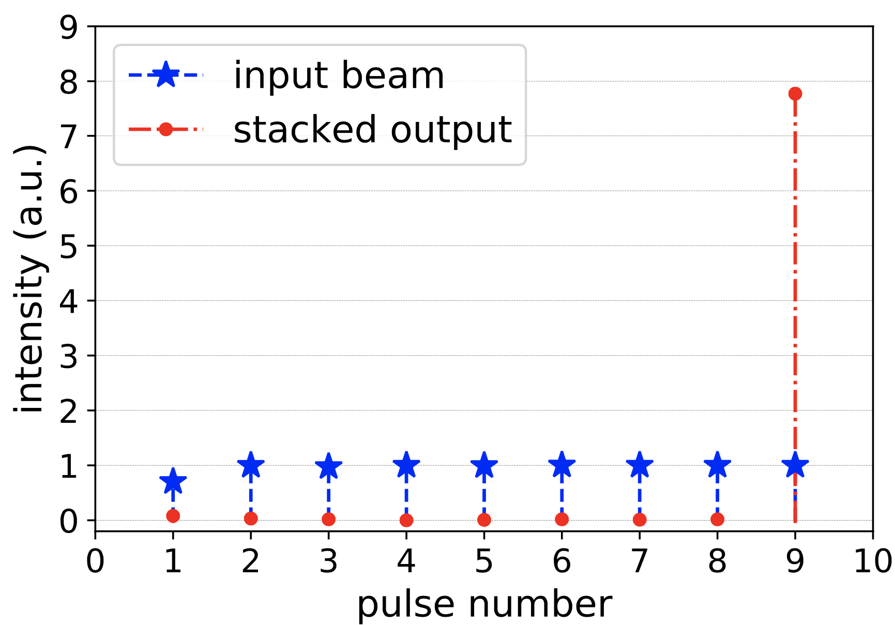
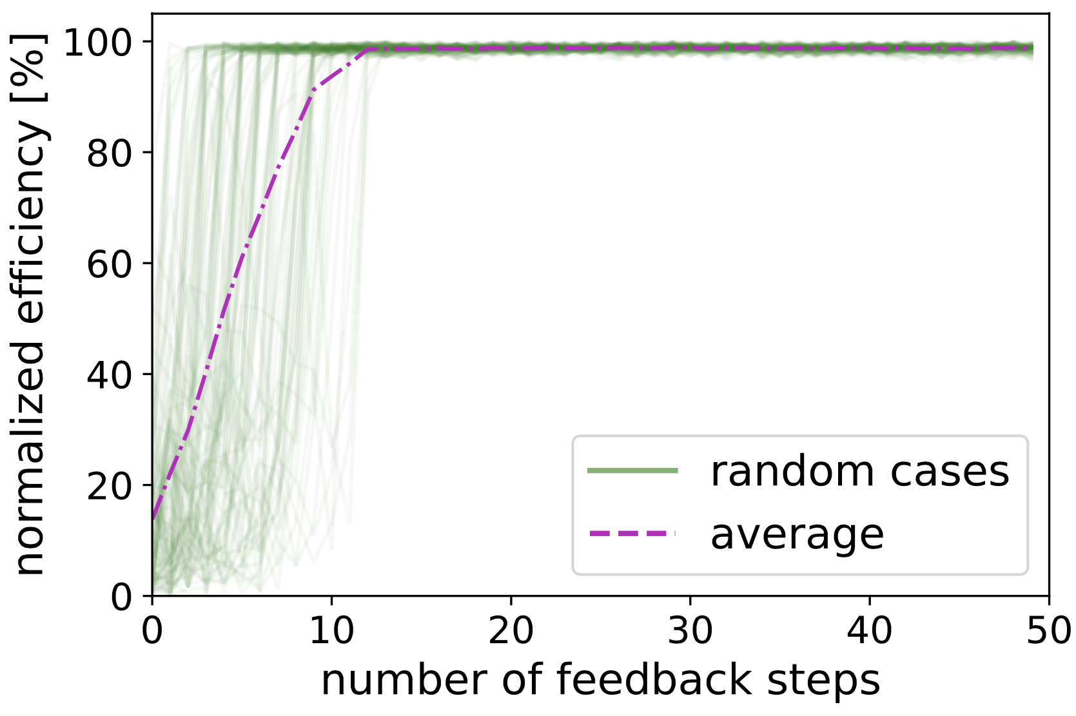
ML control also generalizes to temporal combining
Stack 9 pulses with 4 cavities
(Credit: A. Galvanauskas)
T. Zhou et al. Optics Express 23, 7442-7462 (2015)
ML-controls using Pattern Recognition
D. Wang, IEEE Journal of Quantum Electronics, 3204437, (2022)
Notes:
Physics:
TZ - Many laser pulses can be coherently stacked into one pulse using cascaded optical cavities. (Start video) The pulse and cavity phases are controlled so that all input energies are stored in the cavities, and the last pulse extracts all stored energies out via interference. (Video stops)

Slide 22
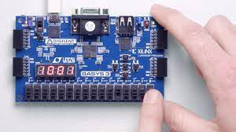
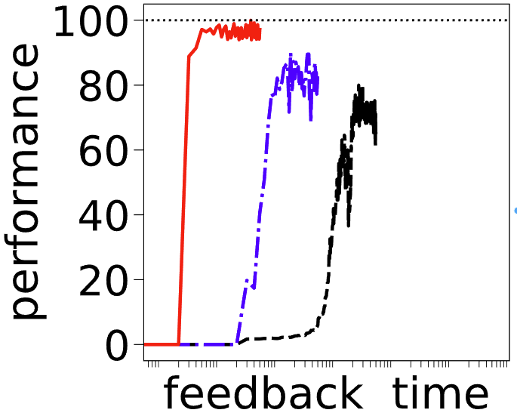
Future work: find more applications, increase feedback bandwidth
Core of ML control approach: learn from data (demo. in simulations for accelerators)
ML on FPGA, increase feedback bandwidth
(mission of Berkeley Accelerator Controls & Instrumentation (BACI) program)
Controller
System
Sensor
path forward
(best so far)
System Error
Measured Pattern
Target Pattern
ML
Generalized concept of patterns in lasers and accelerators:
Traditional
diffractive pattern
laser burst
beam trajectory
phase space
RF signal
Enable kHz applications
Better performance

Slide 23
Outlook: develop ML control along with high power LPA driver (kHz, kW)
Diffractive laser pattern from ①
①
①
②
③
Temporal laser burst from ②
①
Electron beam space from ③
Now: Synergy with ongoing projects building 5kHz, 200mJ fiber laser and LPA demo (short-term 3-5 yrs)
ML will control laser & LPA subsystems end-to-end
Mid-term (<10 yrs): Fiber based LPA facility (kBELLA)
Long-term(>10 yrs): Fiber based laser facilities for future colliders

Slide 24
Conclusion
Combined fiber laser can drive future LPAs, and control is an essential
ML-based pattern recognition addresses the control challenges
Small training range works, avoids non-uniqueness, benefits scaling
Novel differential learning scheme enables robust control in real systems
Excellent control performance in low-power experiment, scale to high power soon
Can be generalized to many systems (lasers, end-to-end LPA, conventional accelerators)
ML is inspired by physics, guided by physics, and benefits physics
24
24
24

Slide 25
Selected Publications
[1] D. Wang, et al.,“Machine learning pattern recognition algorithm with applications to coherent laser combination,” IEEE Journal of Quantum Electronics, 3204437, (2022)
[2] Q. Du, et al., “Experimental beam combining stabilization using machine learning trained while phases drift”. Optics Express. Apr 11;30(8):12639-12653, (2022)
[3] D. Wang, et al., “Stabilization of the 81-channel coherent beam combination using machine learning,” Optics Express, vol. 29, no. 4, pp. 5694–5709, (2021)
[4] Q. Du, et al., “81-beam coherent combination using a programmable array generator,” Optics Express, vol. 29, no. 4, pp. 5407–5418, (2021)
Thank you!

Slide 26
Robust? High precision? Yes! first demo. in real laser system
Experimental Results
NN
SPGD
NN
SPGD

Slide 27
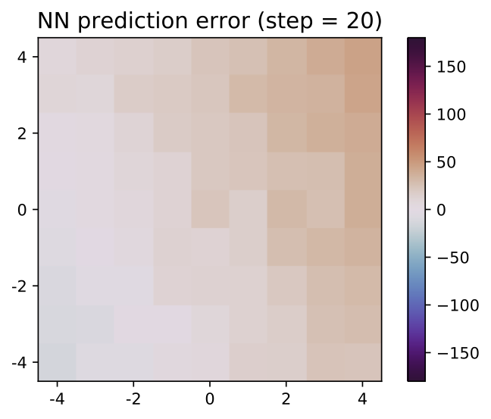
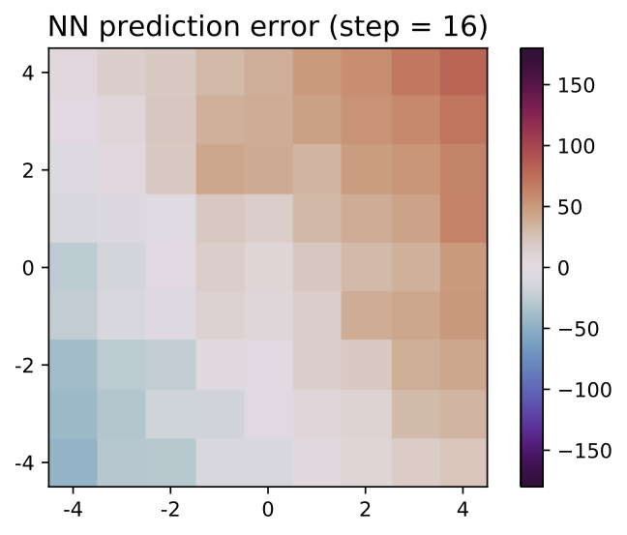
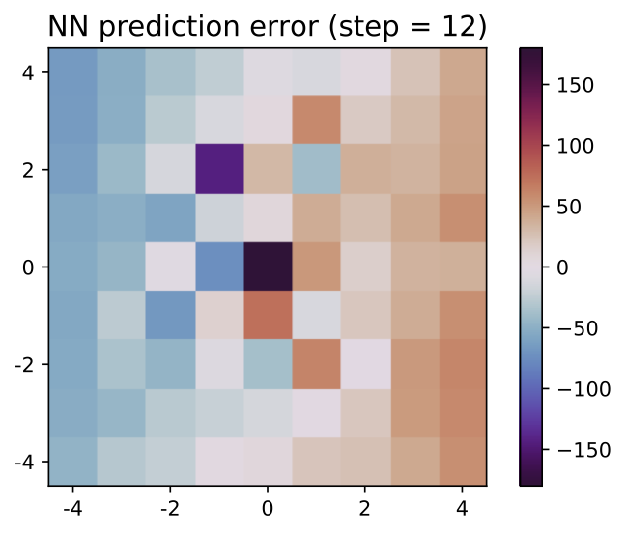
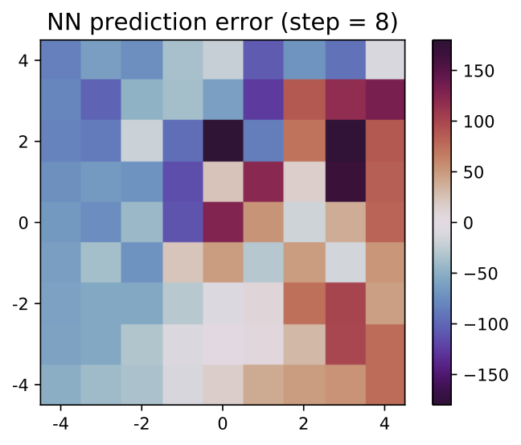
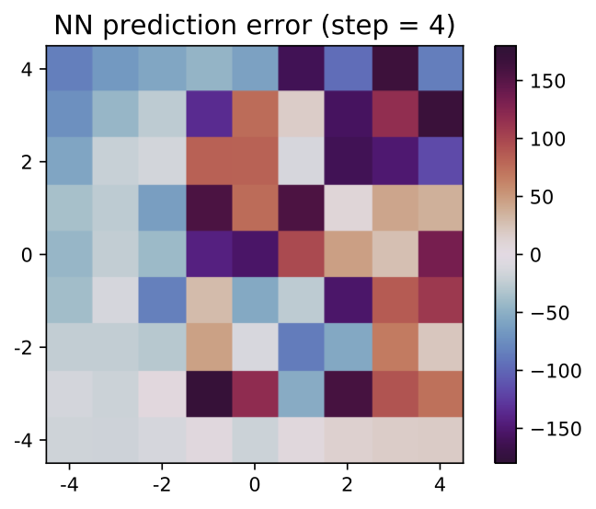
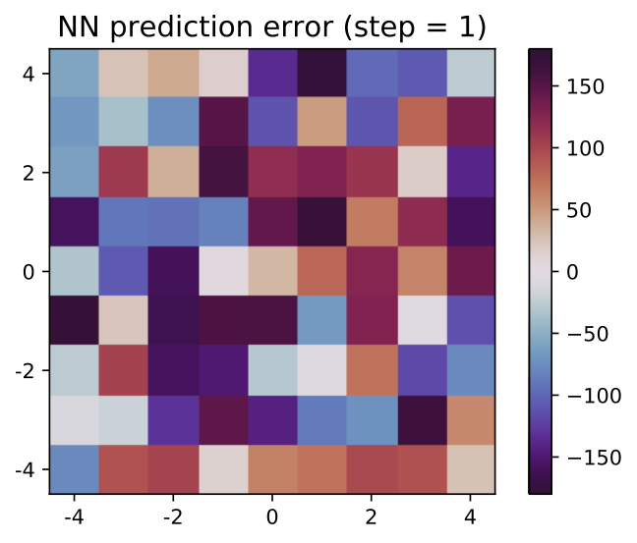
Prediction accuracy usually accumulates, always finds optimal
Simulation:
phase difference from optimal
Wrong predictions
delay convergence
Non-uniqueness issue addressed!

